Slide 1
PANDA DC
Panda DC
FireFly
TX
FireFly
RX
12
FPGA
XCKU15P-FFVA1760
PLL
LMK04610
FireFly
TX
FireFly
RX
12
8 LVDS
FireFly
TX
FireFly
RX
12
MEMORY
HMC-Gen2
FireFly
TX
FireFly
RX
12
16
16
AMC Backplane
FireFly
TX
FireFly
RX
12
+1.8V 2.2A
+2.5V 2.4A
+3.3V 3.5A
LTM4644
+0.85V 30A
2*LTM4620
4-phase
+0.90V 12A
LTM4620
2-phase
+1.20V 20A
LTM4620
2-phase
MMC
ATMega328P
Pawel Marciniewski, PANDA On-line meeting, 24.06.20

Slide 2
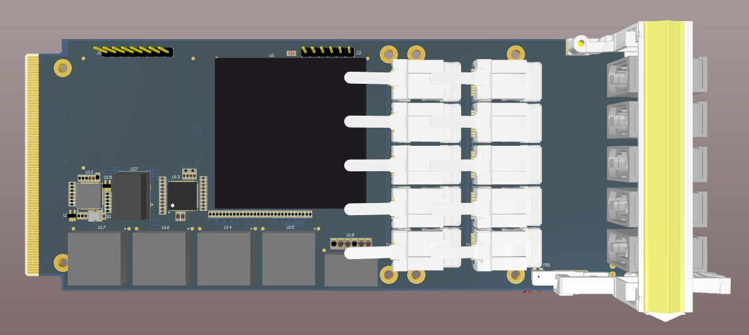
PANDA DC
Panda DC
Pawel Marciniewski, PANDA On-line meeting, 24.06.20

Slide 3
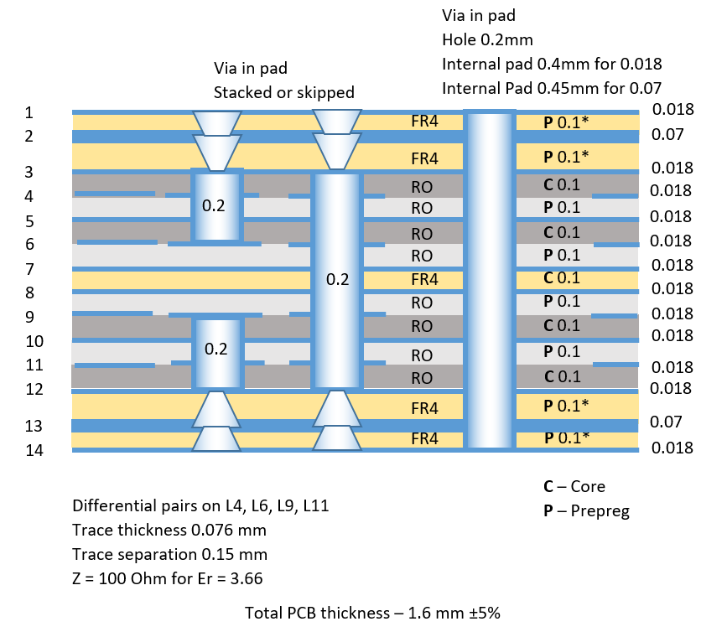
PANDA DC
- PCB Stack
75μ
100μ
18μ
RO4350B
100μ
ε_{r} = 3.66
150μ
Total PCB thickness 1.6 mm
Pawel Marciniewski, PANDA On-line meeting, 24.06.20

Slide 4
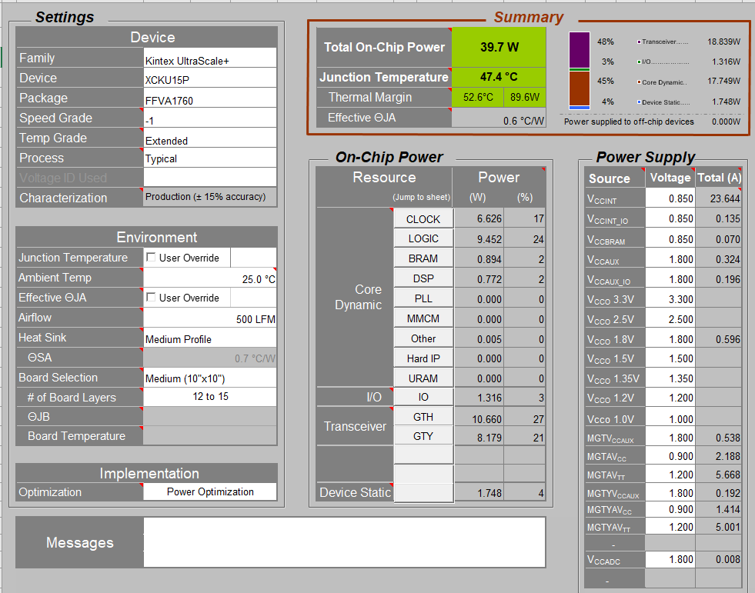
PANDA DC
- Power Budget
P_{TOT} = 39.7W
Pawel Marciniewski, PANDA On-line meeting, 24.06.20

Slide 5
PANDA DC
- Work progress
The design has undergone scrutiny
The PCB manufacturing technology was agreed and is in production
The FPGAs are purchased (10 pcs)
The FireFly modules (non-standard pig-tail lengths) are purchased
Remaining are:
PCB production, assembly, testing
Pawel Marciniewski, PANDA On-line meeting, 24.06.20

Slide 6
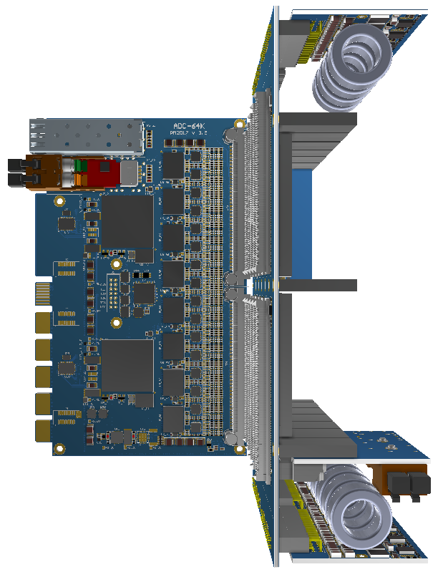
ADC Crate Electronics
ADC Crate Electronics
Pawel Marciniewski, PANDA On-line meeting, 24.06.20

Slide 7
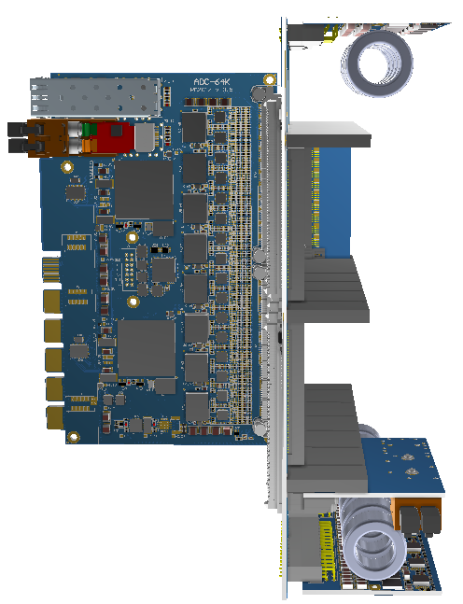
ADC Crate Electronics
Backplane electronics and Rear Compartment
Cooling plate
Wedge holder
Wedge holder
Cooling plate
Pawel Marciniewski, PANDA On-line meeting, 24.06.20

Slide 8
ADC Crate Electronics
- Crate backplane
Tripple slot module division
Backward crate compartment
TOP Power Supply
(Digital 1.0V, 1.5V, 2.5V, 3.3V)
Signal connectors
Crate Control
Bottom Power Supply
(Analog 2.5V)
TOP PS
Signal con
CONTROL
BOT PS
Pawel Marciniewski, PANDA On-line meeting, 24.06.20

Slide 9
ADC Crate Electronics
- Crate backplane
+12V
PWR Con
+12V
I²C AUX
TRIPLE SLOT MODULE
TX/RX - GTX Triple module loop (HF buffered)
Can be used for re-routing of faulty main transceivers or for multiplexing of the readout
I²C AUX – provides differential I2C control for the detector ASICS (requested by Barrel).
Can be used for indicating FPGA configuration status (DONE) to the control system
I²C PWR – For monitoring of the ADC voltages and currents
TX/RX – can be freely used inside of the Crate Control board. Either looped or fed to a control FPGA
JTEN – JTAG enable for operation on the slot
JTAG – Common lines (buffered)
CTRL – PS control
Control – A daisy-chain interface for crate control (optical interface out?)
I²C PWR
+1.0V
TX/RX
ADC Con
Signal Con
+1.5V
Signal Con
Analog
signals
JTEN
Analog
ADC Con
+2.5V
JTAG
+3.3V
+2.5V
I²C AUX
TX/RX
TX/RX
I²C PWR
+1.0V
TX/RX
ADC Con
Signal Con
Signal Con
+1.5V
JTEN
Analog
Analog
signals
ADC Con
+2.5V
JTAG
+3.3V
+2.5V
I²C AUX
TX/RX
I²C PWR
+1.0V
TX/RX
ADC Con
Signal Con
Signal Con
+1.5V
JTEN
Analog
Analog
signals
ADC Con
+2.5V
Control
Control out
JTAG
Crate Control Con
Control in
Control
+3.3V
+2.5V
CTRL
+12V
PWR Con
+12V
Pawel Marciniewski, PANDA On-line meeting, 24.06.20

Slide 10
ADC Crate Electronics
- PolarFire –based Crate Controller
Crate Controller
Direct JTAG configuration of individual ADCs
Reaction to SEU
Health control of ADCs (voltages, currents, temperatures)
Crate PS control
Optical Link
Data/
Control
System
4.8Gb/s
VL
(Optical interface)
ADC DATA
ADC
FPGA
PolarFire
ADC Control
ADC DATA
ADC
ADC Control
Flash based, configuration SEU-immune
ADC DATA
ADC
ADC Control
Trying to get rid of external PLL, which consumes ca 700 mW
PLL
JTAG Cross/Conn
To next module
Pawel Marciniewski, PANDA On-line meeting, 24.06.20

Slide 11
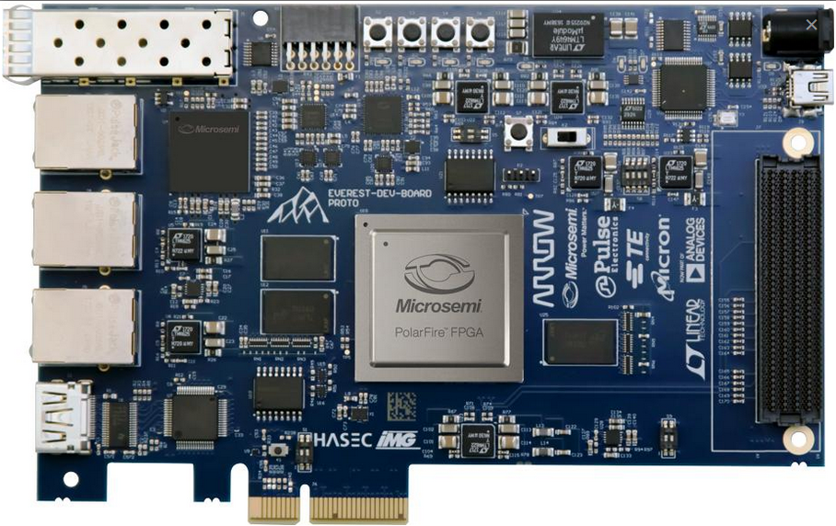
ADC Crate Electronics
- Evaluation card with Alibre development system
Pawel Marciniewski, PANDA On-line meeting, 24.06.20

Slide 12
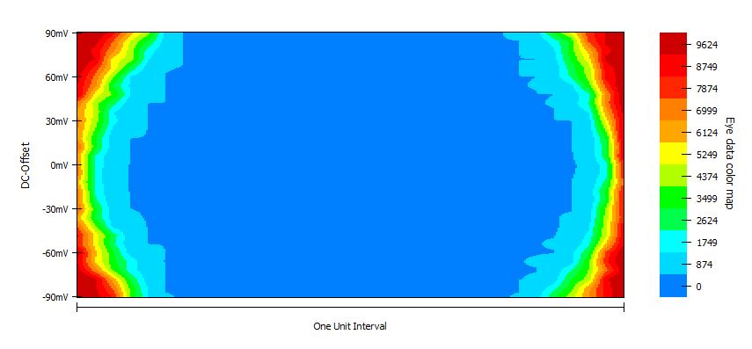
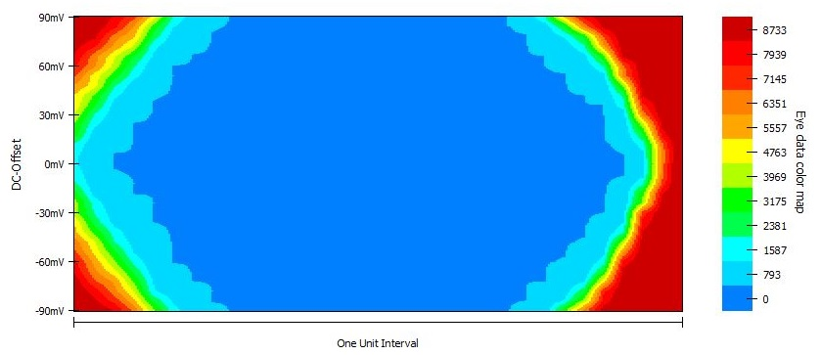
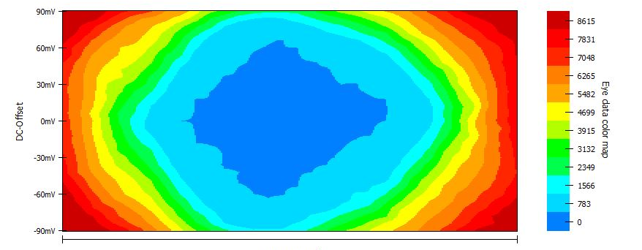
ADC Crate Electronics
PolarFire IBERT test
2 Gb/s
6.25 Gb/s
10 Gb/s
Pawel Marciniewski, PANDA On-line meeting, 24.06.20

Slide 13
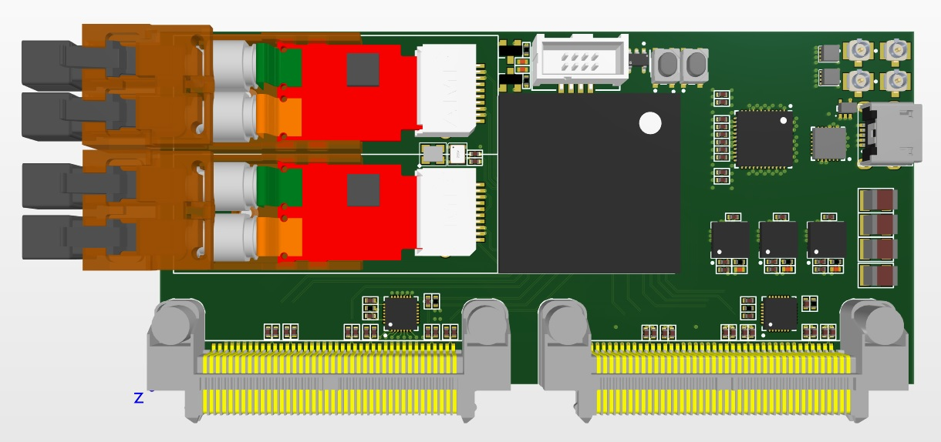
ADC Crate Electronics
Crate Controller
Dual channel VTRx
(test version)
Preliminary layout
VTRx are obsolete
Pawel Marciniewski, PANDA On-line meeting, 24.06.20

Slide 14
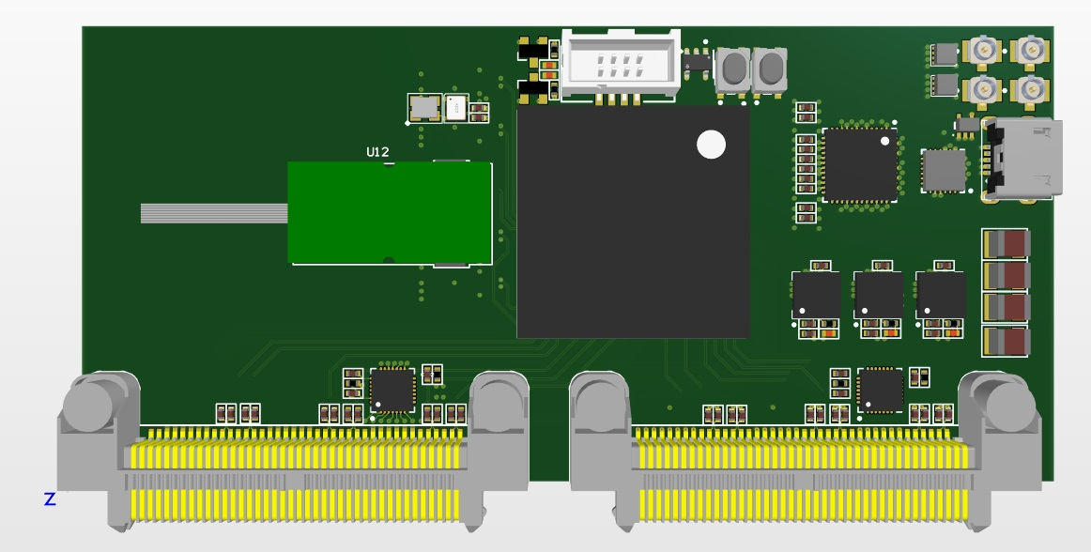
ADC Crate Electronics
Crate Controller
Dual channel VTRx+
Preliminary layout
VTRx+ will be produced 2021
Pawel Marciniewski, PANDA On-line meeting, 24.06.20

Slide 15
ADC Crate Electronics
Power Supply
First prototype
Smart Switch
(Power Driver)
Coil
Output Filter
PWM Controller
3.3V
Smart Switch
(Power Driver)
Coil
Output Filter
2.5V
12V
Power connector
PMBus
Smart Switch
(Power Driver)
Coil
Output Filter
PWM Controller
1.5V
Smart Switch
(Power Driver)
Coil
Output Filter
1.0V
TPS40428
CSD95378BQ5M
500nH
800uF
Voltages coarse programmed by resistors.
Fine adjustable by Control System
Pawel Marciniewski, PANDA On-line meeting, 24.06.20

Slide 16
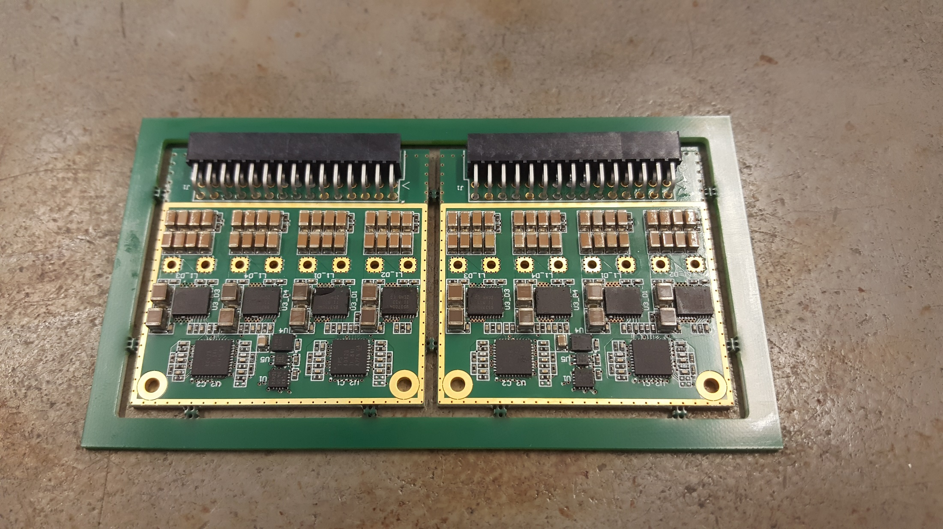
ADC Crate Electronics
Power Supply
First prototype
Difficult to obtain high efficiency
Inaccurate current gauge in the driver
Radiation tollerance around 10¹¹ p/cm²
Pawel Marciniewski, PANDA On-line meeting, 24.06.20

Slide 17
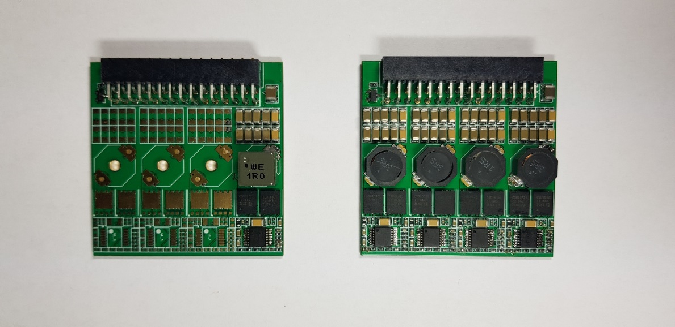
ADC Crate Electronics
Power Supply
Second prototype (based on previous ADC stand alone PS)
Good efficiency
Simple design, simple control
Proven radiation tollerance (to be verified speciffically)
Pawel Marciniewski, PANDA On-line meeting, 24.06.20

Slide 18
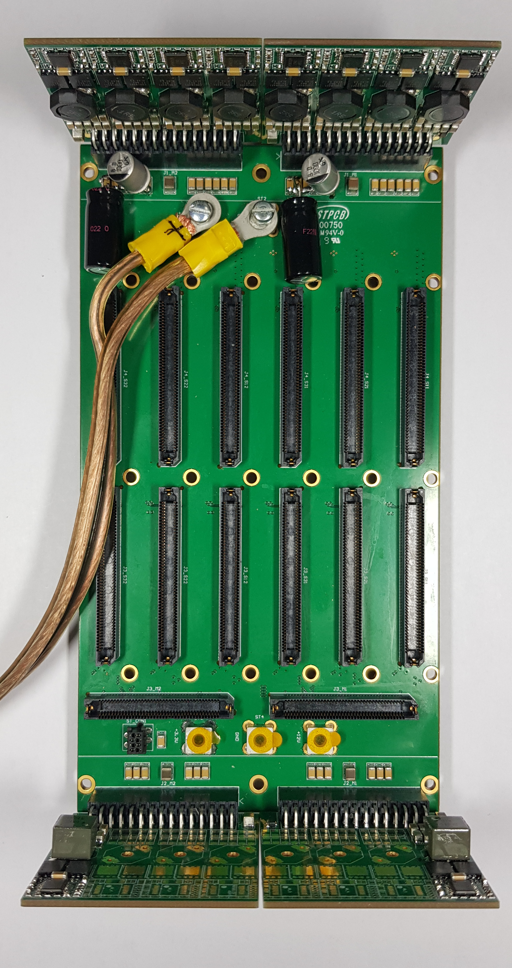
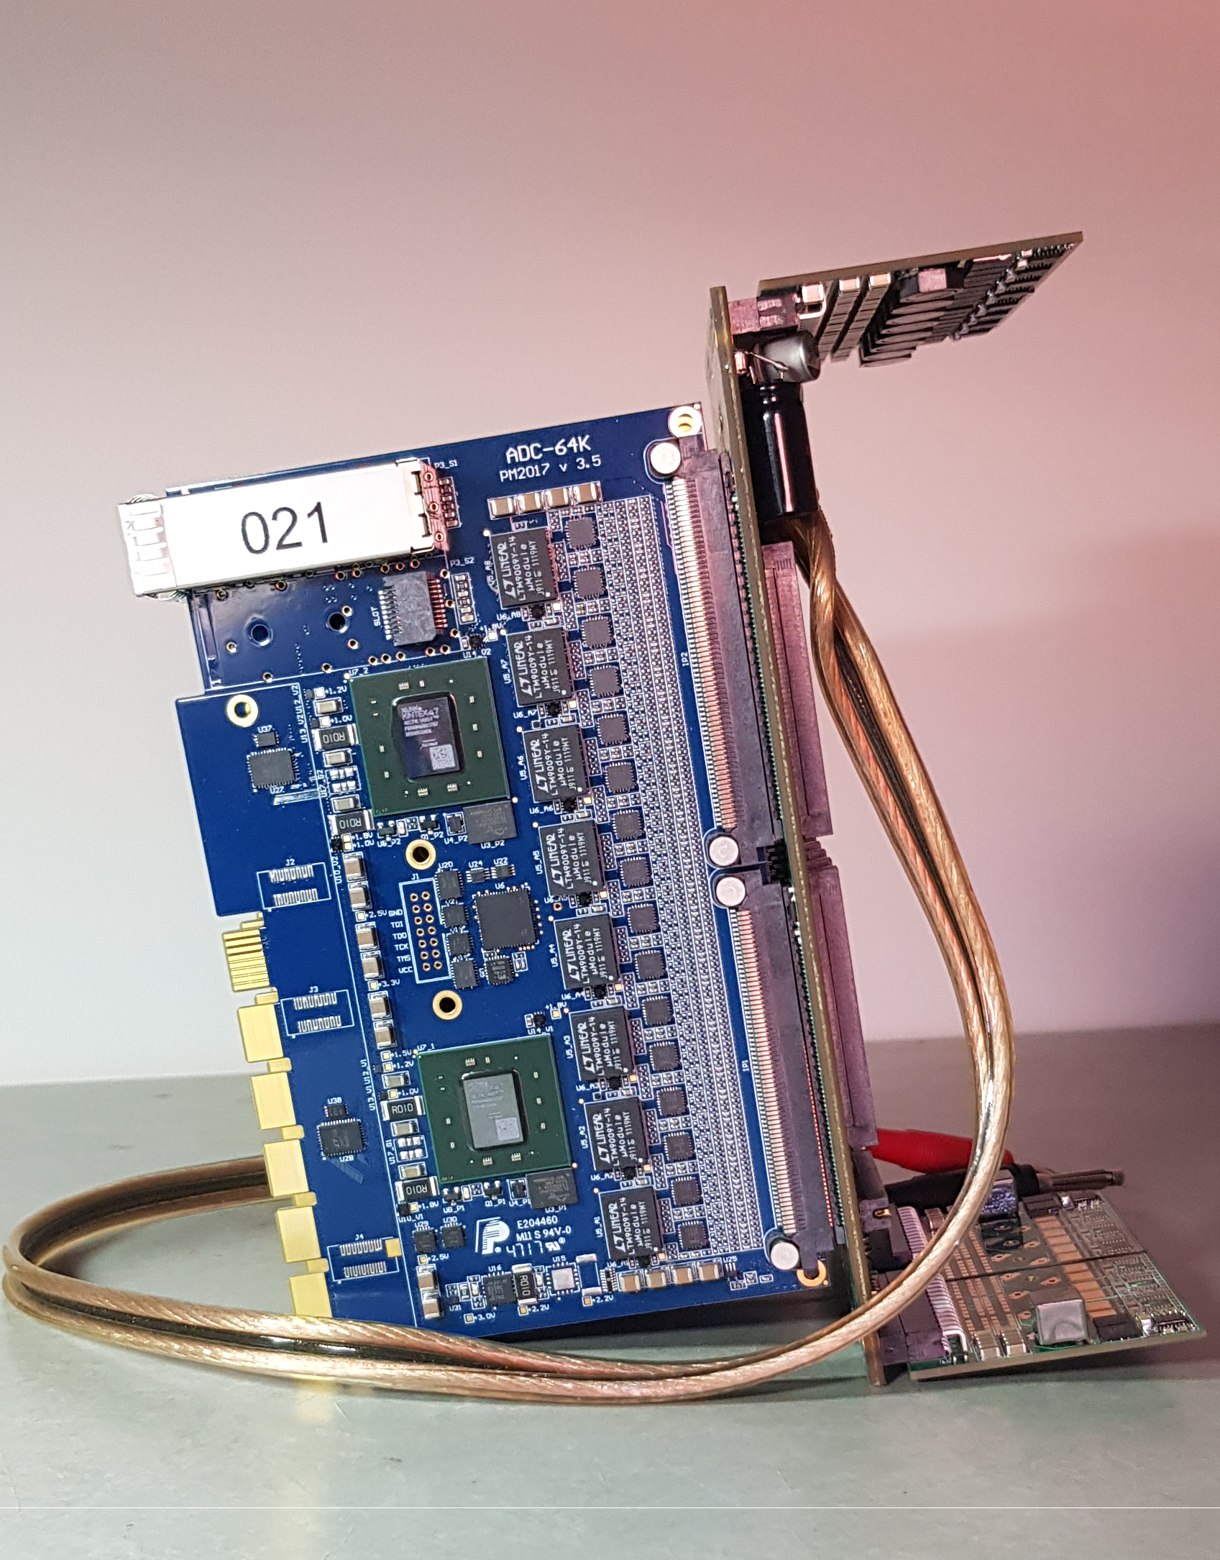
ADC Crate Electronics
- Cooling test electronics
Cooling Test stand awaiting for tests
Pawel Marciniewski, PANDA On-line meeting, 24.06.20

Slide 19
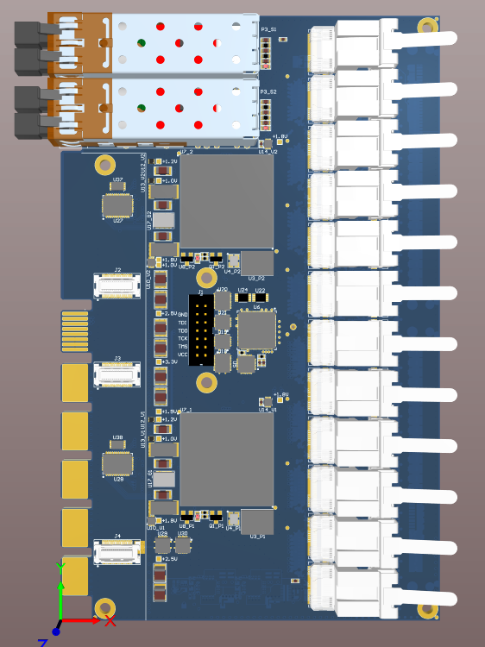
EMC Barrel Electronics
- LVDS ROB
Readout Board obtained from the 64-channel ADC for the EMC Forward Endcap
Status:
Design started
Data connector type needs to be decided
Proposition:
- Samtec ECUE (12-channel)
- safe transfer with buffers (400 Mb/s)
- AC transfer up to 1.2 Gb/s up to 3 m
- 144 I/O
Pawel Marciniewski, PANDA On-line meeting, 24.06.20

Slide 20
ADC for EMC-Endcap
Thank You !
Pawel Marciniewski, PANDA On-line meeting, 24.06.20

