Slide 1
MC Matching for the EMC
15.2.2018 Tobias Stockmanns

Slide 2
EMC – a special case
Tracking Detectors
EMC
8
x
5
9
6
4
7
x
10
3
2
x
1
1

Slide 3
EMC Nomenclature
8
5
Emc Point
9
6
4
7
10
3
2
1

Slide 4
EMC Nomenclature
8
5
Emc Point
9
6
4
7
Emc Hit –
All points in one
crystal
10
3
2
1

Slide 5
EMC Nomenclature
8
5
Emc Point
9
6
4
7
Emc Hit –
All points in one
crystal
10
3
2
Emc Cluster –
All hits in neighboring
crystals
1

Slide 6
New Algorithm
8
5
9
6
4
7
10
2
3
Particle 1 decays before EMC in particle 2 and 3
Start of MC Track
Position of EMCPoint
1

Slide 7
New Algorithm
8
5
9
6
4
7
10
2
For particle 2 an EMC point is detected
3
Start of MC Track
Position of EMCPoint
1

Slide 8
New Algorithm
8
5
9
6
4
7
10
2
For particle 2 an EMC point is detected
How far is the start of MC track away?
3
Start of MC Track
Position of EMCPoint
1

Slide 9
New Algorithm
8
5
9
6
4
7
10
2
For particle 2 an EMC point is detected
How far is the Start of MC Track away?
If below threshold assign mother ID to EMC point (recursive)
3
< fDistanceMotherCut
Start of MC Track
Position of EMCPoint
1

Slide 10
New Algorithm
8
5
9
6
4
7
10
2 → 1
For particle 2 an EMC point is detected
How far is the Start of MC Track away?
If below threshold assign Mother ID to EMC point (recursive)
Otherwise keep track ID
3
< fDistanceMotherCut
Start of MC Track
Position of EMCPoint
1

Slide 11
New Algorithm
8
5
9
6
4
7
10
< fDistancePointCut
2 → 1
For particle 2 another EMC point is detected
How far is it away from the previous point
If below threshold assign MC ID of previous point
Otherwise keep Track ID
3
Start of MC Track
Position of EMCPoint
1

Slide 12
New Algorithm
8
5
9
6
4 → 1
7
10
2 → 1
For particle 4 new EMC point is detected
How far away from mother
If below threshold assign MC ID of previous point
Otherwise keep Track ID
3
Start of MC Track
Position of EMCPoint
1

Slide 13
New Algorithm
8 → 1
5 → 1
6 → 1
9 → 1
4 → 1
7 → 1
10 → 1
2 → 1
3 → 1
Start of MC Track
Position of EMCPoint
1

Slide 14
New Algorithm
8 → 1
5 → 1
6 → 1
9 → 1
4 → 1
7 → 1
10 → 1
2 → 1
3 → 1
Start of MC Track
Position of EMCPoint
1

Slide 15
New Algorithm
8 → 1
5 → 1
6 → 1
9 → 1
4 → 1
7 → 1
10 → 1
2 → 1
3 → 1
Start of MC Track
Position of EMCPoint
1

Slide 16
New Algorithm
8 → 1
5 → 1
6 → 1
9 → 1
4 → 1
7 → 1
No
energy
loss
10 → 1
2 → 1
3 → 1
Start of MC Track
Position of EMCPoint
1

Slide 17
New MC Match Algorithm
Problem – Mother Distance Cut
Start of MC Track
Position of EMCPoint
1

Slide 18
New MC Match Algorithm
Problem – Mother Distance Cut
Start of MC Track
Position of EMCPoint
1

Slide 19
New MC Match Algorithm
Problem – Mother Distance Cut
Start of MC Track
within EMC
Position of EMCPoint
1

Slide 20
New MC Match Algorithm
Problem – Mother Distance Cut
Start of MC Track
within EMC
Position of EMCPoint
1

Slide 21
New MC Match Algorithm
Problem – Mother Distance Cut
Start of MC Track
within EMC
Position of EMCPoint
1

Slide 22
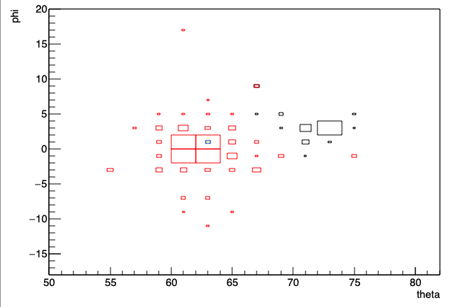
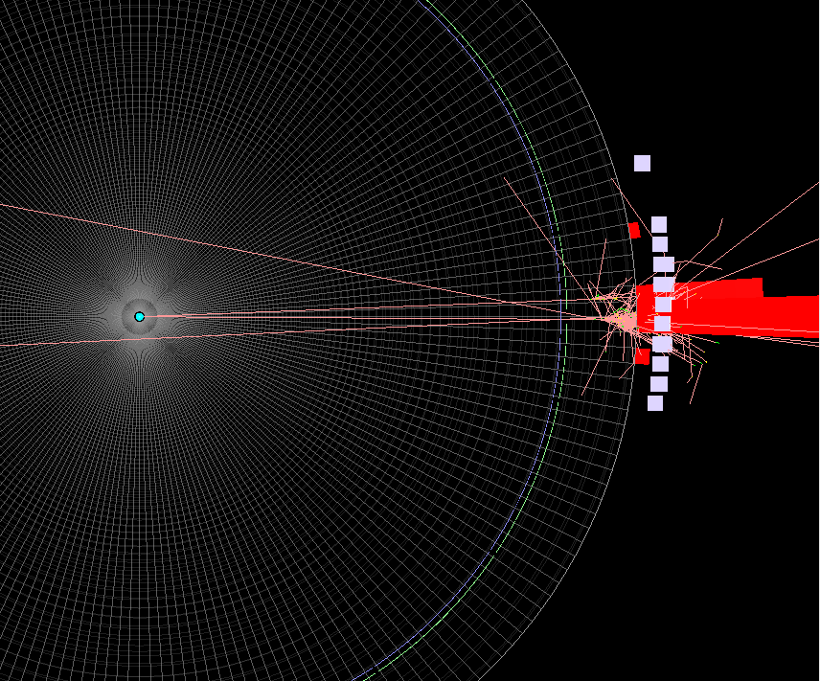
Examples
π⁰ → 𝛾𝛾

Slide 23
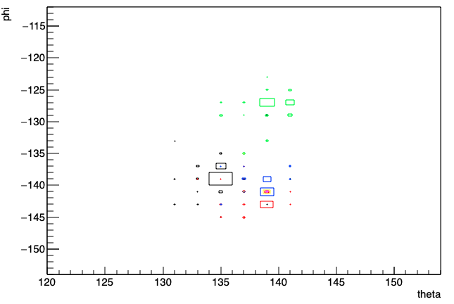
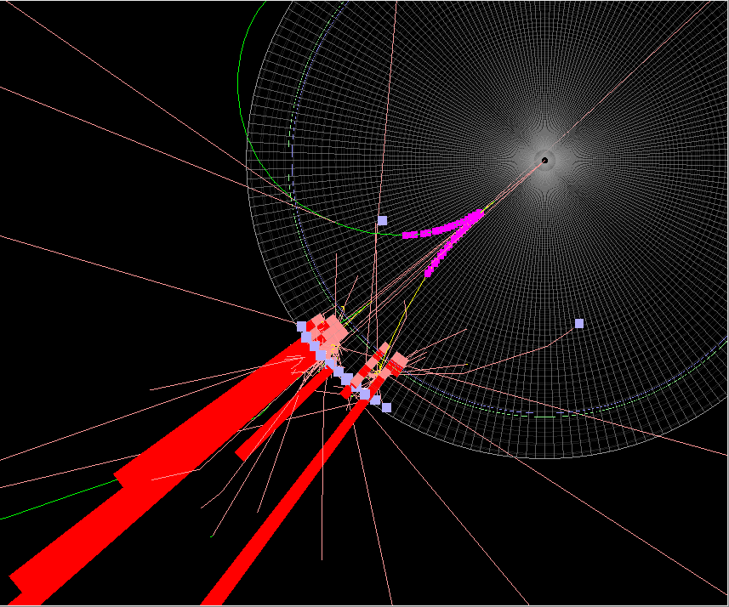
Examples
π⁰ → 𝛾e⁺e⁻

Slide 24
Summary
New EMC MC matching implemented
History of particles taken into account
Should also work with new EMC geometries
Combined with new storage of deposited energy in EMC Hit (by Qing Pu)
Some testing still has to be done
Part of the dev branch of PandaRoot

