Slide 1
Virgo Cluster
M. Al-Turany on behalf of CIT

Slide 2
Disclaimer
What you see here is the result of the work of many people listed (alphabetically) here and others from the CIT
D. Bertini, M. Dessalvi, S. Fleischer, R. Grosso, C. Huhn, R. Karabowicz, D. Klein, J. Knedlik, T. Kollegger, D. Kresan, V. Penso, C. Preuß, K. Schwarz, C. Tacke, F. Uhlig

Slide 3
Current situation: GSI -CIT
Very limited manpower
Rapidly changing hardware and software environments
Increasing and very different requirement from users
  Pretty old software!
  Newest packages and compilers
  GPUs
  ….

Slide 4
Constraints
Cluster Maintenance: We need to be able to “quickly” re-install nodes on the cluster
Even though separated from storage it needs to integrate with the storage (lustre)
We must guarantee “Long-term stability” (e.g. distribution lifetime)

Slide 5
Our Users
Mostly scientific users who need to develop and execute custom software
Knowledge level varies very strongly:
  Change parameter in script and submit
  …
  Develop/compile/submit
  …
  Sophisticated workflows (MPI, FairMQ, …)
External users (e.g: ALICE grid)

Slide 6
Virgo Cluster:
Design decisions
Virtualized approach (Singularity containers).
Separate the Cluster from the rest of the infrastructure.(i.e: Interactive machines, group servers, desktops, etc)
CentOS as the host OS for the batch farm.
  Prerequisite for OpenHPC
  Better hardware (driver) support
  Better compatibility with HEP community
SLURM as resource management system.

Slide 7
Virtualized approach based on Singularity containers
Decouple minimal host system installation from Virtualized Application Environment (VAE)
Host system: Core system packages without application software
VAE: Runtime environment + Application software (CVMFS)
Few VAEs (<5) to support all users maintained by IT
Custom user containers are not excluded but not supported in any form!

Slide 8
Design decisions: Software distribution
Spack as a package manager for application software (https://spack.readthedocs.io)
CVMFS as software distribution service inside and outside the GSI. (https://cernvm.cern.ch/portal/filesystem)

Slide 9
Software distribution and CVMFS
User = Repository Owner := An experiment such as CBM, ALICE, . . .
Each user gets a shared secret needed for publishing (Each user is free to use Spack or whatever he likes to manage his software on CVMFS)
Each user can set up as many remote publishers as he needs (for example one per platform)
It is the responsibility of the user to make sure that there are no unwanted collisions if there are several people/mechanisms publishing to their cvmfs repository

Slide 10
Software distribution and CVMFS
CVMFS Procedures are documented at:
  https://git.gsi.de/dc/cvmfs-server/
Each experiment have to decide for themselves whether to make each of their repositories public or internal.

Slide 11
Containerized environments:
Virtual Application Environments (VAE) is selected by login to specific submit nodes:
Submit node | VAE | Description
virgo-debian8.hpc.gsi.de | Debian 8 | Compatible to Kronos
virgo-centos7.hpc.gsi.de | CentOS 7

Slide 12
Kronos Compatibility:
VAE mimicking the Kronos cluster
Transition to the new cluster
All software previously available via CVMFS on Kronos is mounted in VAE
Applications which run on Kronos should work without modification.

Slide 13
Kronos Compatibility:
OpenMPI test
Denis Bertini
VAE successfully used for typical GSI TNSA Simulation
∼ 3 days running time
Physical results OK

Slide 14
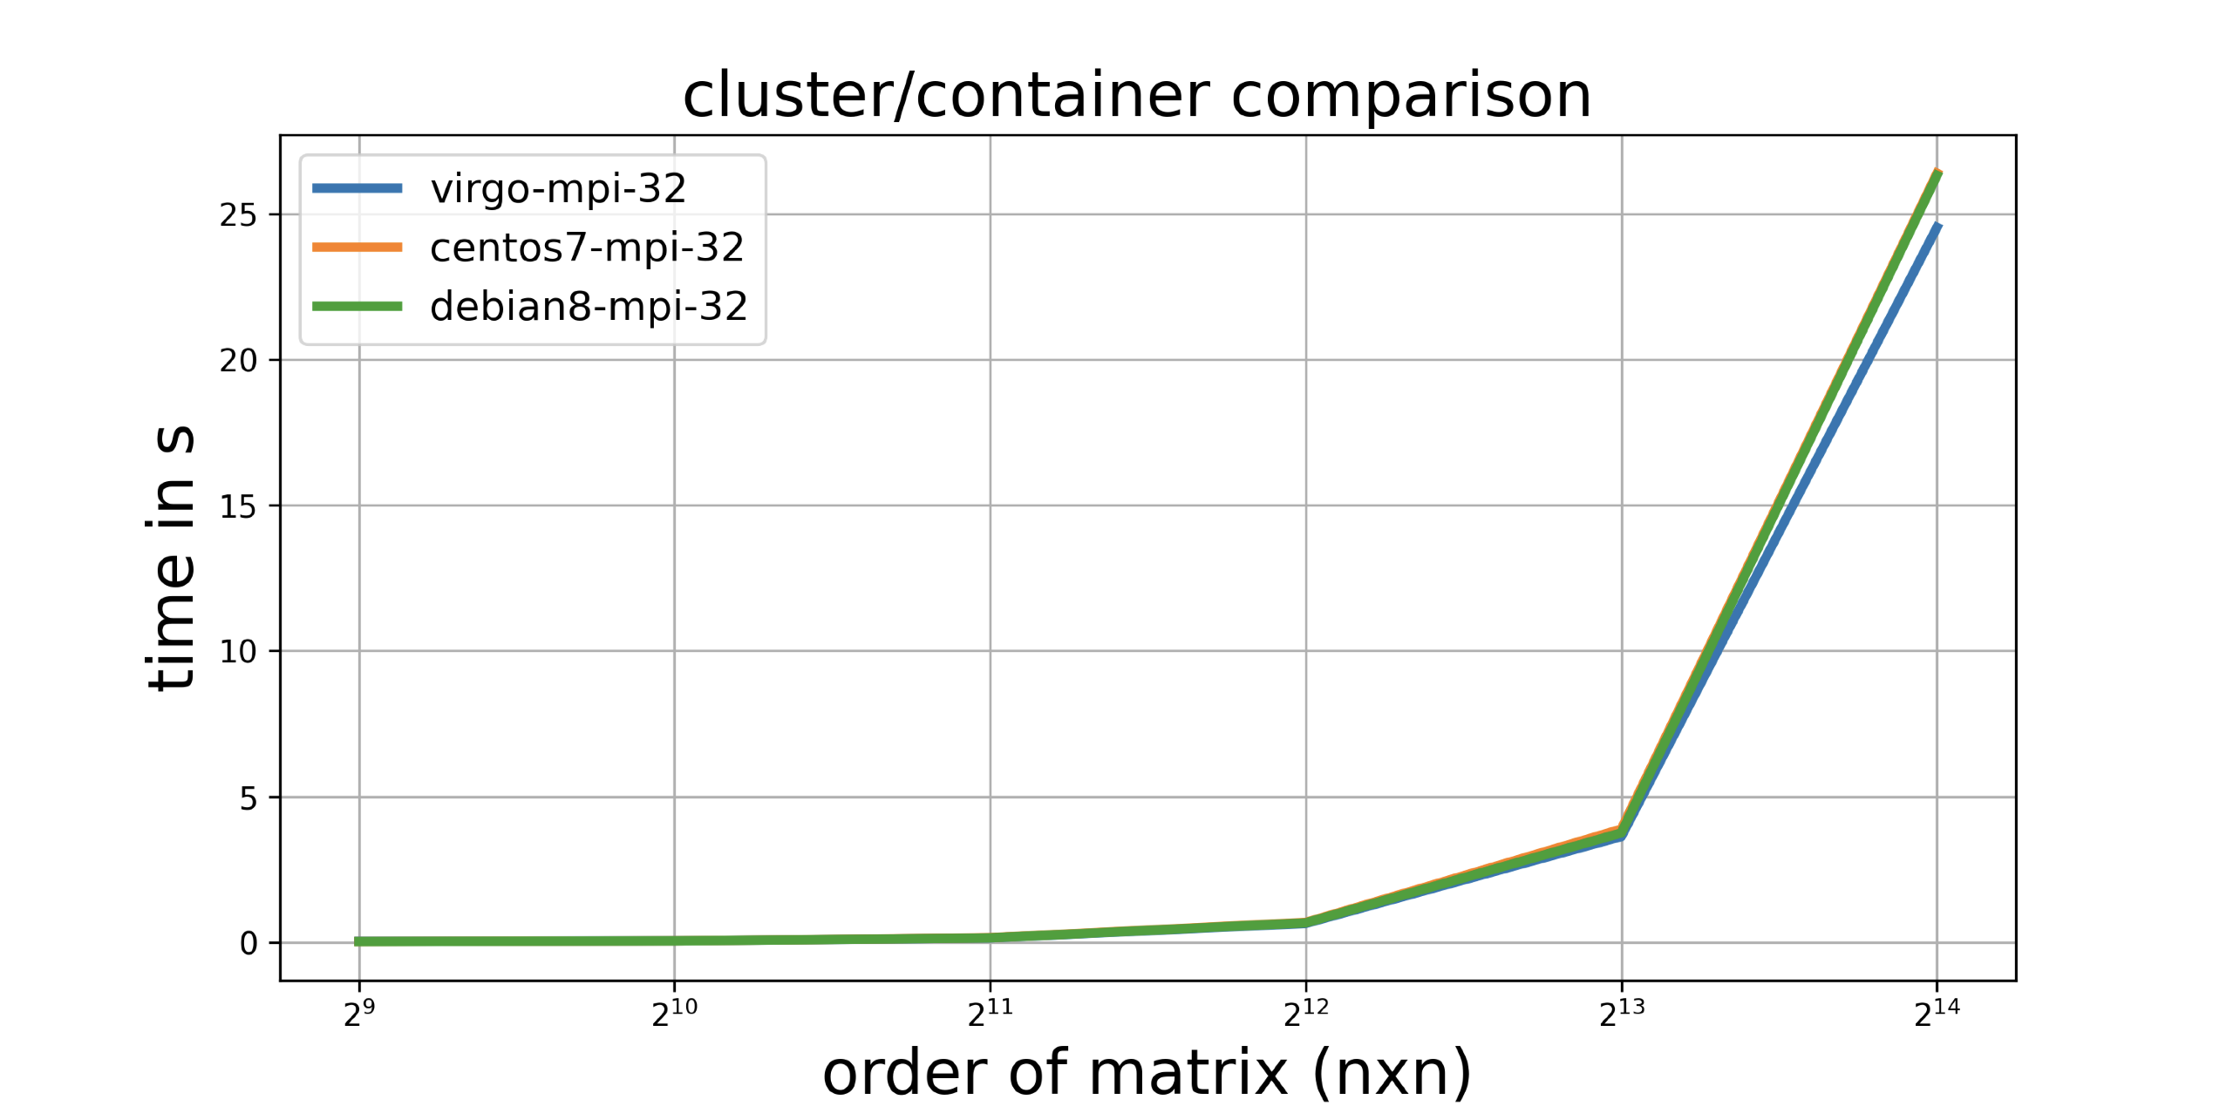
Kronos Compatibility:
MPI/ScaLapack tests
Jan Knedlik
Using AMD AOCL optimized BLAS(BLIS) via ScaLapack’s pzgesv() (solve linear matrix with complex)
Nearly identical behavior native/container (CPU-bound problem)

Slide 15
Kronos Compatibility:
ROOT/FairRoot Test
Dmytro Kresan
Florian Uhlig
Root/FairRoot-based applications run without any issues

Slide 16
Kronos Compatibility:
VAE mimicking the Kronos cluster
This will be supported for limited and short time:
Debian 8 support ends this month
  Kronos will be shut down as soon as all of you move to the Kronos VAE
Kronos VAE should not stay much longer! (maximum until the end of this year)

Slide 17
Software Installation Request Template
Users should fill out the SIR template to request new software:
  https://git.gsi.de/SDEGroup/SIR

Slide 18
User issues
Virgo cluster and CVMFS
  cluster-service@gsi.de
Lustre
  lustre-service@gsi.de

Slide 19
Future plans (very short term)
Make compilers and basic scientific software available for CentOS7 on the new CVMFS (Next week)
Shut down Kronos as soon as possible and integrate the hardware into Virgo

Slide 20
Documentation
CVMFS at GSI: https://git.gsi.de/dc/cvmfs-server/
Virgo cluster: https://hpc.gsi.de/virgo/
Spack: https://spack.readthedocs.io
CVMFS: https://cernvm.cern.ch/portal/filesystem

