Slide 1
Unilac – 9.6.2020
Spare parts (A3DR8: Endplates re-machined, isolation improvements, brazing+welding next)
HLI RF loop: to be fine checked, repaired or built new.
Beam Time:
209Bi, until Thursday 28th May.
Protons from CH3 MUCIS, since 28th March.
Pulsed gas stripper with hydrogen gas until Thursday morning 28th May,
Jet Stripper with nitrogen since Thursday morning 28th May.
High Current Optimizations Tuesday 2nd June
Proton beam with various modified Alvarez Phases Wednesday
Emittance Measurements Thursday
Beam for Users Friday – Monday 6 a.m.

Slide 2
Status UNILAC - machine investigations campaign
Bi⁴⁺ - Bi²⁶⁺ - Bi⁶⁸⁺ (UL-SU (N₂-jet/N₂-pulsed cell) – TKU)
Bi⁴⁺ - Bi²⁶⁺ (UL-SU (N₂-jet/N₂-pulsed cell) – TKG)
stripping efficiency (Bi²⁶⁺) ≈ 13.2 %
optimized set up
full beam characterization: beam current, profile, phase probe signals, beam emittance (UH1, US4, UA4, TK5, TK8)
Bi⁴⁺ - Bi²⁸⁺ - Bi⁶⁸⁺ (UL-SU (H₂-pulsed cell) – TKU)
Bi⁴⁺ - Bi²⁸⁺ (UL-SU (H₂-pulsed cell) – TKG)
stripping efficiency (Bi²⁸⁺) ≈ 23.4 % (75% intensity gain)
optimized set up: 2.7 emA (Bi²⁸⁺), 1.2 emA (Bi⁶⁸⁺) (TK7)
full beam characterization: beam current, profile, phase probe signals, beam emittance (UH1, US4, UA4, TK5, TK8)
A4/A3-comparison campaign (UL-SU (N₂-jet) – TKU)
700 emueA, 11.4 MeV/u,TK7, Bi⁶⁸⁺
570 emueA, 8.6 MeV/u,TK7, Bi⁶⁴⁺
CH₃⁺ - H⁺ (UL-SU-TKG)
optimized set up (with synchronous phase -30 degree => ≈ -60 degree)
stable beam operation since Friday 29th May
H+ High Current Optimizations: 1.3 ema@TK7 (Tuesday 2nd June)
C6+ High Current Optimizations: 0.53 ema@TK7 (Tuesday 2nd June)
H+ Alvarez Voltages/Phases (Wednesday 3rd June):
30 degrees, 1 Volt (standard, difficult for RF)
56 degrees, 1.55 Volt (good, used for operation during this campaign)
65 gegrees, 2.05 Volt (also good)
73 degrees, 3 Volt (not good, too strong longitudinal focusing)
Emittance Measurements UH1, US4, UA4, TK5, TK8 for H+ and C6+. (2.3 mA CH3@UH1, 2.7 mA H+ (1.2 mA C6+)@US4 (1000/4000 mbar), 2.2 mA H+ (1.0 mA C6+)@UA4)

Slide 3
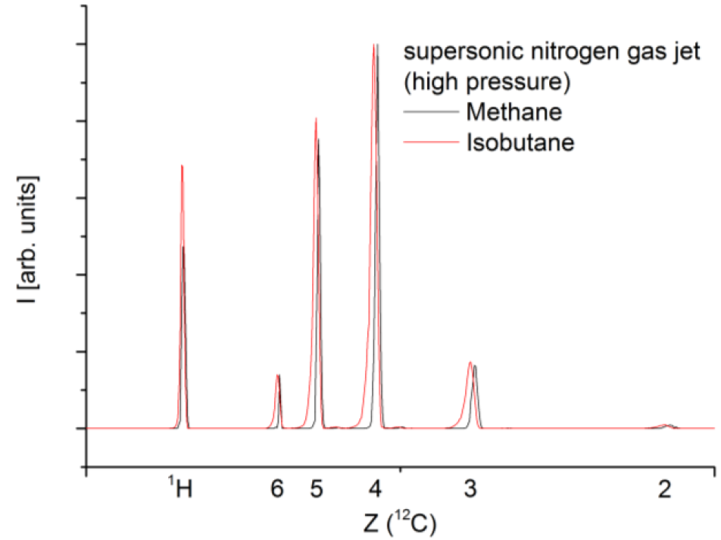
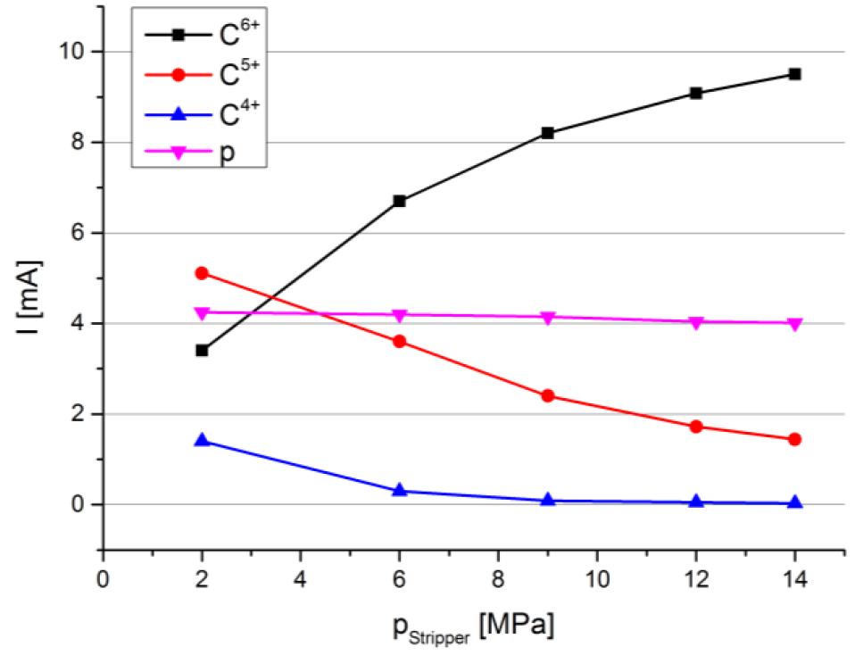
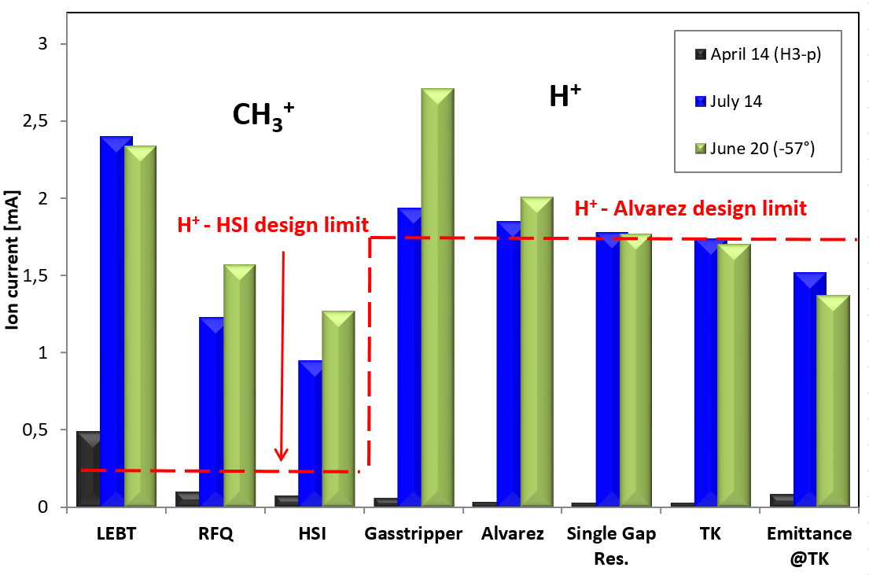
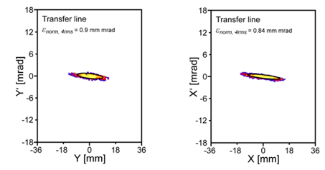
High Intensity Proton Measurements
2015
pulsed gas stripper
confirmed
2020
0.62
1.44
2020
2015

