Slide 1
Performance of LHC Collimation
R. Assmann, CERN
13/09/2010
ColMat Meeting, GSI
… for the LHC Collimation Project
CERN and EuCARD/ColMat Collaboration

Slide 2
LHC Collimation System
The LHC collimation system is the most elaborate collimation system built for any accelerator: 88 movable collimators with two jaws, absorbers, 2 warm cleaning insertions, experimental collimation, radiation handling, material robustness, …
Involves a necessary complex control of ~400 DOF with several settings through the LHC operational cycle.
It is studied and optimized since 2001 in the beam cleaning / collimation WG and the LHC collimation project.
The previous talks explained its functioning and the results obtained with beam in detail.
The system is designed as a cleaning system (determines location of collimators) but also offers passive protection (not ideal phase coverage).
Here focus on MP issues of this complex system…

Slide 3
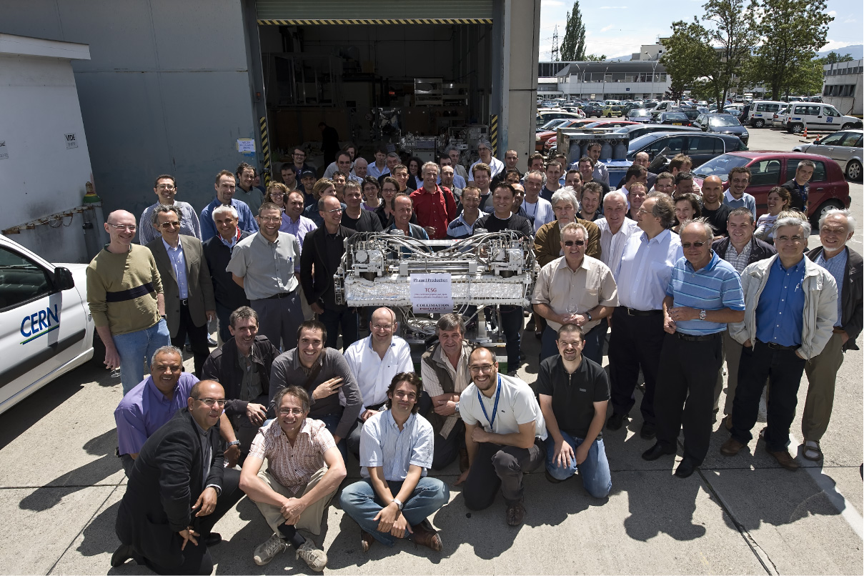
… celebration after 6.5 years of hard work
in BE, EN, TE, RP, …
2009

Slide 4
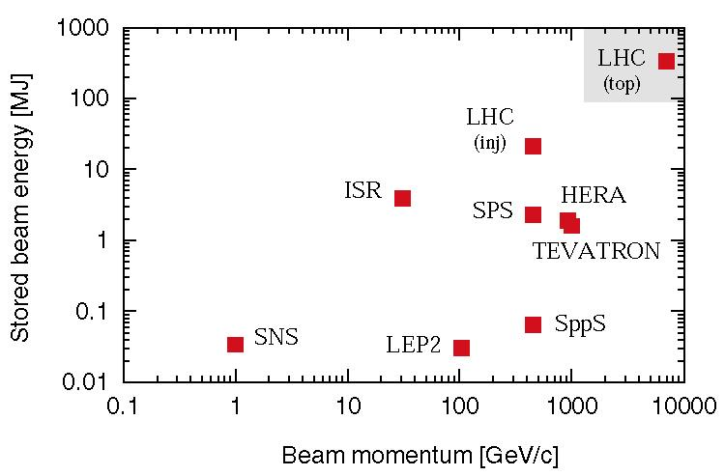
Stored Energy
Comparing stored beam energy
Nominal LHC design: 3 × 10¹⁴ protons accelerated to 7 TeV/c
circulating at 11 kHz in a SC ring
At less than 1% of nominal intensity LHC enters new territory. Collimators must survive expected beam loss…

Slide 5
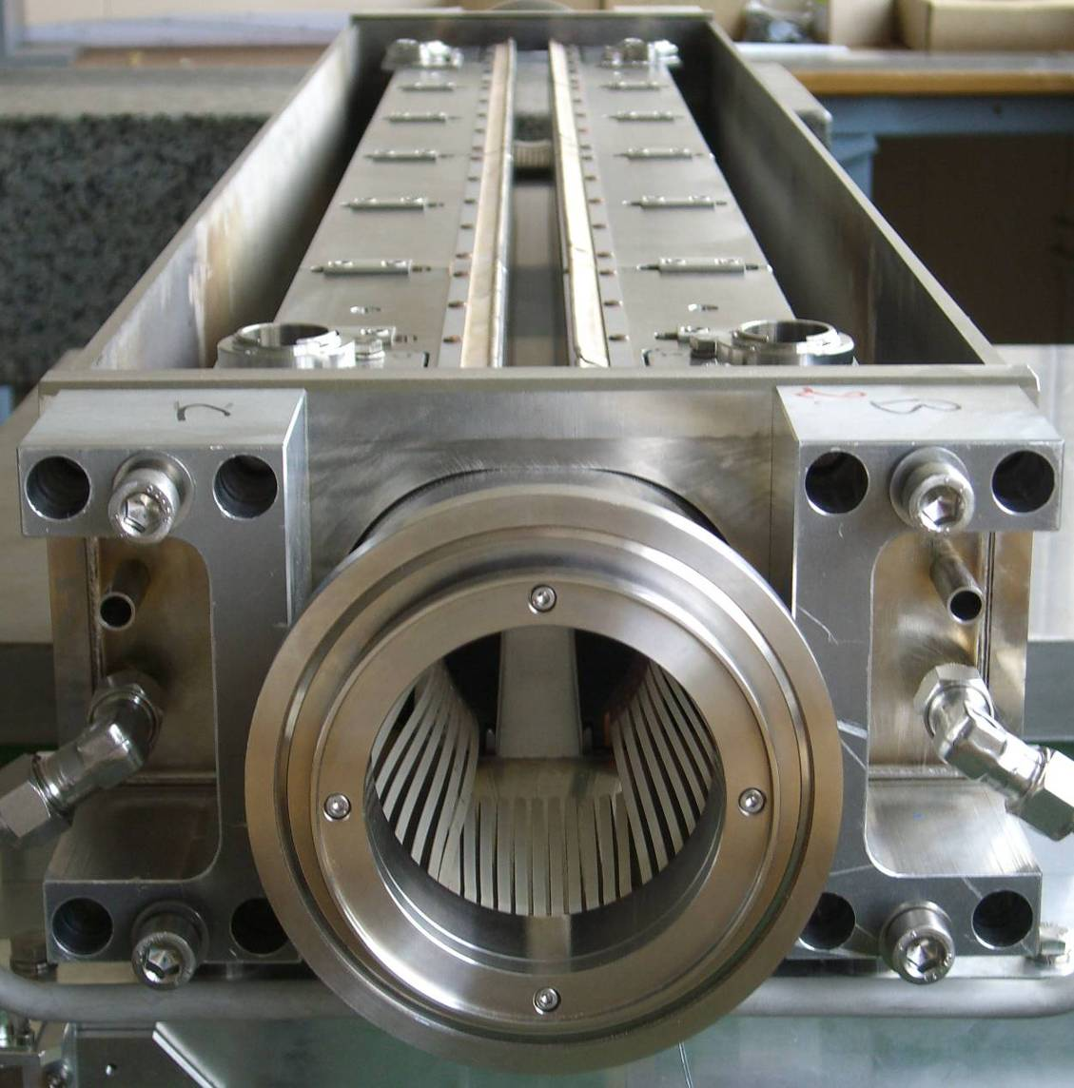
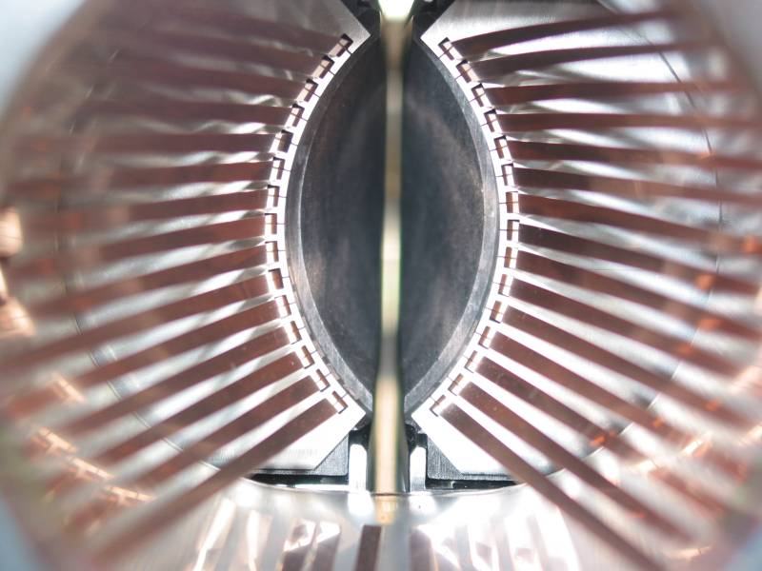
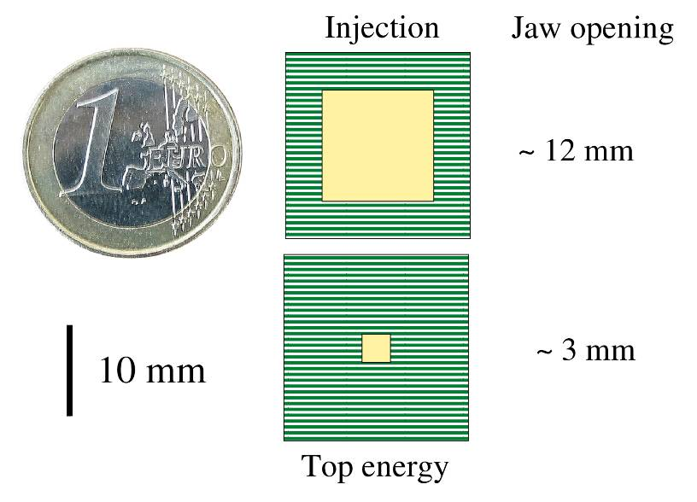
The LHC Collimator (Phase 1 MainDesign)
1.2 m
3 mm beam passage with RF contacts for guiding image currents
Designed for maximum robustness:
Advanced CC jaws with water cooling!
Other types: Mostly with different jaw materials. Some very different with 2 beams!
360 MJ proton beam

Slide 6
Precision Requirements closest to beam: primary (TCP) and secondary (TCS) collimators
Parameter | Unit | Specification
Jaw material |  | CFC
Jaw length TCS TCP | cm cm | 100 60
Jaw tapering | cm | 10 + 10
Jaw cross section | mm² | 65 × 25
Jaw resistivity | μΩm | ≤ 10
Surface roughness | μm | ≤ 1.6
Jaw flatness error | μm | ≤ 40
Heat load | kW | ≤ 7
Jaw temperature | °C | ≤ 50
Bake-out temp. | °C | 250
Minimal gap | mm | ≤ 0.5
Maximal gap | mm | ≥ 58
Jaw position control | μm | ≤ 10
Jaw angle control | μrad | ≤ 15
Reproducibility | μm | ≤ 20
Gaps: ± 6/7 σ
2-3 mm
LHC collimators must work as precision devices!
2003 Specification

Slide 7
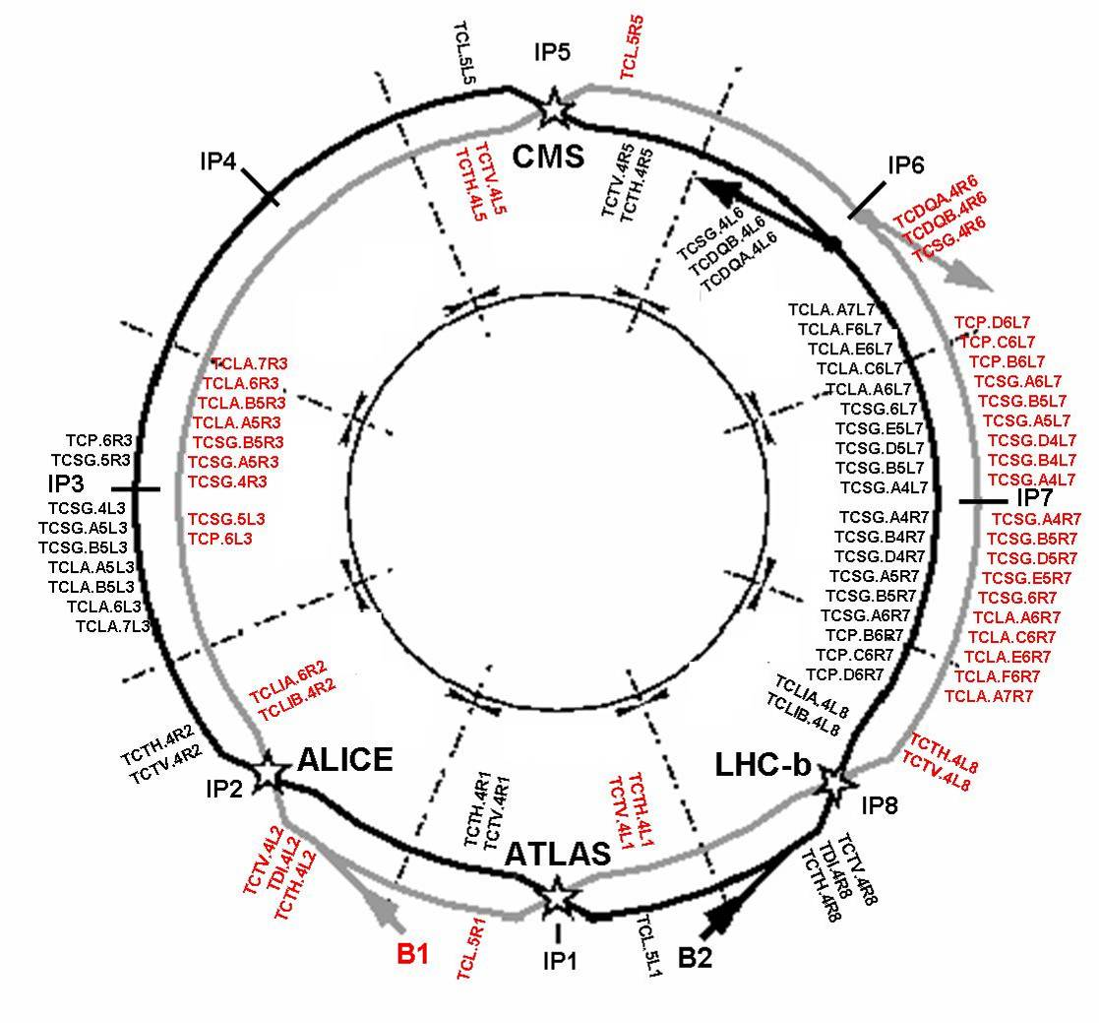
System Design
“Phase I”
Momentum
Cleaning
Betatron
Cleaning
108 collimators and absorbers in phase I (only movable shown in sketch)

Slide 8
Multi-Stage Cleaning & Protection 3-4 Stages
CFC collimator
Beam propagation
Core
Unavoidable losses
Primary
halo (p)
Secondary halo
π
p
Shower
Impact parameter
≤ 1 μm
π
Tertiary halo
p
Primary
collimator
e
p
Shower
Secondary
collimator
e
Super-conducting magnets
High Z coll
SC magnets and particle physics exp.
High Z coll
CFC
CFC
W/Cu
W/Cu

Slide 9
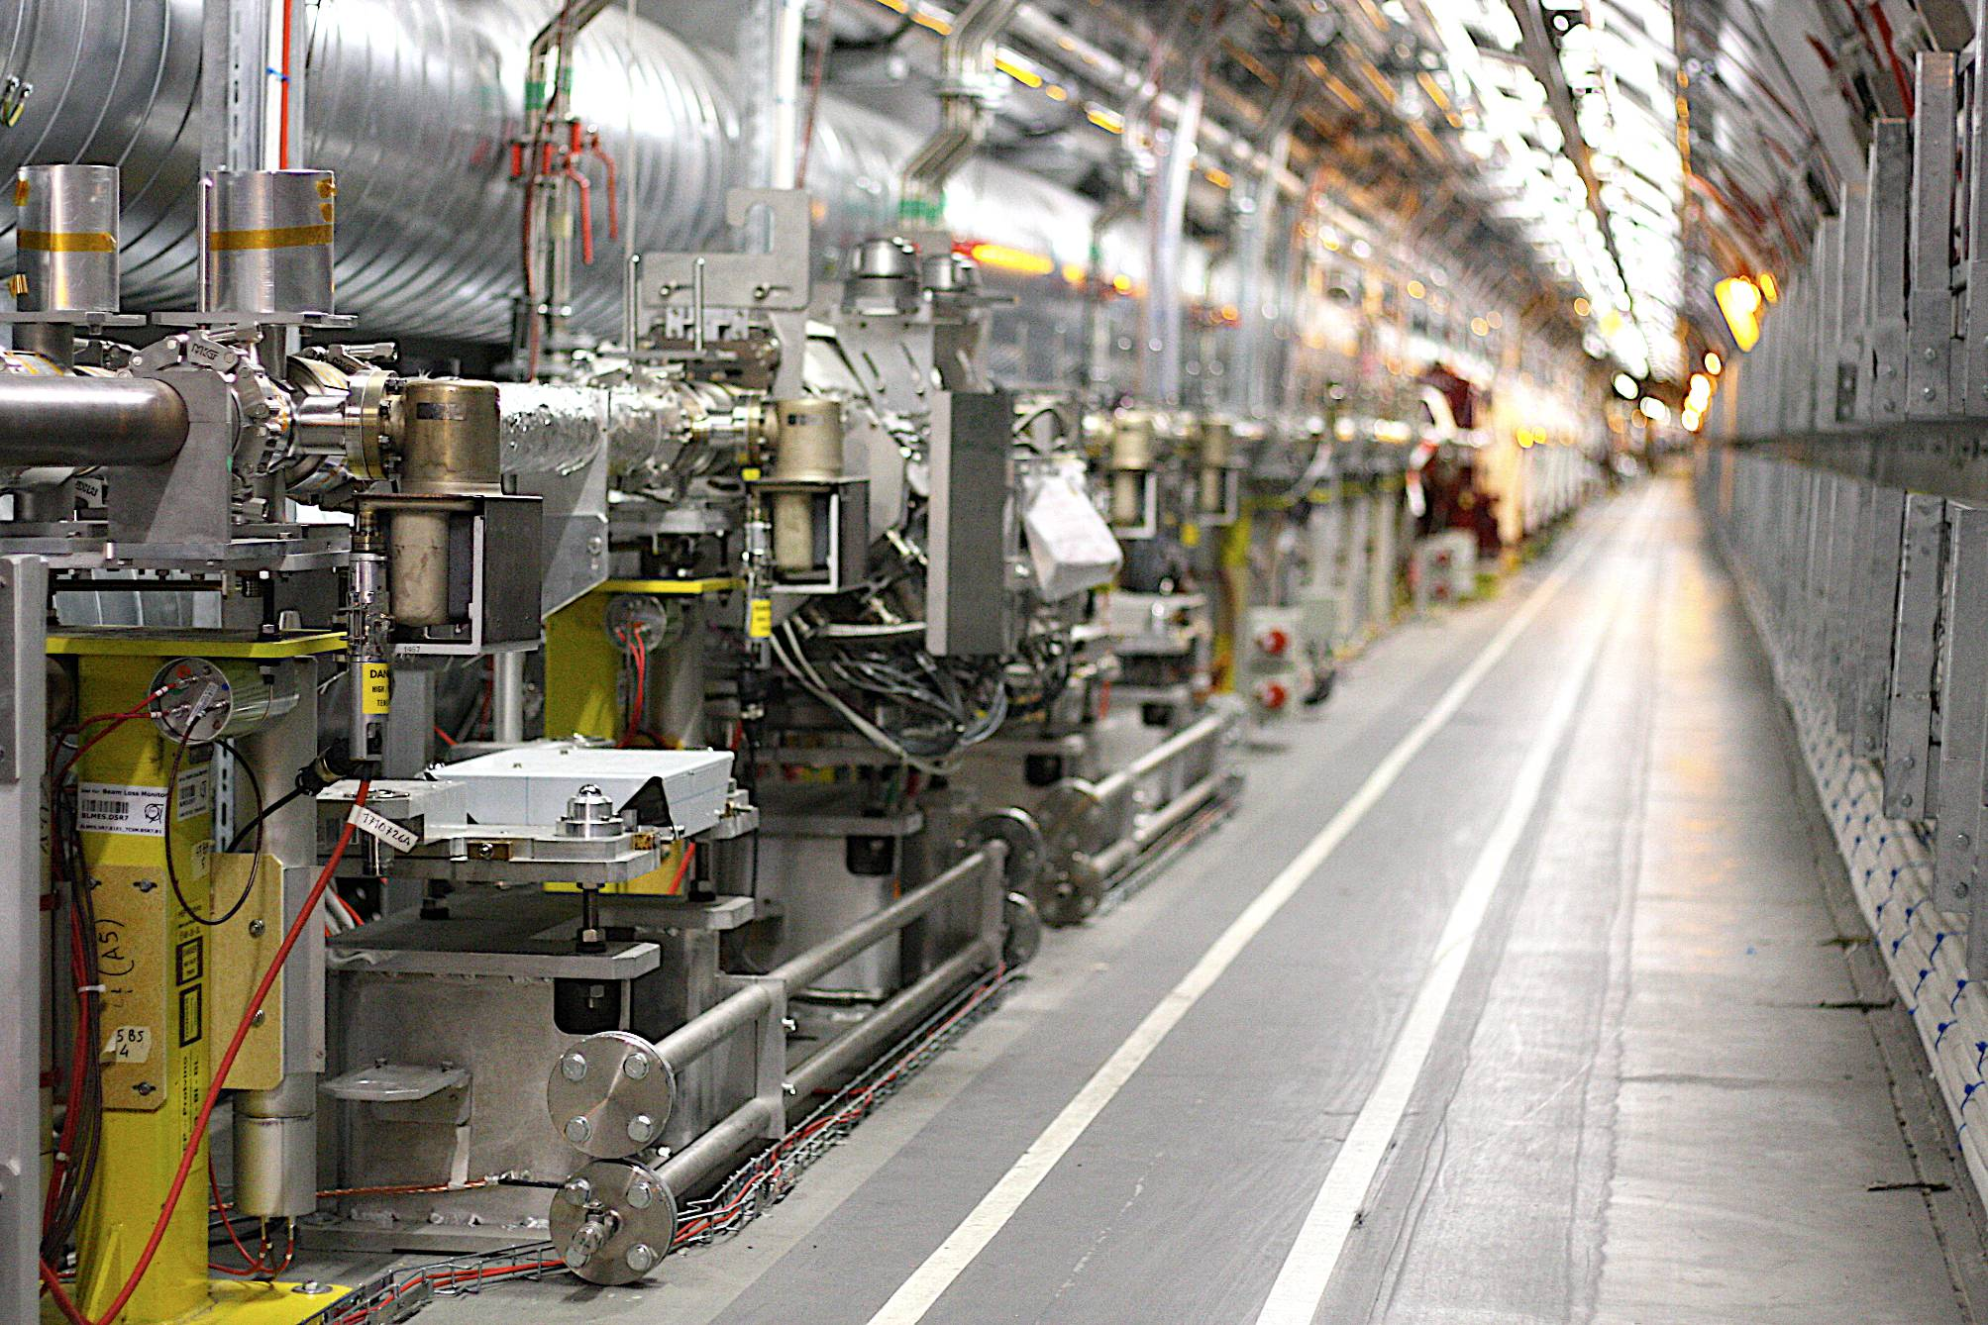
Beam Loss Monitors for Monitoring Losses at Collimators
PHASE I COLLIMATOR TCSG
Beam Direction
Beam Loss Monitors for Collimation

Slide 10
Role of Collimation
Correct setup of collimation ensures highly efficient beam cleaning:
Tolerance for allowable LHC beam losses is maximized.
Risk of quenches is minimized.
Operational efficiency and integrated luminosity is maximized.
Correct setup of collimation ensures also several safety functions:
Protection of accelerator against fast losses, e.g. erroneous dumps, wrong injection kicks, trips of fast magnets, RF trips, … → losses appear at collimators within given phase space coverage.
Protection of accelerator against long-term losses: radiation at foreseen locations, effectiveness of absorbers, survival of magnets, …
Correct environmental impact with losses at foreseen locations.
Robustness of collimation system against failures: collimators only damaged with multiple errors (e.g. asynchronous dump + dump protection out).

Slide 11
Collimation Condition
Good settings for given machine state!
for 2010: setup with relaxed 3.5 TeV tolerances (x 2.8) and limit on β* (> 2.5 m) → intermediate collimator settings!

Slide 12
Collimation Setting Calculation
The collimator settings are calculated to:
Provide good efficiency.
Provide the correct collimator hierarchy (slow primary losses at primary collimators).
Protect the accelerator against the specified design errors.
Provide continuous cleaning and protection during all stages of beam operation: injection, prepare ramp, ramp, squeeze, collision, physics.
Provide maximum tolerances to beam and various collimator families.
Provide warning thresholds on all collimator axis positions versus time.
Provide interlock thresholds on all collimator axis positions versus time.
Provide interlock thresholds on all collimator gaps versus beam energy.
Complex problem with some 100,000 numbers to control the system.
Redundant calculation: time-dependent (ABP), energy-dependent (OP)

Slide 13
Required Flexibility
The LHC collider is not a static accelerator!
As a consequence the collimation system cannot be a static system either!
Several settings for various stages with ramp functions in between.
Interlock thresholds change as a function of operational stage.
Only energy-dependent interlock thresholds remain unchanged.
All collimation tasks in operational sequence → operator has to execute the sequence tasks completely and in correct order.
Initially some problems (private sequences) but now works reliably. Sequence check tasks process implemented to enforce correct execution.

Slide 14
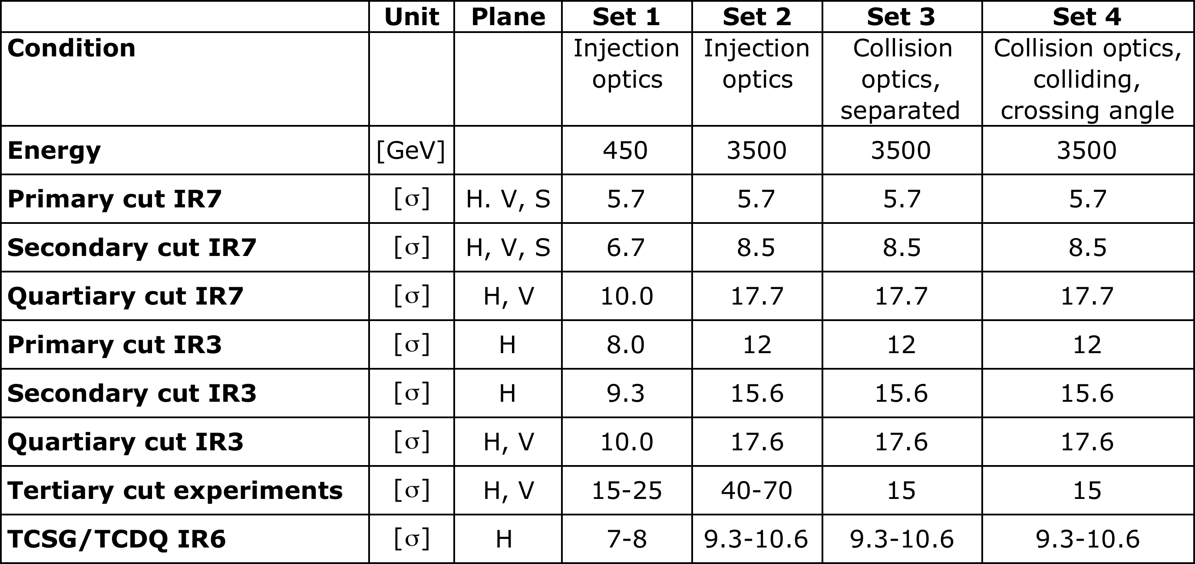
Collimation Setting Overview (in terms of β beam size, valid 12.6. – 30.8.2010)
Ramp functions move smoothly from set 1 to set 2 during energy ramp!
3.5 TeV setup took ~30 h of beam time with single bunch of 1e11 p. Time distributed over 10 days with ~1 collimation shift per day.

Slide 15
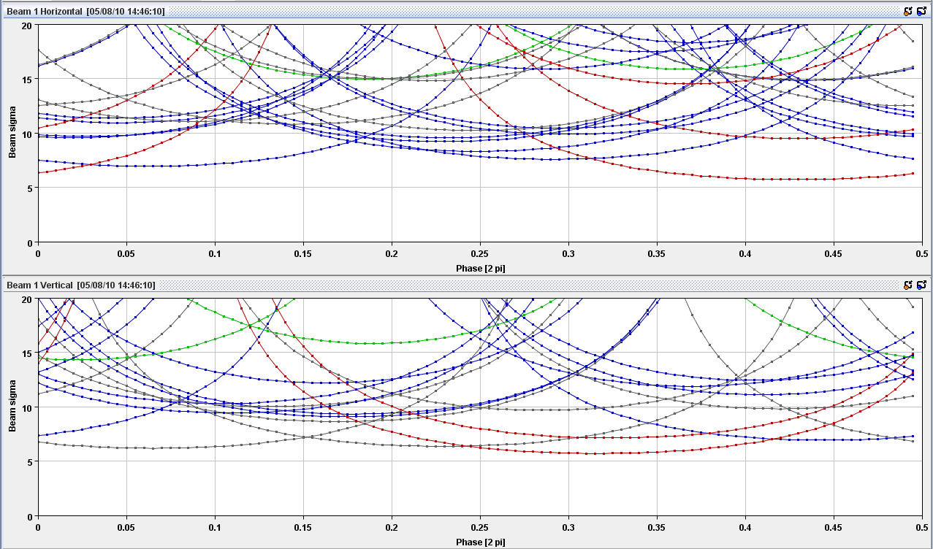
Phase Space Coverage: Injection B1
9σ
TCSG.4R6.B1
TCSG.6R7.B1
TCSG.B4L7.B1
TCP.C6L7.B1
TCLIB.6R2.B1
TCLIA.4R2
TCP.D6L7.B1
TCSG.D4L7.B1

Slide 16
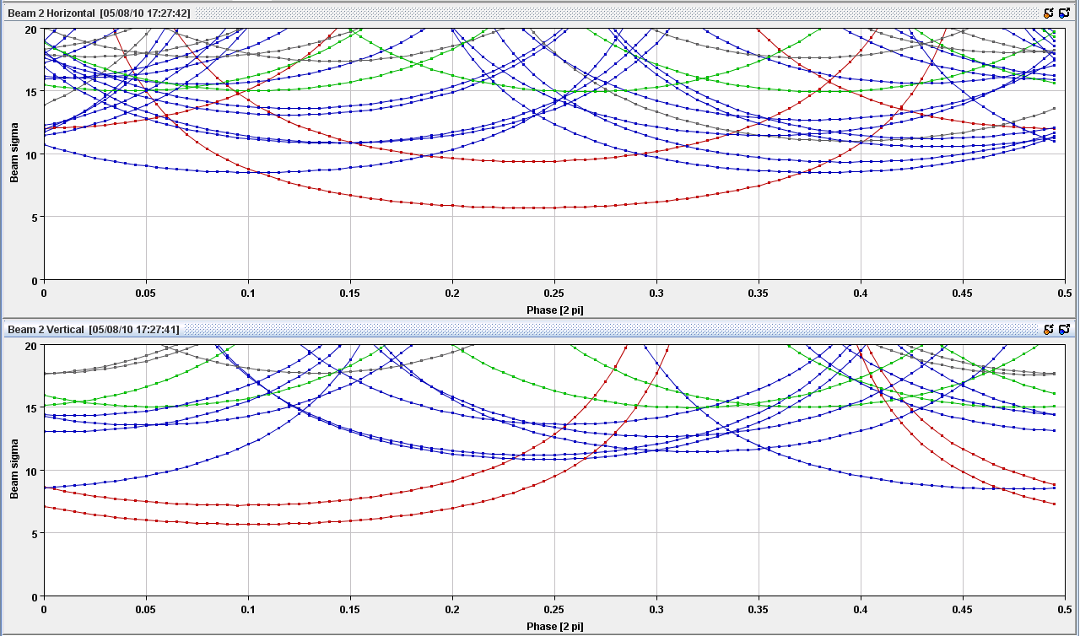
Phase Space Coverage: 3.5 TeV, β*=3.5 m B2
TCSG.6L7.B2
TCSG.B4R7.B2
TCP.C6R7.B2
11.7σ
TCSG.A4R7.B2
TCSG.D5L7.B2
TCSG.D4R7.B2
TCP.D6R7.B2

Slide 17
Measuring Tails (10 min end-of-fill)
Beam Loss
Jaw towards beam
Jaw position
TCP.D6R7.B2

Slide 18
Beam Intensity
- 1.5e11 p
- 3.5 %
Beam dumped from beam loss on Q5 in IR7 (warm) with 84 s integration time!

Slide 19
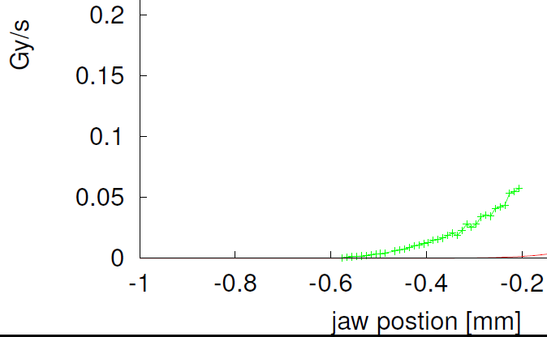
Beam Distribution: Beam 2 Tail V after 13h of Physics
~ 5.7 σ
~ 4.7 σ
~ 3.7 σ
3.5% of beam within 1.5 σ
σ_{y} = 0.27 mm

Slide 20
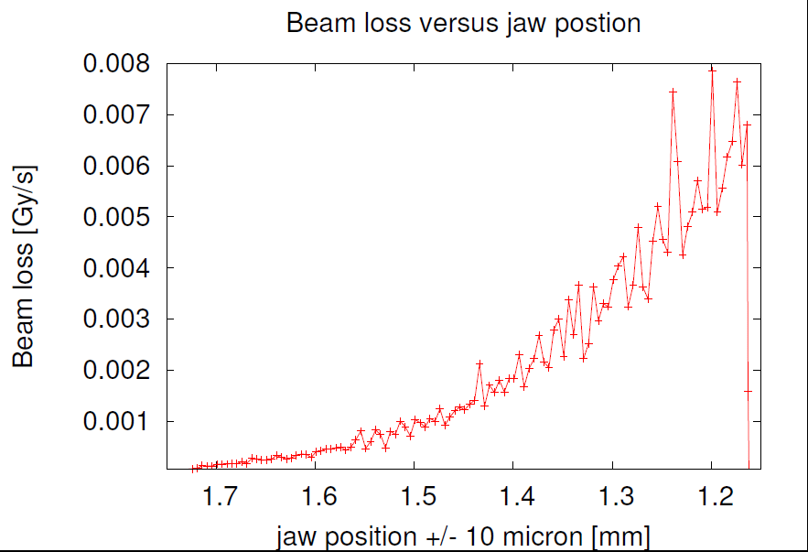
Beam 2 H Tail after 3h30 of Physics
Florian Burkart et al

Slide 21
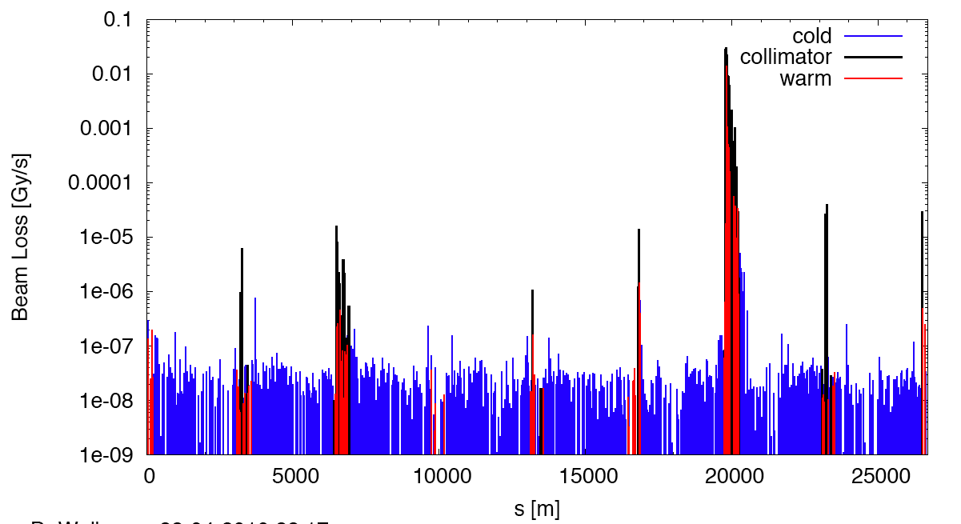
Measured Cleaning at 3.5 TeV (beam1, vertical beam loss, intermediate settings)
Dump Protection Col.
Momentum Cleaning
IR2
IR5
IR8
IR1
2m optics exposes IR’s as expected! Protected by tertiary collimators.

Slide 22
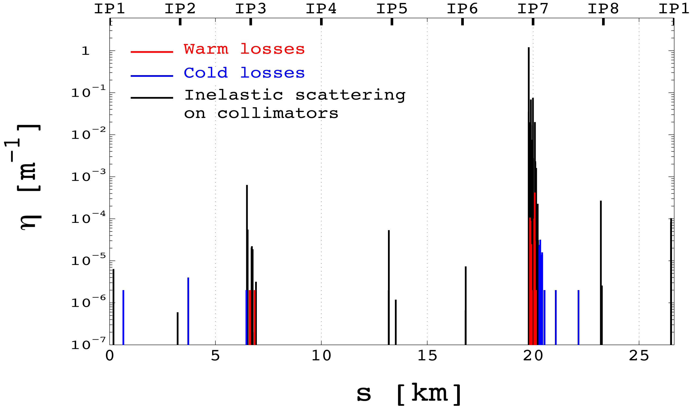
Simulated Cleaning at 3.5 TeV (beam1, vertical beam loss, intermediate settings)
No Imperfections

Slide 23
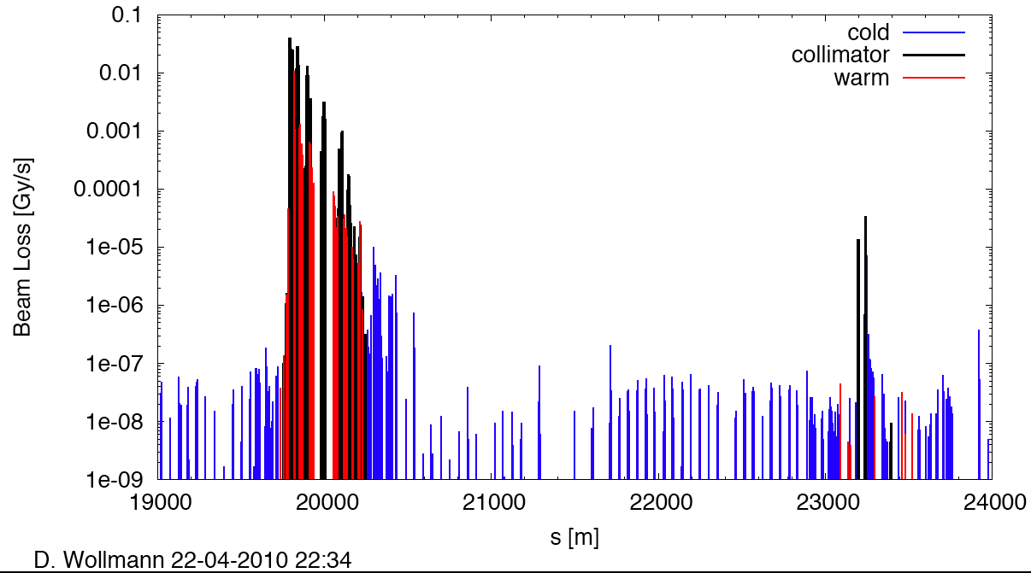
Measured Cleaning at 3.5 TeV (beam1, vertical beam loss, intermediate settings)
Betatron Cleaning
Cleaning efficiency: > 99.975%
factor 4,000
factor 1,000
factor 600,000
IR8

Slide 24
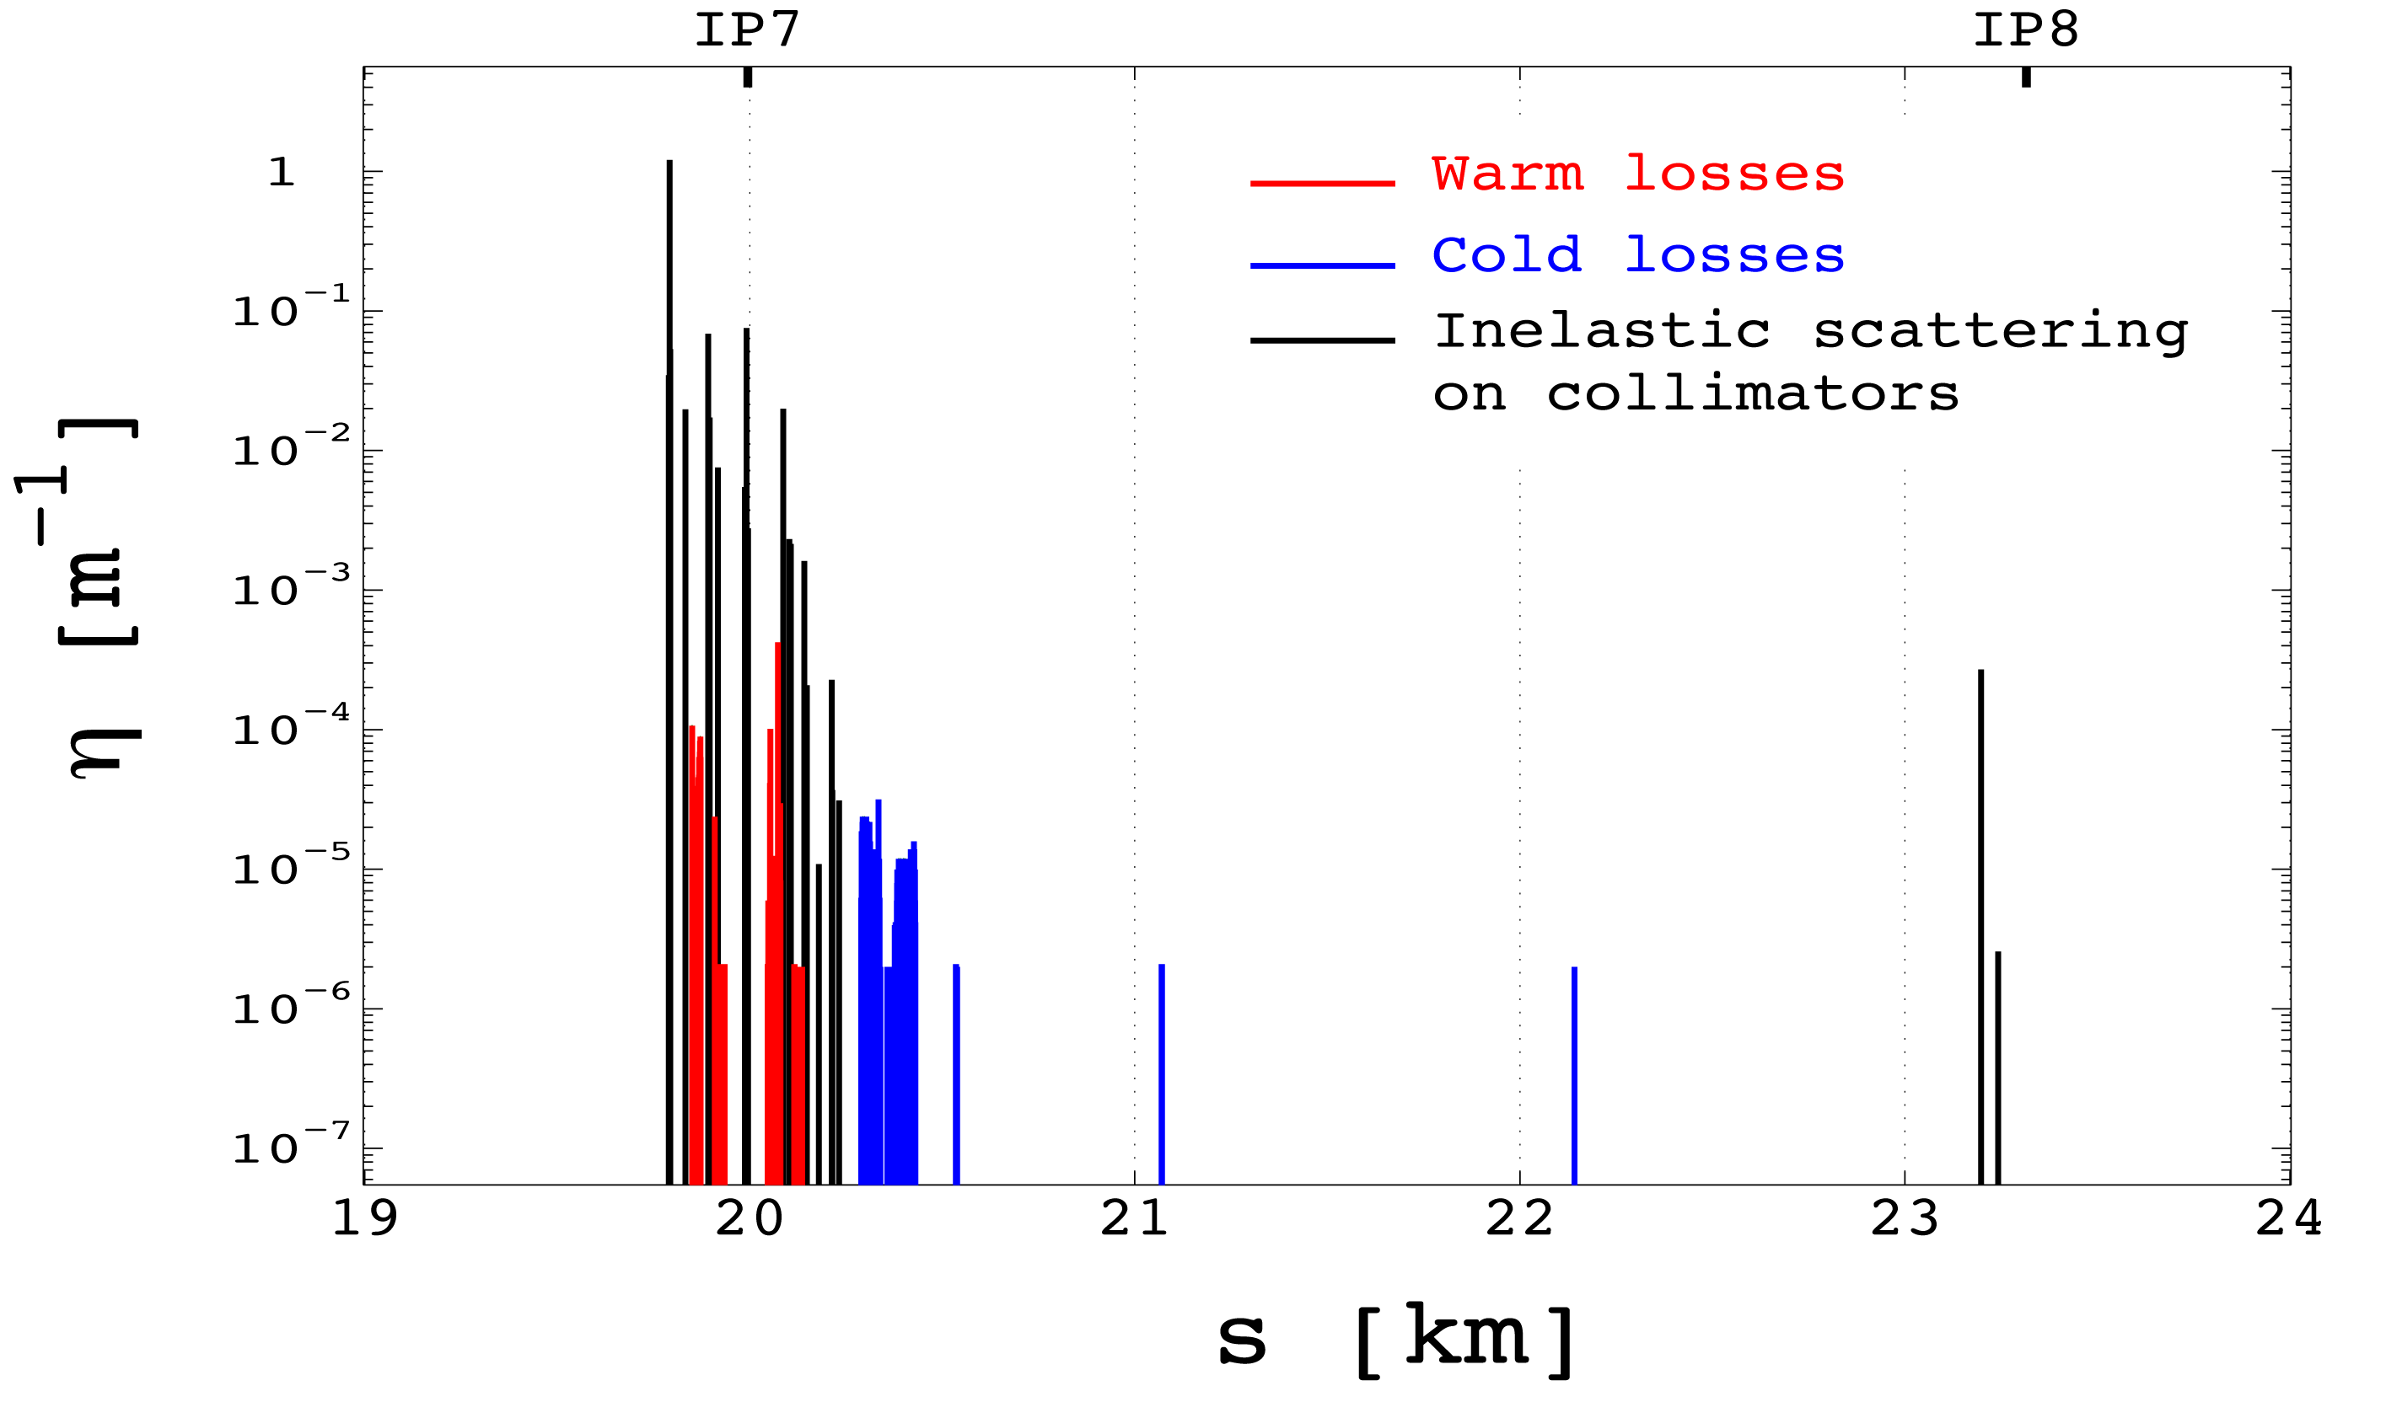
Simulated Cleaning at 3.5 TeV (beam1, vertical beam loss, intermediate settings)
factor 33,000
No Imperfections

Slide 25
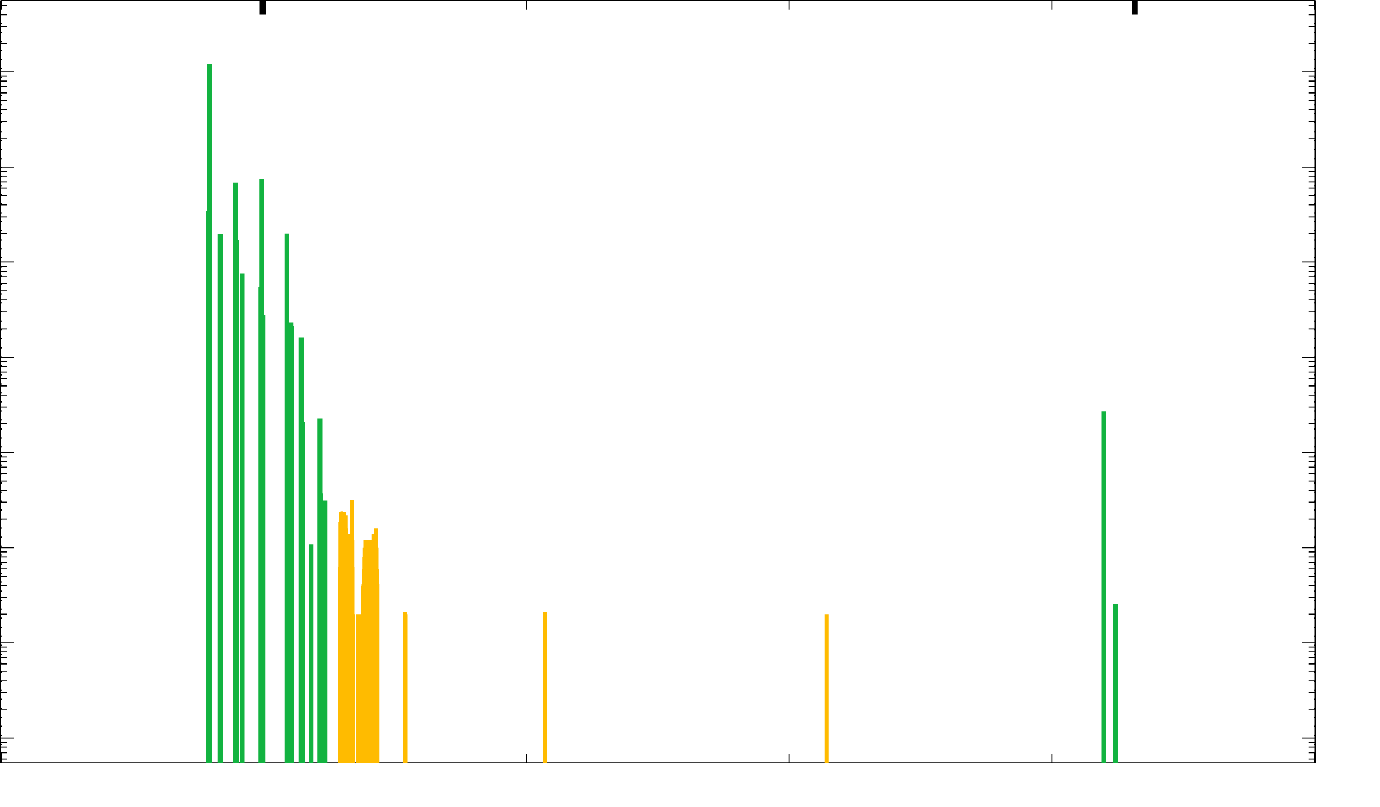
Meas. & Sim. Cleaning at 3.5 TeV (beam1, vertical beam loss, intermediate settings)
IR7
Confirms expected limiting losses in SC dispersion suppressor
Find factor 8 higher, as explained from imperfections!
IR8

Slide 26
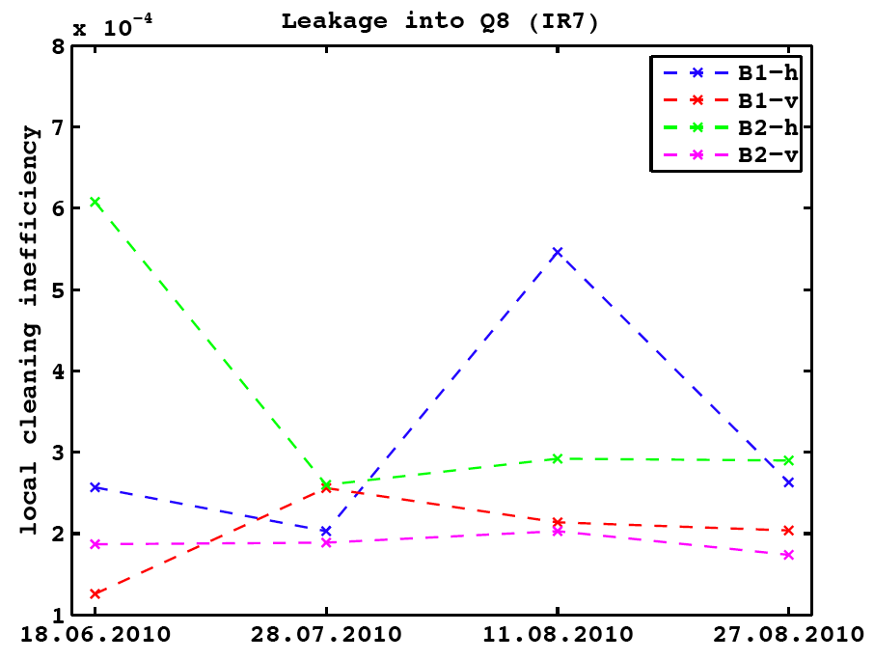
Betatron Cleaning: Peak Leakage to SC Magnet
D. Wollmann et al
3.5 TeV

Slide 27
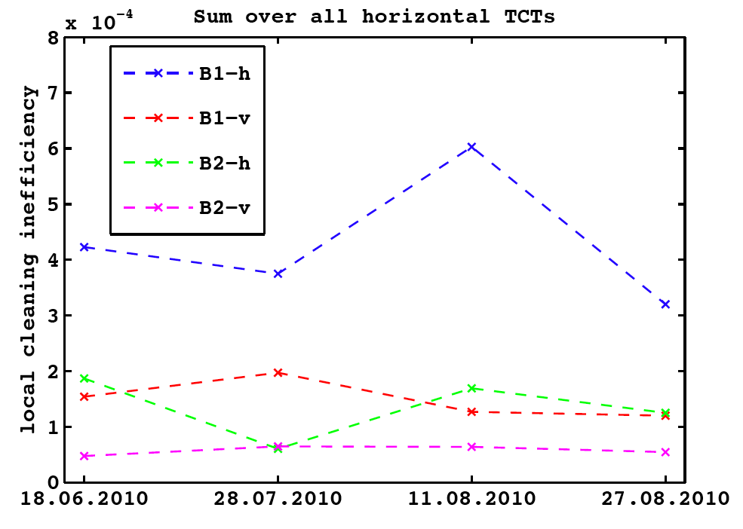
Betatron Cleaning: Leakage (Sum) to Horizontal TCT’s
D. Wollmann et al
3.5 TeV

Slide 28
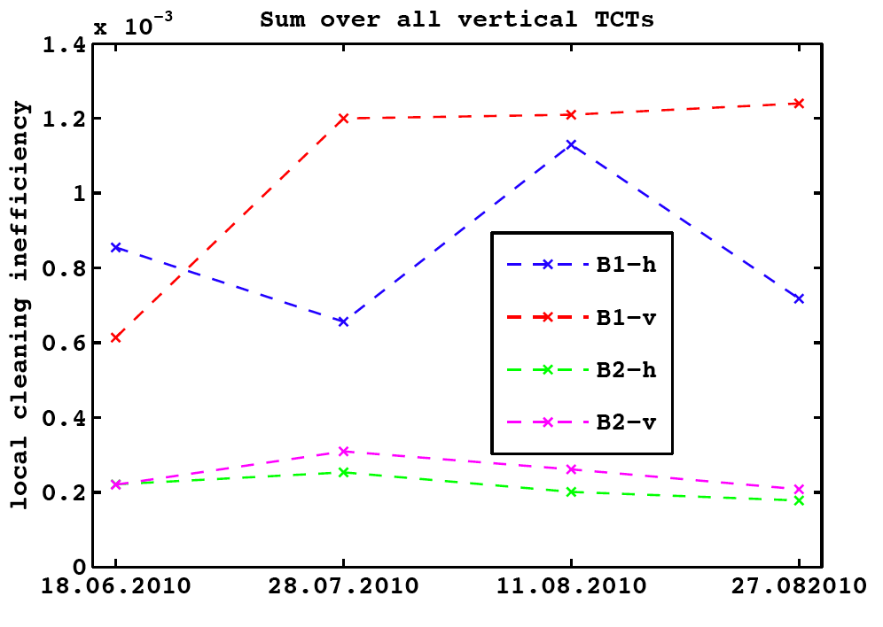
Betatron Cleaning: Leakage (Sum) to Vertical TCT’s
D. Wollmann et al
3.5 TeV

Slide 29
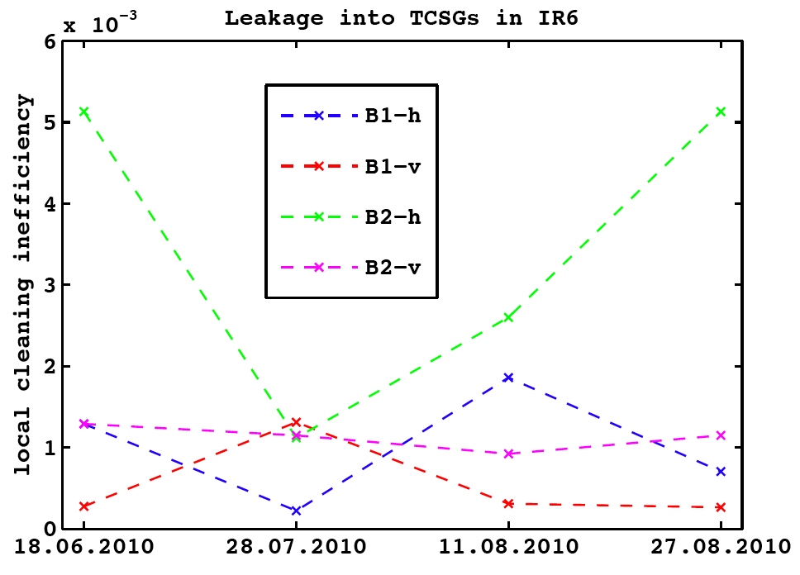
Betatron Cleaning: Leakage to Dump Protection
D. Wollmann et al
3.5 TeV

Slide 30
Stability of Betatron Cleaning 3.5 TeV
Excellent news!
There are some variations by a factor 6. Peak leakage remains very low:
Max to SC magnet: 0.06 %
Max to hor. TCT’s (sum): 0.06 %
Max to ver. TCT’s (sum): 0.12 %
Max to dump protection: 0.52 %
No systematic trend at all visible.
Biggest possible deterioration: factor 2 for TCT in B1 vertical
Ratio from dump protection to hor. TCT’s proves that these tungsten collimators were always in the shadow of the IR6 collimators → SAFE!
August experience proves that we can run stable for long periods without violating safety!
However, …

Slide 31
Momentum Cleaning at 3.5 TeV
Insufficient data to analyze stability.
Still seems to work correctly for the following cases:
Beam 1, positive energy errors
Beam 1, negative energy errors
Beam 2, negative energy errors
Found middle of August to not work correctly in:
Beam 2, positive energy errors
Must be 3.6 sigma error in the system (collimator and/or orbit)
Consequences:
Should be fixed to avoid unnecessary risks (1 protection layer less).
Might have been there since setup: not checked due to large overhead for momentum cleaning tests. Must avoid these short-cuts.
Will be fixed and analyzed at 3.5 TeV.

Slide 32
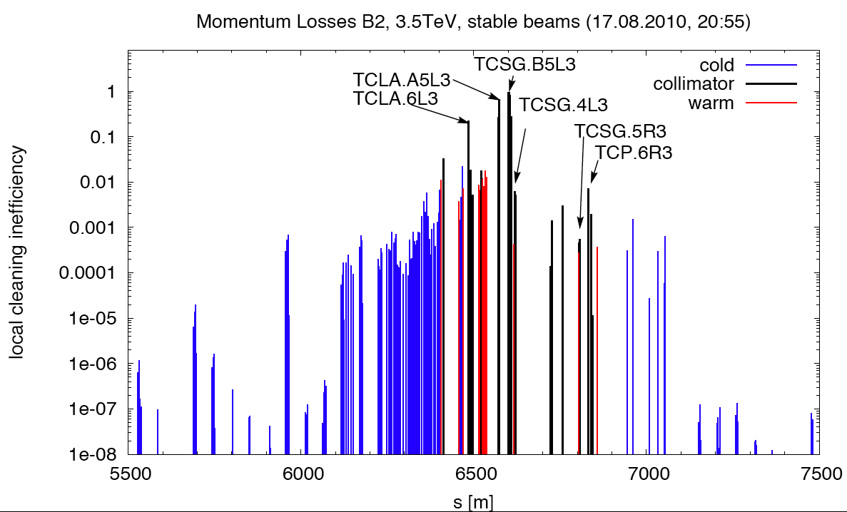
Momentum Cleaning, B2, Positive Energy Offset

Slide 33
Outlook: Upgrades
We plan upgrades on present system for 2011 (during christmas break):
Use of squeeze factor for interlocks during squeeze.
More automated setup: faster and less prone to human error (risk of wrong dump during collimator setup with broken hierarchy).
Upgrades in 2012 shutdown:
Relocate all losses to IR3 (radiation to electronics) and catch losses in dispersion suppressors (DS collimators).
Upgrades in 2016 shutdown:
Full collimation upgrade.
Collimators with in-jaw buttons: non-destructive centering and setup of collimators. 100 times faster setup. Can be done every fill. Precise interlock of orbit – collimator offsets. Tested in SPS successfully.

Slide 34
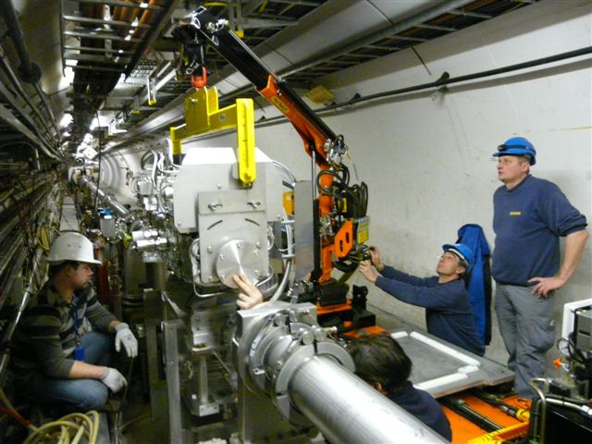
Installation of 1st Phase II Collimator (CERN type, BPM’s in jaws, into SPS for beam tests)
January 8, 2010
EuCARD

Slide 35
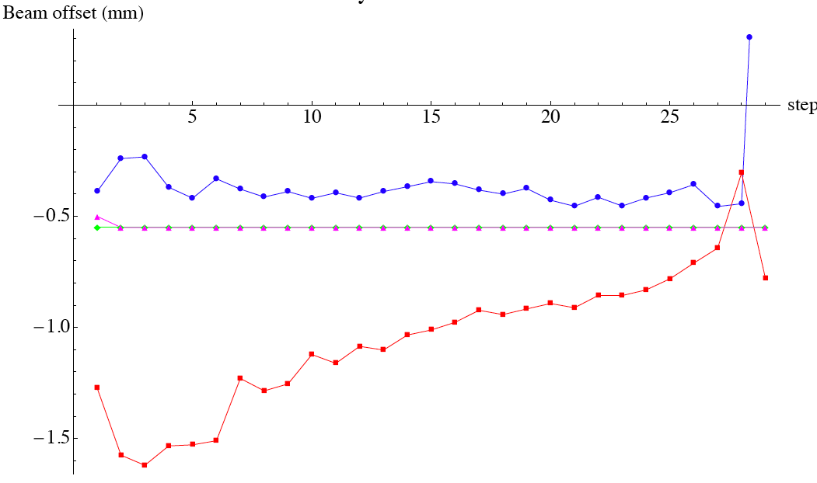
Phase 2 LHC Collimator Test with SPS (for 2016 upgrade)
Instead of halo-based setup (lengthy, risky, special fill) phase 2 collimators will have in-jaw buttons. Much, much easier then! Setup every fill in 10’s of seconds.
SPS results very nice: no clear effect of showers, can track beam center.
Here: Close collimation gap while keeping center
Jaw-BPM measurement upstream
Center while changing gap
Jaw-BPM measurement downstream
(to be understood – calibrated)
EuCARD
Plot: D. Wollmann

Slide 36
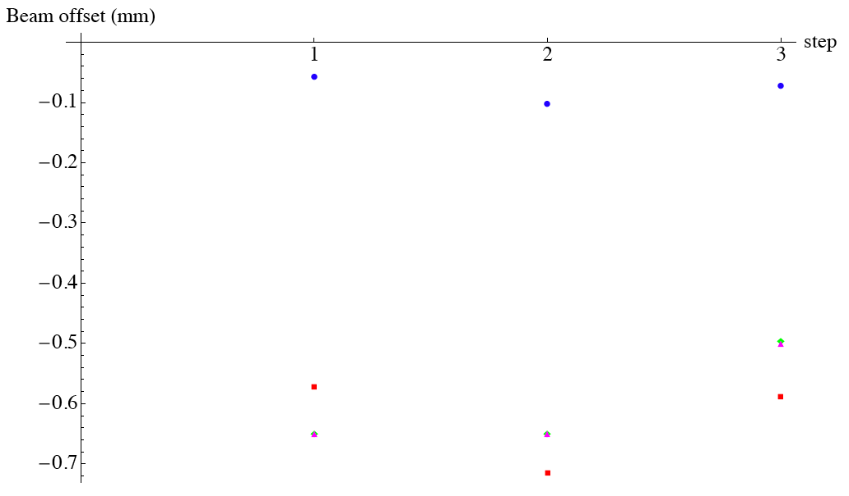
Phase 2 Coll. With SPS Beam Drifts Standard BLM-based Method – Observing Jaw-BPM’s
after 15 min
Jaw-BPM
upstream
Re-do BLM based set-up to follow beam center
→ Brings also back jaw-BPM’s to previous reading!
Agreement BLM – jaw BPM:
10 – 20 μm level
Will solve many LHC issues!
EuCARD
Jaw-BPM
downstream
Set gap center
Plot: D. Wollmann

Slide 37
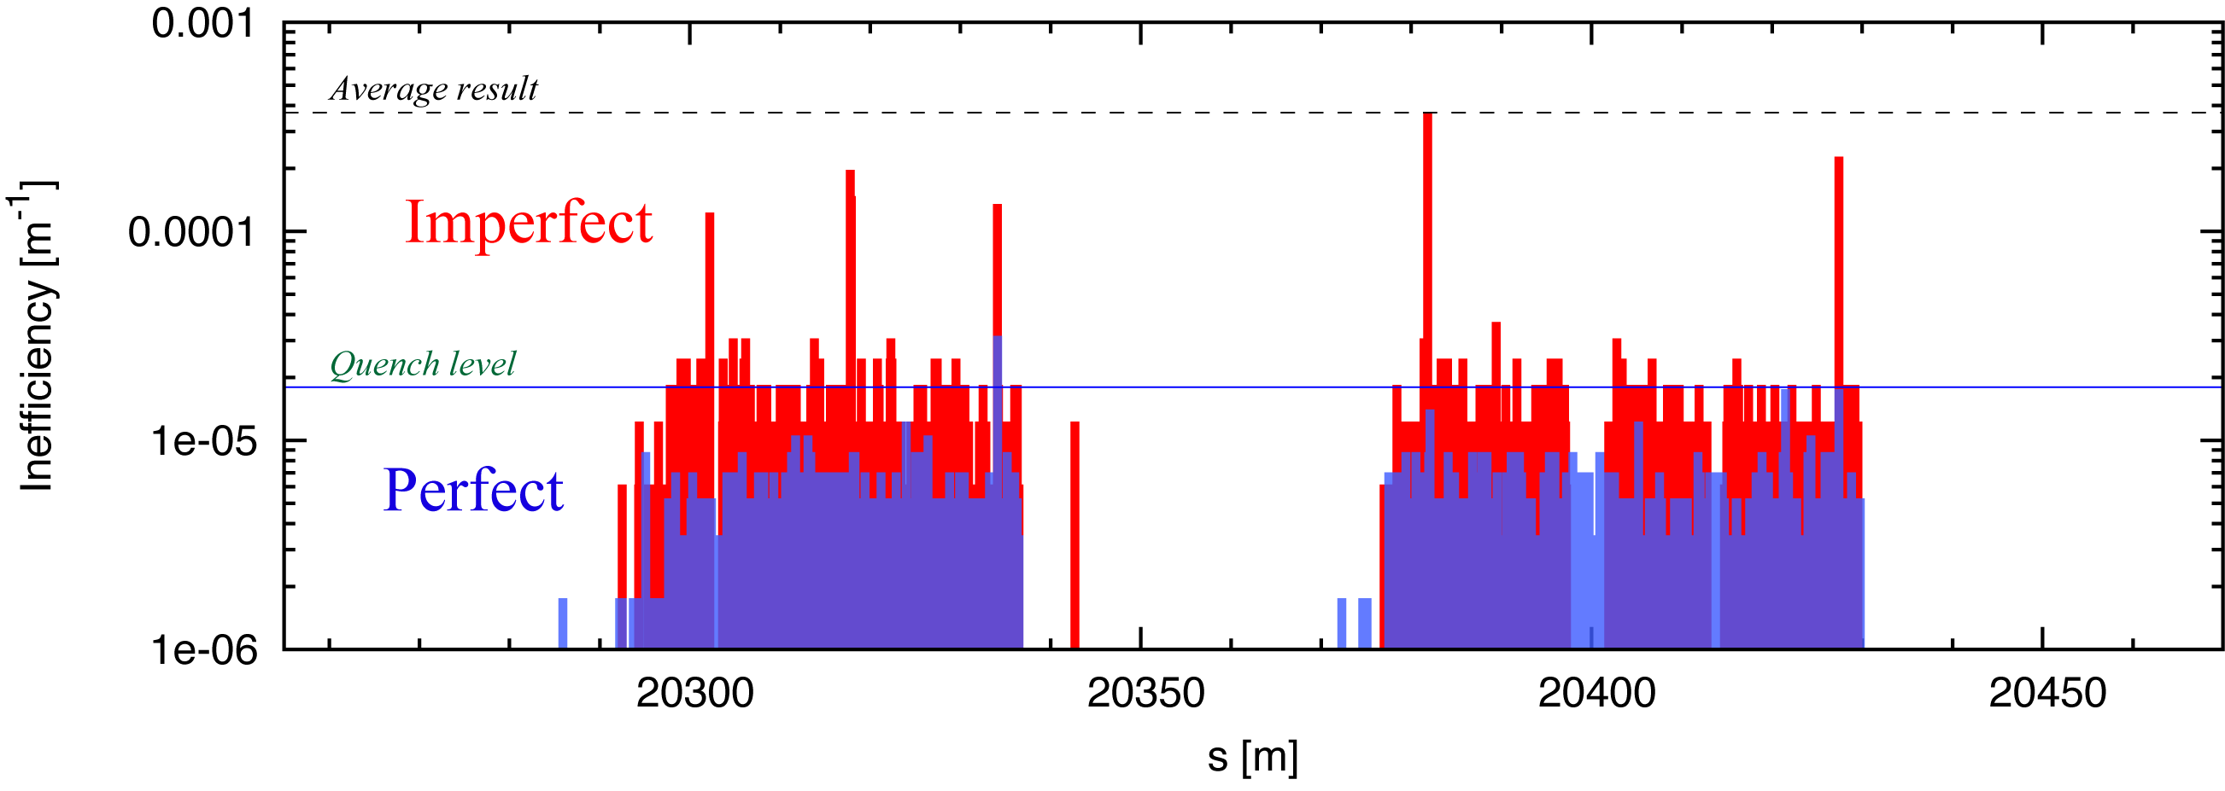
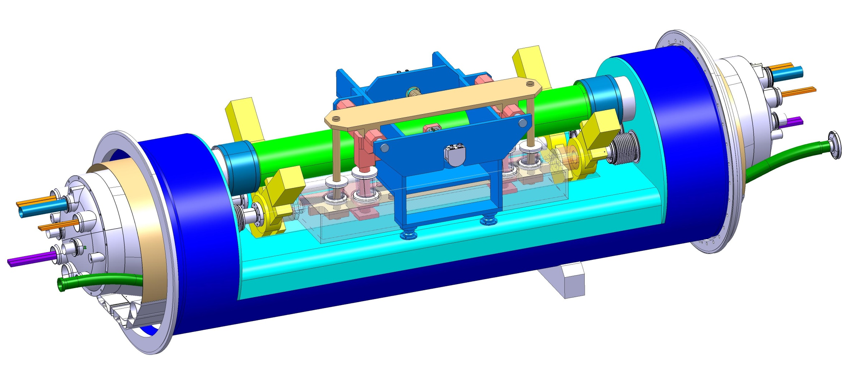
halo
TCRYO
Downstream of IR7 β-cleaning
Losses of off-momentum protons from single-diffractive scattering in TCP
Halo Loss Map
cryo-collimators
Upgrade Scenario
transversely shifted by 3 cm
NEW concept
halo
without new magnets and civil engineering
-3 m shifted in s
+3 m shifted in s

Slide 38
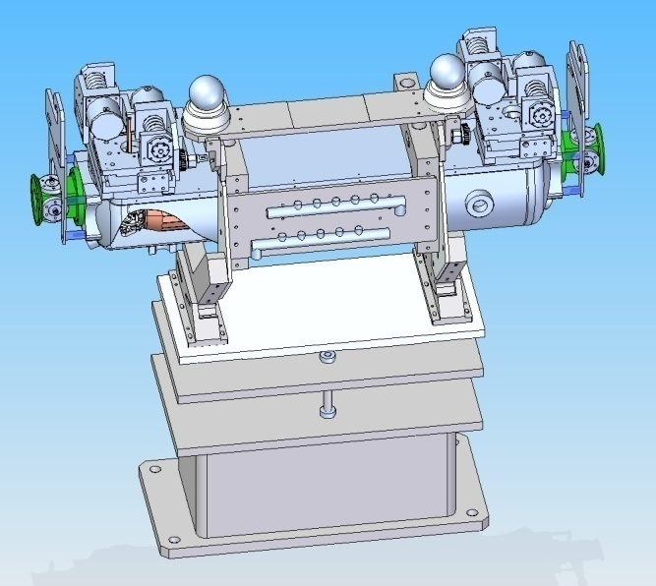
US Work on Phase II Design (LARP funded, SLAC linear collider design to LHC)
Rotatable high Z jaw allows for multiple damaging beam hits!
First prototype to be delivered from SLAC to CERN in August 2010. Installation into SPS in 2010/11 shutdown. Beam tests in 2011.
Time to build 5 collimators: 1 year. If decision in 2012 then available in 2013…
T. Markiewicz
LARP LHC PHASE II COLL RC1 - S. Lundgren 21 Jan 2010 No 1/xx

Slide 39
Conclusion
LHC collimation works with expected performance level and has shown an amazing stability over the last 2 months.
Collimation interlocking has proven very effective, catching even non specified errors (e.g. ramp up of beam energy from 3.5 TeV with beam inside the machine).
The achieved orbit tolerances are non-conform, especially in the IR’s. So far no sign of increased losses in the IR’s. So good enough for intermediate collimation settings at 3.5 TeV and β* = 3.5 m.
The collimation system should be kept well set up, to be prepared for rare and unlikely accident cases. 2 weeks running does not prove safety.

