Slide 1
Thermo-mechanical modeling of high energy particle beam impacts
M. Scapin*, L. Peroni*, A. Dallocchio**
* Politecnico di Torino, Corso Duca degli Abruzzi, 24, 10129 Torino, Italy
** Mechanical and Materials Group, Engineering, CERN, CH-1211 Geneva 23, Switzerland

Slide 2
Contents
Introduction
Problem definition
Material data
Numerical modeling
Results
Results comparison and discussion
Conclusions

Slide 3
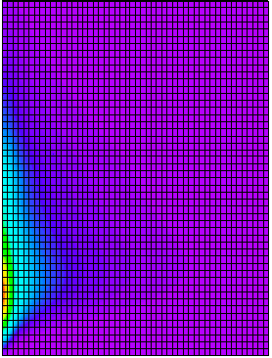
The problem
Objectives:
Numerical simulation of a complex mechanical structure (collimator) subjected to beam impact: energy deposition, shock waves, damage …
Numerical code: LSDyna
General purpose transient dynamic finite element program capable of simulating complex real world problems. It is optimized for shared and distributed memory Unix Linux and Windows platforms.
2D and 3D Lagrangian, Eulerian, ALE, SPH, meshfree
axis of symmetry
Benchmark model
A Copper bar (5 mm radius, 1 m long) facially irradiated with 8 bunches of 7 TeV/c protons (each bunch comprises 1.11x10¹¹ protons)
2D axisymmetric FEM model
beam
radius

Slide 4
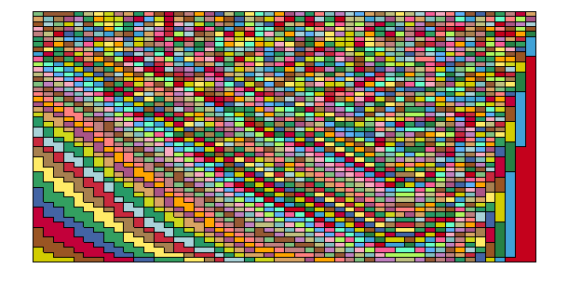
Numerical modeling (I)
The particle beam energy distribution is applied by using a three different case:
all the energy as initial condition E₀
a 200 ns ramp (constant power)
a 8 bunches profile (0.5 ns constant power, 25 ns void, 0.5 ns constant power….)
Explicit integration scheme, time step magnitude 0.01 ns
Different mesh were tested in order to investigate the influence of spatial discretization on the results
Since a LSDyna tabular EOS routine is under developing (using the user-def capabilities and the Fortran routine written for SESAME and CTH) a standard Polynomial LSDyna EOS is used to fit tabular data (and try a simplified approach)
3 different energy deposition methods
x
4 different mesh densitiy
x
2 different polynomial interpolations (solid, solid-liquid-plasma)
time step
radius
axis of symmetry

Slide 5
Numerical modeling (II)
isodensity
Tabular data
isotherms
ONLY SOLID
SOLID LIQUID PLASMA
Interpolation
isoenergy
Isoenergy

Slide 6
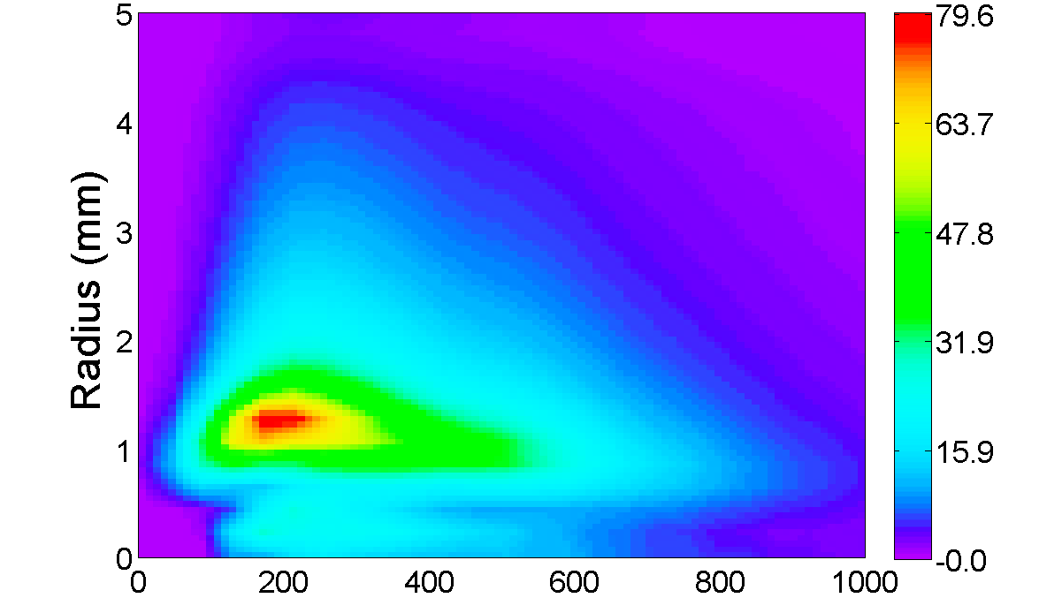
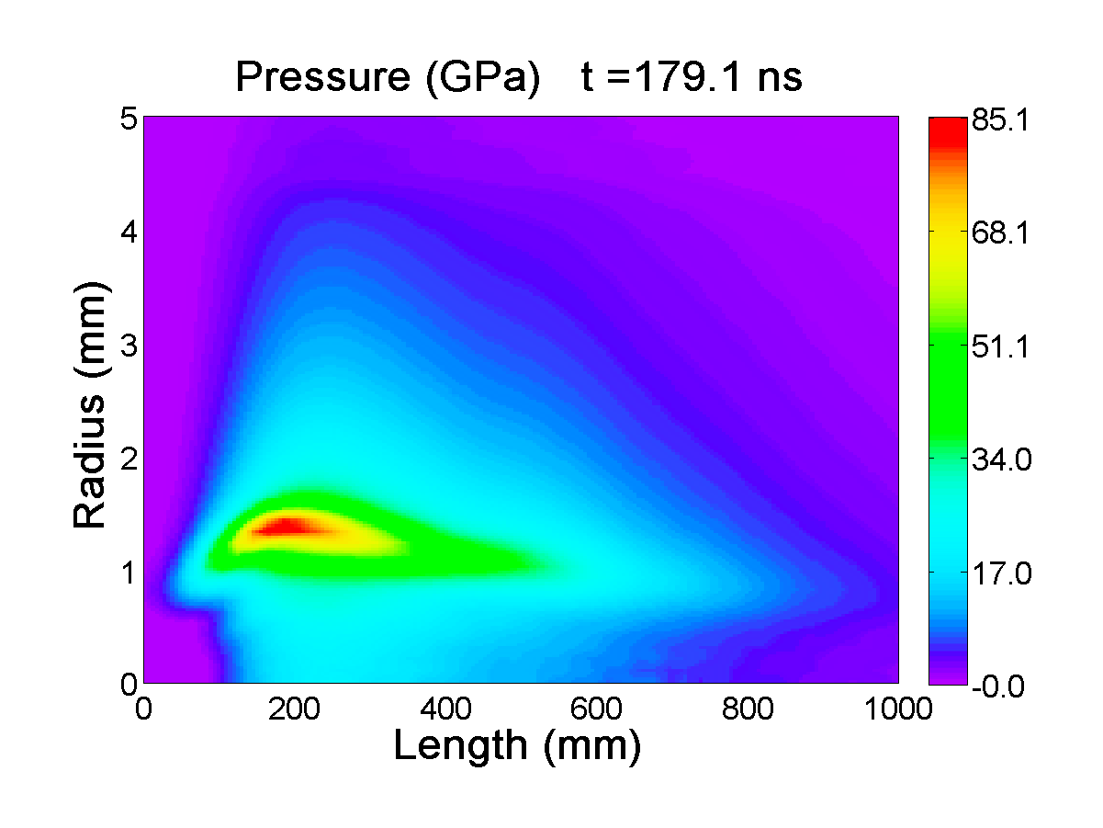

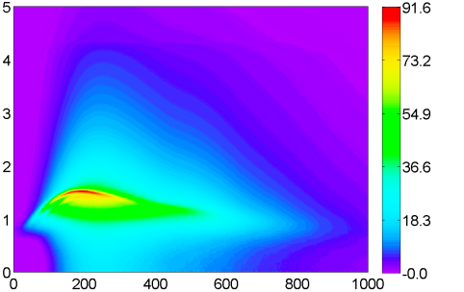
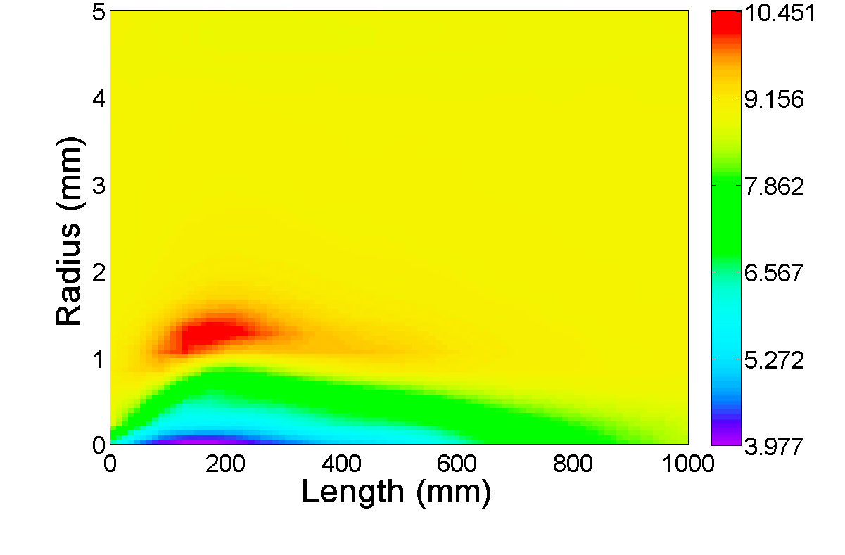
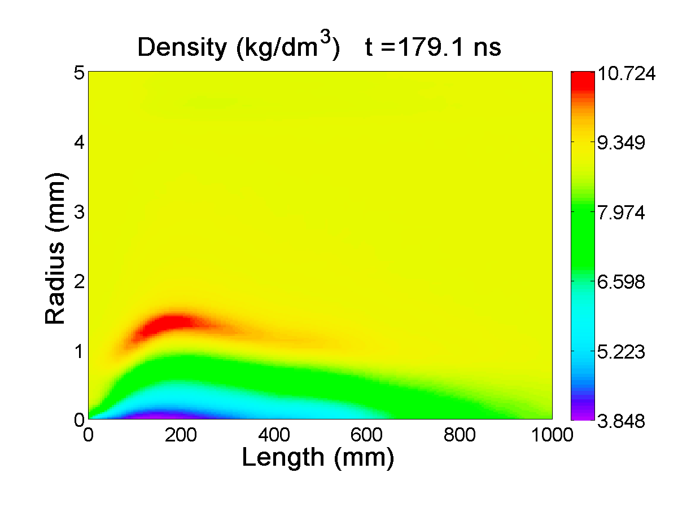
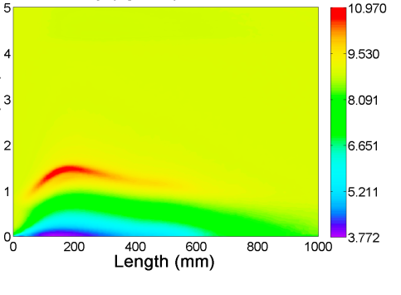
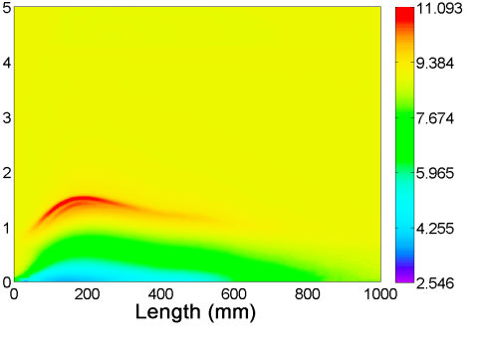
Results (mesh)
25x25
50x50
100x100
200x200
Pressure (GPa)
□
2
□
1
Density (kg/dm³)
BIG2
FEM accuracy
Time step (propagation)
Energy deposition accuracy
1
2

Slide 7
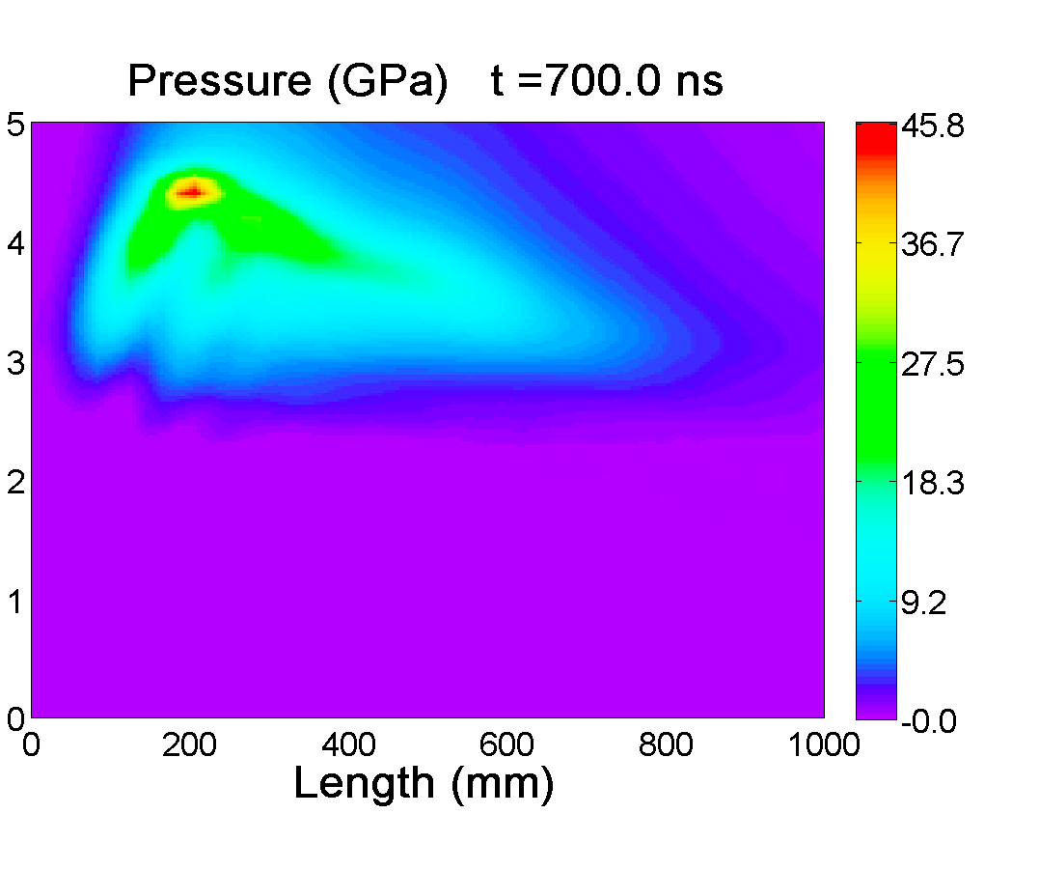
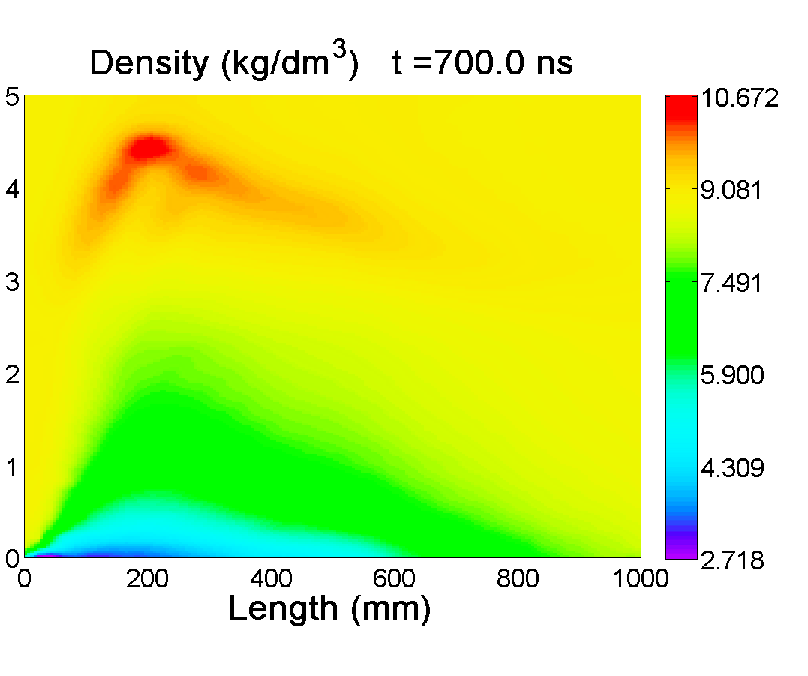
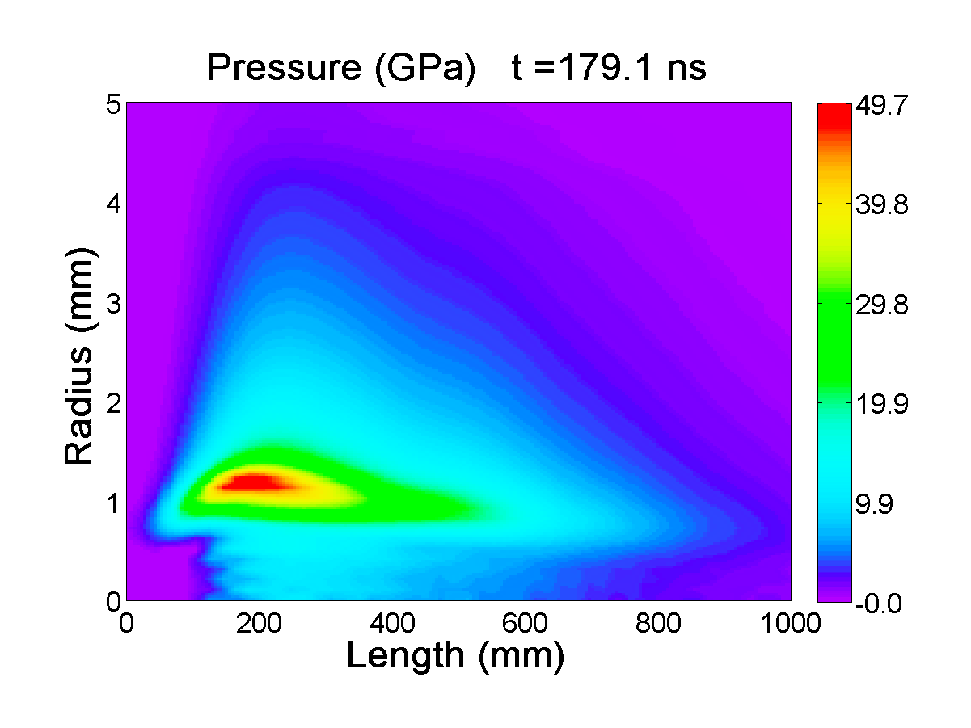
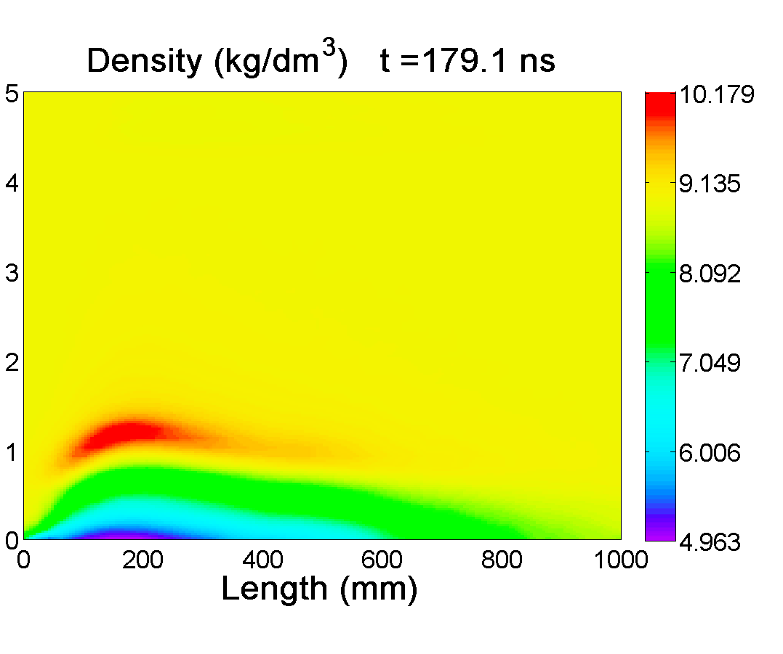
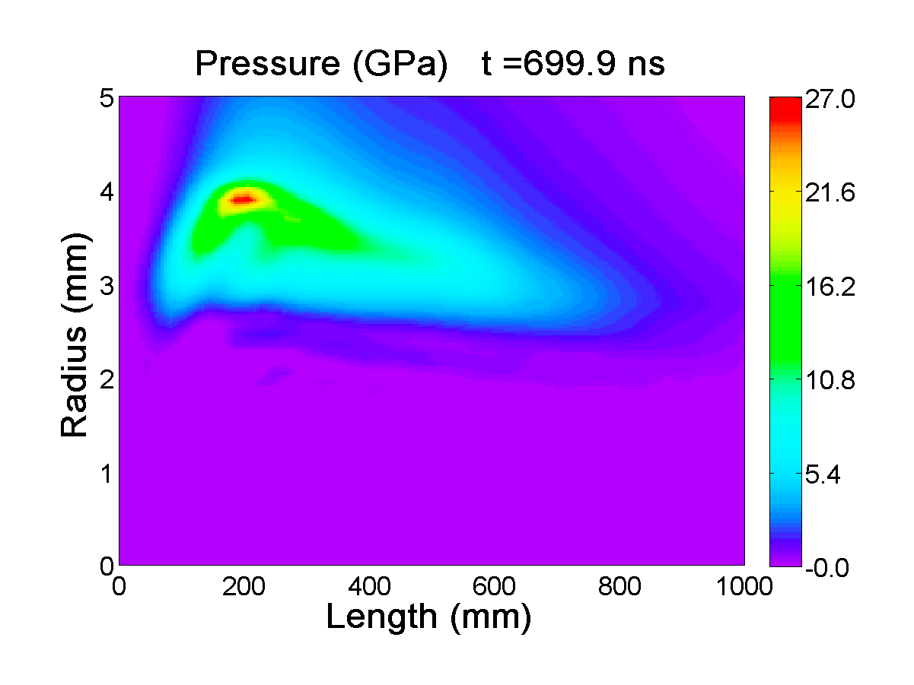
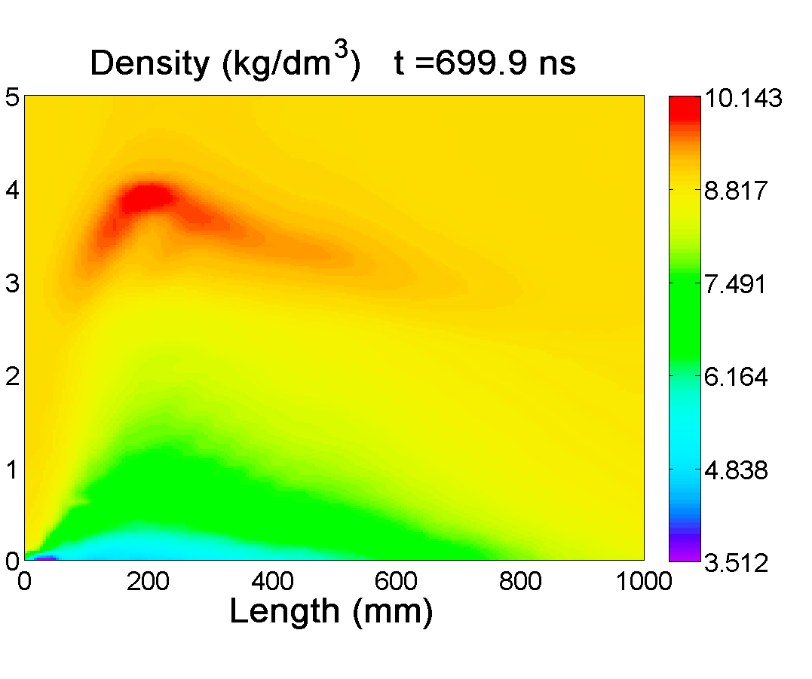
Results (Eos)
EOS obtained from solid data (polynomial/Gruneisen)
EOS obtained from the whole region of interest

Slide 8
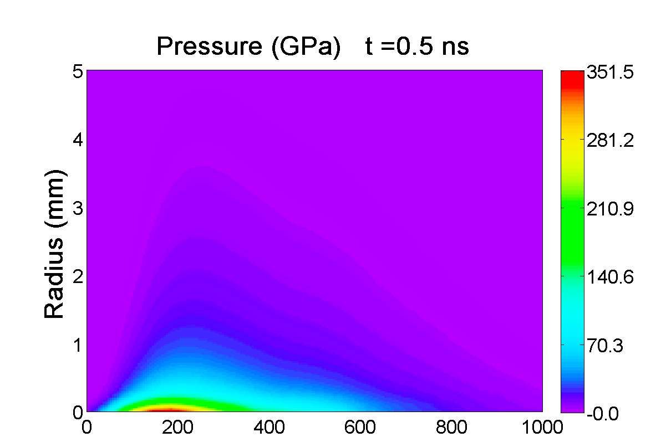
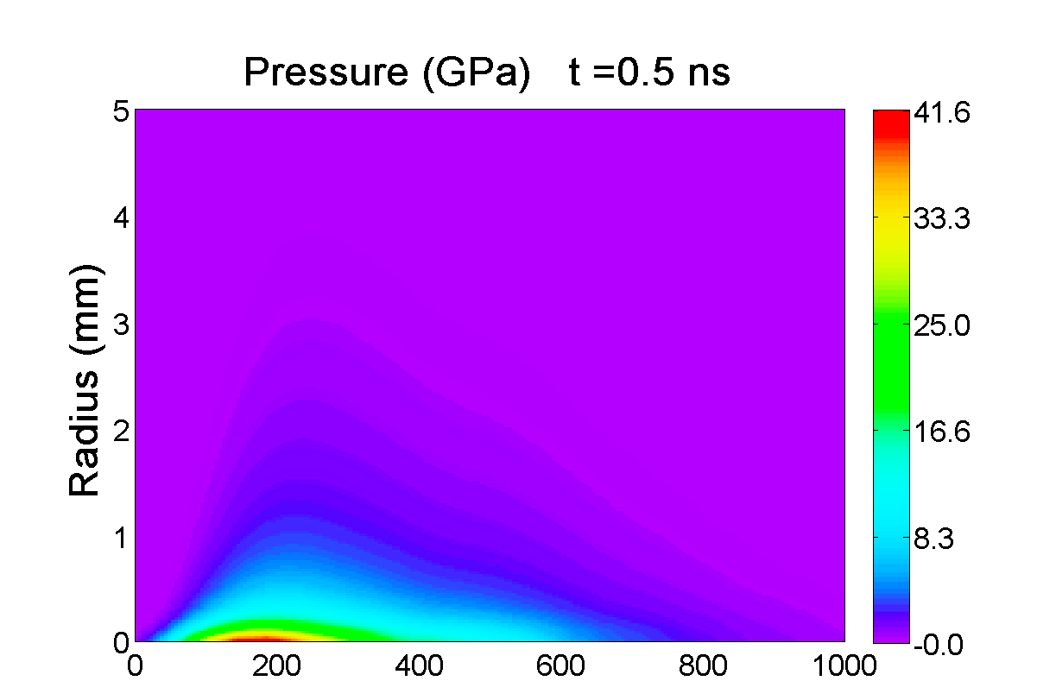
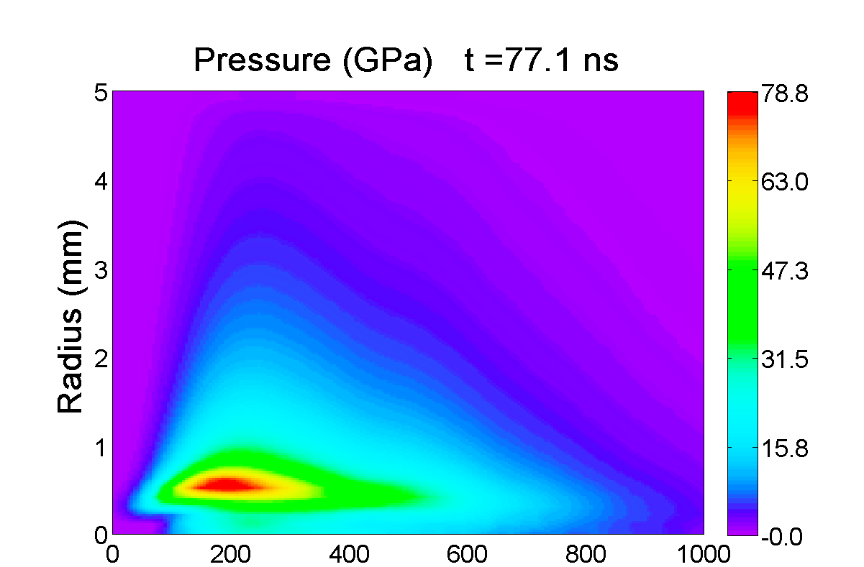
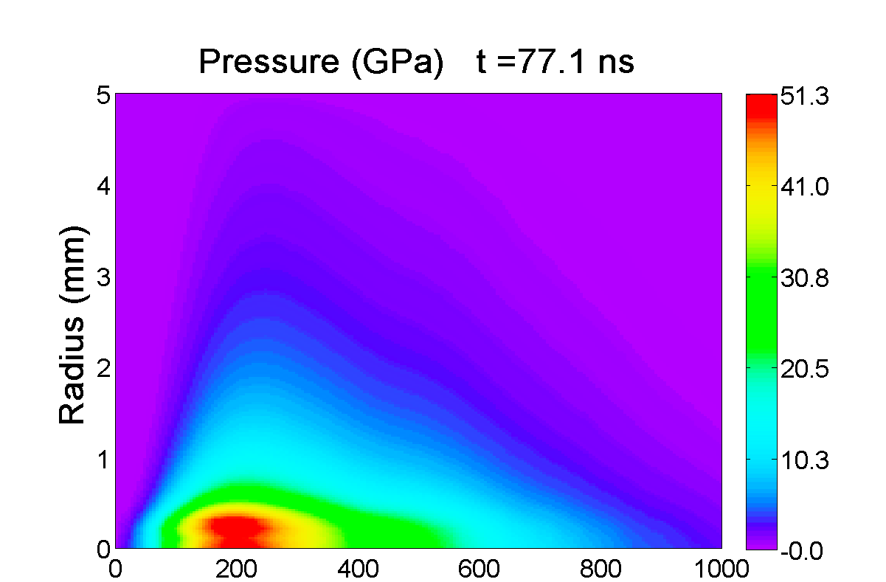
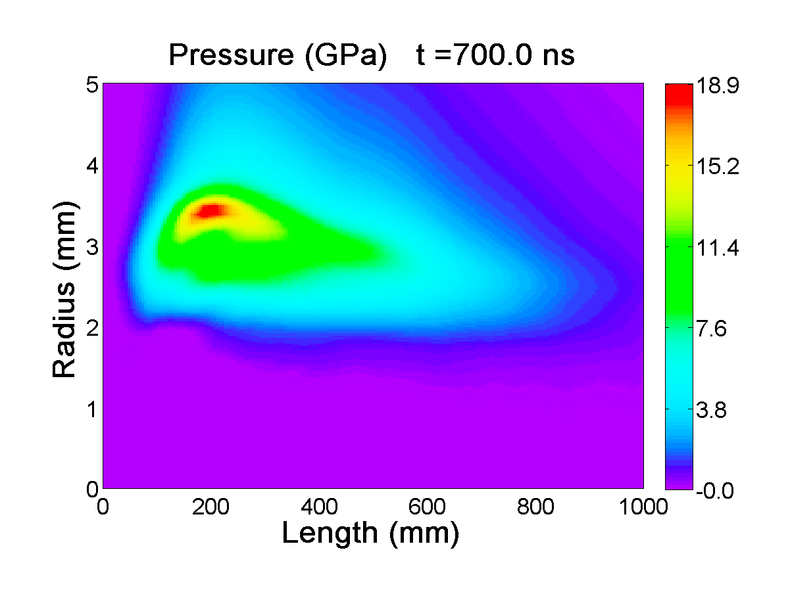
Results (deposition)
2
□
□
2
□
1
□
1
Element 1
00
00
Deposition as 8 bunches profile
(ns)
Deposition as initial condition E₀
Element 2
00
00
00
00
(ns)

Slide 9
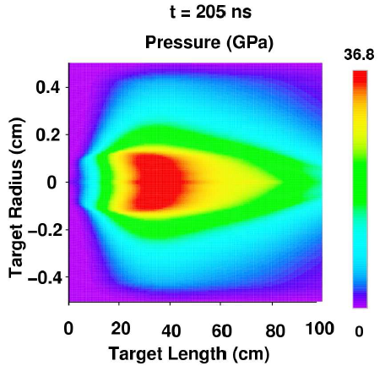
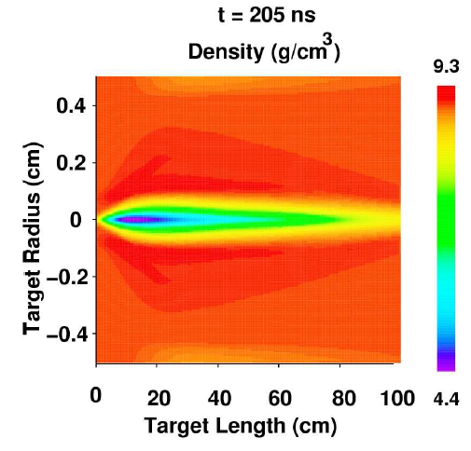
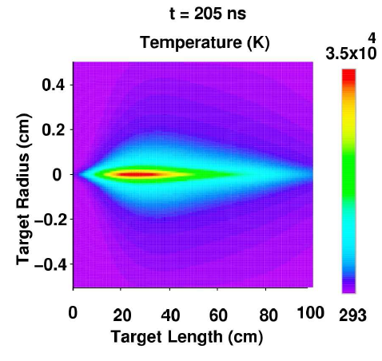
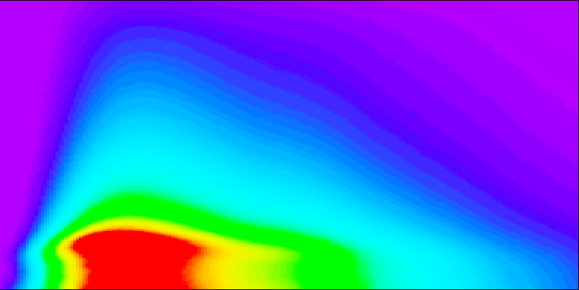
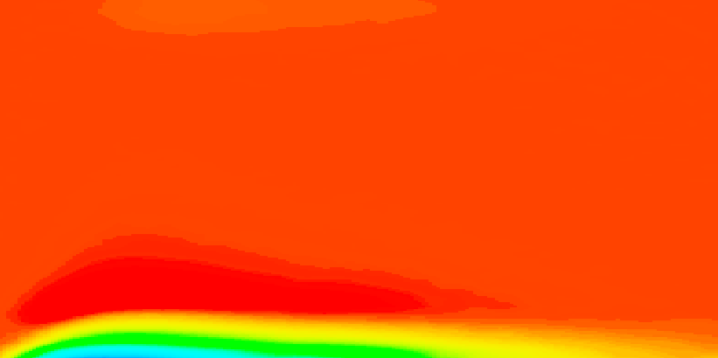

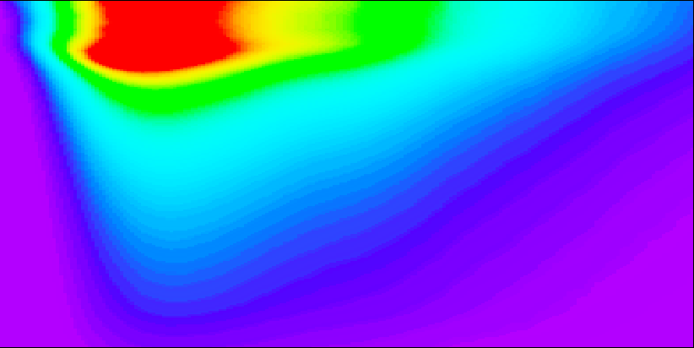
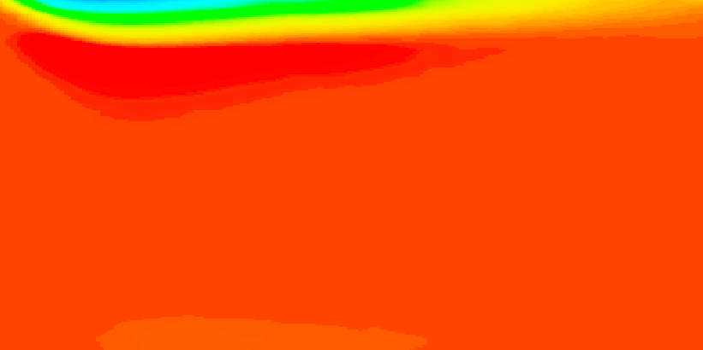
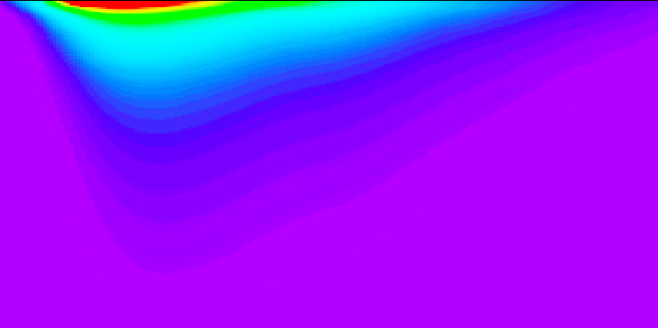
Results comparison
N.A. Tahir et al., Thermo-mechanical effects induced by beam impact on LHC Phase II collimators: preliminary analysis using hydrodynamic approach
Density
BIG2
BIG2
BIG2
LSDYNA
LSDYNA
LSDYNA

Slide 10

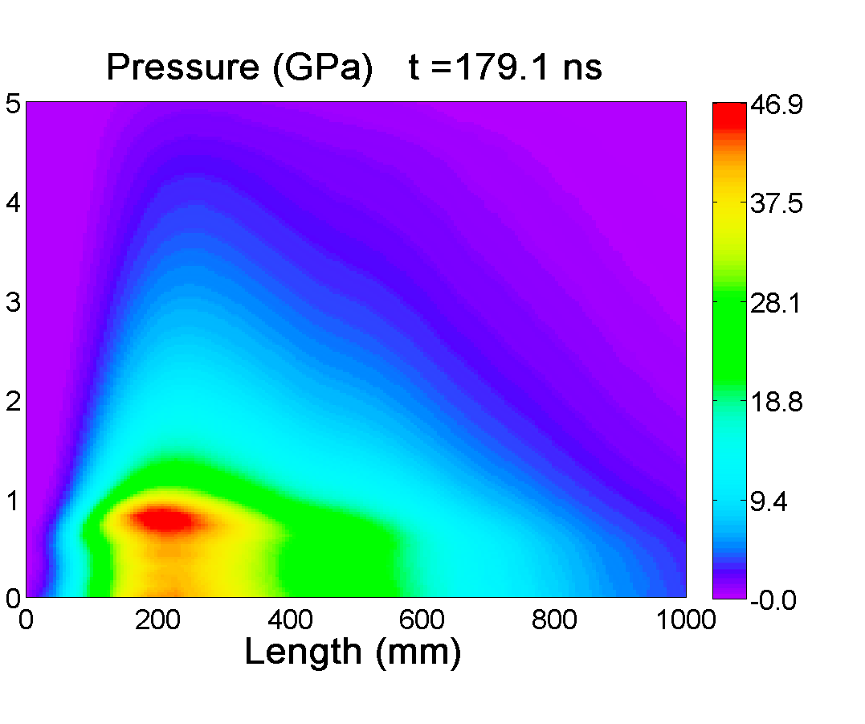
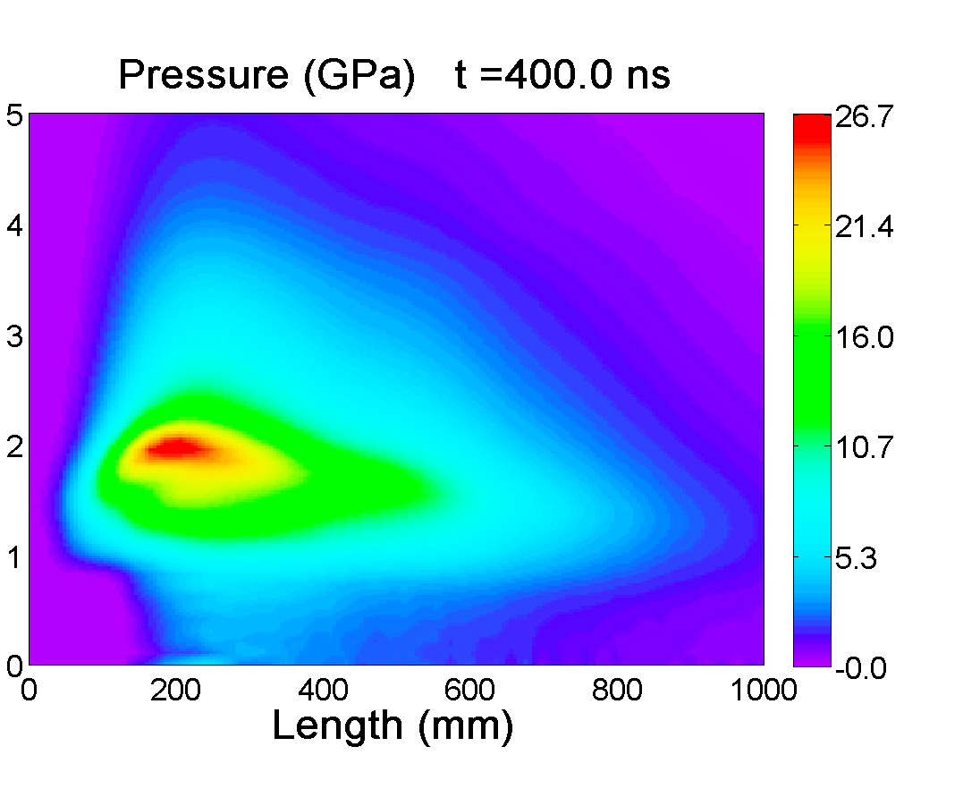
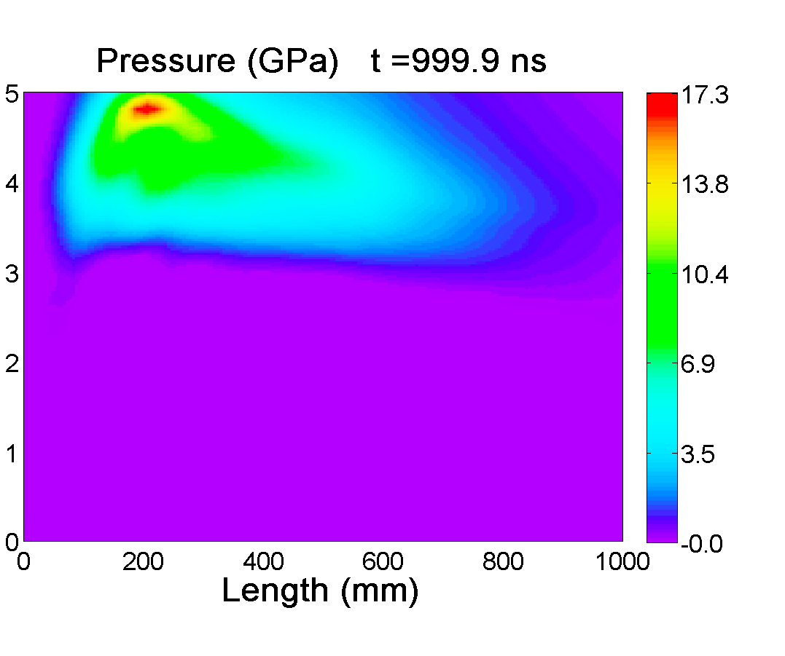
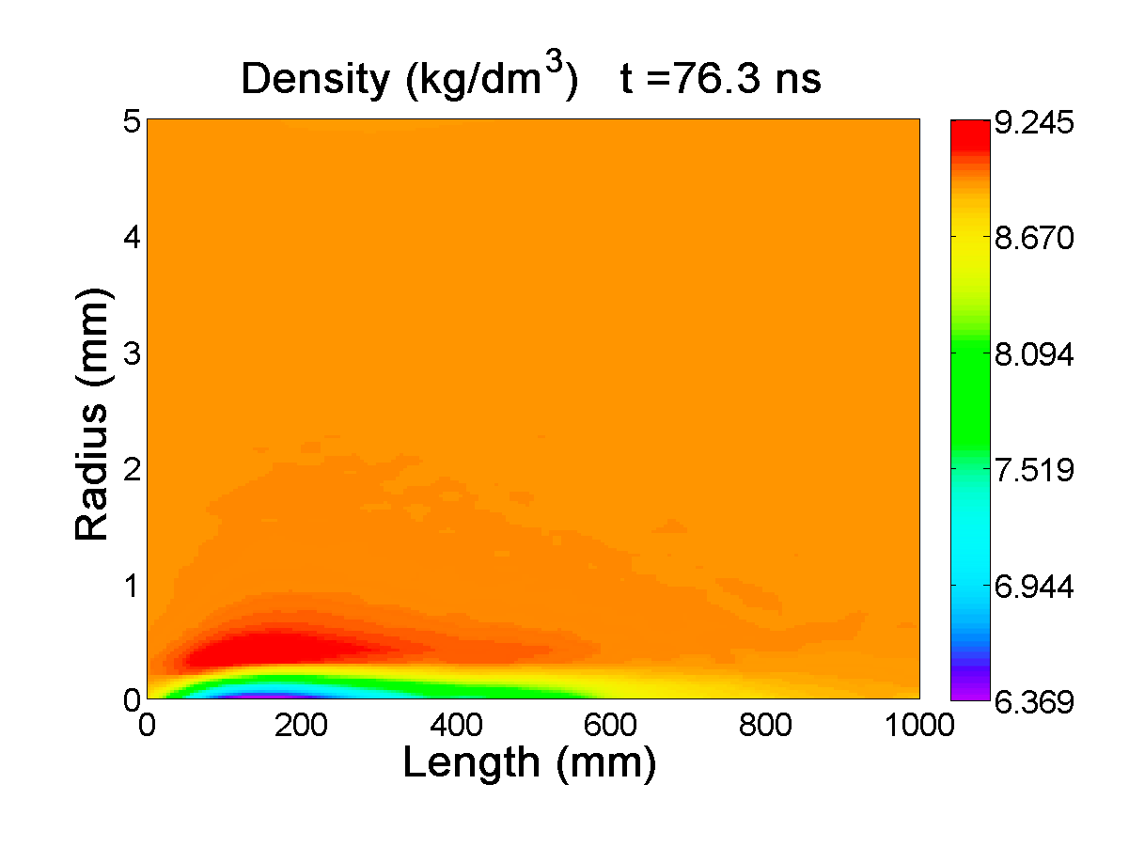
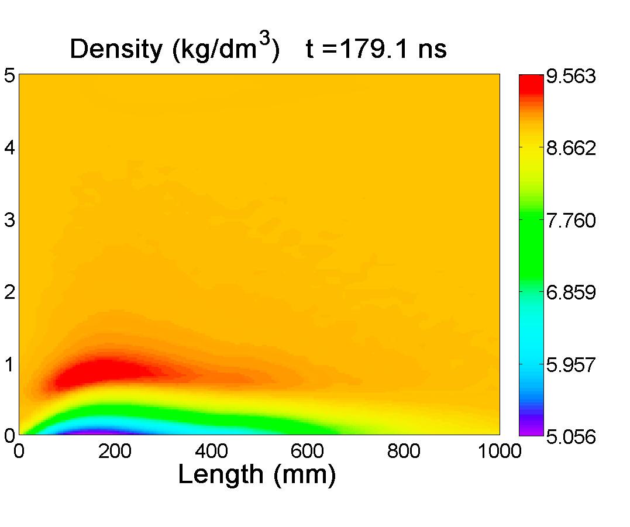
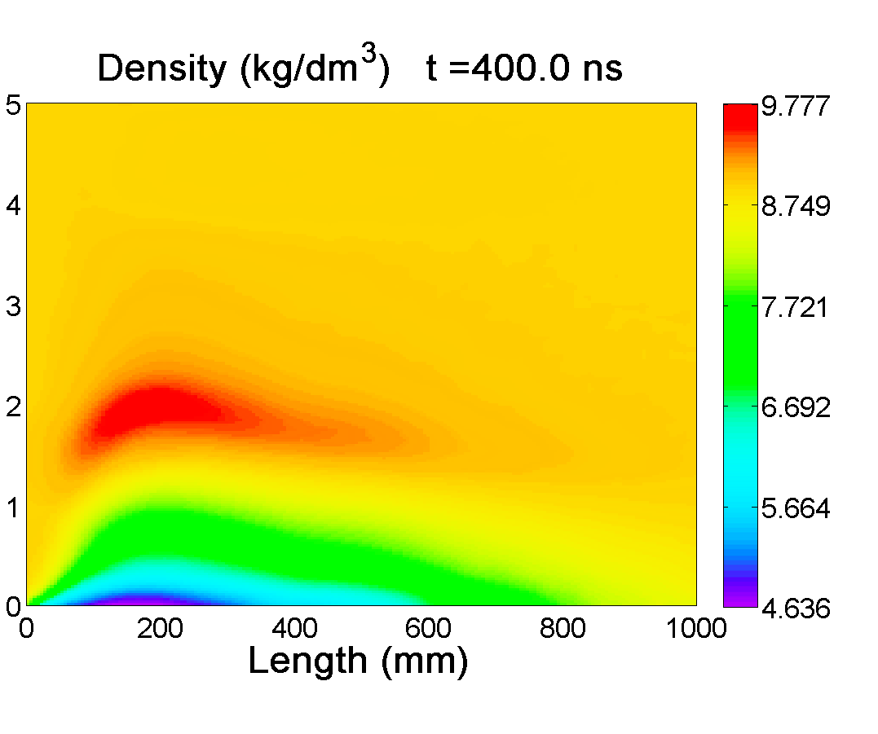
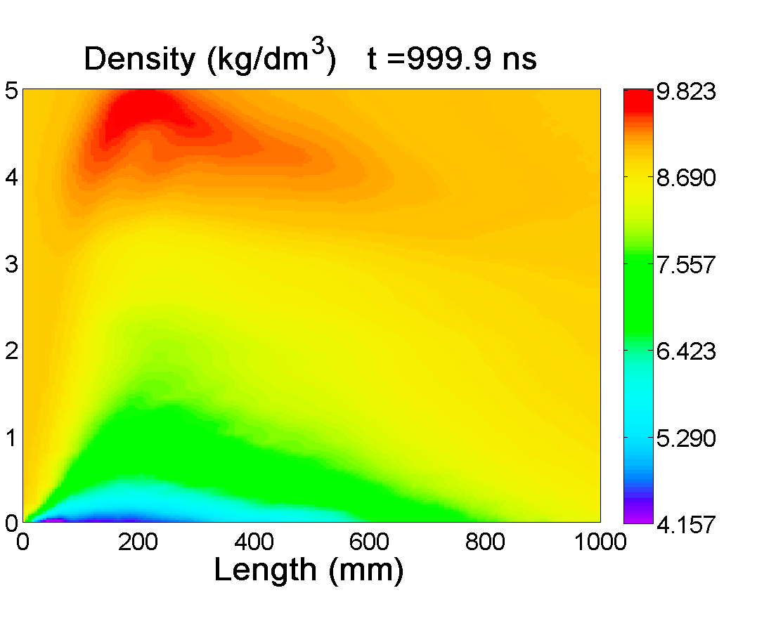
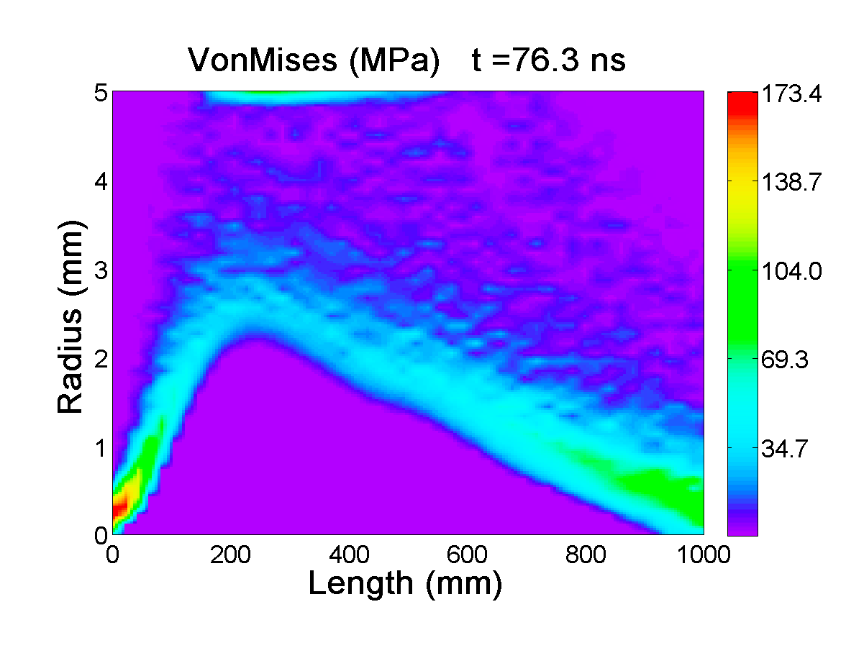
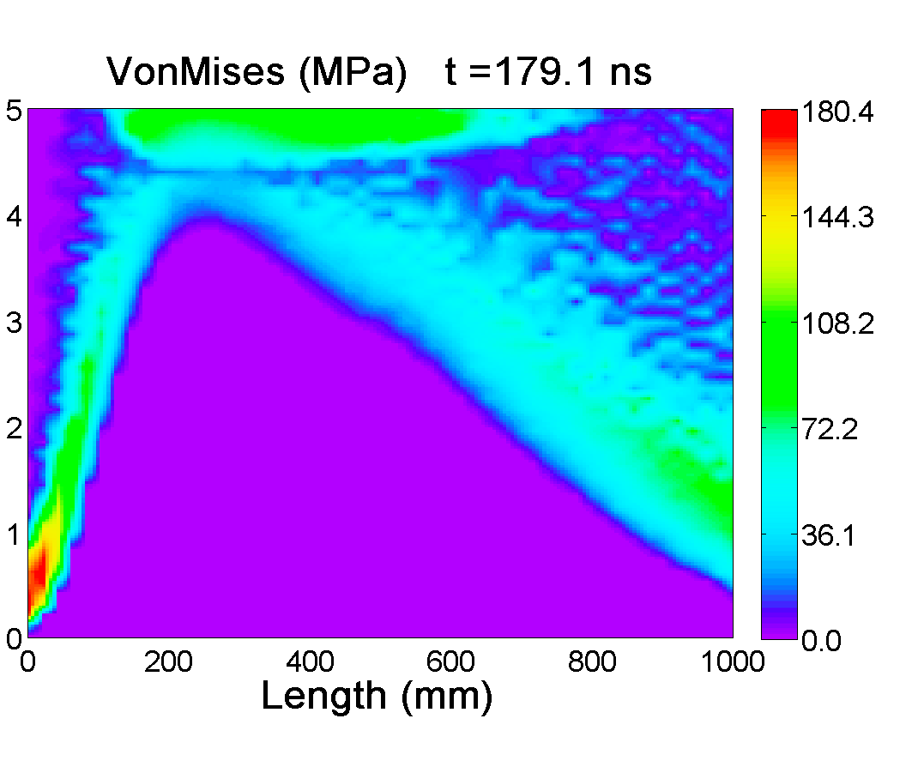
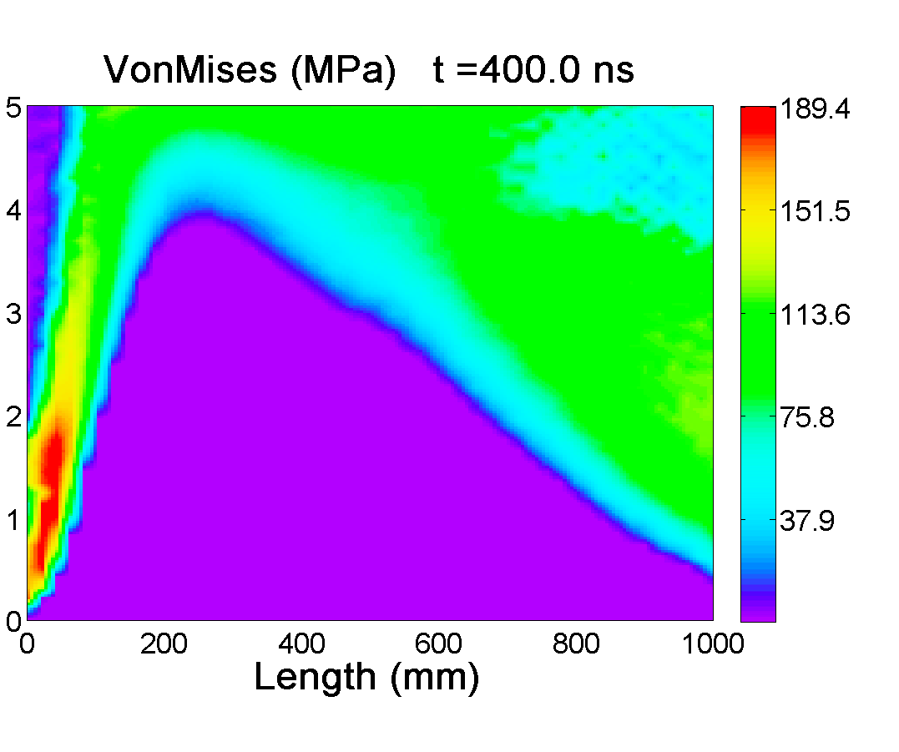
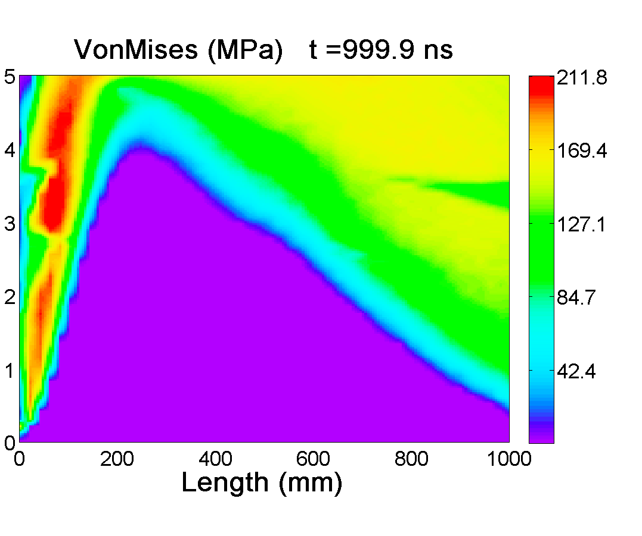
Phenomena evolution

Slide 11
Conclusions (I)
Numerical simulations of interaction of 7 TeV proton beam that is generated by Large Hadron Collider (LHC) at CERN with a solid copper target were presented.
Study has been done to assess the damage caused by these highly relativistic protons to equipment including collimators, absorbers and others in case of an uncontrolled accidental release of the beam.
The protons energy loss in solid copper is calculated using the FLUKA code and these data are then used as input to the FEM code, LSDYNA, to study the hydrodynamic and structural response of the target.
Hydrostatic behaviour of the target material is treated using a polynomial equation-of-state. Elasto-plasticity with J-C material model.

Slide 12
Conclusions (II)
When 8 bunches have been delivered, the material will be heated to very high temperature that will generate a very high pressure. This high pressure launches a radially outgoing shock that leads to a substantial density reduction in the central part of the cylinder.
The energy deposited by 8 proton bunches from the LHC is sufficient to severely damage the target: over than 50% of the target is melted and the remaining portion heavy deformed.

Slide 13
Thermo-mechanical modeling of high energy particle beam impacts
M. Scapin, L. Peroni, A. Dallocchio
Thank you for your attention

