Slide 1
ARIES mitigations workshop
22,23,24,29,30 June and 1 July
33 contributions
A big “Thank you” to SPC:
Mei Bai, Giuliano Franchetti, Shinji Machida, Kazuhito Ohmi, Tatiana Pieloni, Qing Qin, Vladimir Shiltsev, Rogelio Tomas, Frank Zimmermann
Many thanks to all session chairs, all speakers, and scientific secretaries Alexander ENGEDA, Elena FOL, Michael HOFER, Annemarie LAUTERBACH, Tirsi P,REBIBAJ, Giulia RUSSO

Slide 2
Great success – people were chatting in zoom all the time about the intriguing physics – better than bar discussions on live workshops ?!
118 registered participants (Austria: 2, China: 7, France: 5, Germany: 18, Italy: 5, Japan: 10, Russian Federation: 5, Switzerland: 36, UK: 12, USA: 18);
of whom
23 women participants (19.5%)
+addt’l unknown attendees:
Honor 7X, Huawei Mate 20, LiZip,…

Slide 3
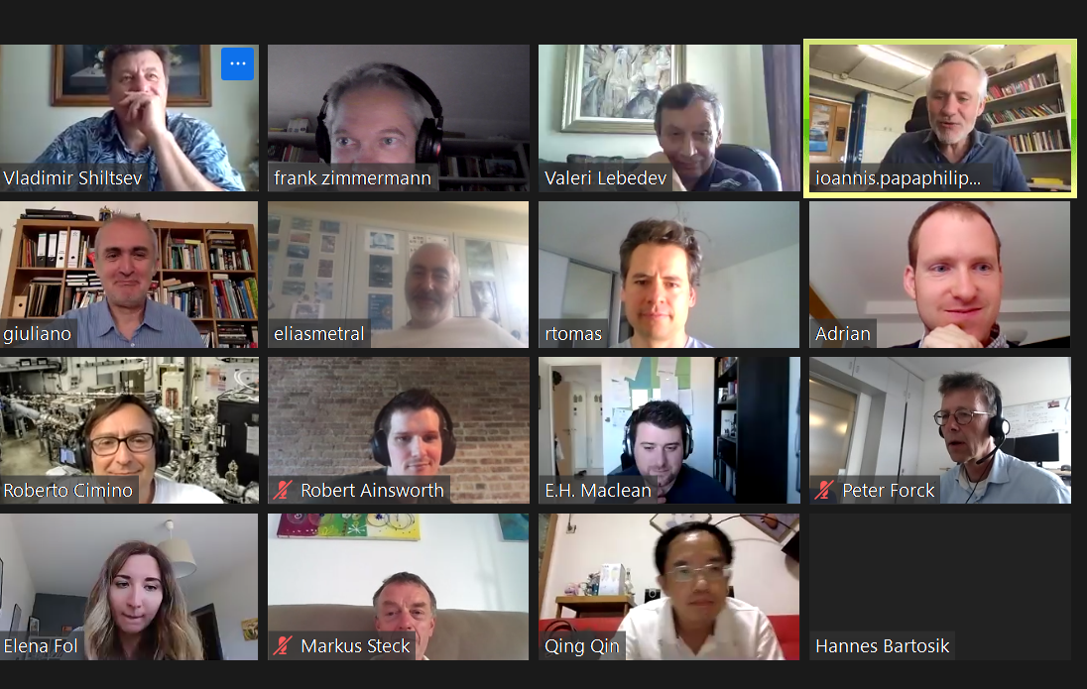
Snapshots from virtual ARIES Mitigations Workshop

Slide 4
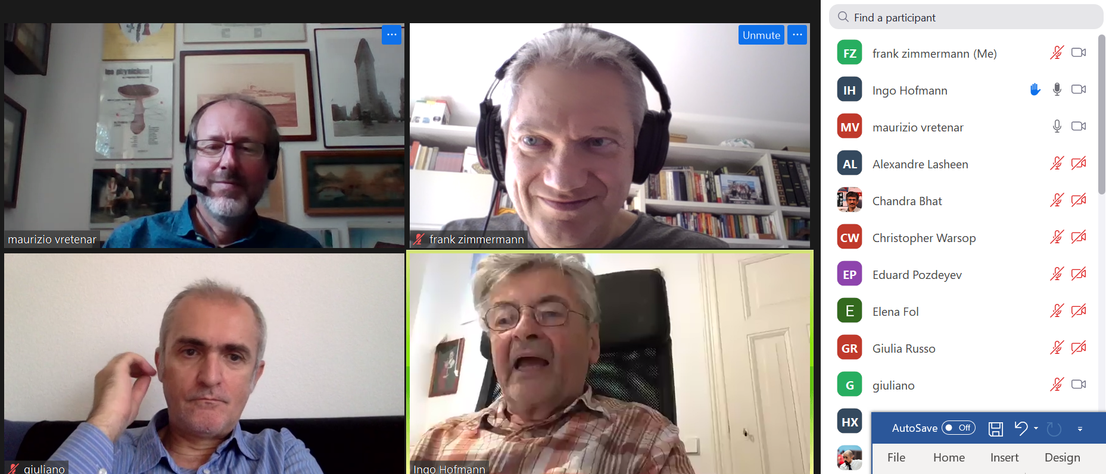
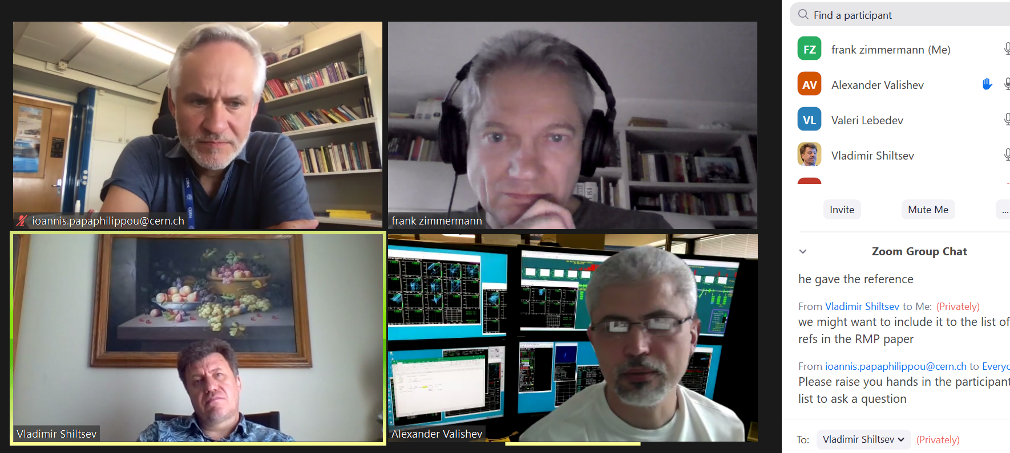
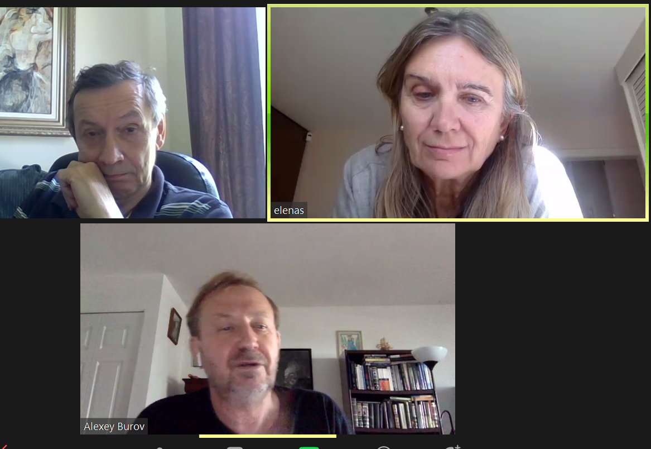

Slide 5
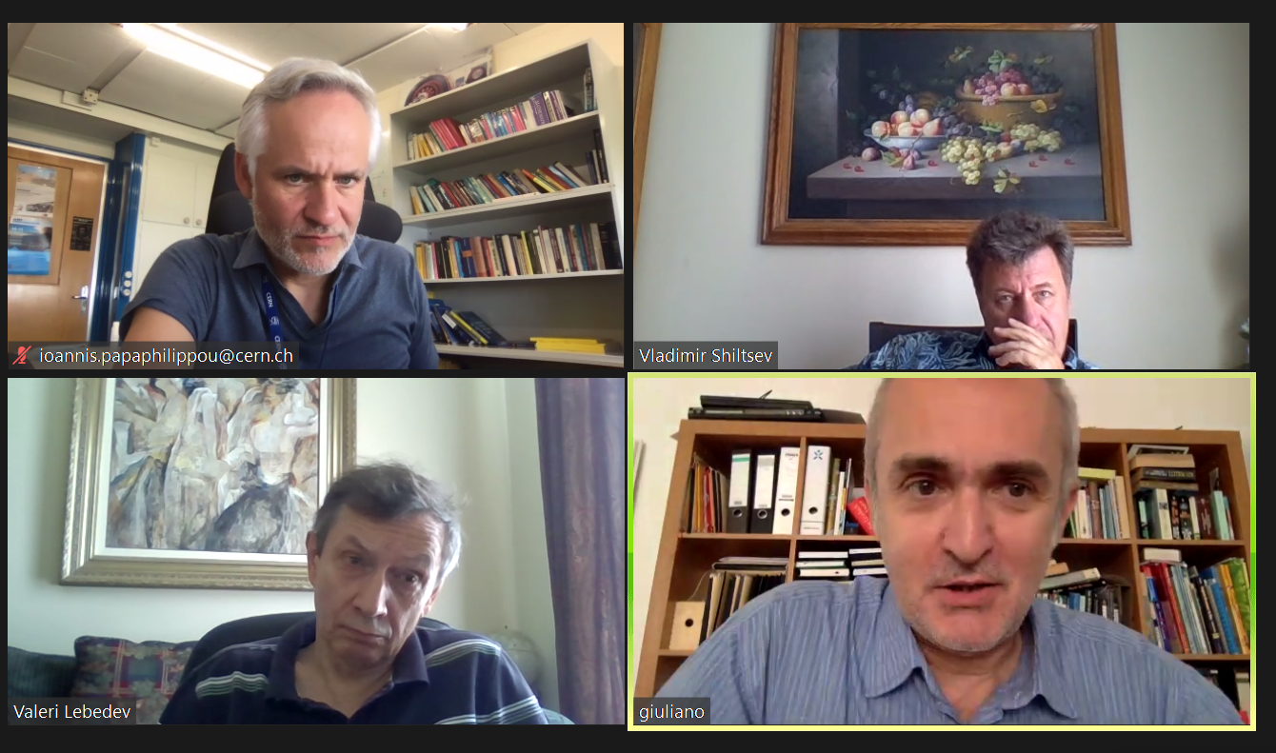
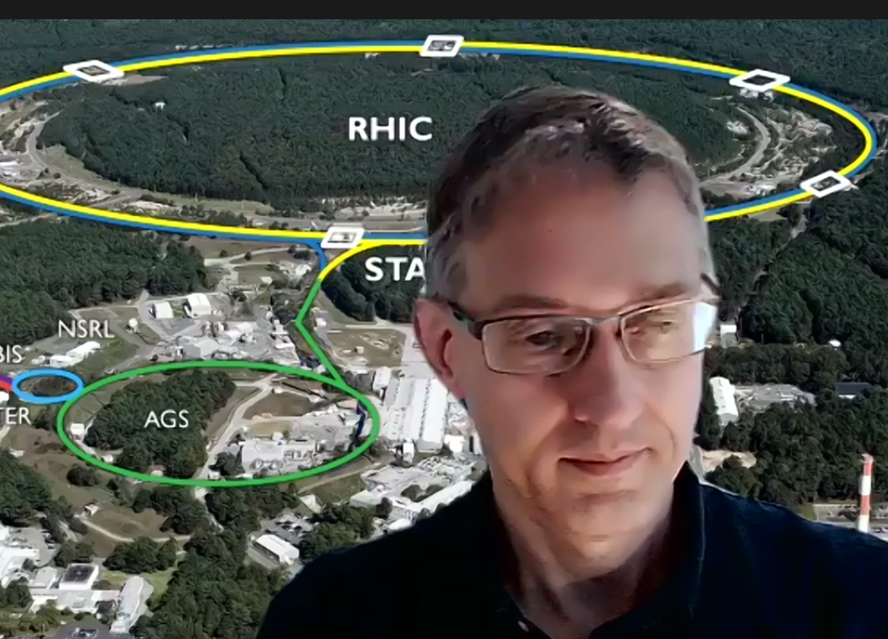
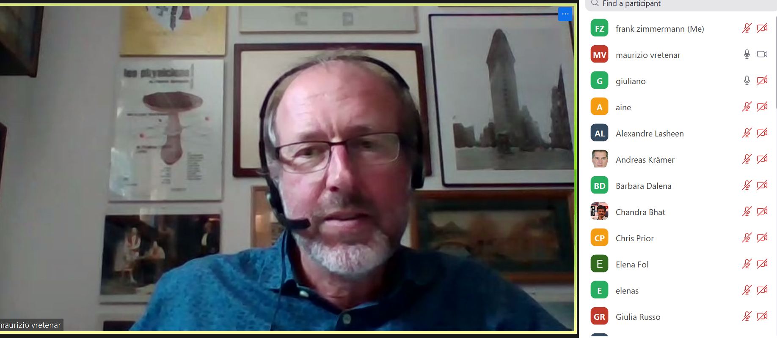

Slide 6
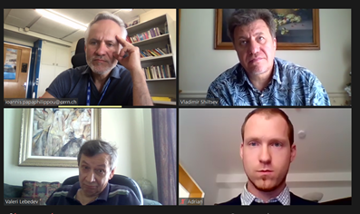
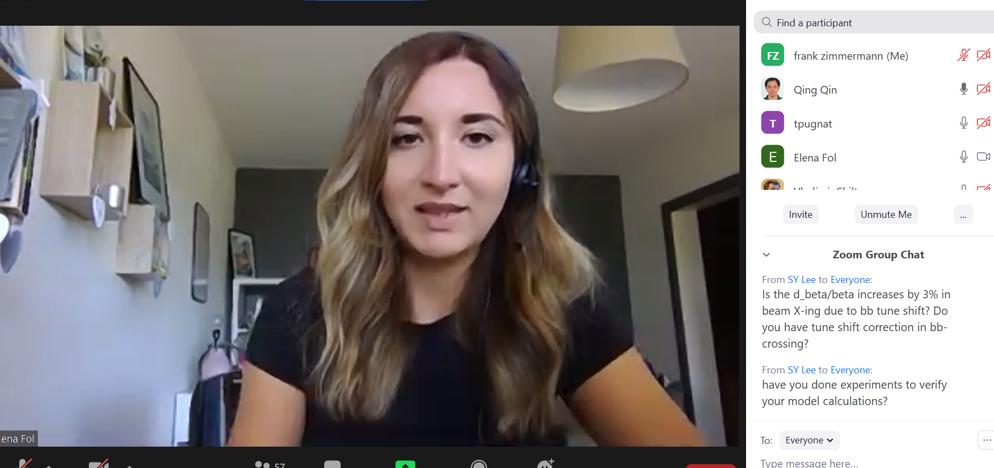

Slide 7
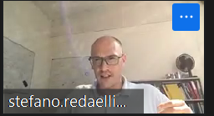

Slide 8
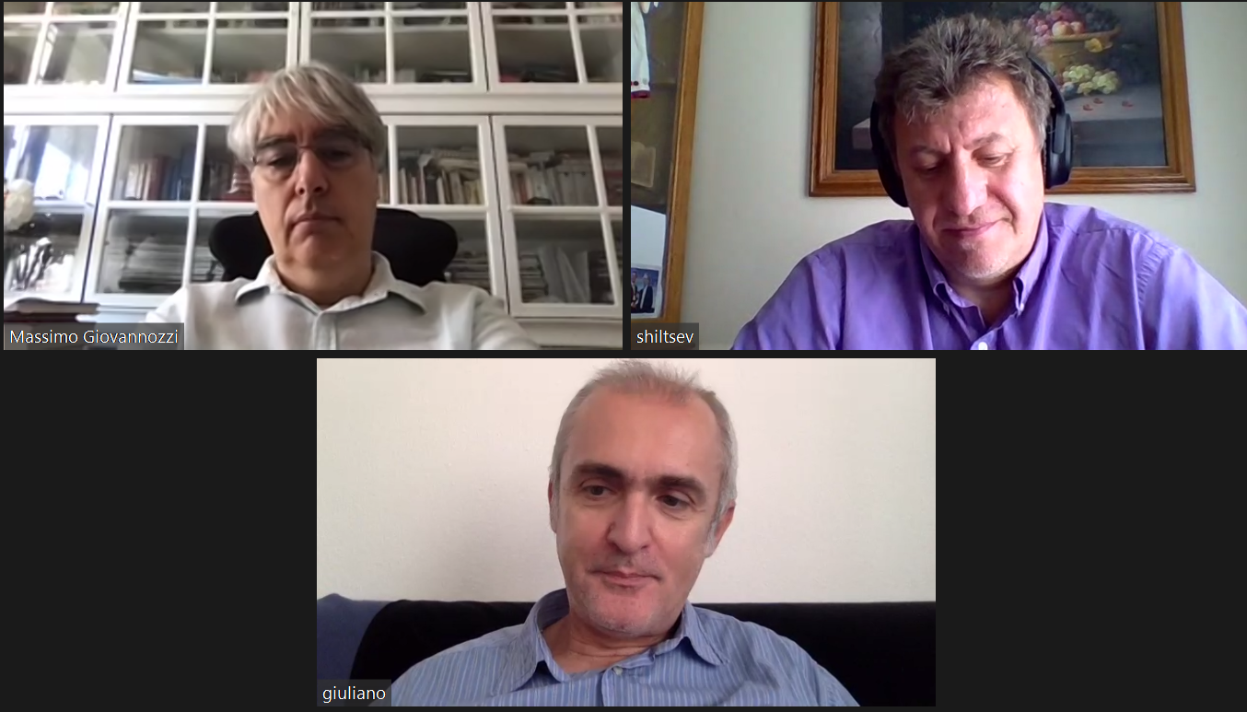

Slide 9
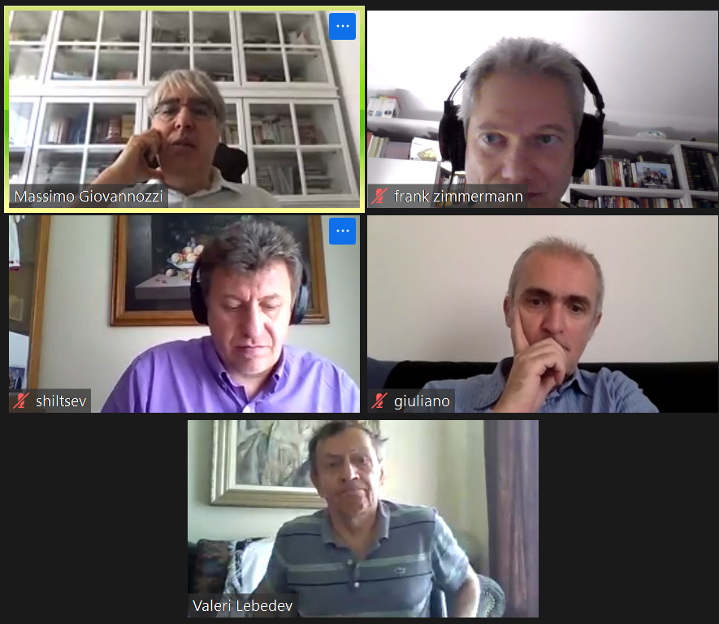

Slide 10
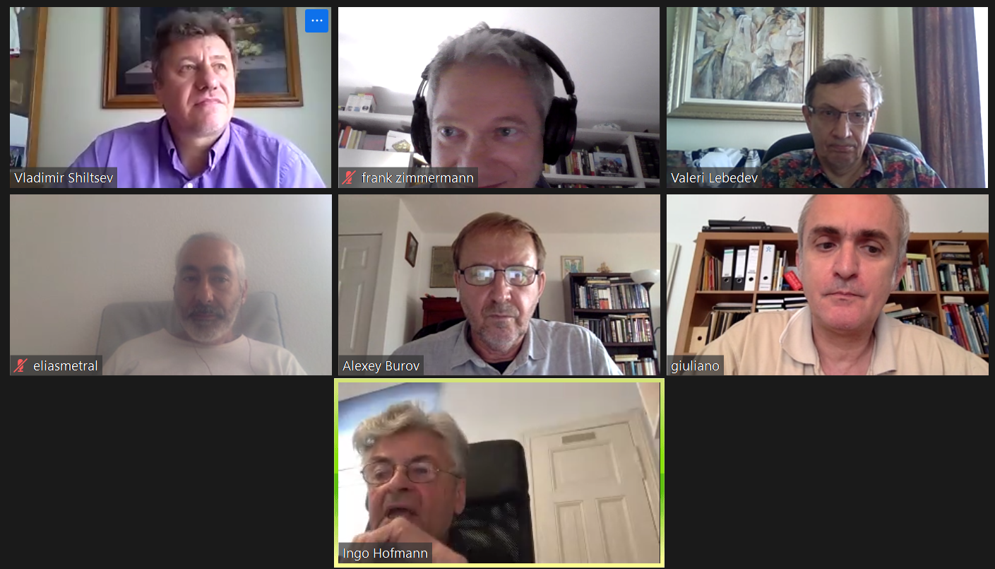

Slide 11
