Slide 1
Loss Control Mitigations for PIP-II*
* the first US Major Project built with In-Kind International Contribution
Luisella Lari
On behalf of the PIP-II Project
ARIES-ASPEC workshop
June 22nd - July 1st, 2020

Slide 2
Outline
Overview of the PIP-II Project
Handling losses in the PIP-II accelerator framework
PIP-II Project approach to loss control mitigation
Summary
Thanks to:
Lia Merminga (PIP-II Project Director)
Eduard Pozdeyev (PIP-II Project Scientist)
PIP-II Accelerator Physics Team (in particular A. Saini, J-P Carneiro)
FNAL Accelerator Division Experts (in particular the Proton Source Dep.)
FNAL MARS15 Team
Joint Booster Intensity Studies Team
International Booster Collaboration
All the PIP-II Project Team

Slide 3

2014 US Particle Physics Project Prioritization Panel (P5)
  Build a world-class neutrino program
  Host it as a global project
  Upgrade Fermilab accelerator complex to provide >1 MW proton beam
Recommendation 13: Form a new international collaboration to design and execute a highly capable Long-Baseline Neutrino Facility (LBNF) hosted by the U.S. To proceed, a project plan and identified resources must exist to meet the minimum requirements in the text. LBNF is the highest priority large project in its timeframe.
Recommendation 14: Upgrade the Fermilab proton accelerator complex to produce higher intensity beams. R&D for the Proton Improvement Plan II (PIP-II) should proceed immediately, followed by construction, to provide proton beams of >1 MW by the time of first operation of the new long-baseline neutrino facility.
Jul 1, 2020

Slide 4
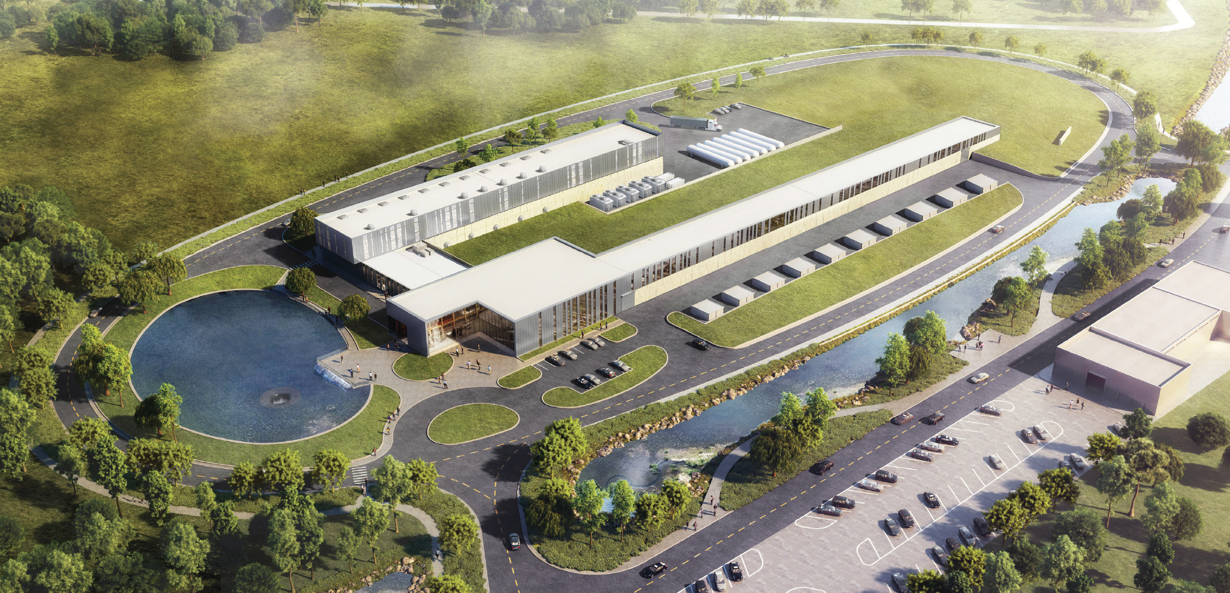
PIP-II / LBNF / DUNE meet P5 requirements
Powerful proton beams (PIP-II)
  to enable world’s most intense neutrino beam
Dual-site detector facilities (LBNF)
  A long baseline (1300 km) neutrino beam
  Deep underground cavern (1.5 km) to support 4x17kt liquid argon volume detectors
Deep Underground Neutrino Experiment (DUNE)
  The next-generation neutrino detectors
PIP-II ACCELERATOR

Slide 5

P5 Report defines the PIP-II Mission Need Statement (MNS)
The MNS for PIP-II identifies three primary goals:
Deliver high beam power to LBNF/DUNE to achieve world-first results
Ensure sustained high reliability operation of the Fermilab complex
Provide a platform for future upgrades to the accelerator complex
PIP-II Performance Requirements:
Beam Power
Meeting the needs for the start of DUNE (1.2 MW proton beam)
Upgradeable to multi-MW capability
Flexibility
Compatible with CW-operations
Customized beams for specific science needs
High-power beam to multiple users simultaneously
Reliability
Fully modernizing the front-end of the Fermilab accelerator complex
Building the world’s most powerful neutrino beam cost-effectively

Slide 6
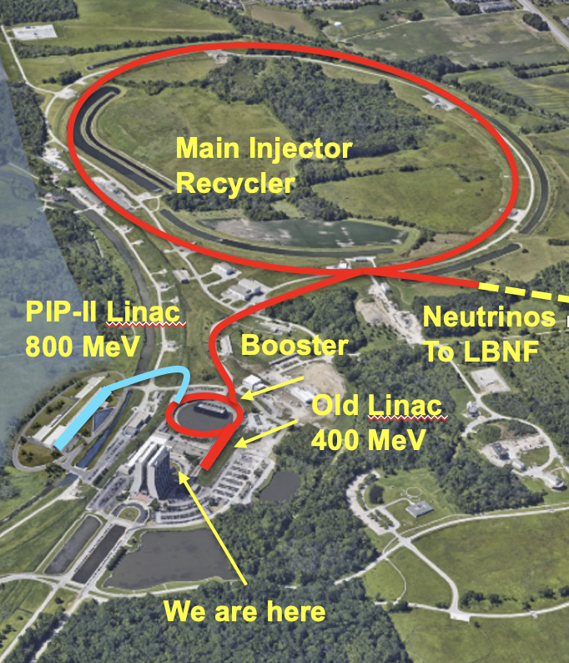
PIP-II Project Scope
New 800 MeV H⁻ Linac (w IKC)
  CW compatible
Linac-to-Booster Transfer Line (BTL)
Upgraded Booster
  20 Hz, 800 MeV injection
  New injection area
Upgraded Recycler & Main Injector
  RF in both rings
Conventional facilities
  Site preparation
  Cryoplant Building
  Linac Complex
  Booster Connection
Enabling the complex to reach 1.2 MW proton beam on LBNF target for 60-120 GeV

Slide 7
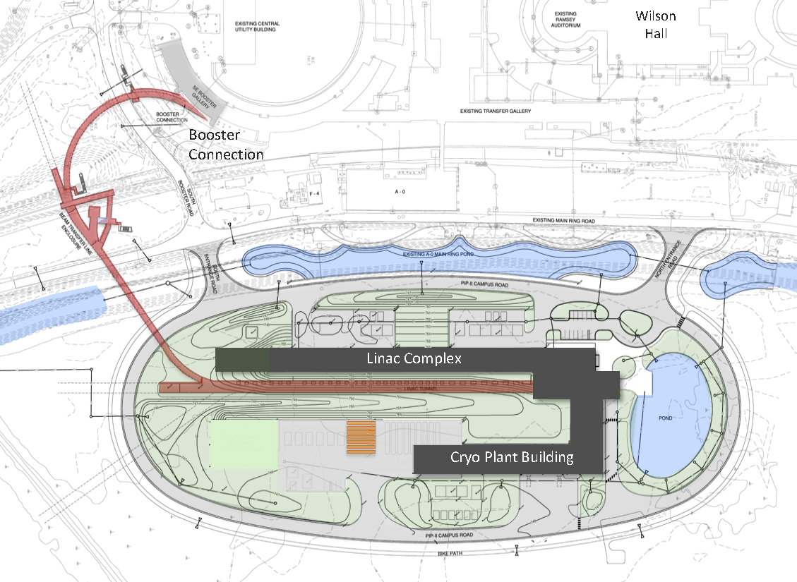
Handling PIP-II Losses
1. Losses in the 800 MeV H⁻ Linac
2. Losses in the Linac-to-Booster Transfer Line (BTL)
3. Losses in the Booster injection/extraction regions
4. Losses in Rings:
4a. Booster
4b. Recycler
4c. Main Injector

Slide 8
Handling PIP-II Losses
1. Losses in the 800 MeV H⁻ Linac
2. Losses in the Linac-to-Booster Transfer Line (BTL)
3. Losses in the Booster injection/extraction regions
4. Losses in Rings:
4a. Booster
4b. Recycler
4c. Main Injector

Slide 9
PIP-II Linac Overview

Slide 10
PIP-II Linac Overview

Slide 11
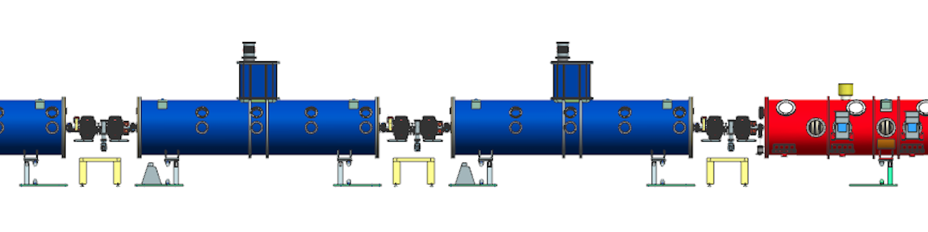
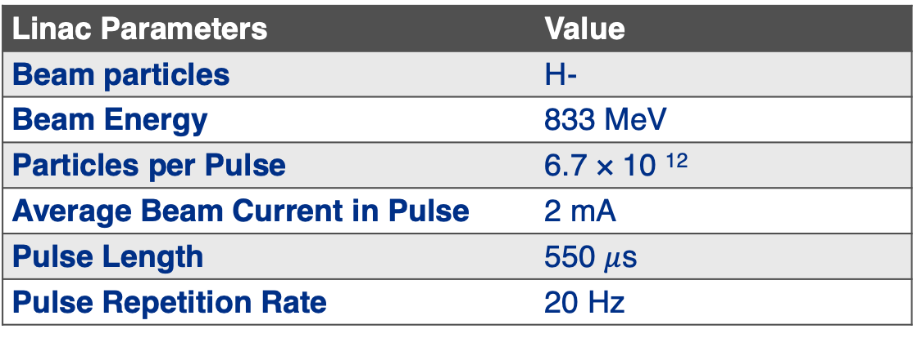
PIP-II Linac Overview
Linac Parameters | Value
Beam particles | H-
Beam Energy | 833 MeV
Particles per Pulse | 6.7 × 10 ¹²
Average Beam Current in Pulse | 2 mA
Pulse Length | 550 $μ$s
Pulse Repetition Rate | 20 Hz
Beam losses design target not to exceed 0.1 W/m

Slide 12
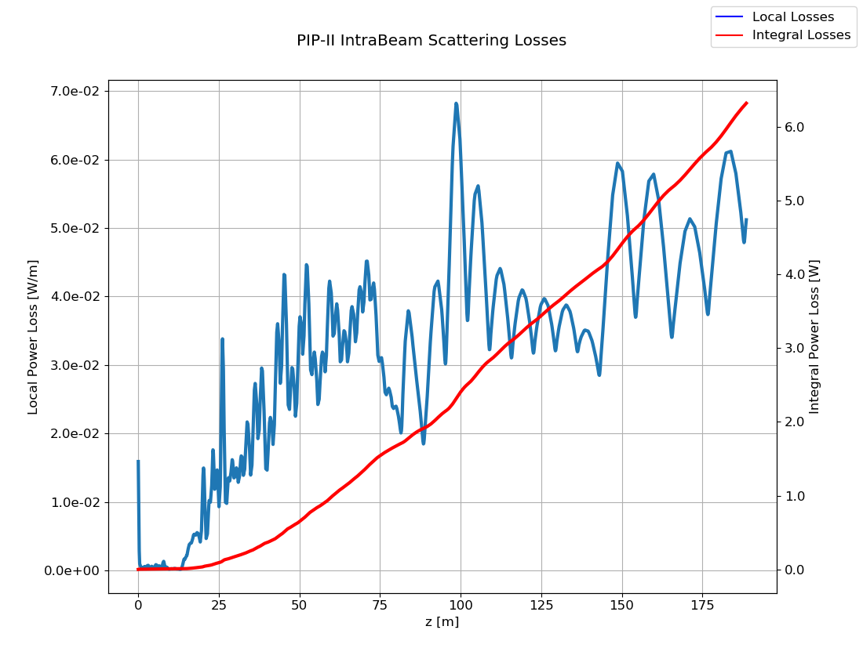
PIP-II Linac Losses Management
Evaluated uncontrolled continuous (slow) beam losses mechanism typical in high-intensity H⁻ Linacs:
Intra-Beam Stripping
Residual Gas Stripping
Lorentz/Magnets field Stripping
Beam Loss due to Halo/Tail
Dark current due to field emission
Intra-beam stripping losses, beam current 2 mA CW
Residual gas stripping losses, beam current 2 mA CW
7e-2
10²
6
Loss Power (W/m)
Loss Power (W/m)
Integral Loss Power (W)
----- Local Losses
----- Integral Losses
z (m)
180
z (m)
180
Results show acceptable level of losses

Slide 13
PIP-II Linac Losses Management
Evaluated intentionally induced beam losses (mitigation by design):
MEBT Scraper System is designed to intercept large transverse particles at the exit of the RFQ, to allow a clean injection in the high-energy SRF section. Each scraper system consists of four paddles that are radiation cooled and able to tolerate 75 W (each paddle) in a CW regime.
MEBT Beam Absorber is designed to tolerate a maximum beam power of 21 kW at 2.1 MeV in a CW regime. It is inserted vertically in the vacuum chamber and its nominal position is optimized to capture the kicked-out undesirable bunches.
Simulation results show that losses are acceptable even for the CW regime (2 mA) in the SRF Linac for longitudinal tails coming from the RFQ, and not intercepted by the MEBT scraper system.

Slide 14
PIP-II Linac Losses Management
Evaluated uncontrolled continuous (slow) beam losses to validate tolerances & requirements :
Realistic Error Simulation results confirm that requirements can be met:
  Misalignment,
  Magnet,
  RF Systems;
Complete evaluation of losses even in the case of some elements not working or under-performing in normal operation.
  PIP-II Linac Reliability Status
Linac can tolerate loss of any single element and meet requirements after re-tuning.
Linac can operate if cavities of one single type underperform by 20%.
Fast accidental losses that typically happen due to malfunctioning hardware, human errors, or other accidents will be mitigated by the Machine Protection System (MPS).

Slide 15
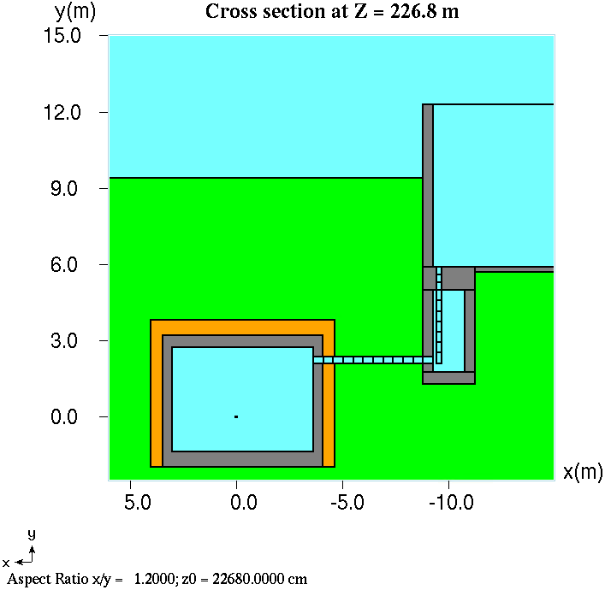
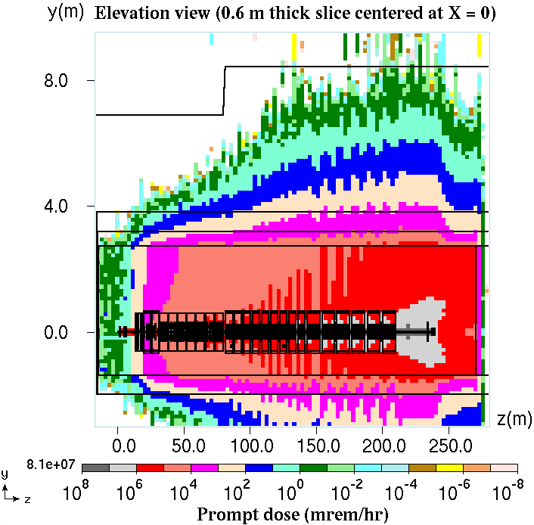
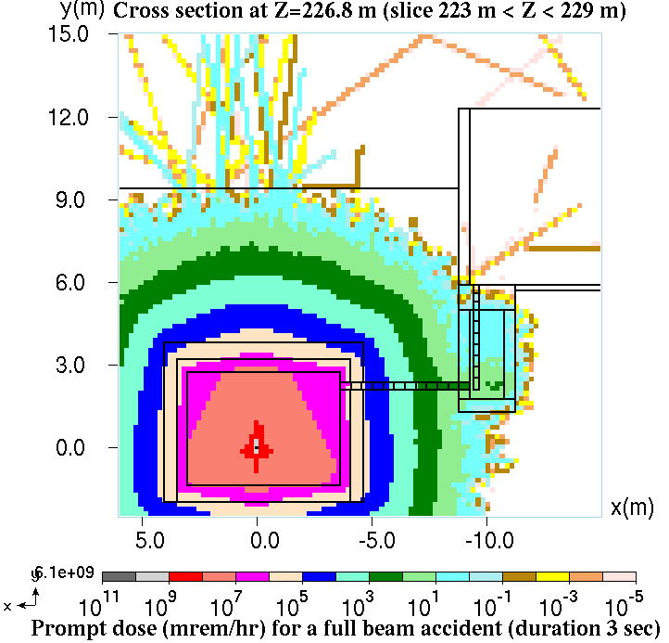
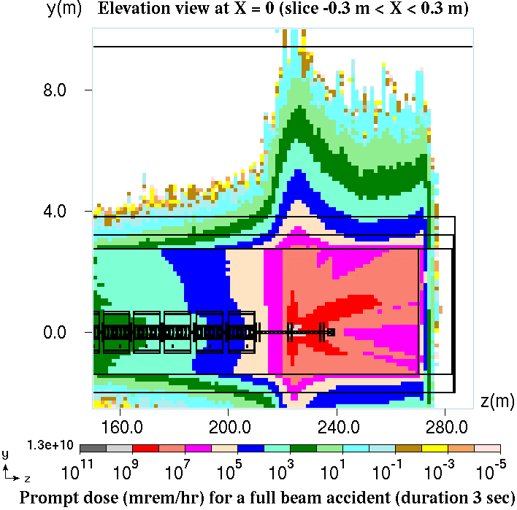
PIP-II Linac Losses Management
On track to be completed for CF Final Design (CY21):
PIP-II shielding analysis in conservative operation condition (impact angle is set to 3 mrad with respect to the beam direction).
PIP-II shielding analysis in accident scenarios: Assuming that beam power at the end of PIP-II Linac is equal to 2 MW, one has 1.25×10¹⁶ H⁻/s at 1 GeV.
MARS15 results
Prompt dose
during
operation
(mrem/hr)
y (cm)
y (m)
x (m)
z (m)
y (cm)
x (m)
10⁶
y (cm)
y (m)
x (m)
x (cm)
x (m)
z (m)
In collaboration with Fluka Team at CERN
10⁹
10⁹
Prompt dose (mrem/hr) duration 3s for beam accident

Slide 16
Linac Losses Mitigation Next steps
PIP-II Linac Design is Robust, Fault-Tolerant as shown by simulation results, but operation can have unexpected surprises!
Ref: Beam Dynamics and Beam Loss in Linacs, M. Plum ORNL/SNS, USPAS Nov. 5-14, 2014

Slide 17
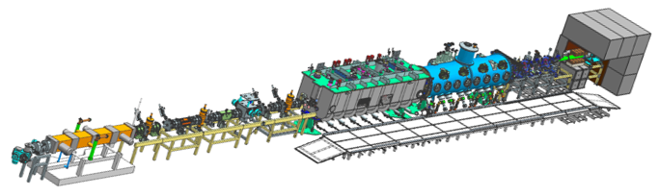
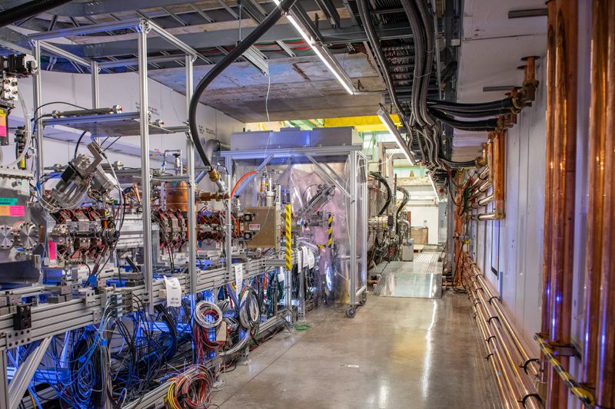
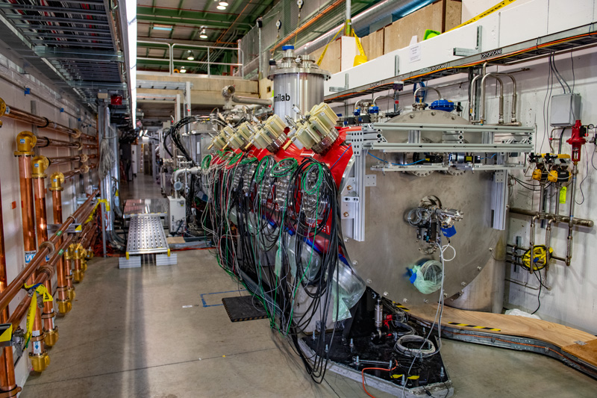
PIP-II Linac Loss Control Mitigations Next steps
PIP-II Injection Test Facility (PIP2IT) serves as Testbed for PIP-II Warm Front End and Critical System. It is planned to start to run beam in middle August 2020 and it will retire a significant technical risks, including “losses checking”.
Jan -2020

Slide 18
PIP-II Linac Loss Control Mitigations Next steps
Linac Beam Commissioning tailored in stages in order to minimize risks in validating the PIP-II project goals (i.e. KPPs).
Machine Learning is planned to be evaluated for applications in machine tuning and “loss mitigations” to improve the reliability
The loss control mitigation is a continuous effort beyond the PIP-II Project goals

Slide 19
Handling PIP-II Losses
1. Losses in the 800 MeV H⁻ Linac
2. Losses in the Linac-to-Booster Transfer Line (BTL)
3. Losses in the Booster injection/extraction regions
4. Losses in Rings:
4a. Booster
4b. Recycler
4c. Main Injector

Slide 20
PIP-II BTL Losses Management
Evaluated uncontrolled beam losses mechanism typical in high-intensity H⁻ Linacs:
Intra-Beam Stripping
  significantly reduced with respect to the Linac due to bunch lengthening
Residual Gas Stripping
Lorentz/Magnets field Stripping
Beam Loss due to Halo/Tail
Magnetic stripping losses
1 Torr = 1.33 mbar
Loss rate per m
10⁻⁸
Field (kG)
10 kGauss = 1 Tesla
Losses are acceptable even for the CW regime

Slide 21
PIP-II BTL Loss Control Mitigation Next steps
Linac Beam Commissioning tailored in stages foreseen to commissioning the machine until the BTL dump to minimize risks in validating the PIP-II project goals (i.e. KPPs).
On going study for a possible collimation system to be implemented in the BTL.
Machine Learning is plan to be evaluated for applications in loss mitigations to improve the reliability
25 kW Dump

Slide 22
Handling PIP-II Losses
1. Losses in the 800 MeV H⁻ Linac
2. Losses in the Linac-to-Booster Transfer Line (BTL)
3. Losses in the Booster injection/extraction regions
4. Losses in Rings:
4a. Booster
4b. Recycler
4c. Main Injector

Slide 23
Booster Inj./Extr. Losses Management & Mitigation
Beam Power injected into Booster will increase 4 times in PIP-2 Era. Beam Power extracted from Booster will be doubled in PIP-2 Era.
PIP-II scope includes:
New 800 MeV Booster Injection Area with ancillary systems, incl collimators
2X larger bore magnets to reduce losses at Booster Extraction
Design and Simulation work on-going to improve accuracy.
Loss Mechanism | Driving Forces | PIP-II Era Mitigation
Emittance Growth at Injection | Space Charge | Painting injection Two stage collimation
Longitudinal Losses at Injection | LLRF Performance Adiabatic capture Field stability | Direct bucket injection with beam chopper
Extraction Losses | Vertical aperture restriction | Two new magnets with larger Aperture (approximately 10% increase) in extraction region
  Details on E. Pozdeyev ARIES talk

Slide 24
Handling PIP-II Losses
1. Losses in the 800 MeV H⁻ Linac
2. Losses in the Linac-to-Booster Transfer Line (BTL)
3. Losses in the Booster injection/extraction regions
4. Losses in Rings:
4a. Booster
4b. Recycler
4c. Main Injector

Slide 25
Losses in Rings Management & Mitigation
PIP-II intensity per pulse upgrade requires
commensurate reduction in Booster loss
PIP-II scope includes:
Booster (excl. inj/extrc. Areas):
  Booster modifications from 15 Hz to 20 Hz operations
  5 new booster cavities, higher voltage, larger aperture to provide higher voltage (1.16 MV) required for 20 Hz and higher intensity
  Collimators, Dampers to control losses in Booster
Recycler ring
  3 New Recycler cavities to support continuous operation mode
Main injector
  20 new RF stations to provide additional RF power to enable acceleration of PIP-II beam
  Gamma_t jump to reduce losses at transition to address higher intensity and larger longitudinal beam emittance
The loss control mitigation is a continuous effort beyond the PIP-II Project goals
  Details on E. Pozdeyev ARIES talk

Slide 26
Summary – Figure of Merit
 | Loss mitigation actions addressed by PIP-II Project (hardware to reach 1.2 MW) | Loss mitigation actions to be addressed by Operation (work to minimize losses) | Lessons Learned implemented
LINAC | YES | YES | YES
Beam Transfer Line | YES | YES | YES
Booster Inj/Ext | YES | YES | YES
Rings:
Booster | YES | YES | YES
Recycler | NO | YES | YES
Main Injector | YES | YES | YES

Slide 27
Summary
PIP-II is a complex Project with an articulate Beam Losses Management.
PIP-II Project is designed to deliver >1 MW of proton beam power from the Main Injector over the energy range 60 – 120 GeV and 1.2 MW at 120 GeV;
PIP-II Linac is CW compatible, beam power of 1.6 MW in the CW regime;
PIP-II Project is mature in evaluating/simulating Beam Losses in the different locations. Some work is on-going:
  International Accelerator Project teams are working to understand losses and high-intensity effects in the Booster to build up a high reliability configuration;
Beam loss mitigations measure are included in PIP-II Project scope and before operation starts.
We are ready to proceed with the Construction Phase.

Slide 28
Additional Slides

Slide 29
PIP-II Project Key Performance Parameters (KPPs)
# | Scope | Threshold KPPs | Objective KPPs
1 | Linac Beam Energy | Accelerate H- beam to 600 MeV | Accelerate H- beam to 700 MeV Linac systems required to accelerate beam to 800 MeV installed and tested
2 | Linac Beam Intensity | Beam delivered to Beam Dump at the end of Linac | Beam with intensity of 1.3E12 particles per pulse (H-) at 20 Hz delivered to Beam Line Dump
3 | Booster/ Recycler/ Main Injector upgrades | Booster, Recycler, and Main Injector Upgrades to support operations with beam power of 1.2 MW on the LBNF target are installed and tested without beam | Linac beam injected and circulated in Booster
Objective KPPs are aligned with the baseline project scope and assure that the accelerator facility, as constructed, is capable of meeting the scientific needs of the Fermilab program.
Notes:
KPP remove objective

Slide 30
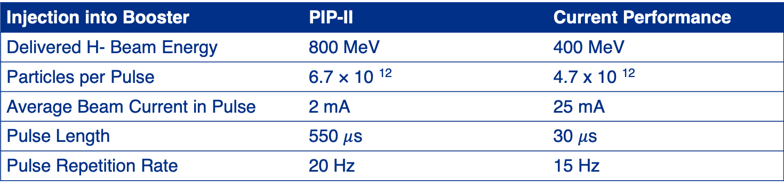
Parameters
Injection into Booster | PIP-II | Current Performance
Delivered H- Beam Energy | 800 MeV | 400 MeV
Particles per Pulse | 6.7 × 10 ¹² | 4.7 x 10 ¹²
Average Beam Current in Pulse | 2 mA | 25 mA
Pulse Length | 550 $μ$s | 30 $μ$s
Pulse Repetition Rate | 20 Hz | 15 Hz
Main Injector | PIP-II | Current Performance
Beam Energy | 60-120 GeV | 120 GeV
Cycle time | 1.2 sec | 1.33 sec
Beam Power (60 - 120 GeV) | 1.1 - 1.2 MW | 0.75 MW (@120 GeV)
Potential Upgrades
Upgrade potential | 2.4 MW
Notes:
KPP remove objective

