Slide 1
Manipulation Measures
Including Cooling for Storage and
Decelerating Highly Charged Isotopes
M. Steck, Accelerator Operations, Storage Rings,
GSI Helmholtzzentrum, Darmstadt

Slide 2
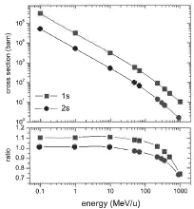
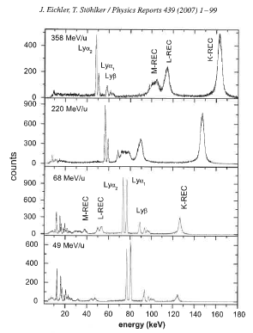
Decelerated Beams for Atomic Physics
relativistic Doppler transformation
relativistic transformation of solid angle:
radiative recombination U⁹²⁺
E_{lab}: photon energy in lab system
E_{proj}: photon energy in emitter system
X-rays of REC U⁹²⁺ -> N₂
deceleration reduces:
dependence on velocity and observation angle θ_{lab}
influence of energy and intensity
deceleration:
provides increased
reaction cross sections
opens new reaction channels
(transitions, polarization)

Slide 3
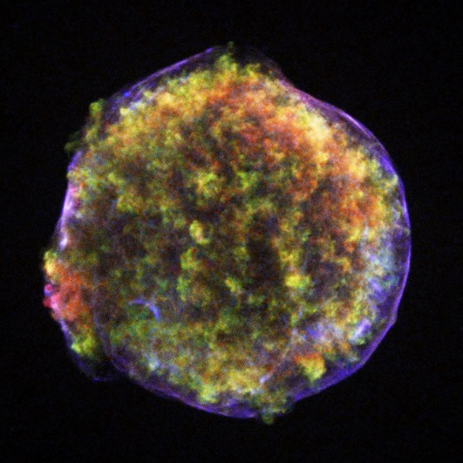
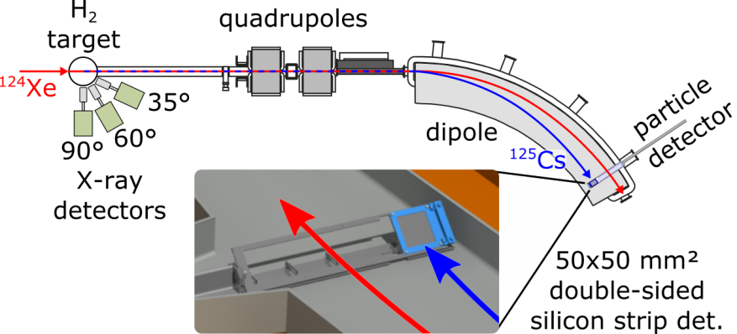
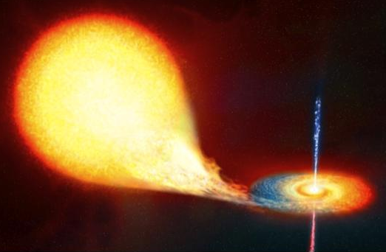
Decelerated Beams for Nuclear Astrophysics
To investigate the origin of elements
in stars, nuclear astrophysics aims for
challenging reaction studies on
rare ion beams.
Heavy ion storage rings at GSI
provide unique possibilities and unrivalled conditions for such experiments.
supernova
remnant
x-ray
binary
Experimental setup of the reaction study ¹²⁴Xe(p,γ)¹²⁵Cs in the ESR at
beam energies as low as 5.5 MeV/u
  high energy production & separation of radioactive beams in FRS
    most efficient and versatile technique available
  deceleration to energies below 10 MeV/u
    access to the famous Gamow window relevant for nuclear physics of stars
  cooled beam in combination with a thin gas jet target
    inverse kinematics studies at unmatched energy resolution
  storage and recycling of the rare ion beam
    extremely efficient technique for studies on beams of limited intensity
Notes:
ESR – early 90s

Slide 4
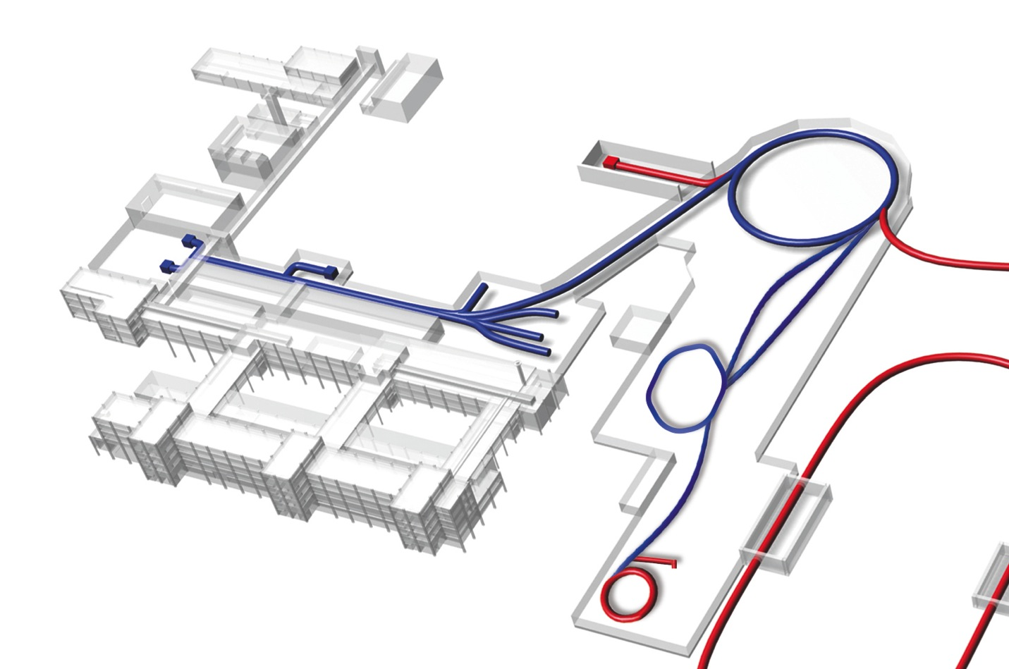
Decelerated Beams for
HITRAP and CRYRING@ESR
11.4 MeV/u
400 MeV/u
400–X MeV/u
UNILAC
SIS
stripper/
production target
FRS
ESR
Slow, heavy, highly charged Ions and Rare Isotopes
Energy range 10 MeV/u to sub eV/ion
10⁵-10⁷ highly charged ions, Pb⁸²⁺,U⁹²⁺
4 K
4 MeV/u
SIS
HITRAP
UNILAC
linear decelerator
HITRAP
FRS
4 MeV/u … 100 keV/u
4-10 MeV/u
ESR
CRYRING@ESR
ring decelerator
CRYRING
@ESR

Slide 5
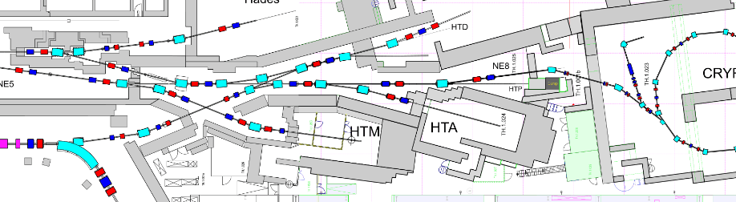
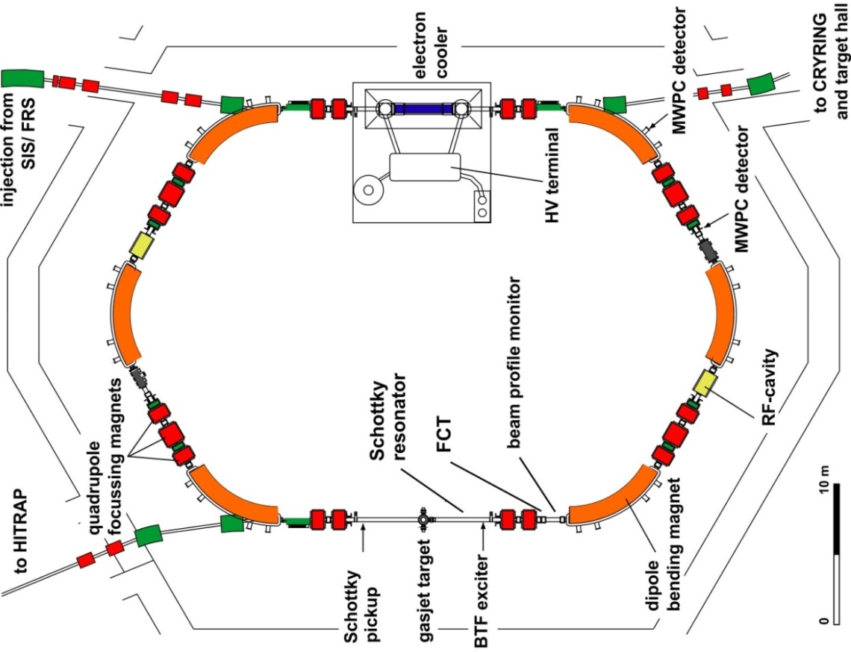
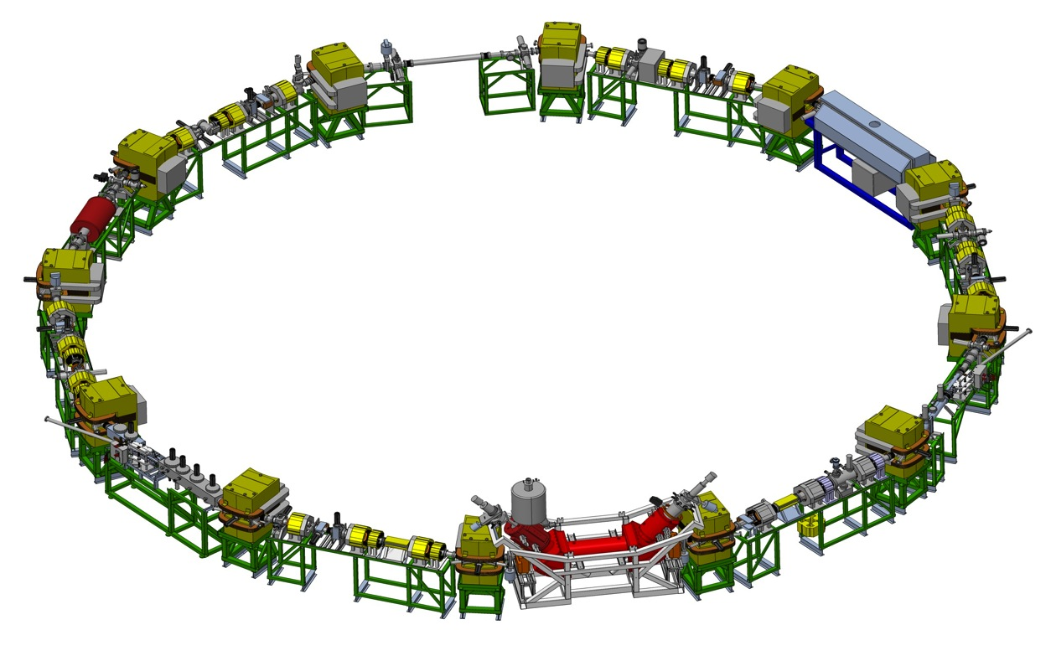
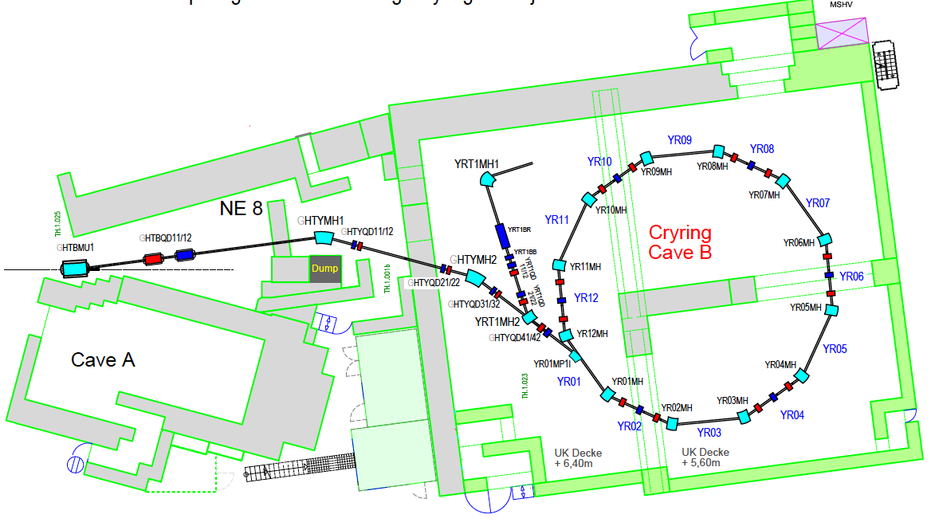
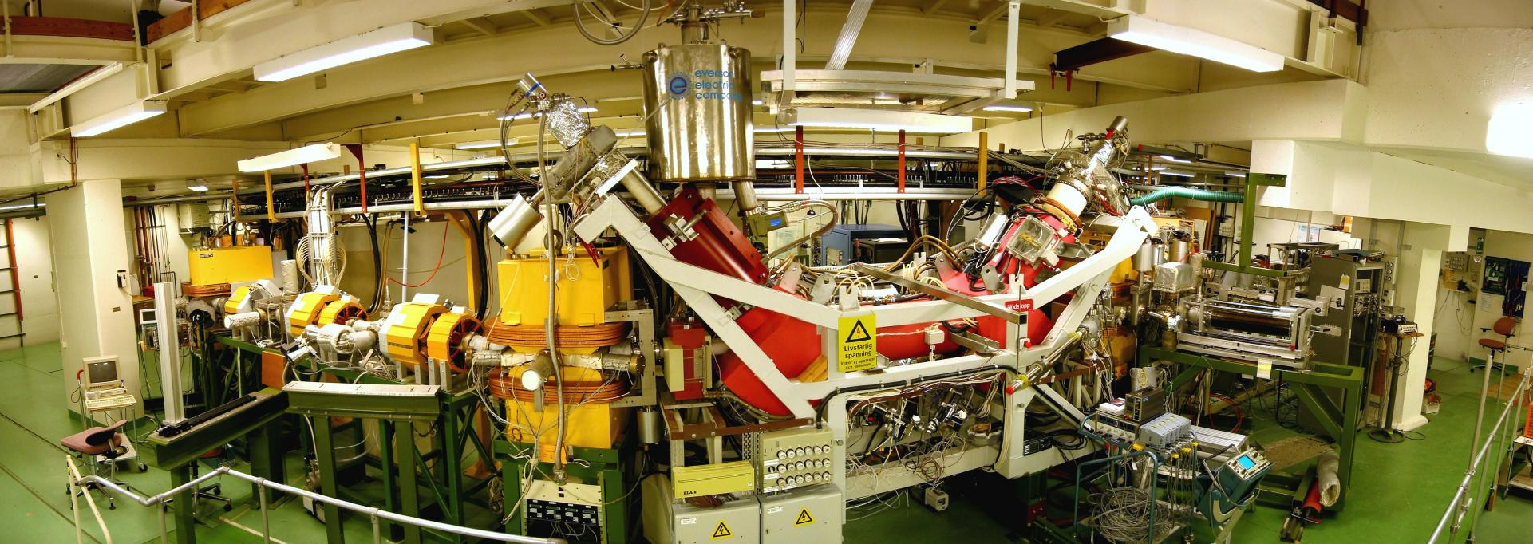
Connecting ESR to CRYRING@ESR
goal: stored, cooled highly charged ions
at lowest energies
ESR decelerates cooled highly charged ions or rare isotope beams from 400 MeV/u to 4-15 MeV/u
max. rigidity 1.44 Tm 15 MeV/u U⁹²⁺
min. rigidity ~ 0.054 Tm 21 keV/u U⁹²⁺
electron cooling with magnetic expansion factor 100

Slide 6
Goals for Deceleration in the ESR
highly charged ions and rare isotopes are produce in thick stripper/target
followed by cooling to reduce the beam emittance after the target
good beam quality of stored beam ⇒ high precision experiments
high luminosity with internal target for internal experiment
long lifetime of stored beam ⇒ vacuum pressure 10⁻¹¹ mbar or below
fast extraction at 4 MeV/u for HITRAP, defined by the decelerator linac
fast extraction below ∼10 MeV/u for CRYRING, defined by bending power
slow extraction employing charge changing processes (cooler, target)
goal: maximum intensity (particles per time interval) to HITRAP/CRYRING,
i.e. large particle number, short cycle time

Slide 7

The Heavy Ion Storage Ring ESR
Fast injection (stable ions / RIBs)
Stochastic cooling ( ≥ 400 MeV/u)
Electron cooling ( 3 - 430 MeV/u)
Laser cooling (C³⁺ 120 MeV/u)
Internal gas jet target
Deceleration (down to 3 MeV/u)
Fast extraction (HITRAP/CRYRING@ESR)
Slow (resonant) extraction
Ultraslow extraction (charge change)
Beam accumulation
Multi charge state operation
Schottky mass spectrometry of RIBs
Isochronous mode (TOF detector)

Slide 8
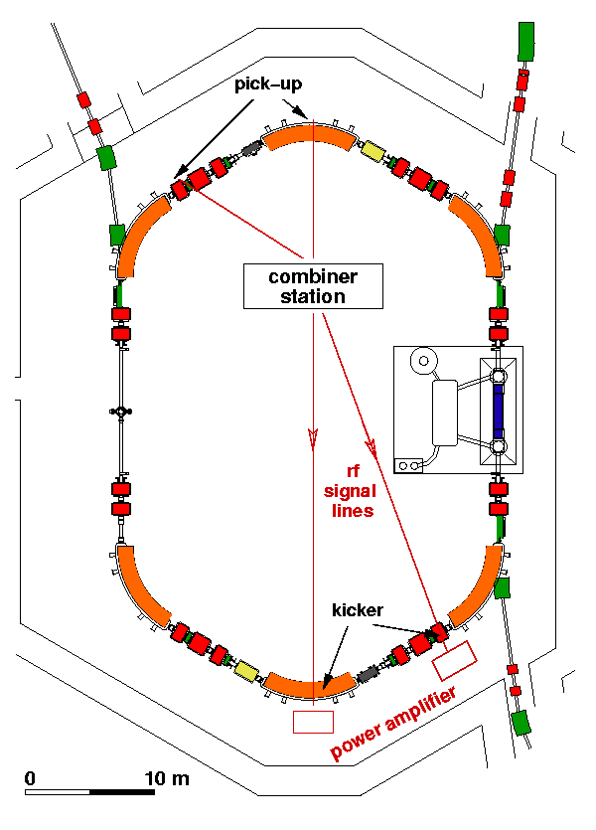
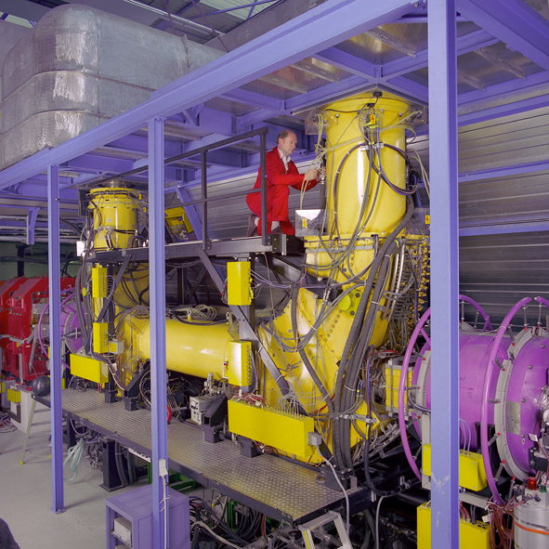
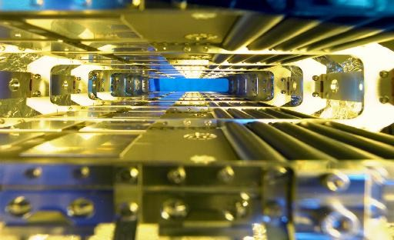
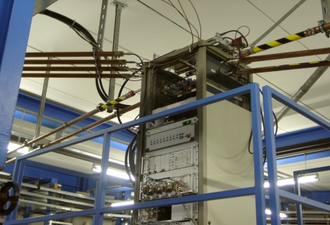
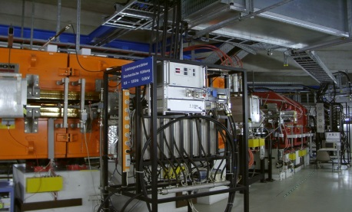
Beam Cooling at the ESR
stochastic pre-cooling on the injection orbit
electron cooling
energy 400 (-550) MeV/u
bandwidth 0.8 GHz (range 0.9-1.7 GHz)
δp/p = ±0.35 % → δp/p = ±0.01 %
ε = 10 μm → ε = 2 μm
electrodes
electron energy 1.6 – 250 keV
electron current 0.001 – 1 A
beam diameter 50.8 mm
magnetic field 0.01 - 0.2 T
collection efficiency 0.9998
transverse temperature 0.1 eV
longitudinal temperature ~0.1 meV
vacuum 1 × 10⁻¹¹ mbar
combiner station
Subsequent electron cooling
fast stochastic
pre-cooling
power amplifiers

Slide 9
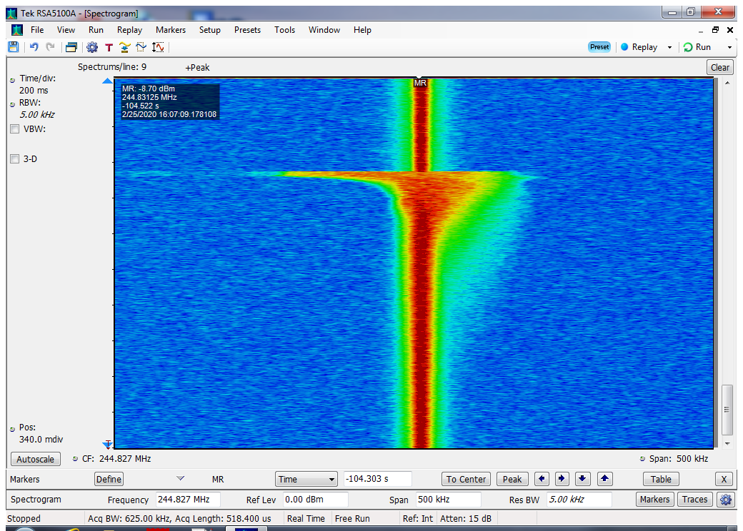
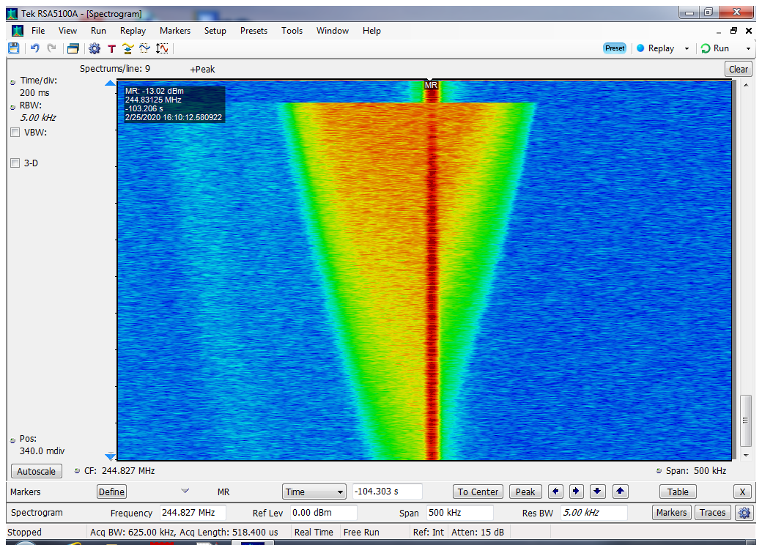
Cooling after Injection
The injection energy of the ESR is flexible (30- 500 MeV/u)
the production rate of highly charged heavy ions increases with energy, but the
larger energy reduction conflicts ⇒ the production rate needs to be traded off
electron cooling can be applied for any energy ≤ 430 MeV/u
stochastic cooling is presently available at 400 MeV/u
but could be extended to higher energies (up to 550 MeV/u)
at 400 MeV/u stochastic cooling is faster than electron cooling
Kr³²⁺ 400 MeV stochastic cooling electron cooling (I_{el}= 300 mA)
T ∼ 350 s
T∼30 s
cooled beam
after ≈ 5 s

Slide 10
Typical ESR Deceleration Cycle
Ni²⁸⁺ 400 → 30 → 4 MeV/u
1100 μA → 180 μA → 25 μA
45% 37%
1.2×10⁸ 2.2×10⁷
cycle time 45 s
1)
2)
3)
4)
5)
6)
7)
rf amplitude
1) injection (at 400 MeV/u)
2) stochastic/electron cooling
3) deceleration to 30 MeV/u
4) electron cooling
5) changing rf harmonic 2 → 4
6) deceleration to final energy
7) electron cooling, bunching, extraction
h=2 → 4
magnetic
field
ion current
maximum change of p (Bρ): 13

Slide 11
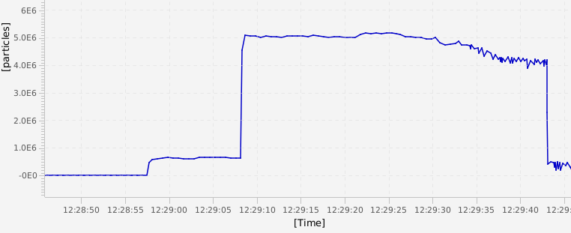
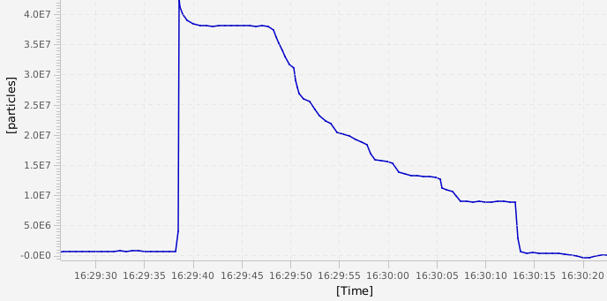
Efficiency of Deceleration
deceleration cycle Bi⁸³⁺ from 400 to 30 MeV/u
loss-free deceleration of some 10⁶ ions
increasing loss above 10⁷ injected ions
stoch.
cooling
particle number
during deceleration
deceleration
electron
cooling

Slide 12
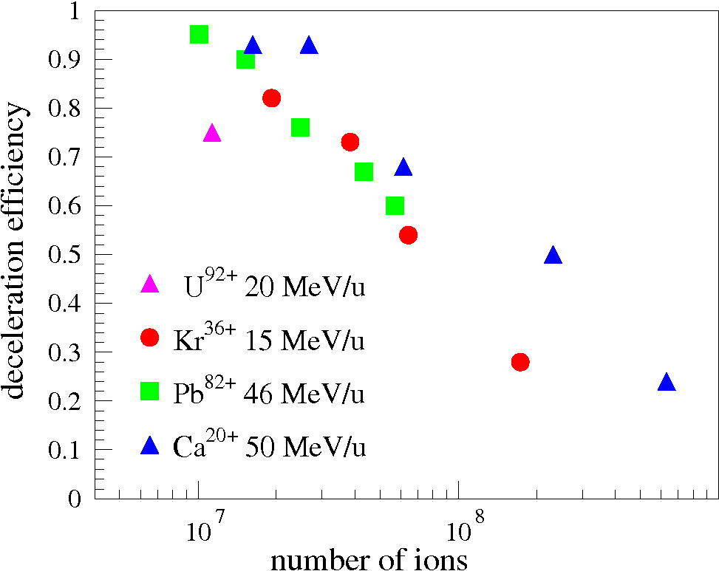
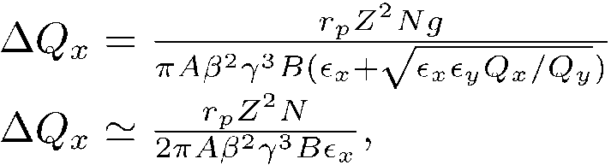

Efficiency of Deceleration
Losses increase with increase of initial stored particle number
most likely due to IBS
in a bunched beam during deceleration
transverse emittance is growing
due to intrabeam scattering
no cooling,
larger emittance of bunched beam
and
due to adiabatic emittance growth (α 1/βγ)
during deceleration the beam is also
approaching the space charge
dominated regime
energies below 15 MeV/u require
a change to a higher rf harmonic
debunching (h=2), rebunching (h=4)

Slide 13
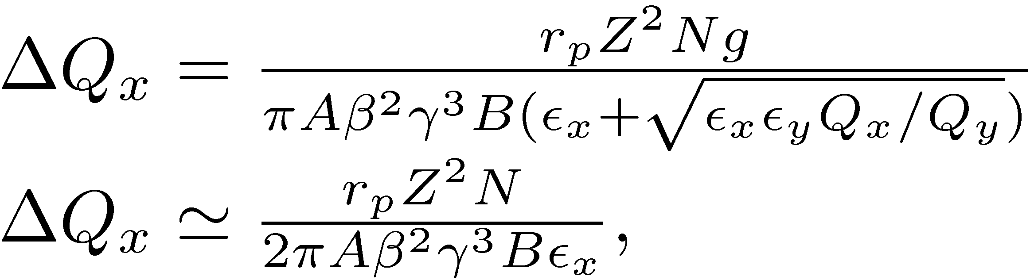
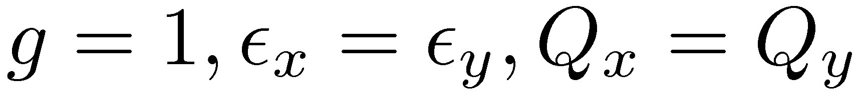
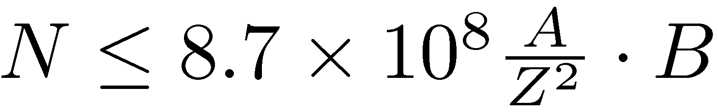
Space Charge Limit
Space charge limit due to incoherent tune shift
at 4 MeV/u, for ΔQ_{x}=0.1 and ε_{x} = 1 mm mrad:
Coasting (B=1): Ne¹⁰⁺: 1.8 × 10⁸
Kr³⁶⁺: 5.8 × 10⁷
U⁹²⁺: 2.5 × 10⁷
Bunched (≤ 1μs, B=1/5): Ne¹⁰⁺: 4 × 10⁷
Kr³⁶⁺: 1 × 10⁷
U⁹²⁺: 5 × 10⁶
For bunched beam the intensity limit is reduced by the bunching factor.
Experimental observation: with rf amplitude 100 V (h=1) the bunching factor is B ≈ 1/20.
Therefore good control of low rf amplitudes is mandatory.

Slide 14
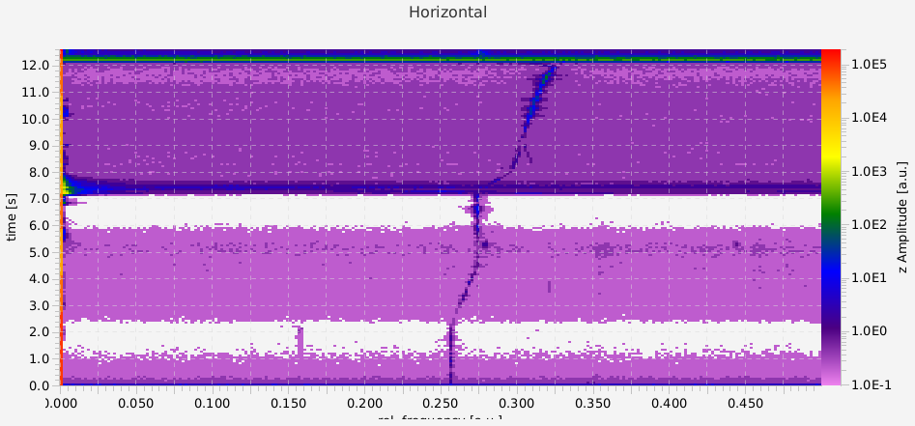
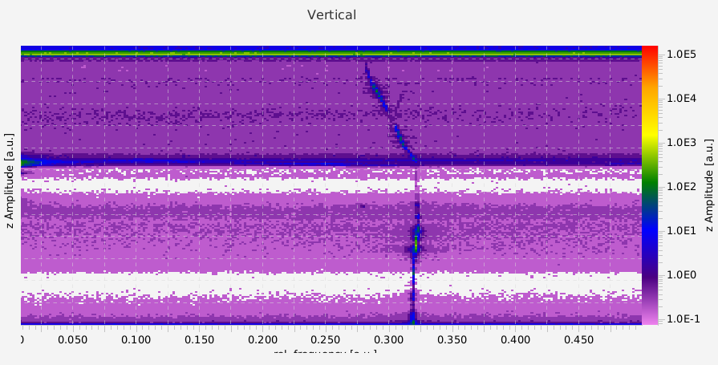
Modernized Beam Diagnostics
bunched beam diagnostics with new BPM digitization
horizontal beam position during a
deceleration cycle from 75 to 15 MeV/u
horizontal tune
deceleration
Pb⁷⁸⁺
time
orbit
shift
orbit shift
position x [m]
deceleration
vertical tune
time
future optimization of the deceleration cycle
is indispensable for highest intensities
of the decelerated beam
tune measurements with moderate excitation

Slide 15
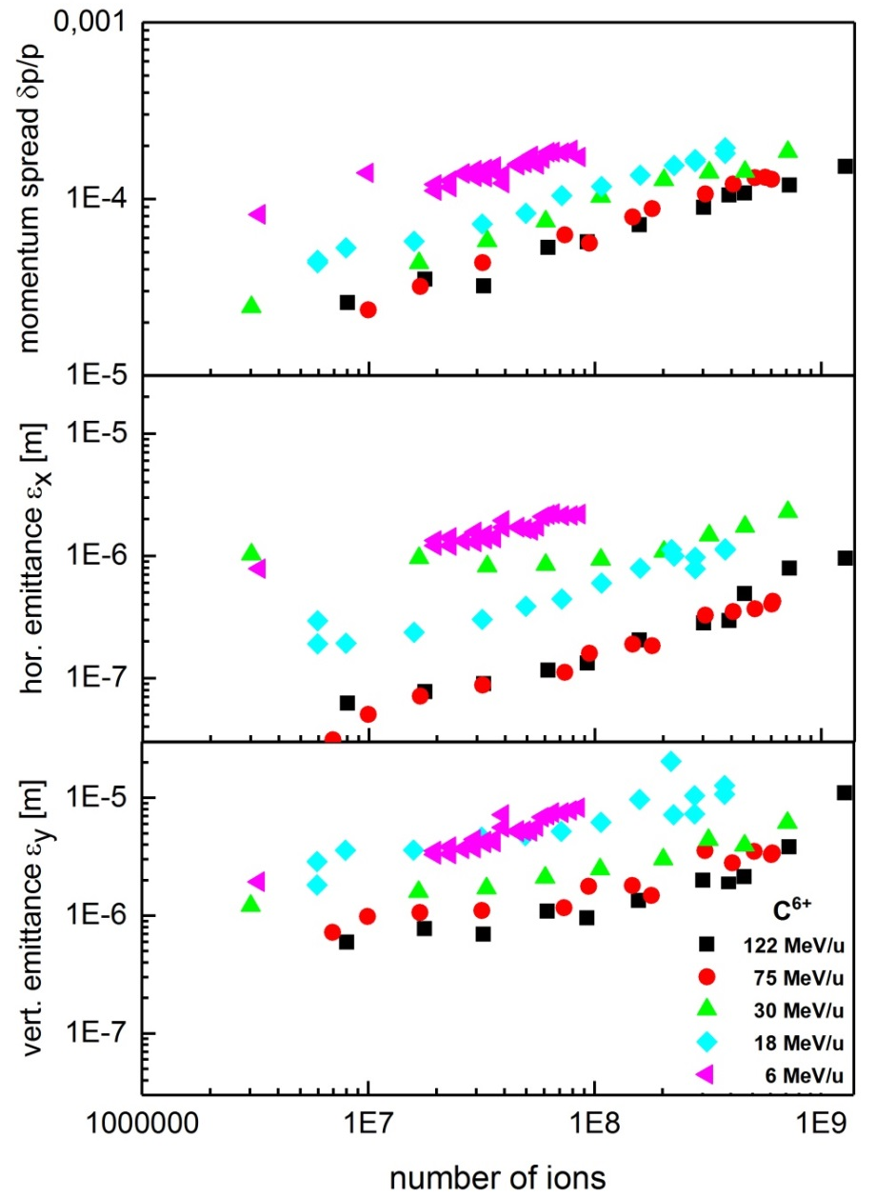
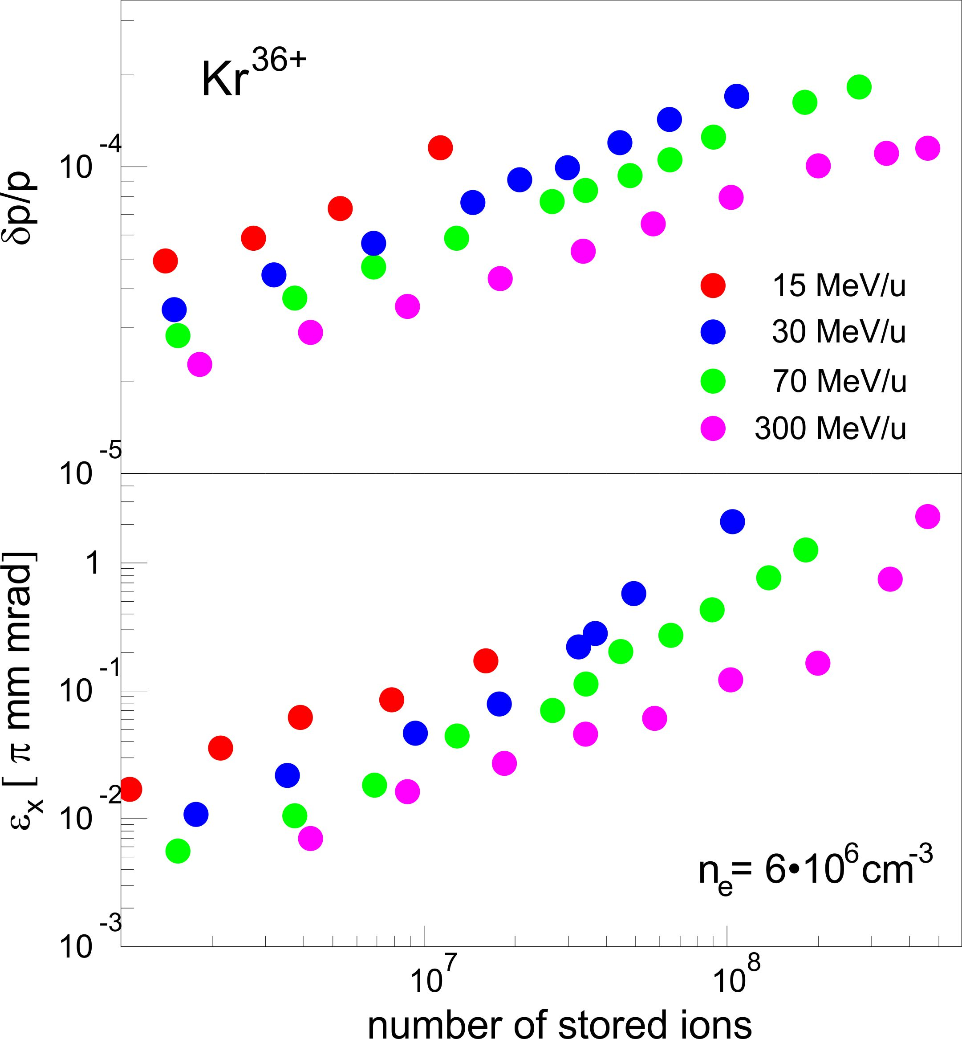
Beam Parameters of Decelerated Ions
equilibrium electron cooling - IBS
n_{e}=5×10⁶ cm⁻³
Intrabeam Scattering rate
in case of equipartitioning:
emittance increases ≈ proportional βγ
C⁶⁺

Slide 16
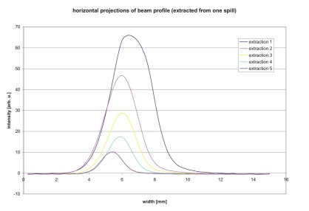
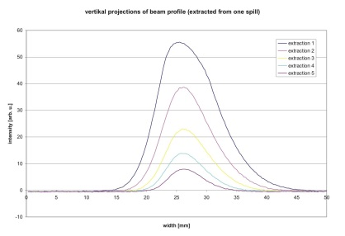
Emittance of Extracted Decelerated Beam
fast extracted beam
Ca²⁰⁺ 4 MeV/u
horizontal profile
vertical profile
the increase of the beam emittance with intensity due to IBS
reflects in the beam size of the extracted cooled beam

Slide 17
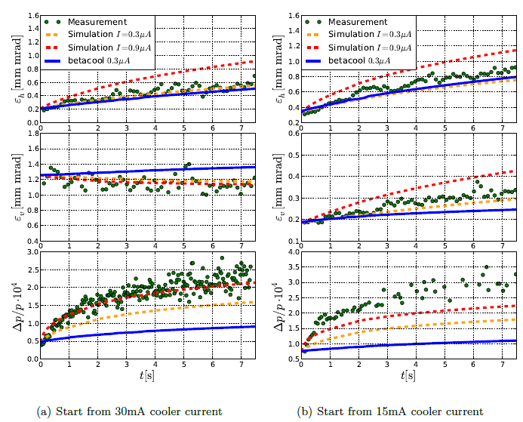
Heating by Intrabeam Scattering
Growth of Beam Emittance due to Intrabeam Scattering
stronger (faster) cooling
results in faster IBS heating
for highly charged ions IBS
is expected to scale with Q⁴/A²
highly charged uranium heats
up 10 times faster than Cr²³⁺
It is an open issue whether an
efficient beam transport from
ESR to CRYRING can be
achieved with the present
extraction mode.
⁵²Cr²³⁺ 4 MeV/u
P. Görgen, Master Thesis, 2011

Slide 18
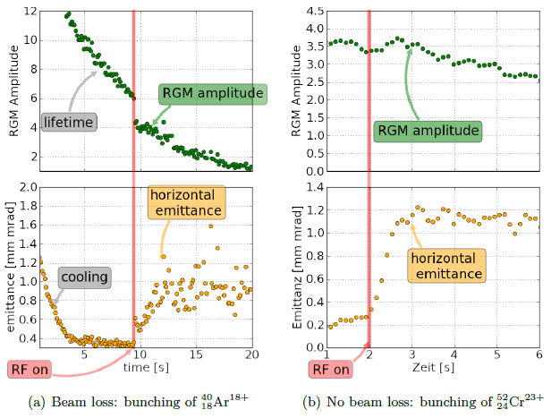
Loss during Bunching a Low Energy Beam
Growth after Bunching the Cooled Coasting Beam
P. Görgen
Master Thesis, 2011
⇒ Precise control of rf amplitude down to small values

Slide 19
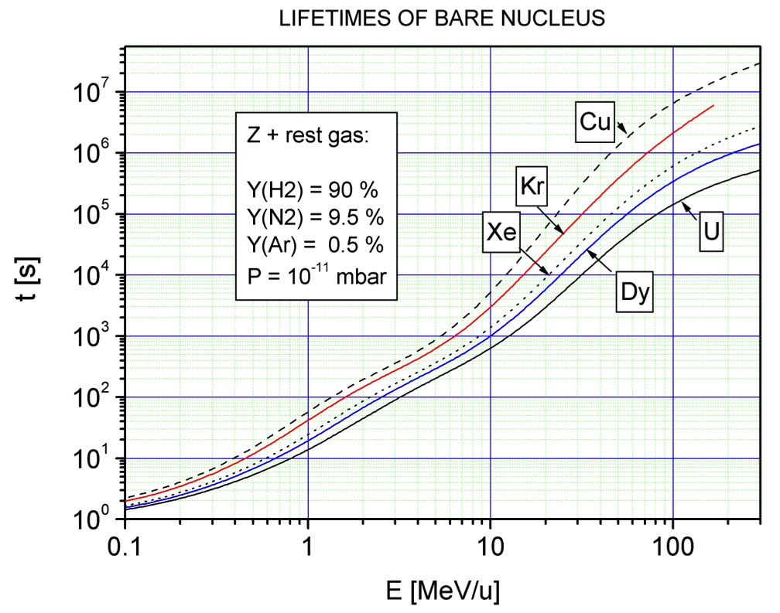
Low Energy Beams – Vacuum
measurement of beam half life with
an average pressure of p ≈ 1 × 10⁻¹⁰ mbar
simulation for CRYRING
V. Shevelko
Xe⁵⁴⁺
Ne¹⁰⁺
Pb⁸²⁺
lifetime in the residual gas and
cooling time can be of similar value
excellent vacuum and fast cooling
are crucial for low highly charged ions
and rare isotopes at lowest energy
σ_{REC} α Z_{P}
4

Slide 20
Deceleration to 4 MeV/u
Ni²⁸⁺ 400 → 30 → 4 MeV/u
cycle time
45 s
Main losses:
End of ramp
Storage and cooling at low energy
1100 μA → 180 μA → 25 μA
45% 37 %
rf amplitude
h=2 → 4
I
extraction
2×10⁷
4×10⁶
bending
field
beam half life (vacuum dominated):
30 MeV/u: T_{1/2} ≈ 480 s
4 MeV/u: T_{1/2} ≈ 2 s
ion current

Slide 21
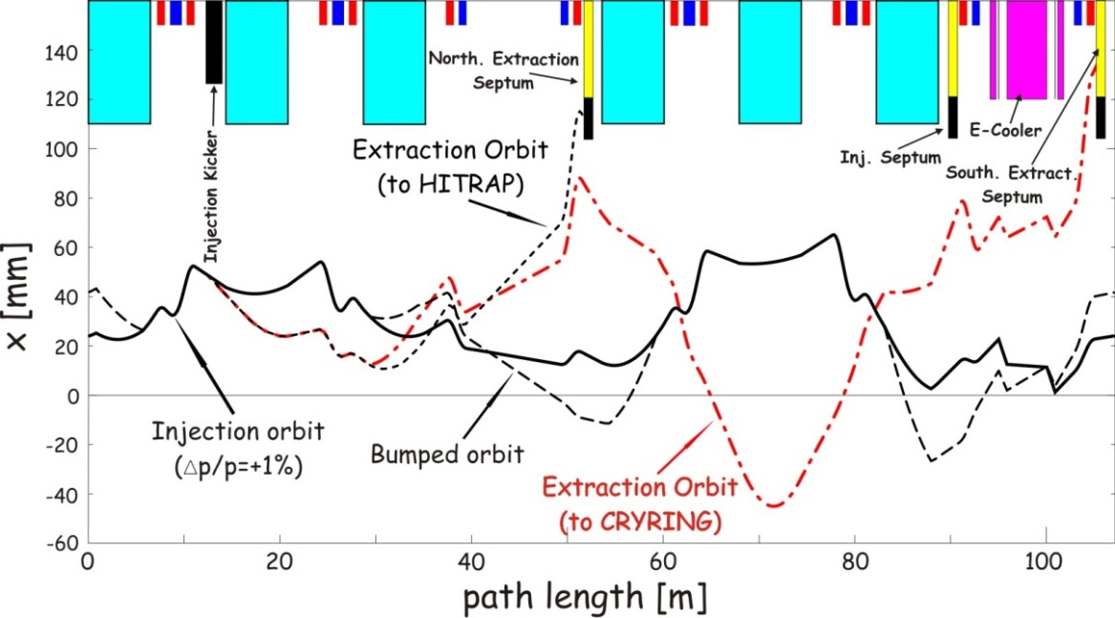
Fast Beam Extraction from
ESR to CRYRING
fast beam extraction from ESR to CRYRING is employing a sophisticated scheme
with a distorted closed orbit for the circulating beam before extraction to CRYRING
consequence: cooling during extraction is questionable, risk of significant heating and emittance growth, particularly for highly charged ions
(expensive remedy: additional kicker in the northern arc)
beam orbit in the ESR:
injection/extraction orbit
corresponds to Δp/p=1%
S. Litvinov

Slide 22
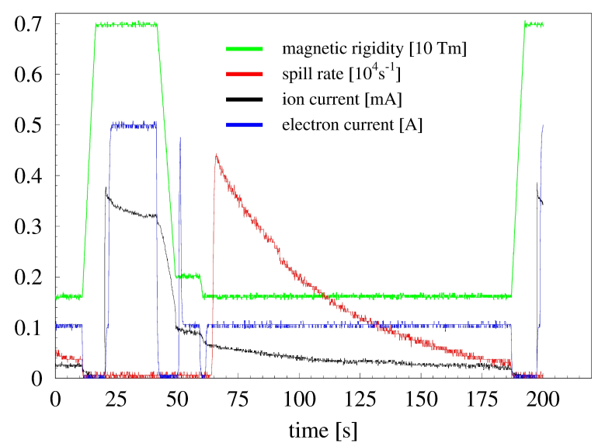
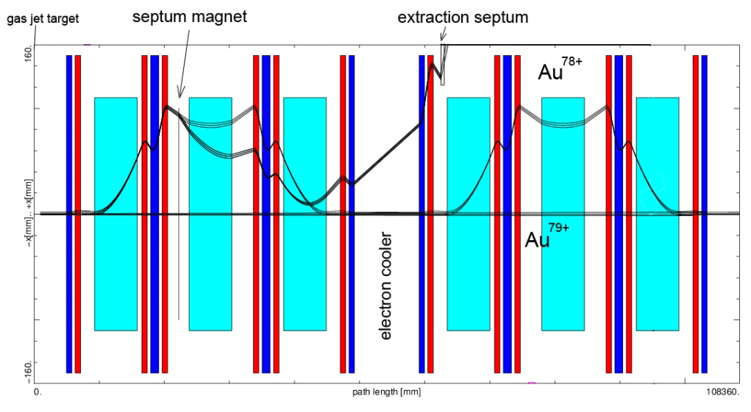
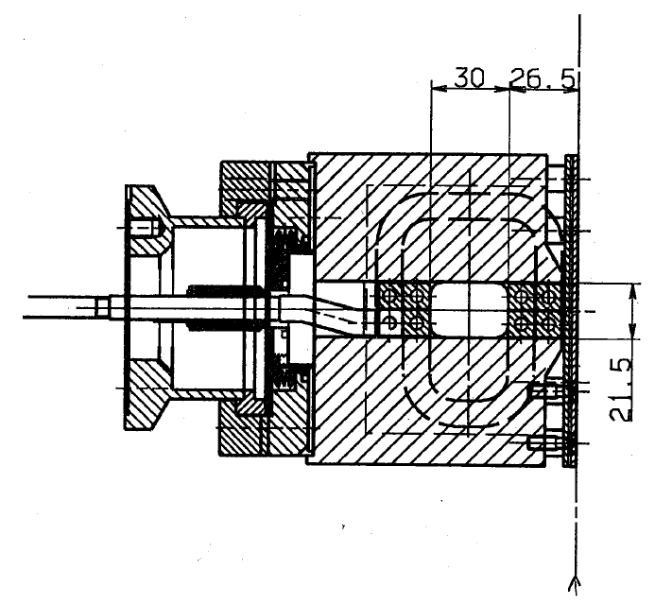
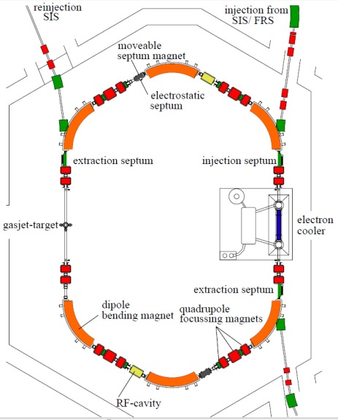
Slow Extraction by Charge Change
two charge states (Au⁷⁹, Au⁷⁸⁺) can simultaneously circulate
extracted dc beam
Au⁷⁸⁺ at 20 MeV/u
septum magnet
installed in UHV
diagnostics in the beamline
extracted cooled beam
after deceleration (to ≥ 10 MeV/u)
small emittance
good control of extraction rate
extraction time minutes to hours

Slide 23
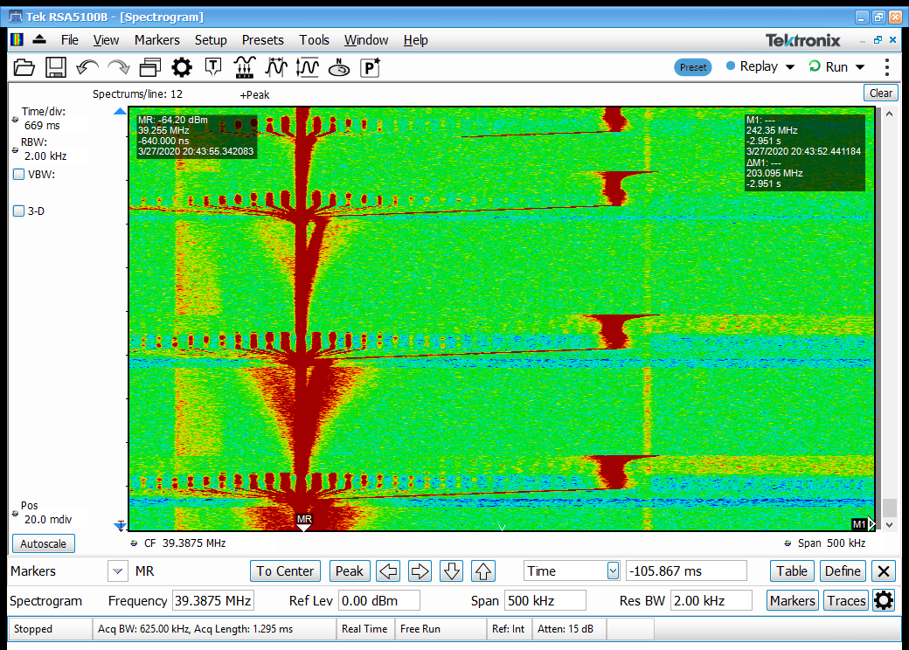
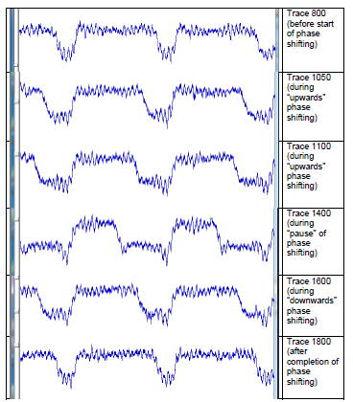
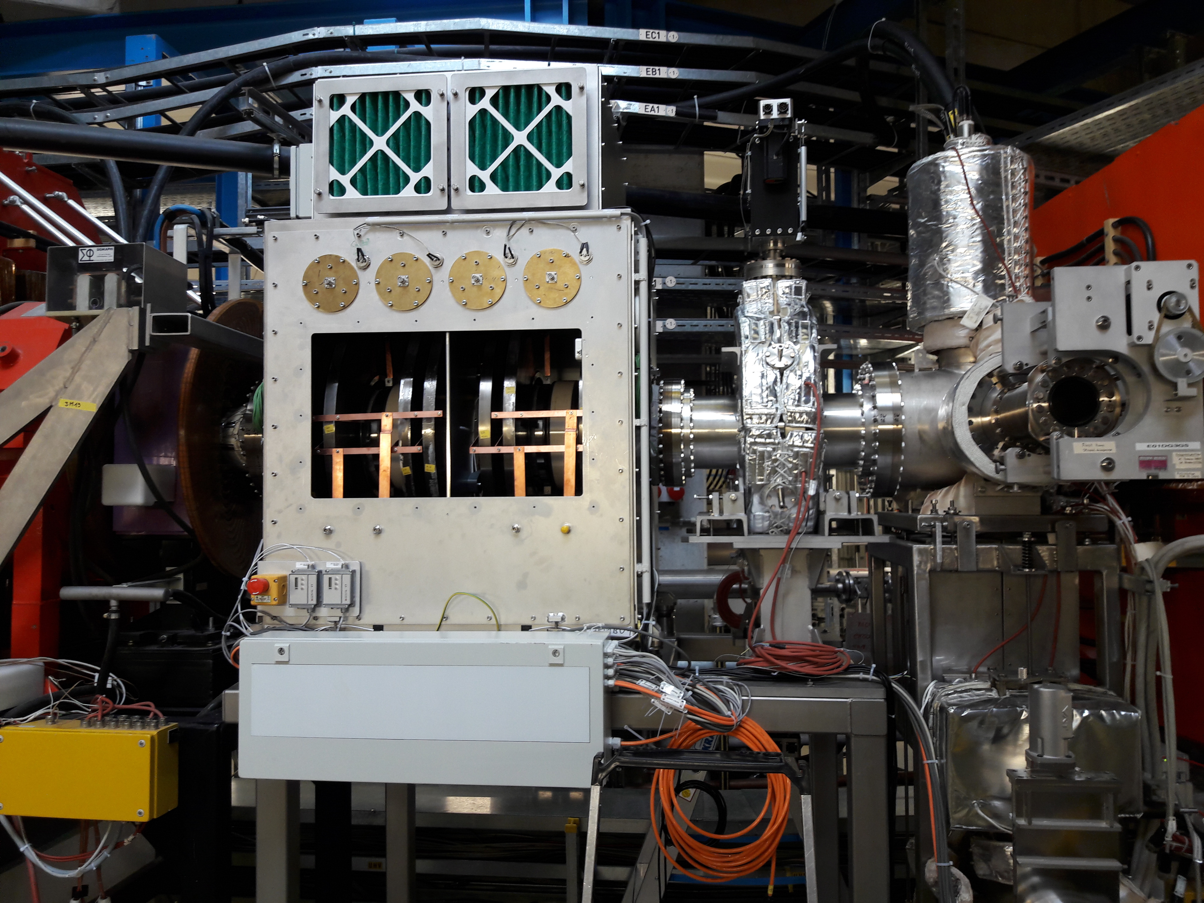
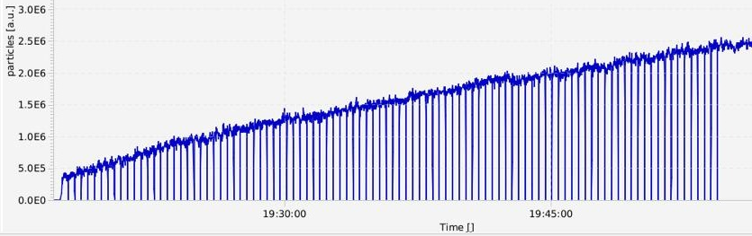
Additional Options
cooling allows accumulation of higher beam intensity
important for low intensity primary beams and secondary (rare isotope) beams
various methods are available, all based on cooling
rf stacking (stochastic/electron cooling on
injection orbit, electron cooling on stack orbit)
barrier bucket stacking
bunch compression
and decompression
injection
orbit
gap for
injection
stack
orbit
≈100 injections over 40 minutes
new barrier bucket cavity
also suitable for flexible creation of bunches at very low energy

Slide 24
Outlook
All manipulations of the ESR operation have to be re-commissioned with the
new FAIR control system which is based on LSA (LHC software architecture).
It offers much larger flexibility in tuning machine parameters.
Optimization of the deceleration cycle of the ESR mainly means optimization
of the parameters of the cooling systems (reduction of cooling time),
in addition: faster ramping is supported by the hardware.
Various advanced diagnostics hardware and tools have to be integrated into
operation and machine optimization, incl. automated procedures.
Vacuum is an issue which requires further investigations.

