Slide 1

Advances in Collimation at GSI
ARIES-APEC workshop "Mitigation Approaches for
Hadron Storage Rings and Synchrotrons"
Lars Bozyk

Slide 2
Content
Introduction and Motivation
  How to generate high intensity heavy ion beams?
  Ionization loss and dynamic vacuum as an intensity limitation
Dynamic Vacuum
  Measurement of dynamic vacuum effects
  Simulation of dynamic vacuum
Activities around charge exchange collimation
  Systematic measurements of collimator materials
  Collimation in SIS100
  Measurement of cryogenic pumping speed

Slide 3
Introduction and Motivation
Reaching higher intensities requires a lower charge state:
  Reduction of space charge
  Reduction of stripping losses
New challenges appear:
  Losses due to charge exchange with residual gas
  Dynamic vacuum by ion induced gas desorption
  Self amplification of losses limiting the intensity
Counter measures:
  UHV to XHV conditions, very low static residual pressure
  Careful lattice design remove losses controlled
  Low desorbing surfaces at defined loss positions
  High pumping speed to quickly remove released gases
→ U²⁸⁺ is used

Slide 4
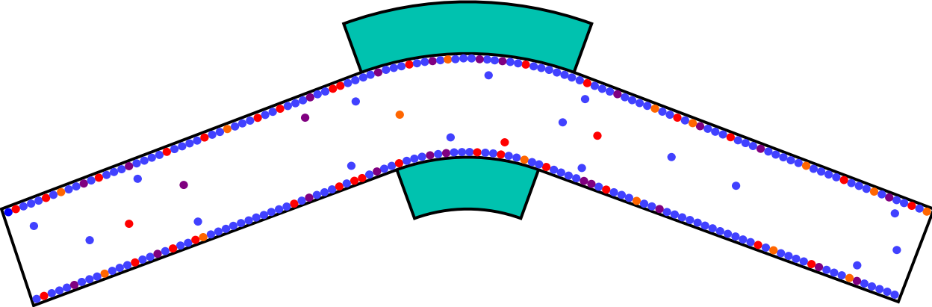
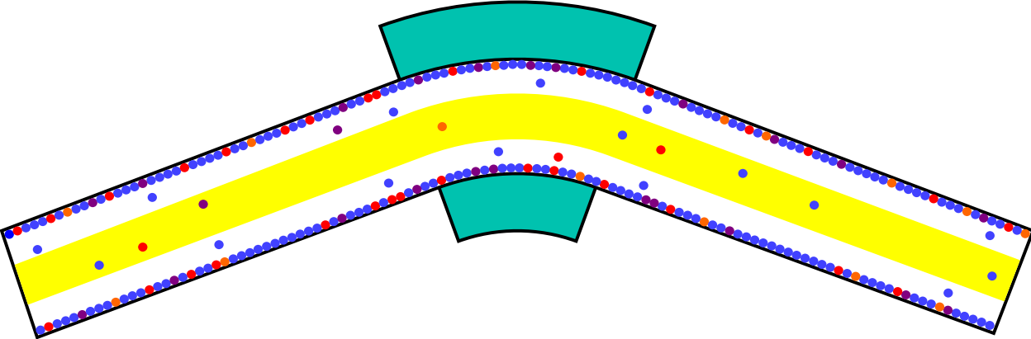
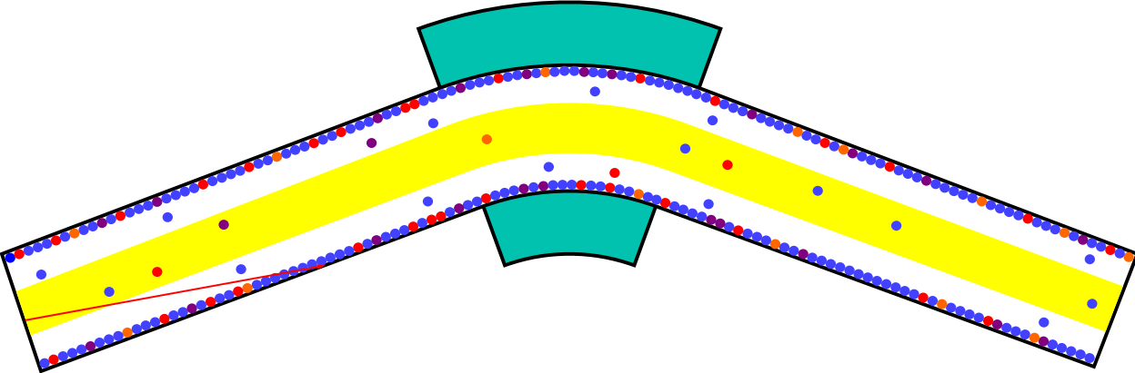
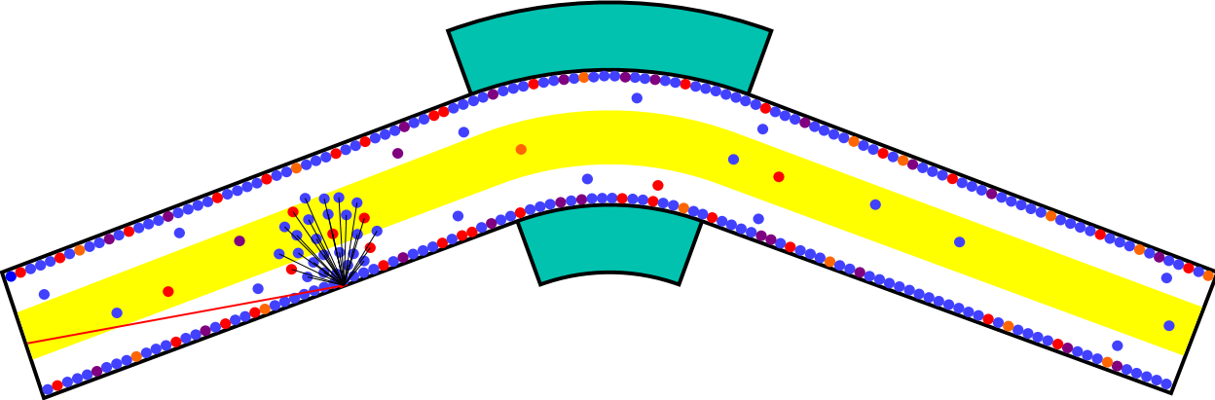
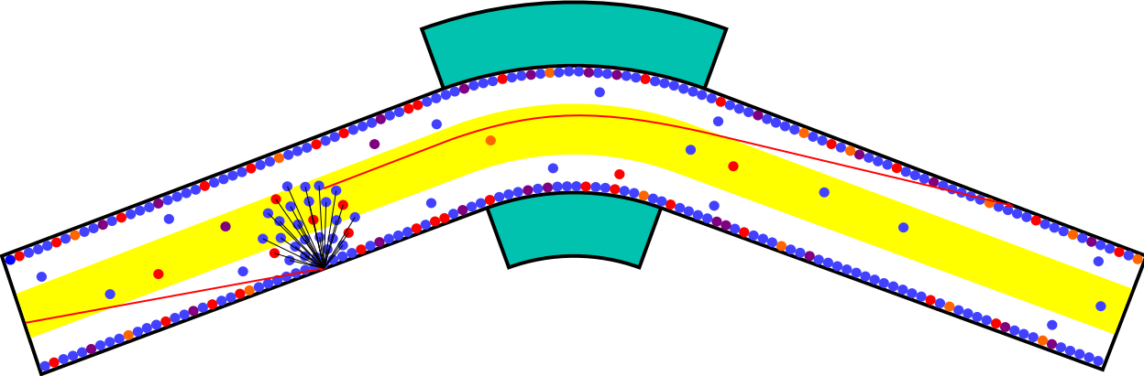
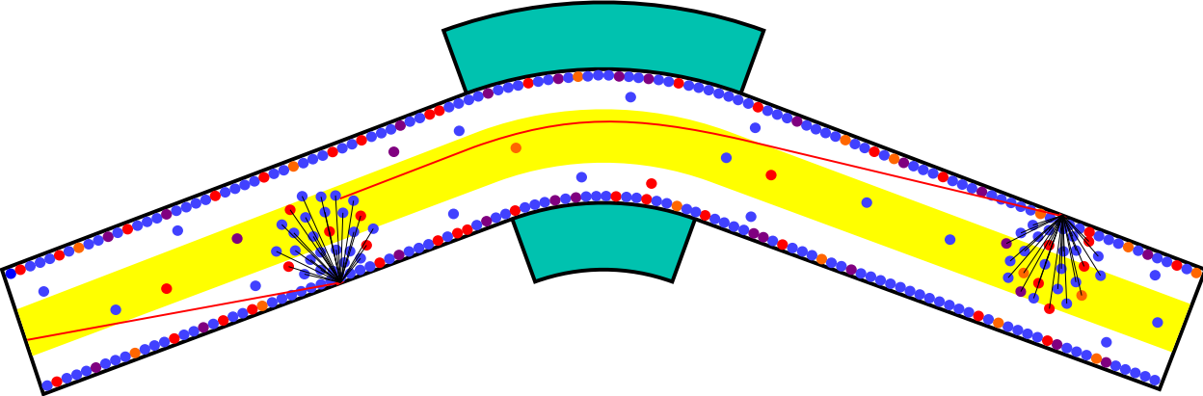
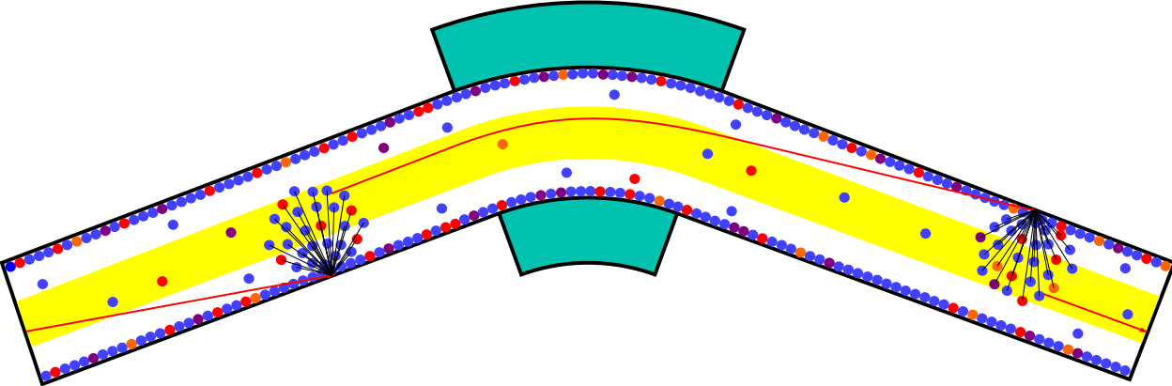
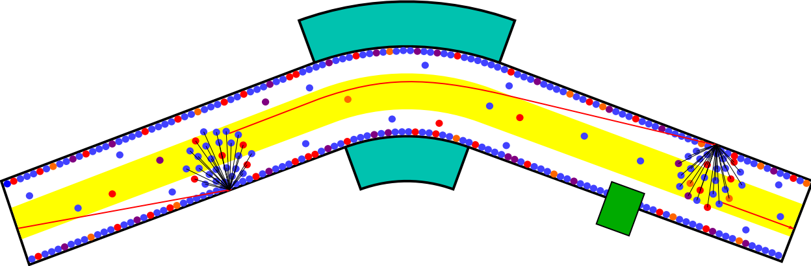
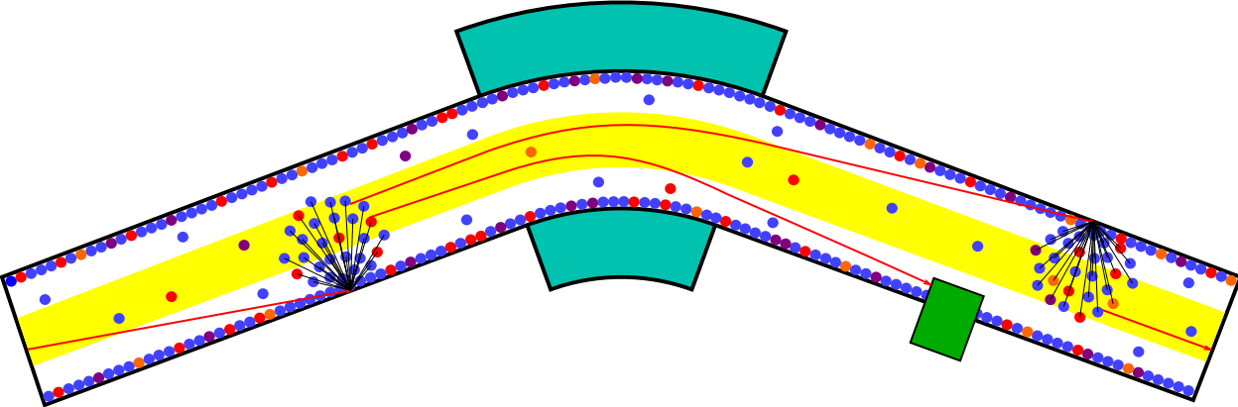

Dynamic Vacuum
electron capture
adsorbed
residual gas
dipole
desorption
electron loss
desorption
beam loss
further
charge exchange
collimator / ion catcher

Slide 5


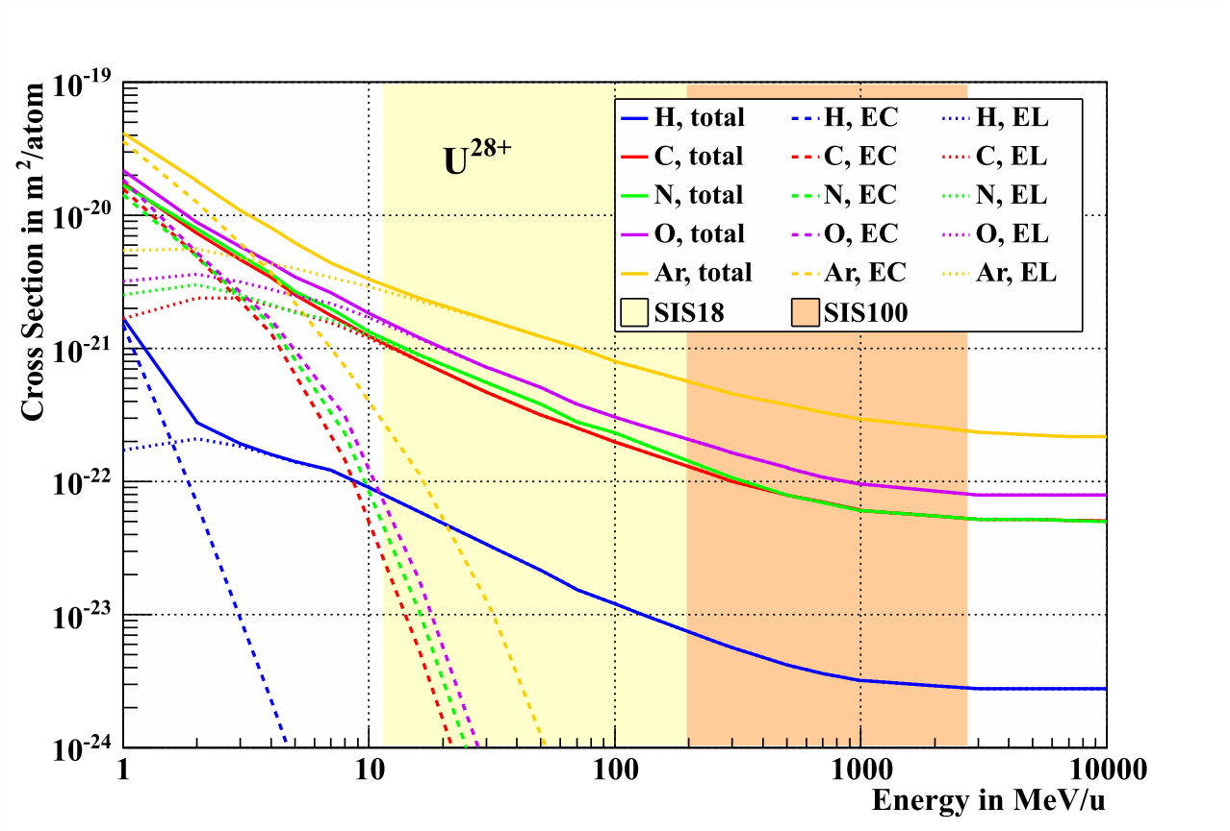
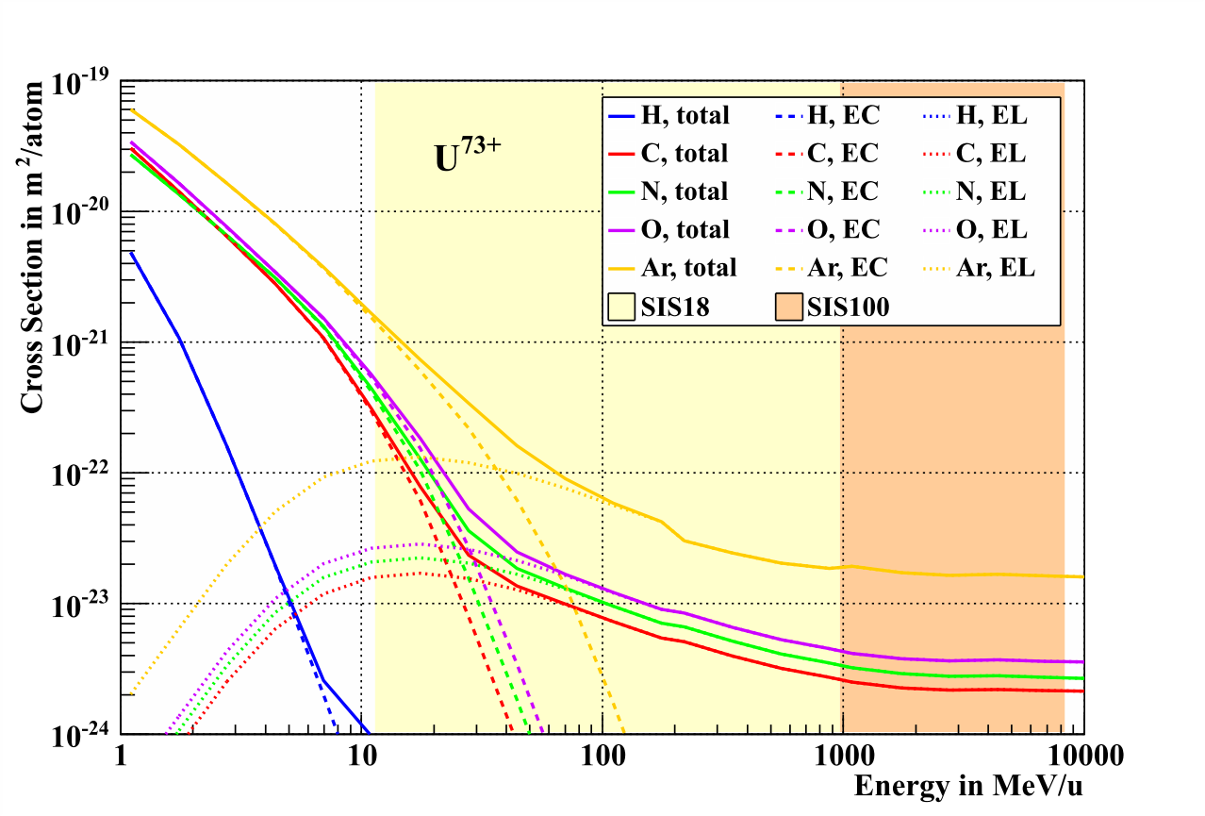
Ionization Cross Sections
Calculated cross sections for single atoms
Cross sections for residual gas molecules are calculated by Bragg‘s additivity rule, e.g.
Assumption on residual gas composition required to calculate total effective cross section

Slide 6
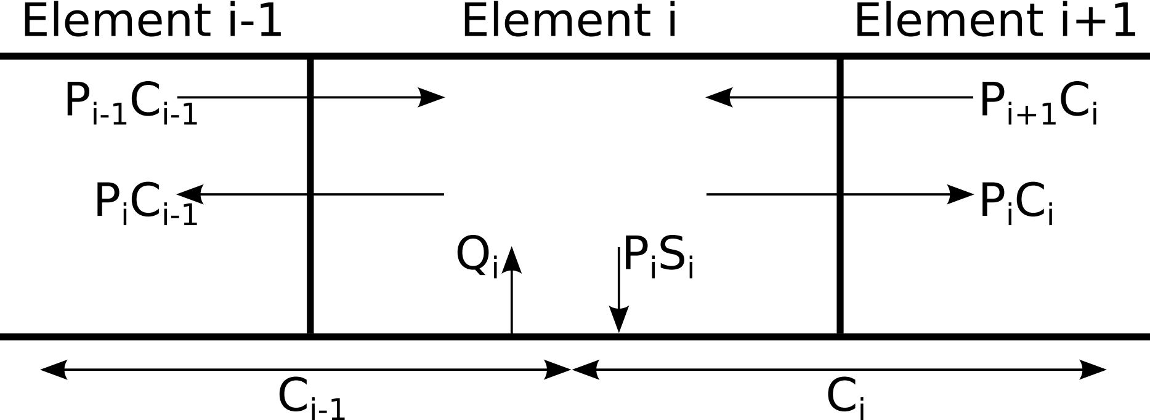
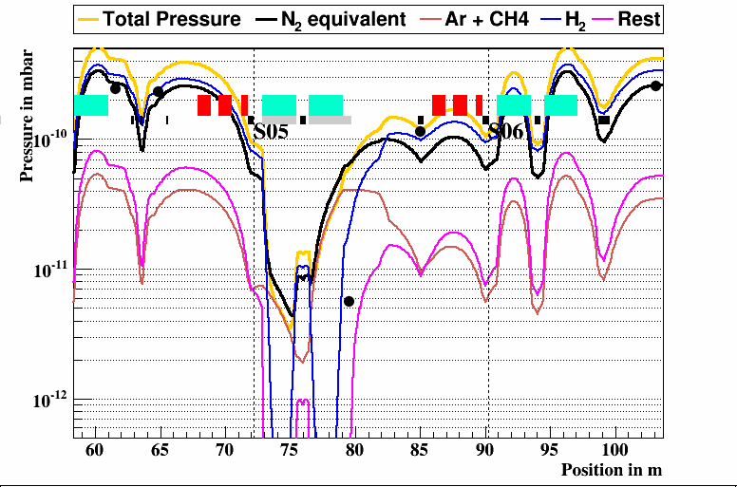
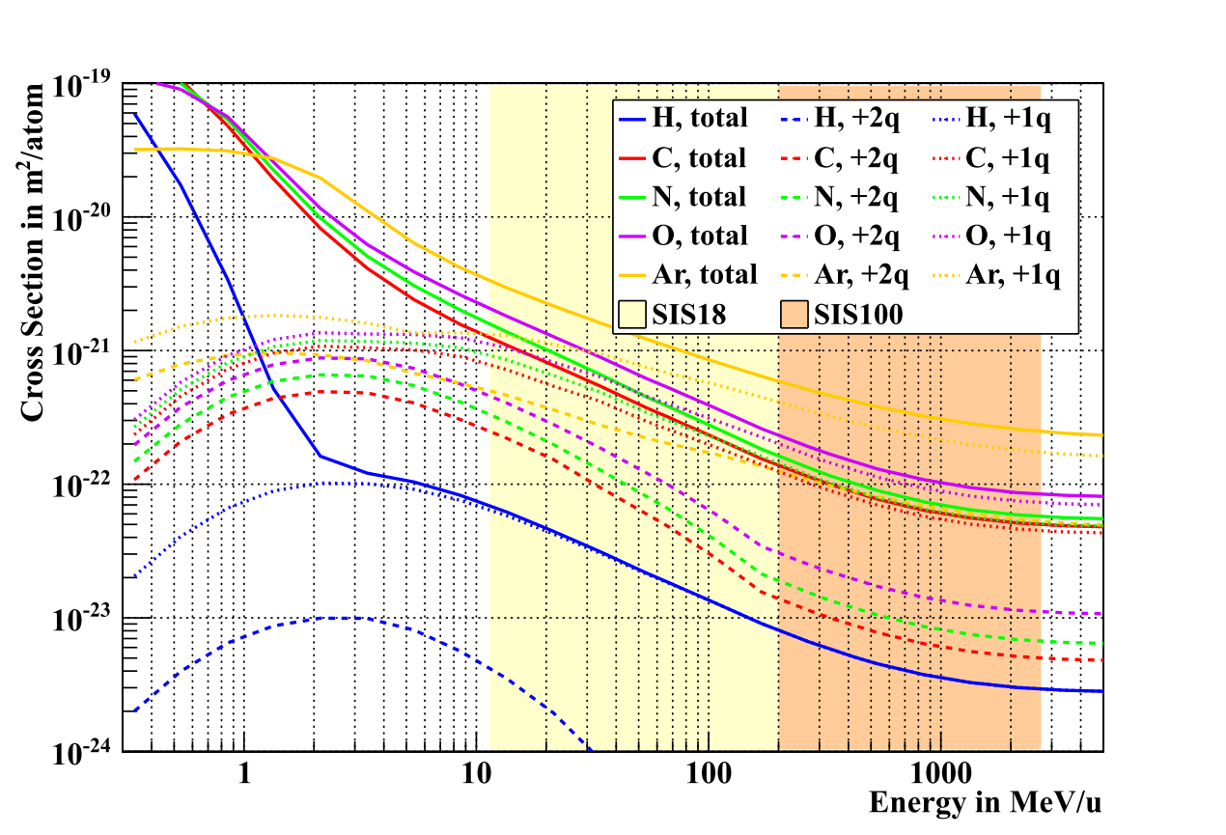
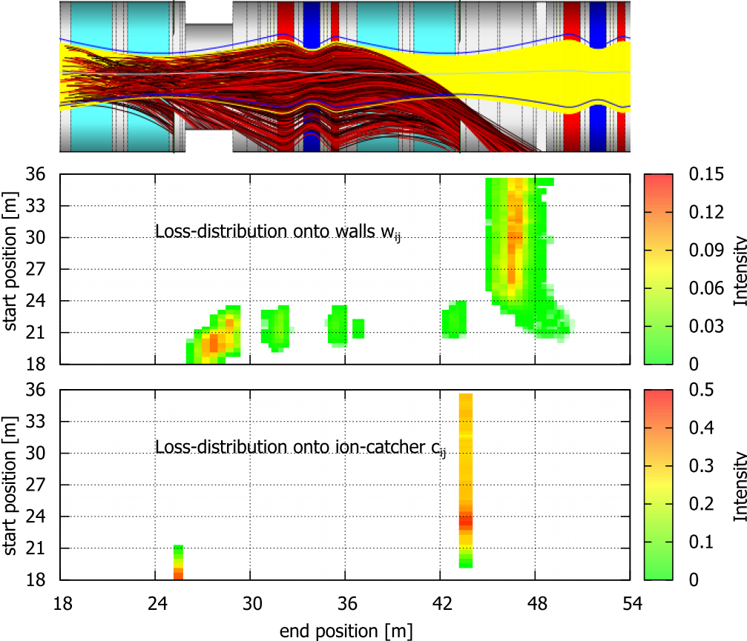
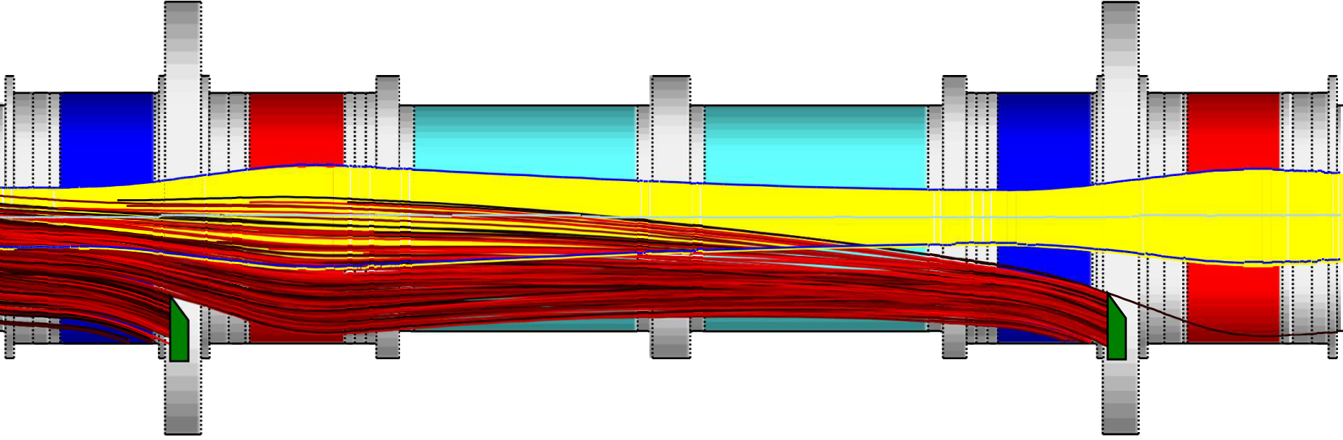
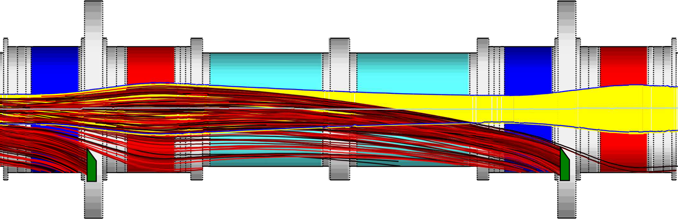
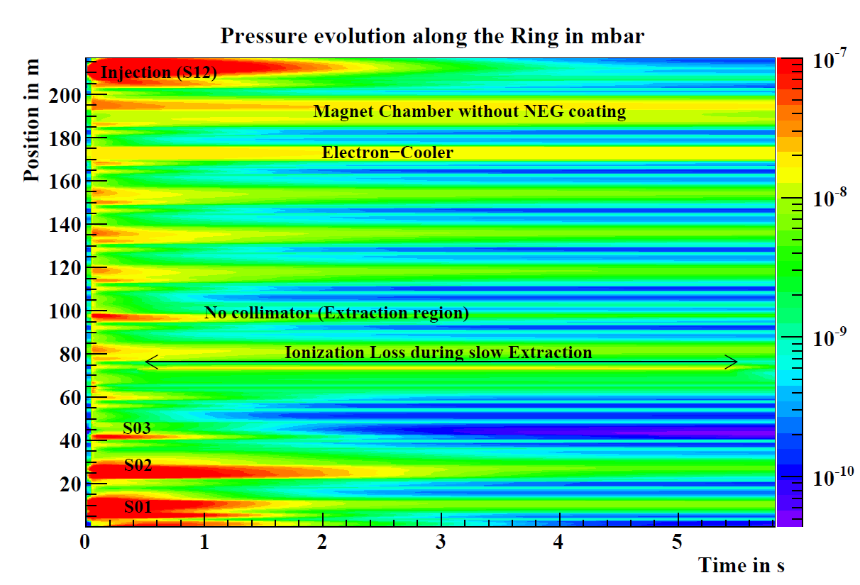
Simulation of Dynamic Vacuum
StrahlSim has been developed in the past decade at GSI:
Simulation of a self-consistent pressure profile along the ring for each residual gas component individually
Number of charge exchanged ions is
calculated for each time step individually, according to energy dependent cross sections for different ionization channels
Loss distribution for each ionization channel is calculated via linear ion optics, ionized ions are distributed according to this mapping
U²⁸⁺ → U²⁹⁺
U²⁸⁺ → U³⁰⁺
Simulation of ion induced desorption: Outgassing at the impact cells is increased, depending on the presence of ion catcher
Number of ions and number of pumped gas particles is counted (saturation calculations)
Pressure profile is re-calculated for the next time step → pressure profile evolution

Slide 7
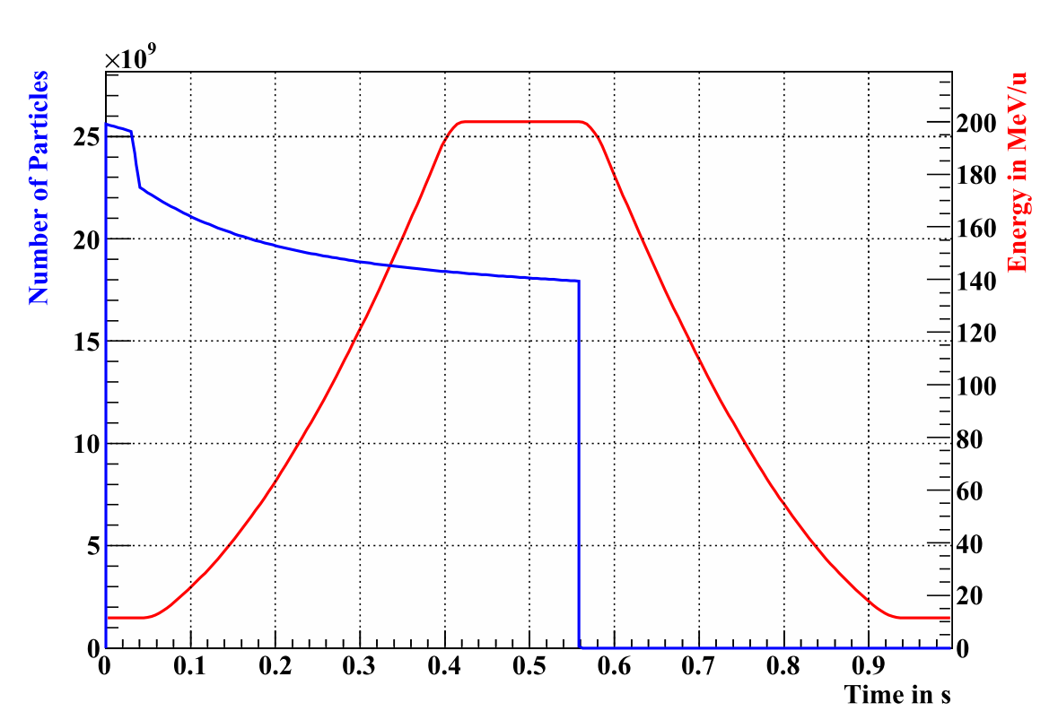
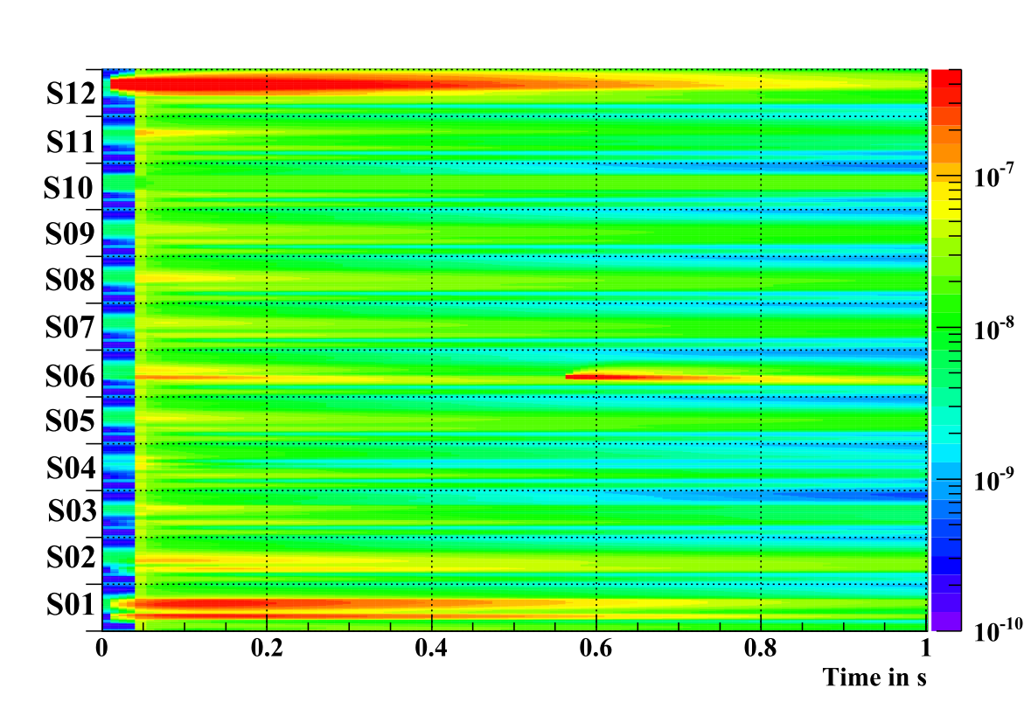
Simulation of Dynamic Vacuum
Injection-Losses
Longitudinal Position
no Ion-Catcher
Extraction-Losses
Pressure in mbar
rf-Capture-Losses (distributed)

Slide 8
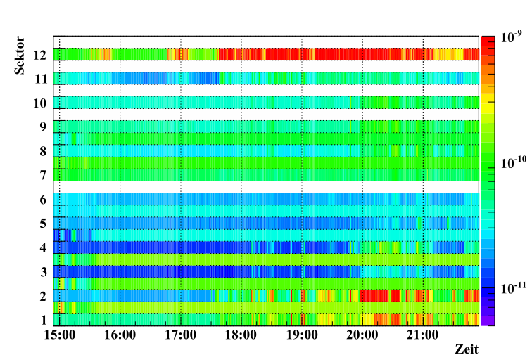
Measurement of Dynamic Vacuum
Residual gas pressure in mbar, 2010-07-31, U³⁹⁺

Slide 9
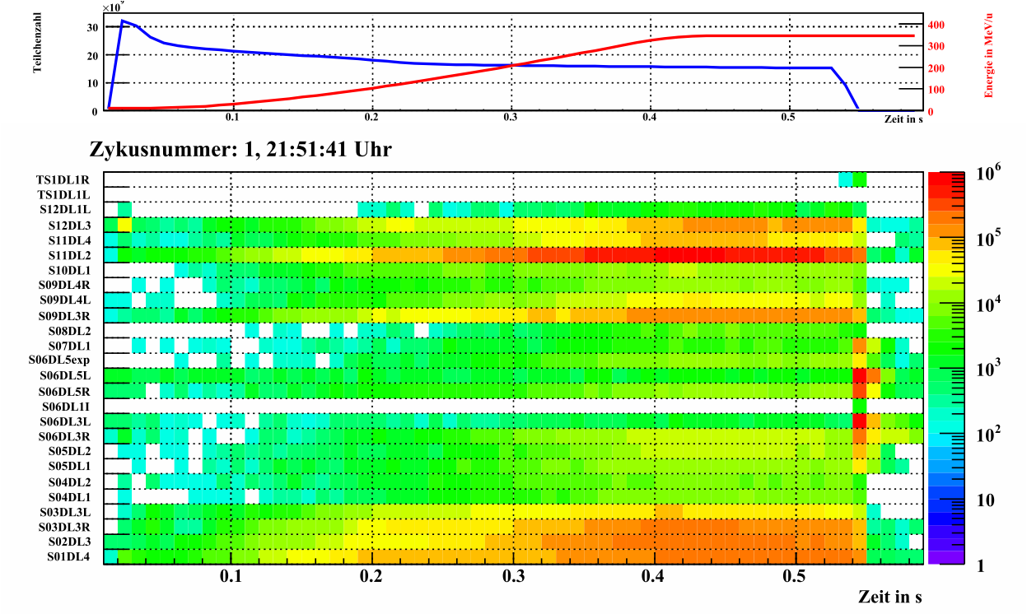
More Measurements of Dynamic Vacuum Effects
Beam Loss Monitors, 2010-07-31, U³⁹⁺

Slide 10
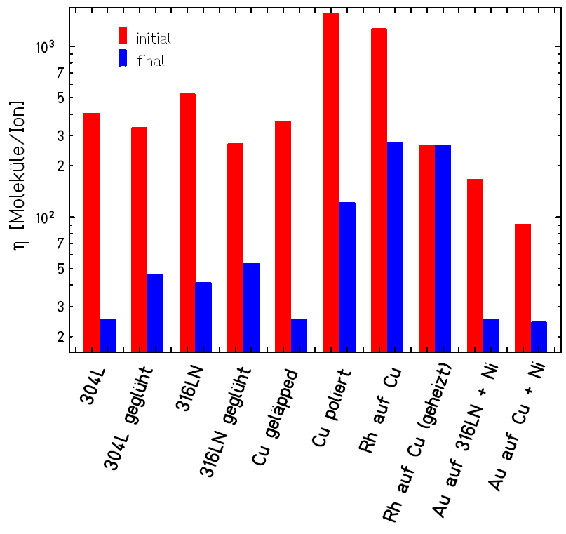
Collimator Material
Most important: perpendicular incidence! for grazing incidence η ≈ 25.000
Different materials and combinations have been investigated in the past
Material of choice for collimators is copper
Coated with gold to prevent the
surface from oxidation
Gold and Copper diffuse into
each other
Hence, a diffusion barrier our of Chromium, Nickel or Silver is applied
Three coating methods available: thermal evaporation, sputter coating and electro deposition. Systematic desorption measurements ongoing in material science department
M.Bender, Dissertation, 2008

Slide 11
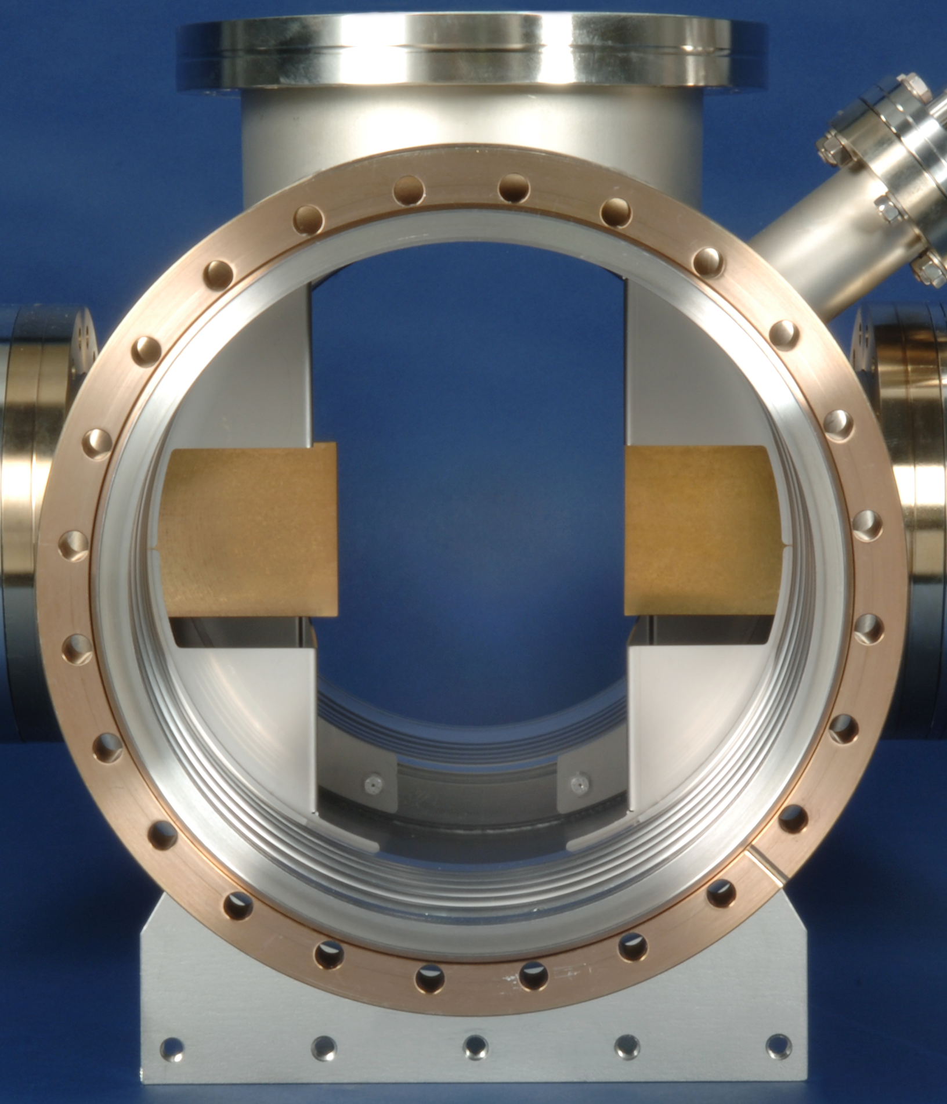
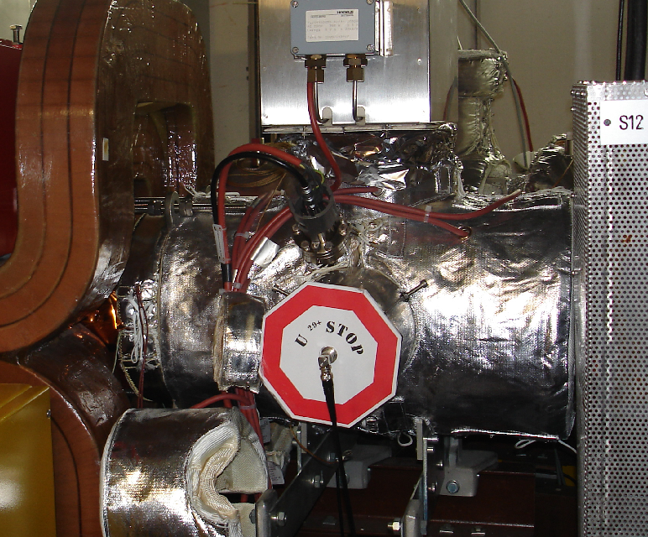
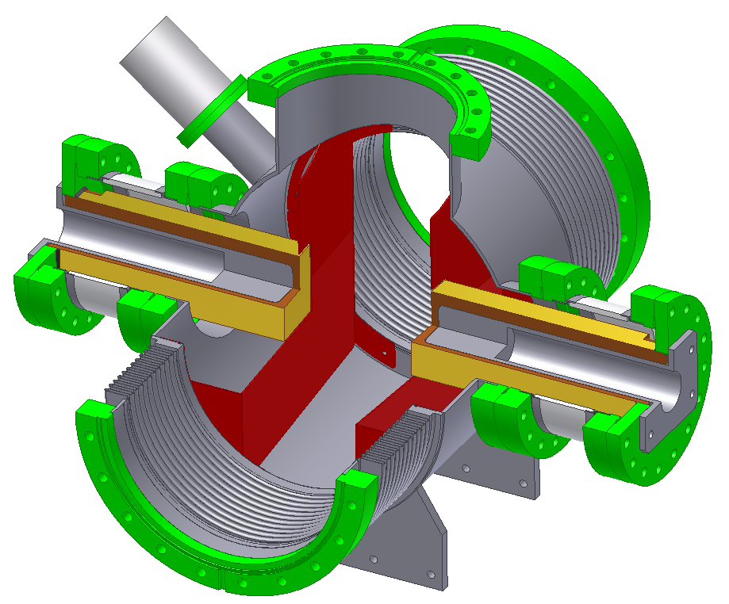
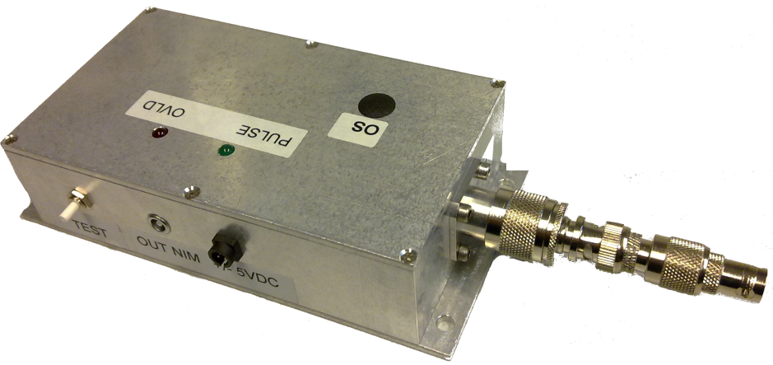
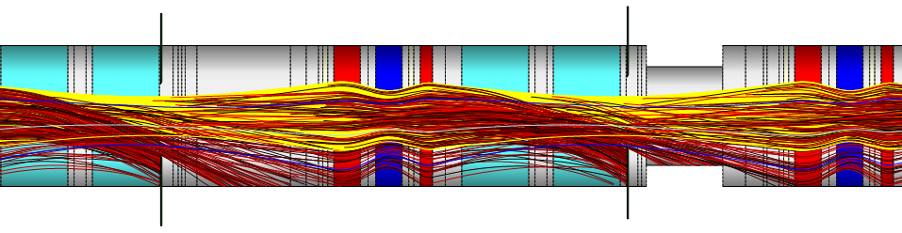
Ion Catcher in SIS18
G.Otto, 2009
U²⁸⁺ → U²⁹⁺
65% Catching efficiency

Slide 12
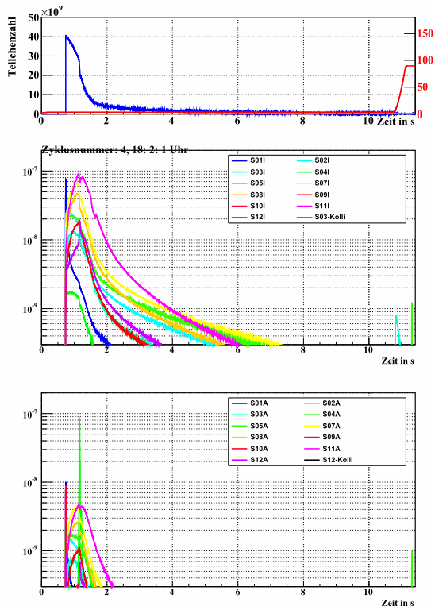
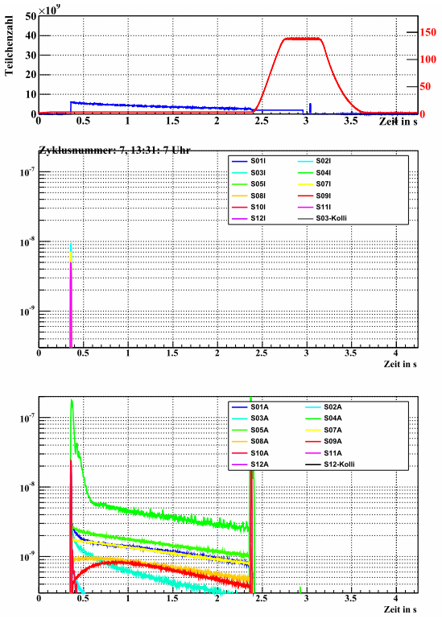
Ion Catcher Currents
U²⁸⁺
U⁶³⁺

Slide 13
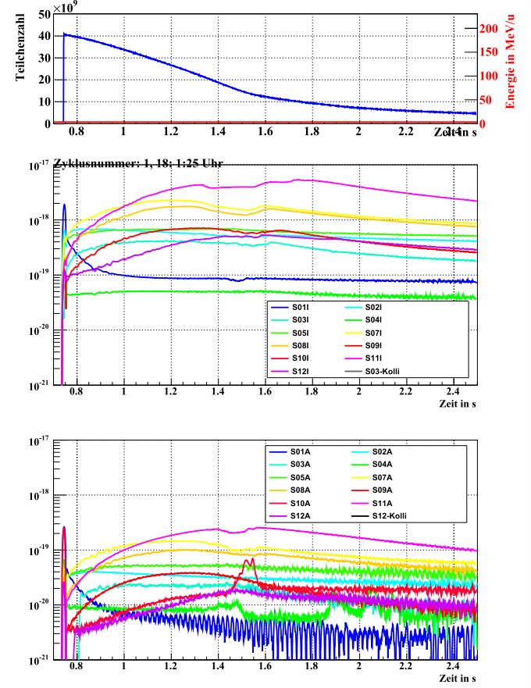
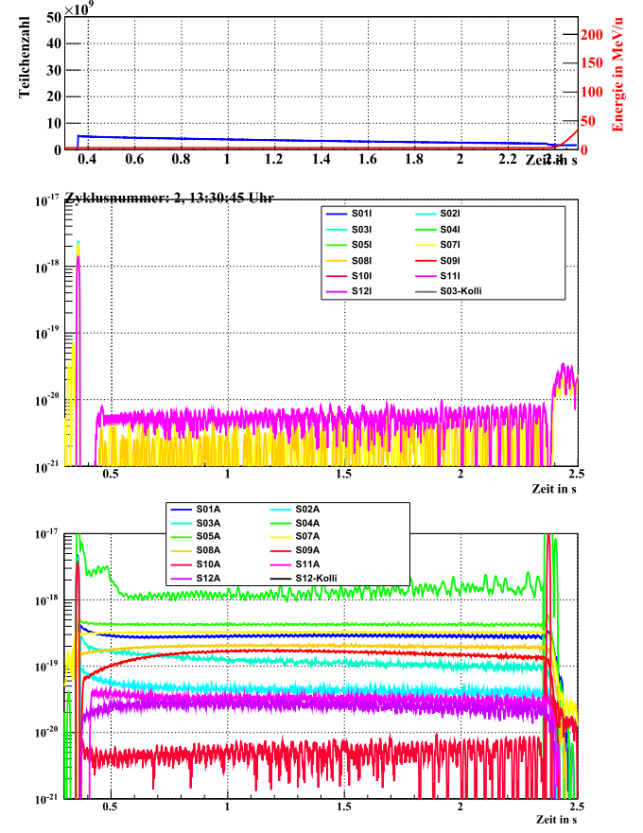
Normalized Ion Catcher Currents
U²⁸⁺
U⁶³⁺
Inner side
Electron Loss
Outer side
Electron Capture

Slide 14
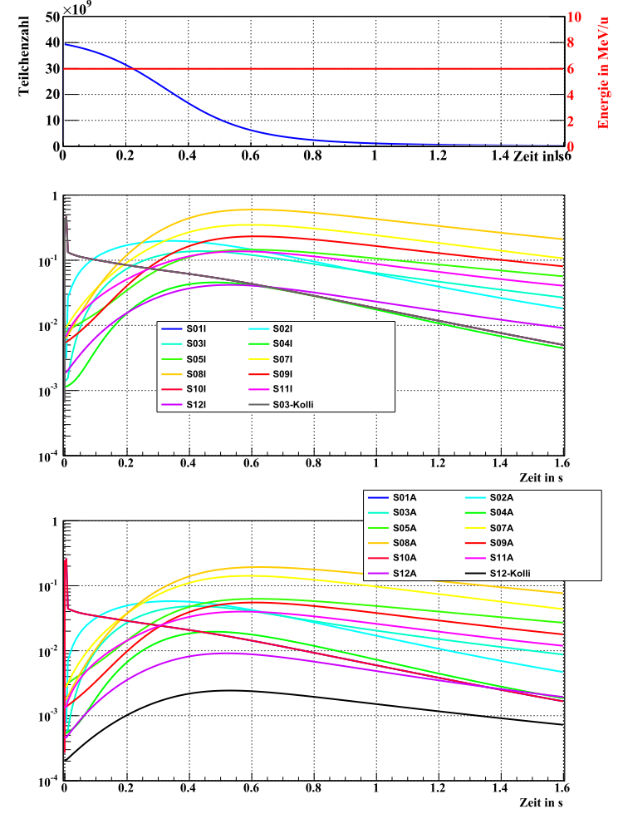
Normalized Ion Catcher Currents U²⁸⁺
Measurement
Simulation

Slide 15
Static Lifetime in SIS18

Slide 16
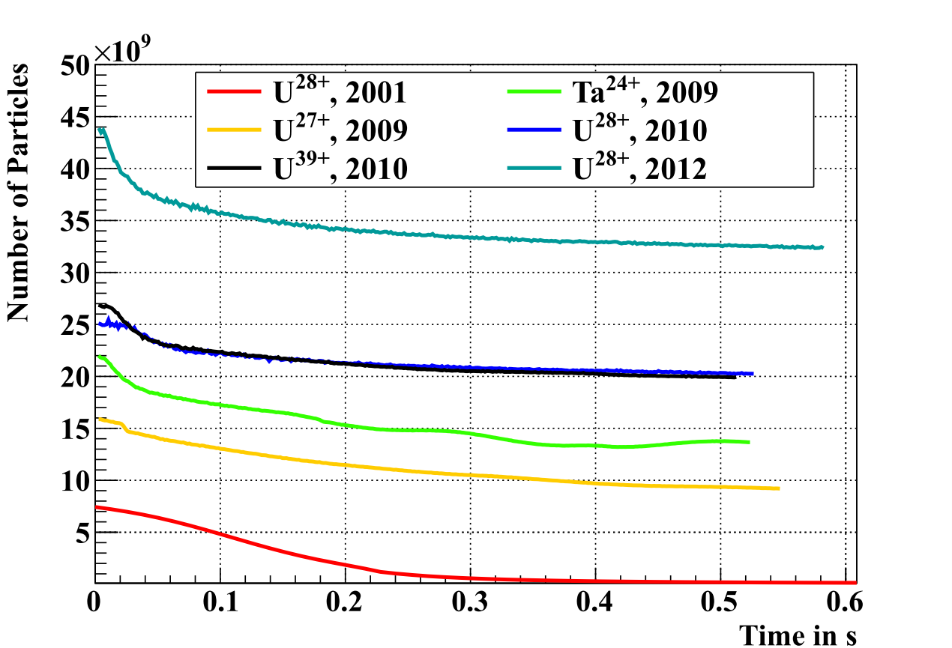
SIS18 - Intensities
world record
NEG-Panels
in injection septum
ion-catcher and
NEG coating
of magnet chambers

Slide 17
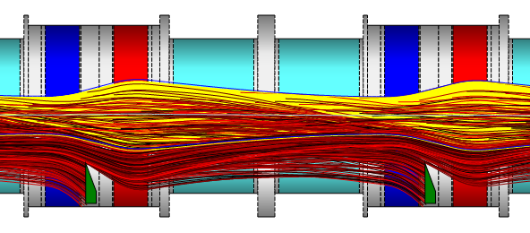
SIS100 Lattice
SIS100 lattice has
been optimized to
reach a maximum
catching efficiency
U²⁸⁺ → U²⁹⁺
Loss distribution is strongly localized between the quadrupoles where the ion catcher will be installed

Slide 18
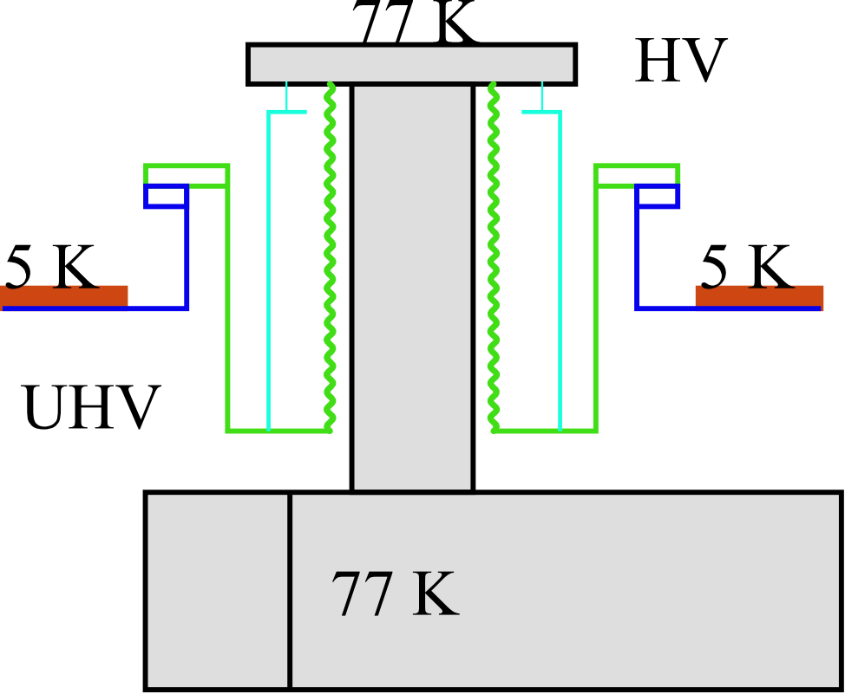
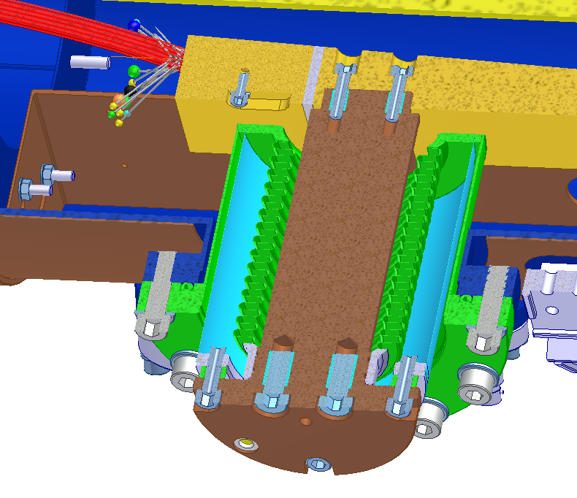
Cryocatcher in SIS100
Keep cryocatcher at higher temperature (e.g. 77 K)
Direct deposited energy from lost ions into thermal shield cooling (cheaper) instead of magnet cooling
Keep load onto LHe low
Fit into cryostat
Heat from
lost ions

Slide 19
SIS100 Cryocatcher
▪ Controlled catching of ionized ions on surfaces with low desorption yield (gold) → most ionized ions are caught by the ion catcher
▪ Surrounding cold chamber acts as cryopump quickly removing desorbed gases
▪ Cryocatcher block will be kept at a higher temperature to prevent gases from cryosorbing on the surface of incidence
▪ Significant reduction of gas desorption → dynamic vacuum effects are suppressed effectively
▪ Activation and radiation damage of magnets by beam losses are reduced

Slide 20
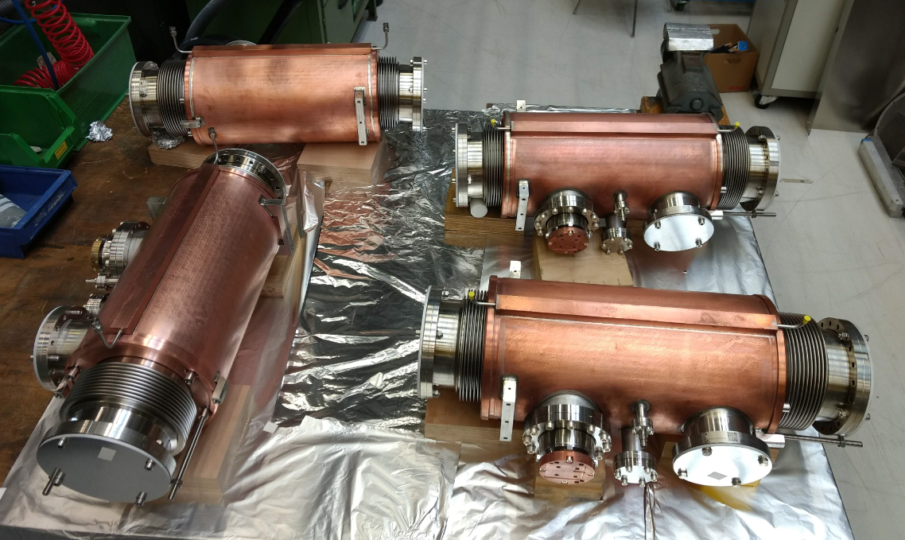
SIS100 Cryocatchers: Series production ongoing
60 Cryocatchers will be installed in SIS100

Slide 21
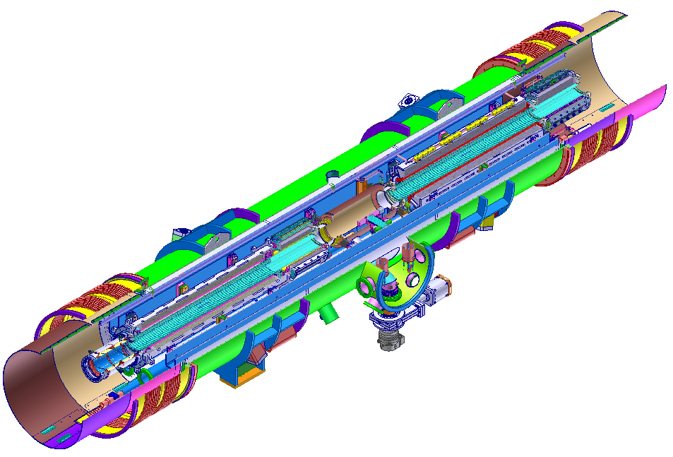
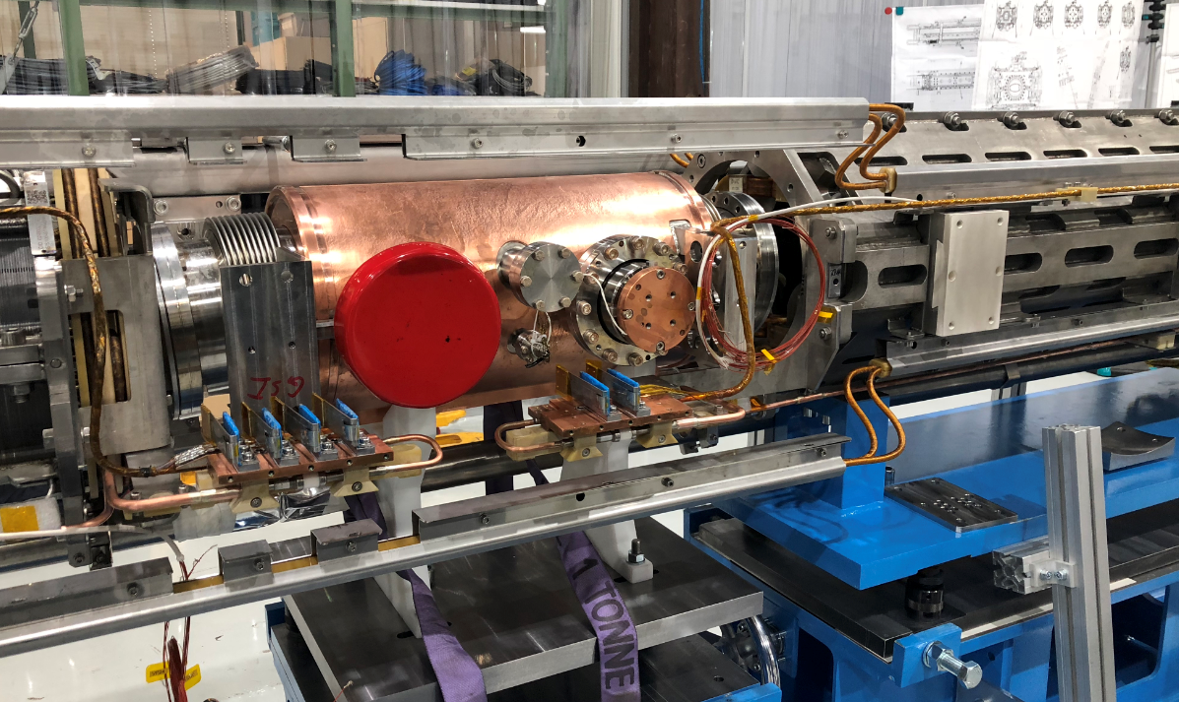
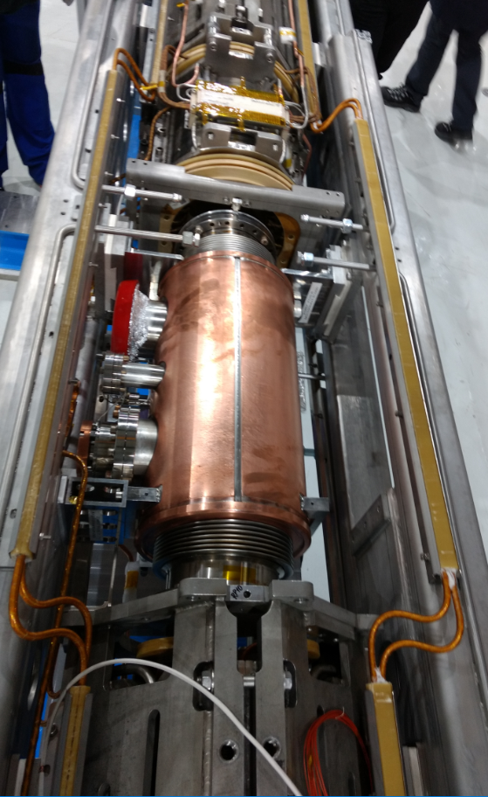
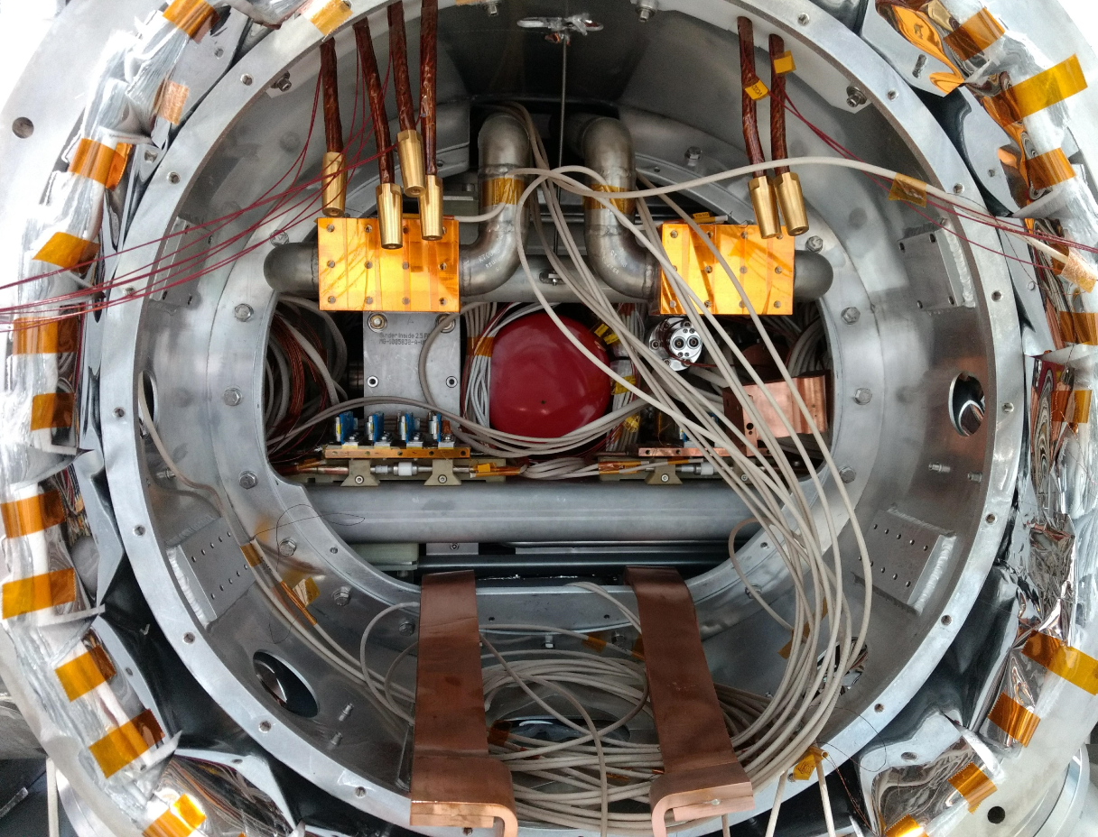
SIS100 Cryocatcher in Quadrupole Module

Slide 22
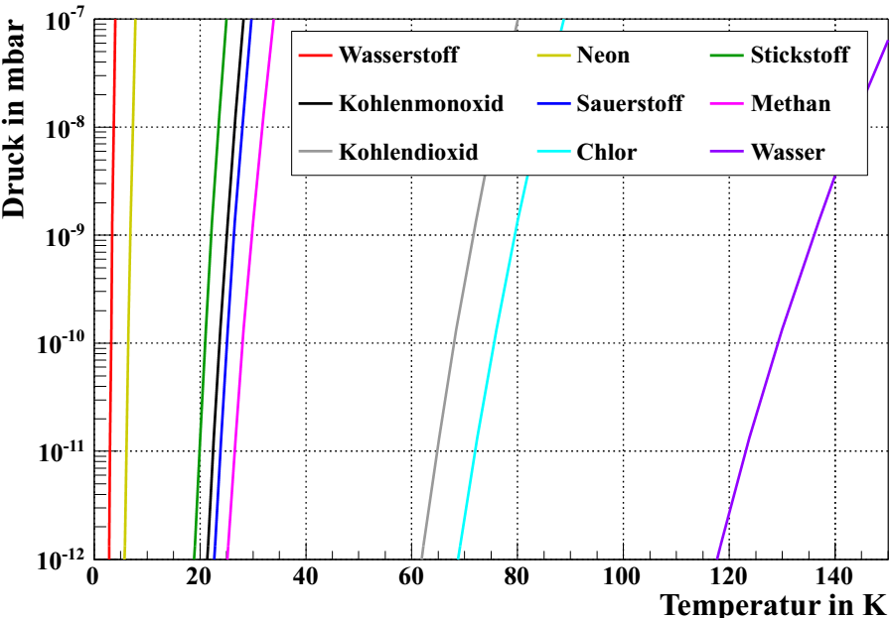
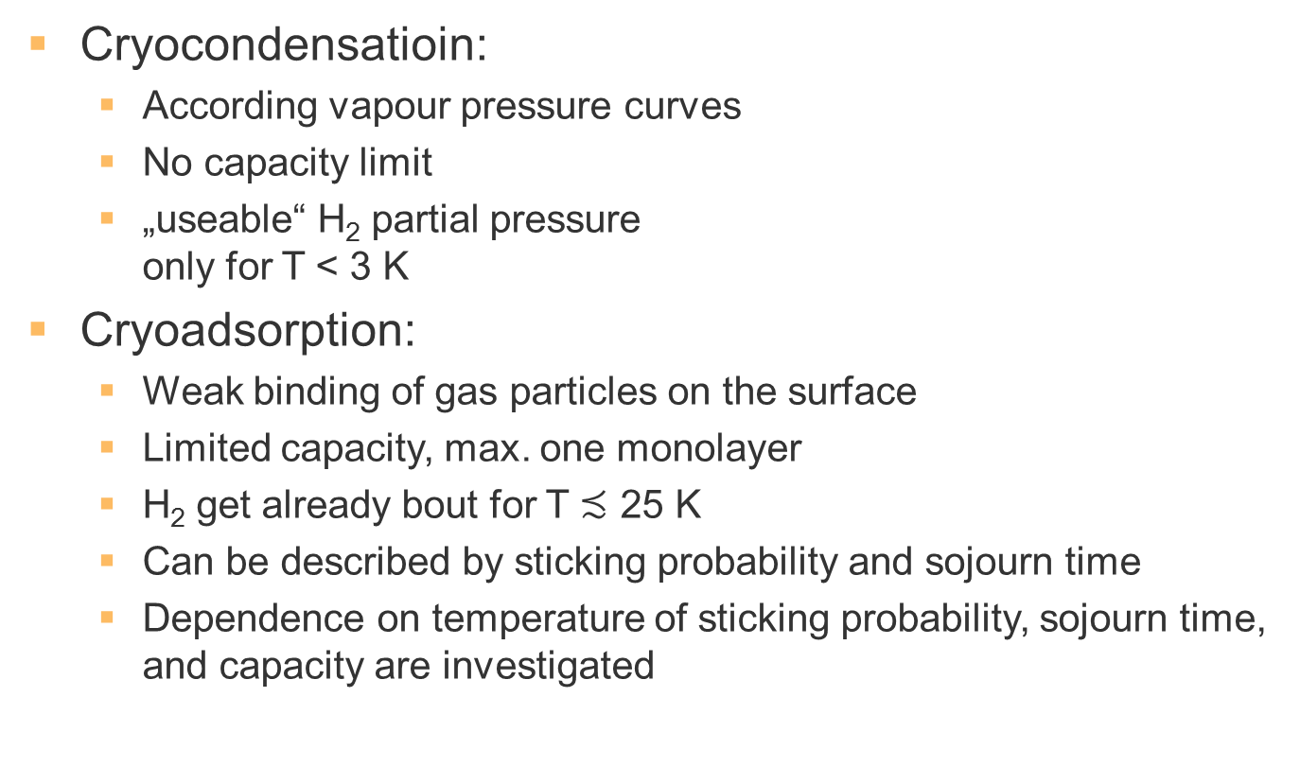
Pumping Properties of Cryogenic Surfaces
Cryocondensatioin:
  According vapour pressure curves
  No capacity limit
  „useable“ H₂ partial pressure
  only for T < 3 K
Cryoadsorption:
  Weak binding of gas particles on the surface
  Limited capacity, max. one monolayer
  H₂ get already bout for T $≾$ 25 K
  Can be described by sticking probability and sojourn time
  Dependence on temperature of sticking probability, sojourn time, and capacity are investigated

Slide 23
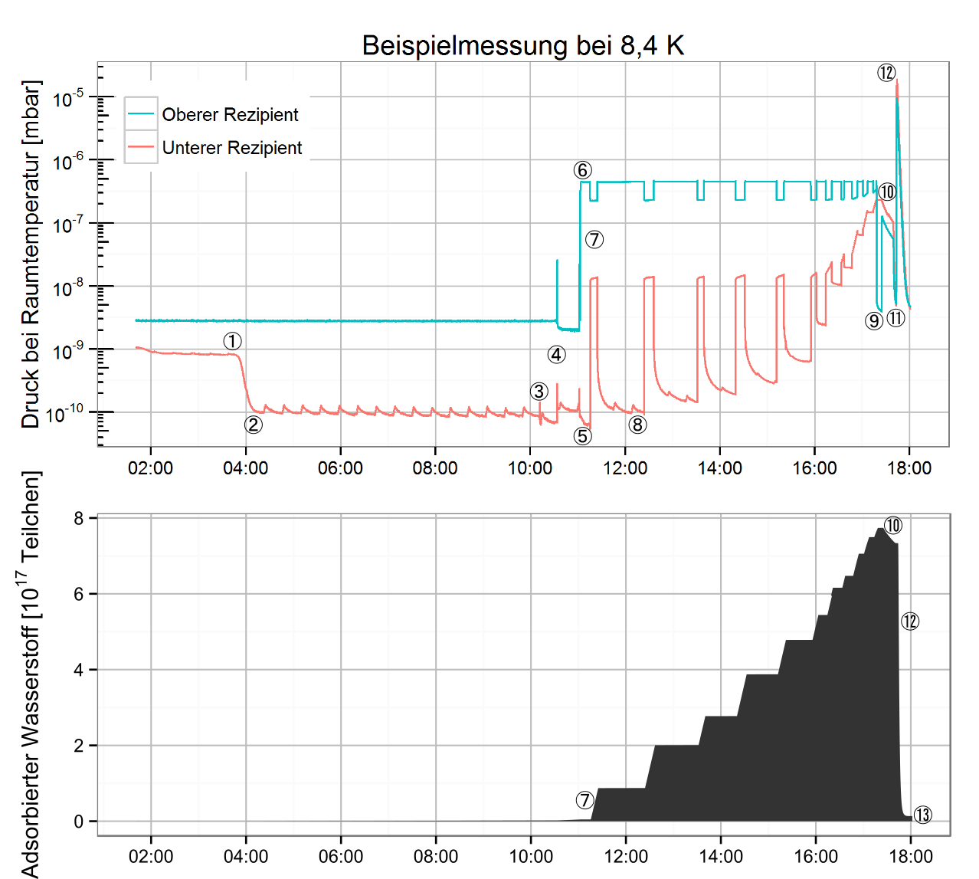
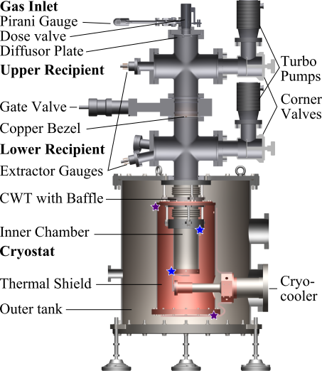
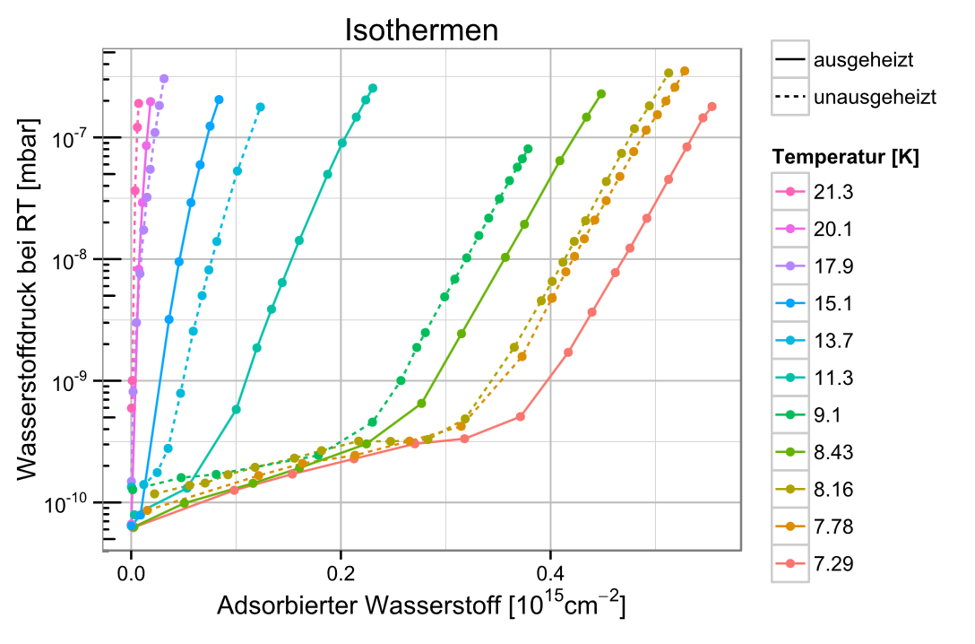
Test Setup Cryopumping
F.Chill

Slide 24
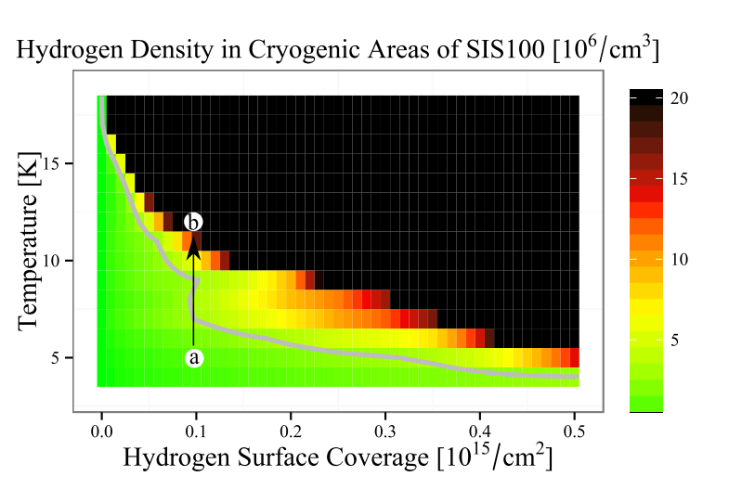
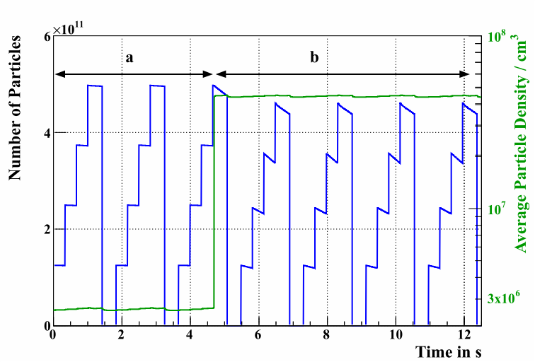
Implementation in StrahlSim
Adsorption isotherms are included in StrahlSim
Residual gas density is calculated, dependent on temperature and surface coverage
Temperature increase can lead to gas release and subsequent increased loss rate

Slide 25
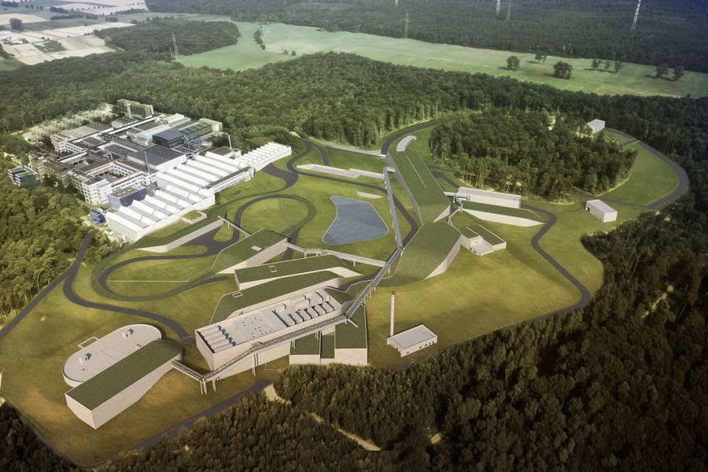
Summary
GSI/FAIR is aiming for highest heavy ion intensities
Dynamic vacuum limits the maximum
achievable intensity
Ion catcher can shift this limit to higher intensities
SIS18 is equipped with an
ion-catcher system, the maximum
beam intensity could be improved
SIS100 was designed around
an ion-catcher system
60 cryocatcher will stabilize the
dynamic vacuum during operation
Thank you.

