Slide 1

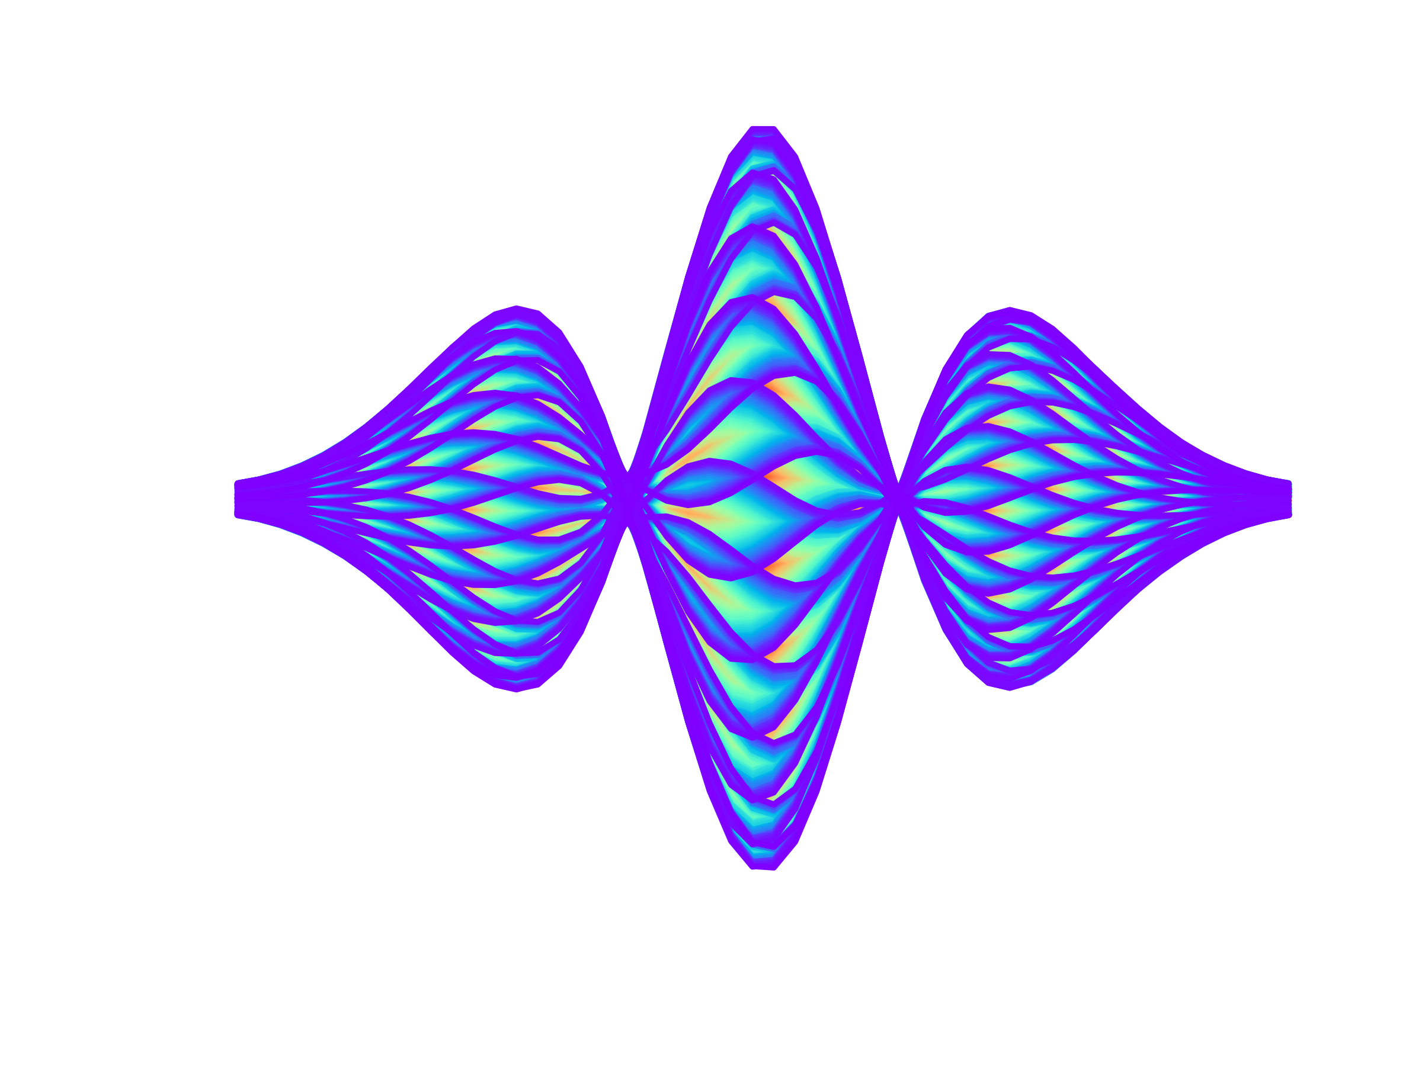


Mitigation of TMCI through Space Charge?
(SC)
E. Métral (many thanks to all the HSC team and for ongoing discussions with
Y. Alexahin, M. Blaskiewicz, X. Buffat, A. Burov, C. Hogh, G. Iadarola and A. Oeftiger)

Slide 2
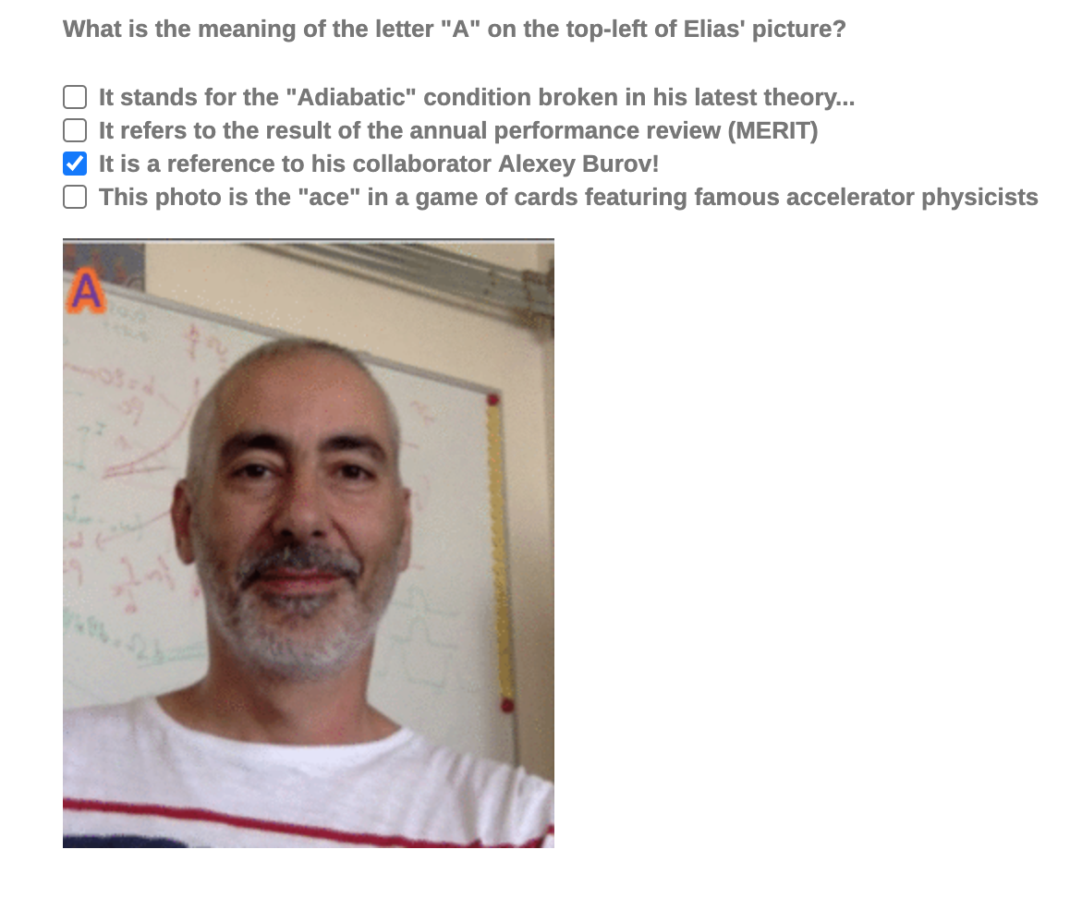
Mitigation of TMCI through Space Charge?
(SC)
E. Métral (many thanks to all the HSC team and for ongoing discussions with
Y. Alexahin, M. Blaskiewicz, X. Buffat, A. Burov, C. Hogh, G. Iadarola and A. Oeftiger)
Many thanks to my dear
friend AlexeyB indeed (for all the very interesting discussions on
this subject and others for many years)! ;-)

Slide 3
Contents
Introduction (and why this question)
Coherent SC modes from GALACTIC Vlasov solver
  vs. ABS (Air-Bag Square-well) model
  vs. BimBim code (using the Circulant Matrix Model)
What can we deduce from the observation of the intra-bunch motion in the CERN SPS (without math)?
Can this be consistent with some previous instability studies?
Conclusion and outlook

Slide 4
Contents
Introduction (and why this question)
Coherent SC modes from GALACTIC Vlasov solver
  vs. ABS (Air-Bag Square-well) model
  vs. BimBim code (using the Circulant Matrix Model)
What can we deduce from the observation of the intra-bunch motion in the CERN SPS (without math)?
Can this be consistent with some previous instability studies?
Conclusion and outlook

Slide 5
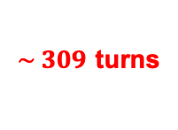
Introduction (and why this question)
1st observations in 2003 at SPS injection with Q26 optics
$\sim 309$ turns

Slide 6
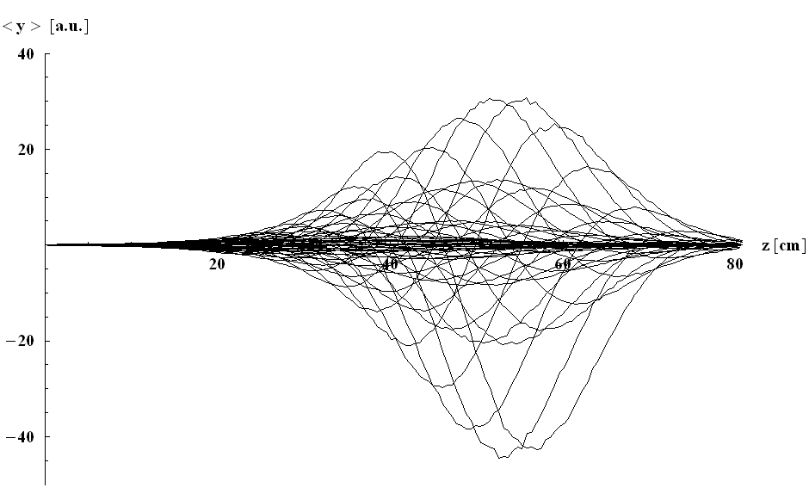
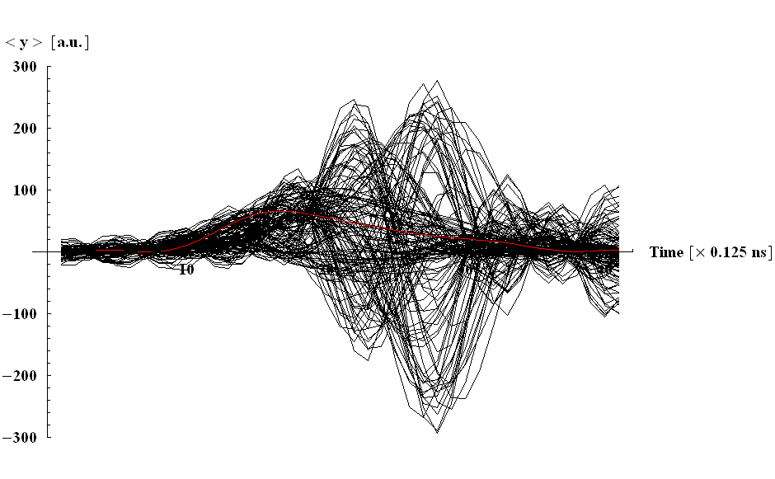


Introduction (and why this question)
1st comparison between the measured and simulated (w/o SC and using the BB resonator model of that time) intra-bunch motions
TMCI
G. Rumolo (HEADTAIL)
Head
Tail
Head
Tail

Slide 7
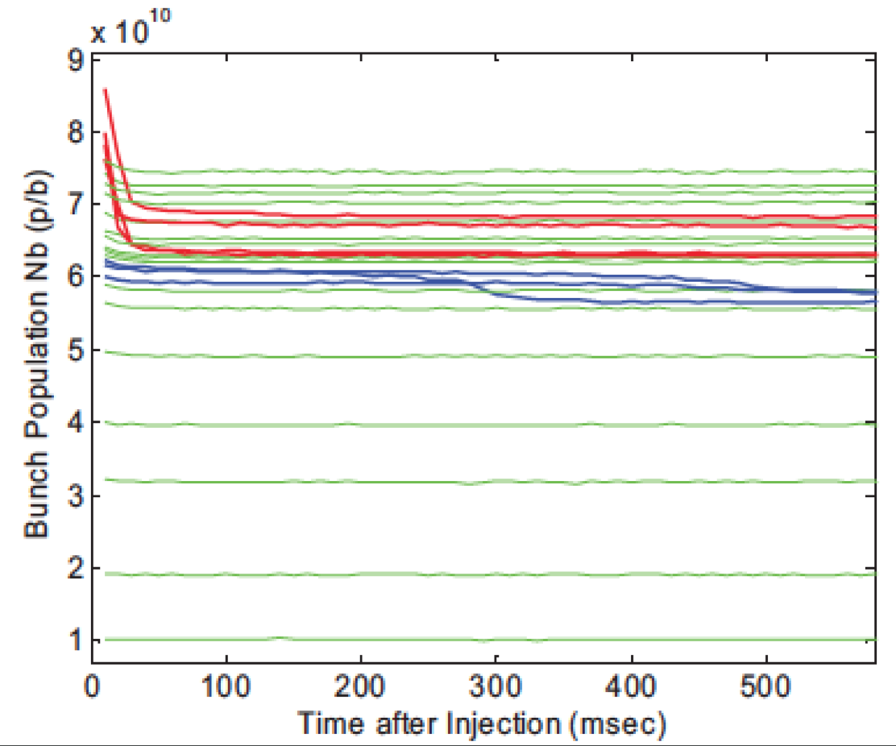
Introduction (and why this question)
Possible “indirect” observation of mode-decoupling (but no direct observation of mode-coupling)
B. Salvant

Slide 8
Introduction (and why this question)
Some other observation of intra-bunch motion

Slide 9
Introduction (and why this question)
PROBLEM: Since 1998 and using the ABS model, it has been found that the TMCI is suppressed by SC => So what could be this instability?

Slide 10
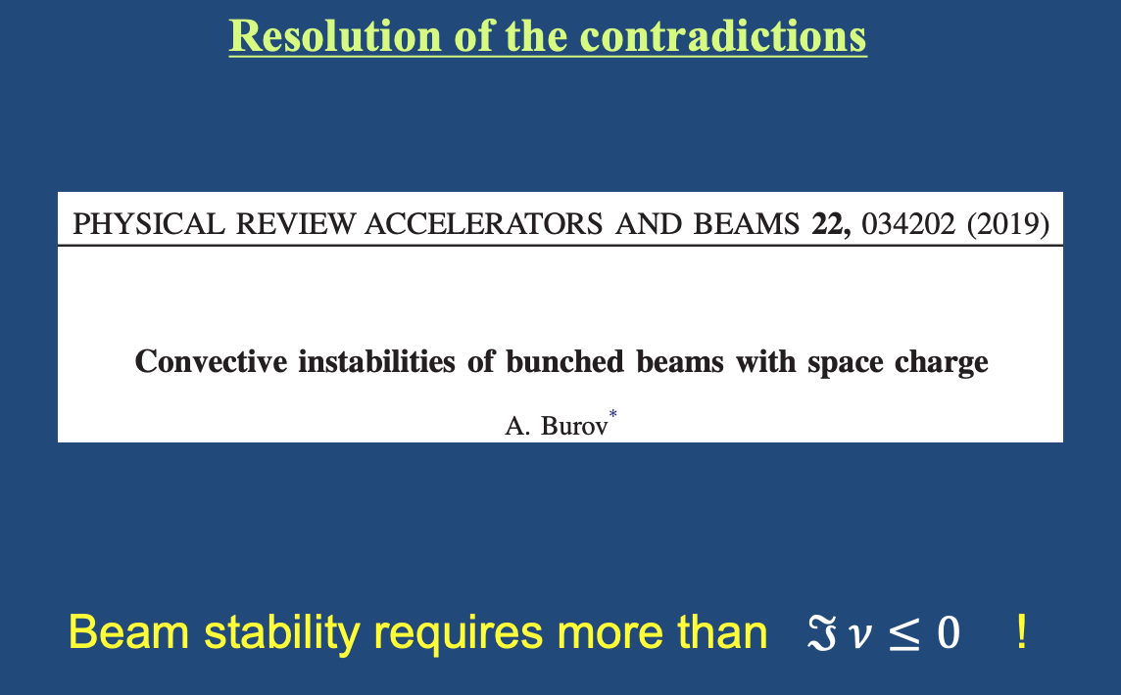
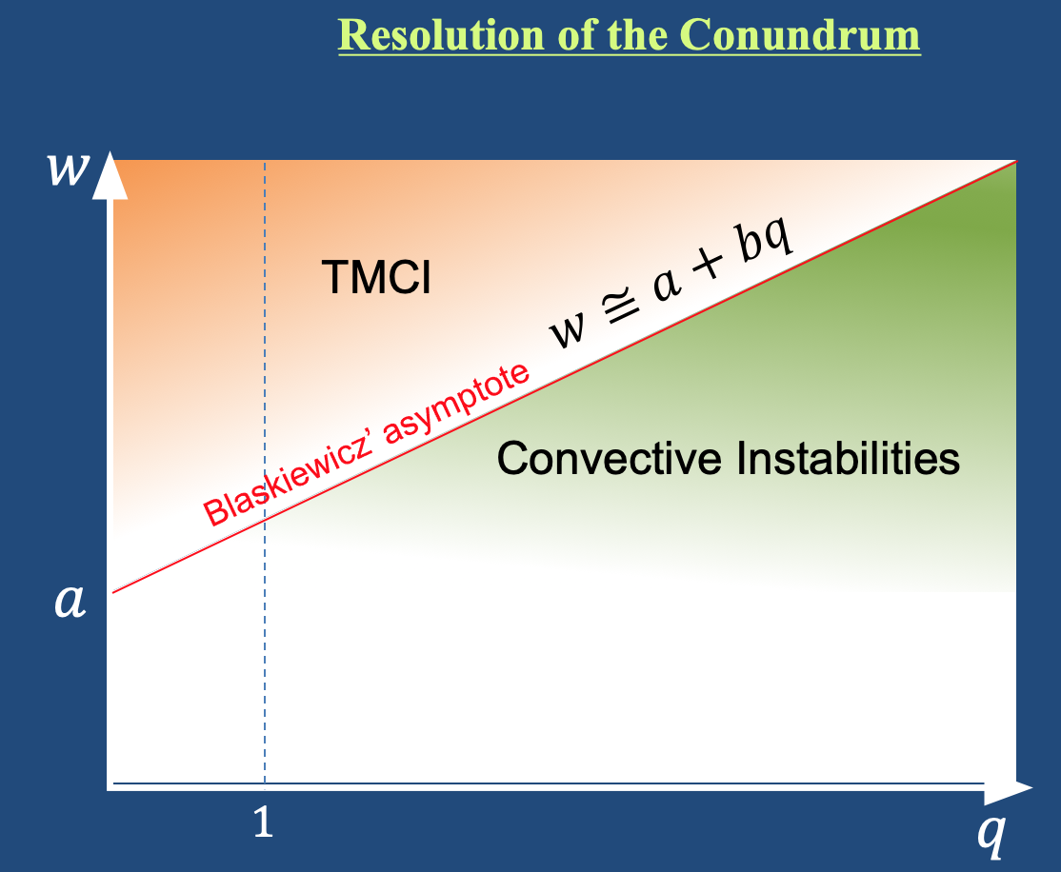
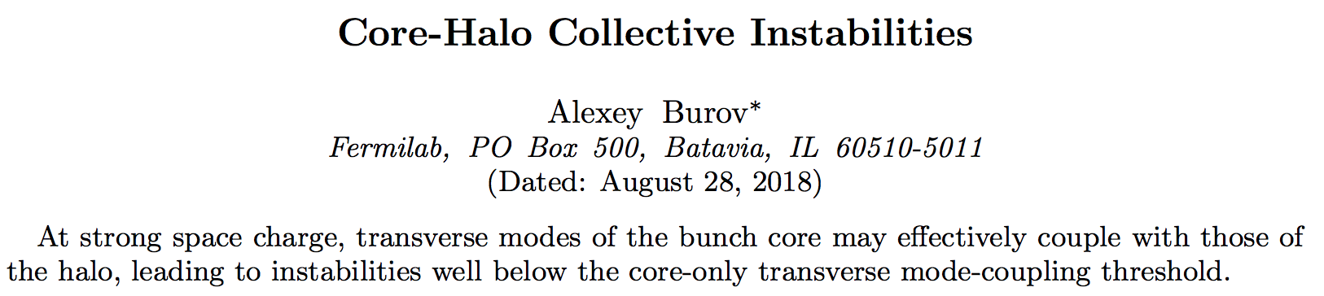
Introduction (and why this question)
PROBLEM: Since 1998 and using the ABS model, it has been found that the TMCI is suppressed by SC => So what could be this instability?
  1st explanation: it is NOT a TMCI
A. Burov, Fermilab APT talk, May 12, 2020
+

Slide 11
Introduction (and why this question)
  2nd (possible) explanation: it is a TMCI but we need a more involved/realistic model to treat it

Slide 12
Introduction (and why this question)
  2nd (possible) explanation: it is a TMCI but we need a more involved/realistic model to treat it
Let’s use the GALACTIC Vlasov solver with the WBL (Water-Bag, Linear RF) model, which will provide also the radial modes => 2-step approach:

Slide 13
Introduction (and why this question)
  2nd (possible) explanation: it is a TMCI but we need a more involved/realistic model to treat it
Let’s use the GALACTIC Vlasov solver with the WBL (Water-Bag, Linear RF) model, which will provide also the radial modes => 2-step approach:
  1) Solve the Eigenvalue system for the SC impedance, which is a “negative inductance”

Slide 14

Introduction (and why this question)
  2nd (possible) explanation: it is a TMCI but we need a more involved/realistic model to treat it
Let’s use the GALACTIC Vlasov solver with the WBL (Water-Bag, Linear RF) model, which will provide also the radial modes => 2-step approach:
  1) Solve the Eigenvalue system for the SC impedance, which is a “negative inductance”
  2) Add the linear force as the SC force is $∝ \left(y−\overline{y}\right)$

Slide 15
Introduction (and why this question)
  2nd (possible) explanation: it is a TMCI but we need a more involved/realistic model to treat it
Let’s use the GALACTIC Vlasov solver with the WBL (Water-Bag, Linear RF) model, which will provide also the radial modes => 2-step approach:
  1) Solve the Eigenvalue system for the SC impedance, which is a “negative inductance”
  2) Add the linear force as the SC force is $∝ \left(y−\overline{y}\right)$
Could be of course
easily extended to Gaussian distribution

Slide 16

Introduction (and why this question)
  2nd (possible) explanation: it is a TMCI but we need a more involved/realistic model to treat it
Let’s use the GALACTIC Vlasov solver with the WBL (Water-Bag, Linear RF) model, which will provide also the radial modes => 2-step approach:
  1) Solve the Eigenvalue system for the SC impedance, which is a “negative inductance”
  2) Add the linear force as the SC force is $∝ \left(y−\overline{y}\right)$
  Pending question: is it fine/sufficient or do we need to solve this fully self-consistently? => Future work to see what the difference between the 2 approaches is

Slide 17
Contents
Introduction (and why this question)
Coherent SC modes from GALACTIC Vlasov solver
  vs. ABS (Air-Bag Square-well) model
  vs. BimBim code (using the Circulant Matrix Model)
What can we deduce from the observation of the intra-bunch motion in the CERN SPS (without math)?
Can this be consistent with some previous instability studies?
Conclusion and outlook

Slide 18
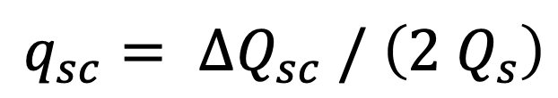
Coherent SC modes from GALACTIC:
first w/o radial modes

Slide 19
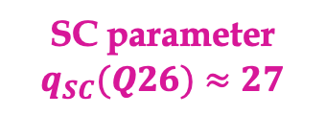
Coherent SC modes from GALACTIC:
first w/o radial modes
SC parameter $q_{SC}(Q26)≈27$

Slide 20
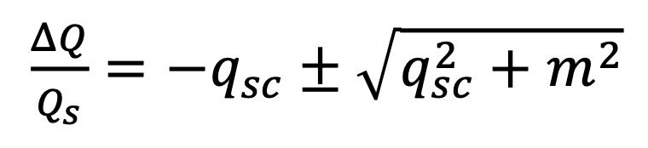
Coherent SC modes from GALACTIC:
first w/o radial modes
ABS model
SC parameter $q_{SC}(Q26)≈27$

Slide 21
Coherent SC modes from GALACTIC:
first w/o radial modes
ABS model
?
SC parameter $q_{SC}(Q26)≈27$

Slide 22
Coherent SC modes from GALACTIC:
first w/o radial modes
Is there something else to compare with?

Slide 23
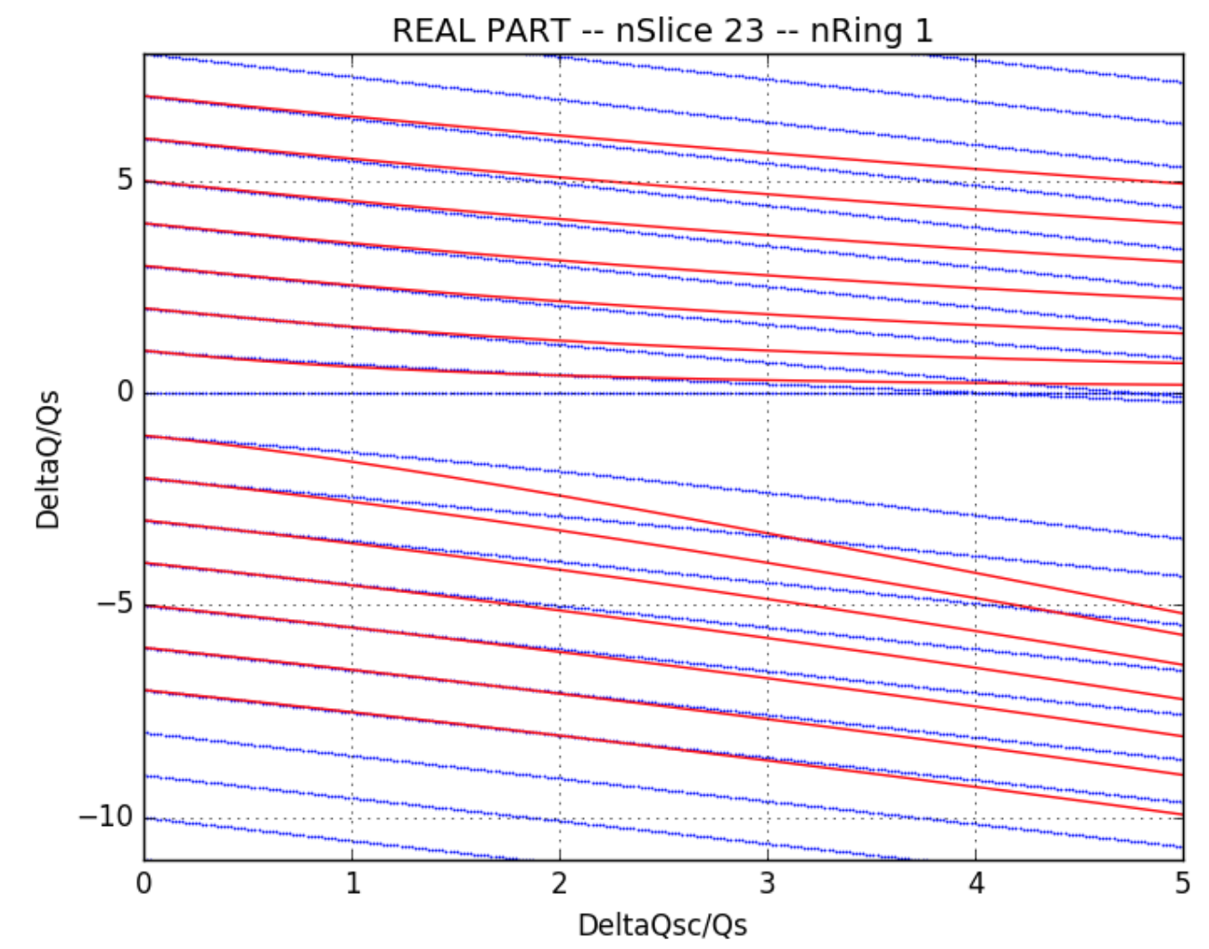
Coherent SC modes from GALACTIC:
first w/o radial modes
Is there something else to compare with?
=> BimBim code (Gaussian)
ABS model
E. Gottlob (with X. Buffat and T. Pieloni, EPFL, 2018)

Slide 24

Coherent SC modes from GALACTIC:
first w/o radial modes
Is there something else to compare with?
WBL model
=> BimBim code (Gaussian)
ABS model
E. Gottlob (with X. Buffat and T. Pieloni, EPFL, 2018)

Slide 25
Coherent SC modes from GALACTIC:
first w/o radial modes
Is there something else to compare with?
WBL model
=> BimBim code (Gaussian)
ABS model
E. Gottlob (with X. Buffat and T. Pieloni, EPFL, 2018)

Slide 26
ABS model
Results from E. Gottlob (BimBim code, 2018)

Slide 27
With factor 1.8 between the SC parameters (horizontal axis)
Results from GALACTIC

Slide 28
With factor 1.8 between the SC parameters (horizontal axis)
Results from GALACTIC

Slide 29
C. Høgh (with X. Buffat and T. Pieloni, EPFL, 2020)

Slide 30
C. Høgh (with X. Buffat and T. Pieloni, EPFL, 2020)
Results from C. Høgh (BimBim code): Gaussian, 20 slices, 1 ring (blue)

Slide 31
C. Høgh (with X. Buffat and T. Pieloni, EPFL, 2020)
Results from C. Høgh (BimBim code): Gaussian, 20 slices, 1 ring (blue)
Results from C. Høgh (BimBim code): Gaussian, 20 slices, 10 rings (pink)

Slide 32
Results from GALACTIC
(WBL model, w/o radial modes)

Slide 33
Coherent SC modes from GALACTIC:
first w/o radial modes
Can we be sure that the positive modes are really crossing 0 as predicted by GALACTIC and observed in BimBim code?

Slide 34
Coherent SC modes from GALACTIC:
first w/o radial modes
Can we be sure that the positive modes are really crossing 0 as predicted by GALACTIC and observed in BimBim code?
=> Let’s check what the BimBim code gives for the ABS model

Slide 35
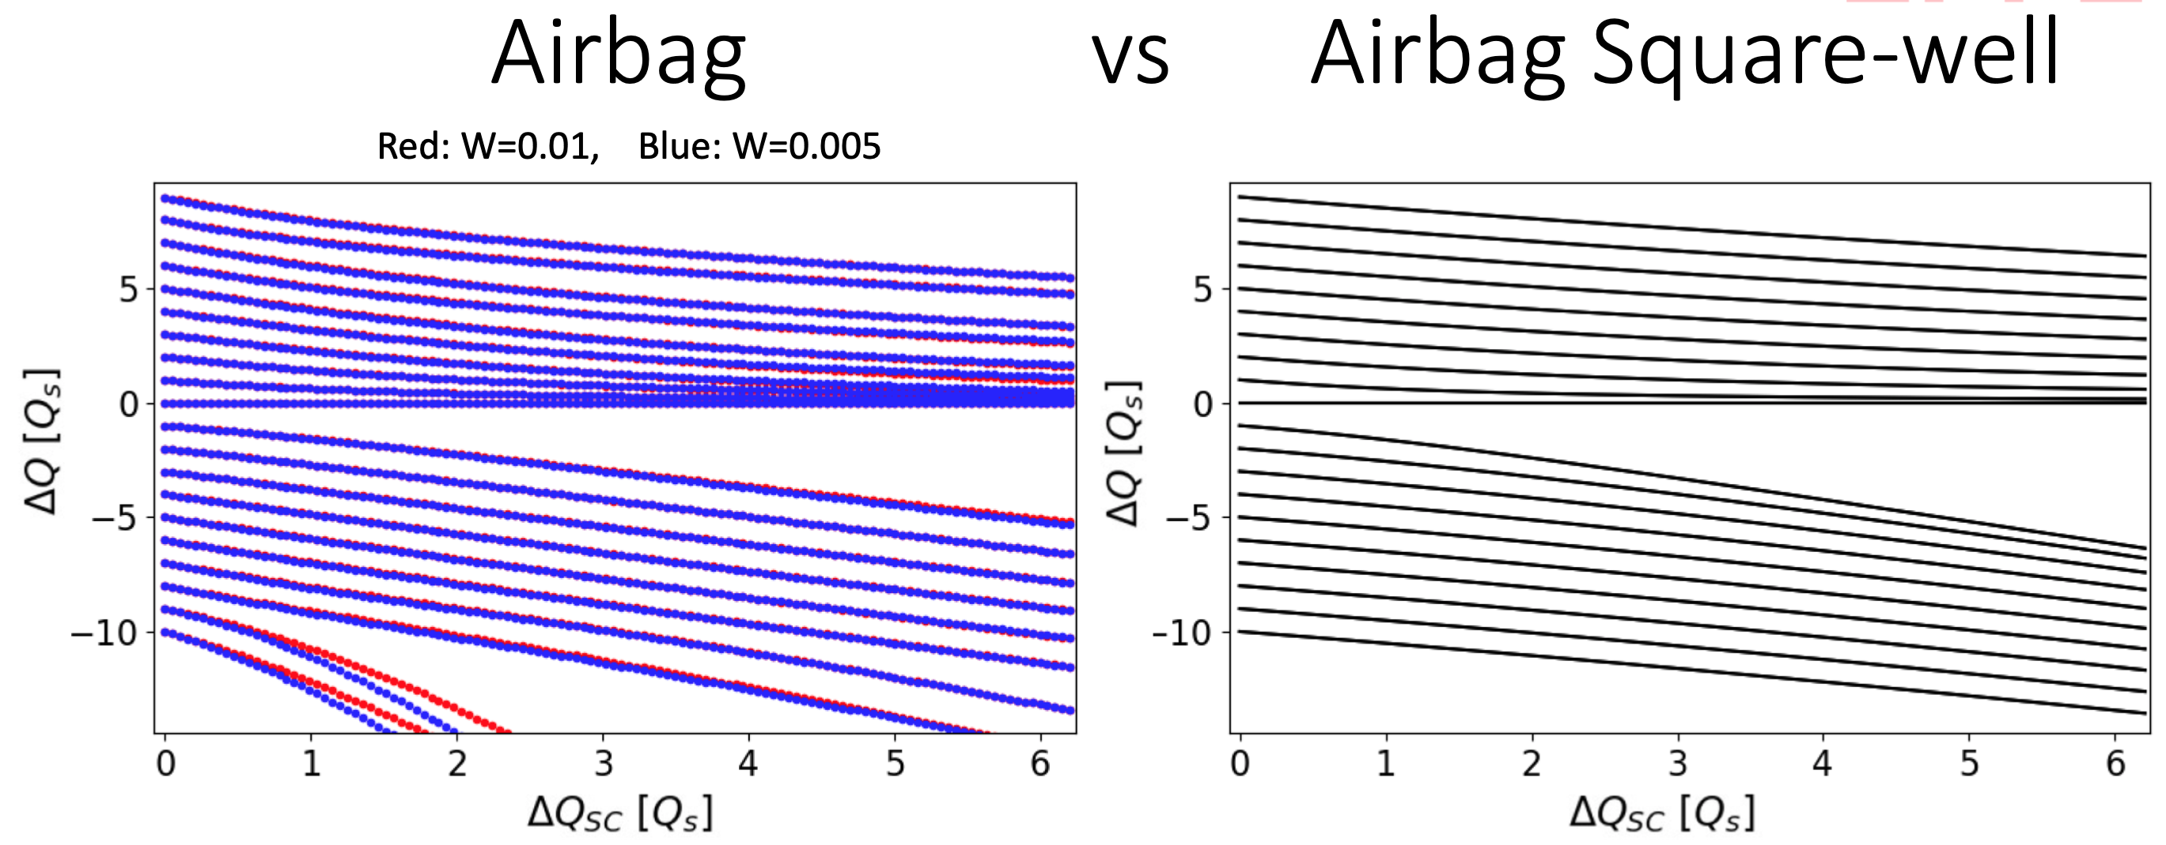
Coherent SC modes from GALACTIC:
first w/o radial modes
Can we be sure that the positive modes are really crossing 0 as predicted by GALACTIC and observed in BimBim code?
=> Let’s check what the BimBim code gives for the ABS model
With Linear
RF (BimBim)
C. Høgh (with X. Buffat and T. Pieloni, EPFL, 2020)

Slide 36
Coherent SC modes from GALACTIC:
first w/o radial modes
Can we be sure that the positive modes are really crossing 0 as predicted by GALACTIC and observed in BimBim code?
=> Let’s check what the BimBim code gives for the ABS model
With Linear
RF (BimBim)
C. Høgh (with X. Buffat and T. Pieloni, EPFL, 2020)
=> Indeed, in this case the positive modes DO NOT cross 0!

Slide 37
Coherent SC modes from GALACTIC:
first w/o radial modes
CONCLUSION: it seems that the coherent SC modes from GALACTIC (Water-Bag) and BimBim (Gaussian) are very different from the ones of the ABS model (Air-Bag): to be checked/confirmed!!!
  => Positive modes become (heavily) negative with SC parameter
  + Radial modes

Slide 38
Coherent SC modes from GALACTIC:
first w/o radial modes
CONCLUSION: it seems that the coherent SC modes from GALACTIC (Water-Bag) and BimBim (Gaussian) are very different from the ones of the ABS model (Air-Bag): to be checked/confirmed!!!
  => Positive modes become (heavily) negative with SC parameter
  + Radial modes
Next question to answer for GALACTIC: why is the mode 00 going down (it remains at 0 for BimBim code)? => See first discussion in Appendix where for instance for the mode 00 in the H-plane of a flat chamber, it was recently found that it is does not remain at 0 (is it also the case here or not?)

Slide 39
Coherent SC modes from GALACTIC:
w radial modes

Slide 40
Coherent SC modes from GALACTIC:
w radial modes
=> Even much more modes becoming negative (as in BimBim or Boxcar model: See Appendix)

Slide 41
Coherent SC modes from GALACTIC:
w radial modes
=> Even much more modes becoming negative (as in BimBim or Boxcar model: See Appendix)
=> Next: to be checked first!!! Then, detailed (quantitative) analysis of the impact of SC on the TMCI intensity threshold from the SPS impedance

Slide 42
Contents
Introduction (and why this question)
Coherent SC modes from GALACTIC Vlasov solver
  vs. ABS (Air-Bag Square-well) model
  vs. BimBim code (using the Circulant Matrix Model)
What can we deduce from the observation of the intra-bunch motion in the CERN SPS (without math)?
Can this be consistent with some previous instability studies?
Conclusion and outlook

Slide 43
Can we understand this intra-bunch signal?

Slide 44
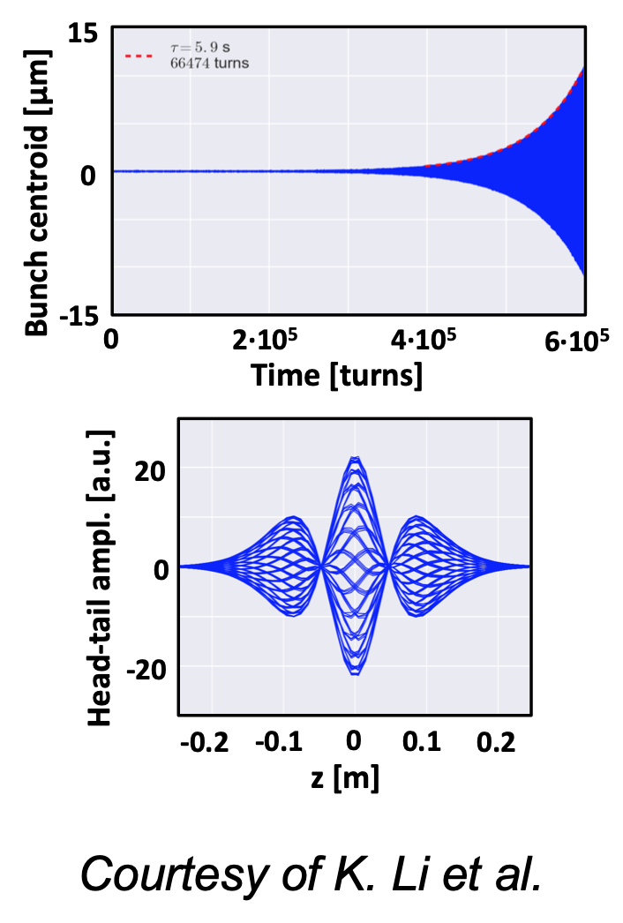
Can we understand this intra-bunch signal?
PyHT simulation with 1 bunch: impedance only (i.e. no SC)
K. Li et al.
Tail
Head

Slide 45
YES! => It is a Head-Tail instability

Slide 46
YES! => It is a Head-Tail instability

Slide 47
YES! => It is a Head-Tail instability
=> See e.g. below results using Laclare’s formalism (assuming independent head-tail modes): standing-wave pattern along the bunch

Slide 48
Can we understand this intra-bunch signal?

Slide 49
Can we understand this intra-bunch signal?
PyHT simulation with 1 bunch: impedance only (i.e. no SC)
M. Beck et al.

Slide 50
YES! => It is a TMCI (“just above” the threshold)

Slide 51
YES! => It is a TMCI (“just above” the threshold)

Slide 52
YES! => It is a TMCI (“just above” the threshold)
=> Here the head-tail modes need to be considered together: travelling-wave pattern along the bunch.
=> See more info here: https://cds.cern.ch/record/2714322/files/CERN-ACC-NOTE-2020-0018.pdf

Slide 53
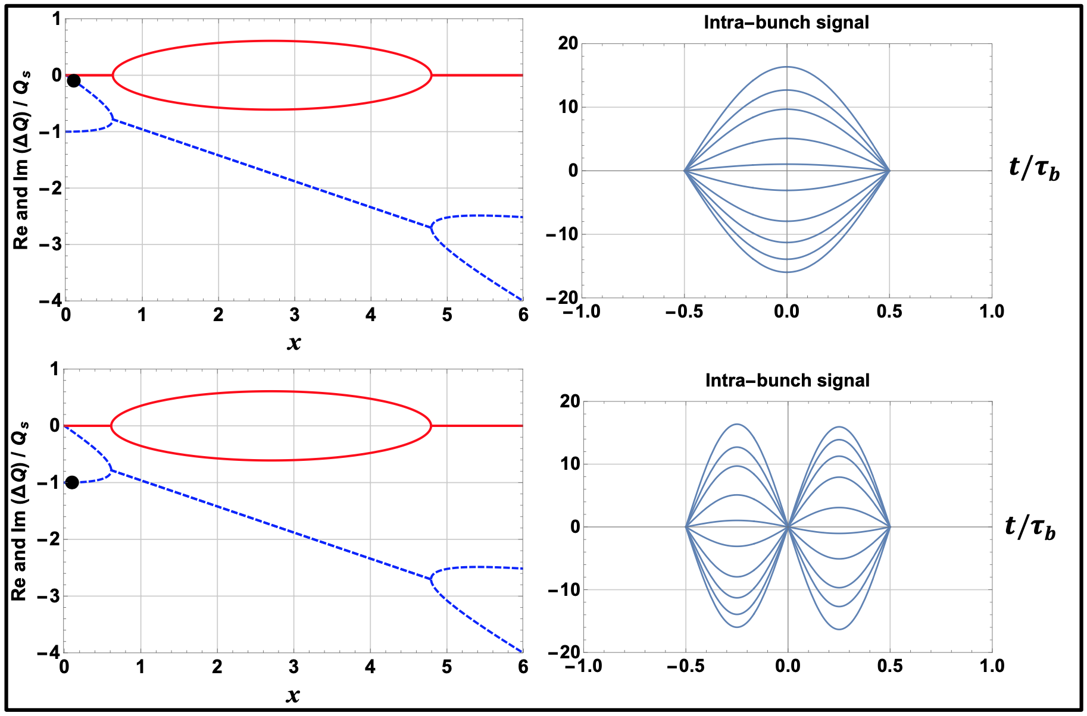
YES! => It is a TMCI (“just above” the threshold)
Head
Tail

Slide 54
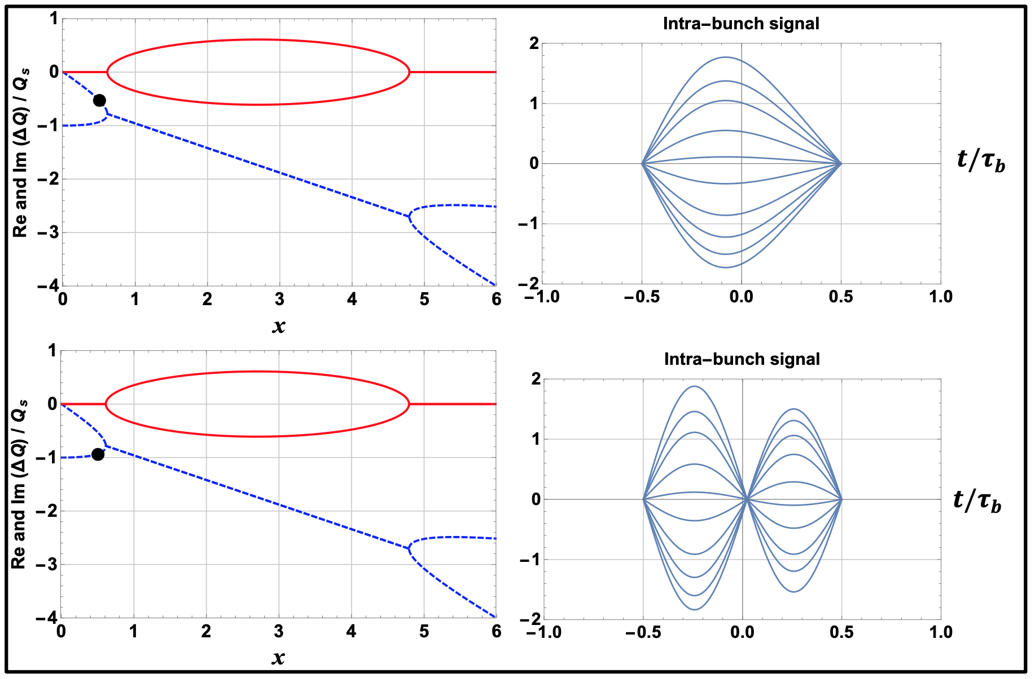
YES! => It is a TMCI (“just above” the threshold)
Head
Tail

Slide 55
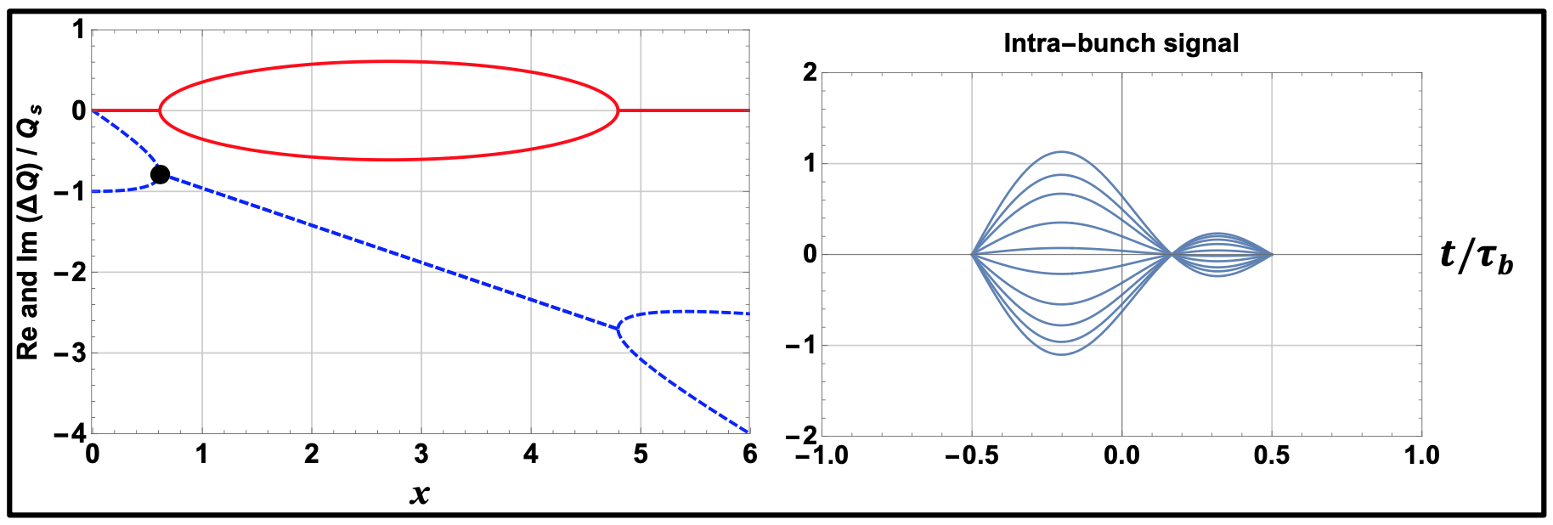
YES! => It is a TMCI (“just above” the threshold)
Head
Tail

Slide 56
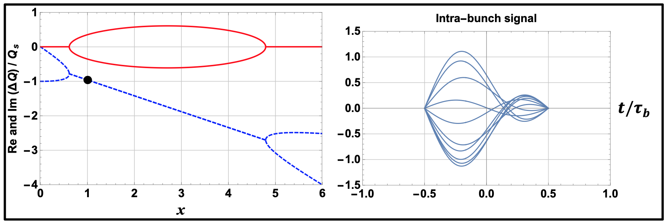
YES! => It is a TMCI (“just above” the threshold)
=> TMCI is head-dominated “just above” the threshold
Head
Tail

Slide 57
YES! => It is a TMCI (“just above” the threshold)
=> TMCI is head-dominated “just above” the threshold
Head
Tail

Slide 58
TMCI: what happens at higher intensities?

Slide 59
TMCI: what happens at higher intensities?
=> The signal moves to the tail: amplification from Head to Tail (the higher the bunch intensity, the larger the amplification)

Slide 60
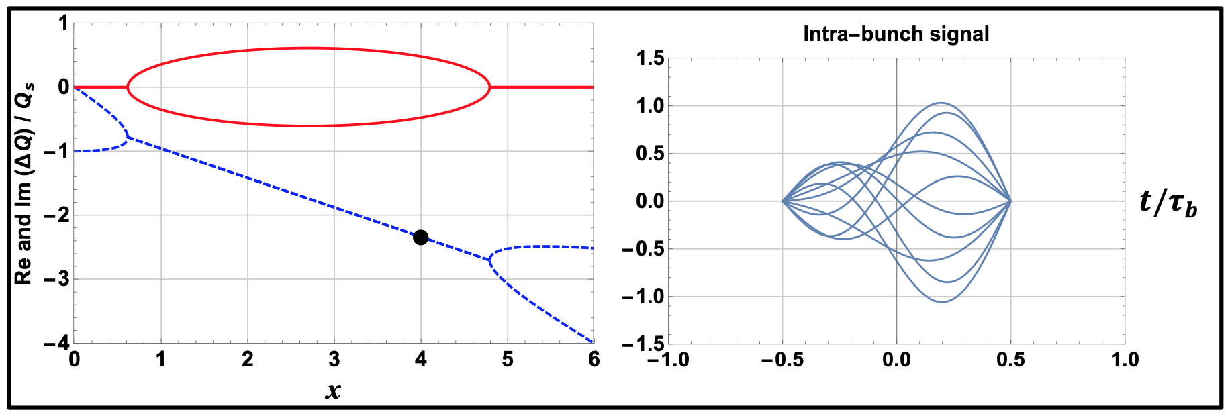
TMCI: what happens at higher intensities?
=> The signal moves to the tail: amplification from Head to Tail (the higher the bunch intensity, the larger the amplification)
Head
Tail

Slide 61
TMCI: what about mode-decoupling?

Slide 62
TMCI: what about mode-decoupling?
=> In case of mode-decoupling, convective instabilities are observed: amplification from Head to Tail with 0 growth rate

Slide 63
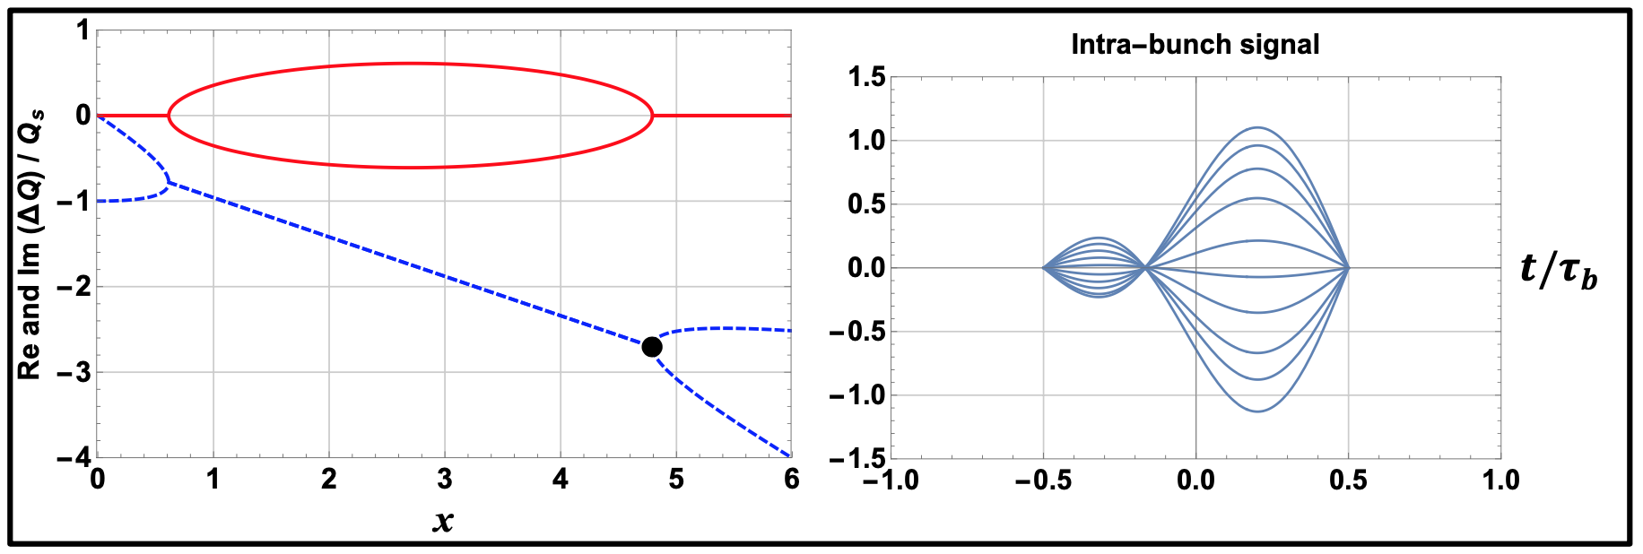
TMCI: what about mode-decoupling?
=> In case of mode-decoupling, convective instabilities are observed: amplification from Head to Tail with 0 growth rate
Head
Tail

Slide 64
TMCI: what about mode-decoupling?
=> In case of mode-decoupling, convective instabilities are observed: amplification from Head to Tail with 0 growth rate
Head
Tail
Head
Tail

Slide 65
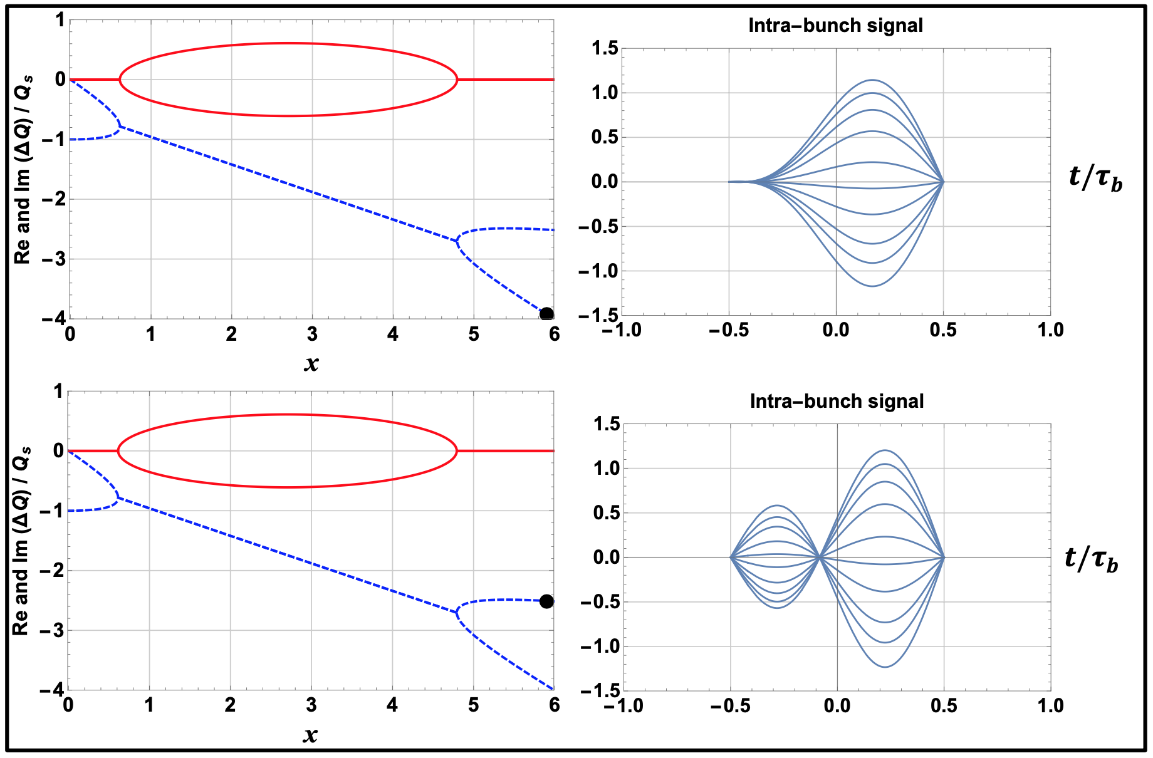
TMCI: what about mode-decoupling?
=> In case of mode-decoupling, convective instabilities are observed: amplification from Head to Tail with 0 growth rate
Head
Tail

Slide 66
TMCI: what about mode-decoupling?
=> In case of mode-decoupling, convective instabilities are observed: amplification from Head to Tail with 0 growth rate

Slide 67
Can we understand this intra-bunch signal?

Slide 68
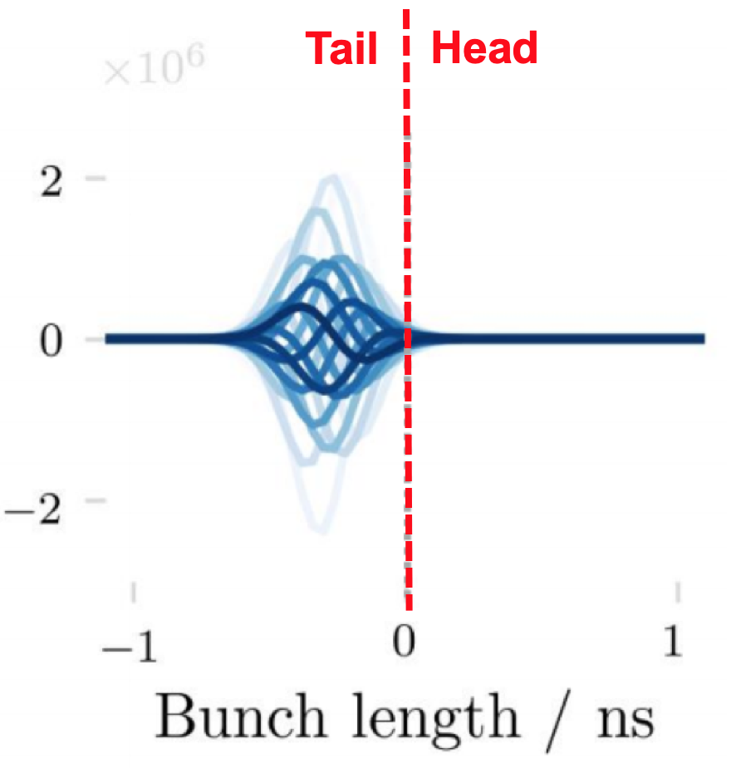
Can we understand this intra-bunch signal?
PyHT simulation with 1 bunch: impedance only (i.e. no SC)
D. Amorim et al.

Slide 69
YES! => It is a TMCI (“well above” the threshold)

Slide 70
YES! => It is a TMCI (“well above” the threshold)

Slide 71
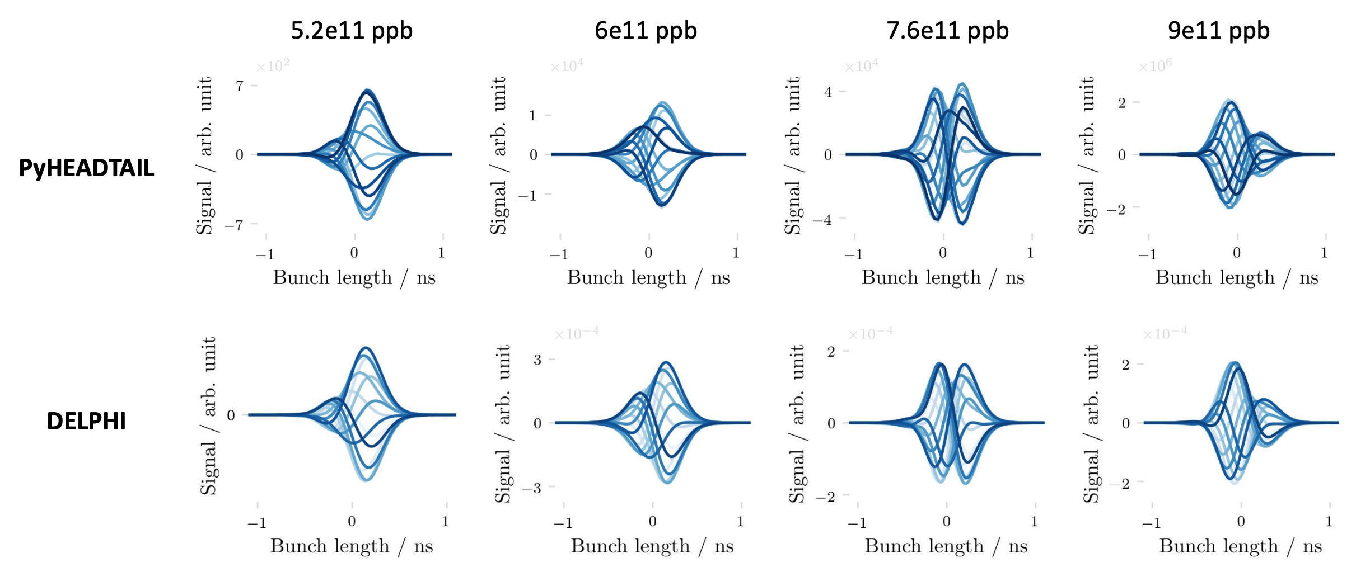
YES! => It is a TMCI (“well above” the threshold)
TMCI intensity threshold
at ~ 5e11 ppb
Tail
Head
D. Amorim

Slide 72
YES! => It is a TMCI (“well above” the threshold)

Slide 73
YES! => It is a TMCI (“well above” the threshold)

Slide 74
Finally, can we understand this intra-bunch signal at SPS injection with Q26 optics?

Slide 75
Finally, can we understand this intra-bunch signal at SPS injection with Q26 optics?
Factor ~ 1.6
above TMCI
w/o SC

Slide 76
Assuming it is a TMCI…
between (2) transverse modes (which still need to be fully characterised)

Slide 77
Assuming it is a TMCI…
between (2) transverse modes (which still need to be fully characterised)
… it can be estimated that
1) The measurement intensity is “well above” the intensity threshold
2) SC decreases the intensity threshold such that the latter is a factor of ~ 10-20 below the measurement intensity

Slide 79
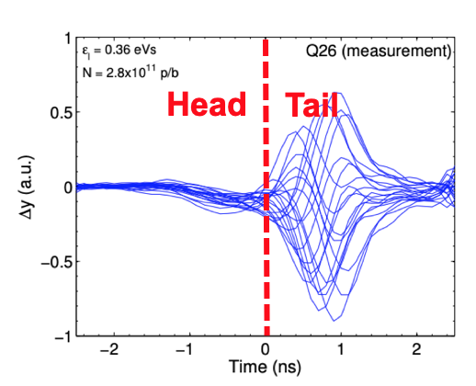
H. Bartosik

Slide 80
H. Bartosik

Slide 81
Contents
Introduction (and why this question)
Coherent SC modes from GALACTIC Vlasov solver
  vs. ABS (Air-Bag Square-well) model
  vs. BimBim code (using the Circulant Matrix Model)
What can we deduce from the observation of the intra-bunch motion in the CERN SPS (without math)?
Can this be consistent with some previous instability studies?
Conclusion and outlook

Slide 82
Can SC decrease so much the intensity threshold?

Slide 83
Can SC decrease so much the intensity threshold?
0
TMCI intensity threshold
Measurement intensity
Bunch
intensity
w/o SC
Factor ~ 1.6 above TMCI threshold

Slide 84
Can SC decrease so much the intensity threshold?
0
TMCI intensity threshold
Measurement intensity
Bunch
intensity
w/o SC
Factor ~ 1.6 above TMCI threshold
TMCI intensity threshold
Measurement intensity
0
Bunch
intensity
w SC
“Well above” TMCI threshold

Slide 85
=> Could be consistent with 5 studies

Slide 86
=> Could be consistent with 5 studies
2-particle model

Slide 87
=> Could be consistent with 5 studies
2-particle model
PyHT simulations

Slide 88
=> Could be consistent with 5 studies
2-particle model
PyHT simulations
2-mode model

Slide 89
=> Could be consistent with 5 studies
2-particle model
PyHT simulations
Soft-slice (instead of rigid-slice) model
2-mode model

Slide 90
=> Could be consistent with 5 studies
2-particle model
PyHT simulations
BimBim simulations
Soft-slice (instead of rigid-slice) model
2-mode model

Slide 91
=> Could be consistent with 5 studies
2-particle model

Slide 92
=> Could be consistent with 5 studies
Chin-Chao-Blaskiewicz_PRAB2016

Slide 93
=> Could be consistent with 5 studies
Chin-Chao-Blaskiewicz_PRAB2016
Succession of mode-coupling mode-decoupling with reduction of instability growth rate

Slide 94
=> Could be consistent with 5 studies
PyHT simulations
Chin-Chao-Blaskiewicz_PRAB2016
Succession of mode-coupling mode-decoupling with reduction of instability growth rate

Slide 95
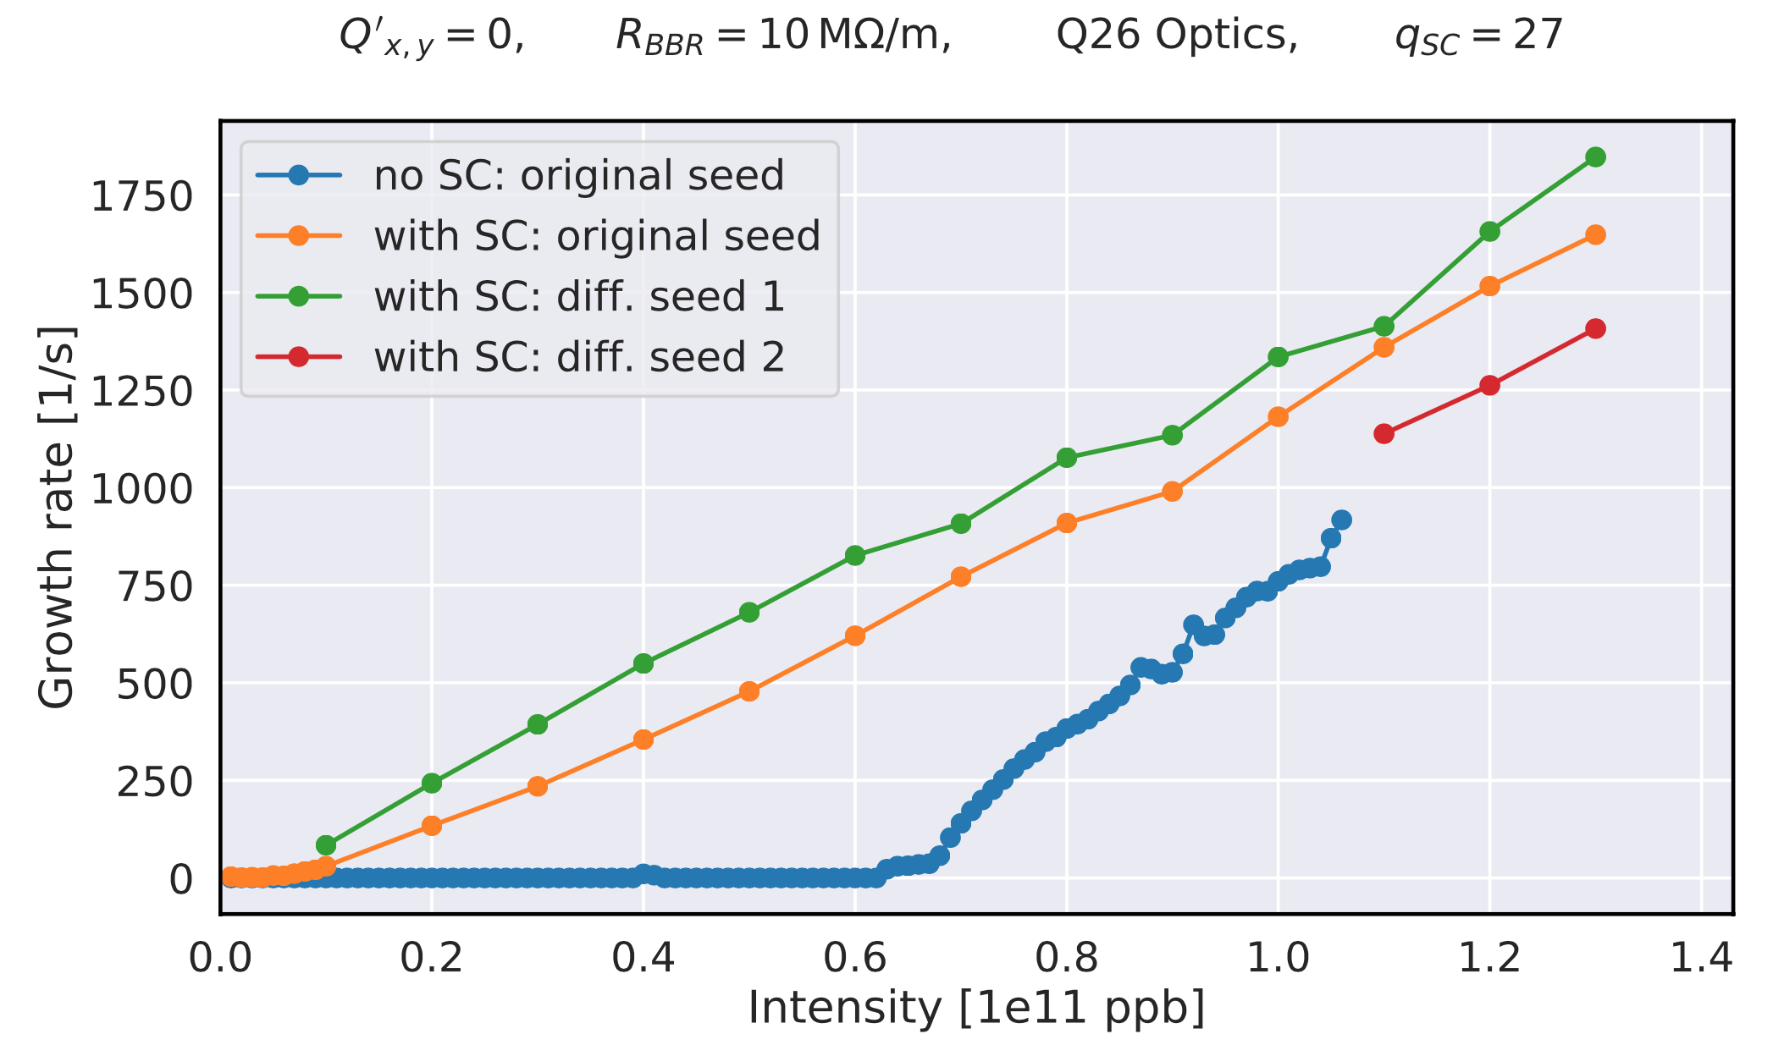
=> Could be consistent with 5 studies
Chin-Chao-Blaskiewicz_PRAB2016
Succession of mode-coupling mode-decoupling with reduction of instability growth rate
A. Oeftiger (2018)

Slide 96
=> Could be consistent with 5 studies
Growth rates to be updated (“envelope fitting” instead of fitting only the first rise)
Chin-Chao-Blaskiewicz_PRAB2016
Succession of mode-coupling mode-decoupling with reduction of instability growth rate
A. Oeftiger (2018)

Slide 97
=> Could be consistent with 5 studies
Growth rates to be updated (“envelope fitting” instead of fitting only the first rise)
Chin-Chao-Blaskiewicz_PRAB2016
Succession of mode-coupling mode-decoupling with reduction of instability growth rate
A. Oeftiger (2018)
2-mode model

Slide 98
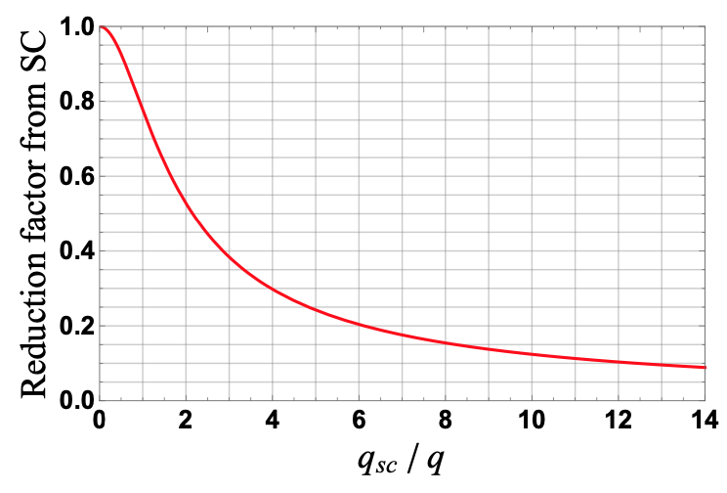
=> Could be consistent with 5 studies
Growth rates to be updated (“envelope fitting” instead of fitting only the first rise)
Chin-Chao-Blaskiewicz_PRAB2016
Succession of mode-coupling mode-decoupling with reduction of instability growth rate
A. Oeftiger (2018)
IPAC19

Slide 99
=> Could be consistent with 5 studies
Growth rates to be updated (“envelope fitting” instead of fitting only the first rise)
Chin-Chao-Blaskiewicz_PRAB2016
Succession of mode-coupling mode-decoupling with reduction of instability growth rate
A. Oeftiger (2018)
See also https://indico.cern.ch/event/924630/contributions/3903233/attachments/2056784/3449240/SPS_TMCI_with_SC_InstabGrowthRate_EM_15-06-20.pdf for discussion about the instability growth-rate
IPAC19

Slide 100
=> Could be consistent with 5 studies
Growth rates to be updated (“envelope fitting” instead of fitting only the first rise)
Chin-Chao-Blaskiewicz_PRAB2016
Succession of mode-coupling mode-decoupling with reduction of instability growth rate
A. Oeftiger (2018)
See also https://indico.cern.ch/event/924630/contributions/3903233/attachments/2056784/3449240/SPS_TMCI_with_SC_InstabGrowthRate_EM_15-06-20.pdf for discussion about the instability growth-rate
Soft-slice (instead of rigid-slice) model
IPAC19

Slide 101
=> Could be consistent with 5 studies
Growth rates to be updated (“envelope fitting” instead of fitting only the first rise)
Chin-Chao-Blaskiewicz_PRAB2016
Succession of mode-coupling mode-decoupling with reduction of instability growth rate
A. Oeftiger (2018)
See also https://indico.cern.ch/event/924630/contributions/3903233/attachments/2056784/3449240/SPS_TMCI_with_SC_InstabGrowthRate_EM_15-06-20.pdf for discussion about the instability growth-rate
Y. Alexahin (MCBI 2019)
IPAC19

Slide 102
=> Could be consistent with 5 studies
Growth rates to be updated (“envelope fitting” instead of fitting only the first rise)
Chin-Chao-Blaskiewicz_PRAB2016
Succession of mode-coupling mode-decoupling with reduction of instability growth rate
A. Oeftiger (2018)
See also https://indico.cern.ch/event/924630/contributions/3903233/attachments/2056784/3449240/SPS_TMCI_with_SC_InstabGrowthRate_EM_15-06-20.pdf for discussion about the instability growth-rate
Y. Alexahin (MCBI 2019)
“Vanishing TMCI threshold instead of a vanishing TMCI”
IPAC19

Slide 103
=> Could be consistent with 5 studies
Growth rates to be updated (“envelope fitting” instead of fitting only the first rise)
Chin-Chao-Blaskiewicz_PRAB2016
Succession of mode-coupling mode-decoupling with reduction of instability growth rate
A. Oeftiger (2018)
See also https://indico.cern.ch/event/924630/contributions/3903233/attachments/2056784/3449240/SPS_TMCI_with_SC_InstabGrowthRate_EM_15-06-20.pdf for discussion about the instability growth-rate
Y. Alexahin (MCBI 2019)
“Vanishing TMCI threshold instead of a vanishing TMCI”
Mentioned to be
also consistent with
Core-Halo TMCI
IPAC19

Slide 104
=> Could be consistent with 5 studies
BimBim simulations

Slide 105
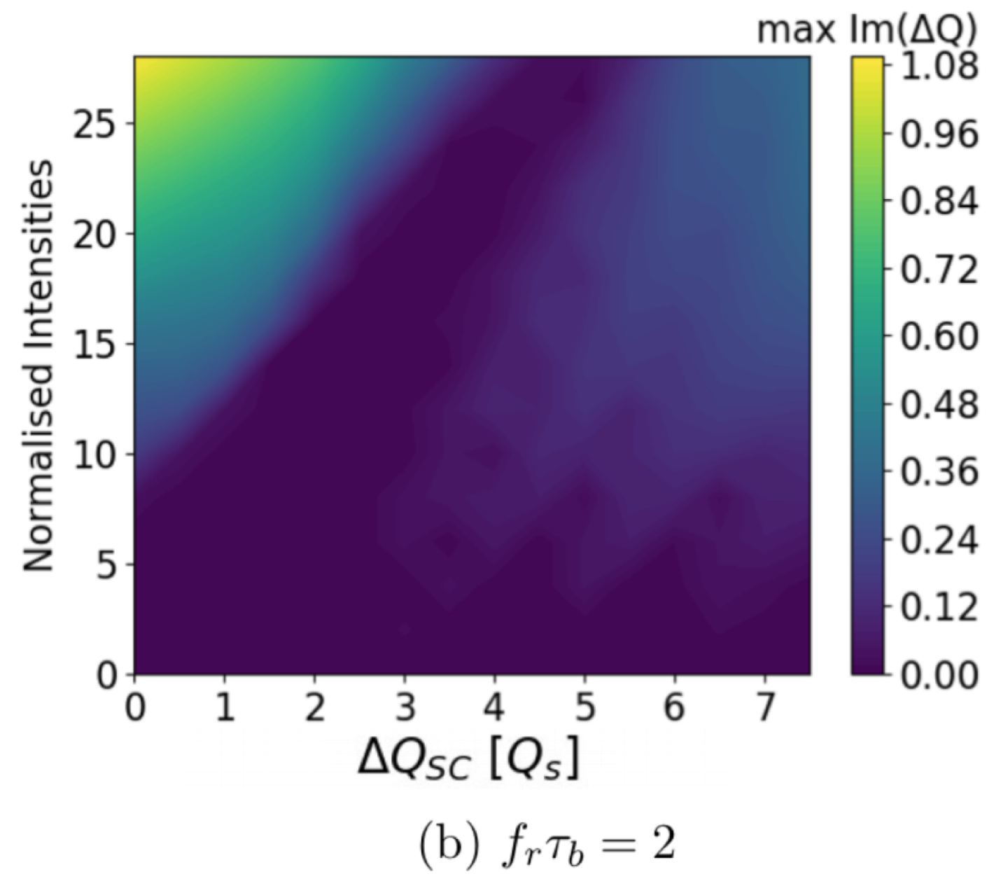
=> Could be consistent with 5 studies
C. Høgh (with X. Buffat and T. Pieloni, EPFL, 2020)
  Ongoing analyses => Intensity threshold reduced for intermediate SC parameter (due to TMCI) with Gaussian distribution, which is not observed with Air-Bag. To be continued with larger SC parameters

Slide 106
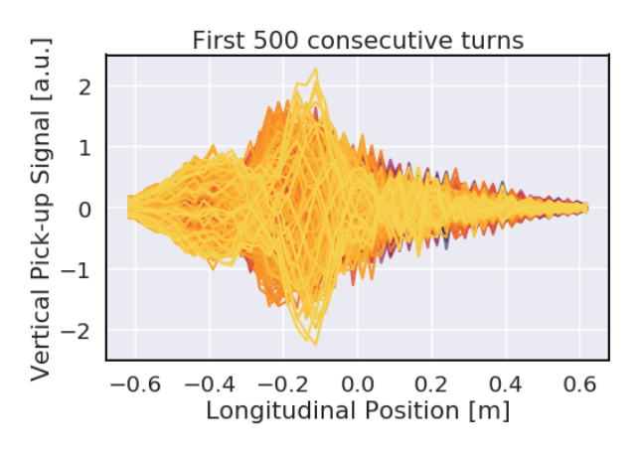
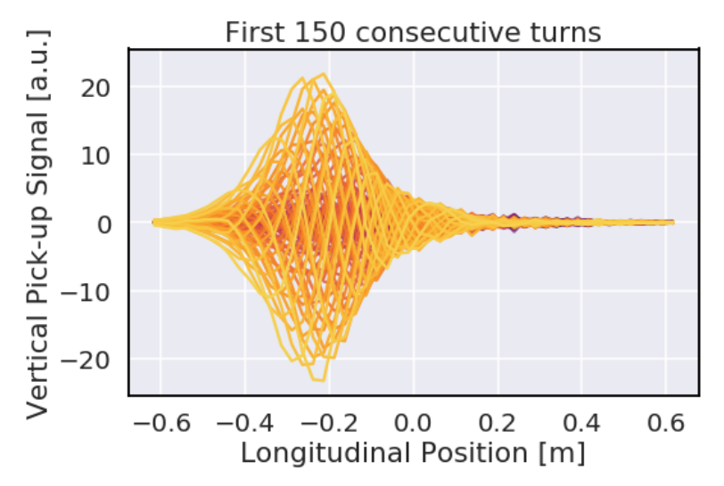
Tail
Head
3e10 ppb
PyHT simulations (with SC) from A. Oeftiger
10e10 ppb

Slide 107
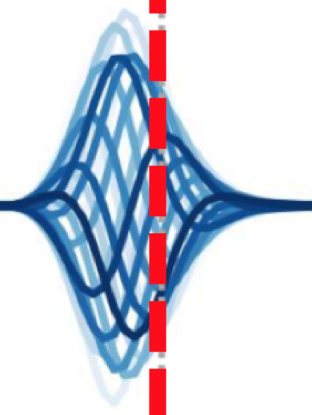
Tail
Head
3e10 ppb
Would be
consistent with factor ~ 4 above TMCI (2e12 ppb
with previous example)
PyHT simulations (with SC) from A. Oeftiger
10e10 ppb

Slide 108
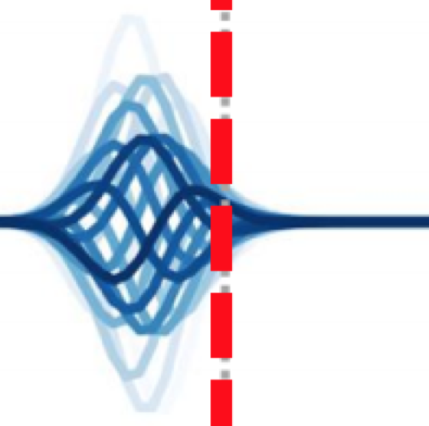
Tail
Head
3e10 ppb
Would be
consistent with factor ~ 4 above TMCI (2e12 ppb
with previous example)
Would be
consistent with factor ~ 12 above TMCI (6e12 ppb
with previous example)
PyHT simulations (with SC) from A. Oeftiger
10e10 ppb

Slide 109
Contents
Introduction (and why this question)
Coherent space charge modes from GALACTIC Vlasov solver
  vs. ABS (Air-Bag Square-well) model
  vs. BimBim code (using the Circulant Matrix Model)
What can we deduce from the observation of the intra-bunch motion in the CERN SPS (without math)?
Can this be consistent with some previous instability studies?
Conclusion and outlook

Slide 110
Conclusion

Slide 111
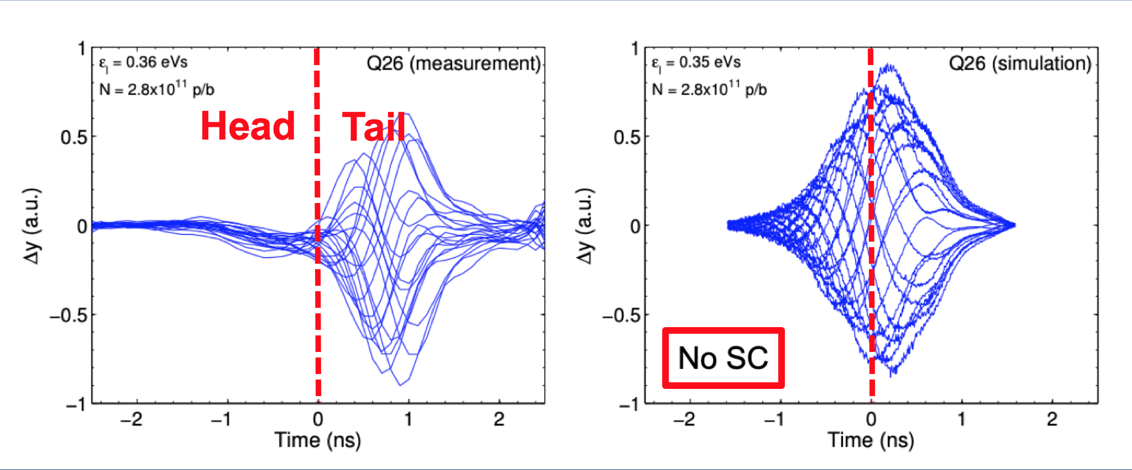
Conclusion
Factor ~ 1.6
above TMCI
w/o SC
This picture
H. Bartosik

Slide 112
Conclusion
Factor ~ 1.6
above TMCI
w/o SC
This picture
H. Bartosik
tells me 2 things
1) It is a TMCI (well above the TMCI intensity threshold)
2) SC decreases the TMCI intensity threshold by more than an order of magnitude!

Slide 113
Conclusion
Factor ~ 1.6
above TMCI
w/o SC
This picture
H. Bartosik
i.e. a coupling between (2) transverse modes
tells me 2 things
1) It is a TMCI (well above the TMCI intensity threshold)
2) SC decreases the TMCI intensity threshold by more than an order of magnitude!

Slide 114
Conclusion
Factor ~ 1.6
above TMCI
w/o SC
This picture
H. Bartosik
i.e. a coupling between (2) transverse modes
tells me 2 things
1) It is a TMCI (well above the TMCI intensity threshold)
2) SC decreases the TMCI intensity threshold such that the latter is a factor of ~ 10-20 below the measurement intensity

Slide 115
=> Answer to the question: I would say NO

Slide 116
=> Answer to the question: I would say NO

Slide 117
=> Answer to the question: I would say NO
NO from measurements => Compatible with TMCI
  Possible “indirect” observation of mode-coupling / mode-decoupling
  Intra-bunch motion from TMCI (“well above” threshold) – travelling-wave
NO from simplified theories: 2-particle (and 2-mode) models => Compatible with TMCI
    Intensity threshold strongly reduced for high SC parameter (due to TMCI)
NO from PyHT simulations => Compatible with TMCI
    Intensity threshold strongly reduced for high SC parameter
NO from theory (soft-slice) => Compatible with TMCI
    Intensity threshold strongly reduced for high SC parameter (due to TMCI)
NO from BimBim simulations => Compatible with TMCI
  Ongoing analyses => Intensity threshold reduced for intermediate SC parameter (due to TMCI)

Slide 118
=> Answer to the question: I would say NO
NO from measurements => Compatible with TMCI
  Possible “indirect” observation of mode-coupling / mode-decoupling
  Intra-bunch motion from TMCI (“well above” threshold) – travelling-wave
NO from simplified theories: 2-particle (and 2-mode) models => TMCI
    Intensity threshold strongly reduced for high SC parameter
NO from PyHT simulations => Compatible with TMCI
    Intensity threshold strongly reduced for high SC parameter
NO from theory (soft-slice) => Compatible with TMCI
    Intensity threshold strongly reduced for high SC parameter (due to TMCI)
NO from BimBim simulations => Compatible with TMCI
  Ongoing analyses => Intensity threshold reduced for intermediate SC parameter (due to TMCI)

Slide 119
=> Answer to the question: I would say NO
NO from measurements => Compatible with TMCI
  Possible “indirect” observation of mode-coupling / mode-decoupling
  Intra-bunch motion from TMCI (“well above” threshold) – travelling-wave
NO from simplified theories: 2-particle (and 2-mode) models => TMCI
    Intensity threshold strongly reduced for high SC parameter
NO from PyHT simulations => Compatible with TMCI
    Intensity threshold strongly reduced for high SC parameter
NO from theory (soft-slice) => Compatible with TMCI
    Intensity threshold strongly reduced for high SC parameter (due to TMCI)
NO from BimBim simulations => Compatible with TMCI
  Ongoing analyses => Intensity threshold reduced for intermediate SC parameter (due to TMCI)

Slide 120
=> Answer to the question: I would say NO
NO from measurements => Compatible with TMCI
  Possible “indirect” observation of mode-coupling / mode-decoupling
  Intra-bunch motion from TMCI (“well above” threshold) – travelling-wave
NO from simplified theories: 2-particle (and 2-mode) models => TMCI
    Intensity threshold strongly reduced for high SC parameter
NO from PyHT simulations => Compatible with TMCI
    Intensity threshold strongly reduced for high SC parameter
NO from theory with soft-slice model => TMCI
    Intensity threshold strongly reduced for high SC parameter
NO from BimBim simulations => Compatible with TMCI
  Ongoing analyses => Intensity threshold reduced for intermediate SC parameter (due to TMCI)

Slide 121
=> Answer to the question: I would say NO
NO from measurements => Compatible with TMCI
  Possible “indirect” observation of mode-coupling / mode-decoupling
  Intra-bunch motion from TMCI (“well above” threshold) – travelling-wave
NO from simplified theories: 2-particle (and 2-mode) models => TMCI
    Intensity threshold strongly reduced for high SC parameter
NO from PyHT simulations => Compatible with TMCI
    Intensity threshold strongly reduced for high SC parameter
NO from theory with soft-slice model => TMCI
    Intensity threshold strongly reduced for high SC parameter
NO from BimBim simulations => Compatible with TMCI
  Ongoing analyses => Intensity threshold reduced for intermediate SC parameter (due to TMCI)

Slide 122
=> Answer to the question: I would say NO
NO from measurements => Compatible with TMCI
  Possible “indirect” observation of mode-coupling / mode-decoupling
  Intra-bunch motion from TMCI (“well above” threshold) – travelling-wave
NO from simplified theories: 2-particle (and 2-mode) models => TMCI
    Intensity threshold strongly reduced for high SC parameter
NO from PyHT simulations => Compatible with TMCI
    Intensity threshold strongly reduced for high SC parameter
NO from theory with soft-slice model => TMCI
    Intensity threshold strongly reduced for high SC parameter
NO from BimBim simulations => TMCI
  Ongoing analyses => Intensity threshold reduced for intermediate SC parameter with Gaussian distribution, which is not observed with Air-Bag See https://indico.cern.ch/event/931949/contributions/3916708/attachments/2064517/3464419/Presentation2.pdf
C. Høgh (with X. Buffat and T. Pieloni, EPFL, 2020)

Slide 123
Conclusion
Interesting to observe that the usual “damping mechanisms” (such as active damping and tune spread) can be detrimental when several modes are involved!

Slide 124
Conclusion
Interesting to observe that the usual “damping mechanisms” (such as active damping and tune spread) can be detrimental when several modes are involved!
This is for
sure not a TMCI anymore!

Slide 125
Conclusion
Interesting to observe that the usual “damping mechanisms” (such as active damping and tune spread) can be detrimental when several modes are involved!
This is for
sure not a TMCI anymore!

Slide 126
Conclusion
Interesting to observe that the usual “damping mechanisms” (such as active damping and tune spread) can be detrimental when several modes are involved!
This is for
sure not a TMCI anymore!

Slide 127
Conclusion
Interesting to observe that the usual “damping mechanisms” (such as active damping and tune spread) can be detrimental when several modes are involved!
This is for
sure not a TMCI anymore!

Slide 128
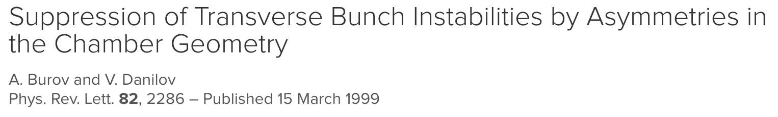
Conclusion
Indeed, the detuning impedance of flat chambers is (also) detrimental (for the same driving impedance) for the SPS TMCI (“long-bunch” regime) and does not suppress/increase it!
=> See https://cds.cern.ch/record/2714848/files/CERN-ACC-NOTE-2020-0019.pdf

Slide 129
Outlook
The coherent SC modes from GALACTIC and BimBim are very different from the ones of the ABS model (different distribution) => Positive modes become negative with SC parameter + Radial modes
  Was it also observed with other models / simulations? => To be checked/confirmed
  What is the impact on the predicted “convective instabilities” (Burov_PRAB2019)?
Finalise study with GALACTIC
  Fully understand if mode 00 is shifting or not with intensity (do we need to integrate the incoherent force in the Eigenvalue problem)?
  Study the impact of the new SC modes on TMCI

Slide 130
Outlook
The coherent SC modes from GALACTIC and BimBim are very different from the ones of the ABS model (different distribution) => Positive modes become negative with SC parameter + Radial modes
  Was it also observed with other models / simulations? => To be checked/confirmed. What could be the mistake in the 2 codes?
  What is the impact on the predicted “convective instabilities” (Burov_PRAB2019)?
Finalise study with GALACTIC
  Fully understand if mode 00 is shifting or not with intensity (do we need to integrate the incoherent force in the Eigenvalue problem)?
  Study the impact of the new SC modes on TMCI

Slide 131
Outlook
The coherent SC modes from GALACTIC and BimBim are very different from the ones of the ABS model (different distribution) => Positive modes become negative with SC parameter + Radial modes
  Was it also observed with other models / simulations? => To be checked/confirmed. What could be the mistake in the 2 codes?
  If confirmed, what would be the impact on the predicted “convective instabilities” (Burov_PRAB2019)?
Finalise study with GALACTIC
  Fully understand if mode 00 is shifting or not with intensity (do we need to integrate the incoherent force in the Eigenvalue problem)?
  Study the impact of the new SC modes on TMCI

Slide 132
Outlook
The coherent SC modes from GALACTIC and BimBim are very different from the ones of the ABS model (different distribution) => Positive modes become negative with SC parameter + Radial modes
  Was it also observed with other models / simulations? => To be checked/confirmed. What could be the mistake in the 2 codes?
  If confirmed, what would be the impact on the predicted “convective instabilities” (Burov_PRAB2019)?
Finalise study with GALACTIC (and compare to BimBim)
  Fully understand if mode 00 is shifting or not with intensity (do we need to integrate the incoherent force in the Eigenvalue problem)?
  Study the impact of the new SC modes on TMCI

Slide 133
Outlook
The coherent SC modes from GALACTIC and BimBim are very different from the ones of the ABS model (different distribution) => Positive modes become negative with SC parameter + Radial modes
  Was it also observed with other models / simulations? => To be checked/confirmed. What could be the mistake in the 2 codes?
  If confirmed, what would be the impact on the predicted “convective instabilities” (Burov_PRAB2019)?
Finalise study with GALACTIC (and compare to BimBim)
  Fully understand if mode 00 is shifting or not with intensity (do we need to integrate the incoherent force in the Eigenvalue problem)?
  Study the impact of the new SC modes on TMCI

Slide 134
Outlook
The coherent SC modes from GALACTIC and BimBim are very different from the ones of the ABS model (different distribution) => Positive modes become negative with SC parameter + Radial modes
  Was it also observed with other models / simulations? => To be checked/confirmed. What could be the mistake in the 2 codes?
  If confirmed, what would be the impact on the predicted “convective instabilities” (Burov_PRAB2019)?
Finalise study with GALACTIC (and compare to BimBim)
  Fully understand if mode 00 is shifting or not with intensity (do we need to integrate the incoherent force in the Eigenvalue problem)?
  Study the impact of the (new, if confirmed) SC modes on the TMCI intensity threshold from the SPS impedance

Slide 135
APPENDIX

Slide 136
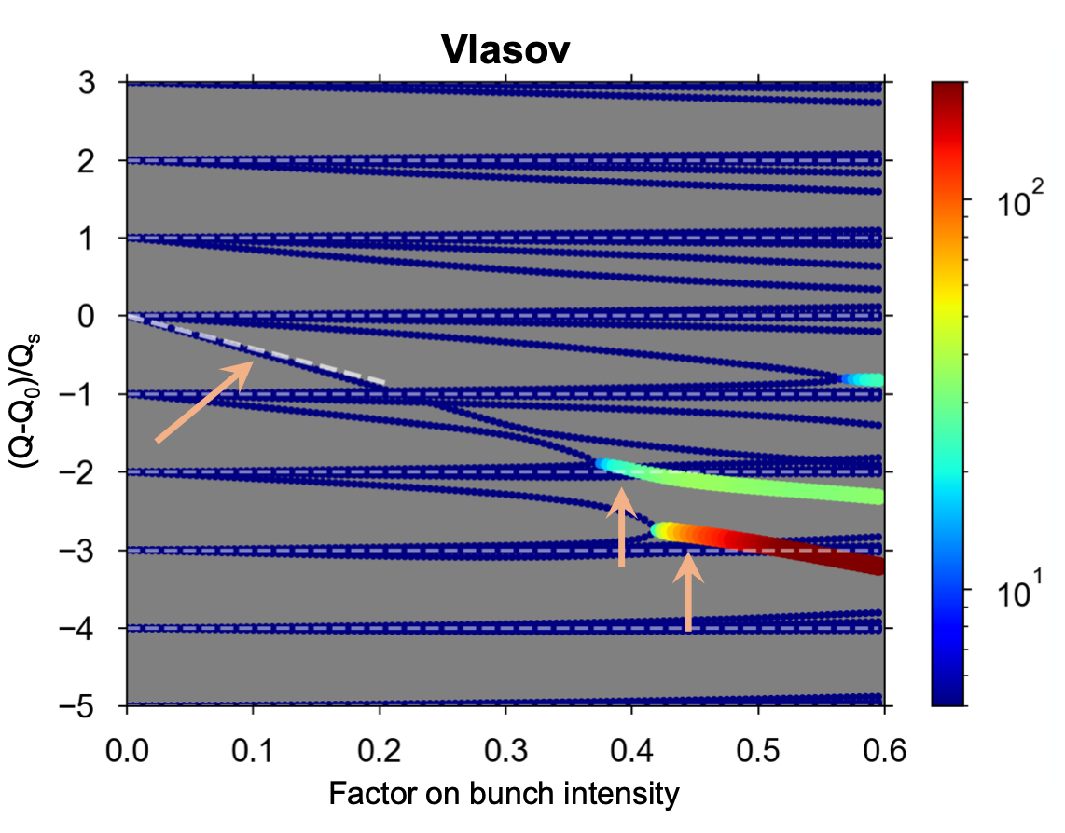
Coherent SC modes vs.
driving+detuning modes in a flat chamber
H modes in a flat chamber
w/o detuning impedance
GianniI

Slide 137
Coherent SC modes vs.
driving+detuning modes in a flat chamber
H modes in a flat chamber
w/o detuning impedance
SC modes (w radial)
w/o incoherent force
GianniI

Slide 138
Coherent SC modes vs.
driving+detuning modes in a flat chamber
H modes in a flat chamber
w/o detuning impedance
SC modes (w radial)
w/o incoherent force
GianniI

Slide 139
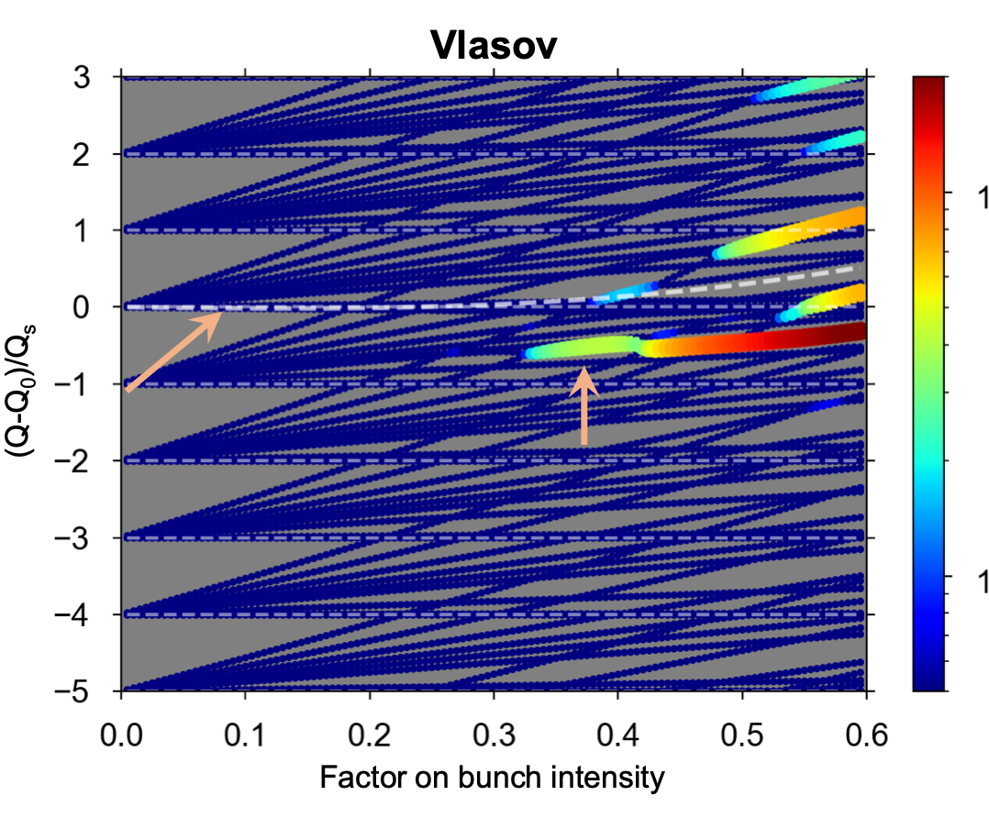
Coherent SC modes vs.
driving+detuning modes in a flat chamber
H modes in a flat chamber
w detuning impedance
GianniI

Slide 140
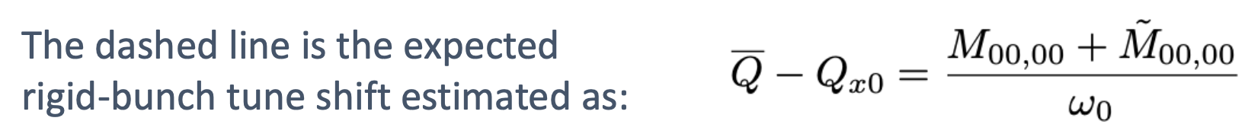
H modes in a flat chamber
w detuning impedance
GianniI

Slide 141
The bend of mode 00 comes from a phase shift (increasing with intensity) which is in the “driving” matrix M
H modes in a flat chamber
w detuning impedance
GianniI

Slide 142
The bend of mode 00 comes from a phase shift (increasing with intensity) which is in the “driving” matrix M
The “detuning” matrix is
linear with intensity
H modes in a flat chamber
w detuning impedance
GianniI

Slide 143
The bend of mode 00 comes from a phase shift (increasing with intensity) which is in the “driving” matrix M
The “detuning” matrix is
linear with intensity
H modes in a flat chamber
w detuning impedance
The small difference
observed comes from the coupling between the
modes
GianniI

Slide 144
The bend of mode 00 comes from a phase shift (increasing with intensity) which is in the “driving” matrix M
The “detuning” matrix is
linear with intensity
H modes in a flat chamber
w detuning impedance
SC modes (w radial)
w incoherent force
The small difference
observed comes from the coupling between the
modes
GianniI

Slide 145
The bend of mode 00 comes from a phase shift (increasing with intensity) which is in the “driving” matrix M
The “detuning” matrix is
linear with intensity
H modes in a flat chamber
w detuning impedance
SC modes (w radial)
w incoherent force
The small difference
observed comes from the coupling between the
modes
The mode 00 is also bent here (GALACTIC, water-bag)
GianniI

Slide 146
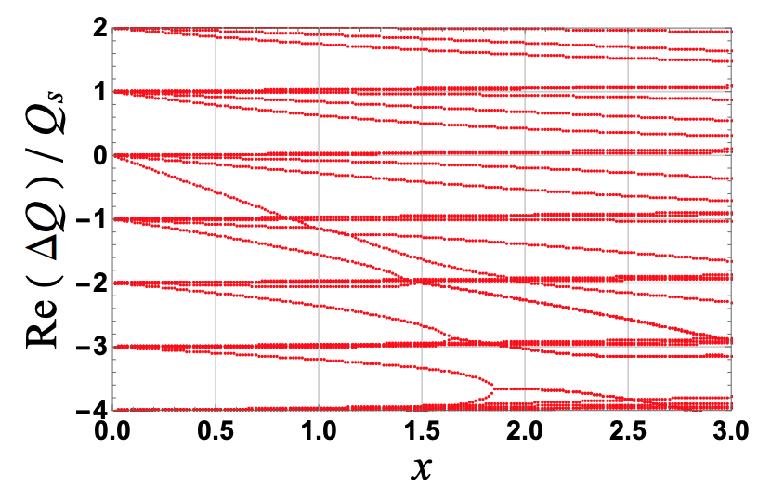
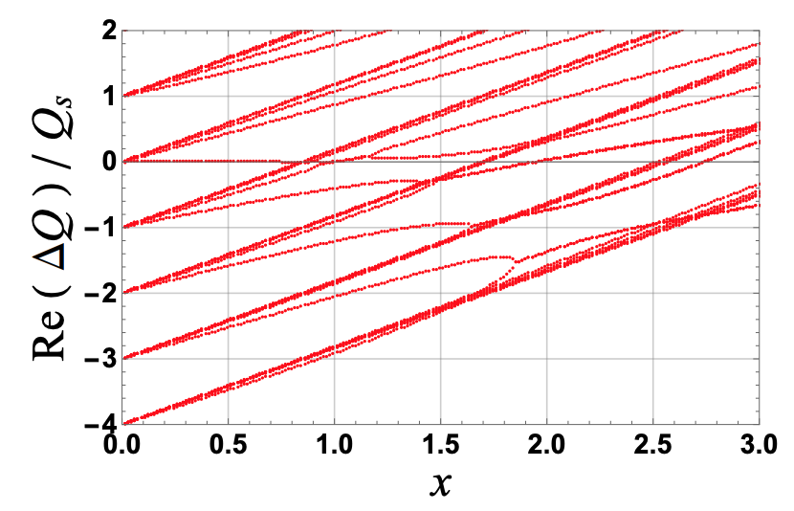
Reminder: driving+detuning from GALACTIC
using a “constant detuning tune shift”
w/o detuning impedance
w detuning impedance
Shift of mode 00 due to
coupling between the modes

Slide 147
Conclusion
The case of the driving+detuning modes in the H-plane of a flat chamber seems now well understood with the new DELPHI of GianniI et al. => In particular the mode 00 is shifting up with intensity due to 2 effects
  A phase shift (increasing with intensity) which is in the driving matrix (but coming from the detuning term)
  Coupling between the modes

Slide 148
Conclusion
A similar effect (shift of the mode 00 with intensity) is also observed with SC using GALACTIC (with a water-bag distribution and applying the incoherent force separately)
  Note: a detuning impedance introduces a kick on the slice centroid, while the SC force cannot do that. For this reason, the effect on the mode-00 tune shift might indeed be different
  This is not observed in the BimBim code (using a Gaussian distribution) where the modo 00 remains at 0
  Is the effect observed in GALACTIC real or due to the fact that the incoherent force is applied separately?
  => To be clarified, checked also with new and new new DELPHI.
  Others?

Slide 149
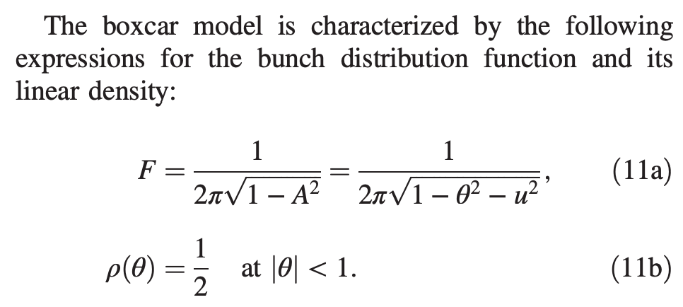
Comparison with boxcar distribution of Balbekov_2017 (https://journals.aps.org/prab/pdf/10.1103/PhysRevAccelBeams.20.034401)
WBL
w 3 radial modes
Boxcar model

Slide 150
Comparison with boxcar distribution of Balbekov_2017 (https://journals.aps.org/prab/pdf/10.1103/PhysRevAccelBeams.20.034401)

Slide 151
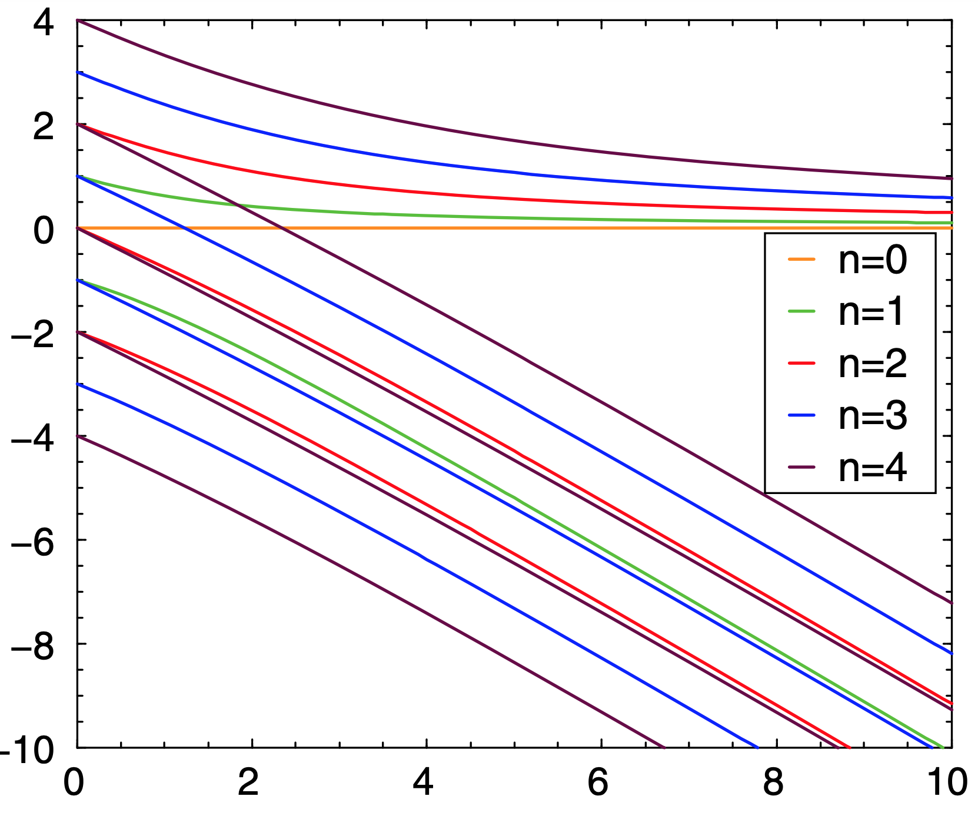
Comparison with boxcar distribution of Balbekov_2017 (https://journals.aps.org/prab/pdf/10.1103/PhysRevAccelBeams.20.034401)

Slide 152
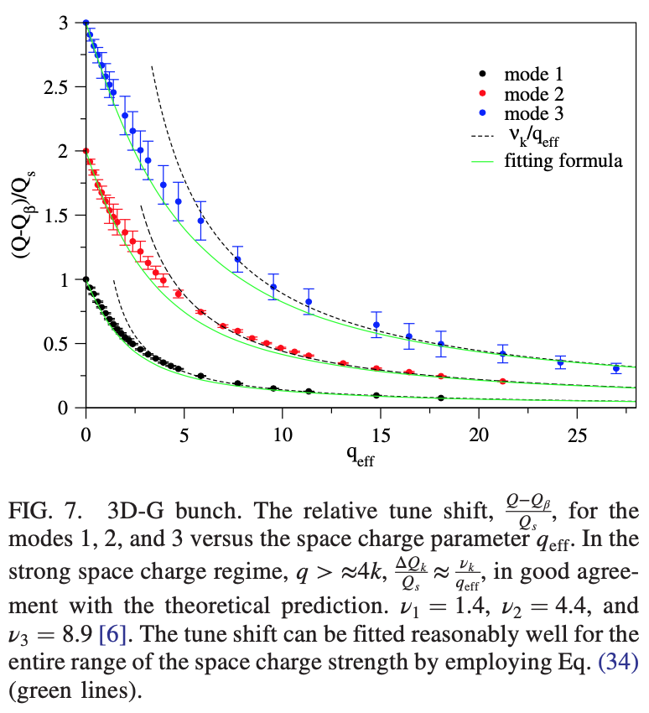
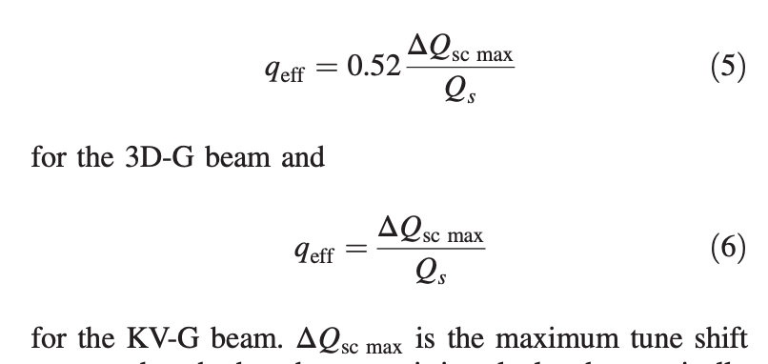
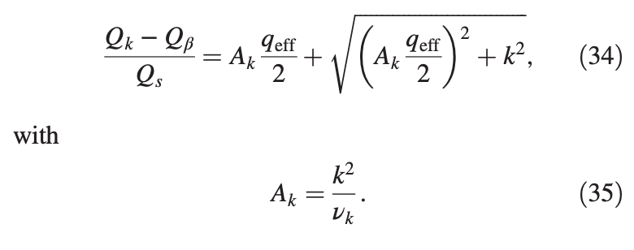
Why the results from the SYNERGIA code seemed to work so nicely with past predictions?
PRAB Burov_2015 (https://journals.aps.org/prab/pdf/10.1103/PhysRevSTAB.18.074401)
Typo: negative sign
missing (comment from A. Burov)

Slide 153
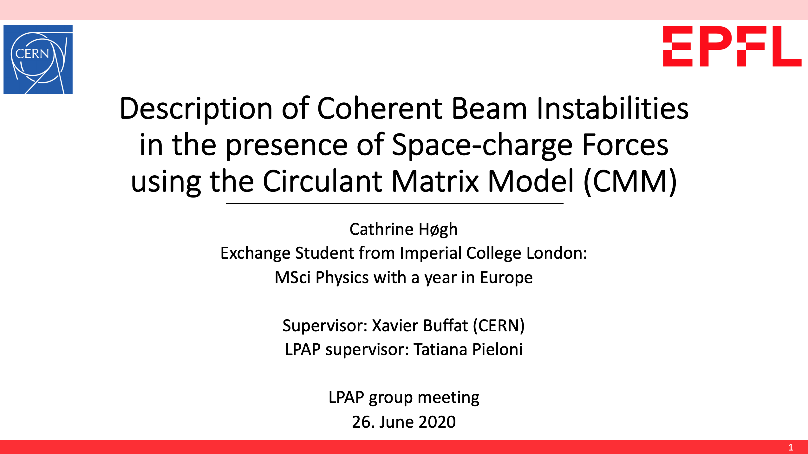

Slide 154
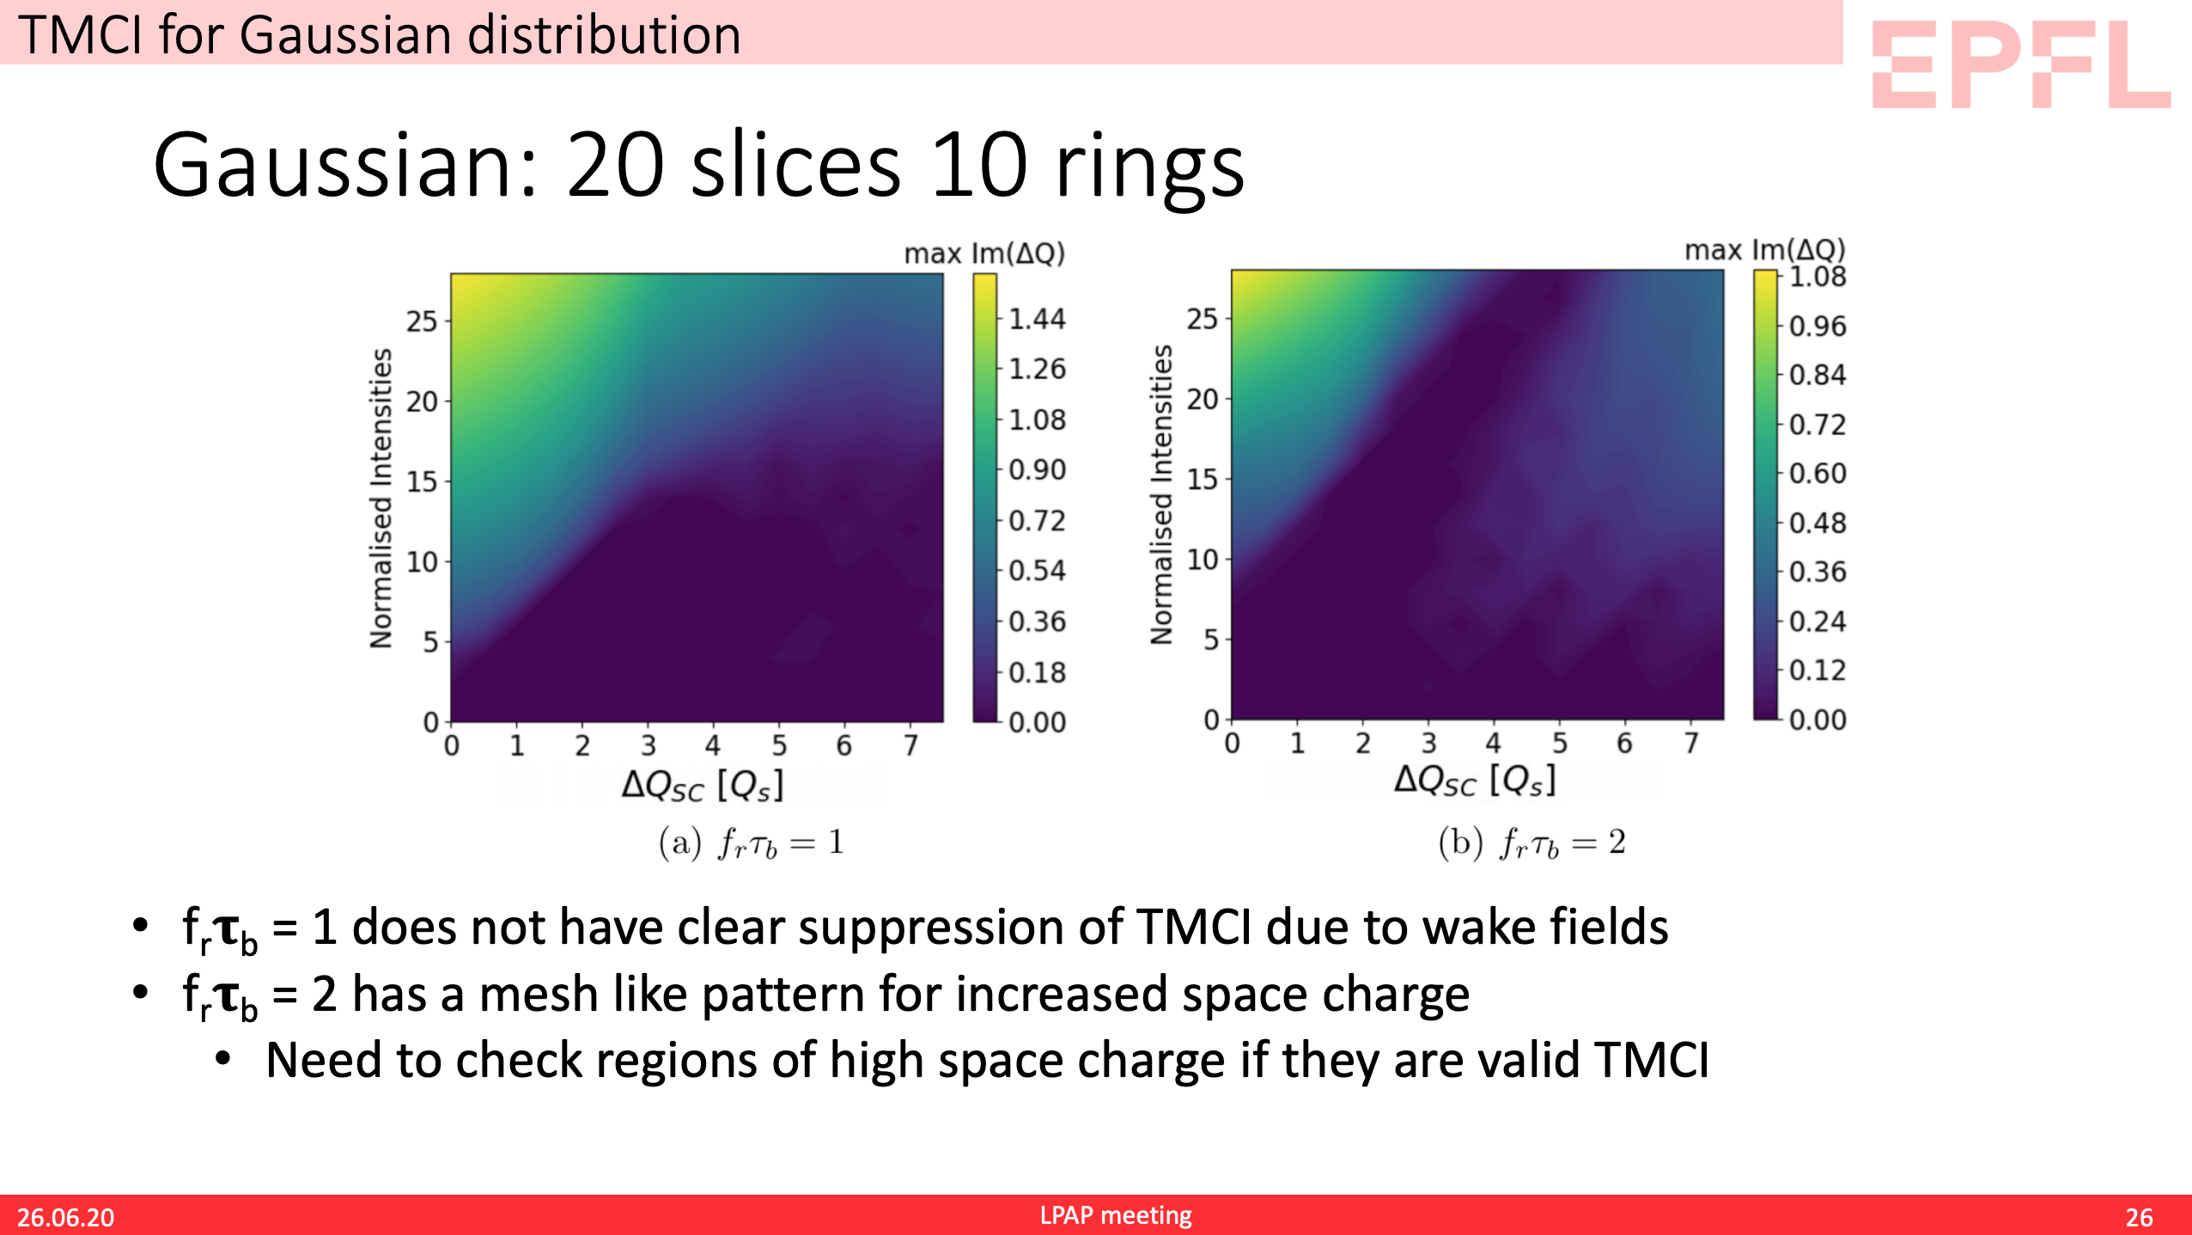

Slide 155
