Slide 1
Capricious beam jitters: power supply ripple & beam performance
S. Kostoglou, G. Sterbini, Y. Papaphilippou, G. Arduini, C. Baccigalupi,
H. Bartosik, M. C. Bastos, X. Buffat, J. P. Burnet, R. De Maria, D. Gamba,
L. Intelisano, T. Levens , M. Martino, V. Montabonnet, N. Mounet,
M. Soderen, H. Thiesen, Y. Thurel, D. Valuch, J. Wenninger
Mitigation Approaches for Storage Rings and Synchotrons
30.06.2020
30/06/2020
Power supply ripple in the LHC

Slide 2
Motivation
LHC performance during Run I & II: proton losses and emittance growth ↑ than anticipated [1-4]
[1] F. Antoniou, et al. Can we predict luminosity? 7th Evian Workshop on LHC beam operation 2016
[2] S. Papadopoulou, et al. Emittance, intensity and luminosity modeling and evolution, 8th Evian Workshop on LHC beam operation 2017
[3] S. Papadopoulou S, et al. What do we understand on the emittance growth? 9th Evian Workshop on LHC beam operation 2019
[4] S. Kostoglou, et al. Luminosity and lifetime modeling and optimization, 9th Evian Workshop on LHC beam operation 2019
30/06/2020
Power supply ripple in the LHC

Slide 3
Motivation
LHC performance during Run I & II: proton losses and emittance growth ↑ than anticipated [1-4] → Noise effects
http://noisestudies.web.cern.ch/
[1] F. Antoniou, et al. Can we predict luminosity? 7th Evian Workshop on LHC beam operation 2016
[2] S. Papadopoulou, et al. Emittance, intensity and luminosity modeling and evolution, 8th Evian Workshop on LHC beam operation 2017
[3] S. Papadopoulou S, et al. What do we understand on the emittance growth? 9th Evian Workshop on LHC beam operation 2019
[4] S. Kostoglou, et al. Luminosity and lifetime modeling and optimization, 9th Evian Workshop on LHC beam operation 2019
30/06/2020
Power supply ripple in the LHC

Slide 4
Motivation
LHC performance during Run I & II: proton losses and emittance growth ↑ than anticipated → Noise effects
Power supply ripple in dipoles & quadrupoles:
http://noisestudies.web.cern.ch/
30/06/2020
Power supply ripple in the LHC

Slide 5
Motivation
LHC performance during Run I & II: proton losses and emittance growth ↑ than anticipated → Noise effects
Power supply ripple in dipoles & quadrupoles:
Observed in LHC & expected in HL-LHC
Harmonics of the mains power frequency (50 Hz)
What is the source? Summary of 2018 observations.
What is the impact on the LHC beam lifetime?
http://noisestudies.web.cern.ch/
30/06/2020
Power supply ripple in the LHC

Slide 6
Motivation
LHC performance during Run I & II: proton losses and emittance growth ↑ than anticipated → Noise effects
Power supply ripple in dipoles & quadrupoles:
Observed in LHC & expected in HL-LHC
Harmonics of the mains power frequency (50 Hz)
What is the source? Summary of 2018 observations.
What is the impact on the LHC beam lifetime?
Expected in HL-LHC
Quadrupoles of the Inner Triplet
Do we expect an impact on the HL-LHC beam performance?
http://noisestudies.web.cern.ch/
30/06/2020
Power supply ripple in the LHC

Slide 7
Power supply ripple spectra
Main dipoles
→ Silicon Controlled Rectifier (SCR)
Inner Triplet quadrupoles
→ Switch-Mode (SM)
30/06/2020
Power supply ripple in the LHC

Slide 8
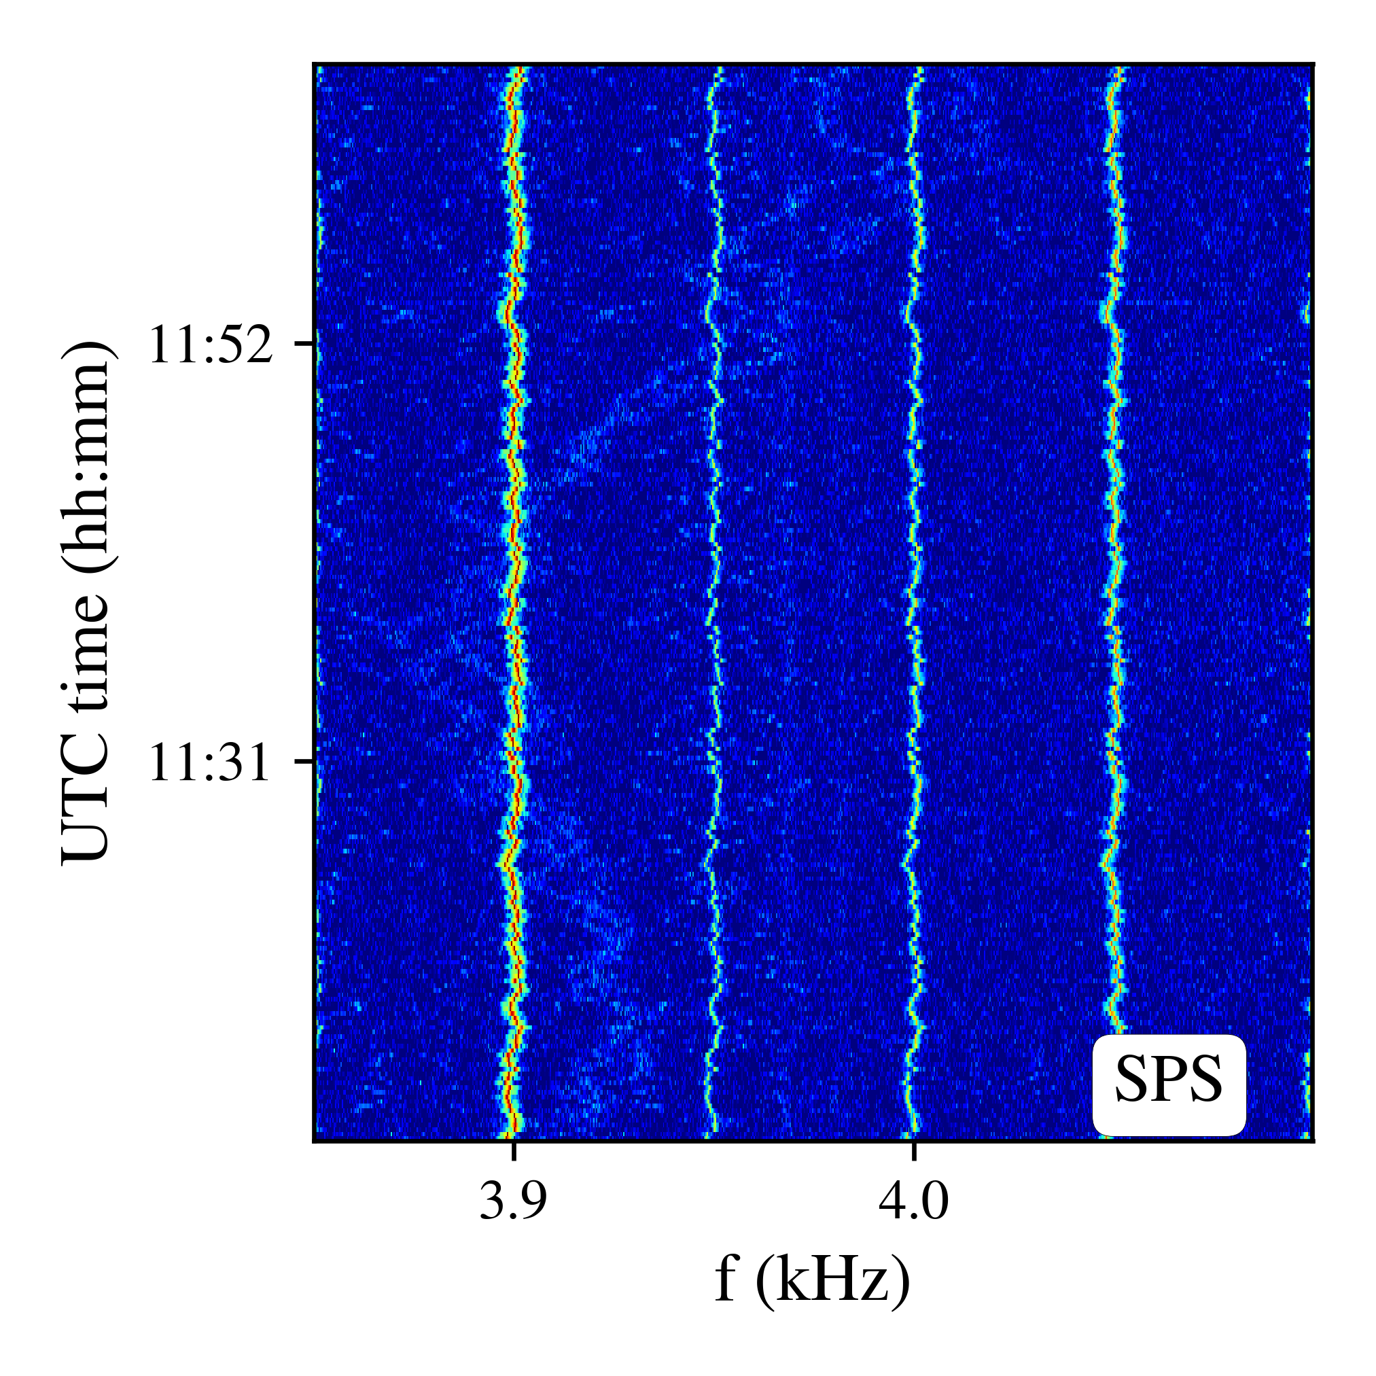
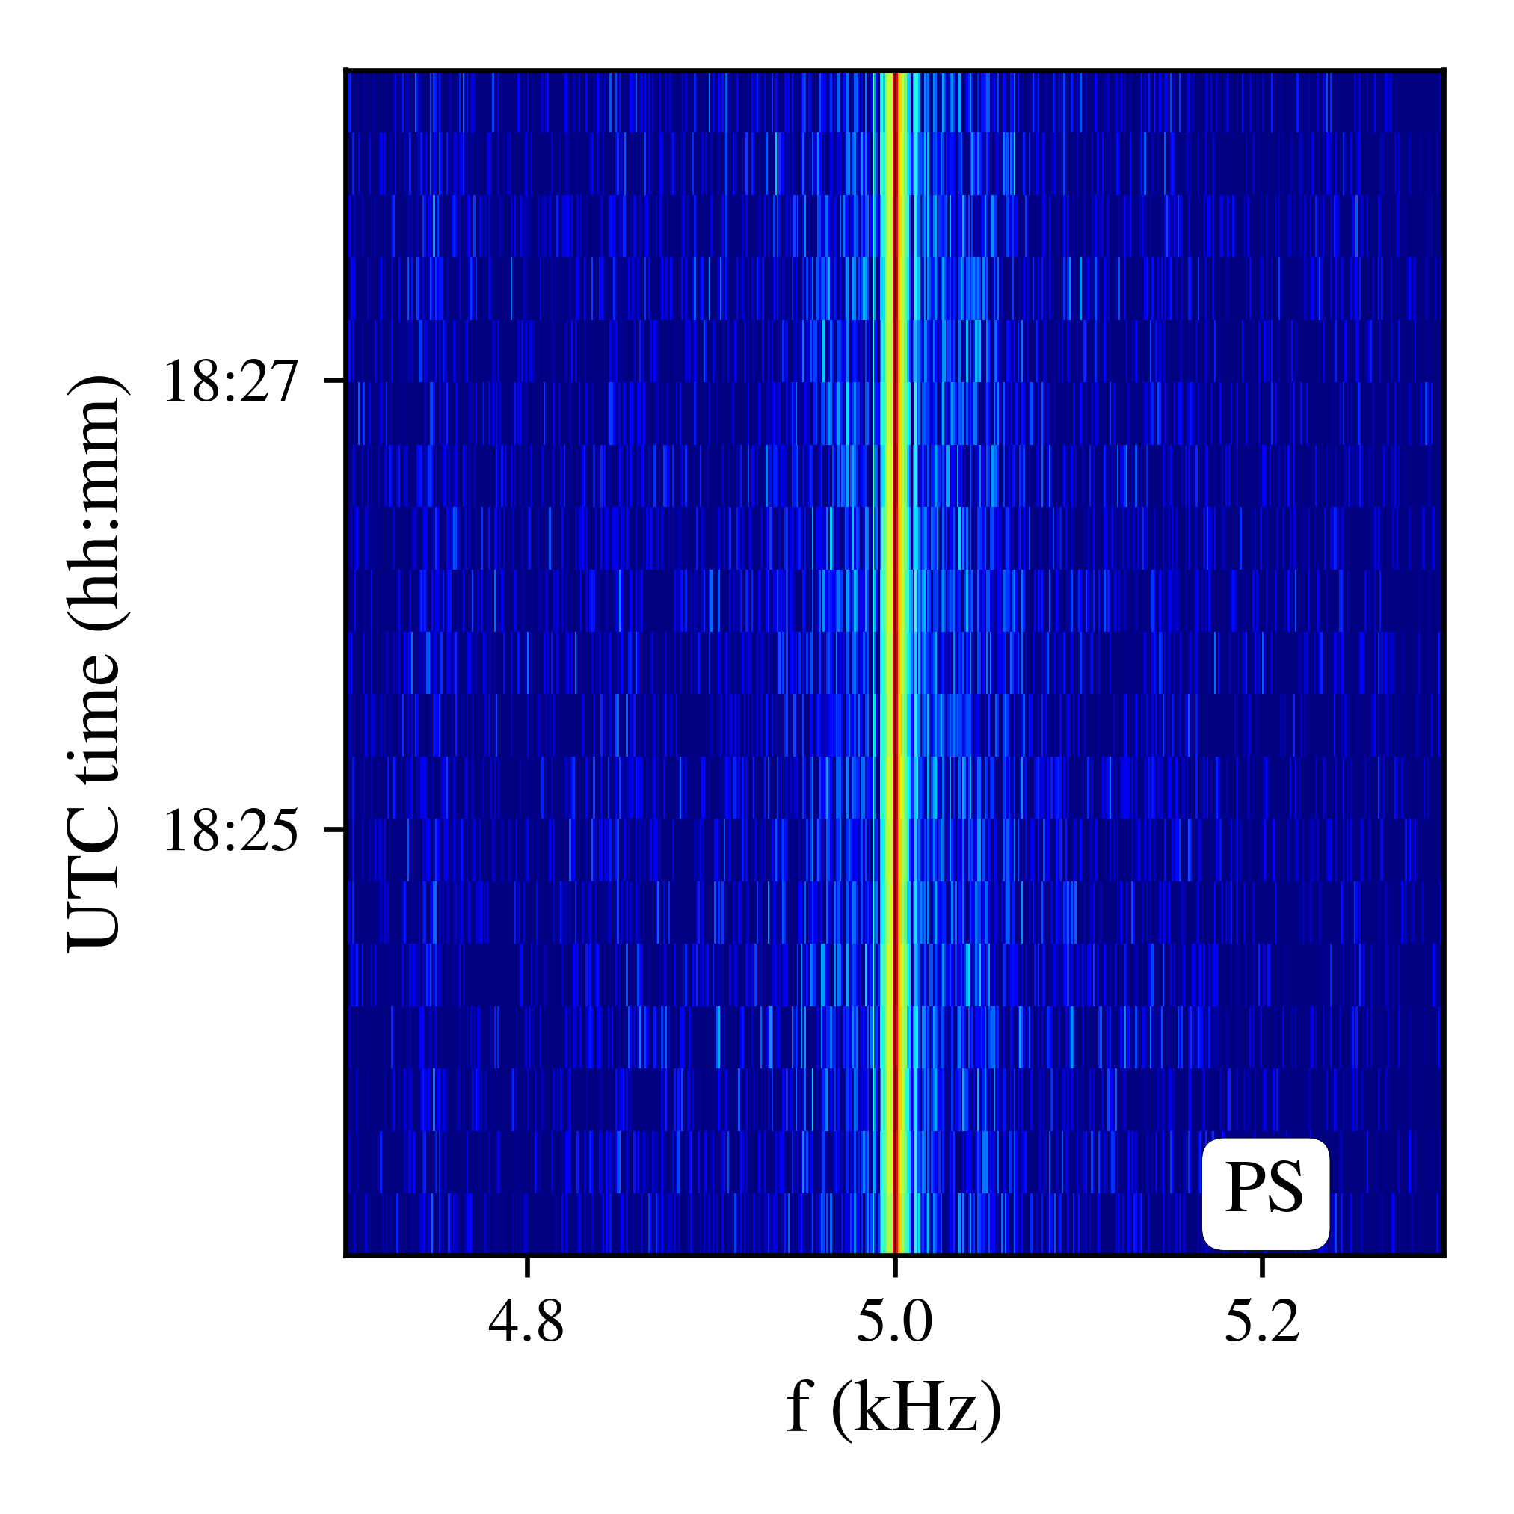
Power supply ripple spectra
Main dipoles
→ Silicon Controlled Rectifier (SCR)
Inner Triplet quadrupoles
→ Switch-Mode (SM)
Example of SCR
Example of SM
Multiple 50 Hz harmonics
Frequency modulation (see next slides)
Switching frequency & its harmonics
30/06/2020
Power supply ripple in the LHC

Slide 9
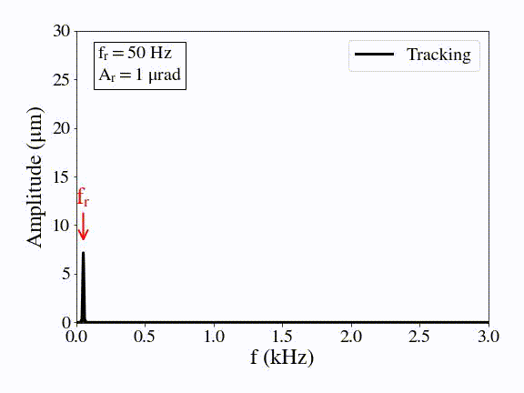
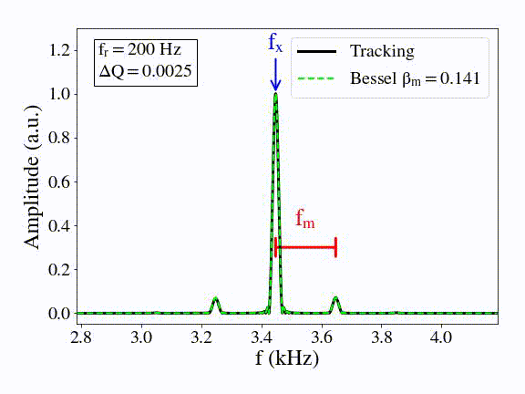
Power supply ripple spectra
Main dipoles
→ Silicon Controlled Rectifier (SCR)
Inner Triplet quadrupoles
→ Switch-Mode (SM)
Example of SCR
Example of SM
Spectrum with
dipolar excitation
Spectrum with
quadrupolar excitation

Slide 10
Power supply ripple spectra
Main dipoles
→ Silicon Controlled Rectifier (SCR)
Inner Triplet quadrupoles
→ Switch-Mode (SM)
Example of SCR
Example of SM
Observed in:
SPS, RHIC, Tevatron, LHC..
Observed in:
RHIC, SPS, HERA..
30/06/2020
Power supply ripple in the LHC

Slide 11
Part 1: Harmonics of the mains frequency on the beam spectrum
30/06/2020
Power supply ripple in the LHC

Slide 12
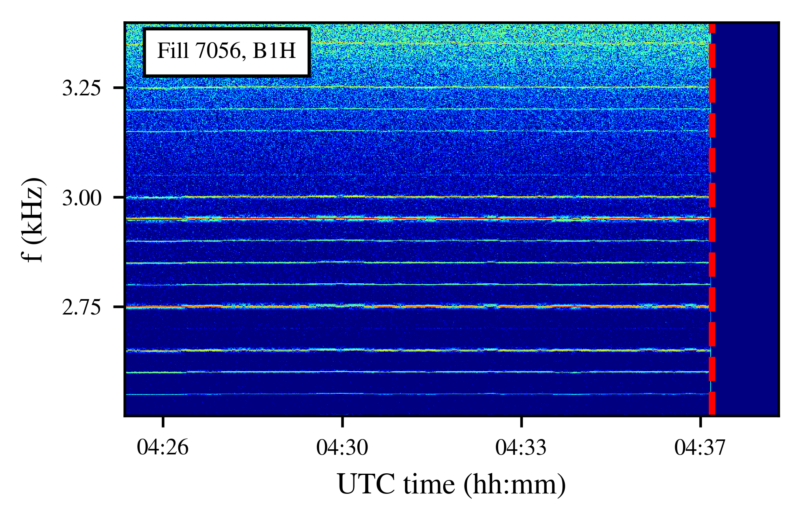
Introduction
Harmonics of 50 Hz in the transverse beam spectrum since the start of the LHC operation.
Observed in several unrelated instruments.
Visible in all beam modes and planes.
Not present without beam.
End of Collisions
30/06/2020
Power supply ripple in the LHC
12

Slide 13
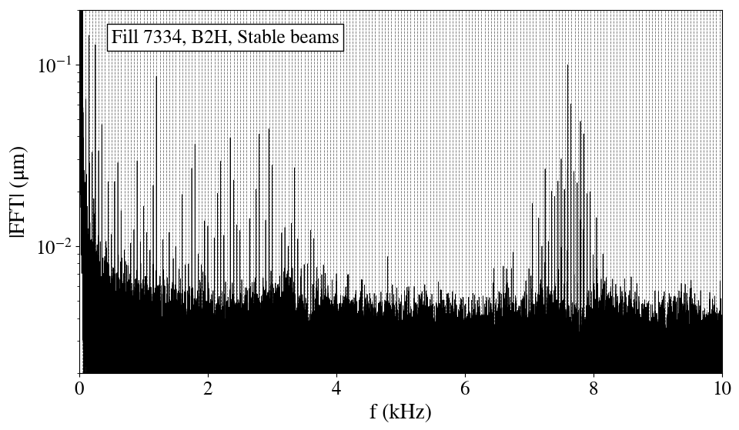
The low and high-f clusters
Computed with bunch-by-bunch calibrated position measurements.
30/06/2020
Power supply ripple in the LHC
13

Slide 14
The low and high-f clusters
Computed with bunch-by-bunch calibrated position measurements.
“Low frequency cluster”
50 Hz harmonics
“High frequency cluster”
50 Hz harmonics
Low-f cluster up to 3.6 kHz.
High-f cluster ~7-8 kHz, in the regime f_{rev}-f_{x}
30/06/2020
Power supply ripple in the LHC
14

Slide 15
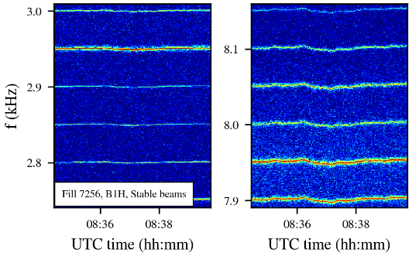
Signature of low and high-f cluster
Low-f cluster + High-f cluster:
Multiple 50 Hz harmonics.
Similar frequency modulation from the mains, with an FM amplitude proportional to order of the harmonic.
“Low frequency cluster”
“High frequency cluster”
30/06/2020
Power supply ripple in the LHC

Slide 16
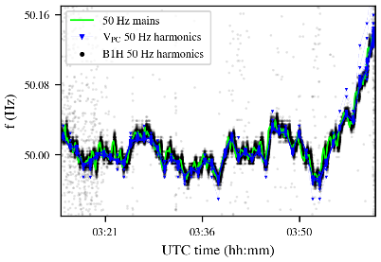
Signature of low and high-f cluster
Low-f cluster + High-f cluster:
Multiple 50 Hz harmonics.
Similar frequency modulation from the mains, with an FM amplitude proportional to order of the harmonic.
50 Hz in the beam
50 Hz in the voltage spectrum of the MB power converter in S12
50 Hz mains*
“Low frequency cluster”
“High frequency cluster”
*RTE, thanks to A. Bland
30/06/2020
Power supply ripple in the LHC

Slide 17
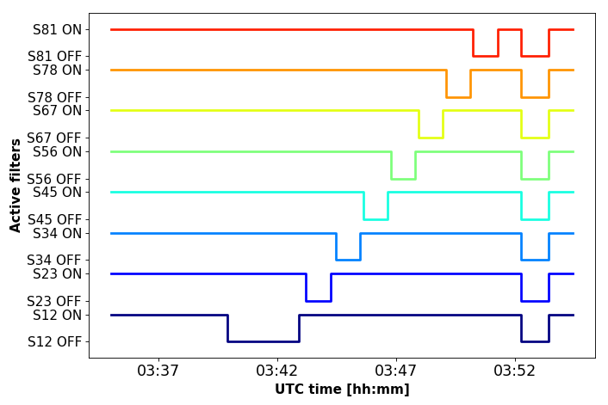
Source of the low-f cluster
Status of active filters of main dipoles
Active filters to reduce 50 Hz harmonics from pc output (although they enhance the high-order harmonics).
30/06/2020
Power supply ripple in the LHC

Slide 18
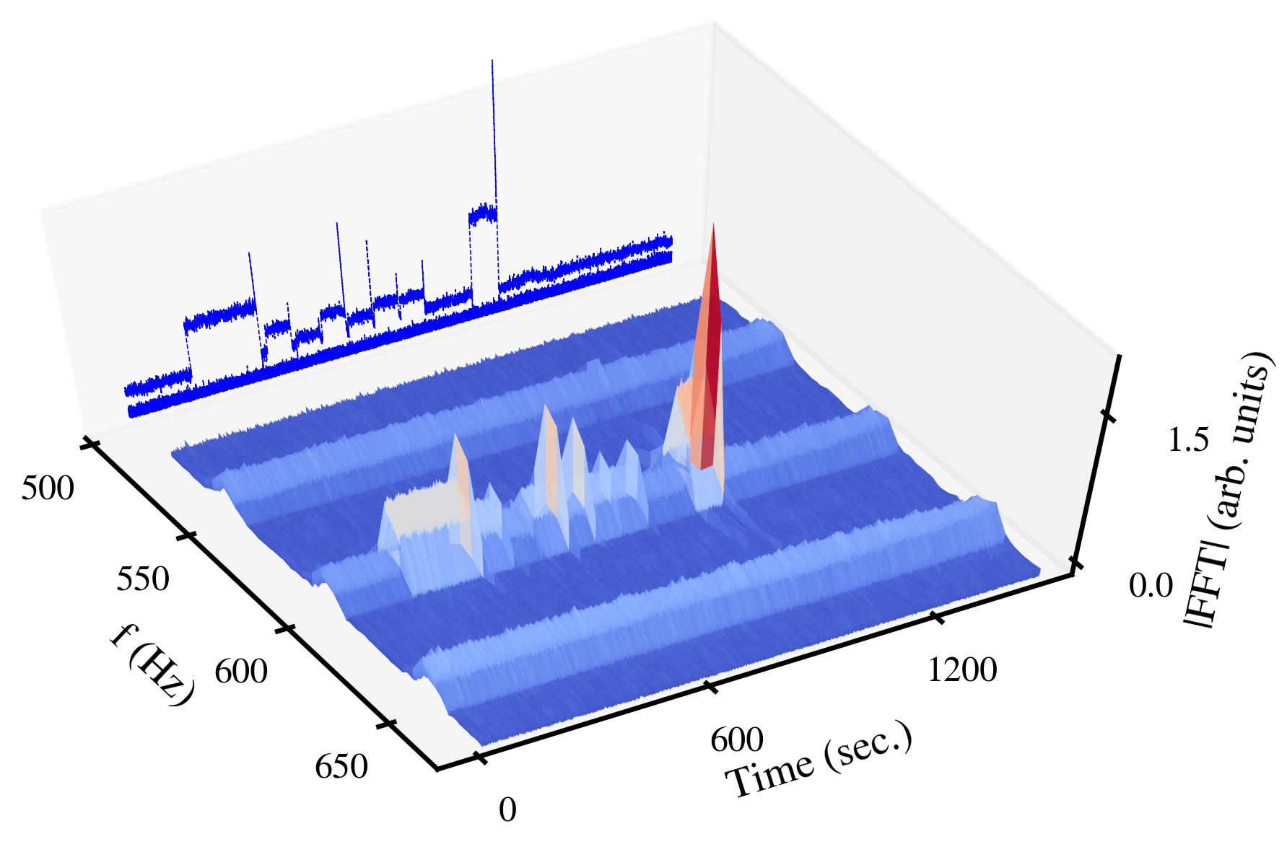
Source of the low-f cluster
Status of active filters of main dipoles
Active filters to reduce 50 Hz harmonics from pc output (although they enhance the high-order harmonics).
Beam’s response during AF tests
30/06/2020
Power supply ripple in the LHC

Slide 19
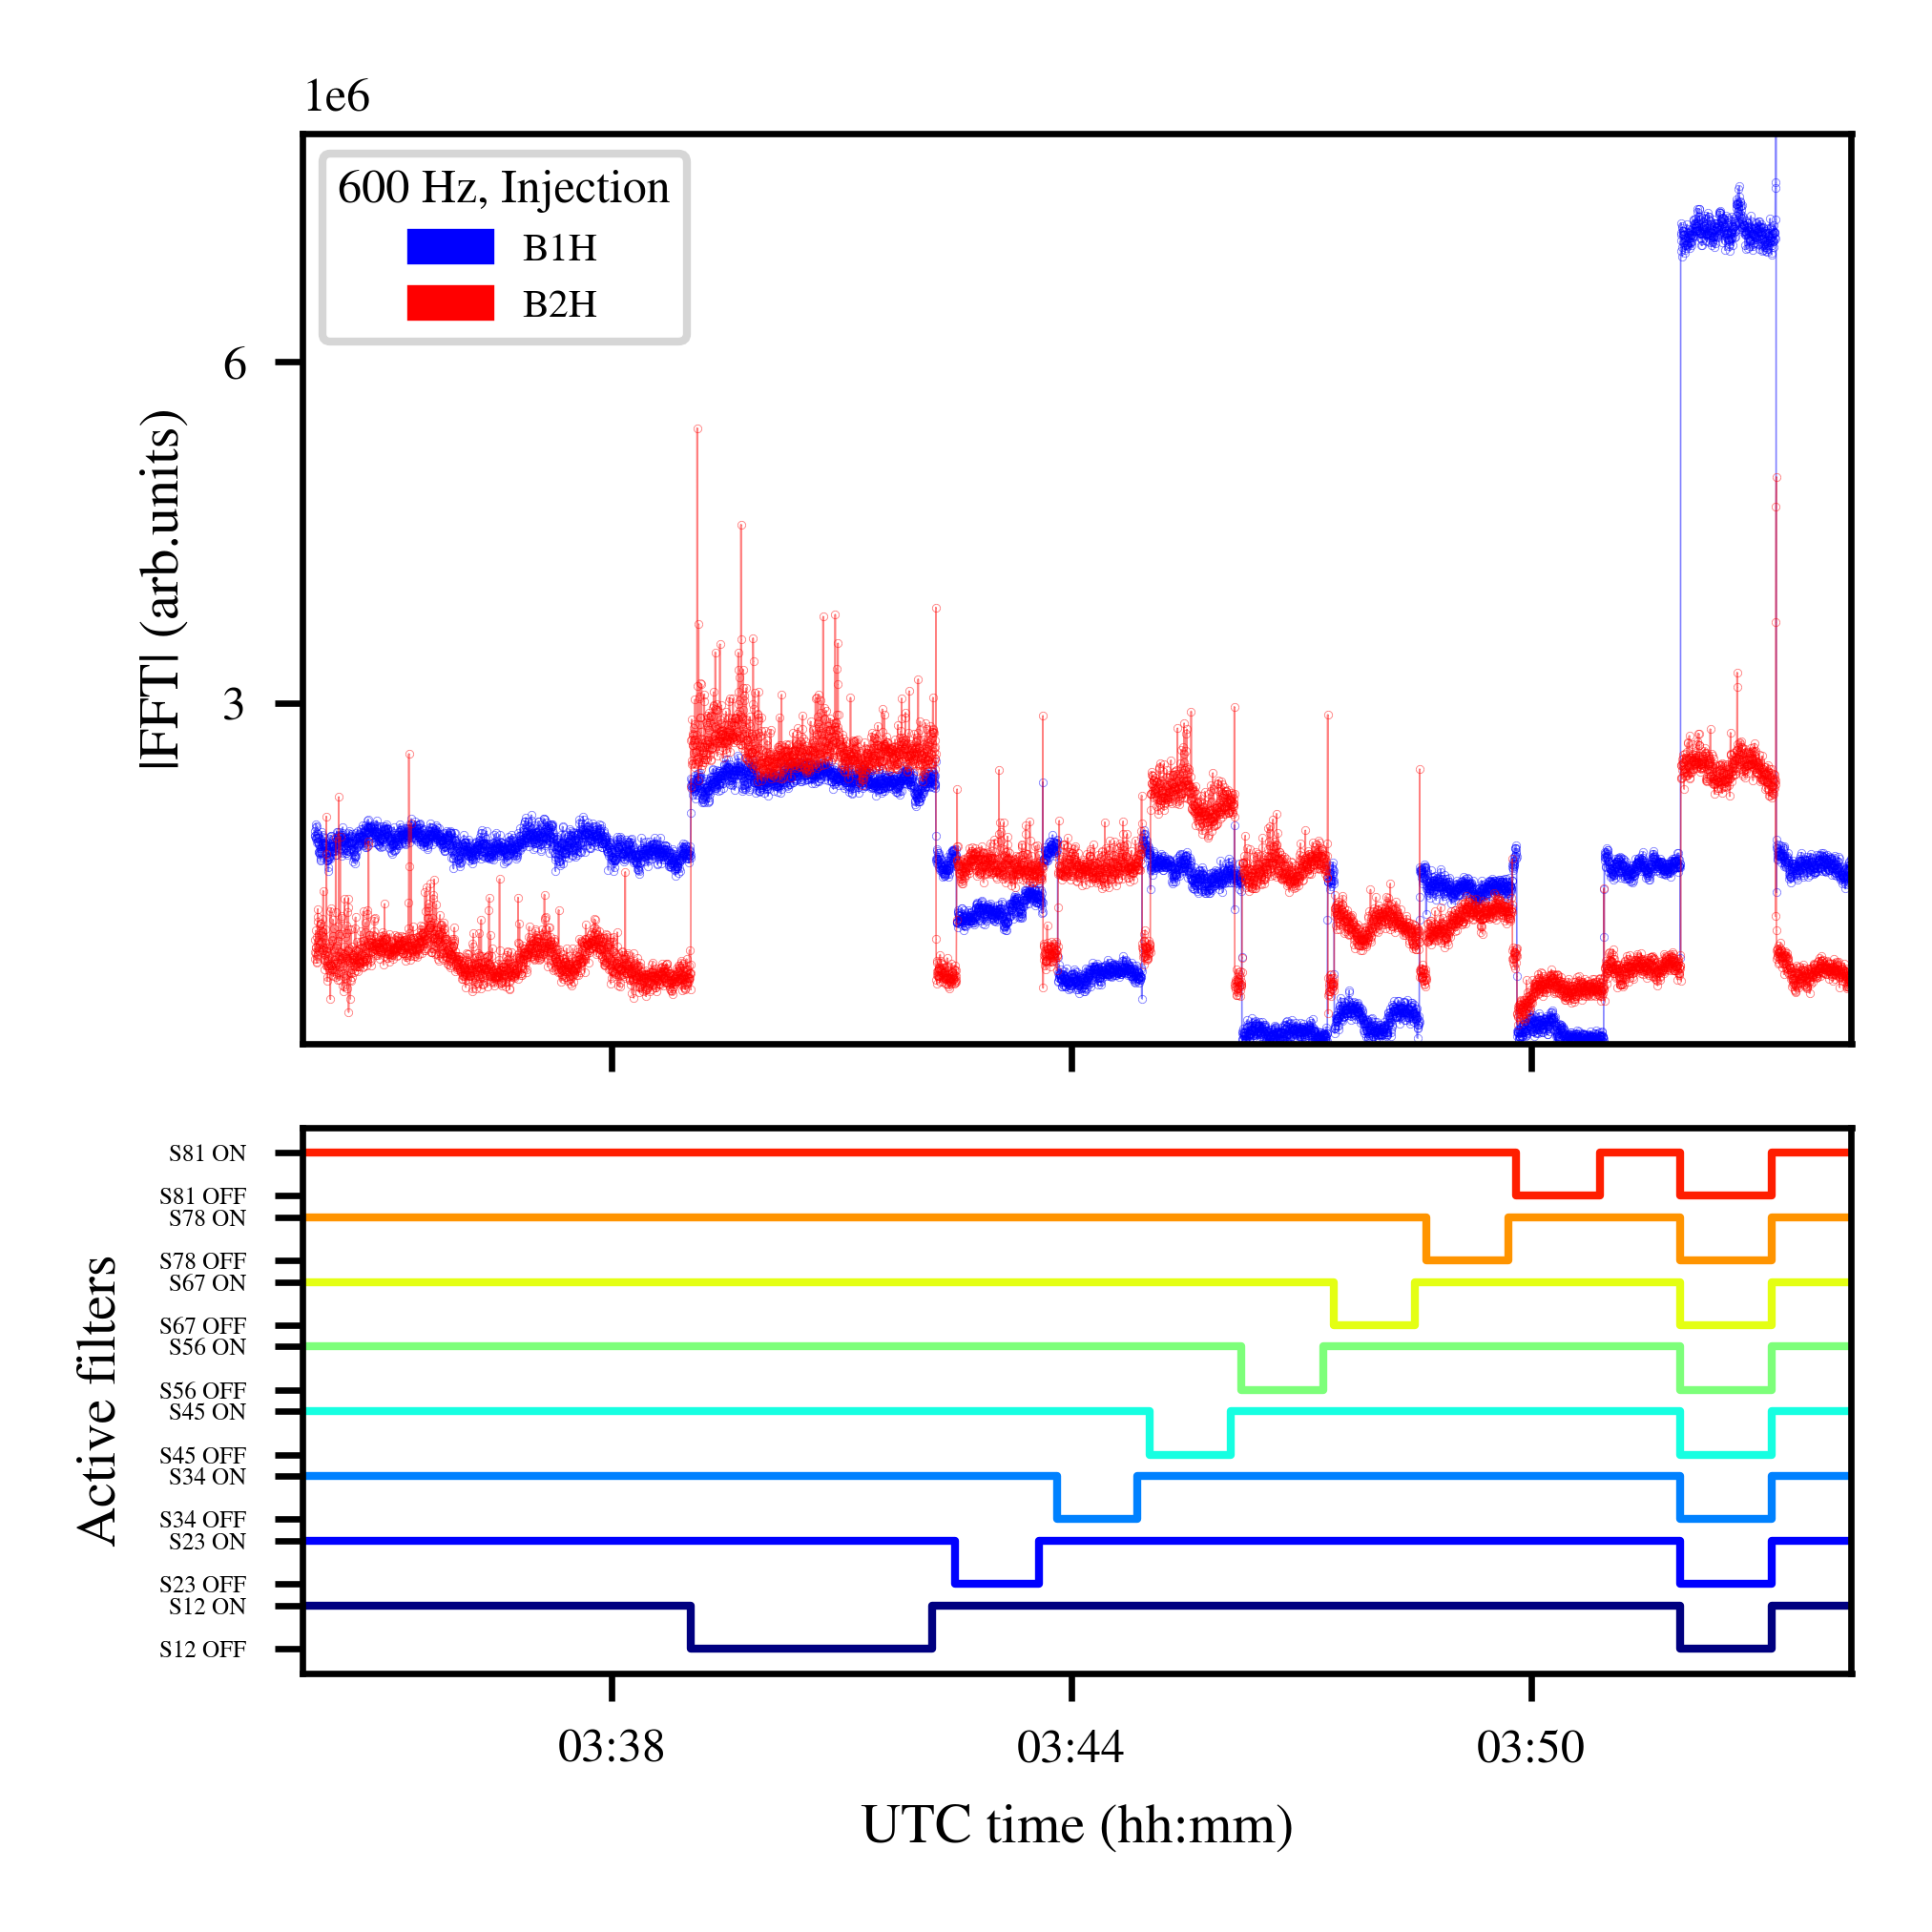
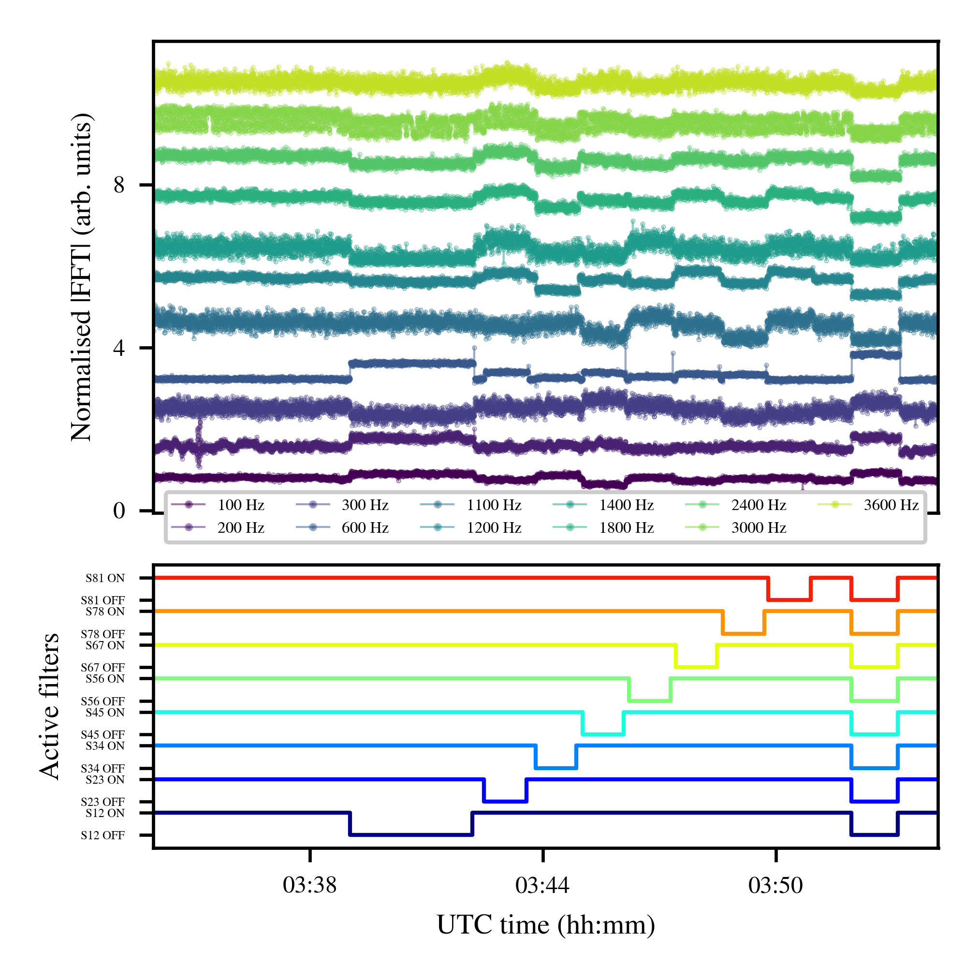
Source of the low-f cluster
ON/OFF active filters MB PC: impact on the harmonics of the low-f cluster.
All eight sectors contribute to this effect.
For the same harmonics, different response between Beam 1 & Beam 2
h=12
30/06/2020
Power supply ripple in the LHC

Slide 20
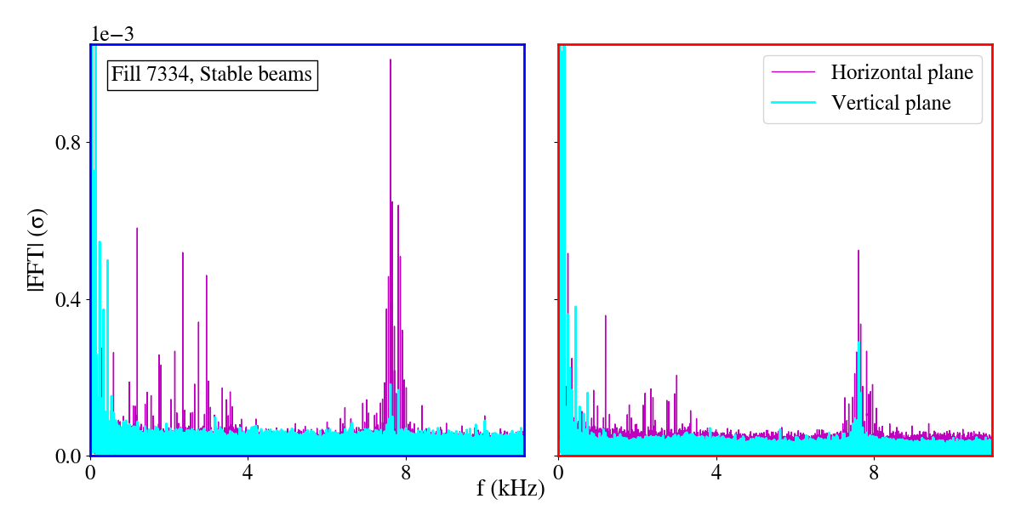
Comparison of Beam 1 & Beam 2
The impact of 50 Hz is higher in Beam 1 by a factor of 2 as compared to Beam 2.
B1
B2
~10⁻³ σ
The horizontal plane of B1 is mainly affected.
Asymmetry between low & high f-cluster.
30/06/2020
Power supply ripple in the LHC

Slide 21
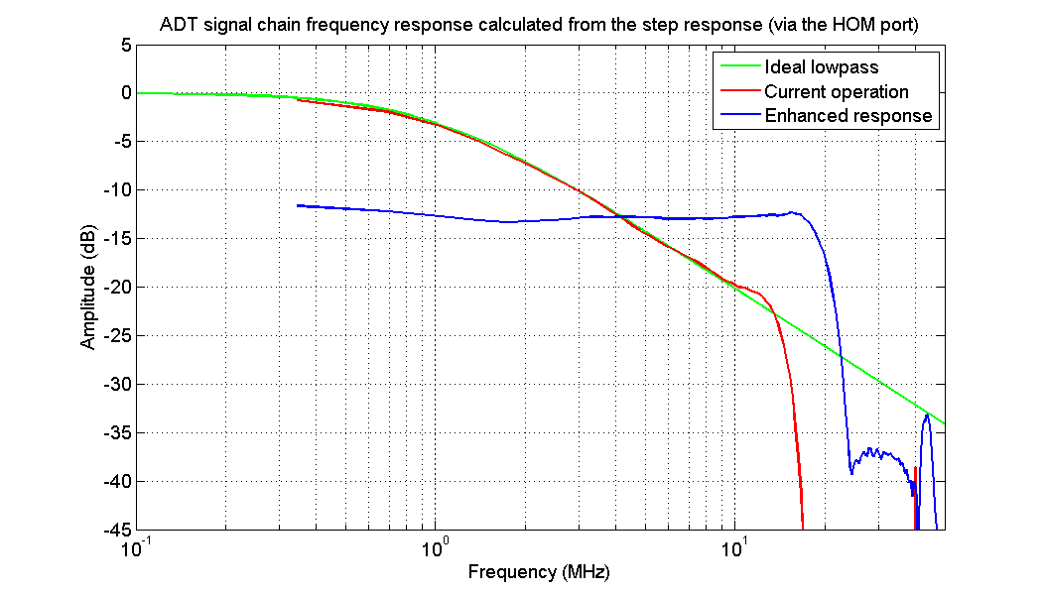
Impact of transverse damper on high-f cluster
Impact of high-f cluster when the ADT BW is changed from “extended” to “standard”.
Standard BW
Extended BW
LBOC, 30/10/2012, D. Valuch
30/06/2020
Power supply ripple in the LHC

Slide 22
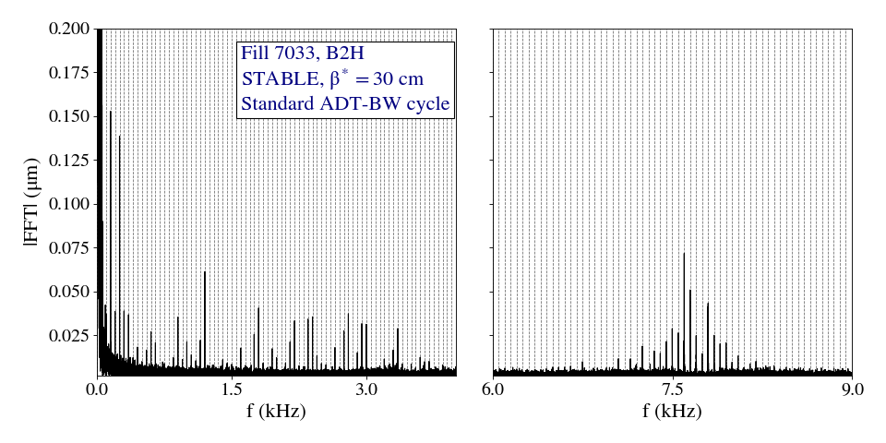
Impact of transverse damper on high-f cluster
Fill 7033, Stable beams
B2H
Standard setting
regular-BW cycle
30/06/2020
Power supply ripple in the LHC

Slide 23
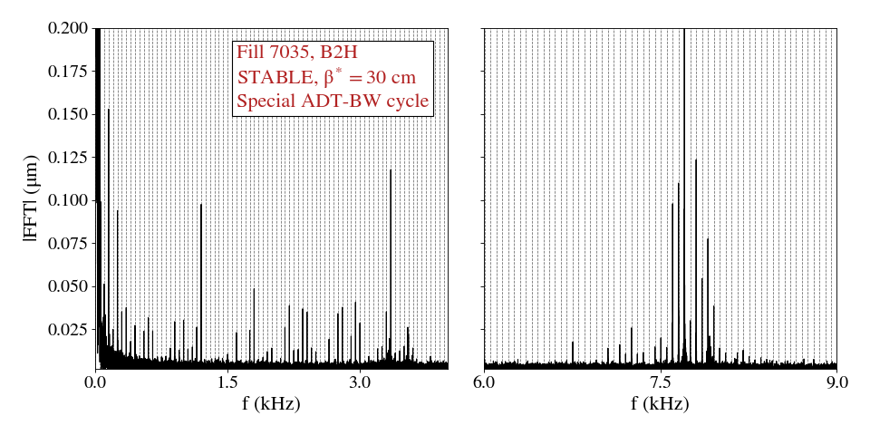
Impact of transverse damper on high-f cluster
Fill 7035, Stable beams
Special settings
Special cycle ADT extended-BW
30/06/2020
Power supply ripple in the LHC

Slide 24
Main unresolved issue in Run 2: The high-f cluster
Expected
From the transfer function of the voltage ripple to the magnetic field seen by the beam*: factor of 2 attenuation of the high-f cluster compared to the low-f cluster.
* M. Morrone M. Martino, et al, Magnetic frequency response of High-Luminosity Large Hadron Collider beam screens., Phys. Rev. ST Accel. Beams
30/06/2020
Power supply ripple in the LHC

Slide 25
Main unresolved issue in Run 2: The high-f cluster
Expected
From the transfer function of the voltage ripple to the magnetic field seen by the beam: factor of 2 attenuation of the high-f cluster compared to the low-f cluster.
Observed
In the beam spectrum, larger amplitudes are observed in the high-f cluster, while also strongly mitigated by the ADT.
30/06/2020
Power supply ripple in the LHC

Slide 26
Main unresolved issue in Run 2: The high-f cluster
Expected
From the transfer function of the voltage ripple to the magnetic field seen by the beam: factor of 2 attenuation of the high-f cluster compared to the low-f cluster.
Observed
In the beam spectrum, larger amplitudes are observed in the high-f cluster, while also strongly mitigated by the ADT.
Possible explanation
Similar signature between the low & high-f cluster indicates that the source is the same. Two directions of study:
A higher sensitivity of the beam’s response to f_{rev}-f_{x} compared to f_{x}.
or
Interplay with additional circuit resonances or other system (UPS*).
* V. Chareyre. Assessment of the High Frequency Noise Produced by the UPS Systems in the LHC Machine.
30/06/2020
Power supply ripple in the LHC

Slide 27
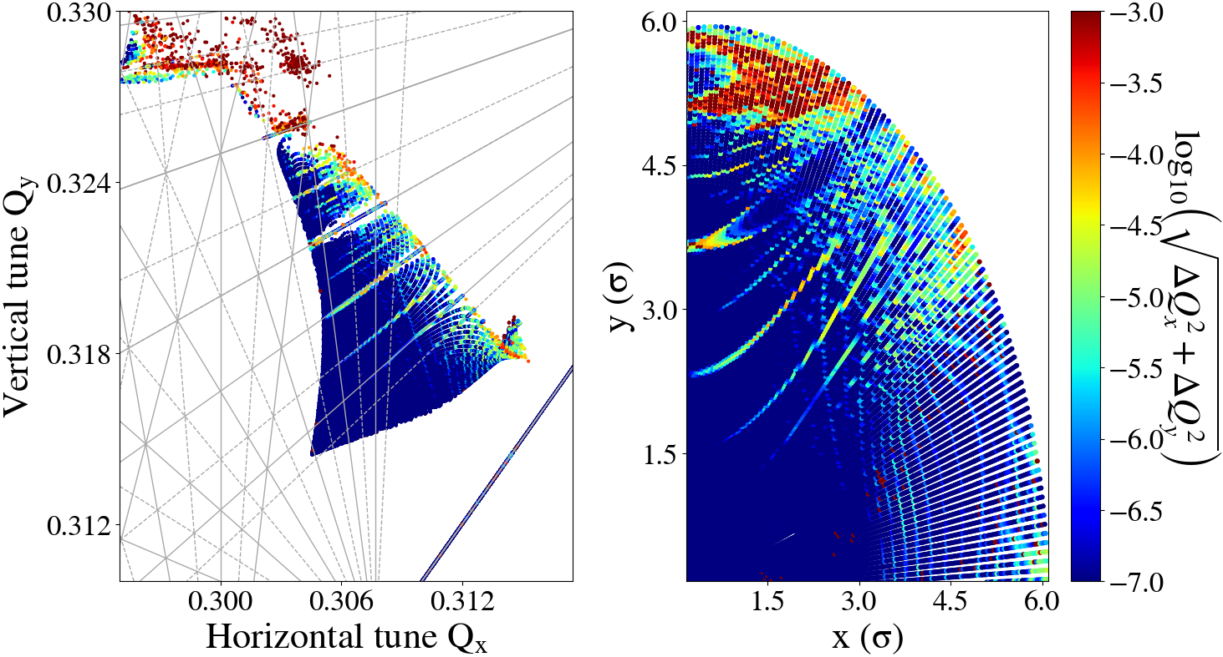
FMA with 50 Hz harmonics
Ideal machine without ripple
30/06/2020
Power supply ripple in the LHC

Slide 28
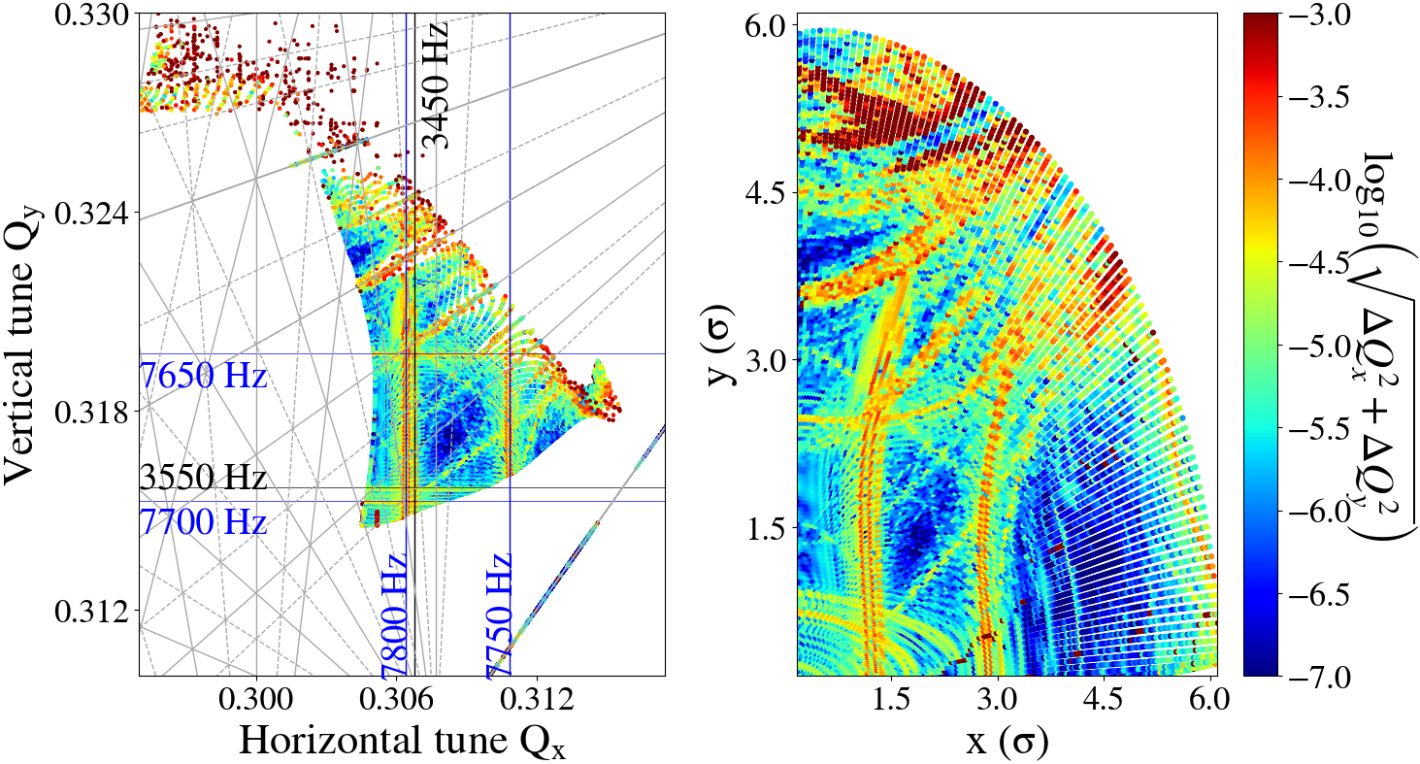
FMA with 50 Hz harmonics
“Low frequency cluster”
“High frequency cluster”
Q_{x} = Q_{r} & Q_{x} = 1-Q_{r}
30/06/2020
Power supply ripple in the LHC

Slide 29
Simulations including 50 Hz
Estimation of beam lifetime with weighted distributions in simulations including:
Realistic 50 Hz spectrum as extracted from ADTObsBox.
Non Gaussian beam profiles: overpopulated tails in the transverse plane^{(*,**)} & underpopulated in the longitudinal**.
“Collimator”/Aperture at 5 σ (for 3.5 μm).
* H. Garcia Morales: WP2 16/06/2020, Halo measurements using collimator scans
** S. Papadopoulou: HSI lumi meeting 18/5/2018 BSRT calibration Fill 6699
30/06/2020
Power supply ripple in the LHC

Slide 30
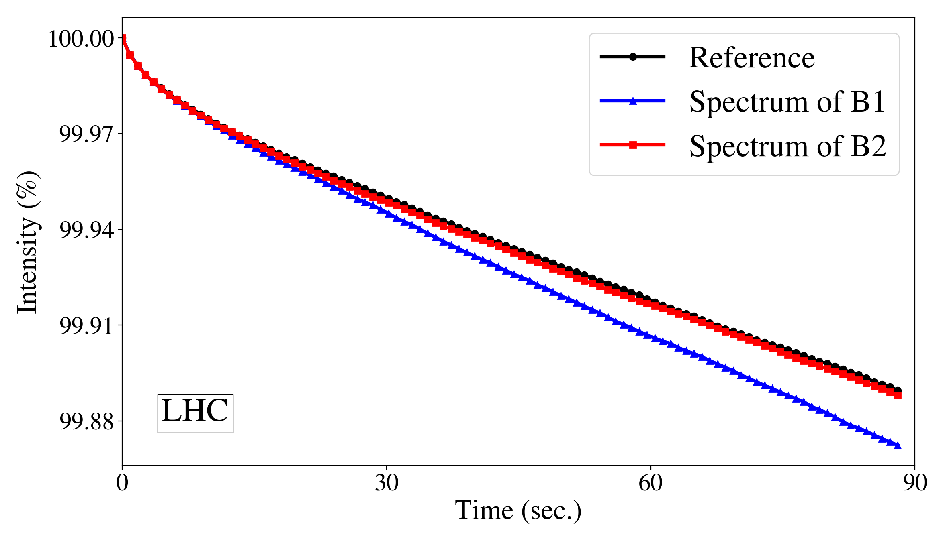
Beam lifetime simulations
LHC
Ideal machine
Spectrum of B2
Spectrum of B1
Impact on Beam 1 intensity evolution especially due to high-f cluster.
30/06/2020
Power supply ripple in the LHC

Slide 31
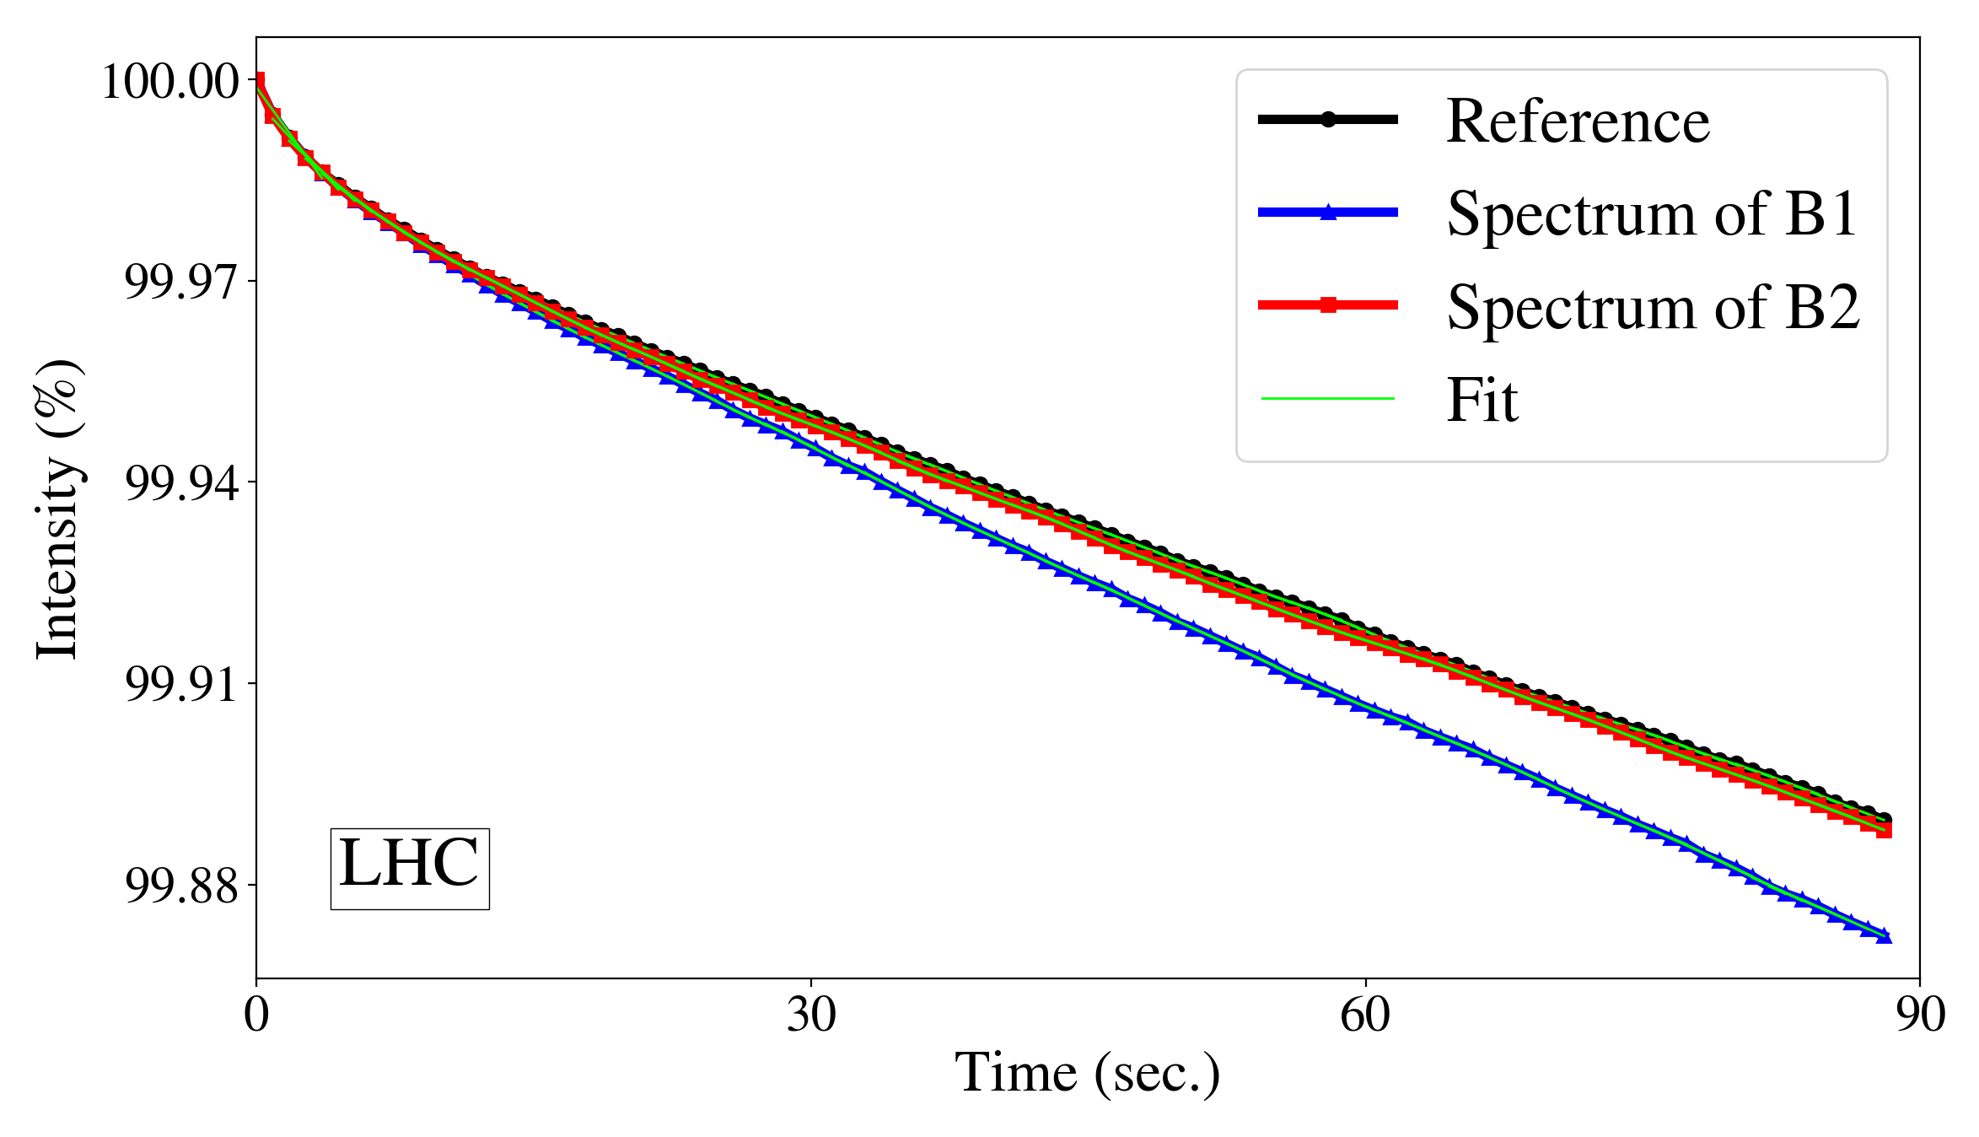
Beam lifetime simulations
LHC
Instantaneous lifetime from fit + moving average
Impact on Beam 1 intensity evolution especially due to high-f cluster.
30/06/2020
Power supply ripple in the LHC

Slide 32
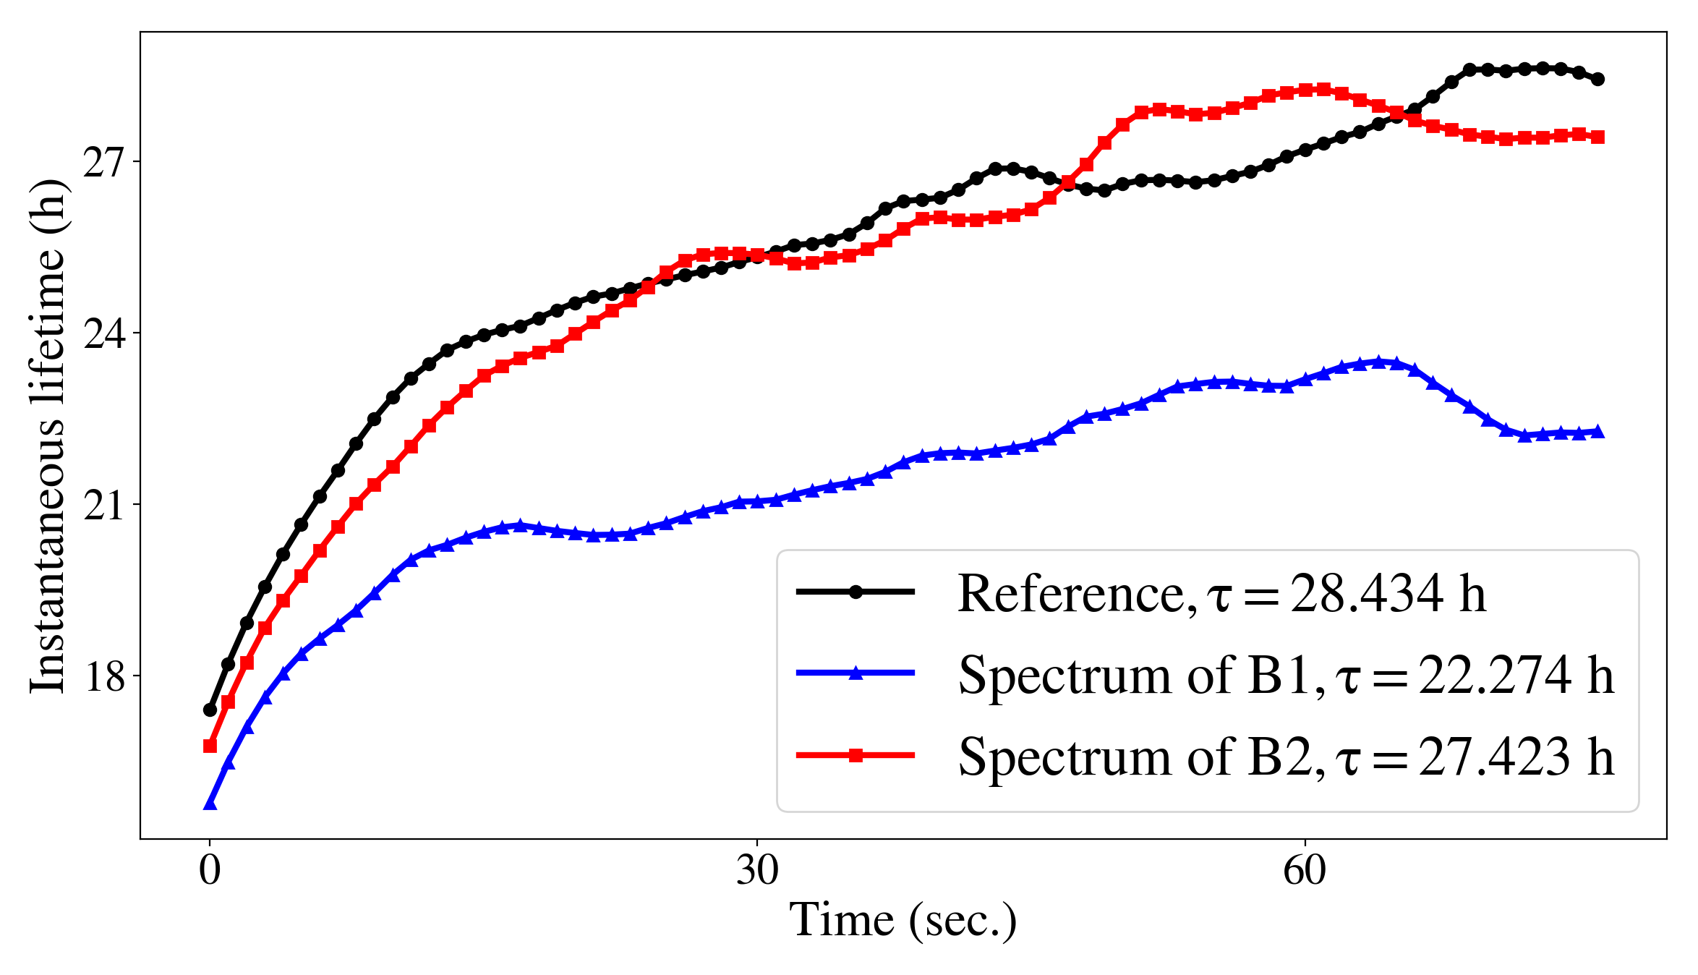
Beam lifetime simulations
LHC
Instantaneous lifetime at 90 s.
The 50 Hz contribute to the asymmetric beam lifetime of Beam 1 & Beam 2
20% reduction of Beam 1 lifetime compared to the ideal machine.
30/06/2020
Power supply ripple in the LHC

Slide 33
Part 2: Power supply ripple in the IT quadrupoles of HL-LHC
30/06/2020
Power supply ripple in the LHC

Slide 34
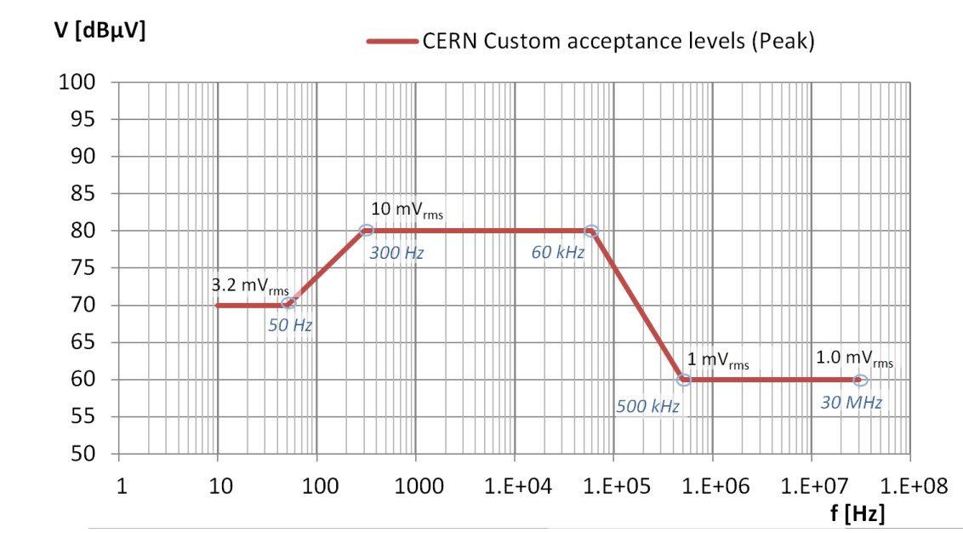
Simulation setup
Maximum output voltage
Simulated parameters at end of β*-levelling (β*=15 cm)
Ripple in Q1, Q2a, Q2b, Q3 IR1 & IR5
Comparison with PC specifications.
Limits from previous studies: Maximum tolerated ΔQ
30/06/2020
Power supply ripple in the LHC

Slide 35
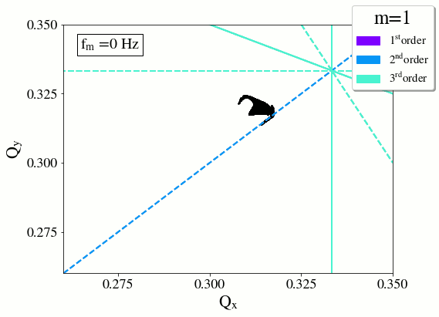
Tune modulation
Dependence on the modulation frequency
k·Qx + l·Qy + 1·Qm= n, Qm ↑ [1]
30/06/2020
Power supply ripple in the LHC

Slide 36
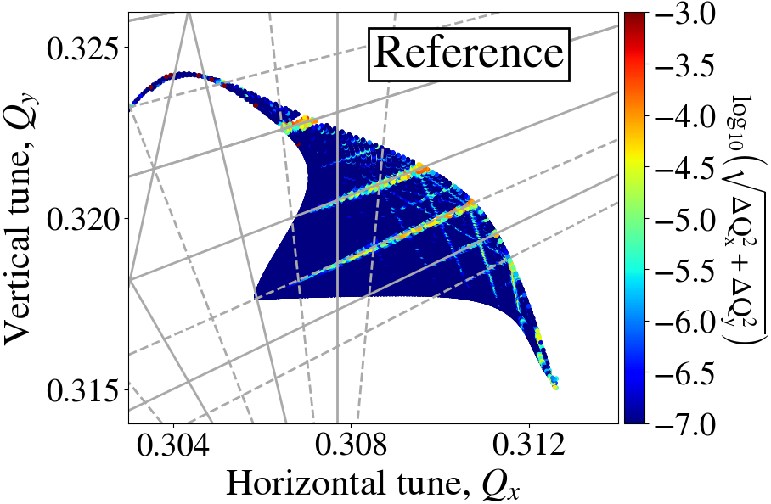
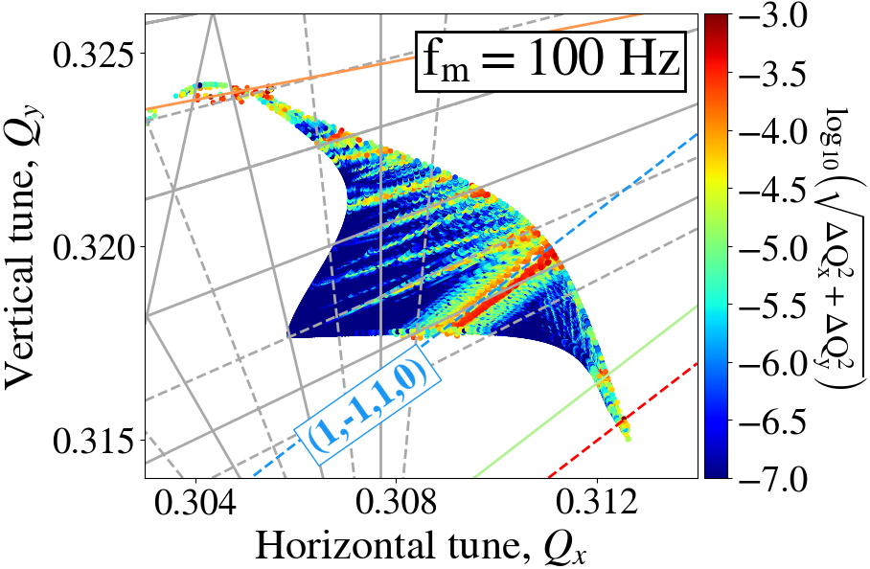
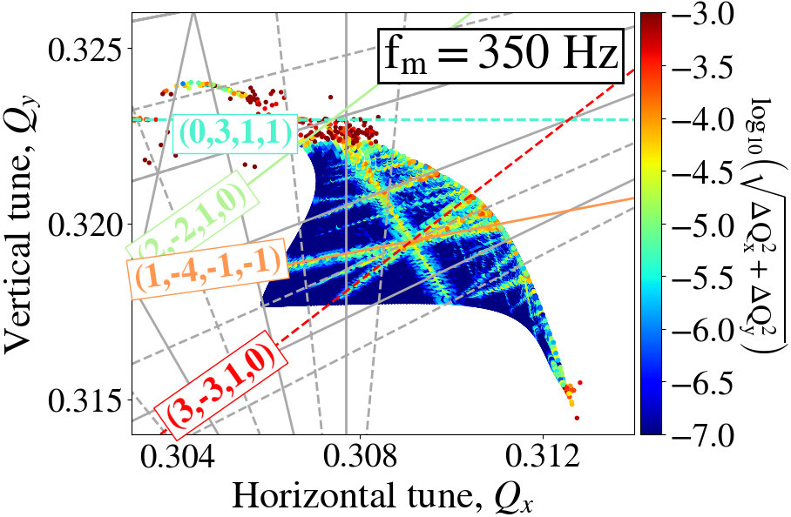
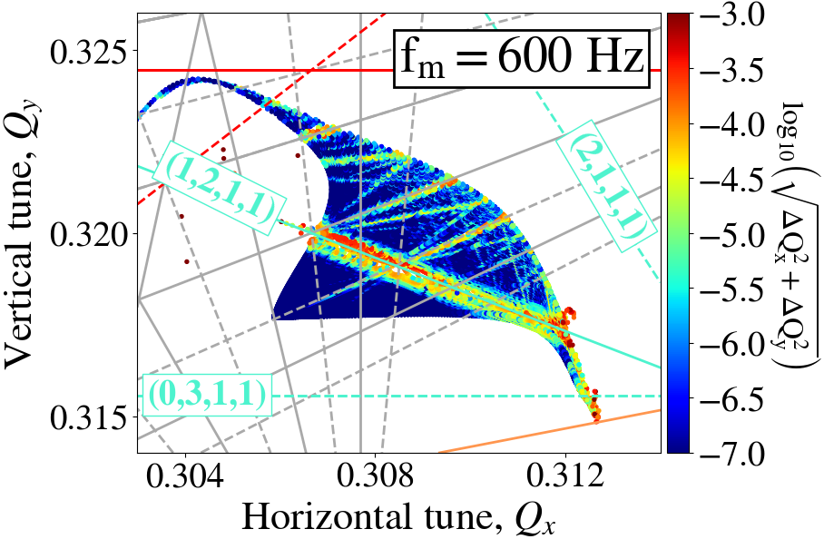
FMAs with power supply ripple in IT
Dependence on the modulation frequency
HL-LHC
Baselinec
100 Hz
350 Hz
600 Hz

Slide 37
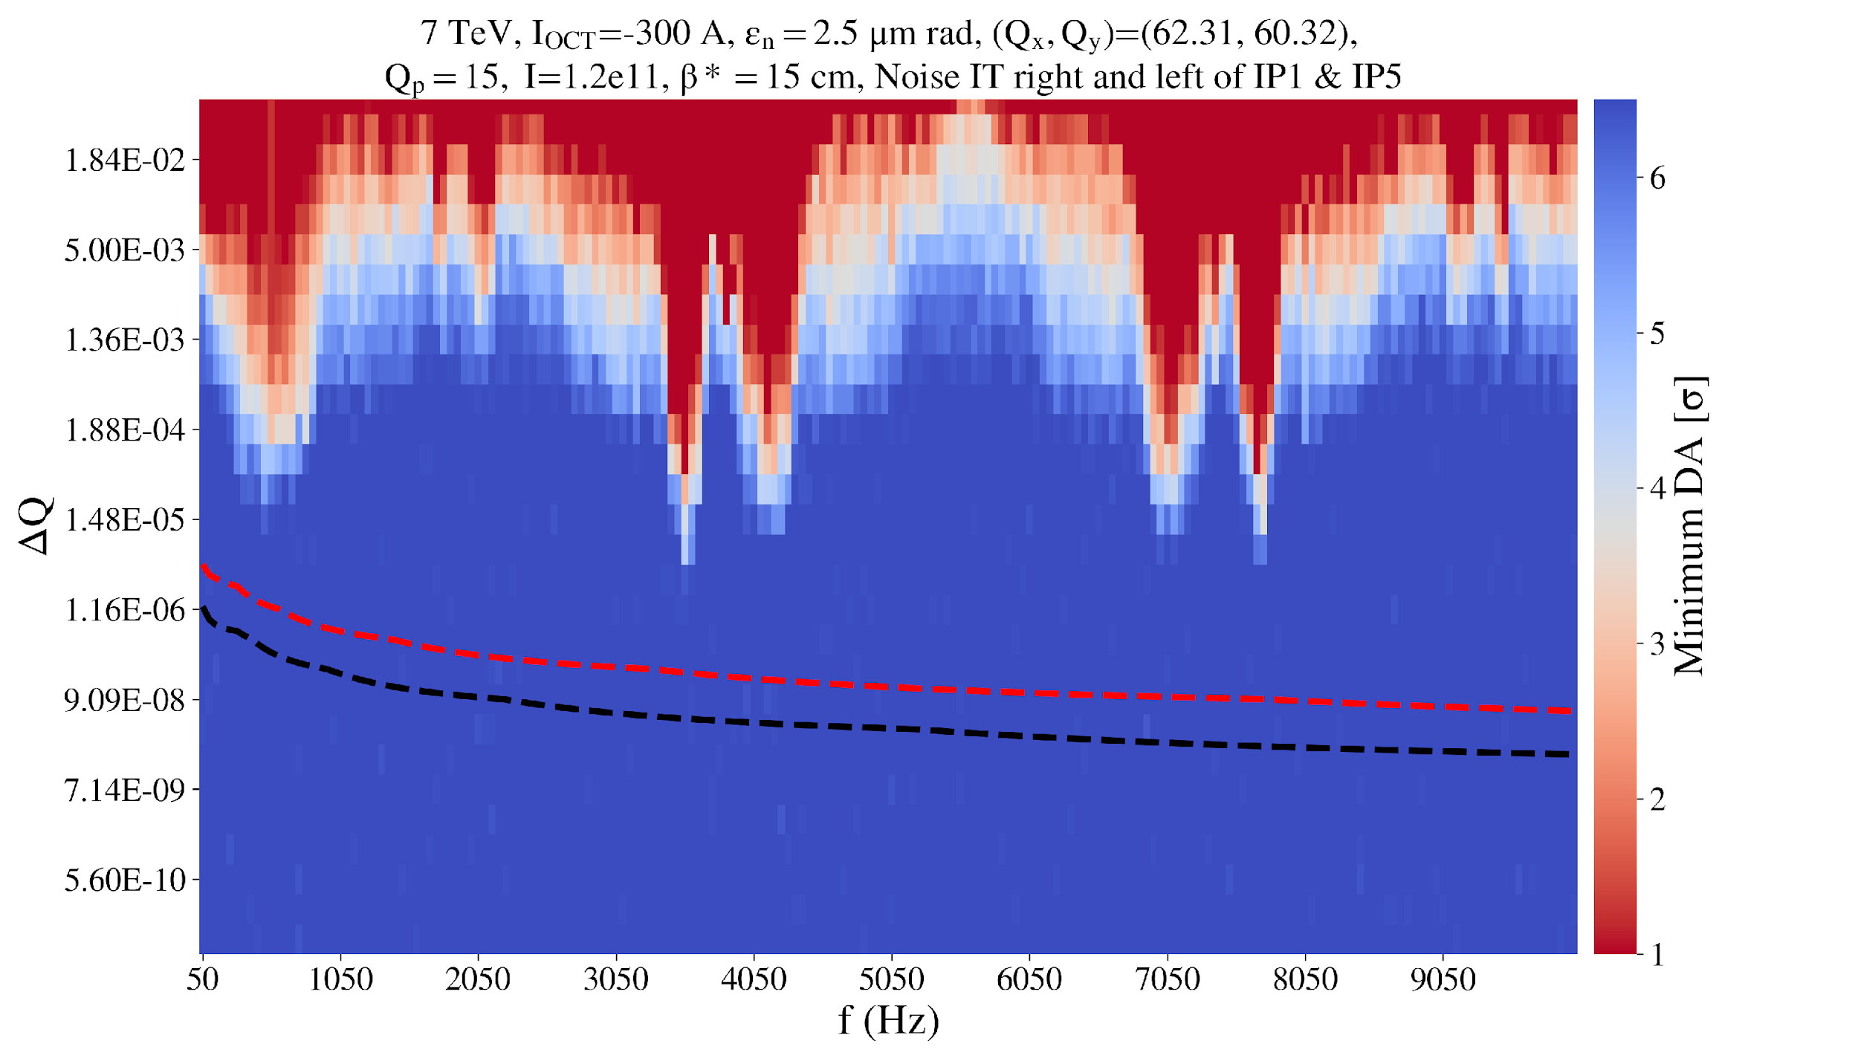
Ripple thresholds with DA scans
Modulation frequency as a function of modulation depth, color-coded with minimum DA
HL-LHC
6D
DA reduction
Sum in phase all triplets circuits
RMS sum
all triplets circuits
30/06/2020
Power supply ripple in the LHC

Slide 38
Conclusions: 50 Hz harmonics
What is the source?
Do they have an impact on the beam performance?
Experimental observations
2 clusters of 50 Hz in beam spectrum: low (up to 3.6 kHz) and high (f_{rev}-f_{x}) frequency clusters.
Both real beam excitations, both dipolar effect.
Low-f cluster source: 8 Main Bends power converters, ripple in all LHC dipoles.
High-f cluster source: exact mechanism to be identified.
Simulations
Contribute to the lifetime asymmetry of Beam 1 and Beam 2, observed since start of Run 2.
Including realistic beam profiles & realistic power supply ripple spectra, 20% beam lifetime reduction compared to ideal machine, especially due to high-f cluster.
Expected to be present in the future operation → mitigation measures.

Slide 39
Conclusions: Inner triplet HL-LHC
Will tune modulation effects pose a limitation in the luminosity production of HL-LHC?
Simulations
Simulations at the end of β* leveling, most critical scenario for power supply ripple studies.
Critical HL-LHC power supply ripple modulation depth 10⁻⁵
Comparison of DA reduction limit and power converter specifications, possible ripple orders of magnitude below the limit of DA reduction.
Tune modulation in HL-LHC from power converter noise & chromatic tune modulation not expected to impact the beam performance.

Slide 40
Conclusions: Inner triplet HL-LHC
Will tune modulation effects pose a limitation in the luminosity production of HL-LHC?
Simulations
Simulations at the end of β* leveling, most critical scenario for power supply ripple studies.
Critical HL-LHC power supply ripple modulation depth 10⁻⁵
Comparison of DA reduction limit and power converter specifications, possible ripple orders of magnitude below the limit of DA reduction.
Tune modulation in HL-LHC from power converter noise & chromatic tune modulation not expected to impact the beam performance.
Two different types of power converters, different mechanisms of coupling to the beam → same analysis tools, can be used to address other beam jitter effects.

Slide 41
Thank you for your attention

