Slide 1
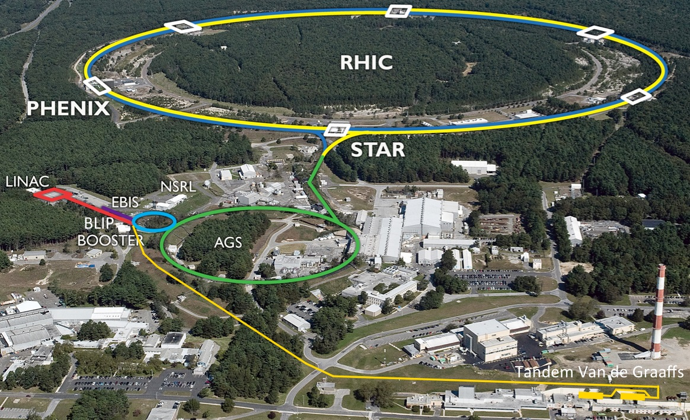
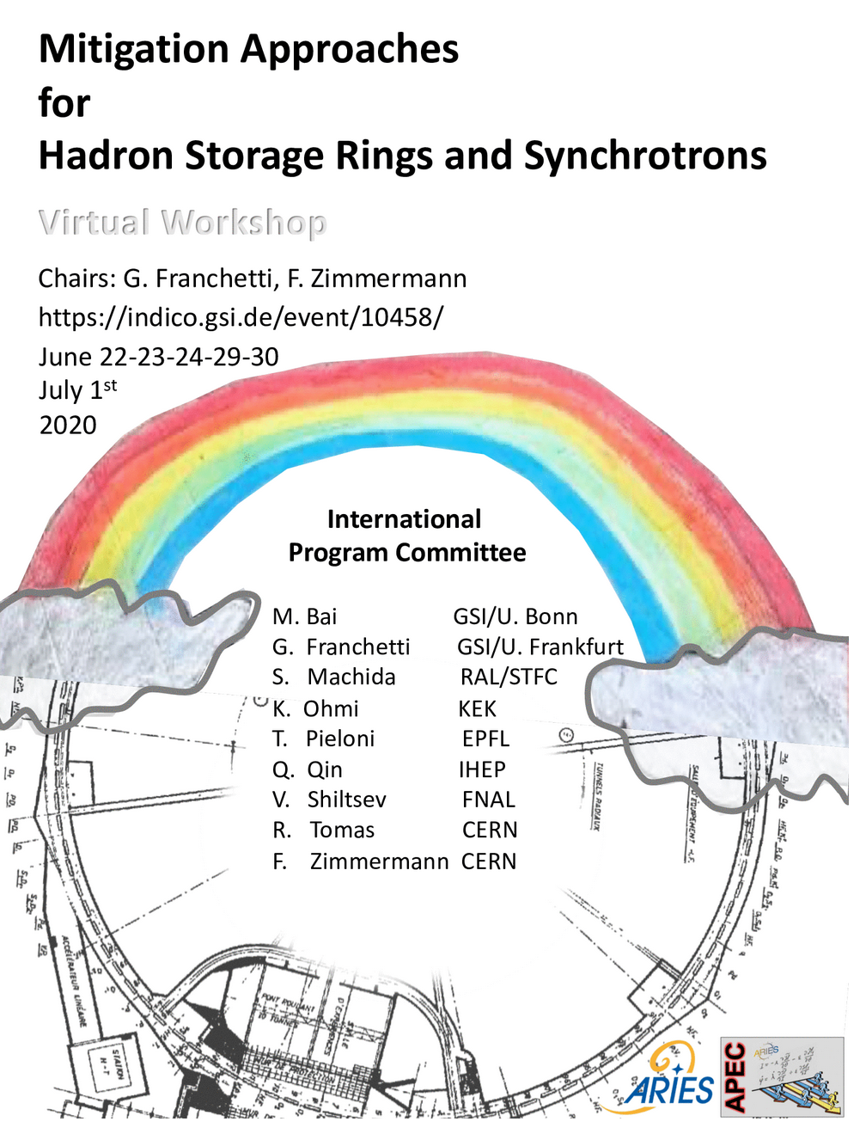

Mitigation strategies for RHIC and EIC hadron beams
Wolfram Fischer
s
Notes:
09:20, 25+10 min, 25 slides

Slide 2
Mitigation of beam degradation in RHIC and EIC
Many topics presented last week in excellent talks
Many of these topics are also relevant in the RHIC/EIC hadron rings,
and the injectors, where all of the standard mitigations are used
Will only highlight some examples that go beyond standard solutions
Will then focus use on beam cooling, which
changed the way we operate RHIC with ions
allowed for experiments not previously possible
(Zr-96 / Ru-96, Au+Au below nominal injection energy with 4x L)
will also play an important role in the EIC

Slide 3
s
high intensity H–
polarized H –
He to U
Start of operation : 2000
Circumference : 3.8 km
Max dipole field : 3.5 T
Species : ph to U (incl. asymmetric)
Energy : Au 100 GeV/nucleon
: ph 255 GeV
Max ph–ph L : 2.67x10³² cm⁻²s⁻¹
Experiments : STAR, sPHENIX
p to Au (backup)

Slide 4
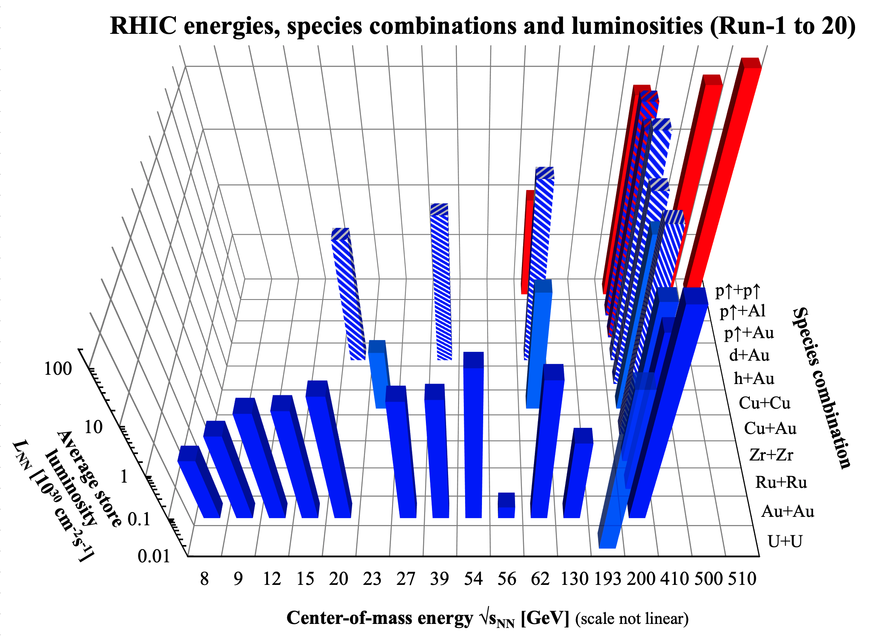
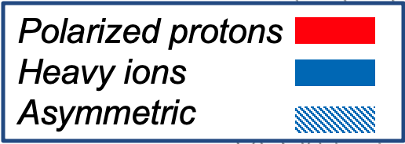
RHIC – study of QGP requires flexibility
nominal injection energy

Slide 5
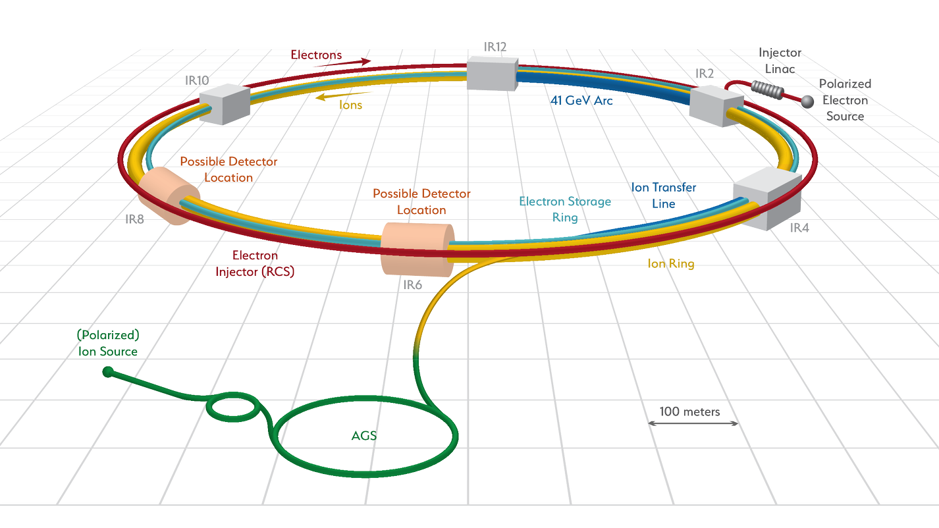
EIC – Electron Ion Collider (now a project, CD-0 Dec 2019)
Start of operation : ~2030
Circumference : 3.8 km
Max dipole field : 3.5 T
Species : eh–ph to eh–U
Energy : eh 18 GeV
: Au 110 GeV/nucleon
: ph 275 GeV
Max eh–ph L : 1x10³⁴ cm⁻²s⁻¹
Experiments : 1 or 2
Addition of electron
Linac (400 MeV)
Rapid Cycling Synchrotron (18 GeV)
Storage Ring (18 GeV)

Slide 6

Booster, AGS, RHIC, EIC
Booster, RHIC, EIC
Booster, RHIC, EIC
Linac, AtR, RHIC, EIC
RHIC, EC
RHIC electron lenses
AGS, RHIC, EC
RHIC, EIC
Booster, AGS, RHIC, EIC
Booster
Booster, AGS, RHIC, EIC

Slide 7
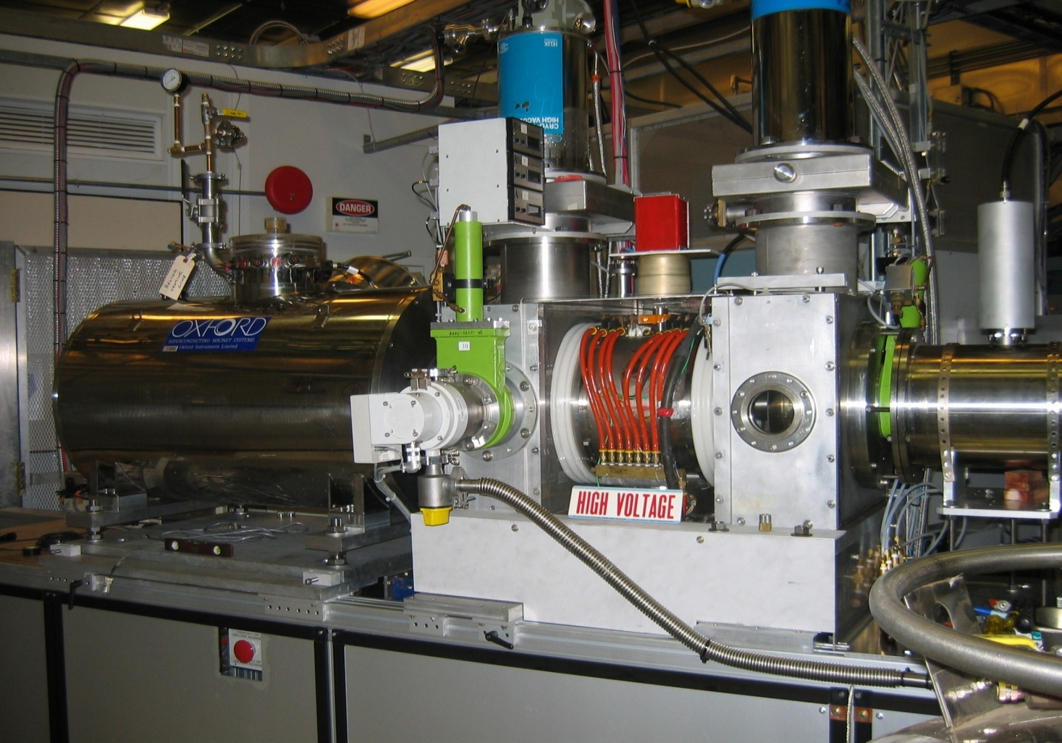
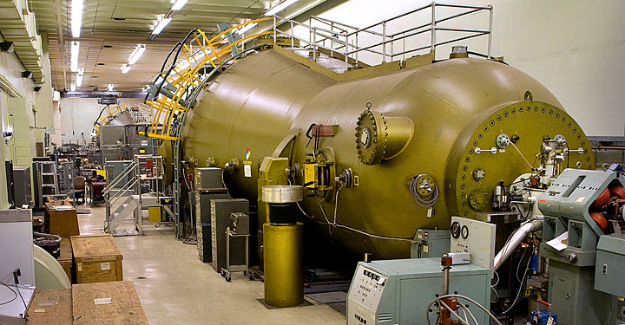
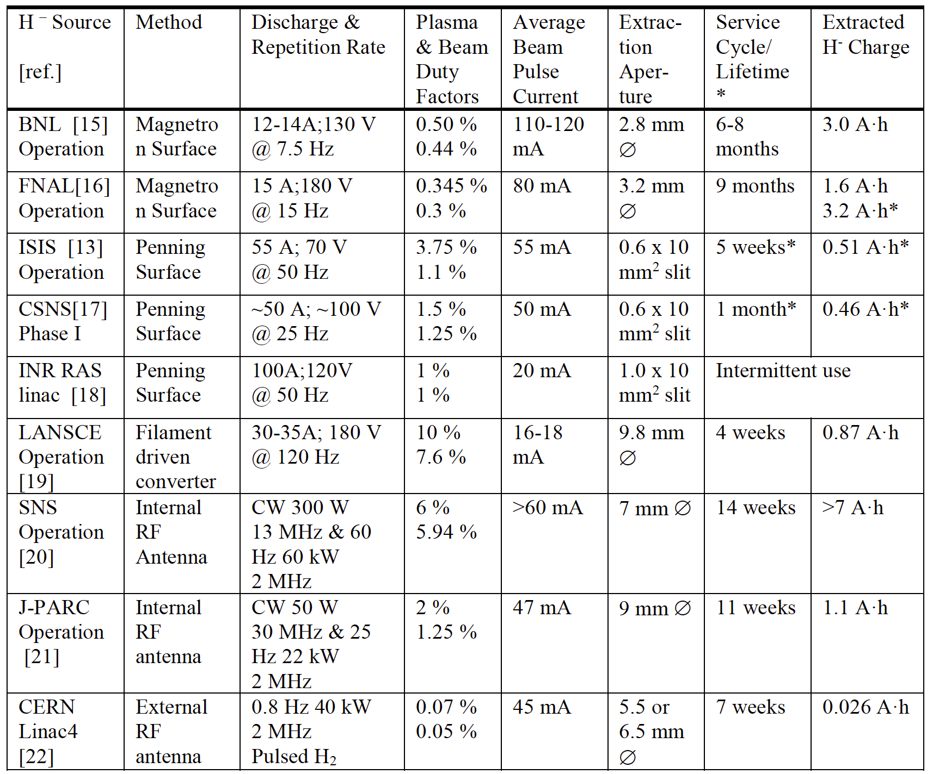
High intensity high brightness ion sources + pre-injectors
Tandem Van de Graaff
Low emittance beams from
electrostatic accelerators
2 electrostatic accelerators
32 MV (=2x16 MV) voltage
>40 ion species p to Au
Unique polarized
H⁻ source for 200 MeV
Linac
reliably 0.5-1.0 mA
polarized H⁻ ion current.
Polarization at 200 MeV:
P = 80-85%.
Beam intensity (ion/pulse)
routine operation:
Source - 10¹² H⁻/pulse
Linac - 5x10¹¹
AGS - 1.5-2.0x10¹¹
RHIC - 1.5x10¹¹/bunch
Highest current H⁻ source
for 200 MeV Linac
Most flexible laser ion source + EBIS
for Booster
NASAL Galactic Cosmic Ray Simulator:
33 beams (species, E) in 80 min
Au¹⁺ ions into EBIS
Au32+ ions out of EBIS
M. Stockli, ICFA BD Newsletter No. 73, 2018

Slide 8
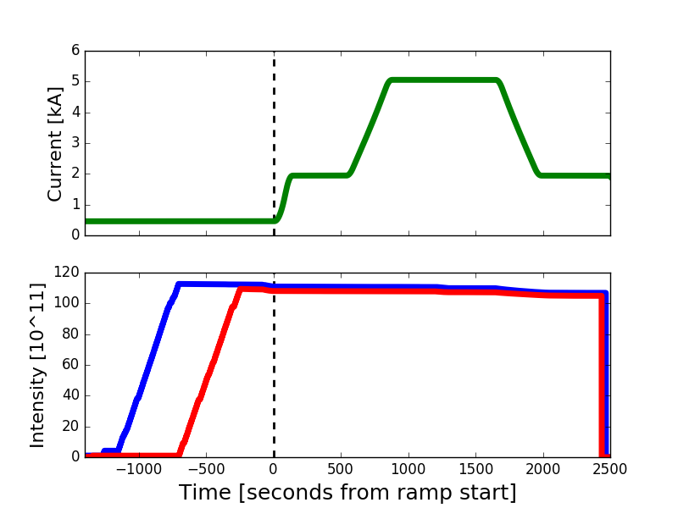
Orbit/tune/coupling/chromaticity feedcbak
V. Schoefer, ARIES 2018
Use orbit (1 Hz, 10 Hz), tune, coupling feedback on every ramp (not shown).
Example is for chromaticity feedback for deceleration (2011), not used since.
Polarimeter analyzing power is energy dependent
Useful calibration is to accelerate-decelerate to an energy plateau and compare polarization
Model uncertainty on down ramp
Chromaticity feedback
  RF freq modulated at 0.5 Hz
  Tune feedback effort deviations over each modulation cycle used to calculate a chrom
  Update sent to the sextupoles
Main dipole current
250 GeV
Ramp start
100 GeV
100 GeV
Beam intensity
Blue beam
Yellow beam
Chrom feedback effort during the down ramp was up to 40 units!
Successful measurement completed in one shift with feedback
Would have taken days without it => Would never have been done
Notes:
Figure of merit for this experiment is not precision of chrom feedback, but cost of experiment

Slide 9
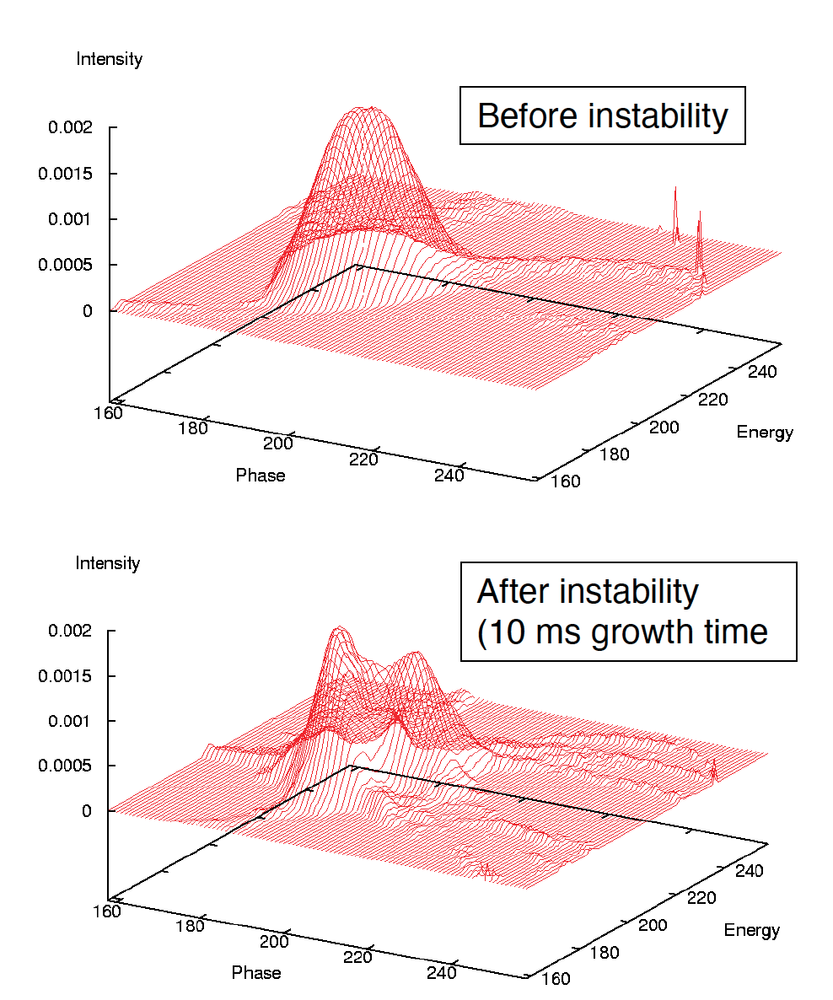
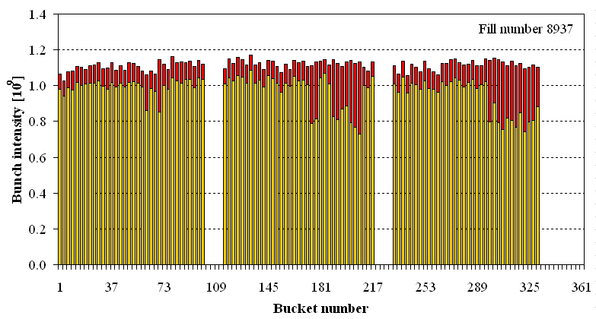
Transition crossing in RHIC
RHIC is only supercond. accelerator crossing transition (all ions except p)
Instabilities at transition occurred in past due to impedance and e-clouds,
leading to emittance growth and beam loss (tail of bunch trains)
=> was intensity limit in previous runs
With stochastic cooling can tolerate emittance growth (not beam loss)
=> allows for more intensity to be accelerated
C. Montag

Slide 10
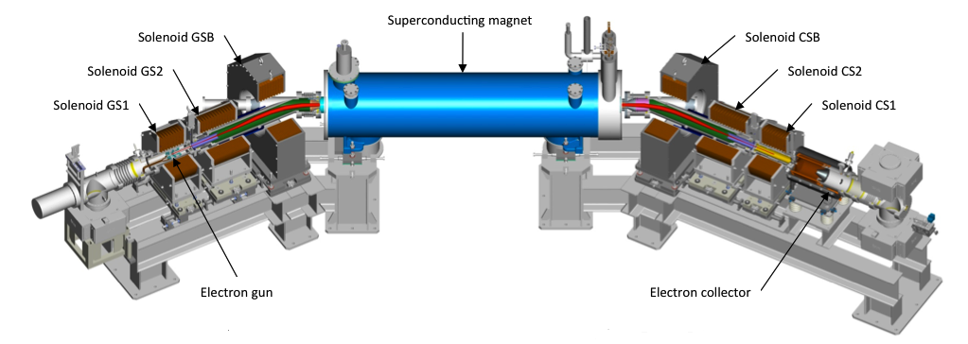
Head-on beam-beam compensation Principle
Correction in same turn, need to fulfill 2 conditions:
beam-beam
parameter
(1) kπ phase advance minimizes beam-beam
resonance driving terms – implemented with
ATS type lattice (Simon White, now ESRF)
new lattice with better DA and larger bb param. ξ
(2) Same amplitude correction kick as bb
kick reduces beam-beam tune spread –
implemented with electron lenses (not
possible with magnets)

Slide 11
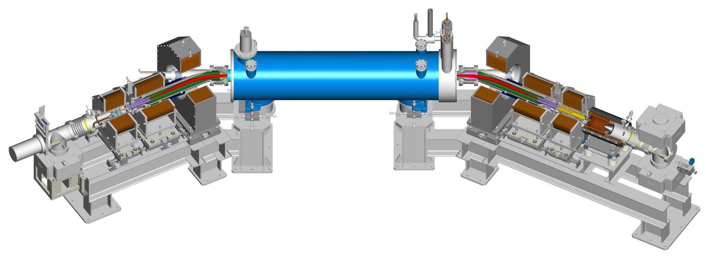
RHIC e-lens Parameters
Technology sources: Tevatron e-lenses (V. Shiltsev et al.),
RHIC Electron Beam Ion Source (EBIS) (J. Alessi et al.)

Slide 12
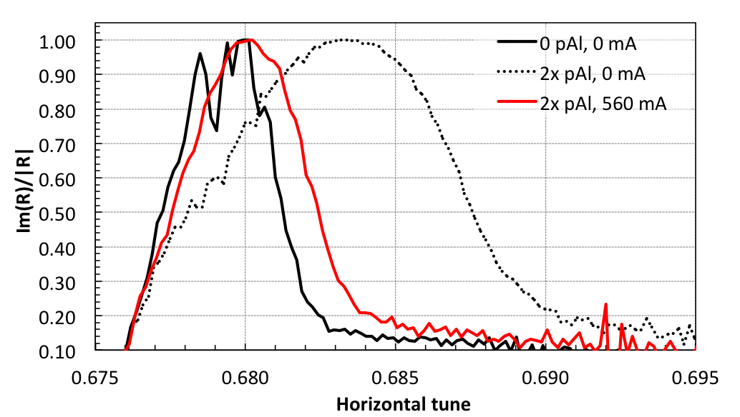
Head-on bb compensation Footprint compression
tune distribution can be measured with BTF and p+Al collisions
proton beam: (Q_{x},Q_{y}) = (.685,.695); Al beam: (Q_{x},Q_{y}) = (.685,.695); ΔQ_{x}, ΔQ_{y} >> ξ => no coherent modes
Can only reduced
BB tune spread
(black curve is limit)
ΔQ reduction
from e-lens
2x bb
no bb

Slide 13
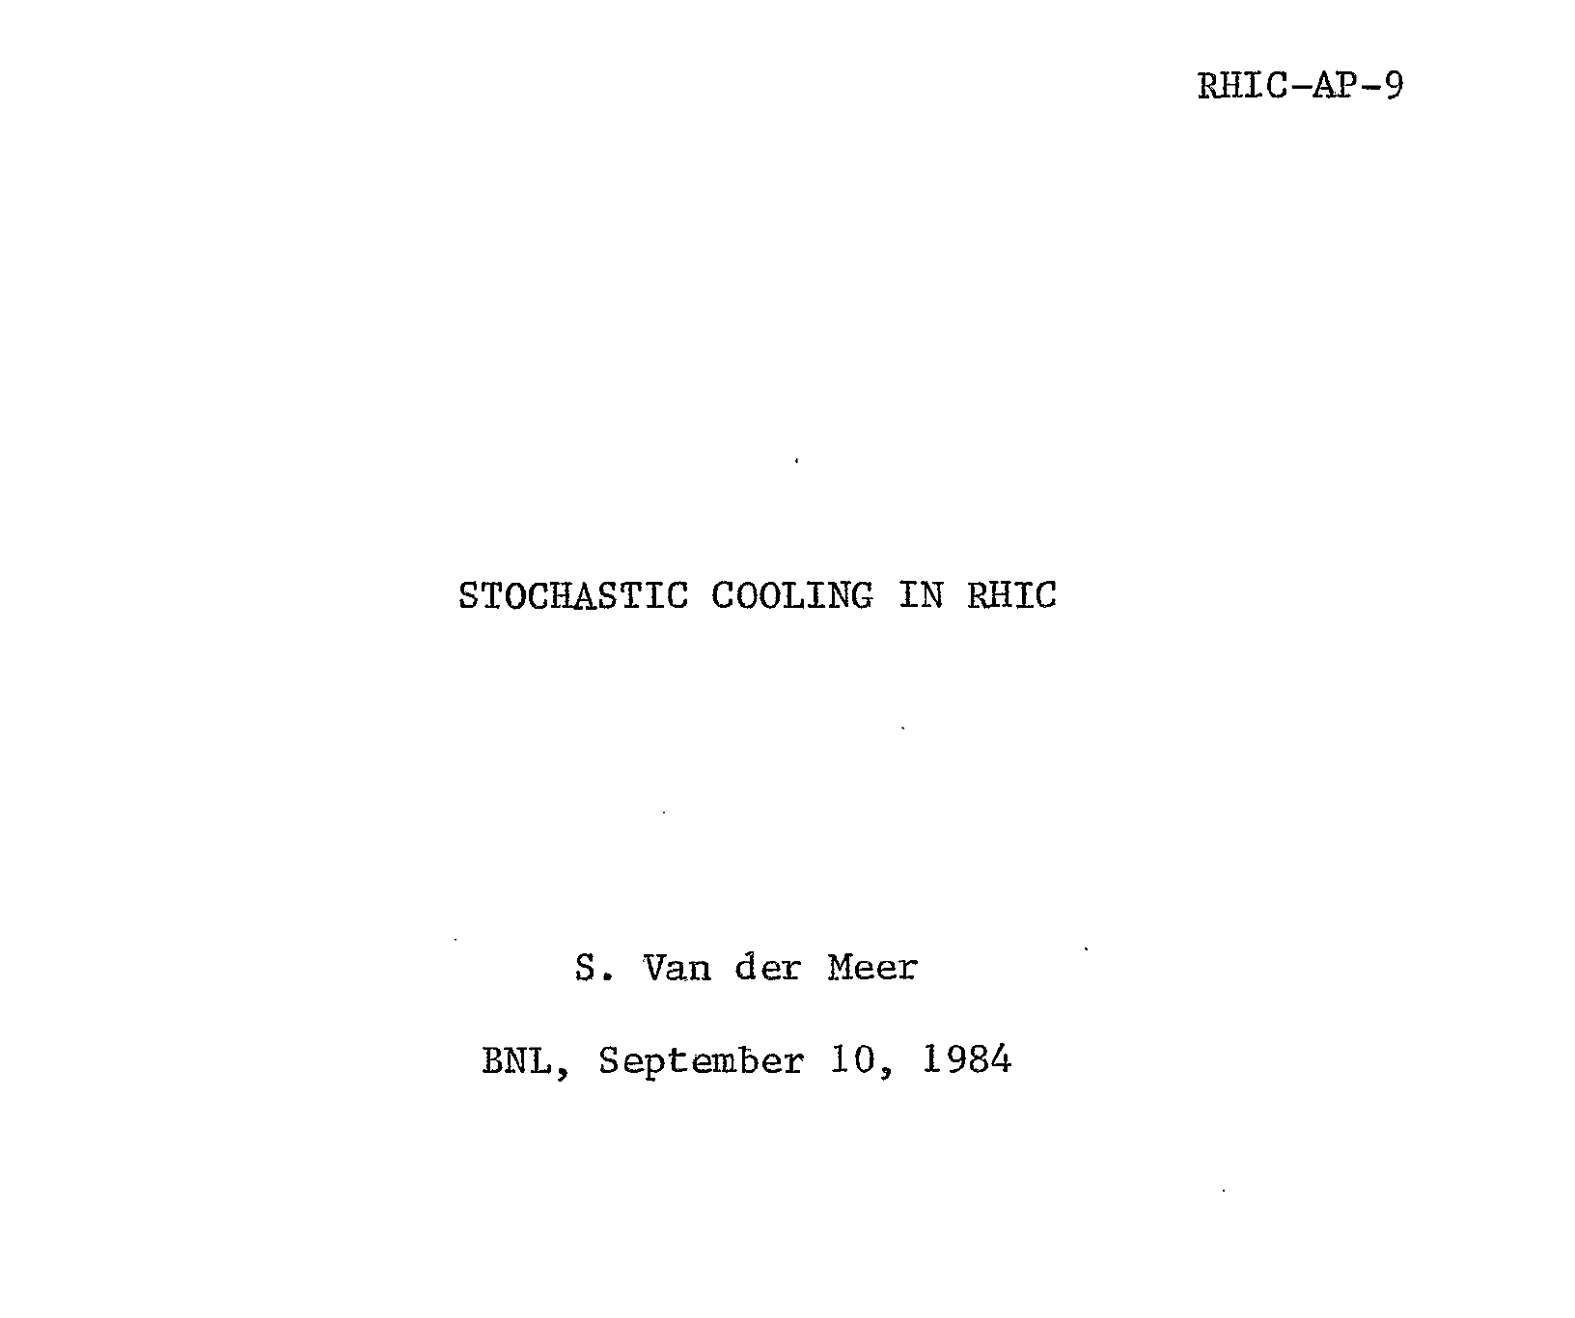
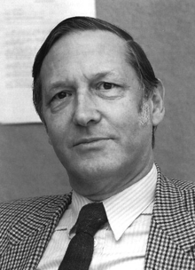
Beam cooling in RHIC and EIC
Heavy ions – strong IBS, cooling
envisioned early, bunch intensity
~100x reduced from protons
RHIC stochastic cooling
  heavy and medium ions
  at high energy
Electron cooling
  Au at low energy (below nominal injection energy)
EIC design options:
  Strong cooling in store (=> strong enough for protons)
  Frequent (every hour) hadron injection with pre-cooling at 25 GeV
t_{min} ~ 820 s
1984 Nobel prize
with C. Rubbia

Slide 14
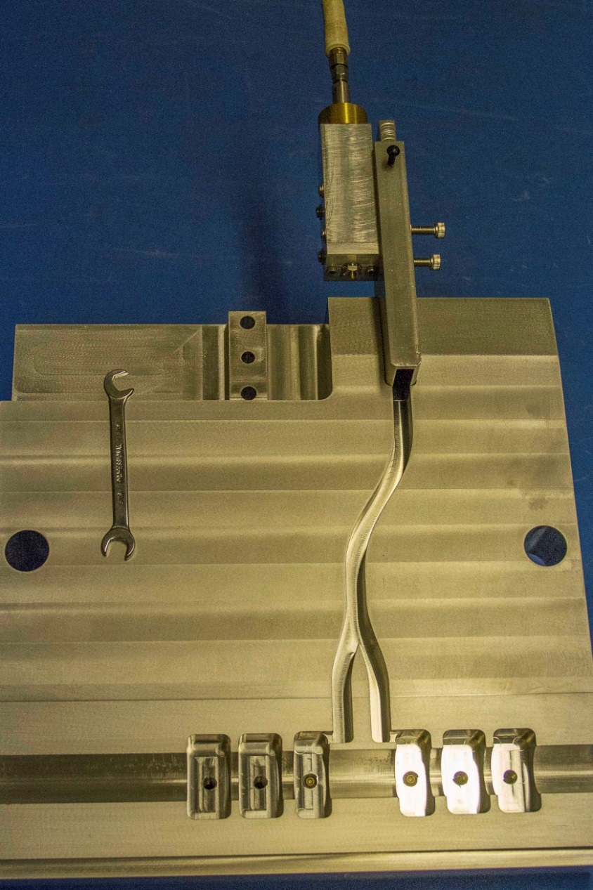
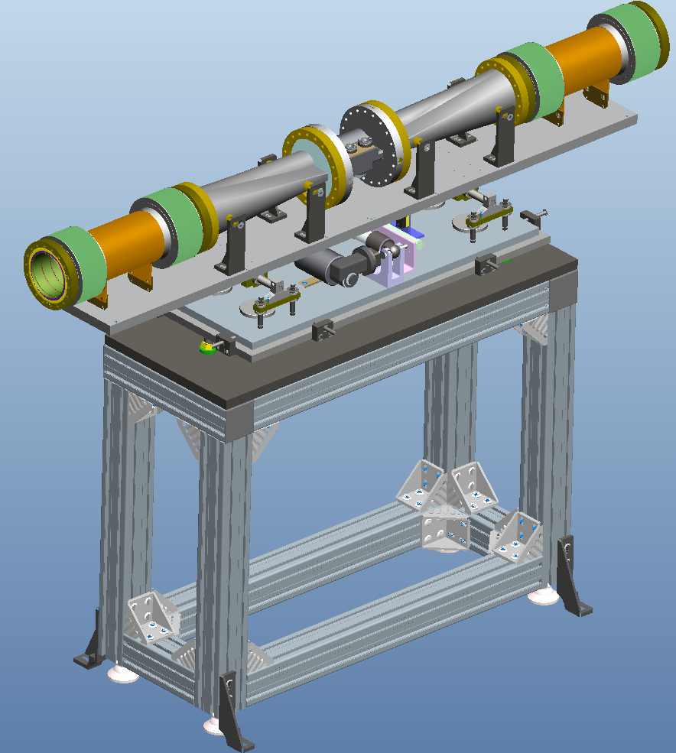
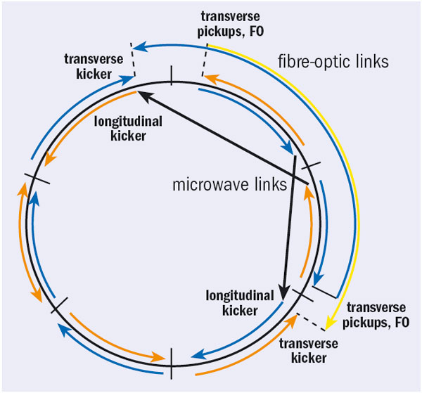
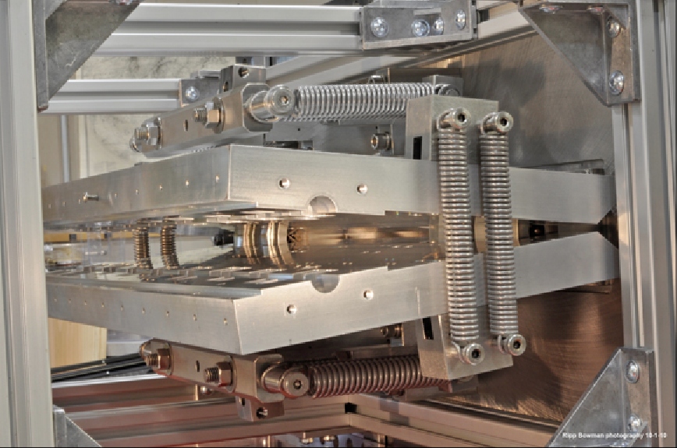
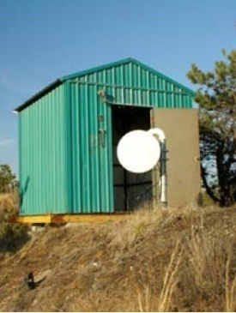
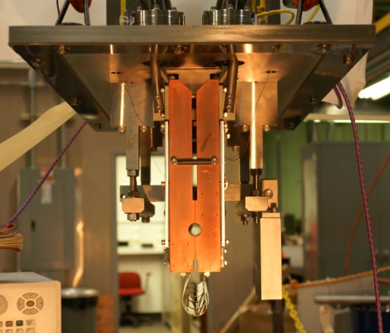
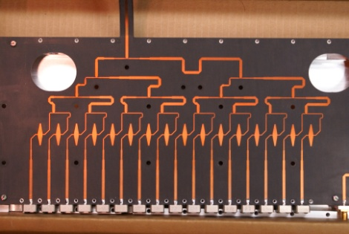
3D stochastic cooling for heavy ions
longitudinal
kicker cavity
(half side with
waveguides)
longitudinal pickup
horizontal kicker
(open)
horizontal and
vertical pickups
vertical
kicker
(closed)
5-9 GHz, cooling times ~1 h
M. Brennan, M. Blaskiewicz, F. Severino, PRL 100 174803 (2008); K. Mernick PRSTAB, PAC, EPAC
Notes:
Frequency range: 5-8 GHz transverse, 6-9 GHz longitudinal

Slide 15
U+U operation at burn-off limit – allows measurement of σ_{tot}
97% of intensity burned off at L_{max}
Burn-off dominated operation allows for
determination of total U+U cross section σ_{tot}
– and comparison with calculation (mostly QED)
published in Phys. Rev. C =>

Slide 16
RHIC Au+Au operation with stochastic cooling
~90% burn-off
Increase in luminosity lifetime result of
3D stochastic cooling,
high peak luminosity not useful without
cooling (IBS), losses burn-off dominated
Increase in initial luminosity
result of larger bunch intensity
2014, End of
RHIC-II upgrade
2007, Beginning
of RHIC-II upgrade

Slide 17
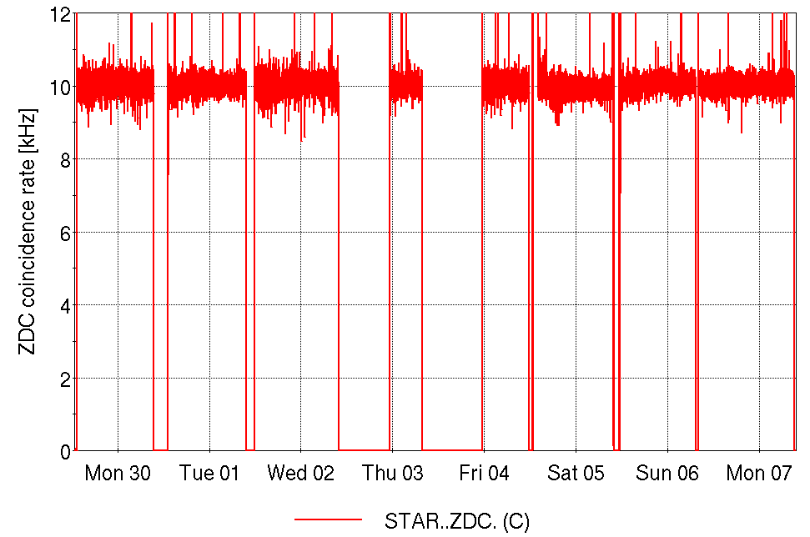
⁹⁶Zr+⁹⁶Zr / ⁹⁶Ru+⁹⁶Ru at 100 GeV/nucleon
VERY expensive source material (Ru-96)
- special enrichment run at ORNL
Need for flat L and same store conditions
Would not have been possible without cooling
Zr+Zr
Zr+Zr
Zr+Zr
Zr+Zr
Ru+Ru
Ru+Ru
Ru+Ru
Ru+Ru
beam experiments
dedicated
scheduled
maintenance
Notes:
WEEK: 30-Apr-18 to 07-May-18

Slide 18
RHIC – study of QGP requires flexibility
nominal injection energy

Slide 19
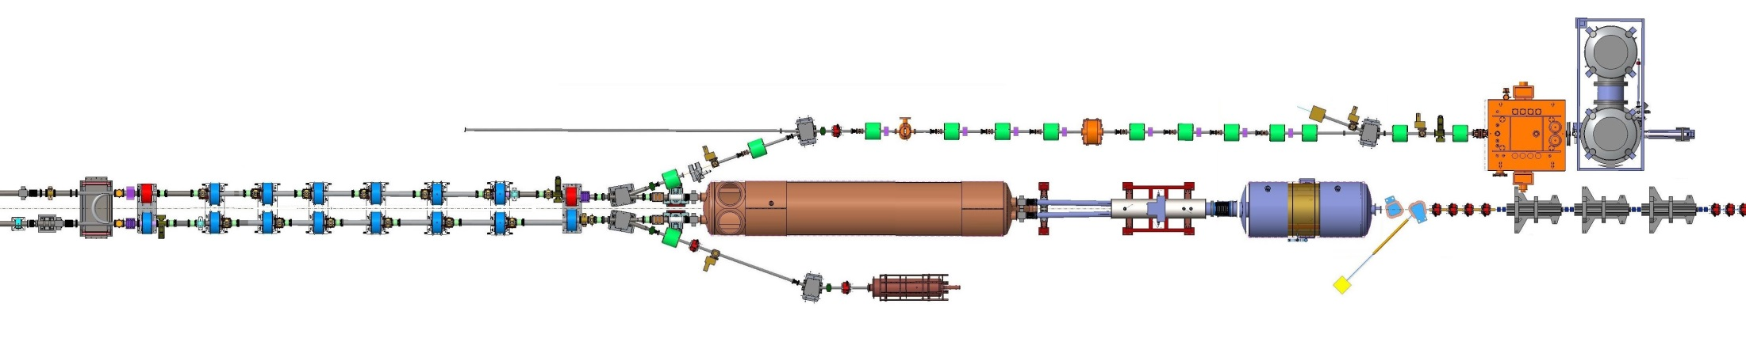



Low Energy RHIC electron Cooling (LEReC)
A. Fedotov
64 m to IP2
(not to scale)
Commissioning
Diagnostic Line 1
704 SRF
Booster Cavity
Commissioning
Diagnostic Line 2
704 MHz
Cu Cavity
9 MHz
Cu Cavity
2.1 GHz
Cu Cavity
DC
e⁻ Gun
e⁻
COOLING
in Yellow RHIC ring
e⁻
RHIC TRIPLET
RHIC DX
e⁻
COOLING
in Blue RHIC ring
LEReC Solenoids
Compensating (LF)
Matching (HF)
Merger/Transport
180° Bending Magnet
20° Bending Magnets
Beam Dump
Energies E : 1.6, 2.0 MeV
Avg. current I_{avg} : 27 mA
Momentum δp/p : 5×10⁻⁴
Luminosity gain : 4×
1st electron cooler
with RF acceleration
+ extends energy reach beyond DC
- dp/p after acceleration 50x too large

Slide 20
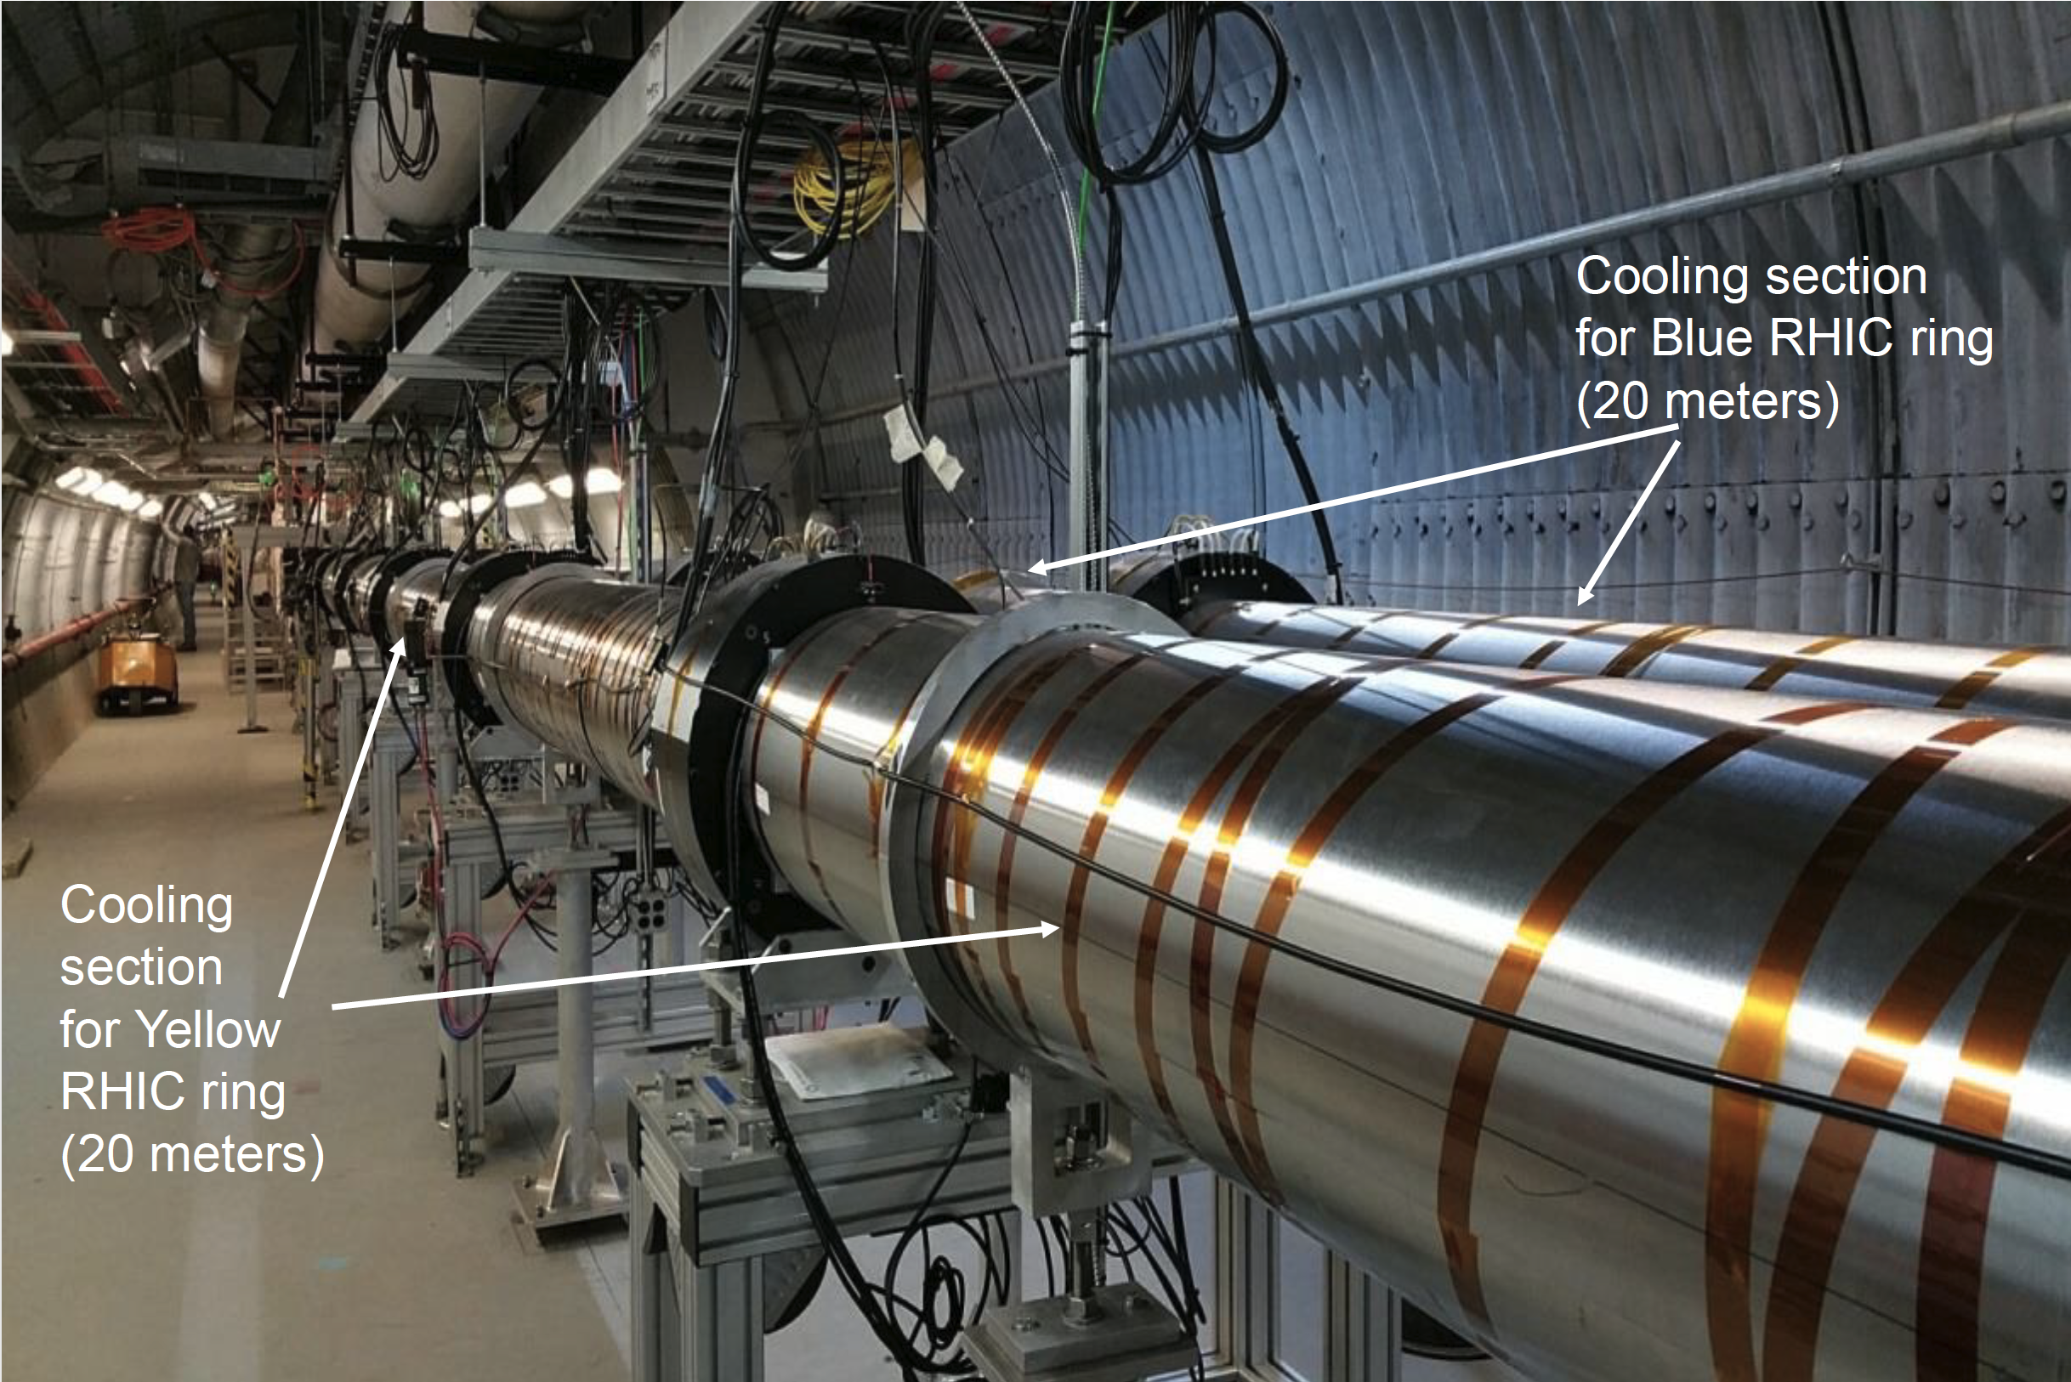
Low Energy RHIC electron Cooler, cooling sections

Slide 21
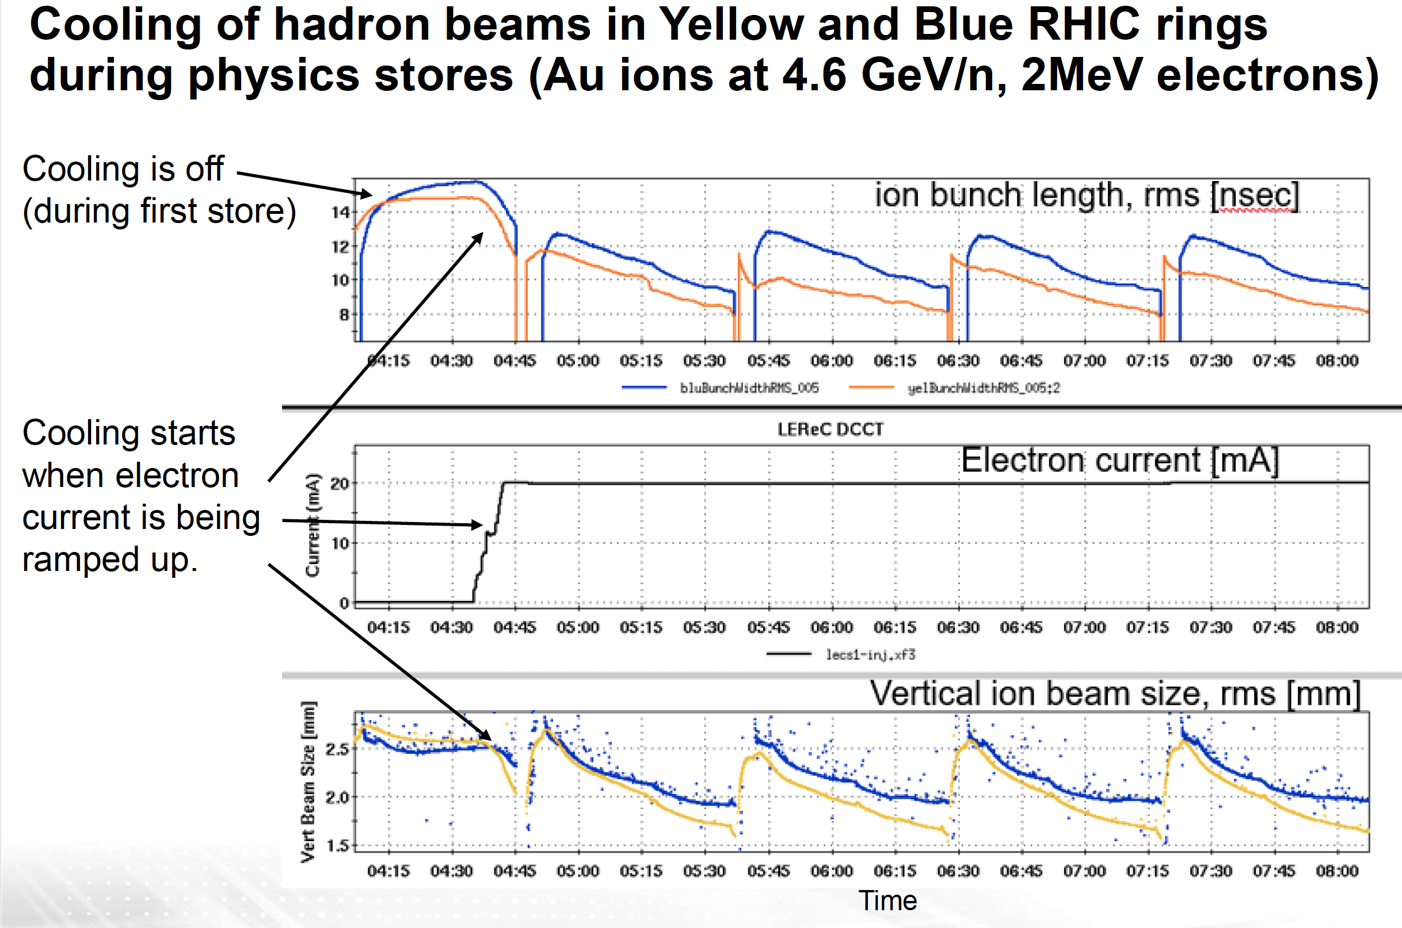
[1] A.V. Fedotov et al., PRL, 23, 021003 (2020)
[2] D. Kayran et al., PRAB 23, 021003 (2020)
[3] X. Gu et al., PRAB 23, 013401 (2020)

Slide 22
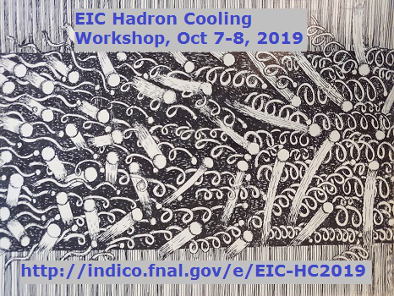
EIC – cooling overview
Ion cooling like in RHIC with upgraded
stochastic cooling system
For highest luminosity eh–ph (1x10³⁴ cm⁻²s⁻¹)
investigate 2 design options
  Strong cooling = proton cooling at full proton energy
  Frequent (~hourly) full energy proton injection
    Use 1 RHIC ring for acceleration, 1 RHIC for storage
    Proton pre-cooling injection (25 GeV) => extend LEReC technology / ERL
Also investigate proton cooling
at 41 GeV for lowest COM
Recent workshop at Fermilab,
organized by Sergei Nagaitsev
explored cooling options

Slide 23
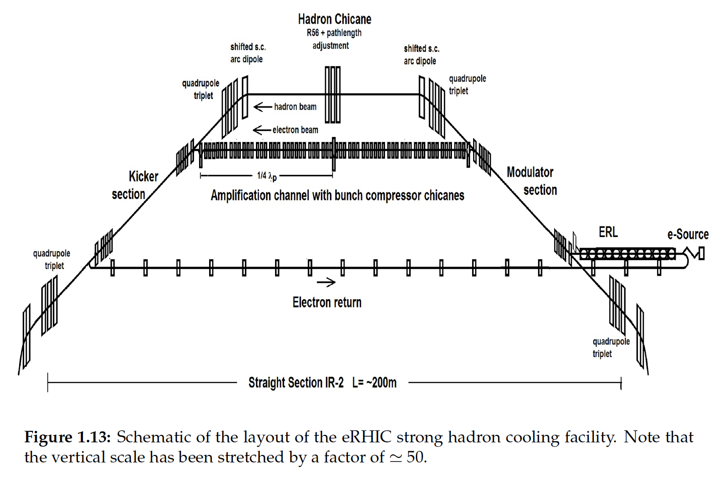
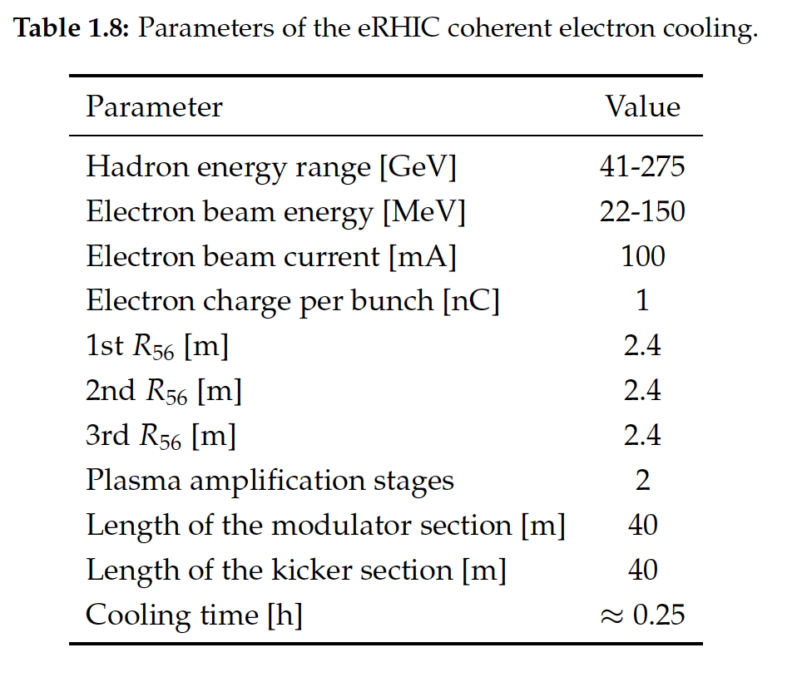
EIC strong hadron cooling in pre-CDR
A number of variants with different amplifiers

Slide 24
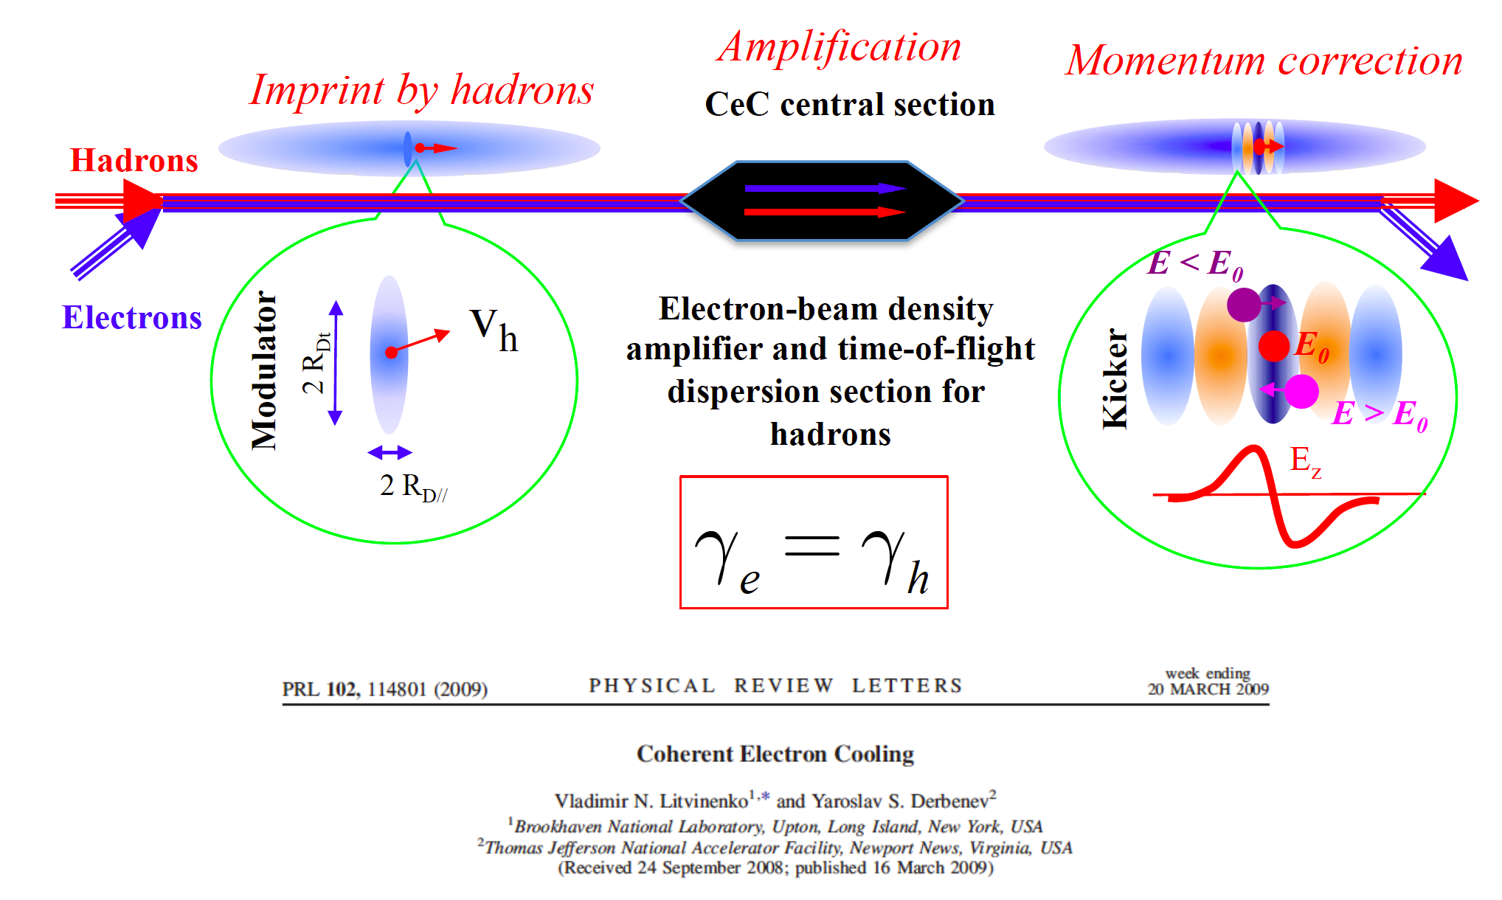
Coherent electron Cooling (CeC), V. Litvinenko et al.
experimentally studied in RHIC
unacceptable electron beam noise suppressed in 2019
2 types of amplifiers (undulators, Plasma Cascade)

Slide 25
Present EIC proton beam cooling concepts
Summary 2019 EIC Cooling Workshop
S. Nagaitsev
Electron pre-cooling (~10 GeV/u) before injection to EIC
Electron cooling (50 – 150 MeV electron beam energy):
  The key idea here is to compensate for the unfavorable γ² dependence with a higher electron beam current density
  ERL- based (JLab/ODU): bunched beam ERL and a multi-turn cooling ring
  Induction Linac – based (Fermilab): DC beam (100 A) and a storage ring
  Ring-based cooler concept (BNL); two-energy ring (JLab/ODU)
Stochastic cooling
  All concepts are based on a transit time method
  The key idea here is to increase the bandwidth from ~GHz to ~many THz’s
  Coherent Electron Cooling (BNL/SBU, SLAC)
  Optical Stochastic Cooling (Fermilab, Cornell)

Slide 26
One alternative: Induction Linac Concept (S. Nagaitsev, Fermilab)
Protons, 100 GeV
Cooling Section, 40-m, 2 kG
Electron ring (115 m circumference)
Beam dump
Electron Induction Linac
100 m, 55 MeV
We are considering a range of electron beam and linac parameters: 100-200 A beam current, 100 – 200 Hz rep. rate
Pulse length: 380 ns (to fill the ring)
Beam power to dump: 0.8 MW (worst case), 200 kW (best case)

Slide 27
EIC – 25 GeV proton beam pre-cooler schematic layout
D. Kayran, A. Fedotov et al.
cooling of proton beams after injection (25 GeV) before acceleration
to full energy (275 GeV)
uses LEReC approach (RF acceleration of e-beam, non-magnetized) + ERL
~11 MeV LINAC
197 MHz +591 MHz structure.
~ 6m (with real estate gradient 2 MeV/m)
2-2.5 MeV x 123 mA
300 kW Beam Dump
~400 keV
~2-2.5 MeV
3-5m Ballistic compression
Some Solenoids
DC Gun
197 MHz
RF structure.
To the cooling section 13.5 MeV
197 MHz
From the cooling section 13.5 MeV
Cooling section: length 130 m, beta* 150-200 m

Slide 28
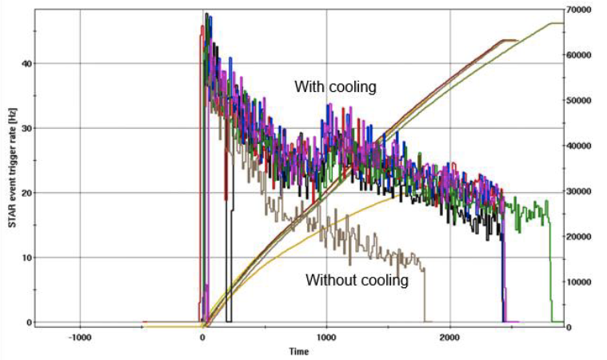
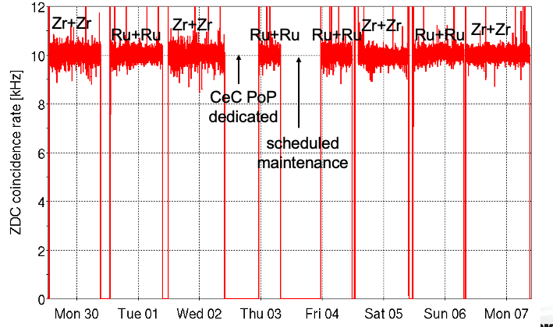
Summary – Mitigation strategies for RHIC and EIC hadron beams
Essentially all standard and some unique techniques
used in AGS Booster, AGS, RHIC and EIC:
bright sources (high-intensity H⁻, polarized H⁻, laser+EBIS)
orbit/tune/coupling/(chromaticity) feedbacks on ramps/in stores
transitions jumps (AGS, RHIC – slow ramping sc machine)
beam-beam compensation with electron lenses
Beam cooling fundamentally
changed how RHIC is operated
2 cooling systems operational (stochastic for high-E ions
electron for low-E Au)
much more luminosity and cleaner operating conditions
operating modes not otherwise possible
Beam cooling also an important technique to
fully realize the EIC potential
Au+Au w/ and w/o
electron cooling

