Slide 1


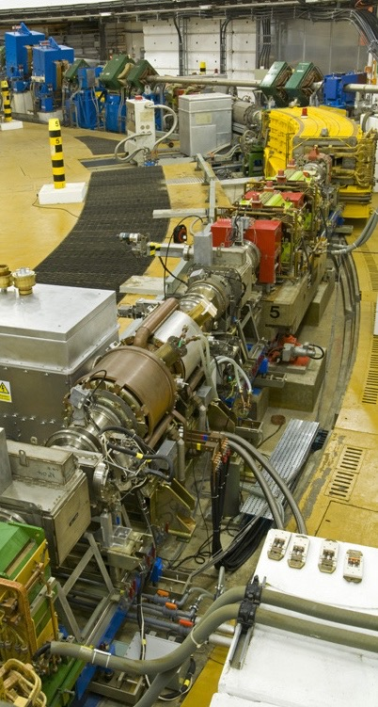
Beam Loss Mitigation for High Intensity Operation at ISIS
Rob Williamson
Synchrotron Group

Slide 2
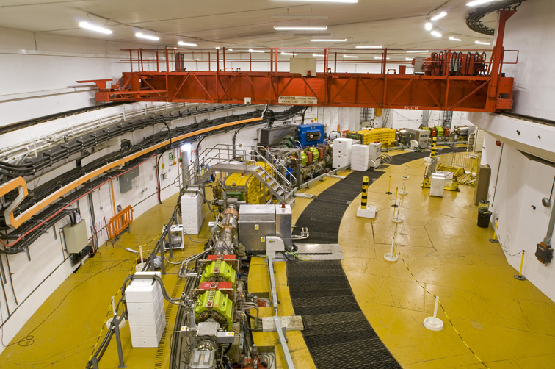
Contents
ISIS Overview
Beam Loss Control
Head-Tail Instability
  Mitigation
  Damping System
Loss Mitigation Developments
Current Status
Future Work

Slide 3
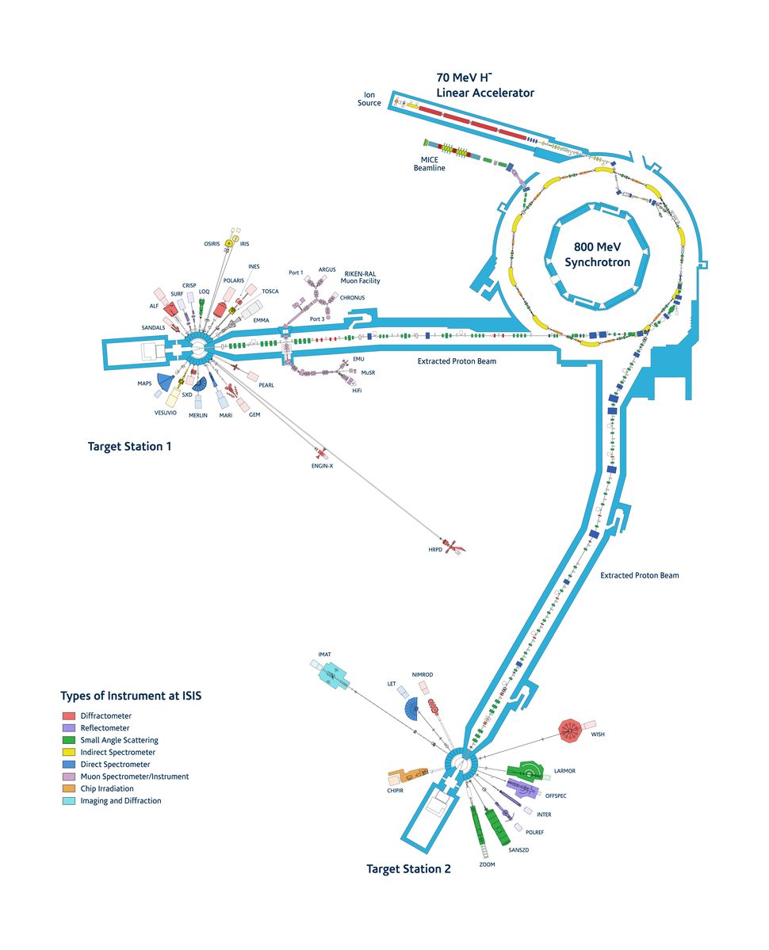
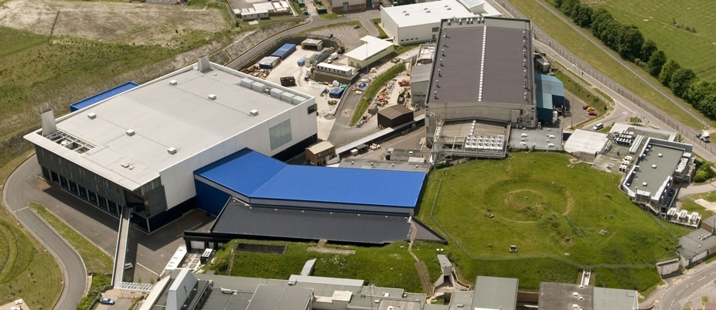
ISIS Overview
70 MeV H- DTL
Charge-exchange injection
50 Hz, sinusoidal main magnet
800 MeV RCS, 10 super periods
3x10¹³ protons, 0.2 MW
RF: 6 h=2 cavities, 4 h=4 cavities

Slide 4
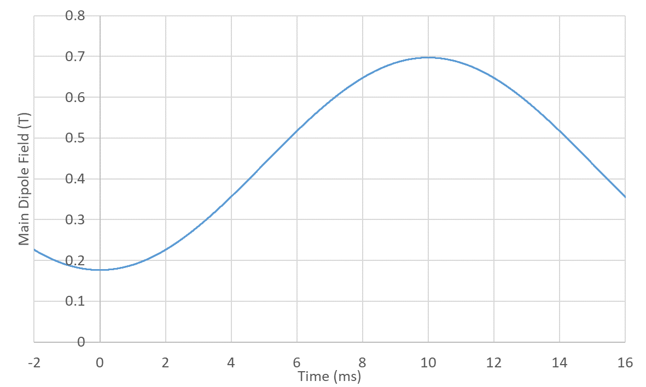
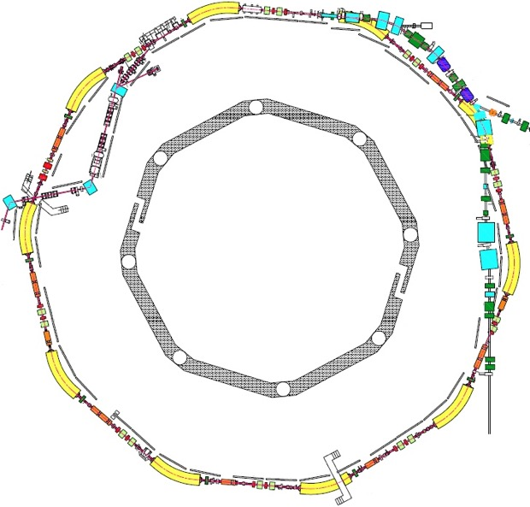
ISIS Synchrotron
Extraction
Trapping
Circumference | 163 m
Energy Range | 70 – 800 MeV
Repetition Rate | 50 Hz
Intensity | ~3x10¹³ ppp
Beam Power | ~200 kW
RF System (2 bunches) | h=2, 1.3 – 3.1 MHz, V_{pk} ~160 kV/turn h=4, 2.6 – 6.2 MHz, V_{pk} ~80 kV/turn
Tunes | Q_{x}, Q_{y} = 4.31, 3.83 (programmable)
Extraction | Single turn, vertical
Losses | Inj: 2%, Trap: <3%, Acc/Ext < 0.5%
Injection
Extraction
Injection

Slide 5
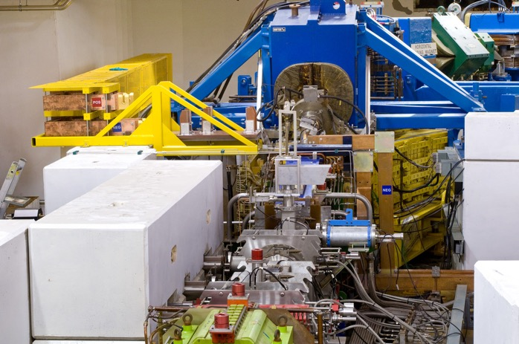
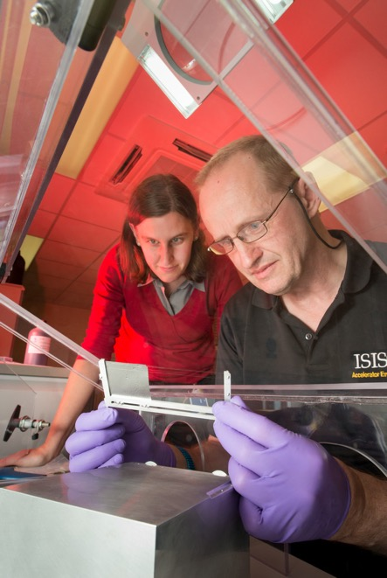
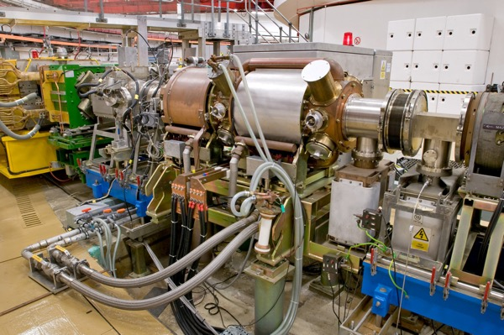
Beam Loss Control
ISIS is loss-limited
Beam loss → component damage, activation
High intensity, space charge and repetition rate
Collimation
Minimize uncontrolled loss
Injection: scattering, stripping efficiency
Trapping: un-chopped, non-adiabatic, transverse space charge
Head-tail instability
Extraction

Slide 6
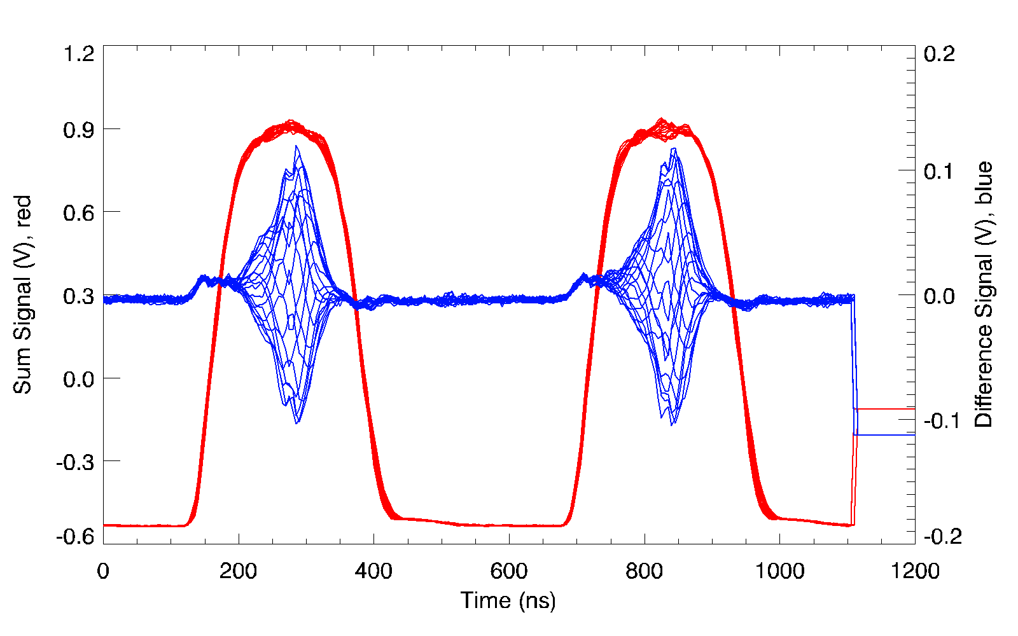
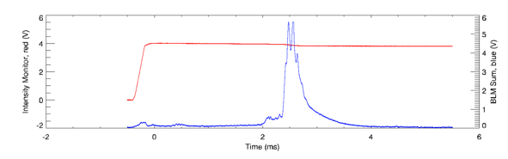
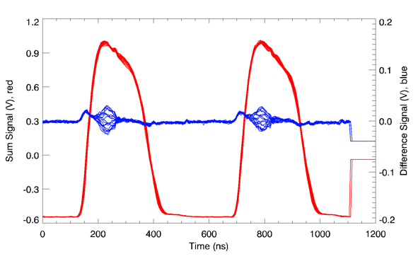
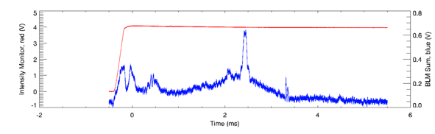
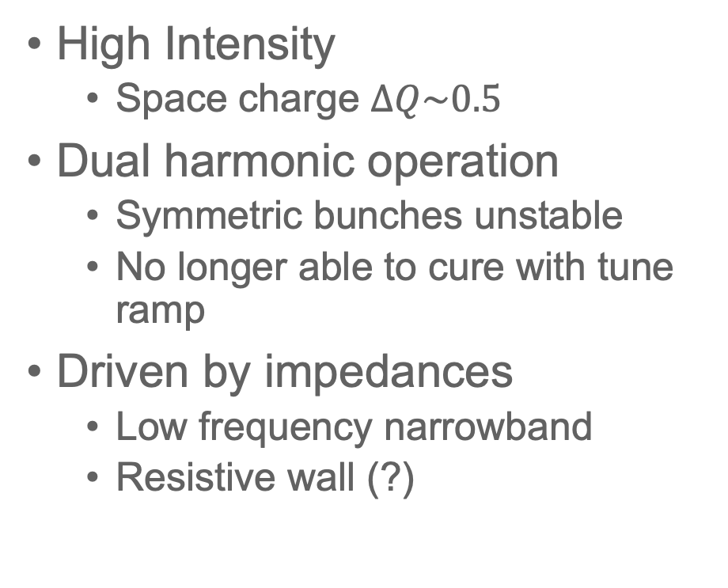
Head-Tail Instability
ISIS Beam Bunches at ~ 2 ms
Normal beam + flat bunch
Large loss!
High Intensity
  Space charge $∆Q\sim 0.5$
Dual harmonic operation
  Symmetric bunches unstable
  No longer able to cure with tune ramp
Driven by impedances
  Low frequency narrowband
  Resistive wall (?)
Loss!
Normal beam + asymmetric bunch
Low loss

Slide 7
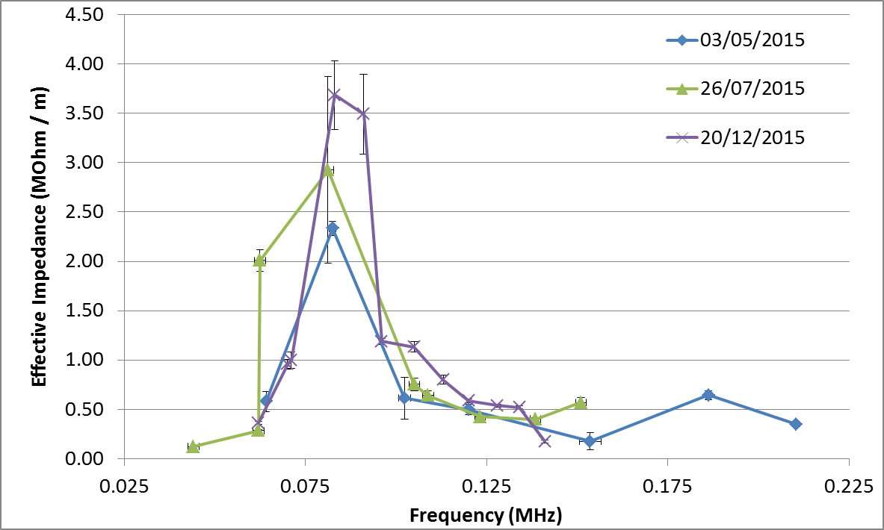
Head-Tail Mitigation
Fast ramp in vertical tune during instability
Longitudinal bunch asymmetry
Injection painting: vertical and longitudinal
Develop Impedance model
  Beam based measurements
  Bench measurements
  Simulations
Effective Impedance Vs Frequency

Slide 8
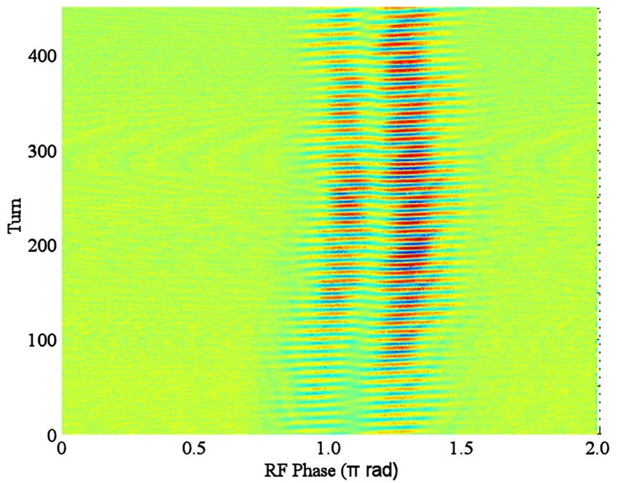
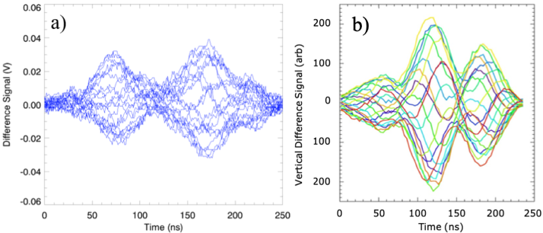
Head-Tail R&D
Experiments
  Simplify to single harmonic RF operation
  Lower intensity => minimal space charge
Theory and simulations with resistive wall predict mode number m=2 (two nodes)
Observations show m=1 (one node)
Less than the full bunch appears to be oscillating
Measurement Vs HEADTAIL* Simulation:
Difference Signal
* Modified CERN code

Slide 9
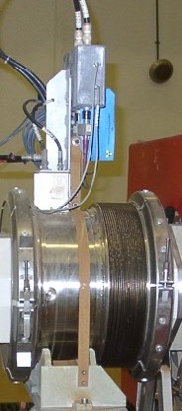
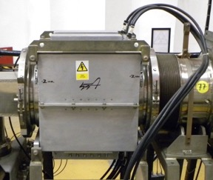
Head-Tail Damping System
Vertical pickup
(R4VM1)
Vertical
Q-kicker
Phase Advance Correction
Programmable
Fine Delay
Power
Amplifier Gain
Use existing components: BPM, ferrite loaded kicker
LLRF electronics for processing signals
FPGA for ADC/DAC, digital filter, delays and gain
Dynamically updated 3-tap FIR filter allows for correct phase for kick through acceleration

Slide 10
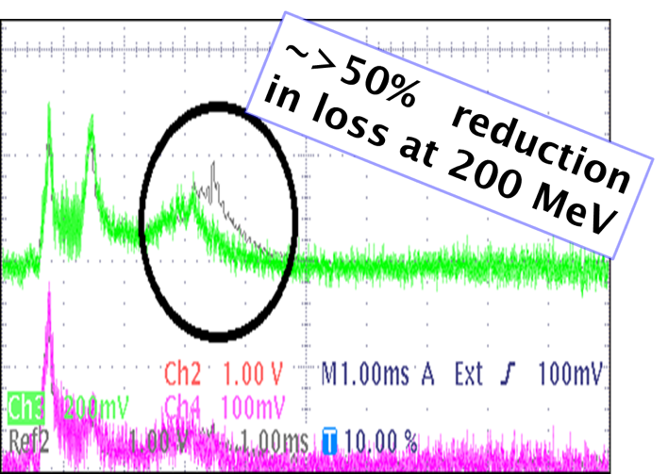
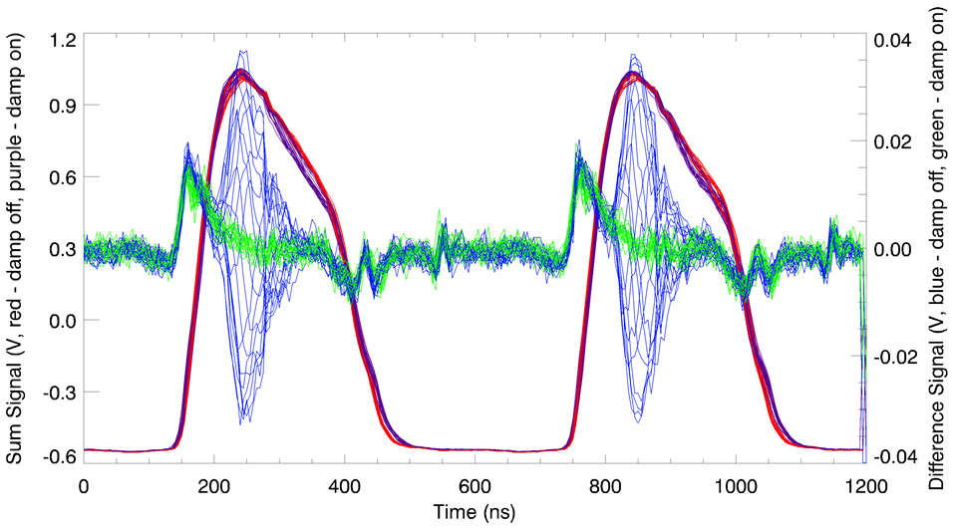
Experimental Results
Vertical head-tail motion 1 - 2.5 ms through acceleration cycle
Suppressed by
  Ramping vertical tune
  Asymmetric longitudinal distribution
  Control of longitudinal and vertical painting
Head-tail effectively damped and beam losses reduced
Further commissioning required
Undamped - blue
Damped - green
RE Williamson et al., MCBI Workshop (2019)

Slide 11
Further Progress in Loss Mitigation
Foil Developments
Digital Low Level RF
Trim Quad Power Supply Filters
Diagnostic Developments

Slide 12
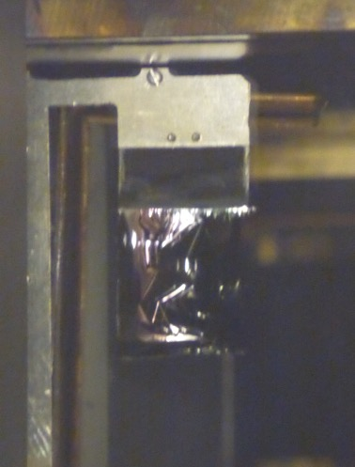
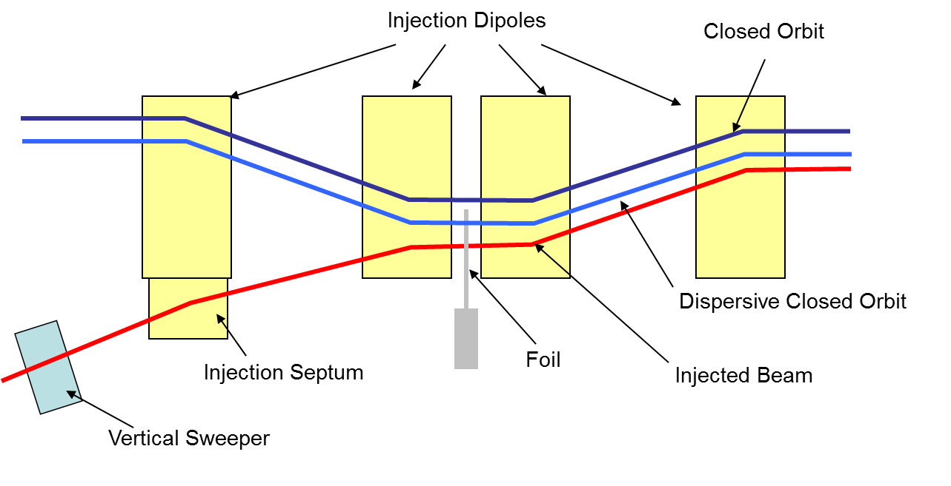
Foil Developments
B Jones & HV Cavanagh, IPAC18 10.18429/JACoW-IPAC2018-TUPAL055
Injecting H- and strip electrons with a thin foil
Proposed ISIS upgrades required new foil material
Trials of carbon based foils
Improvements in foil change time
Beam loss reduction due to foil size
Remaining substrate
35 mm
30 mm
Currently operating with large size nano-crystalline corrugated diamond foil from SNS
H⁻ → H⁺ + 2e⁻

Slide 13
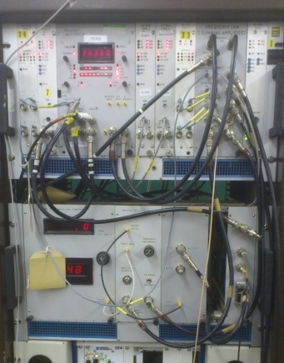
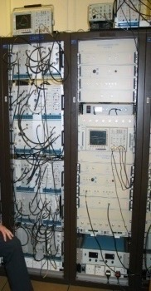
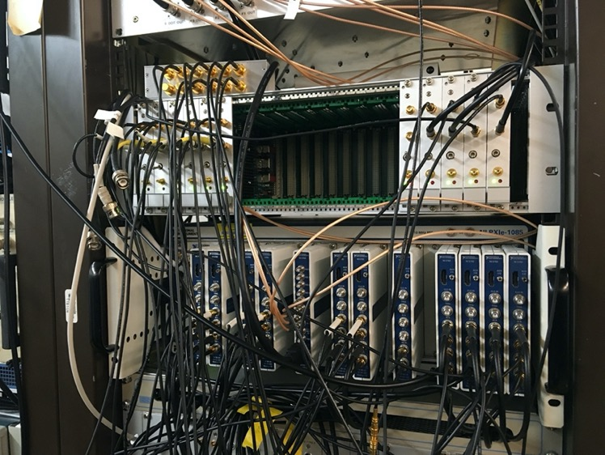
Original (c. 1982)
Frequency Law Generator / Master Oscillator
Digital Low Level RF
Original 1RF Analogue LPRF controls (c.1982)
Loops to control cavity voltage amplitude and phase + tuning
2RF Analogue LPRF controls (c. late 90s)
Ageing components more likely to fail
Replacements harder to source

Slide 14
Digital Low Level RF
NI FlexRIO based system previously used to provide the frequency
Upgraded to include an IQ PID loop around each system
Controls amplitude and phase of the cavity voltage
Digital feed-forward beam compensation now throughout cycle
Digital reference for tuning loop
UPS driven filament power supplies
Level Control Servo / Cavity phase loop
RF
demand
Tetrode
Amplifiers
Intermediate
Amplifier
Subtracter
-
I
Variable
gain
IQ Demod of Beam Intensity signal used to generate FF correction signal
beam
IQ
Demod
IQ
mod
Sum
Electrode
Q
beam
Variable
delay
Digital Gain Function
A Seville et al., LLRF2019, arXiv:1910.07302
Phase
Reference
(sum electrode)
Can be used throughout whole Frequency sweep.

Slide 15
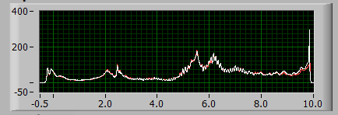
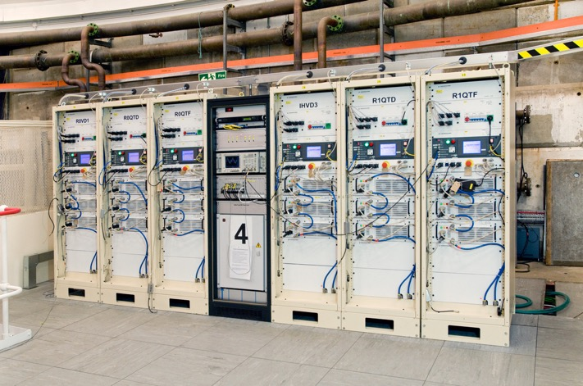
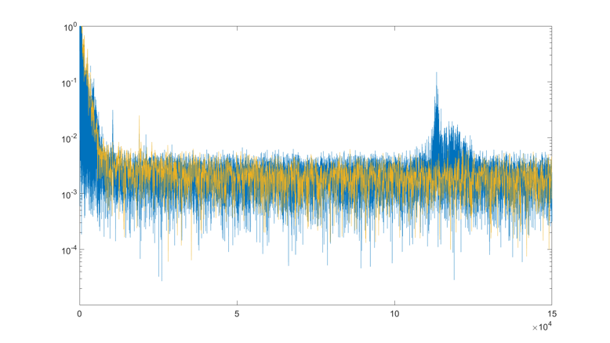
Trim Quad Power Supply Filters
New correction magnet PS installed
Small induced instability and loss
Old PS – 20 kHz, New PS – 120 kHz
Parallel low pass and notch filter installed
Beam Loss Scintillator in Dipole
Fourier Transform of Trim Quad Current
B Jones et al., IPAC19, 10.18429/JACoW-IPAC2019-WEPGW091

Slide 16
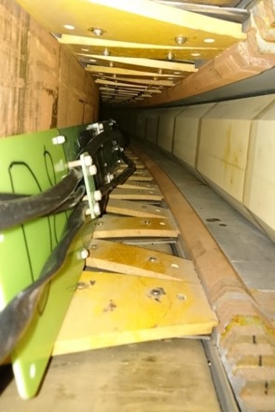
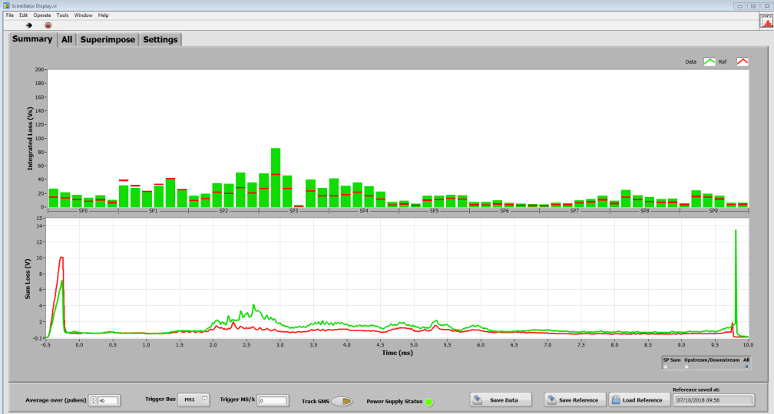
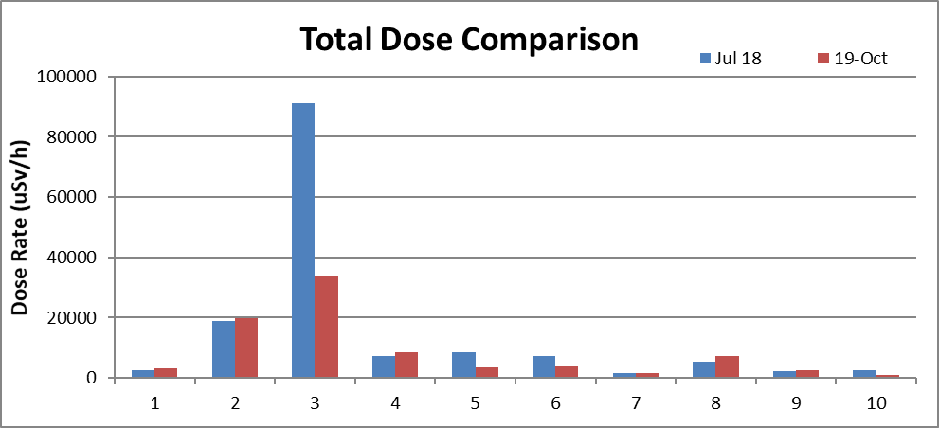
Diagnostic Developments
New beam loss monitors installed in all main dipoles
Investigate/cure cause of RF screen damage
Previously unseen losses inside dipoles now measured
Beam parameters further optimised to reduce loss/activation and protect dipoles
Scintillators installed along vacuum chamber inside dipole
40% reduction in residual activation measured from cycle 2018-1 to 2019-2
B Jones et al., IPAC19, 10.18429/
JACoW-IPAC2019-WEPGW091
DAQ system and LabVIEW software enables monitoring across ISIS network

Slide 17
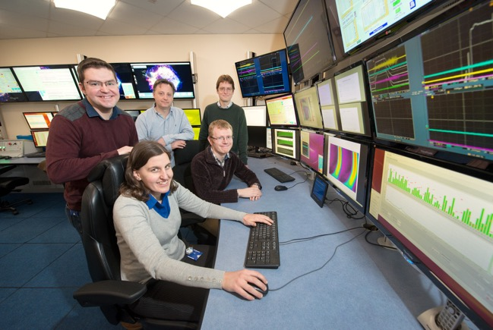
Improved Operations
Beam loss levels have been reduced systematically
RF stability and re-optimized collimation
Trapping and head-tail associated losses mitigated to half their usual value
Trim quad PS instability removed
Progress ongoing with increased beam intensities…

Slide 18

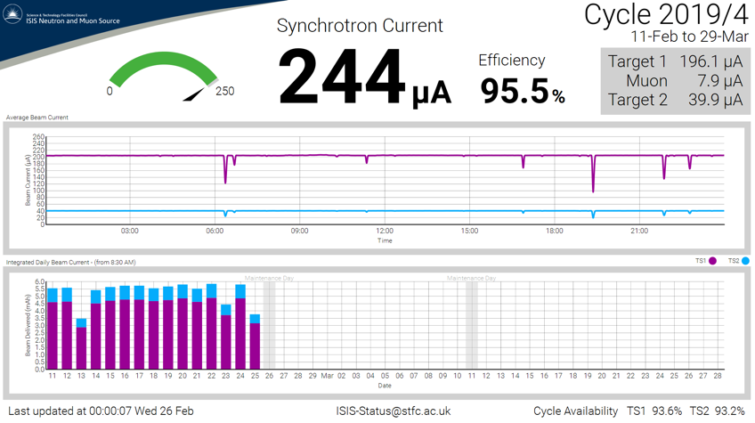
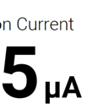
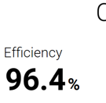
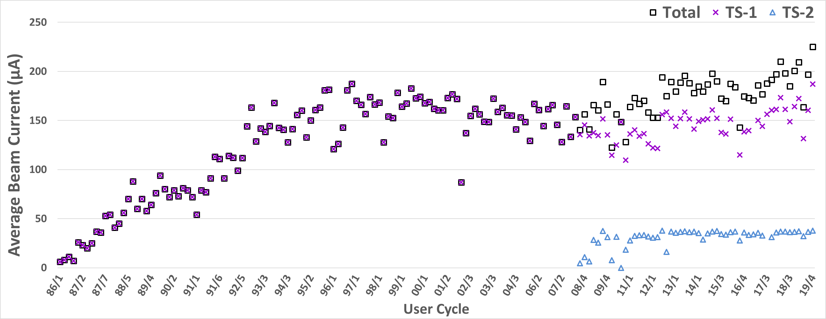
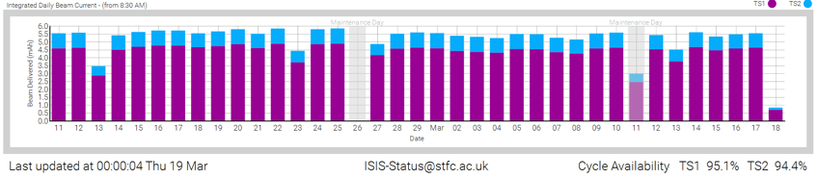
Improved Operations
During Cycle 2019/4 (11th Feb – 27th Mar 2020)
Beam delivery record exceeded 7 times
  Best day was 25th February with 243.5µA and 99.6% availability
  A total of 5.84 mAh delivered to the targets
Overall availability was 95%, the second highest on record
Synchrotron beam current is now the maximum required by the target stations, no longer loss limited!

Slide 19
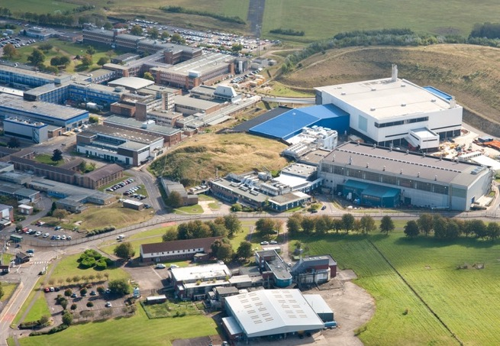
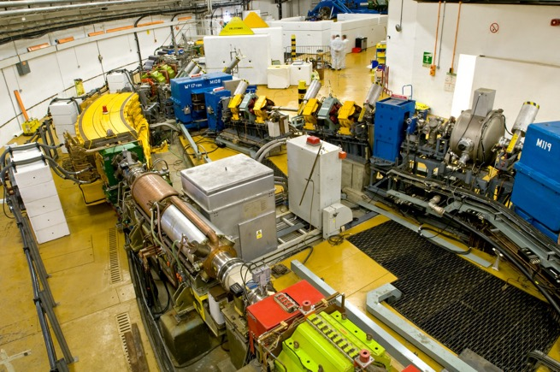
Summary
Need for control of beam loss
Head-tail instability: mechanism & mitigation
Foil developments
RF stability
Magnet power supply frequencies
Diagnostic improvements
Lower beam losses enabling higher intensities with lower activation
DJ Adams et al., “Operational Experience and Future Plans at ISIS”, HB16, 10.18429/JACoW-HB2016-TUPM3Y01
JWG Thomason et al., “The ISIS Spallation Neutron and Muon Source – The First 33 Years”, NIMA, 917 (2019) 61-67

Slide 20

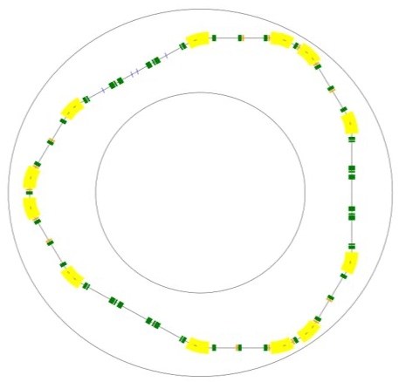
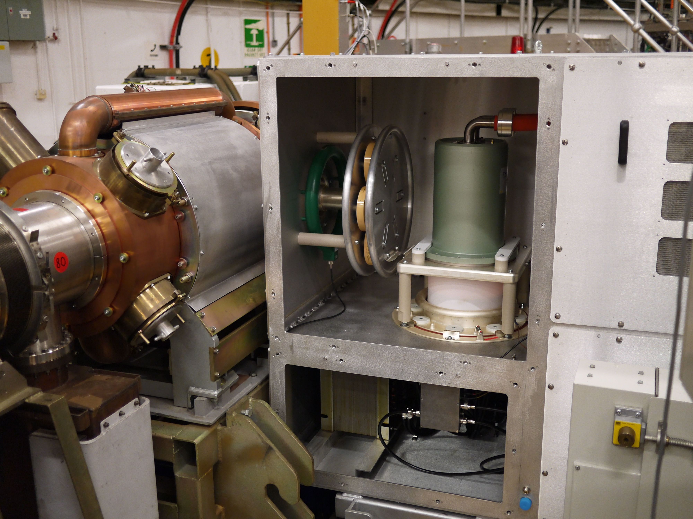
Future Work
Many hands make light work
Work is never complete!
High intensity beam studies
Further commissioning and development of damper system
More digital development alongside new HPDs
Diagnostic upgrades
MEBT upgrade
ISIS-II MW upgrade
  FFA & conventional rings
  Detailed user consultation
R&D on ISIS and FETS
Discussions with the international community

Slide 21
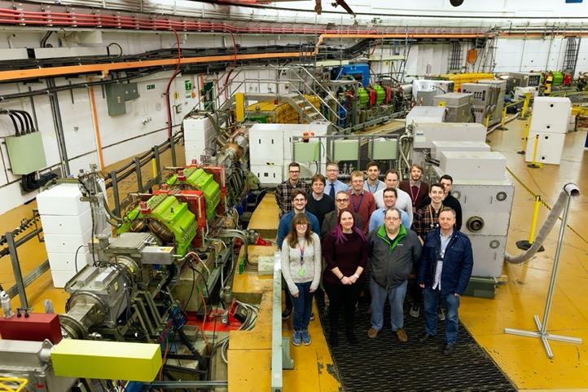
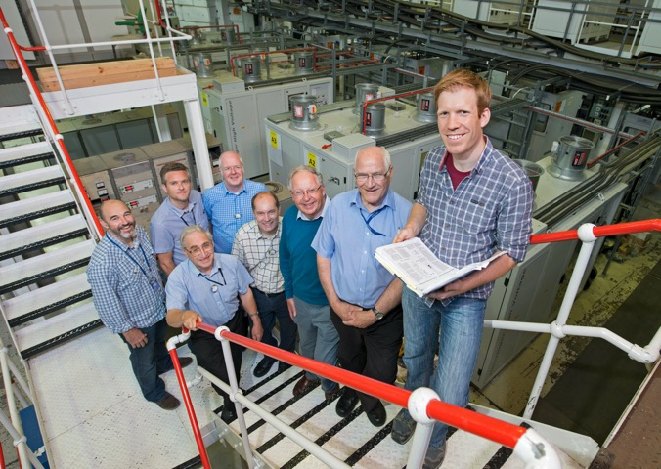
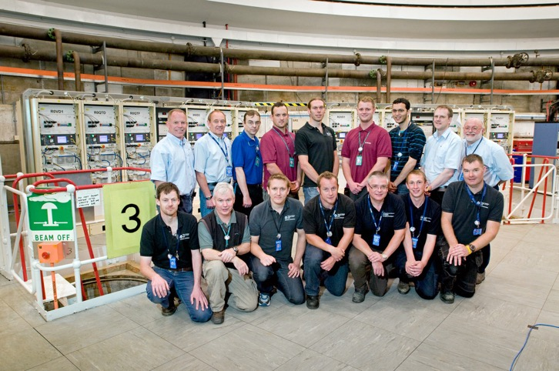
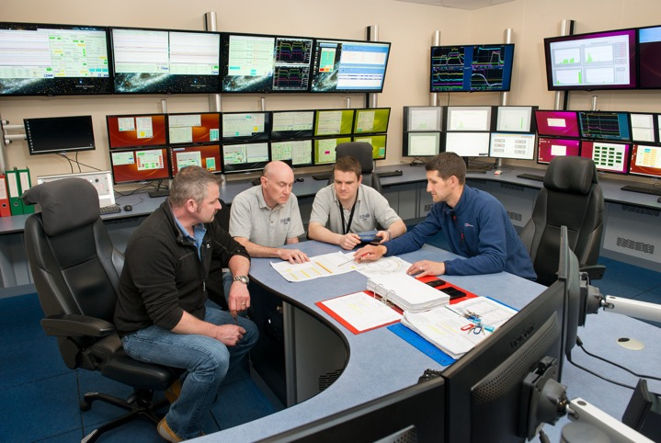
Acknowledgements
ISIS Accelerator Physics
ISIS Diagnostics
ISIS RF
ISIS Electrical Engineering
ISIS Operations Crew

