Slide 1
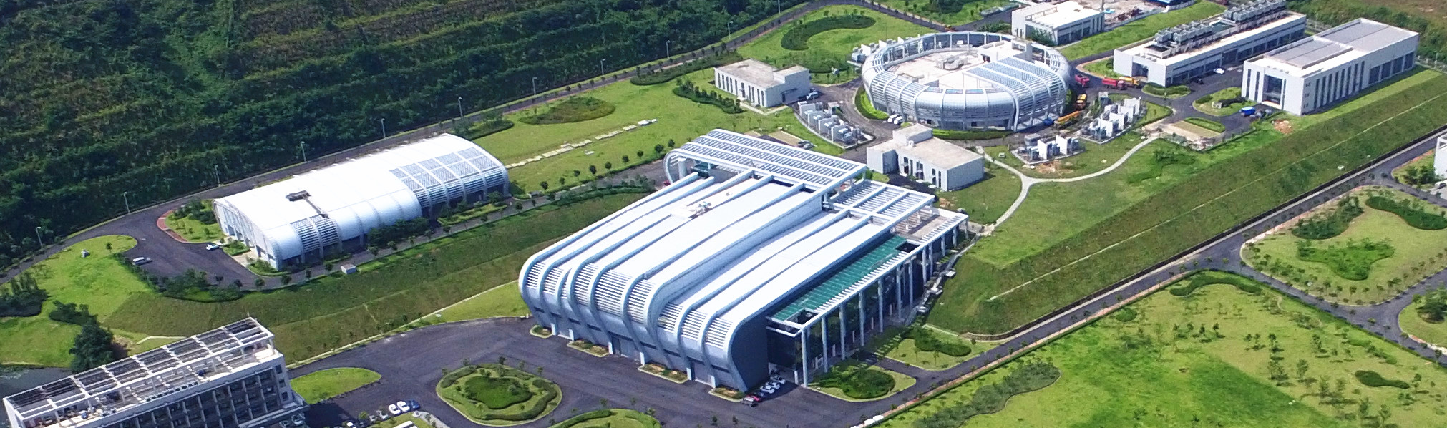
Performance and Limits at CSNS
Sheng Wang
CSNS, IHEP Jun. 29, 2020
Mitigation approaches for Hadron storage rings and synchrotron

Slide 2
Contents
1
Introduction to CSNS
2
Performance of CSNS
3
Beam commissioning and limits
4
Upgrade plan
5
Summary

Slide 3

Site of CSNS
Dongguan branch Established on Feb. 19th 2013, to construct and manage the CSNS
Located in Dongguan, Guangdong Province
★
•
CSNS

Slide 4
Key milestone of CSNS
Proposal for the CSNS Project
Proposal approved
Civil construction started
Feb. 2001
Jan. 2006
Sep. 2008
Sep. 2011
May 2012
Oct. 2014
Prototyping R&D started
Construction started
Construction complete
(6.5 years from start)
DTL-1 Beam commissioning
RCS commissioning start
Jan. 2016
Apr. 2017
May. 2017
Aug. 2017
Mar. 2018
Mar. 2020
Linac beam commissioning
100kW
First beam on target, first neutron beam
4

Slide 5
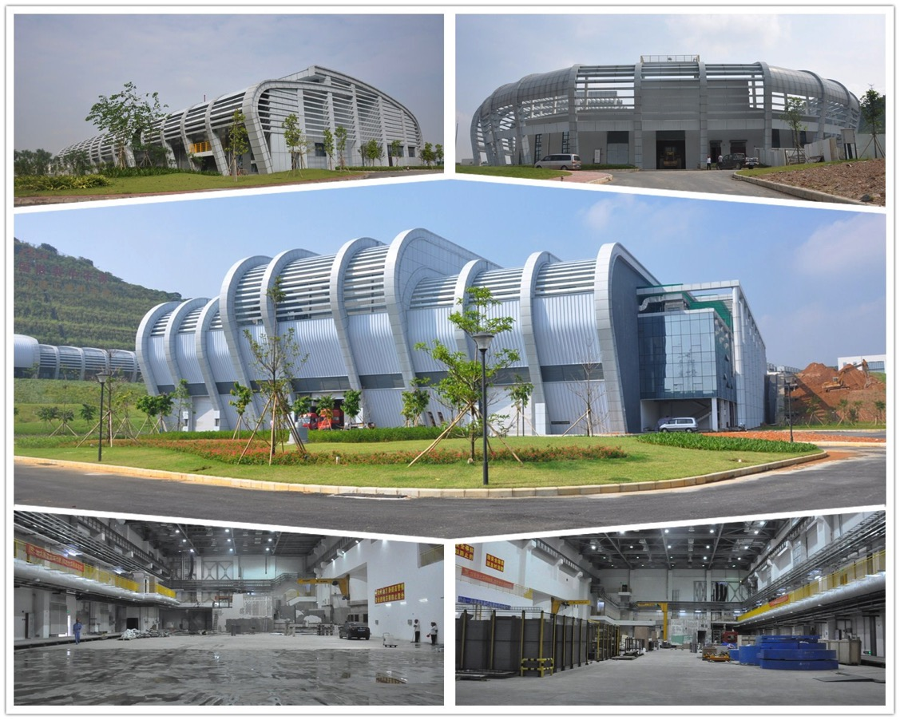
CSNS Civil Engineering
    Linac service building
    RCS service building
    Target and experiment hall
    South experiment hall
    North experiment hall

Slide 6
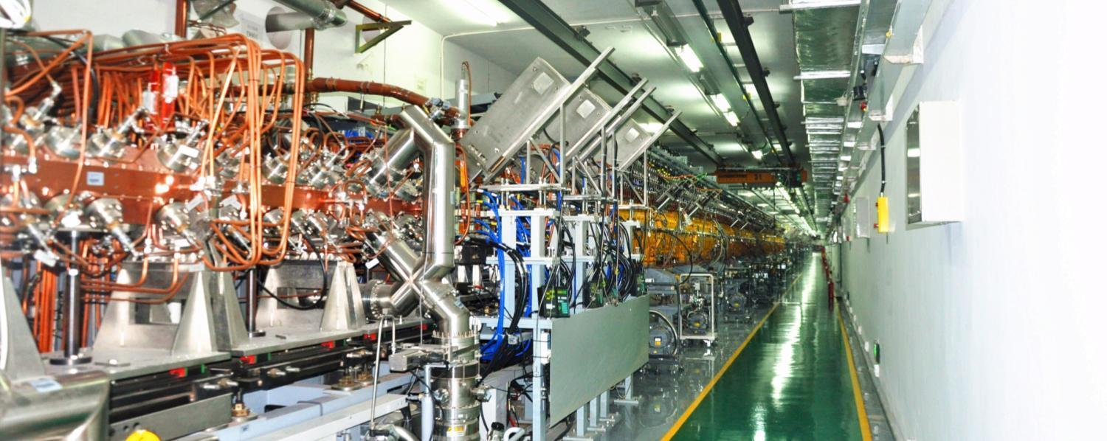
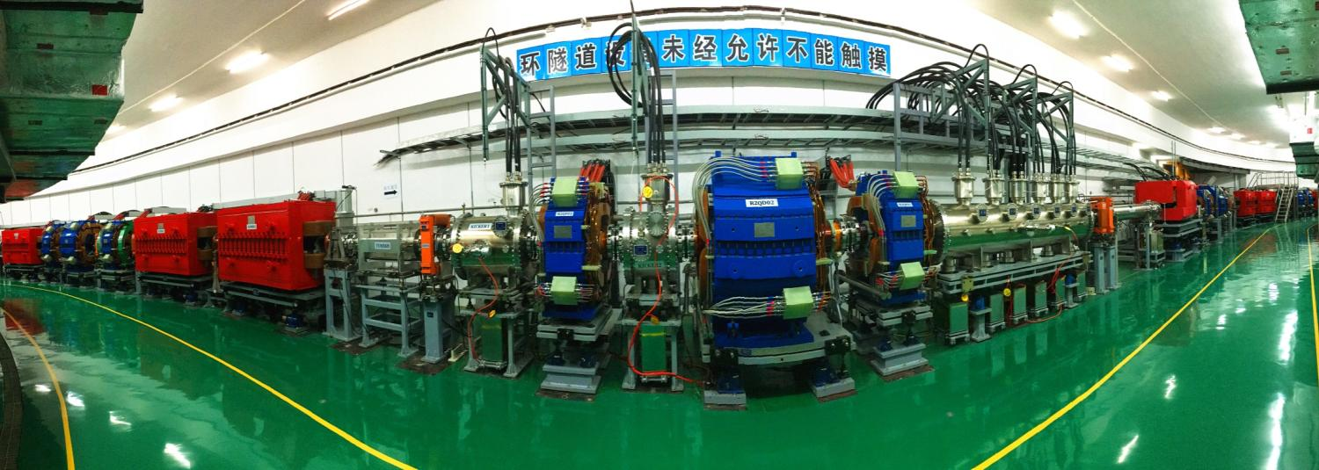
Linac tunnel
RCS tunnel

Slide 7
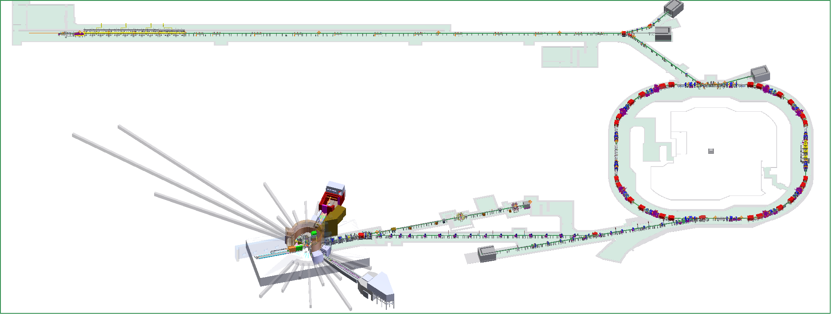
CSNS Overview
80MeV H⁻ linac
1.6GeV, 25Hz
100kW

Slide 8
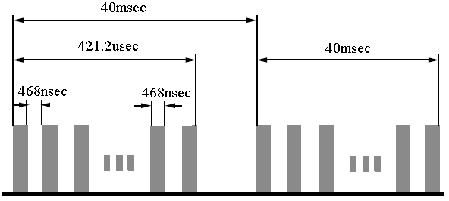
Front End and H- Linac
EMQ option in FFDD lattice for DTL
Electrostatic chopper in LEBT
 | Ion Source | RFQ | DTL
Input Energy（MeV) |  | 0.05 | 3.0
Output Energy(MeV) | 0.05 | 3.0 | 80
Pulse Current (mA) | 20/40 | 15/30 | 15/30
RF frequency (MHz) |  | 324 | 324
Chop rate (%) |  | 50 | 50
Duty factor (%) | 1.3 | 1.05 | 1.05
Repetition rate (Hz) | 25 | 25 | 25

Slide 9
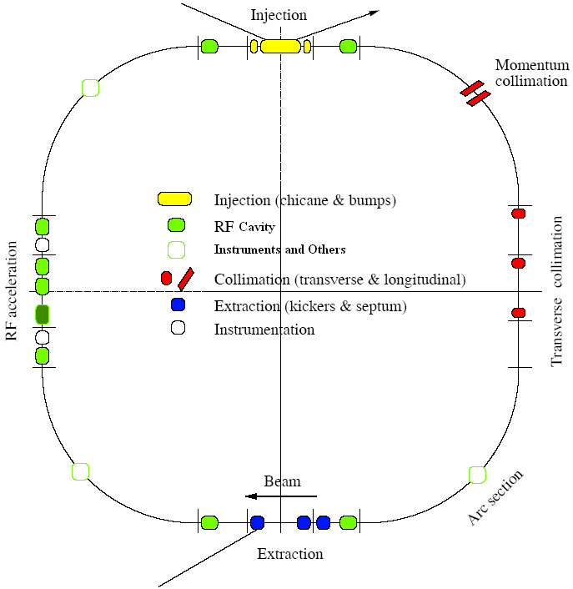
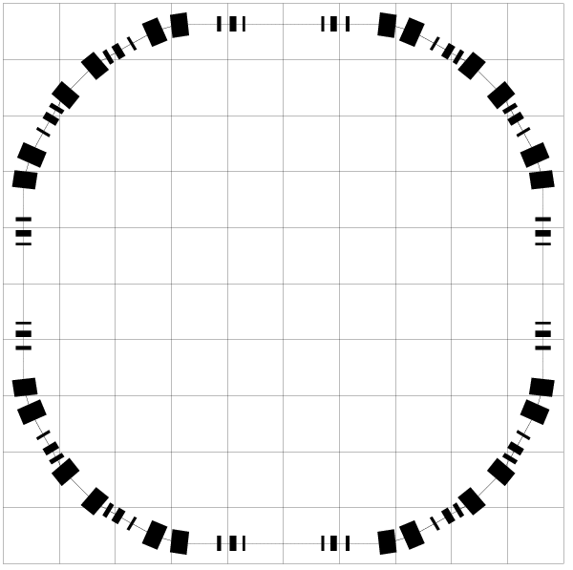
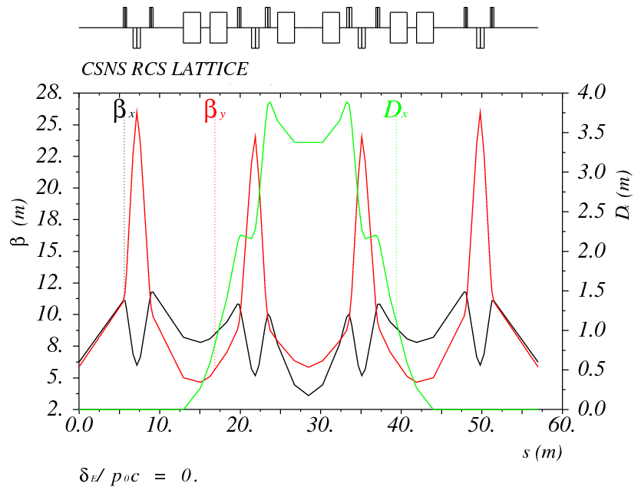
Rapid Cycling Synchrotron
Lattice of 4-fold symmetry, triplet.
227.92m circumference.
Four long straight sections for injection, acceleration, collimation and extraction.
24 main dipoles with one power supply.
48 main quadrupoles with 5 power supplies.
Ceramic vacuum chambers for the AC&pulsed magnets.
8 RF ferrite loaded cavities to provide 165 kV.

Slide 10
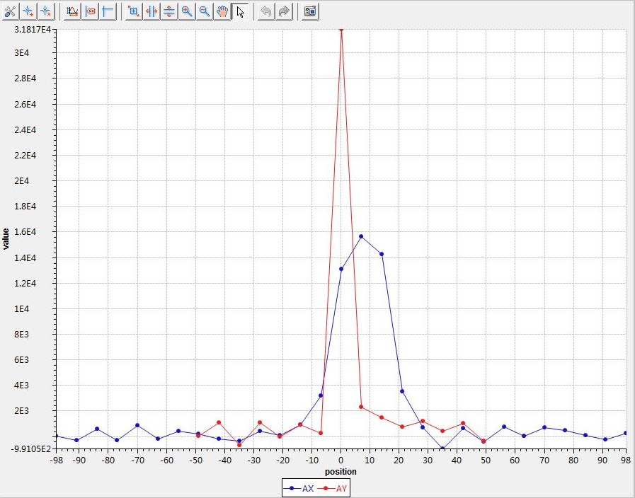
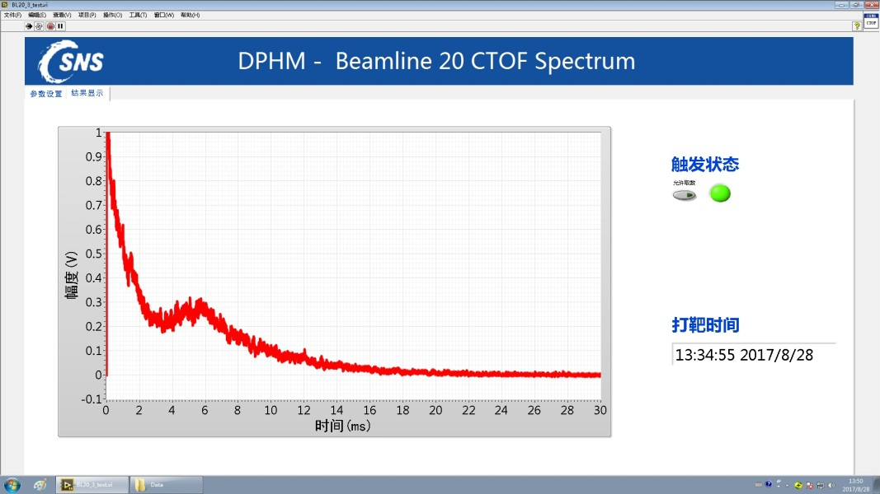
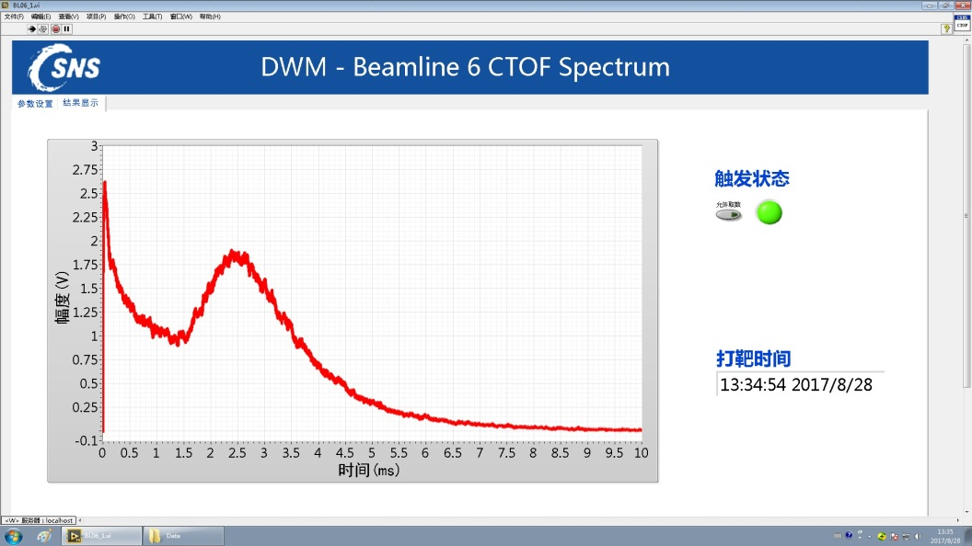
First CSNS Neutron Beam
Aug. 28, 2017

Slide 11
Commissioning plan
Plan
Achieved
IS+LEBT | 2015.4.14 - 2015.4.14
RFQ+MEBT | 2015.4.15 - 2015.7.15
DTL1 | 2015.12.28 - 2016.2.26
DTL2-4+LRBT | 2016.11.20 - 2016.12.20
RCS+RTBT | 2016.12.25 - 2017.6.16
RTBT （on target) | 2017.6.17 - 2017.9.30
First neutron beam | 2017.9.30
10kW | 2017.9.30 - 2017.12.31
To acceptance goal | 2017.12.31
Official acceptance | 2018.3
100kW | 2018.3.1-2021.3.1
2016.1.9
2017.4.14–2017.4.24
2017.5.27–2017.8.27
2017.8.28
2017.8.28
2017.10.25- 2017.11.9
2017.11.9
2018.3
2020.6 100kW

Slide 12
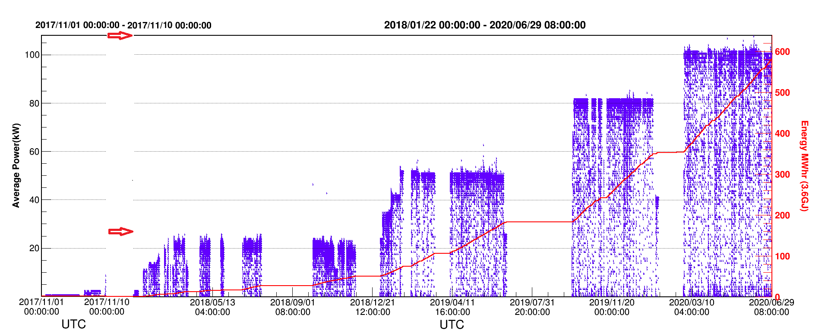
Historical Curve of Beam Power
Nov., 2017, First 10kW beam strike on target for a short while;
Mar. 2018, beam power over 20 kW in the test operation;
Jan. 2019, after 4 weeks beam commissioning , beam power was gradually increased to 50kW+ with well controlled beam loss.
Sep. 2019, based on the 6 weeks beam commissioning, the beam power in user operation was increased to 80 kW step by step.
The beam power was increased to 100kW in the end of Feb. 2020.

Slide 13
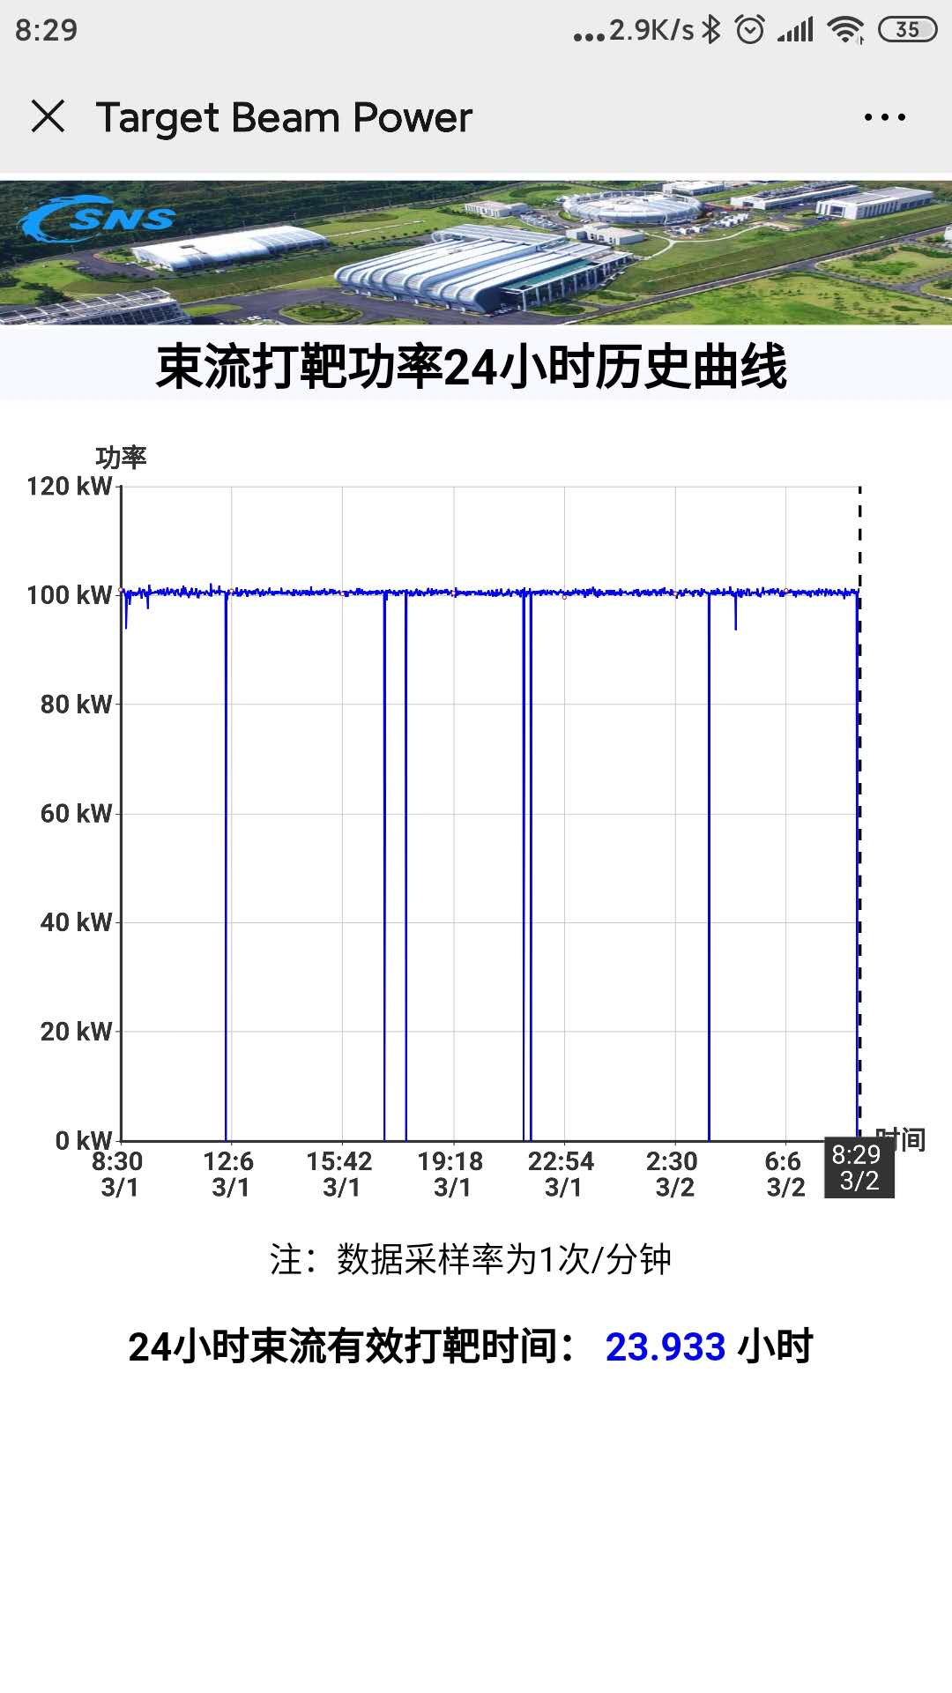
24 hours beam operation (Mar.1,2020)

Slide 14
Machine hours Statistics (2019)
~4500 hours was provided to users in operation of 2020
The availability is over 92% during the user operation
14

Slide 15
Beam Commissioning and Limits

Slide 16
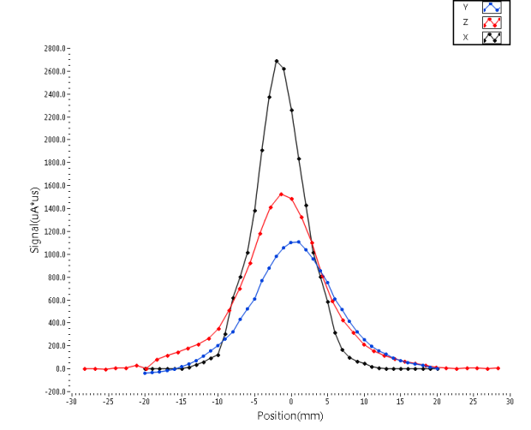
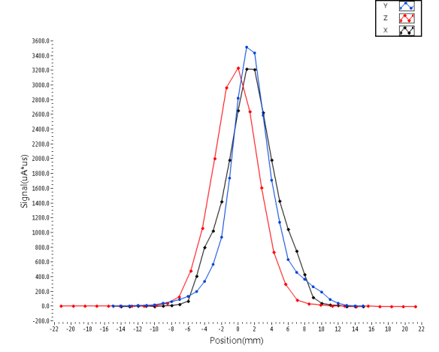
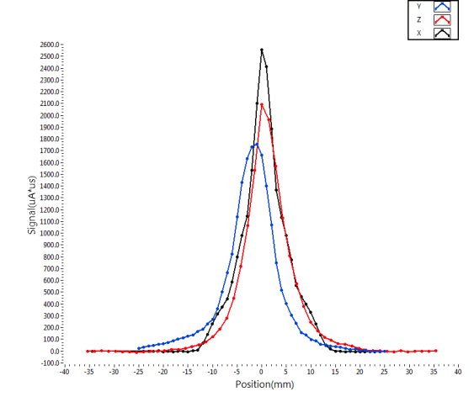
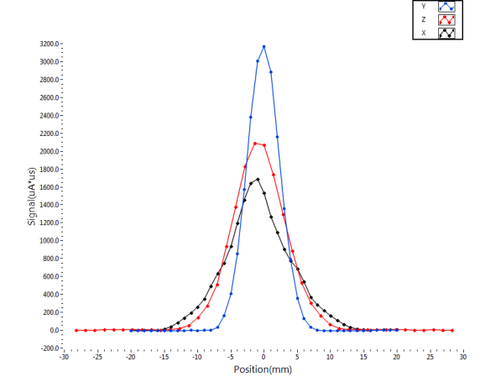
Linac Commissioning
MEBT matching minimizing RMS beam sizes at the exit of the DTL
The stability of Ion source
LRWS00
LRWS01
LRWS02
LRWS03

Slide 17
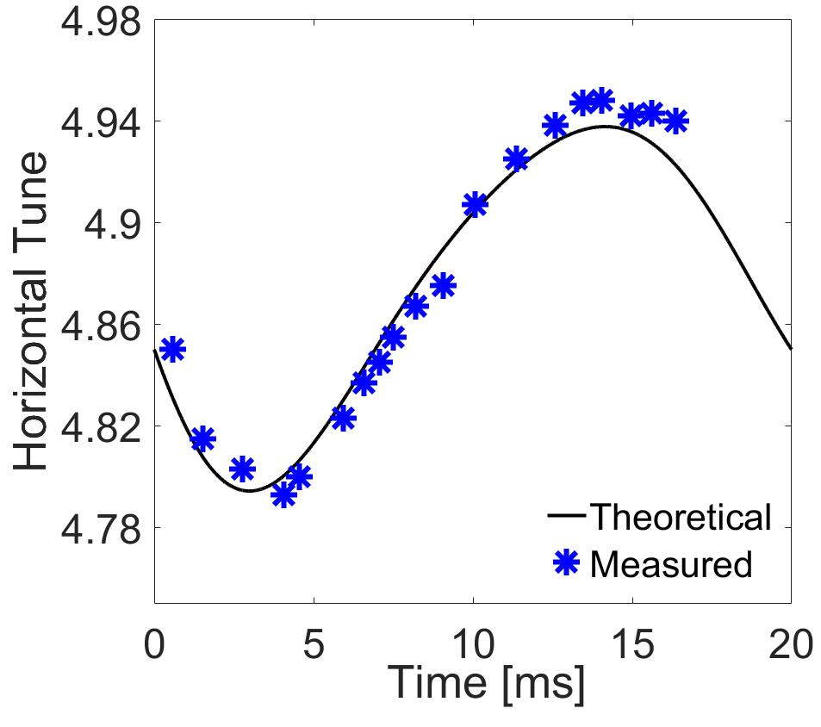
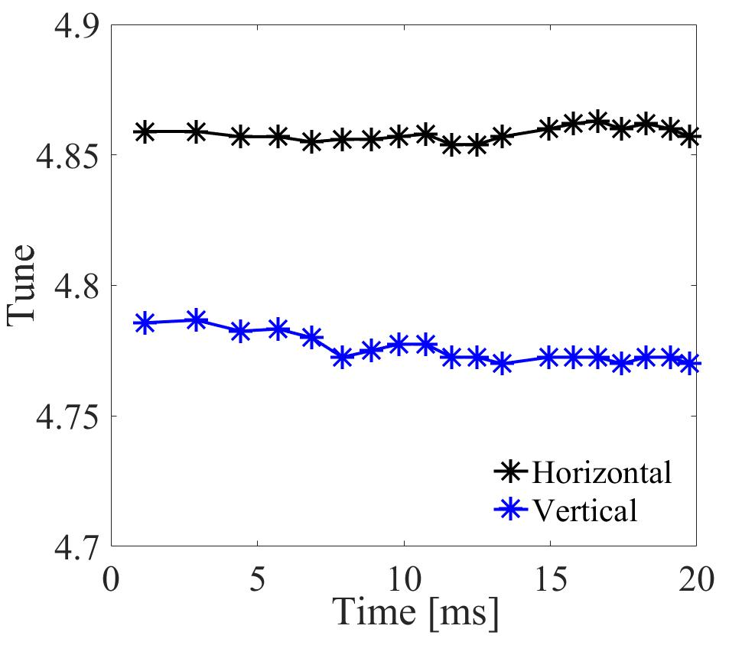
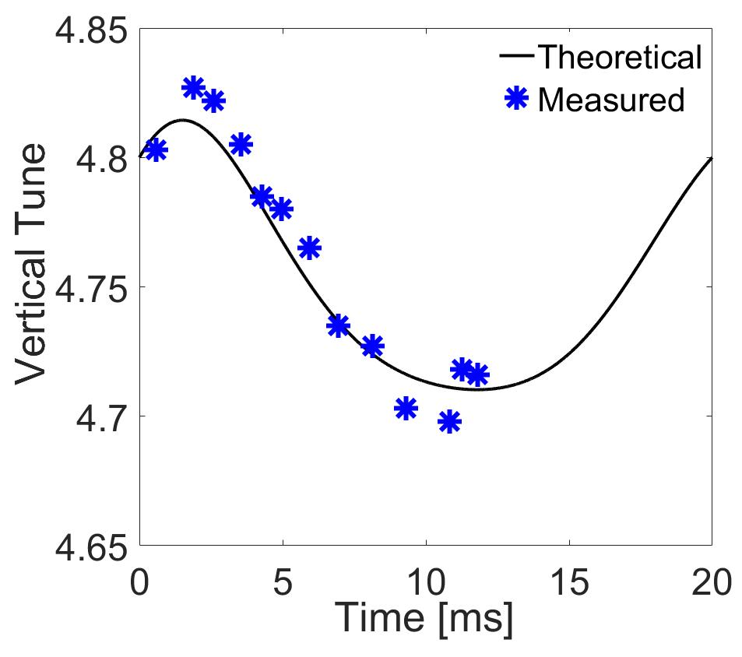
Tune Optimization
Harmonic compensation on magnets was used for the tune optimization
Harmonic compensation
The tune variation during the beam acceleration process was well controlled
The design tunes (4.86 4.78) were adopted at low-intensity beam commissioning
Before harmonic compensation

Slide 18
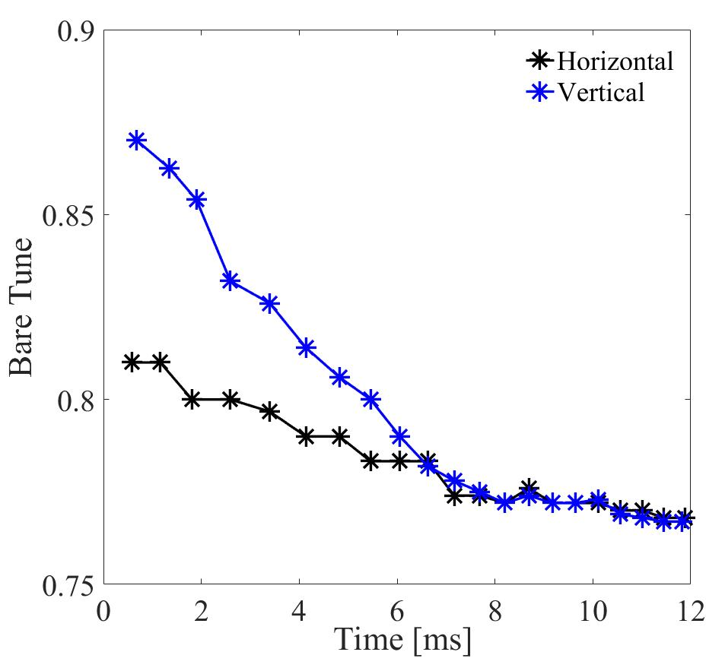
Tune Optimization
Tune optimization at high-intensity beam commissioning
The tunes at injection were set at (4.81, 4.87) to reduce space charge induced beam loss
The tunes were moved downward to suppress the beam instability

Slide 19
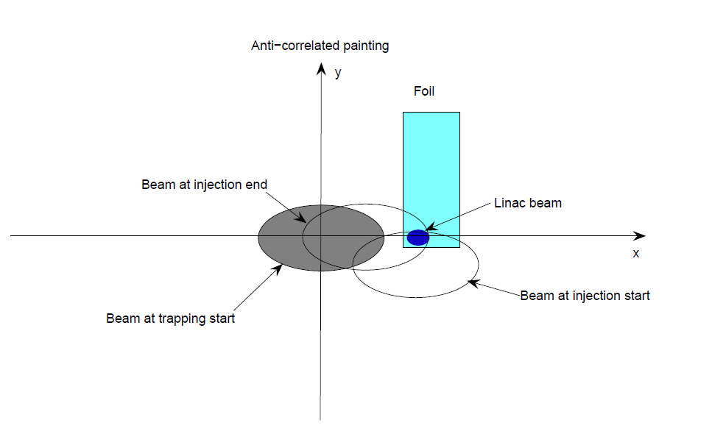
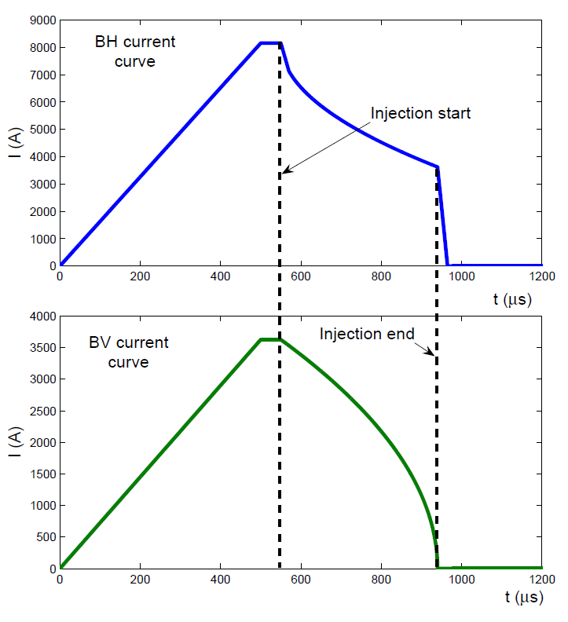
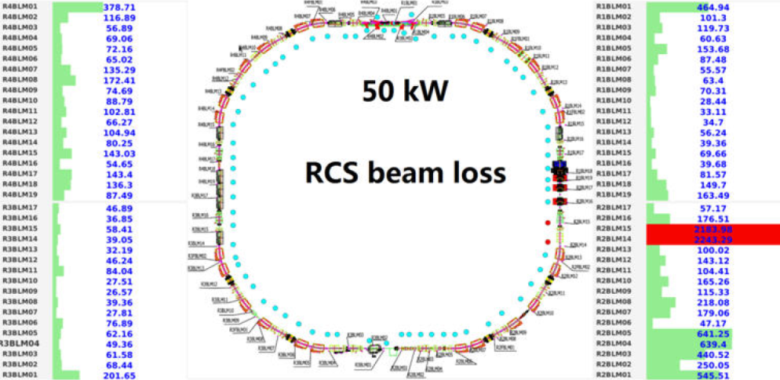
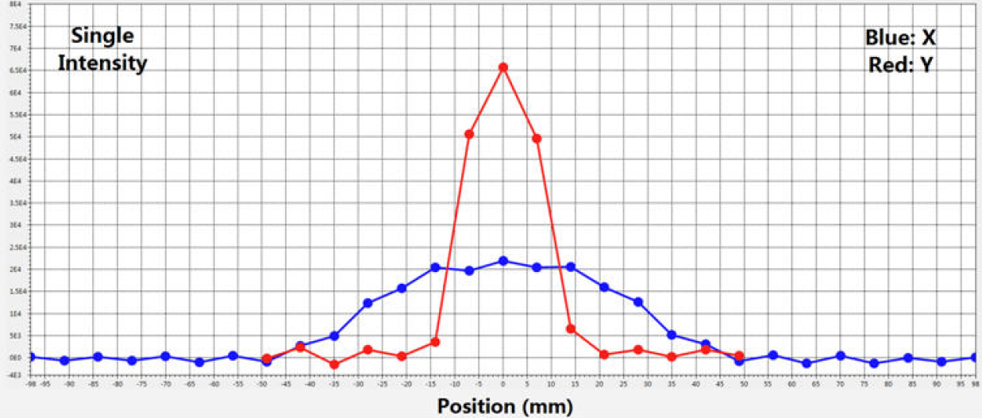
Anti-correlated painting scheme
The anti-correlated painting is design scheme
By using the anti-correlated painting, the beam power reached 50kW.

Slide 20
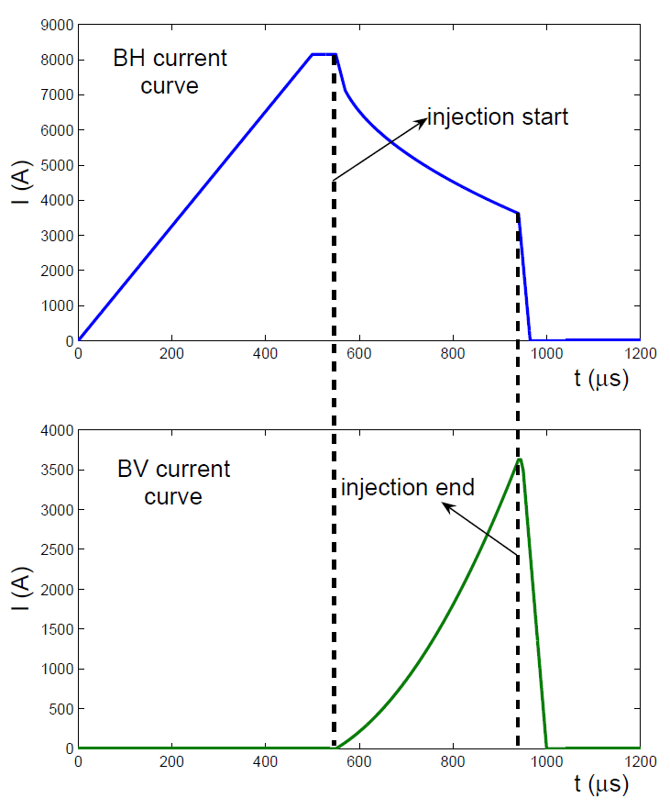
Correlated painting scheme
Emittance growth,
beam loss during injection
Uncontrolled beam loss in acceleration
Distortion of extracted beam distribution
A new methods was proposed to perform the correlated painting under the anti-correlated

Slide 21
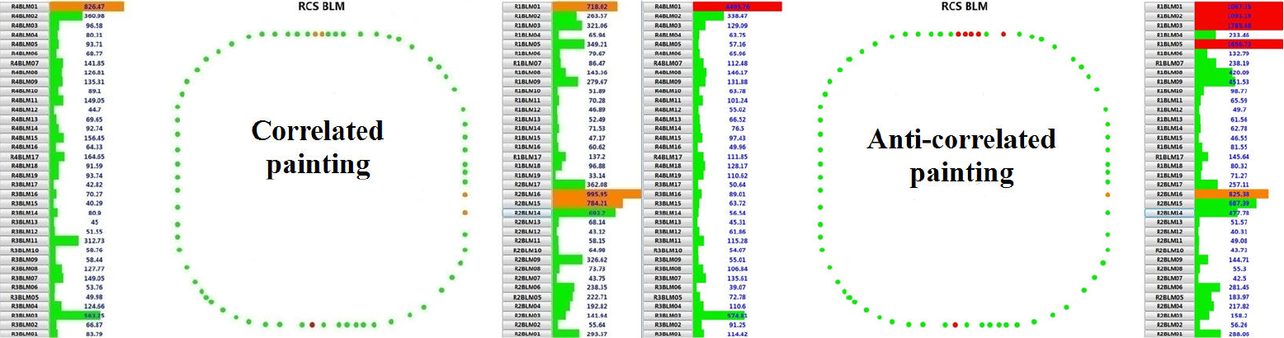
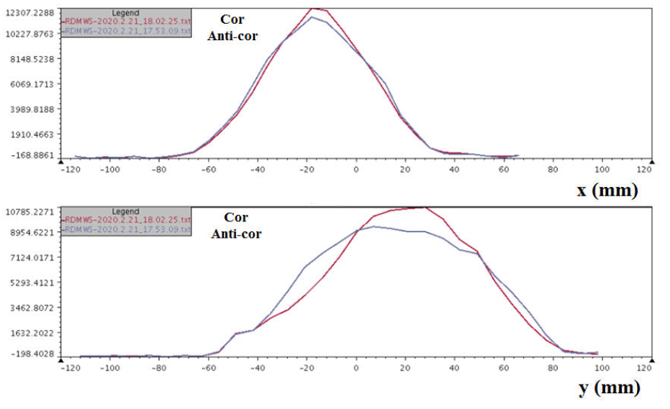
Comparison between the correlated and anti-correlated paintings
By correlated painting:
Beam loss is well controlled
Beam distribution is much better

Slide 22
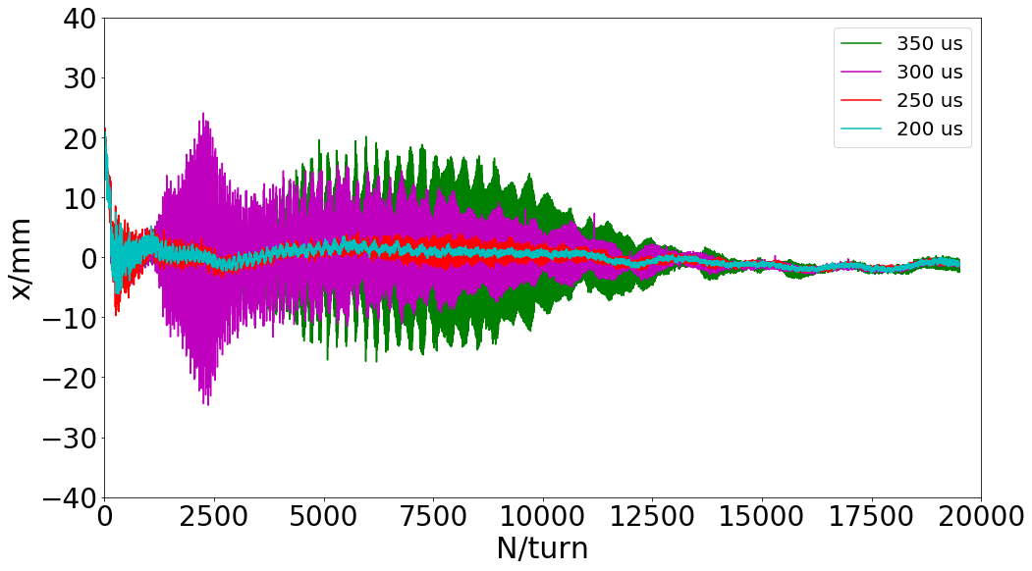
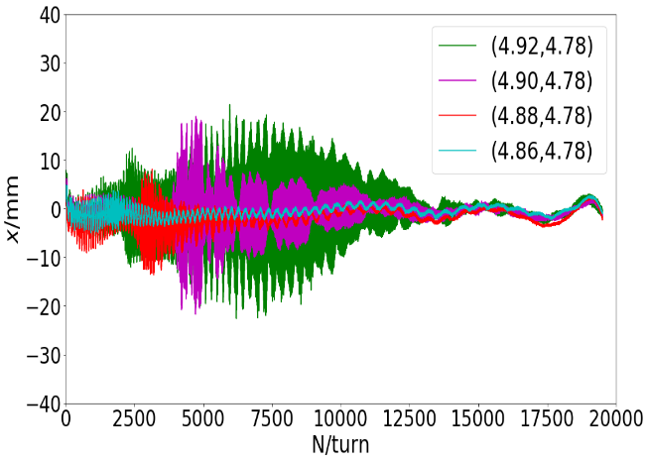
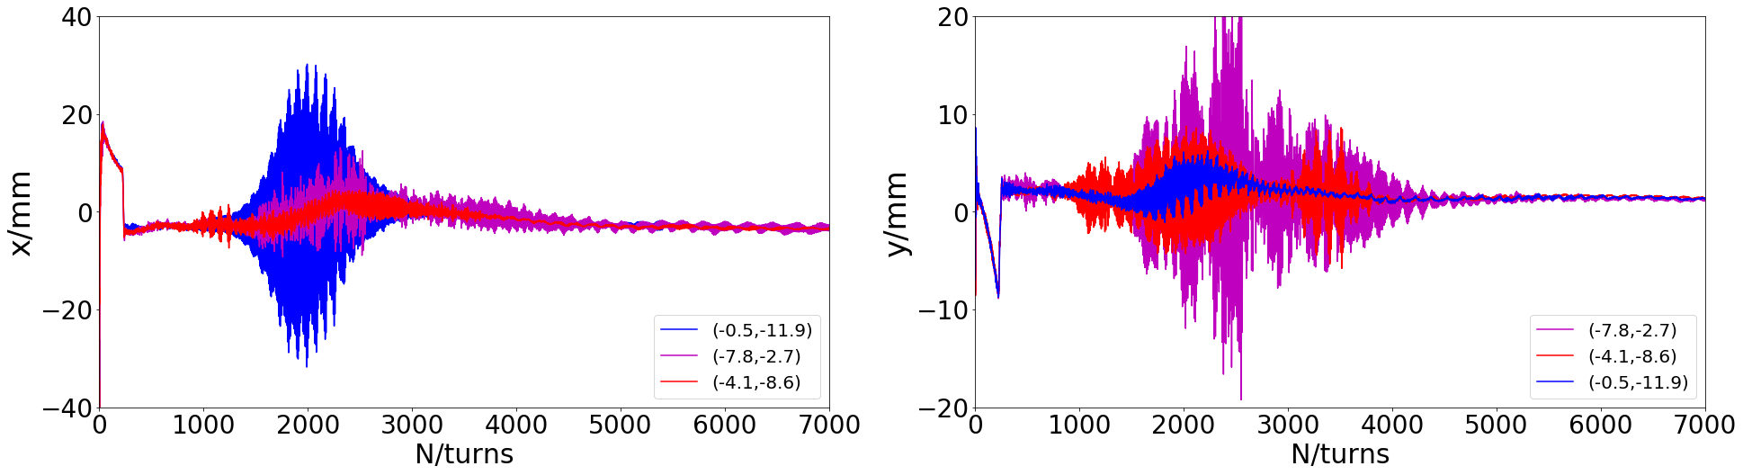
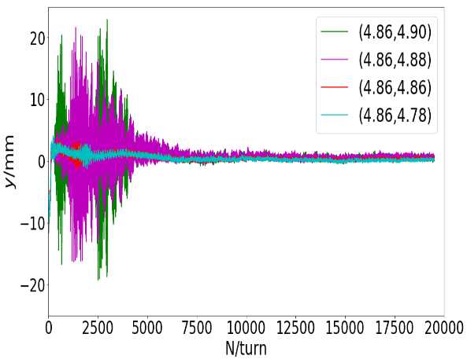
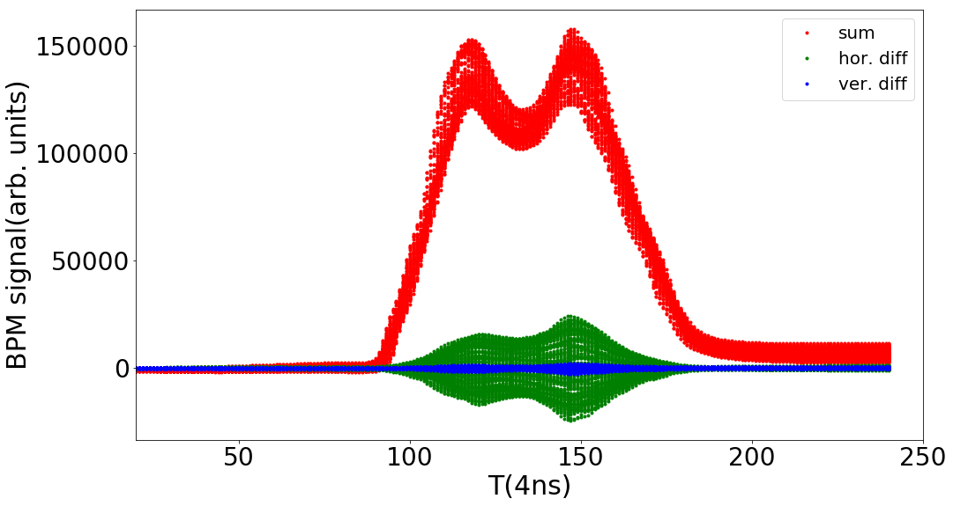
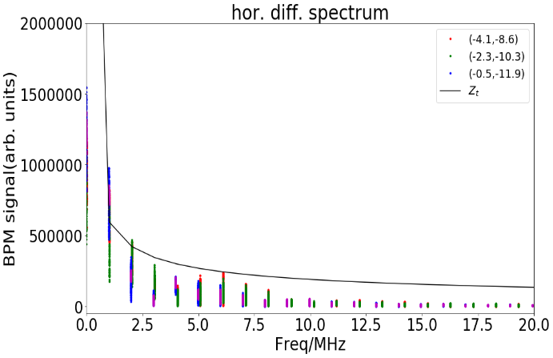
Coherent oscillation study - measurement
A coherent oscillation appears at 2 ms for design mode of 86/78 when the beam power is bigger than 50 kW (7.8E12 ppp)
It depends on circulated beam power, horizontal tune and chromaticity.
The coherent oscillation mainly occurs in horizontal plane, but it also appears in vertical plane with special vertical tune and chromaticity.
The head-tail mode is also detected through BPM waveform
The beam spectrum is consistent of resistive wall impedance

Slide 23
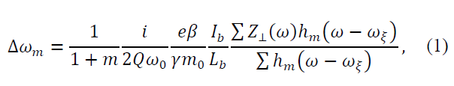

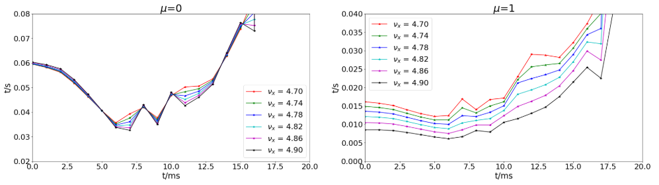
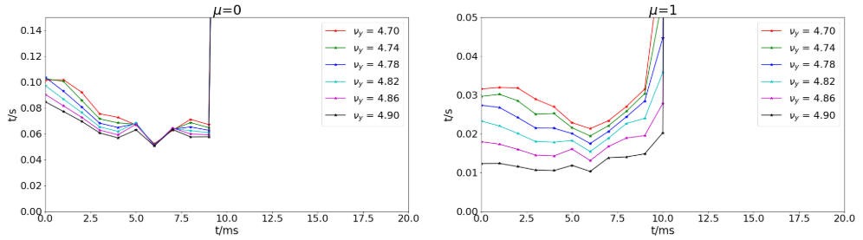
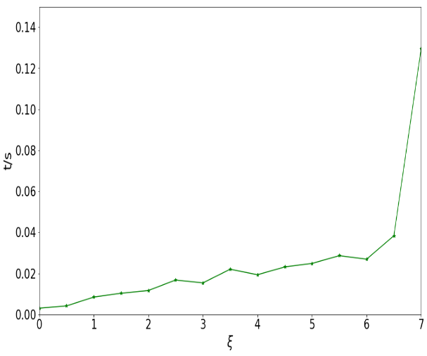
Coherent oscillation study - calculation
The high order headtail instability in RCS is calculated according to the Sacherer formula
The growth time is the function of tune and chromaticity

Slide 24
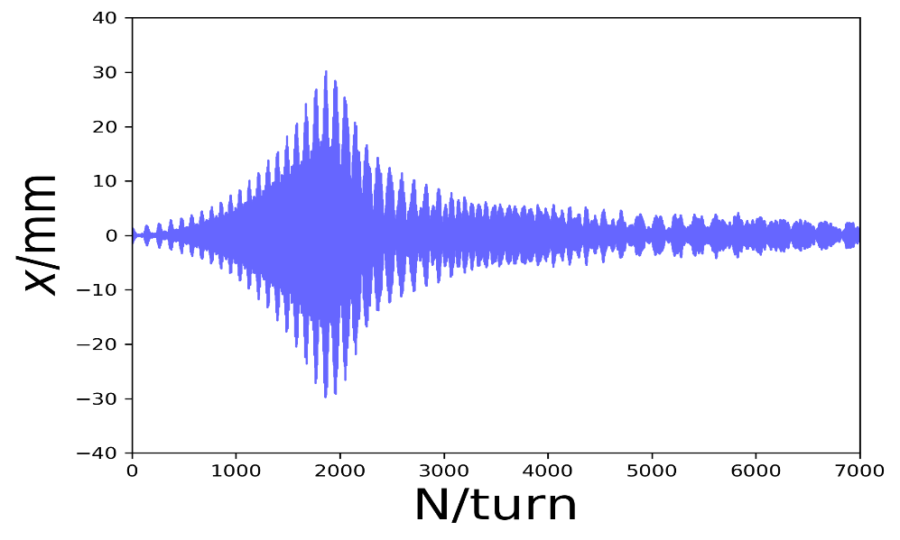
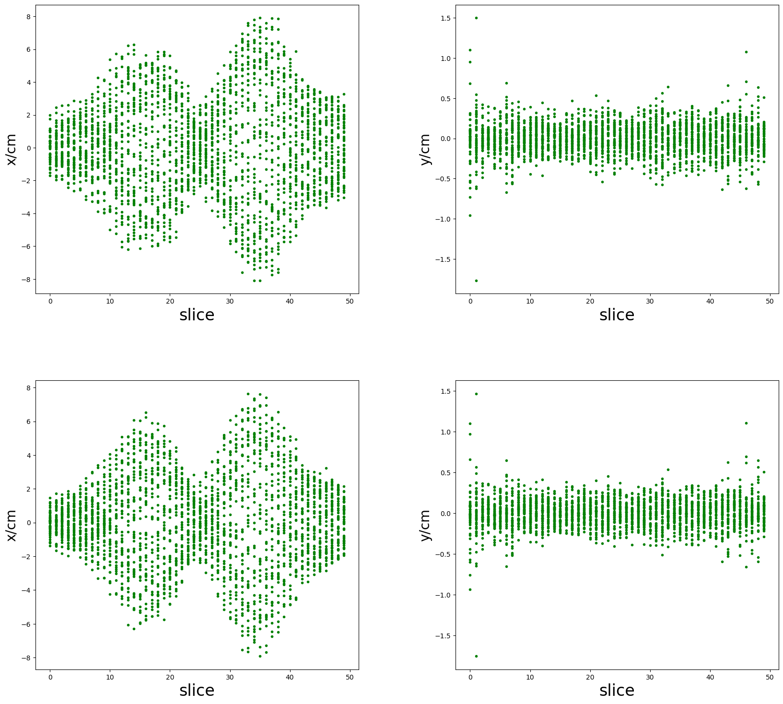
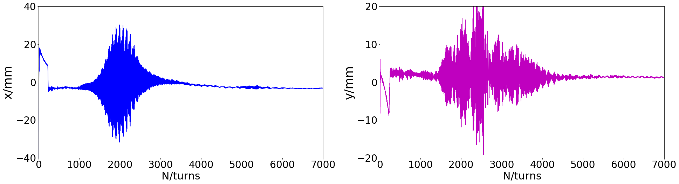
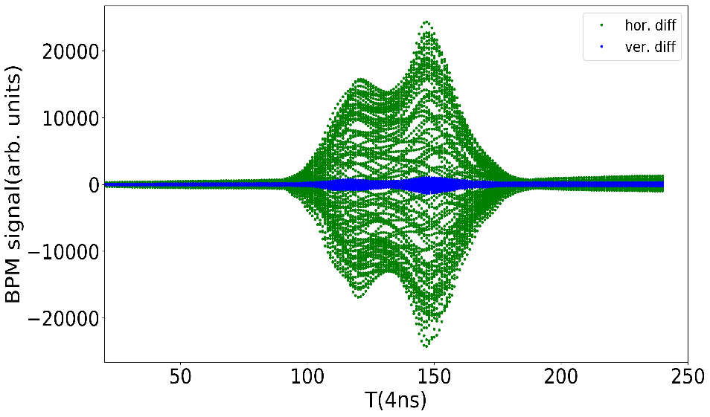
Coherent oscillation study - simulation
The head-tail instability simulation code is developed
The coherent oscillation and head-tail mode are consistent with the measurement.
Simulation
Measurement

Slide 25
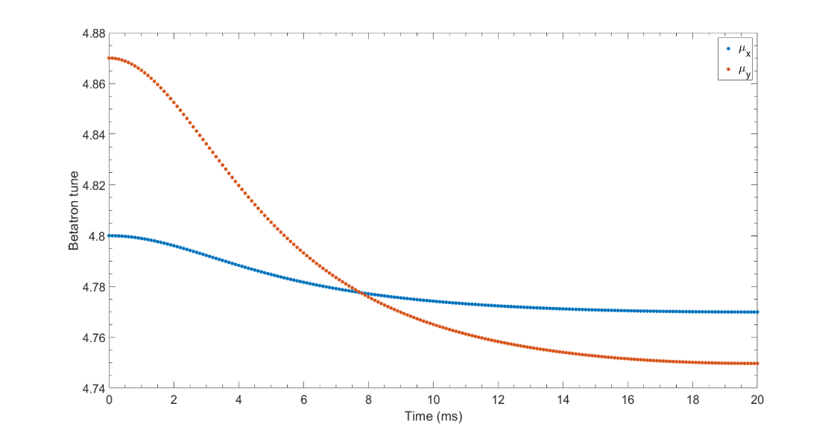
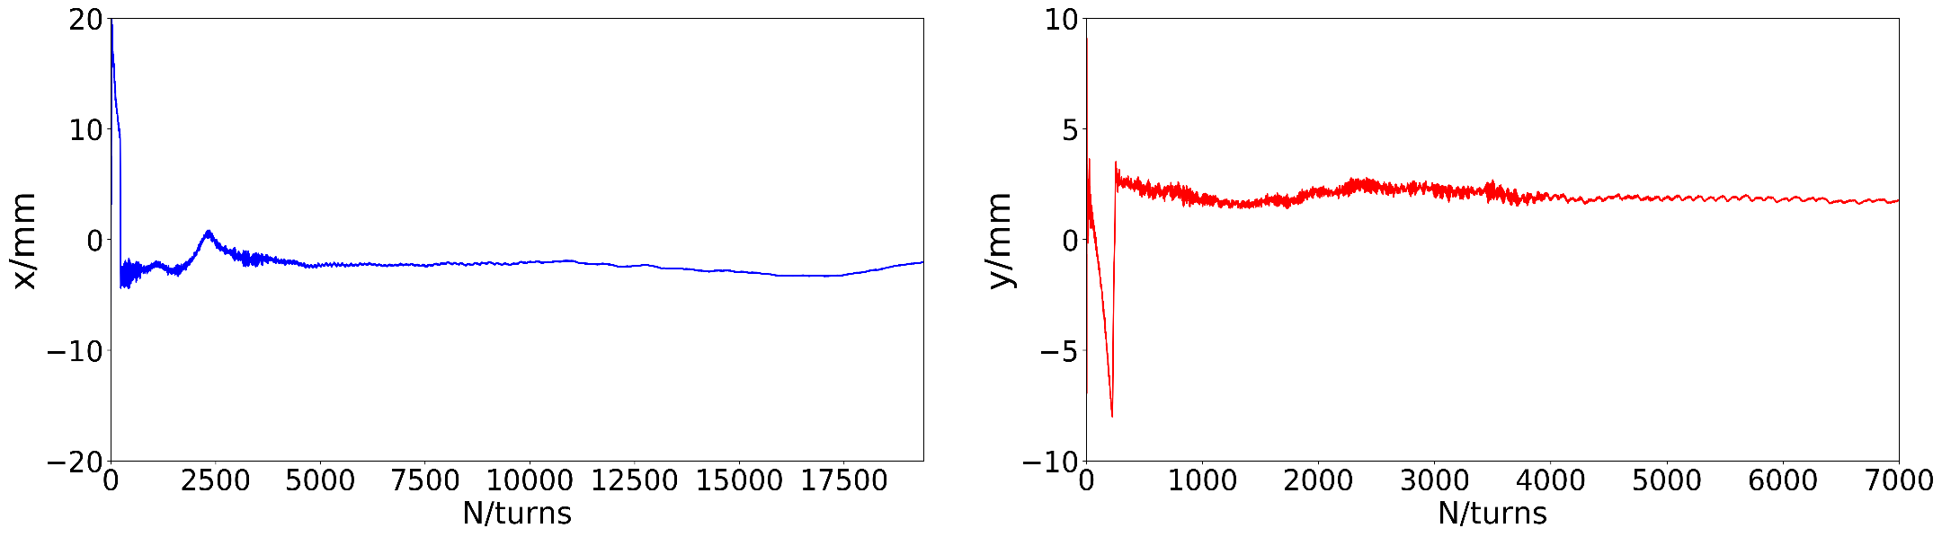
Coherent oscillation study - taming
Depress the oscillation by optimizing the tunes and chromaticity
  The changing tune pattern is adopt
  The operation chromaticity is about -8/ -6.5 (with DC sextupoles)
The oscillation in RCS operation is depressed, but may appears again with much higher beam intensity
TBT orbit

Slide 26
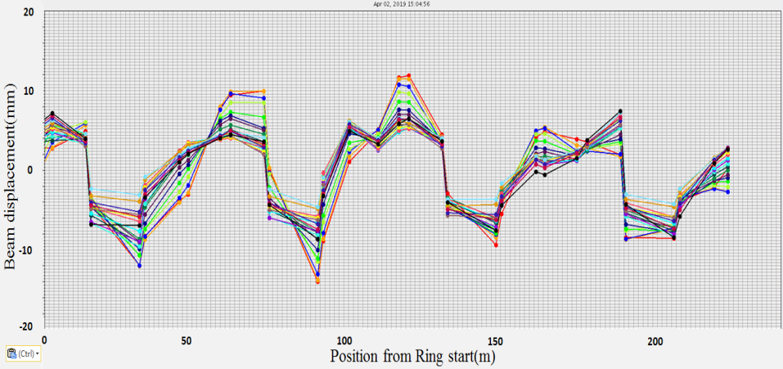
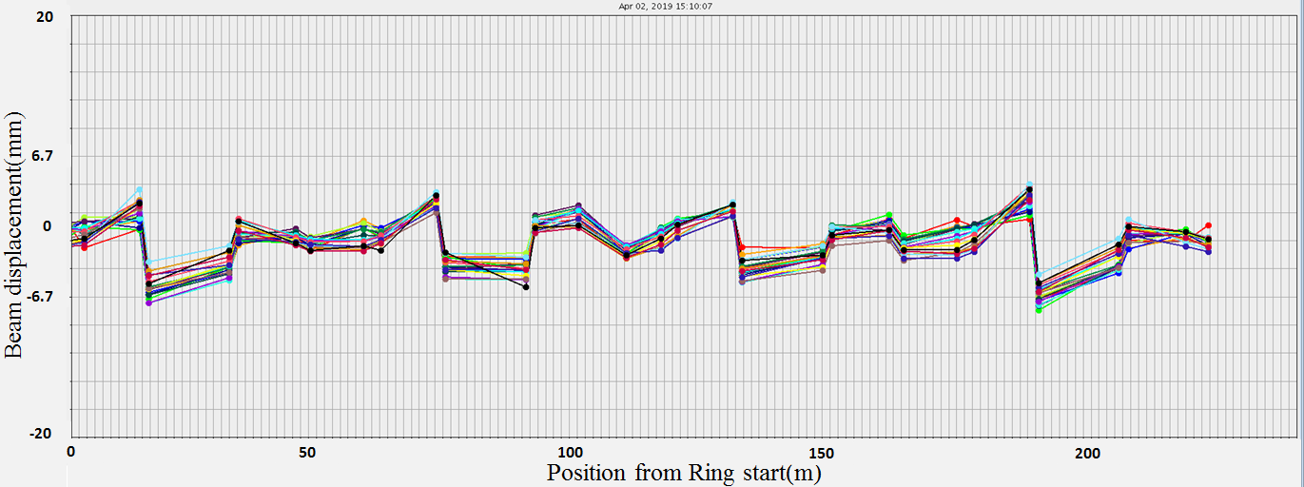
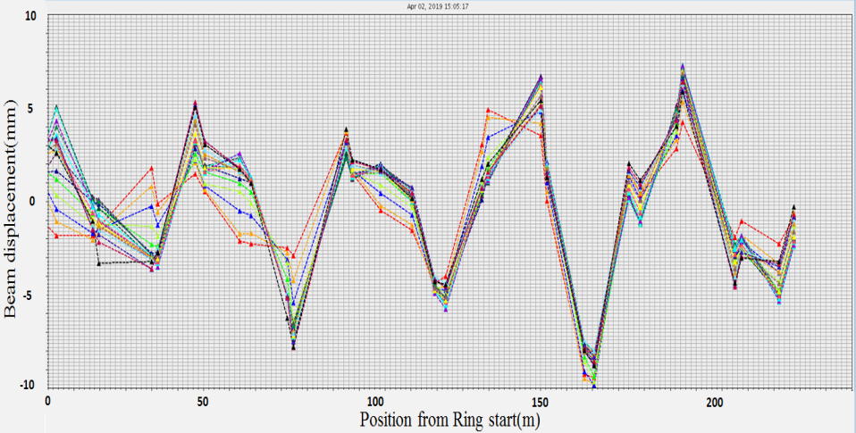
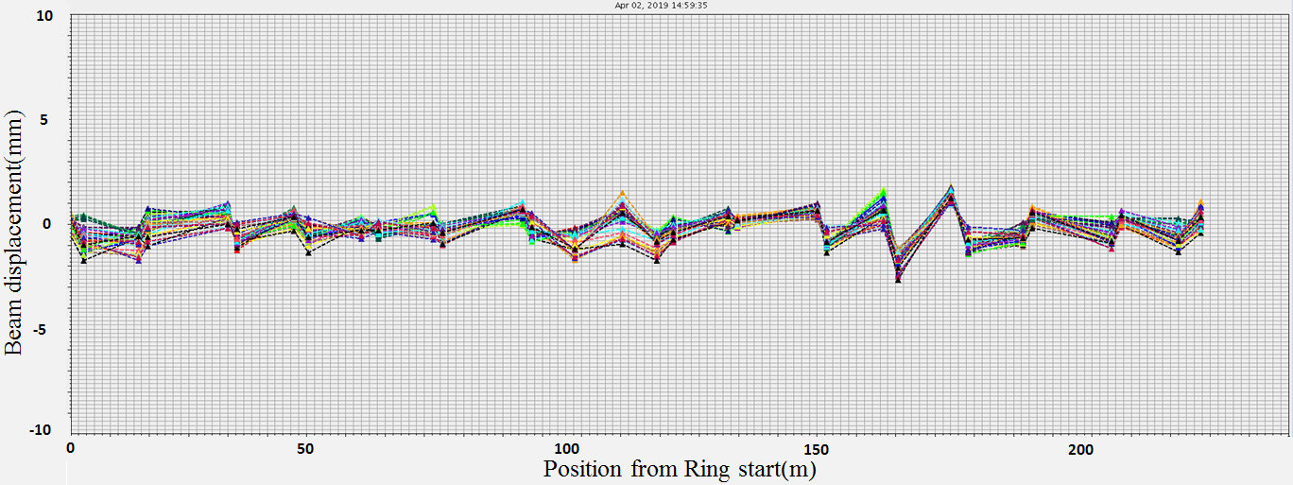
COD Correction (AC)
x-before
x-after
±15mm
±5mm
y-before
y-after
±10mm
±2mm

Slide 27
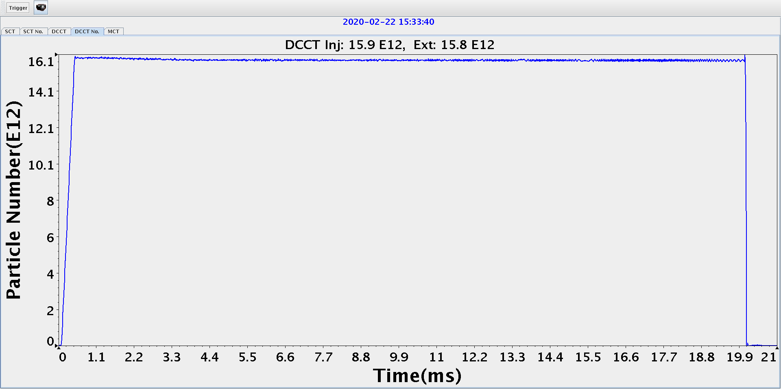


Localizing beam loss
BLM signals along the RCS
The beam transmission was about 99.5% without collimators.
Most of remaining beam loss is well localized at the collimator section;
The collimation efficiency was evaluated to be 95%~98%;
The beam transmission was about 98.5% with collimators.

Slide 28



Beam loss and control

Slide 29
Pushing the limits
Install the Trim-Qs to shape the tune curves
Install the AC sextupoles to control the coherent oscillations
Re-install the injection components to realize the real correlated painting scheme
Re-sorting the dipoles according to the magnetic field measurement at AC mode

Slide 30
CSNS Overview
SC Linac 300-350MeV
80MeV H⁻ linac
Reserved space for linac upgrade
1.6GeV,25Hz
500kW
Dual harmonic RF cavity

Slide 31
Summary
CSNS has been constructed on schedule.
The beam commissioning have been successfully done, reached design goal of 100kW beam power after two and half years beam commissioning.
Quickly open to users, and the availability is over 92%. Many excellent research results have been achieved.
Steps will be taken to push the limits.
Upgrading for high beam power will start in near future.

Slide 32

Thank you !

