Slide 1

Taming the high intensity - space charge
ARIES-APEC workshop: Mitigation Approaches for Hadron Storage Rings and Synchrotrons
F. Antoniou, F. Asvesta, H. Bartosik, A. Huschauer, Y. Papaphilippou, A. Saa Hernandez, T. Prebibaj, A. Santamaria Garcia, F. Schmidt
Acknowledgements:
G. Franchetti, H. Hotchi, S. Machida, R. Wasef, and
colleagues from CERN space charge collaboration

Slide 2
Outline
Space charge induced brightness and intensity limitations
Beam degradation through periodic resonance crossing
Mitigation measures
Summary and conclusions

Slide 3
Outline
Space charge induced brightness and intensity limitations
Beam degradation through periodic resonance crossing
Mitigation measures
Summary and conclusions

Slide 4
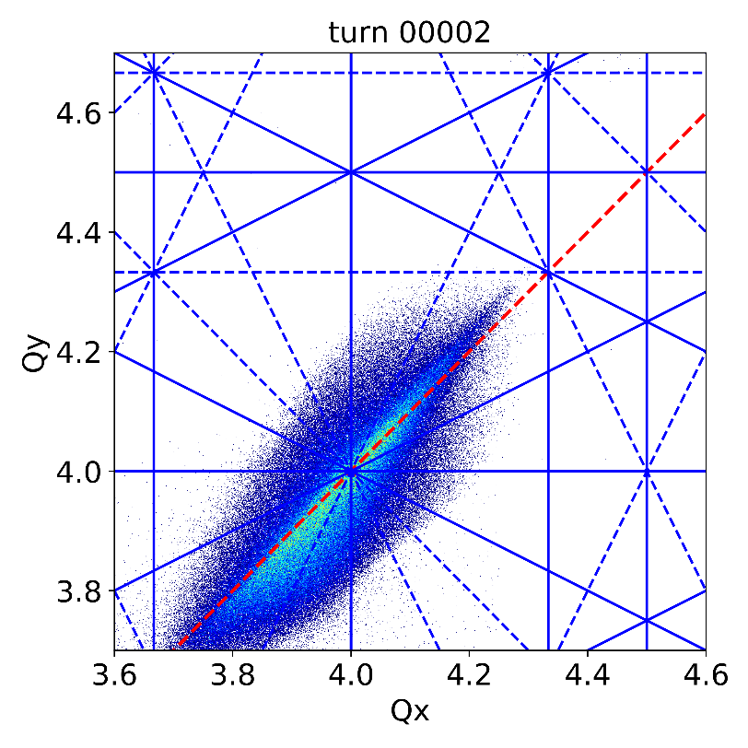
Brightness limitation from direct space charge
Direct space charge induces tune spread, with maximum tune shift:
y
z
x
particles in tails
of distribution

Slide 5
Brightness limitation from direct space charge
Direct space charge induces tune spread, with maximum tune shift:
y
z
x
particles in the core / close to peak density

Slide 6
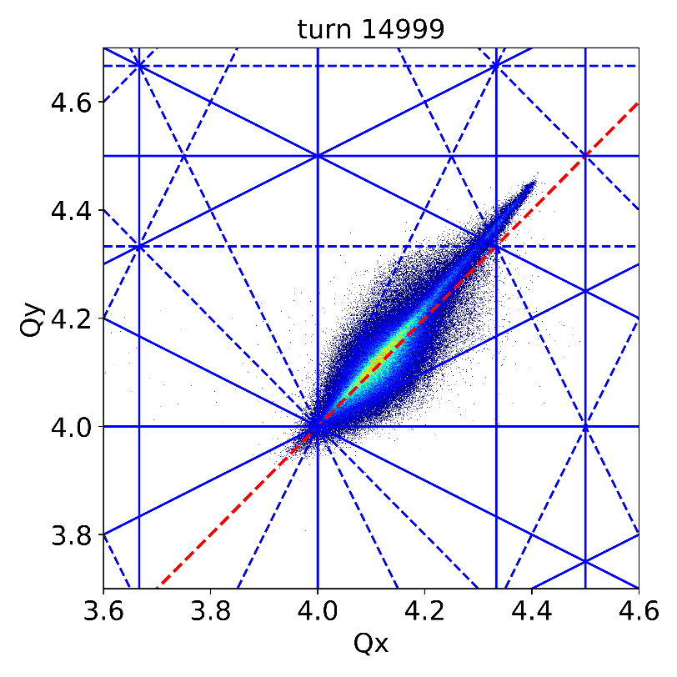
Brightness limitation from direct space charge
Direct space charge induces tune spread, with maximum tune shift:
The achievable brightness N/ε is usually limited by strong resonances
emittance
blow-up

Slide 7
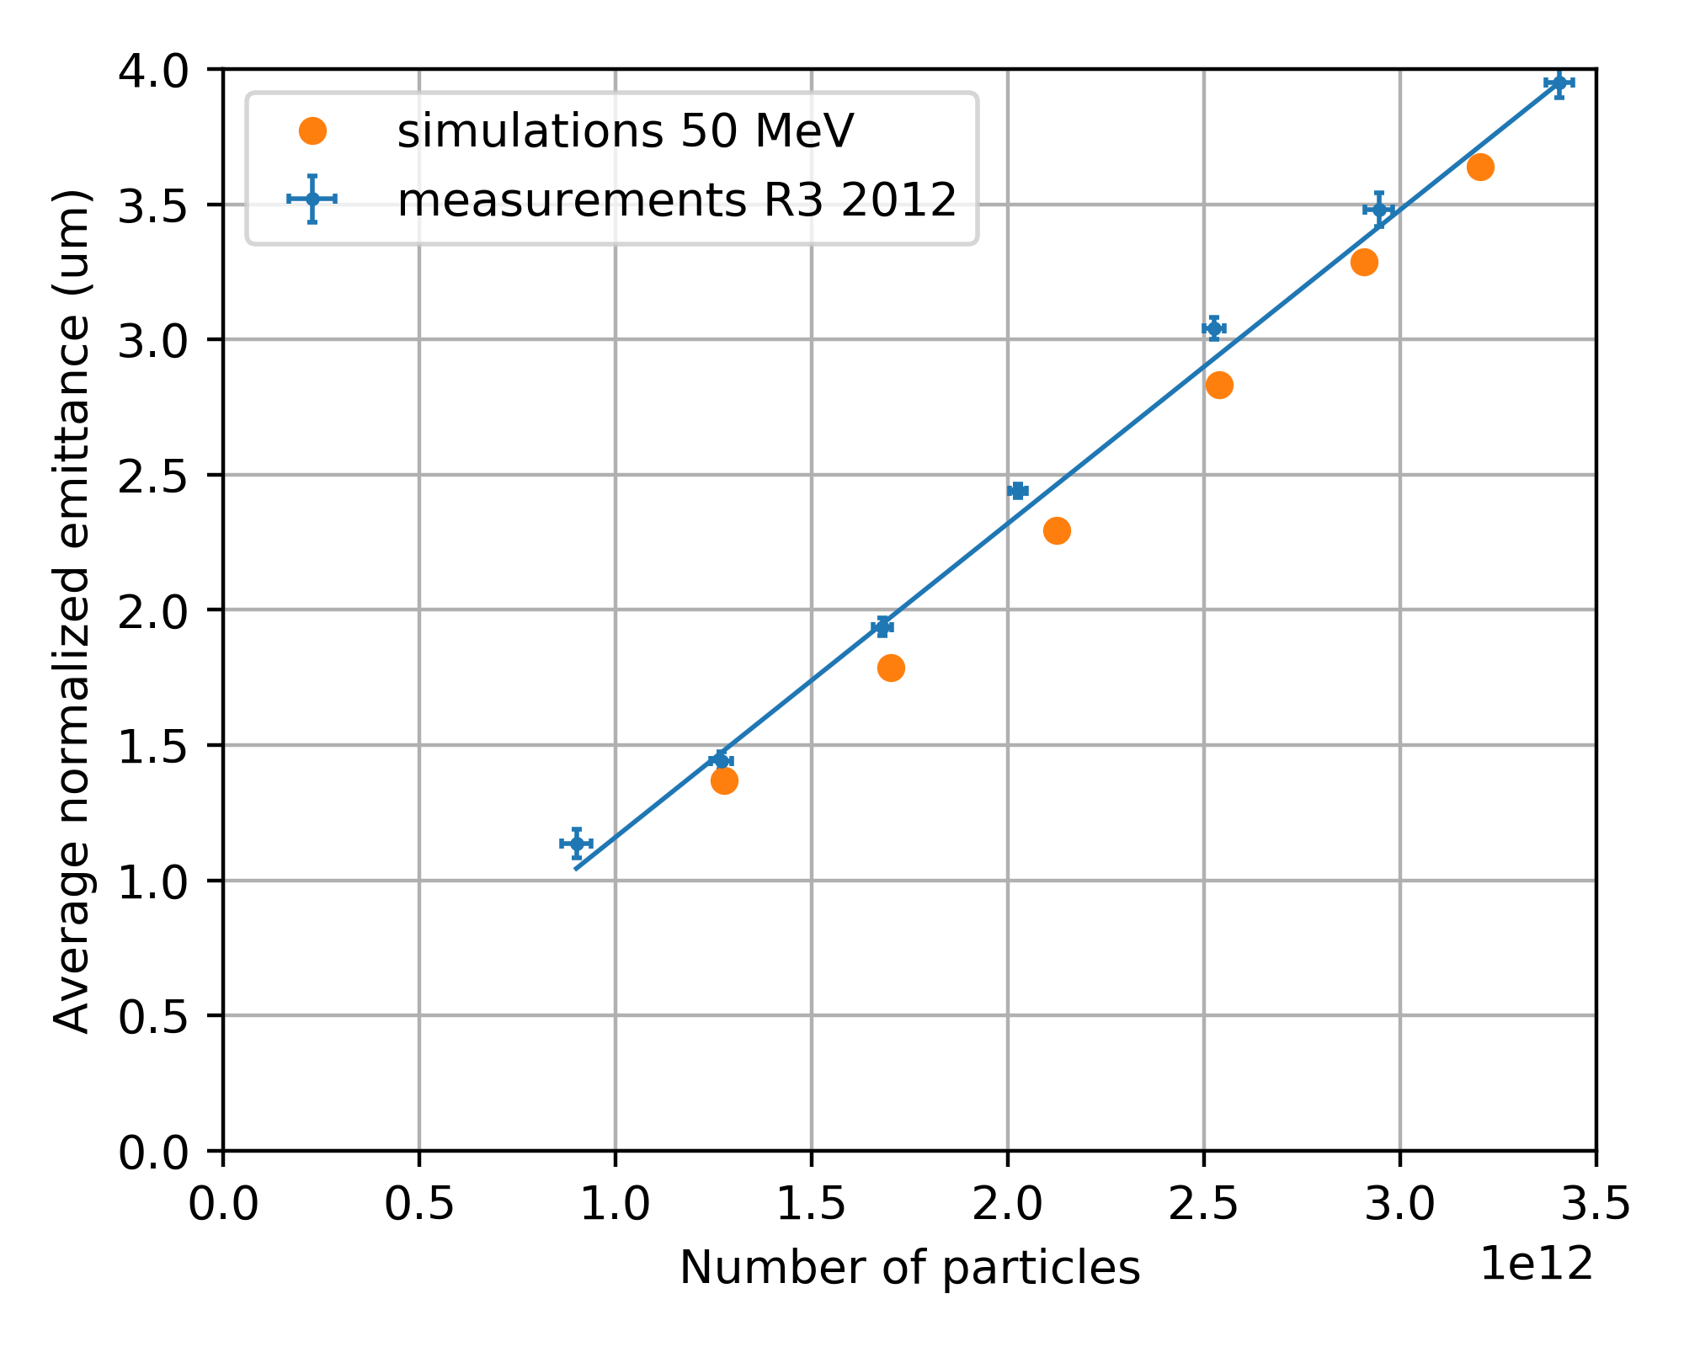
Brightness limitation of the CERN PSB
CERN PSB is operated at constant brightness N/ε
  Measured transverse emittance scales linearly with intensity due to space charge induced transverse emittance blow-up
  Reproduced in space charge simulations (even neglecting multi-turn injection)
Energy upgrade required to reach higher brightness –
presently ongoing as part of LHC injector upgrade project

Slide 8
Ultimately space charge limits intensity
Ultimately the brightness limitation also becomes the intensity limitation when losses resulting from increasing beam size reach collimator capacity
  Especially relevant for high power machines
Simulation study for the J-PARC RCS
H. Hotchi, space charge workshop 2019

Slide 9
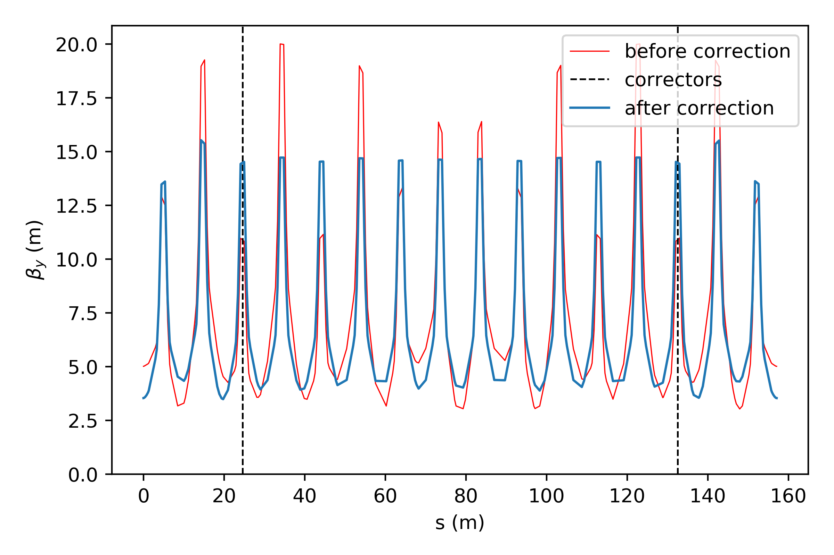
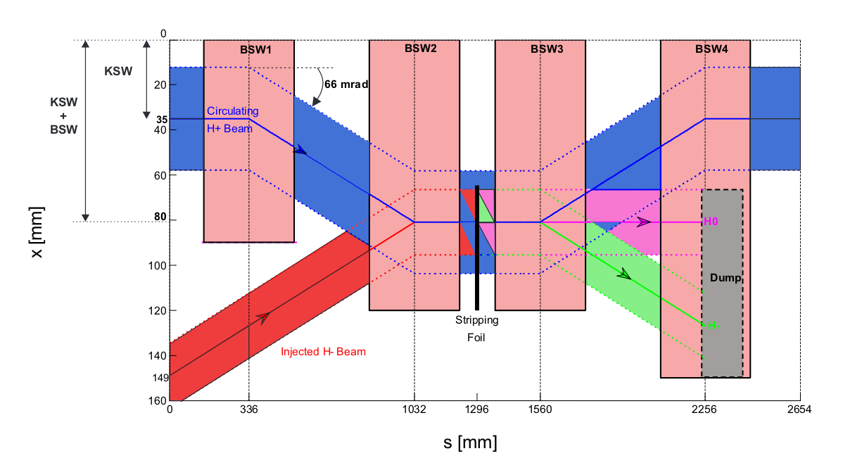
Restricted working point choice
How about working points with fractional higher tunes?
H⁻ injection requires short chicane magnets
  Edge effects create optics distortion
Optics correction in PSB with H⁻ injection
Chicane for H⁻ injection
injection chicane
injection chicane
QDE14
QDE3
Individually powered quads
for optics correction

Slide 10
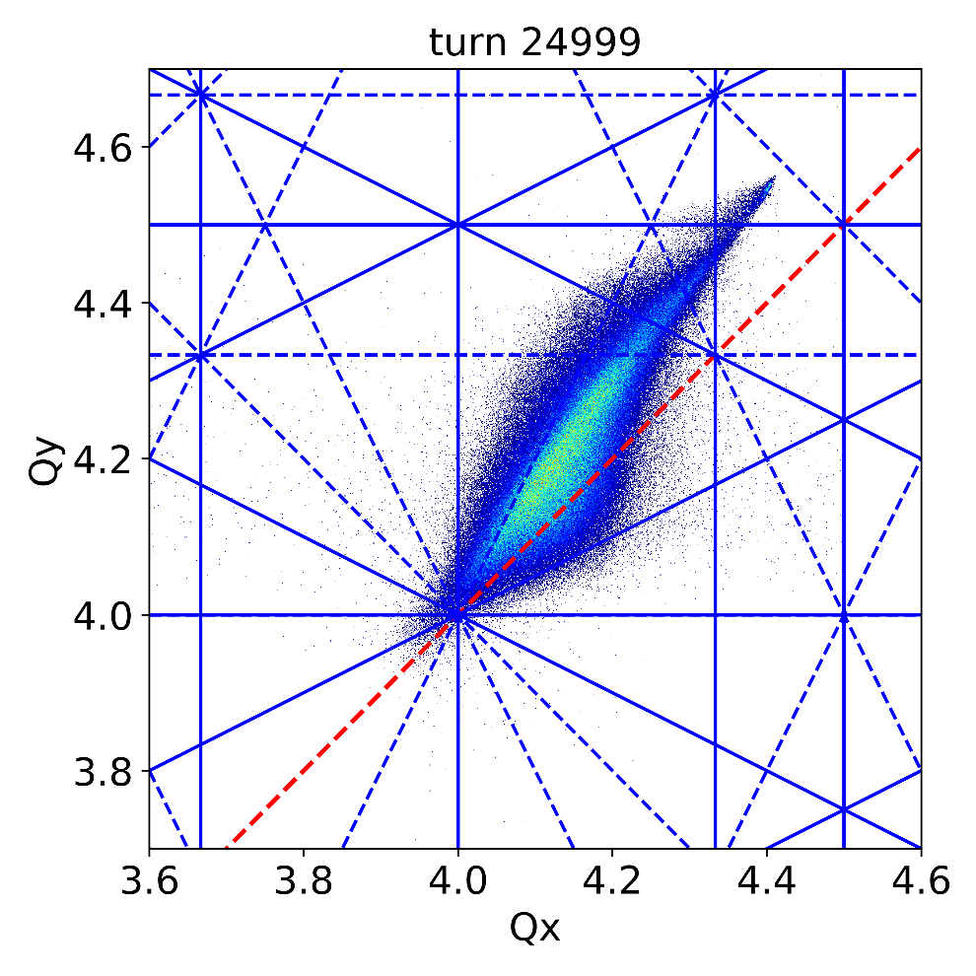
Restricted working point choice
How about working points with fractional higher tunes?
H⁻ injection requires short chicane magnets
  Edge effects create optics distortion
losses
blow-up

Slide 11
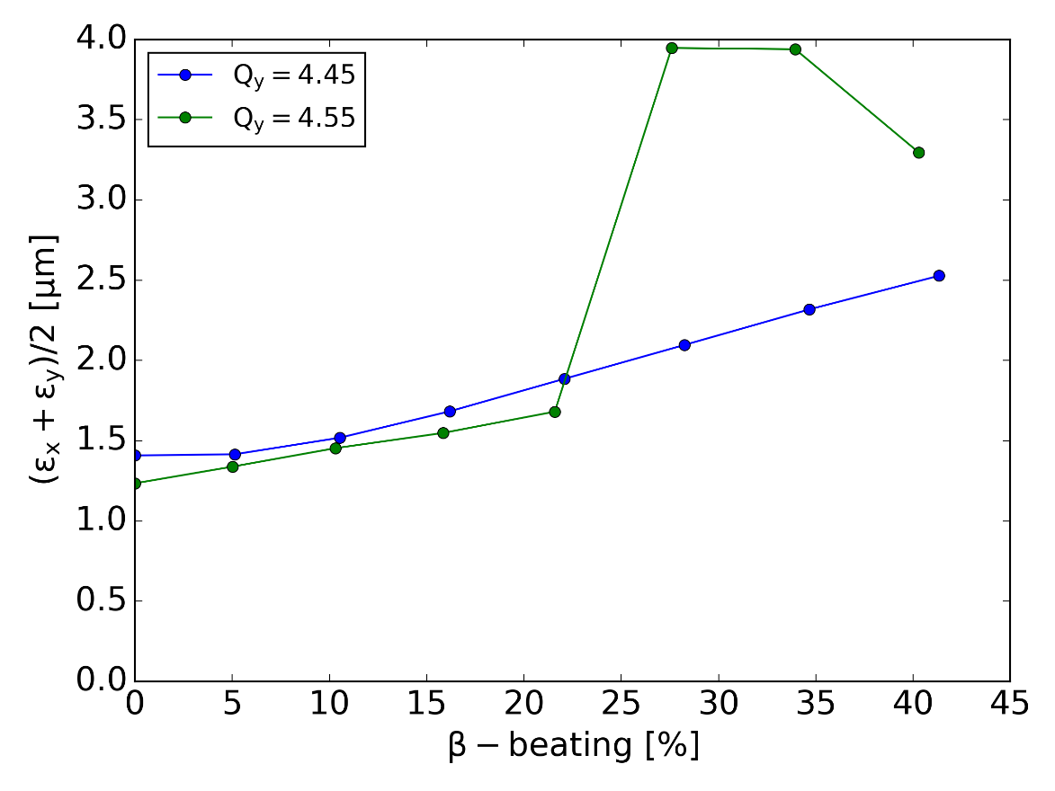
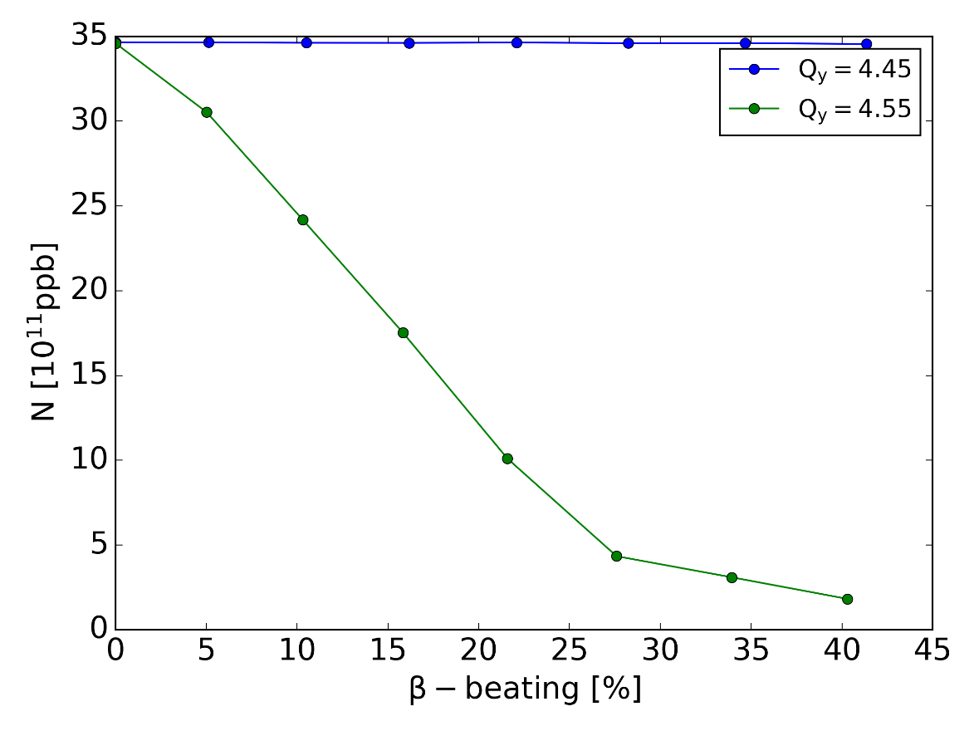
Restricted working point choice
How about working points with fractional higher tunes?
H⁻ injection requires short chicane magnets
  Edge effects create optics distortion
Tunes below half-integer avoid losses due to residual optics errors
  Majority of machines operating below half-integer and ΔQ_{max} = -0.5 (rule of thumb)
  Nevertheless optics perturbations from injection chicane need to be corrected
Simulations for PSB
Simulations for PSB

Slide 12
Outline
Space charge induced brightness and intensity limitations
Beam degradation through periodic resonance crossing
Mitigation measures
Summary and conclusions

Slide 13
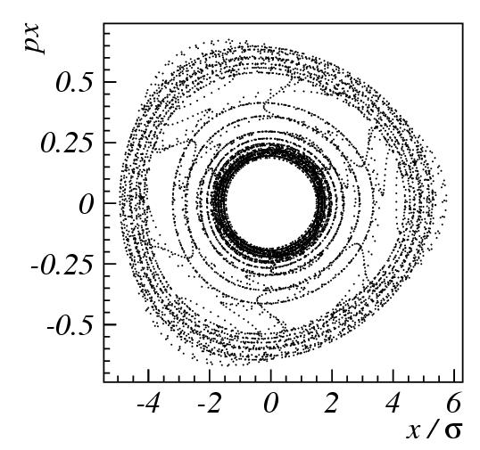
Beam degradation from periodic resonance crossing
adiabatic limit of resonance crossing: particle trapping in resonance islands
1/Qs=20000
space charge detuning varies along bunch
synchrotron motion results in periodic tune modulation of individual particles
chromaticity enhances tune excursion in one half synchrotron period and reduces it in other half
non-adiabatic resonance crossing:
scattering of particle trajectory
1/Qs=1000
G. Franchetti et. al (2005)

Slide 14






Consequences of periodic resonance crossing
Beam loss
regime
Emittance growth
regime
1
emittance growth regime: large as ~
Resonance stop-band
asymptotic
limit larger than
beam loss rate function of K_{n}, ΔQ_{x}
Q_{x}
chromaticity induced stop-band large as or as function of pipe or DA intercepted
G. Franchetti et al., HB 2008

Slide 15
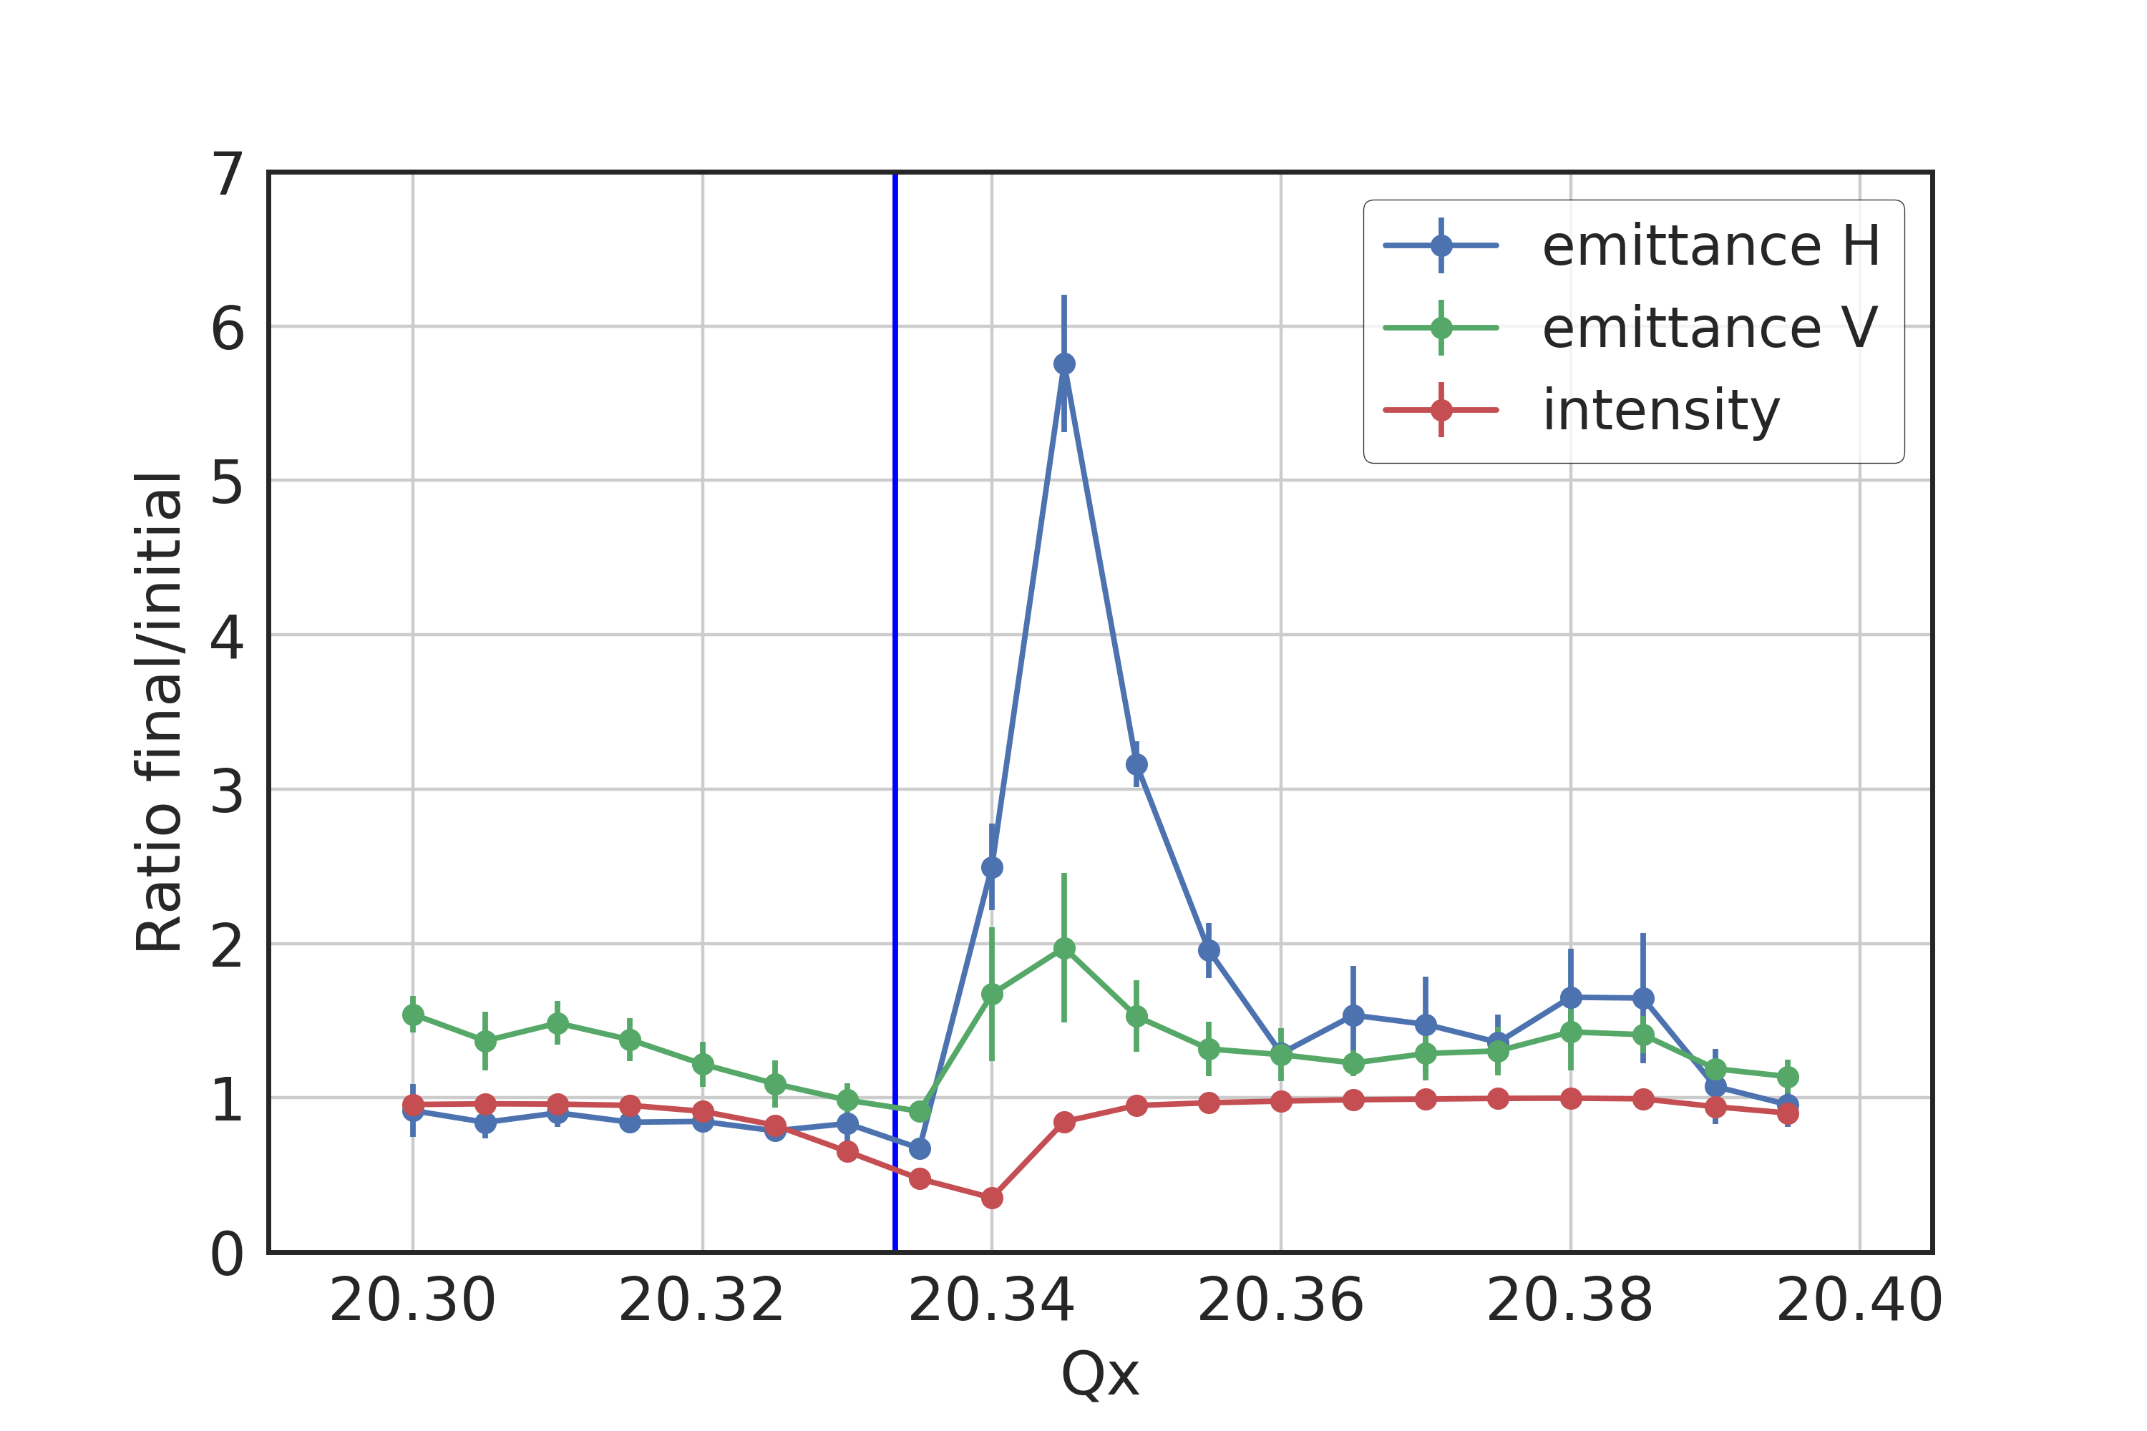
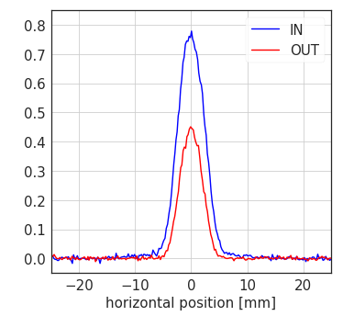
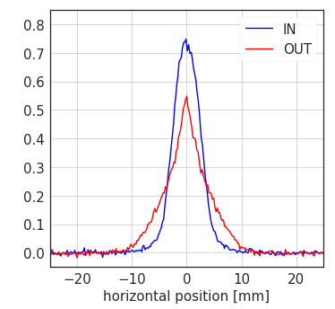
Experiment close to resonance in CERN SPS
Measurements with deliberately excited 3 Qx resonance in SPS
  Clear observation of halo formation in the emittance growth regime

Slide 16
Experiment on coupled resonance at CERN PS
3rd order coupled sum resonance Qx + 2 Qy
  Beam loss and emittance growth regimes (as in case of 1D resonance)
  Asymmetric development of tails / halo – confirmed in simulations
G. Franchetti, S. Gilardoni,A. Huschauer, F. Schmidt, R. Wasef, PRAB 20, 081006 (2017)
1 s storage

Slide 17
Outline
Space charge induced brightness and intensity limitations
Beam degradation through periodic resonance crossing
Mitigation measures
Summary and conclusions

Slide 18
Mitigation measures
Optimize working point to avoid resonances
  Avoid systematic resonances
  Avoid space charge driven resonances
Reduce tune spread
  Flattening of the longitudinal bunch profile
  Optimize beam parameters (e.g. large momentum spread to increase horizontal beam size)
  Increase injection energy
Resonance compensation
  Works for resonances excited by external fields (requires corresponding correctors)
  Simultaneous compensation of multiple resonances is challenging

Slide 19
CERN PSB: Compensation of magnetic resonances
Identify resonances through dynamic tune scan
  Using low intensity large emittance beam (for high sensitivity to resonance losses)
  Measurements at constant energy plateau
  The instantaneous lossrate dN/dt is used as indicator for resonances strength
Qx + 2 Qy
3 Qy

Slide 20
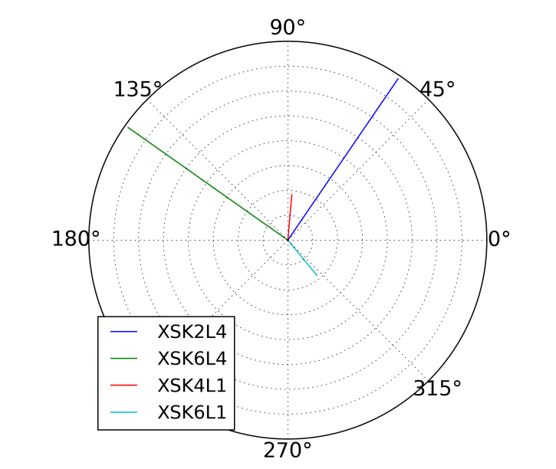
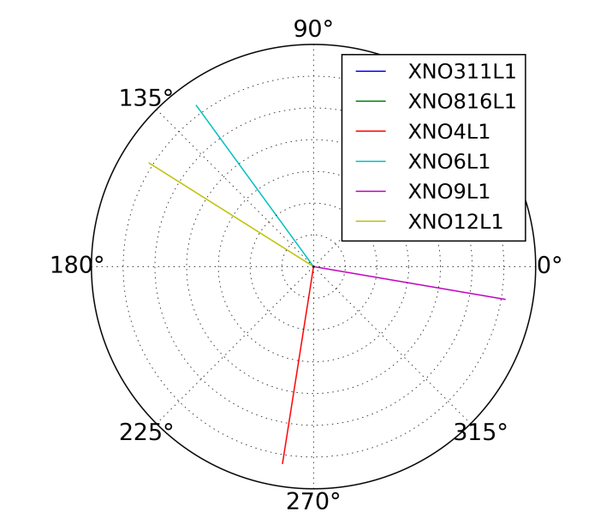
CERN PSB: Compensation of magnetic resonances
Choose most effective correctors for given resonance
  Calculation and plotting of resonance driving terms
  Ideal corrector pairs are orthogonal in complex resonance driving term space
3 Qy (h₃₀₀₀)
Qx + 2 Qy (h₁₀₂₀)

Slide 21
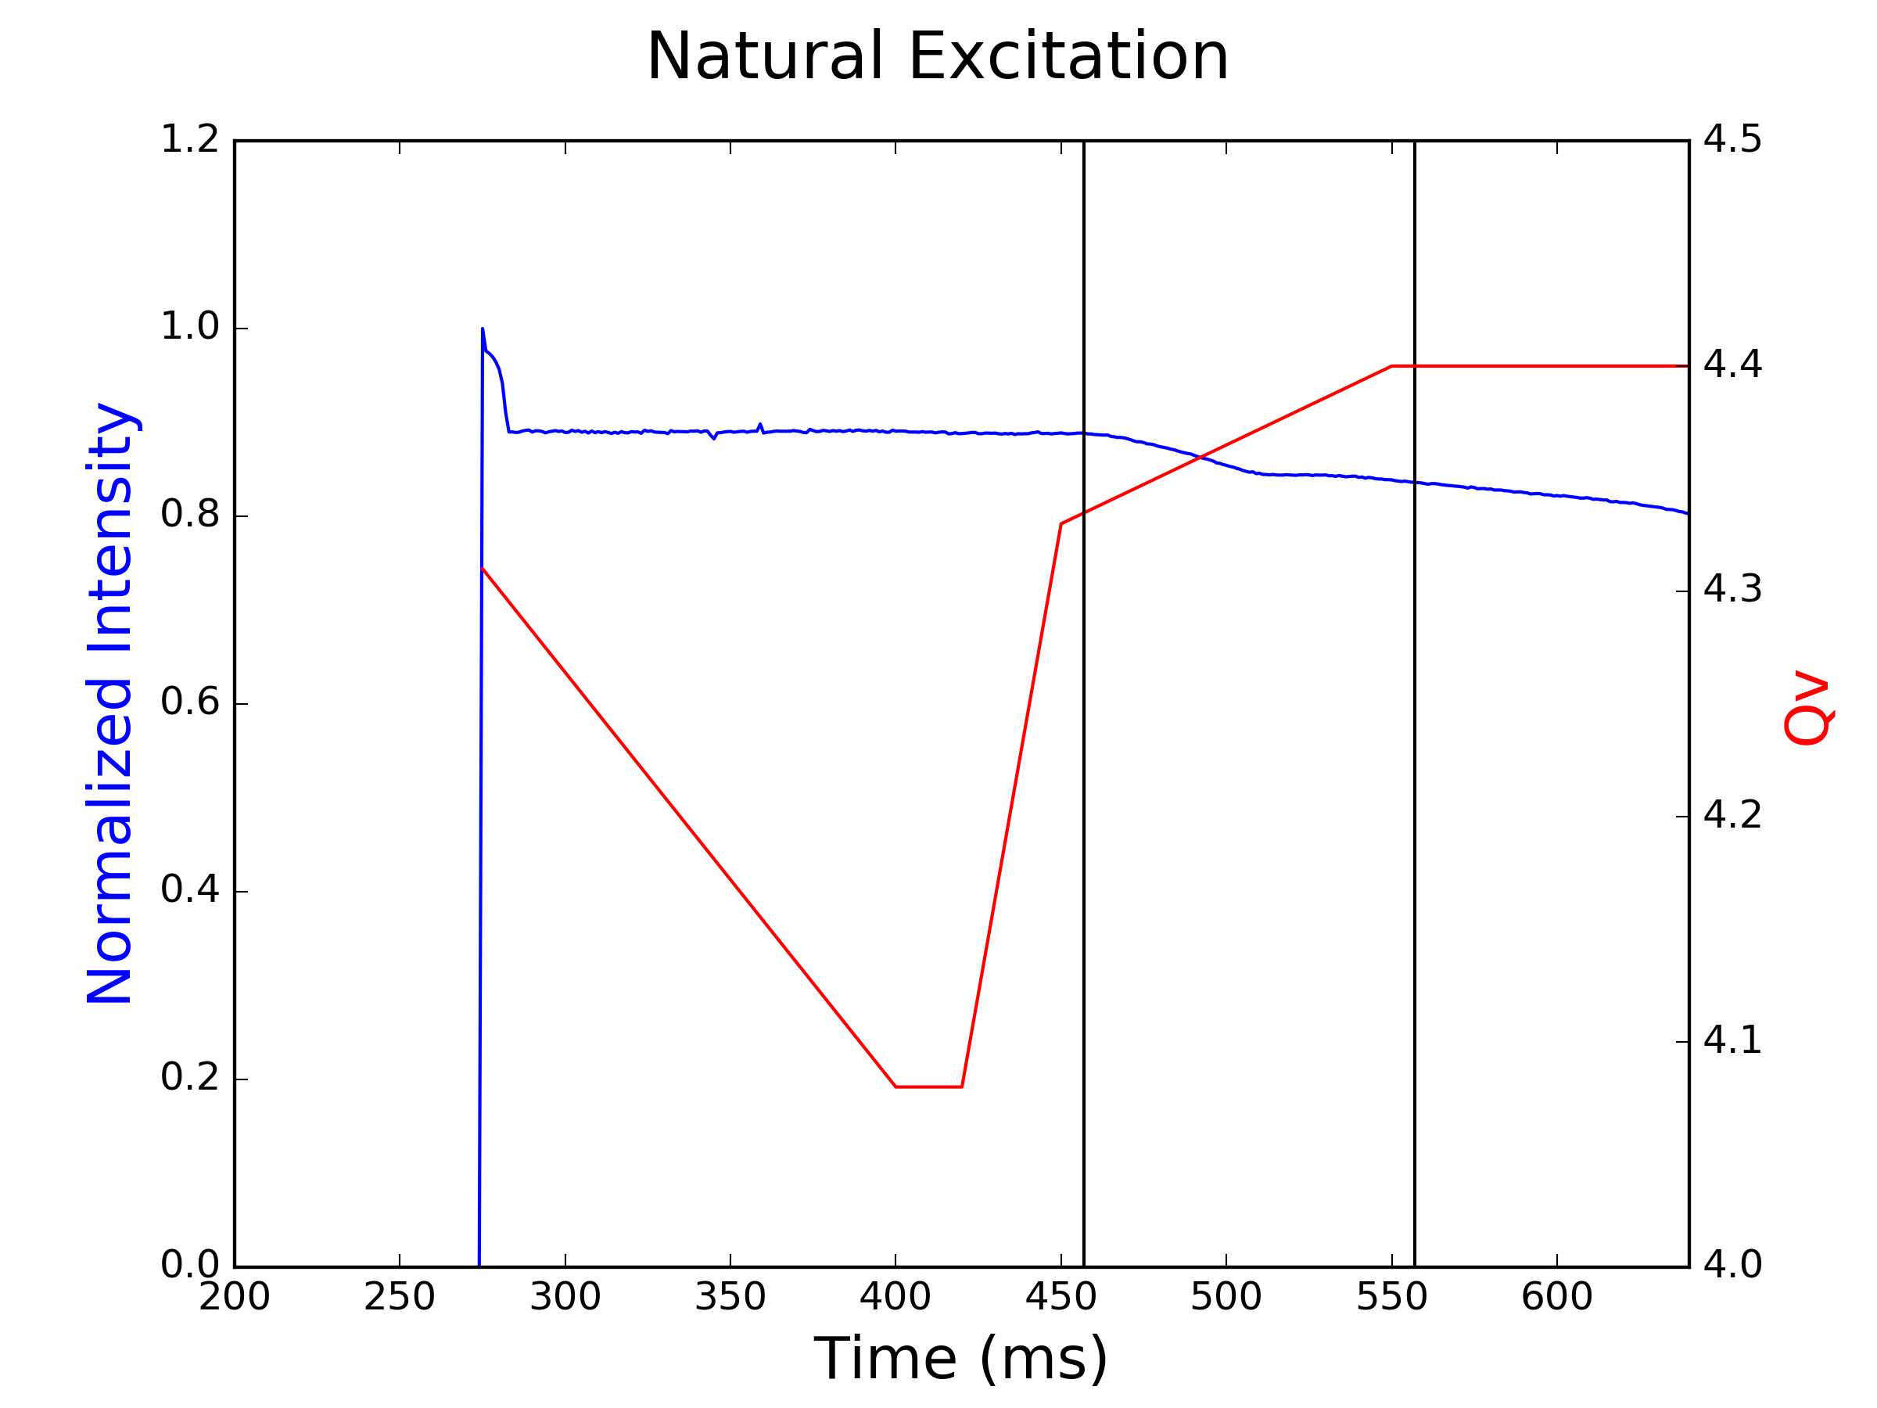
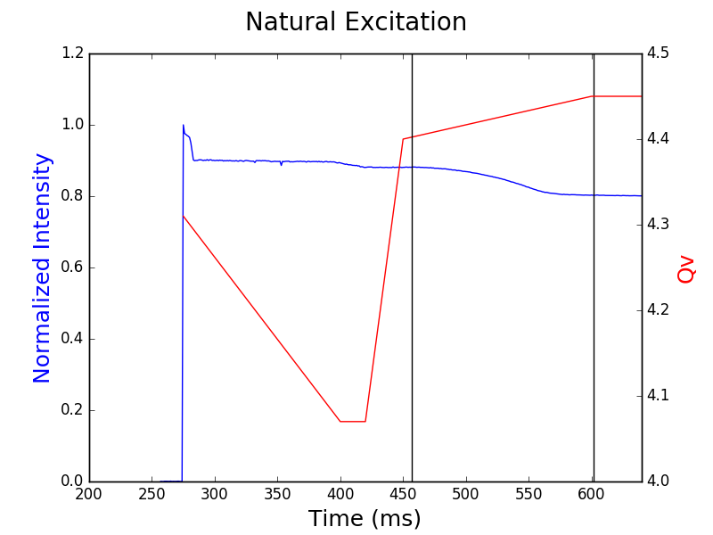
CERN PSB: Compensation of magnetic resonances
Dynamically cross the resonance
  Program tune sweep through resonance
  Using low intensity large emittance beam (for high sensitivity to resonance losses)
3 Qy
Qx + 2 Qy

Slide 22
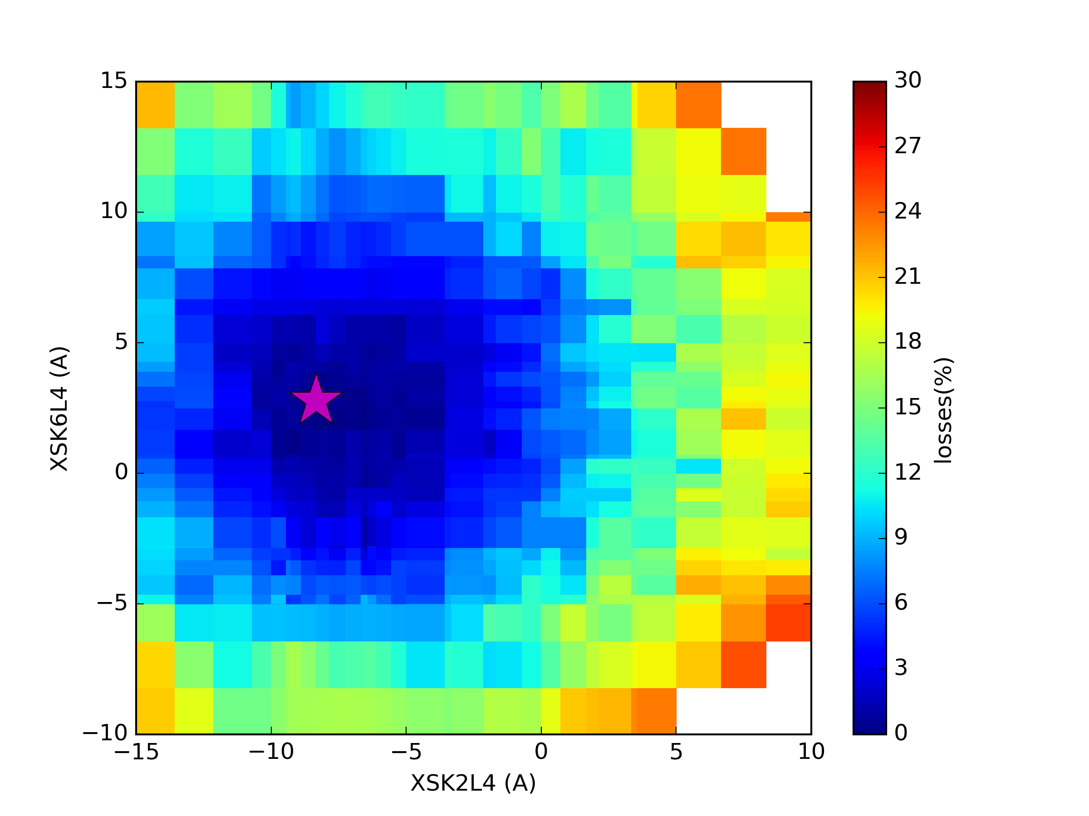
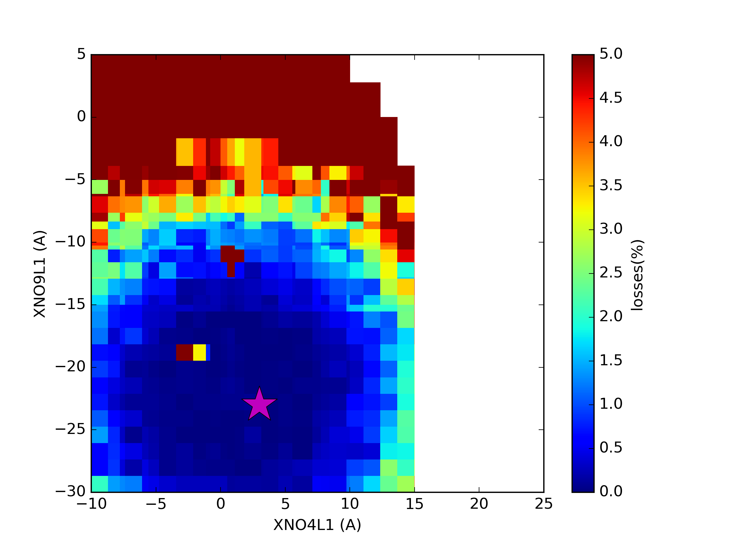
CERN PSB: Compensation of magnetic resonances
Scan the currents of the correctors to minimize losses
  Using losses during resonance crossing as observable to find optimum settings
  One measurement (resonance crossing) for each corrector setting
  Automated scan of settings
3 Qy
Qx + 2 Qy

Slide 23
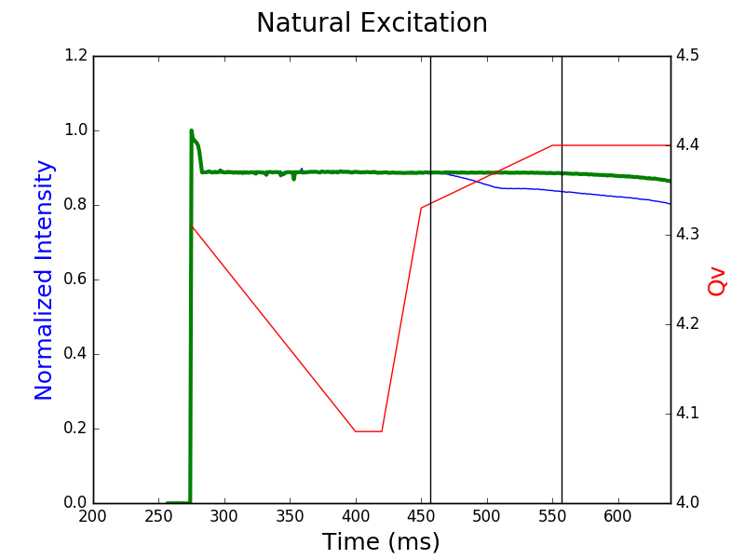
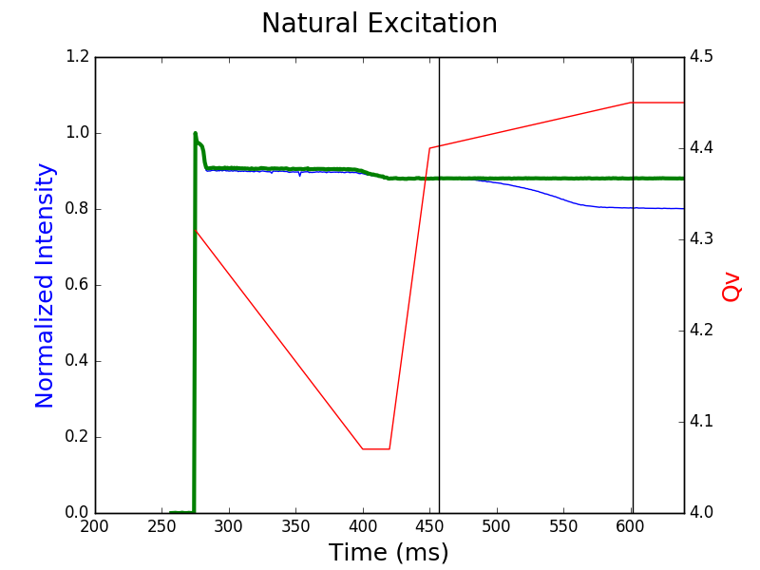
CERN PSB: Compensation of magnetic resonances
Verify correction with best settings
  Negligible losses after successful resonance compensation
3 Qy
Qx + 2 Qy

Slide 24
CERN PSB: Compensation of magnetic resonances
Verify correction with best settings
  Negligible losses after successful resonance compensation
  With the available correctors of the PSB, one of the normal sextupole + one of the skew sextupole resonances can be corrected simultaneously
Without correction
With correction
“resonance free”

Slide 25
CERN LEIR: Compensation of magnetic resonances
Strong resonances in LEIR due to low lattice symmetry
  Skew sextupole resonance 3 Qy close to operational working point quite strong
  Successful compensation with pair of skew sextupoles (even if not orthogonal)
without correction
Scan of skew sextupole settings
with correction

Slide 26
CERN LEIR: maximizing bunching factor
Best performance of LEIR requires bunch flattening to reduce space charge and IBS effects after RF capture
  Clear impact of bunching factor on transmission

Slide 27
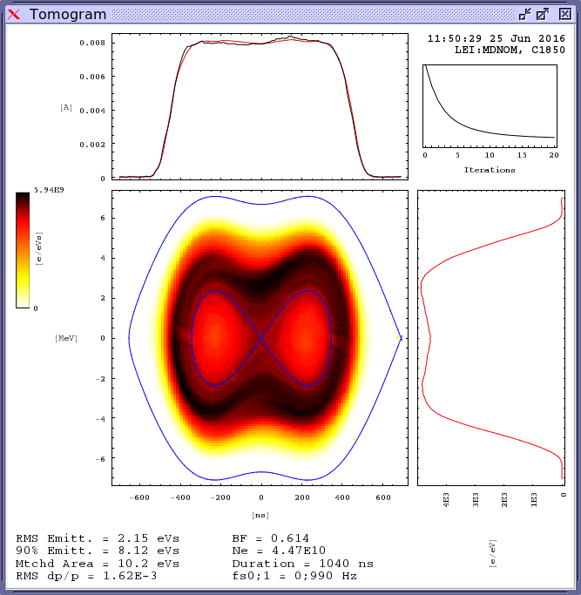
CERN LEIR: maximizing bunching factor
Best performance of LEIR requires bunch flattening to reduce space charge and IBS effects after RF capture
  Clear impact of bunching factor on transmission
  Maximum bunching factor and completely flat bunch profile achieved with special RF capture (off-frequency) after cooling

Slide 28
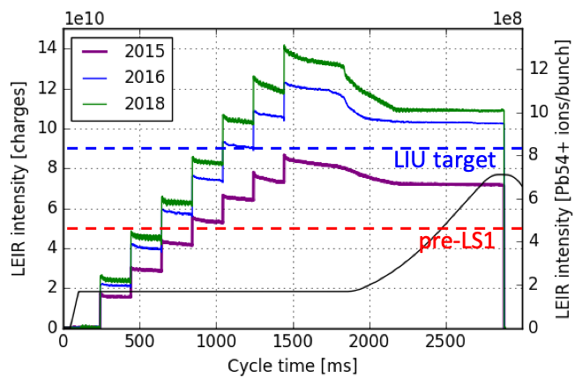
CERN LEIR: Combining mitigation measures
Main ingredients for performance improvement from 2015 to 2018
  Higher current from Linac3 source + optimised injection into LEIR thanks to the new BPMs in injection line
  Mitigation of space charge and intra beam scattering at RF capture through working point optimization, bunch flattening with double harmonic RF and compensation of sextupole resonances

Slide 29
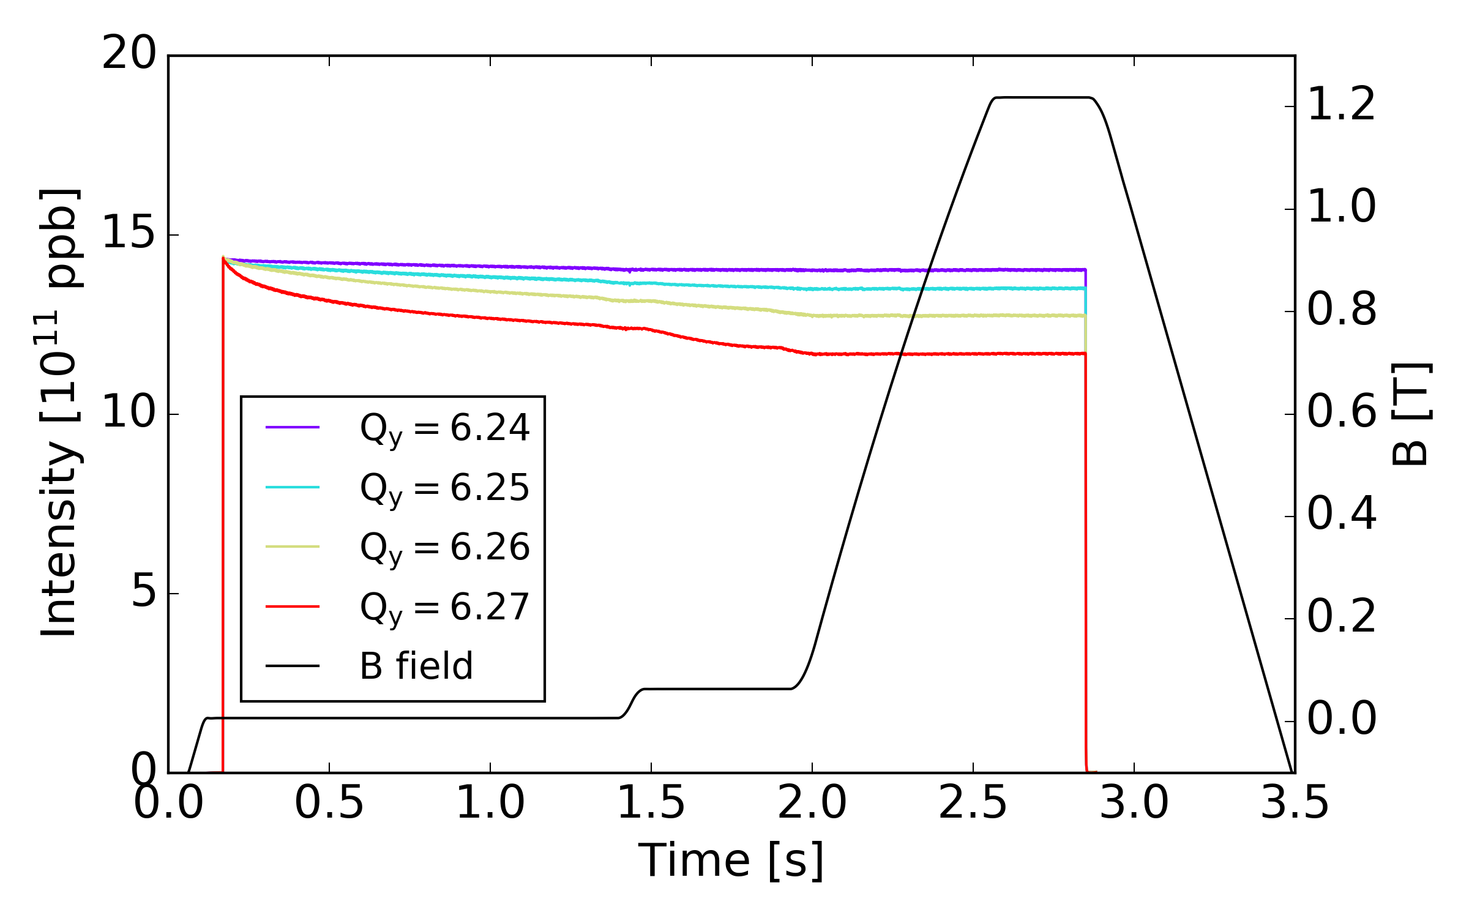
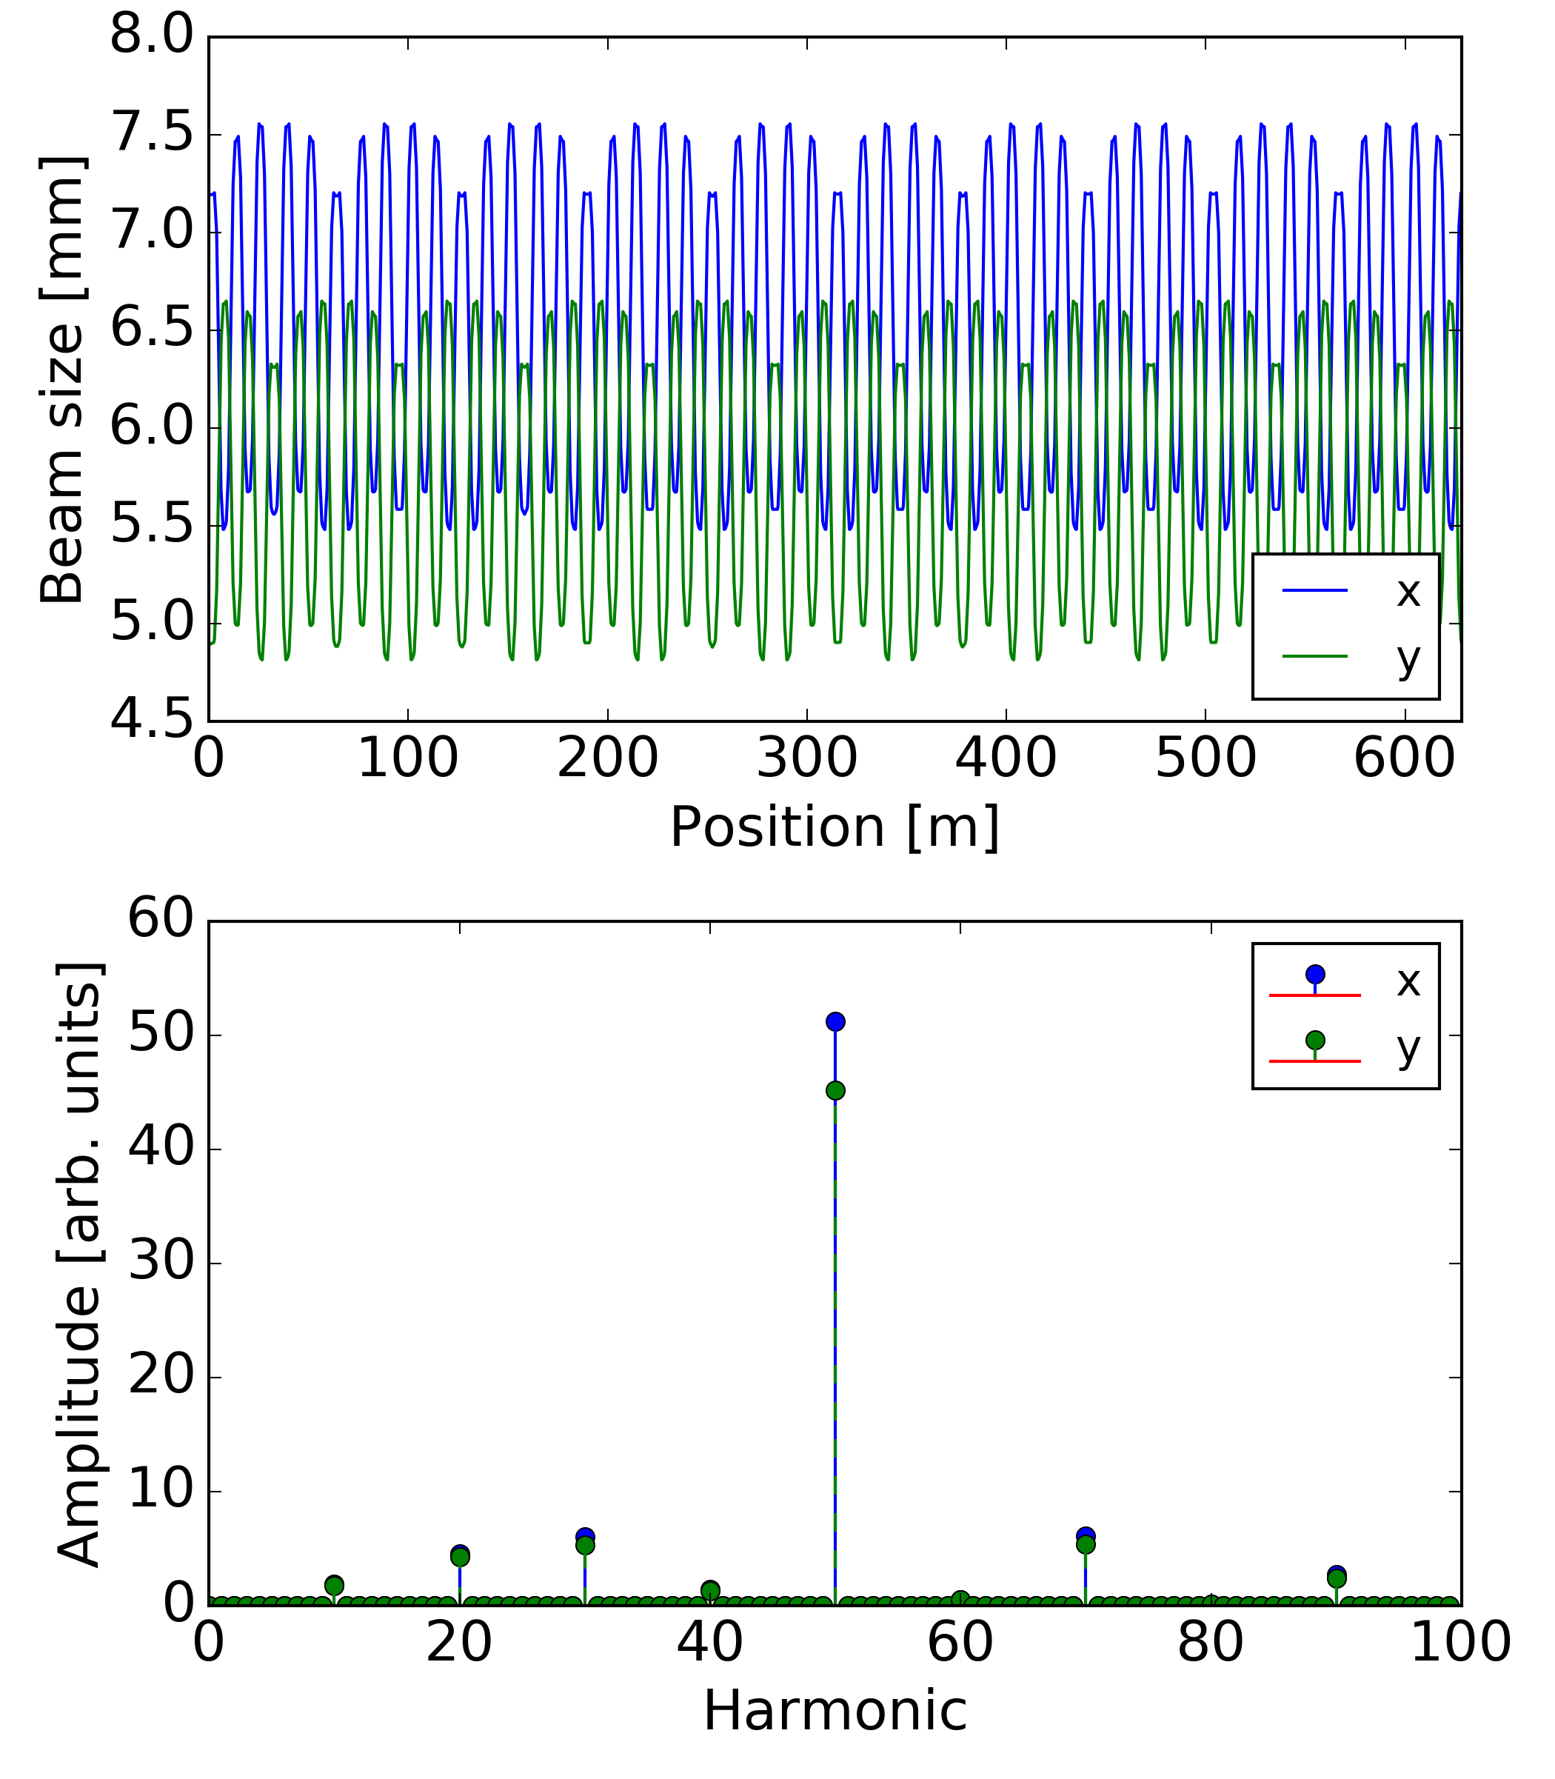
CERN PS: Space charge driven resonances
PS needs to store LHC beam for 1.2 s while waiting for 2nd injection
Losses are observed for working points above Qy=6.25
  Lattice has strong harmonic 50 → space charge potential drives 8th order resonances (8 Qy = 50 and 2 Qx + 6 Qy = 50) – cannot be compensated

Slide 30
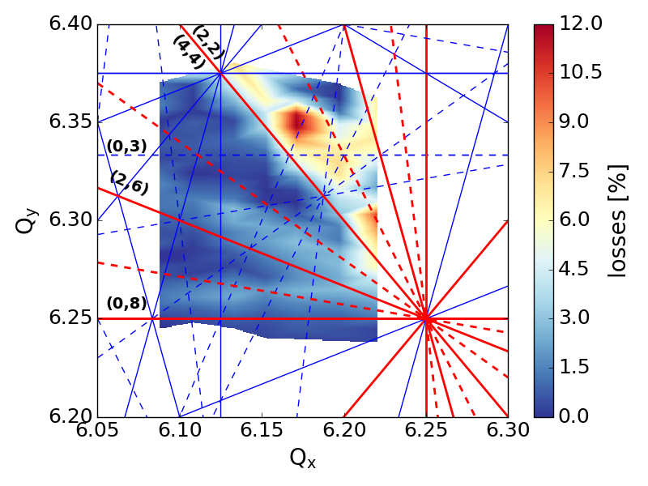
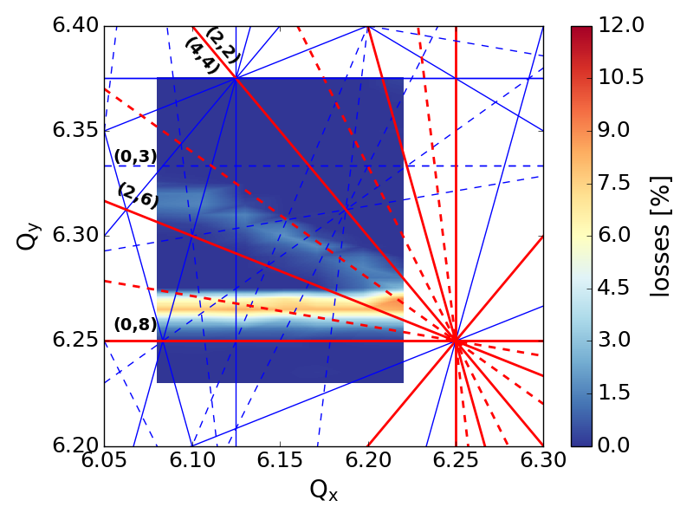
CERN PS: Space charge driven resonances
PS needs to store LHC beam for 1.2 s while waiting for 2nd injection
Losses are observed for working points above Qy=6.25
  Lattice has strong harmonic 50 → space charge potential drives 8th order resonances (8 Qy = 50 and 2 Qx + 6 Qy = 50) – cannot be compensated
Measurements
(medium brightness beam)
Simulations
(no machine nonlinearities)

Slide 31
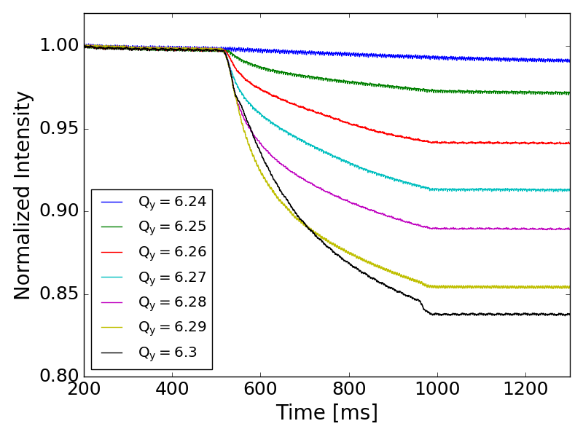
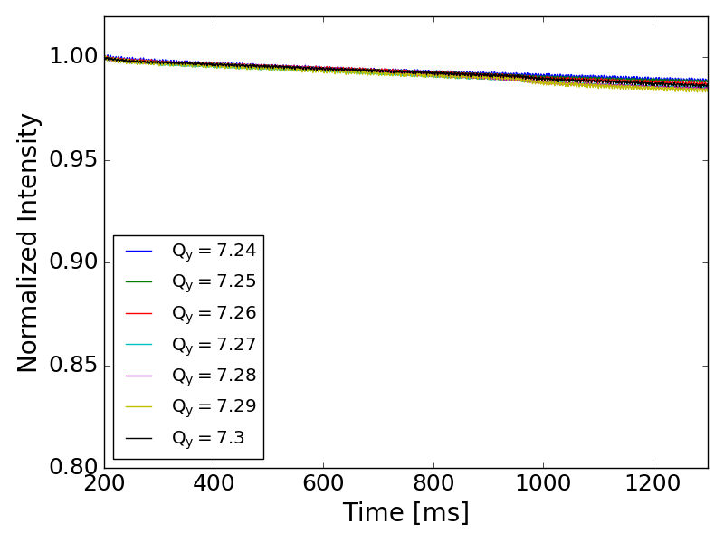
CERN PS: Space charge driven resonances
PS needs to store LHC beam for 1.2 s while waiting for 2nd injection
Losses are observed for working points above Qy=6.25
  Lattice has strong harmonic 50 → space charge potential drives 8th order resonances (8 Qy = 50 and 2 Qx + 6 Qy = 50) – cannot be compensated
Measured losses disappear for another integer tune (avoiding harmonic 50)
  Unfortunately incompatible with acceleration and thus not usable for operation ☹

Slide 32
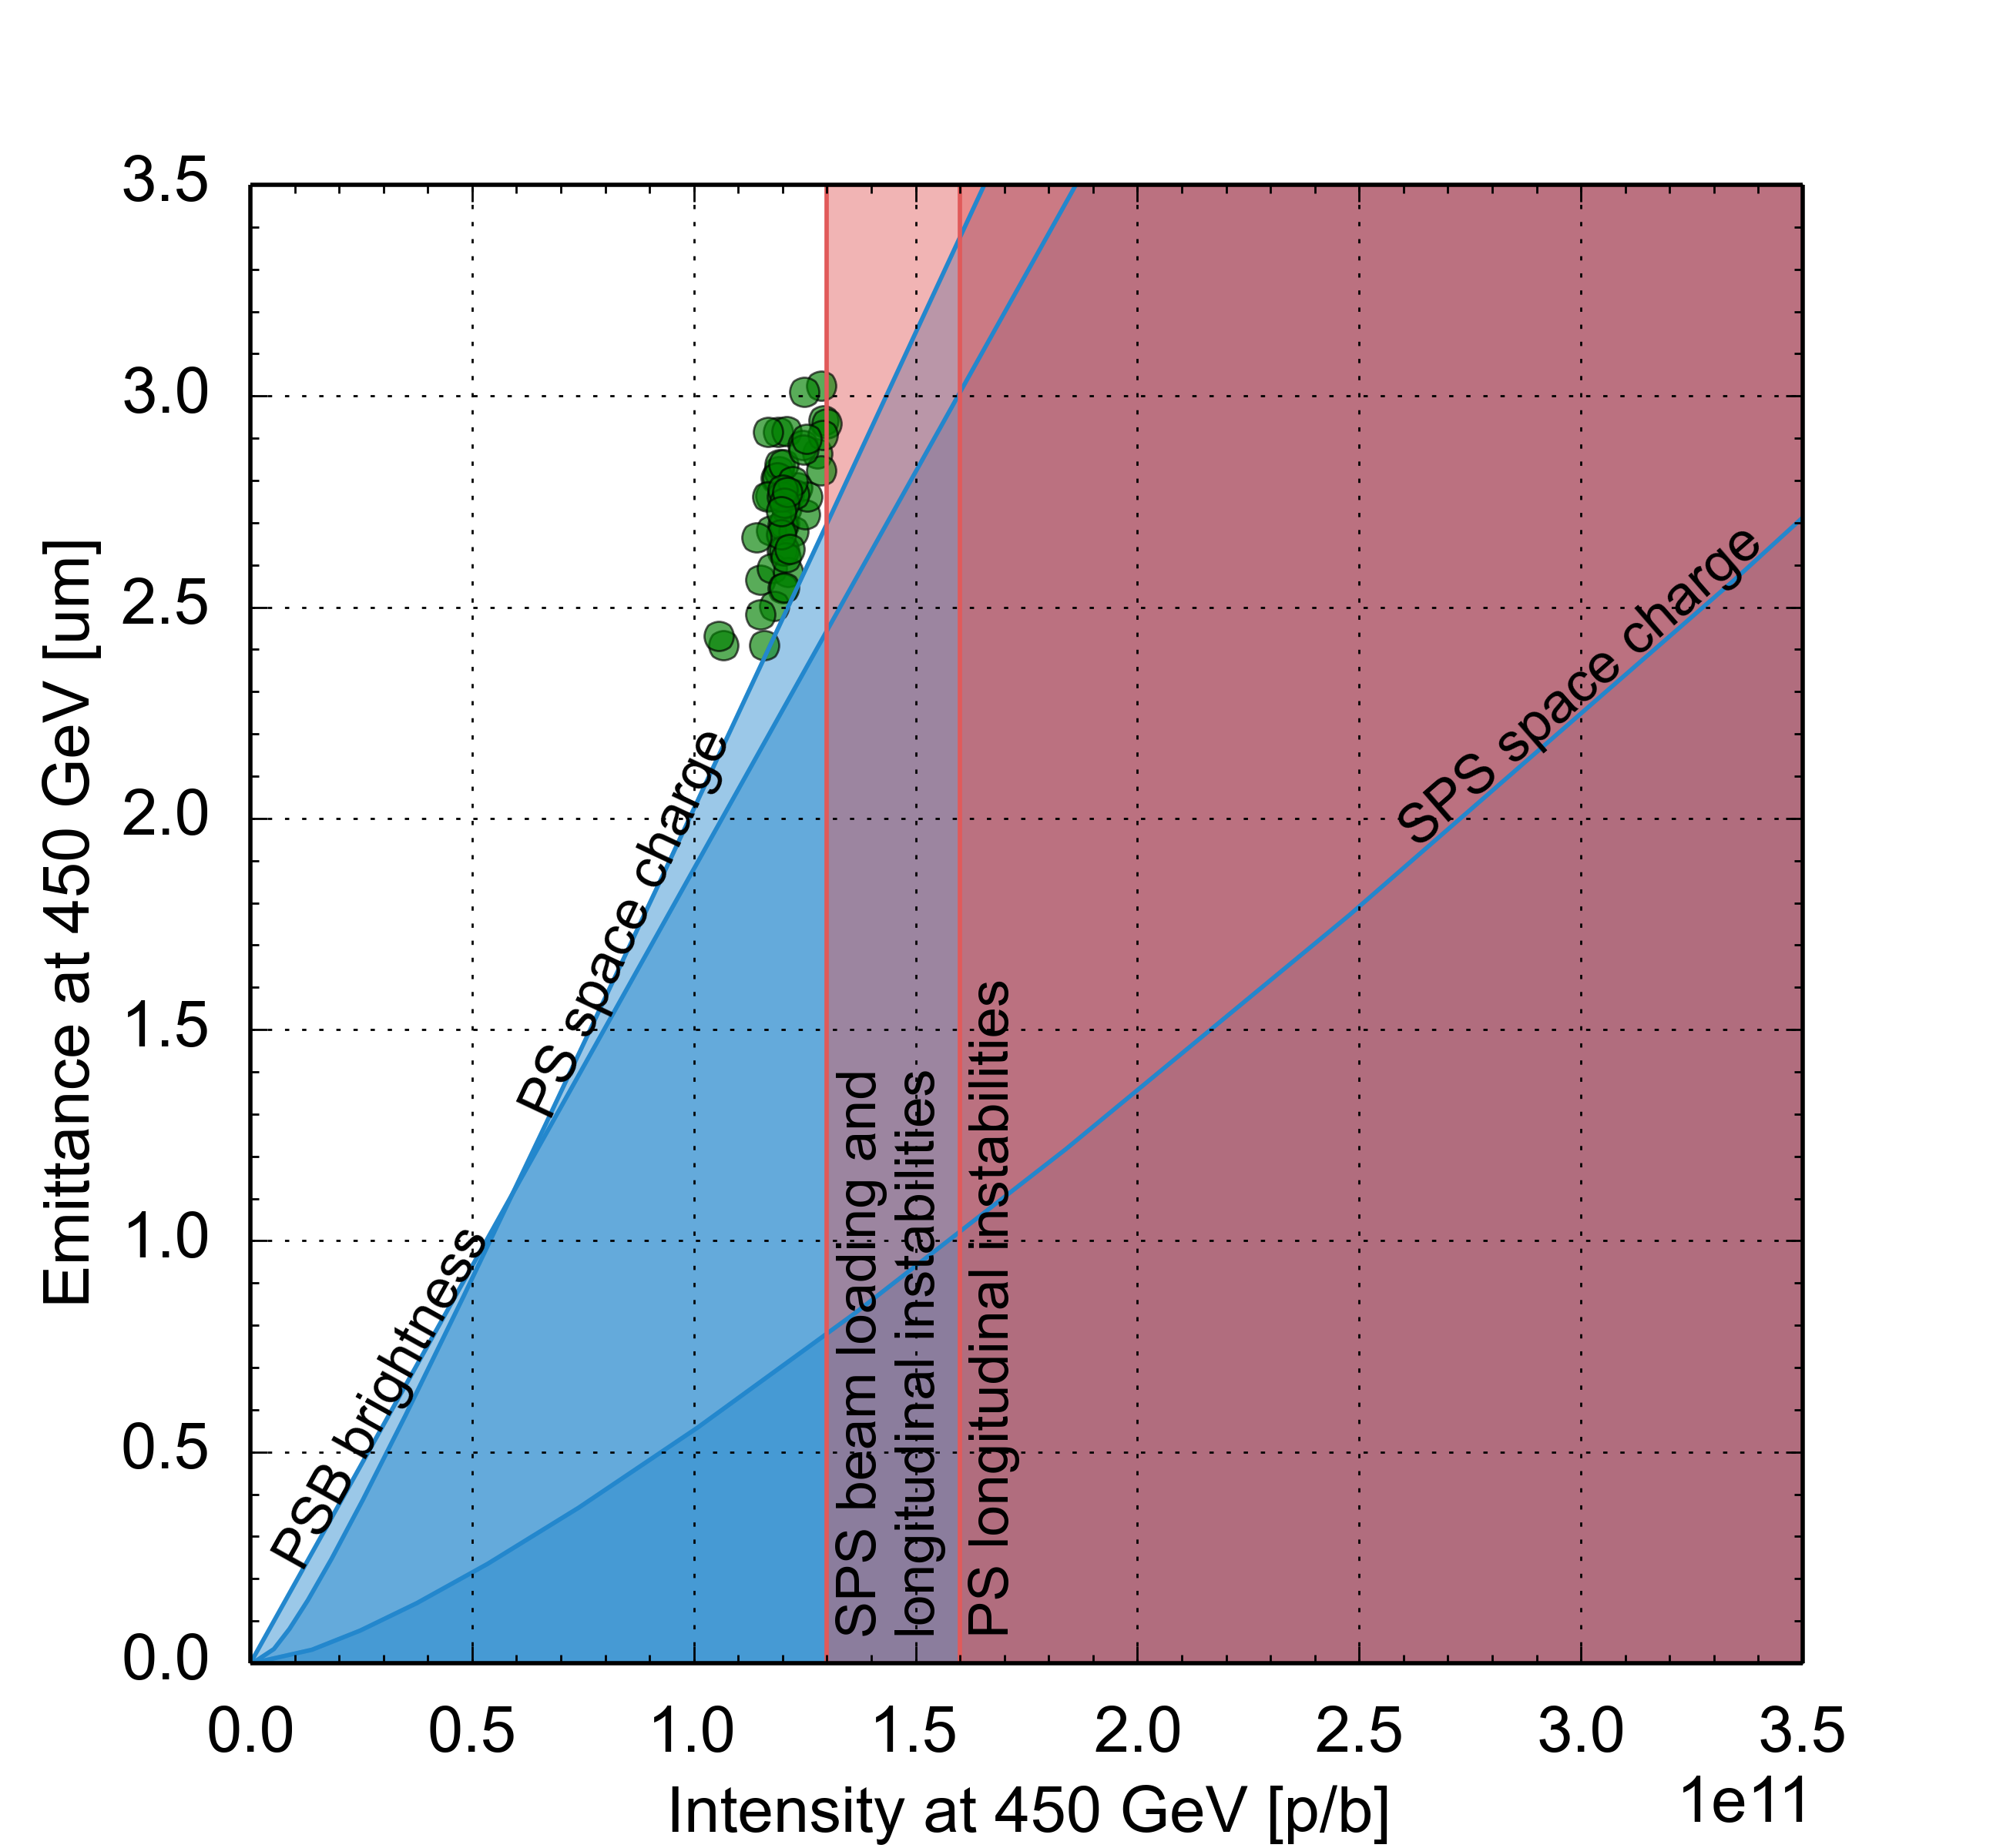
LHC Injector Upgrade (LIU) project
Established performance limitation diagram for entire complex
  Identified bottlenecks and corresponding upgrades
HL-LHC request

Slide 33
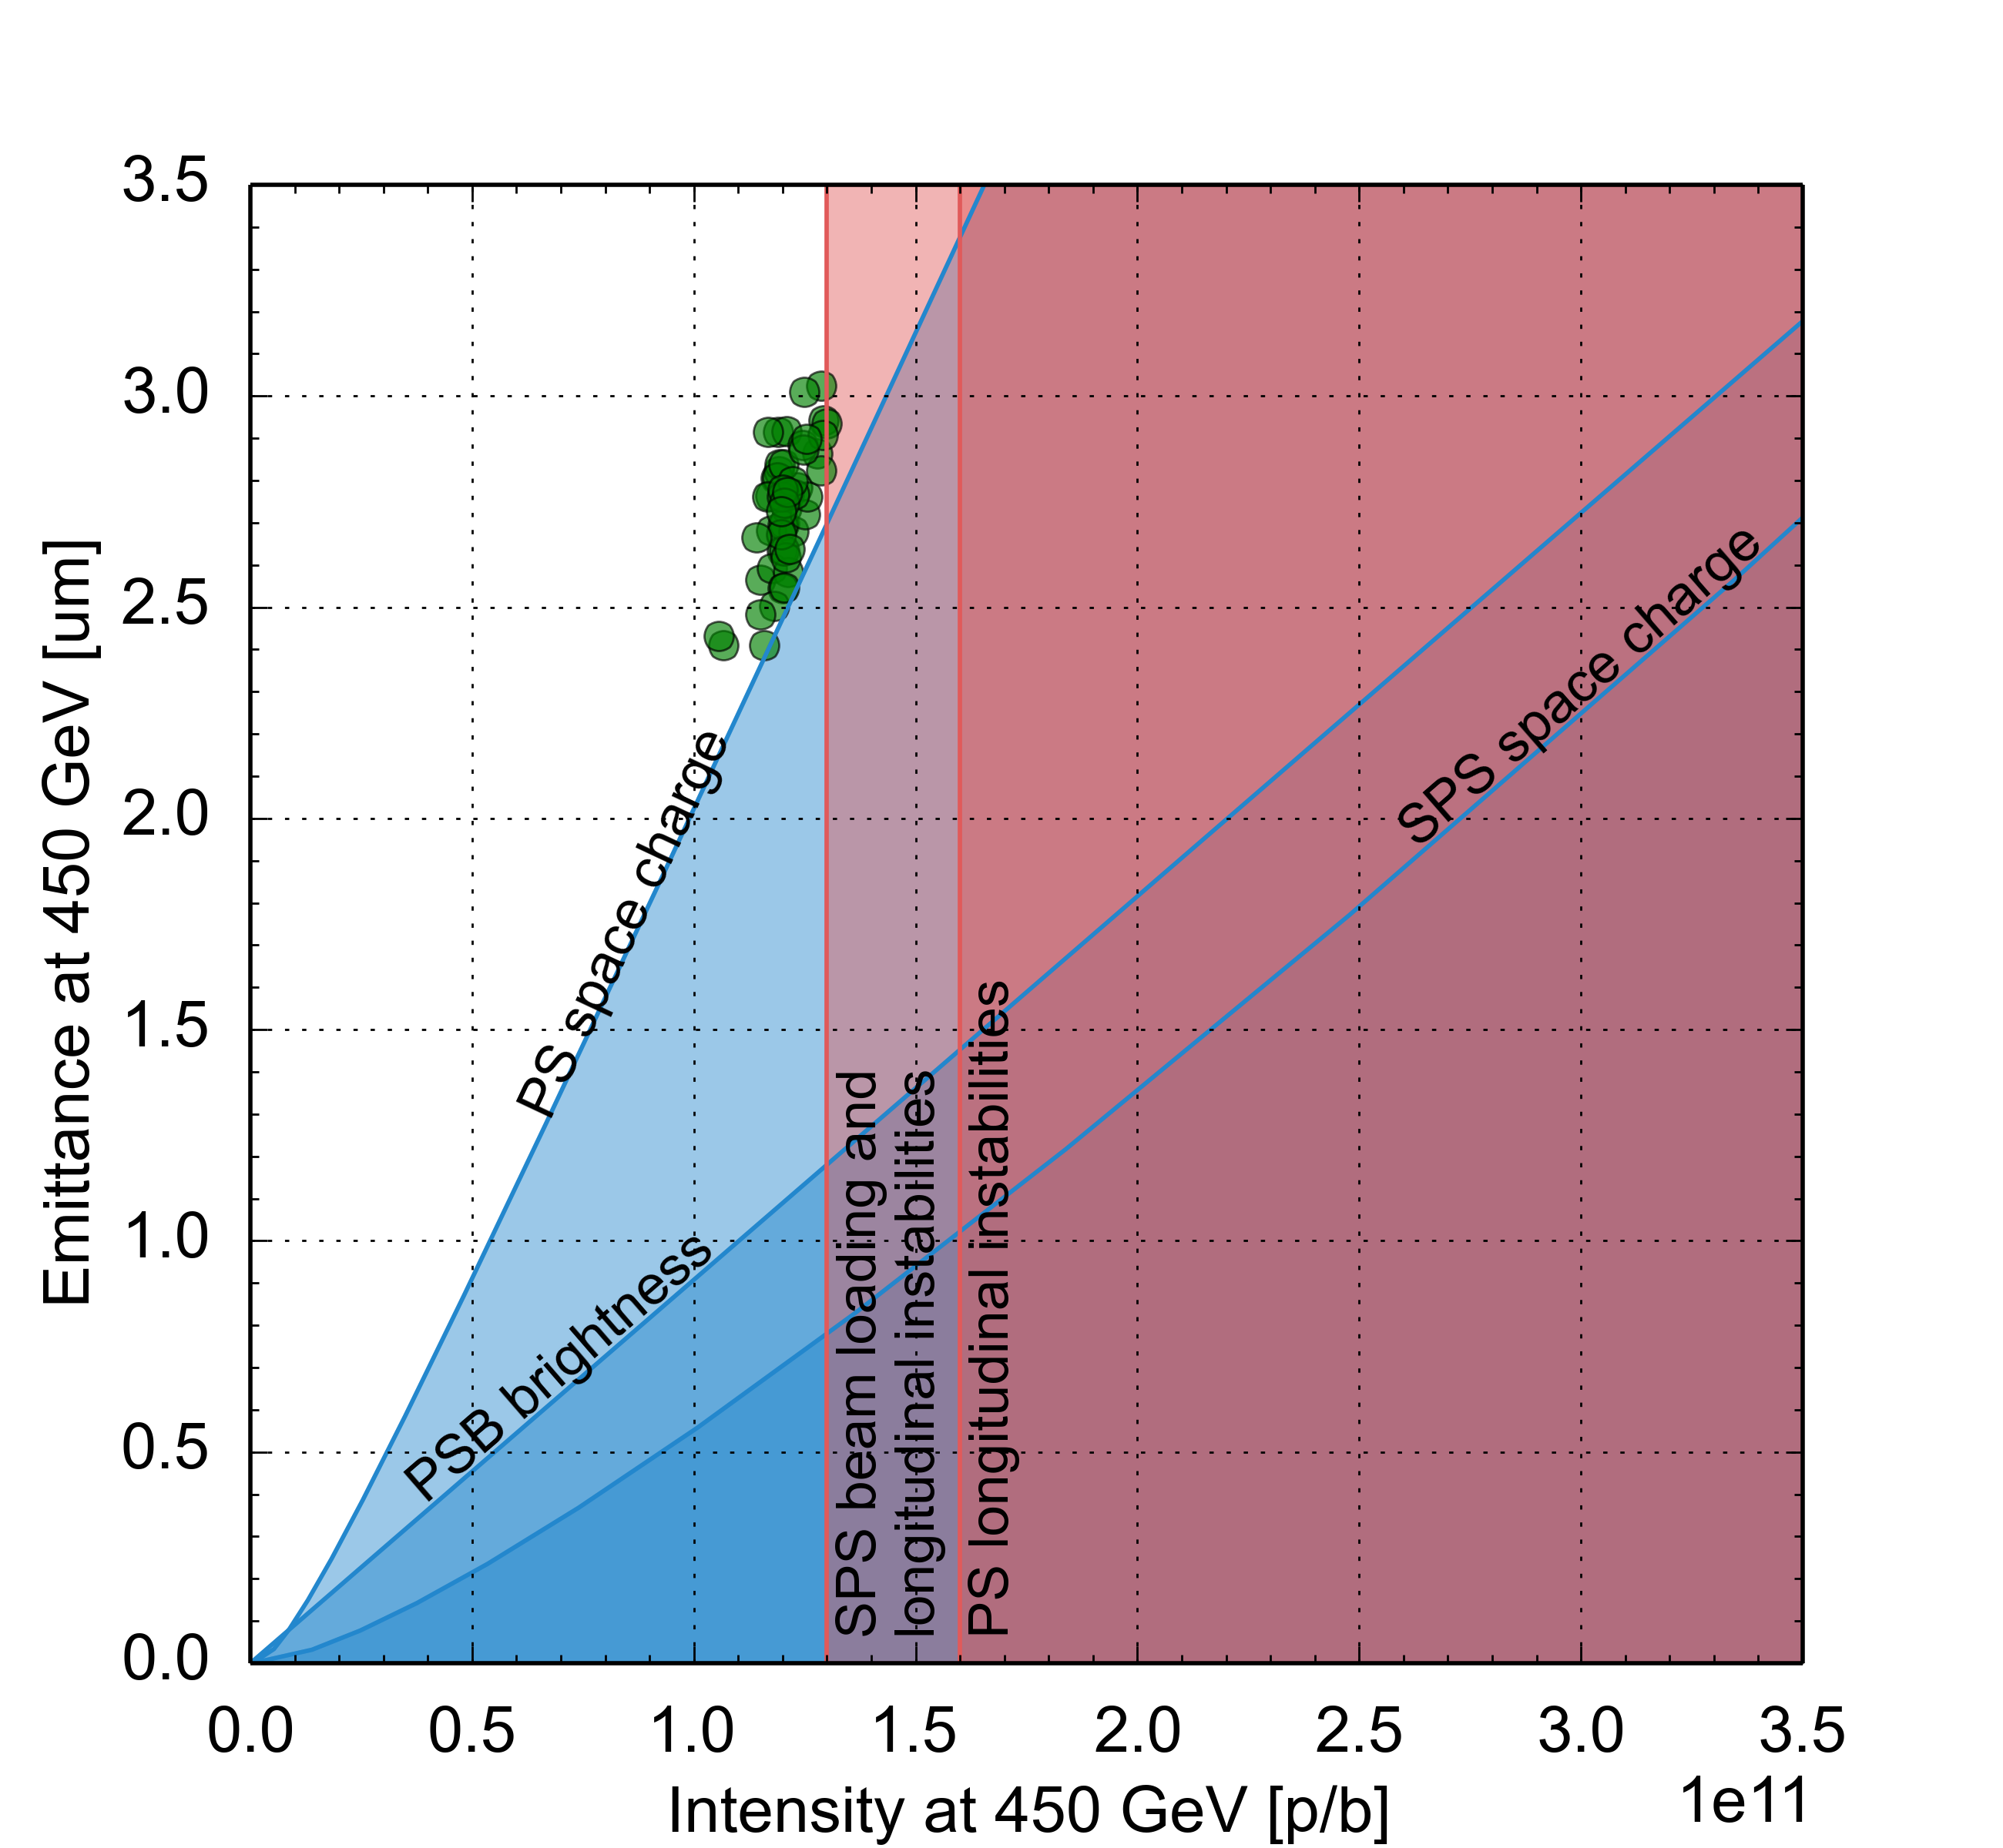
LHC Injector Upgrade (LIU) project
Established performance limitation diagram for entire complex
  Identified bottlenecks and corresponding upgrades
Connection of PSB to Linac4
  Charge exchange H⁻ injection at 160 MeV into PSB
HL-LHC request

Slide 34
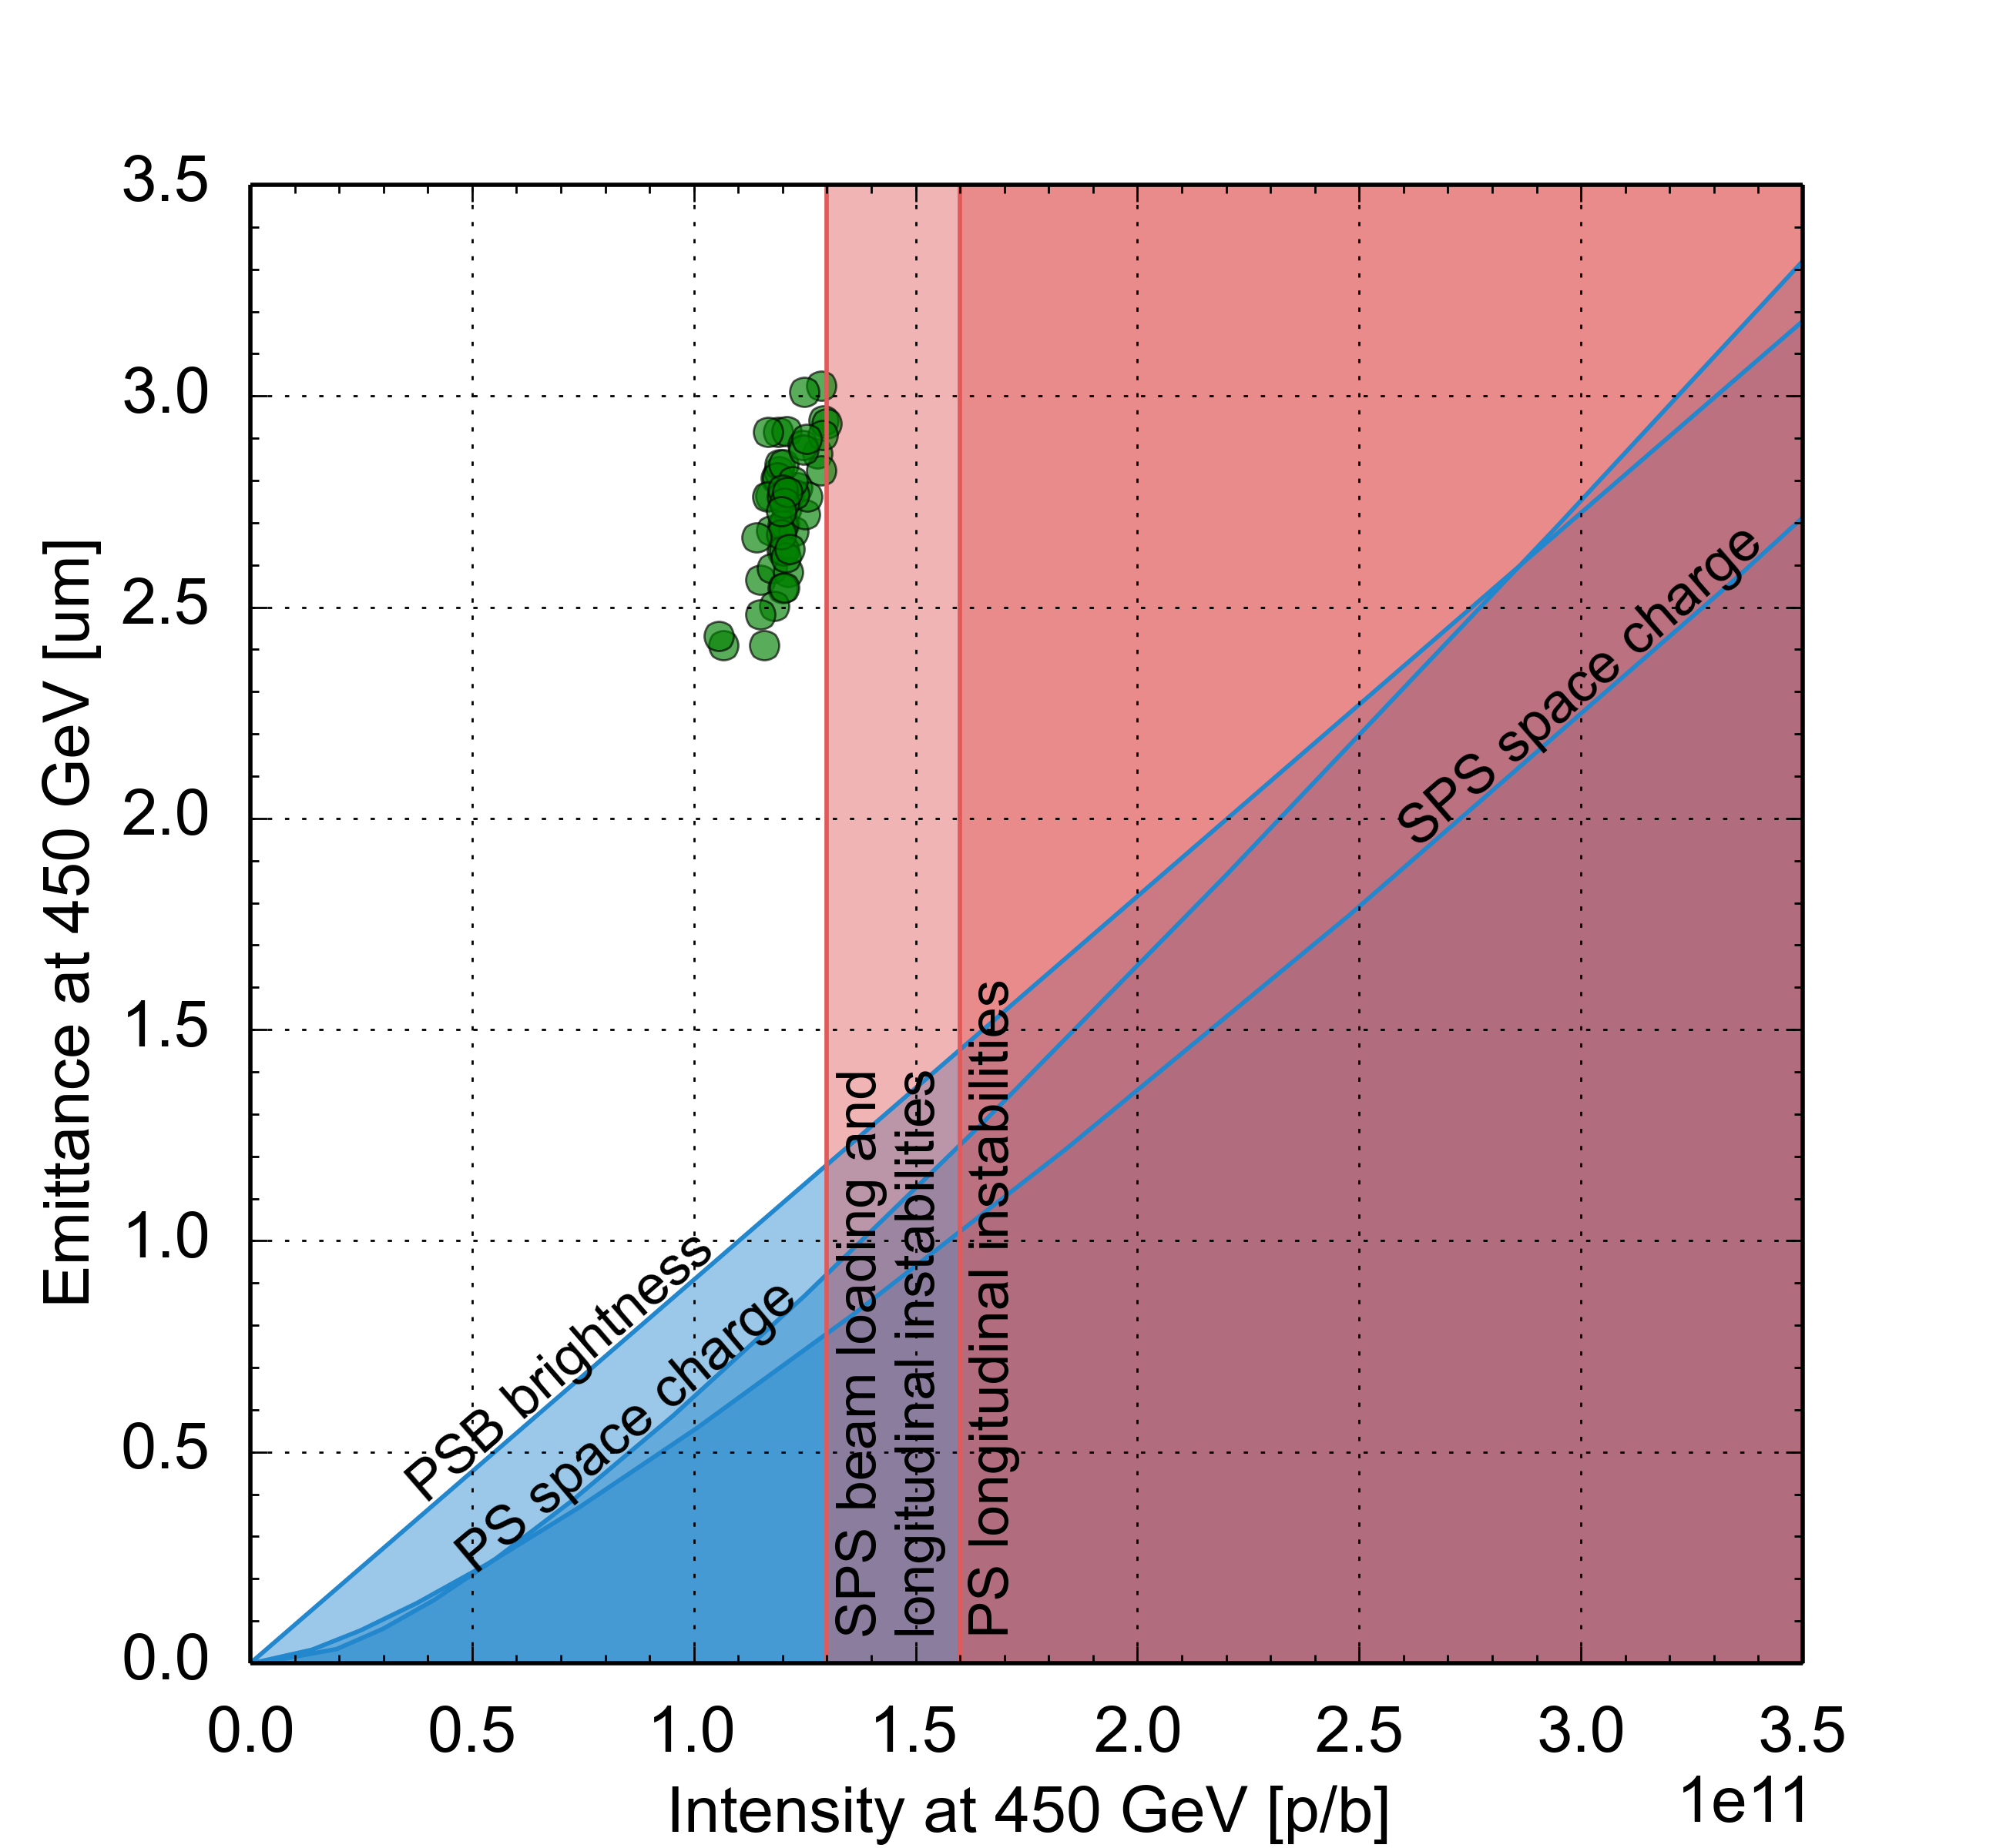
LHC Injector Upgrade (LIU) project
Established performance limitation diagram for entire complex
  Identified bottlenecks and corresponding upgrades
Connection of PSB to Linac4
PSB acceleration to 2 GeV
  Increased energy and large momentum spread enable twice brightness for same space charge tune spread at PS injection
HL-LHC request

Slide 35
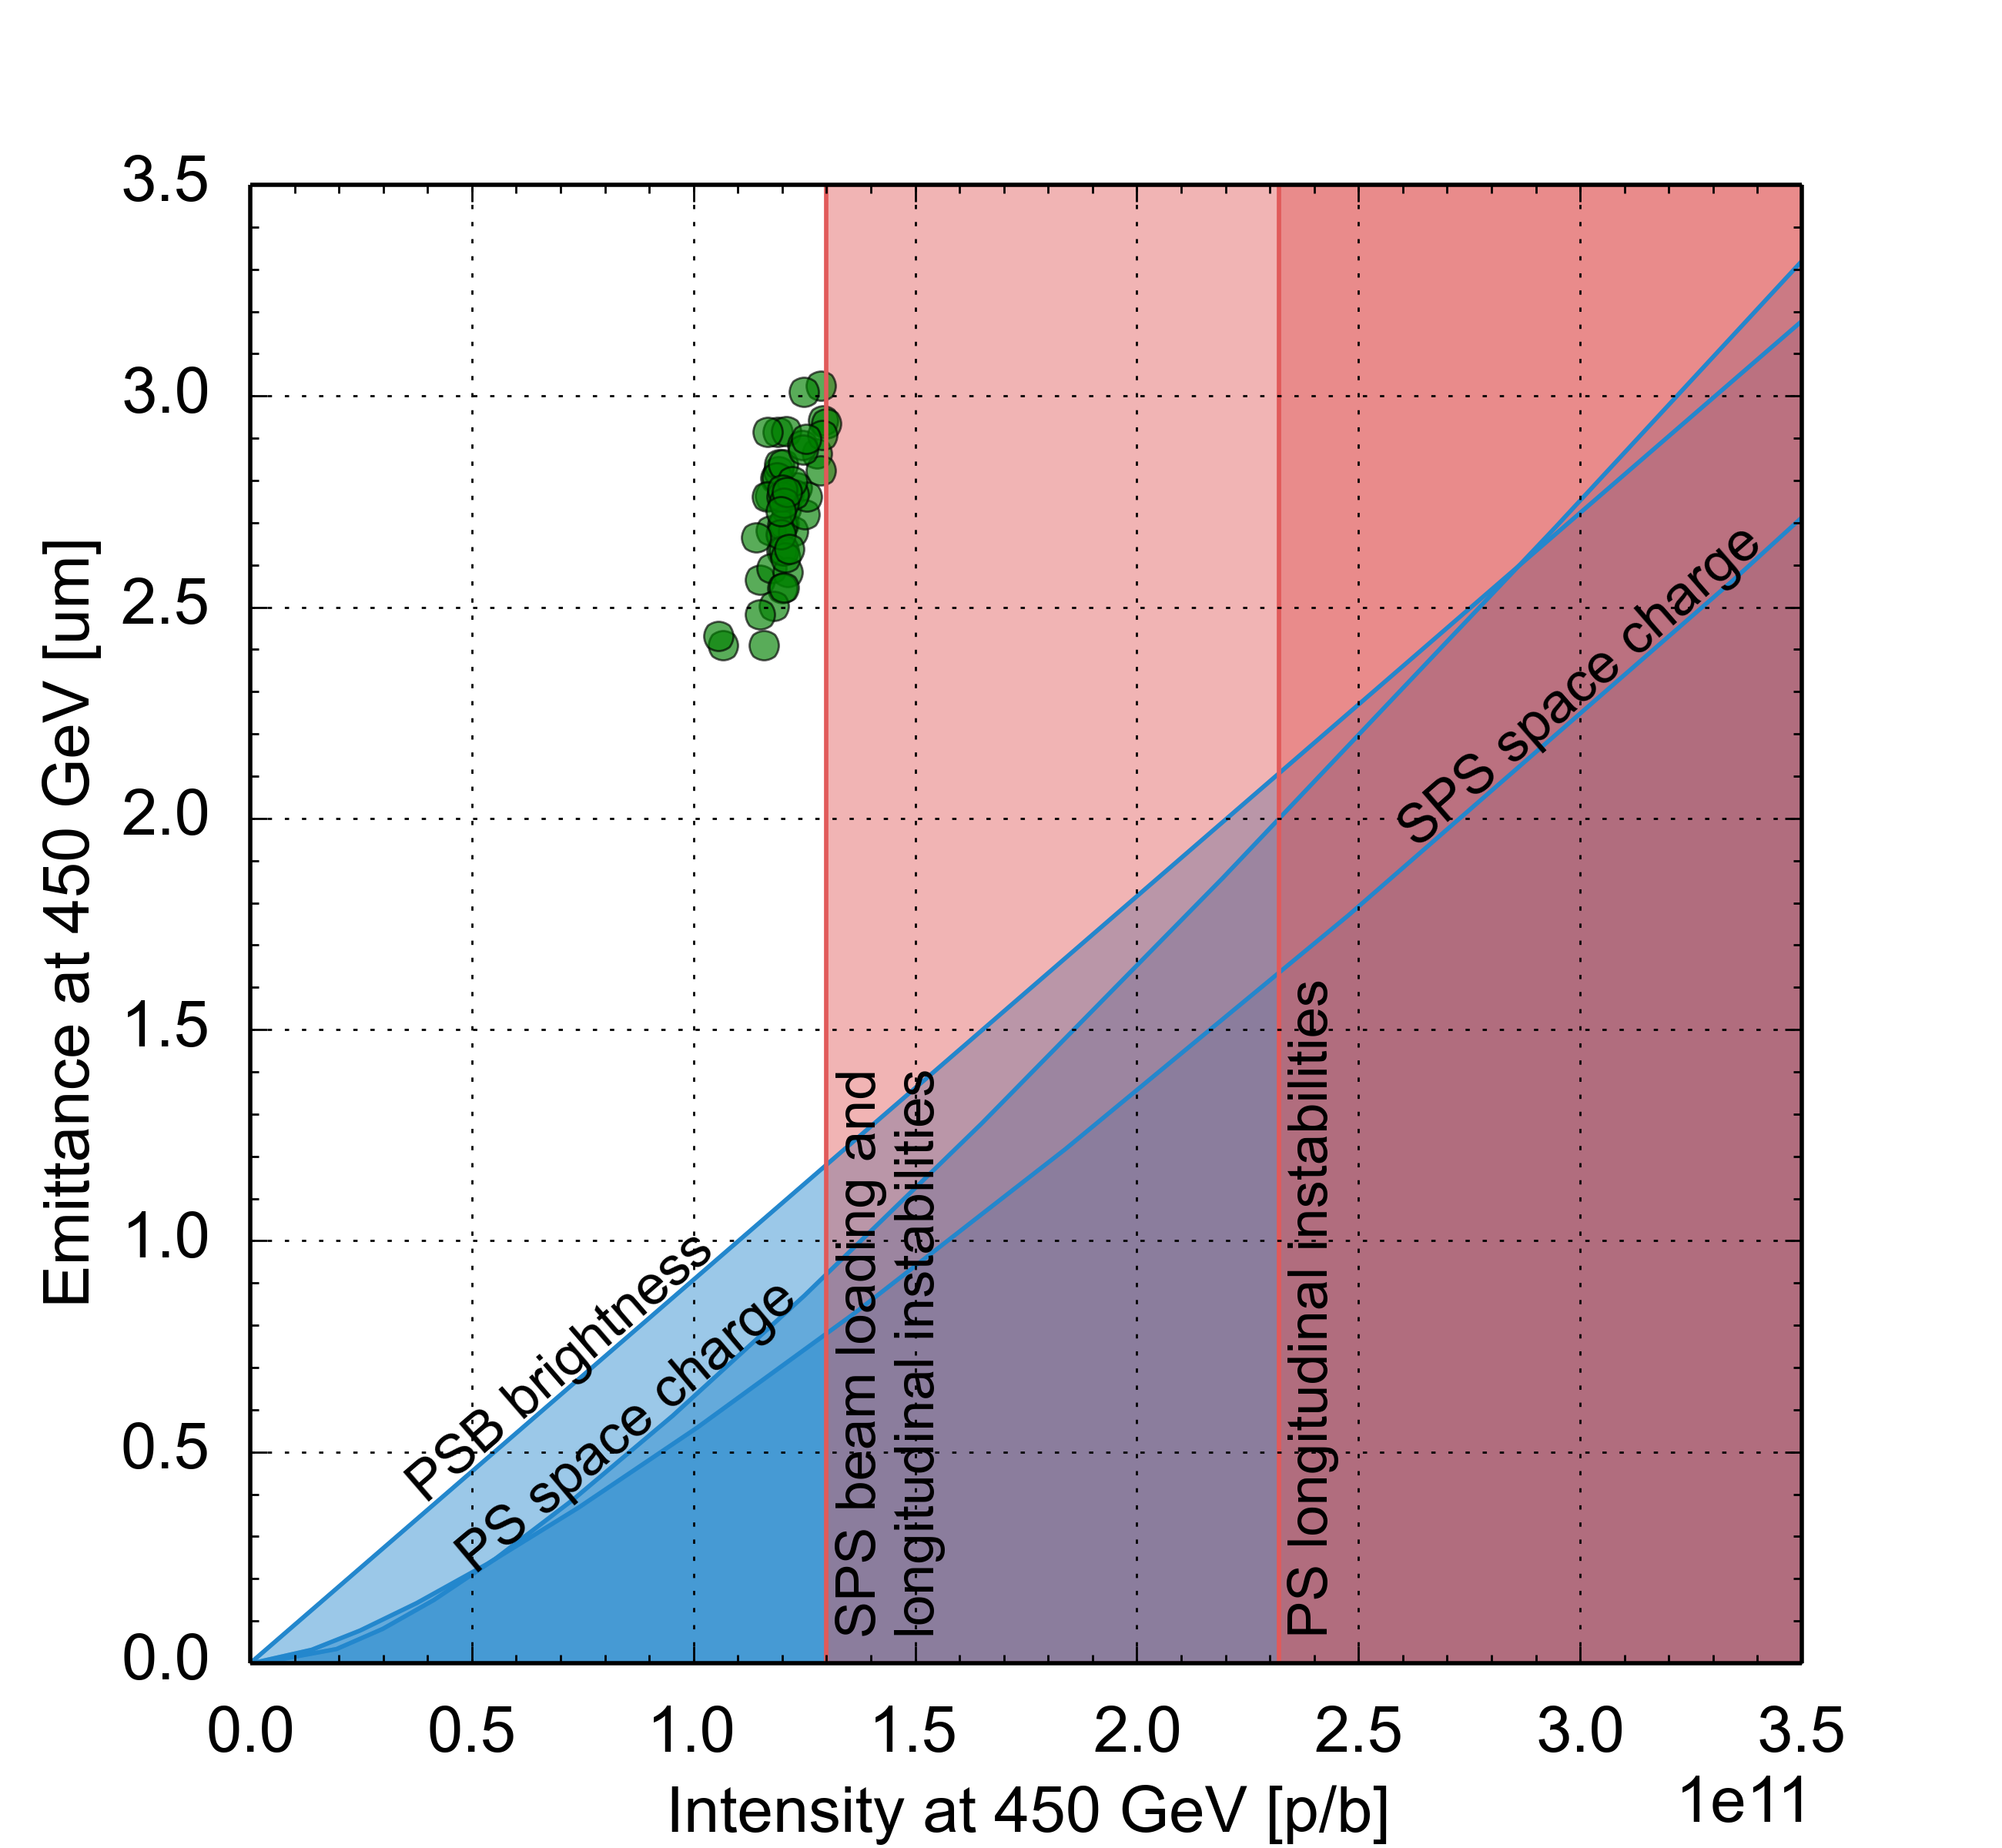
LHC Injector Upgrade (LIU) project
Established performance limitation diagram for entire complex
  Identified bottlenecks and corresponding upgrades
Connection of PSB to Linac4
PSB acceleration to 2 GeV
PS RF upgrades
  New broadband cavity for longitudinal feedback system against instabilities
  Impedance reduction of RF systems
  …
HL-LHC request

Slide 36
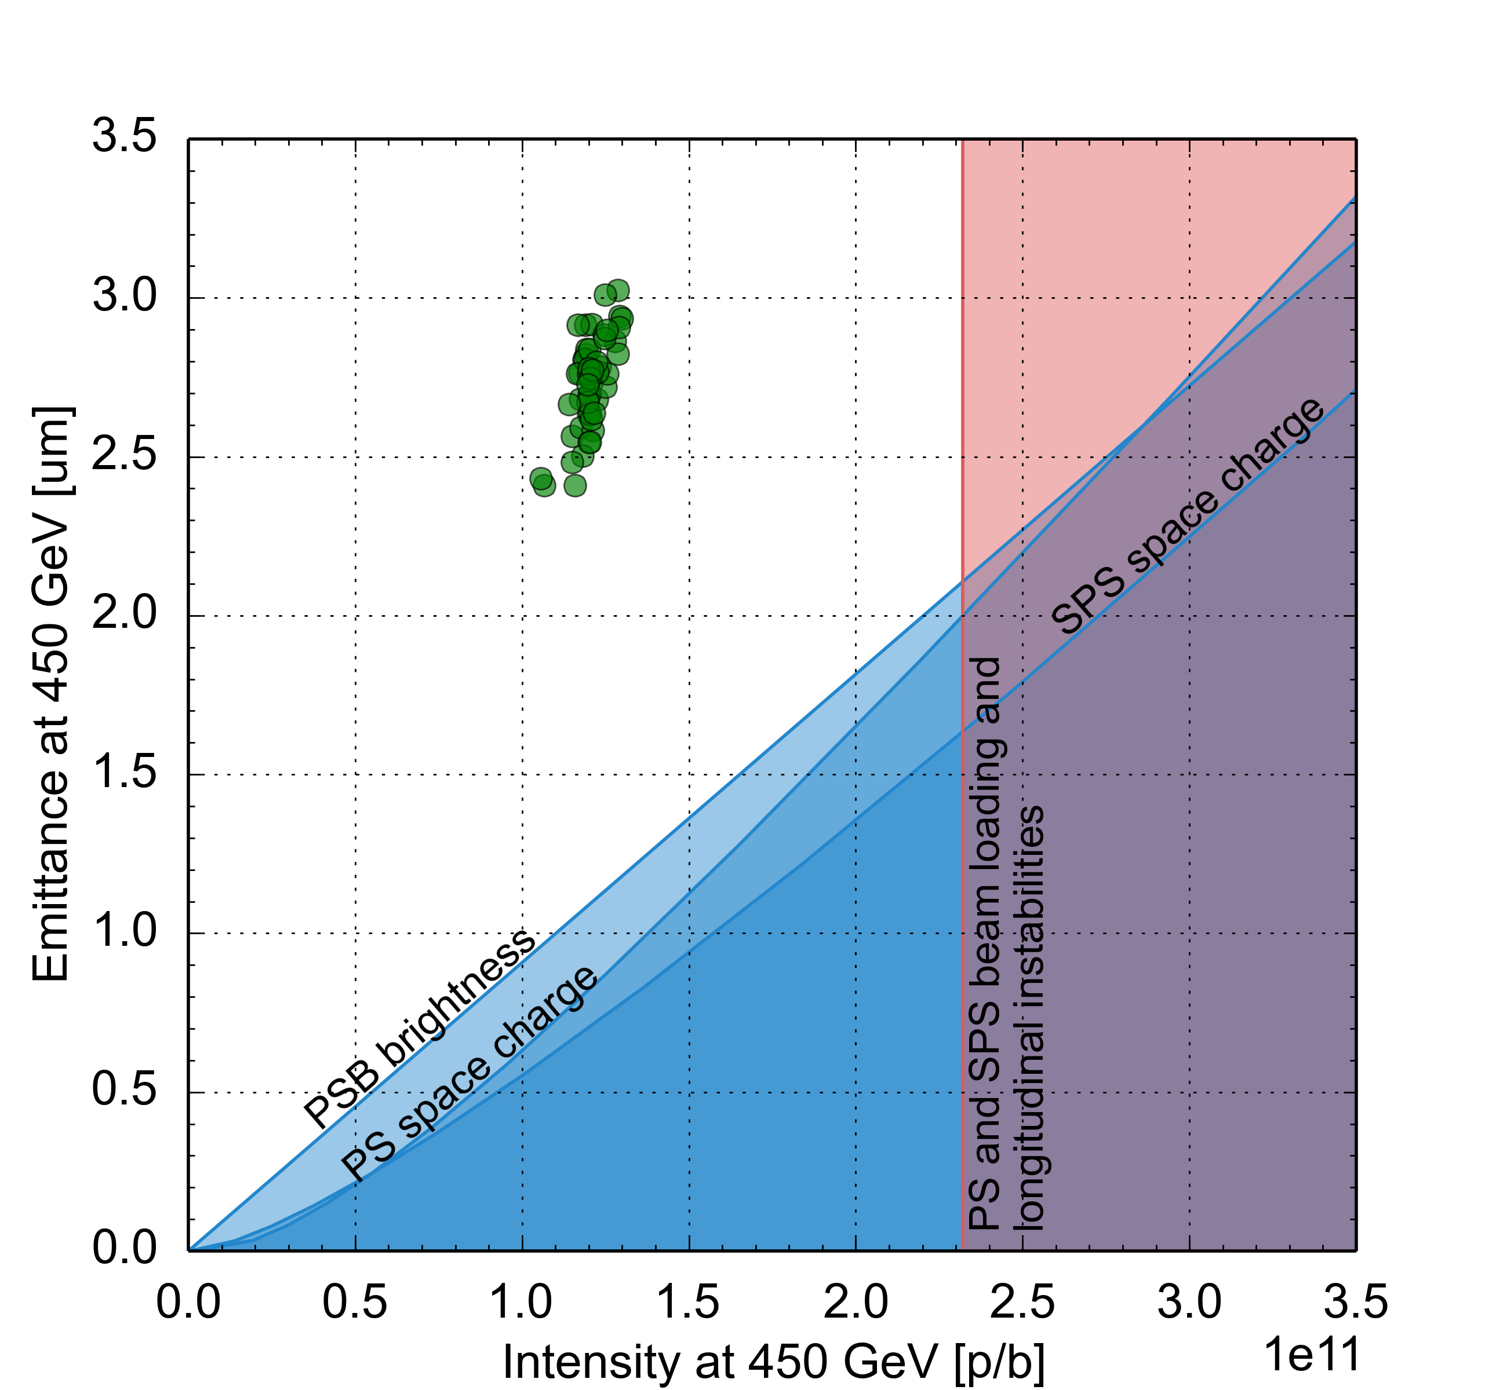
LHC Injector Upgrade (LIU) project
Established performance limitation diagram for entire complex
  Identified bottlenecks and corresponding upgrades
Connection of PSB to Linac4
PSB acceleration to 2 GeV
PS RF upgrades
SPS upgrade
  Power and LLRF upgrade of 200 MHz RF system
  Longitudinal impedance reduction
  a-C coating of focusing quadrupole chambers
  Deployment of low γ_{t} optics
  Upgrade of beam dump and protection devices
HL-LHC request

Slide 37
LHC Injector Upgrade (LIU) project
Established performance limitation diagram for entire complex
  Identified bottlenecks and corresponding upgrades
Connection of PSB to Linac4
PSB acceleration to 2 GeV
PS RF upgrades
SPS upgrade
LIU parameter reach for proton beams matches the HL-LHC target within baseline
HL-LHC request

Slide 38
Outline
Space charge induced brightness and intensity limitations
Beam degradation through periodic resonance crossing
Mitigation measures
Summary and conclusions

Slide 39
Summary and conclusions
Space charge induced tune spread limits machine performance
  Tune spread in combination with resonances limits achievable brightness N/ε
  Losses due to increasing beam size ultimately limit achievable intensity
Mitigation measures
  Flattening of longitudinal bunch profile using multiple RF systems
  Optimization of working point to avoid structure and space charge resonances
  Resonance compensation using corrector magnets
  Energy upgrade
Optimizing machine performance requires
  Good characterization of performance limitations (possibly combination of effects) through experiments and simulation models
  Good control of the machine and reproducible implementation of mitigation measures

Slide 41
PSB tune change along cycle (old integer tunes)

Slide 42
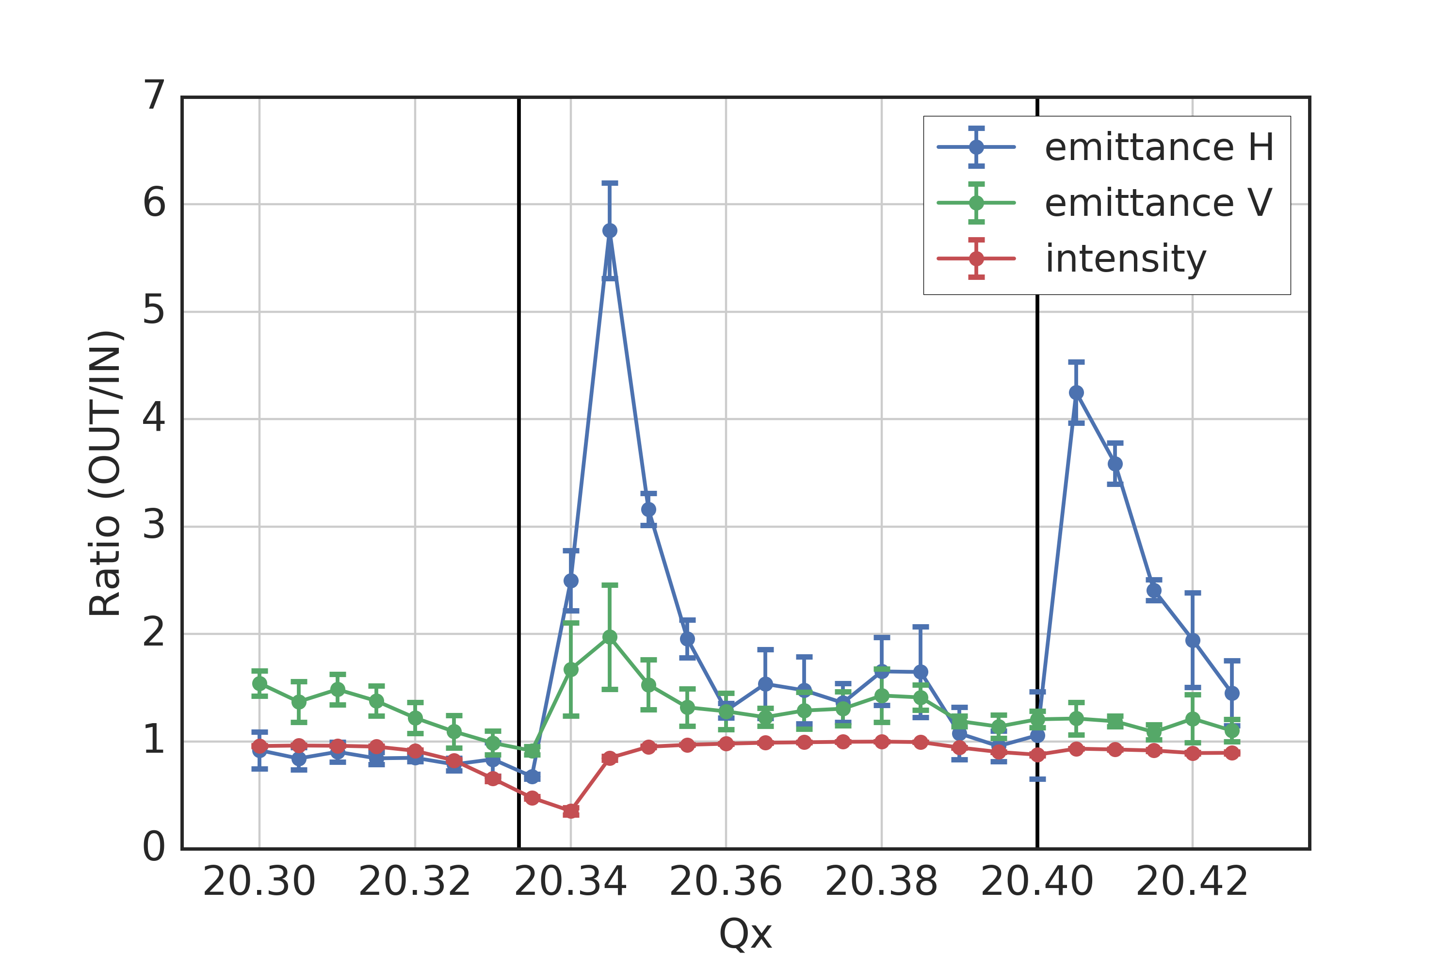
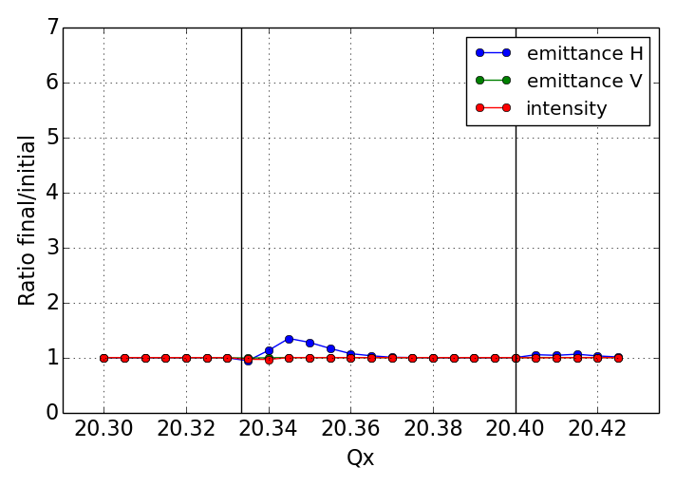
Impact of tune ripple at the CERN SPS
Benchmark experiment at CERN SPS (started in 2016)
  Horizontal 3rd order resonance at Qx = 20.33 deliberately excited
  Additional resonance observed at Qx = 20.40 (most likely space charge driven)
measurements
frozen SC simulations
ΔQx ~ -0.06
3 s storage
???
H. Bartosik and F. Schmidt

Slide 43
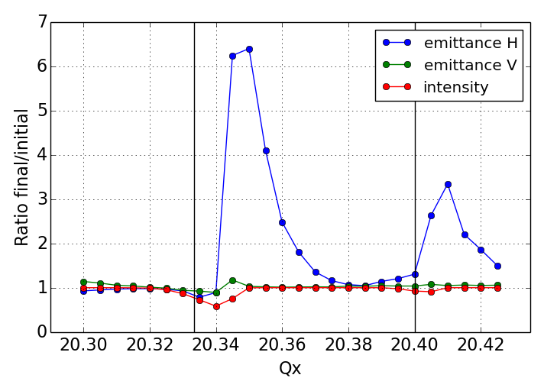
Impact of tune ripple at the CERN SPS
Benchmark experiment at CERN SPS (started in 2016)
  Horizontal 3rd order resonance at Qx = 20.33 deliberately excited
  Additional resonance observed at Qx = 20.40 (most likely space charge driven)
  Simulations with frozen potential far from experiment unless (measured) SPS tune ripple from power converters is taken into account – detailed studies ongoing
measurements
frozen SC simulations with tune ripple
ΔQx ~ -0.06
3 s storage
H. Bartosik and F. Schmidt

Slide 44
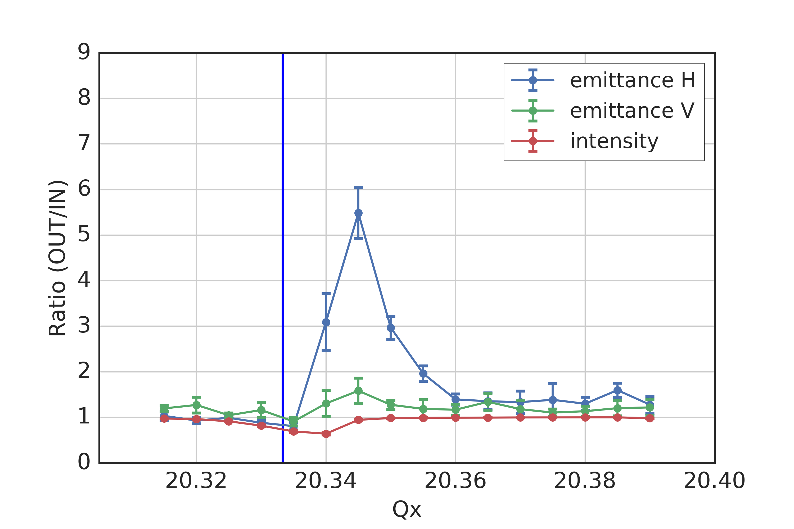
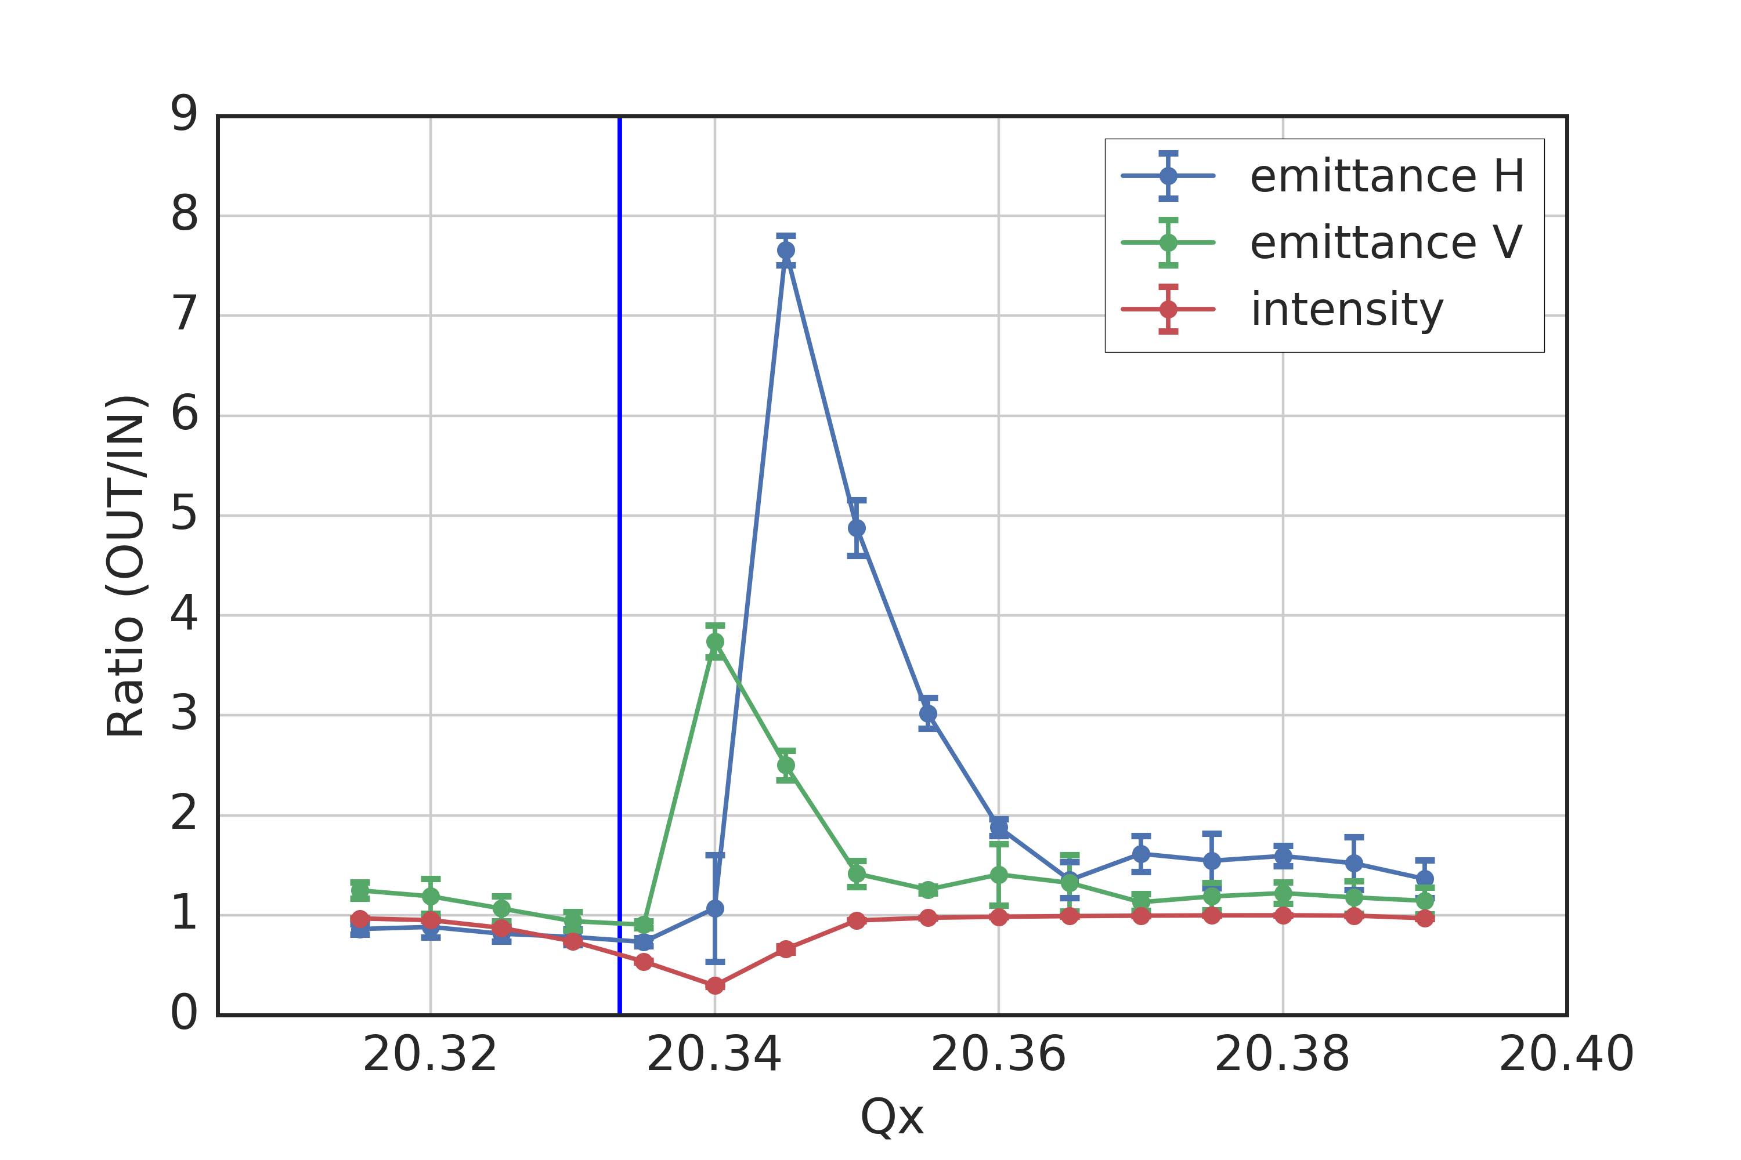
Impact of tune ripple at the CERN SPS
Benchmark experiment at CERN SPS (started in 2016)
  Horizontal 3rd order resonance at Qx = 20.33 deliberately excited
  Additional resonance observed at Qx = 20.40 (most likely space charge driven)
  Simulations with frozen potential far from experiment unless (measured) SPS tune ripple from power converters is taken into account – detailed studies ongoing
  Confirmed in direct experiment with enhanced tune ripple
measurement: natural ripple
measurement: Qx ripple: ±6e-3 @ 90 Hz
blow-up and losses enhanced!
H. Bartosik and F. Schmidt

