Slide 1
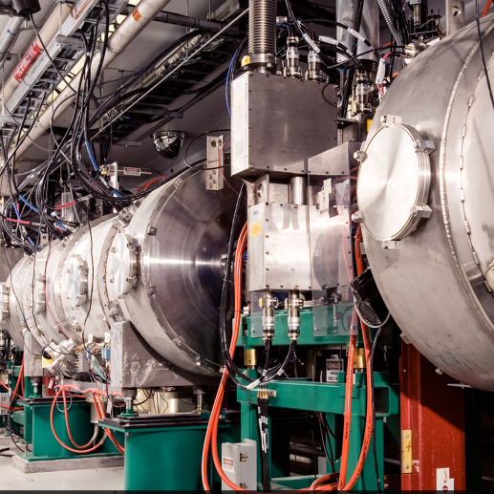
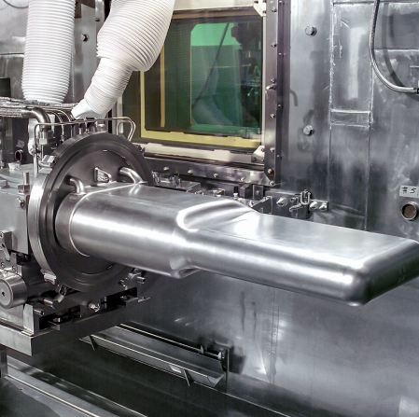
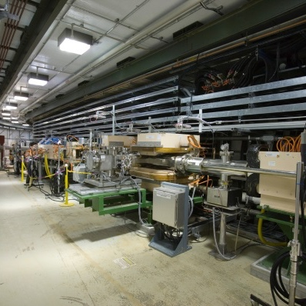
Shaping Injection:
Painting and Laser Stripping
Aries Workshop
CERN
Sarah Cousineau
June 23, 2020

Slide 2
Outline
Painting
Laser Assisted Charge Exchange
Injection Foils
Understanding and implementing painting in terms of charge-exchange
Charge-exchange injection and it’s relationship with painting
The foil complication
Removing the foils with laser-assisted charge exchange (LACE)
Discussion on new freedom with painting

Slide 3
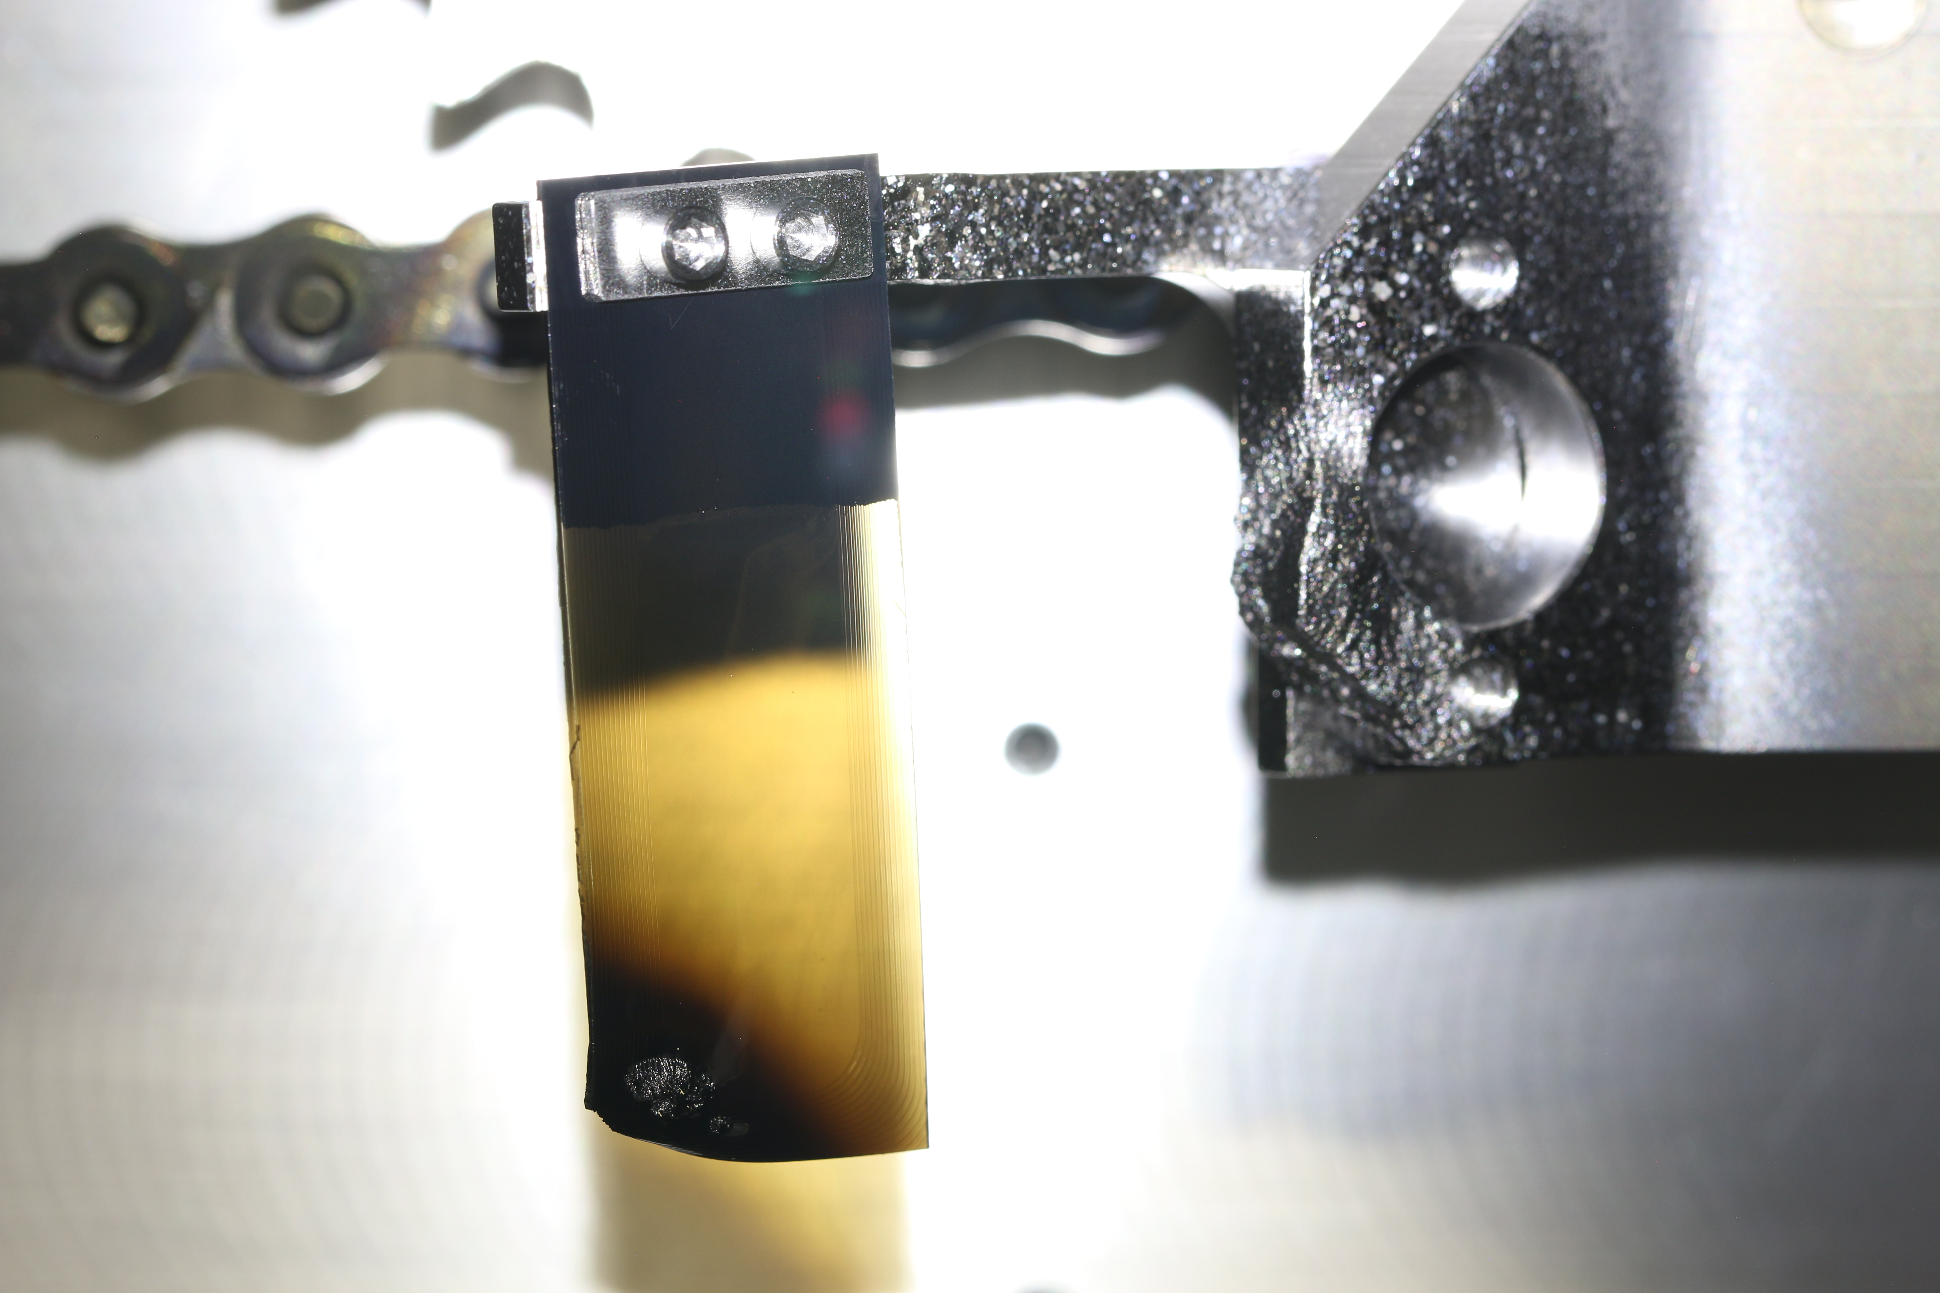
Charge Exchange as a Foundation for Painting
New
After ~1 Month @1.3 MW
Nanocrystalline Diamond ~400 ug/cm² (1 μm)

Slide 4
Charge Exchange as a Foundation for Painting
Painting regime

Slide 5
Injection Painting for Creating Custom Distributions
Priority Ordering for Painting:
Minimize circulating beam traversals
Create distributions with custom properties
Control collective effects
Optimize local hardware

Slide 6
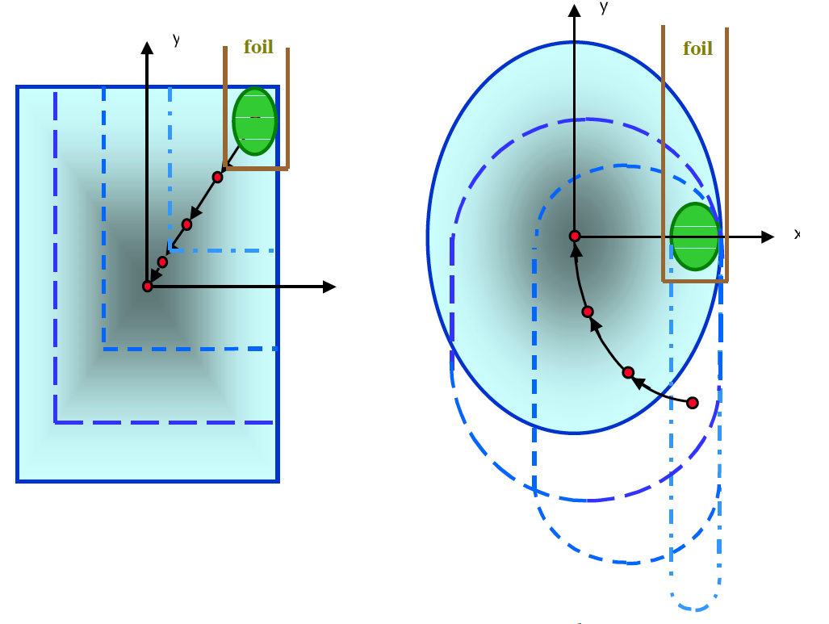
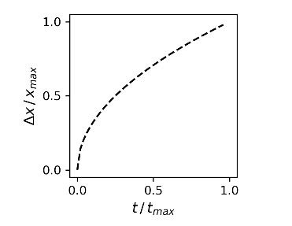
Injection Painting Today – Rules of Thumb for High Power
foil
Correlated
Anti-Correlated
t₀
x
t_{f}
Figs reproduced from BNL/SNS Technote No. 081, J. Beebe-Wang
Rules of thumb to keep foil hits low at high power:
Start with offset between injected and circulating orbits
Move away from foil quickly at the beginning
All else is determined by desired distribution

Slide 7
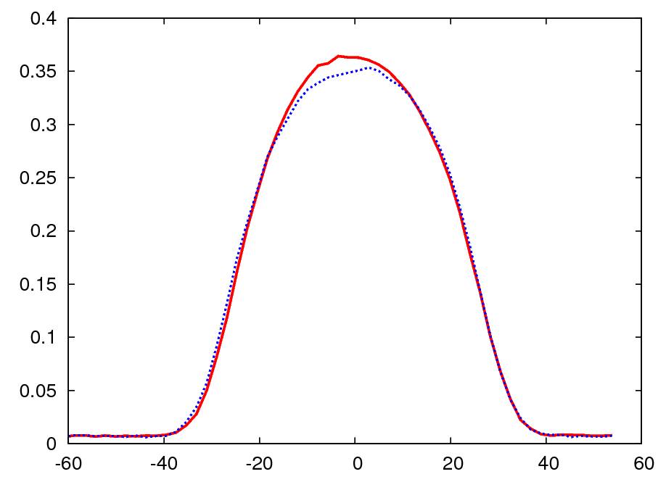
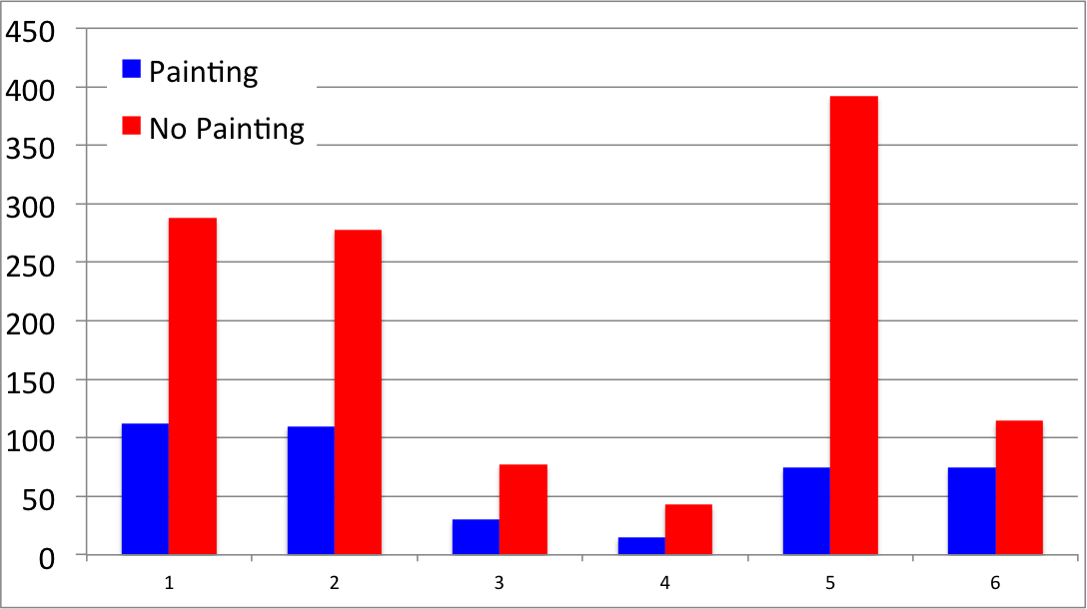
The Necessity of Painting for High Power – SNS Example
~ 1 MW Equivalent Beam Profiles
For Two Equal Emittance Beams
Injection Region Beam Loss Monitor Signals
Painting
No Painting
A11c
A11d
A11e
A13
A13b
B01

Slide 8
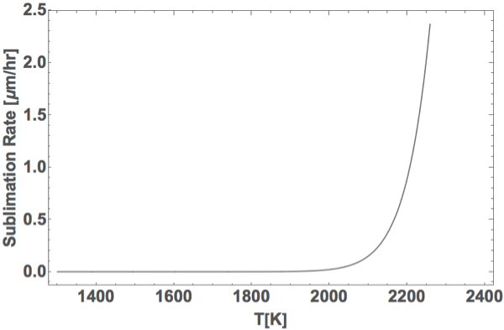
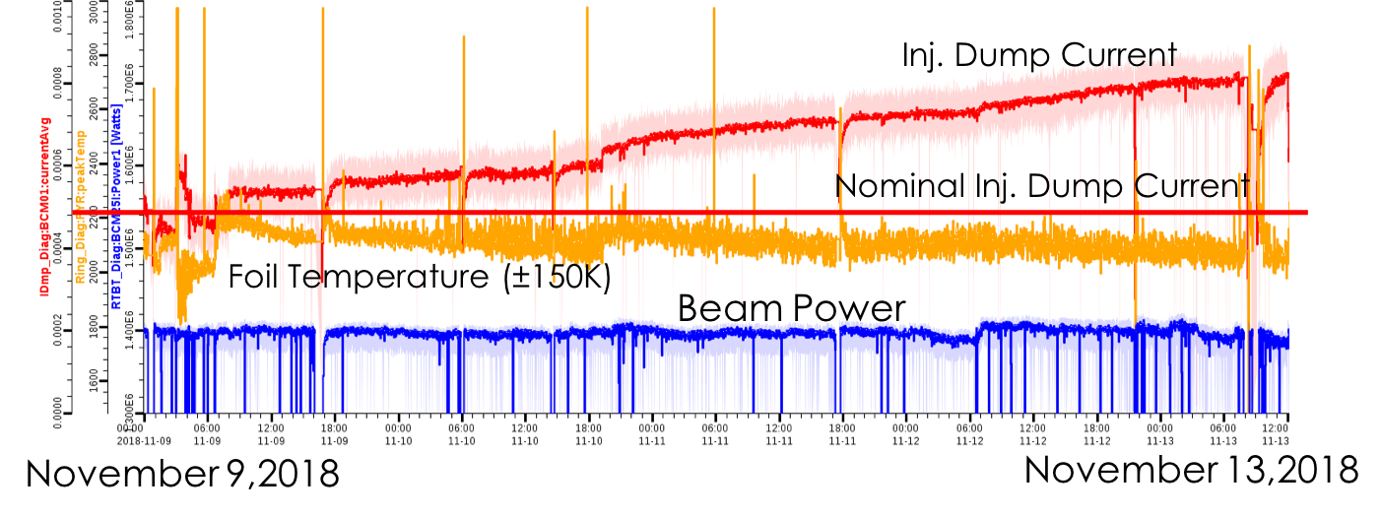
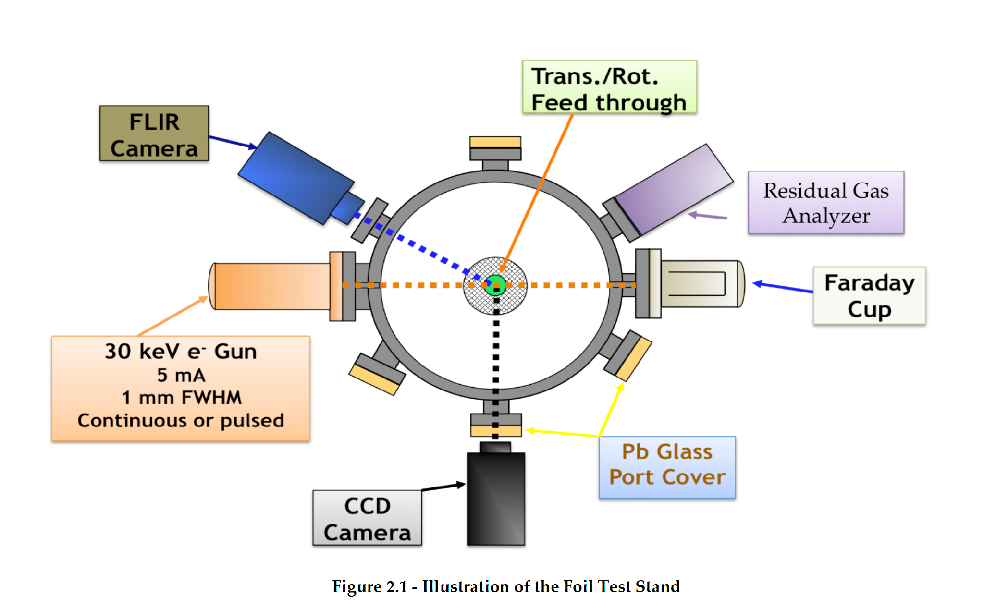
The Foil Complication - Failures
Foil temp measurement
Measured this point for known beam power density
1st prediction of failure limit
Beam-based foil thinning
Foil test stand experiments
2nd prediction of failure limit
Practical beam power limit for foil use at SNS is 6-8 MW for 1 – 1.3 GeV

Slide 9
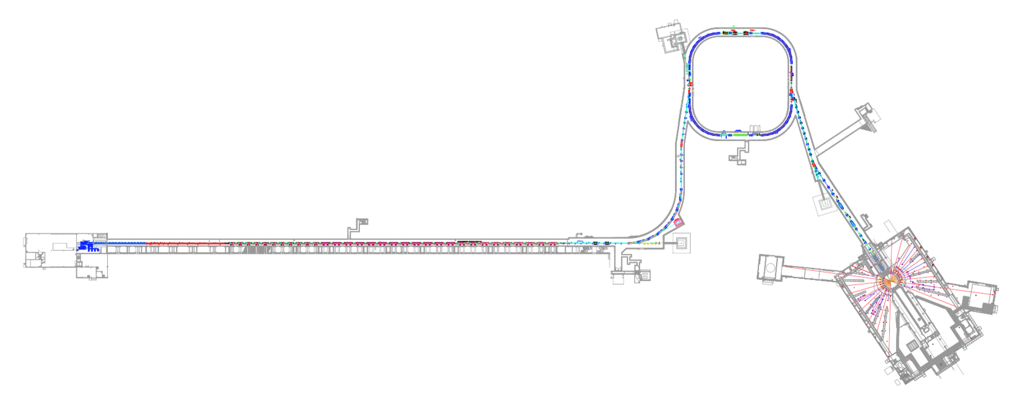
Even With Best Painting, Scaling to 10 MW Not Possible
Another factor of 10 in injected beam power is not possible due to radiation, or foil failure
New technology will be needed
Typical SNS Residual Radiation Levels (mrem/hr @ 30 cm)
90 coll. straight
80
Extr Sptm
Injection
1000 mrem/hr
(0.01 mSv)
50*
DH13
DTL
2 – 30
CCL
8 – 60
SCL
5 – 45
RTBT
5 – 25*
Ring
5 – 40
*1.3 MW until 3 to 5 hours before survey, Sept. 22, 2015
HEBT
<5**

Slide 10
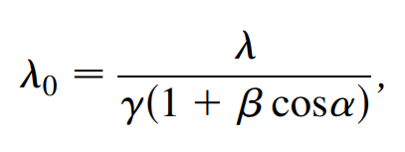
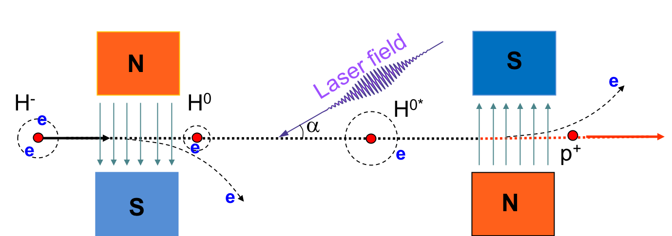
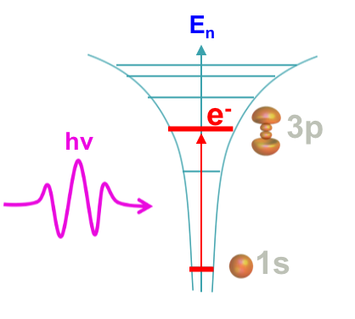
The Concept: Laser Assisted Charge Exchange (LACE)
“Doppler effect” formula
To IDmp
To Ring
n=1→3

Slide 11
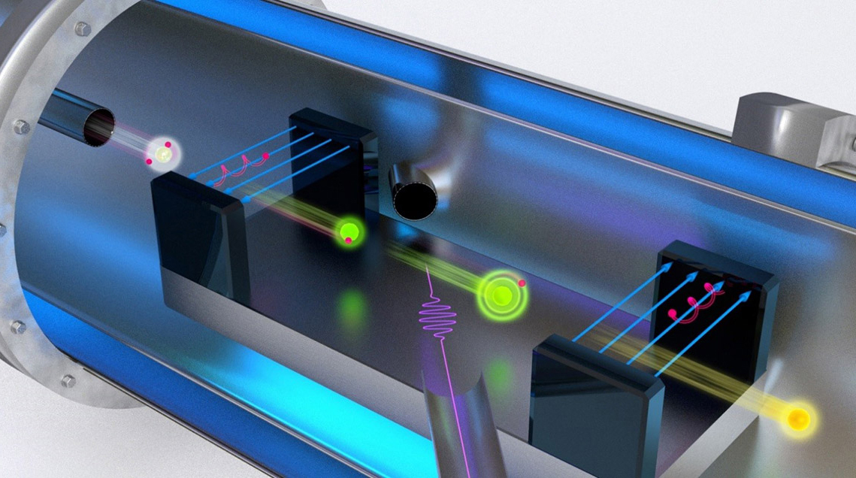
Status: Experiment demonstrated 95% stripping efficiency for 10µs
This work has been partially supported by U.S. DOE HEP grant DE-FG02-13ER41967
H⁻ beam
1000x better than first 6 ns experiment, but 100 time less than needed
Limitation to go to full 1 ms is laser power
1MW laser peak power
protons
An artistic representation of the laser stripping method by https://science.energy.gov/hep/highlights/2017/hep-2017-07-a/
$$\frac{I_{protons}}{I_{H−}}>90\%$$
Unstripped H⁻ current
Stripped p current

Slide 12
Recent Breakthrough: Sequential resonance excitation is the solution to power challenge
n=3 excitation required for H- below 2 GeV
Power savings in two ways:
Less power required for each excitation
Possibility of using other laser wavelengths. Generating UV laser from an IR laser requires cutting original power twice in the harmonic conversion
30 kW
x
x
300 kW
1 MW UV
x
x
This makes LACE operationally feasible

Slide 13
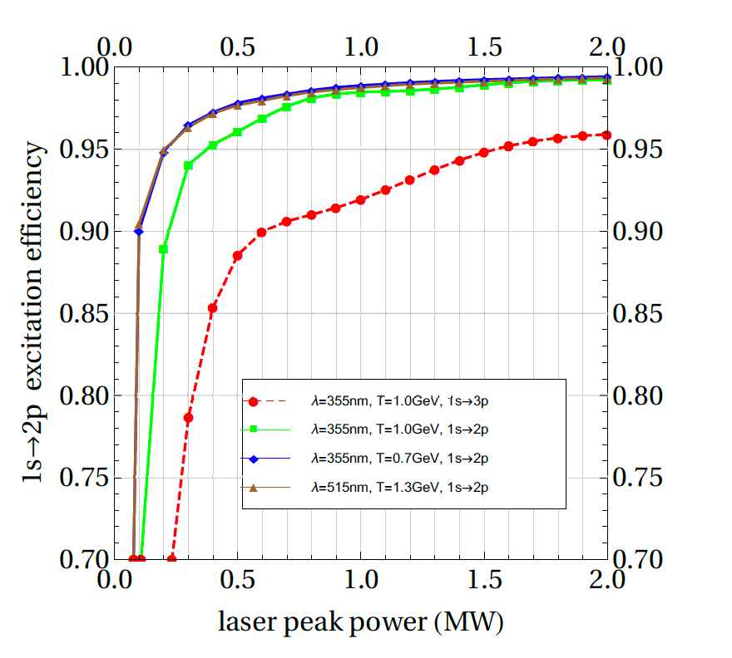
Sequential resonance excitation provides many benefits
First Step n=1→2 is extremely efficient for certain cases:
UV at 700 MeV and Green at 1.3 GeV (blue and brown curves)
Red curve was first experiments at SNS

Slide 14
Two laser-ion interactions in sequential resonance scheme
N
S
e
H⁻
H⁰
e
α
e
e
e
p⁺
e
H^{0*}
S
e
N

Slide 15
Goal: Step 1 of SRE Experiment: Verify n=1→2 transition
wavelength
Intensity
x
$$∆t$$
x
The laser wavelength you observe from the de-excitation will depend on your observation angle.

Slide 16
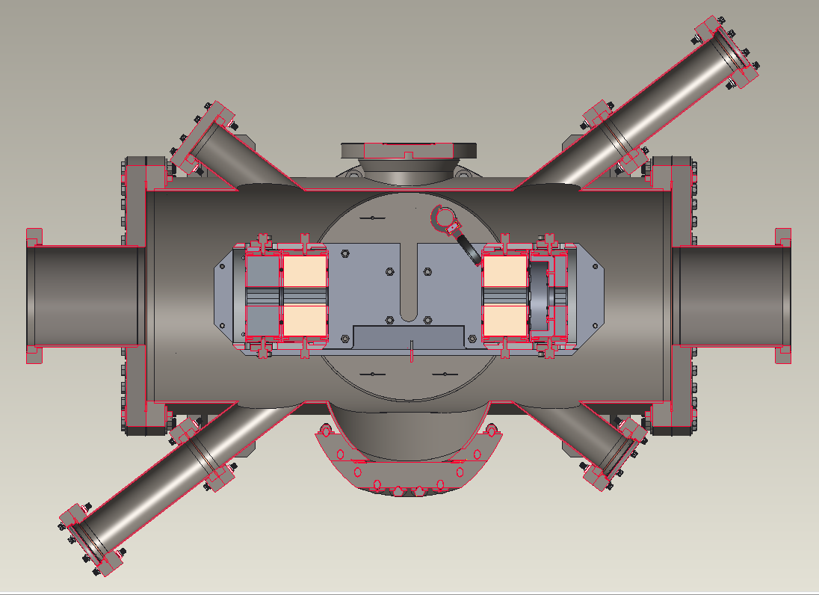
Configuration of first excitation experiment
PMT
H⁻ ion beam
laser beam

Slide 17
Experimental results confirms 1st excitation step
Laser signal
Beam loss
Flourescence (de-excitation)
signal

Slide 18
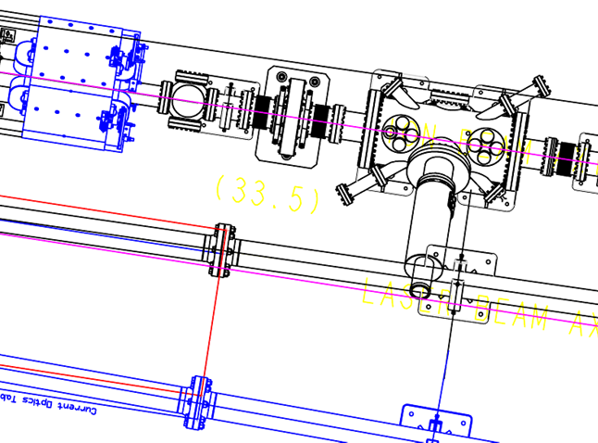
Laser Beam Splitter Will be Used to Make Two Beams for Next Two-Step Experiment
End window
1st Laser Beam
Primary Laser
2nd Laser Beam
Iris
PBS
GE Camera
Iris
PBS
λ/2
Picomotors + Stepper motor

Slide 19
Timeline
2019-2020
2021-2022
2023-2024
2025-2026
Demonstration of 1st step sequential resonance – Done!
Demonstration 2nd step sequential resonance laser-assisted stripping – Design complete, equipment ordered (install July 2020 or Feb 2021)
PPU upgrade to 1.3 GeV @ 2.8 MW at SNS
Install test concept in SNS injection region
Switch to green laser technology and repeat stripping demonstration
Begin design of real injection concept – Postdoc hired in June 2020
Complete design of real injection concept
Test laser stripping for real injection into ring

Slide 20
Laser Stripping as an Opportunity for Painting Freedom
First Thoughts :
No need to separate closed orbit and injection beam reference orbits
Can kick in either angle or position
Smaller magnet apertures?
More compact injection regions?
Optimized distributions for other purposes:
Self-Consistent beams
Smaller emittance beams
Custom distributions (hollow, flat, etc)
Study of resonances with custom distribution
Rethink f(t) away from sqrt(t)
Paint from the outside in?
Paint in several overlapping strokes?
X
X’
t
t
X
X
t
t

Slide 21
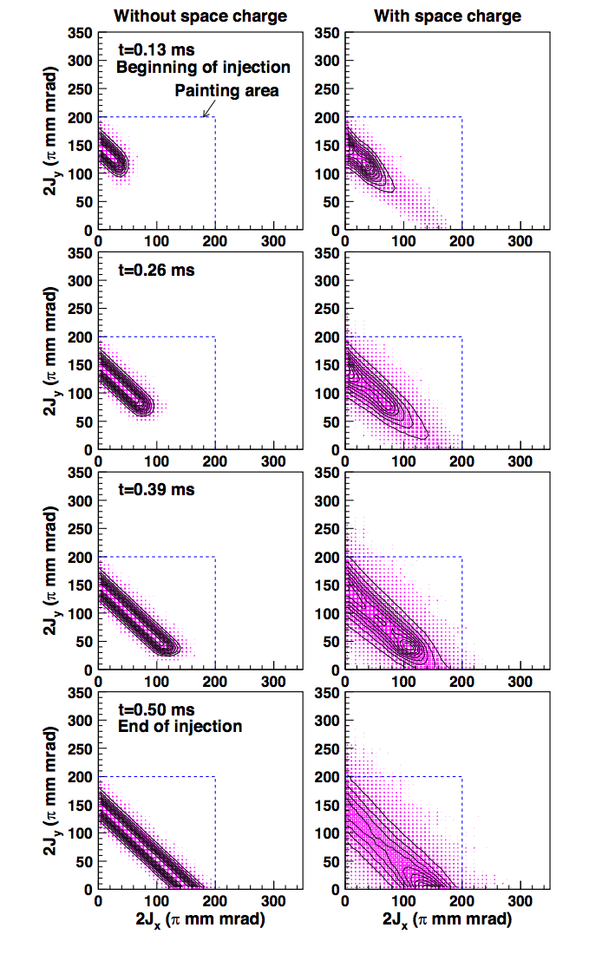
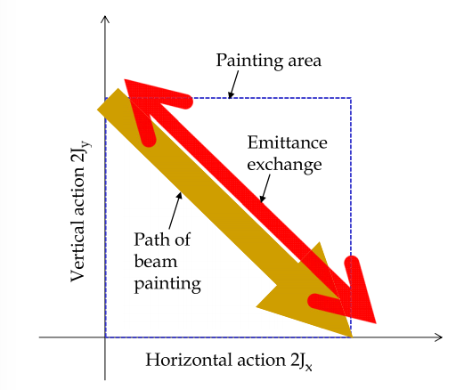
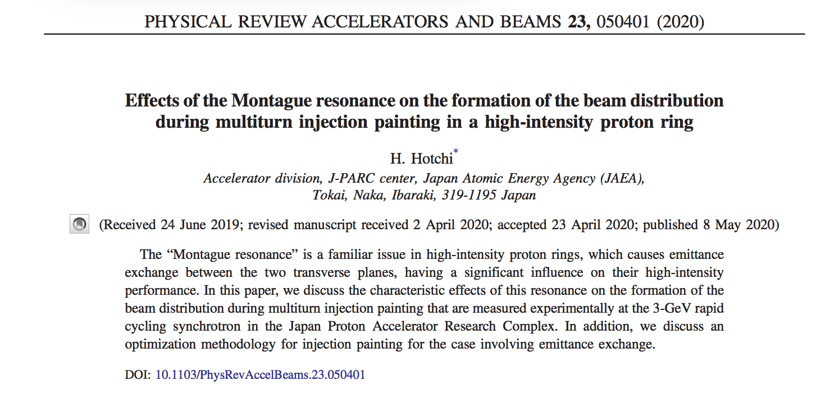
First Example: JPARC Montague Resonance Study with Painting
J-Parc utilized painting to study evolution of emittance in Montague resonance.

Slide 22
Second Example: Painted Self-Consistent Beams
{2,2} Self-consistent rotating distribution (Danilov et al)
All 2D projections give uniform density, linear space charge
Self-consistent painting in normalized coordinates
Figures courtesy A. Hoover (grad student SNS)

Slide 23
Summary
Currently painting is used to satisfy many constraints at the same time
Removing foils from charge exchange removes the main constraint to allow for optimizing for other purposes
Laser assisted charge exchange is feasible from a physics standpoint and is under evolution
New painting schemes can be envisioned without the foil constraint. What do we want?

