Slide 1
“The Curse of Transition Crossing”
in Synchrotrons
W. Pellico
K.Y. Ng,
R. Ainsworth
S. Wolfram
M. Syphers
H. Damerau
Chandra Bhat, Kiyomi Seiya and Jean-Francois Ostiguy
Fermilab, Batavia, Illinois, USA
“Mitigation Approaches for Hadron Storage Rings and Synchrotrons”
ARIES-APEC workshop,
Virtual Workshop, GSI: https://indico.gsi.de/event/10458/page/1098-scientific-program
22 June to 1 July 2020

Slide 2
Outline
Fermilab’s important role in the history of transition crossing
High intensity beam issues at transition.
Mitigation options
Addressing transition issues in our synchrotrons during high intensity PIP-II era

Slide 3
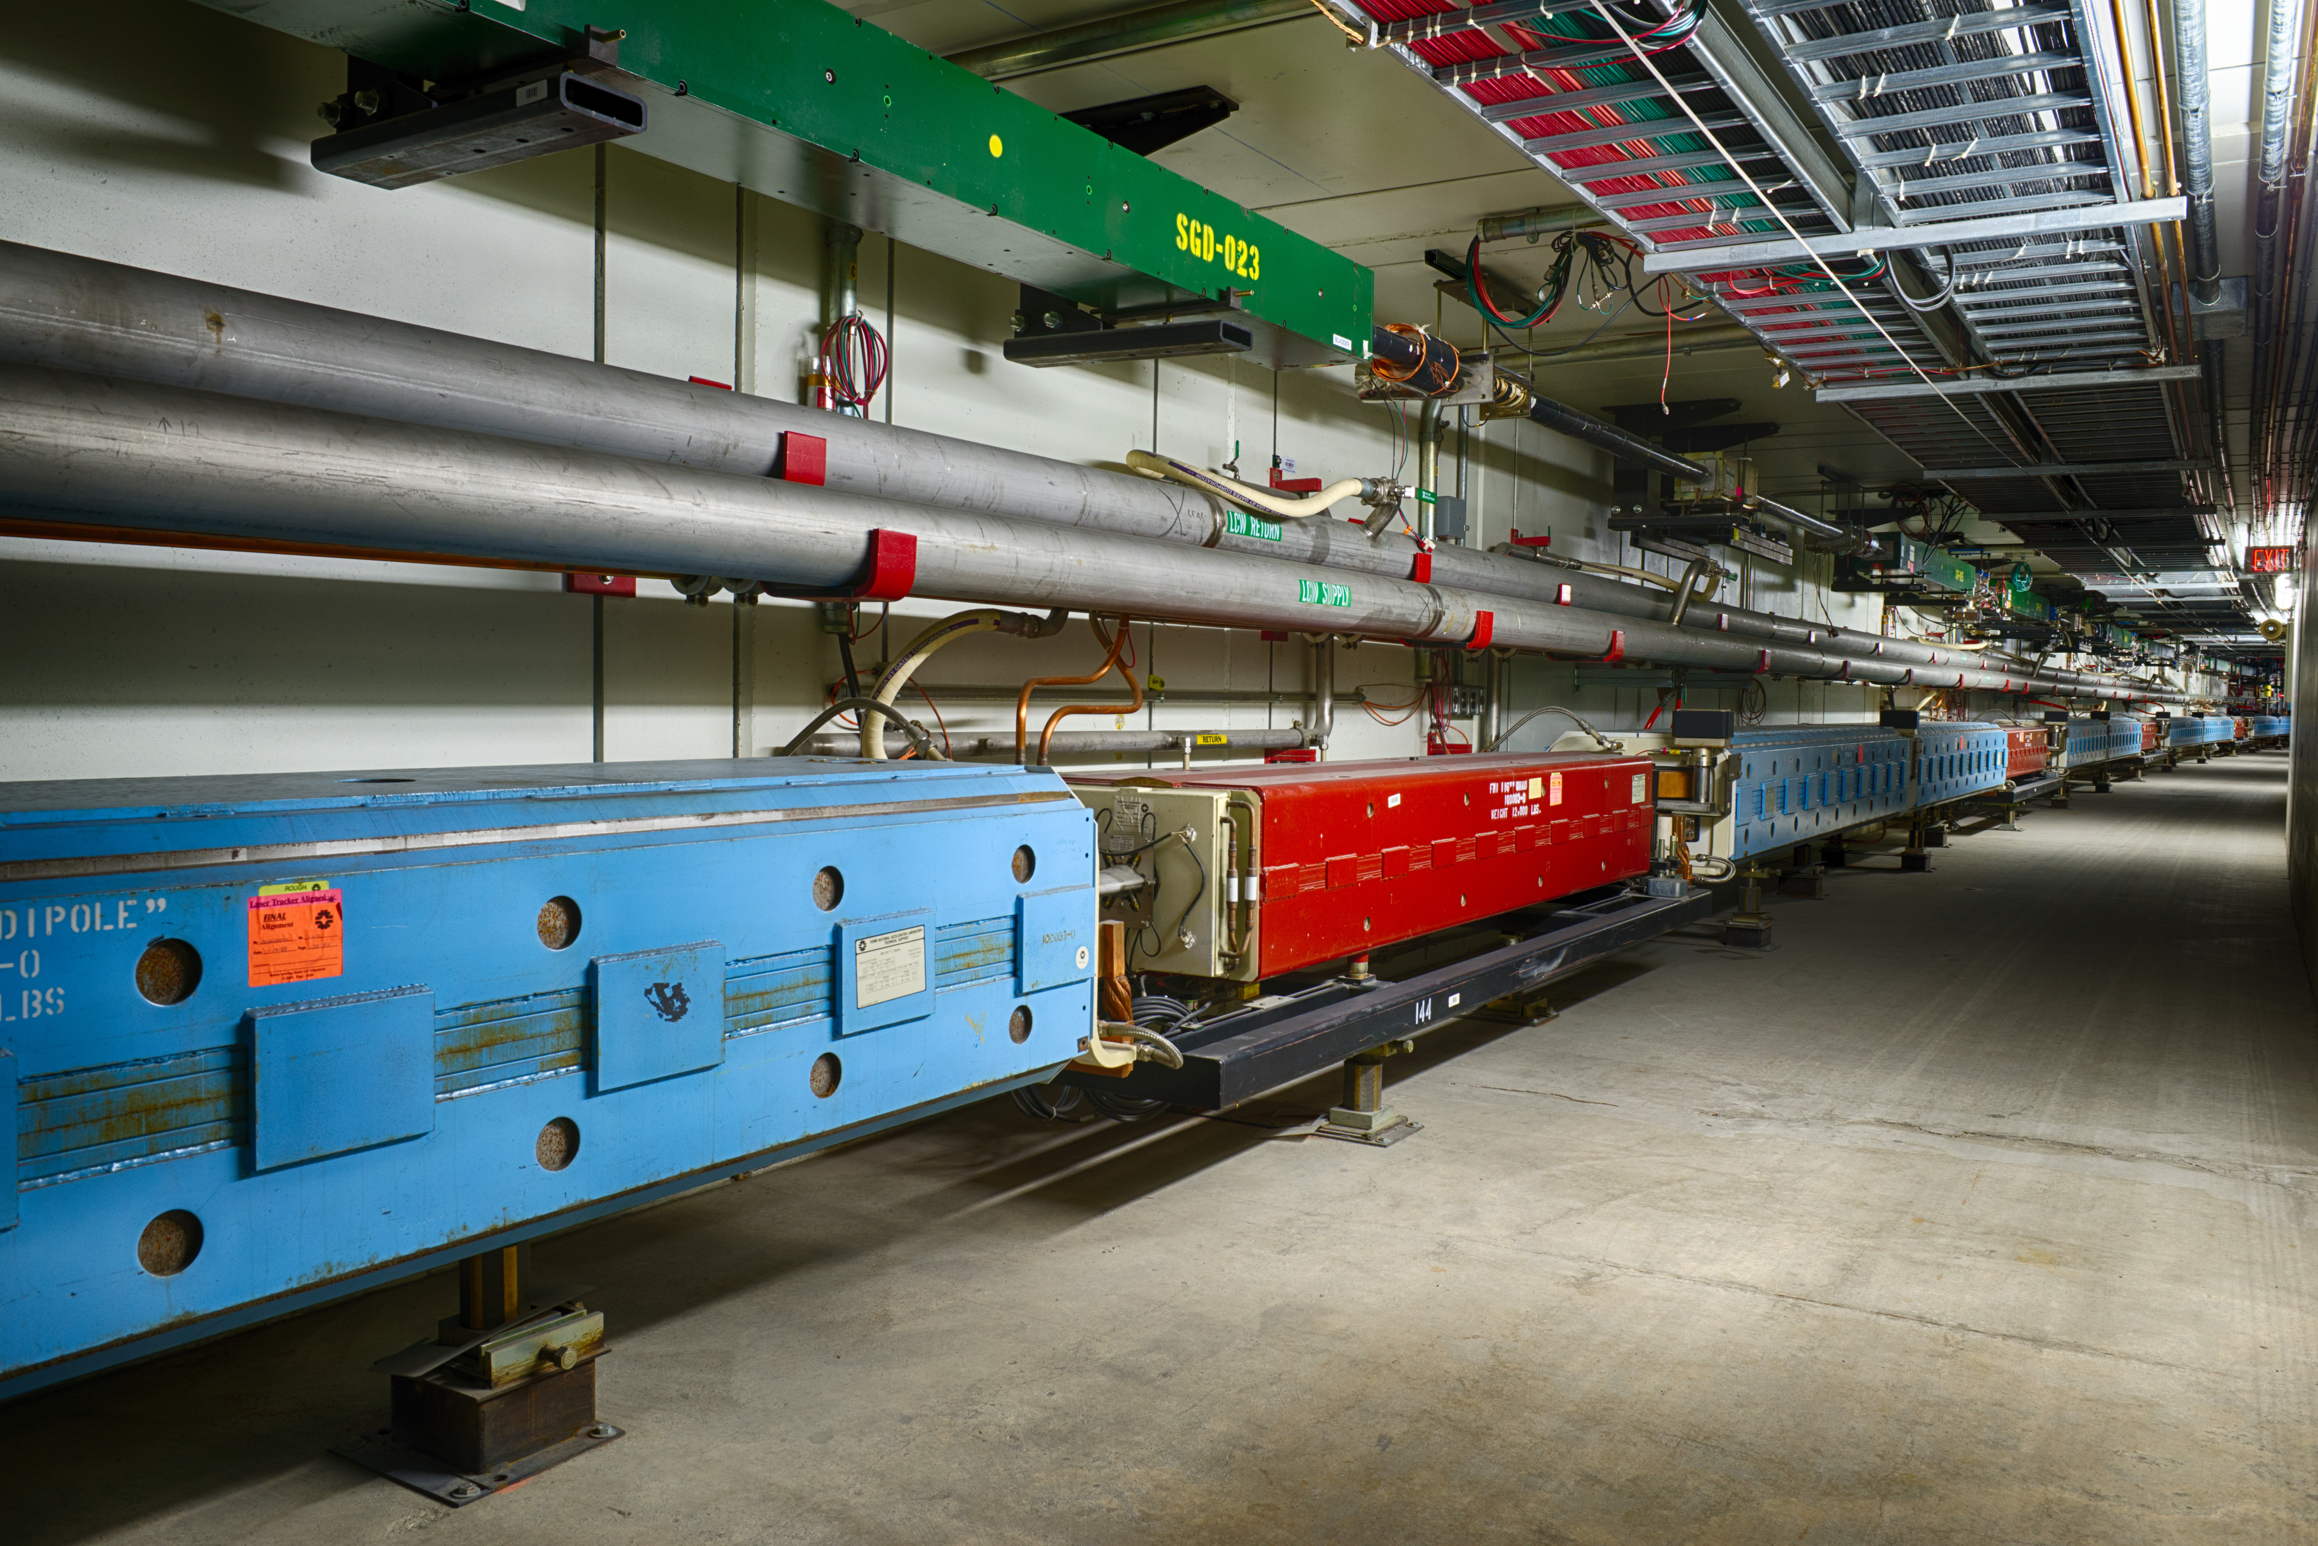
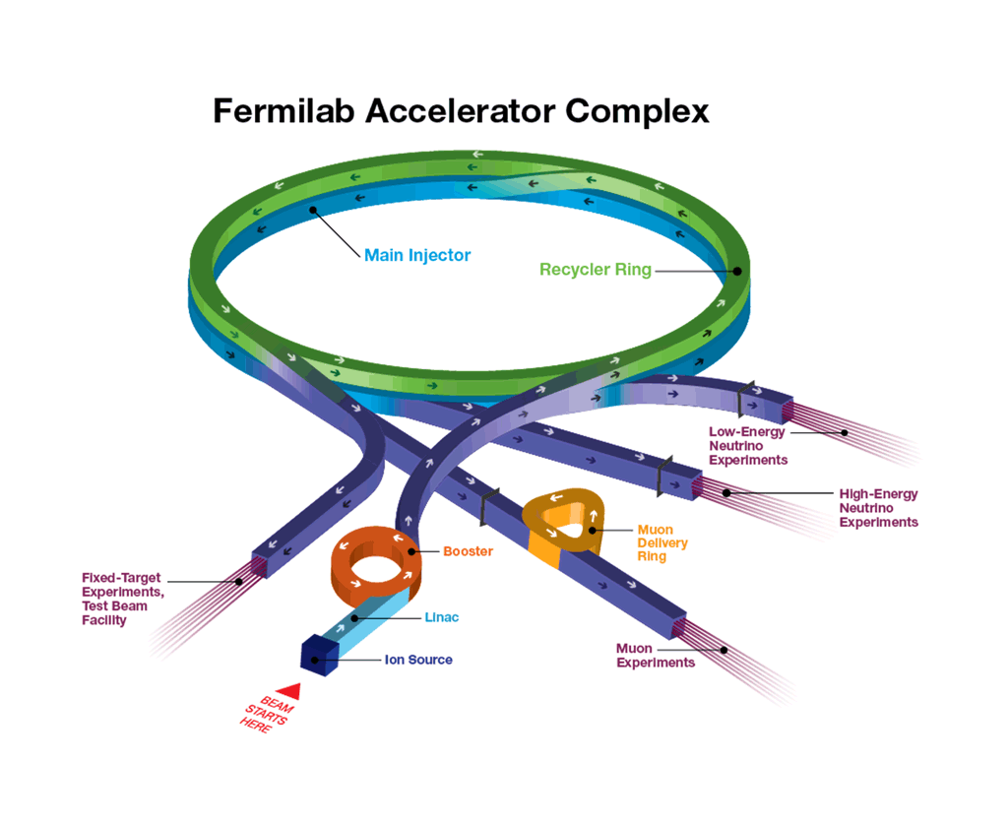
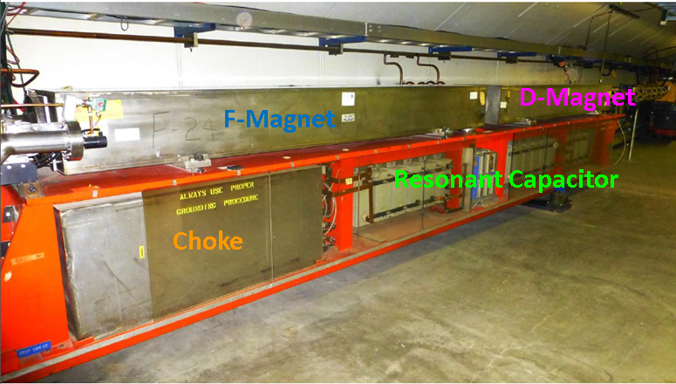
Fermilab Accelerator Complex & Experiments
LINAC
400MeV
Long Baseline Neutrino:
(LBNF/DUNE)
8GeV
Main Injector
 | Booster(RCS) | Main Injector
E (GeV) | 0.4-8 | 8-120
R(m) | 75.4 | 528.7
Beam Cycle | 15(Hz) | 1.2s
$$γ_{T}$$ | 5.47 | 21.65
Beam pipe radius (cm) | No beam pipe | 5.8
Z⎥⎥/n(Ω) | <40* | <10
Slip Stacking
Rebunching
Short Baseline Neutrino:
MicroBooNE, ANNIE, ICARUS (SBND)
Long Baseline Neutrino:
NOvA
Switchyard:
SeaQuest, test beam
(SpinQuest)
Booster
LINAC
400MeV
Ion Source
RFQ
750keV
Muon Campus:
g-2(Mu2e)
2nd Oldest
RCS in the World

Slide 4
Fermilab’s Role in the History of Transition Crossing
“Longitudinal Space Charge Effects at Transition in NAL Booster and Main Ring”. E.D. Courant, FERMILAB-FN-0187,May 20, 1969,
$γ_{T}$-Jump Scheme: “Compensation of Space-charge Mismatch at Transition of Booster using the Transition-Jump Method”, L.C. Teng, FN-207 0400, (1970),
“Beam Bunch Length Matching at Transition Crossing with Space-Charge Forces”, W.W. Lee and L.C. Teng, PAC1971,
“Transition Jump system for the Fermilab Booster”, W. Merz, C. Ankenbrandt and K.Koepke, PAC1987,p 1343, (but removed in 2006)
Focus Free Transition Crossing: “Proposal for Experimental Test of RF Harmonic Transition Crossing in the Main Ring”, J.Griffin and C.M. Bhat, Fermilab Internal Note, MI-0062, (1991); “Transition crossing in proton synchrotrons using a flattened rf wave” C.M.Bhat, J.Griffin,et.al., Phys. Rev. E, Vol. 55, (1997), p.1028,
Imaginary $γ_{T}$ -Lattice for Synchrotrons: “A Transition-less Lattice for the Fermilab Main Injector”, K.Y. Ng, D.Trbojevic and S. Y. Lee, PAC1991, p 159.
Thought about new ways of dealing with $γ_{T}$ crossing

Slide 5
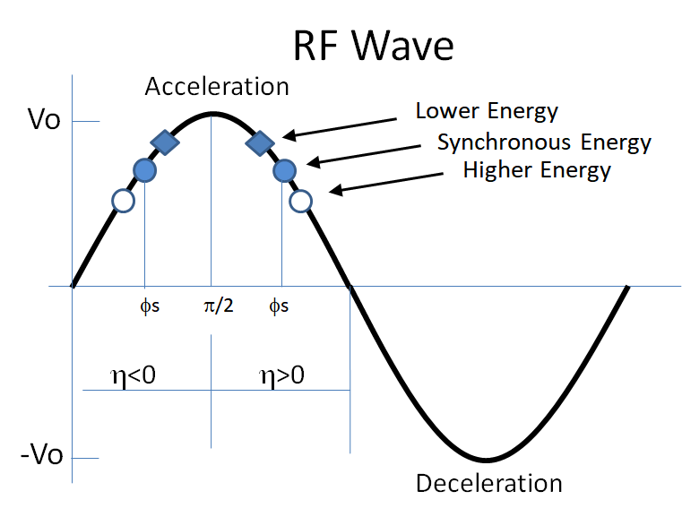
Transition Crossing in a Synchrotron
Transition Energy and What is Transition Crossing?
Particles with different momenta travel along different paths with a revolution period T=C/v
$\frac{∆T}{T}=\frac{∆C}{C}$- $\frac{∆v}{v}=\left(α_{c}−\frac{1}{γ^{2}}\right)\frac{∆p}{p}=η\frac{∆p}{p}\text{= }\left(\frac{1}{γ_{T}^{2}}−\frac{1}{γ^{2}}\right)\frac{∆p}{p}, γ_{T}=\sqrt{\left(\frac{∆p}{p}\right)/\left(\frac{∆C}{C}\right)}$
Momentum Compaction factor
Phase-slip factor
Transition γ
Why Transition Crossing is a Curse?
Beam losses due to large dp/p at transition crossing → Increased beam loading, Space charge effects
Non-adiabaticity around Transition Crossing ←→Disappearance of phase focusing
Johnsen’s effect/non-linear effects
Microwave instability
Negative Mass instability
Umstatter’s Effect
Lattice Issues, Chomaticity-Jump
And Many more ….
In reality the phase jump is not symmetric

Slide 6
Beam Losses due to Large dp/p during Transition Crossing
One can expect beam loss if momentum spread of the beam exceeds momentum acceptance of the machine.
Example:
Fermilab Main Ring
During
Transition
Crossing
dE

Slide 7
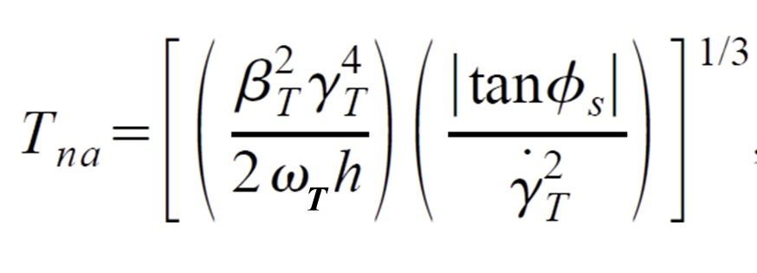
Non-adiabatic and Non-linear Effects in Synchrotrons
Non-adiabatic Time: During transition the synchrotron oscillations of the beam particles are FROZEN for a time interval${ ±T}_{na}$and the longitudinal motion of the particle becomes non-adiabatic,
Johnsen-Effect: Emittance growth due to chromatic non-linearities arising from different particles in a bunch crossing transition at different times. Then the total non-linear time ${±T}_{nl}$ is,
$$T_{nl}=\frac{\frac{3}{2}β_{T}^{2}+α_{1}γ_{T}^{2}}{2{\dot{γ}}_{T}}γ_{T}\hat{δ}$$
$α_{0}=\frac{1}{γ_{T}^{2}}$ and
$$α_{1}≈0.5α_{0}$$
$\hat{δ}$=${\left(\frac{dp}{p}\right)}_{95\%}$
h is harmonic number,
$β_{T} and{ γ}_{T}$ are relativistic quantities at transition,
$ω_{T}$is angular velocity of the synchronous particle,
${\dot{γ}}_{T}$ is the rate of change of $γ$ at transition
$_{s}$ is synchronous phase angle of the bunch
During this time the particles with high and low momenta follow hyperbolic divergent paths.
 | FNAL Booster (PIP/PIPII) | FNAL MI | BNL AGS | BNL RHIC | KEKPS | CERN PS
${\dot{γ}}_{T}$(s⁻¹) | 391(15Hz)/489(20Hz) | 267 | 70 | 1.6 | 40 | 60
$$T_{na}(ms)$$ | 0.213/0.20 | 1.8 | 2.5 | 36 | 1.8 | 1.5
$$T_{nl}(ms)$$ | 0.073/0.08 | 0.2 | 0.6 | 63 | 0.7 | 0.5

Slide 8
Microwave Single Bunch Instability
Generally Microwave single bunch instability is handled using Keil-Schnell -Boussard Criteria for a bunched beam,
SYLee, JWei, LCTeng, JMWang: At $γ≥γ_{T}$ a capacitive ($γ≤γ_{T}$, an inductive) longitudinal coupling impedance Z|| at a “broad-band” frequency will cause a Microwave Instability, if
$$\left|\frac{Z_{||}}{n}\right|≤\frac{2πβ^{2}{(E}_{s}/e)\left|η\right|}{I_{peak}}{\left(\frac{σ_{p}}{p}\right)}^{2}, I_{peak}=\frac{N_{b}e}{\sqrt{2π}σ_{τ}},σ_{τ}=RMS bunch length$$
Because of a small synchrotron frequency spread in this region, Landau damping for microwave single bunch instability vanishes →Keil-Schnell criteria unsuitable
$$D_{||}≈\frac{4hI_{peak}\left|Z_{||}/n\right|}{9V_{RF}\left|\cos\left(φ_{s}\right)\right|σ_{τ}^{2}\left(radian\right)}≥1, I_{peak} and σ_{τ} at Transition Energy$$
V_{RF} is Accelerating RF voltage at Transition Energy

Slide 9
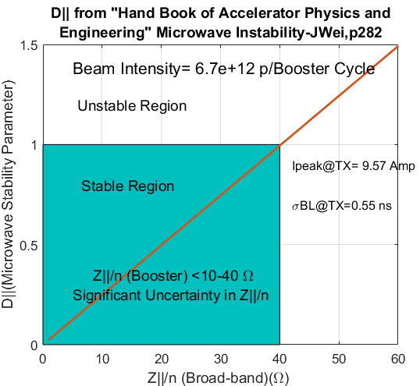
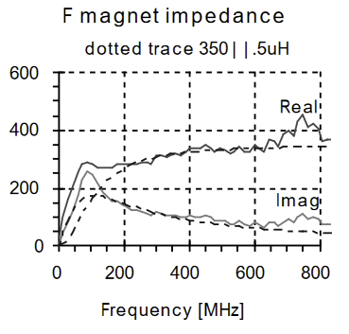
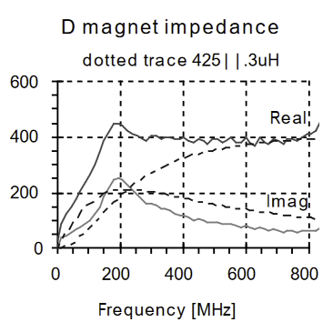
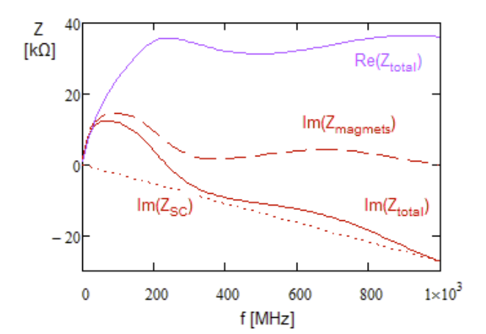
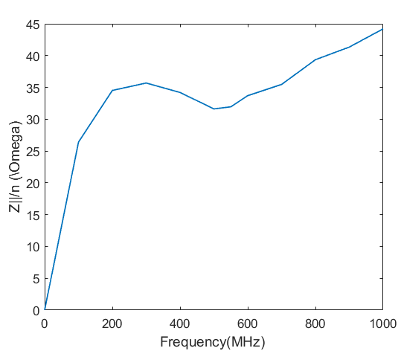
Microwave Single Bunch Instability Limit for Fermilab Booster
Longitudinal Impedance
Measurements: J Crisp,Fermilab-TM-2145, (2001)
Total Longitudinal Impedance
Model: V. Lebedev, BD5146(2016)
Z||/n=40 Ω

Slide 10
Negative Mass instability
Particles with v≈ c can not travel much faster on acceleration but gain momentum and move in orbits of larger radii. Above transition energy, particles that normally repel each other appear to experience an attractive force; this leads to an instability.
According to W. Hardt (Int-Conf-on-HEAccels-Stanford-1974) and K.Ng (FNAL,1994) the net emittance growth resulting from transition crossing is characterized by a critical parameter,
$${ξk}_{cp}{\left(\frac{r_{p}}{R}\right)}^{2}\left(\frac{E_{T}^{5/2}}{h^{1/3}ω_{T}^{4/3}γ_{T}^{2/3}}\right)\left(\frac{N_{b}^{2}g_{0}^{2}{\left|tan⁡(φ_{s})\right|}^{1/3}}{A^{5/2}{\dot{γ}}_{T}^{7/6}}\right)=CP\frac{1}{2}\left[lnN_{b}−ln\left(\frac{k_{b\frac{1}{2}}\sqrt{8π}}{3\sqrt{\frac{1}{2}ln⁡(N_{b})}}\right)\right]$$
If “CP” <1 No blowup due to Negative mass Instability
KYNg,FERMILAB-Conf-94/25
$r_{p}$ is classical radius of the proton, R is radius of the synchrotron.
$N_{b}$ is number of protons per bunch, A= Beam 95% beam emittance
$g_{0}=1+2ln\frac{beam pipe radius (b)}{beam radius (a)},k_{cp}=\frac{γR}{\sqrt{3}}\left(\frac{1.6}{b}+\frac{0.52}{a}\right),$
${k_{b\frac{1}{2}}=\sqrt{3}k}_{cp}\frac{half bunch ength}{πh}$ , $ξ$=4.3494, a numerical constant

Slide 11
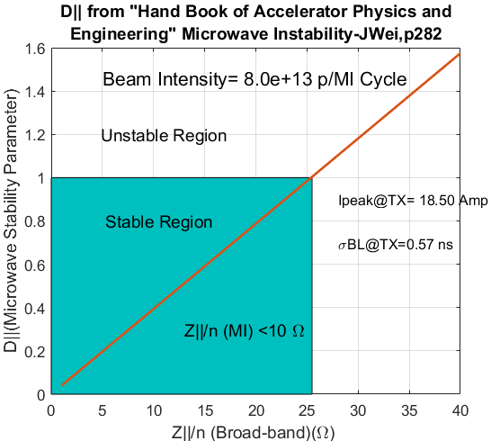
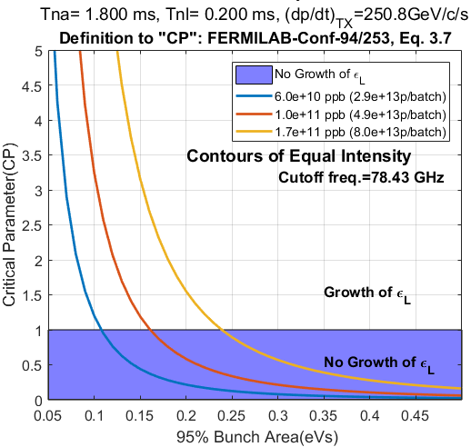
Microwave and Negative Mass Instability Limits in the FNAL Main Injector
${ γ}_{T}$=21.66
CBhat, MI Note 0218, 1997
700kW Beam
1.2MW-Beam
εL=0.11 eVs
εL=0.16 eVs
εL=0.24 eVs
Current emittance

Slide 12
Umstatter’s Effect
The transverse space-charge force changes the tune of each individual particle, making $γ_{T}$ dependent on the azimuthal beam density. Then
$${Δγ}_{T}≈\frac{4hr_{p}R}{2β_{T}^{2}γ_{T}^{4}}\left[\frac{1}{x\left(x+y\right)}−\frac{ε_{1}}{b^{2}}\right]λ\left(0\right),$$
$λ\left(0\right)=\frac{N_{b}}{\sqrt{2π}σ_{τ}hω_{0}}$is linear density at the center of the bunch and
$x \text{and} y$ are transverse beam half width and half height, respectively,
$ε_{1}$is electrostatic image coefficient (Laslett),
Consequently some particles at the center of the bunch will cross transition earlier than synchronous particles by ${ΔT=Δγ}_{T}/(dγ_{T}/dt)≈0.04ms$ for Fermilab Main Injector.
This is much smaller than $T_{na}$ - non-adiabatic time. So, Umstatter effect is negligible.

Slide 13
Mitigation Techniques
$γ_{T}$Jump scheme
Focus free transition crossing (using harmonic cavities, broad-band RF cavities in induction accelerators)
RF Duck-Under ← is done almost at every synchrotron
RF triple jump and other phase jump Techniques
Avoiding $γ_{T}$
Operate the synchrotrons well above the $γ_{T}$
Imaginary $γ_{T}$ Lattice: Total avoidance of transition energy, (issues with imaginary $γ_{T}$lattice)
L. Teng infinite $γ_{T}$
No major lattice change, but, needs good LLRF control

Slide 14
$γ_{T}$-Jump scheme
$γ_{T}$-Jump scheme is a way of crossing transition fast enough to avoid all of the issues mentioned earlier.
This is done by manipulating the focusing properties of the machine. A set of quadrupole magnets are pulsed rapidly to reduce transition crossing to a blip for a period of $≈±\left(T_{na}\text{+ }T_{nl}\right)$
t
t
t
Fermilab Booster
(1987-2006)
CERN PS (since 1969)
 | FNAL Booster | BNL AGS | BNL RHIC | CERN PS
${∆γ}_{T}$ & (Δt msec) | 1 (0.1ms) | 3.5 (2ms) | 1 (40ms) | 3 (0.4ms)
${\dot{γ}}_{T}$(s⁻¹) | 391 | 70 | 1.6 | 60
$${(T}_{na}+T_{nl}) (ms)$$ | 0.28 | 3.1 | 99 | 2

Slide 15
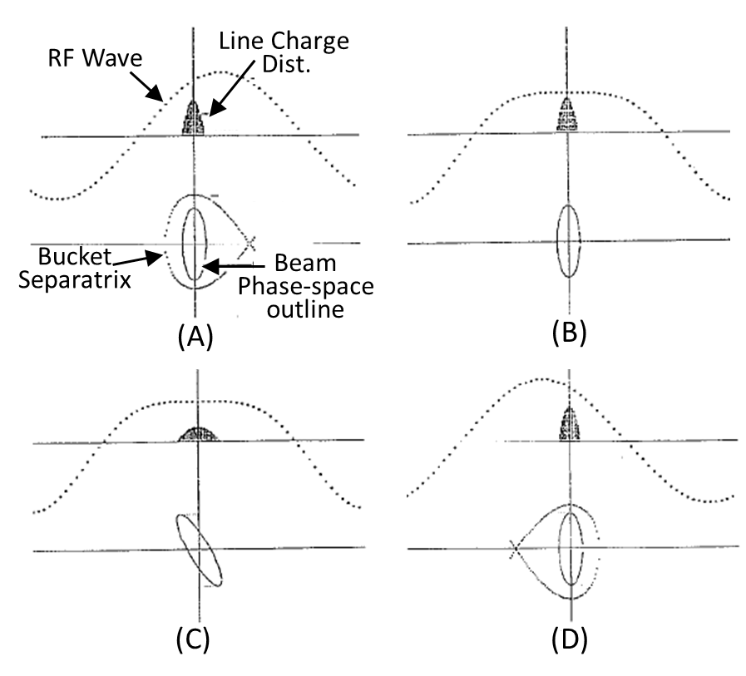
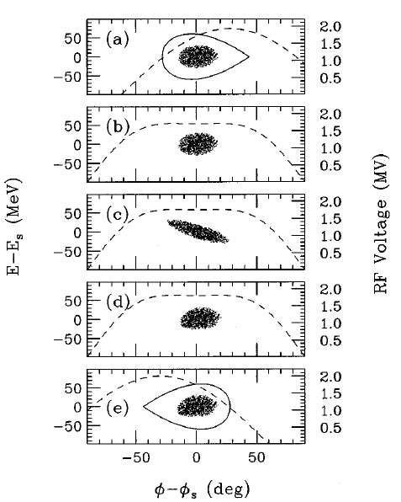
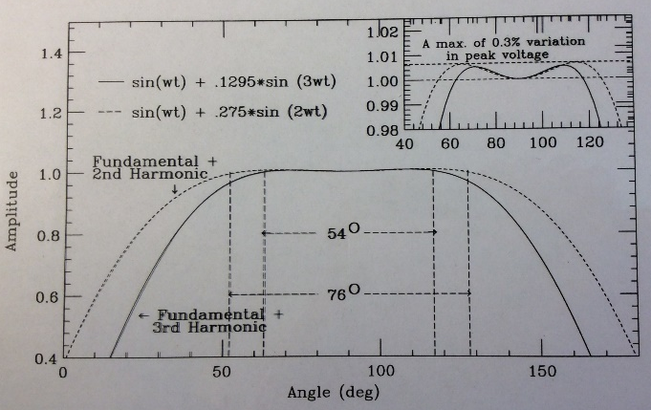
Focus Free Transition Crossing using RF cavities
FFTC is an RF technique to accelerate beam across transition energy.
The rf phase focusing vanishes around the transition energy for a period of $≈±\left(T_{na}\text{+ }T_{nl}\right)$ resulting in growth of momentum spread. This can be controlled using a flattened rf wave that provides constant acceleration to all particles.
ESME Simulations
for 2E10ppb (SC&Imp)
Bhat et. al.,Phys. Rev. E, Vol. 55
2nd Harmonic
3rd Harmonic

Slide 16
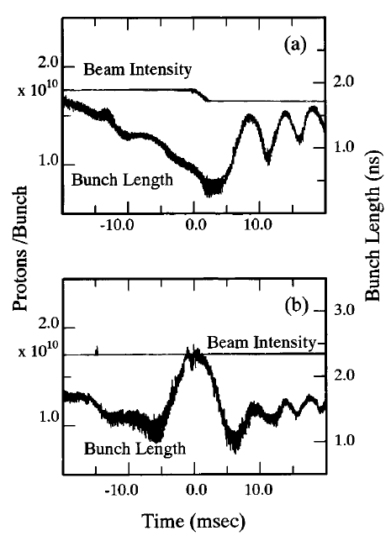
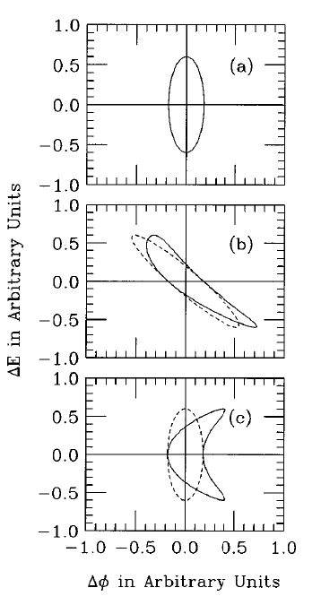
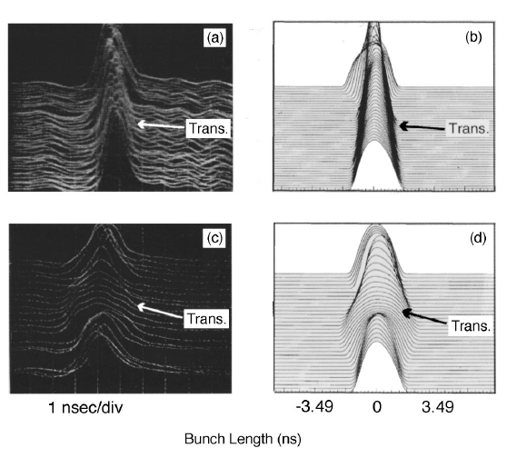
Experiment in the Fermilab Main Ring
${\dot{γ}}_{T}$= 90, $\left(T_{na}\text{+ }T_{nl}\right)≈±$5 ms, V₃/V₁≈ 0.13, with V₃ =270kV, f_{RF} (h=1) ≈ 53MHz
This method is applied in the KEK Induction Accelerator to cross Transition
Cavity from CERN
159 MHz RF
cavity in
the Main Ring
Phys. Rev. E, Vol. 55
NO FFTC
Things get Complicated
NO FFTC
Simulations with and without higher-ordered terms in the slip factor η
→ This mitigation technique has limitations
FFTC
FFTC
Meas. Data
Simulations

Slide 17
Intensity Frontier Efforts at Fermilab

Slide 18
Increasing beam power on 120 GeV neutrino target
PIP*
PIP-PIP II
PIP-II
Target | 700kW** | 900 kW | 1.2MW
Beam line | 1.3E17 pph (NuMI beam line) | 1.7E17 pph (NuMI beam line) | LBNF
Main Injector (MI)/ Recycler(RR) | 4.9E13 ppp 1.333 sec | 5.6E13 ppp 1.2 sec | 7.5E13 ppp 1.2sec
Booster | 4.3E12 ppp 15 Hz | 5.0E12 ppp 15Hz | 6.5E12 ppp 20Hz
LINAC | 25mA | 30mA | PIP-II SC LINAC
*Proton Improvement Plan: PIP
**Record power: 758kW in April, 2019
50% more beam from the Booster
70% increase in beam power from MI

Slide 19
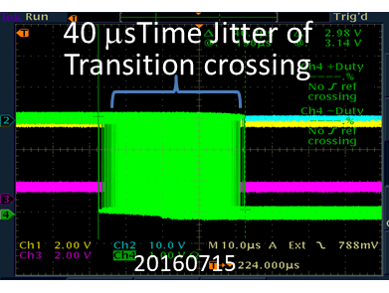
Transition Crossing in Booster (RCS) (history, current and future)
Addressing Transition Crossing in a RCS is not trivial.
Past
Had $γ_{T}$-jump from 1987 -2006
Had ${∆γ}_{T}$ =1, change in 0.1 ms, cross transition ~25 times faster
It didn't help as much as it hurt. Removed in 2006 (Newly developed longitudinal dampers and $γ_{T}$-Jump scheme could not co-exist.)
Current: Issues and Mitigation Techniques
Beam Intensity: 4.3E12-5E12 ppp @Exit
Standard Phase Jump (15Hz)
Issue: Timing jitter (>40 μsec)
Mitigation
Frequency based phase jump
Longitudinal quad damper
Merz et.al., PAC1987,p1343
With $γ_{T}$-Jump asymmetric
$γ$
3 ms
$$γ_{T}$$
t
${∆γ}_{T}$≈1

Slide 20
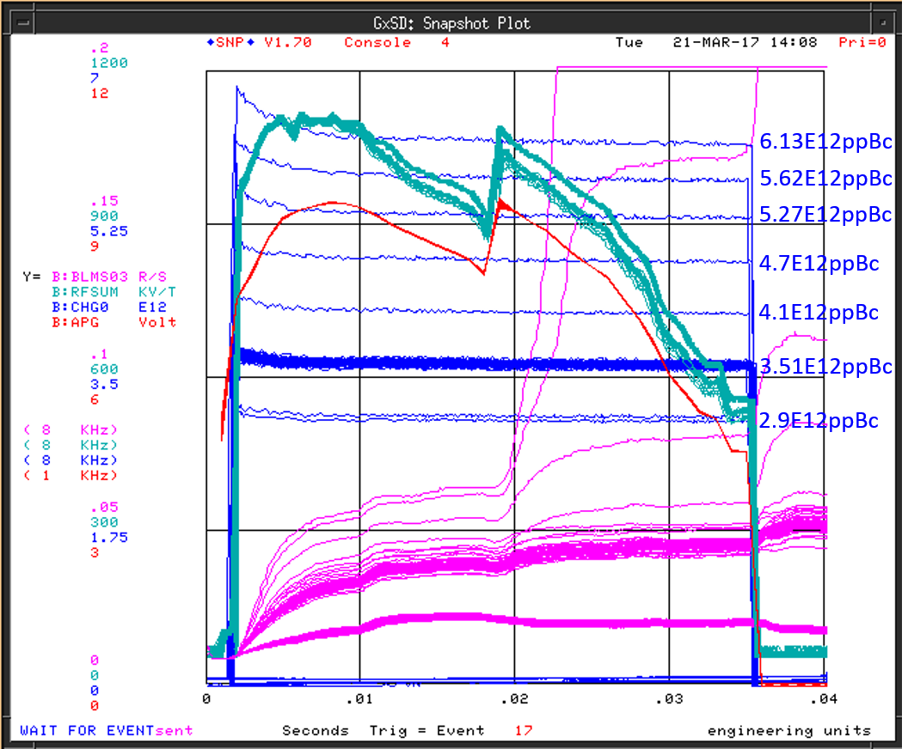
High Intensity Booster Beam through Transition after implementing f_{RF} based Transition Crossing
Inj. to Ext. Efficiency
Mountain Range Plot
of 81 Bunches
at Extraction
91%
Without mode Damper
Operational Intensity
94%
95%
With mode Damper

Slide 21
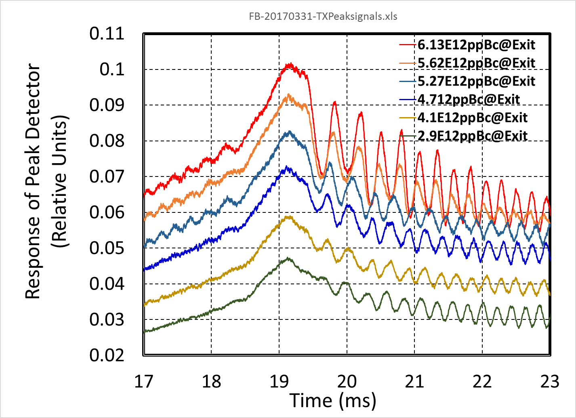
High Intensity Booster Beam through Transition after f_{RF} based Transition crossing (cont.)
Data without Quad Damper
ESME Simulations showed that the observed bunch length oscillations and emittance dilution are primarily due to bunch- to-bucket mismatch after Transition crossing.
Mitigation: LLRF will be improved to make an additional phase jump in addition to normal phase jump of φ→π-φ at transition energy.
(C. Drennan and B. Schupbach)
Current Mitigation Technique: Use of a quad damper

Slide 22
Damping Coupled Bunch Mode-oscillations After Transition Crossing in Booster (Ongoing and Future Mitigation Plans)
PIP-II Requirements
Beam Intensity: 6.5E12 ppp@Exit with ε_{L}(95%)/bunch ≤ 0.1 eVs and (ε_{T} (95%)≤16π-mm-mr)
Standard Phase Jump (20Hz) – no other schemes are in baseline design
Ongoing and Future Upgrade Plans
Quad Digital Damper- in progress
Higher Ordered Mode Dampers: As a side effect of going through transition, bunches become very narrow. The enhanced higher harmonic contents of the beam drives higher order cavity modes- thereby coupled bunch beam modes are excited.
Digital dampers – in progress
Paraphase, RF phase calibration, Digital LLRF Upgrades -ongoing
$\text{Impedance} \text{model} \text{and} \text{simulations}\text{, }\text{ESME}\text{, }\text{BLOND}\text{, }\text{PyOrbit} \text{and} \text{Synergia}$ –in progress
$γ_{T}$-jump using correctors
triple phase jump,
Combination of the above
Lattice modification
Under Consideration

Slide 23
Transition Crossing in the Main Injector (history, current and future)
Past
$γ_{T}$-jump scheme (S. Holmes, S. Peggs, W. Chou,V. Visnjic)
Focus free transition crossing (J. Griffin, C. Bhat, J. MacLachlan, K. Meisner and many)
Transition Free lattice (K.Y. Ng, D.Trbojevic and S. Y. Lee,)
Main Injector Intensity Limitations at Transition, (C. Bhat, MI Note 0218)
Current
Standard Phase Jump; Beam Intensity 4.9E13-5.6e13ppp
Our analysis and experience showed that for intensity ~5-6E13 p/486 bunches (ε_{L}/bunch ≥ 0.2 eVs), transition crossing is not an issue.
f_{RF} based transition crossing since (2001), highly improved LLRF system
Run with high chromaticity
Digital wide-band longitudinal dampers (since 2006)
PIP-II Requirements
Beam Intensity ~8E13 p/486 bunches with (ε_{L}/bunch~0.8 eVs)
Non-linear effects will become an issue
Future Plans
$\text{Simulations}\text{: }\text{Synergia} \text{and} \text{BLOND}$
$γ_{T}$-jump using dedicated pulsed magnets
Transition Crossing is an issue

Slide 24
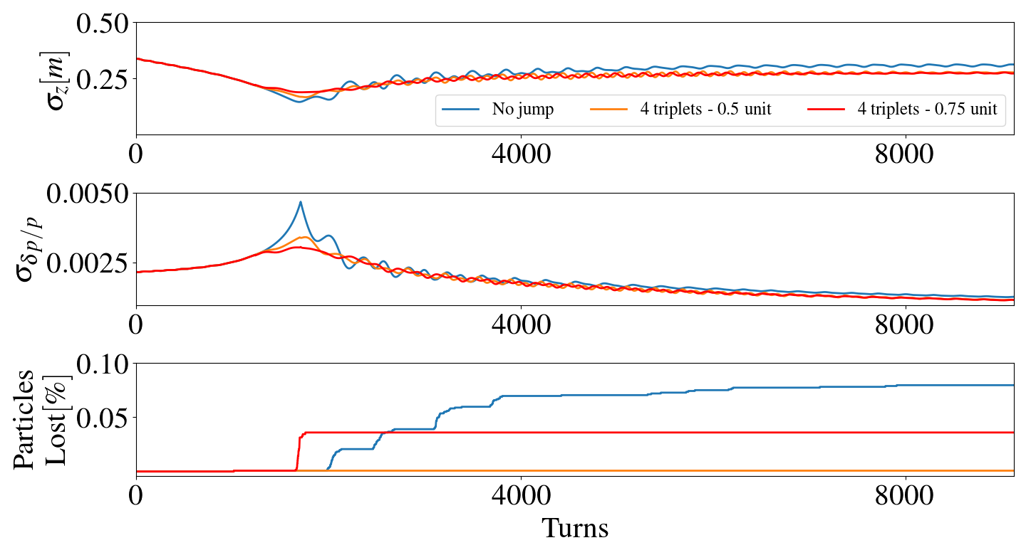
6D Transition Crossing Simulations (including Space Charge effect using PIC code Synergia)
no $γ_{T}$-jump
R. Ainsworth
(IPAC2017,p 3347)
with $γ_{T}$-jump
Horizontal beam size
without $γ_{T}$- jump
Momentum spread
Particle
Loss
Losses seen for the 0.75unit jump
as transverse not longitudinal
Based on PAC1991, p1660
$γ_{T}$- jump will be installed for PIP-II operation.

Slide 25
Summary and Conclusions
“Transition Energy has been both a nuisance in machine operation and a possible blessing… bunches with ultra-small beam width.” – S. Y. Lee
In HEP hadron synchrotrons transition is more a NUISANCE than a Curse.
In this talk we addressed a number of issues one needs to worry about if beam has to go through transition energy.
Fermilab Current and Future Plans for Transition Crossing are discussed
Booster
It is unknown if Transition Crossing will be a problem since there is no “Reliable Modeling”. However, measurements in the Booster indicate that there may not be a problem for the designed that PIP-II intensity.
Continue with standard RF phase jump with improved LLRF system
Efforts are underway to identify issues
Upgrade longitudinal quad dampers and coupled-mode dampers are in place
Work in progress on $γ_{T}$ -jump scheme using existing quad-correctors
Main Injector
Transition Crossing is going to be an issue for PIP-II Intensity
Formal 1st order $γ_{T}$ - jump will be installed for PIP-II operation

