Slide 1
Landau damping in longitudinal plane for single or multi-bunch beams
ARIES Workshop on Mitigations Approaches for Hadron Storage Rings and Synchrotrons
E. Shaposhnikova, T. Argyropoulos, I. Karpov (CERN)
23.06.2020
Thanks to A. Burov, T. Bohl, H. Damerau, J. E. Muller, J. Repond, M. Schwarz

Slide 2
Outline
Introduction
Single bunch
  Loss of Landau Damping in LHC
  Sacherer and Hofmann-Pedersen approaches
  Van-Kampen modes and Lebedev’ equation
Landau damping in a double RF system
Multi-bunch beam
  Stability diagrams in single and double RF
  Bunch-by-bunch Landau damping
Summary

Slide 3
Introduction
Landau damping is a natural mitigation mechanism for beam instabilities
Landau damping is lost when coherent bunch frequency moves outside incoherent frequency band modified by beam-induced voltage
In longitudinal plane, Landau damping of coherent modes is achieved by synchrotron frequency spread ∆ω_{s}, which can be increased by
  increasing filling of the RF bucket
  → minimum RF voltage for a given emittance (limited by particle losses),
  increasing longitudinal emittance
    → controlled emittance blow-up (limited by available RF voltage),
  applying a higher harmonic RF system (in active or passive mode)
Active damping by feedback is needed if these methods are not possible or sufficient

Slide 4
Mitigation of longitudinal instabilities in CERN synchrotrons
Impedance budget control (LHC, …) and reduction programs (SPS, …)
Increasing synchrotron frequency spread by
  controlled emittance blow-up (PSB, PS, SPS, LHC):
    using a high harmonic RF system (PS) or band-limited noise
  multi-harmonic RF systems:
    SPS (and PSB)
    tested recently in the PS
    considered for HL-LHC
Active damping system in longitudinal plane exists only in PS (dipole mode, upgrade to quadrupole ongoing). In all machines: feedbacks for impedance reduction around fundamental RF frequency (beam-loading + instabilities)

Slide 5
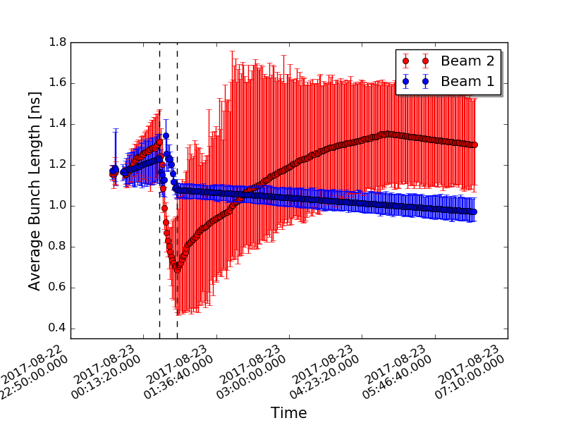

Longitudinal beam stability in LHC
Measured average bunch length during cycle
LHC Design Report: nominal intensity N = 1.0x10¹¹ p/b
From the criterion (F. Sacherer, 1973)
δω_{c} < ∆ω_{s} /4
  with ImZ/n = 0.28 Ohm, 4σ =1 ns, V=16 MV at 7 TeV: N_{th} = 2.4x10¹¹ → natural Landau damping is sufficient,
  no dedicated wide-band feedback (D. Boussard et al, 1999, “Is a longitudinal feedback system required for LHC?”)
To avoid LLD during ramp → emittance ε ~ E^{1/2} or
Much lower LLD threshold was measured: N_{th} = 2.0x10¹¹ for 4σ =1 ns, V=16 MV (scaled to 7 TeV) and ~3 times smaller ImZ/n = 0.09 Ohm
ramp
since
→ τ = const
Beam 1: controlled blow-up: τ = const
Beam 2: emittance blow-up didn’t work
→ instability during acceleration ramp

Slide 6
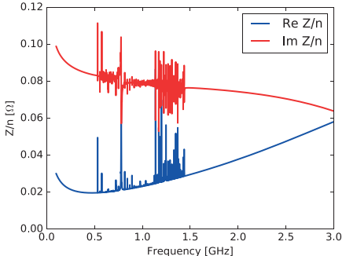
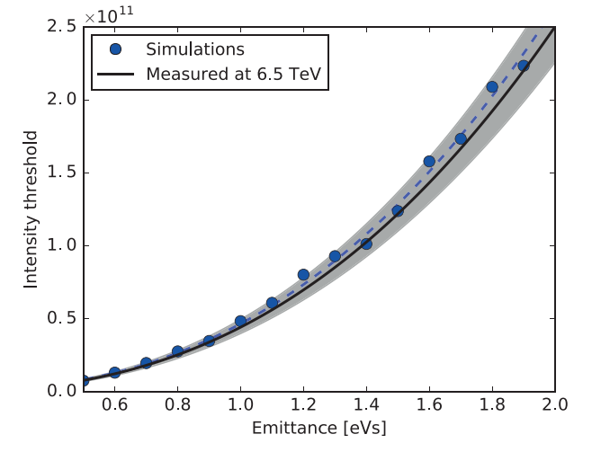

Landau damping in LHC
Measured bunch profiles and their fit with μ = 2
Measured & simulated
LHC threshold intensity
LHC impedance model
450 GeV
N_{th} ~ ε^{5/2}
12 MV
6.5 TeV
Similar simulation results for full impedance model (N. Mounet, 2015) and ImZ/n = 0.09 Ohm
BLonD simulations using full impedance model and bunches with μ = 2 agree with measurements
(PhD thesis J. E. Muller, 2016)

Slide 7
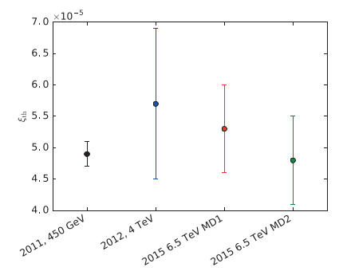
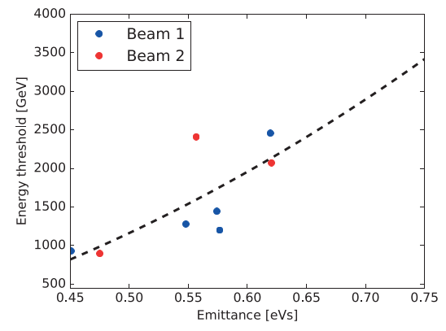
Landau damping in LHC
Measurements in LHC
→ Expected scaling with energy, voltage and bunch length (small range) works in LHC with
ξ_{th} = (5.0±0.5)10⁻⁵ (ns)⁵V
on flat bottom, flat top and during cycle
= ξ
ε ~ E^{1/2}
(PhD thesis J. E. Muller, 2016)
What about absolute values for the threshold?

Slide 8
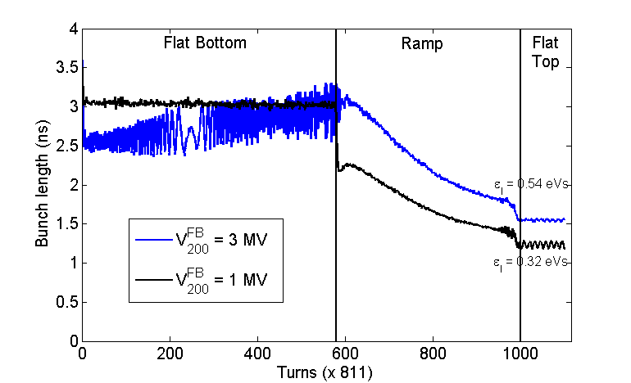
Longitudinal beam stability in the CERN SPS
Measurements: single bunch during cycle in a single RF system
Sacherer’ criterion for ImZ/n = const
predicts a factor 10 higher impedance threshold at injection (26 GeV/c, 2 MV) than on flat top (450 GeV/c)
Measurements: similar thresholds ~1x10¹¹
Good agreement between measurements and simulations (with rotated PS bunches and full SPS impedance model).
Calculations
→ Voltage reduction stabilizes the beam
→ Bunch with smaller emittance becomes unstable later in the cycle
Cycle time [s]

Slide 9



Sacherer formalism (1/2)
General matrix equation (F. Sacherer, 1971) was derived from linearised Vlasov equation.
Dispersion equation was obtained for “synthetic kernel” assuming a rigid bunch motion
and Ꜫ =
Coherent frequency shifts δω_{c,m} are calculated from general matrix equation for spread ∆ω_{s} = 0 and effective impedance Z_{eff}
where
Stability diagrams for binomial particle distribution functions
  → No LD with μ ≤ 1 for η ImZ/n < 0 (space charge above transition)

Slide 10

Sacherer formalism (2/2)
Criterion for the loss of Landau damping was found for a parabolic bunch (μ = 0.5)
From stability diagram for μ = 0.5 and dipole mode (m=1) → [δω_{c}/ ∆ω_{s}]_{stab} = 2/3
The popular criterion δω_{c} < ∆ω_{s} /4 is obtained when the stability limit for μ = 2 (“smooth” distribution) is replaced by a semi-circle with radius [δω_{c}/ ∆ω_{s}]_{stab} = 0.25
Analytical solutions for ∆ω_{c} exist for some distribution functions (Gaussian, binominal with μ = 0, 0.5, 1) → consistent approach only when used together with the exact [δω_{c}/ ∆ω_{s}]_{stab.} Difficulties due to necessity to include the incoherent frequency shift.

Slide 11
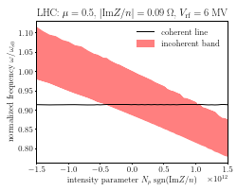


Hofmann-Pedersen formalism
Self-consistent analytical solution for ω_{sc} and ∆ω_{s} for μ = 0.5 and ImZ/n=const
  rigid bunch motion (also)
  coherent frequency calculation: spread ∆ω_{s} is included
  → non-zero threshold for η ImZ/n <0
Threshold for loss of LD
with F = π⁴/30 for short bunches is ~ 30% higher than F = π²/4 from Sacherer criterion for m=1 and μ = 0.5 since [δω_{c}/ ∆ω_{s}]_{stab} = 2/3

Slide 12
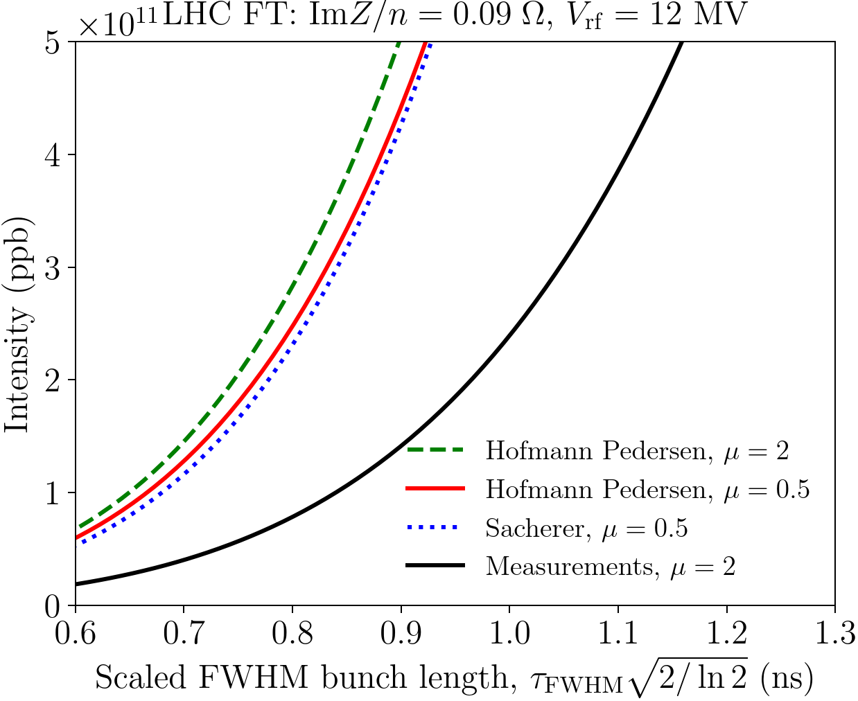
Comparison of loss of LD thresholds for LHC
Expected from Sacherer’ criterion scaling with energy, voltage and bunch length seems to work, but
→ The thresholds predicted from Sacherer’ stability diagrams and Hofmann-Pedersen approach are 3 – 4 times higher than measured and simulated thresholds.
The discrepancy cannot be explained either by
by different particle distribution: thresholds for different distributions are similar for the same FWHM bunch length
by “missing “ impedance due to good agreement between measurements and simulations
→ More accurate methods should be used based on Van Kampen Modes (A. Burov, 2010) or Lebedev equation

Slide 13
Landau damping: Van-Kampen modes
More accurate method (A. Burov, 2010): find Van-Kampen modes solving Vlasov equation for a perturbation of a stationary distribution expanded as (Oide & Yokoya, 1990)
Substitution into linearised Vlasov equation gives the following equation
(which is then transformed into matrix equation by replacing integration over Ꜫ by a sum)
where
Continuous spectrum - singular modes from incoherent band. Discrete modes - coherent solutions described by regular eigenfunctions → their existence outside incoherent band serve as criterion for loss of LD

Slide 14








Lebedev equation
Matrix equation (A. N. Lebedev, 1967) in variables with
where and normalisation
Finally,
where is a solution of equation
where
Affects stability in double RF system!

Slide 15





Sacherer dispersion equation as a low-frequency limit
In a single RF, for short bunches
For Bessel function J_{m} can be replaced by
or
Then, for uncoupled modes m, eigenfunction Is solution of
Lebedev’ equation for mode m → Sacherer’ stability diagram with synthetic kernel used for m > 0
This equation is valid for low frequency impedances with f < 1/(π𝜏) (𝜏 - bunch length)
with effective impedance
The “effective” impedance doesn’t converge for ImZ/n=const

Slide 16
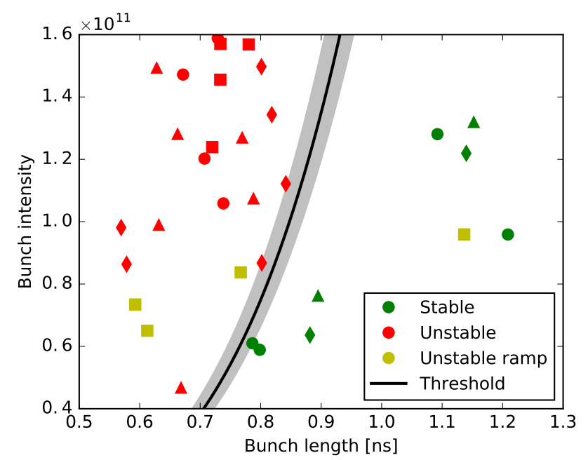
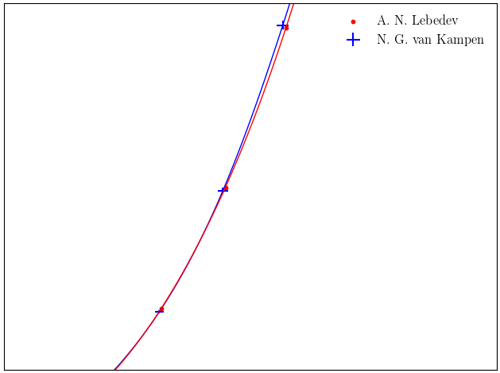
Van-Kampen modes vs Lebedev equation
Loss of Landau damping in LHC: comparison of calculations and measurements
Solution for ImZ/n = const does not converge → physical impedance model should be used.
The results depend on cut-off frequency for ImZ/n = const or resonant frequency of the broad-band impedance model → study ongoing
Good agreement with measurements for μ=2 and b-b impedance: f_{r} = 5 GHz, Q = 1, ImZ/n = 0.076 Ohm, f_{cut} = 20 GHz
→ For HL-LHC nominal bunch length was increased to 1.2 ns
A. N. Lebedev
N. G. van Kampen
→ Code MELODY (I. Karpov, 2019) solving numerically Lebedev equation gives the same thresholds as from Van-Kampen modes
In this case the effect of potential well distortion is < 10%

Slide 17
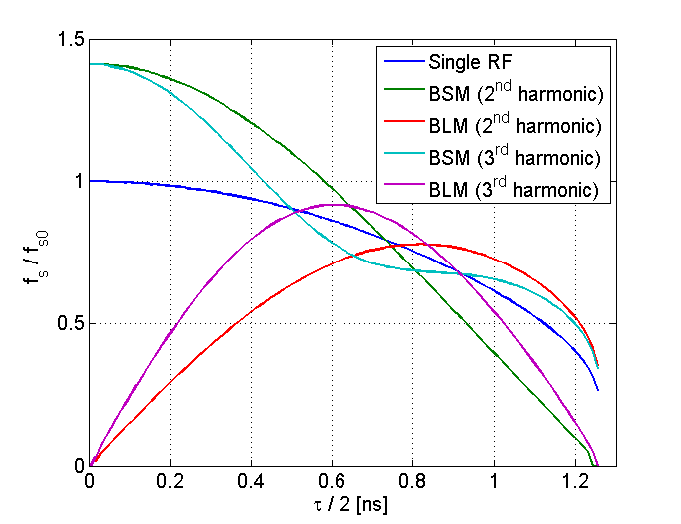
Landau damping in a double RF system
Synchrotron frequency distribution
400
Total voltage in a double RF system:
V = V₁sinφ +V₂ sin(nφ + Φ₂) (nV₂/V₁ < 1)
Maximum change in ω_{s}(0) for Φ₂ = φ₂ – n φ_{s}
Above transition:
φ₂ = 0 - BLM (Bunch-Lengthening Mode)
φ₂ = π - BSM (Bunch-Shortening Mode)
BLM: “flat” bunches, increased bucket, larger spread for V₁/V₂ = n, but region with ω’_{s}(Ꜫ) = 0 exists for any V₂ /V₁ (V. Balbekov, S. Ivanov, 1987) + high sensitivity to error in Φ₂
→ only BSM works for LHC beam in the CERN SPS (n=4), and in PS (H. Damerau et al.)
Lower is n, point ω’_{s}(Ꜫ) = 0 is further away from bunch center
400 MHz RF
→ For short bunches, ∆ω_{s} is significantly increased
(by ~ 10/φ_{b}²) with optimum n ~ 5/φ_{b} (φ_{b} = hω₀𝜏/2)

Slide 18
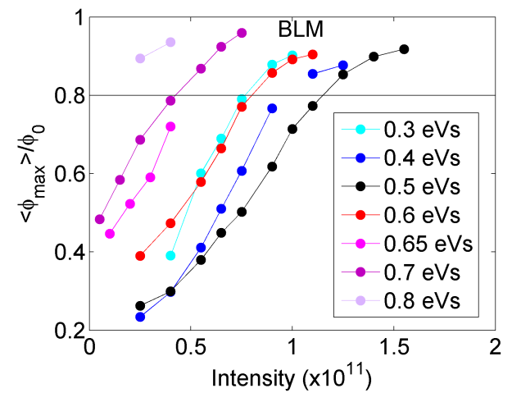
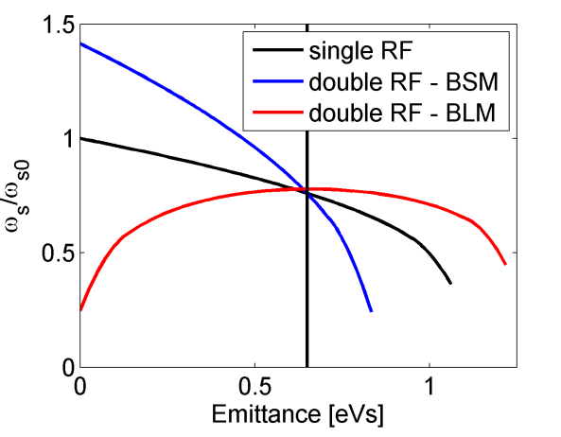
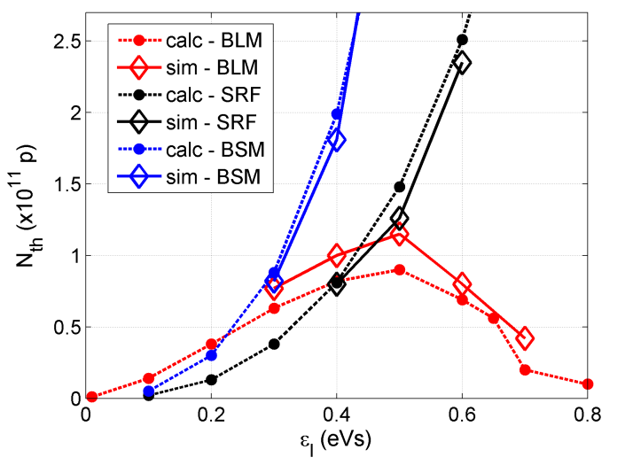
Double RF system: single bunch stability
Oscillation amplitude normalised to the kick amplitude
Thresholds from Van-Kampen modes
and simulations for ImZ/n = const
(inductive impedance above transition)
In simulations the criterion for LLD needs to be chosen (0.8)
→ For n=2, long bunches are more stable in BSM.
Different behaviour below transition (simulations O. Boine - Frankenheim, T. Shukla, PRST AB, 2005)?

Slide 19
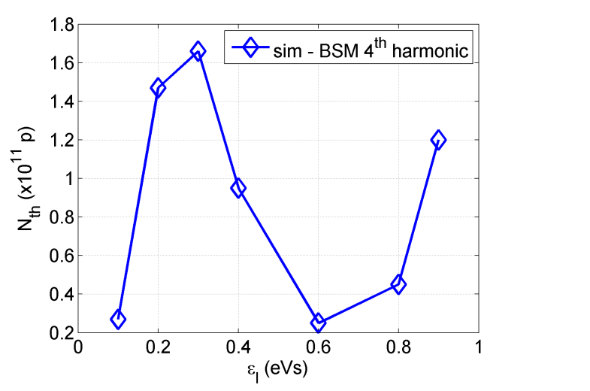
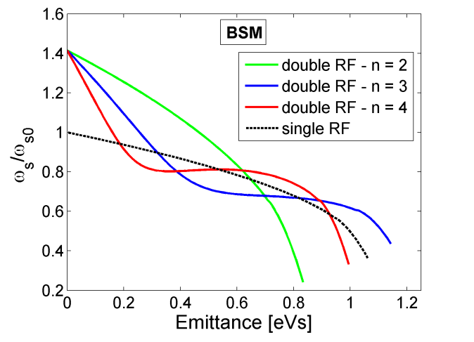
Landau damping in BS-mode for n > 2
Synchrotron frequency distribution
in BS-mode for various n
Threshold from particle simulations
(T. Argyropoulos, PhD thesis, 2015)
→ Flat portion in ω’_{s}(J) appears for n>2
Stability in BSM can be improved by phase shift, also in BLM (T. Argyropoulos, A. Burov, E.S., IPAC’12)
BS-mode with n=4 and V2/V1=n,
V1=0.6 MV @100 MHz , SPS @26 GeV/c

Slide 20

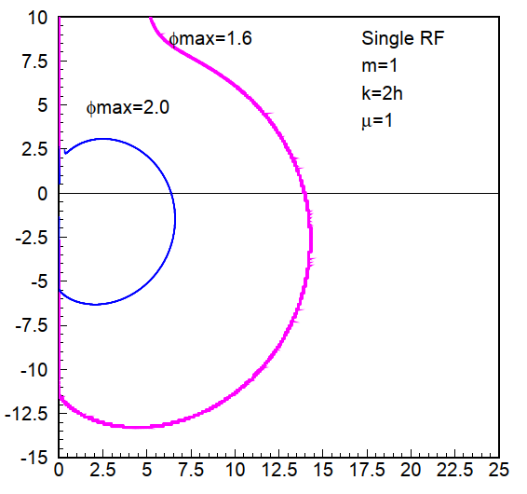




Landau damping for multi-bunch beam
Stability diagram for
For narrow band impedance with ω_{r}, only one resonant harmonic k_{r} = ω_{r} /ω₀ = lM + n can be kept (M - number of equidistant bunches) in Lebedev equation:
From stability diagram
(V. Balbekov, S. Ivanov, 1987):
unstable
stable
with
and
→ Beam is stable if vertical line 1/R_{sh} is inside stability region

Slide 21
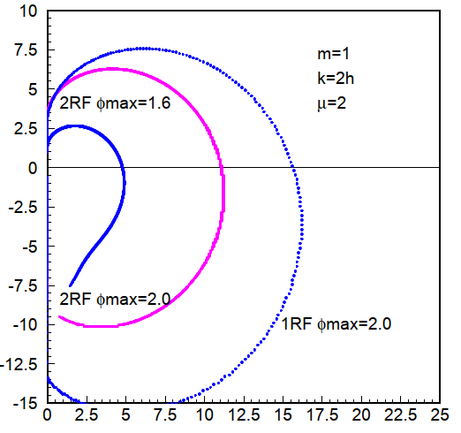
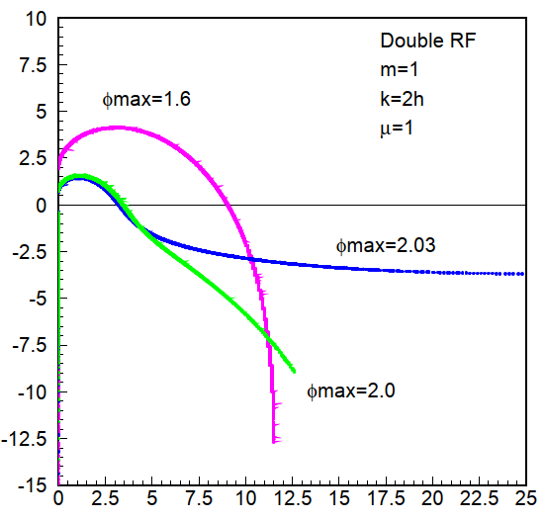

Landau damping for multi-bunch beam: stability diagrams in single and double RF
Stability diagrams (m=1) for μ = 1 and 2 in 1RF & 2RF (BLM) for various φ_{max}
The instability threshold
→ Strong dependence on ω’_{s}/F’
Distributions with non-zero function F’
at the edge are more unstable (μ < 1)
Note that many modes m are excited simultaneously in the BL-mode (not in BS-mode) since
μ= 2: R_{th} in double RF system (BLM) is higher than in single RF
μ= 1: R_{th} in double RF system is decreasing with emittance

Slide 22
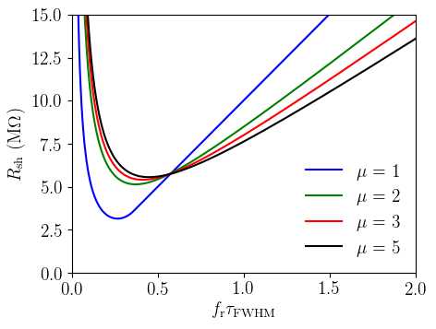

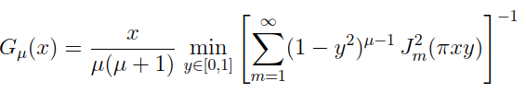
Multi-bunch threshold
In single RF system the threshold (no acceleration)
Only the FWHM bunch length is important
Lebedev matrix equation allows analysis of beam stability with both narrow and broad-band impedances.
where
Threshold R_{sh} for coupled-bunch instabilities in FCC-hh at 50 TeV for nominal intensity N_{b}=10¹¹, V = 38 MV, γ_{t} =99.3 (I. Karpov, E.S., IPAC’19)

Slide 23
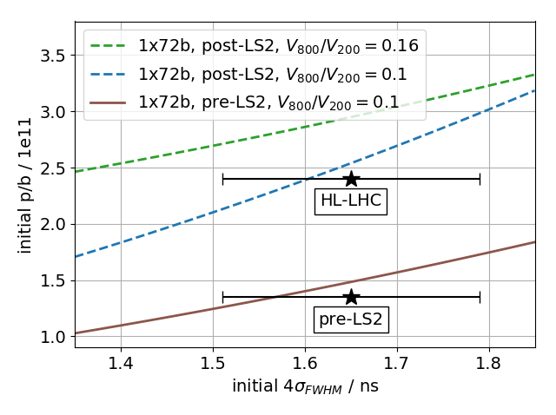
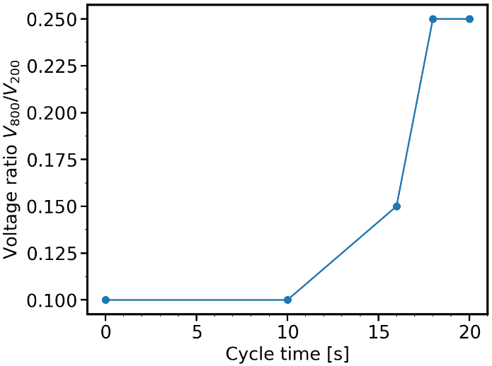
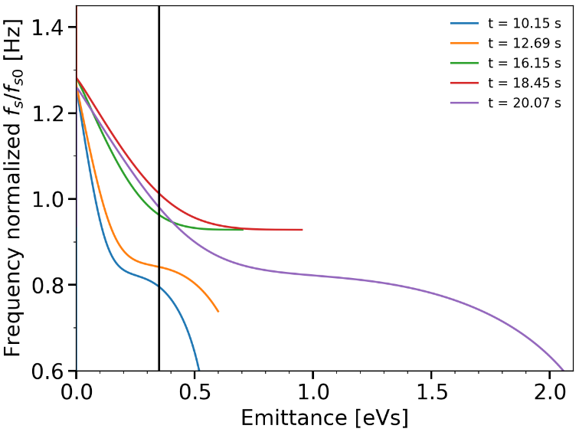
Stabilisation of LHC proton beam in CERN SPS
Bunch intensity should be doubled after RF upgrade, HOM damping and impedance reduction
The LHC beam in SPS is stabilised by the 4th harmonic RF system (~ factor 4 in threshold). → Extra stability margin by optimising the 800 MHz voltage program (V₄ /V₁ = 0.1 used before)
V₈₀₀ = 0.15 V₂₀₀
Optimum V₈₀₀/V₂₀₀
ratio during SPS cycle
SPS @450 GeV
Increasing V₈₀₀ improves stability, …
but only towards the end of the ramp
→ higher bunch intensities were stabilized and injected into LHC

Slide 24
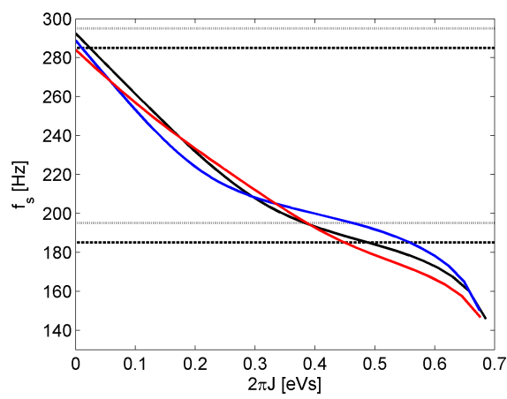
Intensity effects and controlled emittance blow-up in a double RF
bunch position
Strong beam loading in main SPS RF system (even with OTFB) shifts a relative phase between 2 RF systems (200 & 800 MHz) and bunch positions
  Synchrotron frequency spread and Landau damping is varying from bunch-to-bunch
  Optimum noise frequency band is different for each bunch…
- initial
- after BUP
- at flat top
bunch number:
k=1
k=36
k=72
Potential well distortion also shifts incoherent frequency band ~ N/𝜏³
bunch length

Slide 25
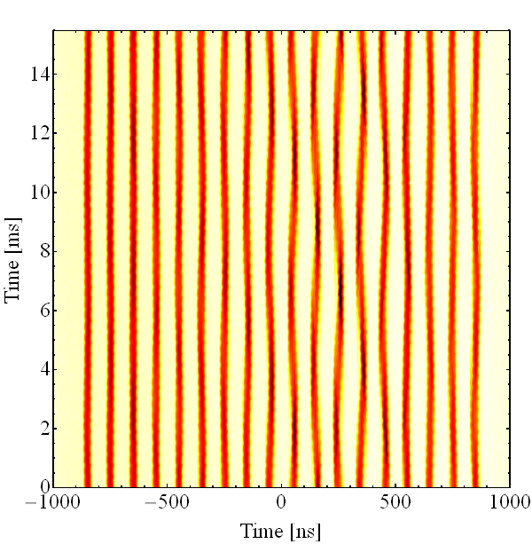
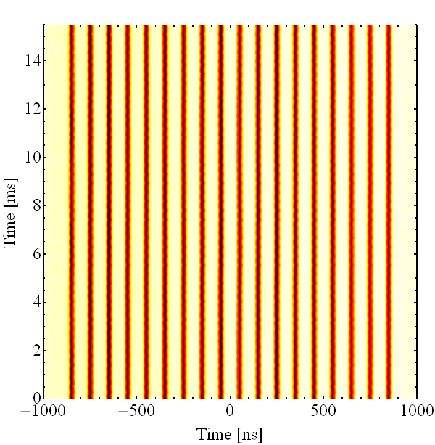
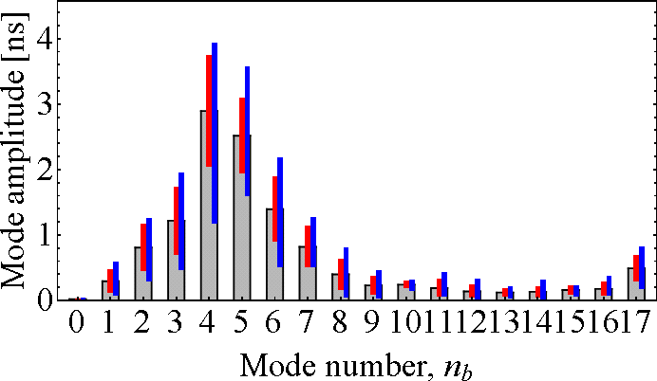
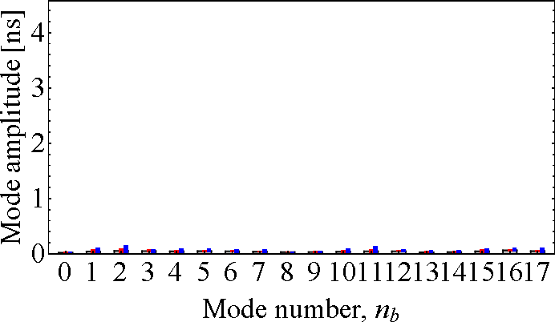
Damping of coupled-bunch instability with higher harmonic RF system in CERN PS
10 & 40 MHz in BL-mode
10 & 40 MHz in BS-mode
Bunch mode spectrum
First successful tests at flat top energy in CERN PS, (H. Damerau et al., 2017)

Slide 26
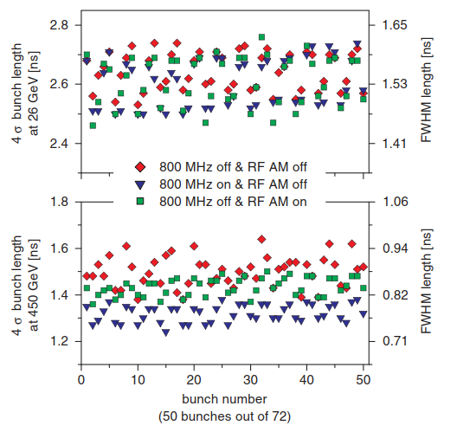
Bunch-by-bunch synchrotron frequency spread
Effect of main RF Amplitude Modulation
Coupled-bunch instability can also be stabilisied by bunch-by-bunch spread ∆ω_{s} > shift ∆ω_{c}:
spread in bunch population
{∆N/N}_{rms} > Im{∆ω_{c}}/Re{∆ω_{c}}
low-frequency voltage-modulation
ω_{s0} ~ V^{1/2}
from RF cavities at (h+1) or residual beam loading (from fractional ring filling) – ESRF storage ring (O. Naumann, J. Jacob, 1997)
CERN SPS simulations: LHC beam is globally more stable with fundamental impedance reduced (by feedback) than removed (J. Repond, M. Schwarz)
SPS, Q26, N_{b} = 3x10¹⁰ ppb, 16% RF AM
E. Vogel, T. Bohl and U. Wehrle, PRST 8 (2005)

Slide 27
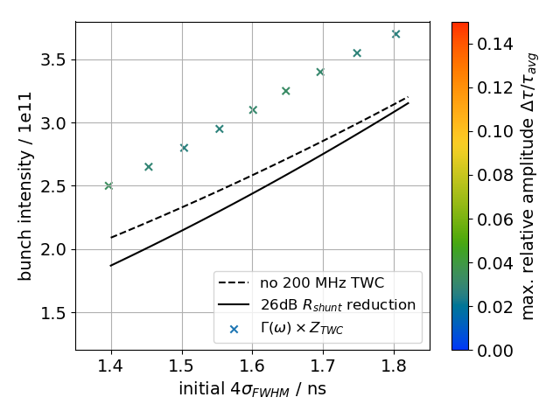
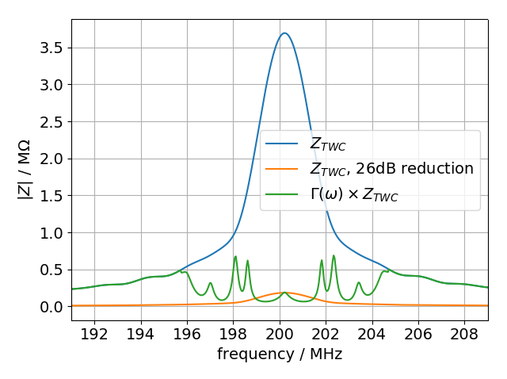
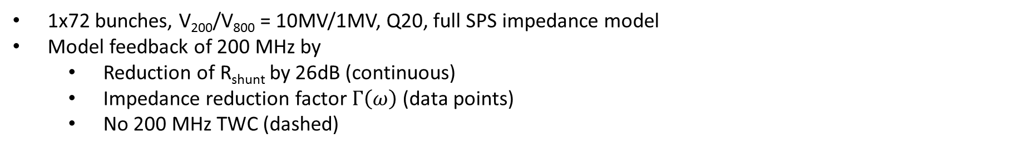
Thresholds for different feedback models
1x72 bunches, V₂₀₀/V₈₀₀ = 10MV/1MV, Q20, full SPS impedance model
Model feedback of 200 MHz by
  Reduction of R_{shunt} by 26dB (continuous)
  Impedance reduction factor $Γ\left(ω\right)$ (data points)
  No 200 MHz TWC (dashed)
Reducing the shunt impedance yields similar threshold as without the 200 MHz TWCs
No threshold was found when using the impedance reduction factor $Γ\left(ω\right)$, even though it has more ‘residual’ impedance around 200 MHz
M. Schwarz, 2019

Slide 28
Summary
Sacherer stability diagrams in longitudinal plane are justified only for low-frequency impedance and in other cases should be used with caution.
More complete formalisms (Van-Kampen modes and Lebedev equation) together with particle simulations are available for accurate threshold estimations, which should be based on realistic impedance model.
Dependence of intensity thresholds on particle distribution can be reduced by using the FWHM bunch lengths.
Landau damping can be significantly increased by additional, higher harmonic RF system, but its limitations in BLM and, for n > 2, in BSM should be taken into account for the choice of the beam and RF parameters.
Main mitigation measures used at CERN against loss of Landau damping and instabilities in longitudinal plane are controlled longitudinal emittance blow-up and high harmonic (Landau) cavity (in addition to FB around main impedance)

Slide 29
Spare slides

Slide 30
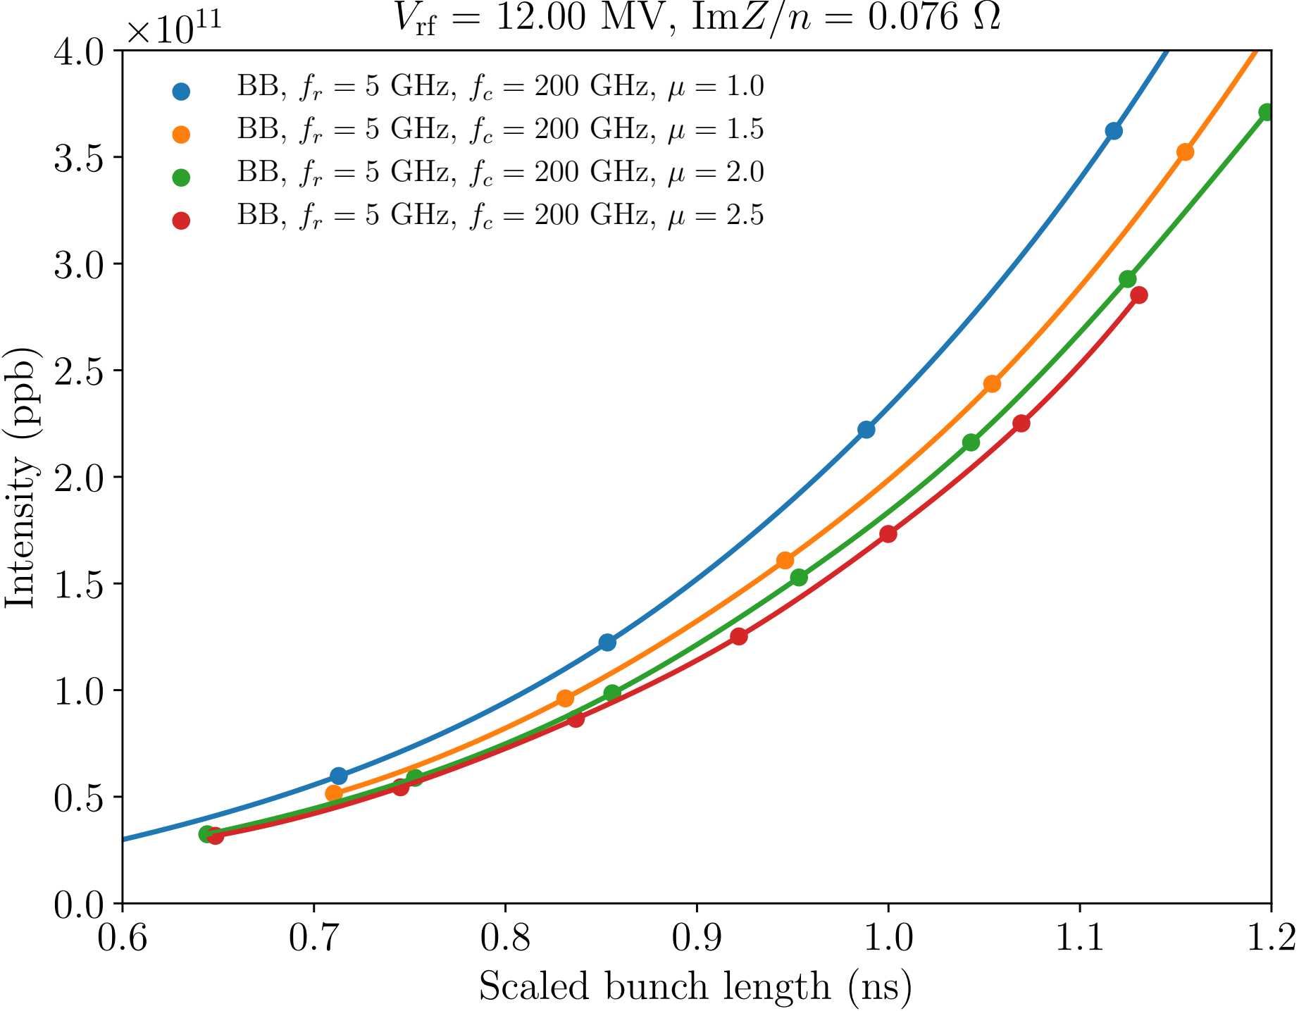

Thresholds for different distribution functions
Distribution function
$$ℱ\left(ℰ\right)={ℱ_{0}\left(ℰ_{max}−ℰ\right)}^{μ}$$
The same full-width half-maximum bunch length
I. Karpov
Again full-width half-maximum bunch length is a good parameter for stability evaluation

Slide 31
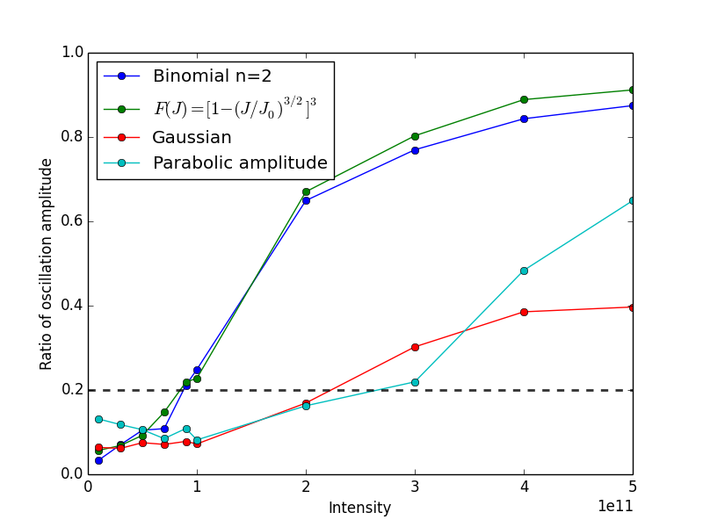
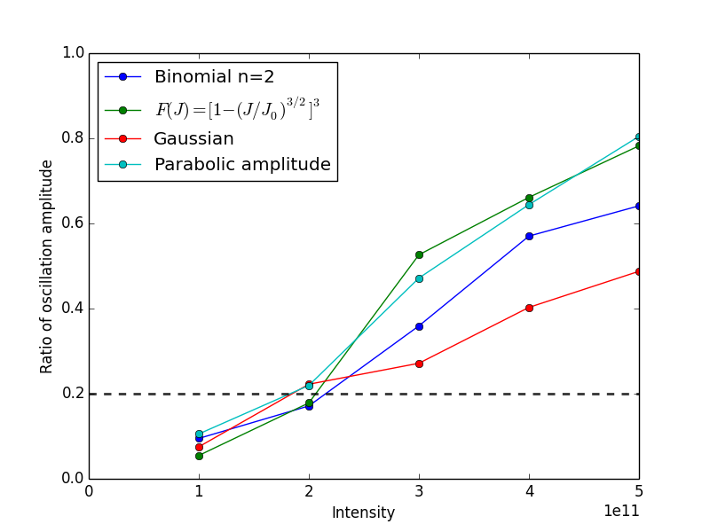
Threshold of loss of Landau damping for different particle distributions
J. E. Muller
Threshold of LLD for different particle distributions with 1 eVs emittance @4.0 TeV
Threshold of LLD for different particle distributions with 0.8 ns FWHM @4.0 TeV

Slide 32
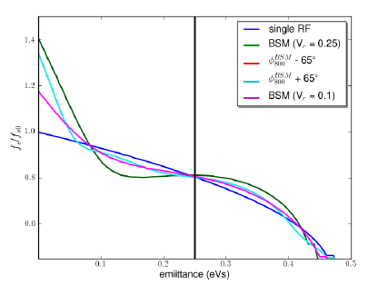
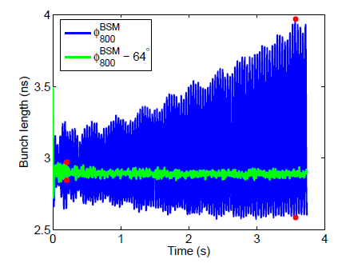
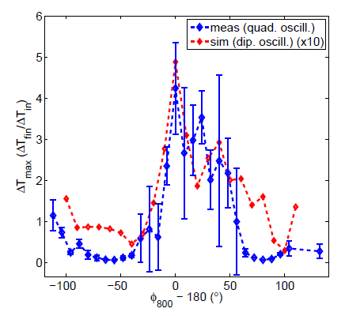
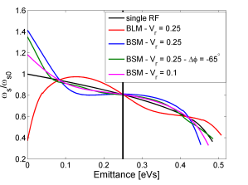
Synchrotron frequency distribution and phase between 2 RF systems in BS-mode
Very good agreement between measurements and simulations (with SPS impedance model):
single bunches are unstable in BS-mode with V2/V1=4
can be stabilised by significant phase shift of 800 MHz RF system
(T. Argyropoulos et al., IPAC’12)

