Slide 1

Marriage & divorce of “Feedbacks” with “Landau damping” – transverse
Nicolas Mounet, CERN/BE-ABP-HSC
With lots of inputs from S. Antipov, S. Arsenyev, X. Buffat, A. Burov, A. Chao, S. Furuseth, G. Iadarola, N. Klinkenberg, J. Komppula, K. Li, A. Maillard, E. Métral, A. Oeftiger, G. Rumolo, M. Schenk, V. Vaccaro, D. Valuch.

Slide 2
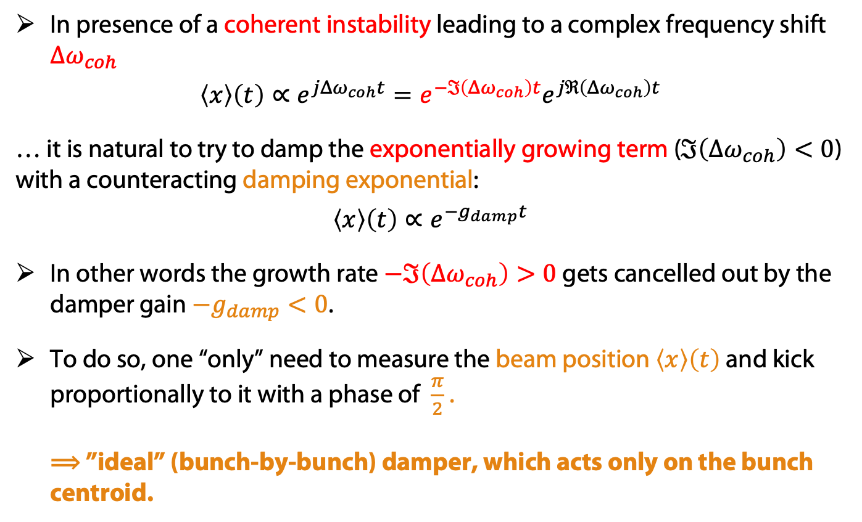
Feedbacks – in a nutshell
In presence of a coherent instability leading to a complex frequency shift $Δω_{coh}$
$$\left\langle x\right\rangle \left(t\right)∝e^{jΔω_{coh}t}=e^{−ℑ\left(Δω_{coh}\right)t}e^{jℜ\left(Δω_{coh}\right)t}$$
… it is natural to try to damp the exponentially growing term ($ℑ\left(Δω_{coh}\right)<0$) with a counteracting damping exponential:
$$\left\langle x\right\rangle \left(t\right)∝e^{−g_{damp}t}$$
In other words the growth rate $−ℑ\left(Δω_{coh}\right)>0$ gets cancelled out by the damper gain $−g_{damp}<0$.
To do so, one “only” need to measure the beam position $\left\langle x\right\rangle \left(t\right)$ and kick proportionally to it with a phase of $\frac{π}{2}$ .
⟹ ”ideal” (bunch-by-bunch) damper, which acts only on the bunch centroid.

Slide 3
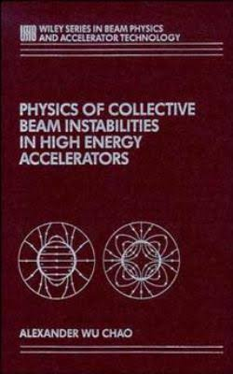
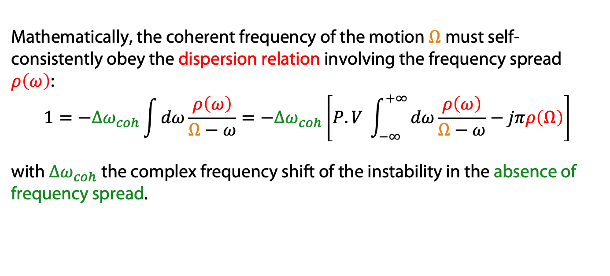
Landau damping – in a nutshell
Alex W. Chao: “[…] there are a large number of collective instability mechanisms acting on a high intensity beam in an accelerator […]. Yet the beam as a whole seems basically stable, as evidenced by the existence of a wide variety of working accelerators[…]. One of the reasons for this fortunate outcome is Landau damping, which provides a natural stabilizing mechanism against collective instabilities if particles in the beam have a small spread in their natural […] frequencies.”
Mathematically, the coherent frequency of the motion $Ω$ must self-consistently obey the dispersion relation involving the frequency spread $ρ\left(ω\right)$:
$$1=−Δω_{coh}\int{dω\frac{ρ\left(ω\right)}{Ω−ω}}=−Δω_{coh}\left[P.V \int_{−∞}^{+∞}{dω\frac{ρ\left(ω\right)}{Ω−ω}}−jπρ\left(Ω\right)\right]$$
with $Δω_{coh}$ the complex frequency shift of the instability in the absence of frequency spread.

Slide 4
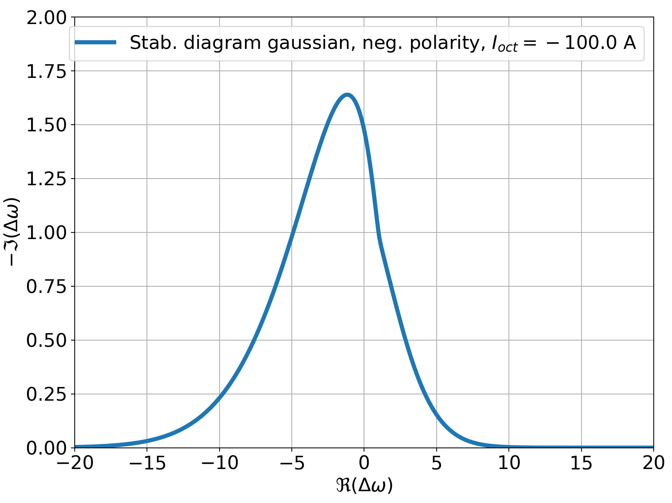
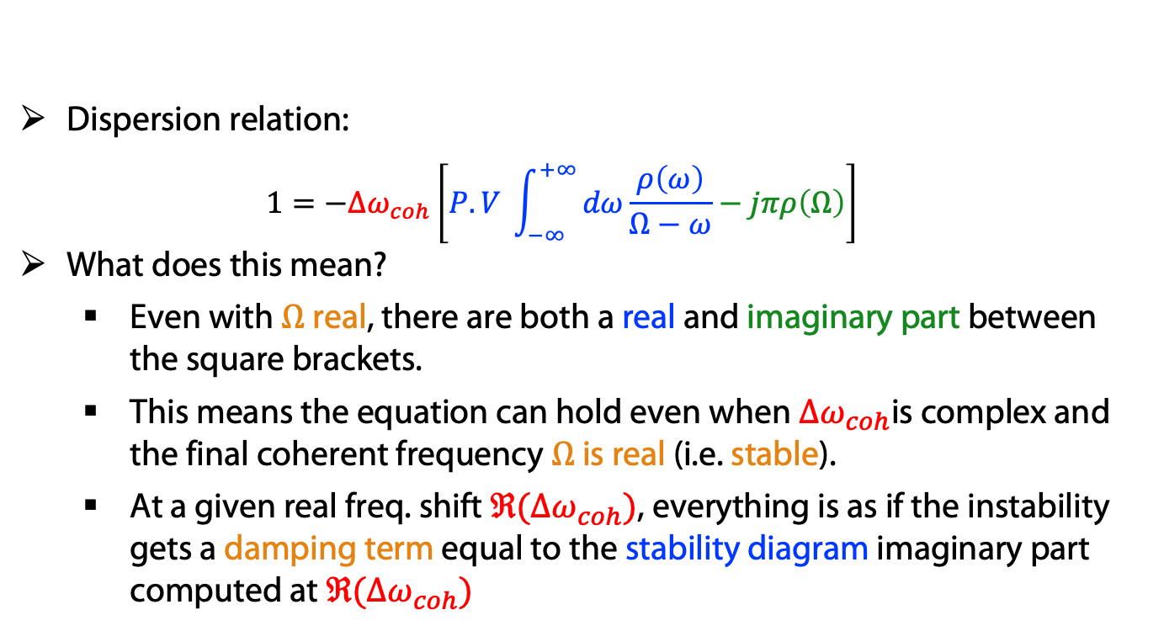
Landau damping – transverse
  Dispersion relation:
  $1=−Δω_{coh}\left[P.V \int_{−∞}^{+∞}{dω\frac{ρ\left(ω\right)}{Ω−ω}}−jπρ\left(Ω\right)\right]$
What does this mean?
  Even with $Ω$real, there are both a real and imaginary part between the square brackets.
  This means the equation can hold even when $Δω_{coh}$is complex and the final coherent frequency $Ω$ is real (i.e. stable).
  At a given real freq. shift $ℜ(Δω_{coh})$, everything is as if the instability gets a damping term equal to the stability diagram imaginary part computed at $ℜ(Δω_{coh})$
Stability diagrams
⇒ modes with a freq. shift inside the diagram are stable
To some extent it looks like the action of a feedback…
damping
Stab. diagram theory from A. Ruggiero and V. Vaccaro, CERN-ISR-TH/68-33

Slide 5
Feedbacks – in reality (LHC)
Bunches “talk to each other” through the feedback
Damper closer to ideal
From D. Valuch, LBOC 24/05/016

Slide 6
Feedbacks – in reality (LHC)
Non ideal feedback has higher gain for modes at lower frequency
…while in ideal feedback the gain is the same for all modes.
From D. Valuch, LBOC 24/05/016

Slide 7
Feedbacks – in macroparticle simulation tools
From K. Li & J. Komppula, HSC meeting, 18/03/2019

Slide 8
Feedbacks can be used in various ways…
Instead of being resistive, they can also be used as reactive feedback, i.e. fighting the real part of the frequency shift
→ used to stabilise TMCI, with limited success (not more than 5-10 % increase of LEP TMCI threshold - several models developed [Danilov-Perevedentsev 1993, Sabbi 1996, Brandt et al 1995].
More generally, one can play with the phase and even use the damper as an instability exciter (was done as a machine study in the LHC):
From S. Antipov, HSC meeting, 04/11/2018

Slide 9
Feedbacks can also create instabilities…
The damper creates an instability.
No damper
⟶ no instability at zero chroma and low intensity.
From E. Métral et al, IPAC’18

Slide 10
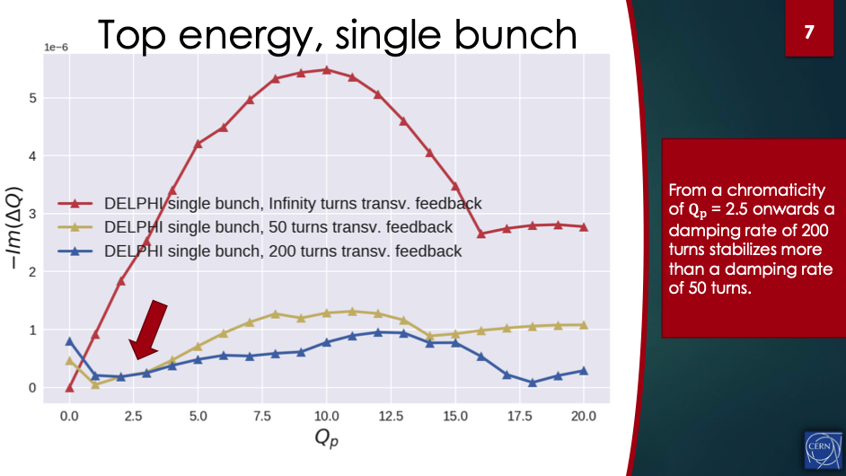
… but also unexpectedly damp others
Case of FCC (it is very similar in the LHC):
From S. Arsenyev and N. Klinkenberg, HSC meeting, 24/09/2018
… while at high chroma the damper seems to damp intrabunch modes
The damper creates an instability.

Slide 11
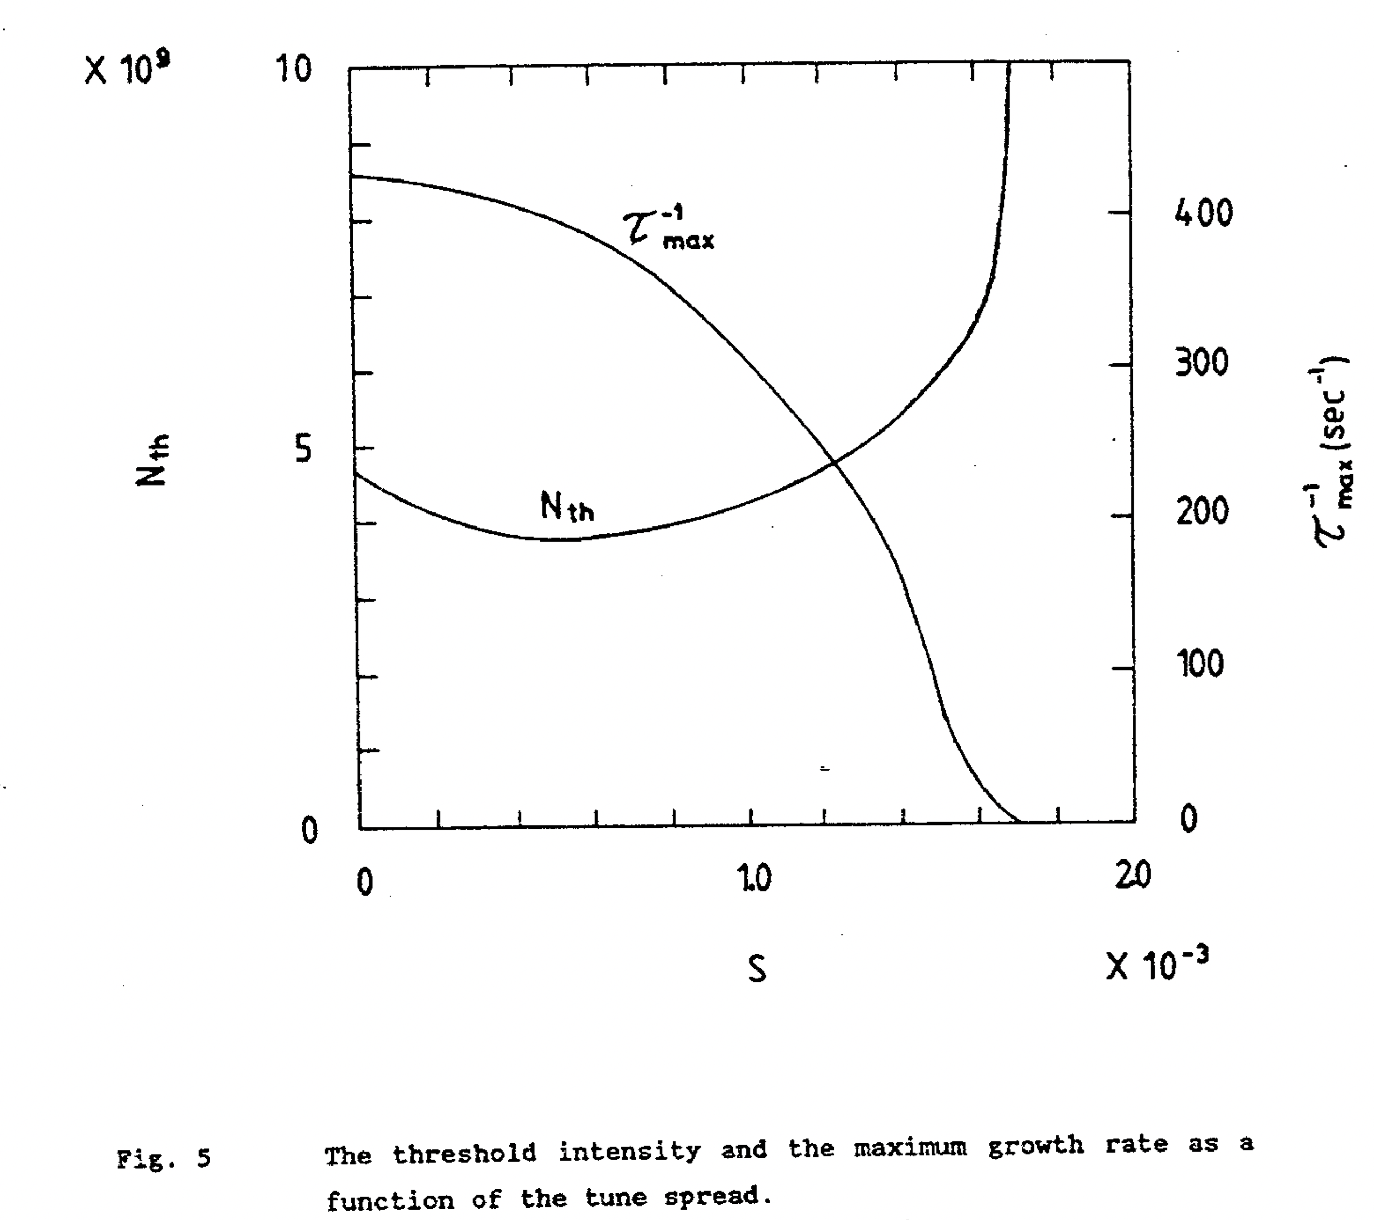
Landau damping – a more complex reality
Sometimes tunespread also has a detrimental effect:
From Y. Chin, CERN/SPS/85-09 (1985).

Slide 12
Landau damping – a more complex reality
Stability diagrams, on one side…
… but on the other hand modes get also modified by tunespread.

Slide 13
Landau damping – a more complex reality
Other effects (e.g. noise) can modify the stability diagram:
⟹ Diffusion effects seem to be able to drill “holes” in the stability diagram.
From S. Furuseth & X. Buffat, MCBI Workshop, 26/09/2019

Slide 14
Feedbacks and Landau damping
Simplistic view: they both introduce a damping rate.
Reality is much more complex:
  complex feedback system,
  non-ideal feedbacks,
  complex modification of the stability diagram.
… and some effects are really contradicting the simple picture:
  destabilizing effect of damper close to zero chromaticity,
  destabilizing effect of tunespread on TMCI,
  modification of coherent modes due to the source of tunespread.
⟹ to get all these effects one needs a more realistic modelling,
⟹ macroparticle simulations or Vlasov solvers.

Slide 15
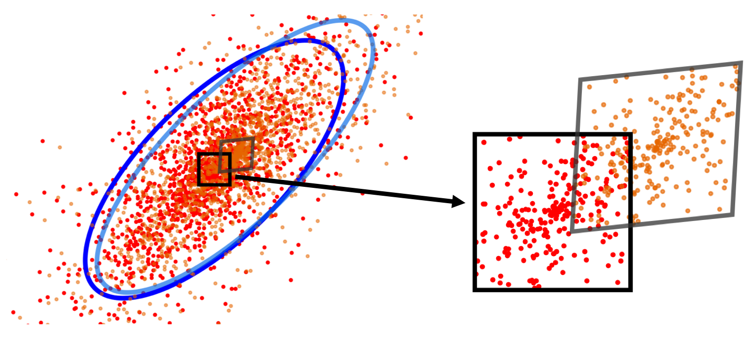
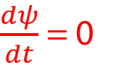
Vlasov equation [A. A. Vlasov, J. Phys. USSR 9, 25 (1945)]
Vlasov equation is based on Liouville theorem (or equivalently, on the collisionless Boltzmann transport equation), which expresses that the local phase space density does not change when one follows the flow (i.e. the trajectory) of particles.
In other words: local phase space area is conserved in time:
$\frac{dψ}{dt}$= 0
Red particles at time t become the orange ones at time t + dt, and the black square becomes the grey parallelogram which contains the same number of particles.

Slide 16
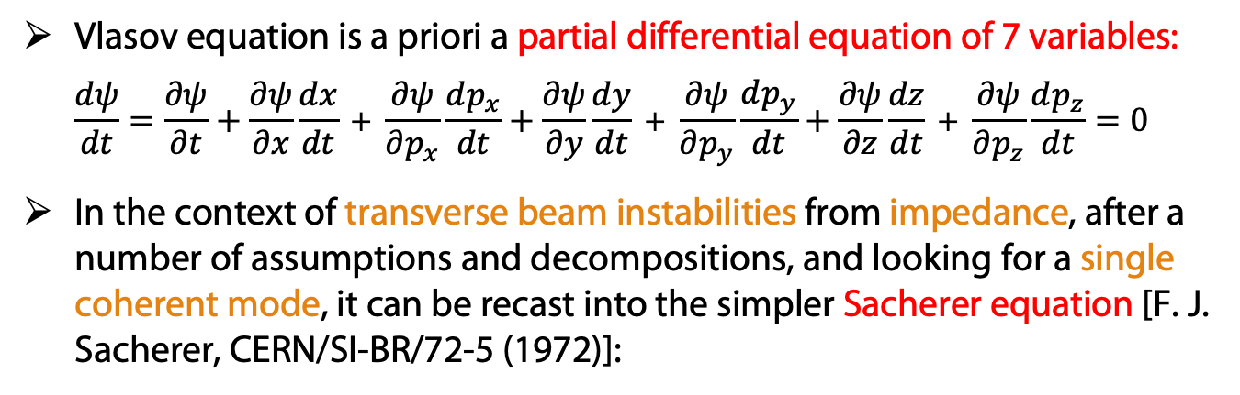
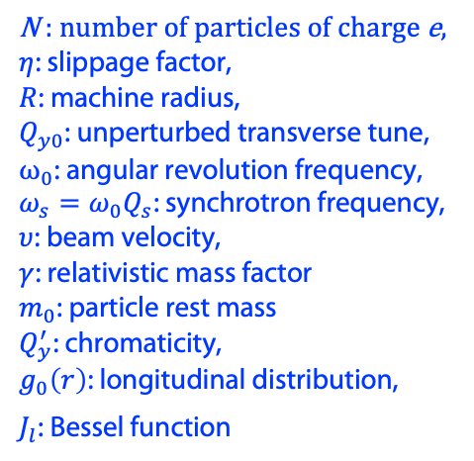
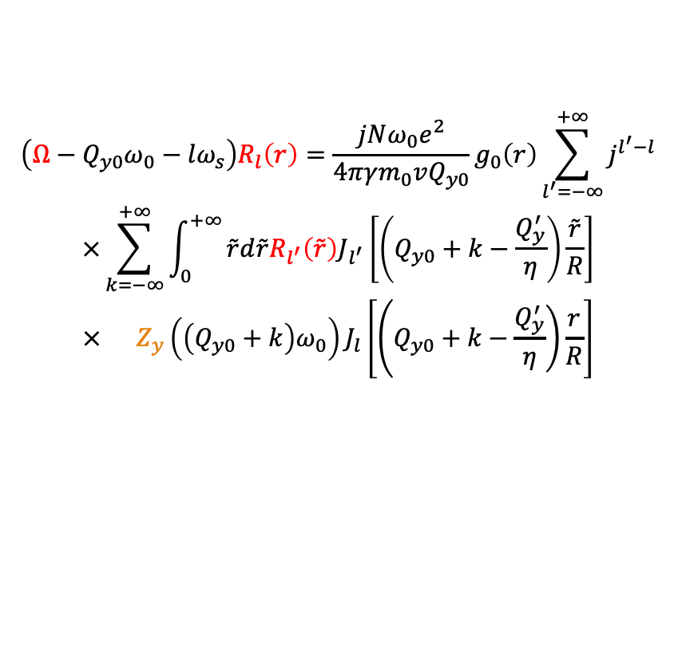
From Vlasov equation to Sacherer equation
Vlasov equation is a priori a partial differential equation of 7 variables:
$\frac{dψ}{dt}=\frac{∂ψ}{∂t}+\frac{∂ψ}{∂x}\frac{dx}{dt}\text{ +} \frac{∂ψ}{∂p_{x}}\frac{dp_{x}}{dt}+\frac{∂ψ}{∂y}\frac{dy}{dt}\text{ +} \frac{∂ψ}{∂p_{y}}\frac{dp_{y}}{dt}+\frac{∂ψ}{∂z}\frac{dz}{dt}\text{ +} \frac{∂ψ}{∂p_{z}}\frac{dp_{z}}{dt}=0$
In the context of transverse beam instabilities from impedance, after a number of assumptions and decompositions, and looking for a single coherent mode, it can be recast into the simpler Sacherer equation [F. J. Sacherer, CERN/SI-BR/72-5 (1972)]:
$$\begin{aligned}\left(Ω−Q_{y0}ω_{0}−lω_{s}\right)R_{l}\left(r\right)&=\frac{jNω_{0}e^{2}}{4πγm_{0}vQ_{y0}}g_{0}\left(r\right)\sum_{l^{′}=−∞}^{+∞}{j^{l^{′}−l}} \\ \begin{aligned}×\sum_{k=−∞}^{+∞}{\int_{0}^{+∞}{\tilde{r}d\tilde{r}R_{l^{′}}\left(\tilde{r}\right)J_{l^{′}}\left[\left(Q_{y0}+k−\frac{Q_{y}^{′}}{η}\right)\frac{\tilde{r}}{R}\right]}} \\ × Z_{y}\left({\left(Q_{y0}+k\right)ω}_{0}\right)J_{l}\left[\left(\left.Q_{y0}+k−\frac{Q_{y}^{′}}{η}\right)\frac{r}{R}\right.\right]\end{aligned}\end{aligned}$$
N : number of particles of charge e,
$η$: slippage factor,
$R$: machine radius,
$Q_{y0}$: unperturbed transverse tune,
$ω_{0}$: angular revolution frequency,
${ω_{s}=ω_{0}Q}_{s}$: synchrotron frequency,
$υ$: beam velocity,
$γ$: relativistic mass factor
$m_{0}$: particle rest mass
$Q_{y}^{′}$: chromaticity,
$g_{0}\left(r\right)$: longitudinal distribution,
$J_{l}$: Bessel function
These are the unknown (frequency and radial distribution of the mode)
This is the impedance

Slide 17

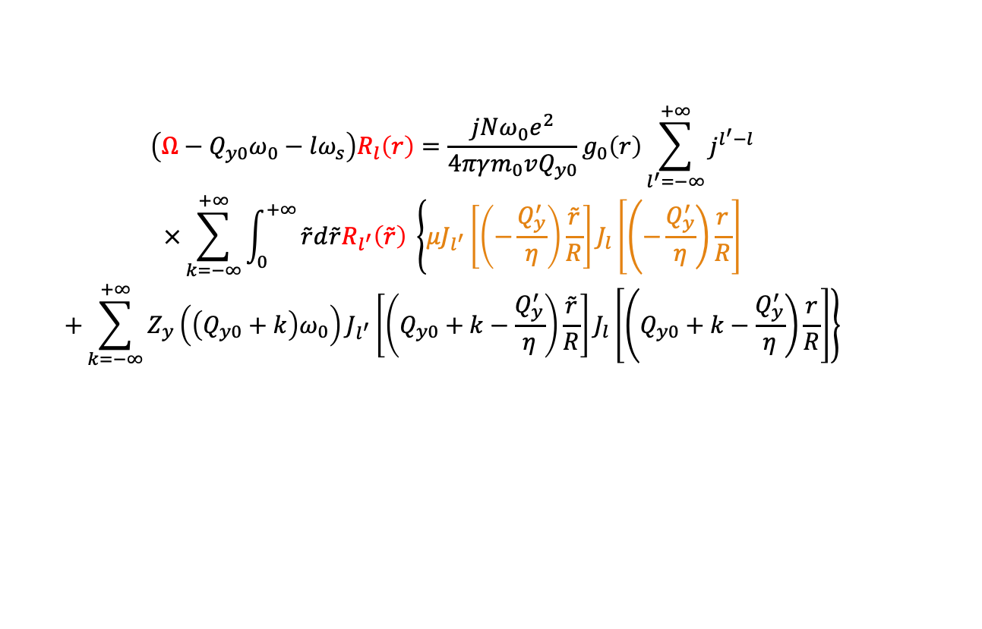
Extension of Sacherer equation with feedback
A non-ideal (but still linear) feedback can be modelled as in impedance
⟶ already in the formalism
An ideal feedback is a delta function impedance (or constant wake)
⟶ needs an extension of Sacherer equation to include it [NM, CERN Yellow Reports: Conf. Proc., 1 (2018) p. 77 ]:
$$\begin{aligned}\left(Ω−Q_{y0}ω_{0}−lω_{s}\right)R_{l}\left(r\right)&=\frac{jNω_{0}e^{2}}{4πγm_{0}vQ_{y0}}g_{0}\left(r\right)\sum_{l^{′}=−∞}^{+∞}{j^{l^{′}−l}} \\ \begin{aligned}×\sum_{k=−∞}^{+∞}{\int_{0}^{+∞}{\tilde{r}d\tilde{r}R_{l^{′}}\left(\tilde{r}\right) \left\{{μJ}_{l^{′}}\left[\left(−\frac{Q_{y}^{′}}{η}\right)\frac{\tilde{r}}{R}\right]J_{l}\left[\left(\left.−\frac{Q_{y}^{′}}{η}\right)\frac{r}{R}\right.\right]\right.}} \\ +\left.\sum_{k=−∞}^{+∞}{Z_{y}\left({\left(Q_{y0}+k\right)ω}_{0}\right)J_{l^{′}}\left[\left(Q_{y0}+k−\frac{Q_{y}^{′}}{η}\right)\frac{\tilde{r}}{R}\right]J_{l}\left[\left(\left.Q_{y0}+k−\frac{Q_{y}^{′}}{η}\right)\frac{r}{R}\right.\right]}\right\}\end{aligned}\end{aligned}$$
Damper part ($μ$ is proportional to damping gain)
Equation can be recast into a standard eigenvalue problem.

Slide 18
Sacherer equation with feedback
Including the feedback in the dynamical system (rather than a posteriori as a simple damping rate) unveiled a number of effects:
destabilising effect of the damper close to zero chromaticity (see before),
damping of high order headtail modes at high Q’ with bunch-by-bunch damper:
The equation is implemented in several Vlasov solvers (NHTVS [A. Burov, PR ST-AB, 17 (2014), DELPHI [NM, CERN Yellow Reports: Conf. Proc., 1 (2018) p. 77], GALACTIC [E. Métral et al, IPAC’18 (2018) pp. 3076–3079 ].
A. Burov, NM et al, ABA model, talk at LBOC, 14/08/2012
⟹ This supported the idea of running at high Q’ with high damper gain in the LHC.

Slide 19
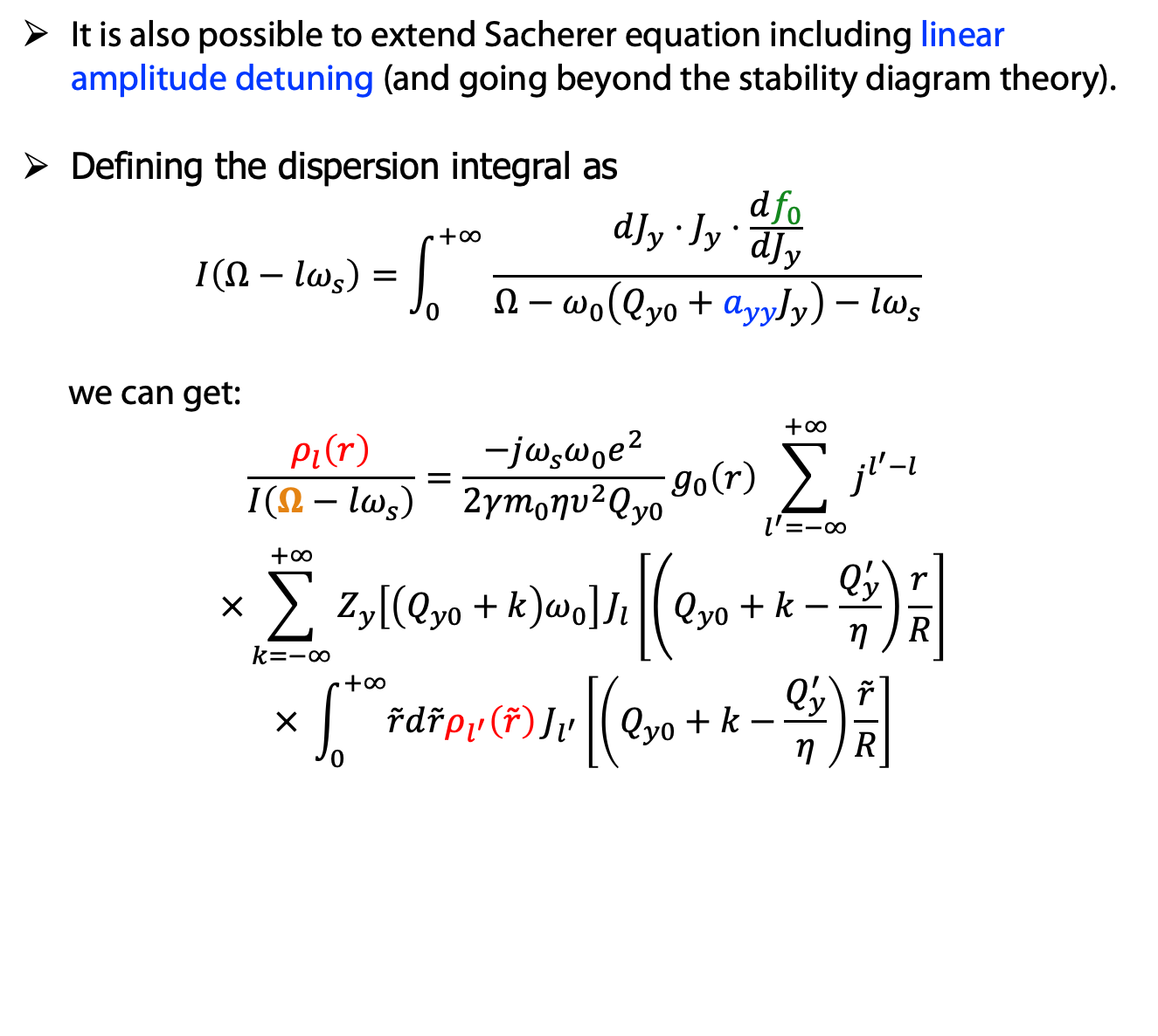
Extension of Sacherer equation with tunespread
It is also possible to extend Sacherer equation including linear amplitude detuning (and going beyond the stability diagram theory).
Defining the dispersion integral as
$I\left(Ω−lω_{s}\right)=\int_{0}^{+∞ }{\frac{dJ_{y}⋅J_{y}⋅\frac{df_{0}}{dJ_{y}}}{Ω−ω_{0}\left(Q_{y0}+a_{yy}J_{y}\right)−lω_{s}}}$
we can get:
$$\begin{aligned}\frac{ρ_{l}\left(r\right)}{I\left(Ω−lω_{s}\right)}&=\frac{−jω_{s}{ω_{0}e}^{2}}{2γm_{0}ηυ^{2}Q_{y0}}g_{0}\left(r\right)\sum_{l^{′}=−∞}^{+∞}{j^{l^{′}−l}} \\ \begin{aligned}×\sum_{k=−∞}^{+∞}{Z_{y}\left[{\left(Q_{y0}+k\right)ω}_{0}\right]}J_{l}\left[\left(\left.Q_{y0}+k−\frac{Q_{y}^{′}}{η}\right)\frac{r}{R}\right.\right] \\ × \int_{0}^{+∞}{\tilde{r}d\tilde{r}ρ_{l^{′}}\left(\tilde{r}\right)}J_{l^{′}}\left[\left(Q_{y0}+k−\frac{Q_{y}^{′}}{η}\right)\frac{\tilde{r}}{R}\right]\end{aligned}\end{aligned}$$
Transverse distribution
Amplitude detuning
Equation obtained first by Y. Chin, CERN/SPS/85-09 (1985).

Slide 20
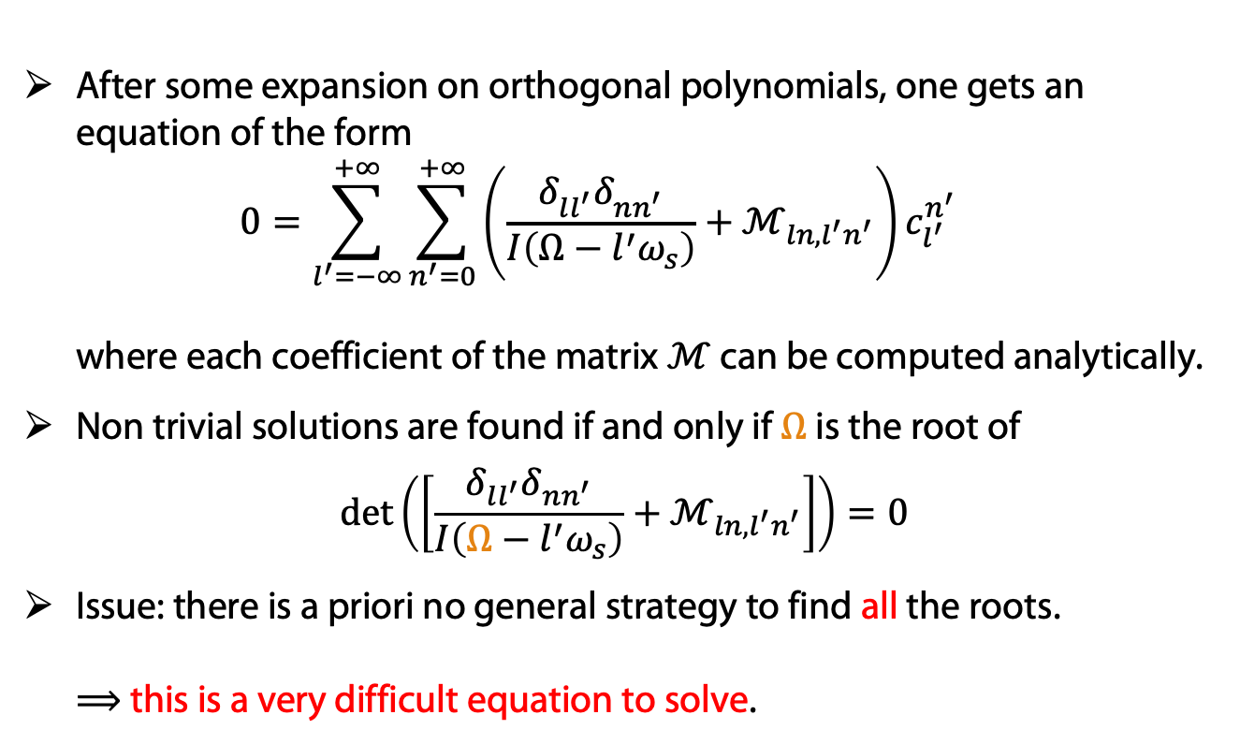
The determinant equation
After some expansion on orthogonal polynomials, one gets an equation of the form
$0=\sum_{l^{′}=−∞}^{+∞}{\sum_{n^{′}=0}^{+∞}{{\left(\frac{δ_{ll^{′}}^{}δ_{nn^{′}}^{}}{I\left(Ω−l^{′}ω_{s}\right)}+ℳ_{ln,l^{′}n^{′}}\right)c}_{l^{′}}^{n^{′}}}}$
where each coefficient of the matrix $ℳ$ can be computed analytically.
Non trivial solutions are found if and only if $Ω$is the root of
$$\det\left(\left[\frac{δ_{ll^{′}}δ_{nn^{′}}}{I\left(Ω−l^{′}ω_{s}\right)}+ℳ_{ln,l^{′}n^{′}}\right]\right)=0$$
Issue: there is a priori no general strategy to find all the roots.
⟹ this is a very difficult equation to solve.

Slide 21
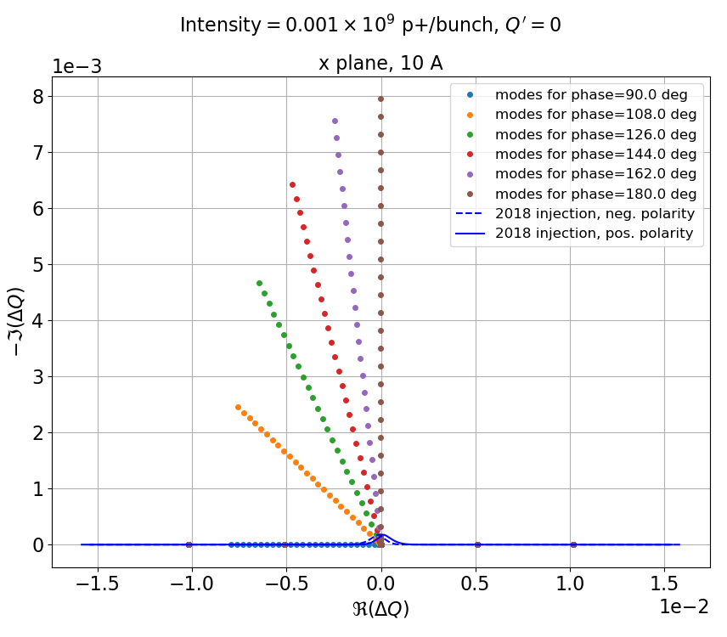
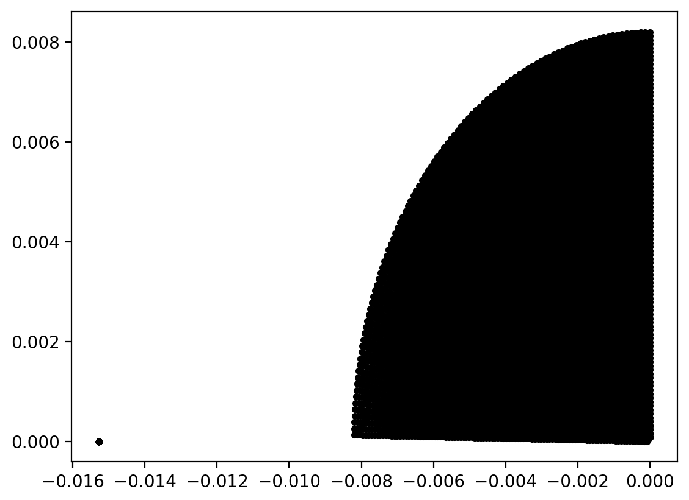
Is there a stability diagram still in the general case?
Without trying to solve the full problem, we try to map the complex plane of tuneshifts, thanks a broad scan of the phases and gains of a damper (inspired by the LHC study by S. Antipov et al, CERN-ACC-NOTE-2019-0034).
Making a fine mesh of phases and gains, we can cover a large area in the complex plane:
Case Q’=0

Slide 22
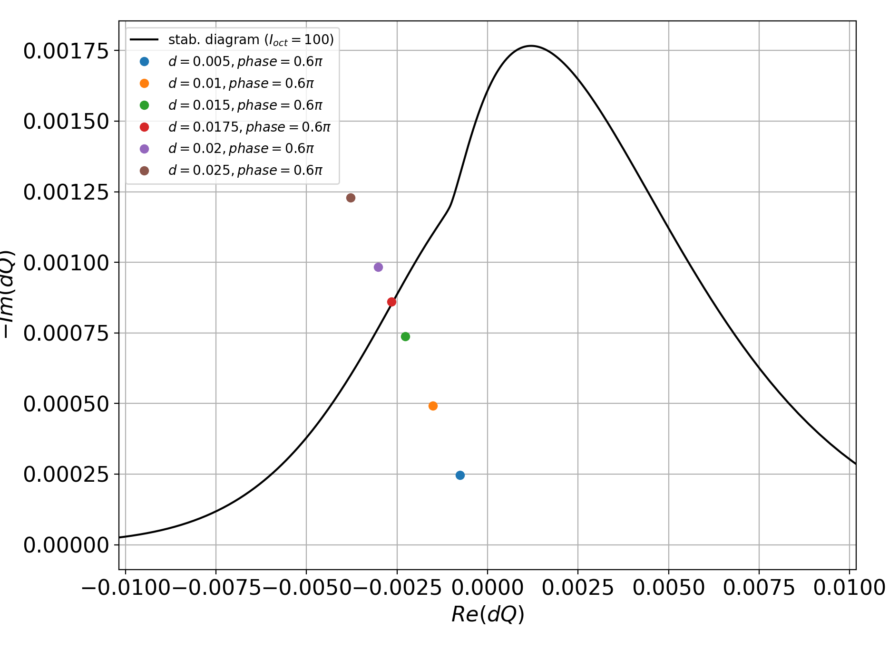
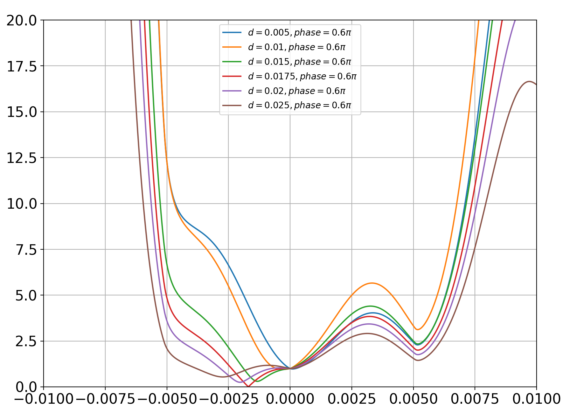
Can we recover the stability diagram theory?
Strategy: for each gain/phase of the damper, we compute the determinant along the real tune shifts→ when it touches the stability diagram, the minimum of this 1D curve should go to zero.
Case Q’=0

Slide 23
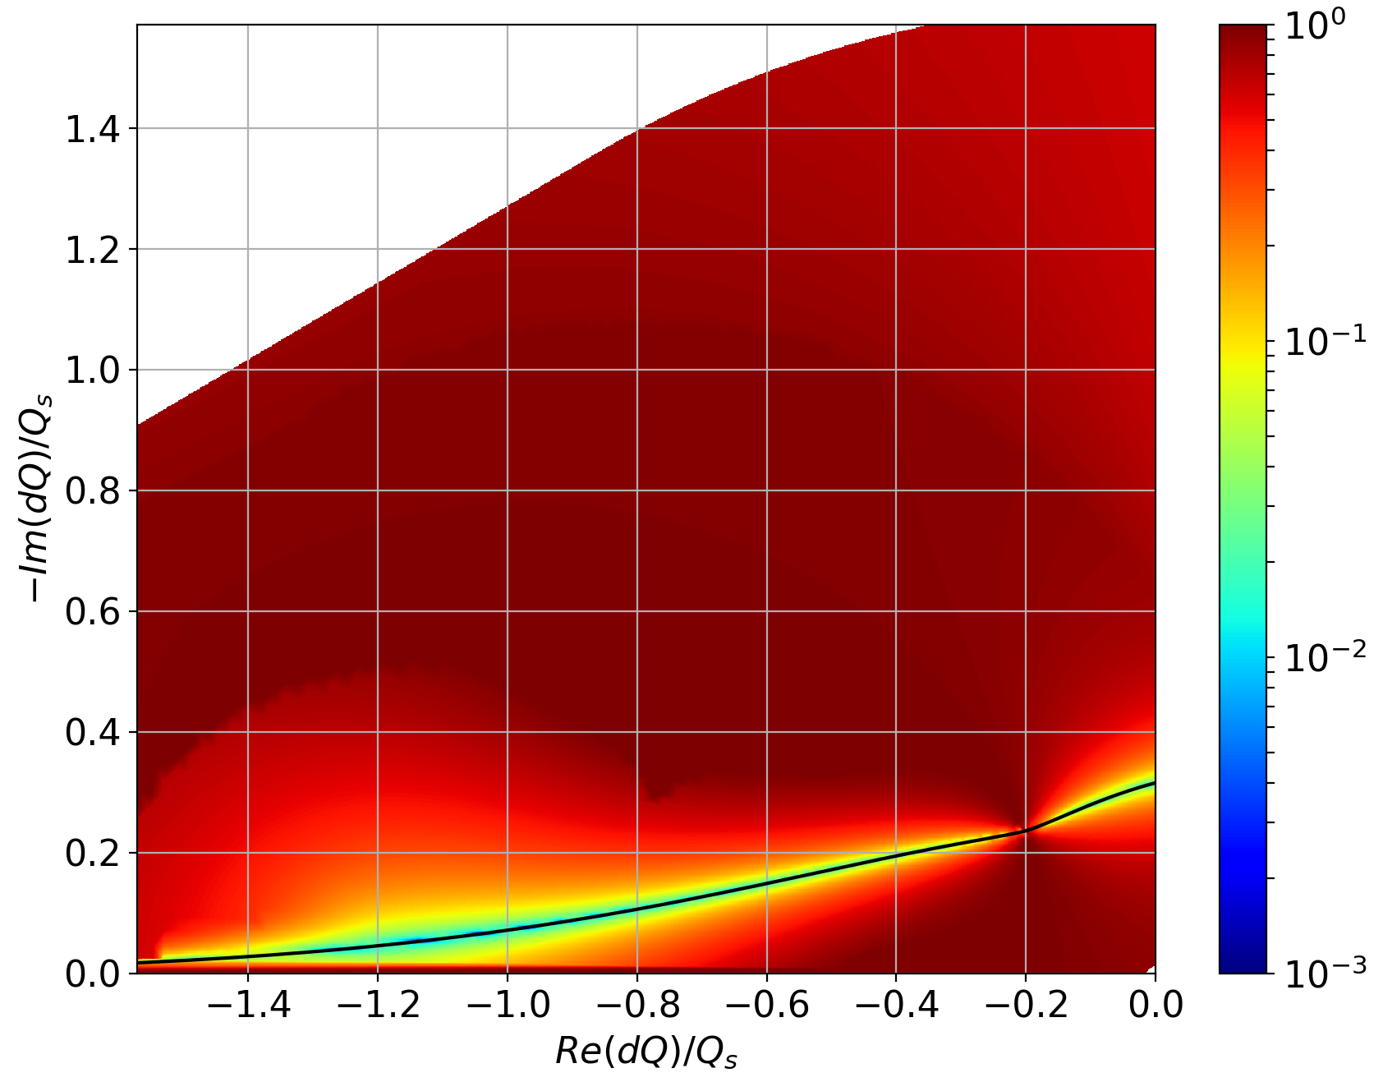
Generalized stability diagrams
The color represents the minimum of the previous 1D curves:
“Usual” stability diagram
Case Q’=0

Slide 24
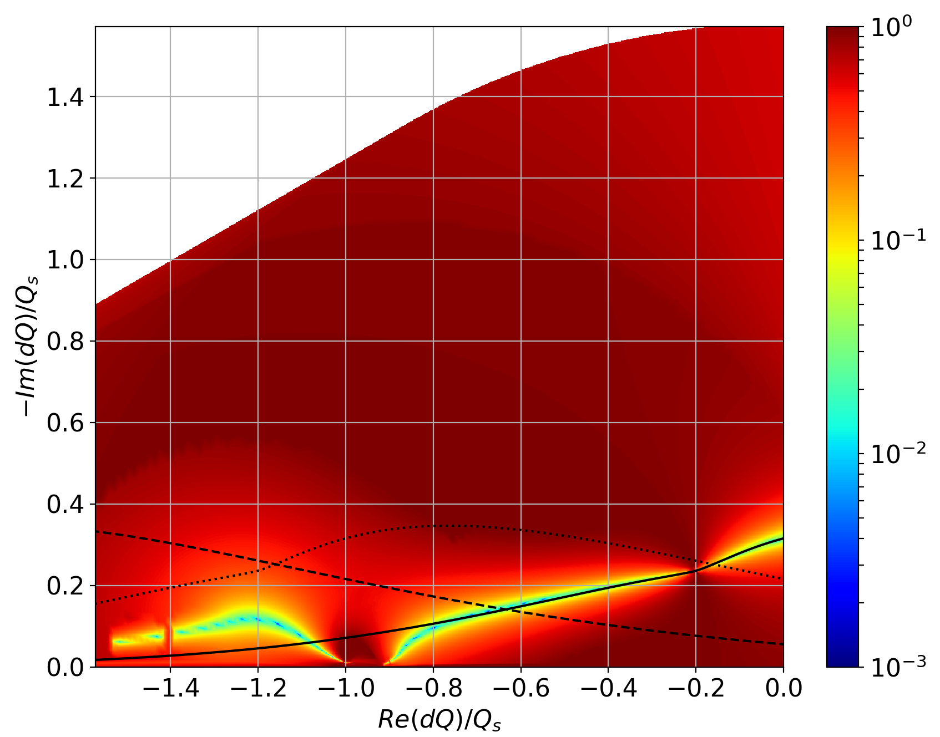
Effect of chromaticity
The color represents again the minimum of the 1D curves:
Usual stability diagrams around 0, -Q_{s} and -2Q_{s}
Case Q’=5

Slide 25
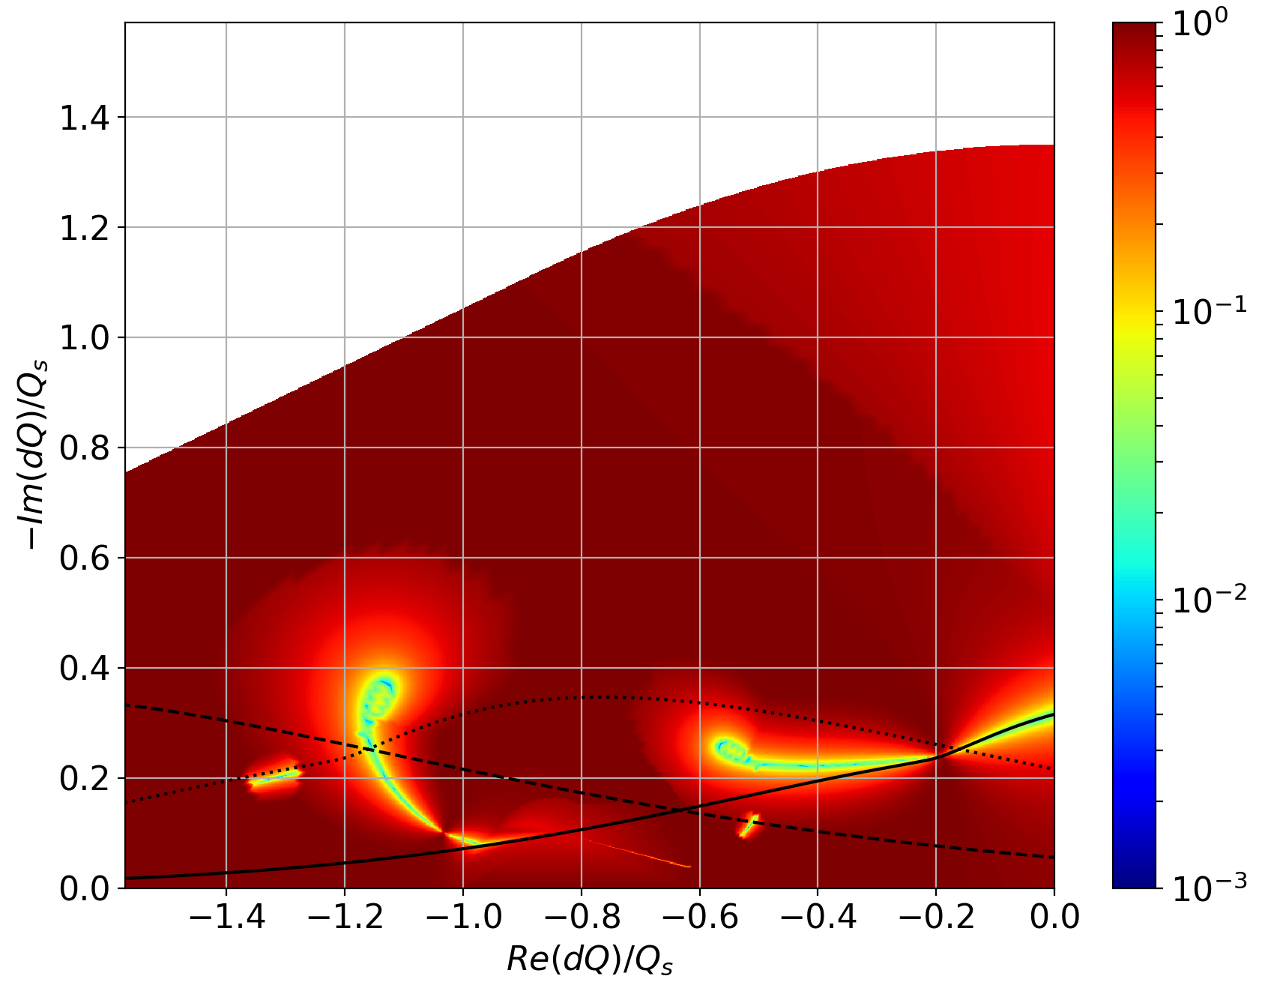
Effect of chromaticity
The color represents again the minimum of the 1D curves:
Usual stability diagrams around 0, -Q_{s} and -2Q_{s}
Case Q’=15
→ Generalized stability diagrams, different from the “usual” ones and chromaticity dependent.

Slide 26
Feedbacks and Landau damping
Both can be understood heuristically as providing a damping rate for certain modes.
However, such a simple picture does not withhold a number of observations, e.g. destabilizing effects.
In a Vlasov treatment, a more realistic picture can be obtained by:
  extending Sacherer equation with an ideal, bunch-by-bunch damper,
  ⟹ unveils the ability of such a damper to stabilize high order headtail modes and to destabilize the beam in some conditions,
  generalizing the same equation with linear amplitude detuning,
  ⟹ could potentially extend the stability diagram theory, but requires to overcome the difficulties to solve the obtained determinant equation.

