Slide 1

Limits of LHC corrections
T. Persson
on behalf of the OMC-team

Slide 2
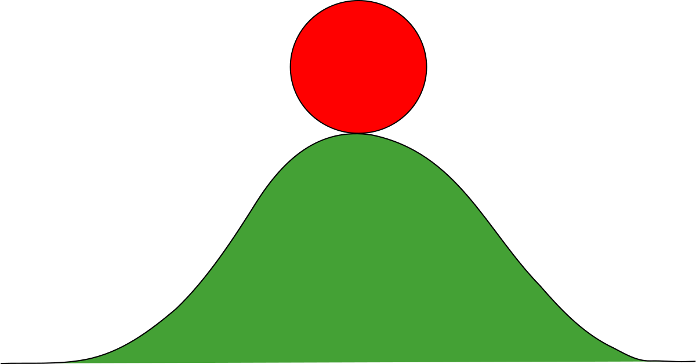
Why do we correct the optics in the LHC?
To protect the machine
To provide the design luminosity to the experiments
Mitigate beam instabilities

Slide 3
Correction strategi the first years of comissioing (2010-2015)
Measure the
virgin
Machine
Measure with Local Corrections
TbT Measure +
K-Modulation
Linear Comissoning (No X-ing)
Calculate Local Corrections
Calculate Global Corrections
Time

Slide 4
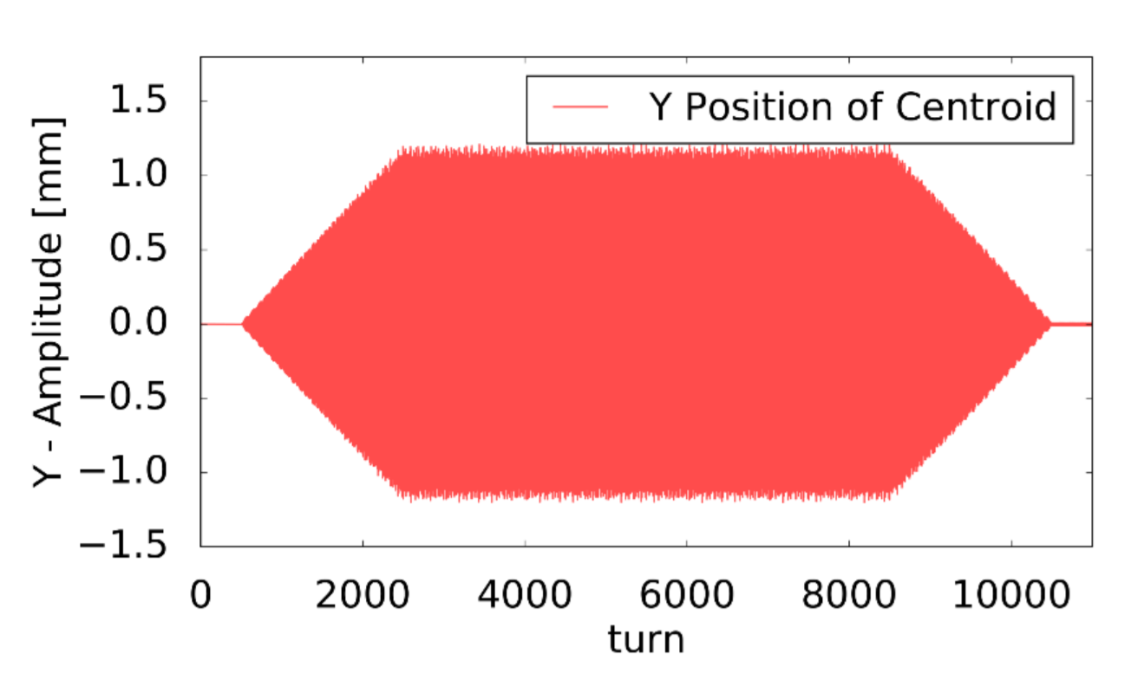
Turn-by-turn measurement
The typical optics measurements are carried out with the AC-dipole
  Adiabatic increase and decrease of the amplitude
  6600 turns (from 2015) at constant amplitude is recorded by 500 available BPMs

Slide 5
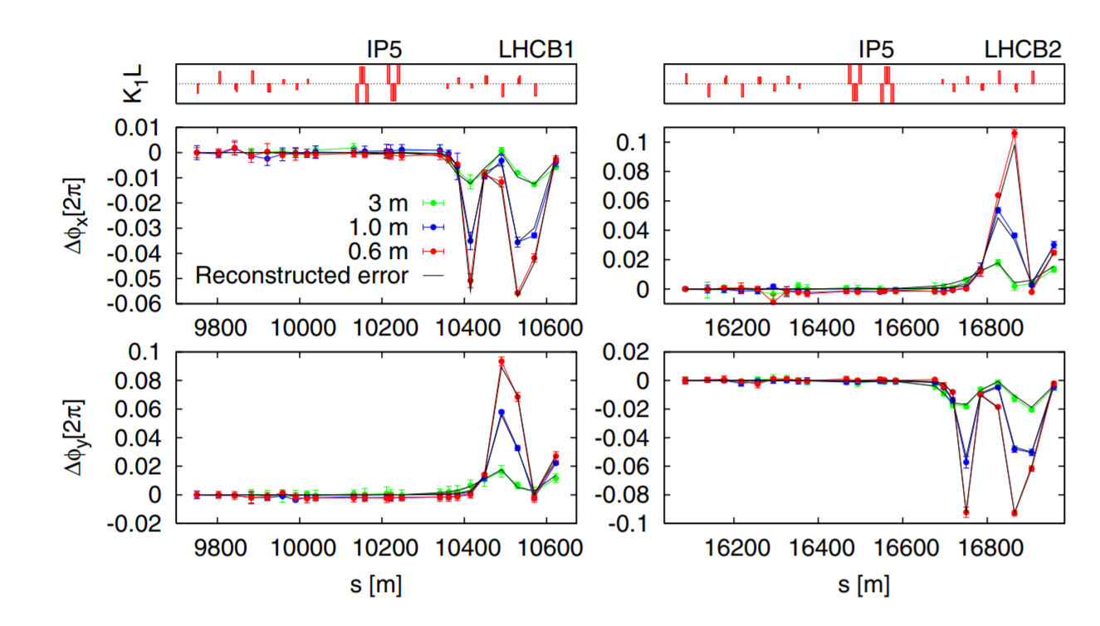
Local correction 2012
R. Tomas
By adjusting the errors in the model it is possible to find an error that reproduce the measurement for different β* and the two beams
R. Tomas et al. "Record low beta beating in the LHC“

Slide 6
Correction strategi the first years of comissioing
Measure the
virgin
Machine
Measure with Local Corrections
TbT Measure +
K-Modulation
Linear Comissoning (No X-ing)
Calculate Local Corrections
Calculate Global Corrections
Time

Slide 7
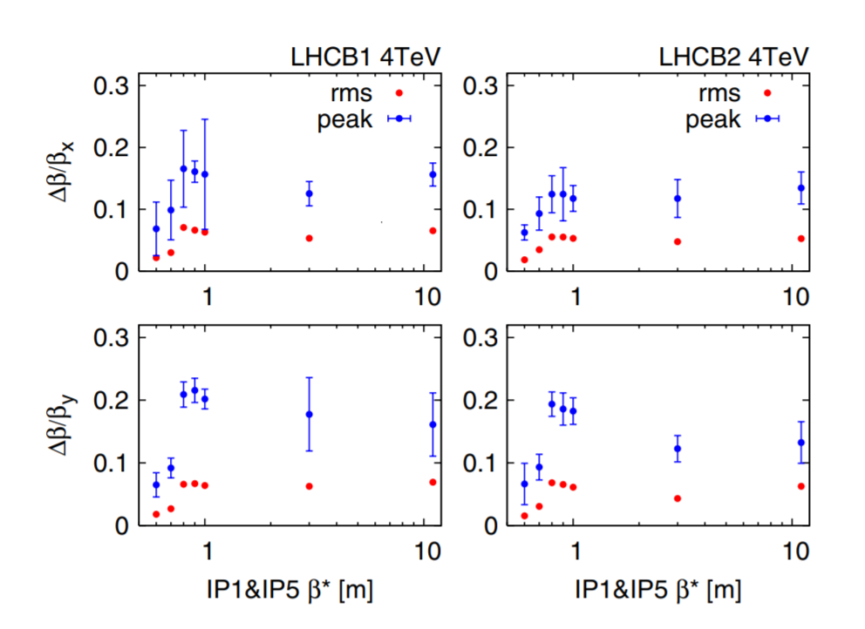
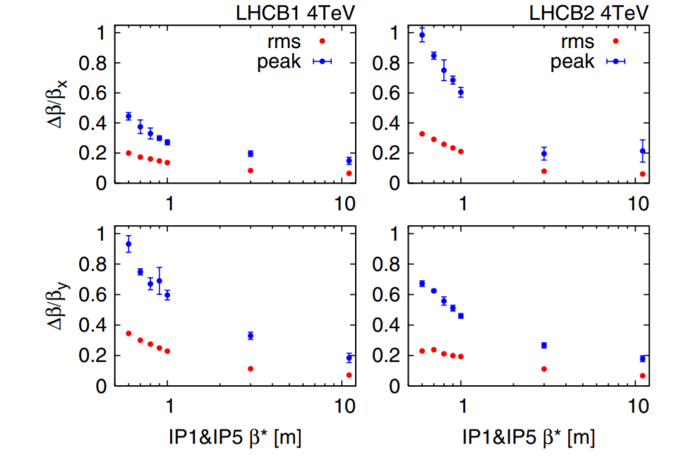
2012
Before correction
After correction
Global corrections in
R. Tomas et al. "Record low beta beating in the LHC“

Slide 8
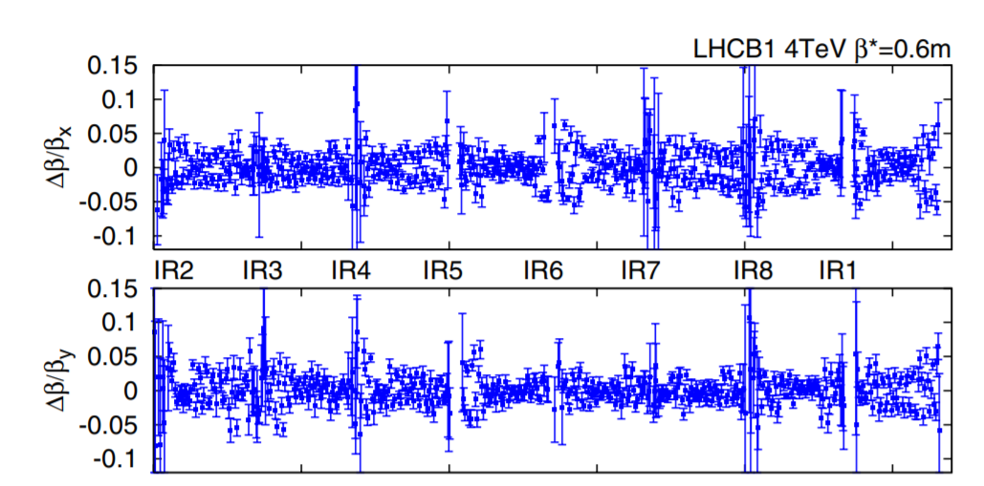
β-beat in 2012
Already a very good control and well within the requirements for a safe machine!
However.. What was limiting us to reach even better corrections?

Slide 9
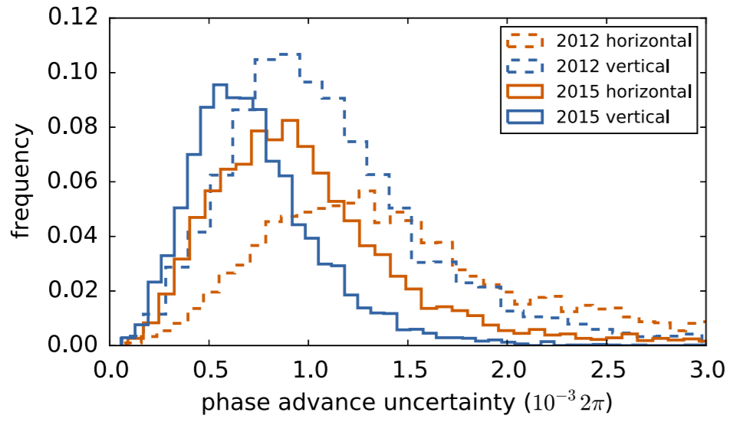
What was limiting (1)?
Measurement noise
  In 2012 we excited for 2200 turns and in 2015 6600 turns
  Reduced the statistical noise
T. Persson et al. ,"LHC optics commissioning: A journey towards 1% optics control"

Slide 10
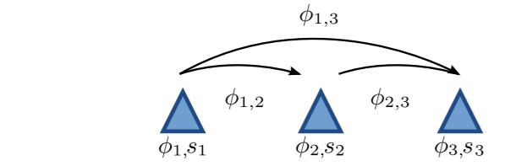
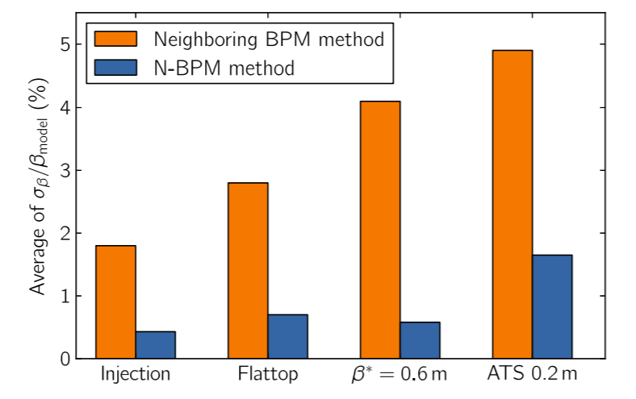
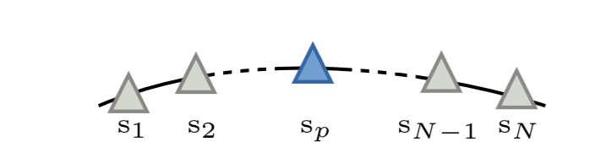
What was limiting (2) ?
The β-functions were reconstructed from the phase advance using the 3-bpm Method
The N-BPM method was developed
  Based on more BPMs and different combinations
  Reduce significantly the uncertainty on the β-functions
Extended later with analytical error estimates
  Significantly faster and better for pushed optics
A. Langner and R. Tomas, "Optics measurement algorithms and error analysis for the proton energy frontier"
A. Wegscheider et al, ”Analytical N beam position monitor method”

Slide 11
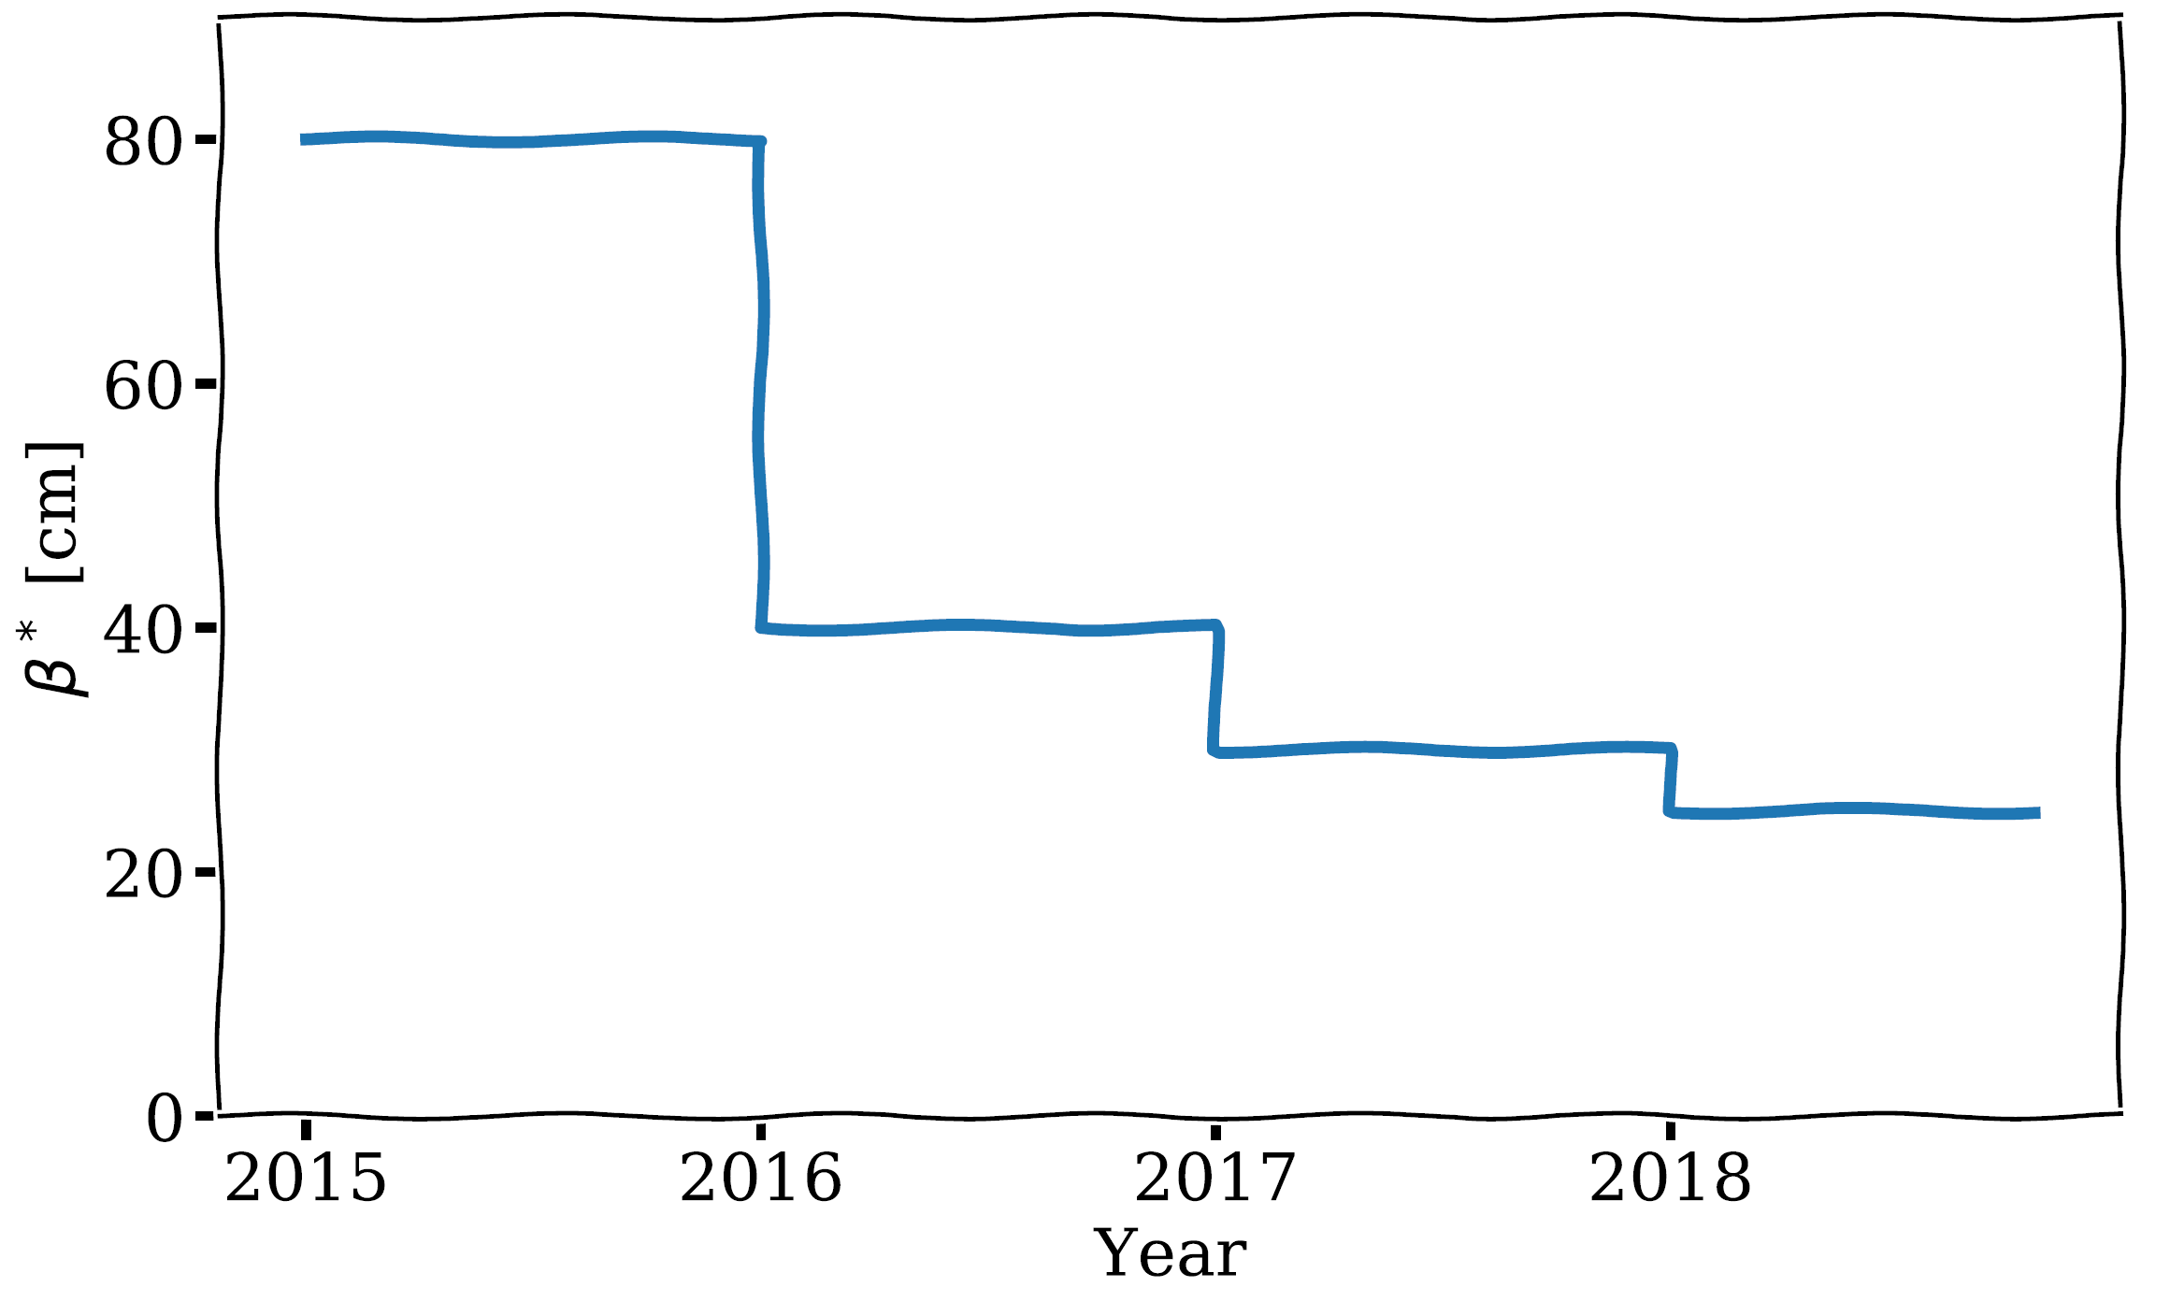
Operational β* in Run 2
The β* is used to label the optics and has been reduced every year from 2015-2018
Small β* at the IP requires high β-functions in the triplet and hence more sensitive to imperfections

Slide 12
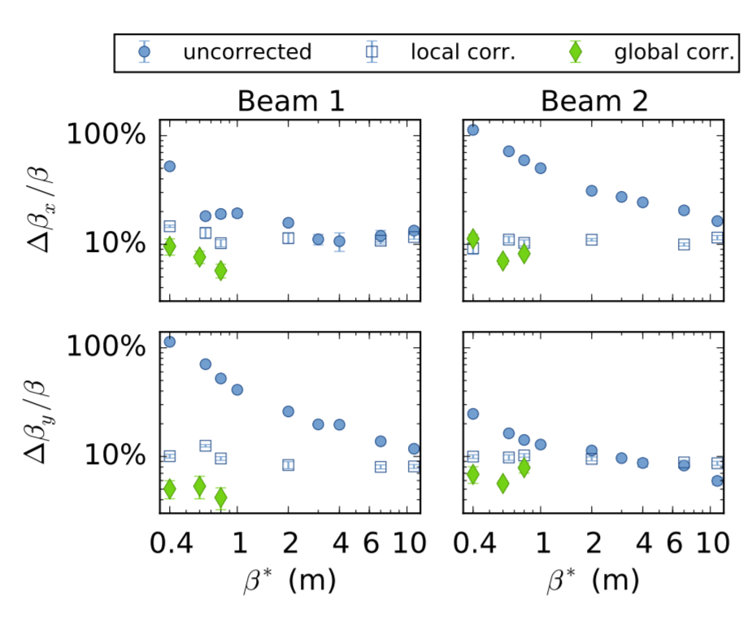
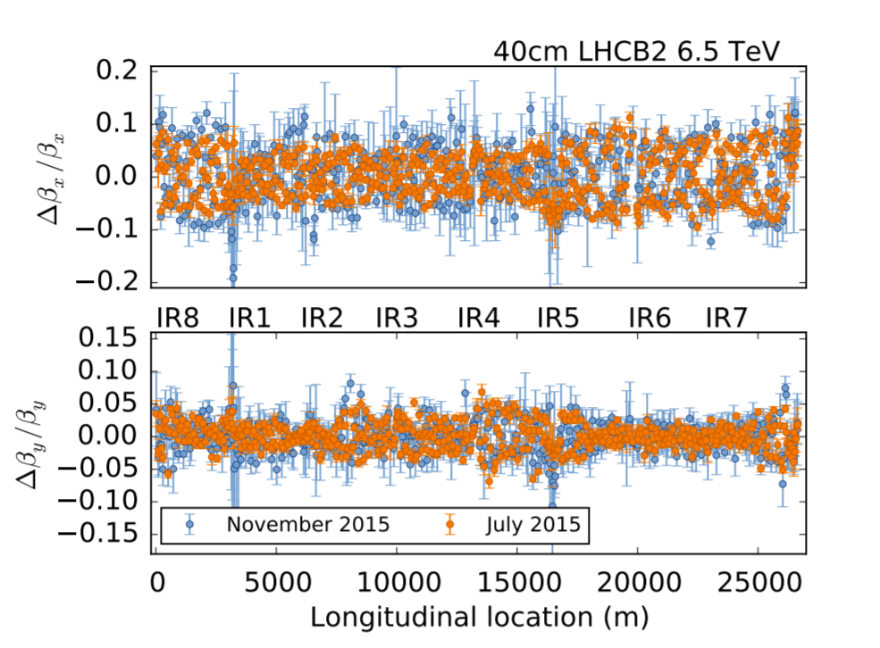
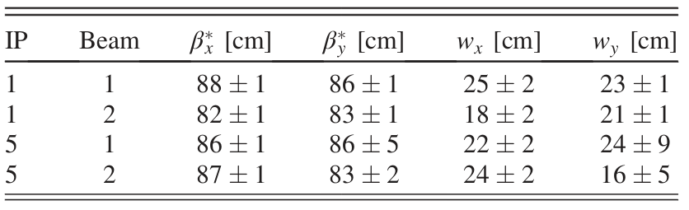
β-beat in 2015

Slide 13
How to improve the β* measurements?
Problem:
Different local corrections can correct the phase error but still cause significant difference in the waist of the β-function
Solutions:
Get precise β-functions from the amplitude of the oscillations
K-modulation of the magnets closest to the IP and use this information to constrain the local corrections.

Slide 14
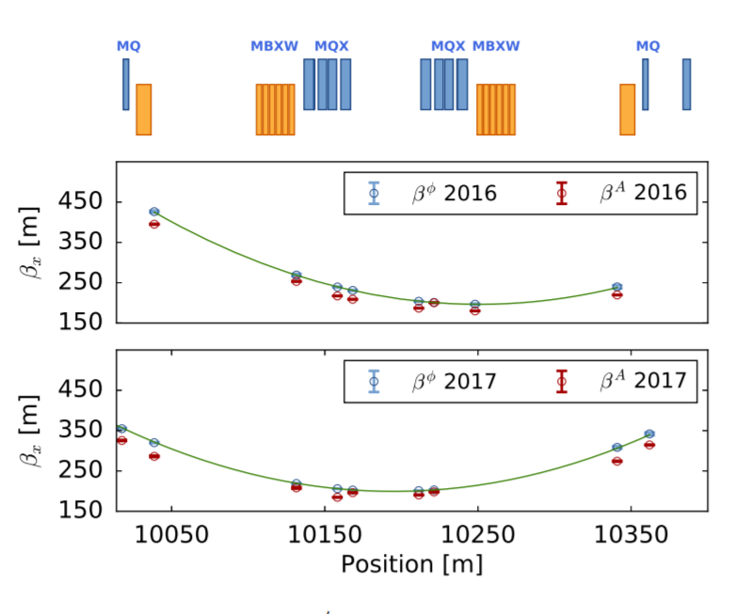
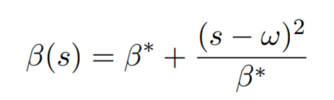
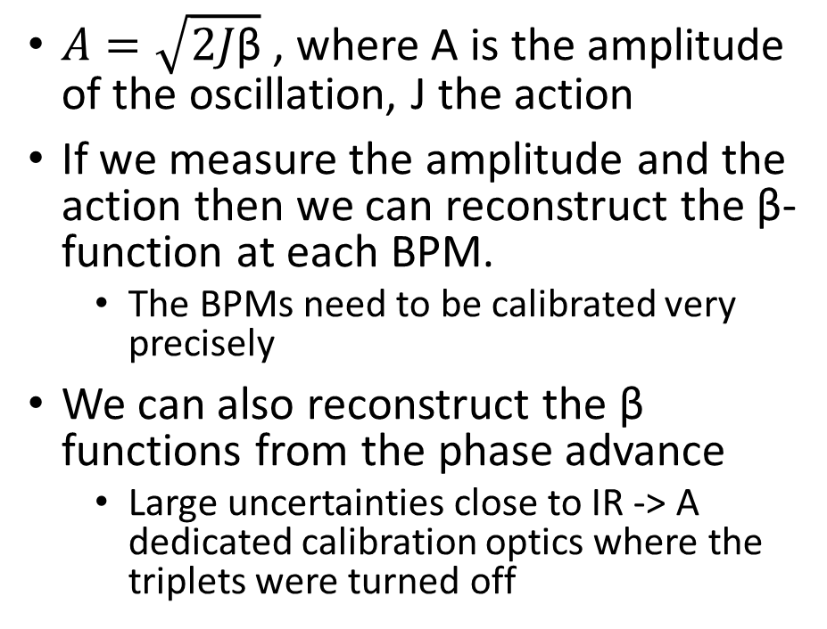
β from amplitude
$A=\sqrt{2J\text{β}}$ , where A is the amplitude of the oscillation, J the action
If we measure the amplitude and the action then we can reconstruct the β-function at each BPM.
  The BPMs need to be calibrated very precisely
We can also reconstruct the β functions from the phase advance
  Large uncertainties close to IR -> A dedicated calibration optics where the triplets were turned off
A. García-Tabarés Valdivieso and R. Tomás, “Optics-measurement-based beam position monitor calibrations in the LHC insertion regions”

Slide 15
Commisiong strategy 2016
K-Modulation
K-Modulation
Measure the
virgin
Machine
Measure with Local Corrections
TbT Measure +
K-Modulation
Linear Comissoning (No X-ing)
Calculate Local Corrections
Calculate Global Corrections
Time

Slide 16
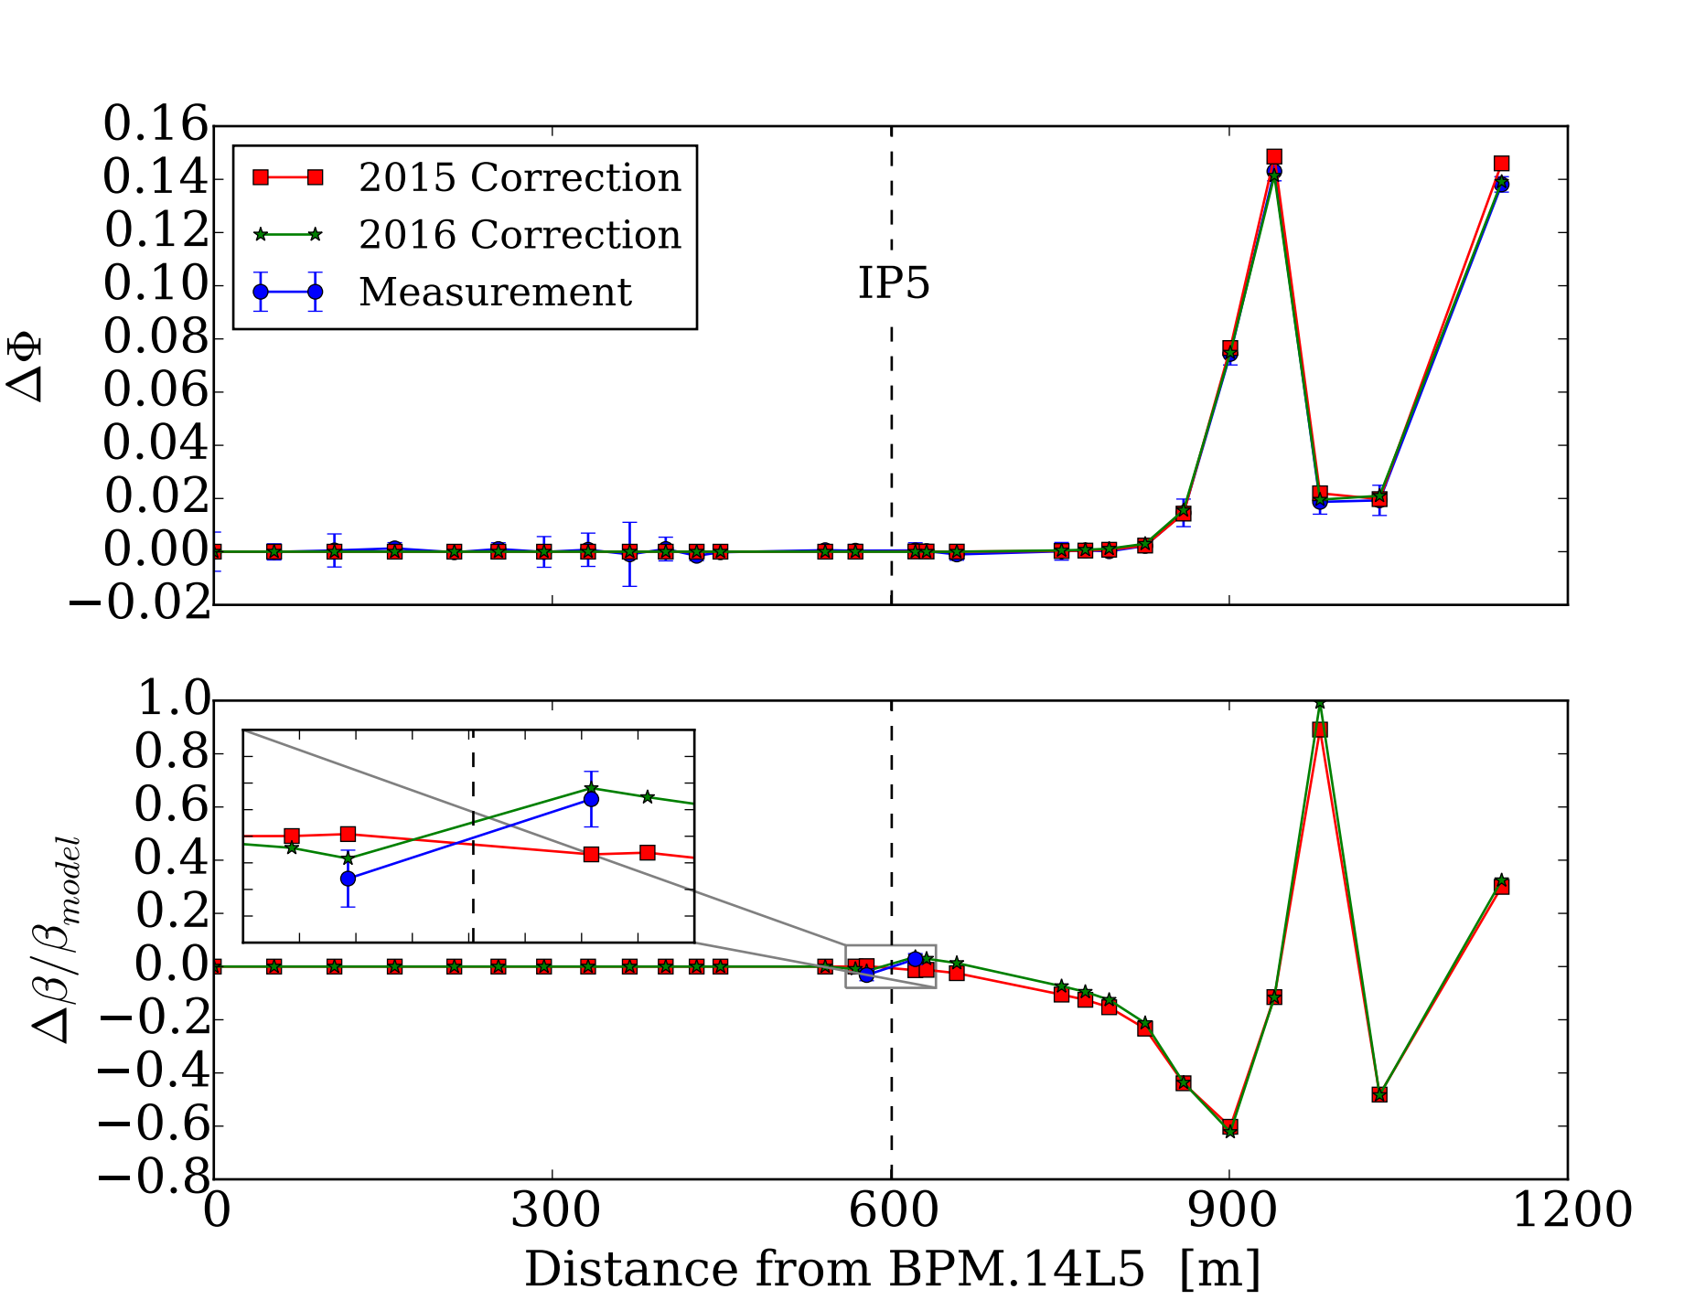
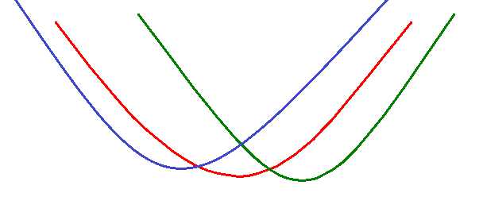
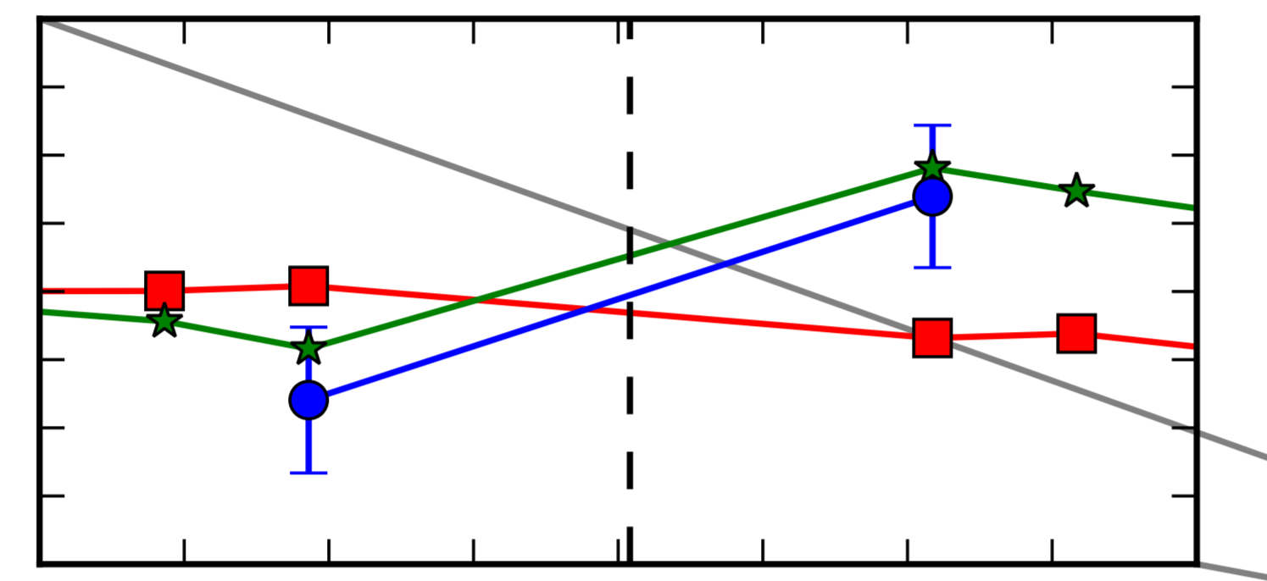

Local corrections
The local phase corrections are degenerate. Possible to find several combinations that correct the phase
  No guarantee that the waist or β_{IP} is well corrected
IP5
Virgin machine
2015 correction
2016 correction

Slide 17
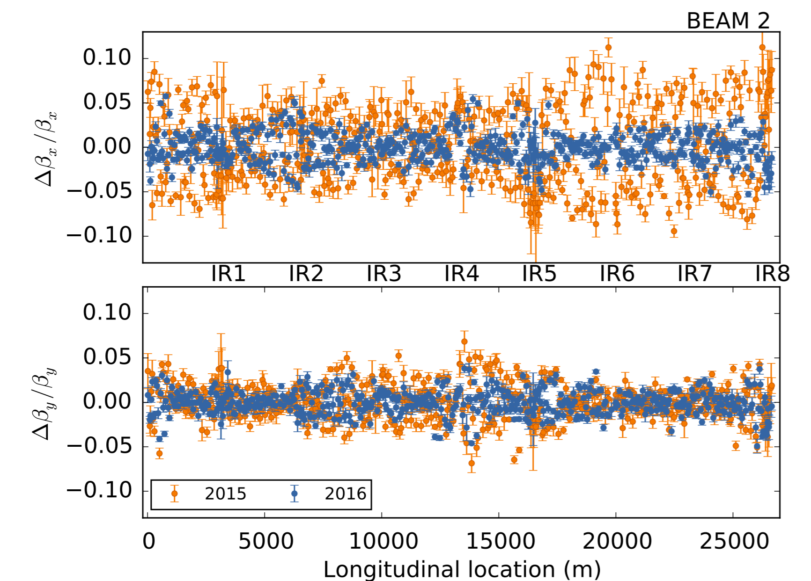
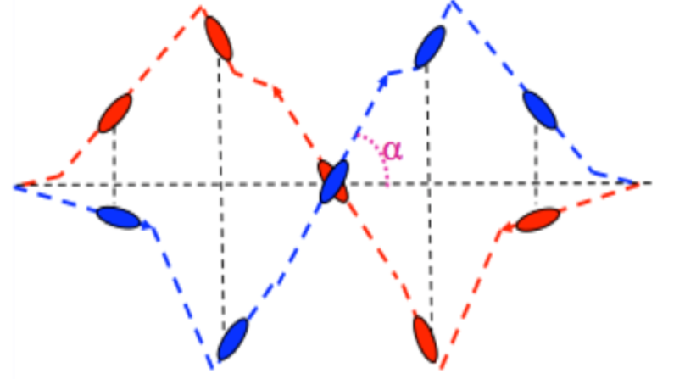
Final Corrections 2016
IP | β_{IP} [m] | β_{IP} err [m] | Waist [m] | waist err [m]
ip1b1.X | 0.398 | 0.007 | 0.047 | 0.009
ip1b1.Y | 0.401 | 0.002 | -0.009 | 0.009
ip1b2.X | 0.398 | 0.001 | 0.009 | 0.011
ip1b2.Y | 0.402 | 0.001 | 0.072 | 0.010
ip5b1.X | 0.399 | 0.003 | -0.009 | 0.008
ip5b1.Y | 0.400 | 0.001 | -0.028 | 0.010
ip5b2.X | 0.395 | 0.003 | 0.070 | 0.013
ip5b2.Y | 0.396 | 0.004 | -0.025 | 0.011
Average | 0.403 | 0.003 | 0.016 | 0.010
RMS β-beat in IP % | 1%
No X’ing!

Slide 18
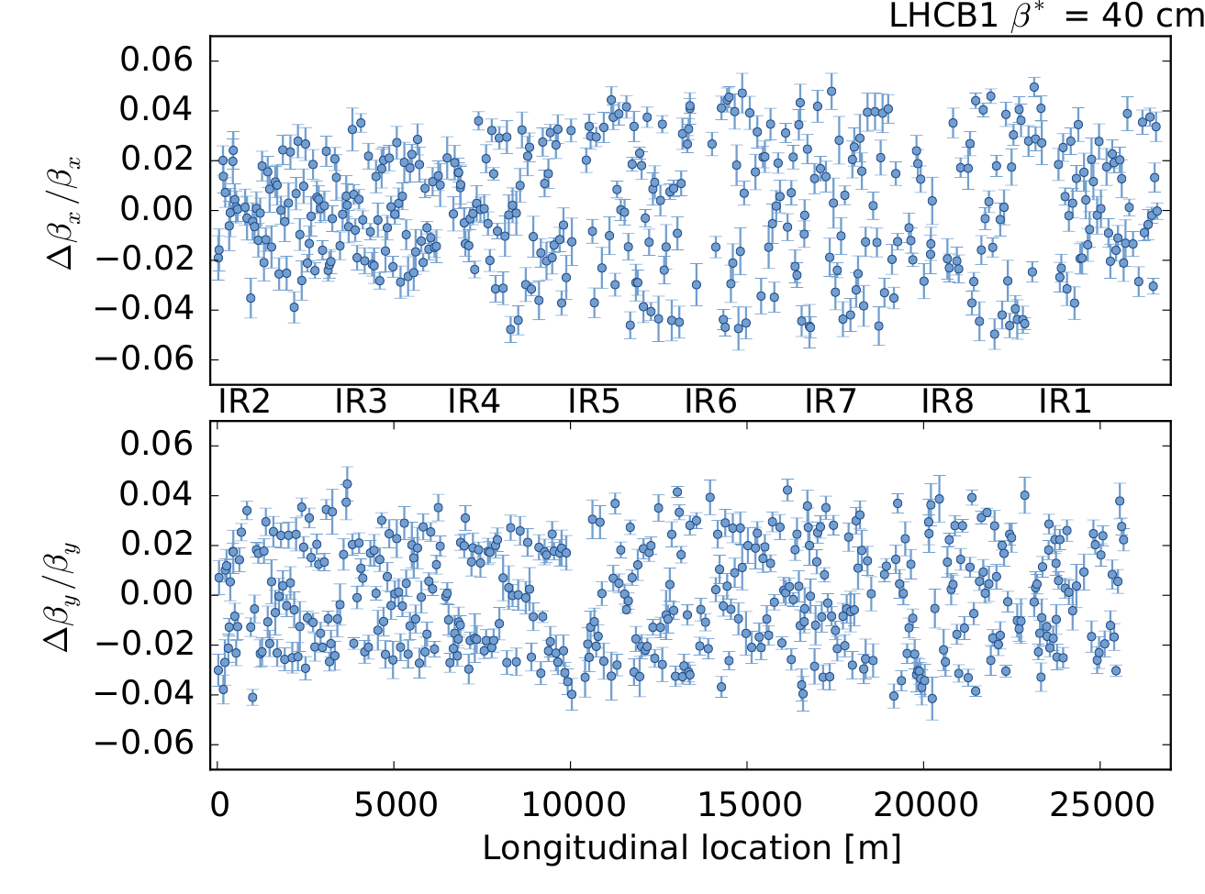
Effect of crossing angles
Crossing angles are needed at the IRs so beams only collide at the IPs.
Optics measured in June (commissioning without crossing angles in April)
  Difference between the two measurements shown in plot below
Consistent with simulation of the IR sextupoles errors + crossing angles
An increase of the peak β-beat in the order of ~3% due to crossing angles + IR sextupole errors

Slide 19
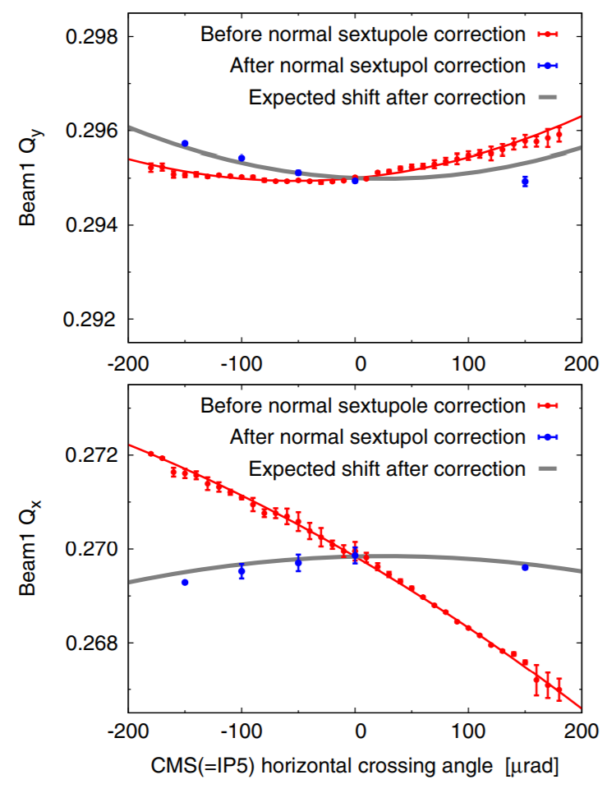
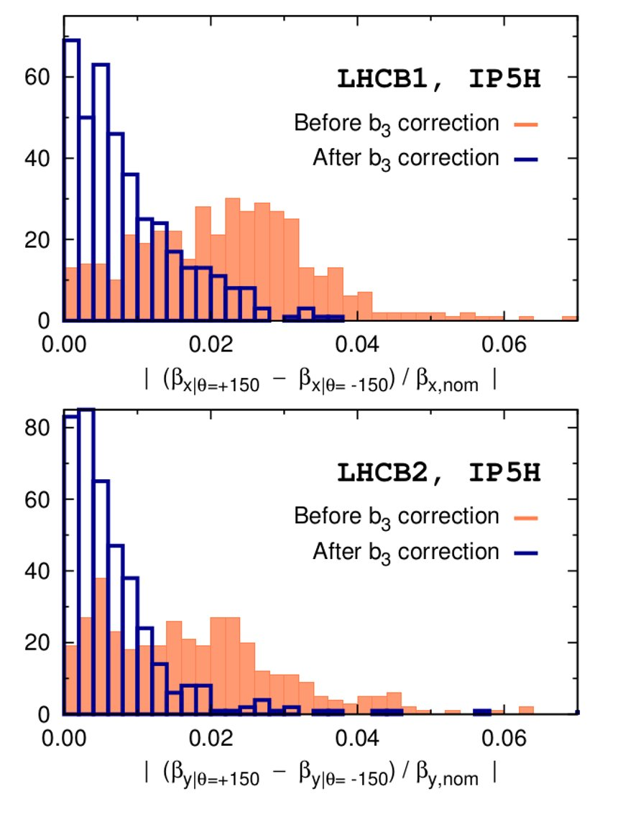
Sextupolar corrections in IR1 and IR5
The crossing angles in the IRs are changed and the feed-down tune and coupling is measured.
Based on this the nonlinear corrections are calculated
E. H. Maclean et al, ”New approach to LHC optics commissioning for the nonlinear era”

Slide 20
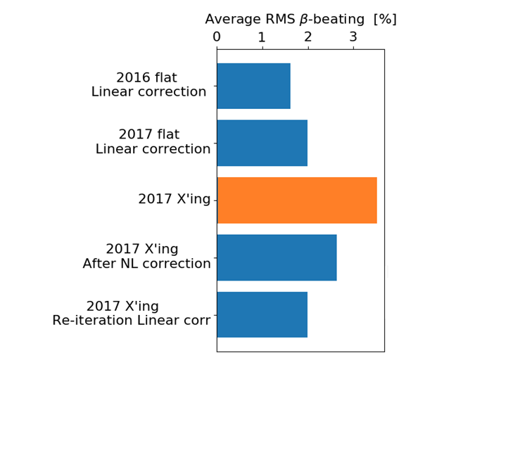
Flat-orbit vs X’ing
The X’ing angles introduce β-beating
The sextupolar correction removes most of it
Re-iteration of the linear correction
  ➔ Same quality of correction as with flat orbit
Measured
Extrapolated

Slide 21
And the LHC lived happily ever after…
Still many challenges!
What will limit us in the future?

Slide 22
Local coupling
Q3
Q2
Q1
IP
Q1
Q2
Q3
MQSX3.L
MQSX3.R
180 deg
Local coupling corrections has been part of the correction strategy since the start of the LHC.
  They rely on the measurement of the f₁₀₀₁ and the f₁₀₁₀ and are corrected with two common skew quadrupoles, one on each side of every IP.
  Creates an almost closed bump.
    Increasing MQSX3.L and at the same time decrease MQSX3.R changes the coupling at the IP but almost undetectable outside
    A knob doing exactly this re-balancing between right and left is called the collinearity knob
A mistake in the implementation of the corrections in 2018 highlighted the importance of them
  Reduced the luminosity with around 50%!

Slide 23
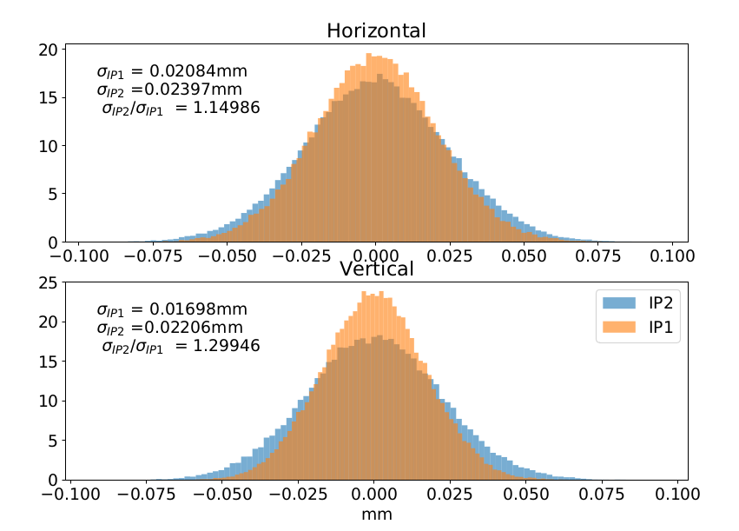
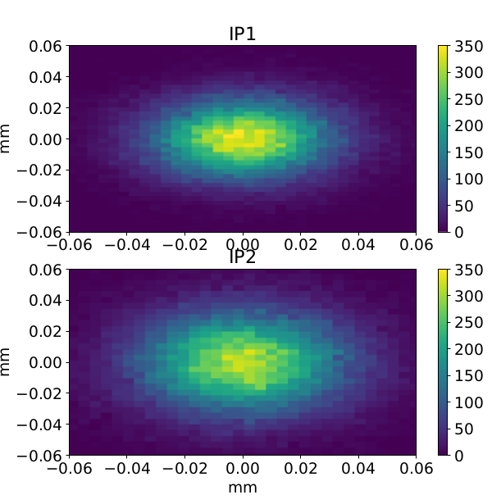
Simulation of the local coupling error
2d histogram x-y
Tracking simulation: Ideal machine (beam 1) + trim of the
colinearity knob = 10 (MQSX.3L2 = 10⁻³ m⁻² and MQSX.3R2 = -10⁻³ m⁻²)
→ Beam size is 15% larger in horizontal and 30% in vertical in IP2 compared to IP1
→ 33% lower luminosity (neglecting effect from crossing angles) compared to the 50% that was observed in the machine
→ Almost identical beam size increase for beam 2 (less than 1% difference)

Slide 24
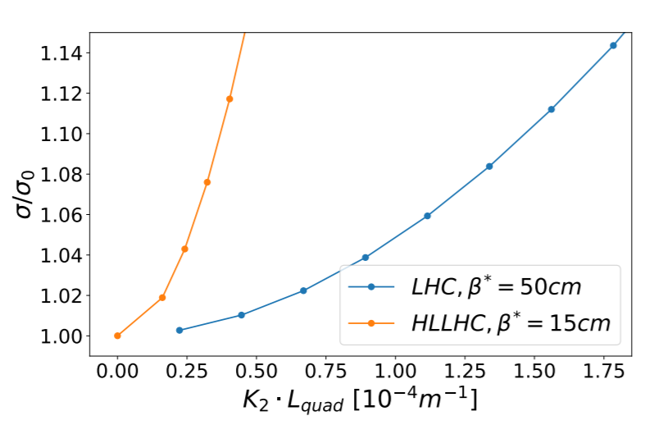
The impact of local coupling on beam-size
Relative small errors in the local coupling can cause a large increase of beam size!
So far we have been limited by how well we can measure the coupling RDTs
  Challenging because of the phase advance in this region

Slide 25
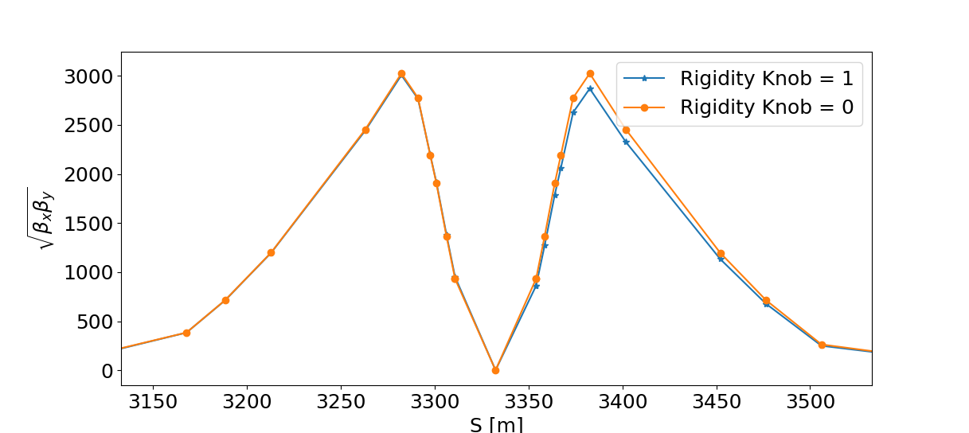
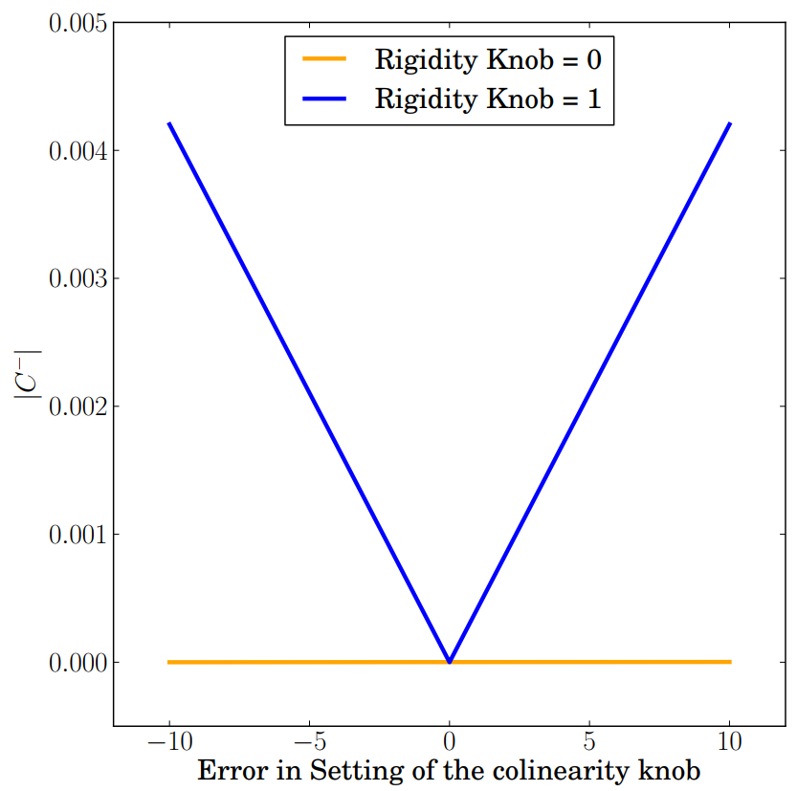
New method to measure the
local coupling
Principle of the rigid waist shift:
  Unbalance the strength of the left and the right triplet
    Breaks the left-right symmetry
The colinearity knob gives no contribution to the global observable |C-|
  After applying the rigidity knob there is a dependency
[m]

Slide 26
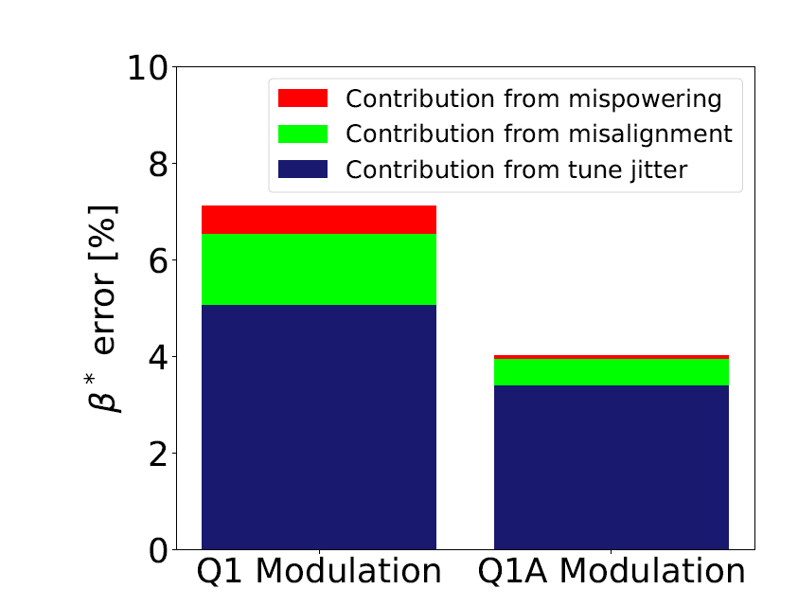
Limitations of K-modulation
As the β* is squeezed further the K-modulation measurements cannot constrain the β* to the desired level
  Limited by:
    Tune jitter
    Misalignment
    Mispowering
β* = 15 cm

Slide 27
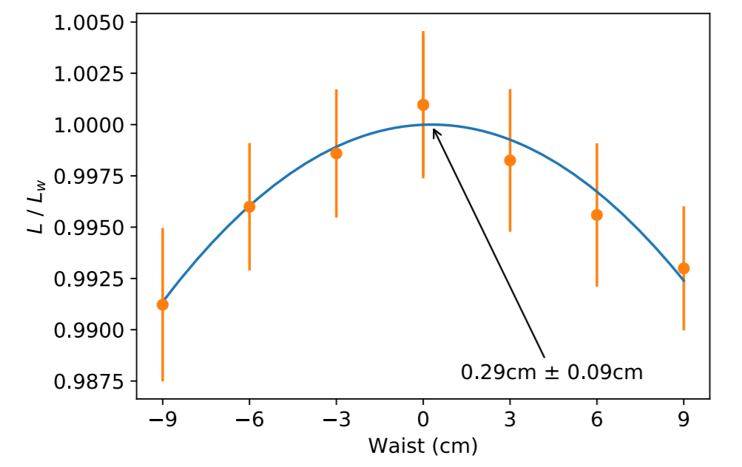
Luminosity scan
A specially designed knob that moves the waist of the β-function
Same method can also be used to adjust the local coupling using the collinearity knob
J. Coello de Portugal et al. , New local optics measurements and correction techniques for the LHC and its luminosity upgrade

Slide 28
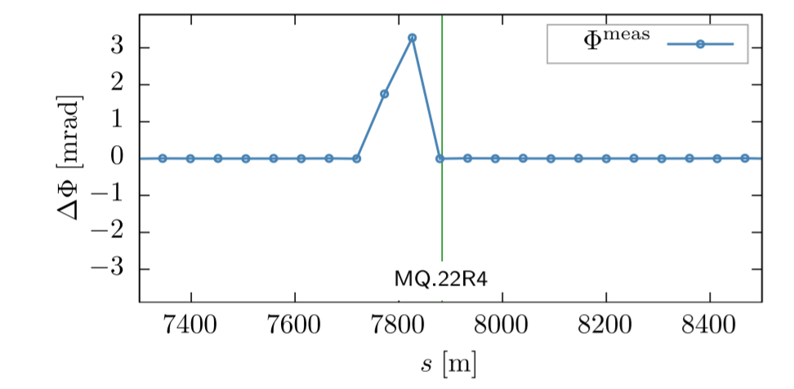
New local observable
Phase advance between two elements does in general depend on all element in the machine
Possible to construct a local observable for linear lattice imperfections
  The effect of quadrupolar field errors up to first order
  Only depends on the phase advance between 4 BPMs
  Could help to better localise imperfections in the machine
A. Wegscheider et al, Local observable for linear lattice imperfections in circular accelerators

Slide 29
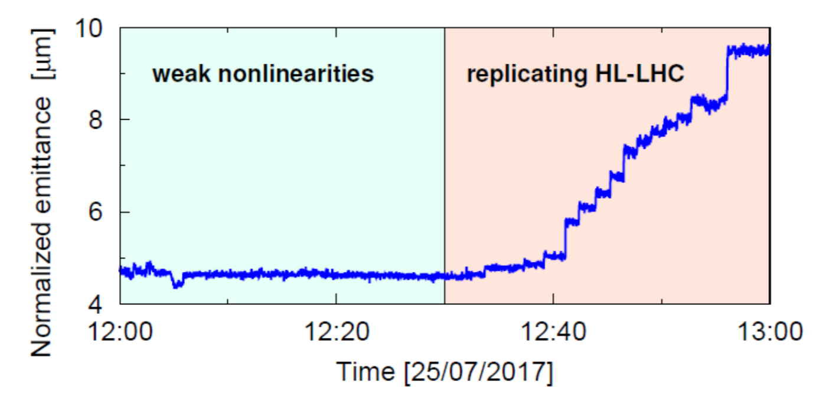
Nonlinearities
As the β* is squeezed further the importance of the nonlinearities becomes more and more important
  Huge impact on the foot print which is crucial for beam-instabilities
  Feed-down to transverse coupling and β-beat
  Reduce dynamic aperture
  Negative impact on the linear commissioning!

Slide 30
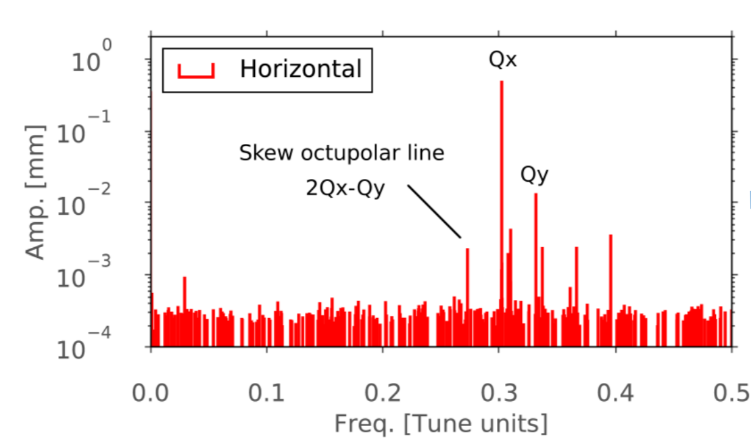
Measuring nonlinearities
Resonance driving terms
Amplitude detuning
Feed-down to tune and |C-|
Each method merits a presentation of its own!
E. H. Maclean et al, ”New approach to LHC optics commissioning for the nonlinear era”

Slide 31
Summary
We have overcome some limitation every year:
  2015: Reduced statstical errors and better reconstruction of the β-functions (N-BPM method)
    → Better corrections and reduced error bars
  2016: Include the results from K-modulation
    → Better control of the β*
  2017: Correct with X-ing + sextupolar and octupolar corrections
    → Improved control of the optics also with X-ing angles in the IPs
  2018: Use RDTs to correct skew octupolar error (a₄)
    → Demonstrated nonlinear corrections based on RDTs which will be important in the HL-LHC era

Slide 32
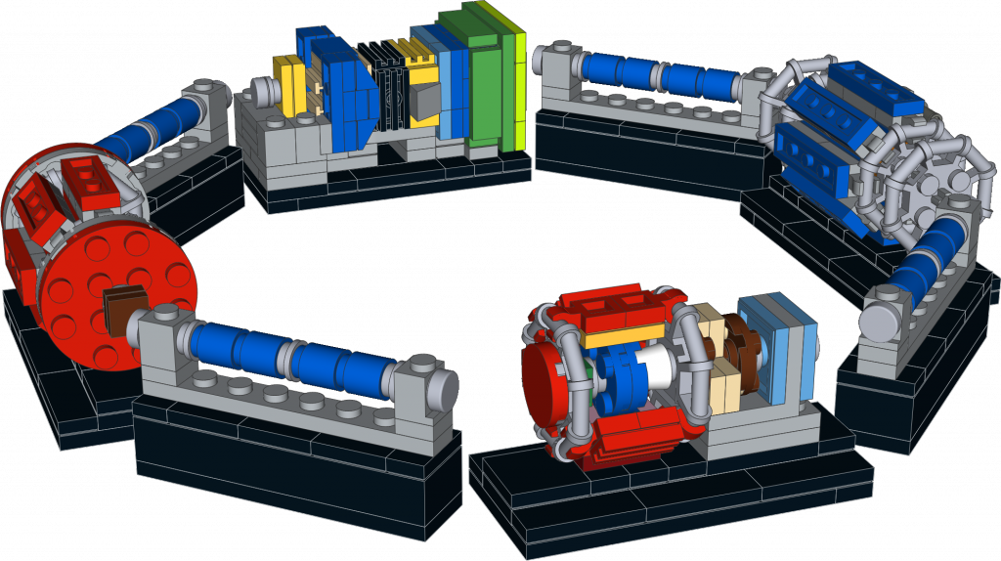
Future challenges
Challenges
Solutions
Measure β* < 0.2 m
K-modulation
Luminosity waist shift scans
Correct Local Coupling
RDTs measurement
Triplet scaling
Luminosity scans
Correct Nonlinearities
RDTs
Amplitude detuning
Feed-down measurements
F. Calier et al, “Optics Measurement and Correction Challenges for the HL-LHC”

Slide 33



Thank you for listening !

Slide 34
Backup

Slide 35
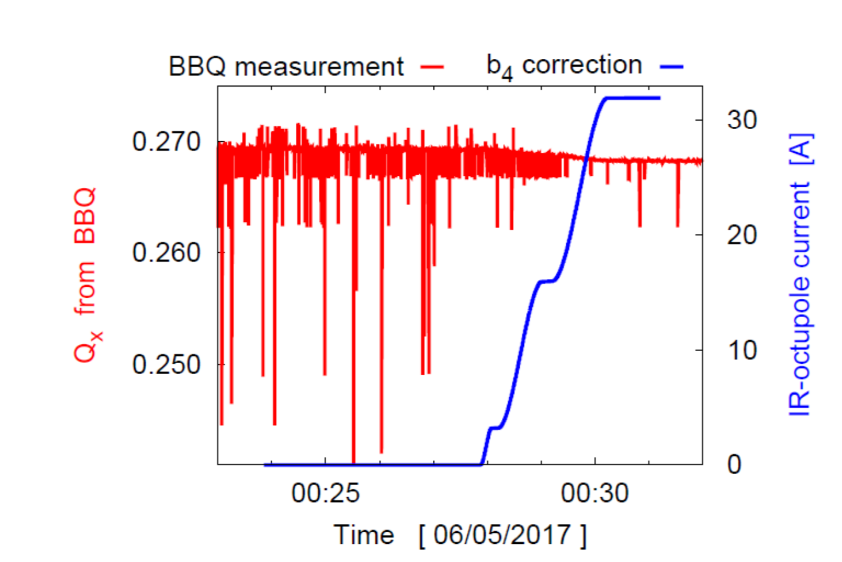
Octupolar Corrections
The corrections were applied in IR1 and IR5
Immediate effect on the online tune measurement (BBQ)
  Important for the linear commissioning
  Clearly shows the interplay between linear and nonlinear
Important for the amplitude detuning
E. H. Maclean et al, ”New approach to LHC optics commissioning for the nonlinear era”

Slide 36
Commisiong strategy 2017
Non-linear commisioning
K-Modulation
K-Modulation
New for the year
Measure the
virgin
Machine
Measure with Local Corrections
TbT Measure +
K-Modulation
TbT Measure +
K-Modulation
Linear Comissoning (No X-ing)
Linear with X-ing
Octupolar
Corrections
Local Corrections
Global Corrections
Sextupolar
Corrections
Global Corrections
Time

