Slide 1
Matching the Laser p- bunch into a CH- DTL
A. Almomani, M. Droba, U. Ratzinger, IAP- Frankfurt
I. Hofmann, GSI
“Milestones and Perspectives of the Projected Test Stand to Capture and Transport Laser-Accelerated Proton Beams”
GSI, August 06, 2010
Introduction
Injector for Accelerators
Pulsed Magnetic Solenoid – LASIN code
H- type Cavities (IH and CH) – LORASR code
Proton Bunch Matching into a CH- cavity
Outlook and Conclusions

Slide 2
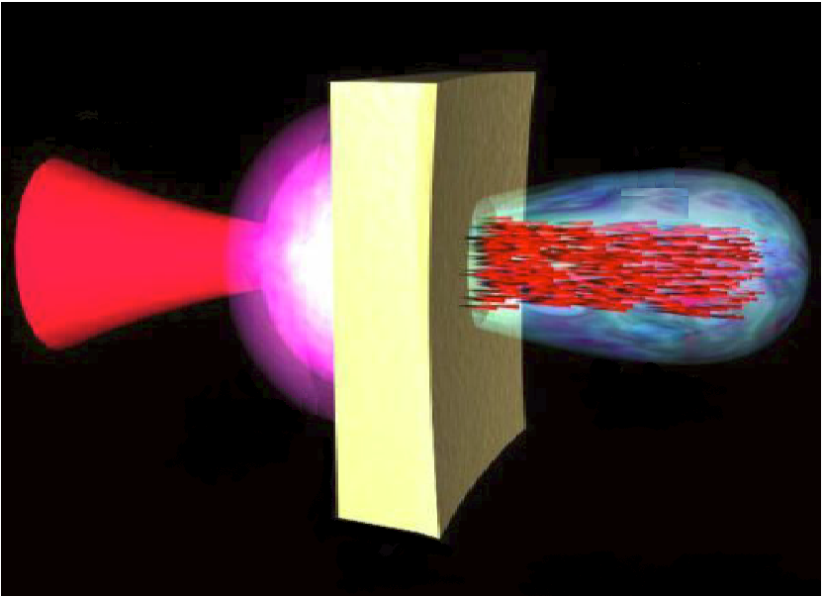
Laser Driven Ion Acceleration in Solid Targets
If an ultraintense and ultrashort laser pulse hits the surface of a thin solid target, intense and energetic (Multi-MeV) ion beams are effectively produced.
Target
Electron Cloud
PHELIX-
Laser
Ions
Blow- off
plasma
The acceleration ions possess unique properties!

Slide 3
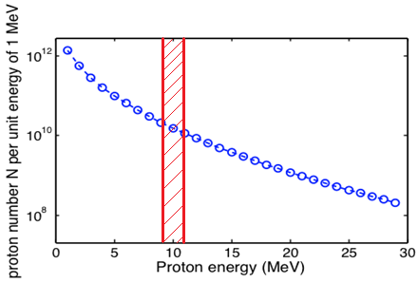
Proton Beams (M. Roth et. al., )
Region of interest

Slide 4
Injector for Accelerators
Laser accelerated ions could be an alternative for classical ion sources and injectors.
Motivation:
- Single Bunch generation; Small emittances and extremely high particle number.
Advantage:
- Beam parameters and quality are comparable or better
- Smaller size and easier to operate.
Open Question:
- Phase Space Matching [Longitudinally and Transversely].

Slide 5
Phase Space Matching
Transverse:
- Large divergence (± 23°) requires strong focusing pulsed solenoid (B > 18 T).
Longitudinal:
- Use only small part of energy spectrum for classical accelerators.
- Bunch length (<1ps, estimated by laser pulse); Small phase spread < 0.1 degree.

Slide 6
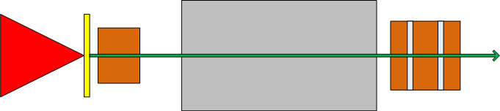
Schematic of the Matching Problem
Target
Solenoid
CH-Cavity
PHELIX
Proton Bunch
Resources:
Models of H- cavities - Long experience in high efficient H-type (IH, CH) drift tube accelerators.
Experimental setups – studies on secondary electrons trapped in the magnetic field, influence on ion beam dynamic.
Codes: LORASR, LASIN, TRACE 3D, MWS.
The Center for Scientific Computing CSC- cluster.

Slide 7
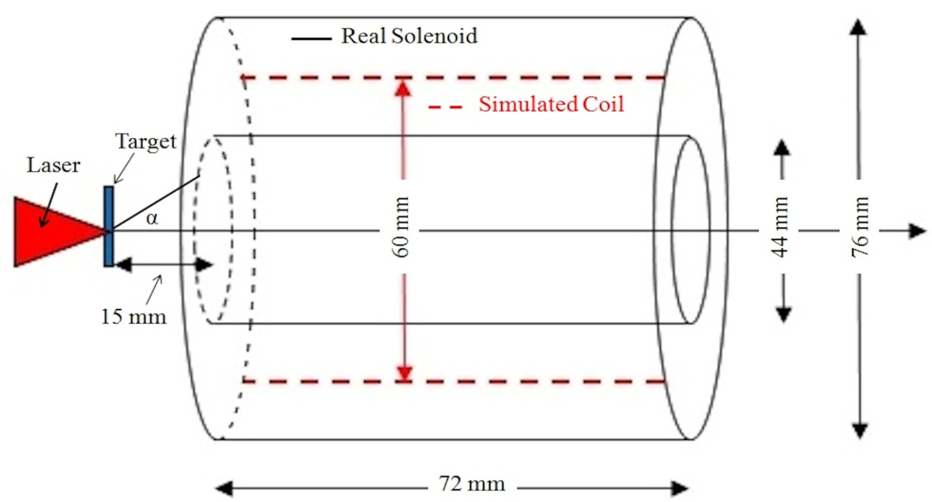
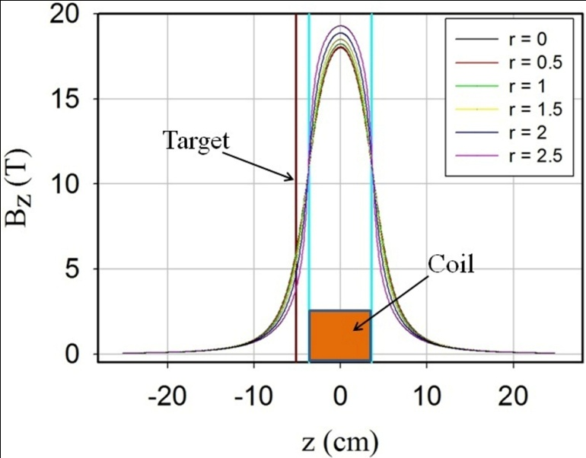
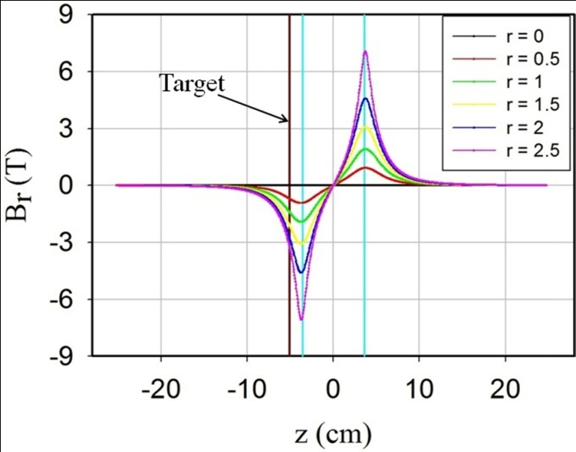
Simulations of the Magnetic Solenoid
33 coils
Current 42 kA.
Without magnetic material.
3D- PIC LASIN code was used.
Field at target position about 6 T

Slide 8
LASIN (LASer INjection) code
New simulation tool
Realistic magnetic fields (target in fringing field) – transport through solenoid.
Multispecies simulation (proton, electron, ions)
Higher order aberration, chromatic and geometric effects.
Influence of electrons – space charge compensation.
PIC code (tracking dimensions transversely from µm – cm
longitudinal ~ m )
Bunch dimensions (longitudinally and transversely tens of µm).
Possibility to use a fine mesh of about 4 µm in longitudinal and transverse directions.
Many particles for statistical reason <=> high energy spread of protons.
Implementation on CSC- cluster.

Slide 9
CPU cluster "Fuchs“
www.csc.uni-frankfurt.de
New part installed in 2009/10 on Campus Riedberg and Campus Bockenheim (old part installed in 2006/07).
4788 CPU cores, 14 TB RAM and 530 TB disk capacity 14 air cooled and 5 water cooled racks.
Infiniband, Myrinet and Gigabit Ethernet interconnects parallel scratch file system with a capacity of 124 TB and an aggregated bandwidth of 6 GB/s.
300 nodes containing 2 AMD Opteron Istanbul (six-core) processors with 2.2 GHz , 32 GB of RAM per node by default.
40 nodes with 64 GB RAM, 8 quad socket nodes with 4 Istanbul CPUs (2.4 GHz), with 128 GB RAM and 850 GB local scratch space per node.
connected by DDR 4x Infiniband (ConnectX for lower latencies) and
with a parallel scratch file system with an aggregated bandwidth of 6 GB/s and a capacity of 124 TB.

Slide 10
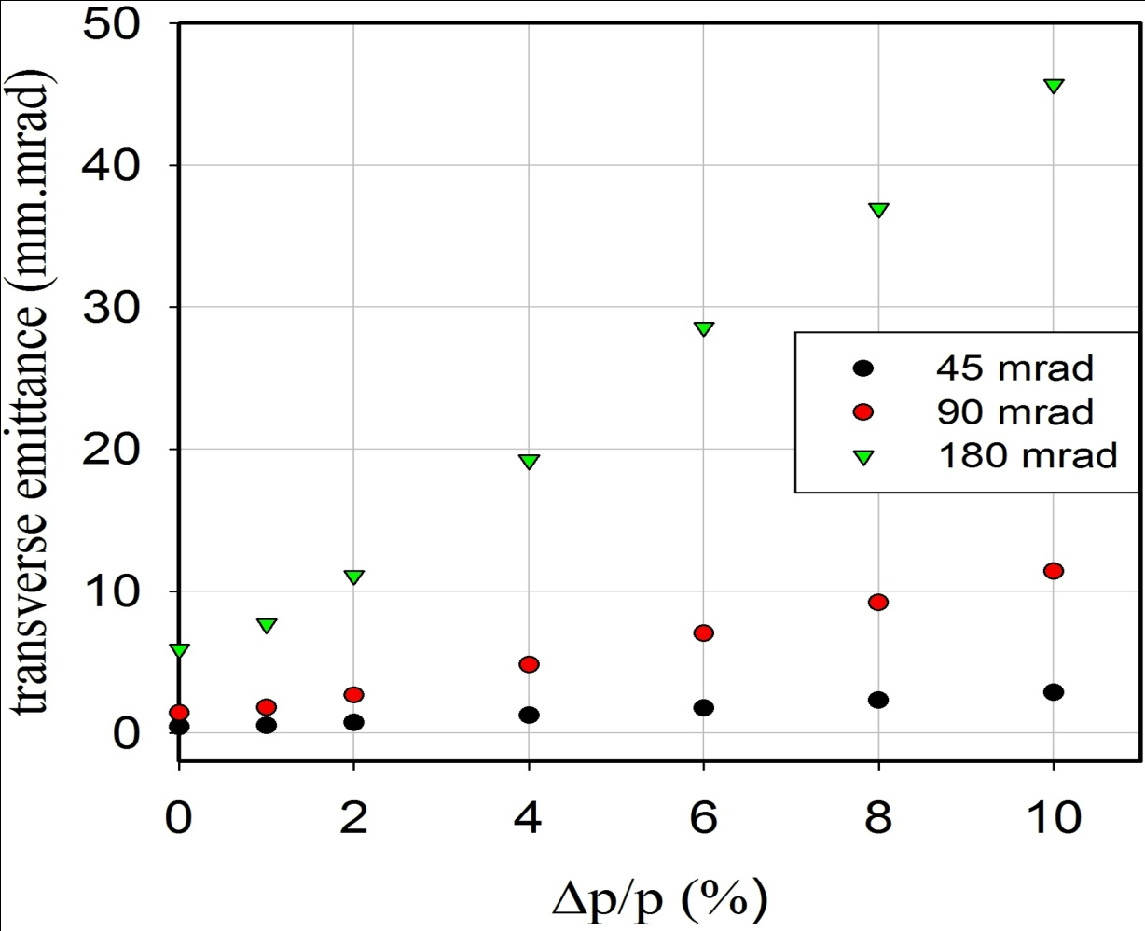
Chromatic and Geometric Aberration
Simulation made for different angles with different momentum spreads.

Slide 11
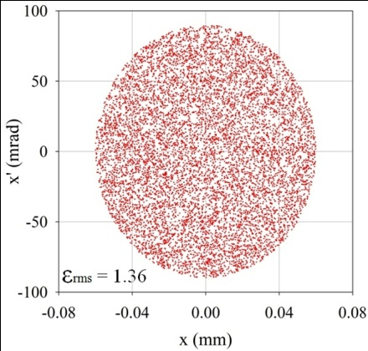
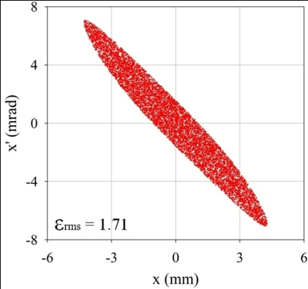
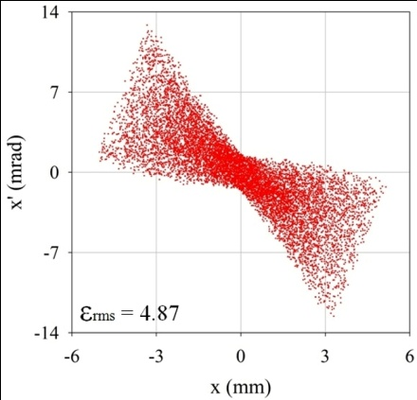
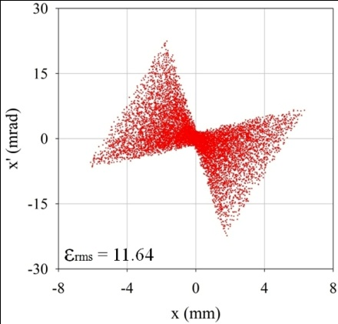
Input and Output distributions (Chromatic aberration)
90 mrad | Δp/p = 0 % | 4 % | 10 %
Input
Output

Slide 12
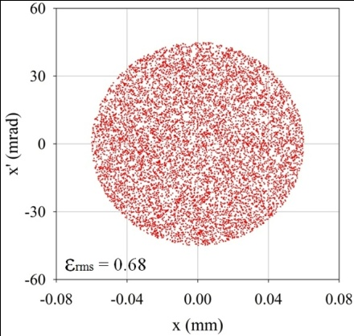

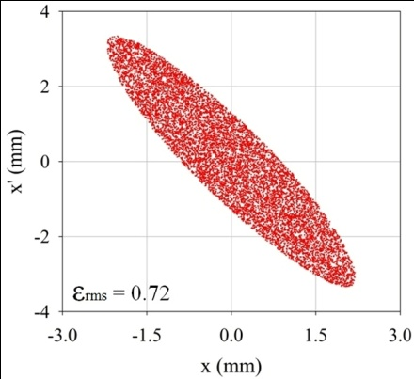
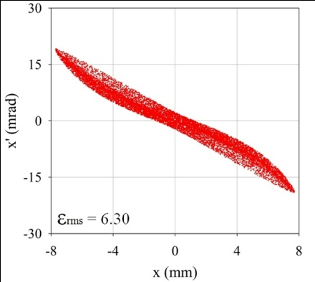
Input and Output distributions (Geometric aberration)
Δp/p = 0% | 45 mrad | 90 mrad | 180 mrad
Input
Output

Slide 13
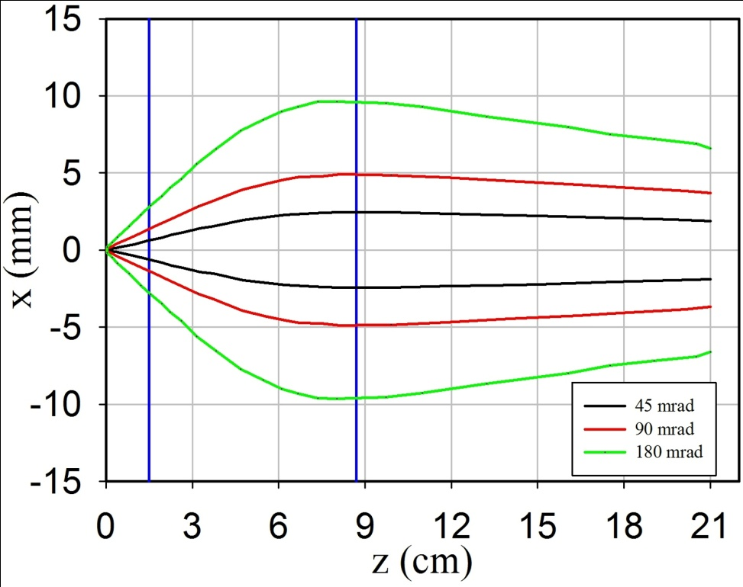
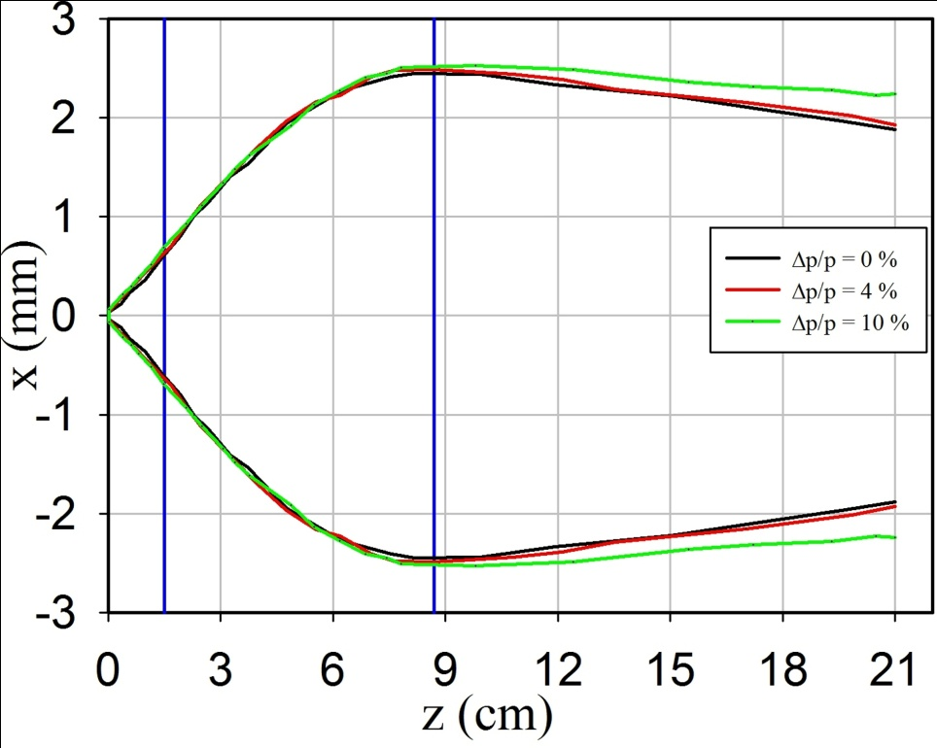
Beam Envelopes
The maximum beam radius remained below 10 mm, even for 180 mrad case.
For different momentum spreads, the main effect can be seen along the drift due to different exit angles behind the solenoid.

Slide 14
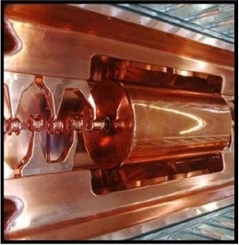
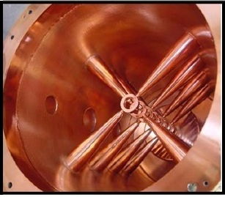
H-Mode Cavities
Interdigital
H
-
Type structure (IH)
IH-DTL
r.t.
W < 30 MeV
30-250 MHz
Crossbar H
Crossbar H
-
-
Type structure (CH)
Type structure (CH)
CH-DTL
r.t. and s.c.
W < 150 MeV
150-700 MHz

Slide 15
Why CH- structure??
High acceleration gradients, due to slim tubes (without focusing elements insides).
Smaller power loss due to transverse current flow on cavity walls.
β- range.
Mechanical robustness.
High shunt impedance (high energy
gain in a given length for a given power
loss).

Slide 16
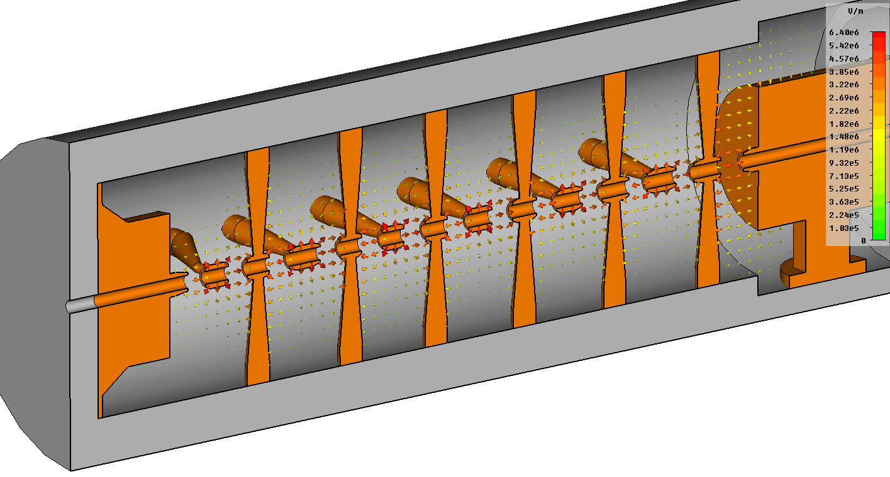
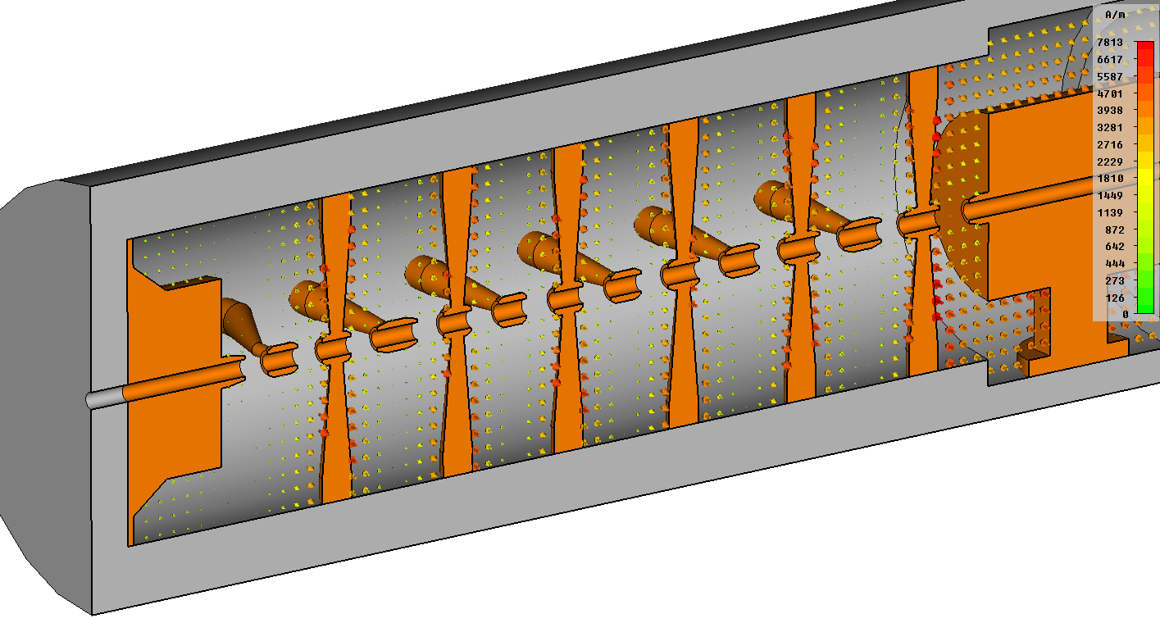
Electric and Magnetic Fields for CH- DTL
E- Field
B- Field

Slide 17
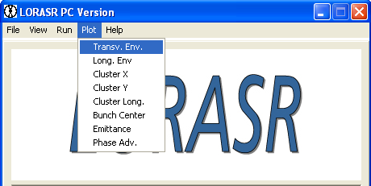
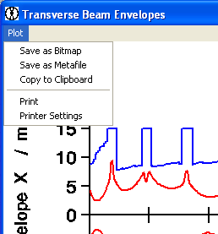
LORASR Code Features - Overview
Longitudinale und radiale Strahldynamikrechnungen mit Raumladung
Longitudinal And Radial Beam Dynamics Calculations including Space Charge
General :
Multi particle tracking along drift tube sections, quadrupole lenses, short RFQ sections including fringe fields, dipole magnets and Solenoid.
Running on PC-Windows platforms (Lahey-Fujitsu Fortran 95) and Linux.
Available Elements :
GUI :
magnetic quadrupole lens
solenoid lens
dipole bending magnet
accelerating gap
RFQ section (constant rf phase, ‘Superlens’)
3D FFT space charge routine
error study routines

Slide 18
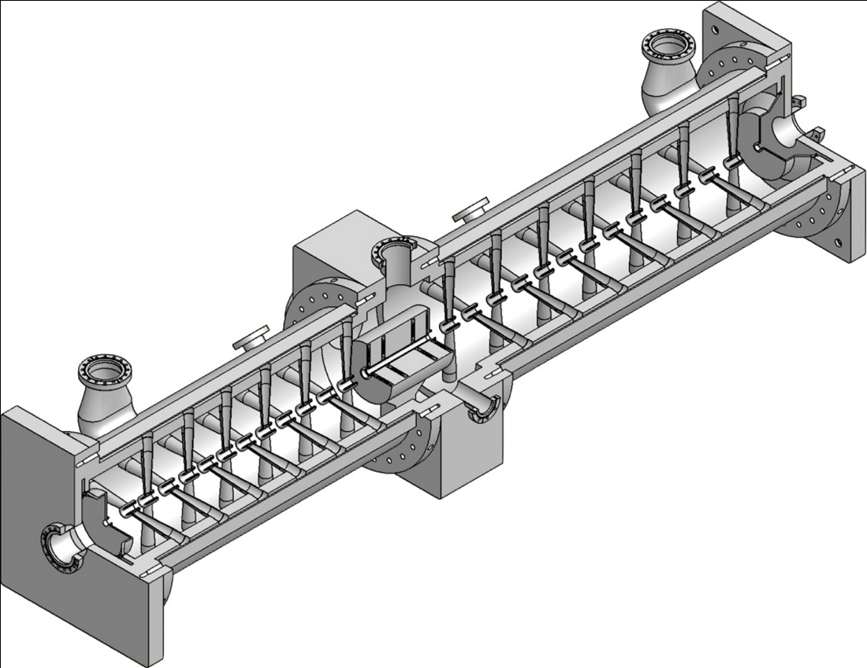
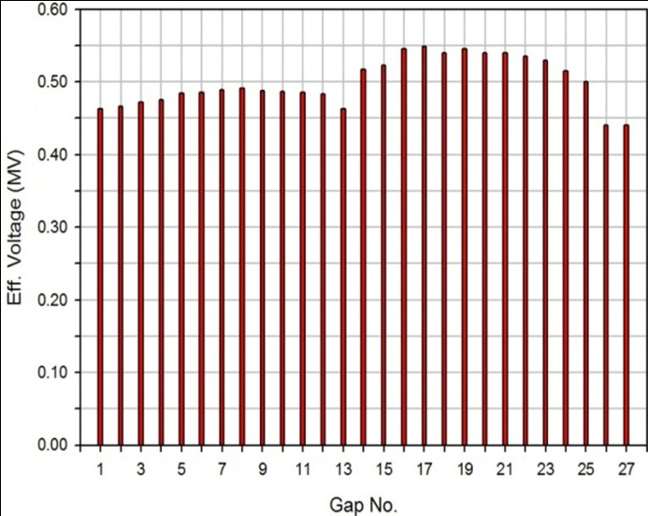
CH- DTL for High Intensity Proton
Crossbar H-type (CH) structure is chosen to be the linac structure for high beam currents.
R. Brodhge & G. Clemente
Current = 500 mA
Frequency = 325 MHz
Energy: 11.69 – 23.57 MeV
Emittance values for the input and output distribution at 500mA
Beam Parameters | Input | Output
ɛ_{tr} | 0.69 | 0.84 mm·mrad
Ɛ_{long} | 7.25 | 10.42 keV·ns
After test the coupled cavity with UNILAC at Z4 area it will situated next to Z6 area near PHELIX.
Voltage dist. calculated by MWS.

Slide 19
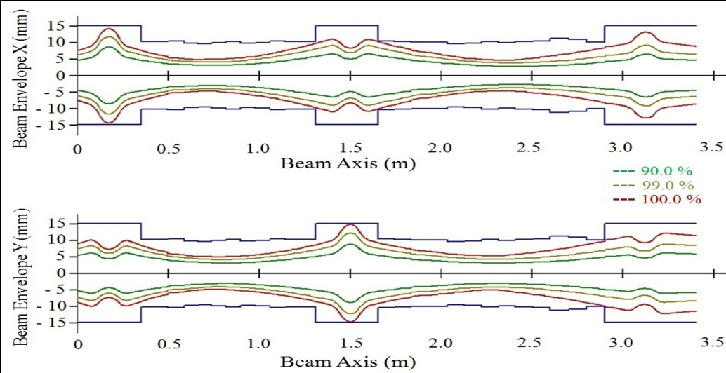
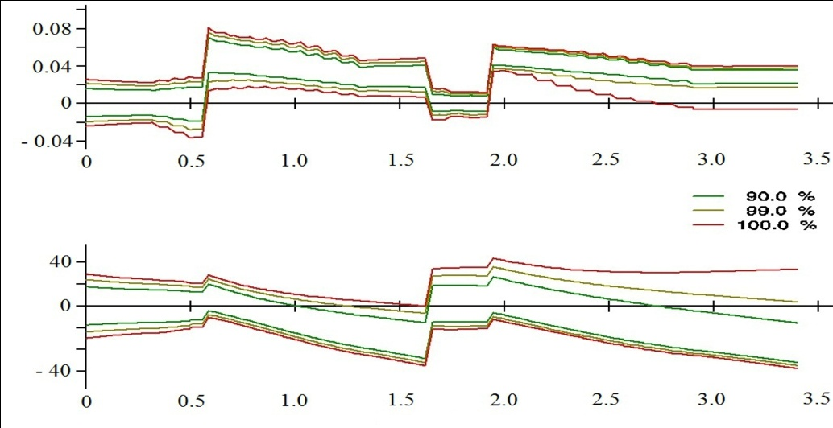
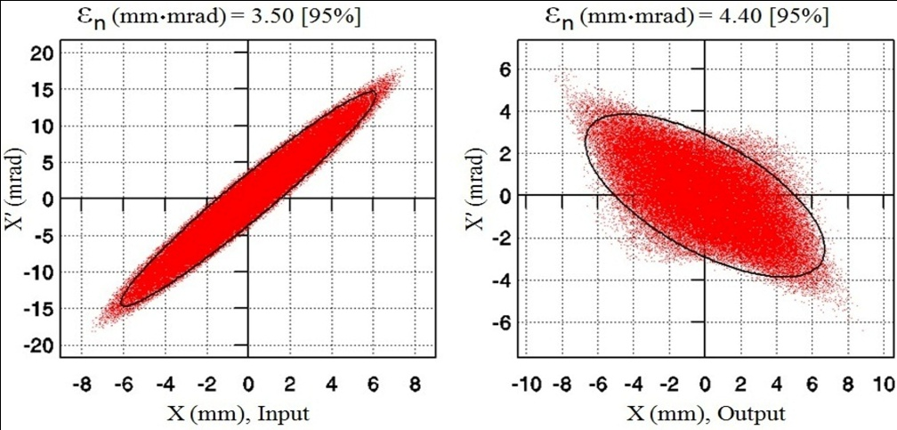
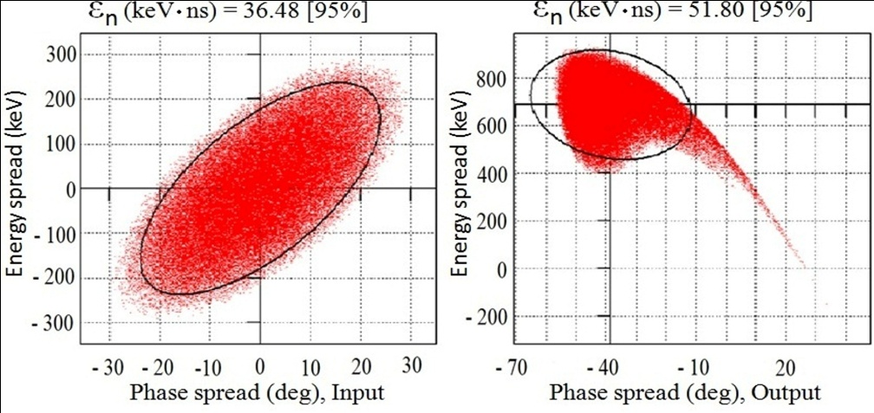
Beam Dynamics
Longitudinal and transverse beam dynamics were performed by LORASR code.
Emittance growth was less than 45 % longitudinally and about 20 % in transverse planes.

Slide 20
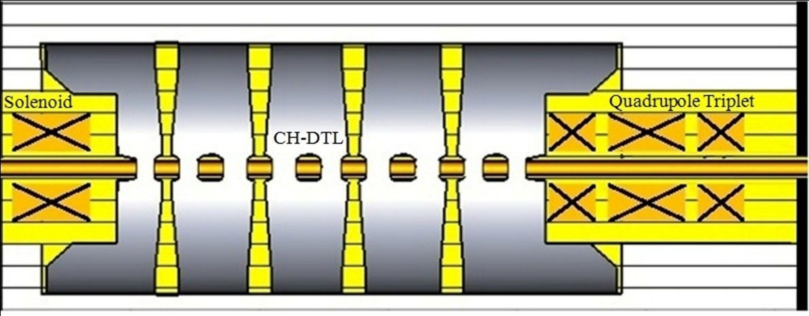
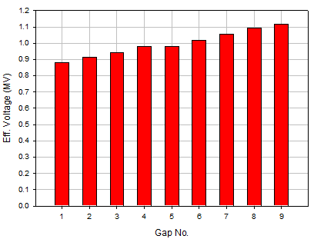
Dedicated Design for a Short CH- Cavity
Current = 500 mA.
Frequency = 325 MHz.
Energy: 10.05 – 17.37 MeV.
No. of Gaps = 9 (4 reb. and 5 acc.)
Magnetic Solenoid is Part of the Design.
Emittance values for the input and output distribution at 500mA
Beam Parameters | Input | Output
ɛ_{tr} | 0.33 | 0.53 mm·mrad
Ɛ_{long} | 3.22 | 4.08 keV·ns

Slide 21
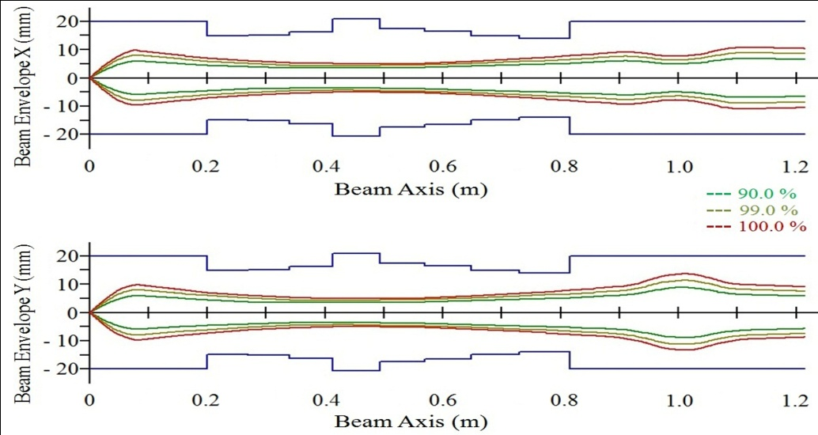
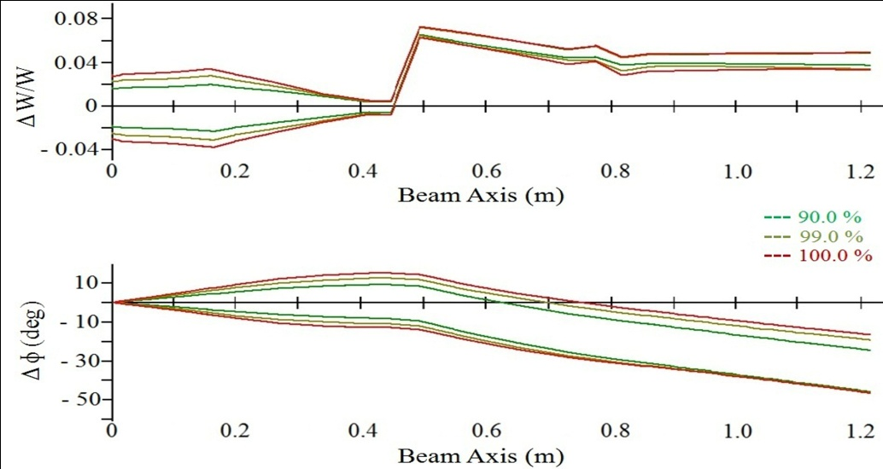
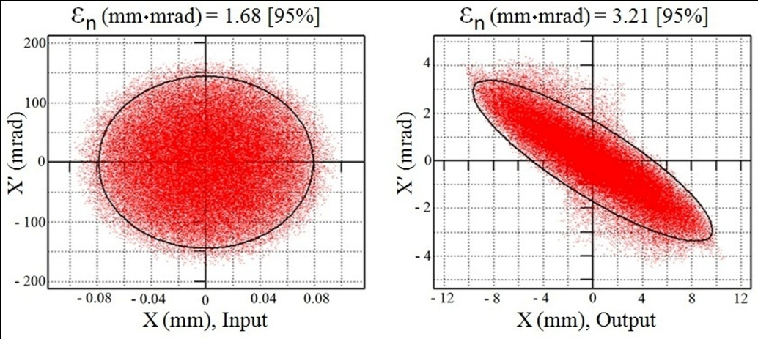
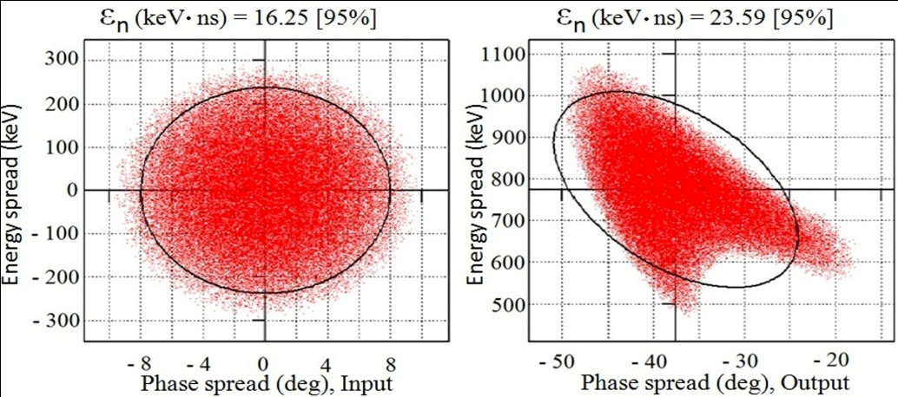
Beam Dynamics
The magnetic field gradients of the quadrupole are ranging up to 65 T/m and up to 18 T for 72 mm solenoid.
Emittance growth was less than 30 % longitudinally and less than 65 % in transverse planes.

Slide 22
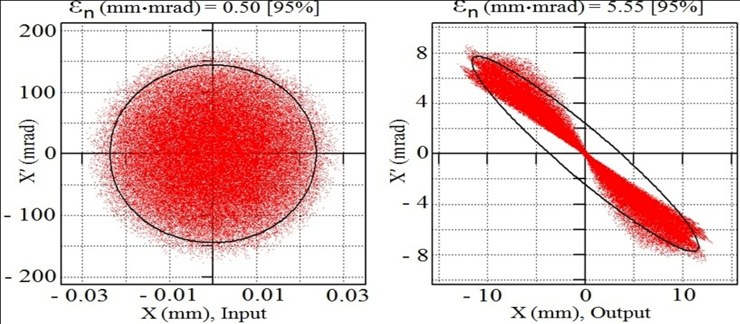
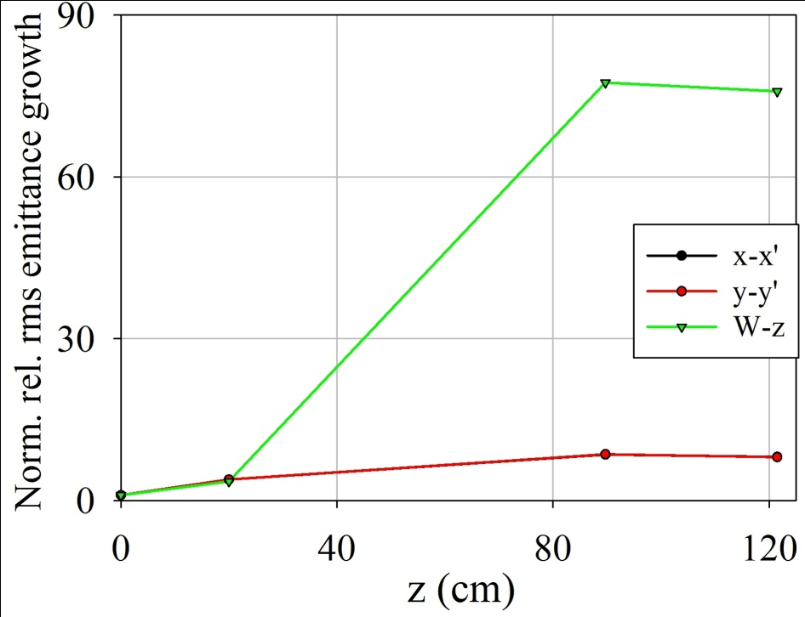
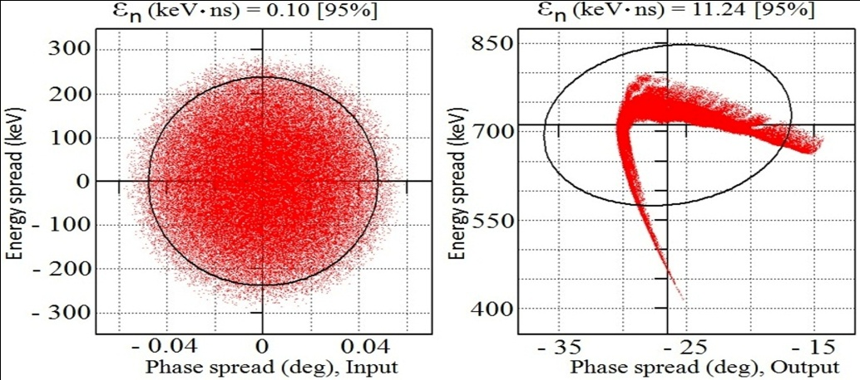
Emittance Behind the Foil and their Indirect Measurements Behind the Tank cavity!!
Proton pulse length Δt < 1 ps (< ± 0.06 degree spread!!).
εlong. = 0.02 keV.ns, εtr. = 0.10 mm.mrad!!
A problem in the Emittance growth!! Especially in longitudianl plane which my shows factors of 100!!

Slide 23
Due to well known transformations of the injected beam emittances along the CH- cavity:
It is aimed to derive the TNSA generated emittances by measuring the beam properties behind of the CH- cavity.
A FAIR coupled cavity for proton linac, will be used for the first injection test of the generated proton by PHELIX at Z6 area.

Slide 24
Conclusions and Outlook
For transverse matching; Magnetic Solenoid > 18 T is required.
Capability of CH-structure linac for high current (500 mA) has been proved .
Due to short proton pulse; longitudinal emittance shows a growth of factors 100 .
Electrons that generated by the laser are influenced on beam dynamics of protons (Started and still under investigation).
Controlled emittance growth process is still under invistegation.
Space charge effect through the solenoid is studied using LASIN (Started and still under investigation).
A run of two species (e, p) Beam Dymanics through the Solenoid (will be done).
The logitudinal and transverse emittace need to be measured .
A laser generated proton bunch will be injected into the CH- coupled cavity, which built for FAIR proton linac, at the Z6 area (near PHELIX) after it is tested with UNILAC at Z4 area .

Slide 25
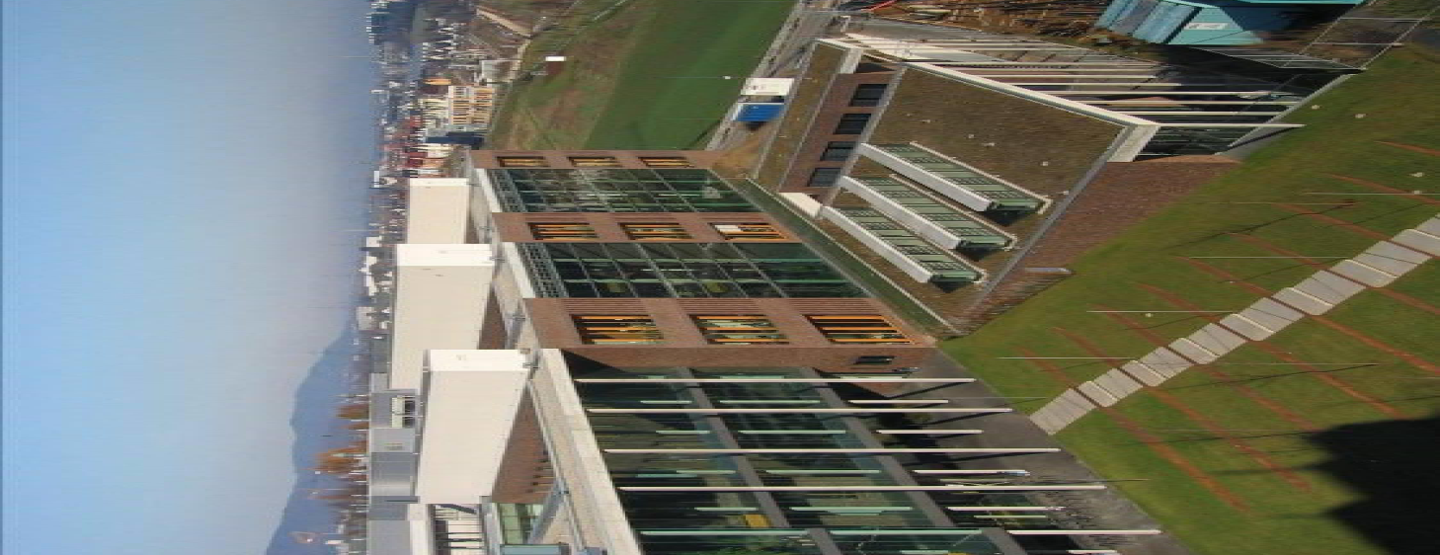
THANK YOU!!

