Slide 1
STUDYING THE NUCLEAR (AND NEUTRON) MATTER EQUATION OF STATE WITH THE CBM EXPERIMENT AT FAIR
Kshitij Agarwal
Eberhard Karls Universität Tübingen (DE)
Hirschegg 2020 – Nuclear Equation Of State and Neutron Stars
International Workshop XLVIII on Gross Properties of Nuclei and Nuclear Excitations
Hirschegg, Kleinwalsertal, Austria, January 12 - 18, 2020

Slide 2
TOPICS ADDRESSED IN THIS TALK
Heavy Ion Collisions ↔ Astrophysical Events & Objects
High Density EoS Observables for CBM@FAIR
  Nuclear Symmetric Matter EOS
  Neutron Matter EOS
    Symmetry Energy
    Hyperons in Dense Matter: ΛN, ΛNN, and ΛΛN interactions
Experimental Challenges
Summary and Outlook

Slide 3
TOPICS ADDRESSED IN THIS TALK
Heavy Ion Collisions ↔ Astrophysical Events & Objects
High Density EoS Observables for CBM@FAIR
  Nuclear Symmetric Matter EOS
  Neutron Matter EOS
    Symmetry Energy
    Hyperons in Dense Matter: ΛN, ΛNN, and ΛΛN interactions
Experimental Challenges
Summary and Outlook
Other relevant ‘experiment’ talks in this workshop:
Mo. 17:00 William Lynch (MSU) – Experimental Constraints on the EoS of Dense Matter
Mo. 17:40 Peter Senger (GSI) – Nuclear Equation of State from Reactions
Wed. 17:00 Arnaud Le Fevre (GSI) – Asymmetry energy and nuclear matter EoS: What have we learnt from experiments at SIS18?

Slide 4
HEAVY ION COLLISIONS
↕
ASTROPHYSICAL EVENTS AND OBJECTS

Slide 5
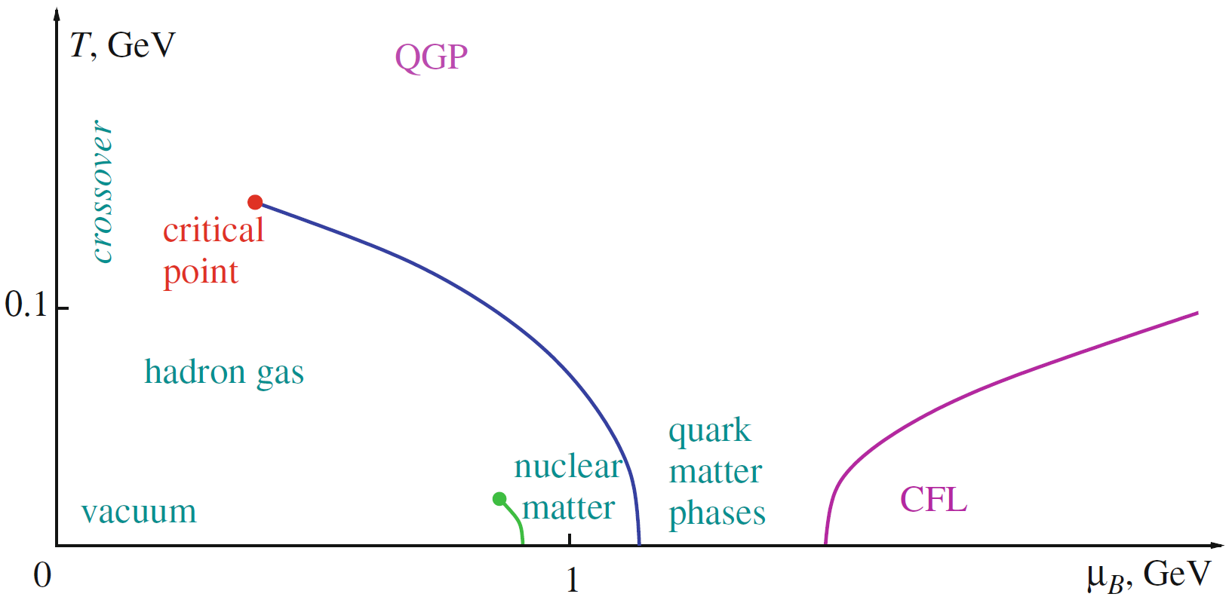

HEAVY ION COLLISIONS ↔ ASTROPHYSICAL EVENTS & OBJECTS
Image credits: Wikimedia
Robin Dienel, Carnegie Institution for Science Friman et al., The CBM Physics Book, Springer (2010)
GSI-DOC-2004-Mar-196-2

Slide 6
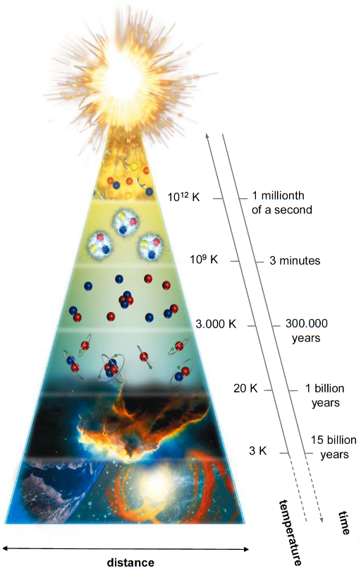
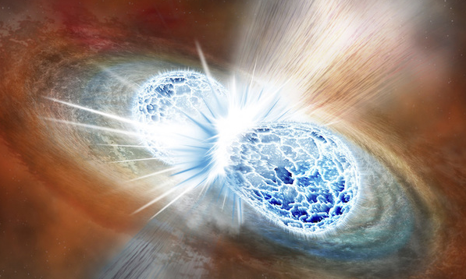
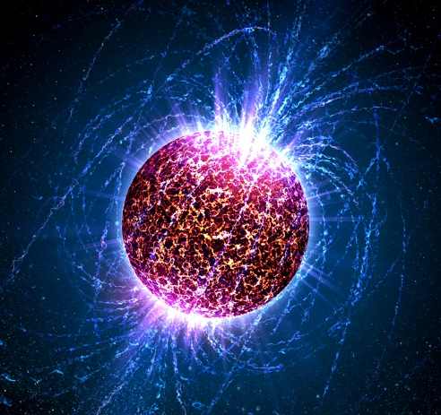
HEAVY ION COLLISIONS ↔ ASTROPHYSICAL EVENTS & OBJECTS
Early Universe
Neutron Star Merger
Image credits: Wikimedia
Robin Dienel, Carnegie Institution for Science Friman et al., The CBM Physics Book, Springer (2010)
GSI-DOC-2004-Mar-196-2
Neutron Stars

Slide 7
HEAVY ION COLLISIONS ↔ ASTROPHYSICAL EVENTS & OBJECTS
Image credits: Friman et al., The CBM Physics Book, Springer (2010)
T. Galatyuk, WE-Heraeus Physics School – 2017

Slide 8
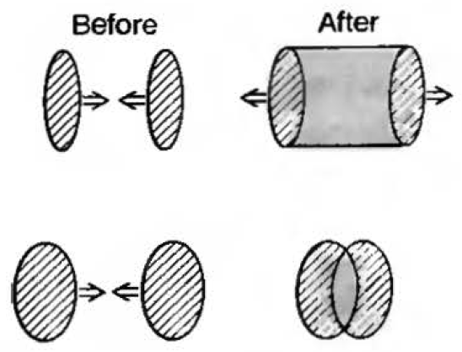
HEAVY ION COLLISIONS ↔ ASTROPHYSICAL EVENTS & OBJECTS
Collider Experiments
Image credits: Friman et al., The CBM Physics Book, Springer (2010)
T. Galatyuk, WE-Heraeus Physics School – 2017

Slide 9
HEAVY ION COLLISIONS ↔ ASTROPHYSICAL EVENTS & OBJECTS
Collider Experiments
Fixed Target Experiments
Image credits: Friman et al., The CBM Physics Book, Springer (2010)
T. Galatyuk, WE-Heraeus Physics School – 2017

Slide 10
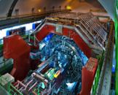

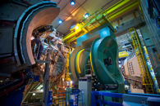

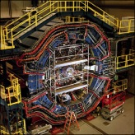

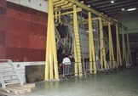

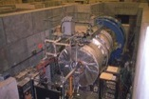
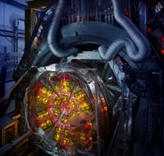

HEAVY ION COLLISIONS ↔ ASTROPHYSICAL EVENTS & OBJECTS
Collider Experiments
Fixed Target Experiments
Image credits: Friman et al., The CBM Physics Book, Springer (2010)
T. Galatyuk, WE-Heraeus Physics School – 2017

Slide 11
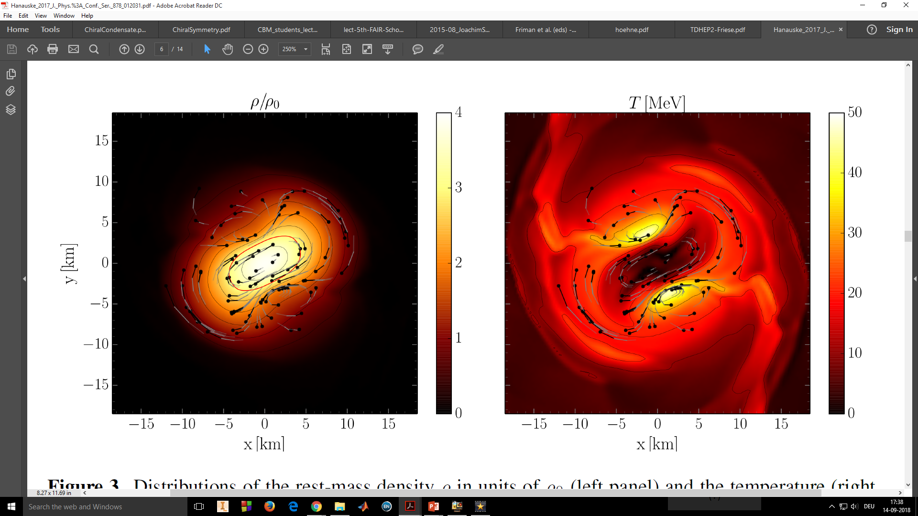
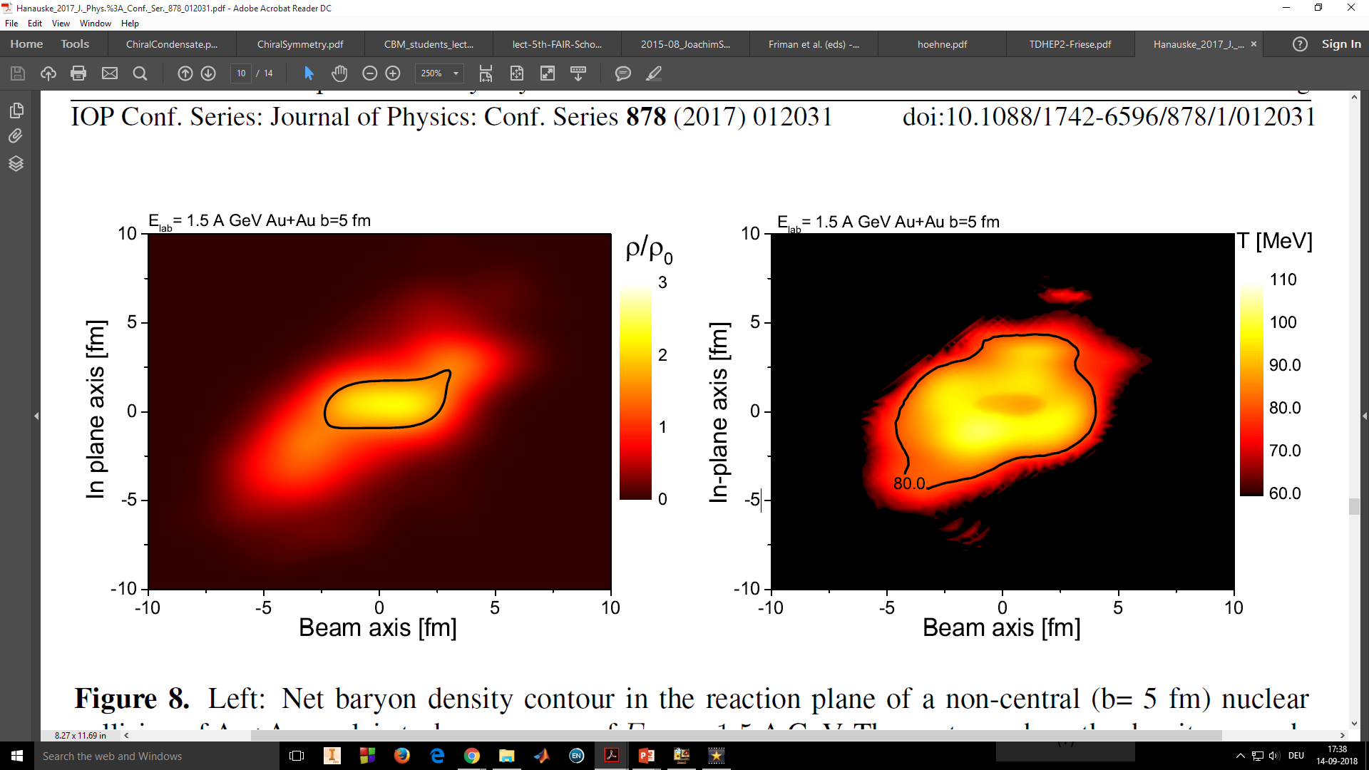
CREATING HIGH-DENSITY (AND HIGH-TEMPERATURE) MEDIUM
Neutron Star Mergers
Equation of State (EOS)
ρ > ρ₀
1.5 AGeV Au+Au (b = 5 fm)
SIS18 Experiments at GSI
Heavy Ion Collisions
M. Hanauske et al., 2017 J. Phys.: Conf. Ser. 878 012031

Slide 12


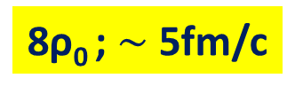

EVEN HIGHER ACHIEVABLE DENSITIES IN AU-AU COLLISIONS
5 A GeV Au+Au (b = 0)
10 A GeV Au+Au (b = 0)
8ρ₀ ; $∼$5fm/c
5ρ₀ ; $∼$10fm/c
Compressed Baryonic Matter (CBM) Experiment
GSI-FAIR SIS100 accelerator – 11 AGeV (Au), 8ρ₀
J. Randrup & J. Cleymans, PRC 74 (2006) 047901
I.C. Arsene et al., PRC 75 (2007) 034902
Friman et al., The CBM Physics Book, Springer (2010)

Slide 13
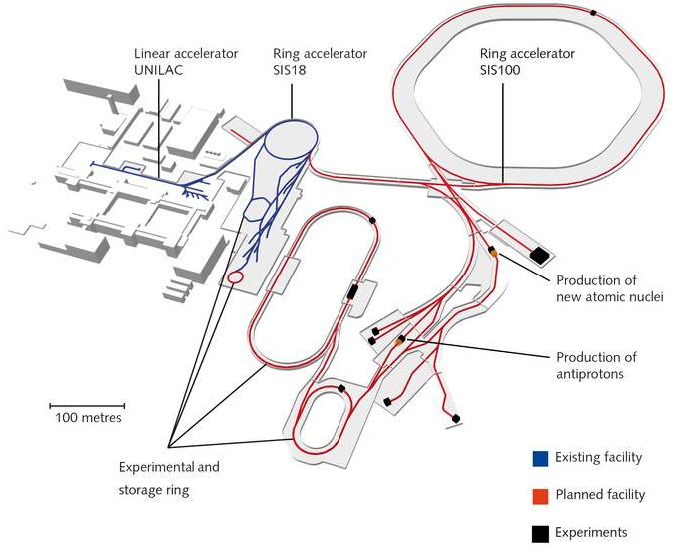
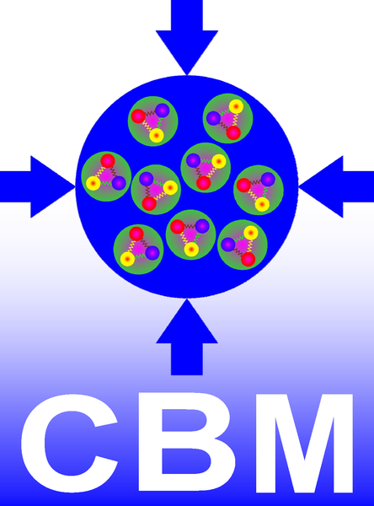
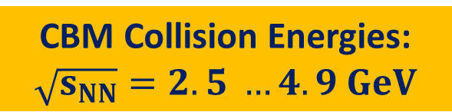
GSI-FAIR FACILITY
Collision Energies and Systems available at SIS100
Beam | Z | A | E (AGeV)
p | 1 | 1 | 29
d | 1 | 2 | 14
Ca | 20 | 40 | 14
Ni | 28 | 58 | 13.6
In | 49 | 115 | 11.9
Au | 79 | 197 | 11
U | 92 | 238 | 10.7
CBM Collision Energies: $\sqrt{s_{NN}}=2.5 …4.9 GeV$

Slide 14
HIGH DENSITY EOS OBSERVABLES FOR CBM@FAIR

Slide 15
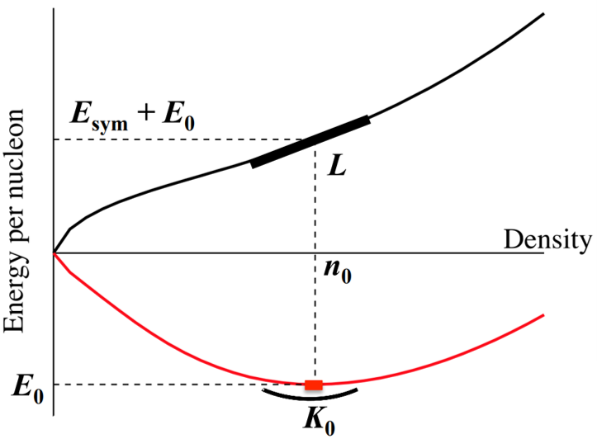
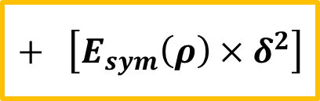
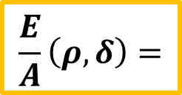

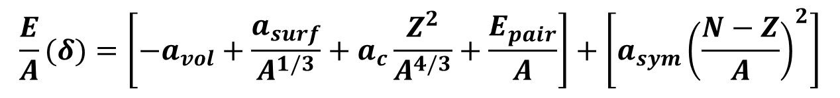

NUCLEAR MATTER EQUATION OF STATE (EOS)
EOS – Equation relating the state variables, such as pressure, temperature, density, energy and isospin asymmetry, under a given set of physical conditions
Binding Energy per nucleon: (semi-empirical mass formula)
$$\frac{E}{A}(δ)=\left[−a_{vol}+\frac{a_{surf}}{A^{1/3}}+a_{c}\frac{Z^{2}}{A^{4/3}}+\frac{E_{pair}}{A}\right]+\left[a_{sym}{\left(\frac{N−Z}{A}\right)}^{2}\right]$$
Neutron Matter (δ = 1)
Symmetry Term
# protons = # neutrons
Asymmetry Term
# protons ≠ # neutrons
$$\frac{E}{A}\left(ρ,δ\right)=$$
$$\left[\frac{E}{A}\left(ρ,0\right)\right]$$
$$+ \left[E_{sym}\left(ρ\right)×δ^{2}\right]$$
Neutron Matter EOS
Nuclear/Symmetric Matter EOS
Symmetry Energy
Nuclear Matter (δ = 0)
where, $δ= \frac{ρ_{N} − ρ_{P}}{ρ_{N}+ ρ_{P}}$
Hajime Togashi, New perspectives on Neutron Star Interiors - ECT* (2017)
Notes:
EOS could be defined as an equation relating the state variables which describe the state of matter under a given set of physical conditions. The most notable of these is the Ideal gas law (pV = nRT)
Another common example could be the binding energy per nucleon, descibed the semi-emperical mass formula. It simply describes the amount of energy needed to pull-out a nucleon out of a nucleus.
For our purposes, we could conviniently divide this equation into 2 parts:
Symmetry term: where the # of protons and neutrons are equal
Assymetry term: where the # of protons and neutrons aren‘t equal.
This conveys that if there is asymmetry inside the nucleus, it is a source of extra binding energy.
To add another variable into this whole concept, if we consider the density of the nucleus as another variable, things could be still be described in the same manner. Now the E/A could be written as a function of the asymmetry and the density.
Intuitively, one could understand that LHS is the condition formed inside the core of a neutron star, where #neutrons >>> #protons. And the RHS could be seen as the normal nuclei found in nature which are approximately symmetric and are used as colliding systems in HIC. And both of these terms are related by the asymmetry term, for which we are currently reliant on theoritical calculations at high densities.
An illustration of how these two terms (BNSM and HIC) behave qualitatively, we can see the figure.
Red: HIC, where minima is ar nuclear matter density
Black/Blue: BNSM, which is nothing but E0 + the asymmetry term
Here we have tried to intuitively understand the relation b/w the EOS from BNSM and HIC.

Slide 16
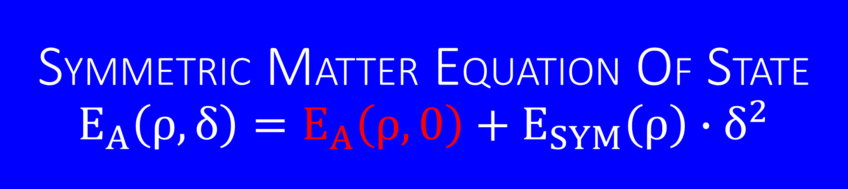
SYMMETRIC MATTER EQUATION OF STATE
$$E_{A}\left(ρ,δ\right)=E_{A}\left(ρ,0\right)+E_{SYM}\left(ρ\right)∙δ^{2}$$
EOS W/ CBM CASE #1

Slide 17
EXPERIMENTAL OBSERVABLES [I] – COLLECTIVE FLOW
Collective flow of nucleons driven by the pressure gradient –
Sensitive to nuclear incompressibility, 𝛋 → Equation of State
Two observables of the high pressures results in matter to be ejected in specific directions:

Slide 18
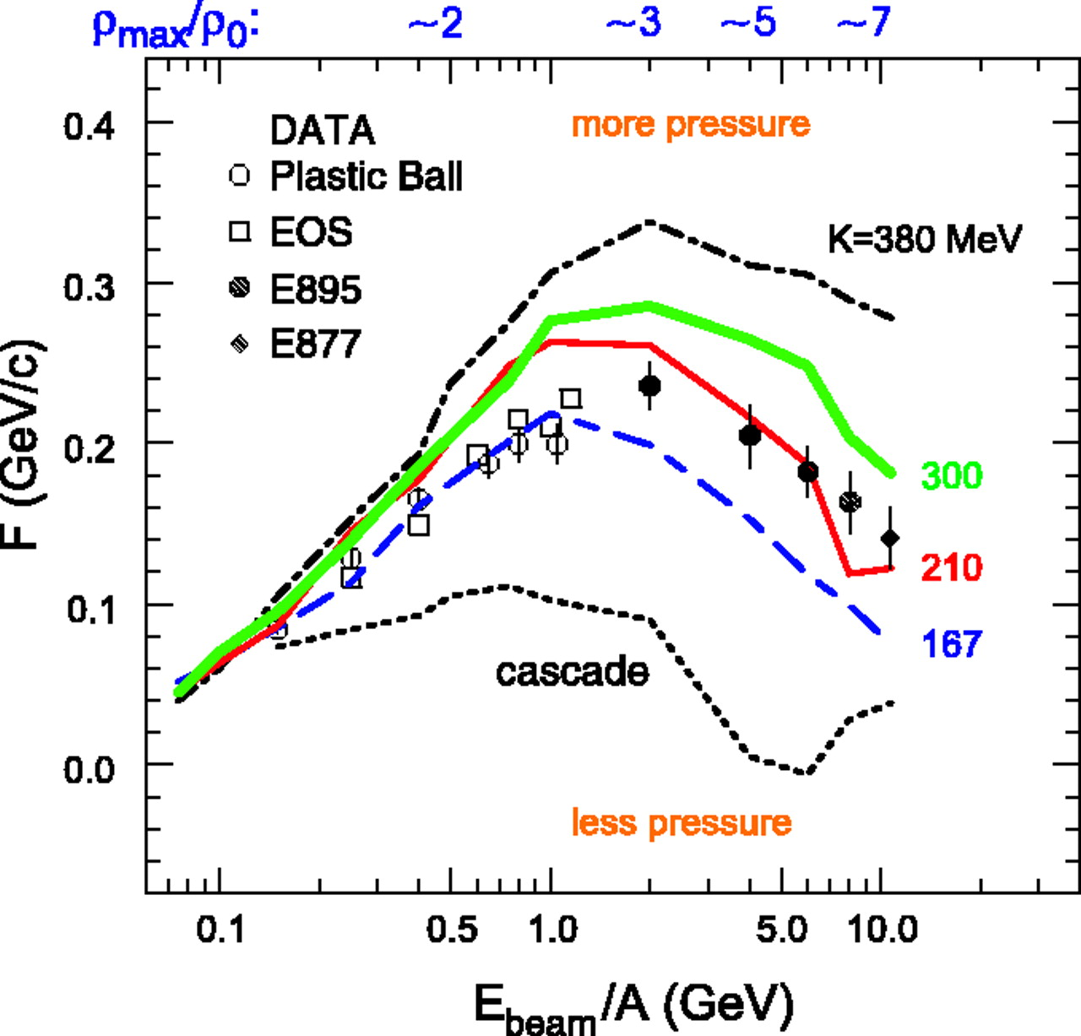
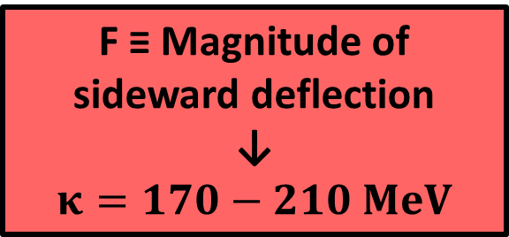
EXPERIMENTAL OBSERVABLES [I] – COLLECTIVE FLOW
Collective flow of nucleons driven by the pressure gradient –
Sensitive to nuclear incompressibility, 𝛋 → Equation of State
F ≡ Magnitude of sideward deflection
↓
$$κ=170−210 MeV$$
Two observables of the high pressures results in matter to be ejected in specific directions:
Directed Flow v₁ Nucleons deflected sideways in the reaction plane

Slide 19
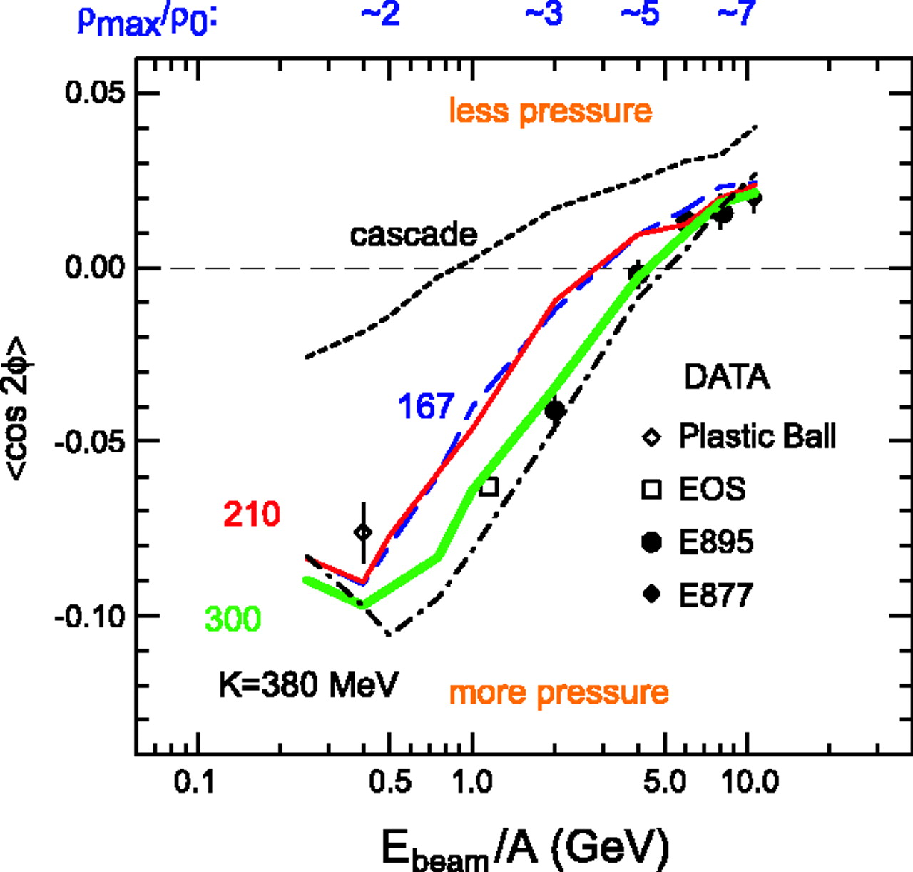
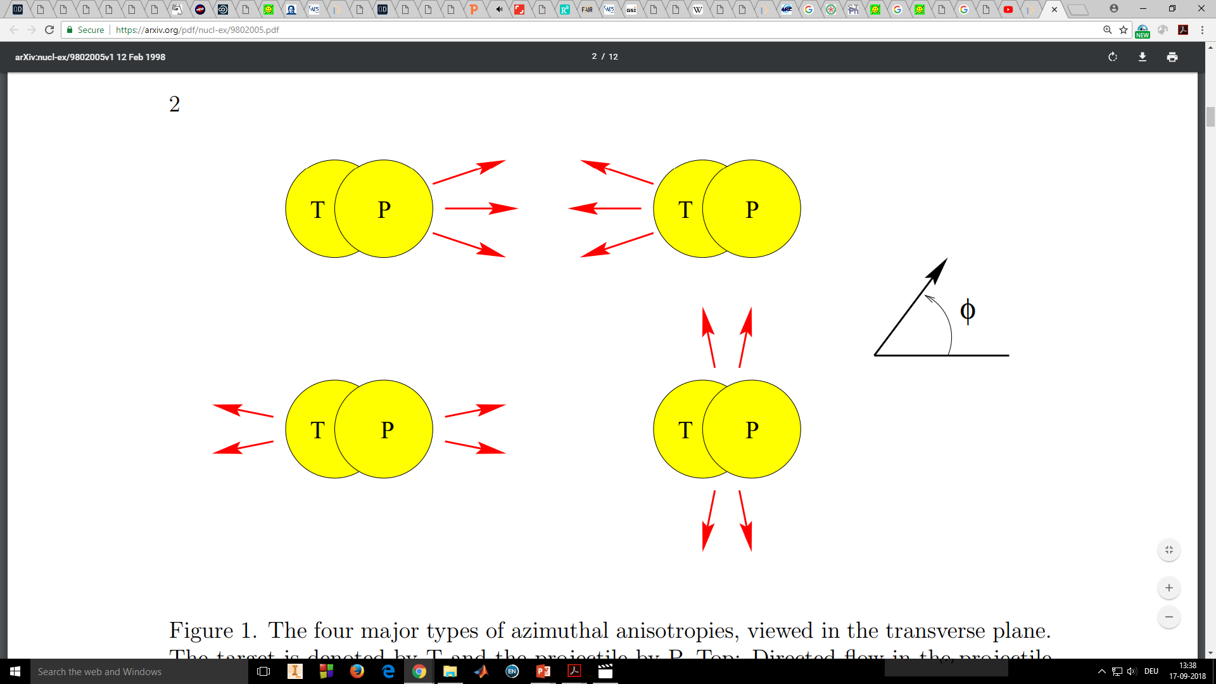
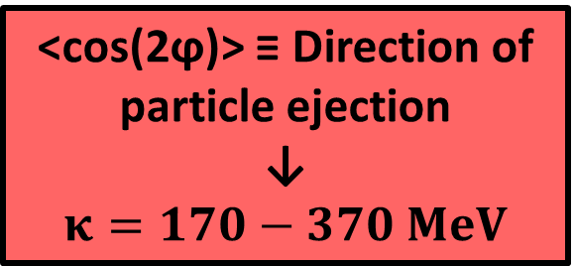
EXPERIMENTAL OBSERVABLES [I] – COLLECTIVE FLOW
Collective flow of nucleons driven by the pressure gradient –
Sensitive to nuclear incompressibility, 𝛋 → Equation of State
F ≡ Magnitude of sideward deflection
↓
$$κ=170−210 MeV$$
<cos(2ϕ)> ≡ Direction of particle ejection
↓
$$κ=170−370 MeV$$
Two observables of the high pressures results in matter to be ejected in specific directions:
Directed Flow v₁ Nucleons deflected sideways in the reaction plane
Elliptic Flow v₂ Nucleons are “squeezed out” above and below or “expanded in” the reaction plane

Slide 20
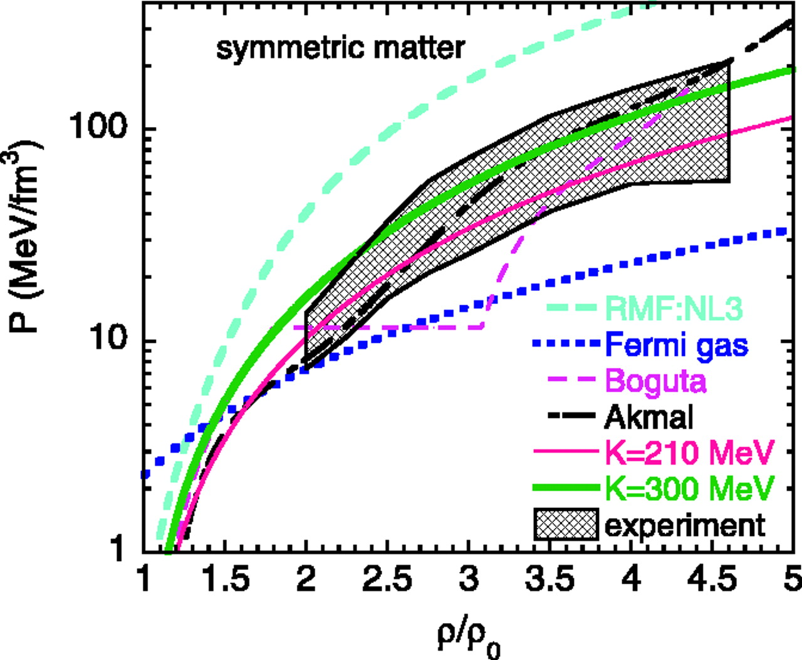
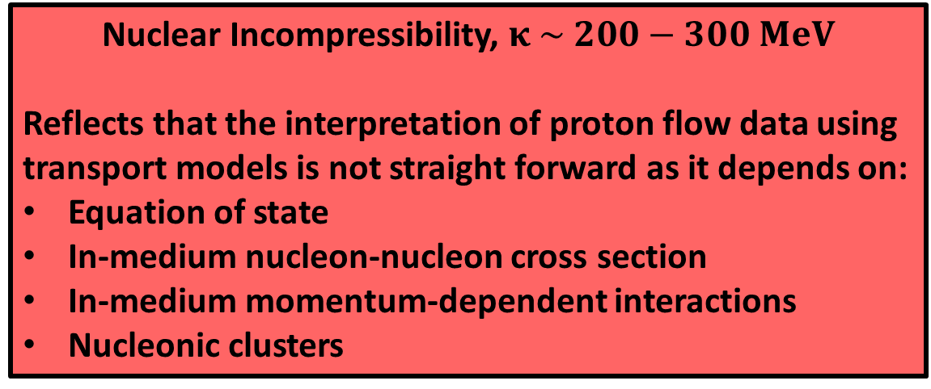
EXPERIMENTAL OBSERVABLES [I] – COLLECTIVE FLOW
Collective flow of nucleons driven by the pressure gradient –
Sensitive to nuclear incompressibility, 𝛋 → Equation of State
Nuclear Incompressibility, $κ \sim 200−300 MeV$
Reflects that the interpretation of proton flow data using transport models is not straight forward as it depends on:
Equation of state
In-medium nucleon-nucleon cross section
In-medium momentum-dependent interactions
Nucleonic clusters
P. Danielewicz et al., Science 298 (2002) 1592
Notes:
These data have been interpreted using microscopic transport models in order to extract information on the nuclear equation-of-state at baryonic densities above 3 times saturation density [132, 134]. It turned out that the strength of the collective flow of protons or fragments in nucleus-nucleus collisions depends not only on the nuclear equation-of-state, but also on the assumptions on the in-medium nucleon-nucleon cross sections, and on momentum-dependent interactions. Therefore, the analysis and interpretation of data on proton collective flow measured at AGS energies (2–10 AGeV) provided only limits on the nuclear compressibility.
Multidifferential flow measurements for a large variety of hadron species, in particular strange hadrons and anti-baryons, are mandatory for a variety of collisions systems and beam energies in the SIS-100 energy range

Slide 21
EXPERIMENTAL OBSERVABLES [I] – COLLECTIVE FLOW
Collective flow of nucleons driven by the pressure gradient –
Sensitive to nuclear incompressibility, 𝛋 → Equation of State
Nuclear Incompressibility, $κ \sim 200−300 MeV$
Reflects that the interpretation of proton flow data using transport models is not straight forward as it depends on:
Equation of state
In-medium nucleon-nucleon cross section
In-medium momentum-dependent interactions
Nucleonic clusters
Precise multi-differential flow measurements for a large variety of hadron species over a range of densities accessible with CBM can narrow down the symmetric matter EOS
P. Danielewicz et al., Science 298 (2002) 1592
Notes:
These data have been interpreted using microscopic transport models in order to extract information on the nuclear equation-of-state at baryonic densities above 3 times saturation density [132, 134]. It turned out that the strength of the collective flow of protons or fragments in nucleus-nucleus collisions depends not only on the nuclear equation-of-state, but also on the assumptions on the in-medium nucleon-nucleon cross sections, and on momentum-dependent interactions. Therefore, the analysis and interpretation of data on proton collective flow measured at AGS energies (2–10 AGeV) provided only limits on the nuclear compressibility.
Multidifferential flow measurements for a large variety of hadron species, in particular strange hadrons and anti-baryons, are mandatory for a variety of collisions systems and beam energies in the SIS-100 energy range

Slide 22
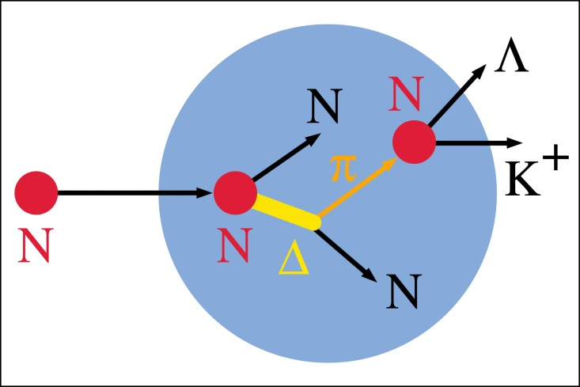
EXPERIMENTAL OBSERVABLES [II] – (SUB)THRESHOLD PRODUCTION
Idea: Strangeness Yield ∝ Baryonic Density ∝ Compressibility ∝ EOS
NN → N∆
N∆ → NK⁺Λ⁰
πN → K⁺Λ⁰
E_{threshold} = 1.58 GeV
Image credit: P. Senger, GSI-Darmstadt
Notes:
For producing any particle, a minimum amount of energy is needed which is called the Threshold Energy. And in a sub-threshold particle production, particles are NOT produced in initial head-on collisions, but in multiple low energy collisions. Therefore its expected that of the density of collision region/fireball is high enough, then probability of these multiple low energy collisions will increase. Thus leading to more production of the desired particles at below threshold level.
Given that method of particle production a highly collective process, it is specially sensitive to the compressibility of nuclear matter at high baryon densities. Thus making it sensitive to the EOS of the nuclear matter.
The “cooking” of particles containing 2 or 3 strange quarks (or antiquarks) is favored at high densities where the mean free path between consecutive collisions is short. Therefore, the yield of multi-strange hyperons depends very much on the density, and, hence on the compressibility of baryonic matter at these particular densities.
An illustrative example of this shown in the bottom left figure, where kaons (single-strange meson) are produced in a sub-threshold particle production by multiple small collisions. In this specific multi step process, 3 or more particles are involved, such as:
Step 1: Forming a Δ-resonance which stores the energy
Step 2: The Δ-resonance collides with a nucleon and then finally the production threshold can be overcome.
Please note that the threshold for K+ production is 1.58 GeV.
Given the fact is Strangeness is always conserved, it makes K+ meson an extremely useful probe. Its because once produced, it cannot be absorbed by the surrounding nucleons. This can be quantitatively shown in the plot shown on the right, with the interaction cross-sections in millibarn on y-axis and particle momentum in GeV on the x-axis. Different colors indicate interaction cross-sections of kaons, anti-kaons and pions with proton. This results in a rather long mean free path of about 7 fm of K+ mesons in nuclear matter and makes them a suitable ’penetrating’ probe for the dense fireball produced in heavy ion reactions. (Final state interactions such as elastic kaon-nucleon scattering or the propagation in potentials influence the dynamics but do not change the total yields)
So the idea is that the strangeness yield ∝ baryon density ∝ compressibility ∝ EOS.
Text Ref:
[1] CBM Physics Book, pg 691-702
[2] Landolt-Börnstein, Chapter - Hadron Production in Heavy Ion Collisions (subsection: Hardon Production below 2 GeV)
[3] C.Sturm, Herschigg 2009 (slides undernotes)
-----------------------------------------------
Extra text:
In fixed-target p+p collisions the threshold for pion production is 0.29 GeV, for K+ it is 1.58 GeV and for K− it is 2.5 GeV. The threshold for K+ is lower than that for K−, because the energy balance has only to account for the excitation of a nucleon to a Λ in the case of K+, whereas together with the K− a K+ has to be produced to conserve strangeness. The reaction dynamics of pions and kaons is quite different. The pion-nucleon cross section, shown in Fig. 1, is large and thus pions are continuously absorbed through the Δ-resonance and re-emitted by its decay. This creation and disappearance can occur during the entire time evolution of the collision. The K+-nucleon interaction cross section, also shown in Fig. 1, on the other hand, is small due to strangeness and energy conservation. There are no partners to react with and only elastic scattering and charge exchange can occur. Therefore, K+ mesons are expected to leave the interaction zone early. These facts have led to the suggestion of time-ordered emission of these two species [4]. The creation of K− requires even higher energies. The dominant production mechanism is strangeness exchange. The interaction probability of K− with nuclear matter is much higher than that of K+ and the mean free path much lower. As a consequence, K− cannot leave the reaction zone undisturbed and they are emitted later

Slide 23
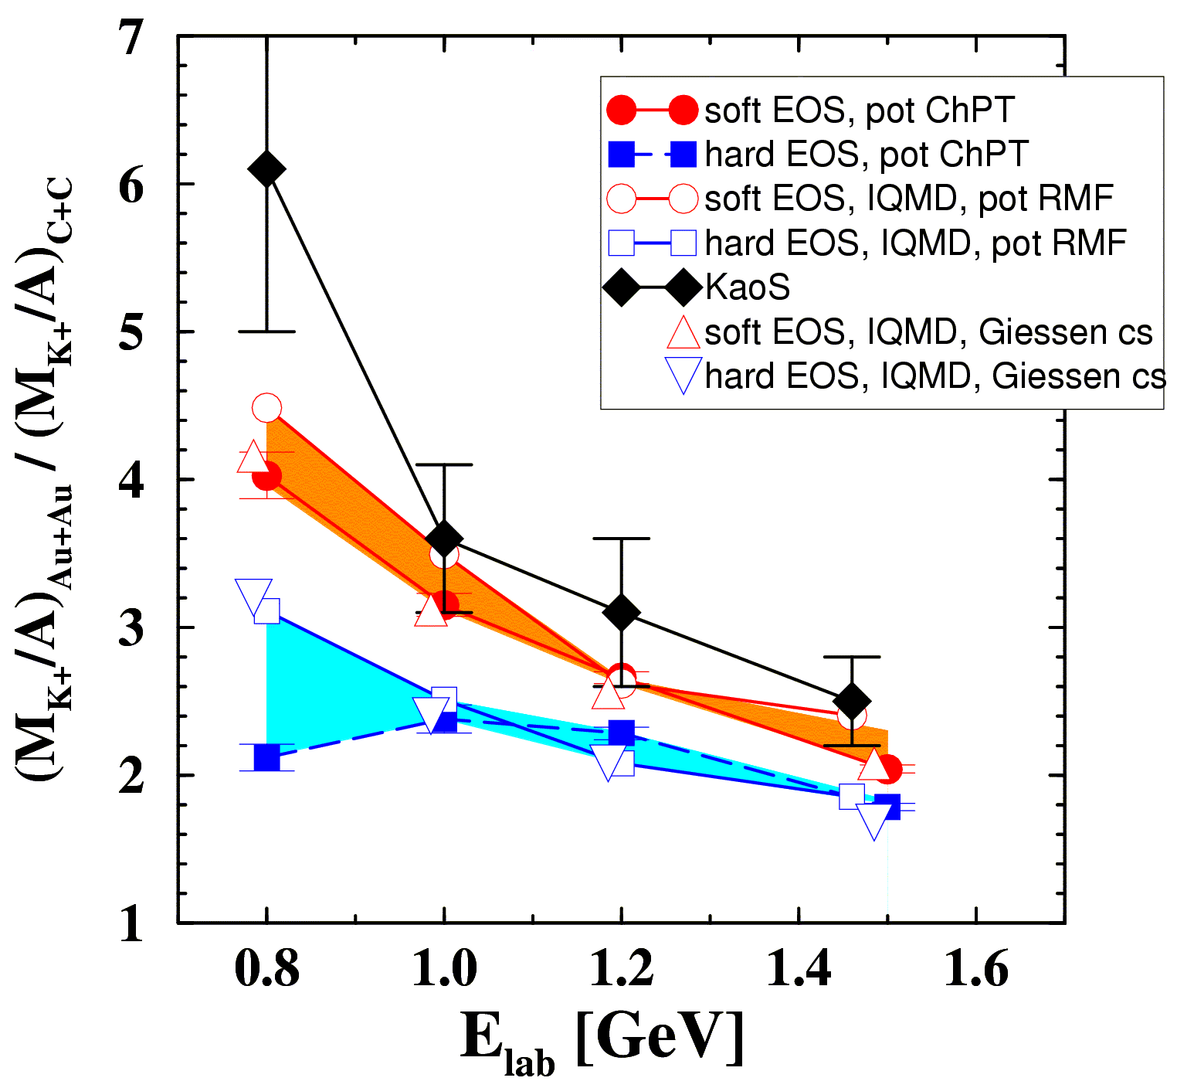
EXPERIMENTAL OBSERVABLES [II] – (SUB)THRESHOLD PRODUCTION
Idea: Strangeness Yield ∝ Baryonic Density ∝ Compressibility ∝ EOS
Experimentally at SIS18: Measuring K⁺ yields in a system where compression is expected (Au-Au) w.r.t. system where no compression is expected (C-C)
NN → N∆
N∆ → NK⁺Λ⁰
πN → K⁺Λ⁰
E_{threshold} = 1.58 GeV
KaoS (Exp.)
Soft EOS (Th.)
Hard EOS (Th.)
Experiment: C. Sturm et al., (KaoS Collaboration) Phys. Rev. Lett. 86 (2001) 39
Theory: QMD Ch. Fuchs et al., Phys. Rev. Lett. 86 (2001) 1974
IQMD Ch. Hartnack, J. Aichelin, J. Phys. G 28 (2002) 1649
Image credit: P. Senger, GSI-Darmstadt
Notes:
For producing any particle, a minimum amount of energy is needed which is called the Threshold Energy. And in a sub-threshold particle production, particles are NOT produced in initial head-on collisions, but in multiple low energy collisions. Therefore its expected that of the density of collision region/fireball is high enough, then probability of these multiple low energy collisions will increase. Thus leading to more production of the desired particles at below threshold level.
Given that method of particle production a highly collective process, it is specially sensitive to the compressibility of nuclear matter at high baryon densities. Thus making it sensitive to the EOS of the nuclear matter.
The “cooking” of particles containing 2 or 3 strange quarks (or antiquarks) is favored at high densities where the mean free path between consecutive collisions is short. Therefore, the yield of multi-strange hyperons depends very much on the density, and, hence on the compressibility of baryonic matter at these particular densities.
An illustrative example of this shown in the bottom left figure, where kaons (single-strange meson) are produced in a sub-threshold particle production by multiple small collisions. In this specific multi step process, 3 or more particles are involved, such as:
Step 1: Forming a Δ-resonance which stores the energy
Step 2: The Δ-resonance collides with a nucleon and then finally the production threshold can be overcome.
Please note that the threshold for K+ production is 1.58 GeV.
Given the fact is Strangeness is always conserved, it makes K+ meson an extremely useful probe. Its because once produced, it cannot be absorbed by the surrounding nucleons. This can be quantitatively shown in the plot shown on the right, with the interaction cross-sections in millibarn on y-axis and particle momentum in GeV on the x-axis. Different colors indicate interaction cross-sections of kaons, anti-kaons and pions with proton. This results in a rather long mean free path of about 7 fm of K+ mesons in nuclear matter and makes them a suitable ’penetrating’ probe for the dense fireball produced in heavy ion reactions. (Final state interactions such as elastic kaon-nucleon scattering or the propagation in potentials influence the dynamics but do not change the total yields)
So the idea is that the strangeness yield ∝ baryon density ∝ compressibility ∝ EOS.
Text Ref:
[1] CBM Physics Book, pg 691-702
[2] Landolt-Börnstein, Chapter - Hadron Production in Heavy Ion Collisions (subsection: Hardon Production below 2 GeV)
[3] C.Sturm, Herschigg 2009 (slides undernotes)
-----------------------------------------------
Extra text:
In fixed-target p+p collisions the threshold for pion production is 0.29 GeV, for K+ it is 1.58 GeV and for K− it is 2.5 GeV. The threshold for K+ is lower than that for K−, because the energy balance has only to account for the excitation of a nucleon to a Λ in the case of K+, whereas together with the K− a K+ has to be produced to conserve strangeness. The reaction dynamics of pions and kaons is quite different. The pion-nucleon cross section, shown in Fig. 1, is large and thus pions are continuously absorbed through the Δ-resonance and re-emitted by its decay. This creation and disappearance can occur during the entire time evolution of the collision. The K+-nucleon interaction cross section, also shown in Fig. 1, on the other hand, is small due to strangeness and energy conservation. There are no partners to react with and only elastic scattering and charge exchange can occur. Therefore, K+ mesons are expected to leave the interaction zone early. These facts have led to the suggestion of time-ordered emission of these two species [4]. The creation of K− requires even higher energies. The dominant production mechanism is strangeness exchange. The interaction probability of K− with nuclear matter is much higher than that of K+ and the mean free path much lower. As a consequence, K− cannot leave the reaction zone undisturbed and they are emitted later

Slide 24
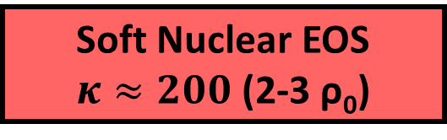
EXPERIMENTAL OBSERVABLES [II] – (SUB)THRESHOLD PRODUCTION
Idea: Strangeness Yield ∝ Baryonic Density ∝ Compressibility ∝ EOS
Experimentally at SIS18: Measuring K⁺ yields in a system where compression is expected (Au-Au) w.r.t. system where no compression is expected (C-C)
NN → N∆
N∆ → NK⁺Λ⁰
πN → K⁺Λ⁰
E_{threshold} = 1.58 GeV
KaoS (Exp.)
Soft EOS (Th.)
Hard EOS (Th.)
Soft Nuclear EOS
$κ≈200$ (2-3 ρ₀)
Experiment: C. Sturm et al., (KaoS Collaboration) Phys. Rev. Lett. 86 (2001) 39
Theory: QMD Ch. Fuchs et al., Phys. Rev. Lett. 86 (2001) 1974
IQMD Ch. Hartnack, J. Aichelin, J. Phys. G 28 (2002) 1649
Image credit: P. Senger, GSI-Darmstadt
Notes:
For producing any particle, a minimum amount of energy is needed which is called the Threshold Energy. And in a sub-threshold particle production, particles are NOT produced in initial head-on collisions, but in multiple low energy collisions. Therefore its expected that of the density of collision region/fireball is high enough, then probability of these multiple low energy collisions will increase. Thus leading to more production of the desired particles at below threshold level.
Given that method of particle production a highly collective process, it is specially sensitive to the compressibility of nuclear matter at high baryon densities. Thus making it sensitive to the EOS of the nuclear matter.
The “cooking” of particles containing 2 or 3 strange quarks (or antiquarks) is favored at high densities where the mean free path between consecutive collisions is short. Therefore, the yield of multi-strange hyperons depends very much on the density, and, hence on the compressibility of baryonic matter at these particular densities.
An illustrative example of this shown in the bottom left figure, where kaons (single-strange meson) are produced in a sub-threshold particle production by multiple small collisions. In this specific multi step process, 3 or more particles are involved, such as:
Step 1: Forming a Δ-resonance which stores the energy
Step 2: The Δ-resonance collides with a nucleon and then finally the production threshold can be overcome.
Please note that the threshold for K+ production is 1.58 GeV.
Given the fact is Strangeness is always conserved, it makes K+ meson an extremely useful probe. Its because once produced, it cannot be absorbed by the surrounding nucleons. This can be quantitatively shown in the plot shown on the right, with the interaction cross-sections in millibarn on y-axis and particle momentum in GeV on the x-axis. Different colors indicate interaction cross-sections of kaons, anti-kaons and pions with proton. This results in a rather long mean free path of about 7 fm of K+ mesons in nuclear matter and makes them a suitable ’penetrating’ probe for the dense fireball produced in heavy ion reactions. (Final state interactions such as elastic kaon-nucleon scattering or the propagation in potentials influence the dynamics but do not change the total yields)
So the idea is that the strangeness yield ∝ baryon density ∝ compressibility ∝ EOS.
Text Ref:
[1] CBM Physics Book, pg 691-702
[2] Landolt-Börnstein, Chapter - Hadron Production in Heavy Ion Collisions (subsection: Hardon Production below 2 GeV)
[3] C.Sturm, Herschigg 2009 (slides undernotes)
-----------------------------------------------
Extra text:
In fixed-target p+p collisions the threshold for pion production is 0.29 GeV, for K+ it is 1.58 GeV and for K− it is 2.5 GeV. The threshold for K+ is lower than that for K−, because the energy balance has only to account for the excitation of a nucleon to a Λ in the case of K+, whereas together with the K− a K+ has to be produced to conserve strangeness. The reaction dynamics of pions and kaons is quite different. The pion-nucleon cross section, shown in Fig. 1, is large and thus pions are continuously absorbed through the Δ-resonance and re-emitted by its decay. This creation and disappearance can occur during the entire time evolution of the collision. The K+-nucleon interaction cross section, also shown in Fig. 1, on the other hand, is small due to strangeness and energy conservation. There are no partners to react with and only elastic scattering and charge exchange can occur. Therefore, K+ mesons are expected to leave the interaction zone early. These facts have led to the suggestion of time-ordered emission of these two species [4]. The creation of K− requires even higher energies. The dominant production mechanism is strangeness exchange. The interaction probability of K− with nuclear matter is much higher than that of K+ and the mean free path much lower. As a consequence, K− cannot leave the reaction zone undisturbed and they are emitted later

Slide 25

EXPERIMENTAL OBSERVABLES [II] – (SUB)THRESHOLD PRODUCTION
Idea: Strangeness Yield ∝ Baryonic Density ∝ Compressibility ∝ EOS
0
1
2
3
4
5
6
7
8
9
10
11
12
13
E_{thr,NN} (GeV)
SIS18
SIS100
K^{+,0}, Λ⁰, Σ
K⁻
Ξ^{-,0}
Ω⁻
$$Λ^{0}\overline{Λ^{0}}$$
Ξ⁺
Ω⁺
Direct Kaon & Hyperon Production:
pp → K⁺Λ⁰p (E_{thr} = 1.6 GeV)
pp → K⁻K⁺p (E_{thr} = 2.5 GeV)
Direct Multi-Strange Hyperon Production:
pp → Ξ⁻ K⁺K⁺p (E_{thr} = 3.7 GeV)
pp → Ω⁻ K⁺K⁺K⁰p (E_{thr} = 7.0 GeV)
pp → Λ⁰Λ̅⁰ pp (E_{thr} = 7.1 GeV)
pp → Ξ⁺ Ξ⁻ pp (E_{thr} = 9.0 GeV)
pp → Ω⁺ Ω⁻ pp (E_{thr} = 12.7 GeV)

Slide 26
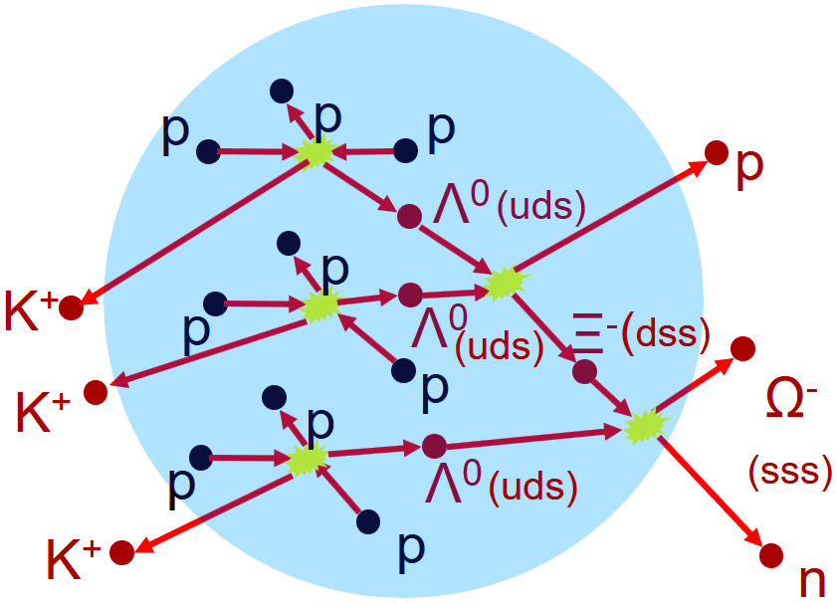
EXPERIMENTAL OBSERVABLES [II] – (SUB)THRESHOLD PRODUCTION
Idea: Strangeness Yield ∝ Baryonic Density ∝ Compressibility ∝ EOS
0
1
2
3
4
5
6
7
8
9
10
11
12
13
E_{thr,NN} (GeV)
SIS18
SIS100
K^{+,0}, Λ⁰, Σ
K⁻
Ξ^{-,0}
Ω⁻
$$Λ^{0}\overline{Λ^{0}}$$
Ξ⁺
Ω⁺
Direct Kaon & Hyperon Production:
pp → K⁺Λ⁰p (E_{thr} = 1.6 GeV)
pp → K⁻K⁺p (E_{thr} = 2.5 GeV)
Direct Multi-Strange Hyperon Production:
pp → Ξ⁻ K⁺K⁺p (E_{thr} = 3.7 GeV)
pp → Ω⁻ K⁺K⁺K⁰p (E_{thr} = 7.0 GeV)
pp → Λ⁰Λ̅⁰ pp (E_{thr} = 7.1 GeV)
pp → Ξ⁺ Ξ⁻ pp (E_{thr} = 9.0 GeV)
pp → Ω⁺ Ω⁻ pp (E_{thr} = 12.7 GeV)
NN → N∆
N∆ → NK⁺Λ⁰
πN → K⁺Y (Y = Λ,Σ)
pp → K⁺pΛ⁰
pp → K⁺pΛ⁰
pp → K⁺pΛ⁰
Λ⁰Λ⁰→ Ξ⁻ p
Λ⁰ Ξ⁻ → Ω⁻ n
Image credit: P. Senger, GSI-Darmstadt

Slide 27
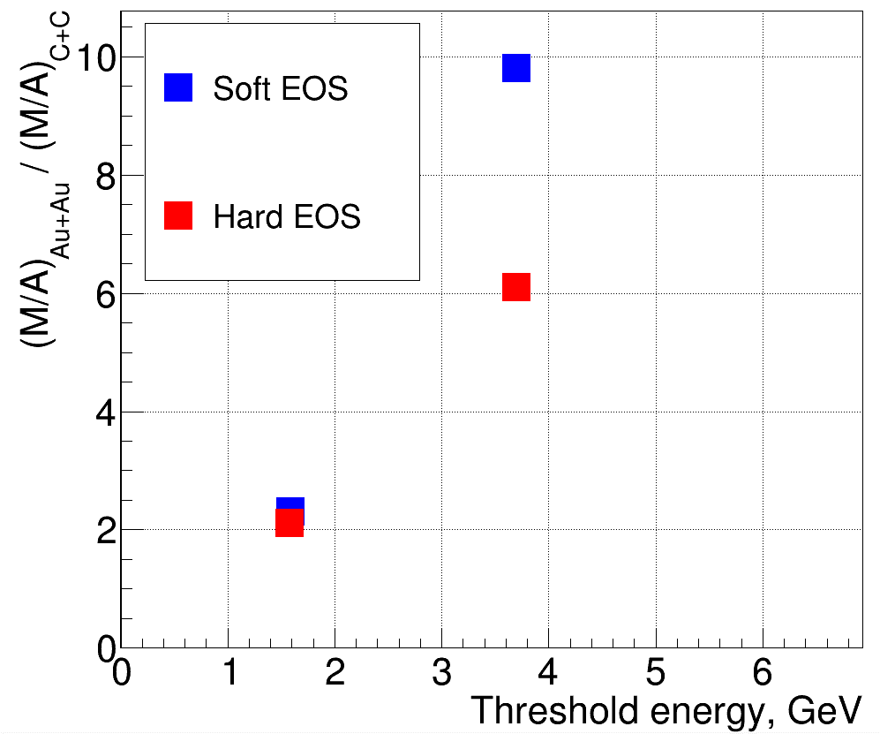


EXPERIMENTAL OBSERVABLES [II] – (SUB)THRESHOLD PRODUCTION
Idea: Strangeness Yield ∝ Baryonic Density ∝ Compressibility ∝ EOS
0
1
2
3
4
5
6
7
8
9
10
11
12
13
E_{thr,NN} (GeV)
SIS18
SIS100
K^{+,0}, Λ⁰, Σ
K⁻
Ξ^{-,0}
Ω⁻
$$Λ^{0}\overline{Λ^{0}}$$
Ξ⁺
Ω⁺
Ξ⁻
$$κ=240$$
$$κ=350$$
Ξ⁻
Multi-Strange Hyperons promising for EOS at
ρ ≥ 2-3 ρ₀
Λ⁰
Λ⁰
PRELIMINARY
4 AGeV, 6M events
Experiment: C. Sturm et al., (KaoS Collaboration) Phys. Rev. Lett. 86 (2001) 39
Theory: QMD Ch. Fuchs et al., Phys. Rev. Lett. 86 (2001) 1974
IQMD Ch. Hartnack, J. Aichelin, J. Phys. G 28 (2002) 1649
PHQMD: J. Aichelin, E. Bratkovskaya, V. Kireyeu et al.
P. Senger, 4th CBM China Workshop (2019)

Slide 28
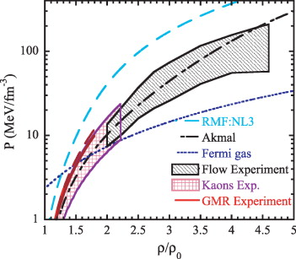
SYMMETRIC MATTER EQUATION OF STATE (EOS) – CURRENT STATUS
Symmetric Matter
W.G. Lynch et al., PrPNP, 62, 427 (2009); arXiv:0901.0412 [nucl-ex]
Notes:
The current experimental status of the symmetric part of EOS from HIC are summarised in the figure on left. It shows that variation of pressure w.r.t. Density, which is another way to represent EOS.
The hatched part shows the results of different experiment and different lines shows results from different models.
Black-grey hatch: Shows data from 2-4.5 rho derived from flow measurements.
Purple hatch: Shows data from 1.2-2.2 rho derived from STPP
Aim of CBM is to reduce these huge experimental uncertaintities and extend this graph to higher densities.

Slide 29
SYMMETRIC MATTER EQUATION OF STATE (EOS) – CURRENT STATUS
Symmetric Matter
Kaon Experiments (ρ/ρ₀ = 1.2 – 2.2)
W.G. Lynch et al., PrPNP, 62, 427 (2009); arXiv:0901.0412 [nucl-ex]
Notes:
The current experimental status of the symmetric part of EOS from HIC are summarised in the figure on left. It shows that variation of pressure w.r.t. Density, which is another way to represent EOS.
The hatched part shows the results of different experiment and different lines shows results from different models.
Black-grey hatch: Shows data from 2-4.5 rho derived from flow measurements.
Purple hatch: Shows data from 1.2-2.2 rho derived from STPP
Aim of CBM is to reduce these huge experimental uncertaintities and extend this graph to higher densities.

Slide 30
SYMMETRIC MATTER EQUATION OF STATE (EOS) – CURRENT STATUS
Flow Experiments (ρ/ρ₀ = 2 – 4.5)
Symmetric Matter
Kaon Experiments (ρ/ρ₀ = 1.2 – 2.2)
W.G. Lynch et al., PrPNP, 62, 427 (2009); arXiv:0901.0412 [nucl-ex]
Notes:
The current experimental status of the symmetric part of EOS from HIC are summarised in the figure on left. It shows that variation of pressure w.r.t. Density, which is another way to represent EOS.
The hatched part shows the results of different experiment and different lines shows results from different models.
Black-grey hatch: Shows data from 2-4.5 rho derived from flow measurements.
Purple hatch: Shows data from 1.2-2.2 rho derived from STPP
Aim of CBM is to reduce these huge experimental uncertaintities and extend this graph to higher densities.

Slide 31

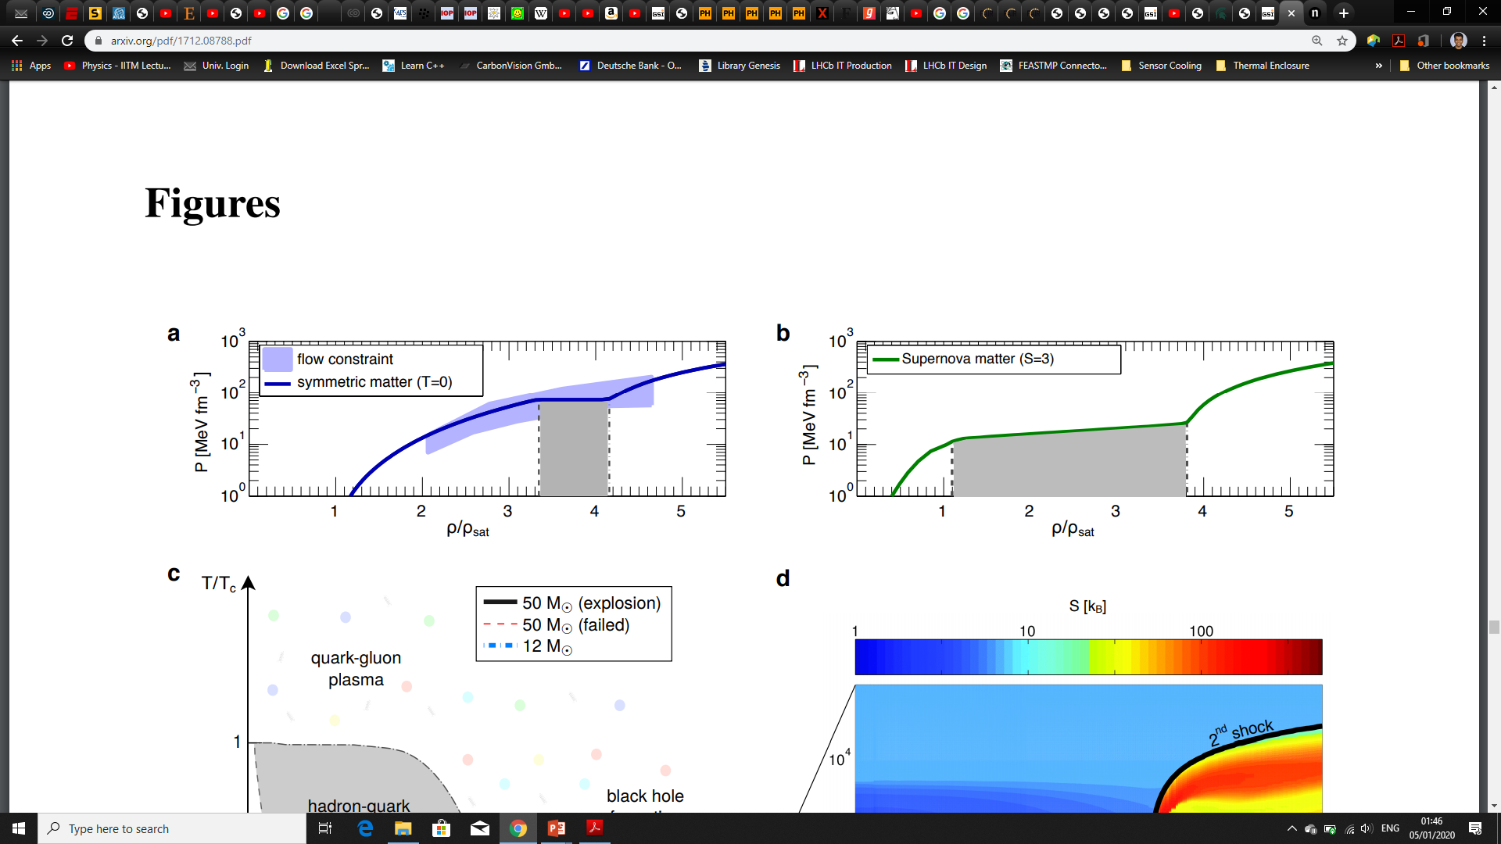
SYMMETRIC MATTER EQUATION OF STATE (EOS) – FUTURE ?
Symmetric Matter
Precision measurement of EOS can enable CBM to detect phase transition in symmetric nuclear matter at high ρ
W.G. Lynch et al., PrPNP, 62, 427 (2009); arXiv:0901.0412 [nucl-ex]
T. Fischer et al., Nat Astron 2, 980-986 (2018); arXiv:1712.08788 [astro-ph.HE]
Notes:
The current experimental status of the symmetric part of EOS from HIC are summarised in the figure on left. It shows that variation of pressure w.r.t. Density, which is another way to represent EOS.
The hatched part shows the results of different experiment and different lines shows results from different models.
Black-grey hatch: Shows data from 2-4.5 rho derived from flow measurements.
Purple hatch: Shows data from 1.2-2.2 rho derived from STPP
Aim of CBM is to reduce these huge experimental uncertaintities and extend this graph to higher densities.

Slide 32
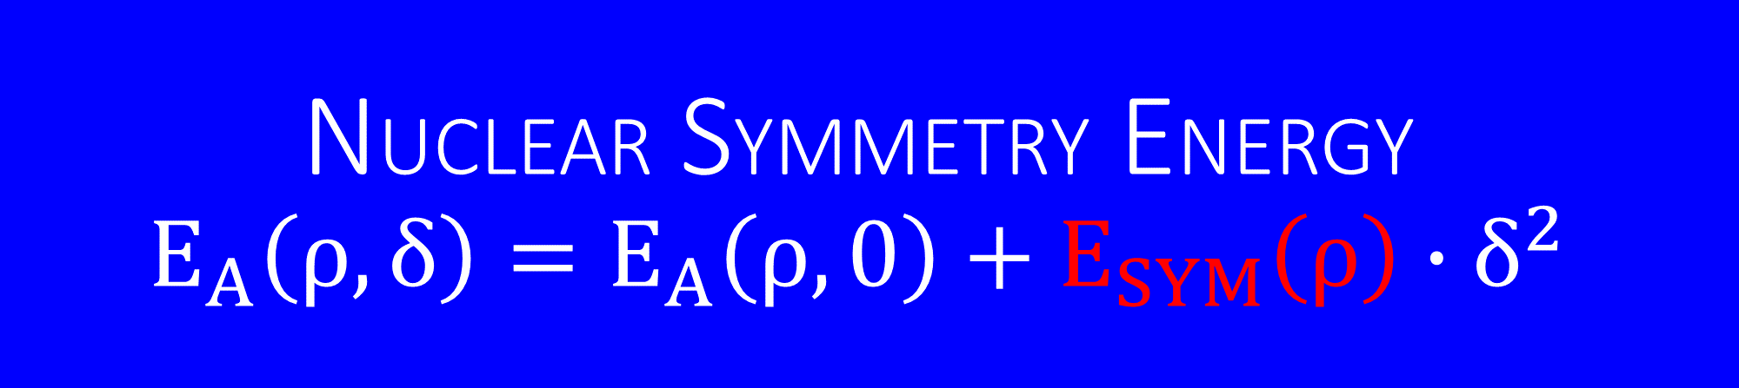
NUCLEAR SYMMETRY ENERGY
$$E_{A}\left(ρ,δ\right)=E_{A}\left(ρ,0\right)+E_{SYM}\left(ρ\right)∙δ^{2}$$
EOS W/ CBM CASE #2

Slide 33
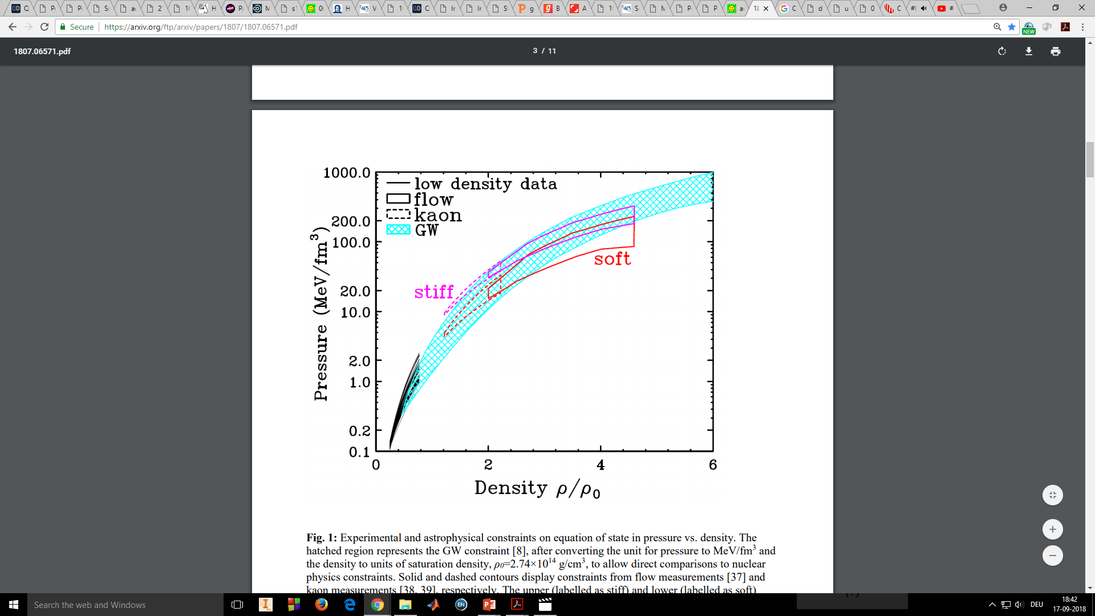
NEUTRON MATTER EQUATION OF STATE (EOS) – CURRENT STATUS
C.Y. Tsang et al., arXiv:1807.06571
LIGO-VIRGO: B. P. Abbott, et al., arXiv:1805.11581 (2018)
Notes:
Upon adding the theoritically obtained values of asymmetry terms, we should obtain EOS for neutron matter.
Soft EOS from HIC is predicted for lower densities.
Soft-stiff EOS from HIC is predicted for higher densities.
So overall picture from HIC is ambigious, which doesn‘t still fit GW measurement.
So more precise results for nuclear matter are needed to justify astrophysical observations.
----------------------------
Figure discription: Experimental and astrophysical constraints on equation of state in pressure vs. density.
The hatched region represents the GW constraint [8], after converting the unit for pressure to MeV/fm3 and the density to units of saturation density, ρ0=2.74×1014 g/cm3 , to allow direct comparisons to nuclear physics constraints. Solid and dashed contours display constraints from flow measurements [37] and kaon measurements [38, 39], respectively. The upper (labelled as stiff) and lower (labelled as soft) constraints correspond to the addition of symmetry pressure from Eqs. (2) and (3), respectively, to the symmetric matter pressure. The black curves below 0.7ρ0 represent Skyrme functionals satisfying the density dependent symmetry energy data from 0.25< ρ/ρ0 < 0.7.
To connect nuclear physics observables to 1.4M⊙ neutron-star observables, we start with a large collection of Skyrme nuclear density functionals. We extrapolate the functionals to densities and asymmetries comparable to that for a neutron star. Following this procedure, we arrived at 163 Skyrme interactions from our collection of 216 interactions [15] that can support a 2.0M⊙ neutron star.
To estimate the additional pressure coming from the symmetry energy, we use the softest and stiffest symmetry energy functionals proposed in Ref. [42] for utilization in neutron-star calculations

Slide 34
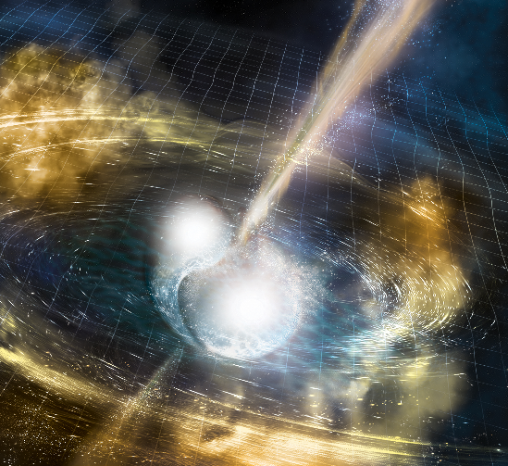
NEUTRON MATTER EQUATION OF STATE (EOS) – CURRENT STATUS
Graviational Waves GW170817
C.Y. Tsang et al., arXiv:1807.06571
LIGO-VIRGO: B. P. Abbott, et al., arXiv:1805.11581 (2018)
Notes:
Upon adding the theoritically obtained values of asymmetry terms, we should obtain EOS for neutron matter.
Soft EOS from HIC is predicted for lower densities.
Soft-stiff EOS from HIC is predicted for higher densities.
So overall picture from HIC is ambigious, which doesn‘t still fit GW measurement.
So more precise results for nuclear matter are needed to justify astrophysical observations.
----------------------------
Figure discription: Experimental and astrophysical constraints on equation of state in pressure vs. density.
The hatched region represents the GW constraint [8], after converting the unit for pressure to MeV/fm3 and the density to units of saturation density, ρ0=2.74×1014 g/cm3 , to allow direct comparisons to nuclear physics constraints. Solid and dashed contours display constraints from flow measurements [37] and kaon measurements [38, 39], respectively. The upper (labelled as stiff) and lower (labelled as soft) constraints correspond to the addition of symmetry pressure from Eqs. (2) and (3), respectively, to the symmetric matter pressure. The black curves below 0.7ρ0 represent Skyrme functionals satisfying the density dependent symmetry energy data from 0.25< ρ/ρ0 < 0.7.
To connect nuclear physics observables to 1.4M⊙ neutron-star observables, we start with a large collection of Skyrme nuclear density functionals. We extrapolate the functionals to densities and asymmetries comparable to that for a neutron star. Following this procedure, we arrived at 163 Skyrme interactions from our collection of 216 interactions [15] that can support a 2.0M⊙ neutron star.
To estimate the additional pressure coming from the symmetry energy, we use the softest and stiffest symmetry energy functionals proposed in Ref. [42] for utilization in neutron-star calculations

Slide 35
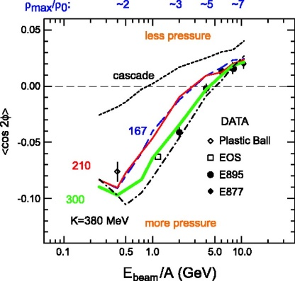

NEUTRON MATTER EQUATION OF STATE (EOS) – CURRENT STATUS
Flow Experiments (ρ/ρ₀ = 2 – 4.5) Soft-Stiff EOS
Kaon Experiments (ρ/ρ₀ = 1.2 – 2.2) Soft EOS
Graviational Waves GW170817
C.Y. Tsang et al., arXiv:1807.06571
LIGO-VIRGO: B. P. Abbott, et al., arXiv:1805.11581 (2018)
Notes:
Upon adding the theoritically obtained values of asymmetry terms, we should obtain EOS for neutron matter.
Soft EOS from HIC is predicted for lower densities.
Soft-stiff EOS from HIC is predicted for higher densities.
So overall picture from HIC is ambigious, which doesn‘t still fit GW measurement.
So more precise results for nuclear matter are needed to justify astrophysical observations.
----------------------------
Figure discription: Experimental and astrophysical constraints on equation of state in pressure vs. density.
The hatched region represents the GW constraint [8], after converting the unit for pressure to MeV/fm3 and the density to units of saturation density, ρ0=2.74×1014 g/cm3 , to allow direct comparisons to nuclear physics constraints. Solid and dashed contours display constraints from flow measurements [37] and kaon measurements [38, 39], respectively. The upper (labelled as stiff) and lower (labelled as soft) constraints correspond to the addition of symmetry pressure from Eqs. (2) and (3), respectively, to the symmetric matter pressure. The black curves below 0.7ρ0 represent Skyrme functionals satisfying the density dependent symmetry energy data from 0.25< ρ/ρ0 < 0.7.
To connect nuclear physics observables to 1.4M⊙ neutron-star observables, we start with a large collection of Skyrme nuclear density functionals. We extrapolate the functionals to densities and asymmetries comparable to that for a neutron star. Following this procedure, we arrived at 163 Skyrme interactions from our collection of 216 interactions [15] that can support a 2.0M⊙ neutron star.
To estimate the additional pressure coming from the symmetry energy, we use the softest and stiffest symmetry energy functionals proposed in Ref. [42] for utilization in neutron-star calculations

Slide 36
NEUTRON MATTER EQUATION OF STATE (EOS) – CURRENT STATUS
Flow Experiments (ρ/ρ₀ = 2 – 4.5) Soft-Stiff EOS
Kaon Experiments (ρ/ρ₀ = 1.2 – 2.2) Soft EOS
Graviational Waves GW170817
C.Y. Tsang et al., arXiv:1807.06571
LIGO-VIRGO: B. P. Abbott, et al., arXiv:1805.11581 (2018)
Constraints on Asymmetric Matter EOS → CBM
Notes:
Upon adding the theoritically obtained values of asymmetry terms, we should obtain EOS for neutron matter.
Soft EOS from HIC is predicted for lower densities.
Soft-stiff EOS from HIC is predicted for higher densities.
So overall picture from HIC is ambigious, which doesn‘t still fit GW measurement.
So more precise results for nuclear matter are needed to justify astrophysical observations.
----------------------------
Figure discription: Experimental and astrophysical constraints on equation of state in pressure vs. density.
The hatched region represents the GW constraint [8], after converting the unit for pressure to MeV/fm3 and the density to units of saturation density, ρ0=2.74×1014 g/cm3 , to allow direct comparisons to nuclear physics constraints. Solid and dashed contours display constraints from flow measurements [37] and kaon measurements [38, 39], respectively. The upper (labelled as stiff) and lower (labelled as soft) constraints correspond to the addition of symmetry pressure from Eqs. (2) and (3), respectively, to the symmetric matter pressure. The black curves below 0.7ρ0 represent Skyrme functionals satisfying the density dependent symmetry energy data from 0.25< ρ/ρ0 < 0.7.
To connect nuclear physics observables to 1.4M⊙ neutron-star observables, we start with a large collection of Skyrme nuclear density functionals. We extrapolate the functionals to densities and asymmetries comparable to that for a neutron star. Following this procedure, we arrived at 163 Skyrme interactions from our collection of 216 interactions [15] that can support a 2.0M⊙ neutron star.
To estimate the additional pressure coming from the symmetry energy, we use the softest and stiffest symmetry energy functionals proposed in Ref. [42] for utilization in neutron-star calculations

Slide 37
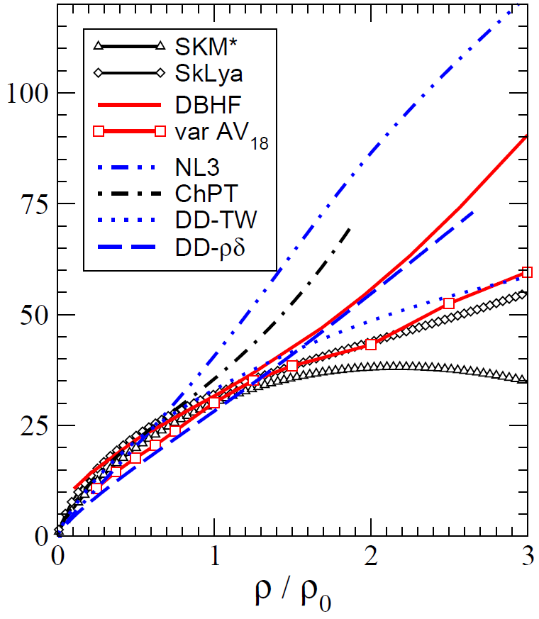
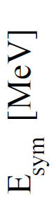
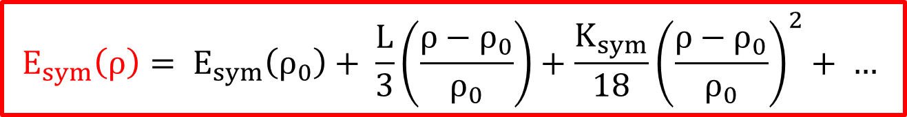
NUCLEAR SYMMETRY ENERGY: $E_{A}\left(ρ,δ\right)=E_{A}\left(ρ,0\right)+E_{SYM}\left(ρ\right)∙δ^{2}$
$$E_{sym}\left(ρ\right)= E_{sym}\left(ρ_{0}\right)+ \frac{L}{3}\left(\frac{ρ−ρ_{0}}{ρ_{0}}\right)+\frac{K_{sym}}{18}{\left(\frac{ρ−ρ_{0}}{ρ_{0}}\right)}^{2}+ …$$
Slope
Curvature
Notes:
It represents the response of nuclear matter to asymmetry. Its study, consequently, requires differential observables measuring differences as a function of asymmetry or isotopic pairs of observables that respond differently to a compression of neutron-rich matter. It is thus essential to identify differential observables as, e.g., differences or ratios of observables measured for isotopic partner systems or reactions. One hopes to enhance the response to asymmetry as the isoscalar dynamics largely cancels. The so-called differential directed flow proposed by Li [30] is the difference of the multiplicity-weighted directed flows of neutrons and protons.

Slide 38
NUCLEAR SYMMETRY ENERGY: $E_{A}\left(ρ,δ\right)=E_{A}\left(ρ,0\right)+E_{SYM}\left(ρ\right)∙δ^{2}$
$$E_{sym}\left(ρ\right)= E_{sym}\left(ρ_{0}\right)+ \frac{L}{3}\left(\frac{ρ−ρ_{0}}{ρ_{0}}\right)+\frac{K_{sym}}{18}{\left(\frac{ρ−ρ_{0}}{ρ_{0}}\right)}^{2}+ …$$
Hard
Slope
Curvature
Largely unconstrained at densities ρ > ρ₀
Related to uncertainty of three-body and tensor forces at high density
Soft
Super-Soft
C. Fuchs, H.H. Wolter, EPJA 30 (2006) 5
B-A Li, À. Ramos, G. Verde et al., Eur. Phys. J. A (2014) 50: 9
Notes:
It represents the response of nuclear matter to asymmetry. Its study, consequently, requires differential observables measuring differences as a function of asymmetry or isotopic pairs of observables that respond differently to a compression of neutron-rich matter. It is thus essential to identify differential observables as, e.g., differences or ratios of observables measured for isotopic partner systems or reactions. One hopes to enhance the response to asymmetry as the isoscalar dynamics largely cancels. The so-called differential directed flow proposed by Li [30] is the difference of the multiplicity-weighted directed flows of neutrons and protons.

Slide 39
NUCLEAR SYMMETRY ENERGY: $E_{A}\left(ρ,δ\right)=E_{A}\left(ρ,0\right)+E_{SYM}\left(ρ\right)∙δ^{2}$
$$E_{sym}\left(ρ\right)= E_{sym}\left(ρ_{0}\right)+ \frac{L}{3}\left(\frac{ρ−ρ_{0}}{ρ_{0}}\right)+\frac{K_{sym}}{18}{\left(\frac{ρ−ρ_{0}}{ρ_{0}}\right)}^{2}+ …$$
Hard
Slope
Curvature
Largely unconstrained at densities ρ > ρ₀
Related to uncertainty of three-body and tensor forces at high density
Soft
Identification of differential observables (e.g. differences or ratios of observables) to enhance the response to asymmetry as the iso-scalar dynamics largely cancels
Super-Soft
C. Fuchs, H.H. Wolter, EPJA 30 (2006) 5
B-A Li, À. Ramos, G. Verde et al., Eur. Phys. J. A (2014) 50: 9
Notes:
It represents the response of nuclear matter to asymmetry. Its study, consequently, requires differential observables measuring differences as a function of asymmetry or isotopic pairs of observables that respond differently to a compression of neutron-rich matter. It is thus essential to identify differential observables as, e.g., differences or ratios of observables measured for isotopic partner systems or reactions. One hopes to enhance the response to asymmetry as the isoscalar dynamics largely cancels. The so-called differential directed flow proposed by Li [30] is the difference of the multiplicity-weighted directed flows of neutrons and protons.

Slide 40
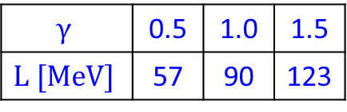
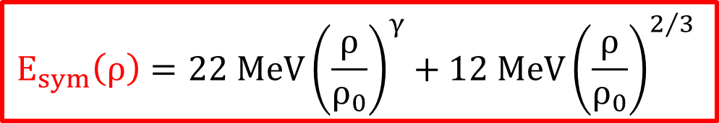
NUCLEAR SYMMETRY ENERGY: $E_{A}\left(ρ,δ\right)=E_{A}\left(ρ,0\right)+E_{SYM}\left(ρ\right)∙δ^{2}$
Parameterization in transport (UrQMD, IQMD)
$$E_{sym}\left(ρ\right)=22 MeV{\left(\frac{ρ}{ρ_{0}}\right)}^{γ}+12 MeV{\left(\frac{ρ}{ρ_{0}}\right)}^{2/3}$$
$$γ$$ | 0.5 | 1.0 | 1.5
$$L [MeV]$$ | 57 | 90 | 123
Hard
Soft
Super-Soft
C. Fuchs, H.H. Wolter, EPJA 30 (2006) 5
B-A Li, À. Ramos, G. Verde et al., Eur. Phys. J. A (2014) 50: 9
Notes:
It represents the response of nuclear matter to asymmetry. Its study, consequently, requires differential observables measuring differences as a function of asymmetry or isotopic pairs of observables that respond differently to a compression of neutron-rich matter. It is thus essential to identify differential observables as, e.g., differences or ratios of observables measured for isotopic partner systems or reactions. One hopes to enhance the response to asymmetry as the isoscalar dynamics largely cancels. The so-called differential directed flow proposed by Li [30] is the difference of the multiplicity-weighted directed flows of neutrons and protons.

Slide 41


NUCLEAR SYMMETRY ENERGY: $E_{A}\left(ρ,δ\right)=E_{A}\left(ρ,0\right)+E_{SYM}\left(ρ\right)∙δ^{2}$
Parameterization in transport (UrQMD, IQMD)
$$E_{sym}\left(ρ\right)=22 MeV{\left(\frac{ρ}{ρ_{0}}\right)}^{γ}+12 MeV{\left(\frac{ρ}{ρ_{0}}\right)}^{2/3}$$
$$γ$$ | 0.5 | 1.0 | 1.5
$$L [MeV]$$ | 57 | 90 | 123
Hard
Idea: Measurement of differential collective flow of neutrons w.r.t. protons or overall charged particles
Soft
Au-Au 0.4 AGeV
FOPI-LAND and ASY-EOS @ SIS18
L = 72 ± 13 MeV
K_{sym} = -70 … -40 MeV
FOPI-LAND: $γ=0.90±0.40$
ASY-EOS: $γ=0.72±0.19$
Super-Soft
P. Russotto et al., Phys.Lett. B697 (2011) 471-476
P. Russotto et al., Phys.Rev. C94 (2016) no.3, 034608
Notes:
It represents the response of nuclear matter to asymmetry. Its study, consequently, requires differential observables measuring differences as a function of asymmetry or isotopic pairs of observables that respond differently to a compression of neutron-rich matter. It is thus essential to identify differential observables as, e.g., differences or ratios of observables measured for isotopic partner systems or reactions. One hopes to enhance the response to asymmetry as the isoscalar dynamics largely cancels. The so-called differential directed flow proposed by Li [30] is the difference of the multiplicity-weighted directed flows of neutrons and protons.

Slide 42
NUCLEAR SYMMETRY ENERGY: $E_{A}\left(ρ,δ\right)=E_{A}\left(ρ,0\right)+E_{SYM}\left(ρ\right)∙δ^{2}$
Parameterization in transport (UrQMD, IQMD)
$$E_{sym}\left(ρ\right)=22 MeV{\left(\frac{ρ}{ρ_{0}}\right)}^{γ}+12 MeV{\left(\frac{ρ}{ρ_{0}}\right)}^{2/3}$$
$$γ$$ | 0.5 | 1.0 | 1.5
$$L [MeV]$$ | 57 | 90 | 123
Hard
Idea: Measurement of differential collective flow of neutrons w.r.t. protons or overall charged particles
Soft
Au-Au 0.4 AGeV
FOPI-LAND and ASY-EOS @ SIS18
L = 72 ± 13 MeV
K_{sym} = -70 … -40 MeV
FOPI-LAND: $γ=0.90±0.40$
ASY-EOS: $γ=0.72±0.19$
Super-Soft
Moderately soft asy-EOS ≤ 2ρ₀
Possible at higher densities (≥ 2ρ₀) with CBM
P. Russotto et al., Phys.Lett. B697 (2011) 471-476
P. Russotto et al., Phys.Rev. C94 (2016) no.3, 034608
Notes:
It represents the response of nuclear matter to asymmetry. Its study, consequently, requires differential observables measuring differences as a function of asymmetry or isotopic pairs of observables that respond differently to a compression of neutron-rich matter. It is thus essential to identify differential observables as, e.g., differences or ratios of observables measured for isotopic partner systems or reactions. One hopes to enhance the response to asymmetry as the isoscalar dynamics largely cancels. The so-called differential directed flow proposed by Li [30] is the difference of the multiplicity-weighted directed flows of neutrons and protons.

Slide 43
2,3-BODY HYPERON-NUCLEON (Λ-N) AND HYPERON-HYPERON (Λ-Λ) INTERACTIONS
EOS W/ CBM CASE #3

Slide 44
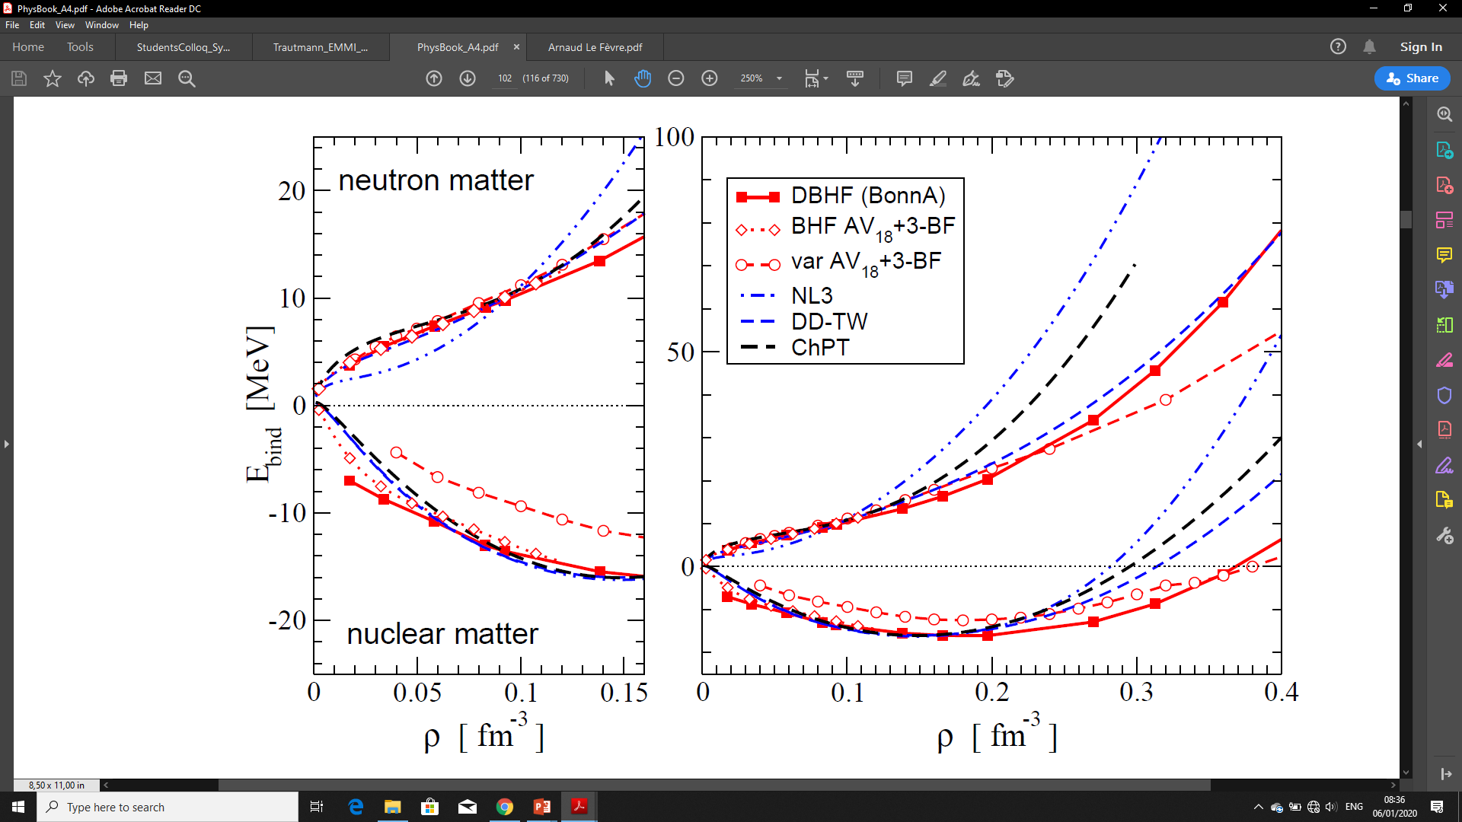
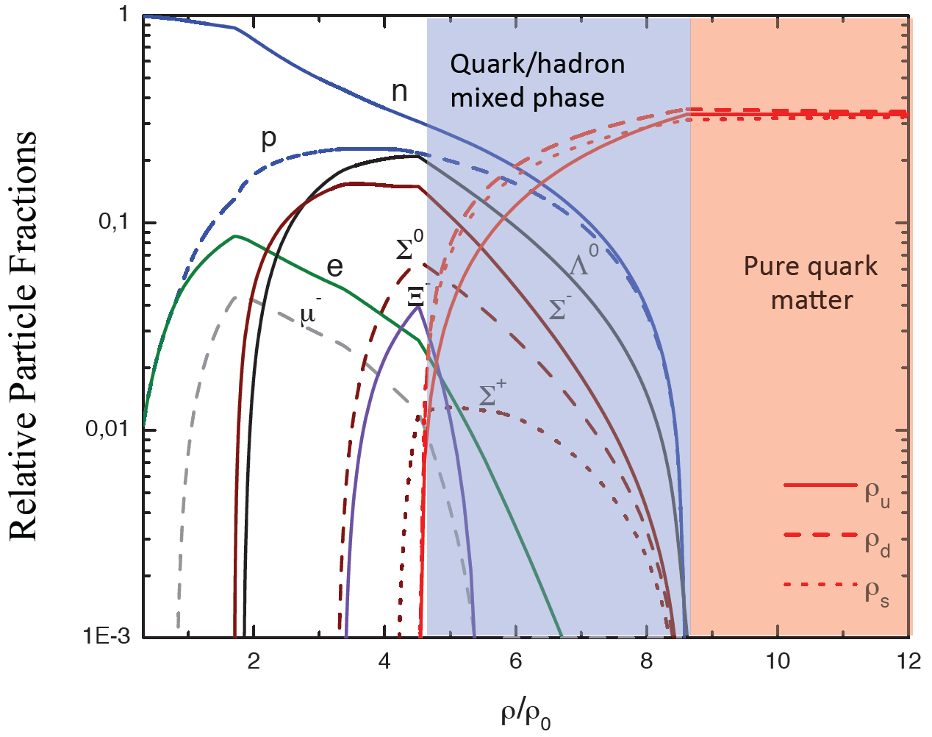
‘STRANGE MATTER’ – HYPERONS IN MASSIVE NEUTRON STARS
At higher densities (> 4ρ₀), inclusion and interactions of hyperons become an important ingredient to microscopically connect neuclear and neutron matter
Neutron Matter
Nuclear Matter
C. Fuchs, H.H. Wolter, EPJA 30 (2006) 5
B-A Li, À. Ramos, G. Verde et al., Eur. Phys. J. A (2014) 50: 9
M. Orsaria, H. Rodrigues, F. Weber, G.A. Contrera, arXiv:1308.1657
Phys. Rev. C 89, 015806, 2014

Slide 45
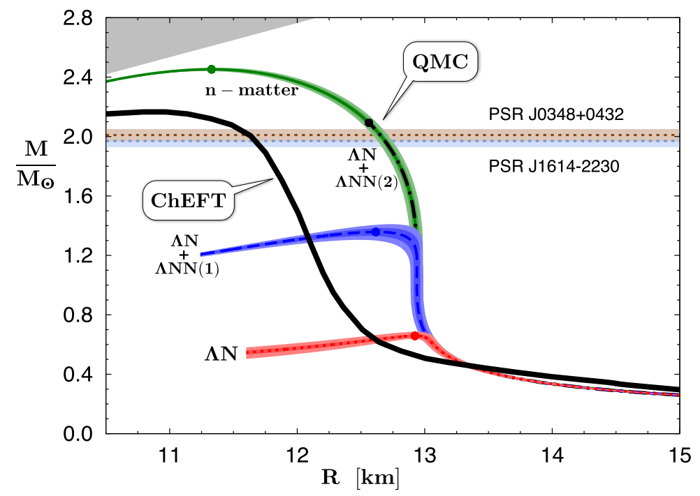
‘STRANGE MATTER’ – HYPERONS IN MASSIVE NEUTRON STARS
But: Inclusion of hyperons results in EoS too soft to support 2-solar-mass n-stars
Unless: Strong repulsion in YN and YNN … interactions
W. Weise, EMMI Workshop - Probing Dense Baryonic Matter with Hadrons (2019)
M. Orsaria, H. Rodrigues, F. Weber, G.A. Contrera, arXiv:1308.1657
Phys. Rev. C 89, 015806, 2014

Slide 46
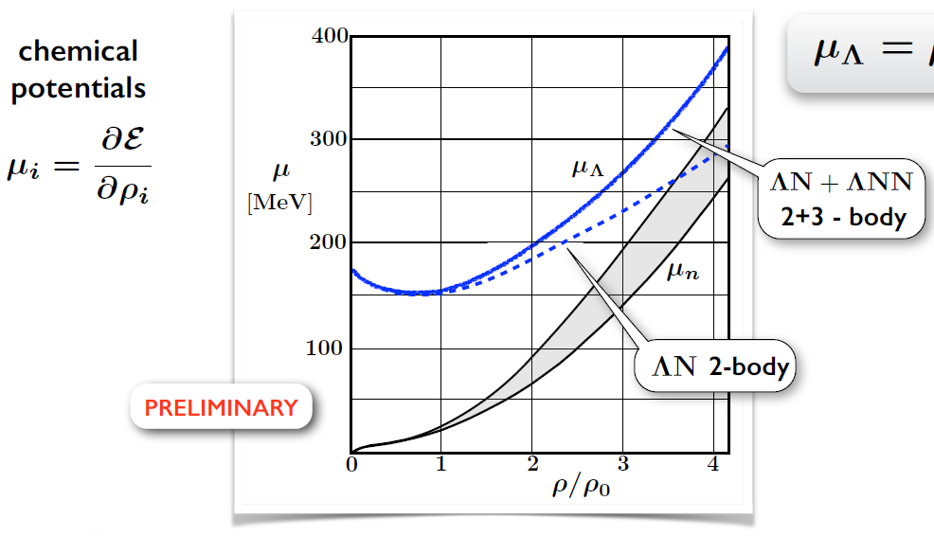
‘STRANGE MATTER’ – HYPERONS IN MASSIVE NEUTRON STARS
But: Inclusion of hyperons results in EoS too soft to support 2-solar-mass n-stars
Unless: Strong repulsion in YN and YNN … interactions
Extrapolations using Λ single particle potential in neutron (star) matter from Chiral SU(3) EFT interactions
W. Weise, EMMI Workshop - Probing Dense Baryonic Matter with Hadrons (2019)

Slide 47




UNDERSTANDING Λ-N, Λ-Λ INTERACTIONS WITH CBM
CBM
Hypernuclei produced in dense matter are excellent particles to study Λ-N, Λ-Λ interactions!
P
P
P
$${}_{Λ}^{3}H$$
P
N
$${}_{ΛΛ}^{5}H$$
N
$${}_{ΛΛ}^{6}{He}$$
N
N
N
Λ
Λ
Λ
Λ
Λ
Experimental Observables
Particle Yields (also shown in the image)
Lifetimes
Collective Flow
No experimental data in CBM energy range
Huge discovery potential !!!
Thermal Model: A. Andronic et al., Phys. Lett. B697 (2011) 203

Slide 48
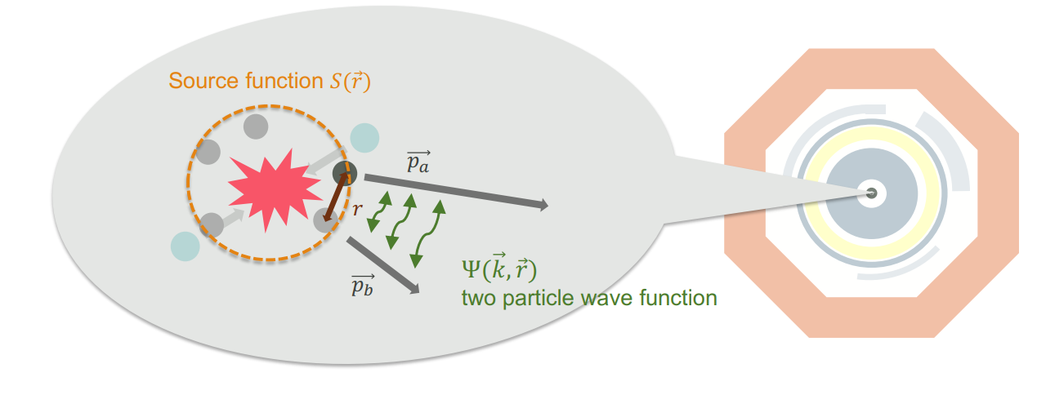


UNDERSTANDING Λ-N, Λ-Λ INTERACTIONS WITH CBM
Idea: Femtoscopy to study the correlation functions (cross-sections) w.r.t. momentum

Slide 49
UNDERSTANDING Λ-N, Λ-Λ INTERACTIONS WITH CBM
Idea: Femtoscopy to study the correlation functions (cross-sections) w.r.t. momentum
CATS – Correlation Analysis Tool Using the Schrödinger Equation (TUM - Fabbietti et al.)
Numerical sol. of the Schrödinger Solution to obtain ‘exact’ solutions to obtain the correlation functions

Slide 50

UNDERSTANDING Λ-N, Λ-Λ INTERACTIONS WITH CBM
Idea: Femtoscopy to study the correlation functions (cross-sections) w.r.t. momentum
CATS – Correlation Analysis Tool Using the Schrödinger Equation (TUM - Fabbietti et al.)
Numerical sol. of the Schrödinger Solution to obtain ‘exact’ solutions to obtain the correlation functions

Slide 51
UNDERSTANDING Λ-N, Λ-Λ INTERACTIONS WITH CBM
Idea: Femtoscopy to study the correlation functions (cross-sections) w.r.t. momentum
CATS – Correlation Analysis Tool Using the Schrödinger Equation (TUM - Fabbietti et al.)
Numerical sol. of the Schrödinger Solution to obtain ‘exact’ solutions to obtain the correlation functions
Experimentally shown for ALICE@LHC (μ_{B} = 0)
Possible at CBM@FAIR (μ_{B} > 0)?

Slide 52
SUMMARY OF THE EOS EXPERIMENTAL PROBES WITH CBM@FAIR
Nuclear Symmetric Matter EOS:
Collective flow of Baryons (π, K, p, Λ, Ξ, Ω,...) driven by the fireball’s pressure gradient
Sub-Threshold Particle Production of Multi-Strange Hyperons via multi-step processes
Neutron Matter EOS:
Symmetry Energy:
    Neutron/Proton Elliptic Flow
    Sub-Threshold Particle Production of isospin-opposite particles (I₃ = ± 1) ?
    Hyperon Puzzle (ΛN, ΛNN, and ΛΛN interactions)
    Hypernuclei production and yields
    Hypernuclei lifetime
    Hypernuclei Collective Flow
    Correlation functions to study interaction cross-sections by using CATS

Slide 53
EXPERIMENTAL CHALLENGES

Slide 54


(TOO) RARE PROBES
CBM Interaction Rates – 10MHz
Alternating Gradient Synchrotron (AGS)
High Density Region
Statistical model, A. Andronic, priv. comm. to P. Senger
T. Ablyazimov et al. [CBM Collaboration] Eur. Phys. J. A (2017)

Slide 55

DAY-1: EXPECTED PARTICLE YIELDS AU+AU @ 6, 10 AGEV
I. Vassiliev, 34th CBM Collaboration Meeting (2019)

Slide 56

IT’S TOUGH
EXPERIMENTAL CHALLENGES
PHYSICISTS & ENGINEERS
Image Credits: https://imgflip.com/memetemplate/166876537/kid-vs-sumo-wrestler

Slide 57
IT’S TOUGH
EXPERIMENTAL CHALLENGES
PHYSICISTS & ENGINEERS
10⁵ - 10⁷ Au + Au reactions/sec
Determination of (displaced) vertices (σ ≈ 50 μm)
Identification of leptons and hadrons
Fast and radiation hard detectors
Trigger-less Free-streaming readout electronics
High speed data acquisition and high performance computer farm for online event selection
4-D event reconstruction
Image Credits: https://imgflip.com/memetemplate/166876537/kid-vs-sumo-wrestler

Slide 58

CBM EXPERIMENTAL SETUP

Slide 59
CBM EXPERIMENTAL SETUP
Ring Imaging Cherenkov Detector (RICH) e⁺e⁻ (p > 8GeV/c)
Transition Radiation Detector (TRD) e⁺e⁻ (p > 1.5GeV/c), γ, Heavy Fragments
Time-Of-Flight (TOF) Hadron Identification
Electron Calorimeter (ECAL) γ
Projectile Spectator Detector (PSD) Centrality
Muon Chamber (MUCH) µ⁺µ⁻ , γ
MVD + Magnet Open Charm
STS + Magnet Δp/p = 1-2%

Slide 60








PARTICLE IDENTIFICATION (PID) WITH CBM
ToF
Hadron Identification
RICH
Electron
Identification
$$e^{−}$$
$$π^{−}$$
$$\overline{p}$$
$$p$$
$$K^{−}$$
$$K^{+}$$
$${\left(e^{−},μ^{−}\right),π}^{−}$$
$${\left(e^{+},μ^{+}\right),π}^{+}$$
TRD + ToF
Electron, Light Nuclei, Heavy Fragments
High purity identification of
charged protons, pions, electrons and light nuclei

Slide 61

KALMAN FILTER PARTICLE FINDER (KFPF)
Almost 150 decays
All decays are reconstructed in one go – online!
Based on the Kalman filter method – mathematically correct parameters and their errors
Available in and approbated within STAR, ALICE, PANDA
M. Zyzak, I. Vassiliev et al. – GSI Darmstadt

Slide 62





CBM‘S CAPABILITES IN HYPERON DETECTION & RECONSTRUCTION
CBM
$Ξ^{−}$Decay Topology reconstructed in CBM
$$Λ^{−}$$
Particle Multiplicity in central Au-Au/Pb-Pb
$$Ξ^{−}$$
$$π^{−}$$
C. Blume, J. Phys. G 31, S57 (2005)
I. Vassiliev, Quark Matter (2018)
Notes:
Figure on left shows the experimental particle multiplicities of strange hadrons in central heavy ion collisions at AGS, SPS and RHIC experiments.
Low particle multiplicities and scarce data available in CBM energy range. E.g. no data on production below 40AGeV (√s_{NN}= 8.8GeV) exist, except for 312 Ξ⁻ measured at 6AGeV at the AGS
So, there is a HUGE DISCOVERY POTENTIAL which could help us pin down EOS at higher density regimes.

Slide 63

CBM‘S CAPABILITES IN HYPERON DETECTION & RECONSTRUCTION
CBM
CBM Performance using UrQMD Au+Au collisions 10 AGeV (b=0)
Particle Multiplicity in central Au-Au/Pb-Pb
C. Blume, J. Phys. G 31, S57 (2005)
I. Vassiliev, 34th CBM Collaboration Meeting (2019)
Notes:
Figure on left shows the experimental particle multiplicities of strange hadrons in central heavy ion collisions at AGS, SPS and RHIC experiments.
Low particle multiplicities and scarce data available in CBM energy range. E.g. no data on production below 40AGeV (√s_{NN}= 8.8GeV) exist, except for 312 Ξ⁻ measured at 6AGeV at the AGS
So, there is a HUGE DISCOVERY POTENTIAL which could help us pin down EOS at higher density regimes.

Slide 64




CBM‘S CAPABILITES IN HYPERON DETECTION & RECONSTRUCTION
CBM
STAR BES-II
STAR BES-II Performance at Au+Au collisions 14.5 GeV (200M events)
Particle Multiplicity in central Au-Au/Pb-Pb
CBM’s online particle reconstruction package (KFPF) works seamlessly with STAR BES-II
I. Vassiliev, 3rd EMMI Workshop on Anti-Matter, Hyper-Matter and Exotica Production at the LHC (2019)
C. Blume, J. Phys. G 31, S57 (2005)
Notes:
Figure on left shows the experimental particle multiplicities of strange hadrons in central heavy ion collisions at AGS, SPS and RHIC experiments.
Low particle multiplicities and scarce data available in CBM energy range. E.g. no data on production below 40AGeV (√s_{NN}= 8.8GeV) exist, except for 312 Ξ⁻ measured at 6AGeV at the AGS
So, there is a HUGE DISCOVERY POTENTIAL which could help us pin down EOS at higher density regimes.

Slide 65



CBM’S PERFORMANCE FOR DIRECTED FLOW (v₁)
CBM Performance using UrQMD Au+Au collisions 10 AGeV
$π^{+}$ Centrality Dependence
“Input” model v₁ is recovered using “data-driven” methods with projectile spectators
V. Klochkov, PhD Thesis – Uni. Frankfurt (2019)
O. Golosov et al., Quark Matter (2019)
O. Golosov et al., 34th CBM Collaboration Meeting (2019)

Slide 66

NUCLEAR SYMMETRY ENERGY AT HIGHER DENSITIES (ρ ≥ 2ρ₀)
TRD
Current CBM Setup
(No neutron detection)
MAGNET +
STS + MVD
MuCH
TOF
PSD
BEAM

Slide 67
NUCLEAR SYMMETRY ENERGY AT HIGHER DENSITIES (ρ ≥ 2ρ₀)
CBM Setup with NeuLAND ?
MAGNET +
STS + MVD
NeuLAND
TOF
PSD
BEAM
NeuLAND
Image credit: P. Senger, GSI-Darmstadt

Slide 68

UNDERSTANDING Λ-N, Λ-Λ INTERACTIONS WITH CBM
${}_{ΛΛ}^{6}{He}$Decay Topology reconstructed in CBM
CBM
Thermal Model: A. Andronic et al., Phys. Lett. B697 (2011) 203
I. Vassiliev, Quark Matter (2018)

Slide 69

UNDERSTANDING Λ-N, Λ-Λ INTERACTIONS WITH CBM
 | Multiplicity | Yield 1 week | Int. Rate | Branching Ratio, Efficiency
_{ΛΛ}⁵H | 5 ⋅ 10⁻⁶ | 3000 | 1 MHz | 10%, 1%
_{ΛΛ}⁶He | 1 ⋅ 10⁻⁷ | 60 | 1 MHz | 10%, 1%
CBM
CBM Performance using UrQMD Au+Au collisions 10 AGeV (b=0)
Thermal Model: A. Andronic et al., Phys. Lett. B697 (2011) 203

Slide 70

FAIR PHASE 0 – AVOIDING RISKS AND SPECTACULAR FAILURES...

Slide 71
mCBM @ SIS18
mCBM @SIS18
mCBM – Test-setup at SIS18 at 10 MHz
Free streaming read-out and data transport to the mFLES
Online reconstruction
Offline data analysis
Controls
Detector tests of final detector prototypes
UrQMD sim. – Ag+Au 1.58 AGeV
mToF Event Display
Beam Rate - R(T₀) 2 x 10⁷Hz
With Target Thickness P_{int} = 10 %
So, Interaction Rate R_{int} = 2 x 10⁶Hz
High rate capability of mCBM demonstrated at 2 MHz!

Slide 72


eTOF @ STAR-BNL
Successfully Installed and Operational
36 modules, 108 MRPCs, ~7000 channels

Slide 73


MORE LITERATURE ???
The CBM Physics Book
Foreword by Frank Wilczek
Springer Series:
Lecture Notes in Physics, Vol. 814
1st Edition., 2011, 960 p., Hardcover
ISBN: 978-3-642-13292-6
“Challenges in QCD Matter Physics – the scientific programme of the Compressed Baryonic Matter Experiment at FAIR”
Electronic Authors version:
http://www.gsi.de/documents/DOC-2009-Sep-120-1.pdf
T. Ablyazimov et al. [CBM Collaboration] Eur. Phys. J. A (2017)

Slide 74
SUMMARY
CBM@FAIR (2 – 11 AGeV Au-Au) provides unique conditions in lab to probe QCD matter properties at neutron star core densities, including the high density EOS, and the search for new phases expected for densities above 5ρ₀
Nuclear Symmetric Matter EOS:
Collective flow of Baryons (π, K, p, Λ, Ξ, Ω,...) driven by the fireball’s pressure gradient
Sub-Threshold Particle Production of Multi-Strange Hyperons via multi-step processes
Neutron Matter EOS:
Symmetry Energy:
    Neutron/Proton Elliptic Flow → Possible to upgrade with NewLAND
    Sub-Threshold Particle Production of isospin-opposite particles (I₃ = ± 1) ?
    Hyperon Puzzle (ΛN, ΛNN, and ΛΛN interactions)
    Hypernuclei production, yields, lifetime, collective flow
    Correlation functions to study interaction cross-sections by using CATS

Slide 75
SUMMARY
Experimental Requirements
Unique measurements of bulk & rare probes with CBM
High-rate capability of detectors and triggerless DAQ
Online event reconstruction and selection
Testing CBM components and analysis methods within FAIR Phase-0
mCBM campaign ongoing → great learning experience and proof-of-principle for DAQ
eTOF @ BES-II sucessfully installed
KF Particle Finder successfully used in BES-II particle reconstruction

Slide 76
OUTLOOK – HOPEFULLY THE TIMELINES REMAIN ‘STIFF’
2021
2022
2023
2024
2025
1.5 years
from now !
Shell construction
finished 2021-04
Building
certification
Services installation
Construction site rules
construction site services
Normal operation rules
Rail system
1st installation window
platforms, base supports,
some service lines, ….
2nd installation window
services (HV,LV, gas)
detector supports, detectors
Commis-
sioning
No access
Crane
E10
2020-09
Crane
E40
2021-04
Basic
services
2022-06
Hbo
2022-10
Cryo
2023-03
SIS100
beams
A12-A
2025-04
M10 rail
M10 supports
M10 services
M10 detectors
W.F.J. Müller, Joint FAIR ECE 11 and ECSG 02 meeting (2019)

Slide 77

ALMOST THERE…

Slide 78

ALMOST THERE…

Slide 79

ALMOST THERE…

Slide 80

ALMOST THERE…

Slide 81

THANKS A LOT FOR YOUR ATTENTION ☺

Slide 82
BACK-UP
ADDITIONAL SLIDES

Slide 83
HEAVY ION COLLISIONS ↔ ASTROPHYSICAL EVENTS & OBJECTS
Based on numerical-relativity simulations of merging neutron star binaries, the emitted GW and the interior structure of the generated hyper-massive neutron stars (HMNS) have been analyzed in detail.
Distributions of the rest-mass density ρ in units of ρ0 (top panel) and the temperature (bottom panel) on the equatorial plane at a post-merger time of t = 6.34 ms for the LS220-M132 binary.
Also shown are portions of the flowlines of several tracer particles that remain close to the (x, y)-plane and for which we show only the final part of the flowlines.
In the top picture, the black iso-contours have been drawn at ρ/ρ0 = 0.5n (n ∈ N), while the red iso-contour indicates ρ = 3 ρ0. The temperature iso-contours (right picture) have been drawn at T = 10n MeV
M. Hanauske et al., 2017 J. Phys.: Conf. Ser. 878 012031

Slide 84
HEAVY ION COLLISIONS ↔ ASTROPHYSICAL EVENTS & OBJECTS
1.5 AGeV Au+Au (b = 5 fm, non-central), SIS18 Experiments at GSI
(Snap-shot of the densities at t = 15fm/c → partially in local equilibrium)
The contour where the density exceeds two times nuclear ground state density is highlighted (black dashed line).
The densities where calculated using the UrQMD transport model.
The contour where the density exceeds 80 MeV is highlighted (black dashed line).
The temperature has been calculated from the density and energy density using the QχP model (Quark-Hadron Chiral Parity Doublet Model) for the equation of state
M. Hanauske et al., 2017 J. Phys.: Conf. Ser. 878 012031

Slide 85

HEAVY ION COLLISIONS ↔ ASTROPHYSICAL EVENTS & OBJECTS
1.5 AGeV Au+Au (b = 5 fm, non-central), SIS18 Experiments at GSI
(Snap-shot of the densities at t = 15fm/c → partially in local equilibrium)
QχP model: In this approach, an explicit mass term for baryons in the Lagrangian is possible, which preserves chiral symmetry. In this model, the signature for chiral symmetry restoration is the degeneracy of the usual baryons and their respective negative-parity partner states
M. Hanauske et al., 2017 J. Phys.: Conf. Ser. 878 012031

Slide 86


HEAVY ION COLLISIONS ↔ ASTROPHYSICAL EVENTS & OBJECTS
Global Thermal Model Freeze-Out Data
Hadronic Freeze-Out Line comparison RHIC v/s FAIR (Au-Au in AGeV)

Slide 87



GSI-FAIR FACILITY
Collision Energies and Systems available at SIS100
Beam | Z | A | E (AGeV)
p | 1 | 1 | 29
d | 1 | 2 | 14
Ca | 20 | 40 | 14
Ni | 28 | 58 | 13.6
In | 49 | 115 | 11.9
Au | 79 | 197 | 11
U | 92 | 238 | 10.7
$$\frac{E}{A}= \sqrt{{\left(0.3∙B∙r∙\frac{Z}{A}\right)}^{2}+m^{2}} −m$$
$B∙r$ = Beam Rigidity [T.m]
= 100 T.m for SIS100
$m$ = Mass of nucleon
Essentially the energy available is determined by the bending power of the magnets, quantified as Beam Rigidity (B.r)
$$E_{CM}= \sqrt{s}=\sqrt{{m_{1}}^{2}+{m_{2}}^{2}+2∙m_{2}∙E_{proj}}$$
For fixed target experiments,
$$E_{CM}= \sqrt{s}≅\sqrt{2∙m_{2}∙E_{proj}}$$
$$\sqrt{s_{NN}}= \frac{\sqrt{s}}{A}$$

Slide 88

EXPERIMENTAL OBSERVABLES [I] – COLLECTIVE FLOW
Collective flow of nucleons driven by the pressure gradient –
Sensitive to nuclear compressibility: EOS
Au-Au 1AGeV
Front Plane
Pressure Contours
Top Plane
Density Contours
P. Danielewicz et al., Science 298 (2002) 1592
Two observables of the high pressures results in matter to be ejected in specific directions:
Directed Flow v₁ Nucleons deflected sideways in the reaction plane
Elliptic Flow v₂ Nucleons are “squeezed out” above and below or “expanded in” the reaction plane

Slide 89




SYMMETRIC MATTER EQUATION OF STATE
Nuclear equation-of-state at T = 0 :
"compressional" energy
Effective NN-Potential (Skyrme)
stiff EoS
α
[MeV]
β
[MeV]
γ
κ = 380 MeV
-124
70.5
2
κ = 200 MeV
-356
303
7/6
soft EoS
Compression Modulus :
Image and slide credits: C. Sturm, GSI-Darmstadt

Slide 90


EXPERIMENTAL OBSERVABLES [I] – COLLECTIVE FLOW
Collective flow of nucleons driven by the pressure gradient –
Sensitive to nuclear compressibility: EOS
F ≡ Magnitude of sideward deflection
↓
F ∝ Fireball Pressure
Nuclear Incompressibility,
$$κ=170−210 MeV$$
Two observables of the high pressures results in matter to be ejected in specific directions:
Directed Flow v₁ Nucleons deflected sideways in the reaction plane
Elliptic Flow v₂ Nucleons are “squeezed out” above and below or “expanded in” the reaction plane

Slide 91
EXPERIMENTAL OBSERVABLES [I] – COLLECTIVE FLOW
Collective flow of nucleons driven by the pressure gradient –
Sensitive to nuclear compressibility: EOS
Reflects higher pressure of the fireball
↓
[ϕ = 90°, 270°] [cos(2ϕ) = -1]
Two observables of the high pressures results in matter to be ejected in specific directions:
Directed Flow v₁ Nucleons deflected sideways in the reaction plane
Elliptic Flow v₂ Nucleons are “squeezed out” above and below or “expanded in” the reaction plane

Slide 92


EXPERIMENTAL OBSERVABLES [I] – COLLECTIVE FLOW
Collective flow of nucleons driven by the pressure gradient –
Sensitive to nuclear compressibility: EOS
Reflects lower pressure of the fireball
↓
[ϕ = 0°, 180°] [cos(2ϕ) = +1]
Nuclear Incompressibility,
$$κ=170−370 MeV$$
Two observables of the high pressures results in matter to be ejected in specific directions:
Directed Flow v₁ Nucleons deflected sideways in the reaction plane
Elliptic Flow v₂ Nucleons are “squeezed out” above and below or “expanded in” the reaction plane

Slide 93

EXPERIMENTAL OBSERVABLES [II] – (SUB)THRESHOLD PRODUCTION
(Sub)Threshold Particle Production – Particles NOT produced in initial head-on collisions, but in multiple low energy collisions → Collisions are enhanced in high-density medium
Strangeness – Kaon yields (K⁺(us̄)) are particularly sensitive to the medium density [proven at KAOS-GSI] Long mean-free path length of K⁺ (only elastic scattering) & no absorption → Penetrating probe
Idea: Strangeness Yield (K⁺) ∝ Baryonic Density ∝ Compressibility ∝ EOS
Mean Free Path at ρ₀
NN → N∆
N∆ → NK⁺Λ⁰
πN → K⁺Λ⁰
E_{threshold} = 1.58 GeV
Image credit: (Left ) P. Senger, GSI-Darmstadt
(Right) PDG, Phys.Rev D 54, 1 (1996)
Notes:
For producing any particle, a minimum amount of energy is needed which is called the Threshold Energy. And in a sub-threshold particle production, particles are NOT produced in initial head-on collisions, but in multiple low energy collisions. Therefore its expected that of the density of collision region/fireball is high enough, then probability of these multiple low energy collisions will increase. Thus leading to more production of the desired particles at below threshold level.
Given that method of particle production a highly collective process, it is specially sensitive to the compressibility of nuclear matter at high baryon densities. Thus making it sensitive to the EOS of the nuclear matter.
An illustrative example of this shown in the bottom left figure, where kaons (single-strange meson) are produced in a sub-threshold particle production by multiple small collisions. In this specific multi step process, 3 or more particles are involved, such as:
Step 1: Forming a Δ-resonance which stores the energy
Step 2: The Δ-resonance collides with a nucleon and then finally the production threshold can be overcome.
Please note that the threshold for K+ production is 1.58 GeV.
Given the fact is Strangeness is always conserved, it makes K+ meson an extremely useful probe. Its because once produced, it cannot be absorbed by the surrounding nucleons. This can be quantitatively shown in the plot shown on the right, with the interaction cross-sections in millibarn on y-axis and particle momentum in GeV on the x-axis. Different colors indicate interaction cross-sections of kaons, anti-kaons and pions with proton. This results in a rather long mean free path of about 7 fm of K+ mesons in nuclear matter and makes them a suitable ’penetrating’ probe for the dense fireball produced in heavy ion reactions. (Final state interactions such as elastic kaon-nucleon scattering or the propagation in potentials influence the dynamics but do not change the total yields)
So the idea is that the strangeness yield ∝ baryon density ∝ compressibility ∝ EOS.
Text Ref:
[1] CBM Physics Book, pg 691-702
[2] Landolt-Börnstein, Chapter - Hadron Production in Heavy Ion Collisions (subsection: Hardon Production below 2 GeV)
[3] C.Sturm, Herschigg 2009 (slides undernotes)
-----------------------------------------------
Extra text:
In fixed-target p+p collisions the threshold for pion production is 0.29 GeV, for K+ it is 1.58 GeV and for K− it is 2.5 GeV. The threshold for K+ is lower than that for K−, because the energy balance has only to account for the excitation of a nucleon to a Λ in the case of K+, whereas together with the K− a K+ has to be produced to conserve strangeness. The reaction dynamics of pions and kaons is quite different. The pion-nucleon cross section, shown in Fig. 1, is large and thus pions are continuously absorbed through the Δ-resonance and re-emitted by its decay. This creation and disappearance can occur during the entire time evolution of the collision. The K+-nucleon interaction cross section, also shown in Fig. 1, on the other hand, is small due to strangeness and energy conservation. There are no partners to react with and only elastic scattering and charge exchange can occur. Therefore, K+ mesons are expected to leave the interaction zone early. These facts have led to the suggestion of time-ordered emission of these two species [4]. The creation of K− requires even higher energies. The dominant production mechanism is strangeness exchange. The interaction probability of K− with nuclear matter is much higher than that of K+ and the mean free path much lower. As a consequence, K− cannot leave the reaction zone undisturbed and they are emitted later

Slide 94
EXPERIMENTAL OBSERVABLES [II] – (SUB)THRESHOLD PRODUCTION
Kaons
Antikaons
u
d
s
u
d
u
Λ
p
u
d
d
u
d
d
n
n
Associate K⁺ production with K⁻
s
u
K⁺
s
u
K⁺
u
d
u
s
u
K⁻
u
d
u
d
d
u
p
p
n
d
d
u
n
production threshold
in NN collisions :
production threshold
in NN collisions :
Image and slide credits: C. Sturm, GSI-Darmstadt

Slide 95





REPULSIVE KAON (K⁺N) POTENTIAL
V_{K+N} = + 25 ± 5 ρ/ρ₀ MeV
Envelope of several microscopic calculations: all predict the same trend!
repulsive
K⁺ N potential
1. Effect on Production → Yield
Reduced K+ yield due to increased in-medium K+ mass
2. Effect on Propagation → Angular Dist.
Preferential out-of-plane flow (squeeze out) for K+ suggests repulsive potentials
attractive
K⁻ N potential
Image and slide credits: C. Sturm, GSI-Darmstadt
Image credit (Right-Top):
Data: M. Menzel et al., (KaoS Collab.), Phys. Lett. B 495 (2000) 26
K. Wisniewski et al., ( FOPI Collab.), Eur. Phys. J A 9 (2000) 515
Image credit (Right-Bottom):
Data: Y. Shin et al., (KaoS Collaboration), Phys. Rev. Lett. 81 (1998) 1576
F. Uhlig et al., (KaoS Collaboration), Phys. Rev. Lett. 95 (2005) 012301
Calculations: A. Larionov, U. Mosel, nucl-th/0504023

Slide 96


ATTRACTIVE ANTI-KAON (K⁻N) POTENTIAL
V_{K-N} = - 80 ± 20 ρ/ρ₀ MeV
Envelope of several microscopic calculations: all predict the same trend!
repulsive
K⁺ N potential
1. Effect on Production → Yield
The results of the calculations depend on the density dependence of the
cross section for strangeness exchange which is still a matter of investigations
2. Effect on Propagation → Angular Dist.
Preferential in-plane flow for K- suggests attractive potentials
attractive
K⁻ N potential
Ni+Ni 1.93 AGeV
3.8 fm < b < 6.5 fm
Λ (1405)
K⁻
K⁻
Image and slide credits: C. Sturm, GSI-Darmstadt
N⁻¹
K⁻ resonant around threshold and requires non-perturbative approaches
Density dependency and off-shell behavior of the hyperon resonances?
IQMD
Image credit (Right-Top):
Data: M. Menzel et al., (KaoS Collab.), Phys. Lett. B 495 (2000) 26
Image credit (Right-Bottom):
Data: F. Uhlig et al., (KaoS Collaboration), Phys. Rev. Lett. 95 (2005) 012301
Calculations: C. Hartnack, J. Aichelin, J. Phys. G 28, 1649 (2002)

Slide 97


EXPERIMENTAL OBSERVABLES [II] – (SUB)THRESHOLD PRODUCTION
“Subthreshold” K⁺ production
“Subthreshold” K⁺ mesons predominantly produced by collective effects → multi step processes
Probability of multi step processes
increases nonlinearly with the
baryon density
Peripheral
Collisions
Central
Collisions
IQMD: Au+Au 1AGeV
stiff EoS ρ_{max} / ρ₀ ≅ 2.7
soft EoS ρ_{max} / ρ₀ ≅ 3.1
M: multiplicity = number / per collision
A_{part} : number of participating nucleons
Image and slide credits: C. Sturm, GSI-Darmstadt

Slide 98


EXPERIMENTAL OBSERVABLES [II] – (SUB)THRESHOLD PRODUCTION
Idea: Strangeness Yield (K⁺) ∝ Baryonic Density ∝ Compressibility ∝ EOS
Experimentally: Measuring K⁺ yields in a system where compression is expected (Au-Au) w.r.t. system where no compression is expected (C-C)
KaoS (Exp.)
Soft EOS (Th.)
Hard EOS (Th.)
Au-Au
Soft Nuclear EOS
$κ≈200$ (2-3 ρ₀)
C-C
Experiment: C. Sturm et al., (KaoS Collaboration) Phys. Rev. Lett. 86 (2001) 39
Theory: QMD Ch. Fuchs et al., Phys. Rev. Lett. 86 (2001) 1974
IQMD Ch. Hartnack, J. Aichelin, J. Phys. G 28 (2002) 1649
IQMD C. Hartnack

Slide 99


EXPERIMENTAL OBSERVABLES [II] – (SUB)THRESHOLD PRODUCTION
Idea: Strangeness Yield ∝ Baryonic Density ∝ Compressibility ∝ EOS
0
1
2
3
4
5
6
7
8
9
10
11
12
13
E_{thr,NN} (GeV)
SIS18
SIS100
K^{+,0}, Λ⁰, Σ
K⁻
Ξ^{-,0}
Ω⁻
$$Λ^{0}\overline{Λ^{0}}$$
Ξ⁺
Ω⁺
Ω⁻
Ω⁺
Yield Soft (κ = 240 MeV)
Yield Hard (κ = 350 MeV)
Λ
Ξ⁺
Yield Soft (κ = 240 MeV)
Yield Hard (κ = 350 MeV)
Ξ⁻
Λ
Ξ⁻
Λ
PRELIMINARY
4 AGeV Au-Au, 6M events
PRELIMINARY
4 AGeV C-C, 6M events
PHQMD: J. Aichelin, E. Bratkovskaya, V. Kireyeu et al.
P. Senger, 4th CBM China Workshop (2019)

Slide 100

PARTON-HADRON-QUANTUM-MOLECULAR DYNAMICS (PHQMD)
PHQMD: E. Bratkovskaya, Strange Quark Matter SQM (2019)

Slide 101




NUCLEAR SYMMETRY ENERGY: $E_{A}\left(ρ,δ\right)=E_{A}\left(ρ,0\right)+E_{SYM}\left(ρ\right).δ^{2}$
Parameterization in transport
$$E_{sym}\left(ρ\right)=22 MeV{\left(\frac{ρ}{ρ_{0}}\right)}^{γ}+12 MeV{\left(\frac{ρ}{ρ_{0}}\right)}^{2/3}$$
$$γ$$ | 0.5 | 1.0 | 1.5
$$L [MeV]$$ | 57 | 90 | 123
Idea: Measurement of differential collective flow of isospin opposite particles (neutrons w.r.t. protons or overall charged particles)
Au-Au 0.4 AGeV
FOPI-LAND and ASY-EOS
L = 72 ± 13 MeV
K_{sym} = -70 … -40 MeV
Moderately soft asy-EOS ≤ 2ρ₀
Higher densities???
$$γ=0.90±0.40$$
$$γ=0.72±0.19$$
P. Russotto et al., Phys.Lett. B697 (2011) 471-476
P. Russotto et al., Phys.Rev. C94 (2016) no.3, 034608
Notes:
It represents the response of nuclear matter to asymmetry. Its study, consequently, requires differential observables measuring differences as a function of asymmetry or isotopic pairs of observables that respond differently to a compression of neutron-rich matter. It is thus essential to identify differential observables as, e.g., differences or ratios of observables measured for isotopic partner systems or reactions. One hopes to enhance the response to asymmetry as the isoscalar dynamics largely cancels. The so-called differential directed flow proposed by Li [30] is the difference of the multiplicity-weighted directed flows of neutrons and protons.

Slide 102



NUCLEAR SYMMETRY ENERGY: $E_{A}\left(ρ,δ\right)=E_{A}\left(ρ,0\right)+E_{SYM}\left(ρ\right).δ^{2}$
The isospin and momentum-dependent mean-field potential
Idea: Measurement of particle yields of isospin opposite particles (pions) for lower energies
Described by very soft asy-EOS ≤ 2ρ₀
Inconsistent with the n/p flow data
Still true for higher densities???
pion optical potential
self energies different for π- and π+
potentials and characteristics of Δ
WORK IN PROGRESS
Xiao et al., Phys. Rev. Lett. 102, 062502 (2009)
M. D. Cozma, Phys. Rev. C 95, 014601 (2017)
Notes:
It represents the response of nuclear matter to asymmetry. Its study, consequently, requires differential observables measuring differences as a function of asymmetry or isotopic pairs of observables that respond differently to a compression of neutron-rich matter. It is thus essential to identify differential observables as, e.g., differences or ratios of observables measured for isotopic partner systems or reactions. One hopes to enhance the response to asymmetry as the isoscalar dynamics largely cancels. The so-called differential directed flow proposed by Li [30] is the difference of the multiplicity-weighted directed flows of neutrons and protons.

Slide 103

NUCLEAR SYMMETRY ENERGY AT HIGHER DENSITIES (ρ ≥ 2ρ₀)
Idea: Measurement of yield ratios of isospin opposite particles at sub-threshold energies is suitable for higher energies where pion ration could loose sensitivity
I₃ | Particle | Production | E_{thr} | Decay
+1 | Σ⁺(uus) | pp → Σ⁺K⁺n pp → Σ⁺K⁰p pn → Σ⁺K⁰n | 1.8 GeV | Σ⁺ → pπ⁰ Σ⁺→ nπ⁺
-1 | Σ⁻(dds) | pn → Σ⁻K⁺p nn → Σ⁻K⁺n | 1.8 GeV | Σ⁻ → nπ⁻
+½ | Ξ⁰ (uss) | pp → Ξº K⁺K⁰p pn → Ξ⁰ K⁰K⁰p nn → Ξ⁰K⁰K⁰n | 3.7 GeV | Ξ⁰ → Λπ⁰
-½ | Ξ⁻ (dss) | pp → Ξ⁻ K⁺K⁺p pn → Ξ⁻ K⁺K⁺n nn → Ξ⁻ K⁰K⁺n | 3.7 GeV | Ξ⁻ → Λπ⁻
?
Jun Hong and P. Danielewicz, Phys. Rev. C90, 024605 (2014)
P. Senger, 3rd and 4th CBM China Meeting (2018-2019)

Slide 104

MODELLING THE CORRELATION FUNCTION
Andi Mathis, ALICE Collaboration, Exploring the perfect liquid, München (2018)

Slide 105

LEDNICKY MODEL
Valentina Mantovani Sarti, ALICE Collaboration, – QNP18 Satellite Workshop (2018)

Slide 106

CATS
Valentina Mantovani Sarti, ALICE Collaboration, – QNP18 Satellite Workshop (2018)

Slide 107

CORRELATION FUNCTIONS AND INTERACTIONS
Valentina Mantovani Sarti, ALICE Collaboration, – QNP18 Satellite Workshop (2018)

Slide 108

P-XI- CORRELATION FUNCTION IN P-PB 5.02 TEV
Valentina Mantovani Sarti, ALICE Collaboration, – QNP18 Satellite Workshop (2018)

Slide 109

4D RECONSTRUCTION
Maksym Zyzak, CBM Collaboration, EUNPC 2018,

Slide 110


Slide 111


CBM SC magnet
In-kind contribution by Russia, built by BINP Novosibirsk
Production status:
- The bare SC cable is manufactured
Cross section (photo)
Cable for 3 coils
- Contract for SC cable insulation
signed with VNIIKP
- Machining of the magnet yoke
will start in October 2019
Next steps:
Preliminary Design Review in Nov. 2019
Agreement on the cooling circuit, cryostat, coil support struts, control system
Final Design Review in May 2020
All technical drawings finished
Construction in 2020 - 2021

Slide 112





Silicon Tracking System
➢ Charged particle track reconstruction, momentum determination
In-kind contributions by Germany, Russia, Poland:
GSI, JINR, KIT Karlsruhe, JU + AGH Krakow, KINR Kiev, Univ. Tübingen, Warsaw UT
STS
Silicon microstrip sensors
Status:
TDR approved by FAIR in July, 2013
Radiation tolerance of silicon sensors tested up to n_{eq} (1 MeV) = 2 × 10¹⁴ /cm².
1100 silicon microstrip sensors ordered from vendor Hamamatsu Photonics,
delivery scheduled in batches from 11/2019 to 10/2020.
Second design iteration of the STS-XYTER ASIC made, applied to prototype modules.
Carbon fiber ladders ordered in company, delivery until 10/2019.
Module and ladder assembly procedures established, working towards declaring production readiness. Start of series production in 2020.
System engineering and system integration progressing.
Demonstrator detector mSTS operated in mCBM experiment.
Module assembly at GSI and JINR
112

Slide 113




Charged particle track reconstruction
Event generators UrQMD 3.3, PHSD
Transport code GEANT3, FLUKA
Realistic detector geometries, material budget and detector response
reconstruction
Au+Au 10 A GeV
momentum
resolution
track reconstruction efficiency
Notes:
113
113
113

Slide 114


The high-rate MRPC TOF wall
➢ Particle identification
Challenge: Time resolution 50 ps up to 25 kHz/cm². Total area 100 m²
In-kind contributions by Germany, China, Romania:
THU Beijing, NIPNE Bucharest, GSI Darmstadt, TU Darmstadt, IfI Frankfurt, USTC Hefei,
Univ. Heidelberg, ITEP Moscow, HZDR Rossendorf, CCNU Wuhan.
Status:
TDR approved Feb. 2015
Full size prototype TOF MRPC detectors installed and operated at mCBM (GSI) and STAR (RHIC)
PID capability at STAR demonstrated
TOF at STAR
TOF at mCBM
114

Slide 115



Hadron identification by STS + TOF
p̅
p
_{K}-
_{K}+
(µ⁻,e⁻) π⁻
π⁺ (µ⁺,e⁺)
Au+Au collisions
10 A GeV

Slide 116





Hyperon reconstruction (STS+TOF)
5 M central Au+Au collisions 10A GeV/c
MC Ξ⁻
Reco Ξ⁻
Efficiency Ξ⁻
Purity Ξ⁻

Slide 117




Hypernuclei reconstruction (STS+TOF)
5 M min. bias Au+Au collisions 10A GeV/c
_{ΛΛ}⁶He yield 60/week
(reaction rate 1 MHz, BR 10%, efficiency 1%)
Example:
_{ΛΛ}⁶He
p
p
π
⁶_{ΛΛ}He
⁵_{Λ}He
t
Nagara event

Slide 118



Micro Vertex Detector (MVD)
In-kind contributions by Germany, France: Univ. Frankfurt, IPHC Strasbourg
➢ Background suppression for di-electron measurements
Determination of secondary vertices of open charm decays (τ = 10⁻¹²-10⁻¹³ s)
Improved tracking for hyperon-ID
Status:
Prototyping well advanced with PRESTO module: integration concept (vacuum operation / material budget) demonstrated
Dedicated CBM sensor in synergy with ALICE-ITS upgrade: improved in-pixel logic and data throughput, R/O time ~ 5 μs.
Dedicated CBM MVD pixels sensor prototype MIMOSIS-0 in house and being characterized.
First full size sensor MIMOSIS-1 design reviewed, submission in Sept. 19.
118

Slide 119





Open charm (MVD + STS + TOF)
cτ = 60…312 μm
O. Lynnik et al., Nucl. Phys. A 786 (2007) 183
D⁺
K⁻
π⁺
π⁺
Simulation p + N 15 GeV
Ni + Ni central collisions at 15 A GeV
260 D⁰ and 45 D⁰ in 2 weeks at IR = 0.1 MHz
UrQMD
δ electrons

Slide 120




Ring-Imaging Cherenkov (RICH) Detector
➢ Electron identification
In-kind contributions by Germany, Russia:
Univ. Gießen, Univ. Wuppertal, PNPI Gatchina, GSI
e
π
Status:
All 1100 H12700 MAPMTs delivered and tested, 428 MAPMTs including readout chain integrated in HADES RICH detector; successful participation in HADES beam time 2019
Concept for new structure of mirror wall with substantially reduced material budget, first prototype under stress test
First hardware/ software implementation for the measurement of mirror misalignments and software correction cycle ready
HADES beam time:
ω-meson candidate
120

Slide 121



Transition Radiation Detector (TRD)
➢ Electron identification, energy-loss measurements
In-kind contributions by Germany, Romania:
NIPNE Bucharest, Univ. Frankfurt, Univ. Heidelberg, Univ. Münster
pion suppression
Challenge:
ε(e±)= 90%
ε(π) = 5%
at 100 kHz/cm²
Status:
Beam and laboratory tests
First results from GIF++: Stable chamber and readout
operation at high γ-irradiation
X-ray test setup in Bucharest: 2-D position reconstruction of irradiated area
Infrastructure
First design suggestions for support structure (Münster)
Integration of type-1 modules in progress (Bucharest)
Front-end electronics
15000 SPADIC2.2 chips (final version) produced in engineering run
➢ Chips are packaged (BGA) and being mounted on FEBs
121

Slide 122

Dilepton invariant mass spectra
for central Au+Au collisions at 8A GeV
Di-electrons: MVD+STS+RICH+TRD+TOF

Slide 123


Muon Chamber (MuCh) System
➢ Muon identification
In-kind contributions by india, Russia:
VECC Kolkata +12 Indian Inst.,
PNPI Gatchina,
PSD
MuCh at SIS100:
2 GEM triplets, 2 tracking detector tripletts,TRD
Bakelite RPCs under investigation for stations 3 and 4.
High rate (kHz) operationrequires low resistivity Bakelite
Status:
TDR approved in Feb. 2015
Full size prototype GEM detectors build at VECC and under test in mCBM
The GBTx emulator was implemented and tested.
mainframe and absorbers and under construction at PNPI
Full size GEM detectors tested with free-streaming read-out electronics in the mCBM setup at GSI 2019
123

Slide 124

Dilepton invariant mass spectra
for central Au+Au collisions at 8A GeV
STS+MUCH+TRD+TOF
Di-muons

Slide 125

Charmonium
for central Au+Au collisions at 10A GeV
STS+MUCH+TRD+TOF
Sub-threshold charm production in nuclear collisions J. Steinheimer, A. Botvina, M. Bleicher arXiv:1605.03439
6480 J/ψ in 2 weeks at IR = 10 MHz
ε_{J/ψ} = 0.9 %
S/B ratio = 1.0

Slide 126




Projectile Spectator Detector
➢ determination of collision centrality and orientation of the reaction plane
In-kind contributions by Russia, Czech Rep.: INR Moscow, TU Darmstadt, Rez Prague
PSD at
BM@N JINR
20 modules.
June 2019
PSD at
NA61 CERN SPS.
13 modules.
April 2019
PSD at
mCBM GSI.
1 module.
April 2019
Status:
TDR approved Feb. 2015;
At present, all 44 PSD CBM modules have been fully assembled at INR, Moscow;
Prototype of the PSD readout electronics based on PANDA ECAL sampling ADC is tested and integrated for mPSD readout at mCBM;
PSD modules tested with cosmic rays at INR Moscow and withhadron beams at CERN
Most of the PSD CBM modules have been already integrated in the BM@N, NA61 and mCBM experiments and will be used during FAIR-Phase-0;
Reconstruction algorithms for the reaction plane and centrality determination were developed
126

Slide 127
Projectile Spectator Detector
Reconstructed directed flow of π⁻ in Au+Au collisions at 10 A GeV

Slide 128


Successful Multi Project Chip Prototyping for CBM
In-kind contributions by Germany, Poland: GSI Darmstadt, Univ. Heidelberg, AGH Krakow
5 final prototype chips for CBM:
STS-XYTER and Much-XYTER
Get4 in two versions for TOF
PADI production for CBM@STAR
SPADIC for CBM-TRD
Produced Chips:
Several thousand STS-XYTER and MUCH-XYTER Chips for detector prototyping
Full number of PADI Chips needed for CBM-Tof at STAR
Full number of Get4 TDC chips needed for CBM-Tof at STAR
Full number of SPADIC Chips for CBM-TRD

Slide 129


CBM online systems
In-kind contributions by Germany, Poland, India:
Univ. Frankfurt, FIAS, GSI Darmstadt, KIT Karlsruhe, IIT Kharagpur, Warsaw UT
First-level Event Selector
GSI Green IT Cube
Novel readout system: no hardware trigger on events, detector hits with time stamps, full online 4-D track and event reconstruction.
Status:
FLES input interface designed
FLESnet software successfully applied in beam tests with detectors
TDRs on DAQ, FLES
129

Slide 130





mCBM DAQ
2019: The mCBM DAQ link to the GC
Green Cube: online timeslice building
and event selection
mCBM DAQ container:
data pre-processing
green
cube
μ-slices
green cube
FLIM
Green Cube
flow
300m
data
50m
GBT
mini CBM: high-rate heavy-ion experiment at GSI

Slide 131



4D track and event reconstruction
Au beam 8 A GeV
one single ion
passing the target
FairIon + GEANT3
Au+Au 8 A GeV
central collision
UrQMD + GEANT3
Au+Au 8 A GeV
peripheral collision
UrQMD + GEANT3

Slide 132
4D track and event reconstruction
Hit and track time distribution for
Au+Au 10 AGeV mbias events at 10 MHz (UrQMD)

Slide 133

4D reconstruction
10 MHz Au+Au, 10 AGeV,
300k mbias UrQMD events, ideal PID
 |  | K⁰s | Λ | Λ̅ | Ξ⁻
 | ε_{method}, % | 68.6 | 61.2 | 67 | 46.7
 | ε_{4π}, % | 20.7 | 19.4 | 28 | 10.5
 | S/B | 10.6 | 23.7 | 12.7 | 21.8
 | ε_{method}, % | 68.5 | 62.0 | 62 | 45.2
 | ε_{4π}, % | 21.1 | 20.6 | 32 | 11.7
 | S/B | 9.8 | 12.9 | 10 | 14.2
 | ε_{method}, % | 67.5 | 60.9 | 59 | 46.0
 | ε_{4π}, % | 19.4 | 18.7 | 26 | 10.6
 | S/B | 9.3 | 12.5 | 10 | 12.3
 | ε_{method}, % | 66.8 | 60.0 | 64 | 41.8
 | ε_{4π}, % | 17.6 | 16.7 | 28 | 8.2
 | S/B | 9.2 | 12.2 | 8 | 11.7
3 D
0.1 MHz
1 MHz
10 MHz
all mother particles emitted from one primary vertex

Slide 134

Titelmasterformat durch Klicken bearbeiten
successfully used online in the STAR experiment

Slide 135

Real data analyzed with CBM KF Particle Finder
STAR 4.4 M mbias AuAu collisions, √s_{NN}=7.7 GeV

Slide 136

What makes 3FD-Hydro so special to be used even at SIS energies, despite being below the HYDRO limits (perfect fluid)?
This indicates the transition from density-driven dynamics with non-vanishing viscosity to the geometry-driven dynamics of almost perfect hydrodynamics. It suggests that at RHIC energies
particle densities are already large enough, respectively interaction lengths short enough, for the systems to reach the hydrodynamical limit.

