Slide 1
P. R. Zenkevich ITEP Beam Physics Group: A. Ye. Bolshakov, V. V. Kapin, A. V. Barchudaryan.
Beam Dynamics at ITEP.

Slide 2
Contents
ITEP TWAC device, its status and future plans.
ITEP studies on particle dynamics:
Main directions of theoretical and numerical studies.
Last advances in slow IBS analysis.
Numerical modeling of space charge effects.
Nechoroshev’s theorem and its application to octupole families of SIS100
Method of harmonic gradient correction .
Acknowlwdgements.,

Slide 3
ITEP Accelerator Facility (Brief history of construction)
1958-1961 - construction of 7 GeV proton synchrotron U-7 with 5 MeV Van de Graaf (Electrostatic) Injector
1967 - construction of 25 MeV linear injector I-2
1973 - reconstruction of the U-7 lattice for the machine energy increase up to 10 GeV, accelerator gets hew name U-10
1985 - new project of machine reconstruction was started for heavy ions acceleration, but it was not finished and terminated in 1989
1997-2003 - proton synchrotron U-10 was reconstructed to proton-ion accelerator-accumulator facility ITEP-TWAC
2004-200х – ITEP-TWAC operation for research and applications, optimization of machine parameters, extending of its functional potentialities

Slide 4
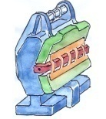
ITEP Accelerator Facility
Notes:
1)Состав
2) Общие характеристики
3) Функциональная схема

Slide 5
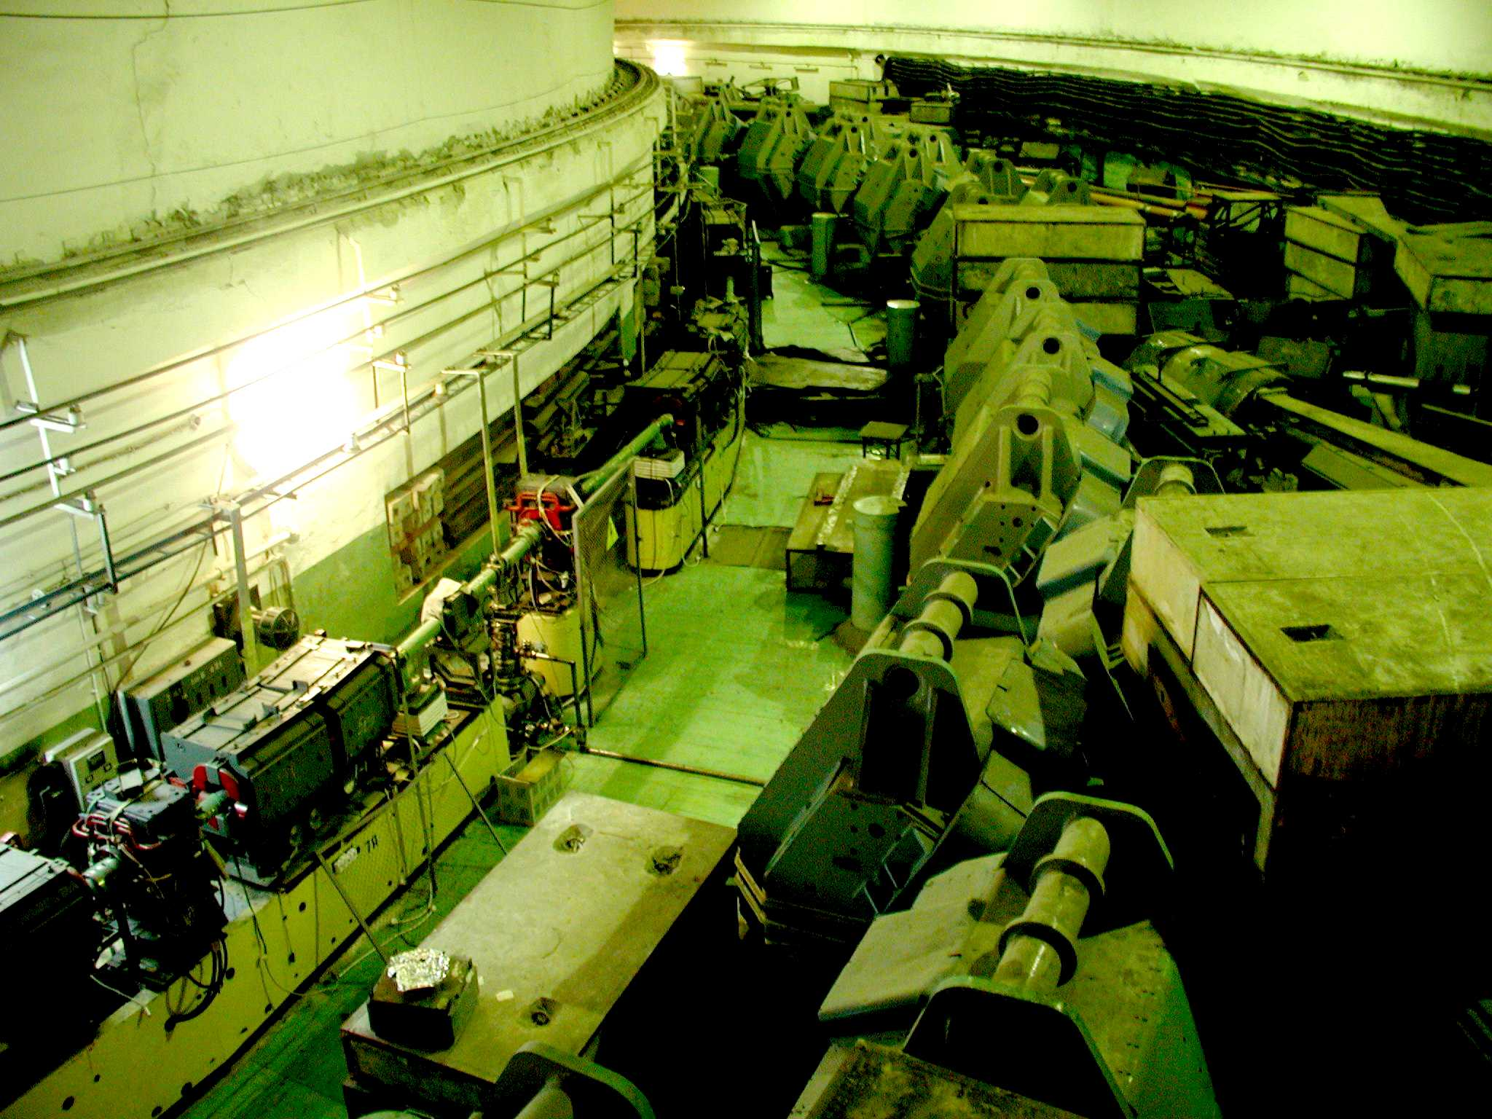
Ring magnets hall of ITEP-TWAC Facility
Booster synchrotron UK
Accelerator-accumulator U-10

Slide 6
ITEP-TWAC machine development for progress in extreme parameters of beams
Raising of beam intensity and compressed beam power
1) Improvement of Booster synchrotron UK systems: - chromaticity correction, - increase of acceleration rate,
2) Modernization of beam accumulation technology: - improvement of charge exchange injection system, - expansion of accumulator ring dynamic aperture - increase of beam compression voltage
3) Construction of high current ion injector
Extension of accelerated and stacked ion species to heavier one
1) Development of laser ion source technology
Notes:
Развитие машины для повышения ее предельных параметров осуществляется по двум направлениям: расширение массового состава ускоряемых и накапливаемых ионов, 2) повышение интенсивности ускоряемых и накапливаемых и мощности компрессированных пучков.
2) Массовый состав высокозарядных ионов, с которыми мы работает, определяется технологией лазерного ионного источника, которая развивается в нашем институте. Здесь получено определенное продвижение …
3) Интенсивность и мощность пучков определяется в настоящее время 1) инжектором И-3 (главным образом), 2) трансмиссией пучка через бустерный синхротрон, где есть определенные резервы, 3) эффективностью технологии перезарядной инжекции и накопления ионов, где также есть резервы

Slide 7
Progress in ITEP-TWAC beam parameters (2006-2009)
 | 2006 | Reached to 2009 | Expected to 2010 | Plans
Accelerated particles | С⁴⁺ | ₂₇Al¹⁰⁺, ₅₆Fe¹⁶⁺, ₁₀₉Ag¹⁹⁺ |  | up to U²⁹⁺ (2011)
Stacked particles | С⁶⁺ | Al¹³⁺, Fe²⁶⁺ | up to Сu²⁹⁺ (2010)
Repetition rate, Hz | 0.3 |  | 0.5 | 1 (2012)
Energy of beam stacking, MeV/u | 200 | 400 | 500 | 700 (2012)
Intensity of UK synchrotron (for С⁴⁺ ions) | 10⁹ | 2x10⁹ | 3x10⁹ | >10¹⁰ (2012)
Beam momentum spread, % | 0.05 | 0.04 | 0.03 | <0.03
Efficiency of charge exchange injection, % | ~50 | ~60 | ~80 | ~100
Dynamic aperture of U-10 ring, π mm mrad | 7 | 12 | 15-20 | 50
Efficiency of beam stacking, % | >80 |  | >90 | ~100
Life time of stacked beam, с | 200 |  | >250 | >500
Beam stacking factor | 70 |  | 100 | 200
Intensity of stacked beam (С⁶⁺) | 3x10¹⁰ | 4x10¹⁰ | >10¹¹ | >10¹² (2011) ~10¹³ (2012-13)
Compressed bunch width, ns | 150 | 120 | 100 | 70-50
Power of stacked beam, Вт | 1х10⁸ | 3х10⁸ | ~10⁹ | >10¹⁰ (2011) 10¹¹ (2012-13)

Slide 8
Main directions of theoretical studies at ITEP.
Main directions of theoretical studies are connected mostly with our accelerator complex and FAIR design. The significant part of them are made with close collaboration with GSI beam physics group, especially with Prof. I. Hoffmann, Prof. O. Boine-Frenkenheim and D-r G.Franchetti, and Juelich accelerator physicists: D-r A. Lerach and D-r Yu. Senichev.
Our studies are devoted the following topics:
Development of numerical methods for slow IBS analysis.
Numerical modeling of space charge effects.
Nechoroshev’s theorem and its application to octupole families.of SIS100
Correction of perturbations due to errors of magnetic field (closed orbit distortions , beta-function distortions and so on).
One-beam coherent instabilities/
Multi-species studies (beam neutralization, collective instabilities in presence of electron cooling systems).
Slow ejection schemes and its optimization.
Final beam compression by voltage jump.
I will consider mostly the first four points which seems to me the most interesting ones for present meeting..

Slide 9
Introduction.
Two kinds of IBS:
Multiple IBS.
Single-event IBS.
We consider only the multiple IBS!
We have three approaches:
Gaussian models: Bjorken and Mtingwa, M. Martini.
Gaussian models does not allow to calculate beam losses and evolution of the distribution function!
2. Binary collision model –BCM (Zenkevich, Bolshakov).
BCM sumulate the IBS process using artificial acts of “particle-particle” collisions with appropriate scattering angles. However, in BCM necessary computer time grows proportional to (where is a number of macro-particles), which drastically limits ; besides this method results in significant fluctuations of the beam parameters and suffers from indefinity in choice of basic computational parameters.
3. Approximate model based on solution of Focker-Planck equation in momentum-coordinate space –AMM (P. Zenkevich, O.Boine-Frenkenheim, A.Bolshakov) .
Model assumes that the beam distribution in momentum coordinate space is Gaussian one.(model similar to “frozen core” model for DA analysis) Such assumption allows us to calculate losses for small deviations from Gaussian distribution).
Drawbacks of the model: since the beam distribution in momentum coordinate space oscillates along the lattice it is necessary to solve FPE for set of different points of lattice. This mode of operation increases significantly the consuming computer time. These two models were included in our code MOCAC.

Slide 10
Structure of program MOCAC

Slide 11
Approximate method of IBS analysis using Fokker- Planck equation in invariant space (AMI).
FPE equation in invariant space is:
The friction coefficients
I n paper S. Nagaitsev IBS times were expressed through Karlson’s “complete elliptic integrals”, which are defined by
These expressions have the following form:
We derive d similar formulae for coefficients of the diffusion tensor. Thus found expressions
does not depend on lattice.
This allows us to use Langevin equations in invariant space.

Slide 12
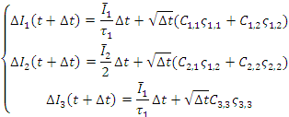
Algorithm of approximate method using FPE in invariant space.
For IBS calculation we use multi-particle method. Each particle is characterized by three invariants, which are changed in “slow time”. For calculating of IBS we assume that the particle distribution on invariants is Gaussian one (distribution on phases is uniform. The algorithm includes the following steps:
Calculation of average values of invariants , using given ensemble of particles.
Calculation of friction vector and diffusion tensor in invariant space by integration on lattice using mentioned above “complete elliptic integrals”.
Calculation of the emittance changes using Langevin equations:
Here are three random numbers with Gaussian distribution and unity dispersion. Coefficients are calculated using components of the diffusion tensor .
We are going to write new module and include it in MOCAC code.
The work is in the progress!

Slide 13
Numerical Modeling of Space Charge Effects (coasting beam).
Dynamical space charge effects:
Linear shift of incoherent betatron tunes, which results to beta-function distortions (BFD) due to half-integer resonance.
Non-linear coherent tune shifts.
Non-linear coupling resonance due to octupole components of s.c. non-linearity(Montegue resonance).
Non-linear incoherent tune shifts depending on the betatron amplitudes.
Let us underline that BFD formally does not make a particle motion unstable but in fact they limit the chamber acceptance. Besides in frozen core method we neglect by non-linear coherent tune shifts. These tune shifts are decreased with resonance number ; however for the second order resonance due to gradient perturbations the coherent tune shifts is large and it should be taken into account.
It is necessary to be very careful in numerical modeling of space charge effects using “frozen core” model!
For illustration let us consider our old work, which seems to me correct from methodical point of view.

Slide 14
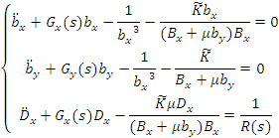
Equations for rms envelopes and dispersion
,
Twiss parameters and dispersion function are considered by solution of the following system of the differential equations: for beam envelopes and dispersion function:
Here ,
Beam potential is calculated for given solution of the envelope equations and given set of the ring lattice. The distribution in the invariant space is initial parameter of the code. The beam is presented as set of macro-particles. For each macro-particle the betatron phase is determined by random number in interval [0,2pi]. Then we solve numerically Poisson equation for rectangular area with sides a and b and zero boundary conditions . For solution it is used scheme HODIE with final differences on uniform set. Found components of the space charge field it is used for following calculation of the particles trajectories (”frozen core” method).

Slide 15
Numerical simulation of space charge effect on the beam dynamics in storage ring (Bolshakov and Zenkevich, Atomnaya Energiya, 2001).
Table 1. Parameters of ACR ring (RIKEN, JAPAN)
Table 2. Parameters of TWAC storage ring.
.
Circumference (m) | 134,788
Chamber acceptance (mm*mrad) | 125/40
Momentum spread % | 1
Betatron tunes | 3.228/2.575
Maximal magnetic rigidity (T*m) | 7.4
Circumference (m) | 251.1
Chamber acceptance (mm*mrad) | 251.1
Momentum spread % | 1
Betatron tunes | 9.291/9.315
Maximal magnetic rigidity (T*m) | 9.3

Slide 16
Calculation of the beam trajectories and chamber acceptance.
For trajectory calculations each element of the ring is divided on N intervals. The transfer matrix of each half- interval is found from beam envelopes calculated in previous section.
Kick matrix is a thin non-linear lense located in the middle of the interval (such algorithm provides the second order of accuracy). такой алгоритм имеет второй порядок точности по длине интервала [4] ). Матрица передачи от точки 0 до точки 1 связана с параметрами Твисса
The kick amplitude:
Here the term proportional to describes non-linear components of the magnetic field.
The algorithm is symplectic since we use thin lenses with determinant equal to unity. In fact we made tracking with account of the electric field calculated in “frozen beam” approximation.
The particle coordinates during the tracking is compared with chamber size ; if particle is outside chamber it is considered as lost. This method allow us to find not only classical dynamic aperture but also so named “physical” aperture, which can be considerably less than DA.
The second advantage of this method is automatic account of the envelope perturbations. Application of MADX becomes wrong if variations of the envelopes are significant.

Slide 17
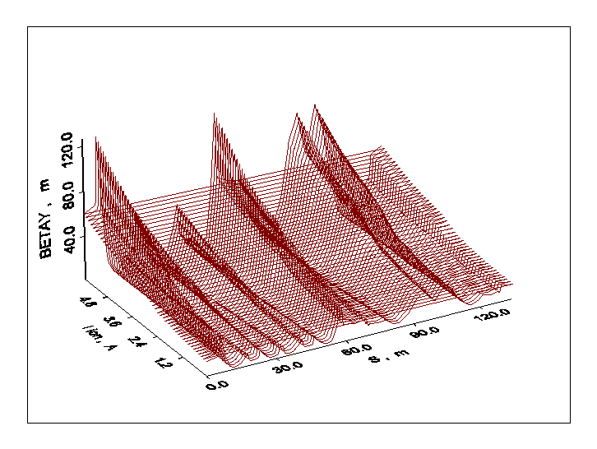
Dependence of vertical beta-function on beam current for different points of the ring (ACR, RIKEN, Japan).
We have studied dependence of Twiss parameters on beam current. Calculations have shown that for chosen betatron tunes such dependence is critical only for vertical beta function, which strongly depends on the beam current.

Slide 18
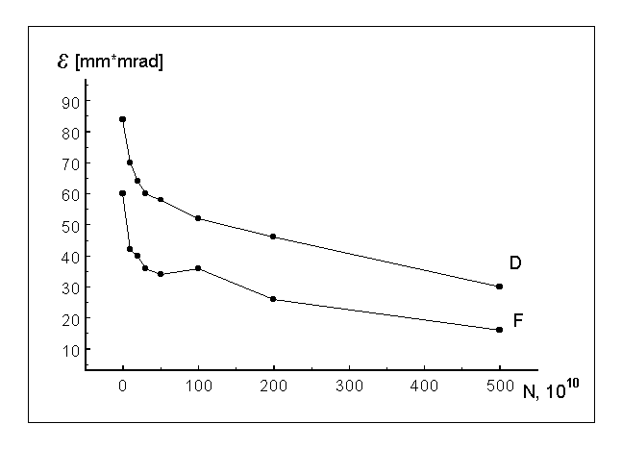
Dependence of physical (F) and dynamical (D) vertical aperture on particle number.
We see that there is large difference between physical vertical aperture (calculated for limited chamber) and classical DA. A reason is connected with beta function modulation due to half-integer resonance.

Slide 19
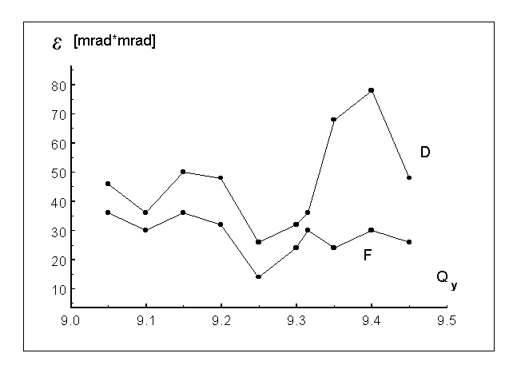
Dependence of physical (F) and dynamical (F) vertical aperture on vertical tune for TWAC storage ring.
. The beam parameters: kind of ions ²⁷Al⁺¹³, rms beam emittance: = 10.0/8.0 π⋅мм⋅мрад, momentum spread Δp/p =0,0009, Kinetic energy = 700 MeV/n, Number of partccles = 1.3 10¹² .
We see that account of chamber limitations strongly limits the chamber acceptance

Slide 20
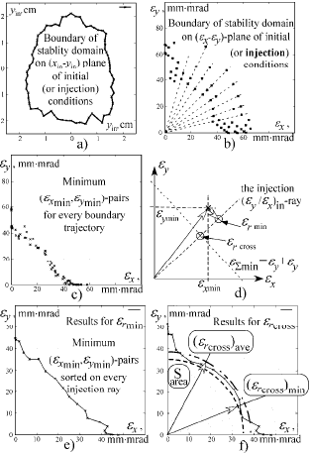
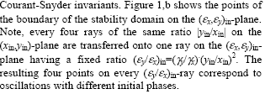
Methodics of DA MADX calculations (according to G.Franchetti). Space charge is included using by Kapin’s method

Slide 21
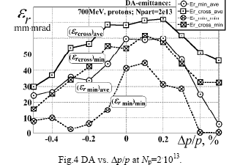
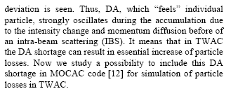
DA in TWAC storage for 2e13 protons.

Slide 22
Discussion on SC models.
I guess that it is desirable to take into account coherent envelope oscillations and final chamber sizes in MADX calculations of DA. It can be made by use of the following scheme:
Solution of self-consistent Kapchinsky-Vladimirsky equations (if we take into account the momentum spread it should be included in K-V equations).
Choice of beam-beam kicks strengths in correspondence with found solution.
Including of diaphragms in MADX calculations in order to simulate influence of final chamber sizes.

Slide 23
Nekhorochev’s theorem and its application to SIS100.
Nekhorochev’s theorem.
Quasi-convex functions.
How to apply this theory to accelerator problems?
Physical sense of Nekhoroshev’s criterion.
Octupole families.
Application to SIS100.
Summary and discussion.

Slide 24
Nekhorochev’s theorem.
.
Russian mathematician Nekhorochev in paper of 1974 year has considered a stability of Hamiltonian systems with the following Hamiltonian written in “action-phase” ( ) variables:
(1)
for a case of weak perturbation ( ).
Theorem. Let function satisfies some “convex conditions” (see below). Then there are positive constants and , which have the following feature:
(2)
For all where
(3)
Constants a and b depend only on function . Constant depends on and on two parameters of function estimating value and diminishment rate of expansion coefficients of this function in Fourrier series on variables .
Convex conditions we will name “stability conditions in Nekhorochev’s sense”.

Slide 25
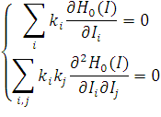
“Quasi-convex” functions
Important class of convex functions is so named “quasi-convex” functions. According to the paper function is “quasi-convex” in area G, if for each point the following equations are valid:
Grad .
System
(4)
has no real roots ( ) (besides the trivial solution ( k =0).
As a simple example let us study the following Hamiltonian (corresponding to octupole non-linearity):
Substitution of this Hamiltonian in the second equation of system (2) gives the following characteristic equation:
(5)

Slide 26
Nekhorochev’s criterion (according to Yu. Senichev)
Yu. Senichev has shown that this equation has no real roots if “Nekhorochev’s criterion” (NEC) satisfies to the following condition:
(7)
We see that this criterion can be valid only if signs and coincide. In MADX notations we have:
(Here are betatron tunes). Then we can rewrite Eq. (7) as follows:
(8)
A goal of this report is study of octupole families optimization from point of view of Nekhoroshev’s criterion given in this form.

Slide 27
How to apply this theory to accelerator problems?
Let us consider transverse motion in magnetic rings. In presence of magnetic field perturbations the perturbed Hamiltonian has the following form:
(9)
Here n, m are positive integer numbers, function describes the distribution on the longitudinal variable s. Transforming to Courant-Snyder invariants and phases , expanding in Fourrier series and averaging on fast variables we obtain the following expression:
(10)
Here are integer numbers, R is machine numbers, and are amplitudes and phases of corresponding harmonics, are corresponding betatron tunes tune shifts
We see that Hamiltonian depends besides action-phase variables depends on independent variable s.
Conclusion: strictly speaking Hamiltonian of transverse motion does not satisfy to conditions of NEKHOROSHEV’S THEOREM!!! It can be applied only for isolated resonance when we can exclude longitudinal variable. Let us consider such resonance.

Slide 28
Isolated resonance of two-dimensional transverse oscillations.
However there is a case when conditions are satisfied: isolated resonance of two-dimensional transverse oscillations. Yu. Senichev has shown that DA of the ring (for circulating beam) is sharply improved if the “Nekhorochev’s criterion is satisfied . To simplify the mathematics he considered the simplest case of quadratic Hamiltonian .
(11)
Here , where the resonance shift , - integer numbers, j and g are, correspondingly, a number of the resonance harmonics and its effective strength, which is defined by well-known formula:
(12)
Here are beta-functions on two transverse degrees of freedom, s is the longitudinal variable along the orbit, L is the ring circumference, function describes a distribution of the non –linearity along the ring;
are phases of Floquet functions.

Slide 29
“Nechorochev’s criterion for two-dimensional resonance.
Substitution of this Hamiltonian in the second equation of system (2) gives the following characteristic equation:
Analysis of this simple quadratic equation made by Yuriy Senichev has shown that this equation has no real roots if “Nechorochev’s criterion” satisfies to the following condition:
We see that this criterion can be valid only if signs and coincide. In MADX notations we have:
(here are betatron tunes). Then we can rewrite this equation as follows:
Let us consider physical sense of this criterion.

Slide 30
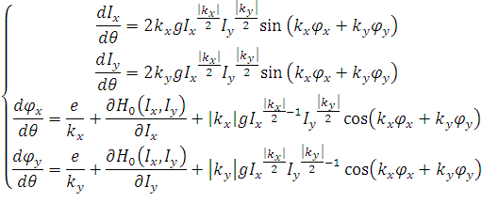
Physical sense of Nechoroshev’s criterion 1.
Let us consider this two-dimensional resonance. The corresponding equations of motion (here independent variable , , where R is the ring radius) are:
Then we have the first integral
This formula allows us to exclude one of actions (for example, express through ):
Then we obtain for a point of the resonance surface:

Slide 31
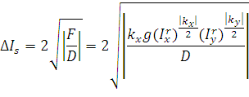
Physical sense of Nechoroshev’s criterion 2.
In the separatrix center . Expanding the invariant around the resonance point:
after some algebra we obtain the following equations for small oscillations near the resonance center
Here two signs correspond two different stable points. The corresponding Hamiltonian
We see that it is a pendulum Hamiltonian. The separatrix width
We see that for the separatrix width ; that means that for the non-linear stabilization is absent.
For one-dimensional resonance
and non-linear stabilization always take place in presence of dependence of tune on action.
: .

Slide 32
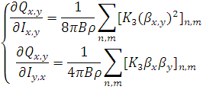
Octupole families 1.
Sometimes in the ring there it is included a set of octupole families, which are used for improvement of the coherent beam stability by enhancement of Landau damping . The derivatives from tunes over actions are defined by the following formulae :
(16)
Using these relations we can write the Nechorochev’s criterion in the following form:
(17)
After some algebra, dividing on we obtain the following quadratic equation relative to
parameter :
(18)

Slide 33
Octupole families 2.
Due to negative sign of parameter u function for . Thus the function can be positive only if equation has real roots. Thus we obtain the following condition:
(19)
Substituting expressions for the coefficients after simple algebra we can write this condition in the following form:
(20)
For octuplole families of SIS100 we have:
5.815494232, = 17.6845878; =17.21739929, =5.777722238.
Substitution these numbers in Eq. (20) gives ; thus we see that N C can not be satisfied for SIS100.
For illustration let us consider symmetrical case: . Then we obtain the following condition:
(21)
Dividing on and introducing the notation we obtain simple quadratic equation: . The root of this equation is . Thus NEC requires:

Slide 34
Numerical calculations.
For checking of the theory V. Kapin has made numerical calculations of DA by use of MADX. Octupole circuits of SIS 100 include 12 octupole lenses each.
Calculations were made in following assumptions:
COD=0;
space charge is absent;
systematic errors in magnets are taken into account;
random errors are equal to 30% from systematic ones.
The results are given at Table 1 (see below). Emittances are measured in ; unharmonicities ( ), ( ), and ( ) are measured in .
.

Slide 35
Tabl.1. Machine parameters of SIS100 for different values of octupole strengths
0 | 50 | 121 | 749 | -516 | -175 882 | 86.1 | 103.8
0 | 0 | 45.9 | 46.2 | -55.4 | -954 | 107.8 | 123.8
0 | -50 | -30 | -657 | 405 | -145 129 | 85.9 | 113.1
50 | 50 | 781 | 825 | -964 | -295 975 | 82.2 | 98.3
50 | 0 | 705 | 122 | -503 | -167 310 | 91.7 | 107.4
50 | -50 | 630 | -581 | -42 | -367 850 | 80.3 | 107.8
-50 | 50 | -538 | 674 | -69 | -367 167 | 82 | 96.5
-50 | 0 | -613 | -30 | 392 | -135 876 | 80.5 | 102.6
-50 | -50 | -689 | -733 | 854 | -223 688 | 84.9 | 102.9

Slide 36
Discussion1.
NEC for magnetic ring is not strict since it can be applied only for Hamiltonian, which does not depend on longitudinal variable.
NEC can be applied for isolated resonance in action-phase variables; taking into account only octuplole non-linearity it can be written in the following simple form:
This condition has simple physical sense: it means that for any isolated two-dimensional resonance the non-linearity creates the separatrix stabilizing the oscillations near the resonance.
For two octupole families NEC can be expressed through beta-functions as follows:
For chosen octupole families of SIS100 this condition is not satisfied since we need in strong modulation of beta-functions: . However so strong modulation is undesirable since it makes strong all nonlinear effects.
Nechoroshev’s criterion explains why SIS100 octupole families decrease the dynamical aperture: these families create “bad” average non-linearity

Slide 37
Conclusions.
Nekhoroshev’s theorem is not universal key to problem of DA improvement:
It is can be applied only for thin isolated resonance when the first order approximation of perturbation theory is valid. When the resonances are strong we should take into account interaction between resonances and use high order approximations of the perturbation theory.
Nevertheless the Senichev’s calculations have shown that in some cases this method significantly increases DA.
For its application we should specially design magnetic lattice to achieve strong modulation of beta-functions in lenses of octupole families.
From my point of view, question is open. It is clear that machine with strong modulation has increased widths of non-linear resonances. It is difficult to say, which factor is more important: suppression of the resonances due to good (from NEC) cubic non-linearity or their development due to increased widths.

Slide 38
Harmonic method of measurement and correction of beta-function (Zenkevich, Barchudaryan).
Distortions of beta-functions (BFD) appear in circular accelerators because of the gradient perturbations, as well as closed orbit distortions (COD) appear because of magnetic field errors.
These distortions were observed and corrected in our accelerator ( ITEP proton synchrotron) many years ago (in sixties of the last century). For correction we used resonant method. We fabricated four resonant circuits: two for horizontal oscillations (“sinus” and “cosine”) and two vertical ones. Currents in these coils are chosen by “black box” method: for each coil we measured dependence of the average intensity on current . In spite of primitive character of the procedure we reached significant increase of the beam intensity (on 15-20 %).
Recently (2009) we suggested new method of BFD correction. Idea of the method consists of artificial excitation of COD by use of kicker magnet. Comparison of measured value of COD in pick-up monitors with ideal ones corresponding in absence of gradient errors allows us to calculate the optimal currents in resonant correction circuits. Let us consider shortly the algorithm of the method and results of its numerical modeling for synchrotron SIS 100.

Slide 39
COD because of the dipole magnet in presence gradient perturbations.
COD by point-like dipole magnet are defined by periodic solution of the next equation:
In presence of gradient perturbations we obtain
Here complex function
Constant
Let us use standard linearization procedure
Then
Here functions , , are known, functions are Fourrier harmonics of perturbation, which we should find.

Slide 40
Algorithm of BFD corrections.
This formula allows us to find currents in correcting gradient coils. Using the algorithm including the following stages:
Measurement of COD in all pickups ( , where j is pickup number).
Excitation of the dipole magnet with known characteristics (strength and effective length).
New measurement of COD with switching on magnet ( ) and calculation difference of the orbits
Calculation for all pickups - orbit deviation for the ideal gradient, as well as difference of these parameters
5. Calculation amplitudes of cosine and sine BFD harmonics using found values of parameter by least square method. .
Repetition of the procedure for the second degree of freedom.
Calculation of the strengths of correction lenses.
Estimation of the correction efficiency.

Slide 41
BFD for point-like gradient perturbation in SIS100 (betatron tune is equal to 17,3). Blue line are BFD without correction, red lines are BFD after correction with use of six harmonics of BFD (harmonics with numbers 32÷37).

Slide 42
Conclusions.
We see that correction of six harmonics effectively (in 5-10 times) suppresses the rms BFD. However maximal of BFD is decreased only on 30%. Perhaps this effect is connected with point-like character of perturbation.
The main problem for this method is accuracy of COD measurements. It is necessary to mark possible errors due to coupling of the oscillations and non-linear effects.
If the gradient errors are small the intensity enhancement for small beam intensity can be negligible. However space charge effects results in decrease of the betatron tunes, which go to the half-integer resonance. Accurate correction of the resonant harmonics allows us to work near this resonance or cross it.

Slide 43
Acknowledgements.
I would like to congratulate GSI Beam Physics Group (especially, Prof. I. Hoffmann, Prof. O. Boine-Frenkenheim and D-r G. Franchetti) for fruitful collaboration and help. I hope that our long working experience was useful not only for ITEP but, too, for GSI and FAIR project.

