Slide 1
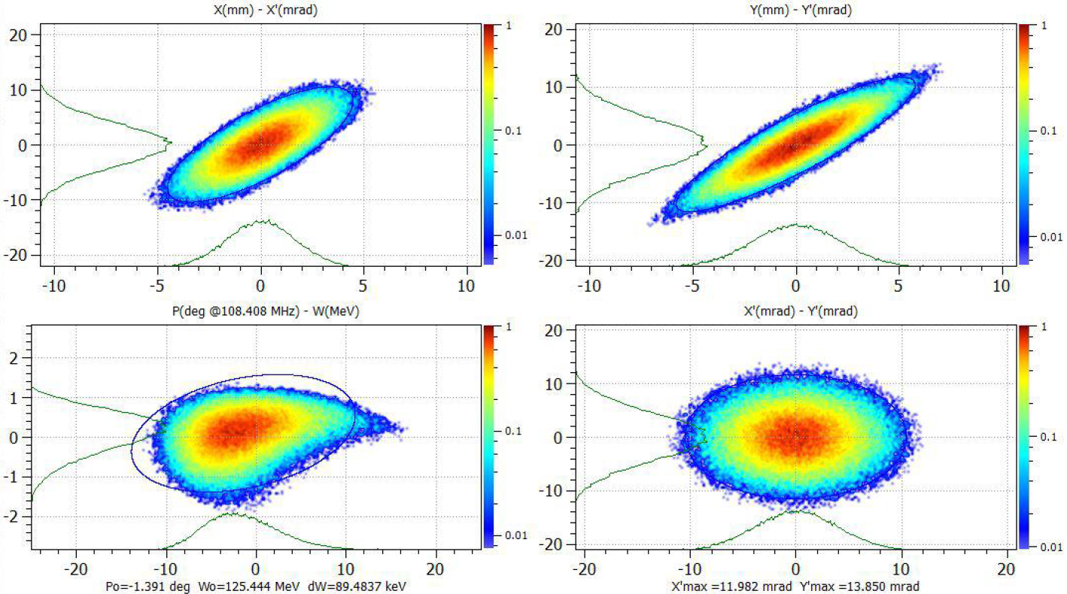
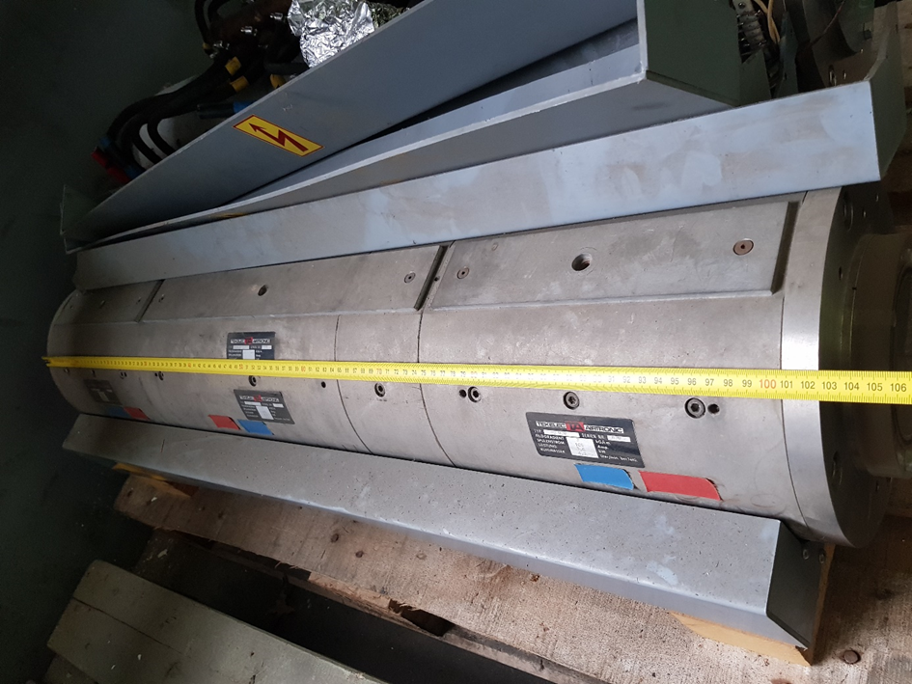
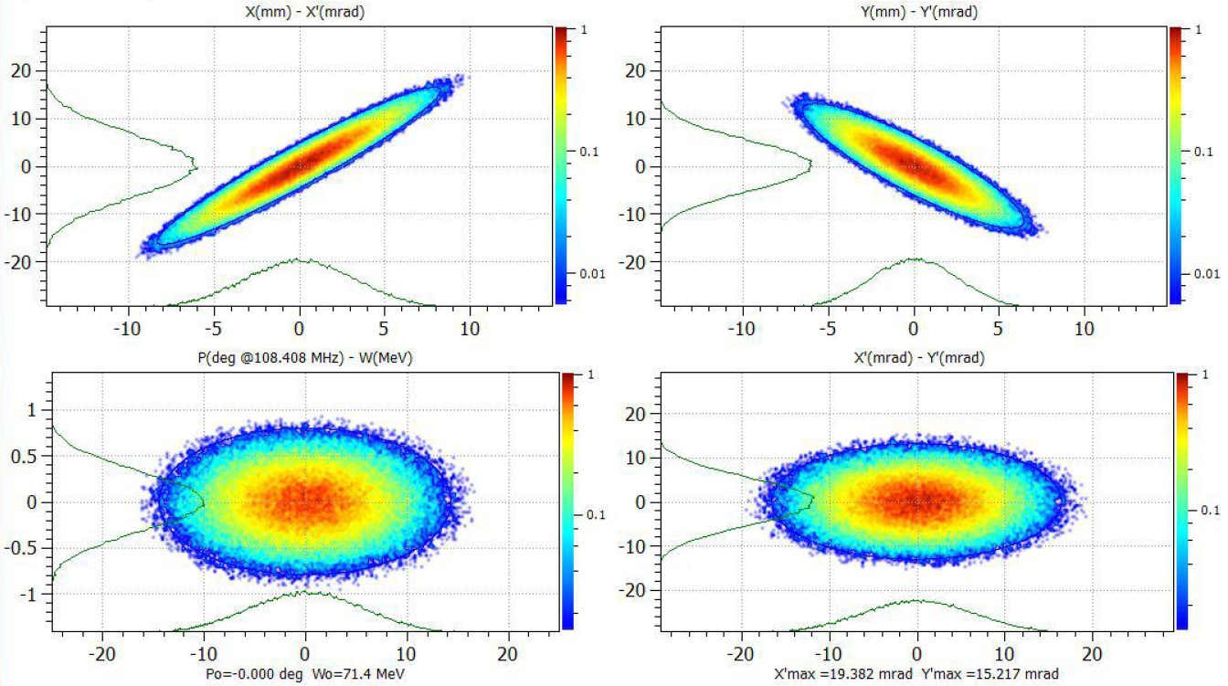
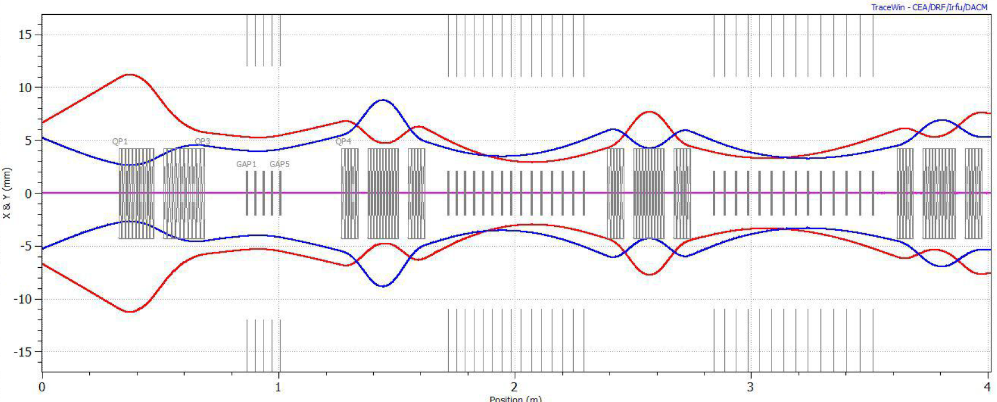
cw-LINAC (10.03.2020)
CH1 will be moved to GSI => Mechanical survey => another HPR at RI
CH2 @ IAP Frankfurt (start of test promised after eastern!)
Mechanical surveye of cavity dummies started => to be integrated in cryostat at CRYOWRLD Co.
SH1: further adaption of bunker roof, cabeling at Lhe-supply controls, etc.
Test cryostat removed from HIM-bunker => MESA-cryomodule test campaign already started
call for tender for clean room maintenance
Design review II/cw-IH-protype => layout of intertank sections => next meeting scheduled (23.3.)
Design review CH3-5 (cryomodule 2) scheduled => start of call for tender Q2/2020
Preparation for beam test end of October 2020:
Definition of collimation scheme to provide for beam based aligment und cryo conditions, etc.
schedule for further preparation of matching line – cryomodule and beam diagnostics teststand

