Slide 1
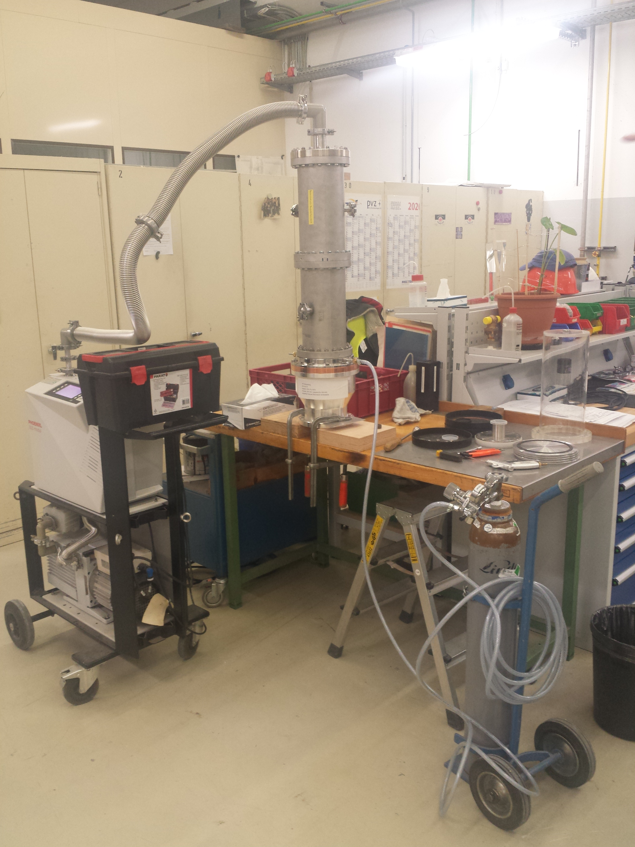
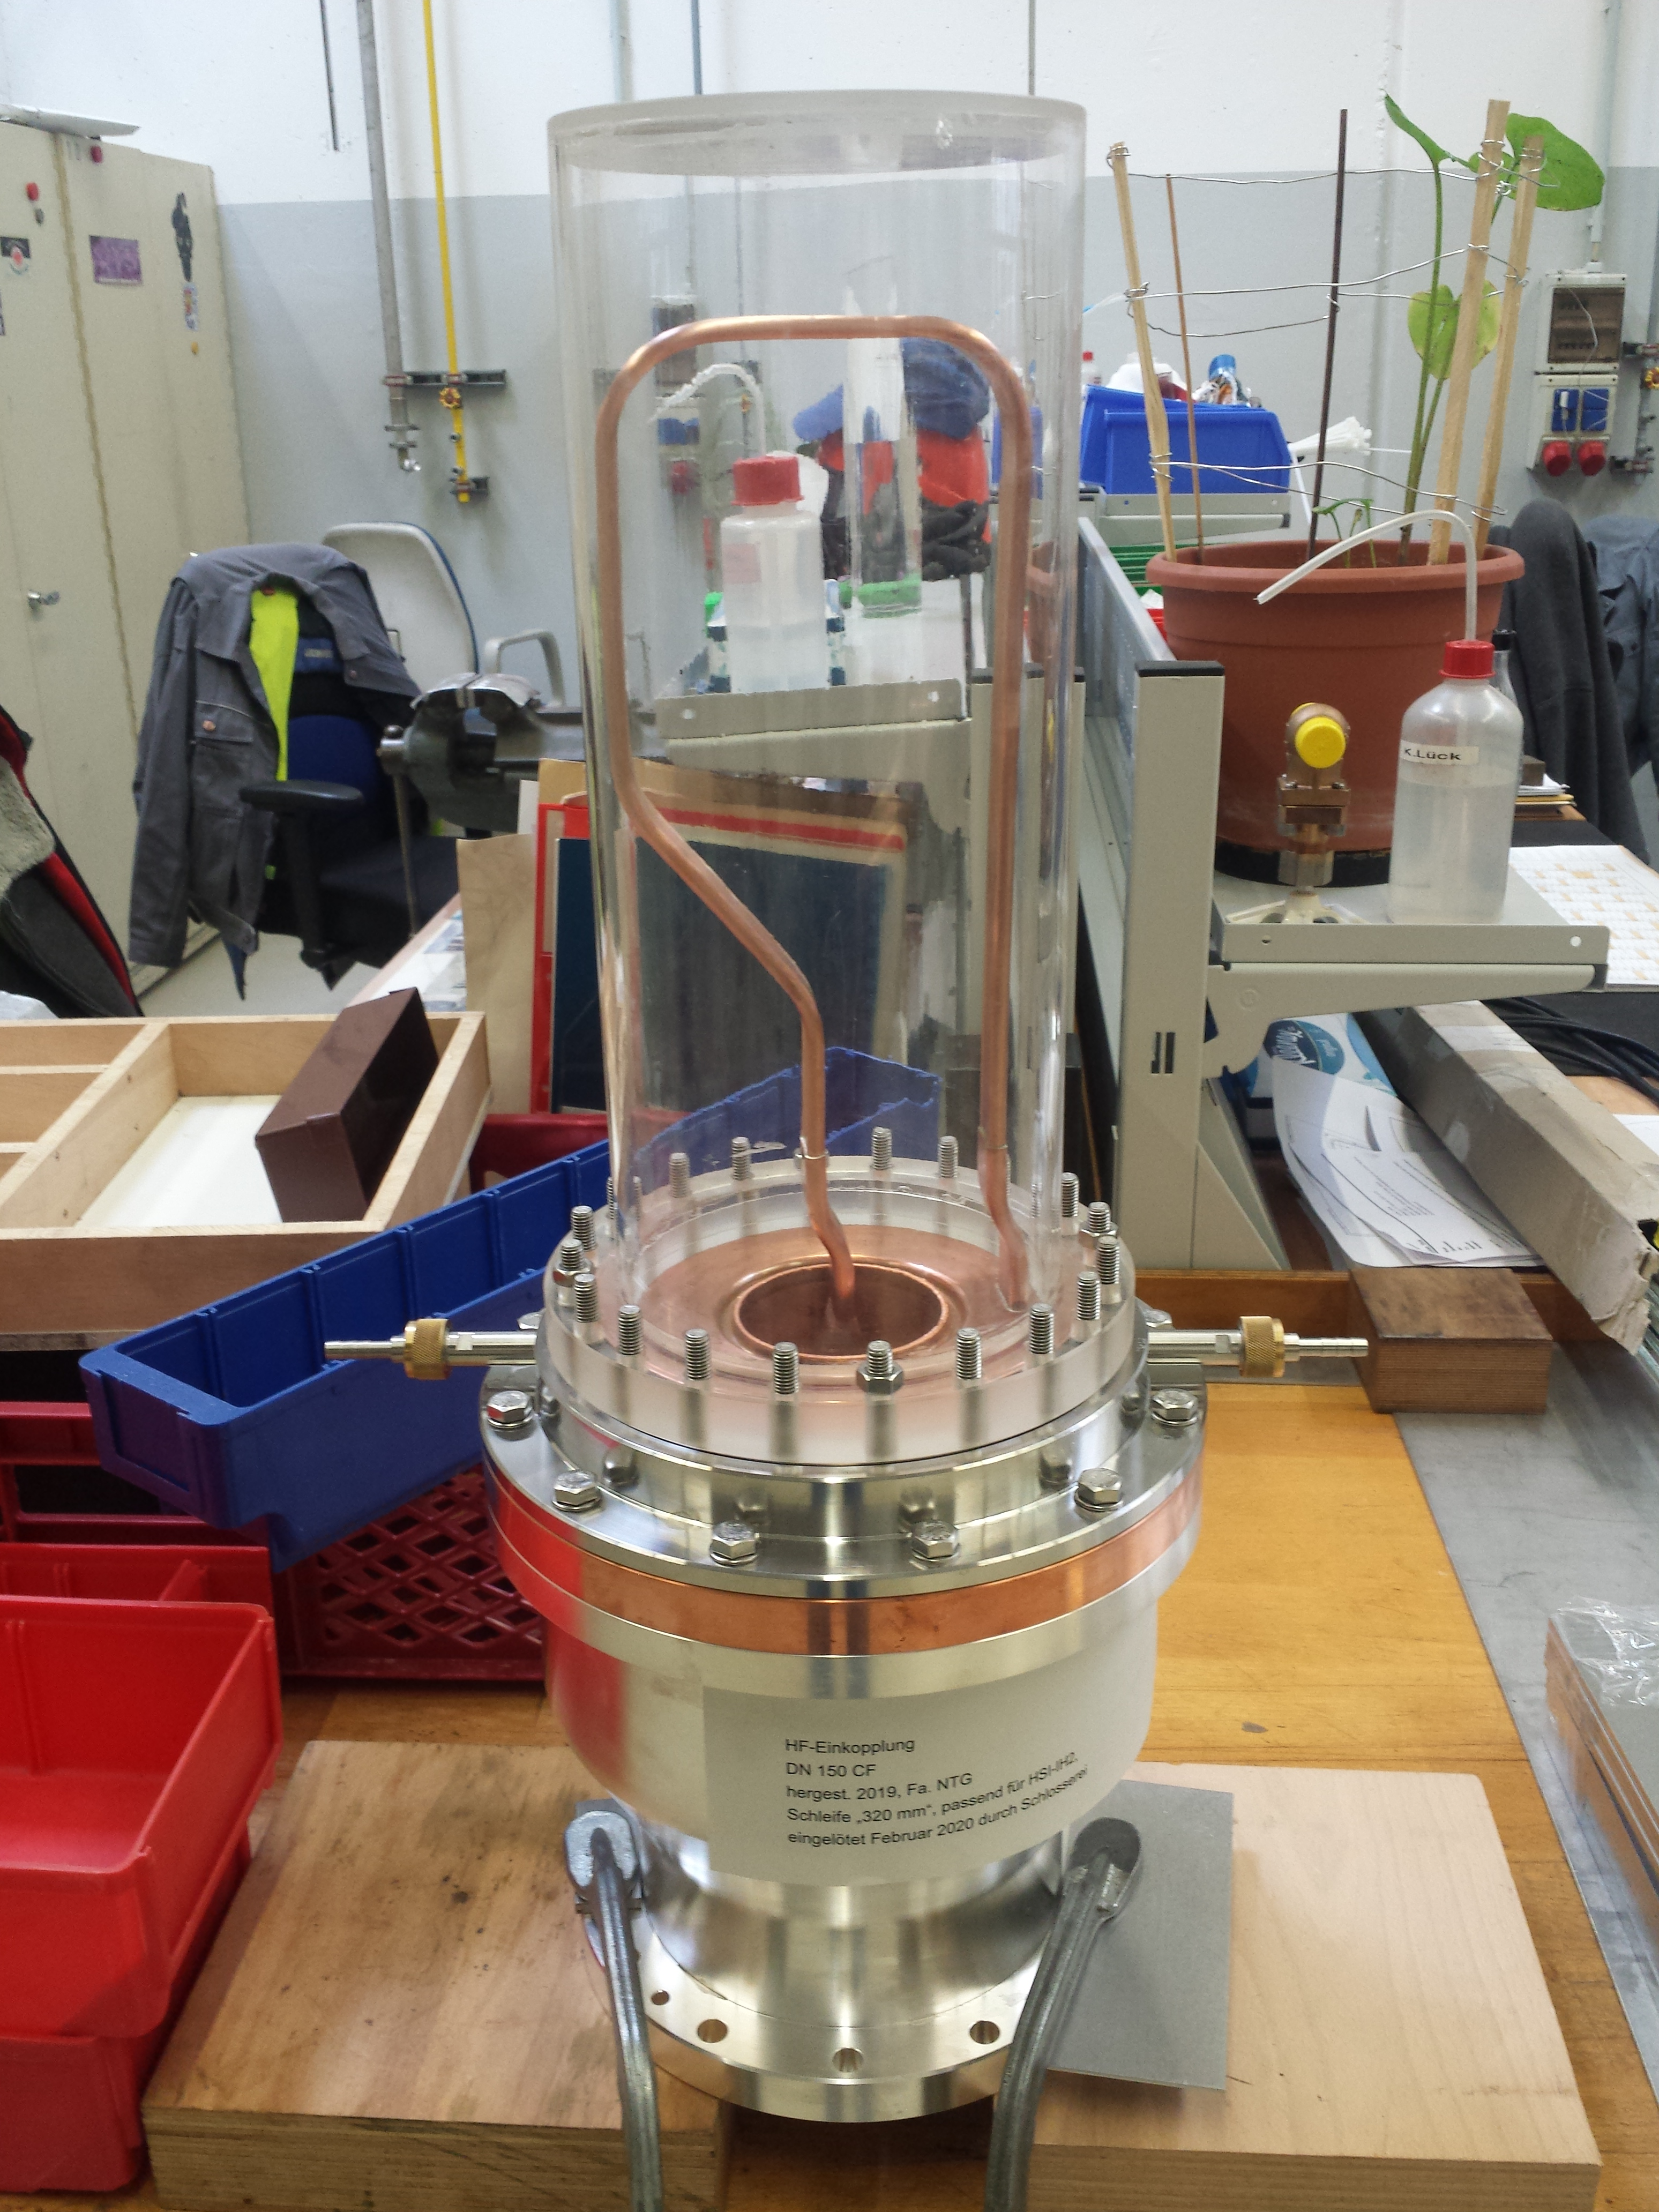
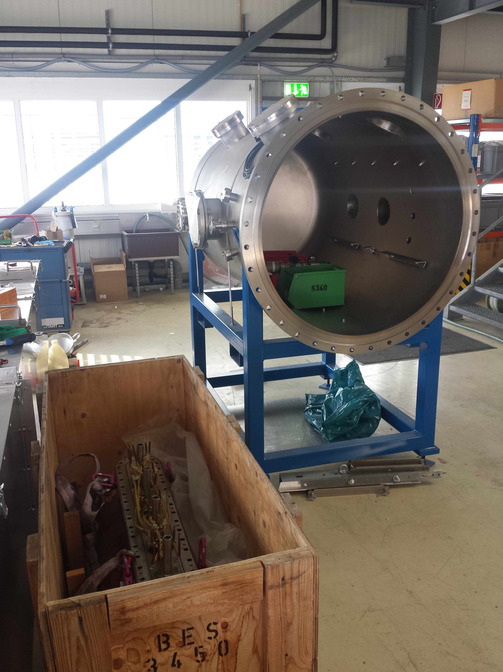
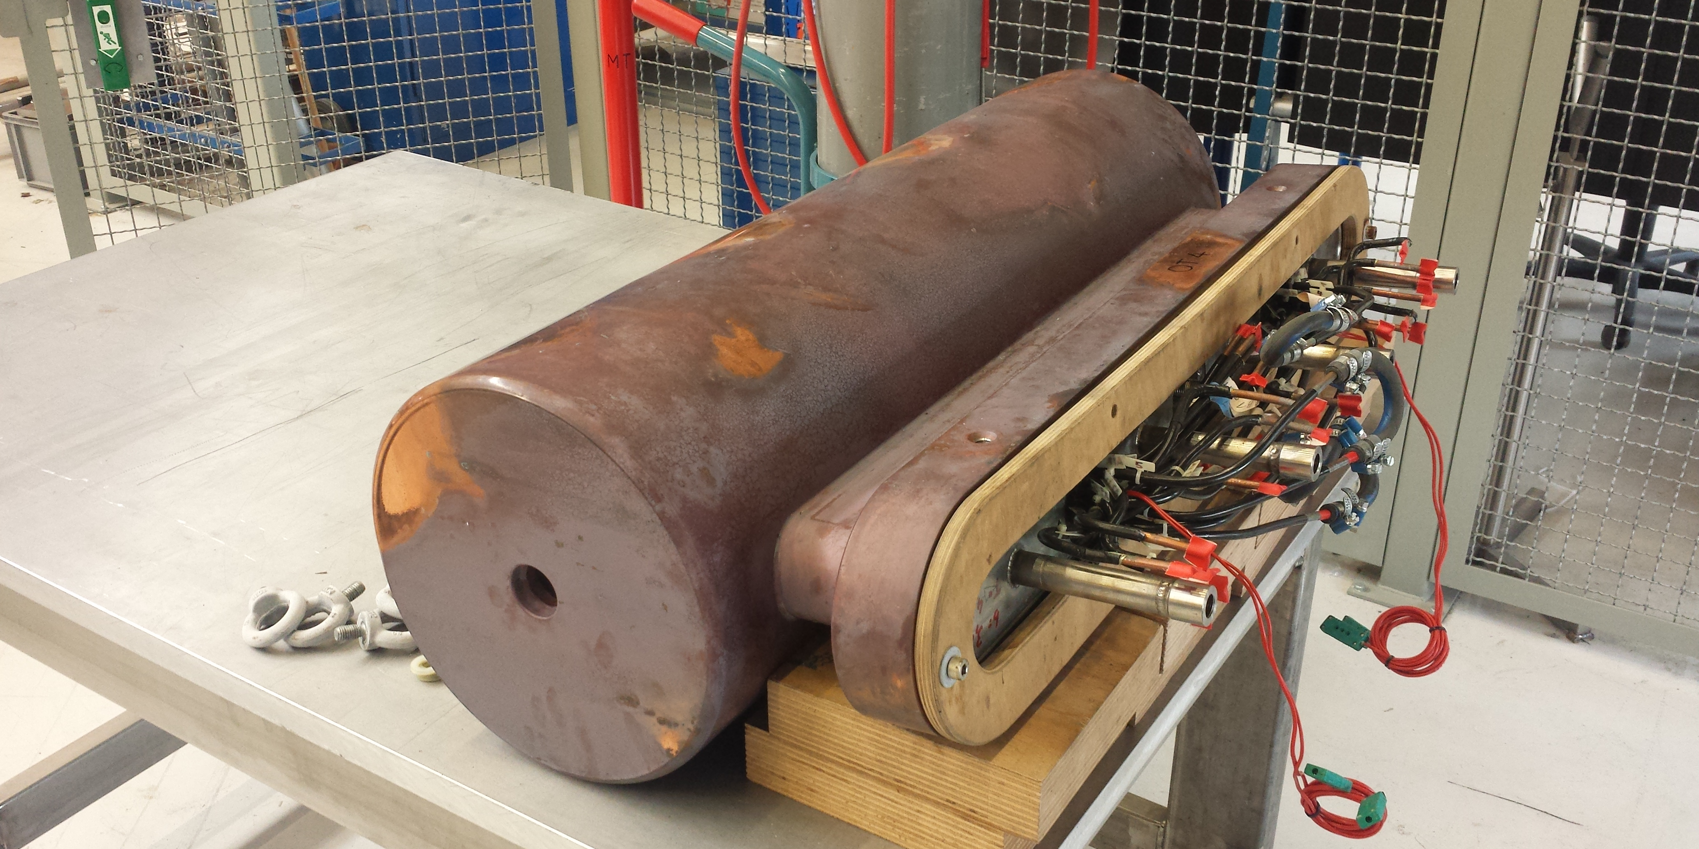
Unilac – 10.3.2020
RF:
Still some work on
A3,
A4 (internal energy control, timing upgrade work in progress),
Single Gap Resonators (two transmitter units brought back into operation, but two units taken out instead).
UH4 Spare parts:
IH2 coupling loop brazed, vacuum test successful.
QT4: 1 kV okay, check magnet materials/corrosive?
QT3 pumped down to E-3 mbar in a large vac chamber (drying).
Beam Time:
Xenon from MUCIS, until 23rd March.
Gold from PIG, until 18th March.
Helium 4 from ECR, for Biology, only on Sunday 8th March,
IH2 coupler
QT3
(in the box)
QT4

Slide 2
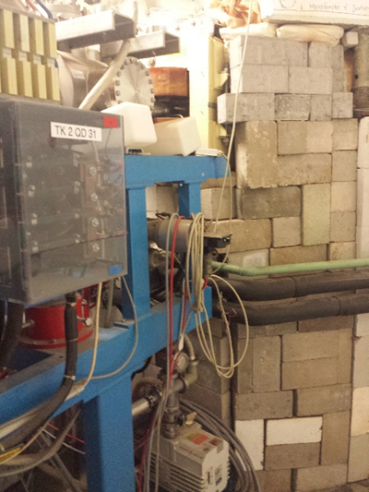
TK2MU3 in the wall Tunnel UNILAC-Transfer Channel TK
in the opened wall
(photograph 22nd August 2019)
in the closed wall
(photograph 5th September 2019).

Slide 3
Strahlzweigplan TK

Slide 4
Beam Jittering at TK7 (2020-02-12 to 2020-02-19
The carbon beam for the SIS (C4+ from UNILAC, C6+ after TK stripper, 11.4 MeV/u) was jittering on Wednesday afternoon, 2020-02-12 (10 mm horizontal on TK7DG3). Several magnet power supplies had been checked during the following days, also energy jittering/deviation (from RF) had been checked, without solution.
On Tuesday afternoon, 2020-02-18, the dipole magnet TK2MU3 was checked again, because it is a strong 22.5 degree dipole with a large effect. Actually there was a jitter of appr. 3 milli Volt (set value 1.5 Volt), which was proven to cause the horizontal offset. Switching the PS from field controlled to current controlled solved the jitter problem, and was kept so as a work around.
On Wednesday, 2020-02-19, investigations on the hall probe and its wiring started in the morning. In the afternoon it was found out that the hall probe’s pre amplifier was laying on a steel support frame, thus causing a ground loop and the jitter. The pre amplifier was then positioned correctly isolated, the PS was switched back to field controlled. Since then the magnet is working properly again without jitter.
The pre amplifier had been put there on the support frame probably during the wall opening works for the complete survey and alignment from 2019-08-21 to 2019-09-05 (TK2MU3 is located in the wall between UNILAC tunnel and transfer channel). After the wall closing on 2019-09-05 photographs were taken by the MK UNILAC, without recognizing that the amplifier is positioned not properly, and as a result of that without informing the hall probe expert.

Slide 5
TK in Mirko

Slide 6
GSI beam parameter measurement campaign 2020
6 shifts UNILAC
1 shift assembly and commissioning pulsed gas stripper/hydrogen
1 shift high current injector tuning
2 shifts post stripper and transfer channel tuning (TKU 73+ and TKG 28+)
2 shifts measurements of current, emittance, energy, profils, pick-ups (phase probes) @ UH1, US4, UA4, TK5
6 persons in shifts (none of them has been asked yet?): W. Barth, H. Vormann, M. Vossberg, S. Yaramyshev, F. Dziuba, P. Gerhard (for stripper assembly)?
On Call services as usual (plus evtl. gas stripper? or skip nights?)
Gas stripper hydrogen at the moment not possible (technically: IL missing. Safety permission missing).
LINAC personnel needed also for SIS injection!

