Slide 1
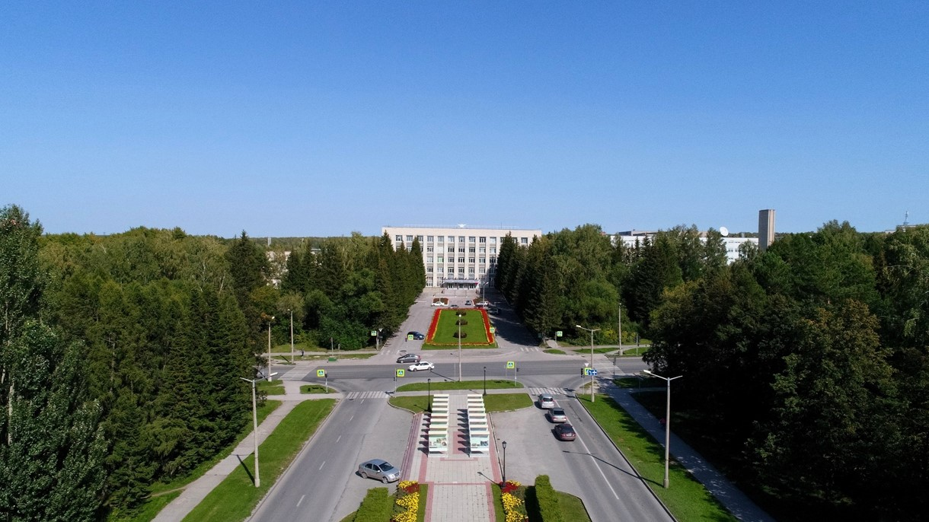
4th BINP-FAIR Collaboration Coordination Workshop
Status production PANDA solenoid
E.Pyata, BINP, Novosibirsk

Slide 2
Development of the PANDA solenoid magnet
Name of item | Status of work
Yoke and frame | Design is ready, production
Cryostat of solenoid | Design is ready, technological development, Call for tender
Cold mass | Design is ready, technological development, Call for tender
Conductor purchasing | Development work, Call for tender
Control Dewar box | Preliminary design September 2020
PANDA solenoid power cabling | Design is ready, production
Power supply and energy extraction system | Detail design is ready, production
Magnet safety system | in process

Slide 3
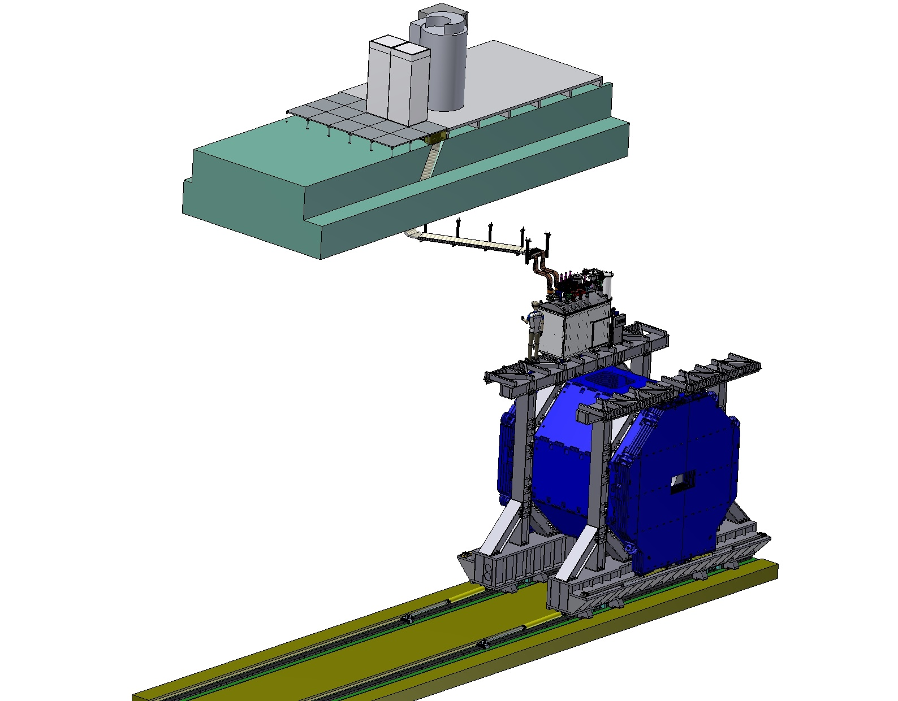
PANDA solenoid magnet, BINP responsibility
Power supply and energy extraction system
Control Dewar box
Cable channel
Solenoid and yoke
Frame of Yoke

Slide 4
3D model of the Magnet and Control Dewar.
Control Dewar box
Cryostat and Coil

Slide 5
The main milestones of the yoke production
Name of milestone |  | Date 2017/10 | Comments
Production of the all barrel octants |  | 04/2020 | Ready
Production of the frame and beams |  | 04/2020 | Ready
Production of the doors | Upstream | 05/2020 | Ready
 | Downstream | 06/2020 | June 2020
Control assembling at SET |  | 07– 09/2020
Finalization of the parts |  | 08 - 10/2020
Assembling of the Yoke at BINP |  | ?

Slide 6
The main milestones of the Cryostat production
Name of milestone |  | Date 2017/10
FDR of the Cryostat |  | 08/02/2019
FDR of the Cold Mass |  | 17/04/2019
Status production
Cryostat and stands for assembling solenoid and magnet | Design is ready, technological development, Call for tender
Cold Mass | Design is ready, technological development, Call for tender
First Prototype of the Coil | 11/2019
Second Prototype of the Coil | 03/2020
Third Prototype of the Coil | 08/2020
Tooling for winding Coil (and Prototype) | 11/2019
Tooling for impregnation of Coil (and Prototype)/modified | 11.2019/03.2020
Tooling for winding and impregnation of PANDA Coil | Design is ready, technological development, Call for tender
Prepress prototype coil into cold mass | 08/2020

Slide 7
Status of the PANDA conductor development/ procurement

Slide 8
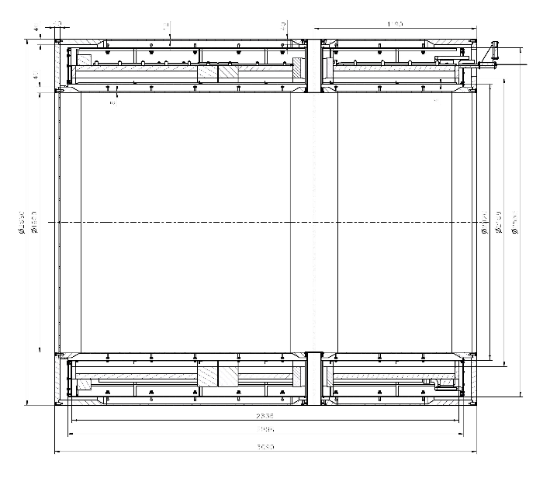
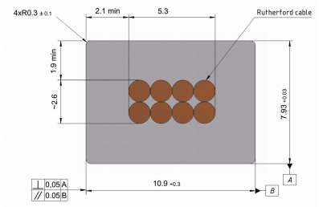
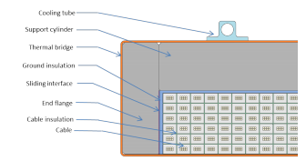
Main risks
Purchasing super conductive conductor - lack of a manufacturers
Rutherford cable, 8 strands, extruded in Al matrix
Thickness (after cold work) at 300 K | mm | 7.93 | ± 0.03
Width (after cold work) at 300 K | mm | 10.95 | ± 0.03
Critical current (at 4.2 K, 5 T) | A | > 14690
Critical current (at 4.5 K, 3 T) | A | > 16750
Overall Al/Cu/sc ratio |  | 10.5/1.0/1.0
Aluminum RRR (at 4.2 K, 0 T) |  | > 1000
Al 0.2% yield strength at 300 K | MPa | > 30
Longitudinal section of the cryostat with cold mass.
Conductor mechanical and electrical parameters.
Cold mass cross-section.
Cross-section of the conductor.

Slide 9
Status of the PANDA conductor development/ procurement
Development works with a prototype Rutherford cable (Cu or NbTi) to co-extrusion/ conklad in a pure Al 995 and Aluminum A95
No. | Process | Plan | Comments
1 | Conklad with a prototype NbTi PANDA cable and A995/998 wire 9,5 mm. | 02/2020 | ? Depend from production A995
2 | Tests of the prototype NbTi PANDA cable and A995/998 matrix after Conklad | 02-03/2020 | After step 1
3 | Co-extrusion/ Conklad in SARKO with Cu Rutherford cable 1000m and A95 wire 9,5 mm. | 07-08/2020 | Discussing details of contract with SARKO
4 | Co-extrusion/ Conklad in SARKO with Cu Rutherford cable 1000m and A995/998 wire 9,5 mm. | ? | After step 1
5 | Cold work to result the overall geometrical conductor dimensions | 09-10/ 2020 | After steps 3 and 4; purchasing dies

Slide 10
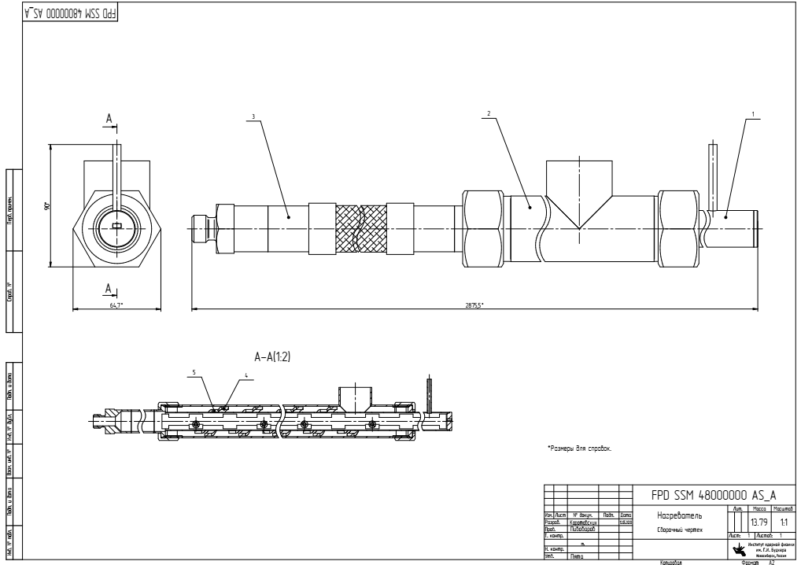
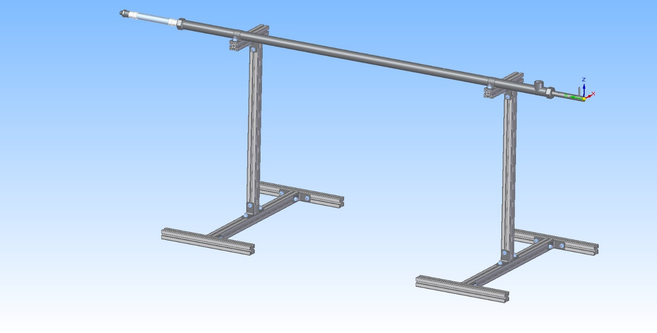
Status of the PANDA conductor development/ procurement
Development works with a prototype Rutherford cable (Cu or NbTi) to co-extrusion/ conklad in a pure Al 995 and Aluminum A95
Oven for preheating a Rutherford cable.
Temperature - 200 ÷ 450°C;
Shielding gas – N₂

Slide 11
Status of the PANDA yoke production

Slide 12
3D model of the Yoke and Frame.
Frame
Yoke
Control assembling 12/2019

Slide 13
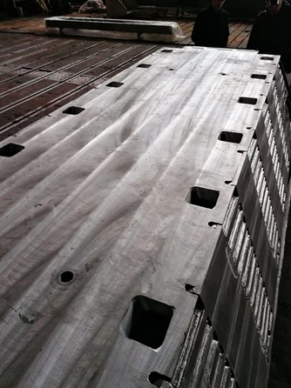
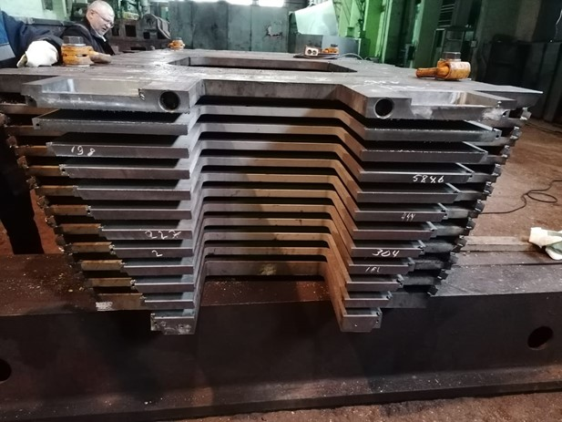
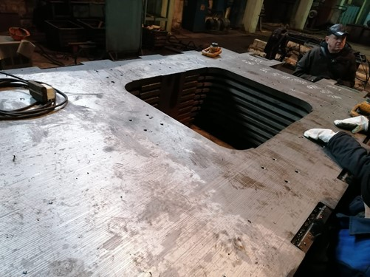
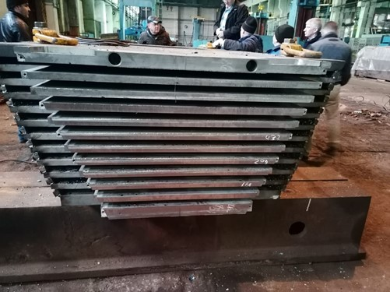
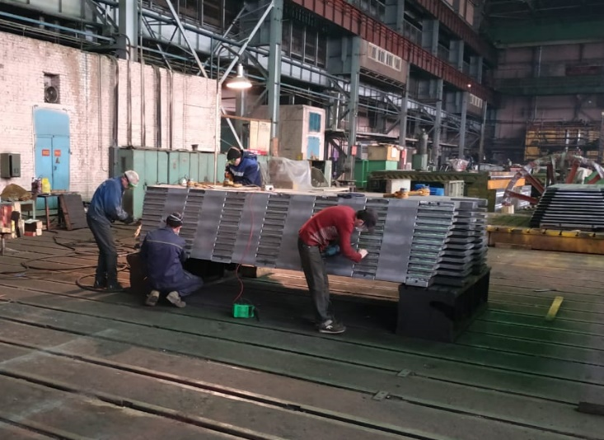
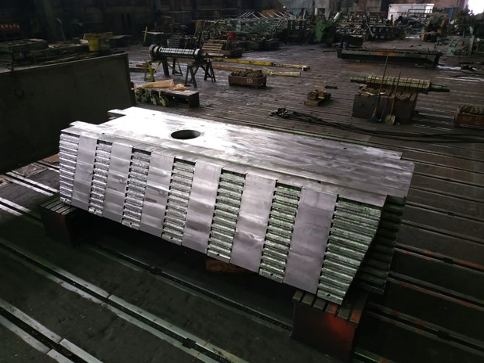
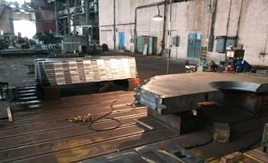
Production of the parts of the Yoke
Modules W5 and W7 after final machining
Acceptance tests of the W5 and W7 modules in plant site

Slide 14
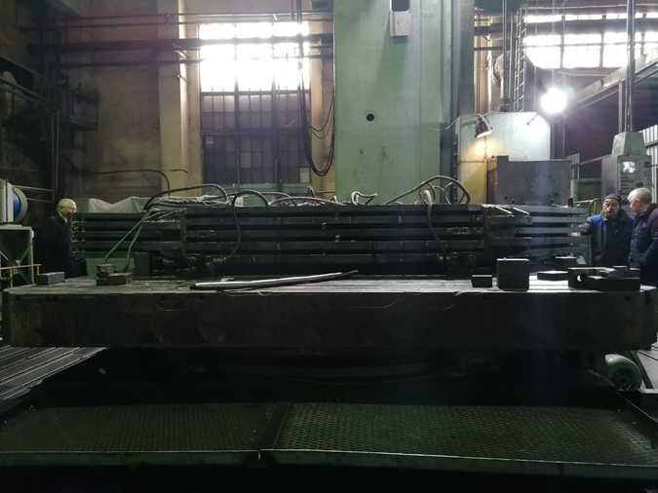
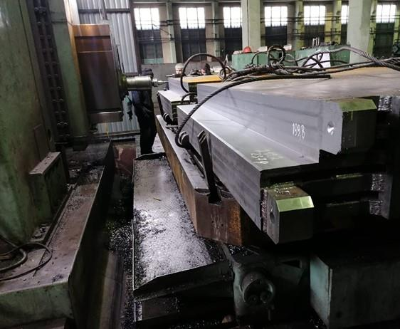
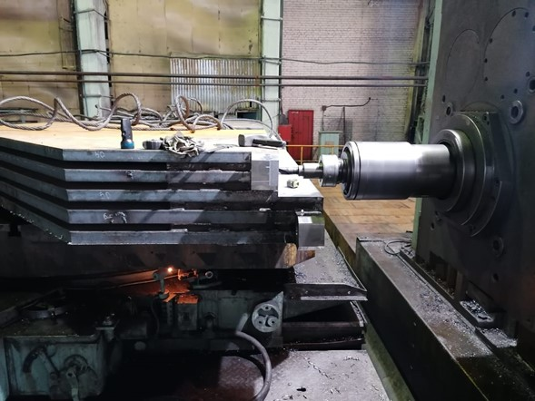
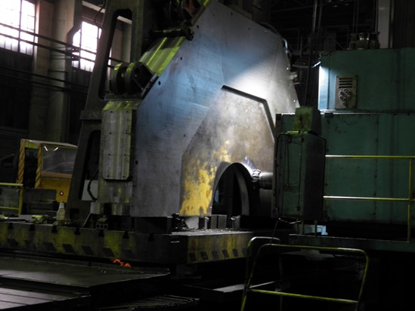
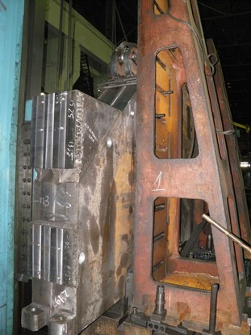
Production of the parts of the Yoke

Slide 15
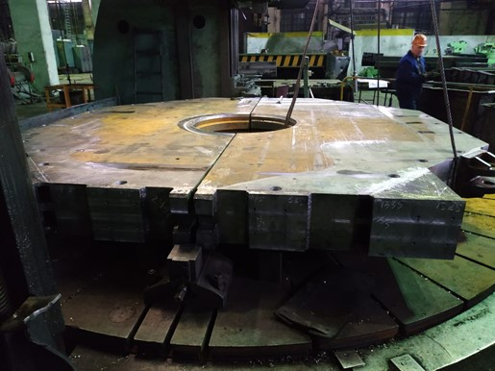
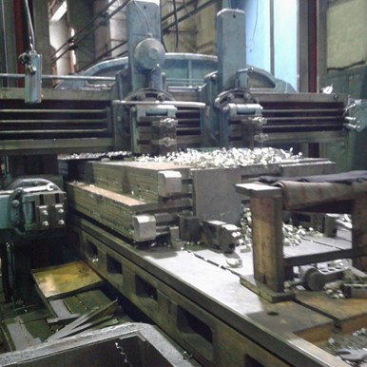
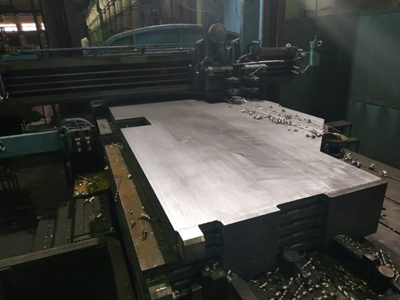
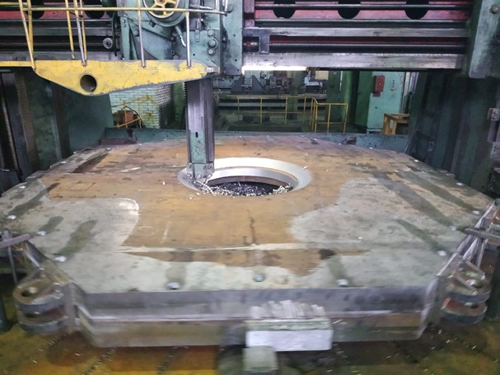
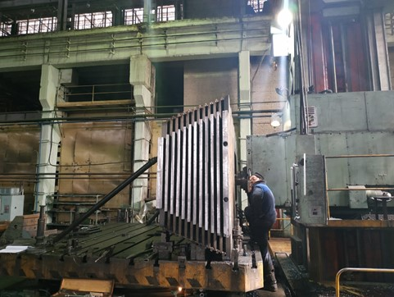
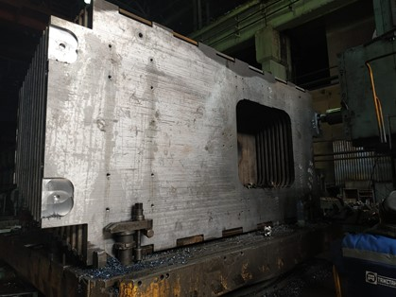
Production of the parts of the Yoke

Slide 16
Status of the PANDA coils production

Slide 17
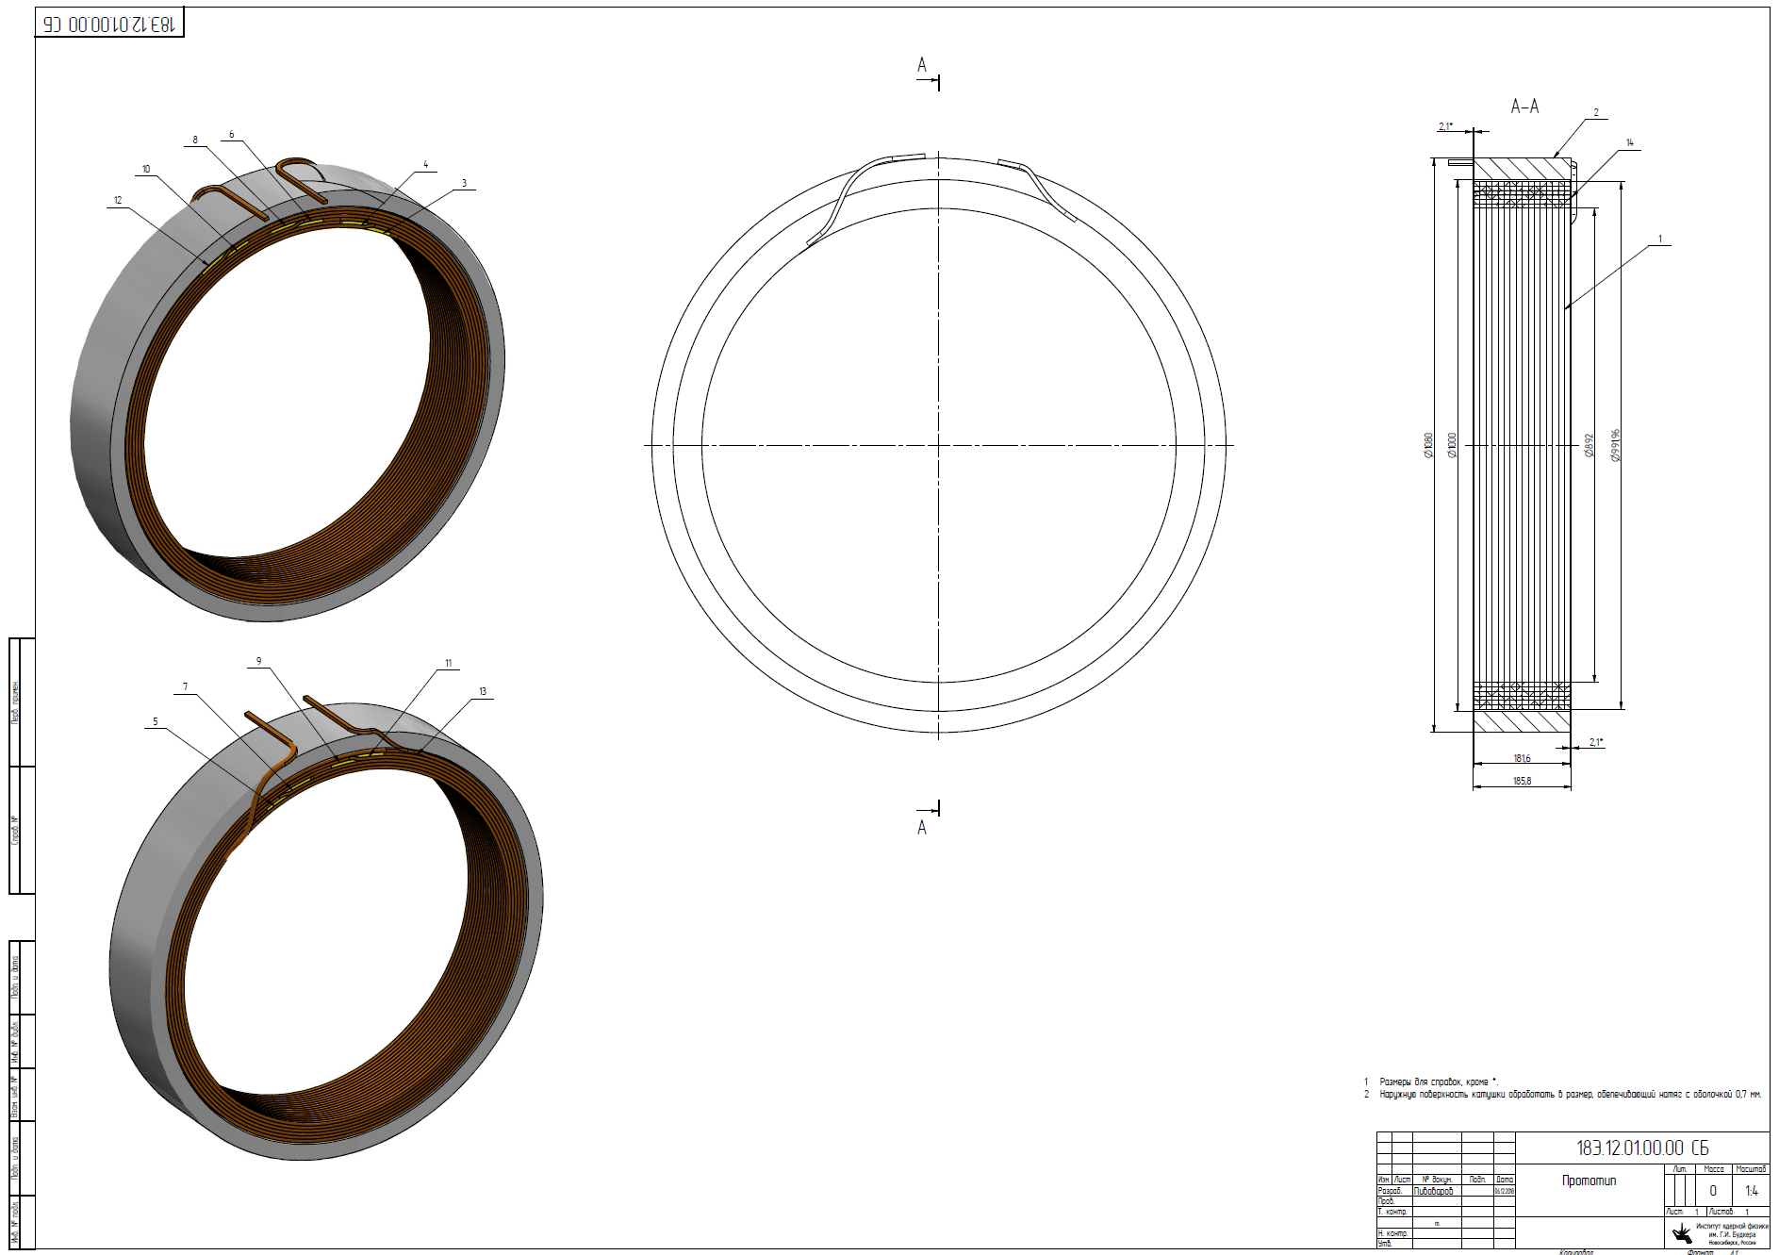
The Prototype of the Coil (3pcs.)
OD = 1m,
h=180 mm
Conductor:Al
10,85 мм x 7.93 мм,
6 layers
16 turns
Design is ready, 2 prototype produced
.

Slide 18
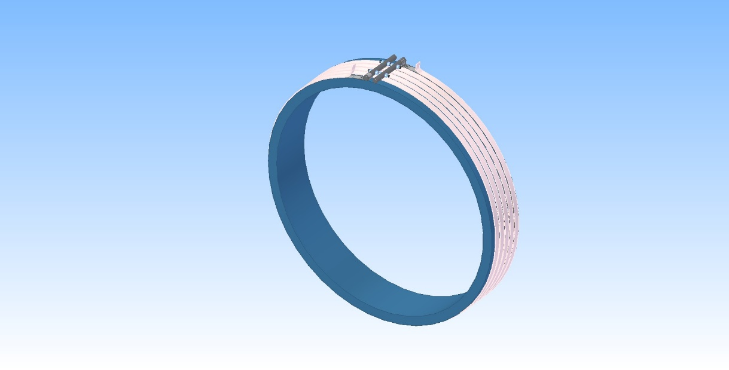
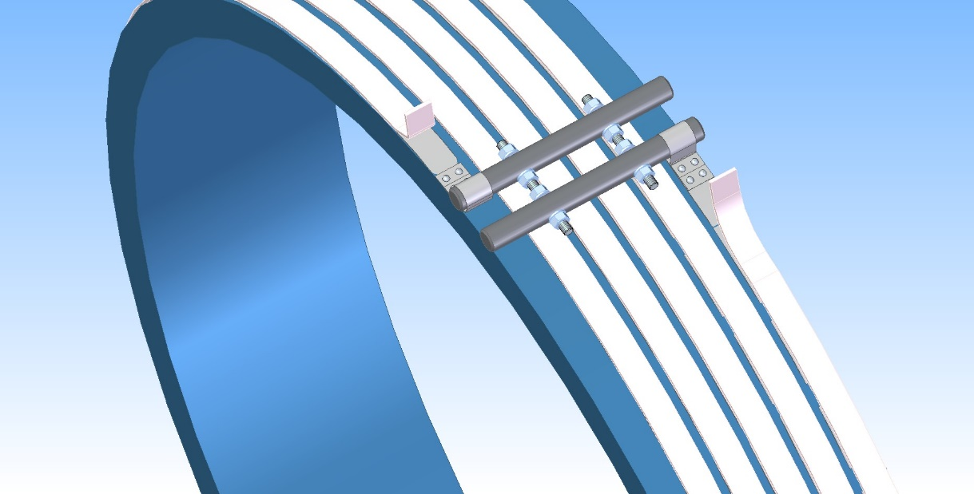
The Prototype of the Coil (3pcs.)
Preparation prestress procedure of coil
to an aluminum shell
For prototype heater:
Length - 17m;
Power - 3,5 kW;
Cross section - 24 x 3 mm;
Quantity - 1 pc.
For PANDA coil
Length - 36m;
Power - 3,0 kW;
Cross section - 24 x 3 mm;
Quantity - 8-9 pc.
Design is ready, preparation heat system
.

Slide 19
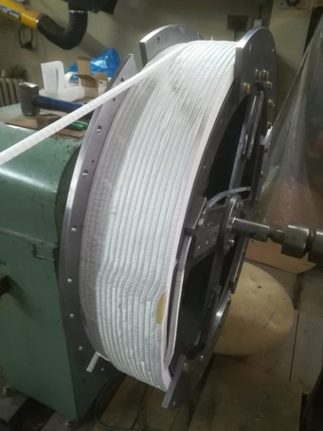
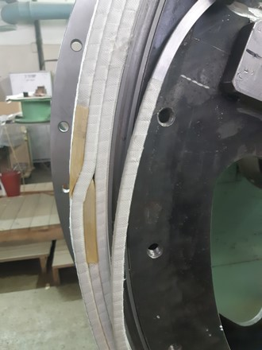
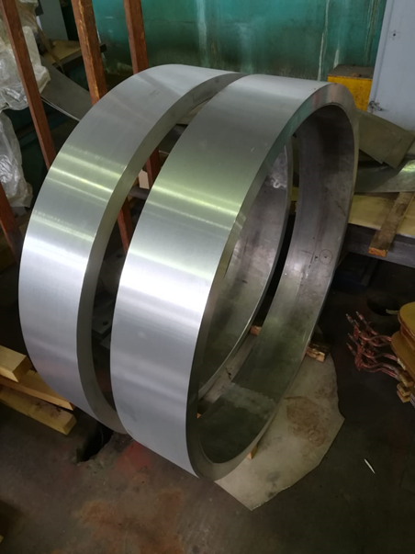
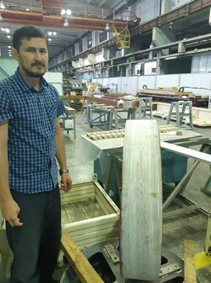
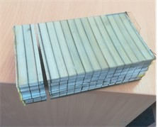
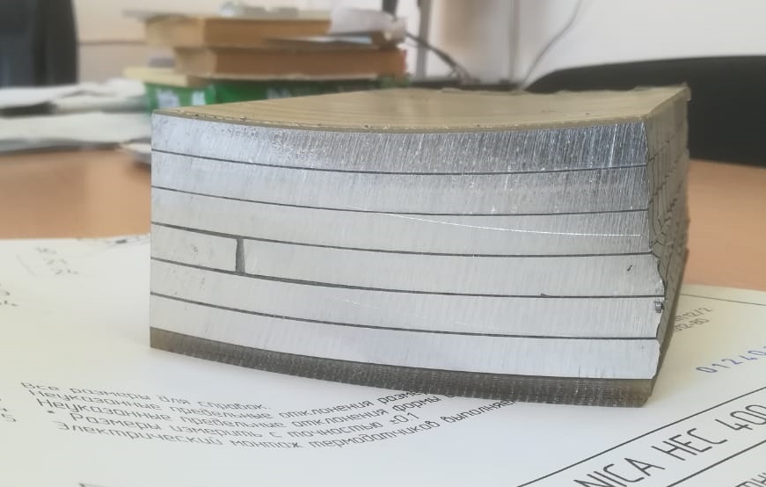
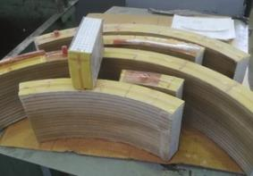
Production of the coil prototype

Slide 20
Status of the PANDA coil development/ production
Development works with a prototype Rutherford conductor.
Material is Aluminum A95
Second prototype
Electrical tests;
Procedure heating Al shell with control uniformity distribution of temperature, temperature rate, shell expansion measurement;
Assembling coil and Al shell with prestress;
Mechanical test coil assembling;
Destroy tests;
Checking quality of an epoxy penetration, mechanical tests;
Analysis of the manufacturing quality of the second prototype;
Preparation production of the third prototype

Slide 21
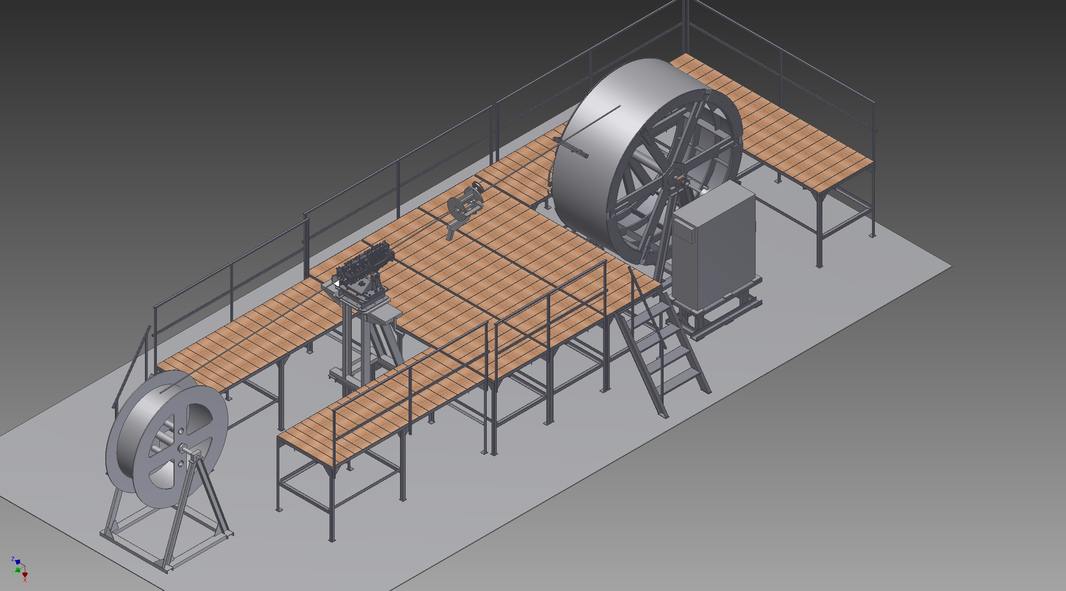
Drawing of the Devices for winding coil (scheme).
Design is ready, production until 2020

Slide 22
Status of the PANDA cryostat and cold mass production

Slide 23
Status of the PANDA cryostat, cold mass and stands production
Item | Plan | Status
Design |  | Ready
Specification for production |  | Ready
Call for tender |  | In process
Procurement raw materials | 08-09/ 2020 | In process
Ti bars for suspend system | 10/ 2019 | Ready
Procurement interconnector Al/Stainless steel | 12/ 2020 | Negotiation with producers
Procurement Al pipes of cold mass | 2021 | In plan
Al pipes for thermoshields |  | In BINP

Slide 24
LHe and GHe sealing

Slide 25
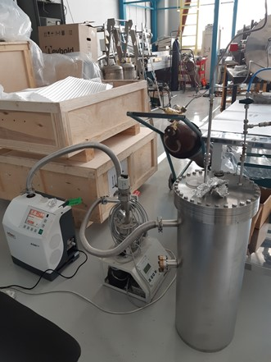
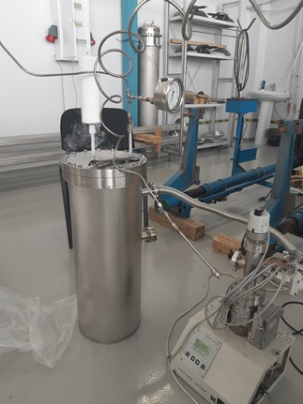
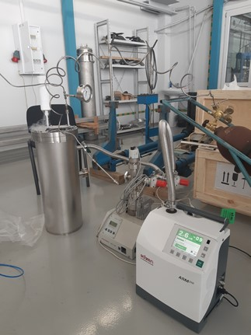
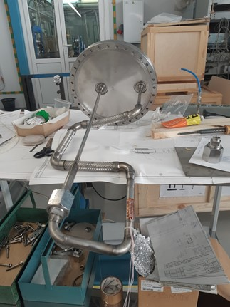
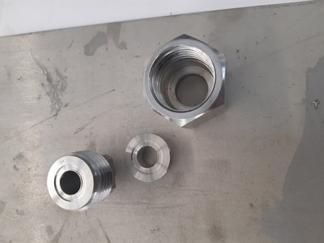
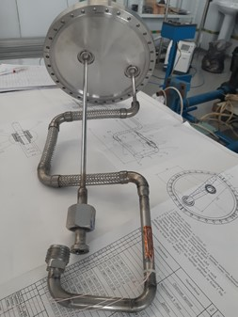
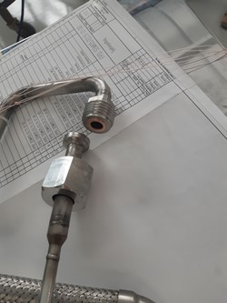
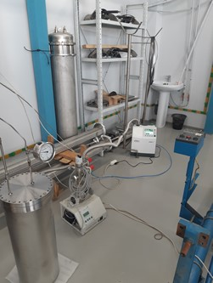
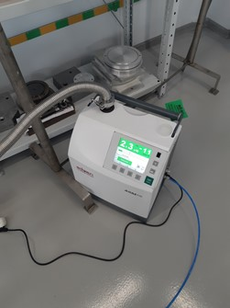

Slide 26
Vacuum tests of the MO (Matsumot - Ohtsuka) type flange
Connection cryogenic process pipes in place assembly / disassembly transfer line between He liquefier and Control Dewar to move PANDA detector from beam position to assembling area.
Connection MO flange 1 | Date | Quantity cycle 78K – 300K without leakage | Test Leak rate, mbar x l/s | Pressure tests, bar | Time tests 78K, min | Leakage, mbar x l/s
Gasket 1 | 20/04 2020 - | 1 - 17 | ≤5 x 10E-10 | 25 | 30-40 | no
 | 25/05/2020 | 18 | 1,6 x 10E-11 | 10 | 1 | 8 x 10E-9
Gasket 2 | 27/05 – present time | 3 | ≤5 x 10E-10 | 25 | 30-40 | no
Gasket 3
Connection MO flange 2..3

Slide 27
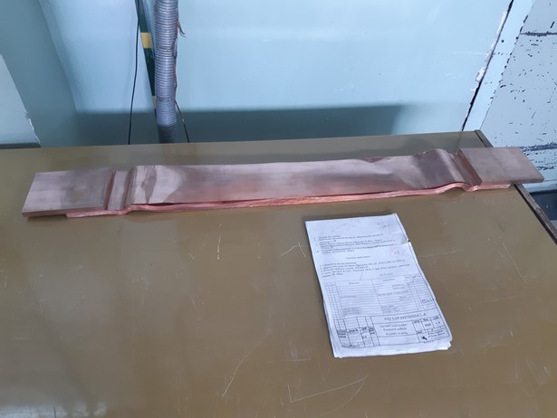
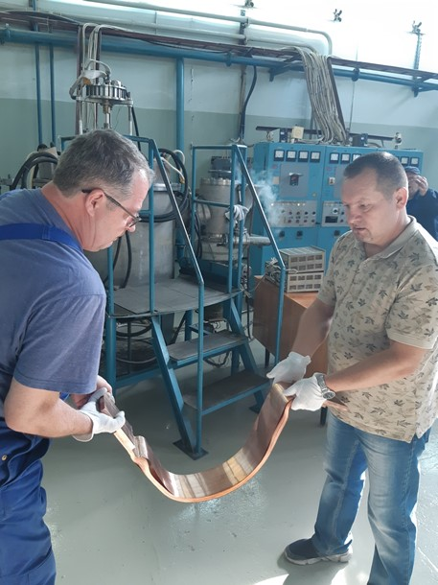
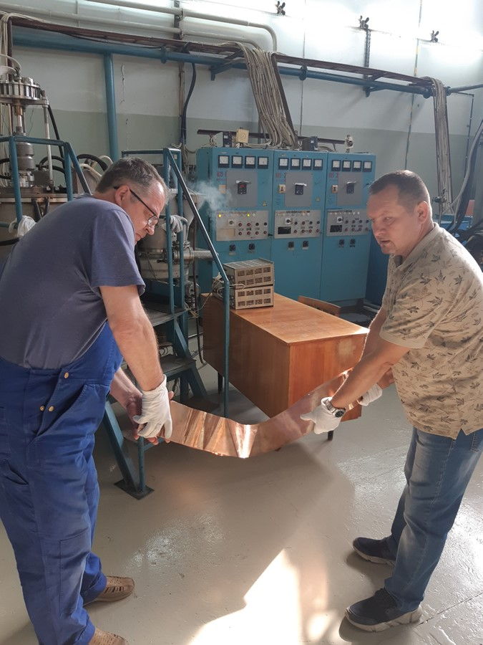
Flexible bus bar between cable way and current leads

Slide 28
Preparation tests in BINP

Slide 29
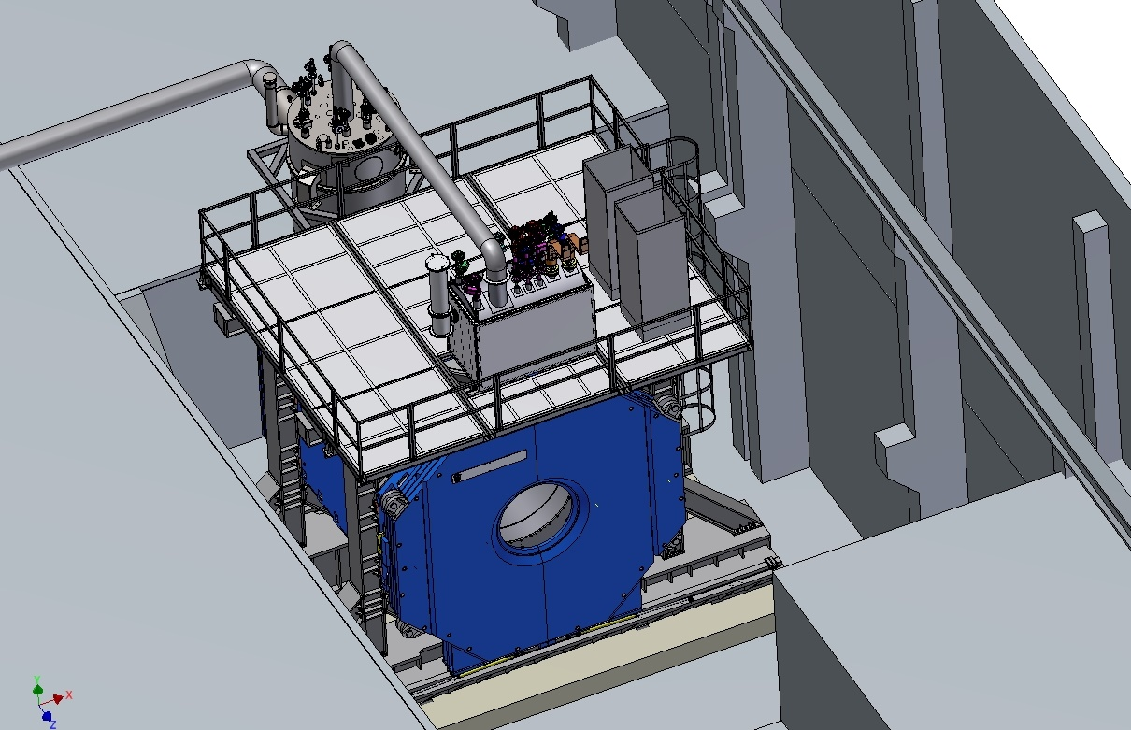
PANDA magnet, bld. 13. Area for cryogenic and coils tests and measurements of a magnetic field

Slide 30
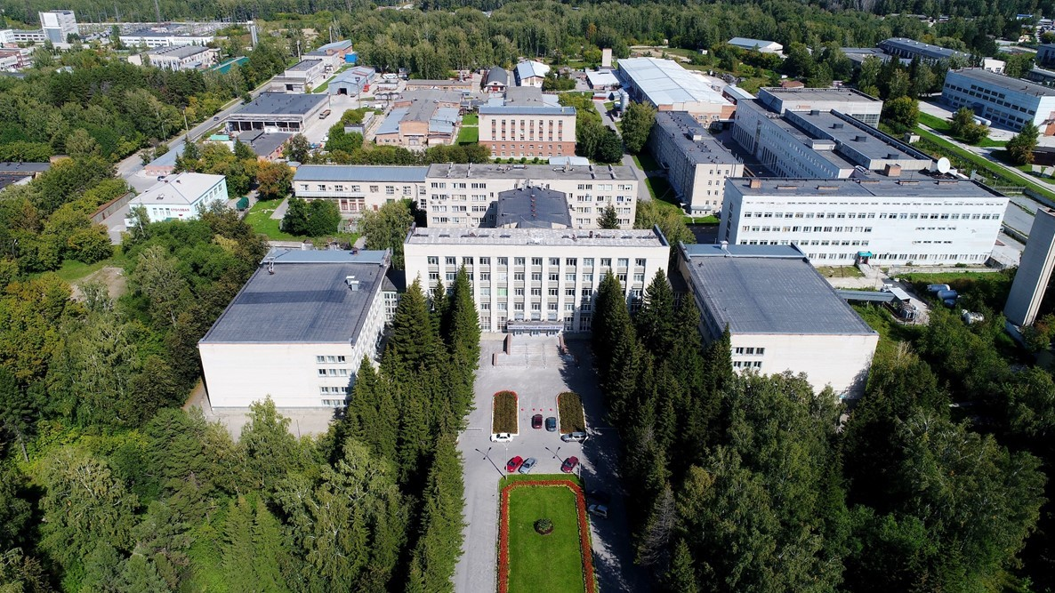
Thank you for your attention

