Slide 1
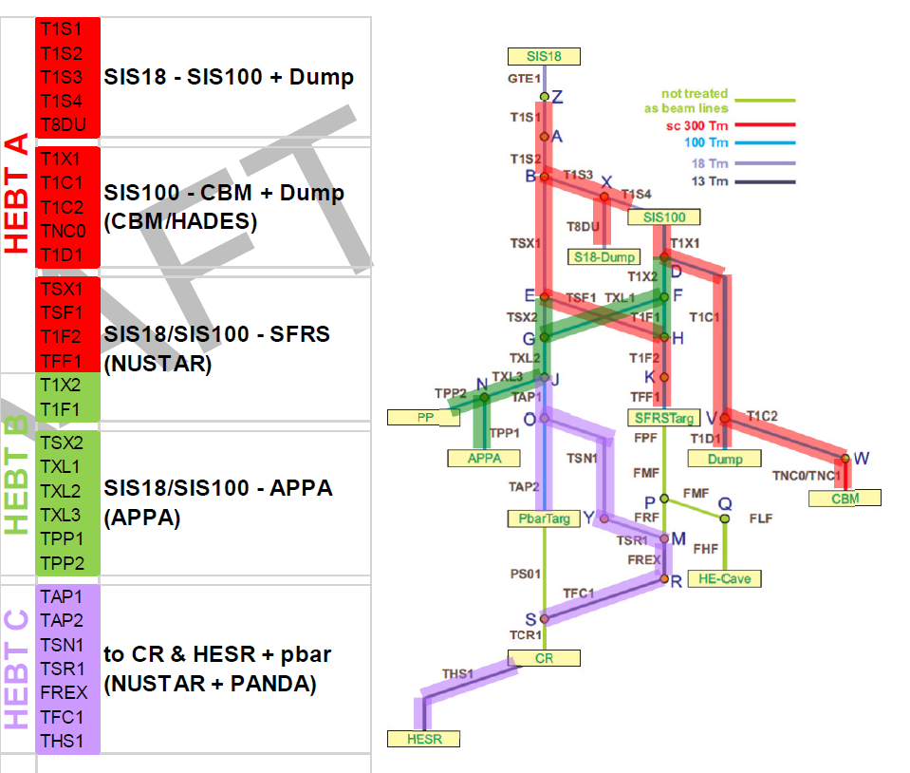
4rd BINP-FAIR Collaboration Coordination Workshop
HEBT-A: magnet production status

Slide 2
4rd BINP-FAIR Collaboration Coordination Workshop
HEBT-A: magnet production status
T1S1, T1S2, T1S3, T1S4
At FAIR
Prepares for shipment
Still production
Dipoles
T1S1MH01 | dip15_0
T1S1MH02 | dip15_0
T1S1MH06 | dip15_0
T1S1MH07 | dip15_0
Dipoles
T1S1MH08 | dip15_1
T1S1MH04 | dip16_0
T1S1MH05 | dip17_0
Quadrupoles
T1S1QS03 | Quadrupole 2 | 1
T1S1QS10 | Quadrupole 2 | 2
T1S1QS11 | Quadrupole 2 | 3
T1S1QS12 | Quadrupole 2 | 4
T1S1QS13 | Quadrupole 2 | 5
T1S1QS14 | Quadrupole 2 | 6
T1S1QS15 | Quadrupole 2 | 7
T1S1QS16 | Quadrupole 2 | 8
T1S1QS17 | Quadrupole 2 | 9
T1S1QS18 | Quadrupole 2 | 10
T1S1QS02 | Quadrupole 2 | 24
T1S1QS04 | Quadrupole 2 | 25
T1S1QS05 | Quadrupole 2 | 26
T1S1QS06 | Quadrupole 2 | 27
T1S1QS07 | Quadrupole 2 | 28
T1S1QS08 | Quadrupole 2 | 29
T1S1QS09 | Quadrupole 2 | 30
T1S1QS19 | Quadrupole 2 | 11
T1S2QS01 | Quadrupole 2 | 12
T1S2QS02 | Quadrupole 2 | 13
T1S2QS03 | Quadrupole 2 | 14
T1S2QS04 | Quadrupole 2 | 15
Quadrupoles
T1S2QS05 | Quadrupole 2 | 16
T1S2QS06 | Quadrupole 2 | 17
T1S4QS02 | Quadrupole 2 | 19
T1S4QS03 | Quadrupole 2 | 20
T1S4QS04 | Quadrupole 2 | 21
T1S4QS05 | Quadrupole 2 | 22
T1S4QS06 | Quadrupole 2 | 40
T1S4QS07 | Quadrupole 2 | 41
T1S4QS08 | Quadrupole 2 | 42
T1S4QS09 | Quadrupole 2 | 43
Quadrupoles
T1S4QS01 | Quadrupole 2 | 18
T1S1QS01 | Quadrupole 2 | 23
T1S3QS02 | Quadrupole 2 | 32
T1S3QS03 | Quadrupole 2 | 33
T1S3QS04 | Quadrupole 2 | 34
T1S3QS05 | Quadrupole 2 | 35
T1S3QS06 | Quadrupole 2 | 36
T1S3QS07 | Quadrupole 2 | 37
T1S3QS08 | Quadrupole 2 | 38
T1S3QS09 | Quadrupole 2 | 39
T1S4QS10 | Quadrupole 2 | 44
T1S4QS11 | Quadrupole 2 | 45
Steering Magnet HEBT18
T1S1KV03 | Steering Magnet HEBT18 | 6
T1S1KV06 | Steering Magnet HEBT18 | 9
T1S3KH01 | Steering Magnet HEBT18 | 14
T1S3KH02 | Steering Magnet HEBT18 | 15
T1S3KV01 | Steering Magnet HEBT18 | 16
T1S3KV02 | Steering Magnet HEBT18 | 17
T1S4KH02 | Steering Magnet HEBT18 | 19
T1S4KV01 | Steering Magnet HEBT18 | 20
T1S4KV02 | Steering Magnet HEBT18 | 21
T1S4KV03 | Steering Magnet HEBT18 | 22
T1S4KV04 | Steering Magnet HEBT18 | 23
T1S1KH01 | Steering Magnet HEBT18 | 1
T1S1KH02 | Steering Magnet HEBT18 | 2
T1S1KH03 | Steering Magnet HEBT18 | 3
T1S1KV01 | Steering Magnet HEBT18 | 4
Steering Magnet HEBT18
T1S2KH01 | Steering Magnet HEBT18 | 10
T1S2KH02 | Steering Magnet HEBT18 | 11
T1S2KV01 | Steering Magnet HEBT18 | 12
T1S2KV02 | Steering Magnet HEBT18 | 13
T1S1KV05 | Steering Magnet HEBT18 | 8
Steering Magnet HEBT18
T1S1KV02 | Steering Magnet HEBT18 | 5
T1S1KV04 | Steering Magnet HEBT18 | 7
T1S4KH01 | Steering Magnet HEBT18 | 18

Slide 3
4rd BINP-FAIR Collaboration Coordination Workshop
HEBT-A: magnet production status
T1X1, T1C1, T1C2, TNC0, T1D1
At FAIR
Prepares for shipment
Still production
Dipoles
T1C2MH01 | dip10_0 | 1
TNC0MH01 | dip13_0 | 1
TNC0MH02 | dip13_0 | 2
T1X1MV01 | dip19_0 | 1
TNC0KH01 | Steering Magnet HEBT100 | 19
TNC0KV01 | Steering Magnet HEBT100 | 20
T1C1KH02 | Steering Magnet HEBT100 | 2
T1C1KV02 | Steering Magnet HEBT100 | 4
T1C2KV01 | Steering Magnet HEBT100 | 5
TNC0QS01 | Quadrupole 11 | 27
T1C1QS04 | Quadrupole 11 | 3
T1C2QS02 | Quadrupole 11 | 4
Quadrupoles
T1X1QS03 | Quadrupole 11 | 11
T1X1QS04 | Quadrupole 11 | 12
T1X1QS05 | Quadrupole 11 | 13
T1X1QS06 | Quadrupole 11 | 14
T1X1QS07 | Quadrupole 11 | 15
T1C1QS02 | Quadrupole 11 | 1
T1C1QS03 | Quadrupole 11 | 2
T1C1QS01 | Quadrupole 12 | 1
T1C2QS03 | Quadrupole 11 | 5
T1C2QS04 | Quadrupole 11 | 6
TNC1QS02 | Quadrupole 10 | 1
TNC1QS03 | Quadrupole 10 | 2
TNC1QS04 | Quadrupole 10 | 3
TNC1QS05 | Quadrupole 10 | 4
Steering Magnet HEBT 100
T1X1KH01 | Steering Magnet HEBT100 | 34
T1X1KH02 | Steering Magnet HEBT100 | 35
T1X1KH03 | Steering Magnet HEBT100 | 36
T1X1KV01 | Steering Magnet HEBT100 | 37
T1X1KV02 | Steering Magnet HEBT100 | 38
T1C1KH01 | Steering Magnet HEBT100 | 1
T1C1KV01 | Steering Magnet HEBT100 | 3
T1C2KH01 | Steering Magnet HEBT100 | 32
T1C2KV02 | Steering Magnet HEBT100 | 33

Slide 4
4rd BINP-FAIR Collaboration Coordination Workshop
HEBT-A: magnet production status
TSX1, TSF1,TFF1
At FAIR
Prepares for shipment
Still production
TFF1QS01 | Quadrupole 11 | 26
TFF1QS02 | Quadrupole 11 | 68
TSX1QS01 | Quadrupole 2 | 69
TSX1QS02 | Quadrupole 2 | 70
TSX1QS03 | Quadrupole 2 | 71
TSX1QS04 | Quadrupole 2 | 72
TSX1QS05 | Quadrupole 2 | 73
TSX1QS06 | Quadrupole 2 | 74
TSX1QS07 | Quadrupole 2 | 75
TSX1QS08 | Quadrupole 2 | 76
TSX1QS09 | Quadrupole 2 | 77
TSX1QS10 | Quadrupole 2 | 78
TSX1QS11 | Quadrupole 2 | 79
TSX1QS12 | Quadrupole 2 | 80
TSX1QS13 | Quadrupole 2 | 81
TSF1QS01 | Quadrupole 2 | 68
T1F2QS01 | Quadrupole 12 | 6
TFF1QS03 | Quadrupole 11 | 69
TSX1KH01 | Steering Magnet HEBT18 | 37
TSX1KH02 | Steering Magnet HEBT18 | 38
TSX1KV01 | Steering Magnet HEBT18 | 39
TSX1KV02 | Steering Magnet HEBT18 | 40
TSX1KV03 | Steering Magnet HEBT18 | 41
TSX1KV04 | Steering Magnet HEBT18 | 42
TSF1KH01 | Steering Magnet HEBT18 | 35
TSF1KV01 | Steering Magnet HEBT18 | 36

Slide 5
4rd BINP-FAIR Collaboration Coordination Workshop
We thank the participants for the opportunity to coordinate our efforts.
We will pay attention to accelerating the production of HEBT-A magnets.
We've accelerated the documents preparation for the magnets delivery.
Drawings for the assembly of chambers with magnets will be available after vacuum chamber FDR.

Slide 6
4rd BINP-FAIR Collaboration Coordination Workshop
Production plan HEBT-A Magnets
Magnets | Quantity | At FAIR | Ready | 2020
 |  |  |  | 6 | 7 | 8 | 9 | 10 | 11 | 12
dip10_0 | 2 |  | 1 | 1
dip13_0 | 2 |  |  | 1 | 1
dip19_0 | 1 |  |  |  |  |  |  |  | 1
dip15_1 | 1 |  |  | 1
dip16_0 | 1 |  |  |  | 1
dip17_0 | 1 |  |  |  |  | 1
Quadrupole 2 | 58 | 22 | 11 | 5 | 5 | 5 | 5 | 5 | 2
Quadrupole 11 | 17 |  | 7 | 5 |  | 5 | 6 | 6 | 6 | 5
Quadrupole 12 | 6 |  |  |  |  |  |  | 1 |  | 5
Steering 18 | 31 | 8 | 12 | 6 | 5
Steering 100 | 19 | 10 | 6 | 1 |  |  |  | 2
Total | 139 | 40 | 37 | 20 | 12 | 11 | 11 | 14 | 9 | 10

