Slide 1
Results Super-FRS
Haik Simon
May, 2020
Hanno Leibrock/ FAIR-GSI Workshop, video conference, 25-29 May 2020

Slide 2
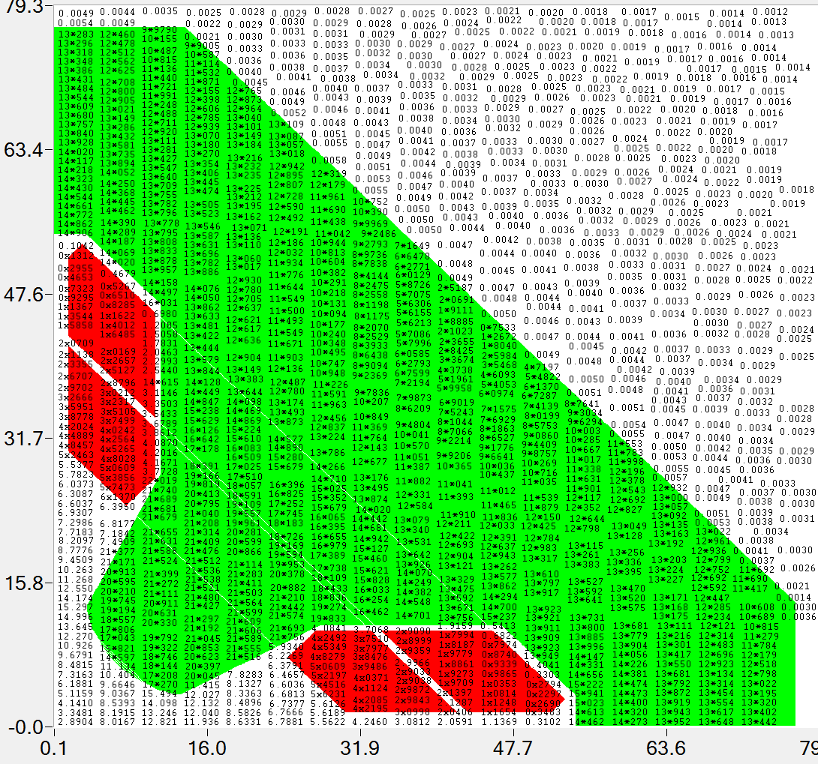
nc-Multipoles
Field in yoke (kGs) at maximal gradient value
R&D: Full 3D magnet calculations completed for 3 Quads and Sextupole
(Mermaid), Parameters satisfied slightly above margins for field qualities ➔ CDR ok – final design with possible improvements
Mechanical models for all magnets now presented
Conclusion on IK-contract value and timeline not yet reached → upcoming steering meetings

Slide 3
ncDipoles
final check of 3D model for FDR at GSI within next 2 weeks
almost finidshed, interfaces done, only one multipin connector needs to be finalized
Final 2D-drawings to be derived within next 3 month
FDR data possibly in September/October
Iron procurment could be extended to multipoles
cables ready to be sent by GSI → BINP (autumn)
Instrumentation
BPM contract in preparation!

Slide 4
Vacuum
R&D on nc Dipole chamber started with first results
Diagnostic chambers (FDR drawings received, now under revision)
Scope Support vacuum items eventually clarified → value now in evaluation at BINP
Branched sc-dipole chamber contract now in preparation
sc-dipole chambers further steps toward CDR discussed
Temperature jump and maximum stress
P = 3 W/cm^2, Energy 4.5 J per pulse, repetition 1.5 s
 | Ro g/cm^3 | R length cm | Cm J/g/K | Cv J/cm^3/K | deltaT | J/g | E GPa | σ₋₁ Mpa | a 1/K | DeltaT max
BT1 | 4,54 | 6,7E-02 | 0,53 | 2,41 | 27,75 | 14,71 | 103,00 | 280,00 | 8,2E-06 | 464,13
BT3-1 | 4,54 | 6,7E-02 | 0,53 | 2,41 | 27,75 | 14,71 | 115,00 | 450,00 | 8,2E-06 | 668,08
BT6 | 4,43 | 6,9E-02 | 0,53 | 2,35 | 27,75 | 14,71 | 113,00 | 450,00 | 8,2E-06 | 679,91
Stainless steel | 7,90 | 3,9E-02 | 0,46 | 3,63 | 31,97 | 14,71 | 200,00 | 280,00 | 1,6E-05 | 122,50
Inconel 718 | 8,20 | 3,7E-02 | 0,50 | 4,10 | 29,41 | 14,71 | 210,00 | 700,00 | 1,30E-05 | 358,97
AMg5 | 2,70 | 1,1E-01 | 0,92 | 2,48 | 15,98 | 14,71 | 70,00 | 125,00 | 2,3E-05 | 108,70
potential solution with Inconel chamber and Ti shield
to be continued …

Slide 5
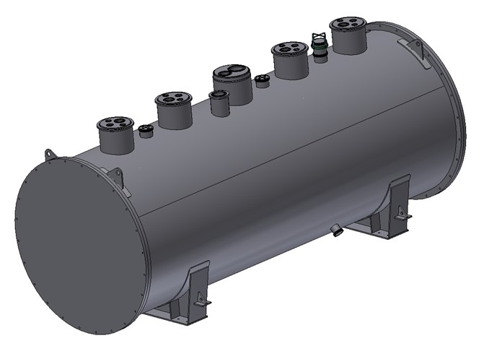
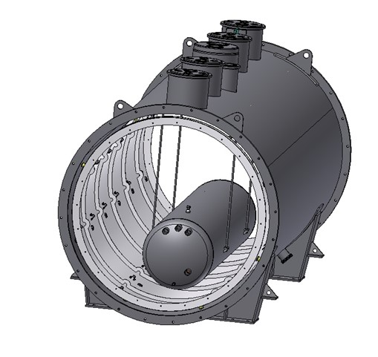
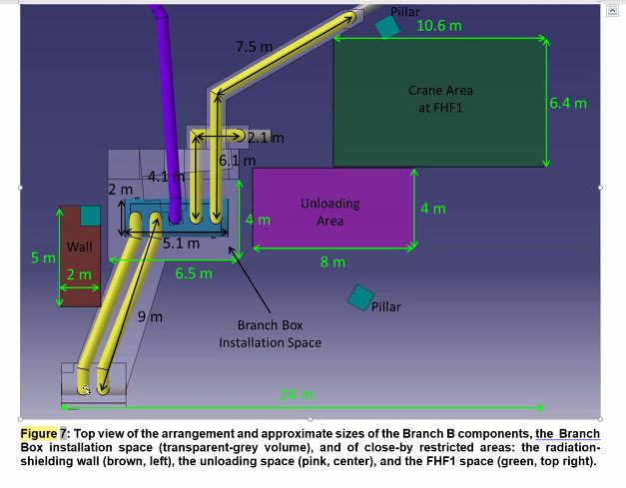
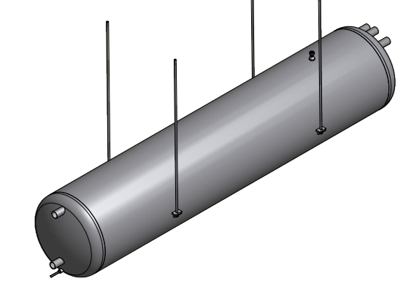
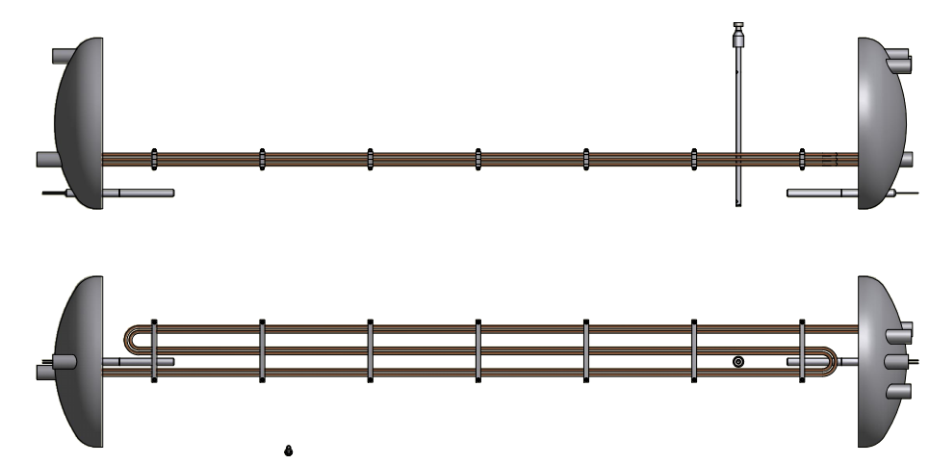
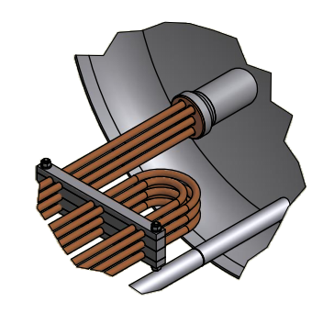
First design of the BRANCH BOX (BB)
BINP suggestion
for sub-cooler

Slide 6
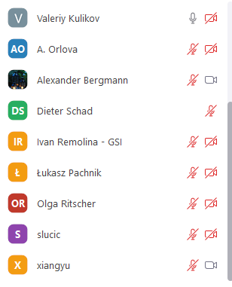
Very constructive meeting, few discrepancies to be solved within the next steering meetings
Technical solutions achieved or in R&D phase
Thanks to all participants in the sessions !
Next meeting again in person ?!

