Slide 1
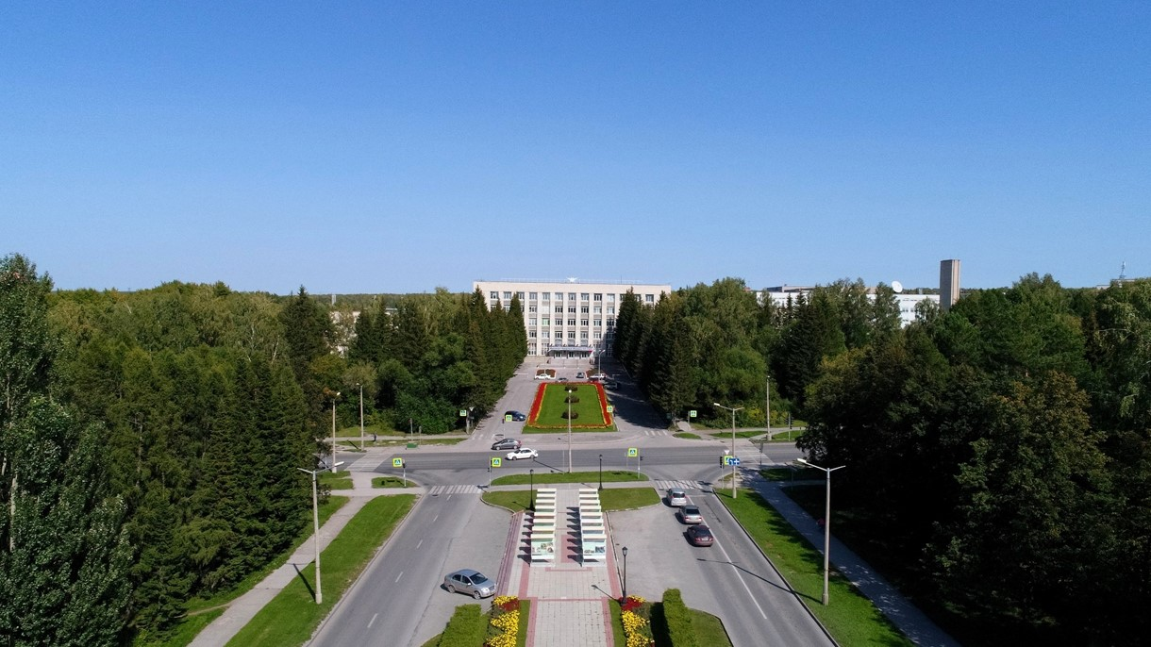
4th BINP-FAIR Collaboration Coordination Workshop SFRS local cryogenic

Slide 2
design of the BRANCH BOX (BB)
Accelerator Implementing Agreement No. 2 to the ACCELERATOR CO-OPERATION Agreement of dated by October 2, 2019. The scope of cooperation of this work includes, first of all, the technological design of the branch box (BB), which distribute helium supply to four SFRS experimental branches. Conceptual design and preparation for the introduction of devices will be performed by both organizations GSI and BINP SB RAS. BINP SB RAS will perform technological design. The GSI will provide scientific support.
BINP developed sub-cooler of the BB. 1000 l LHe vessel, 105 g/sec flow; BINP defined a design of vacuum shell. Conceptual 3D model is ready; For next design works, BINP needs a Detail specification of BB. It should be ready 2020/01.
According to our agreements 27 November 2019, GSI will prepare a contract FAIR-BINP for development and production of Transfer lines, part of Feed/End boxes and BB in May, 2020.

Slide 3
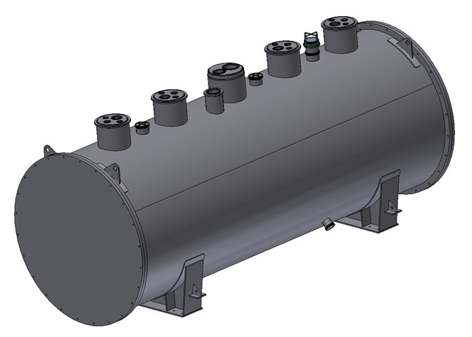
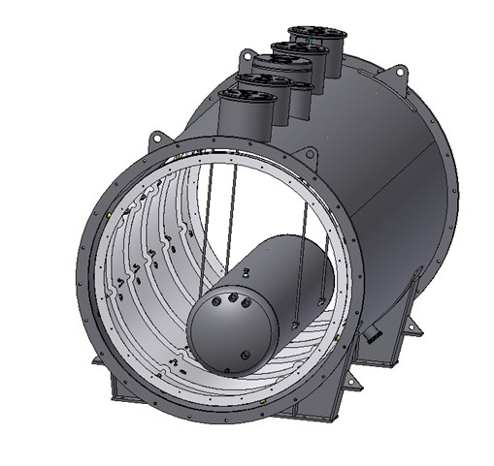
design of the BRANCH BOX (BB)

Slide 4
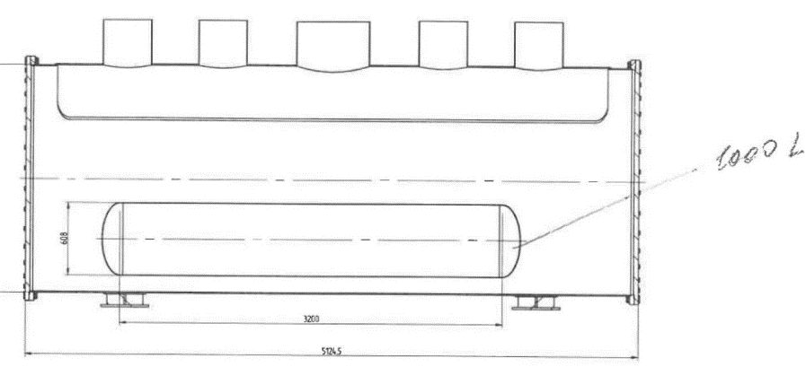
design of the BRANCH BOX (BB)
Evaluation of sub-cooler (Y. Xiang 11/11/2019)
The subcooler vessel layout above was presented by the BINP colleague, Sergei G. Pivovarov on 07-11-2019 at GSI. The total effective volume of the subcooler vessel can be calculated, ca. 929 liter (= [ π x (0.608/2)² x 3.2 ] x 1000).

Slide 5
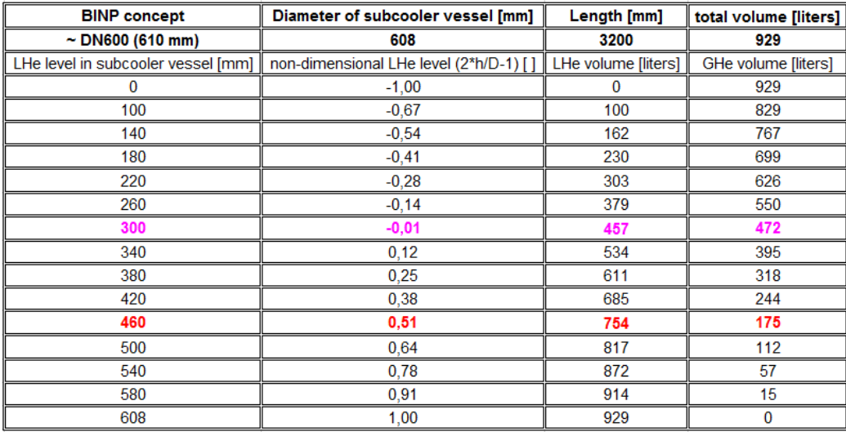
Sub-cooler of the BRANCH BOX
According to the specification (draft) of GSI, the required ullage is ~ 20% of total volume: ca. 185 liter (=
929 x 0.2). Therefore the maximum LHe level in vessel shall be less than 460 mm from the bottom.

Slide 6
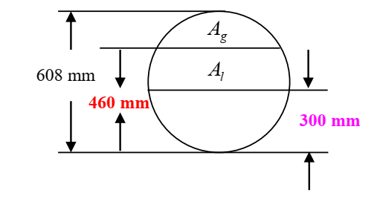
Sub-cooler of the BRANCH BOX
According to the specification (draft) of GSI, the required ullage is ~ 20% of total volume: ca. 185 liter (=
929 x 0.2). Therefore the maximum LHe level in vessel shall be less than 460 mm from the bottom.
In addition, the minimal required Lhe volume above the heat exchanger in subcooler is ca. 300 liters. Therefore the installation height of the heat exchanger has to below 300 mm from the bottom. It shall be very tight!

Slide 7
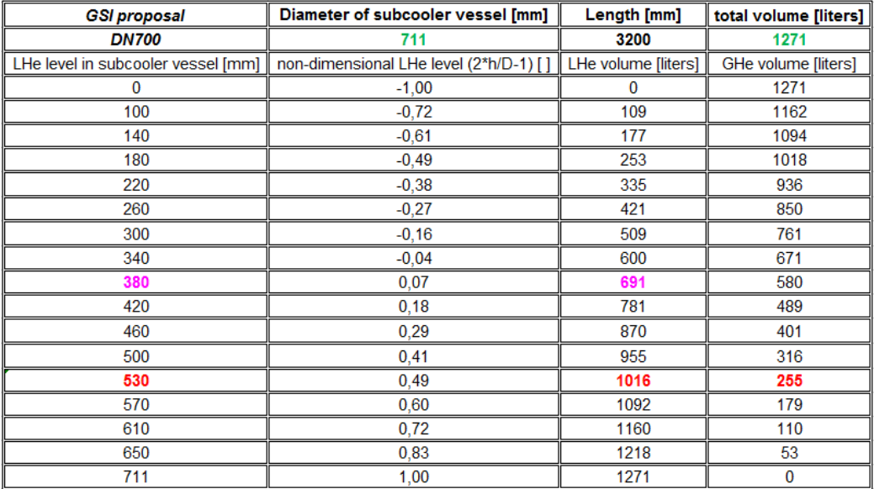
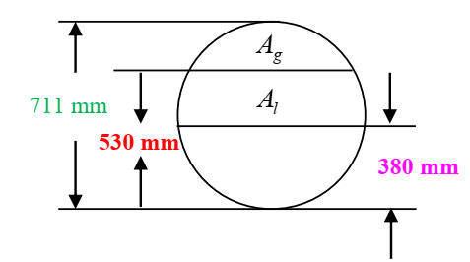
Sub-cooler of the BRANCH BOX
According to the specification (draft) of GSI, the required ullage is ~ 20% of total volume: ca. 185 liter (=
929 x 0.2). Therefore the maximum LHe level in vessel shall be less than 460 mm from the bottom.
GSI suggests to enlarge the LHe vessel as follows.

Slide 8
Sub-cooler of the BRANCH BOX
GSI suggests to enlarge the LHe vessel as follows.
The maximum LHe level in vessel shall be about 530 mm from bottom. The LHe volume ca. 1000 liters in the subcooler vessel as well as the required ullage, ca. 254 liters shall be garanteed. The installation height of the heat exchanger shall be around 380 mm from the bottom. It is more than 25% of installation height increases compared with the BINP layout, i.e., 300 mm. It shall cause the increase, ca. 17% of the vessel diameter from 608 mm (~DN600) to 711 mm (DN700). In fact the installation height increase of about 100 mm for cryo-valves and internal pipings shall be neglectable compared with the overal height of vacuum vessel design ca. 2m for Branch Box.

Slide 9
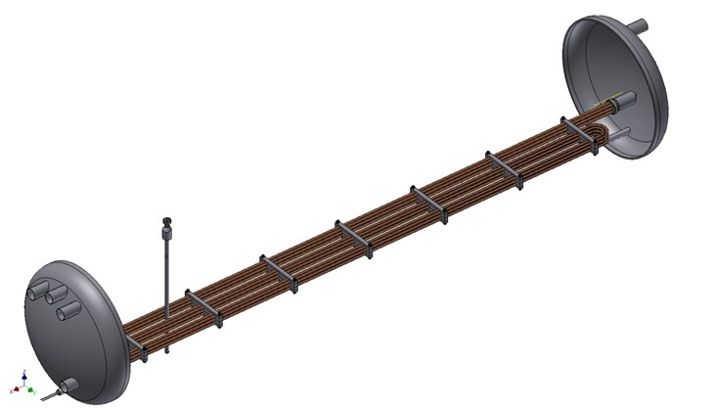
Sub-cooler of the BRANCH BOX
Specified
The maximum design pressure is 20 bara against vacuum at all possible operating temperatures.
Temperature inlet – 6 K;
Temperature outlet – 4,6 K;
Pressure inlet - 4,0 bar;
Pressure outlet, worst case - 3,9 bar;
Flow rate - 105 g/s;
The volume of liquid helium above the highest position of the heat exchanger in the LHe vessel shall be 300 liters at least
BINP suggestion
The maximum design pressure is 20 bara against vacuum at all possible operating temperatures. OD 711 mm, ID695 mm. Thickness of covers are 12 mm;
Temperature inlet – 6K;
Temperature outlet – 4,6K;
Pressure inlet - 4,0 bar;
Pressure outlet - 3,96 bar;
Flow rate - 105 g/s;
6 copper pipes OD12 x 1mm and length of the each pipe is 9 meters.
The volume of liquid helium above the highest position of the heat exchanger in the LHe vessel shall be 300 liters at least - OK

Slide 10
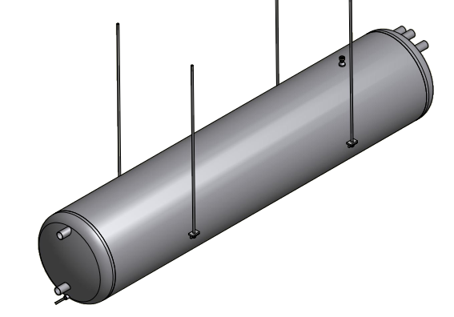
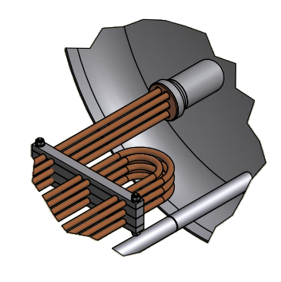
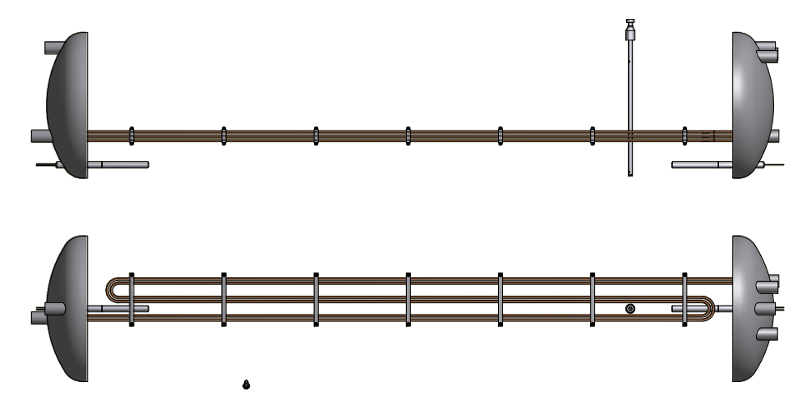
Sub-cooler of the BRANCH BOX
BINP suggestion

Slide 11
Thank you for your attention

