Slide 1
BINP magnets for the pbar
Hanno Leibrock
May, 2020
Hanno Leibrock / BINP-FAIR Collaboration Coordination Workshop, 25-29 May 2020

Slide 2
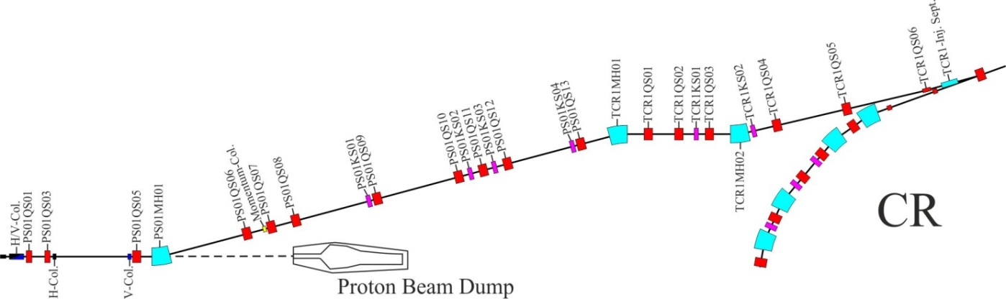
pbar layout
Standard pbar magnets, most of them similar or identical in construction with CR magnets. Coaxial cables between power converter and magnets. The coaxial cables are not water cooled.
The magnets after the pbar-target must be radiation resistant. No vacuum chambers inside the magnets!
The dipole will be made with water cooled coils, all other magnets (3 quadrupoles and one steering magnet) are air cooled.

Slide 3
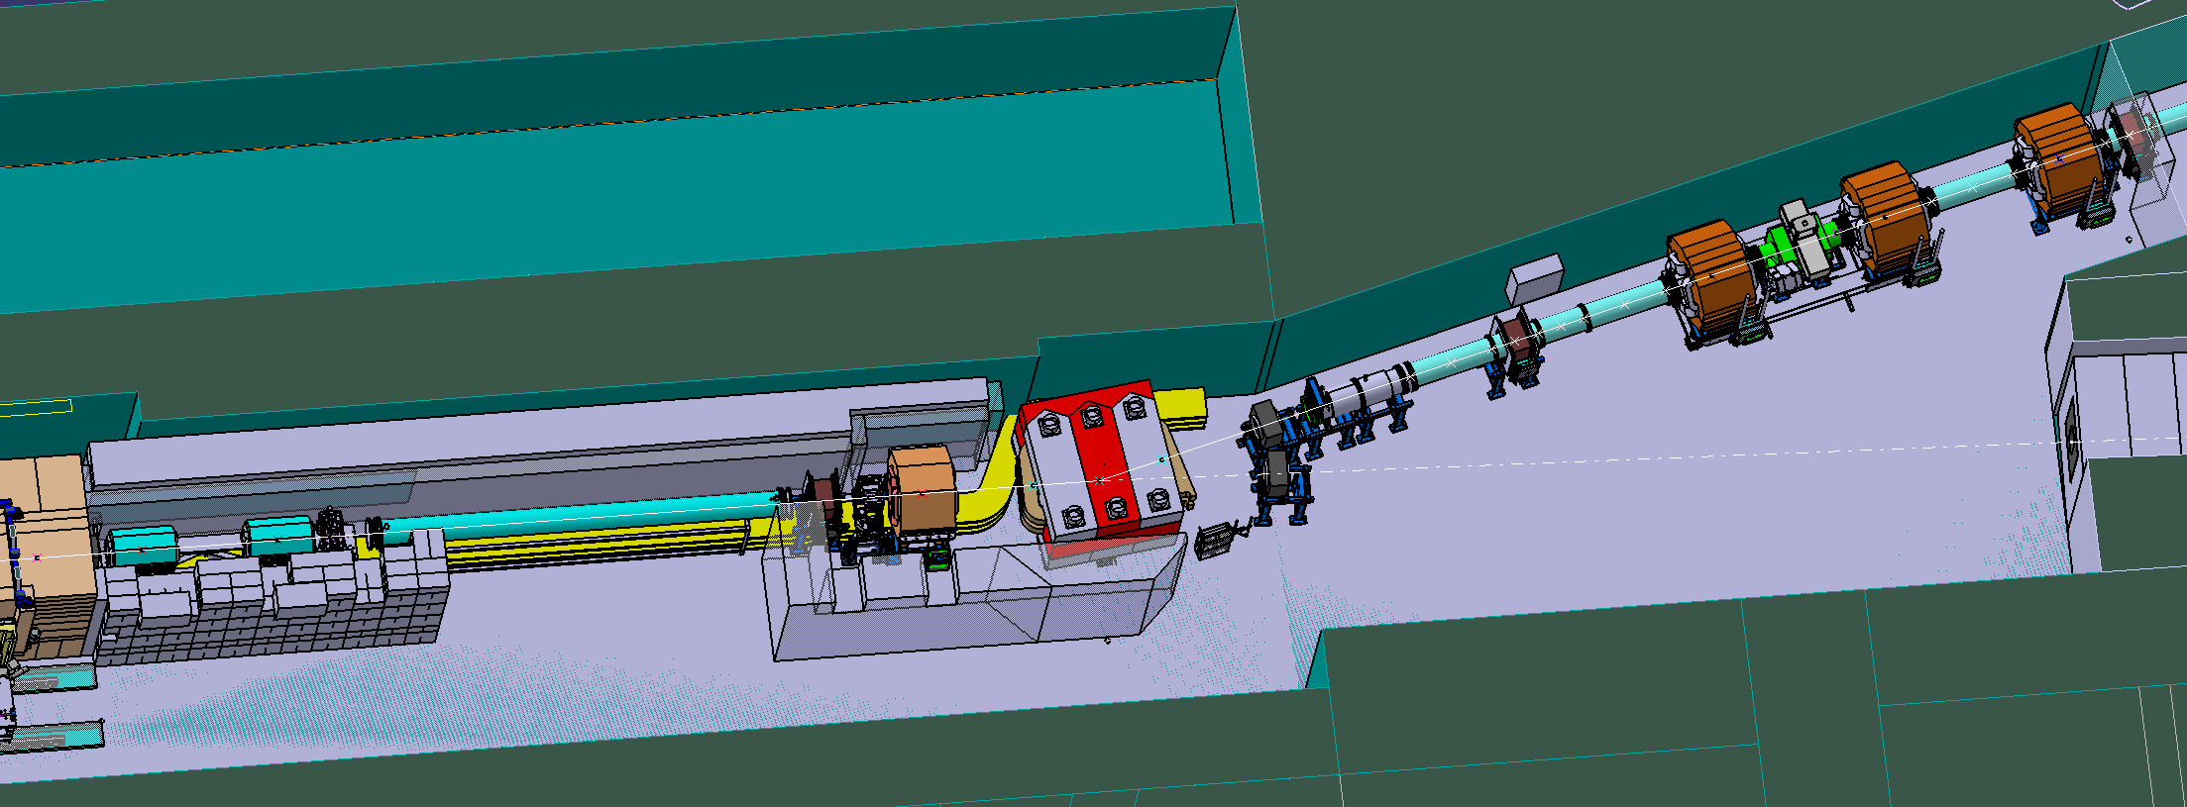
no topic this time
radiation resistant quadrupoles

Slide 4
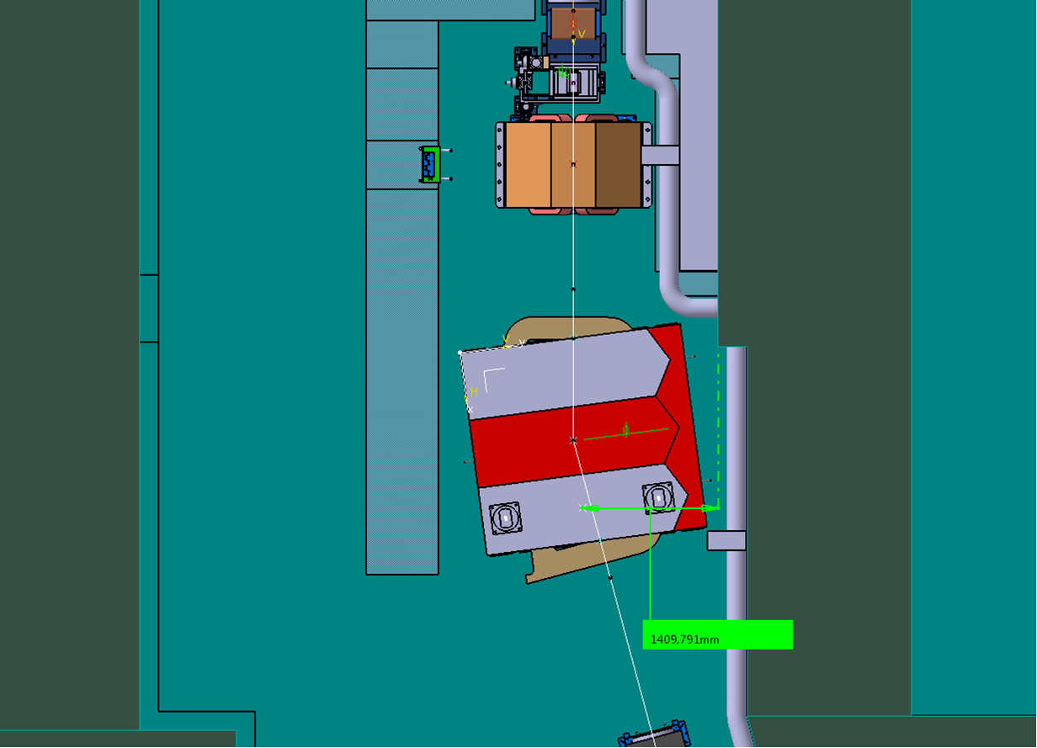
radiation resistant dipole
Problem 1: it must be radiation resistant
Problem 2: the maximum load of the crane in the pbar building is 10 tons. The weight of every removable part must be less than 10 tons (with traverse)
center of beamline
Problem 3: the maximum sideway movement of the crane hook ends above the beamline. The center of mass of every removable yoke part must be on the left side of them.

Slide 5
no topic this time
Problem 4: every part heavier than 10 tons must be installed before this shielding wall is built.

Slide 6
Main parameters of a possible magnetic design solution of the dipole magnet (CR)
Bending angle | 15 ⁰
Bending radius | 8.125 m
Flux density within gap | 1.6 T
Ramping rate | 0.054 T/s
Air gap height | 170 mm
Air gap width | 756 mm
Homogeneity width | 380 mm
of ∆B/B | 0.2 %
Effective length along beam path | 2153 mm
Yoke length | 2121 mm
Total magnet length | 2690 mm
Steel weight | 53.54 to
Conductor weight | 3.783 to
Stored energy (gap only) | 330.556 kJ
Number of turns | 176
Current | 1420.455 A
Resistance | 62.44 mΩ
Low field inductance | 480 mH
DC - losses | 126 kW
Duty cycle | 100.000 %
Average losses | 126 kW
Cooling water requirements | 92.5 l/min
for temperature rise | 20 ⁰C
Pressure difference | 6.95 bar
Only a field quality of 0.2 % is required.
The parameters can be modified by mutual agreement with the Company

Slide 7
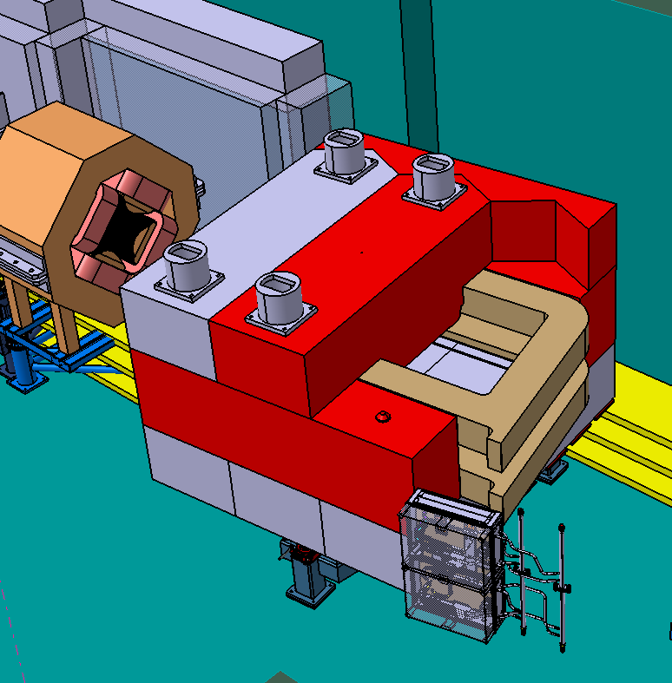
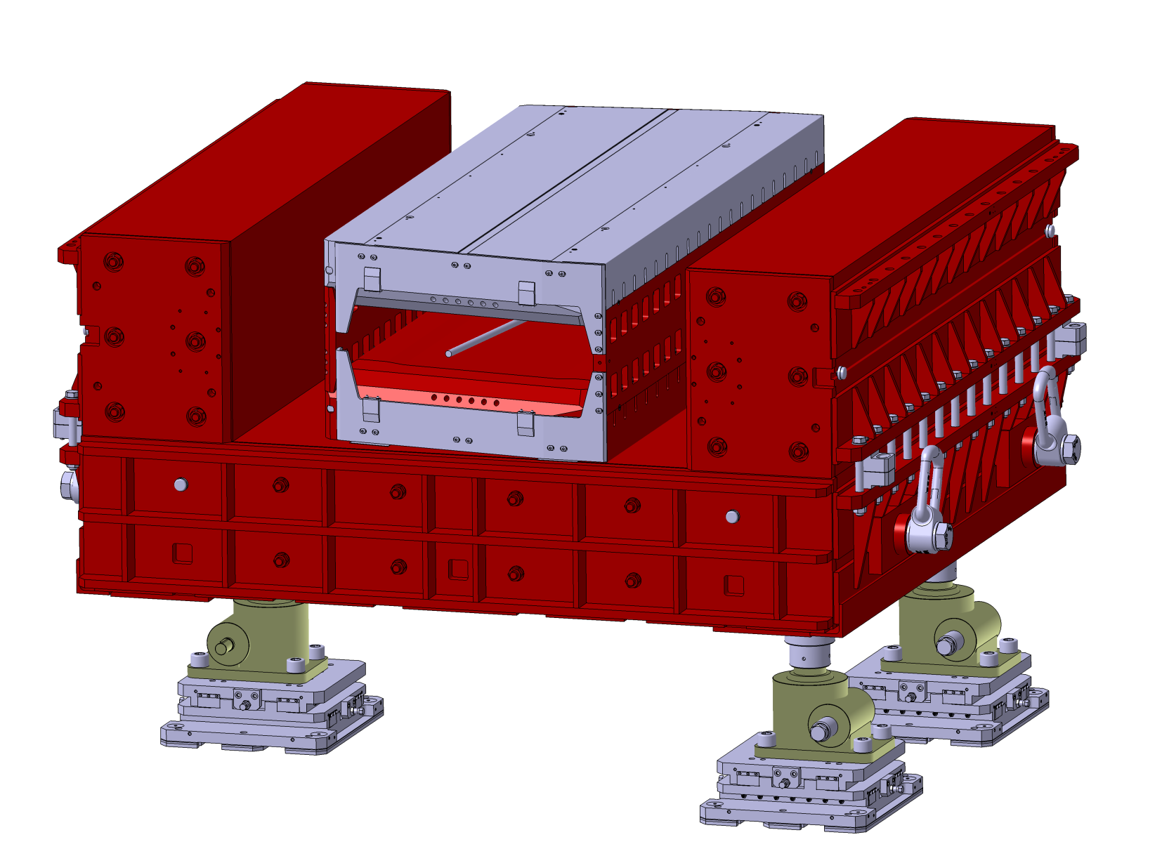
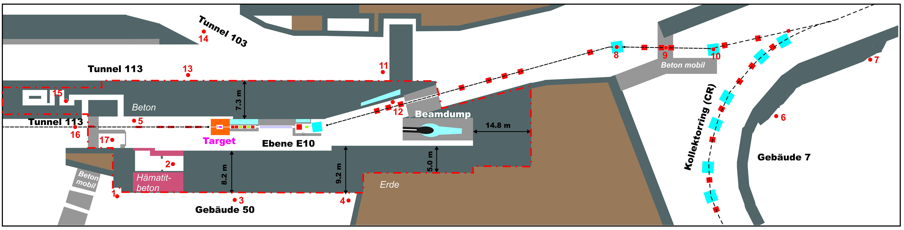
Dipole Magnet
lower yoke parts of a standard CR dipole
pole assembly
pbar dipole:
no chamber
rad. hard coil
upper yoke in parts < 10 t
special connection box
identical with CR dipole

Slide 8
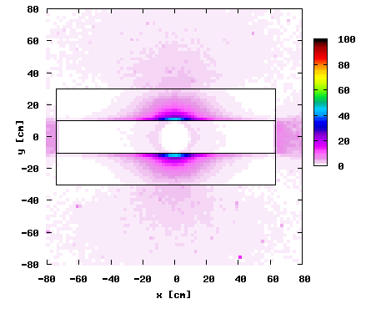
radiation dose at the dipole
Expected accumulated dose in MGy after 20 years of operation at the front of the dipole.
This is the area with the highest radiation exposure at the dipole.
A standard CR-dipole coil cannot be used.
The pole assembly must be radiation resistant too.
A saddle shaped coil would reduce the dose on the coil but would lead to a more complex winding tool.

Slide 9
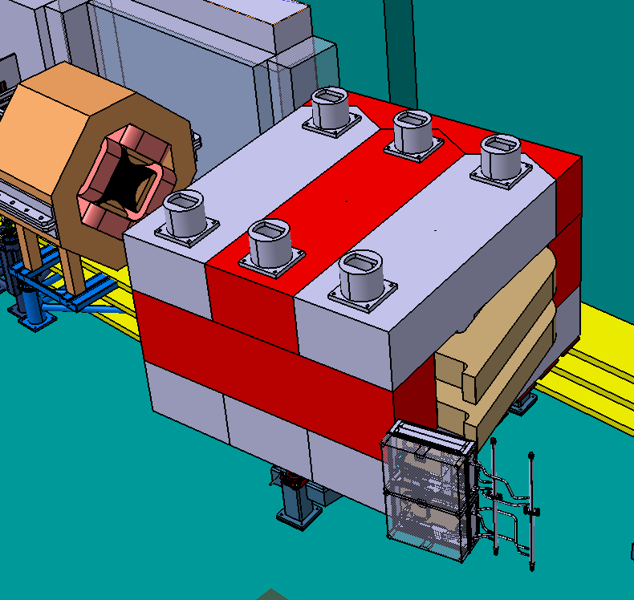
pbar dipole

Slide 10
pbar dipole
How to exchange a broken coil

Slide 11
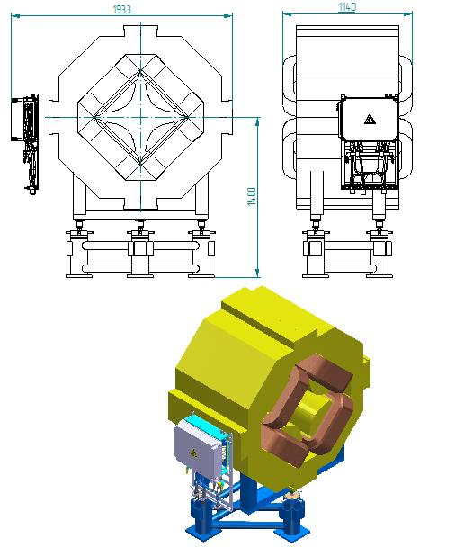
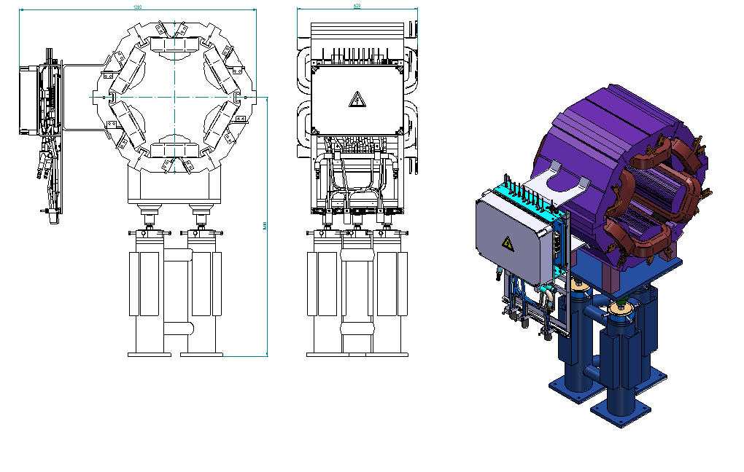
quadrupole and sextupole
quadrupole
sextupole
PSP code | Type | Quantity
2.9.2.2.1.1 | CR WQ | 8
PSP code | Type | Quantity
2.9.2.3 | CR WS | 4
GSI will provide extra adapter boxes to enable coaxial cables.
Number of required sextupoles is in discussion.
Contract with BINP is in preparation.

Slide 12
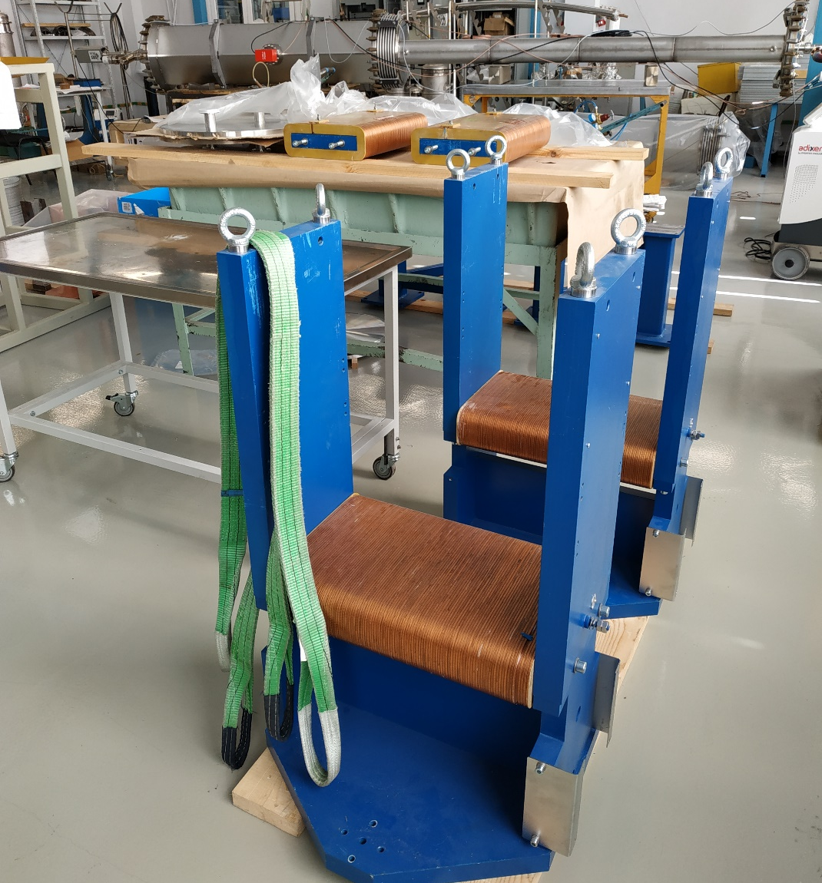
pbar steering magnets
Standard CR-Typ steering magnets should be used. Problem: they provide a steering angle of 1.5 mrad instead of 3 mrad
2 Vertical correctors practically ready (A. Starostenko, May 2020)

Slide 13
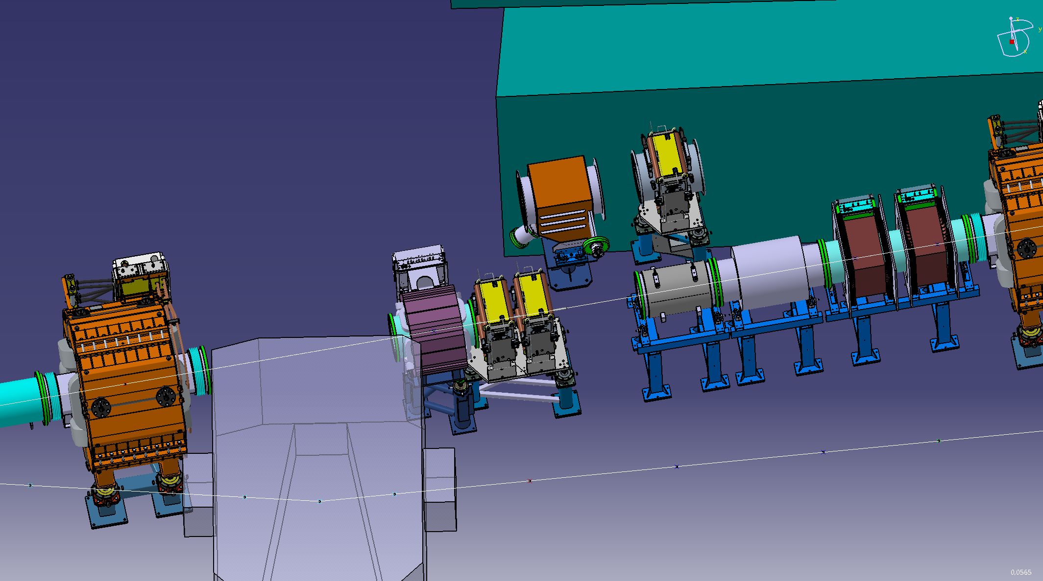
pbar steering magnets
2 CR steerer can substitute 1 special steerer for 3 mrad
a pair of two single steerers on individual stands would take to much space
model of special steerers for 3 mrad

Slide 14
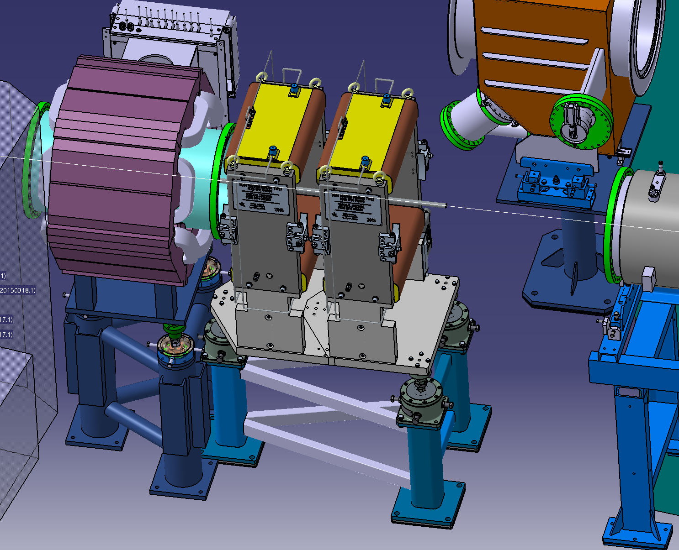
pbar steering magnets
two vertical steerers on a common stand

Slide 15
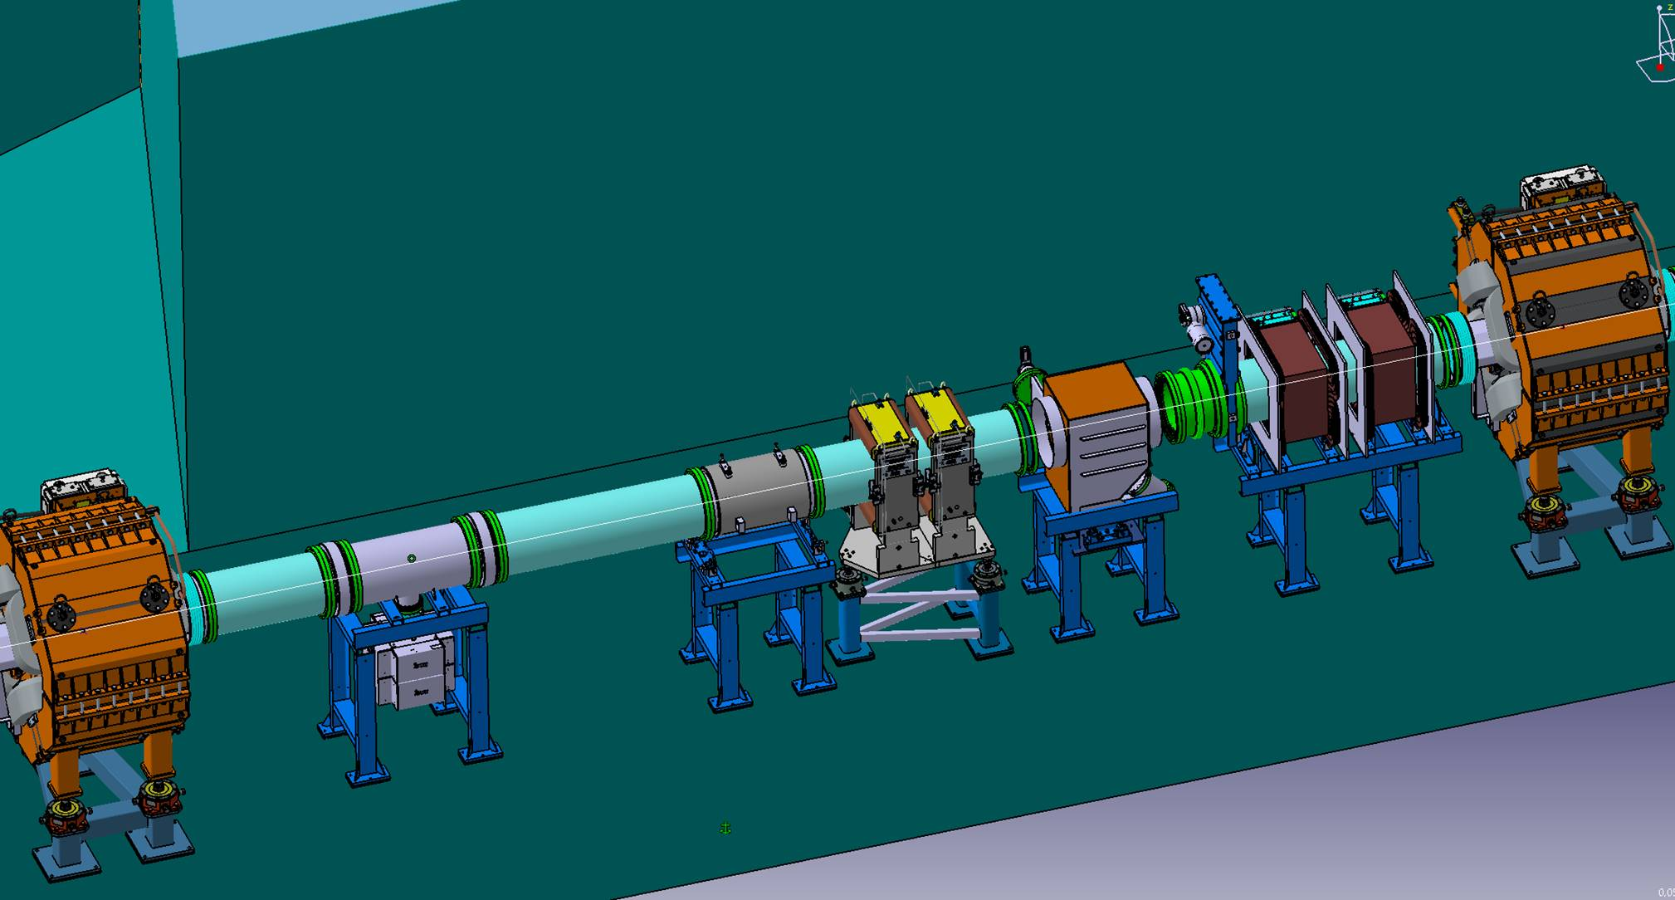
pbar steering magnets
Question to BINP: can two identical steerers be combined on one common stand for saving space?
Task for GSI:
Must be every 3mrad steerer substituted with two 1.5 mrad steerer?
Where are the optimal positions for the steering magnets?
How many 1.5 mrad steerers do we need?

Slide 16
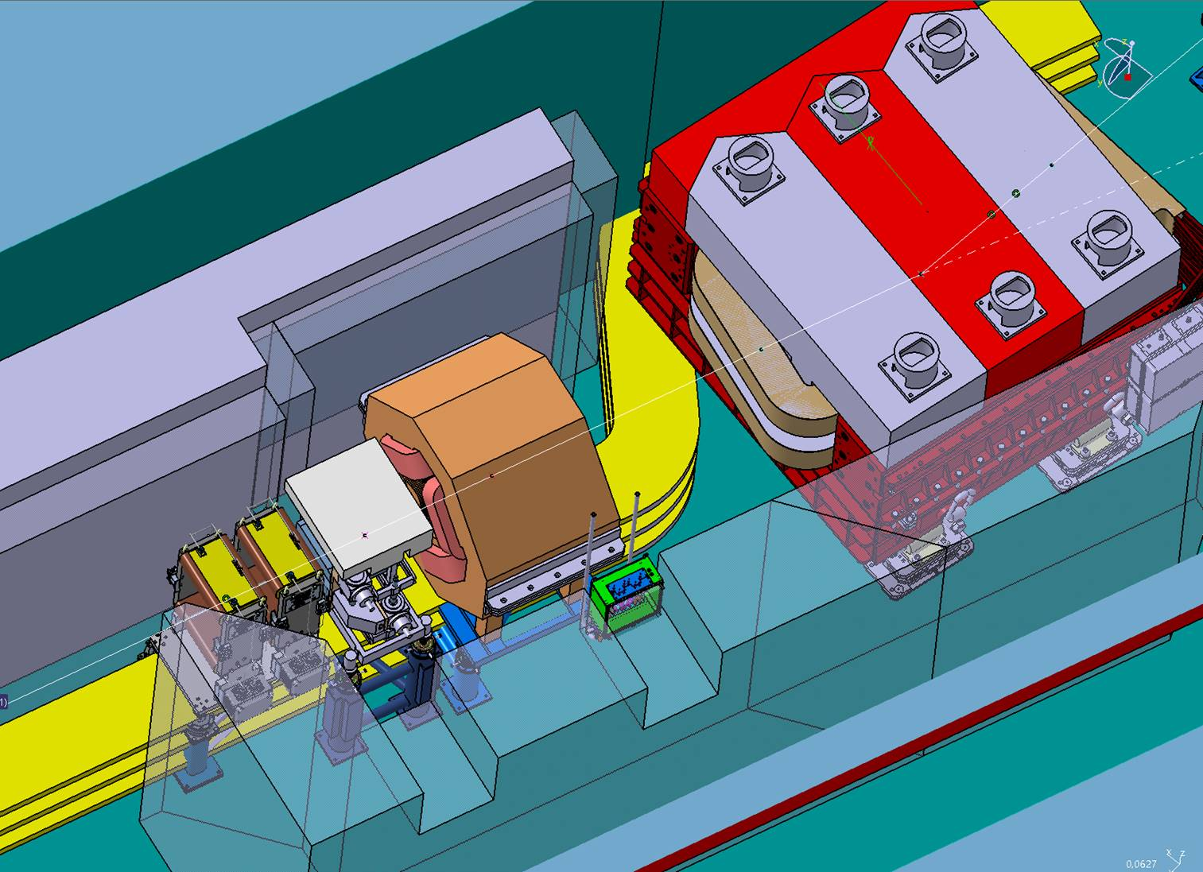
pbar steering magnets
Question to BINP: besides the coils and the connection box, is the rest of the magnet radiation resistant?

Slide 17
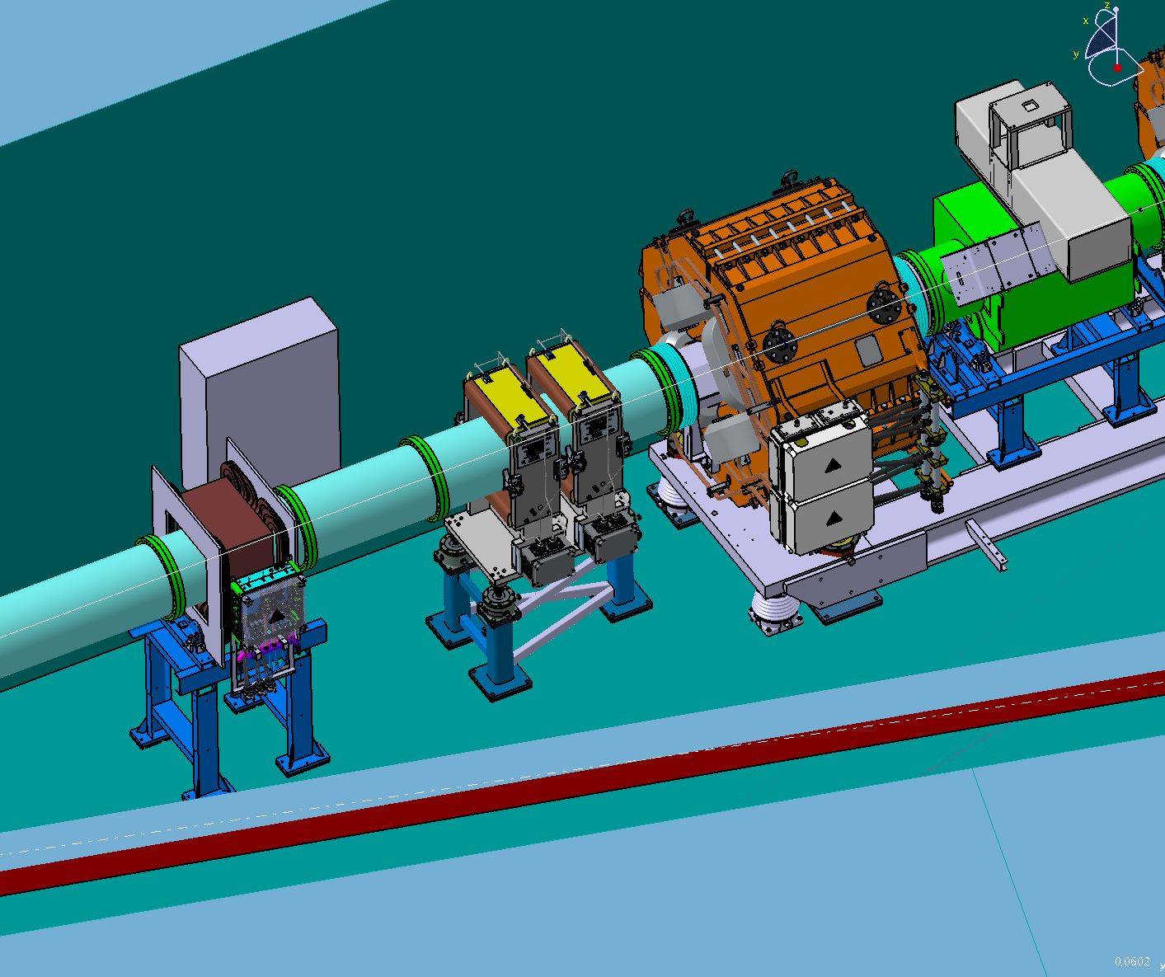
pbar steering magnets

