Slide 1
FAIR SFRS vacuum
BINP
A. Krasnov
4th BINP-FAIR Collaboration Coordination Workshop

Slide 2
General information
Name | Signed | End | Cost M€ | Status
AFAA1 SFRS Diagnostic chambers | 03.2019 | 12.2021 | 1.11 | CDR for FoS is passed. 2D and FEM analysis for FOS are uploaded into EDMS (for FDR) and accepted under reserve. Materials for FoS production are ordered.
AFAA3 SFRS Vacuum chambers inside SC dipoles | 10.2019 | 06.2022 | 0.87 | 3D model of combined chamber with pumping port is created. There is a problem with bellows fixation. Conception of assembly the combined chamber into SC magnet under consideration.
AFAA5 SFRS vacuum components |  |  | 1.5 | Time schedule is agreed. Cost is under consideration. Waiting detailed specification
SFRS branching chambers inside SC dipoles |  |  | 0.31 | BINP agrees to produce the chambers

Slide 3
SFRS diagnostic chambers
CDR for FoS is passed. 2D and FEM analysis for FOS are uploaded into EDMS (for FDR) and accepted under reserve. Materials for FoS production are received.
Equipment for vacuum tests is ordered. Laser Cleaner ???
FAT expectation: November 2020
Still needed for FDR (to be done in June 2020):
Corrections in 2D drawings
Cleaning procedure
Vacuum test procedure
Needed from FAIR:
Priority list for serial production

Slide 4
SFRS SC dipole chamber
3D of the FoS chamber is practically complete.
Open questions:
how to fix bellows against atmosphere pressure
Installation into SC magnet (will be discussed during this workshop)

Slide 5
SFRS SC dipole chambers
Placement and construction of supports must be checked from assembly convenience point of view

Slide 6
SFRS SC dipole chamber
Proposal to installation procedure
Equipment: a crane or hoist with two hooks with independent lifting and synchronous horizontal moving. 2 slings must be applied for F1 and 1 or 2 for F2. At least 2 slings must be with lanyards for precise tuning the chamber to horizontal position and proper height.
Phase 1: Lift up the chamber, tune to horizontal position and proper height. Move to the position shown in the figure. Disconnect F2.
F2 (by a crane)
F1 (by a crane)
Fixing support for wheel
lanyards
Magnet
f (by hand and crane)
Temporary table
Adjustment support

Slide 7
SFRS SC dipole chamber
Proposal to installation procedure
Phase 2: Move the chamber through magnet by hand and crane F1 to final position (precision?). Apply F2 to remove temporary table and wheel together with its fixation elements. Tune adjustment support. Fix the chamber roughly to the support (at one side!). Disconnect F1 and F2
Phase 3: Weld flange DN400CF and provide vacuum tests
F2 (to remove temporary table end wheel)
F1 (by a crane)
Fixing support for wheel
f (by hand and crane)
Temporary table
Adjustment support

Slide 8
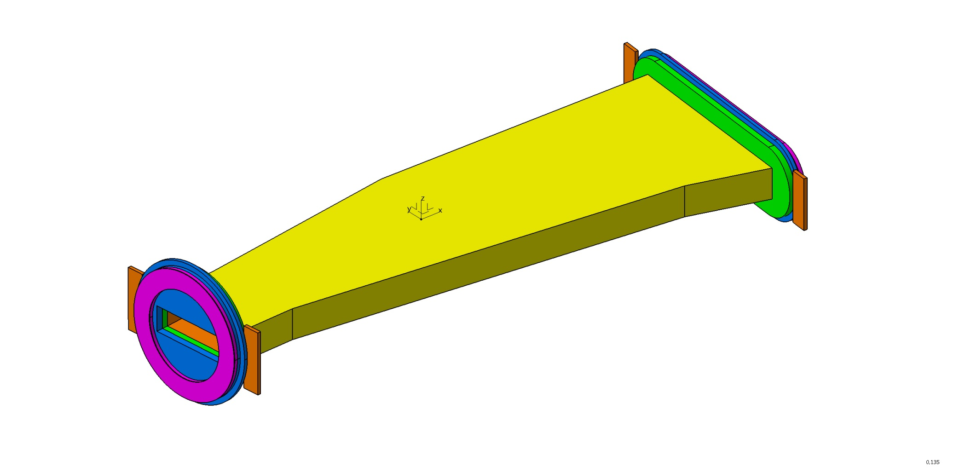
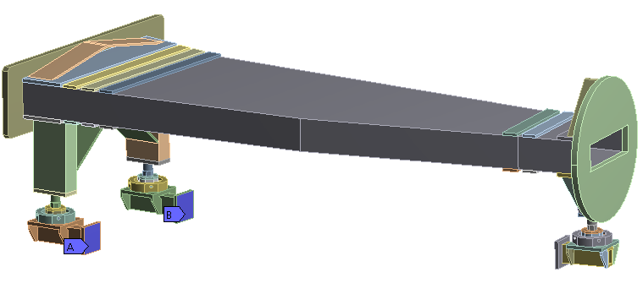


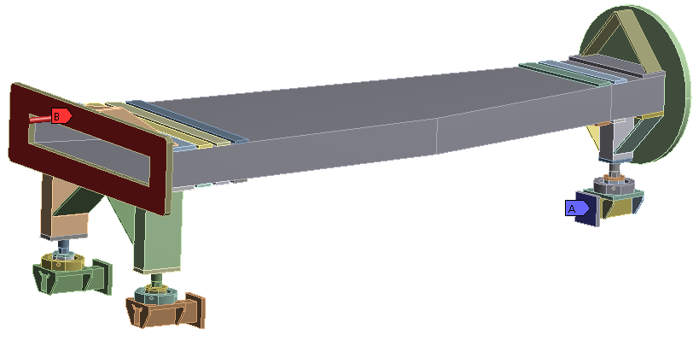

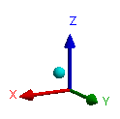
SFRS R&D for NC wide chamber
Stop
Bellow race track
view
Stop
Beam chamber
Flange
Flange
Polished plate
Polished plate
Bellow D 500mm
Ti
Radiation
power 3 kW
Ti
No space!

Slide 9
Side view
cooling water feedthrough
Stainless steel pressure vessel
Dipole chamber flange
Cross-sectional view
cooling water lines
Titanium primary beam absorber
Titanium primary beam absorber
Stainless steel pressure vessel
Required open aperture

Slide 10
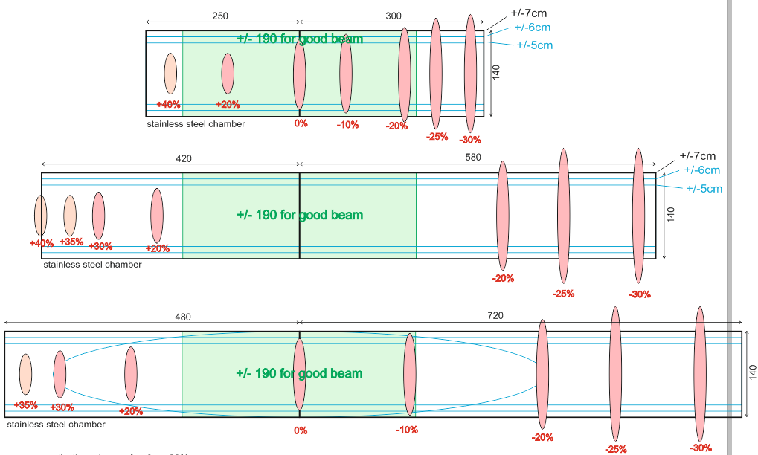
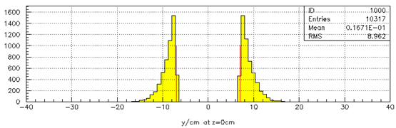
Beam shape in Dipole (MH12) 1.0015
entrance of dipole
exit of dipole
end of chamber
(exit + 700mm)
beam losses
(count events)
If absorption at top/bottom is allowed, why do not absorb the ions at side wall,
which can be thick enough and well cooled?
Then width will be +/-250 mm

Slide 11
SFRS NC dipole chamber
Temperature jump and maximum stress
P = 3 W/cm^2, Energy 4.5 J per pulse, repetition 1.5 c
Radiation length 20.4 g/cm^2 (2.6cm for stainless steel) 1500 MeV U
Incident angle 15 mrad
13%
 | Ro g/cm^3 | R length cm | Cm J/g/K | Cv J/cm^3/K | deltaT | J/g | E GPa | σ₋₁ Mpa | a 1/K | DeltaT max
BT1 | 4,54 | 6,7E-02 | 0,53 | 2,41 | 27,75 | 14,71 | 103,00 | 280,00 | 8,2E-06 | 464,13
BT3-1 | 4,54 | 6,7E-02 | 0,53 | 2,41 | 27,75 | 14,71 | 115,00 | 450,00 | 8,2E-06 | 668,08
BT6 | 4,43 | 6,9E-02 | 0,53 | 2,35 | 27,75 | 14,71 | 113,00 | 450,00 | 8,2E-06 | 679,91
Stainless steel | 7,90 | 3,9E-02 | 0,46 | 3,63 | 31,97 | 14,71 | 200,00 | 280,00 | 1,6E-05 | 122,50
Inconel 718 | 8,20 | 3,7E-02 | 0,50 | 4,10 | 29,41 | 14,71 | 210,00 | 700,00 | 1,30E-05 | 358,97
AMg5 | 2,70 | 1,1E-01 | 0,92 | 2,48 | 15,98 | 14,71 | 70,00 | 125,00 | 2,3E-05 | 108,70

Slide 12
SFRS NC dipole chamber
Temperature jump and maximum stress

Slide 13
SFRS NC dipole chamber
Wall thickness + deflection = 90 – 1.5 – 70 = 18.5 mm
140
2a
 | E GPa | σ_{e} MPa | 2a | h | d | P MPa
StSt | 200 | 230 | 935 | 14 | 4,50 | 214
Ti alloy | 110 | 900 | 805 | 14 | 4,50 | 156
StSt | 200 | 230 | 805 | 14 | 2,50 | 156
Inconel 718 | 210 | 1050 | 945 | 14 | 4,50 | 220
Inconel 718 | 210 | 1050 | 805 | 9 | 9,00 | 380

Slide 14
SFRS NC dipole chamber
Temperature jump and maximum stress

Slide 15
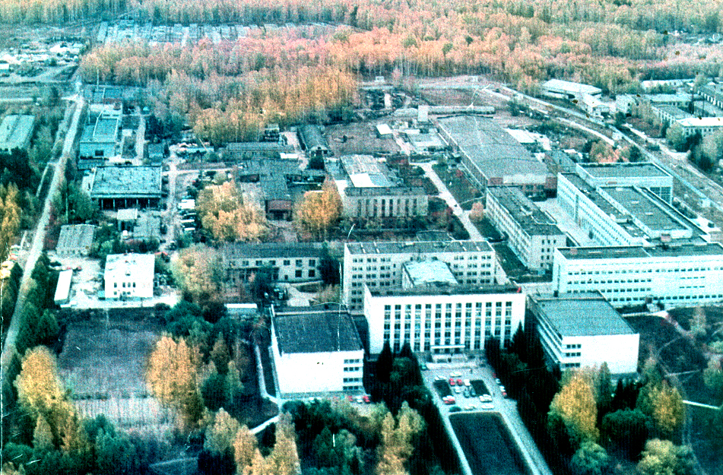
Thank you for your attention

