Slide 1
Radiation resistant SFRS magnets.
D. Gurov, A.Utkin
BINP, Novosibirsk
28.05.2020

Slide 2
Contents
Contents
Parameters of multipoles
Wire for coils
Quadrupole 1-b
Quadrupole 1-a
Quadrupole 2
Sextupole
3D CAD model of cermet outlet Field in yoke
Calculated parameters of multipolesField quality

Slide 3
Parameters of multipoles
2.4.2.2.1 | Quadrupole 1a | 1 | 1.6 T/m | 15.4 T/m | 0.933 | Ø 130 | ±1∙10⁻³
2.4.2.2.1 | Quadrupole 1b | 1 | 1.2 T/m | 11.8 T/m | 1.244 | Ø 180 | ±1∙10⁻³
2.4.2.2.2 | Quadrupole 2 | 1 | 0.6 T/m | 6.1 T/m | 1.200 | 380 × 240 | ±1∙10⁻³
2.4.2.3.1 | Sextupole 1 | 2 | 3.5 T/m² | 34 T/m² | 0.600 | Ø 380 | ±5∙10⁻³

Slide 4
Wire for coils
Wire 2000A-H
Minimal bending radius 120-130 mm.
Maximal length of wire – 60 m.
Maximal current 2000 Amper.

Slide 5
Construction of Quadrupole-1b
Coil contain 4 separate segments 9 turns each (36 turns)
Maximal current – 50 kA ( 1390 A per turn)
Quarter of yoke with coils (dimensions are in cm)

Slide 6
Preliminary construction of Quadrupole-1b coil
Longitudinal dimensions of all segments of coil are equal on area 55 mm.
The ends of wire in segments are directed upwards (along the neck of the yoke)
We propose to make not a monolithic, but a composite coil and place the segments in the frame and rigidly fix them in places of their equal longitudinal size

Slide 7
3D magnetic calculations for quadrupole-1b
Calculations was made at “Mermaid” software for magneto-static calculatins
Calculated 1/8 of quadrupole magnet
Steel type, used in calculations – Armco
Calculations was made for total currents 4, 14, 24, 34, 44, 50 kA
Yoke length 1180 mm.
Inscribed radius 95 mm.

Slide 8
Field in yoke
Field in yoke (kGs) at maximal gradient value
Permeability in yoke at maximal gradient value

Slide 9
Yoke saturation and longitudinal field distribution

Slide 10
Field quality
Field quality at 90 mm radius

Slide 11
3D CAD model of Quadrupole-1b

Slide 12
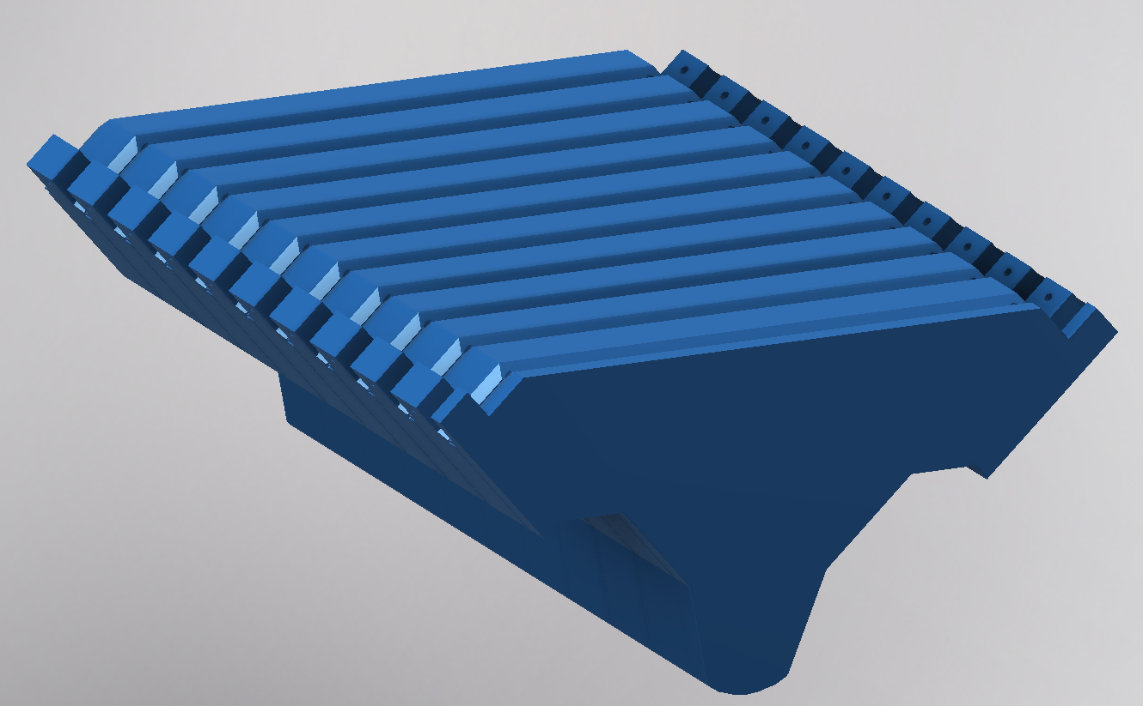
Yoke construction of Quadrupole-1b
Single plate
Segment of yoke

Slide 13
Diemensions of yoke Quadrupole-1b

Slide 14
Construction of coil of Quadrupole-1b

Slide 15
Construction of Quadrupole-1a
Coil contain 3 separate segments 9 turns each (27 turns)
Maximal current – 36 kA ( 1334 A per turn)
Quarter of yoke with coils (dimensions are in cm)

Slide 16
Preliminary construction of Quadrupole-1a coil
Longitudinal dimensions of all segments of coil are equal on area 15 mm.
The ends of wire in segments are directed upwards (along the neck of the yoke)
We propose to make not a monolithic, but a composite coil and place the segments in the frame and rigidly fix them in places of their equal longitudinal size

Slide 17
3D magnetic calculations for quadrupole-1a
Calculations was made at “Mermaid” software for magneto-static calculatins
Calculated 1/8 of quadrupole magnet
Steel type, used in calculations – Armco
Calculations was made for total currents 1.6, 10, 20, 30, 35, 36 kA
Yoke length 875 mm.
Inscribed radius 70 mm.

Slide 18
Field in yoke
Field in yoke (kGs) at maximal gradient value
Permeability in yoke at maximal gradient value

Slide 19
Yoke saturation and longitudinal field distribution

Slide 20
Field quality
Field quality at 65 mm radius

Slide 21
3D CAD model of Quadrupole-1a

Slide 22
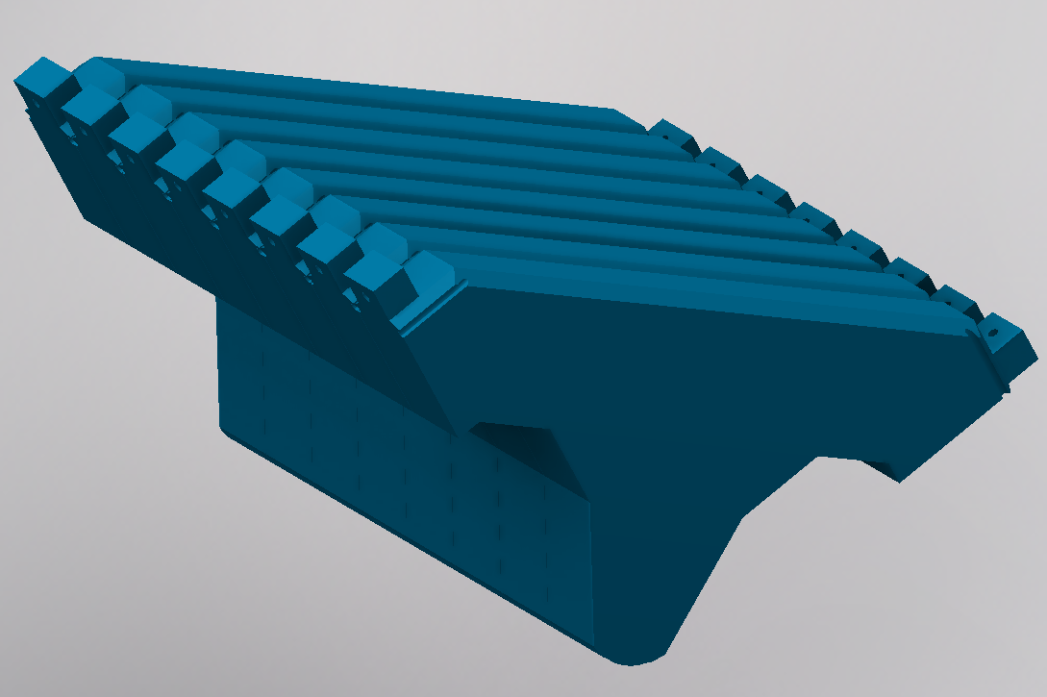
Yoke construction of Quadrupole-1a
Single plate
Segment of yoke

Slide 23
Diemensions of yoke Quadrupole-1a

Slide 24
Construction of coil of Quadrupole-1a

Slide 25
Construction of Quadrupole2
Coil contain 4 separate segments 11 turns each (length of wire in segments varies from 42 to 50 meters)
Maximal current – 76 kA ( 1730 A per turn)
Quarter of yoke with coils (dimensions are in cm)

Slide 26
Preliminary construction of Quadrupole-2 coil
Longitudinal dimensions of all segments of coil are equal on area 96 mm.
The ends of wire in segments are directed upwards (along the neck of the yoke)
We propose to make not a monolithic, but a composite coil and place the segments in the frame and rigidly fix them in places of their equal longitudinal size

Slide 27
3D magnetic calculations for quadrupole2
Calculations was made at “Mermaid” software for magneto-static calculatins
Calculated 1/8 of quadrupole magnet
Steel type, used in calculations – Armco
Calculations was made for total currents 10, 20, 40, 60, 75.4 kA
Yoke length 1060 mm.
Inscribed radius 163 mm.

Slide 28
Field in yoke
Field in yoke (kGs) at maximal gradient value
Permeability in yoke at maximal gradient value

Slide 29
Yoke saturation and longitudinal field distribution

Slide 30
Field quality
Field quality at 140 mm radius

Slide 31
Field quality

Slide 32
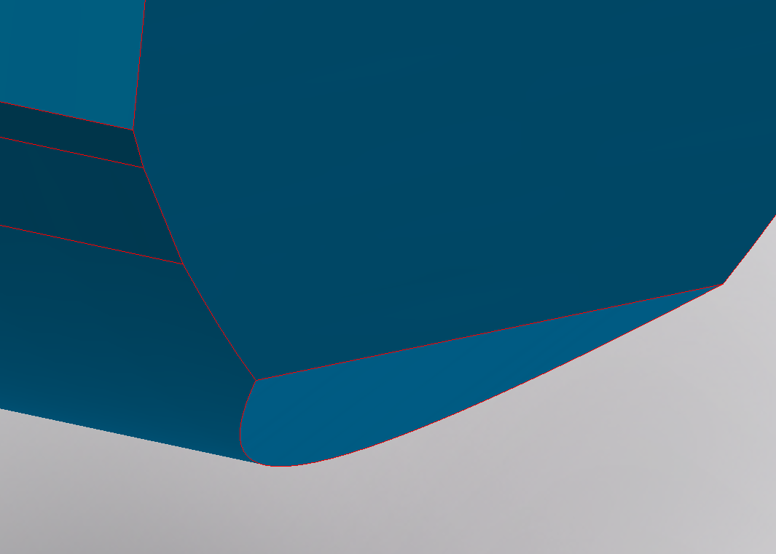
3D CAD model of Quadrupole-2

Slide 33
3D CAD model of Quadrupole-2

Slide 34
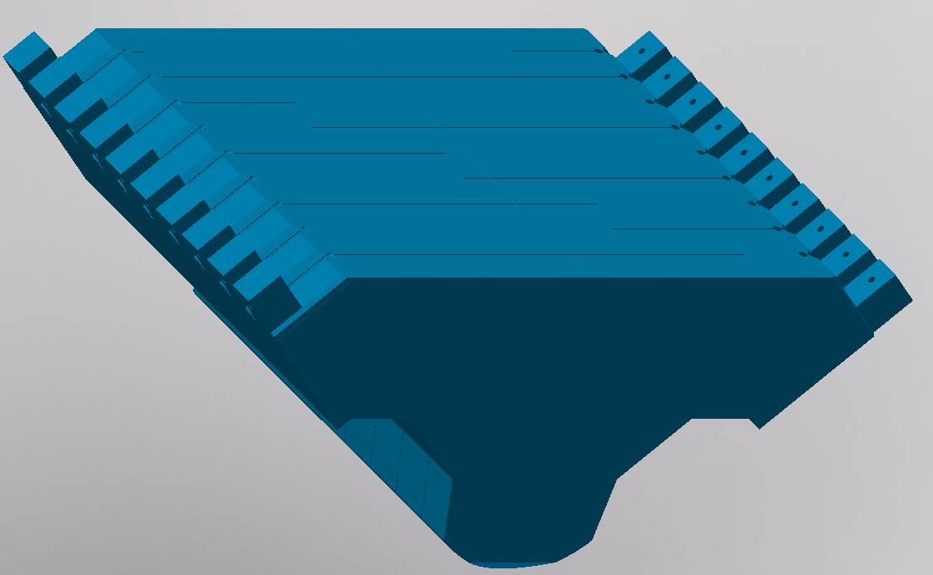
Yoke construction of Quadrupole-2
Single plate
Segment of yoke

Slide 35
Diemensions of yoke Quadrupole-2

Slide 36
Construction of coil of Quadrupole-2

Slide 37
Construction of coil of Quadrupole-2

Slide 38
Construction of sextupole
Coil contain 28 turns (length of wire 58 meters)
Maximal current – 52 kA ( 1857 A per turn)
Sextupole | X (mm) | Y (mm) | R (mm)= | 200
A= | -70 | 224.39
Hyperbola | Y^3-3*Y*X^2=R^3
B= | 70 | 224.39
 | 80 | 227.81
 | 94.69 | 234.01
 | 97.19 | 238.34
 | 110 | 330
 | 110 | 510
 | 215 | 510
 | 274.6 | 475.6
 | 369.6 | 640.1
 | 265.9 | 700
 | -265.9 | 700
 | -369.6 | 640.1
 | -274.6 | 475.6
 | -215 | 510
 | -110 | 510
 | -110 | 330
 | -97.19 | 238.34
 | -94.69 | 234.01
 | -80 | 227.81

Slide 39
3D magnetic calculations for sextupole
Calculations was made at “Mermaid” software for magneto-static calculatins
Calculated 1/8 of sextupole magnet
Steel type, used in calculations – Armco
Calculations was made for total currents 5, 10, 20, 30, 40, 52 kA
Yoke length 490 mm, inscribed radius 200 mm.
Length of wire, required for coil is about 58 meters.
Imax= 1857A

Slide 40
Field in yoke
Field in yoke (kGs) at maximal gradient value
Permeability in yoke at maximal gradient value

Slide 41
Yoke saturation and longitudinal field distribution

Slide 42
Field quality
Field quality at 190 mm radius

Slide 43
3D CAD model of Sextupole

Slide 44
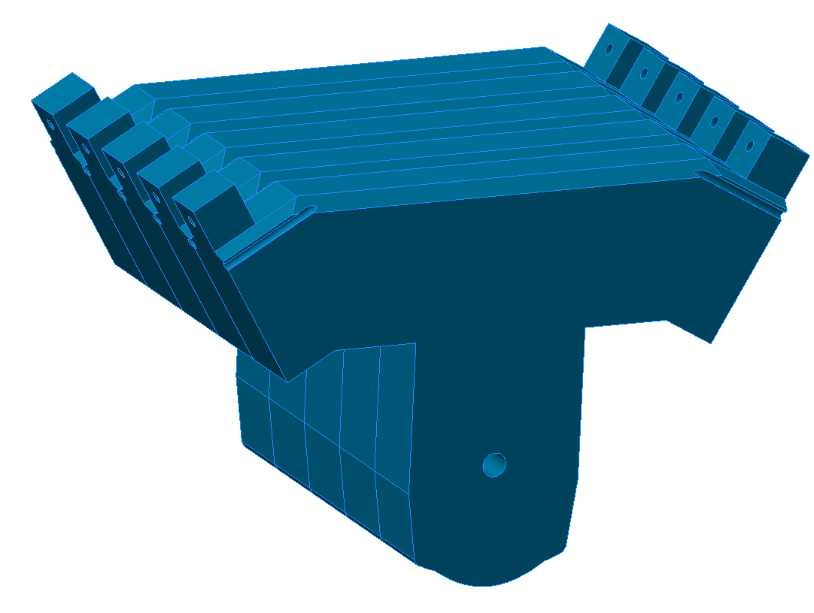
Yoke construction of Sextupole
Single plate
Segment of yoke

Slide 45
Diemensions of yoke of Sextupole

Slide 46
Construction of coil of Sextupole

Slide 47
3D CAD model of cermet outlet

Slide 48
Parts of cermet outlet

Slide 49
Calculated parameters of multipoles
Obtained
PSP code | Magnet | Number of magnets | Min. field strength | Max. field strength | Effective length (m) | Useable aperture (mm) | Field Quality
2.4.2.2.1.1 | Quadrupole 1a | 1 | 1.6 T/m | 15.4 T/m | 0.933 | Ø130 | ±1·10⁻³
2.4.2.2.1.2 | Quadrupole 1b | 1 | 1.2 T/m | 11.8 T/m | 1.244 | Ø180 | ±1.5·10⁻³
2.4.2.2.2 | Quadrupole 2 | 1 | 0.6 T/m | 6.1 T/m | 1.2 | Ø280 | ±1.5·10⁻³
 |  |  |  |  |  | 380x240 | ±7·10⁻³
2.4.2.3.1 | Sextupole | 2 | 3.5 T/m² | 34 T/m² | 0.6 | Ø380 | ±6·10⁻³
Required
2.4.2.2.1 | Quadrupole 1a | 1 | 1.6 T/m | 15.4 T/m | 0.933 | Ø 130 | ±1∙10⁻³
2.4.2.2.1 | Quadrupole 1b | 1 | 1.2 T/m | 11.8 T/m | 1.244 | Ø 180 | ±1∙10⁻³
2.4.2.2.2 | Quadrupole 2 | 1 | 0.6 T/m | 6.1 T/m | 1.200 | 380 × 240 | ±1∙10⁻³
2.4.2.3.1 | Sextupole 1 | 2 | 3.5 T/m² | 34 T/m² | 0.600 | Ø 380 | ±5∙10⁻³

