Slide 1
Radiation resistant magnets for the Super-FRS
Hanno Leibrock
May, 2020
Hanno Leibrock/ FAIR-GSI Workshop, video conference, 25-29 May 2020

Slide 2
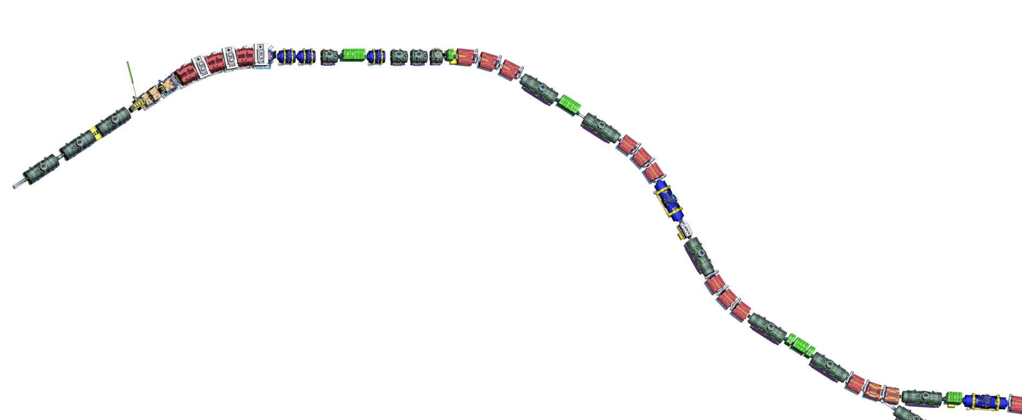
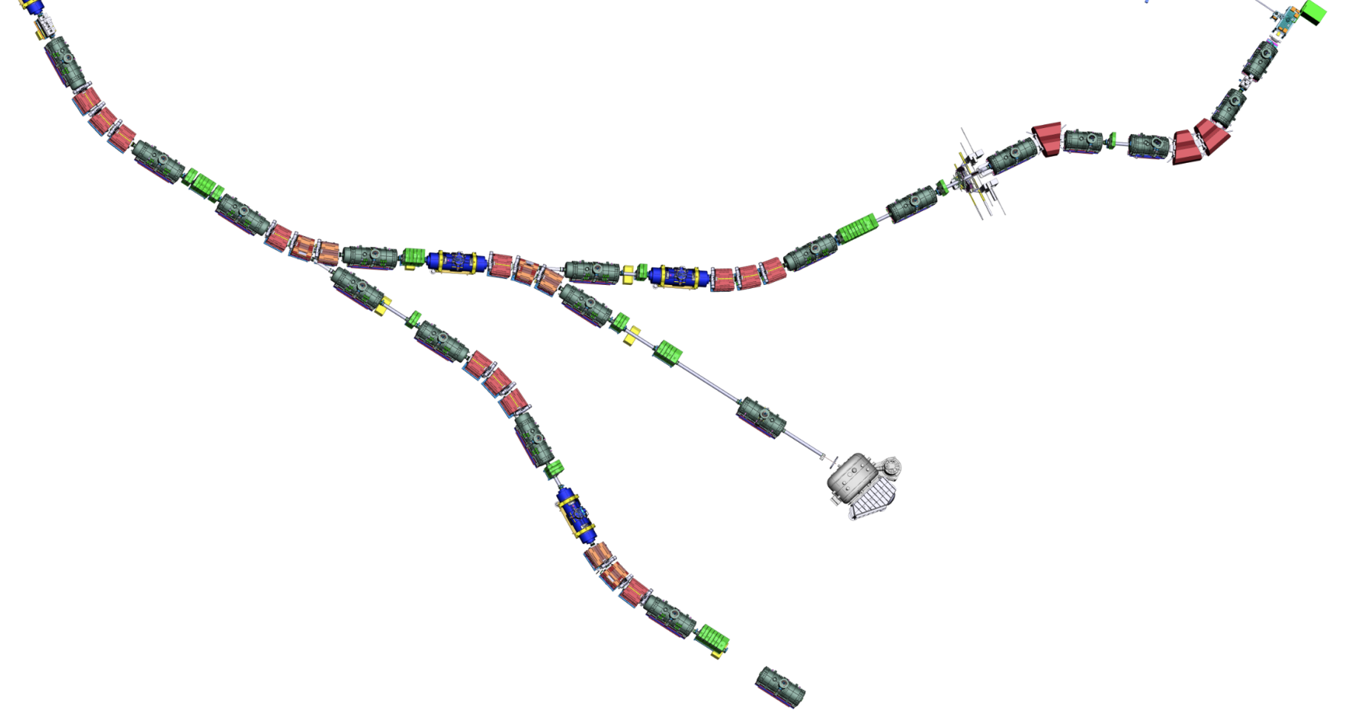

Super-FRS layout
BC3-NCS
Assembly Units
along the beamline
NC_D3
SM_02
SM_01
SM_03
SM_04
SM_07
SCD_01
SM_05
NC_D2
DC_02
SM_06
DC_03
SCD_02
BC1
BC2
SCD_03
NC_D1
NC_QS
LM_04
NC_QQ
DC_04
TA
FPF1
FPF2
FPF3
LM_03
LM_05
VAC_02
SCD_04
LM_02
FPF0
FPF4
DC_01
SCD_05
LM_01
SCD_06
VAC_01
FTF1
LM_06
DC_05
FLF6
FMF1
LM_07
FLF5
DC_17
SCD_07
FLF3
SCD_08
FLF4
EBM_05
SCD_09
VAC_06
DC_16
LM_08
DC_14 (maybe)
EBM_04
DC_06
FMF3
FLF2
DC_07
DC_08
LM_17
EBD_03
SCD_11 (branch)
VAC_05
NC_QQ nc quadrupole 1a + quadrupole 1b
NC_QS nc quadrupole 2 + sextupole
NC_D nc dipole
BC beam catcher
BC3-NCS beam catcher 3 + nc sextupole
TA target chamber
DC diagnostic chamber
SM sc short multiplet
LM sc long multiplet
SCD sc dipole
VAC vacuum part
EBD EB dipole
EBM EB multiplet
BDN Beam dump NUSTAR
LM_09
DC_15
FLF1
EBM_02
SCD_10
DC_13
EBD_01
EBM_03
EBD_02
FMF2
SCD_12
SCD_14 (branch)
LM_16
EBM_01
LM_10
SCD_13
DC_09
LM_11
LM_14
SCD_18
SCD_17
SCD_15
SCD_16
LM_15
DC_12
LM_18
LM_12
VAC_07
DC_18
DC_10
LM_19
VAC_03
FRF1
SCD_19
DC_11
SCD_20
FHF1
VAC_04
SCD_21
LM_13
LM_20
VAC_ NUSTAR
FRF2
DC_19
FHF2
VAC_08
GLAD
LM_21
BDN
SCD_22
FHF3
VAC_09
SCD_23 (branch)
SCD_24
LM_22
DC_20
FRF3
VAC_10
LM_23
VAC_11

Slide 3
BINP slide: Construction of Quadrupole-1a coil
Longitudinal dimensions of all segments of coil are equal on area 15 mm.
The ends of wire in segments are directed upwards (along the neck of the yoke)
We propose to make not a monolithic, but a composite coil and place the segments in the frame and rigidly fix them in places of their equal longitudinal size

Slide 4
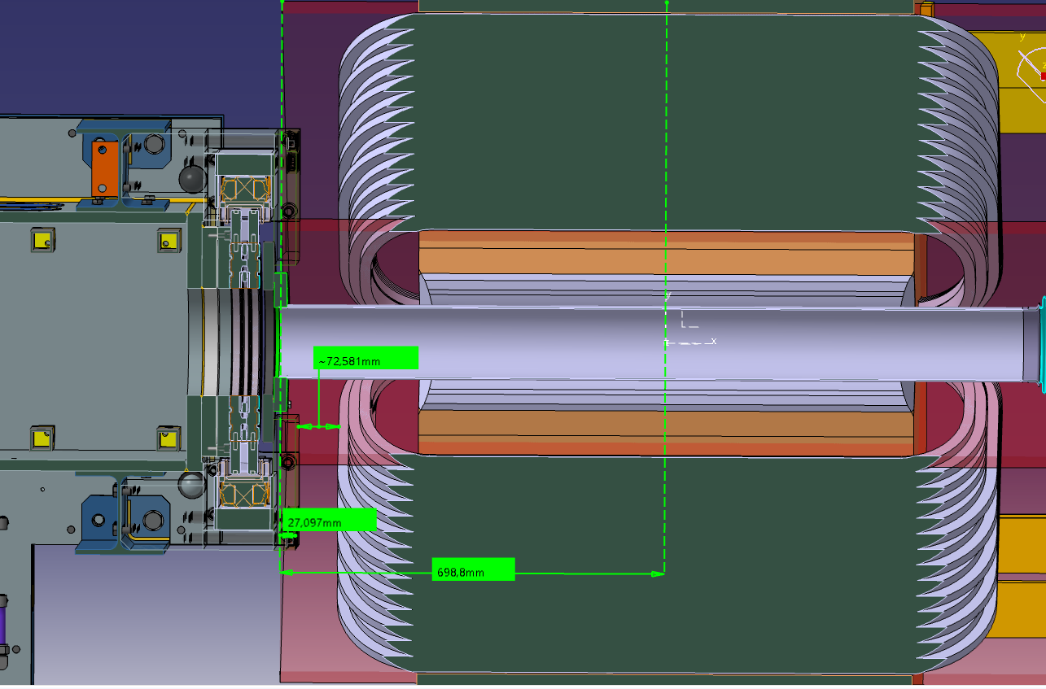
Installation space for Quad 1a
There is a collision between the ends of the coils and the target chamber if the coil ends will be connected on the beam entrance side.

Slide 5
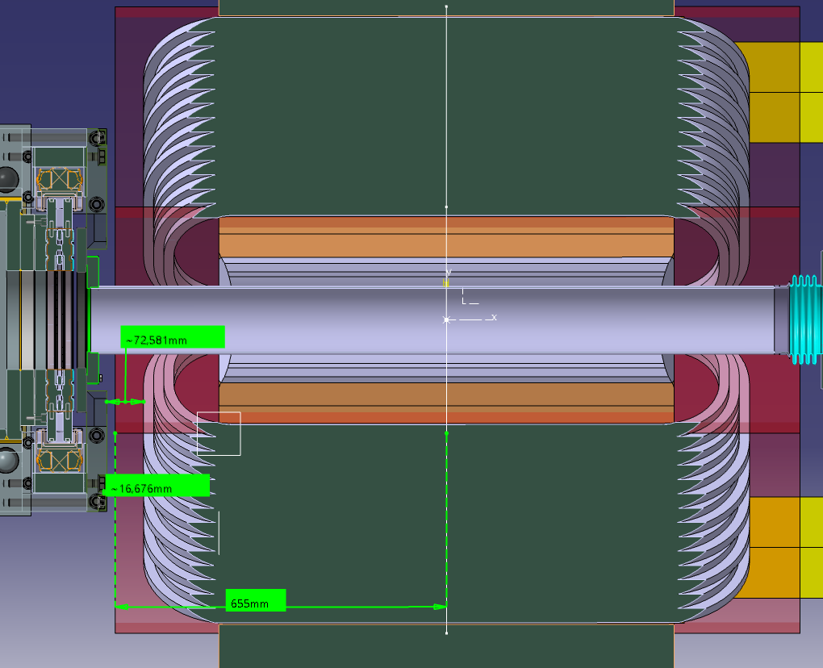
Installation space for Quad 1a
If the coils will be connected on the beam exit side than the distance between coils and target chamber is about 16.67 mm.
It should be 70 mm instead.

Slide 6
BINP figure: Field quality of Quadrupole 2
The deviation is significant higher than the required ±1∙10⁻³

Slide 7
Super-FRS Magnets
Radiation Resistant Quadrupole 2
76 kA ampere turns is higher than 61.2 kA of an alternative design (with questionable coil structure) => modification of coil design?

