Slide 1
Radiation resistant dipole magnet.
D. Gurov, A.Utkin for SFRS team
BINP, Novosibirsk
28.05.2020
4rd FAIR-BINP Workshop, Novosibirsk, RUSSIA

Slide 2
Contents
Main parameters of radiation resistant dipole magnet
Construction of dipole magnet
Construction of yoke
Construction of coil
3D magneto static calculations
Changes in oke and coil
Remote water connections (adjustable)
Remote current connections (adjustable)
Adjusting principles
Assembling and installing magnet into the tunnel
Planned activity

Slide 3
Radiation resistant dipole magnet
CC 2.4.2.1.1.2 (03.2019 – 10.22)
Parameter | Value
Lamination thickness | 130 mm
Number of RRDM dipole magnets | 3
Overall weight | 95 t
Coil current | 640 A
Number of coil turns | 192
Coil resistance | 343 mΩ
Coil inductance | 2200 mH
Maximum DC power loss | 140 kW

Slide 4
Construction of magnet
Transversal dimensions of magnet
Longitudinal dimensions of magnet

Slide 5
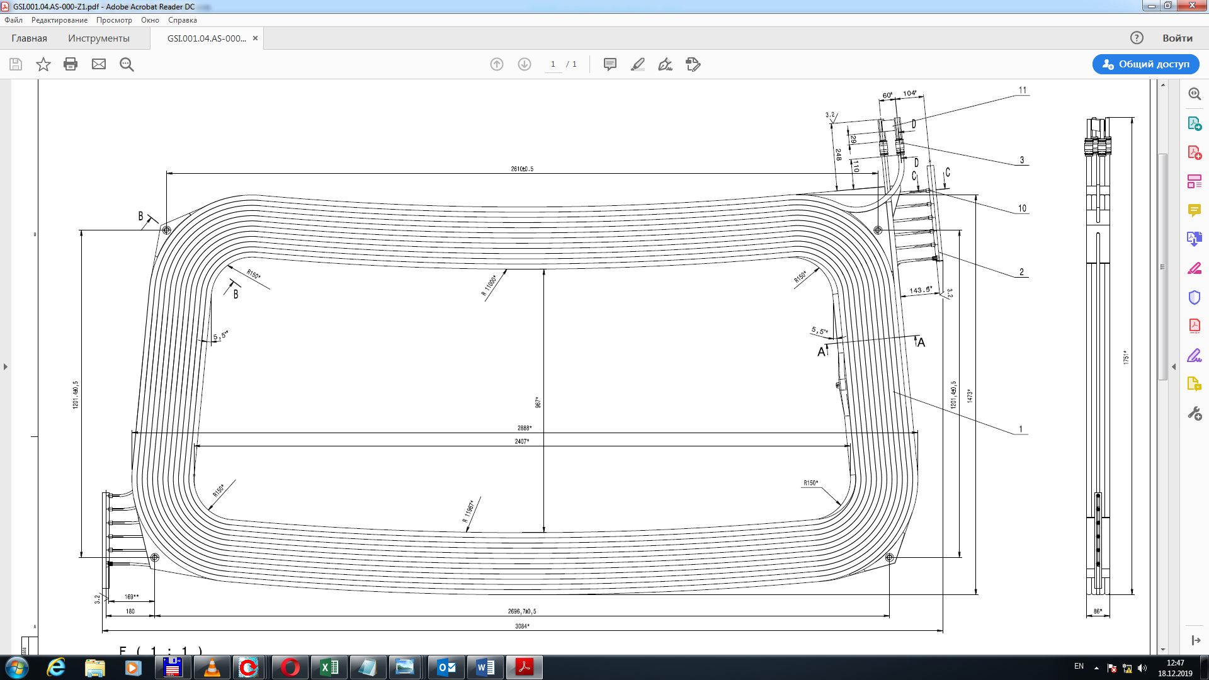
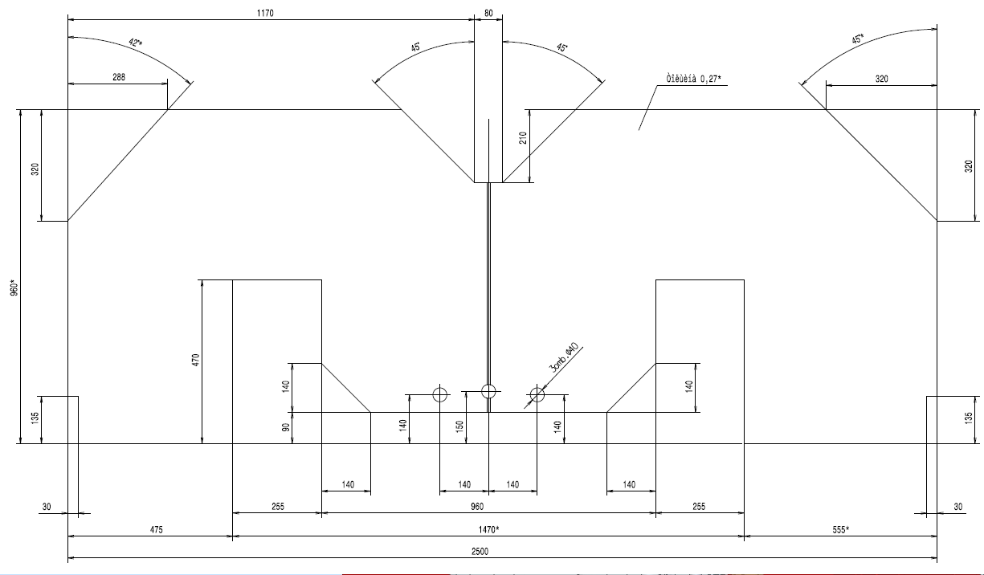
Construction of magnet
Yoke of magnet
Coil of magnet

Slide 6
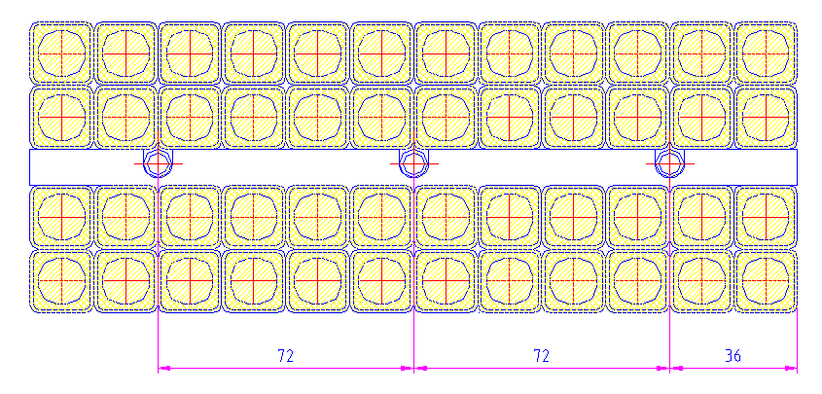
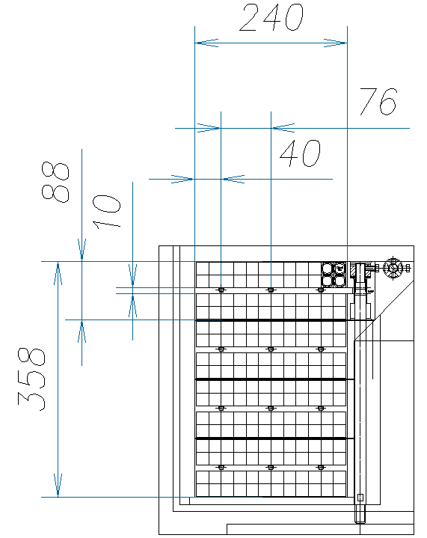
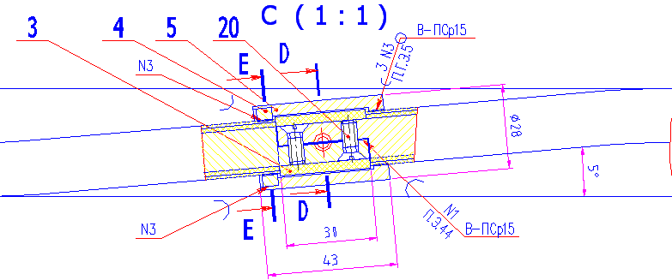
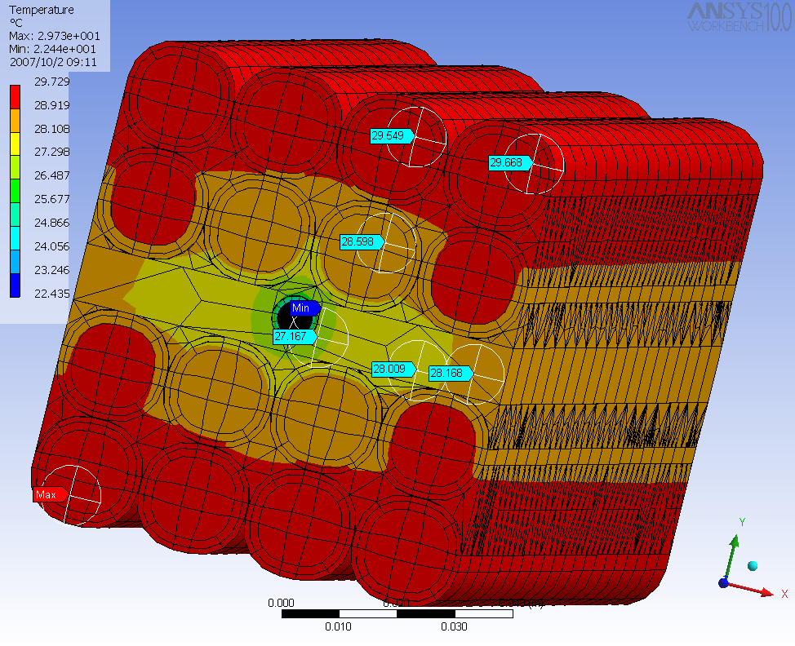
Construction of coil
Cross section of segment
Junction of braids of wire
Construction of
coil
Calculation thermal distribution

Slide 7
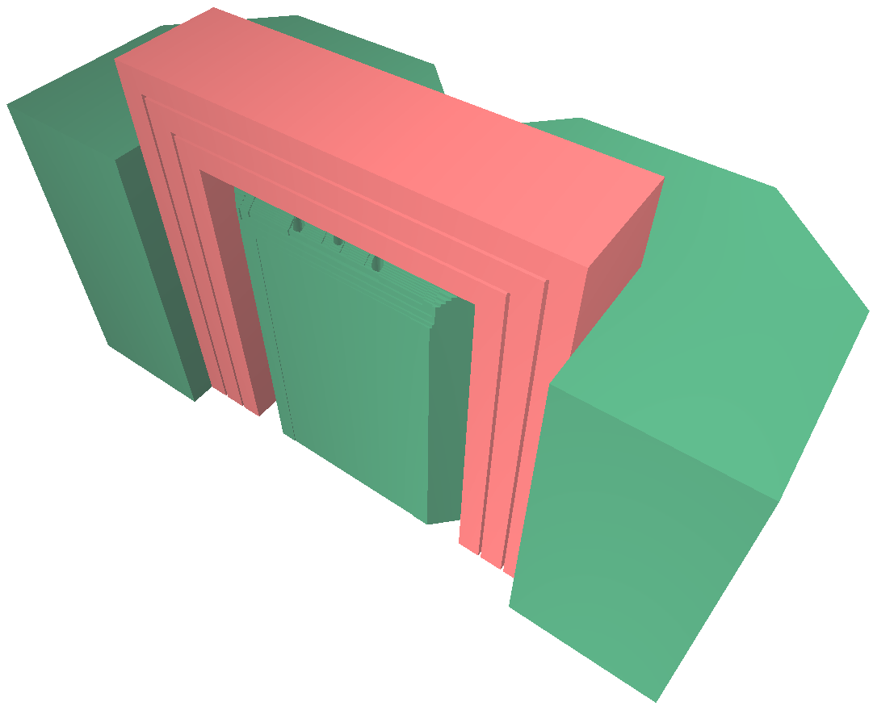
3D magnetostatic calculations
Cross section of pole piece
Removable chamfer
3D magneto static model of ¼ of dipole
Integral field homogeneity without using holes
Integral field homogeneity while using holes

Slide 8
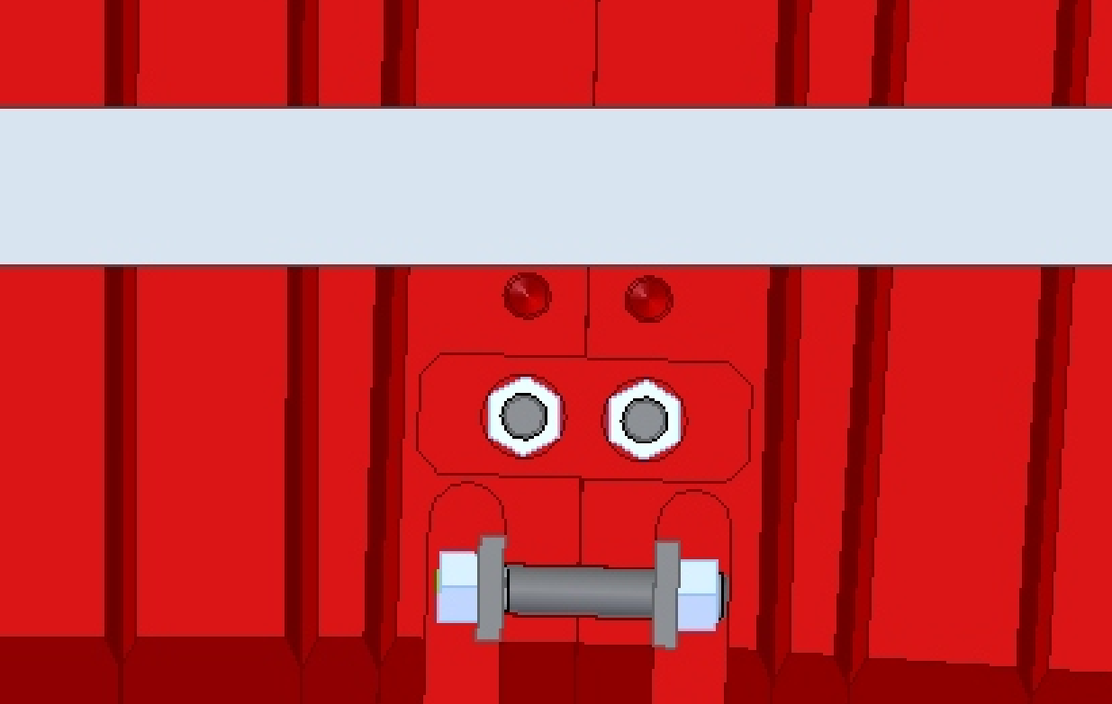
Yoke modification for a new stand
Bottom side of yoke
Adjustment plate

Slide 9
Changes in water collectors of coils
<- Water collector in prototype
Water collector in current construction ->

Slide 10
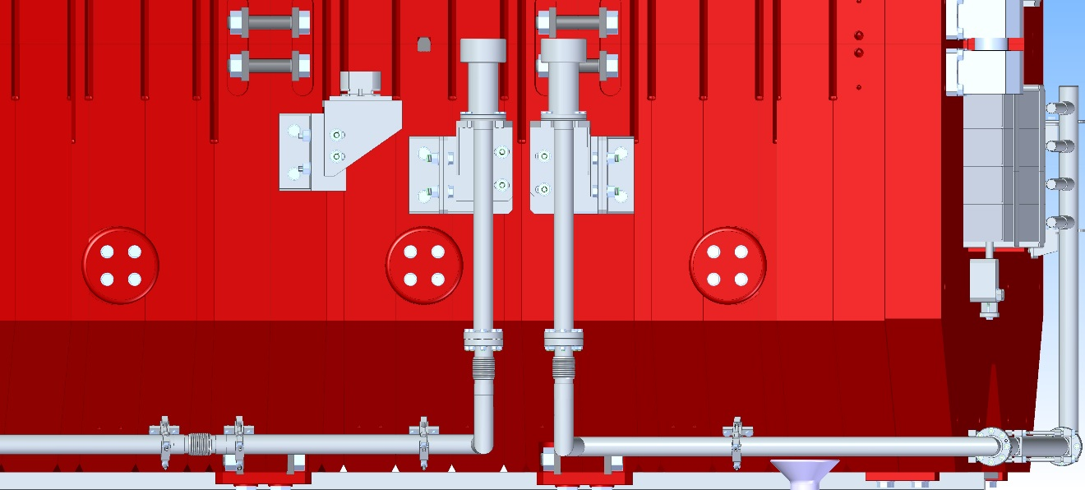
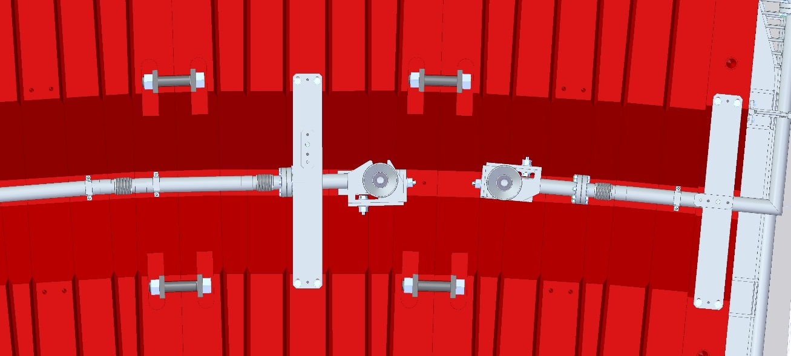
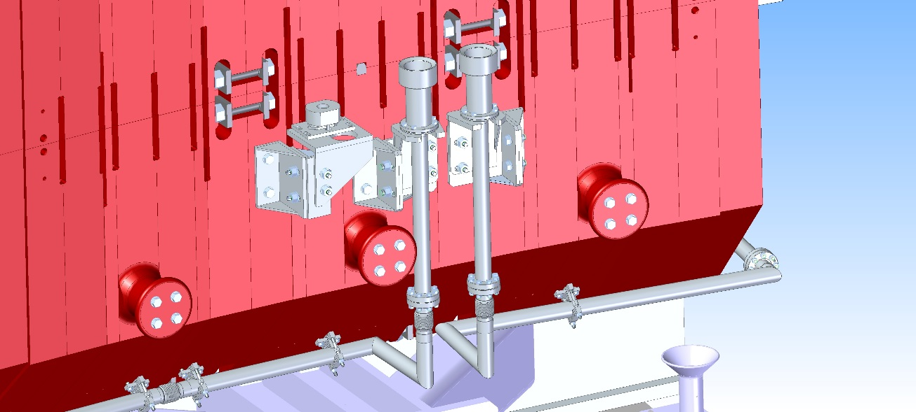
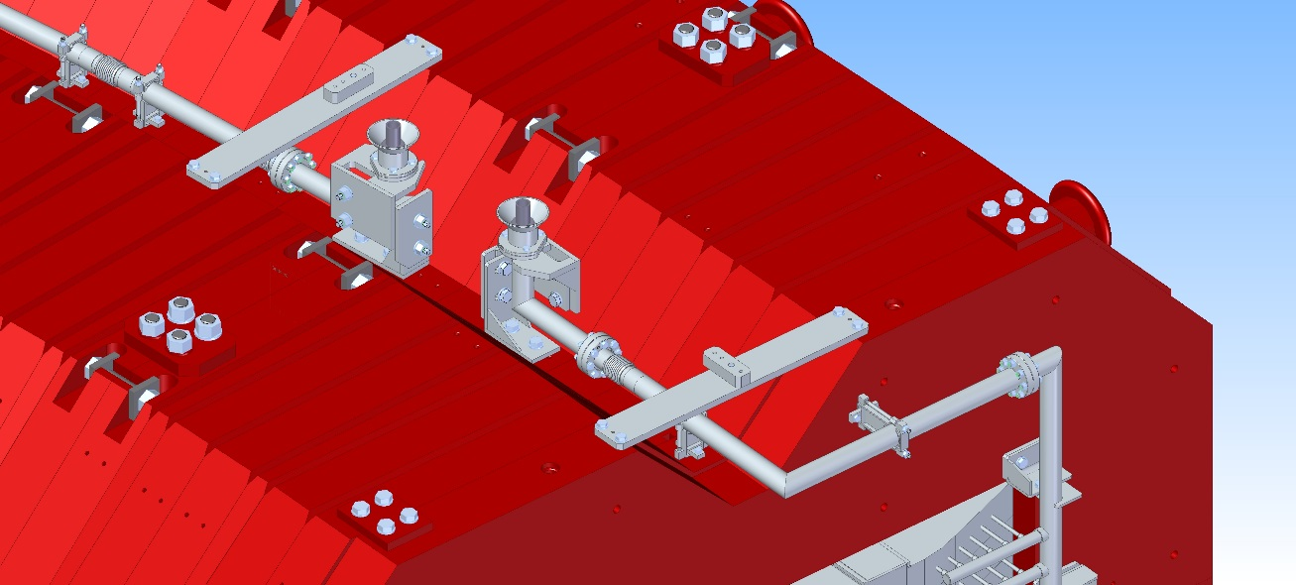
Remote water connections (adjustable)
Water connections for lower half
Water connections for upper half

Slide 11
Remote water connections (adjustable)
Water connections for lower half
Water connections for upper half

Slide 12
Remote current power connections (adjustable)
Current connections
for lower half

Slide 13
Remote current power connections (adjustable)
Type 1
Current connections
for upper half
Type 2

Slide 14
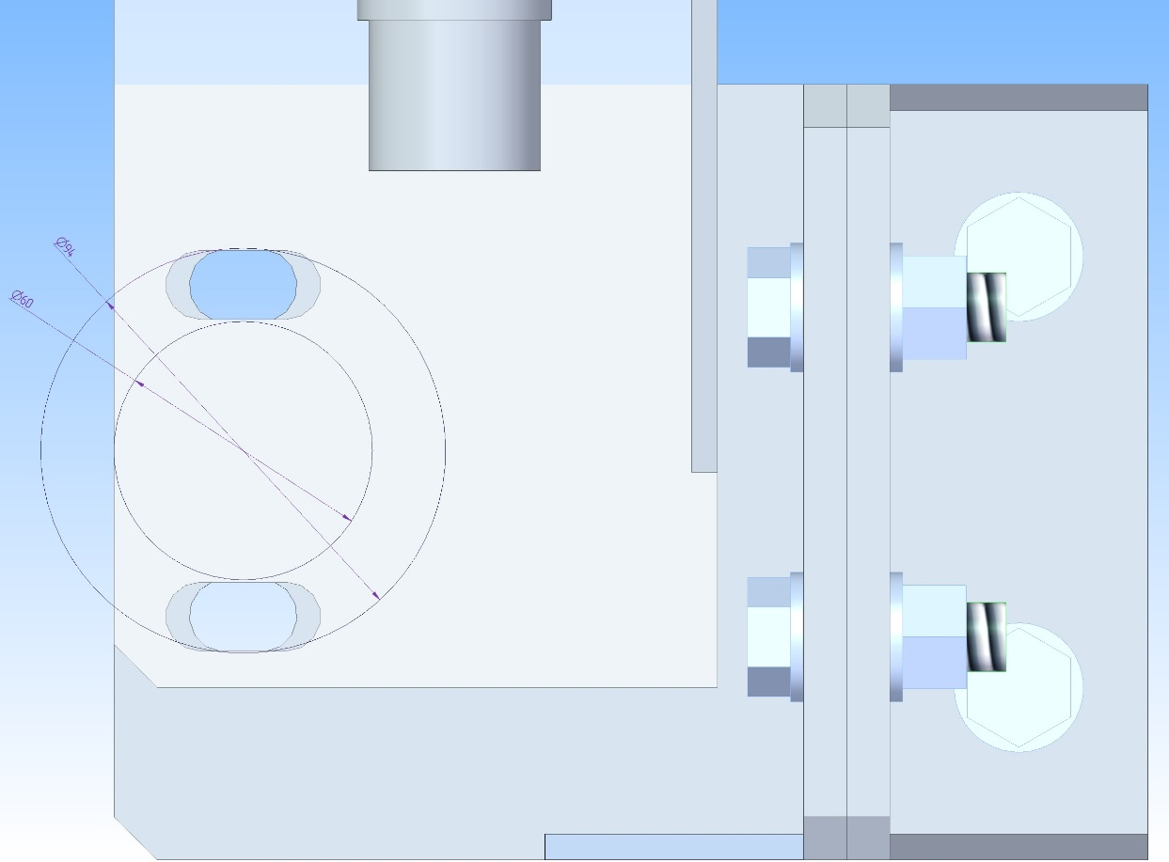
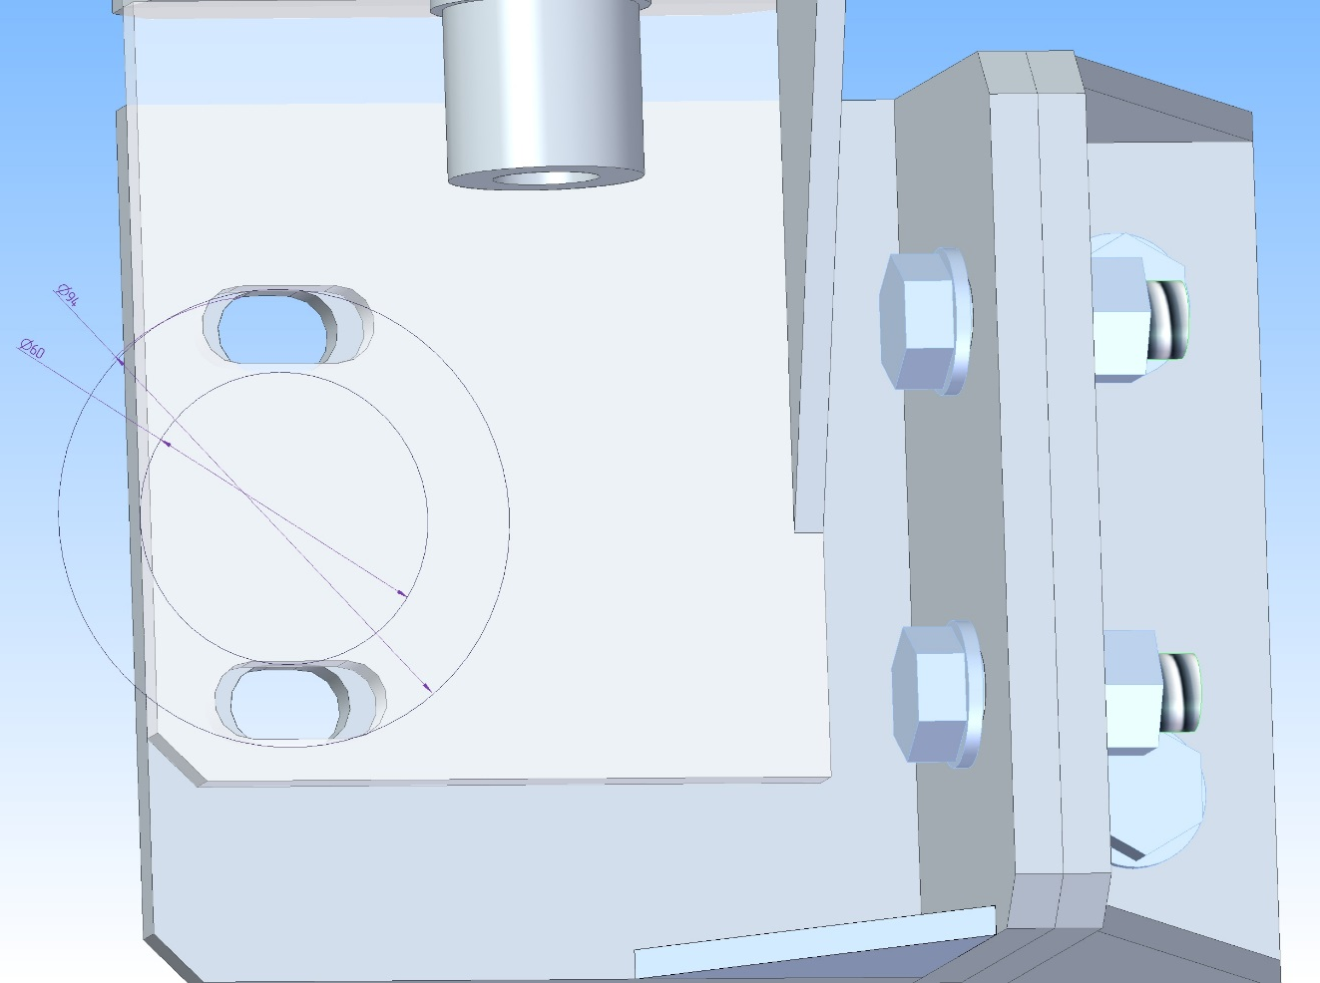
Adjusting principles
Two plates with holes of two types (oval and bow)are provide horizontal movement along one direction (+/- 10 mm.) and rotation in this plane (+/- 6 deg.)

Slide 15
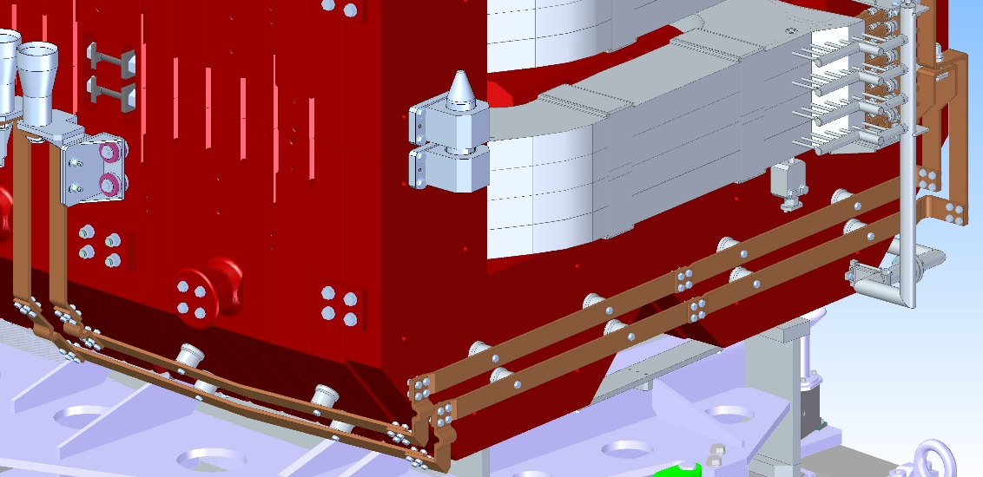
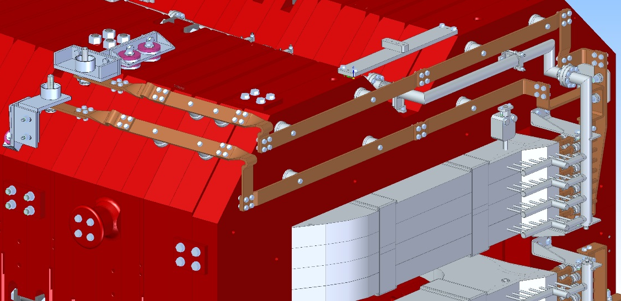
Water and current interconnections

Slide 16
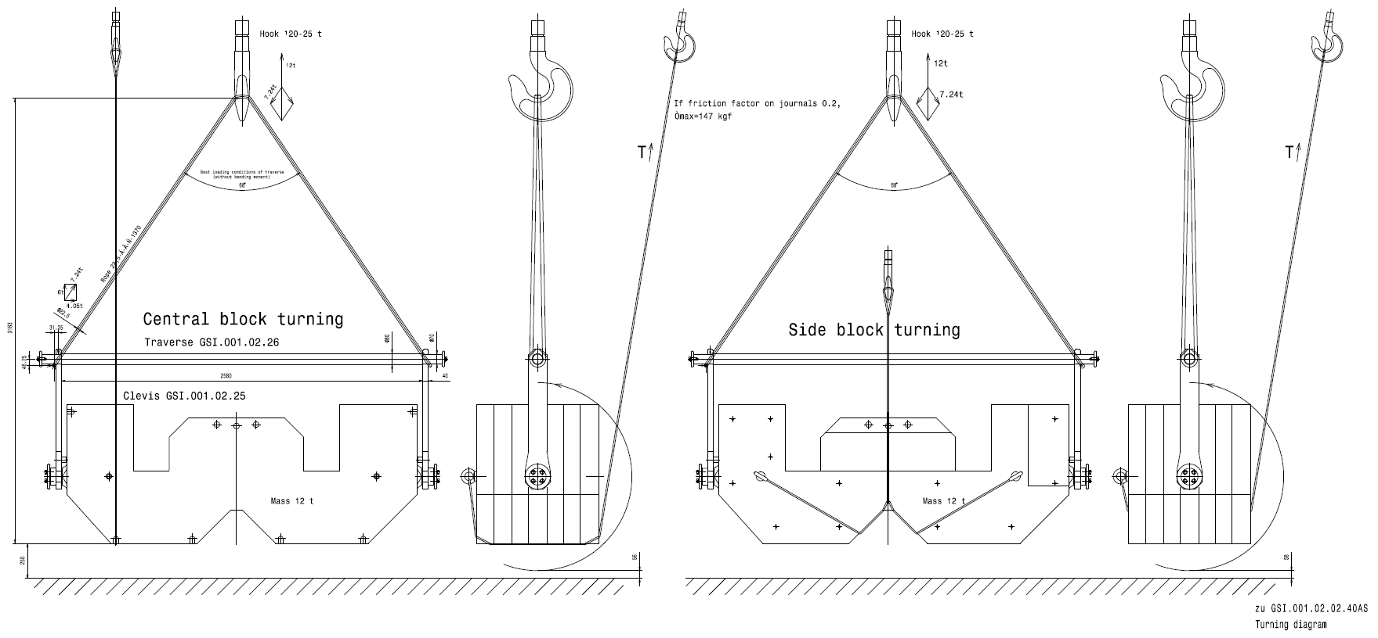
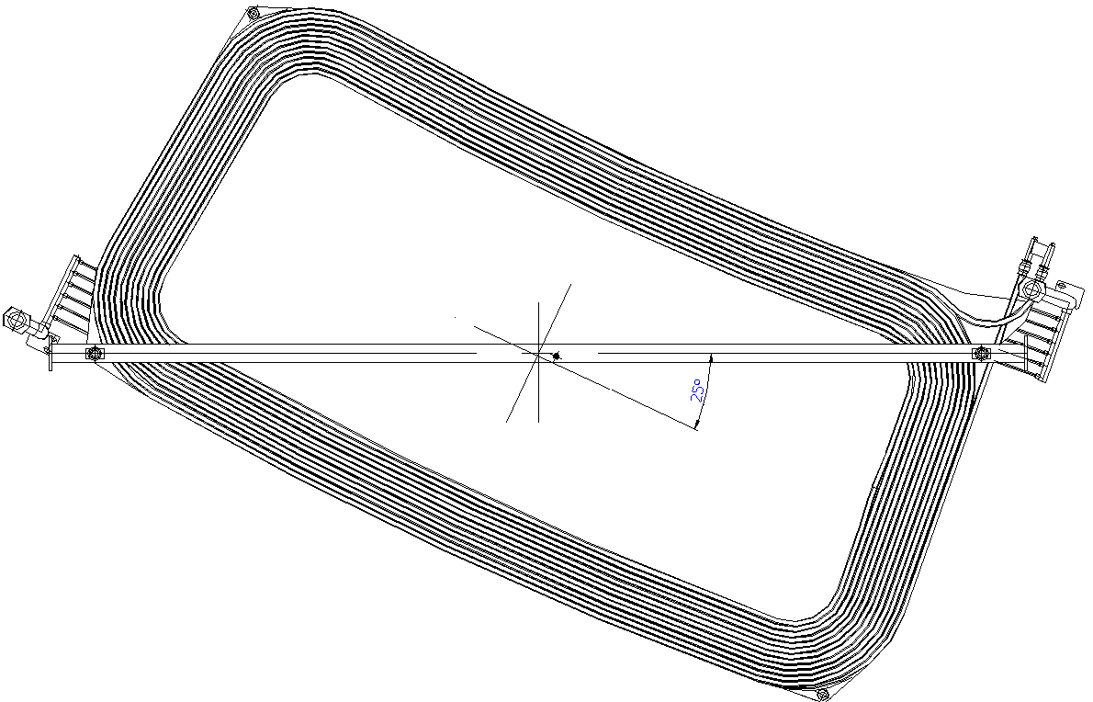
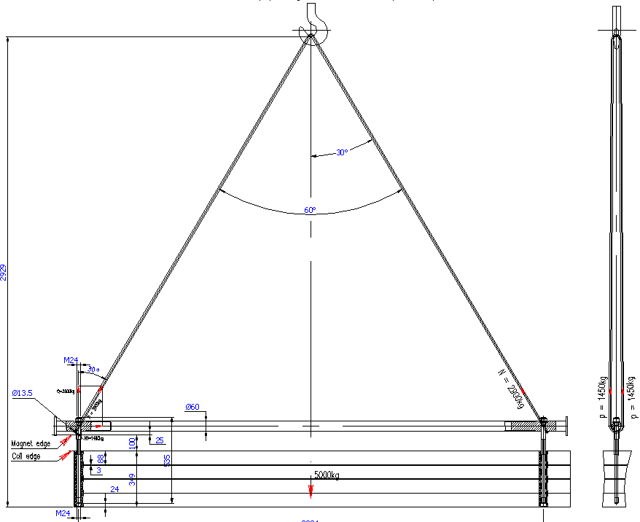
Assembling and installing magnet into the tunnel
Lifting tool for the blocks of yoke
Lifting tool for the coil
Installing the magnet
into the tunnel

Slide 17
Planned activity
Adaptation of drawings for stand
In June, the end of 3D CAD design of a dipole magnet
Creating drawings for the production of magnets
Negotiations for the procurement of metal for the yoke of magnets

