Slide 1
Radiation resistant SFRS magnets.
D. Gurov, A.Utkin for SFRS team
BINP, Novosibirsk
25.05.2020
4rd FAIR-BINP Workshop, Novosibirsk, RUSSIA

Slide 2
Contents
Radiation resistant dipole magnet
Changes in dipole design
Planned activity
Status of RR multipoles for SFRS
3D magnetostatic simulations of magnets
3D CAD models

Slide 3
Radiation resistant dipole magnet
CC 2.4.2.1.1.2 (03.2019 – 10.22)
Parameter | Value
Lamination thickness | 130 mm
Number of RRDM dipole magnets | 3
Overall weight | 95 t
Coil current | 640 A
Number of coil turns | 192
Coil resistance | 343 mΩ
Coil inductance | 2200 mH
Maximum DC power loss | 140 kW

Slide 4
Changes in dipole design
remote water connections (adjustable)
remote current power connections (adjustable)
remote connections for thermal monitoring and grounding (adjustable)
water and current commutation of the magnet
change water collector coils
magnet yoke modification for a new stand

Slide 5
Planned activity
In June, the end of 3D CAD design of a dipole magnet
Creating drawings for the production of magnets
Negotiations for the procurement of metal for the yoke of magnets

Slide 6
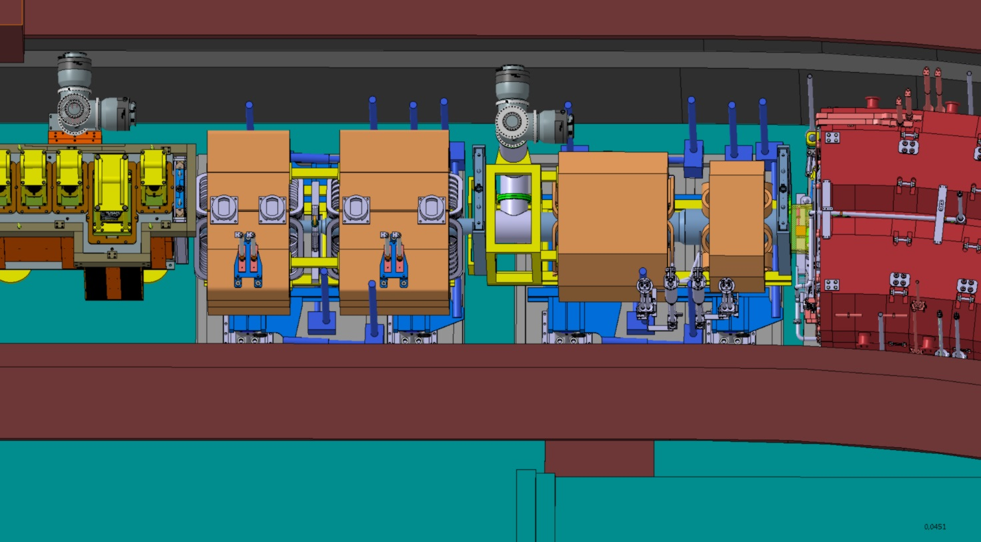
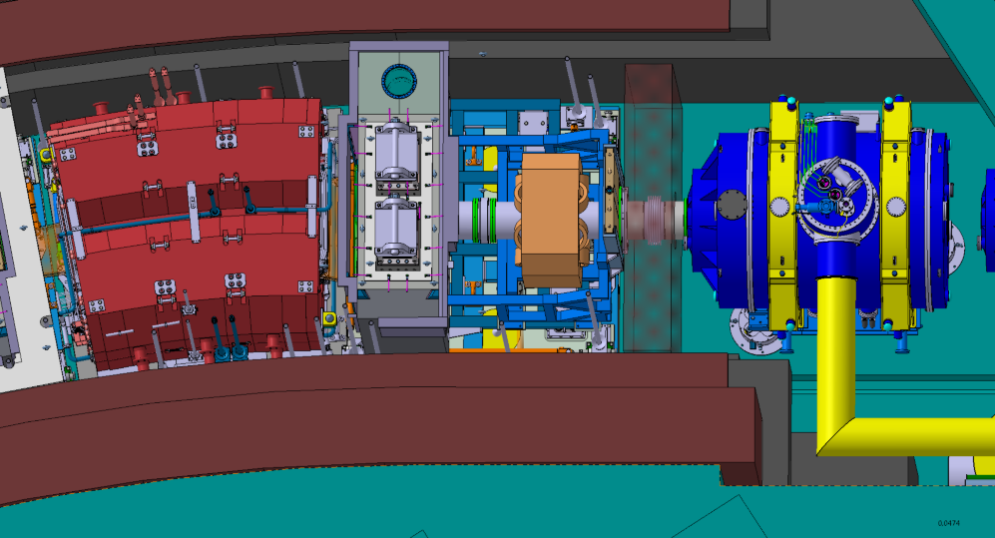
Status of RR multipoles for SFRS
2.2.05.0121 Accelerator Implementing Agreement No. 1, GSI
2.4.2.2.1 | Quadrupole 1a | 1 | 1.6 T/m | 15.4 T/m | 0.933 | Ø 130 | ±1∙10⁻³
2.4.2.2.1 | Quadrupole 1b | 1 | 1.2 T/m | 11.8 T/m | 1.244 | Ø 180 | ±1∙10⁻³
2.4.2.2.2 | Quadrupole 2 | 1 | 0.6 T/m | 6.1 T/m | 1.200 | 380 × 240 | ±1∙10⁻³
2.4.2.3.1 | Sextupole 1 | 2 | 3.5 T/m² | 34 T/m² | 0.600 | Ø 380 | ±5∙10⁻³

Slide 7
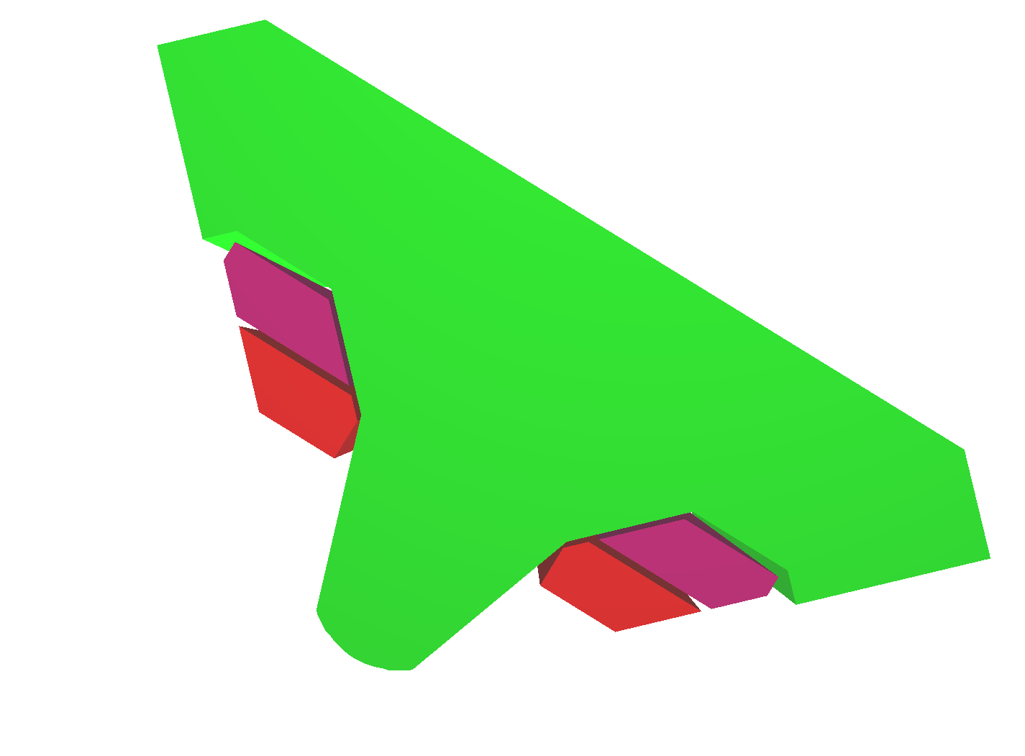
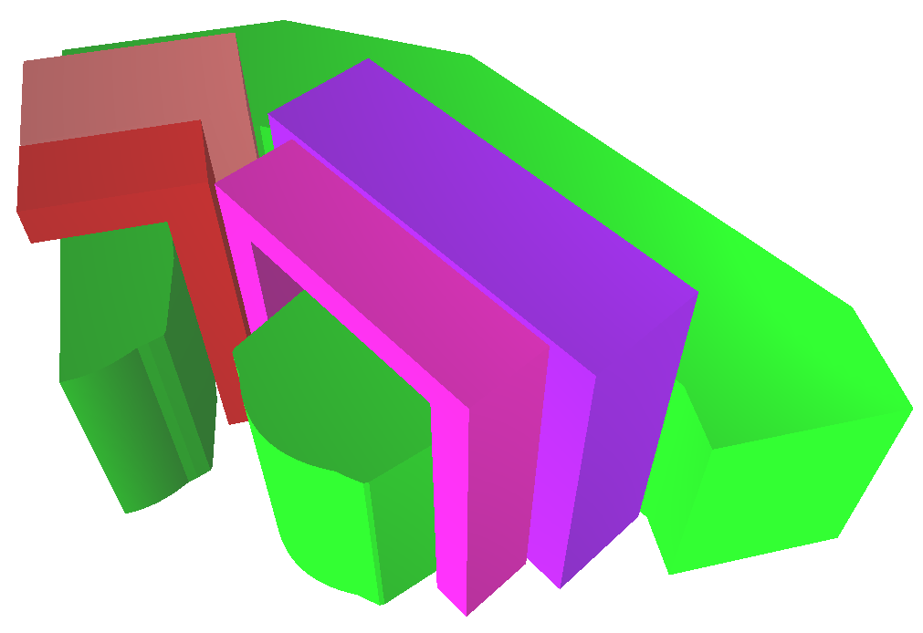
3D magnetostatic simulations of magnets
3D magnetostatic calculations were made for three quadrupole and sextupole magnets
The optimal configuration of the iron yoke of magnets was found to obtain the maximum possible homogeneity of the magnetic field gradients in the working ranges of magnets
quadrupole-1a
quadrupole-1b
Quadrupole-2
sextupole

Slide 8
3D CAD models
On the basis of magnetostatic calculations, 3D CAD systems of magnets are created
Created a general design concept for the yoke of magnets
The design of radiation-resistant coils is being developed, depending on the types of magnets
The current and water commutation of magnets is currently under development.

