Slide 1
Oleksiy Dolinskyy 28th May, 2020
Antiproton yield in chain
of the “target +separator + CR

Slide 2
Antiproton yield, r
$r=\frac{N_{pbar}}{N_{protons}}$
N_{proton} - number of protons coming from SIS100 : (1-2)x10¹³
N_{pbar} - required number of antiprotons, which is extracted to HESR: 10⁸
The goal value: r ≥ 10⁻⁵
What is the predicted value r having the present design of antiproton target station, antiproton separator, injection line and CR ring.

Slide 3
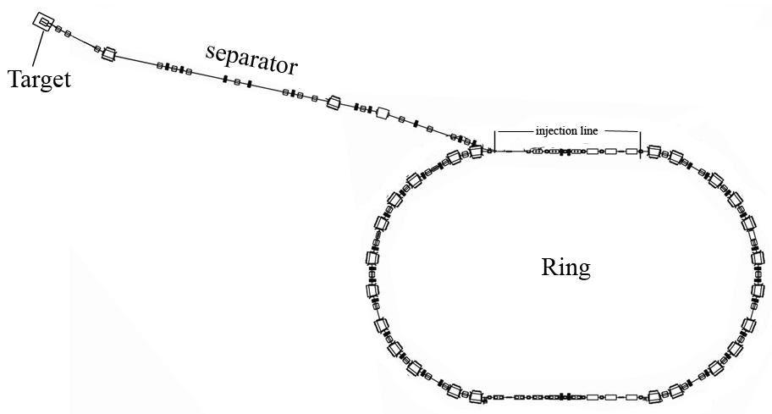
Considered chain
Particle tracking by 3 steps:
1. separator including septa
2. injection line
3. CR ring

Slide 4
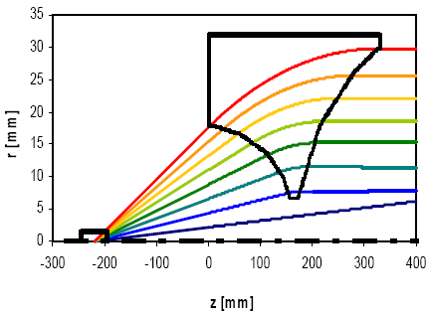
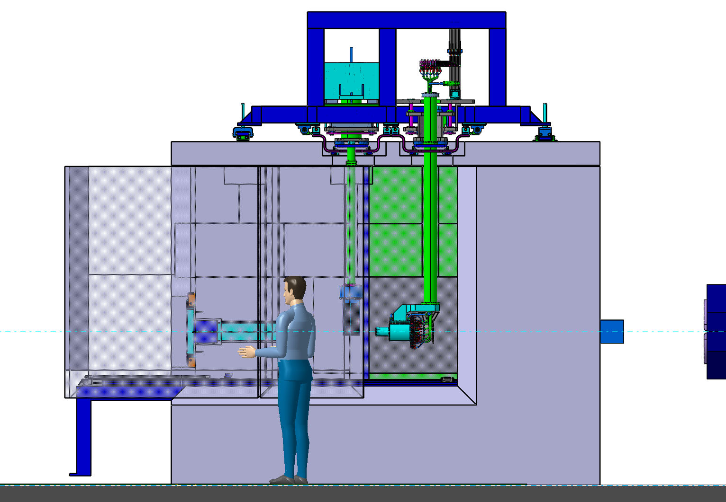
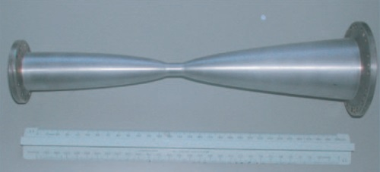
pbar distribution after horn lenz
The particle distribution after horn lens was calculated
by K.Knie considering the target system:
Ti window
inside: Ni rod (r = 15 mm, L = 10 cm) within graphite cylinder (r = 1 cm)
target
20 mrad < θ < 80 mrad can be collected
I = 400 kA
Distance target center - lens: 220 mm
more simple and reliable, less expensive
Protons from SIS100
antiprotons
First quadrupole
horn

Slide 5
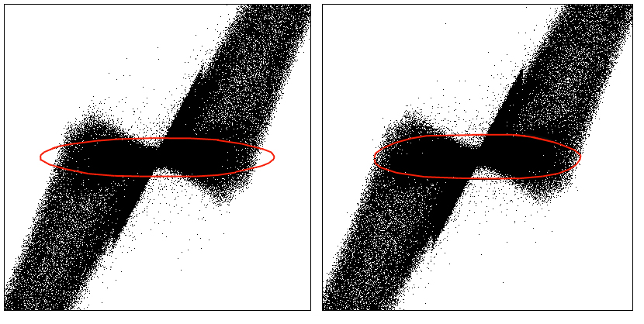
After Horn
Klaus Knie simulations:
10⁹ number of protons before the target
2.95x10⁵ number of anti-protons after the horn-lens
r=2 x 10⁻⁵
93% pbars out
of acceptance
7 % pbar
captured in
acceptance
acceptance of the antiproton separator
240 mm mrad 1.98x10⁴ inside acceptance with dp/p=+-3%

Slide 6
Antiproton separator
End of septum
End of Horn.lenz
1. Horizontal and vertical collimation
2. Momentum collimation
3. Chromatic effect of magnets
4. Non-linear field errors
5. Orbit destortion up to 4 mm.
6. Apertute of magnet.

Slide 7
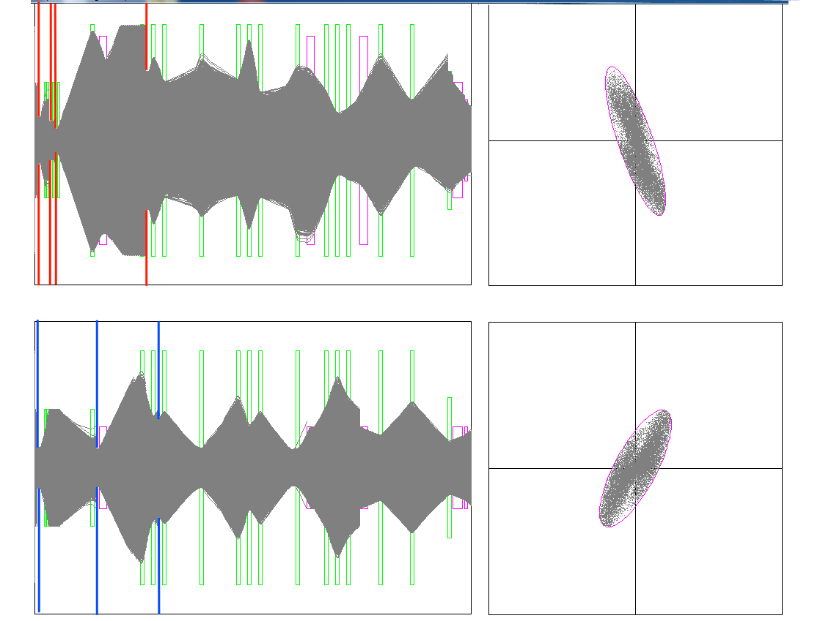
1 st step of Particle tracking p-bar separator
The particle tracking from the horn-lens to the end of the CR septum
Hor. collimators
Mom. collimator
At the end of CR septum
horizontal plane
r=1.6 x 10⁻⁵
vertical plane
Sextupole magnets
are included
Ver. collimators
Horizontal and vertical emittances: 240 mm mrad

Slide 8
particle tracking in the injection region
r=1.6 x 10⁻⁵
Injection region in the CR

Slide 9
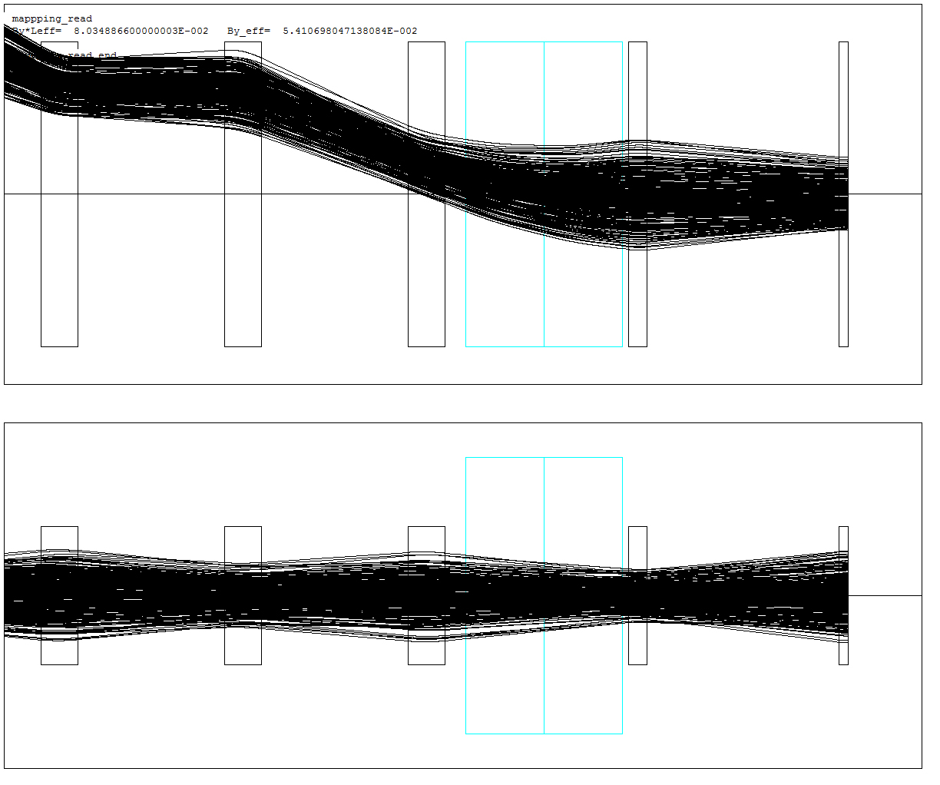
Particle tracking in injection line
end of septum magnet
3D Field map of kicker magnets
Q04
- 3D field map of Kicker magnets
are included in simulations.
chromatic effect is on
- The real aperture of all quadrupoles
and other elements are included as given in TDR
(the first two quads as well)
The super-elliptical shape of
vacuum chambers are considered.

Slide 10
Magnet Field of the 3 modules
The magnet field over the length of 2.135 m, 3 modules
$$x^{′}=\frac{\int_{0}^{L_{max}}{B_{y}dl}}{BR}=\frac{{\left(BL\right)}_{eff}}{BR}$$
L_{max}=2.135 m
BR=13 Tm
B_{y} from 3D field map
(Marc Petryk calculations)
The required kick angle x‘ is 5 mrad for all three modules, which means (BL)_{eff}=65 mTm
Presently (see figure) we have (BL)_{eff}=92 mTm, which gives x‘=7.07 mrad.

Slide 11
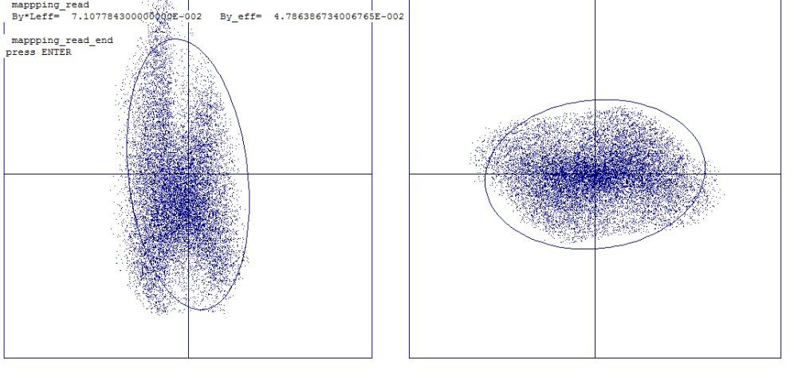
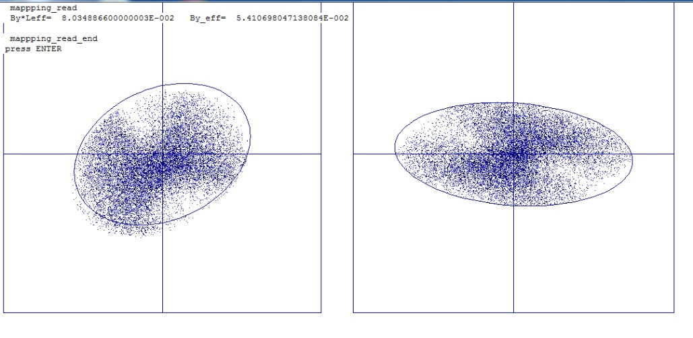
2nd step of particle tracking Injection line
phase space at the middle of Q04
GSI optics
Number of particles
N=1.7 x 10⁴ (no losses)
BINP optics
Number of particles N=1.6 x 10⁴ (no losses)

Slide 12
Particle tracking at ring
1000 turns is calculated (time needed for bunch rotation)
real apertures of all
CR systems and magnets
are included taking into
account their shape of
vacuum champers.
The RF cavities and CCC
are ‚bottleneck‘, where the
aperture is 70 mm.

Slide 13
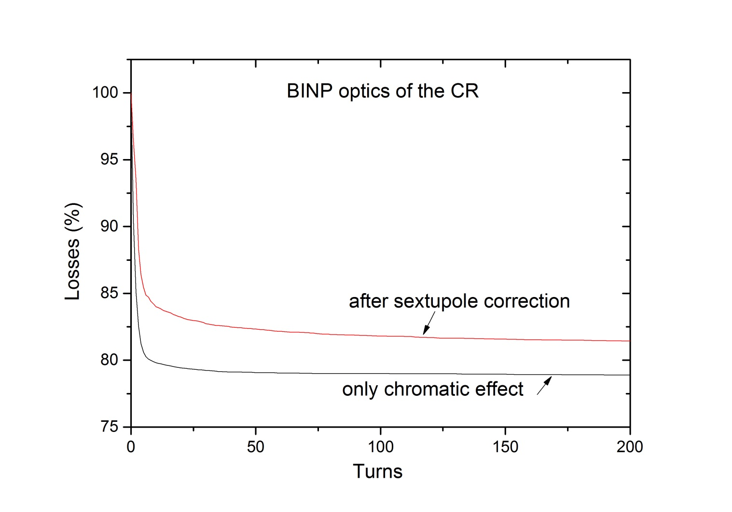
Particle tracking in the CR
Particle tracking at CR (1000 turns)
18 % of losses
r_{pbar} = 1.328 x 10⁻⁵

Slide 14
Antiproton yield
Antiproton production yield
(1.2 – 1.3) x 10⁻⁵
One can see that we have about 20 – 30 % margin.
The real production yield depends on several factors, which are not possible
theoretically to predict :
- Real closed orbit distortions.
- RF de-bunching and re-bunching efficiency
- SC cooling performance in reality
- Real field quality of magnets in CR
Extraction efficiency
The acceptable theoretical particle losses should not exceed 1-3% in the
septum magnet only due to field error.

Slide 15
Next steps
My proposal is following:
The updated optics of the separator should be used to study the injection
efficiency into CR taking into account following :
The 3D field map of the septum magnet. The map exists and now under
implementation into particle tracking code.
The sextupole correction in the separator must be included. It can help
to compensate the chromatic effects of quadrupole (which means to reduce
the losses due to mismatching)
The 3D field map of inj. kicker calculated by BINP should be used to calculate
the antiproton transmission from separator to the CR.
Particle tracking in the CR taking into account
Stochastic cooling effect (acceptance). Time domain code is under development.
RF bunch rotation and re-bunching process
Measured field quality of magnets.
Closed orbit distortion (depends on alignment of magnets, quality of correctors
and BPM). This is most unpredictable effect.

