Slide 1
4. GSI-BINP-Workshop
Session 7: HEBT-Magnets
27.5.2020

Slide 2
Topics
dip3_3 replacement by CR-dipole (connection box problem)
Coil dip13_0
Pending magnets (FAT issues, documentation)
  dip10_0 – Field quality evaluation
  Quad11
  Quad2 – Newly sent documents not yet checked
MM program QPs
Assembly drawings magnet with chamber
Assembly in tunnel (equipment, work wear, small parts, …)
Turning device
Production schedule
Procurement of raw materials

Slide 3
dip3_3 replacement by CR-dipole
2 dipoles in beam line to CR
Connection box collides with other beam lines
Possible solution:
  Move box from side to front face (as done in a very early CR-design)
  Tooling for coil stays identically
  Box may be moved without a lot of changes; mainly box holders
Magnets needed for operation of CR
BINP: Design capacity is limited

Slide 4
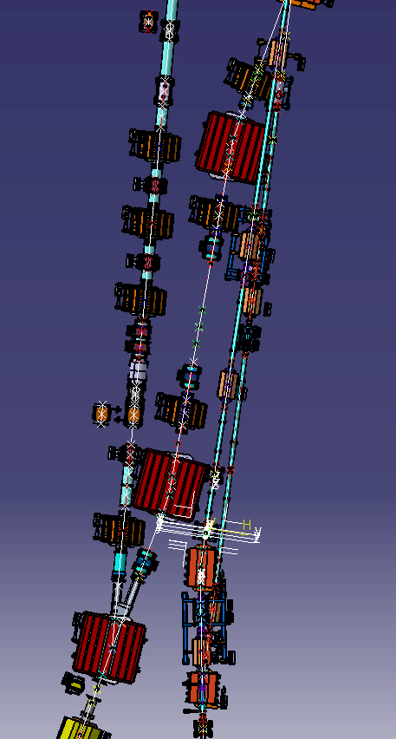
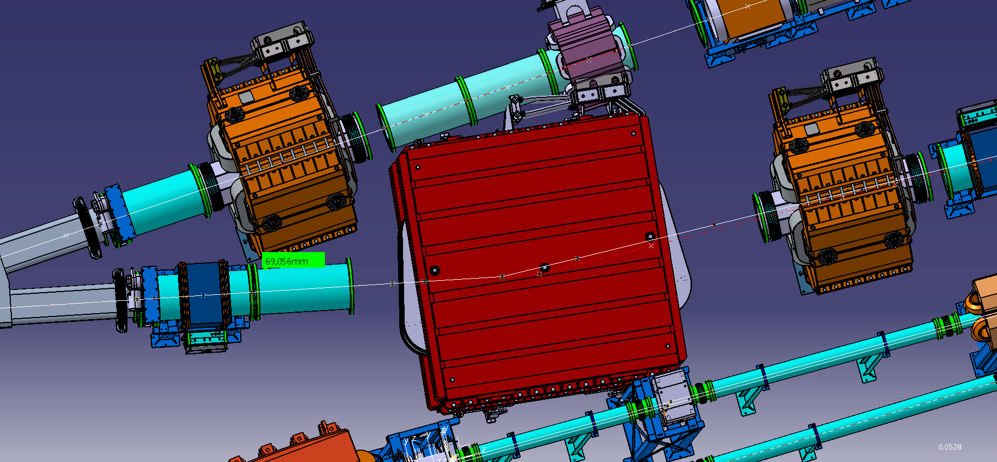
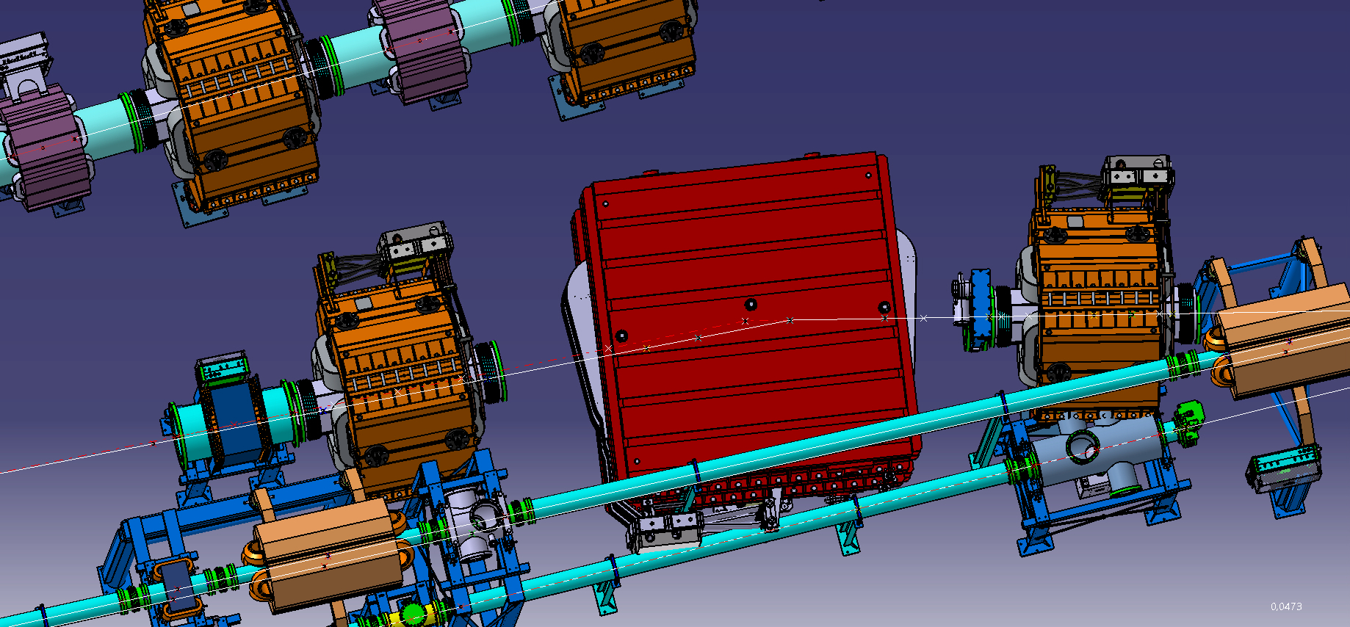
Collisions CR-dipole

Slide 5
Dip10
Field quality on paths with ideal radius ok
Polarity issue fixed
B-field units issue fixed
NCRs signed (some BINP signatures missing, please complete)
-> accepted

Slide 6
QUAD11
Table 5.1: perpendicularity of quadrants – information exchange by email necesarry
Magnetic measurement results
  good field region -> elliptical aperture +/-67.5mm -> actual ~+/-60mm (+/-63mm)
  First 5 QUADs will have round chambers -> ok
  What to do for the ones with elliptical chambers? -> Machining of facets possible

Slide 7
Assembly drawings magnet with chamber
Drawings
Procedures
…
A. Krasnov:
  Fully busy with the manufacturing drawings of the vacuum chambers in the moment
  Will be done later
  No special equipment expected to be necessary
  Common despcription on magnet opening/closing, chamber insertion – probably exists
  Examples from GSI/FAIR are highly appreciated
C. Will:
  BINP assembly group has to plan
H. Reich:
  It must be clear who does what? – Must be written down, to find a common understanding.

Slide 8
Assembly in tunnel
H. Reich
  Standard tools – carts will be supplied
  Work wear, safety equipment – supplied by GSI/FAIR
  Fork lifters, cranes - supplied by GSI/FAIR
  Special tools (e.g. special traverses) – to be supplied by BINP, needs certificates on safety
  …
  Assembly of CR-dipole will be used as test

Slide 9
Turning device
Delivery end of June / beginning of July to BINP.
M. Marenich amendment with BINP not finished yet.
Delivery to GSI in Sep./Oct.20
Design for adaptations still open. Only sketches exist.

Slide 10
Production schedule
.
Procurement of raw material
  16t of iron recieved
  Money for copper limited
  Dipole19, QUAD12 may be influenced

