Slide 1
CR vacuum
BINP
A. Krasnov
4th BINP-FAIR Collaboration Coordination Workshop

Slide 2
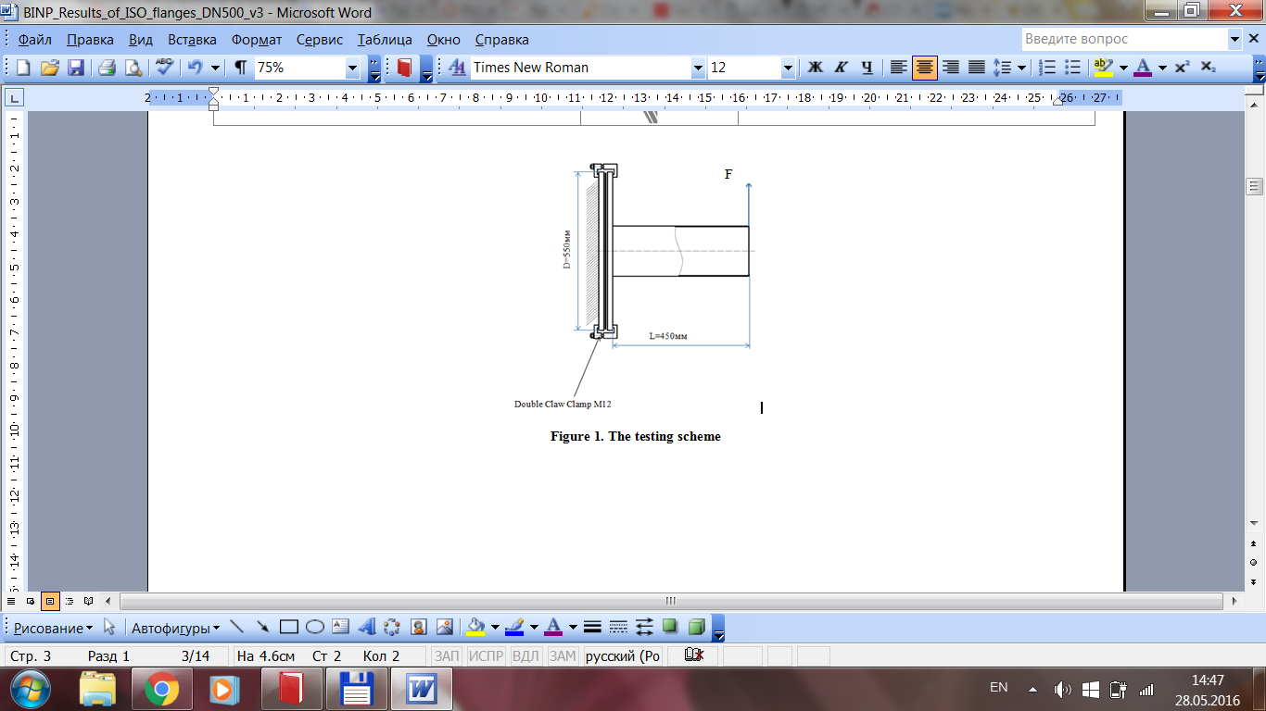
Springy metal seals for ISO-K
Preliminary BINP experience
Type | CE-052800-6.35H-2/0-4-SN50 | CSE-052800-6.35H-2/2-1-S50
Seal Diameter, mm | 528 | 528
Axial Section, mm | 6,35 | 6,35
Material of C-ring | Alloy 718 | Alloy 718
Spring material | - | Alloy 718
Plating | SnBi | Ag
Plating thickness, μ | 30÷50 | 30÷50
Load, N/mm | 160 | 770
Treatment | solution annealing + precipitation hardened | work hardened
Number of clamps | 24 | 48
Torque, N*m | 45* | 45**
Nominal deformation | Reached (5,2 mm) | Did not reach
Max. deformation load, kN*m | 10*** | 10***
Number of sealing cycles | 5 (at least) | 2 (at least)
Number of tested seals | 3 | 2
Leak tightness liter*mbar/s | < 1E-10 | < 1E-10
Number of unsuccessful sealing | 0 | 0
Experimental installation
Flange type: flat symmetrical ISO-K with external spacer
Advantages
- weight: 32 kg (COF type – 80 kg)
symmetry: does not need angular orientation
(COF needs oval holes on one of connected flanges to compensate angular inaccuracy)
- space: 80 mm along beam (COF needs 155 mm)
* Sealing reached at 15 N*m
** Sealing reached at 30 N*m
*** Experiment with DN 250 CF shown leak appearance at 8 kN*m
BINP ordered seals with spring and Ag coating
to provide final tests for approval the solution
a.a.krasnov@inp.nsk.su

Slide 3
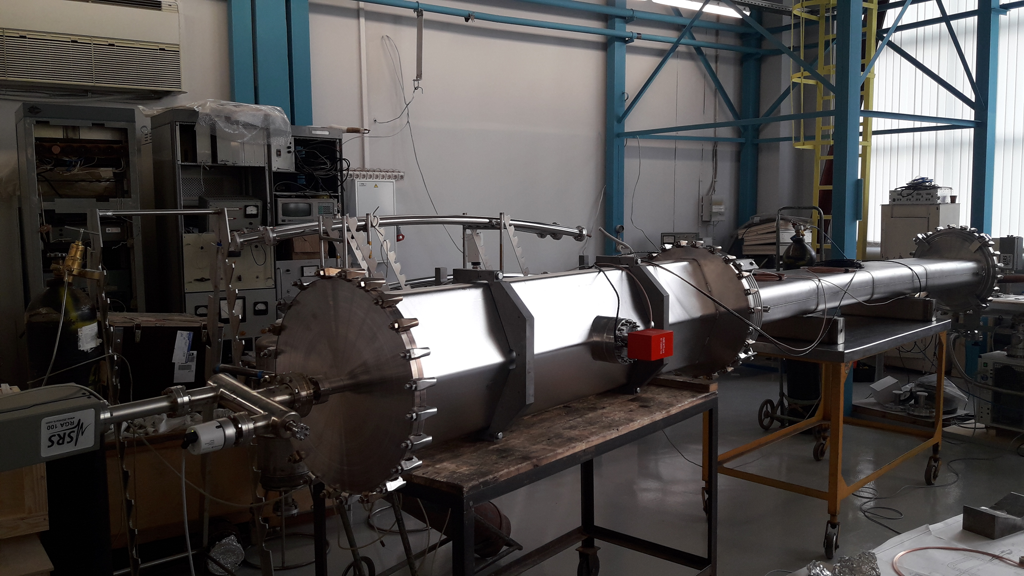
Mock-up installation
2 pumps for dipole + quadruple chambers – average pumping ‘density’ per meter in CR
Pressure level 2.3E-9 mbar after 1 month pumping and 3 getter activation
Both type of HTMS sealing rings are working well. But SnBi is better because it needs less number of clamps – 24 (we will use 36 to be in safe side).

Slide 4

Thank you for your attention

