Slide 1

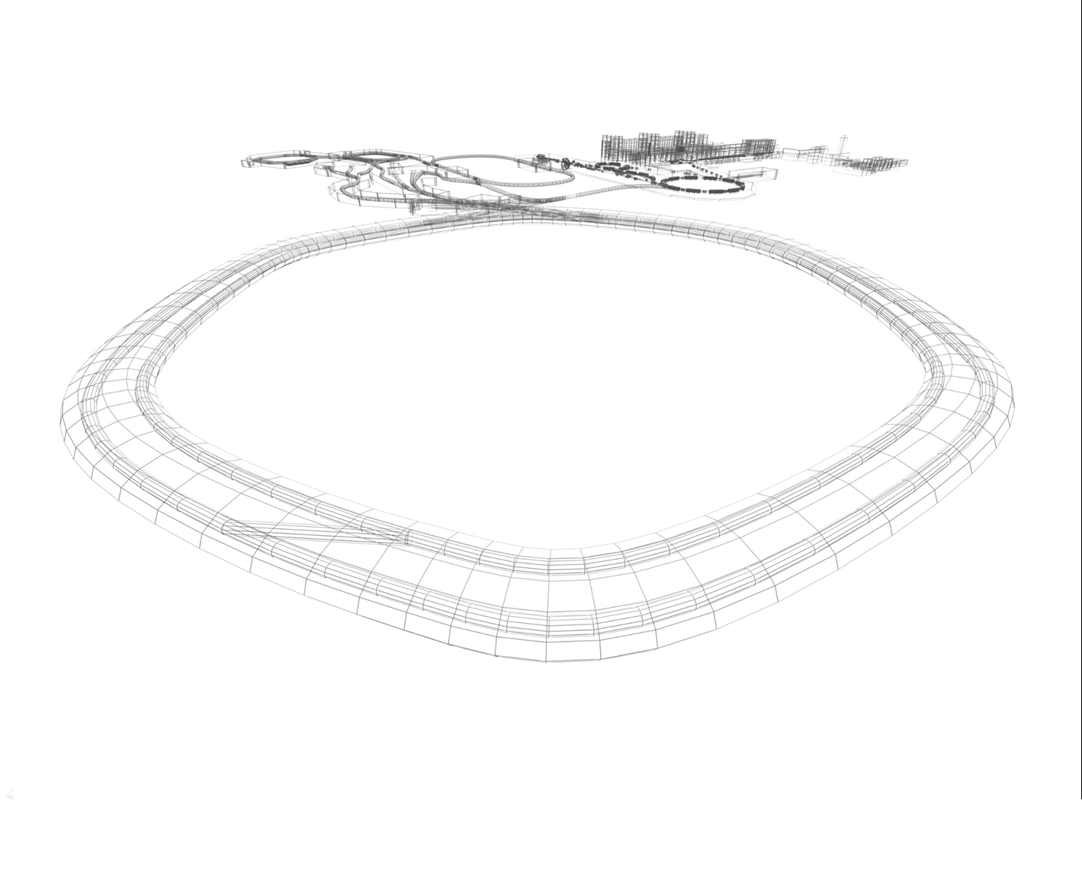
CR Power Converters
4th Joint BINP-FAIR CC Workshop
25.05 - 30.05.2020
Status

Slide 2
CR magnet system
4th Joint BINP-FAIR CC Workshop
25.05 - 30.05.2020
24
DIPOLES
1 POWER
CONV
DC magnets/ correctors
40 QUADRUPOLES
15 POWER
CONV
24 SEXTUPOLES
6 POWER
CONV
CR Magnet System
48+12
CORR+OCT
48+12 CORR
PS
Injection/ Extraction
magnets
KICKER
MAGNETS
KICKER
PSs
INJECTION
SEPTUM
INJ SEPTUM PS
EXTRACTION
SEPTUM
EXT SEPTUM PS

Slide 3
TCR1 magnet system
4th Joint BINP-FAIR CC Workshop
25.05 - 30.05.2020
2
DIPOLES
2 POWER
CONV
TCR1 Magnet System
DC magnets/ correctors
6 QUADRUPOLES
6 POWER
CONV
2
SEXTUPOLES
2 POWER
CONV
5
CORRECTORS
5 CORR
PS

Slide 4
CR+TCR1 Power Converters
4th Joint BINP-FAIR CC Workshop
25.05 - 30.05.2020
CR DPC type
CR QPC Type
CR SPC Type
CR OPC Type
CR CPC Type
1 CR Dipole magnets Power
Converter
15 CR Quad magnets Power
Converters
6 CR Sext magnets Power
Converters
12 CR Octupol magnets Power
Converters
48 CR Steer. magnets Power
Converters
2 TCR1 Dipole magnets Power
Converters
2 TCR1 Sext magnets Power
Converters
7 TCR1 Steer. magnets Power
Converters
6 TCR1 Quad magnets Power
Converters
1 PC
23 PCs
8 PCs
12 PCs
55 PCs

Slide 5
CR magnets types
4th Joint BINP-FAIR CC Workshop
25.05 - 30.05.2020
TYPE | SUB | Qty | Imax A | Lm mHn | Rm mOm | Vm V | Deviat
DIPOLES | - | 24 | 1450 | 377 | 62.45 | 91 | 10ppm
QUADRUPOLES | EWQ | 3 | 1500 | 49.8 | 26.31 | 38 | 100ppm
 | WQ | 14 | 1500 | 59 | 26.31 | 38 | 100ppm
 | SWQ | 12 | 1500 | 44 | 21.67 | 31 | 100ppm
 | NQ | 11 | 1450 | 11 | 10.1 | 15 | 100ppm
SEXTUPOLES | - | 24 | 500 | 6 | 35 | 18 | 0.1%
OCTUPOLES | - | 12 | 30 | 86 | 2450 | 74 | 1%
CORRECTORS | H | 24 | 6 | 182 | 9560 | 58 | 1%
 | V | 16 | 14 | 158 | 4200 | 59 | 1%
 | H/V | 8 | 20 | 90 | 760 | 16 | 1%

Slide 6
4th Joint BINP-FAIR CC Workshop
25.05 - 30.05.2020
CR MAGNETS POWER CONVERTERS PARAMETERS
PARAMETER | DPC | QPCTYPE1 | QPCTYPE2 | QPCTYPE3 | SPC | OPC | CPC
MAINS | AC 20kV 50Hz T | AC 400 V 50Hz TN-S
IOUT MAX | 1450 A | 1500 A |  |  | 500 A | 30A | 6/14/20 A
VOUTMAX | 2750 | 200 V | 100 V | 50 V | 100 V | 90V | 75/75/40 V
ΔIOUT/IOUT | 10ppm | 100ppm |  |  | 0.1% | 1% | 1%
LONG TERM STABILITY | 10ppm | 100ppm |  |  | 0.1% | 1% | 1%
CONTROL | GSI CONTROL UNIT
DCCT | GSI CONTROL UNIT |  |  |  | Built In | Built In
MAX POWER | 4MW | 300kW | 150kW | 75kW | 50kW | 2.7kW | < 1kW

Slide 7
4th Joint BINP-FAIR CC Workshop
25.05 - 30.05.2020
POWER CONVERTERS SETUP
High Power part. It is supplied by a 20kV, 3-phase Common supply system C2
Control part. It is supplied by a 400V, 3-phase Common supply system C2

Slide 8
4th Joint BINP-FAIR CC Workshop
25.05 - 30.05.2020
POWER CONVERTERS SETUP
High Power part. It is supplied by a 400V, 3-phase Common supply system C2
Control part. It is supplied by a 400V, 3-phase Common supply system C2

Slide 9
DIP MAGNETS POWER CONVERTER DIAGRAM
4th Joint BINP-FAIR CC Workshop
25.05 - 30.05.2020
1.5kA 2750V
20kVAC
MAINS
5.2 MVA
Step-Down
TRANSFORMER
+ POLARITY
12 pulse SCR RECTIFIER
POLARITY
12 pulse SCR
RECTIFIER
OUTPUT
FILTER
DCCT
DIP
MAGNETS
1.5kA

Slide 10
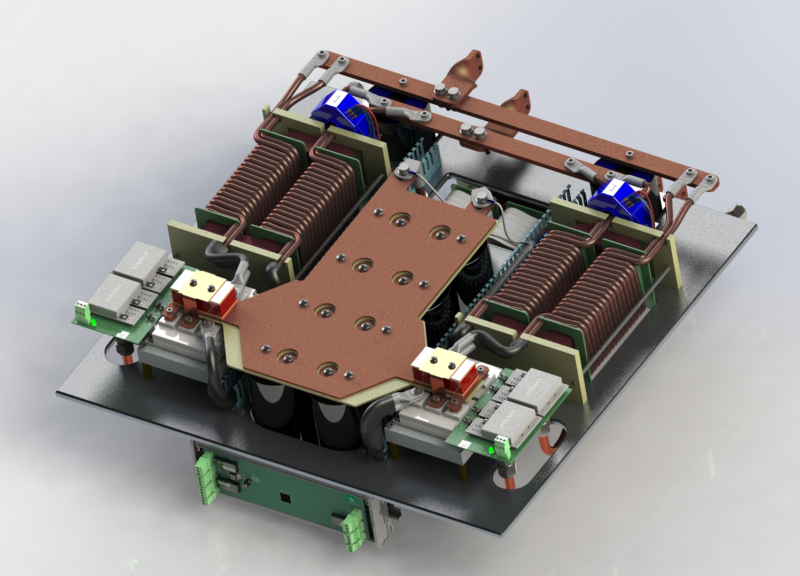
QUAD MAGNETS POWER CONVERTER DIAGRAM
4th Joint BINP-FAIR CC Workshop
25.05 - 30.05.2020
TYPE1
TYPE2
TYPE3
1.5kA 200V
1.5kA 100V
1.5kA 50V
IGBT
H-BRIDGE
1.5kA 600V
20kHz
OUTPUT
FILTER
400VAC
MAINS
Step-Down
TRANSFORMER
RECTIFIER
IGBT
H-BRIDGE
1.5kA 600V
20kHz
OUTPUT
FILTER
IGBT
H-BRIDGE
6x250A 600V
20kHz
OUTPUT
FILTER
DCCT
QUAD
MAGNETS
1.5kA

Slide 11
SEXTUPOLE MAGNETS POWER CONVERTER DIAGRAM
4th Joint BINP-FAIR CC Workshop
25.05 - 30.05.2020
500A 100V
400VAC
MAINS
Step-Down
TRANSFORMER
RECTIFIER
IGBT
H-BRIDGE
1.5kA 600V
20kHz
OUTPUT
FILTER
IGBT
H-BRIDGE
2x250A 600V
20kHz
OUTPUT
FILTER
DCCT
SEXT
MAGNETS
500A

Slide 12
OCTUPOLE MAGNETS POWER CONVERTER DIAGRAMM
4th Joint BINP-FAIR CC Workshop
25.05 - 30.05.2020
30A 90V
400VAC
MAINS
3kW
100 V OUT
AC/DC
IGBT
H-BRIDGE
20kHz
OUTPUT
FILTER
DCCT
OCT
MAGNET
30A

Slide 13
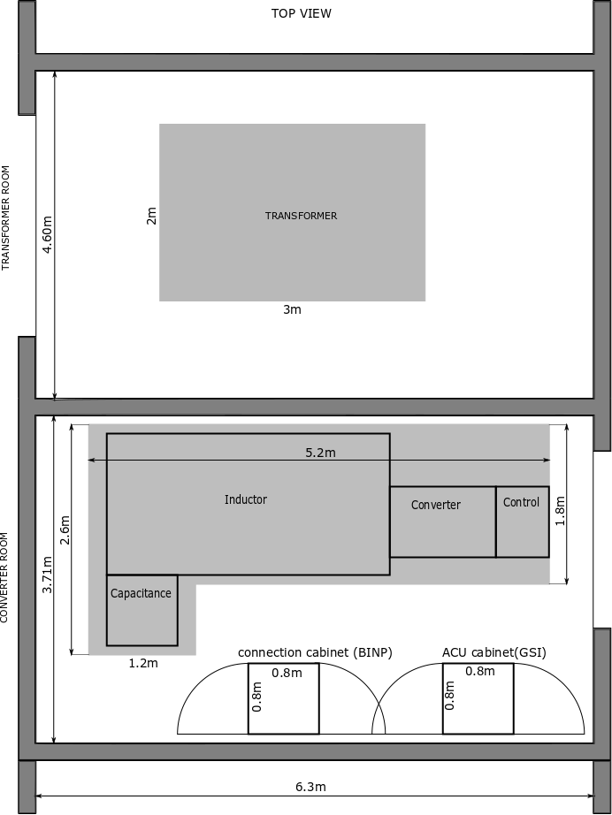
4th Joint BINP-FAIR CC Workshop
25.05 - 30.05.2020
POWER CONVERTERS LOCATION

Slide 14
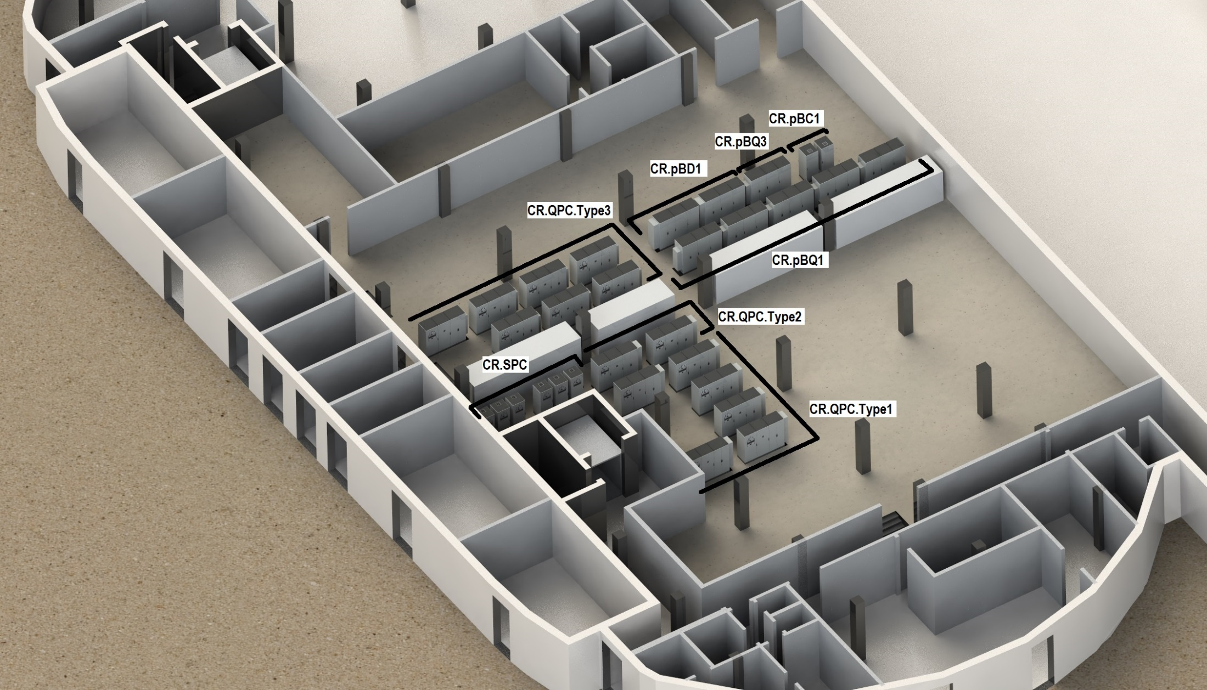
4th Joint BINP-FAIR CC Workshop
25.05 - 30.05.2020
POWER CONVERTERS LOCATION

Slide 15
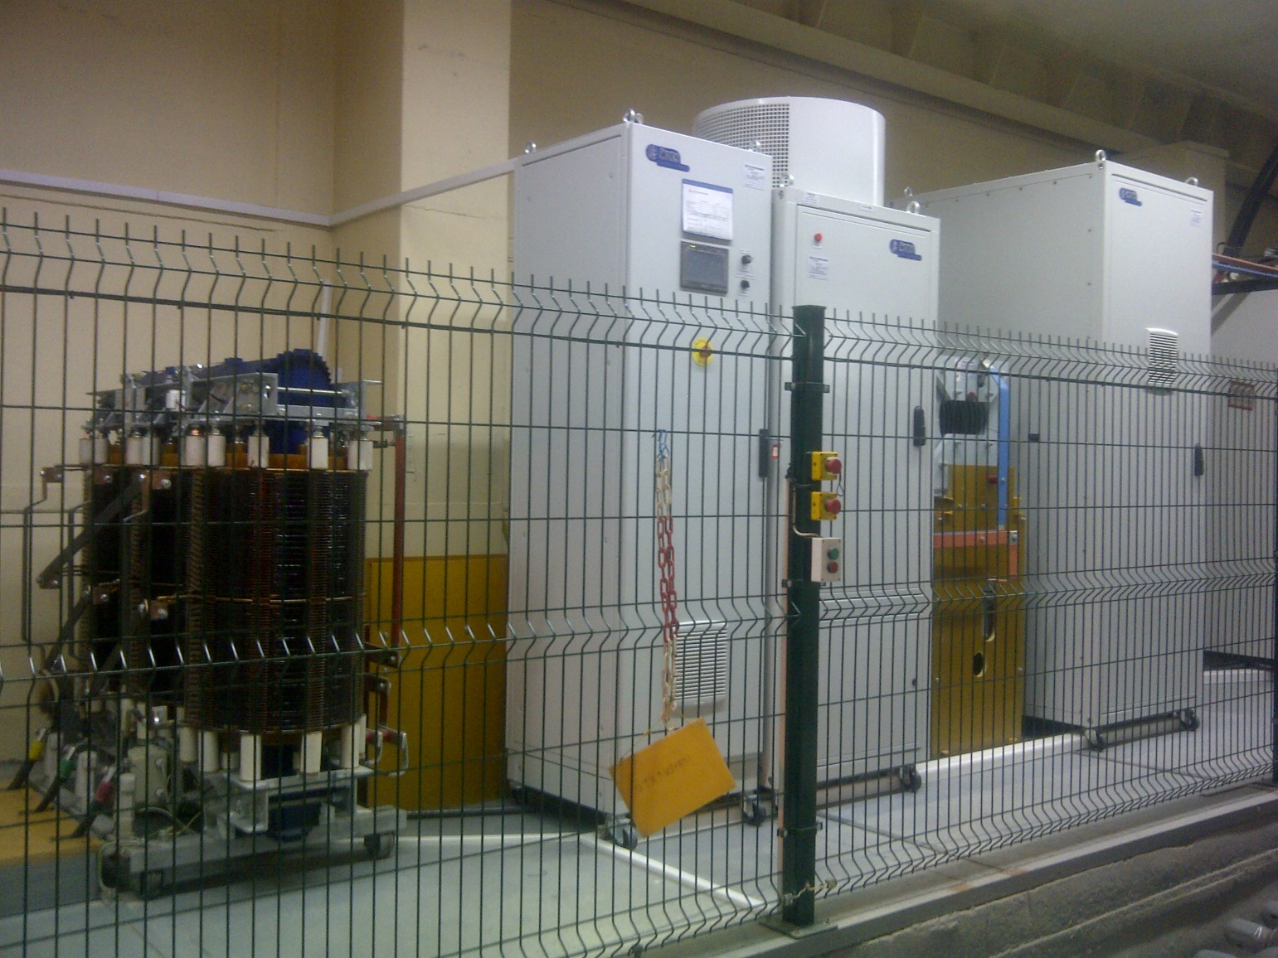
3MVA (1kA 3kV) ČKD DC SOURCE
4th Joint BINP-FAIR CC Workshop
25.05 - 30.05.2020

Slide 16
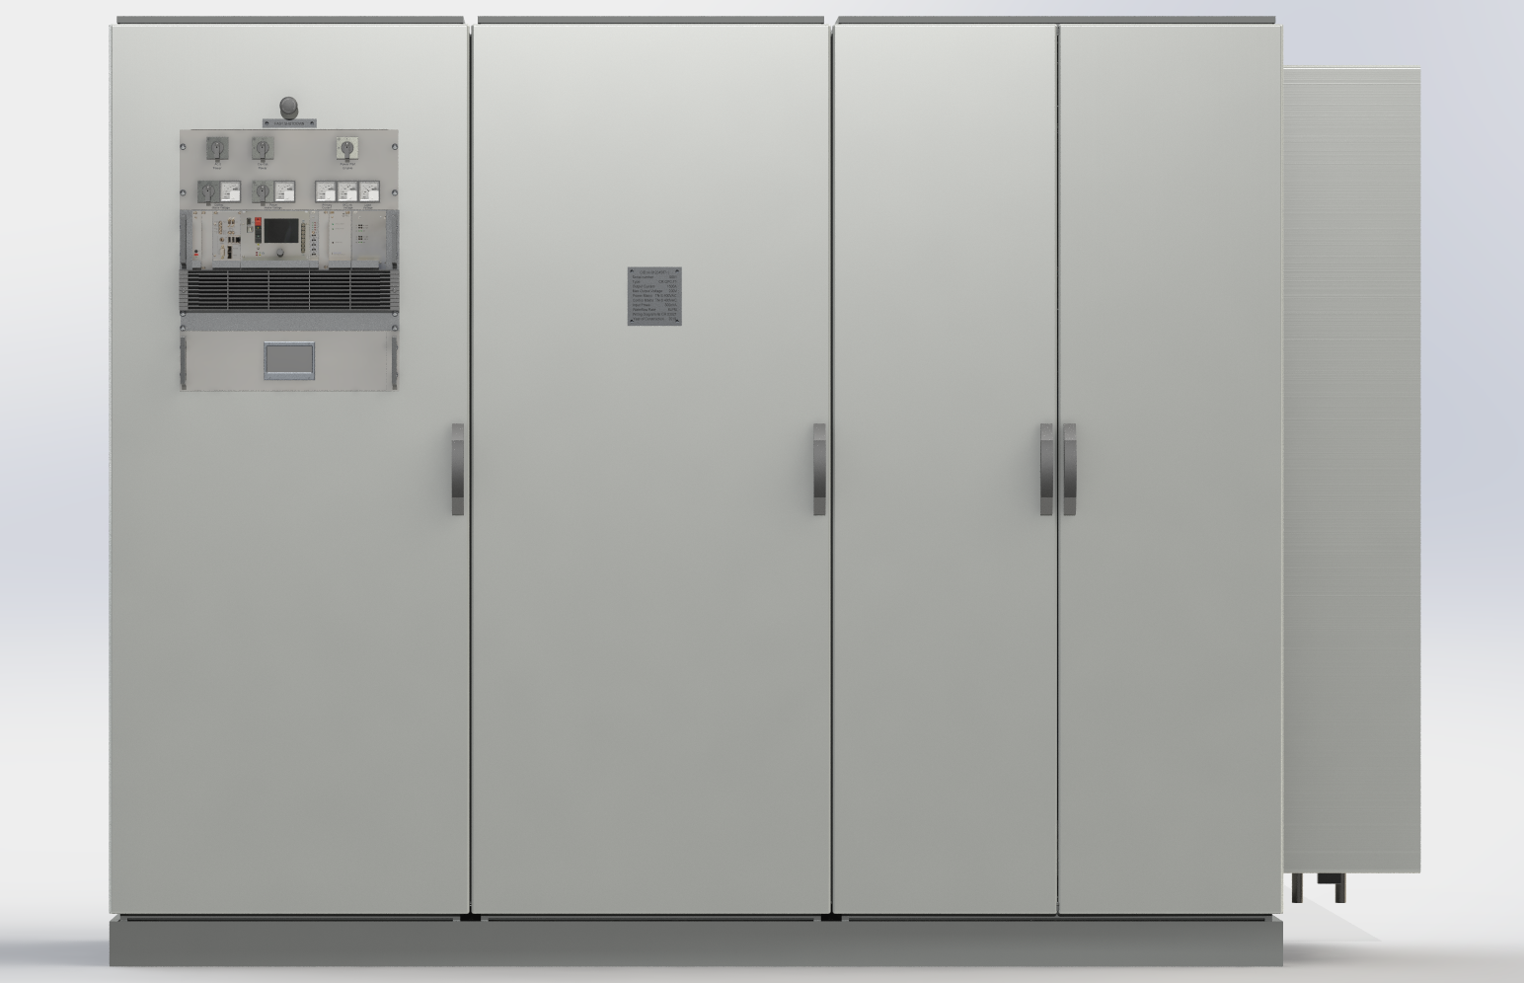
QUAD POWER APPEARANCE
4th Joint BINP-FAIR CC Workshop
25.05 - 30.05.2020

Slide 17
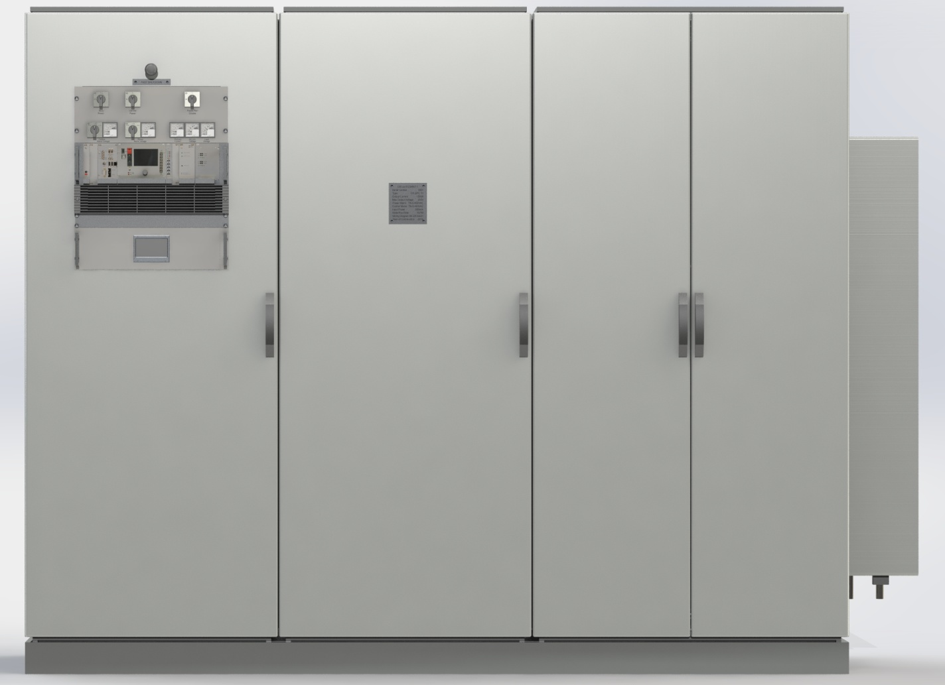
QUAD POWER APPEARANCE
4th Joint BINP-FAIR CC Workshop
25.05 - 30.05.2020

Slide 18
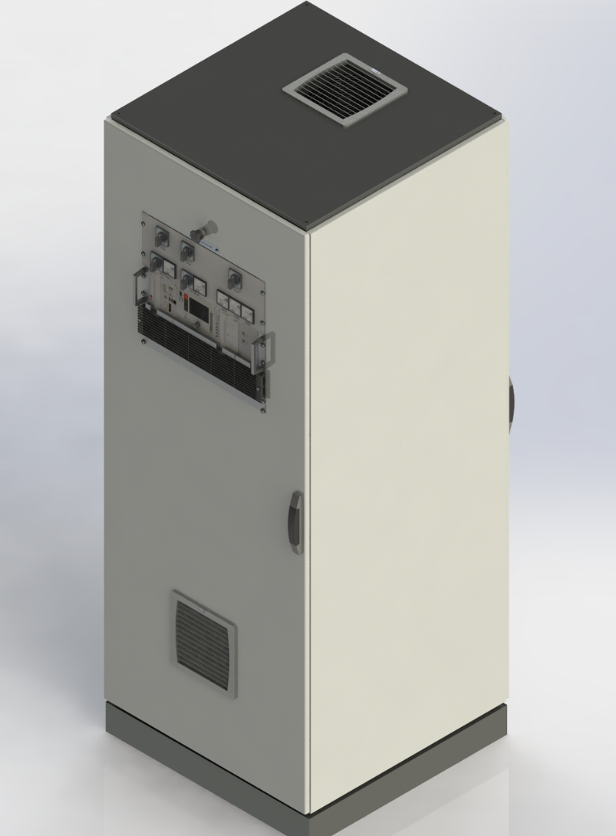
SEXTUPOLES POWER CONVERTER RACK LAYOUT
4th Joint BINP-FAIR CC Workshop
25.05 - 30.05.2020
500A
Power Section

Slide 19
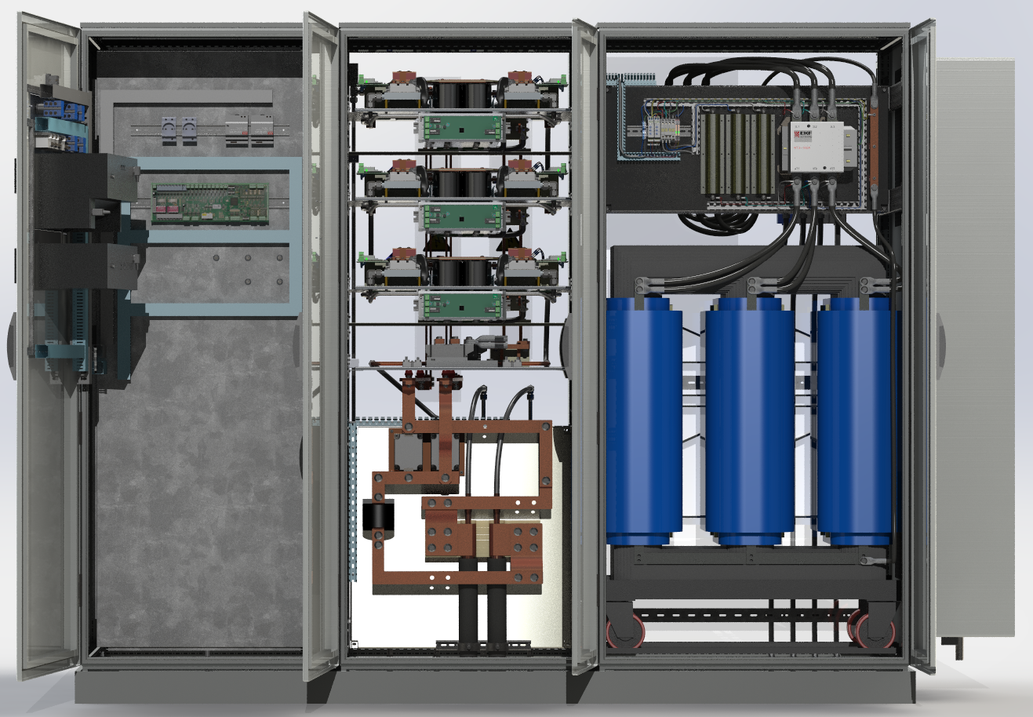
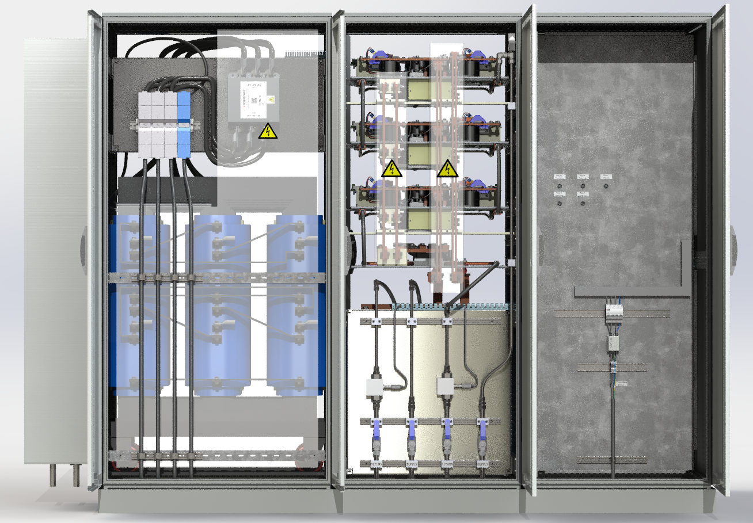
4th Joint BINP-FAIR CC Workshop
25.05 - 30.05.2020
POWER CONVERTERS CONNECTIONS
Connection to electrical power : TN-S
Connection to load: watercooled cables
Open doors Front view:
Open doors Rear view:

Slide 20
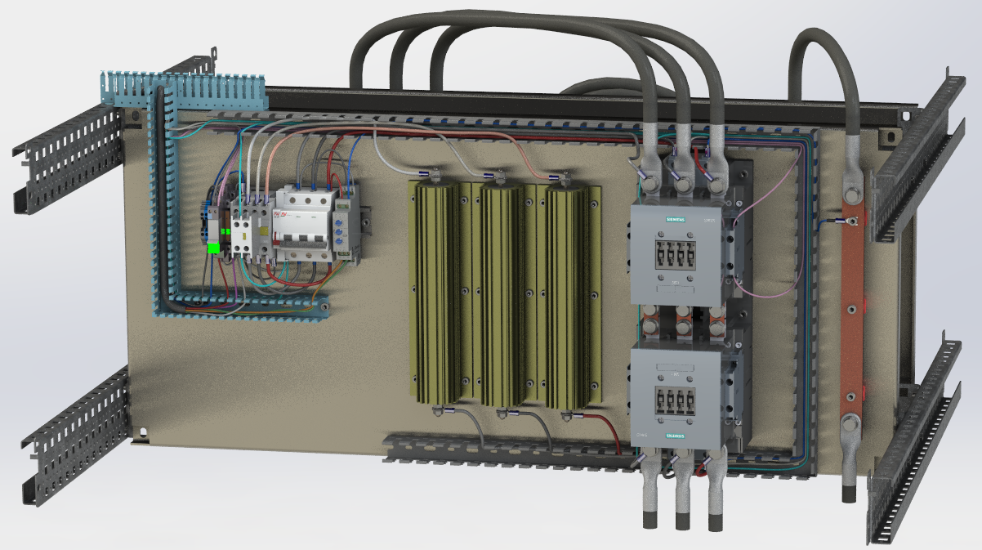
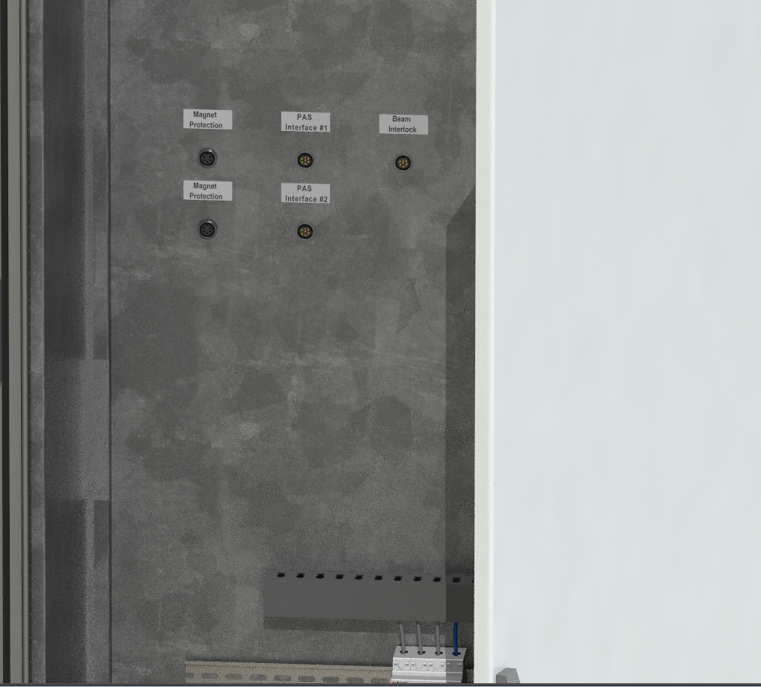
4th Joint BINP-FAIR CC Workshop
25.05 - 30.05.2020
PAS SYSTEM

Slide 21
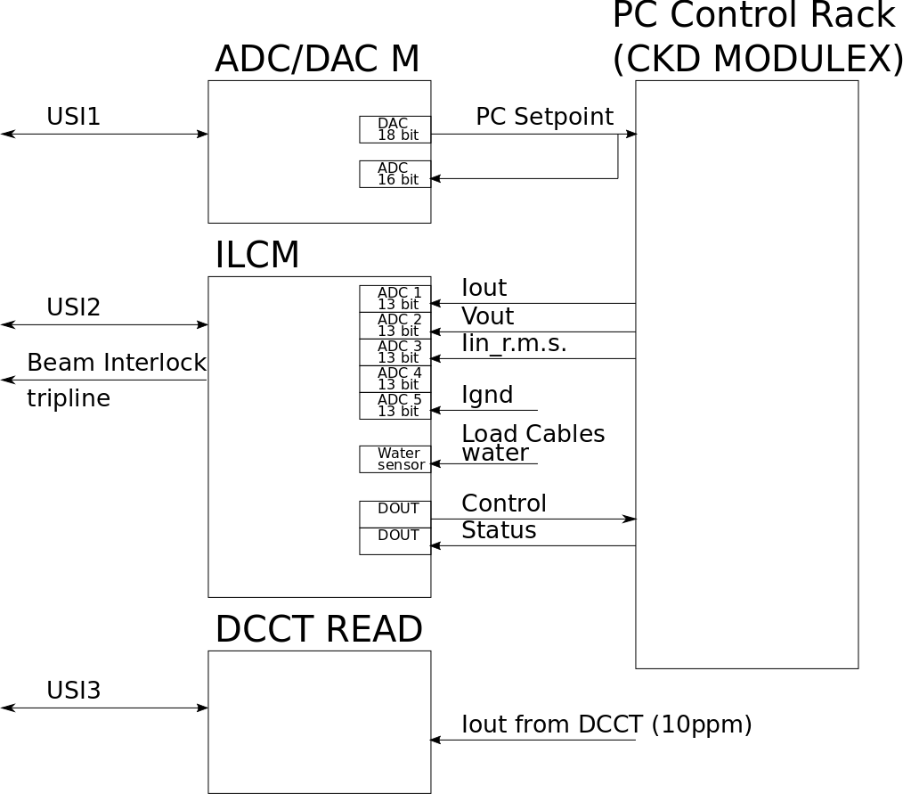
DIPOLE POWER CONVERTER CONTROL DIAGRAMM
4th Joint BINP-FAIR CC Workshop
25.05 - 30.05.2020

Slide 22
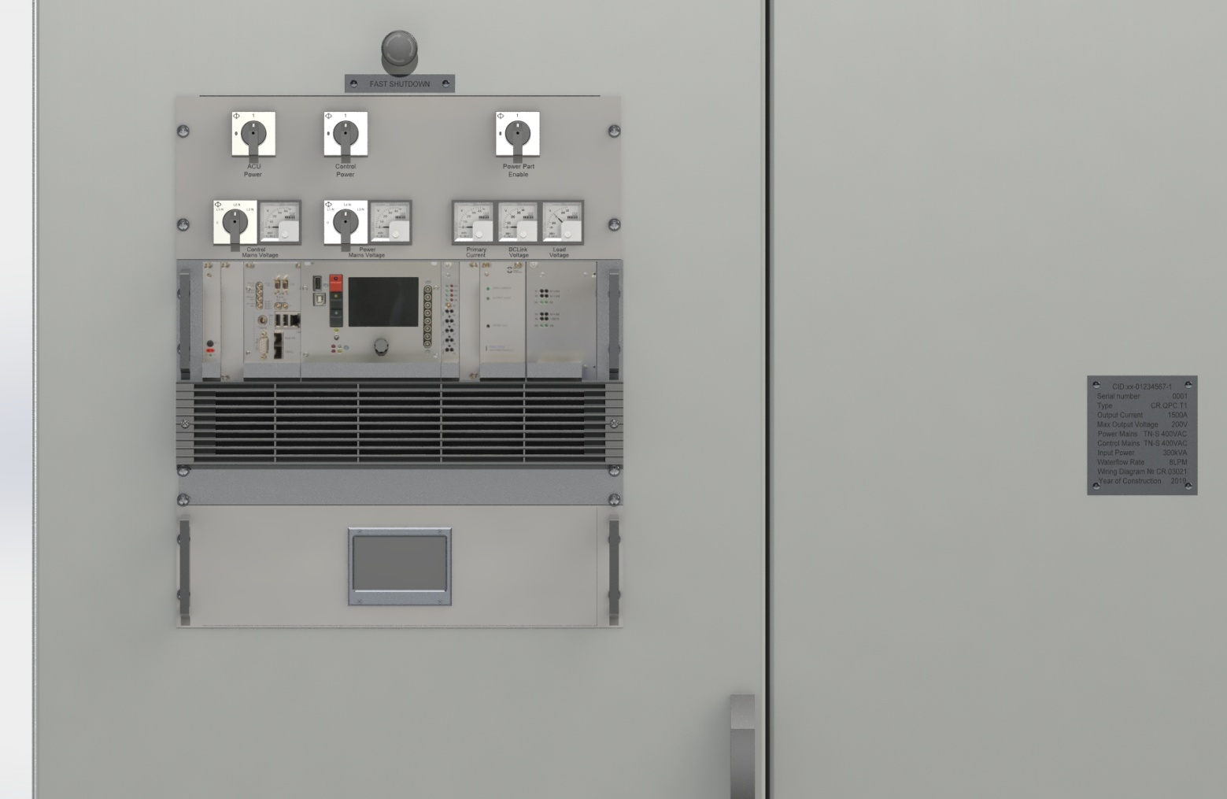
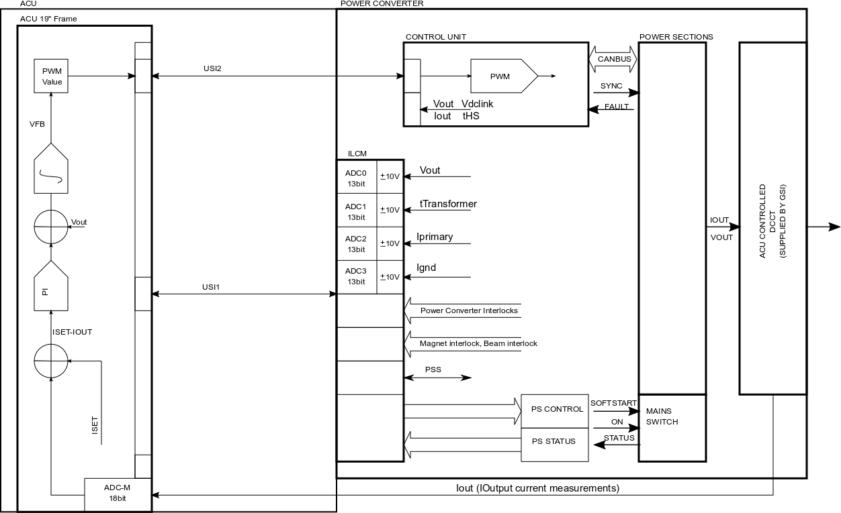
QUAD POWER CONVERTER CONTROL
4th Joint BINP-FAIR CC Workshop
25.05 - 30.05.2020

Slide 23
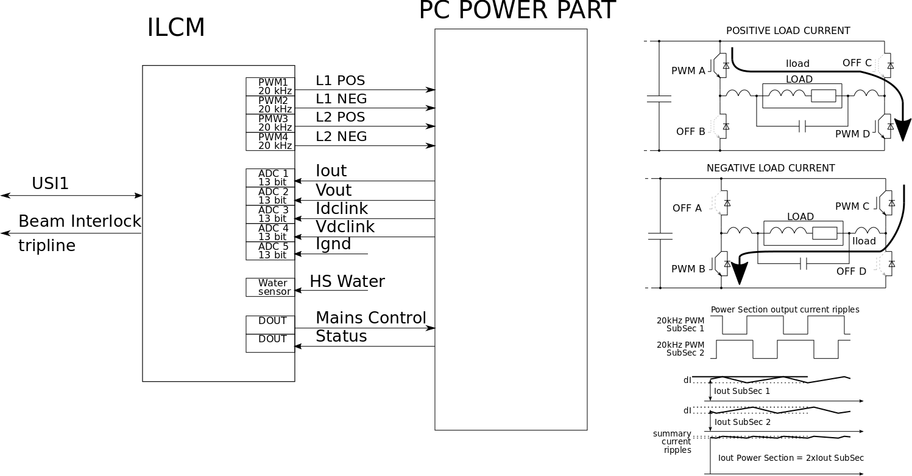
SEXTUPOLE POWER CONVERTER CONTROL
4th Joint BINP-FAIR CC Workshop
25.05 - 30.05.2020

Slide 24
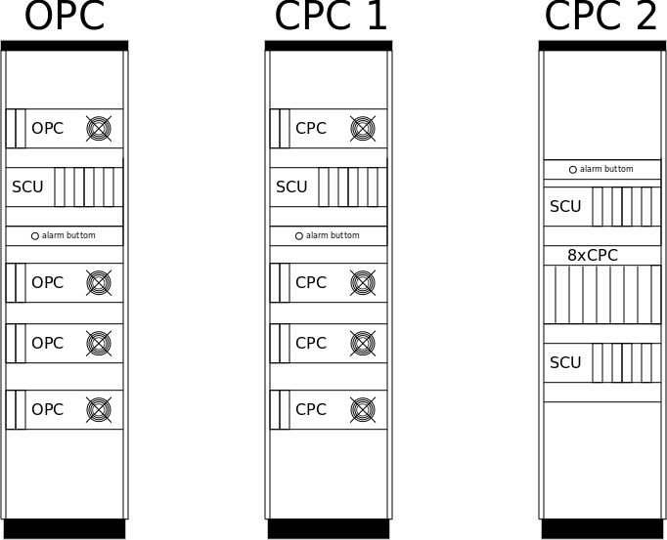
OCTUPOLE & STEERER POWER CONVERTERS
RACK LAYOUT
4th Joint BINP-FAIR CC Workshop
25.05 - 30.05.2020

Slide 25
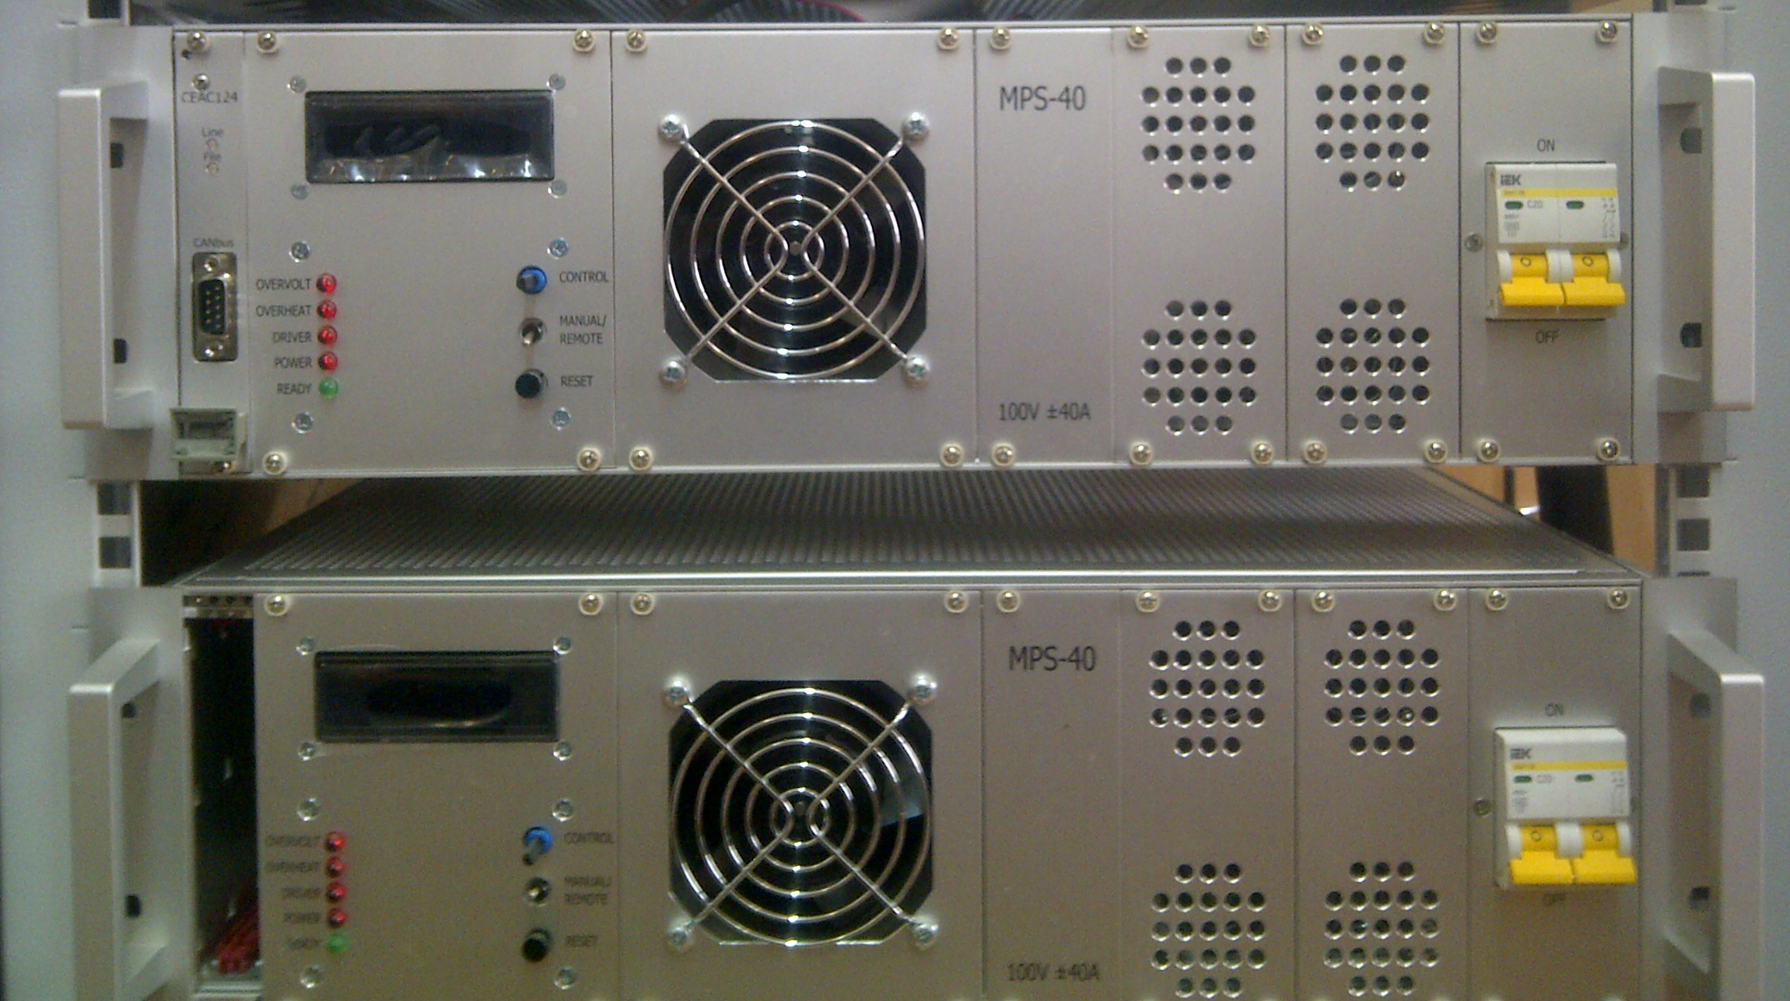
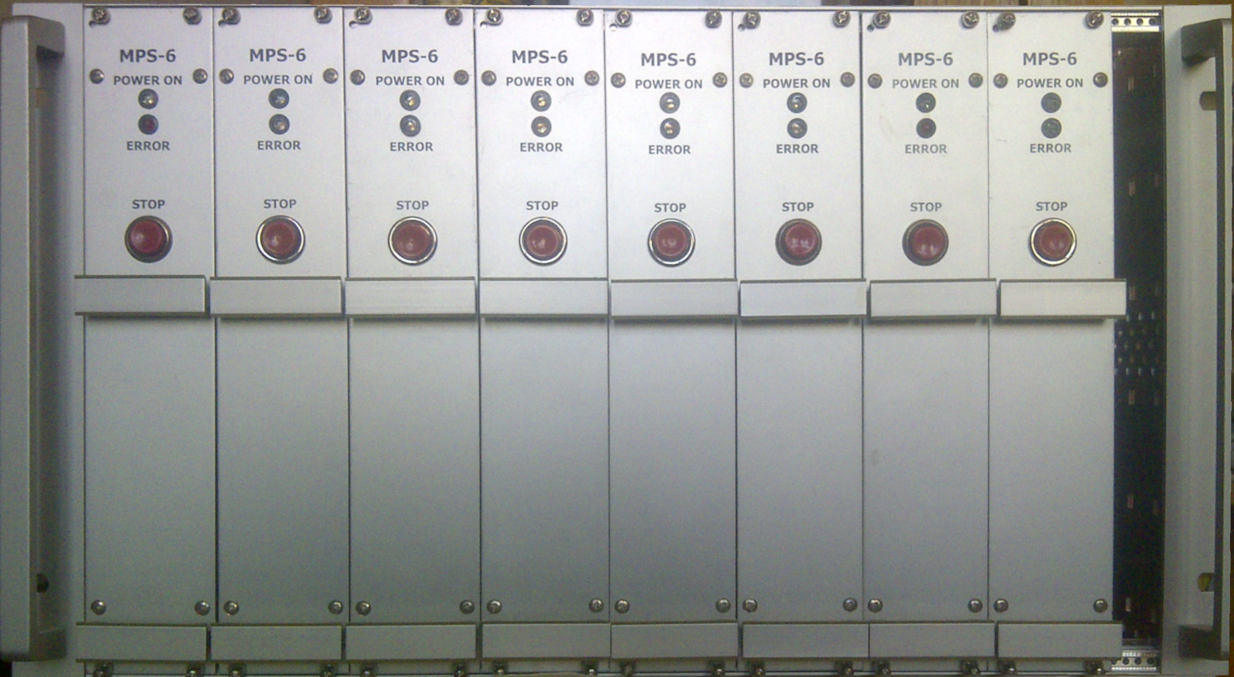
OCT. & CORR. POWER BLOCKS
4th Joint BINP-FAIR CC Workshop
25.05 - 30.05.2020

Slide 26
Current status
4th Joint BINP-FAIR CC Workshop
25.05 - 30.05.2020
Concept
Discussed and agreed
Specifications
Released
Design
Prototyped
CDR
Released for QPC
FDR
planned to 09.2020 – 12.2020

Slide 27
Current status
4th Joint BINP-FAIR CC Workshop
25.05 - 30.05.2020
ACU
Planned to be delivered to Novosibirsk autumn 2020 for tests
Marnetic Measurements PC
One will be build for Novosibirsk stand
One will be delivered to GSI test stand (QPC prototype)

Slide 28
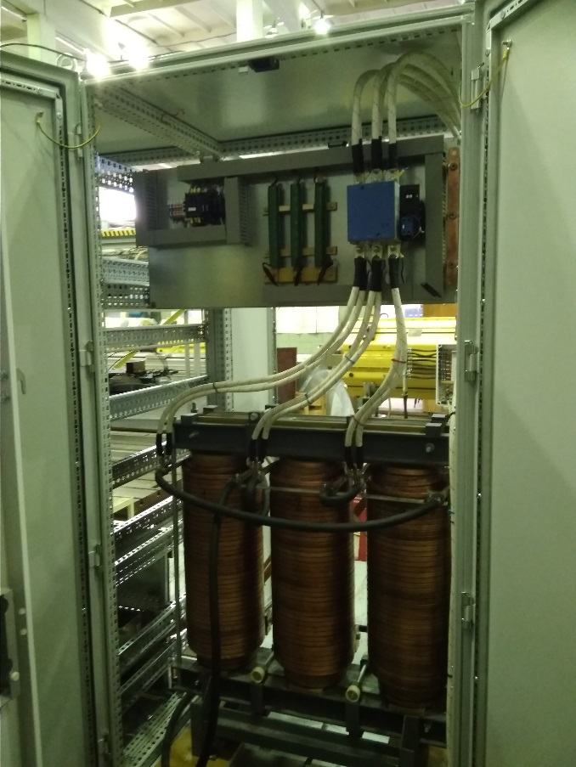
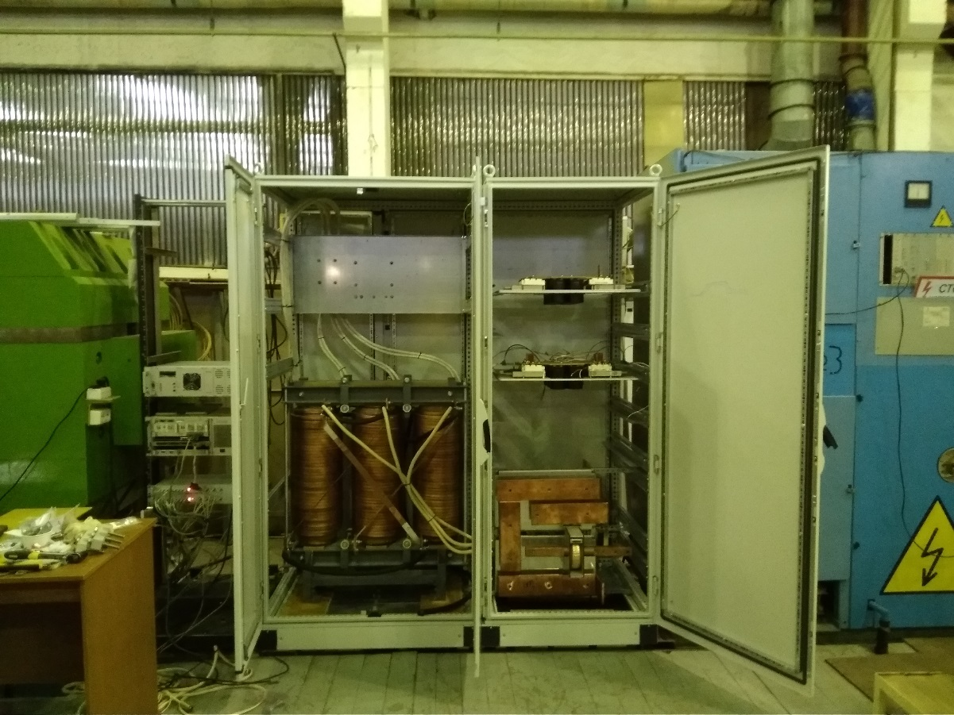
Current status
4th Joint BINP-FAIR CC Workshop
25.05 - 30.05.2020
Prototype for magnetic measurements: is planned to be ready summer-autumn 2020

Slide 29
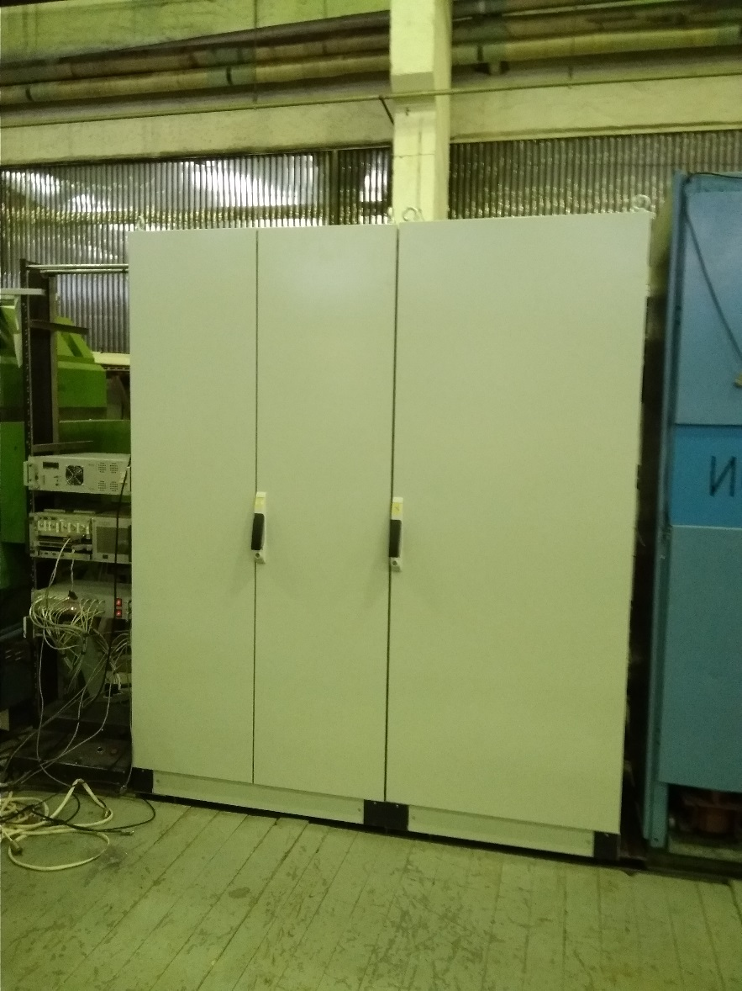
Current status
4th Joint BINP-FAIR CC Workshop
25.05 - 30.05.2020

Slide 30
Thank you for attention
4th Joint BINP-FAIR CC Workshop
25.05 - 30.05.2020

