Slide 1
CR
Main Magnetic Elements
STATUS
Alexandr Starostenko
May 2020

Slide 2
Common Status report
Qualitative rating:
done
as planned
critical, but reachable
very critical, unreachable
not applicable
PSP | 2.5.2
WP | CR Magnets
WP-Leader | Alexandr Starostenko
Report period | May 2020
X
PSP` | Subproject | Responsibility | S | CDR | FDR | PR FoS | FAT FoS | SAT FoS | SP | FAT SP | DL | SAT SP | IN | CO | Activities in reporting period / Risks
2.5.2.1 | Dipole Magnets | A. Starostenko | x | x | x |  |  |  |  |  |  |  |  |  | Top and Bottom parts was manufactured. First two coils was manufactured. Yoke Side spacers is in production
2.5.2.2 | Quadrupole Magnets | A. Utkin D. Gurov | x | x |  |  |  |  |  |  |  |  |  |  | FDR WQ done FDR – SWQ, EWQ, NQ, NQM, NFQ documents is in preparation Stamps is in preparation for production
2.5.2.3 | Sextupole Magnets | A. Tsyganov | x | x |  |  |  |  |  |  |  |  |  |  | FDR is in preparation, Stamp is in production
2.5.2.4 | Octupole Correction Magnets | D. Gurov | x |  |  |  |  |  |  |  |  |  |  |  | CDR is in preparation
2.5.2.6 | Orbit Correction Magnets | A. Tsyganov | x | x | х | х |  |  |  |  |  |  |  |  | FoS is ready
WP subprojects (4th level):
Legend:
S - Specification; CDR Conceptual Design Review; FDR Final Design Review; PR- Production FoS; FAT FoS Factory acceptance test) FoS; SAT FoS - Site Acceptance Test of FoS; SP – Series Production; FAT SP – Factory acceptance test of Series Production; DL –Delivery; SAT SP – Site Acceptance Test of Series Production; IN – Installation; CO – commissioning without beam

Slide 3
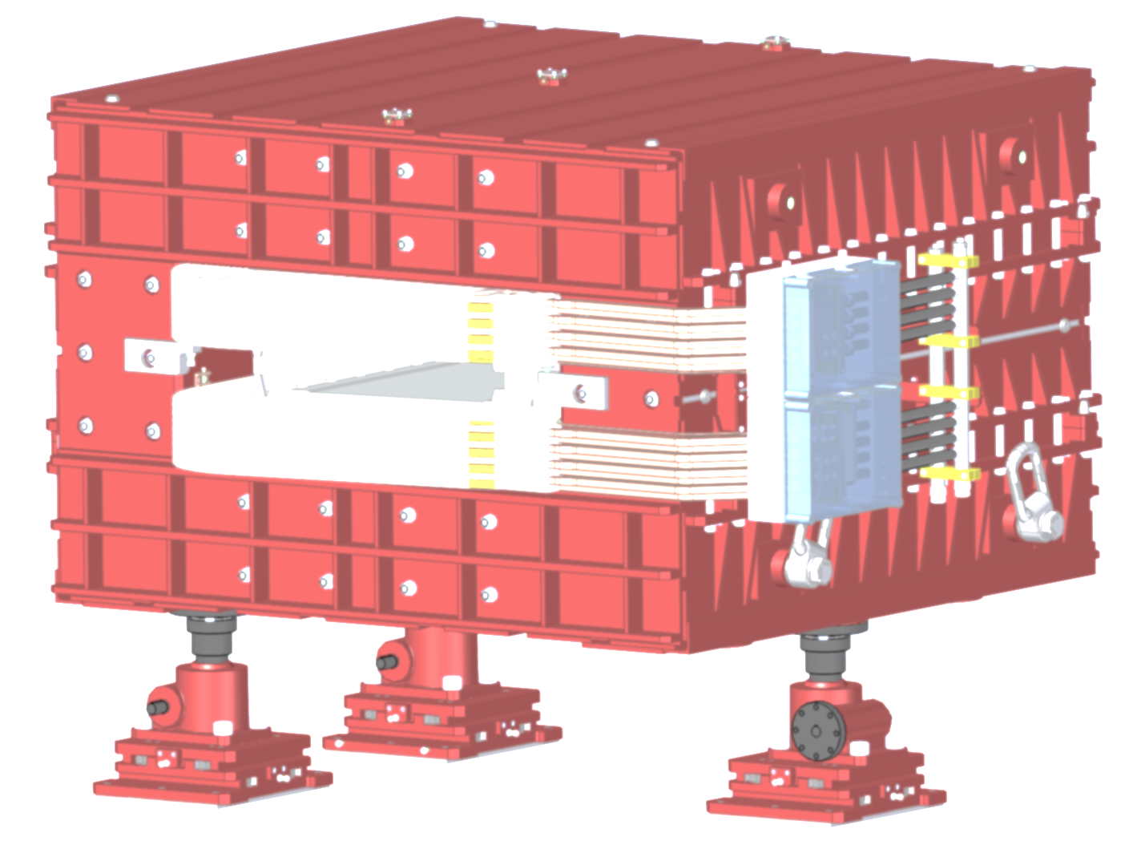
CR dipole

Slide 4
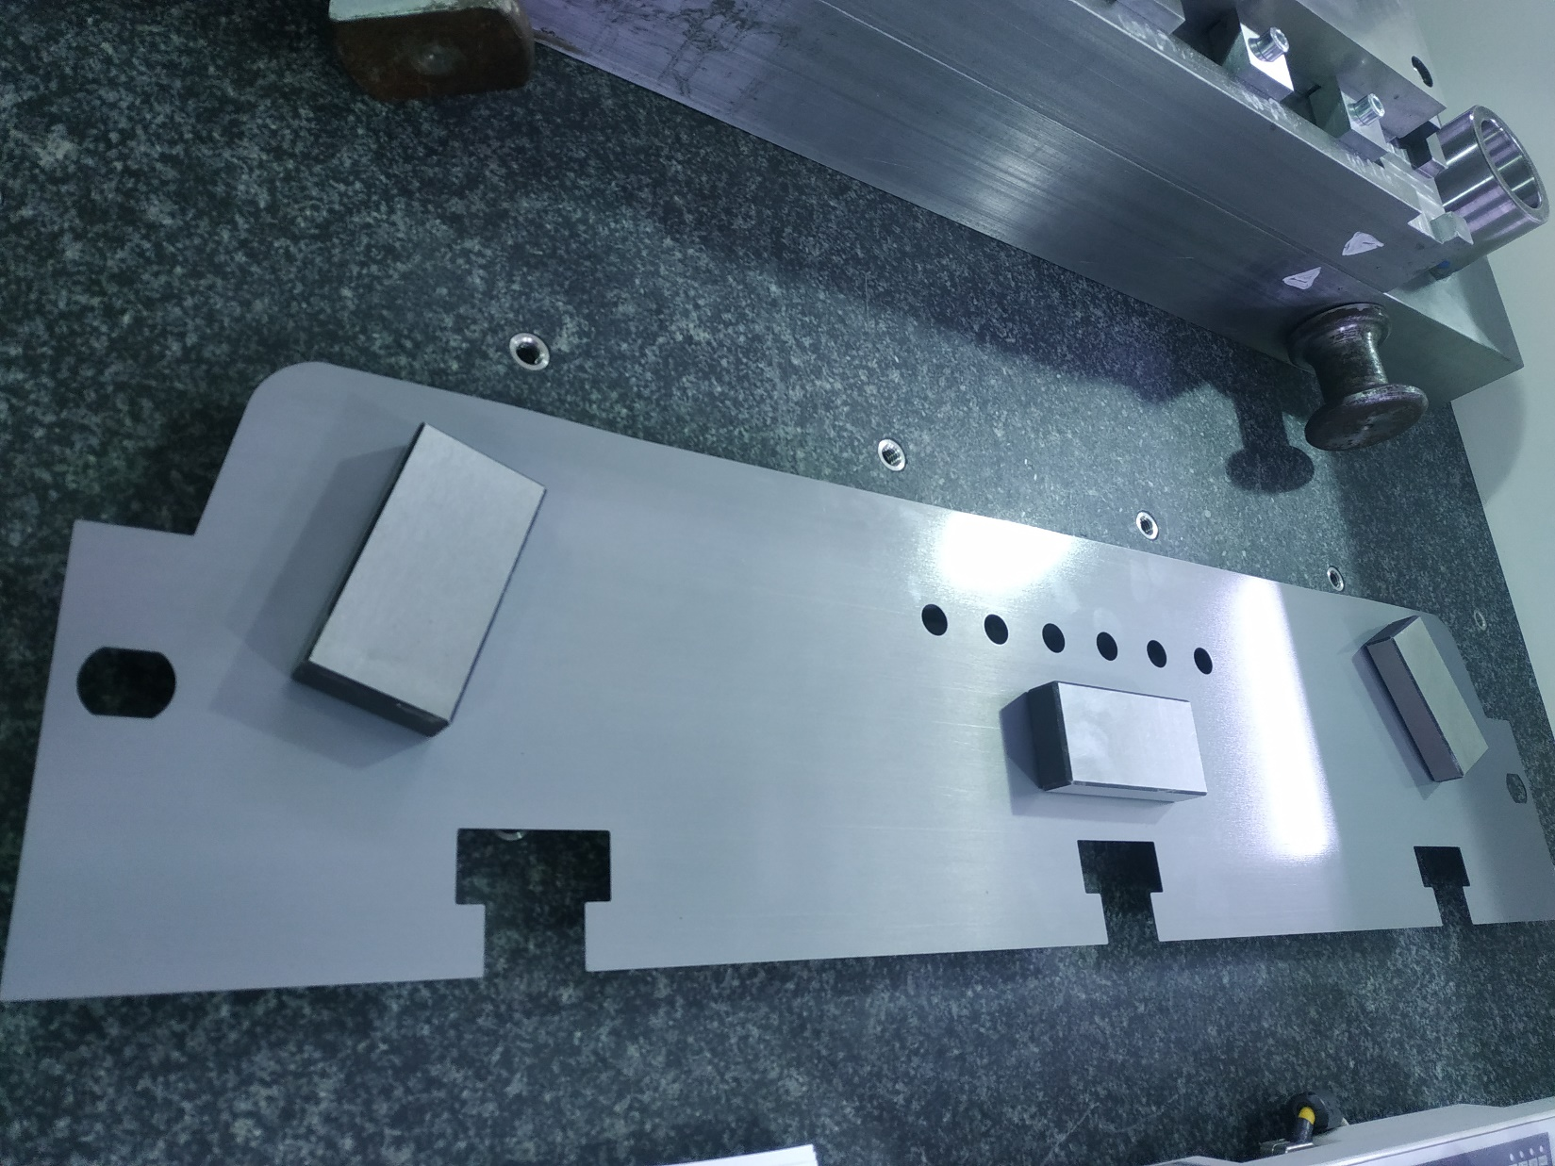
Poles lamination. Geometrical test

Slide 5
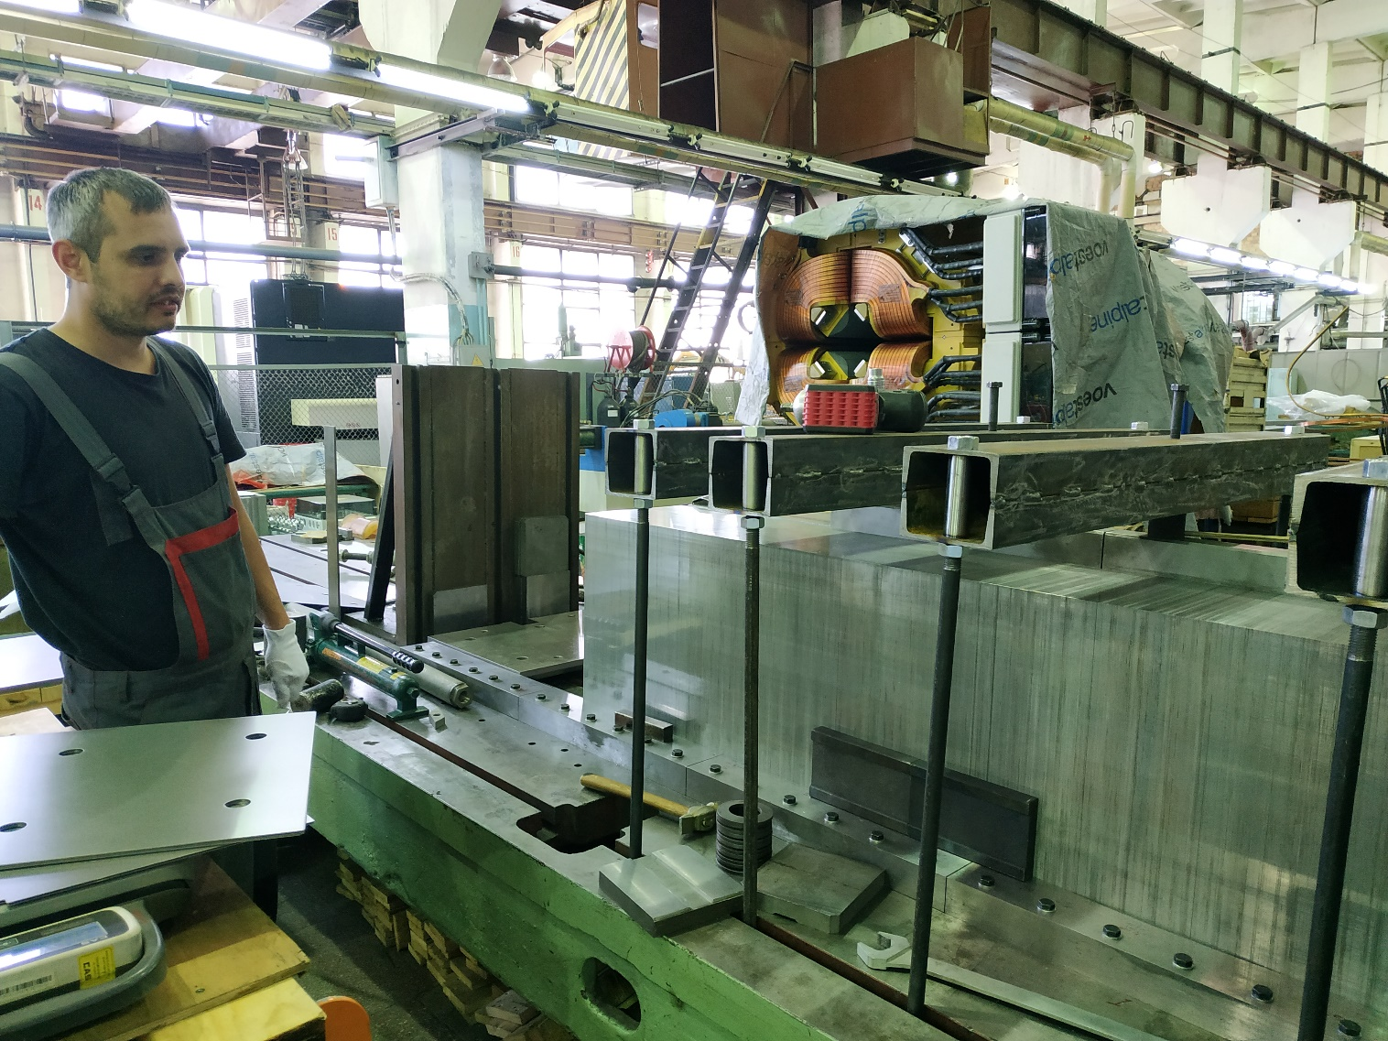
Yoke side block. First block is create on the Stacking fixture

Slide 6
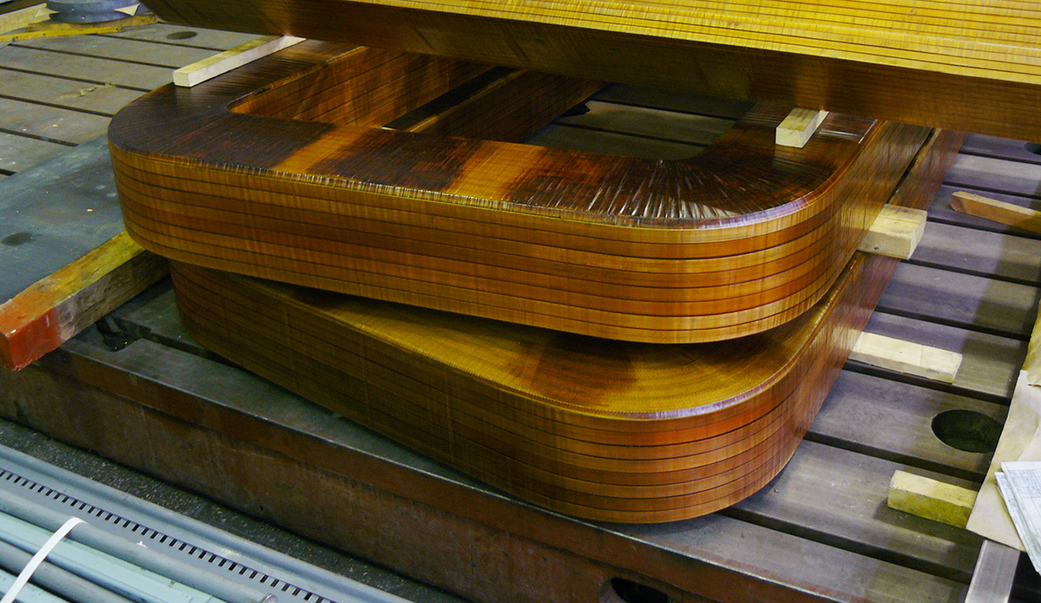
Coils. First set of coils is ready

Slide 7
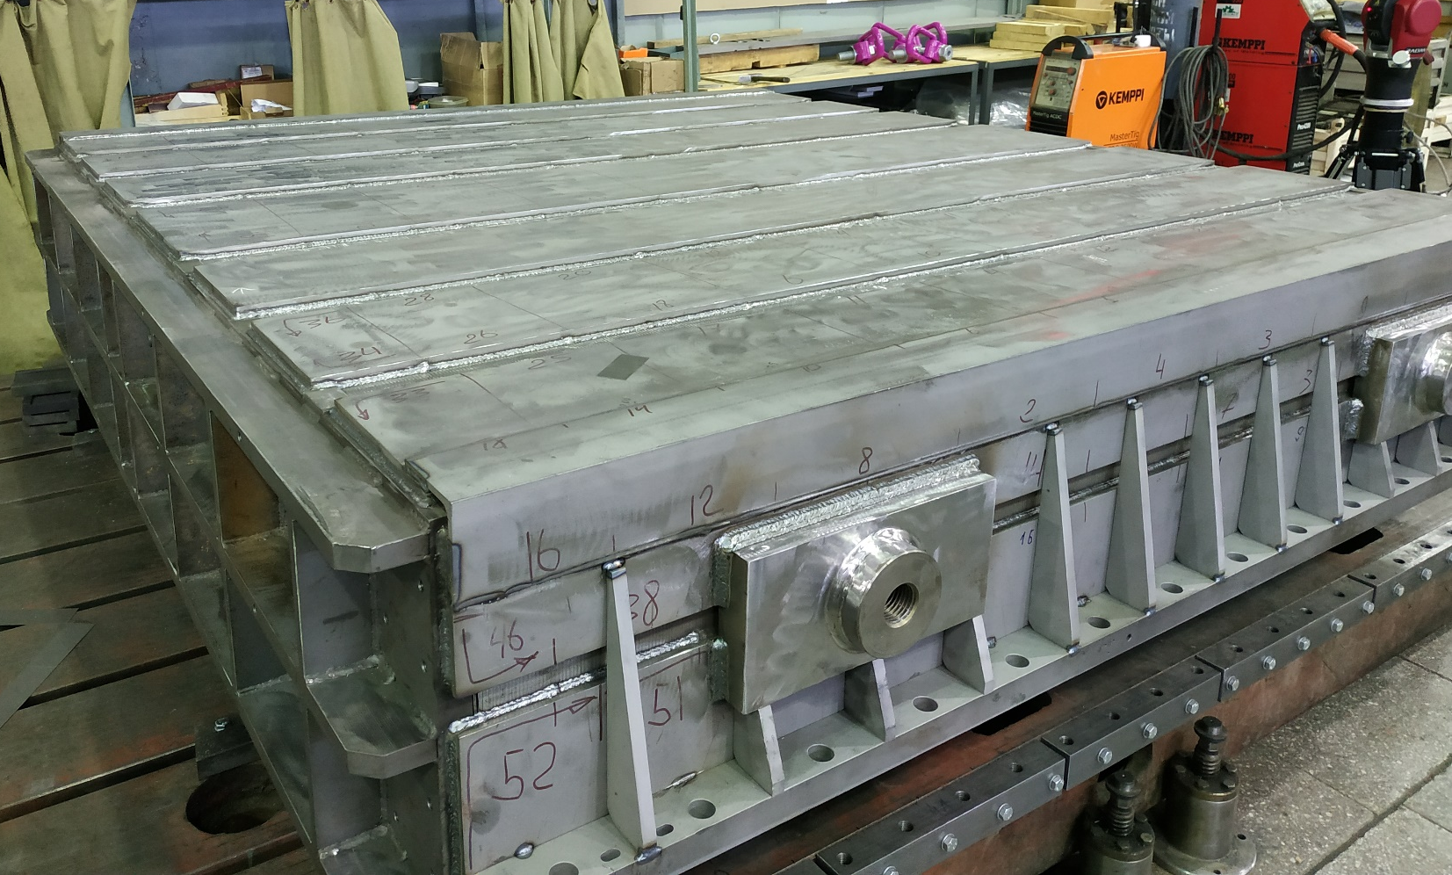
Outer yoke. Top and bottom plates are ready

Slide 8
CR
steerers

Slide 9
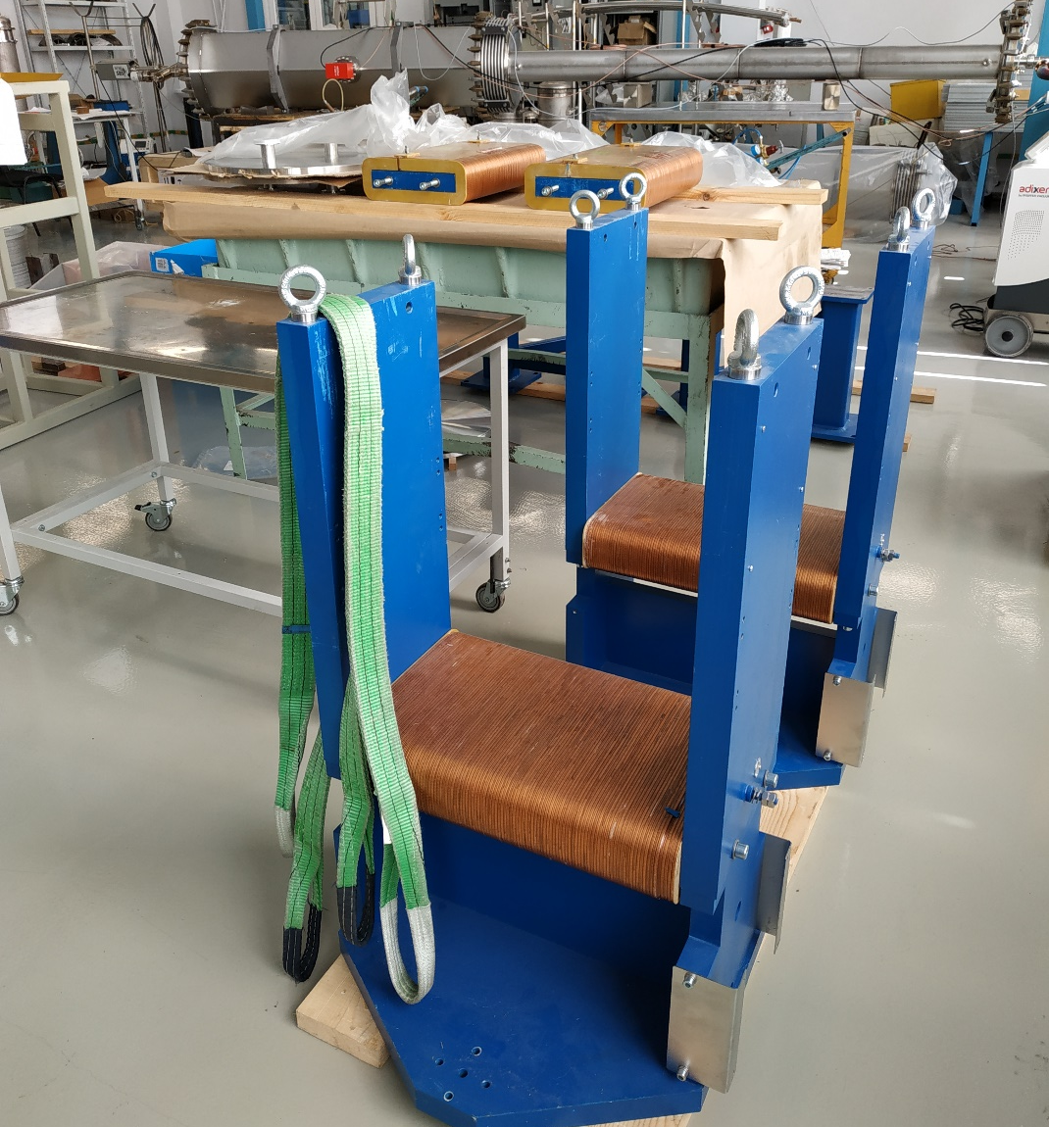
CR steerers.
2 Vertical correctors practically ready!

Slide 10
Thanks!

