Slide 1
4th BINP Workshop Video-Conference 25. – 29.05.2020 Site Management – Resource Planning
H Reich-Sprenger & H Hagelskamp

Slide 2
Site Management – Resource Planning
Objectives:
Collaboration agreements for HEBT
Pre-Assembly / Installation HEBT A – Resource Planning
Pre-Assembly / Installation HEBT B – Resource Planning
Pre-Assembly / Installation HEBT C – Resource Planning
FAIR Resource Planning HEBT
Resource Planning CR (BINP)
Resource Planning SRFS (BINP)

Slide 3
Site Management – Resource Planning
Pre-Assembly HEBT Magnets & Vacuum Chambers Batch2&3
Provider Obligations
Installation of vacuum chambers into the magnets at the Company‘s site together with 3rd party and with support of the Company
To support the mounting of the vacuum chambers into the magnets at FAIR site, this equates an effort of 2200 person-hours for the vacuum part of mounting 272 vacuum chambers.

Slide 4
Site Management – Resource Planning
Tunnel installation HEBT Magnets & Vacuum Chambers
Provider Obligation
For Batch 2&3
Preparation for installation on Company‘s site (including vacuum chamber installation into magnets).
Provision of personnel for the transport and approximate placement into the tunnel.
Necessary training of the Company personnel.
For Batch 4:
Installation of the complete system at the FAIR company site.

Slide 5
Site Management – Resource Planning
HEBT A Scope:
pre-assembly and installation of 145 VC (incl. Efremov Batch 1) and 107 NCM
pre-assembly to start 6 months before installation (Dec-2020)
estimated resource required:
pre-assembly: ...... from BINP; ...... from FAIR.
installation: …… from BINP; …… from FAIR.
batch 4 VC to be delivered in 2021.

Slide 6
Site Management – Resource Planning
HEBT B Scope:
pre-assembly and installation of 87 VC and 83 NCM
pre-assembly to start 6 months before installation (Dec-2021).
estimated resources required:
pre-assembly: …… from BINP; …… from FAIR
installation: …… from BINP; …… from FAIR
Batch 4 VC delivery to start in 2021.

Slide 7
Site Management – Resource Planning
HEBT C Scope:
pre-assembly and installation of 71 VC and 71 NCM
pre-assembly to start 6 months before installation.
estimated resource required:
pre-assembly: …… from BINP; …… from FAIR.
installation: …… from BINP; …… from FAIR.
Batch 4 VC Deliveries to start in 2021.

Slide 8
Site Management – Resource Planning
FAIR Site Management
Installation Resource Planning

Slide 9
Site Management – Resource Planning HEBT Installation - Mechanicals
Based on FAIR Installation Concept HEBT – November 2019

Slide 10
Site Management – Resource Planning HEBT Installation - Electricians
Based on FAIR Installation Concept HEBT – November 2019

Slide 11
Site Management – Resource Planning HEBT Installation - Mechanicals
Based on BINP Installation Concept CR – February 2020

Slide 12
Site Management – Resource Planning HEBT Installation - Electricians
Based on BINP Installation Concept CR – February 2020

Slide 13
Installation Ressources SFRS Mechanicals
SFRS
Pre-Assembly of Magnet Chambers at FAIR Site.
BINP Resource Planning ??

Slide 14
Installation Ressources SFRS Mechanicals

Slide 15
Installation Ressources SFRS Electricians

Slide 16
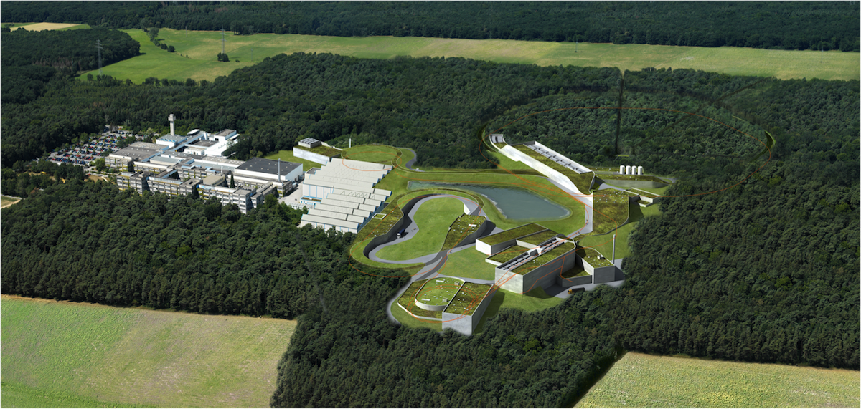
Thank you very much !

Slide 17
Installation Ressources HEBT / SFRS Mechanicals

Slide 18
Installation Ressources HEBT / SFRS Electricians

