Slide 1
CR status
Dmitry Shwartz
on behalf of the BINP team
4th BINP-FAIR Collaboration Coordination Workshop, WWW, 25-29 May 2020

Slide 2
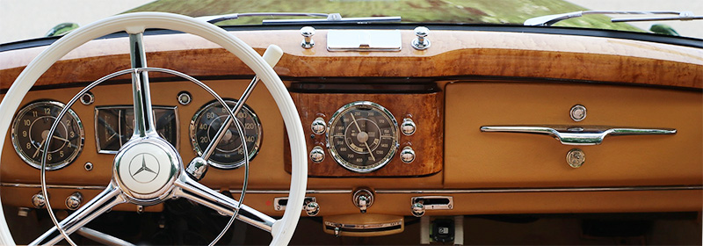
CR status
Dmitry Shwartz
on behalf of the BINP team
Not based on a dashboard,
just status as is
4th BINP-FAIR Collaboration Coordination Workshop, WWW, 25-29 May 2020

Slide 3
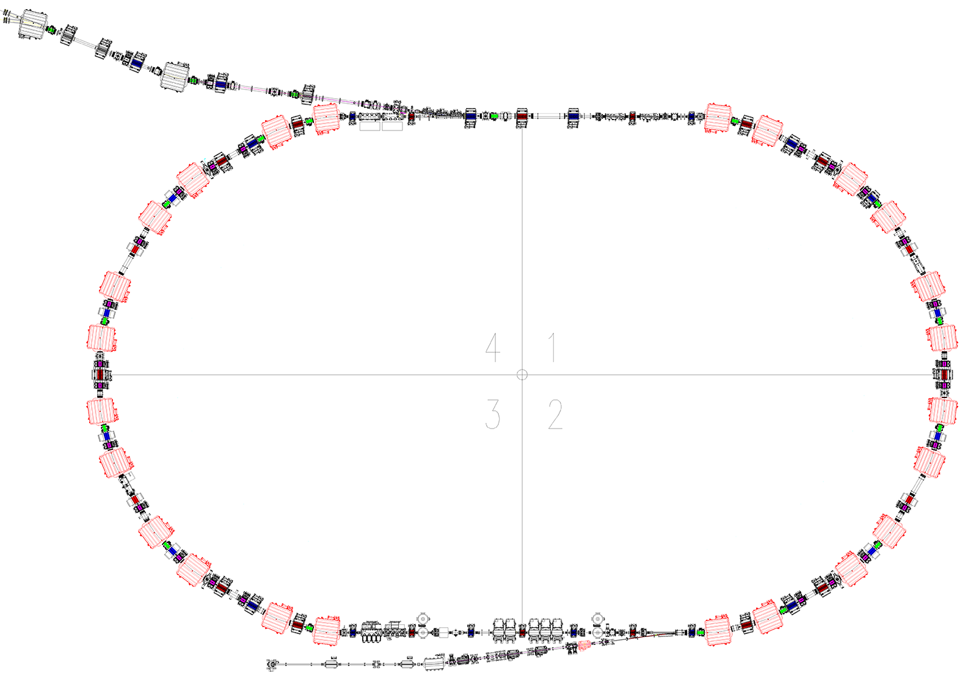
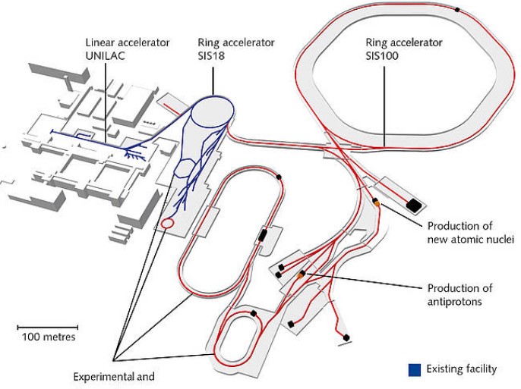
Collector Ring overview
Beam from
p_bar & SFRS
Inj septa
EWQ
NQ
Dipole
WQ
SWQ
Stochastic cooling
kickers
Inj/Extr kickers
HESR
Pickup
CR
Stochastic cooling
pickups
ToF detector
Sextupole
RF debunchers
Extr septa
Extraction
to HESR

Slide 4
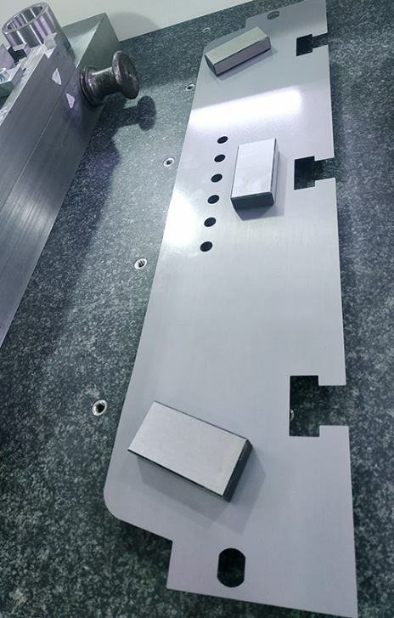
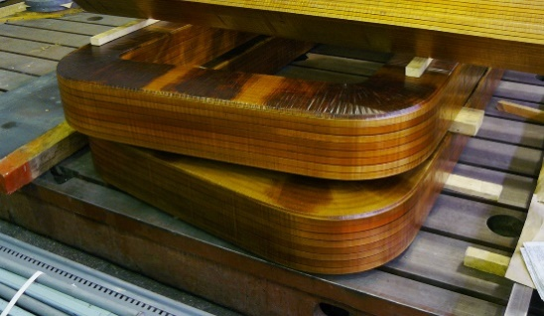
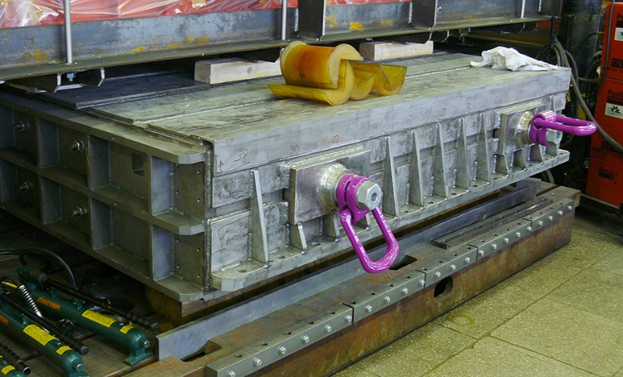
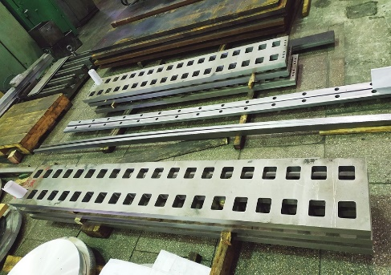
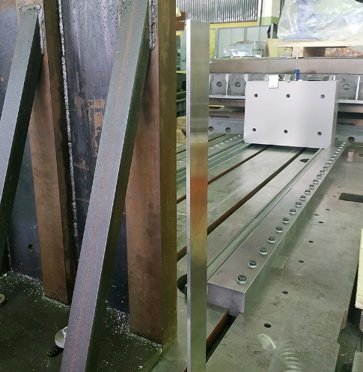
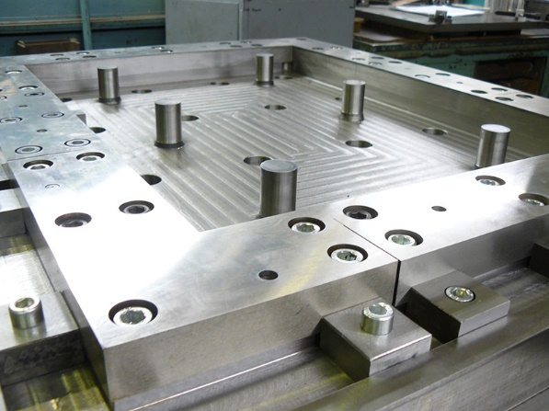
Magnets: Dipole
Spec
CDR
FDR
FoS
FAT
SAT
FoS coils
Test lamina of the magnet pole part @ measuring machine
Parts of inner pole block
One of two (upper and lower) 20 ton yoke blocks
Stamping matrix for side blocks
Yoke side block in press cradle
FoS ready for tests: July-2020
Delivery to FAIR: Dec-2020

Slide 5
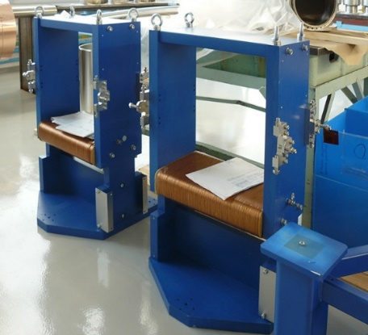
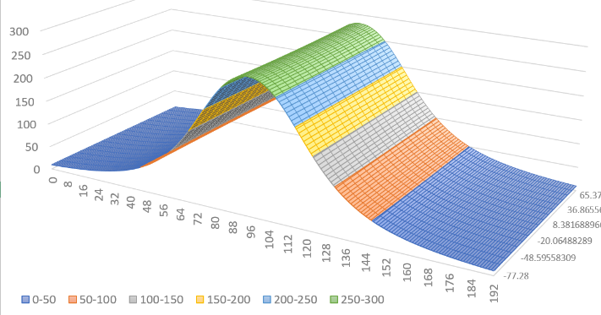
Magnets: multipoles and steerers
WQ and sextupole
Spec
CDR
FDR
FoS
FAT
SAT
WQ – FDR released, both for CR/TCR1. FoS production has been started.
SWQ, EWQ, NQ, NQM, NQS – CDR done, docs corrections nearly finished. Manufacturing tooling design is ongoing.
Sextupoles – CDR presented, design is ongoing.
Octupoles coils – CDR presented, design is nearly finished.
Wide Steerers – CDR released, FDR done, corrections ongoing.
Combined steerers – CDR released, FDR done, corrections ongoing. Two FoS are manufactured, preliminary magnetic measurements has been performed.
TCR1 combined steerer (1 pcs) – spec is in work.
WQ support stress analysis
Steerer FoS preliminary magnetic measurements
Wide vertical steerers

Slide 6
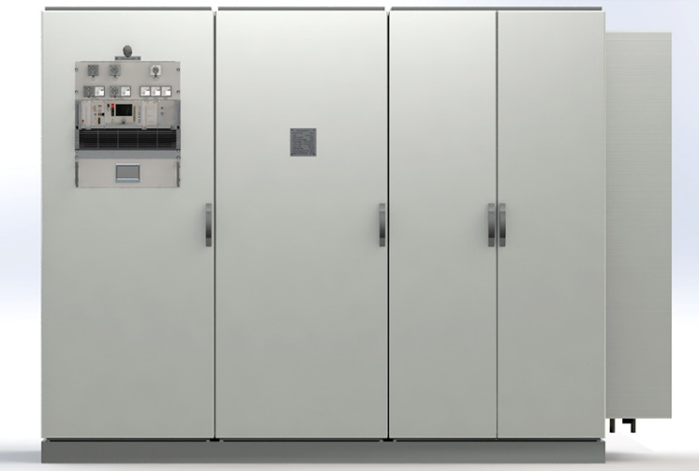
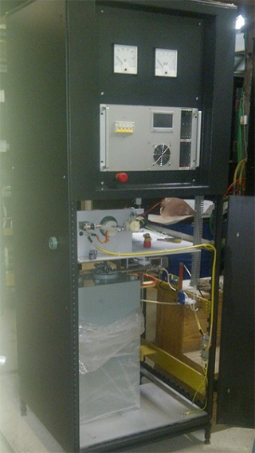
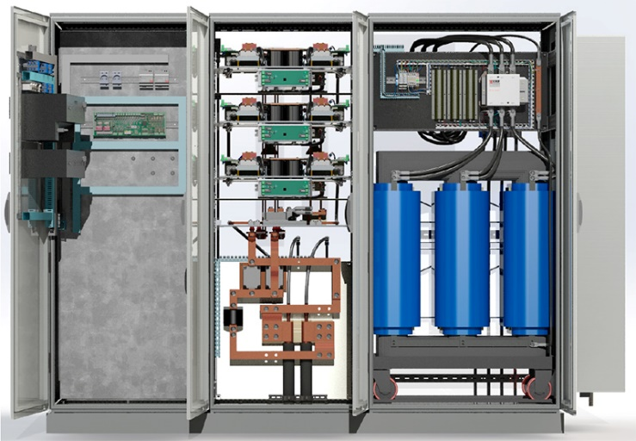
Power Converters
Spec
CDR
FDR
FoS
FAT
SAT
QPC racks model
Dipole PC – CDR is in progress, procurement of main power part via FAIR is foreseen (~700 k€).
QPC – Type-1,2 CDR released, Type-3 CDR done. Pre-prototype is under study. Prototype production has been started.
Sextupoles PC – CDR under preparation.
Steerers PC – CDR under preparation.
QPC pre-prototype
testing
QPC prototype delivery to FAIR for dipole measurements: Dec-2020

Slide 7
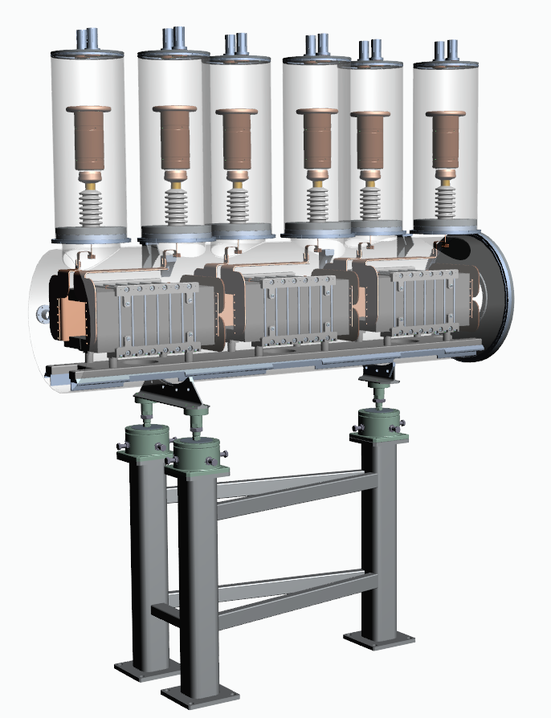
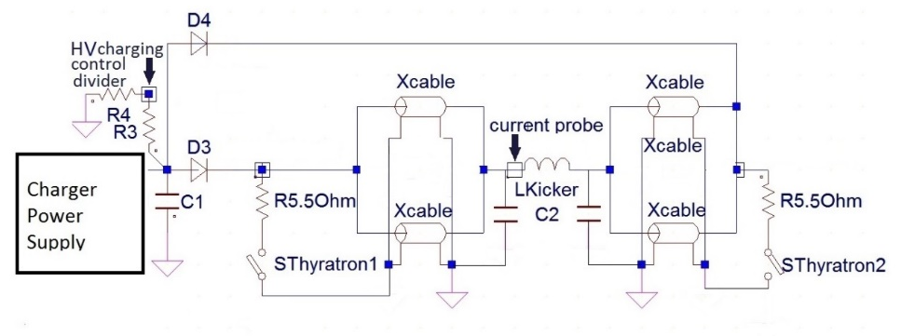
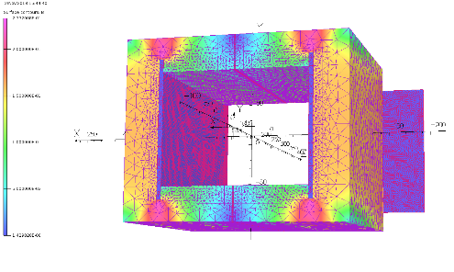
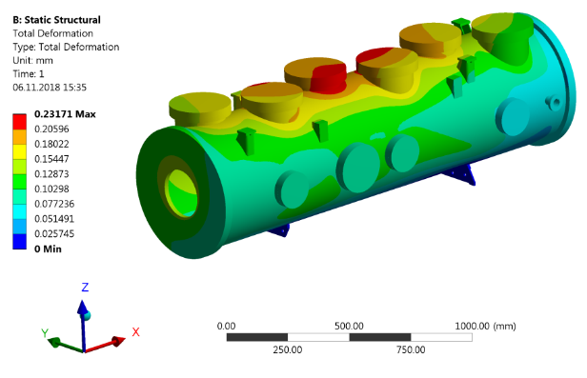
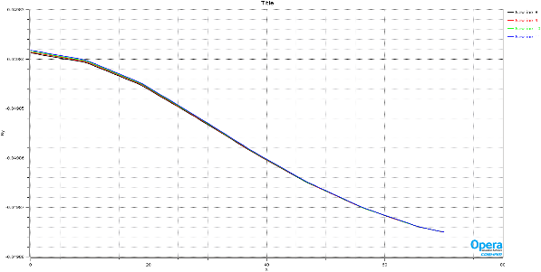
Injection/Extraction Kickers
Spec
CDR
FDR
FoS
FAT
SAT
Kicker module 3D-model
CDR was presented in Nov-2019. The set of docs ready for upload to EDMS.
HV cables is still not agreed: coax is a baseline. EMI is under discussion.
Procurement of ferrites, feedthroughs and HV PC via FAIR has been started after Ammendment-1 signing.
Field distribution
Vacuum tank stress analysis

Slide 8
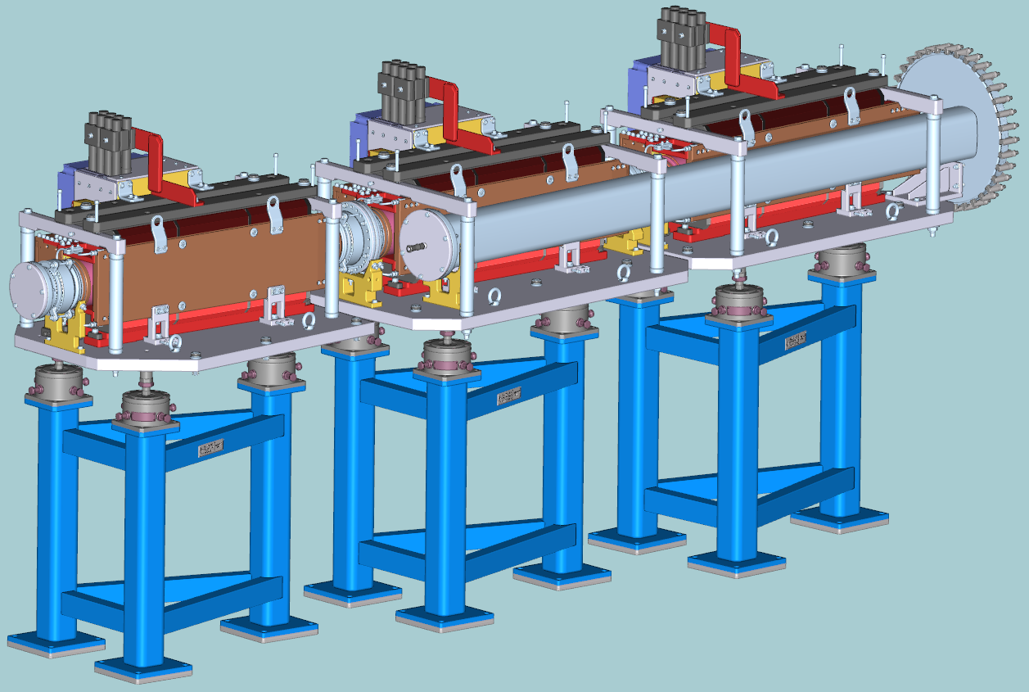
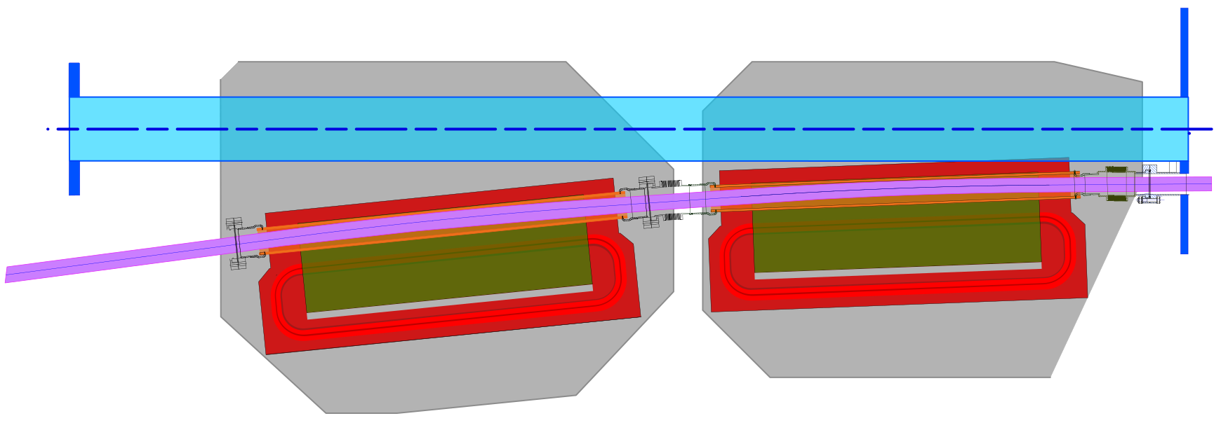
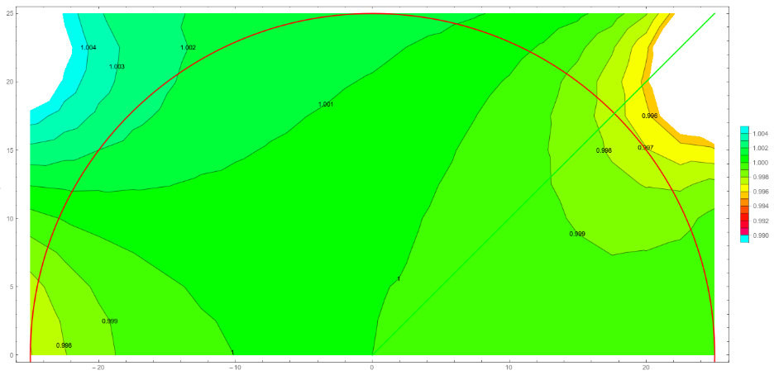
Injection/Extraction Septa
Injection septa
Spec
CDR
FDR
FoS
FAT
SAT
Inj septa pre-CDR was presented in Nov-2019. Docs are in progress.
Hot topic: field quality demands in the spec are too tough. Change request prepared.
Extr septum: divided into 2 magnets. Design is ongoing. CR for spec is needed.
Extraction septum pulsed field inhomogeneity
Septum electrode
Support platforms
CR Vac. chamber
550mm
flange
300mm
flange
Vac.chamber
4σ pbar beam
Bellow
knob
to HESR
Secondary
coil envelope
16 turns
primary coils
60mm ceramic
Vac.Chamber
Yoke

Slide 9
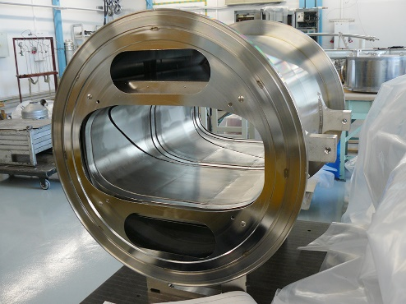
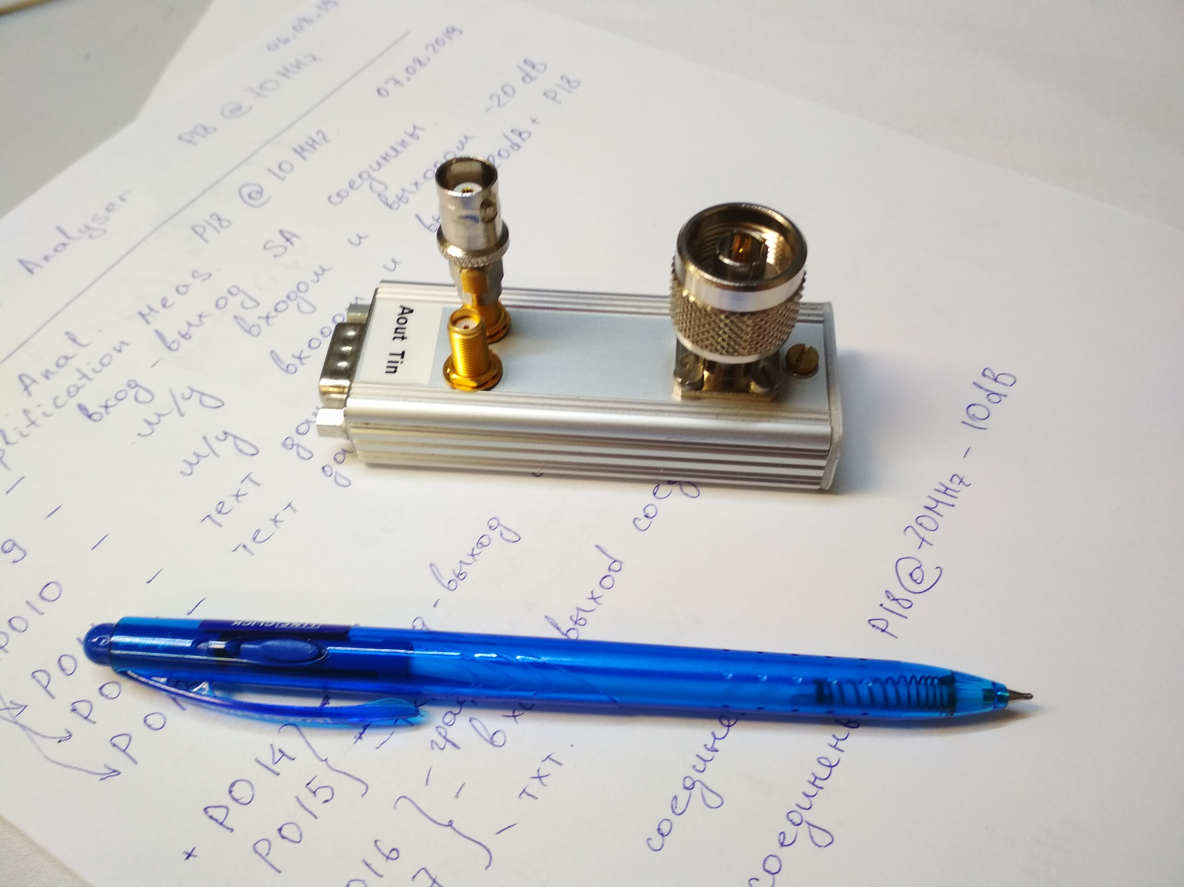
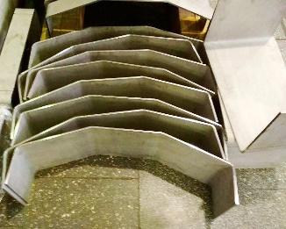
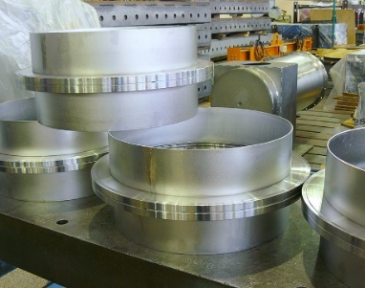
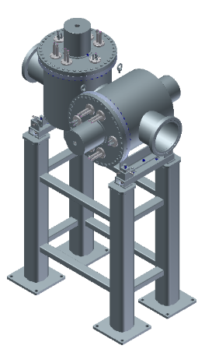
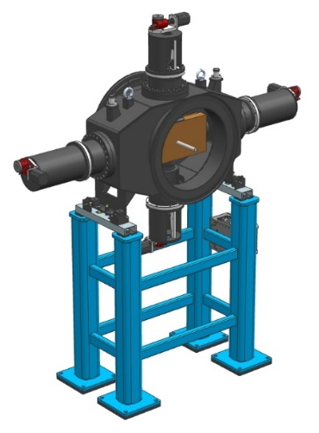
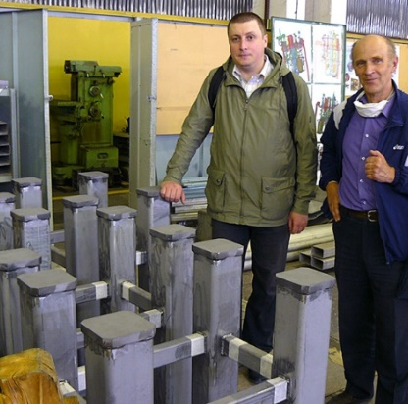
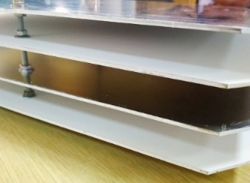
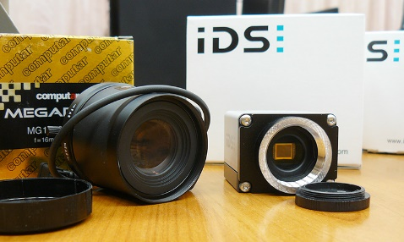
Diagnostics
Pickup preamplifier prototype
Spec
CDR
FDR
FoS
FAT
SAT
Pickups – FDR done in Nov-2019. Docs are in progress. Wide prototype is under intensive study. Small prototype manufacturing is ongoing. One TCR1 pickup in not designed yet.
Scrapers – FDR done in Nov-2019. Docs are nearly ready. Wide type manufacturing is ongoing.
Scintillators – CDR released. FDR coming soon. Scintillating plates partially produced. Optical components are purchased. Manufacturing has been started.
Stoppers – CDR released. Design is finished. FDR upcoming.
RGM – CDR docs are nearly finished, coming soon.
FCT, DCCT – CDR,FDR released. Purchase via FAIR is assumed. Annoying item: TCR1 FCT is not contracted!
Scrapers vacuum chamber parts
Wide pickup prototype
Scrapers supports
Scintillating screens: manufactured plates, purchased objectives & CCDs
RGM 3D-model
Scraper 3D-model

Slide 10
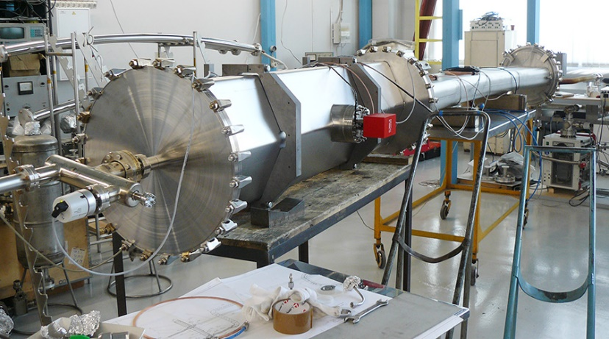
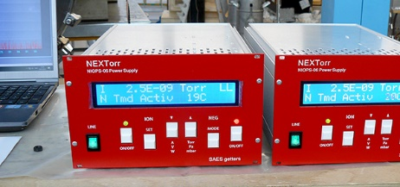
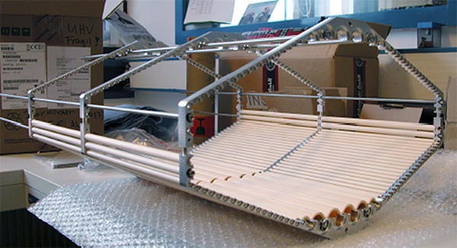
Vacuum
Spec
CDR
FDR
FoS
FAT
SAT
Dipole chamber – CDR released. Prototype ready and tested.
Quadrupole camber – CDR released. 2 prototypes tested, one will be delivered to FAIR for tests with MW ceramic tubes.
Other CR components – specs released, design is finished. CDRs upcoming.
Pumps – are part of FAIR purchase.
TCR1 components – design is ongoing, specs are in progress.
All the welded flanges changed to CR-K type.
Assembly of dipole and quad chambers prototypes test: vacuum achieved!
MW damping system to be installed into hexagonal chamber

Slide 11
Summary
Subproject Collector Ring moves from design phase to the manufacturing phase.
The documentation/models/drawings matching that are needed for milestones passage takes significantly more time than we expected.
Various managing efforts are ongoing: contracts amendments; procurement via FAIR; temporary import; etc.
Vacuum chamber for SC MW damping system tests will be ready for delivery in July.
First CR component delivery (FoS dipole and QPC prototype) is expected @ FAIR site in December 2020.
Thank you for your attention!

