Slide 1
FAIR SFRS vacuum
BINP
A. Krasnov
4th BINP-FAIR Collaboration Coordination Workshop

Slide 2
General information
Name | Signed | End | Cost M€ | Status
AFAA1 SFRS Diagnostic chambers | 03.2019 | 12.2021 | 1.11 | CDR for FoS is passed. 2D and FEM analysis for FOS are uploaded into EDMS (for FDR) and accepted under reserve. Materials for FoS production are ordered.
AFAA3 SFRS Vacuum chambers inside SC dipoles | 10.2019 | 06.2022 | 0.87 | 3D model of combined chamber with pumping port is created. There is a problem with bellows fixation. Conception of assembly the combined chamber into SC magnet under consideration.
AFAA5 SFRS vacuum components |  |  | 1.5 | Time schedule is agreed. Cost is under consideration. Waiting detailed specification
SFRS branching chambers inside SC dipoles |  |  | 0.31 | BINP agrees to produce the chambers

Slide 3
SFRS diagnostic chambers
CDR for FoS is passed. 2D and FEM analysis for FOS are uploaded into EDMS (for FDR) and accepted under reserve. Materials for FoS production are ordered.
FAT expectation: November 2020

Slide 4
SFRS SC dipole chamber
3D of the FoS chamber is practically complete.
Open questions:
how to fix bellows against atmosphere pressure
Installation into SC magnet (will be discussed during this workshop)

Slide 5
SFRS SC dipole chambers
Placement and construction of supports must be checked from assembly convenience point of view

Slide 6
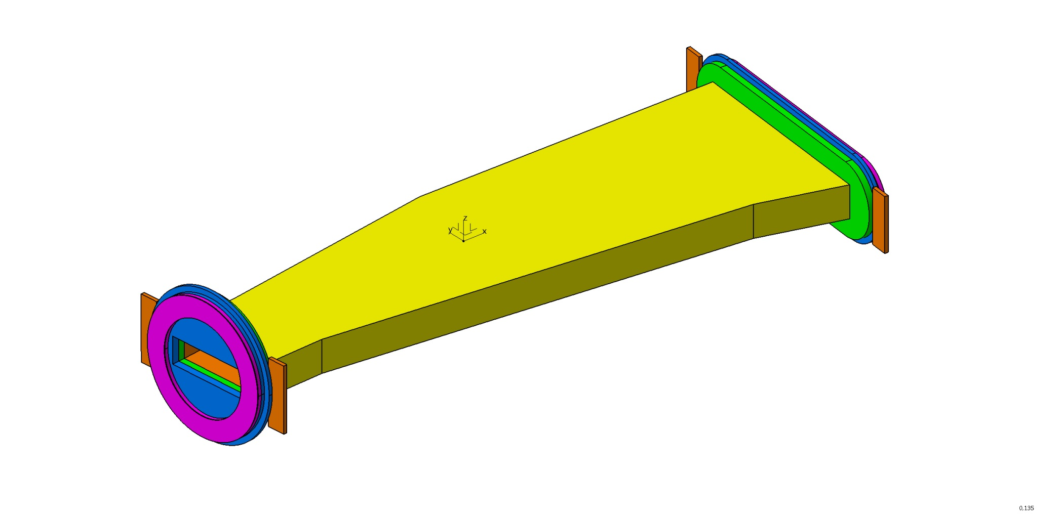
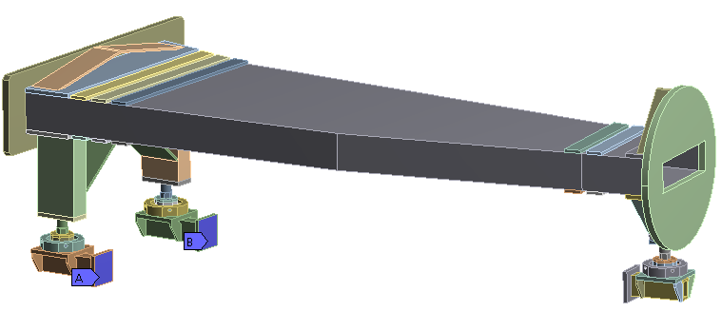


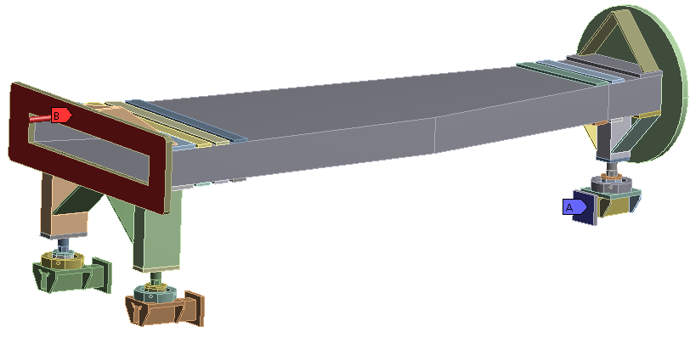

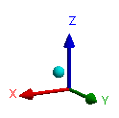
SFRS R&D for NC wide chamber
Stop
Bellow race track
view
Stop
Beam chamber
Flange
Flange
Polished plate
Polished plate
Bellow D 500mm
Ti
Radiation
power 3 kW
Ti
Results of 2D calculation is coming soon

Slide 7
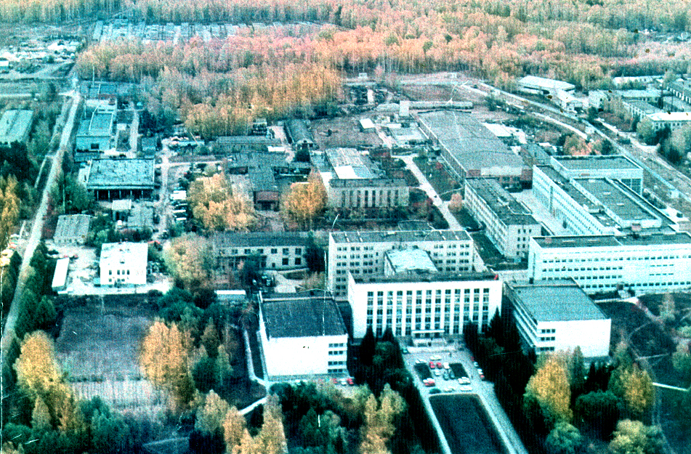
Thank you for your attention

