Slide 1
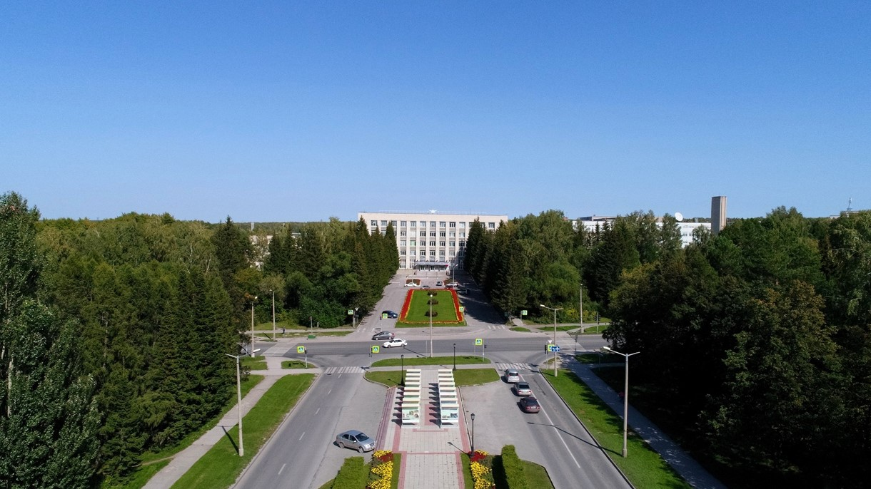
BINP participation in EXFEL cryogenics 2009 - 2017

Slide 2
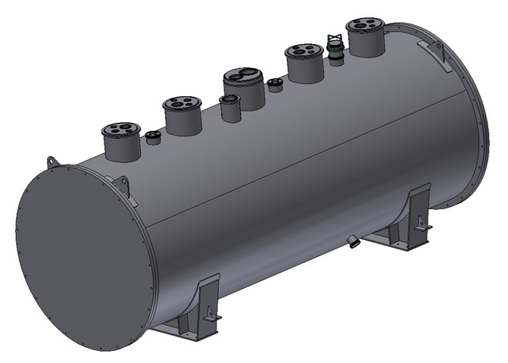
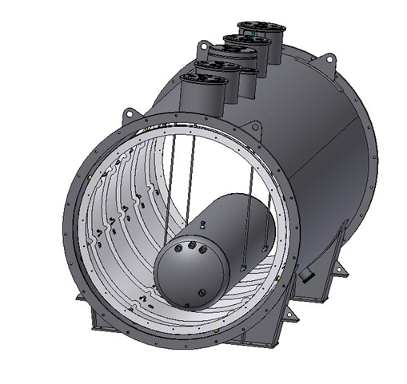
design of the BRANCH BOX (BB)

Slide 3
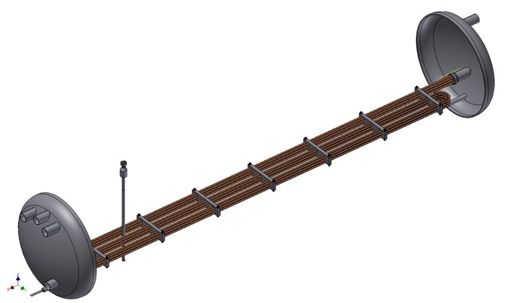
Sub-cooler of the BRANCH BOX
The maximum design pressure is 20 bara against vacuum at all possible operating temperatures.
Temperature inlet – 6 K;
Temperature outlet – 4,6 K;
Pressure inlet - 4,0 bar;
Pressure outlet, worst case - 3,9 bar;
Flow rate - 105 g/s;
The volume of liquid helium above the highest position of the heat exchanger in the LHe vessel shall be 300 liters at least
The maximum design pressure is 20 bara against vacuum at all possible operating temperatures. OD 711 mm, ID695 mm. Thickness of covers are 12 mm;
Temperature inlet – 6K;
Temperature outlet – 4,6K;
Pressure inlet - 4,0 bar;
Pressure outlet - 3,96 bar;
Flow rate - 105 g/s;
6 copper pipes OD12 x 1mm and length of the each pipe is 9 meters.
The volume of liquid helium above the highest position of the heat exchanger in the LHe vessel shall be 300 liters at least - OK

Slide 4
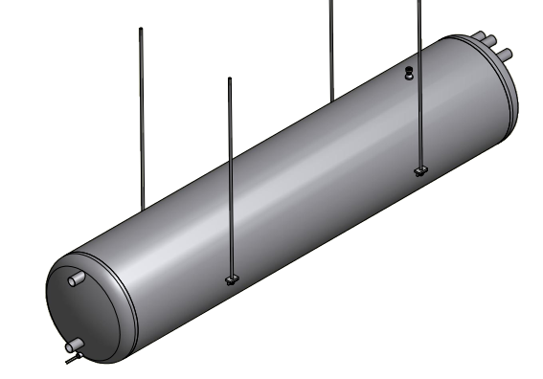
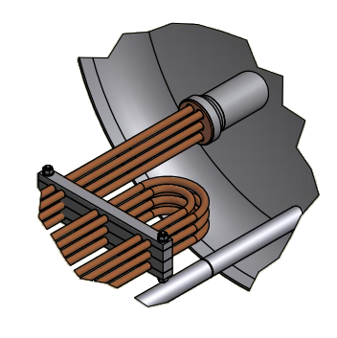
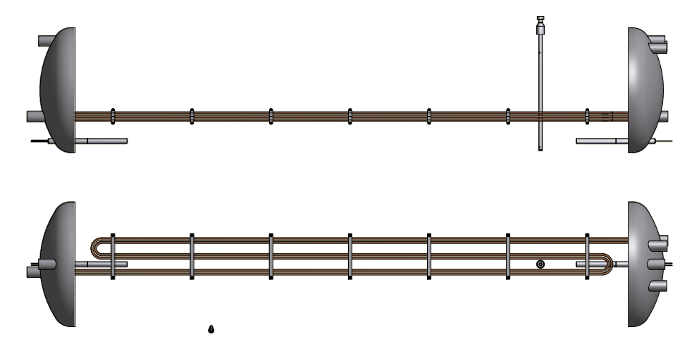
Sub-cooler of the BRANCH BOX

Slide 5
Thank you for your attention

