Slide 1
FAIR HEBT vacuum Batch 2,3 & 4
BINP
A. Krasnov
4th BINP-FAIR Collaboration Coordination Workshop

Slide 2
General information
Name | Signed | End | Cost M€ | Status
AFAA2 HEBT Batch 2-3 Vacuum chambers | 05.2019 | 07.2021 | 1.71 | There is delay but not critical. CDR – 50%. 2D drawings – 30%. 40% of materials are under ordering. First FAT is expected in July 2020.
AFAA4 HEBT Batch 4 Vacuum chambers | 11.2019 | 12.2022 | 4.18 | 3D model of most complex chamber (x-cross) is accepted. 2D drawings of the x-cross chamber, standard pumping ports, drift chambers and supports are under consideration at BINP workshop

Slide 3
HEBT Batch 2-3
 | Q-ty | Types | Description | CDR | FDR* | FAT | SAT Ab | May 2020, current work
WP1 | 6 | 3 | dip10 branch trapec 3.8m | 10/2019 | 01/2020 | 08/2020 | 12/2020
WP2 | 5 | 1 | dip13 (ch. 55 Batch 1) | 05/2019 | 07/2019 | 12/2019 | 04/2020 | material ordering, 3 chambers are produced
WP3** | 7 | 5 | dip15-17 2 - 2.5m | 05/2019 | 07/2019 | 12/2019 | 04/2020 | material ordering
WP6 | 4 | 1 | dip19 120x80 3,7m | 07/2019 | 09/2019 | 04/2020 | 08/2020 | material ordering
WP7 | 91 | 13 | q1, q2, d120 some with bellow | 09/2019 | 01/2020 | 08/2020 | 11/2020 | design, material ordering
WP8 | 4 | 1 | q10, d160, 2,8m | 06/2019 | 07/2019 | 12/2019 | 04/2020 | material ordering
WP9 | 69 | 19 | q11, d100, oval 140x70, some with bellow | 10/2019 | 02/2020 | 12/2020 | 03/2021 | design
WP10*** | 17 | 8 | q12, some branch, oval, up to 2.1m, some with bellows | 09/2019 | 12/2019 | 12/2020 | 03/2021 | design, material ordering
WP11 | 63 | 35 | s100, s18, d150, some with bellow | 10/2019 | 12/2019 | 06/2020 | 07/2020 | design
WP13 | 4 | 3 | s13, d400 | 11/2019 | 02/2020 | 10/2020 | 02/2021
WP14 | 2 | 2 | d4, 1 branch, 1 bend, 100x67 | 03/2020 | 06/2020 | 12/2020 | 04/2021
 | 272 | 91 |  | All dates are contractual dates |  | In process
 |  |  |  | done | close to be done | in process | delay 6 - 8 months
Questions for discussions:
*Several procedures like cleaning, vacuum tests are under minor corrections to be done during this week
** Open question regarding drawings versions
*** Mechanical analysis of the branching chambers WP10 is complex. Is there reason to do sub-separation of WP10 on sets of simple chambers and complex branching chambers?

Slide 4
Batch 2-3
Branching chamber inside Quad12
Preliminary: support is strong enough.
If not, we will apply double support or additional support applied at pump
200 kg

Slide 5
Batch 4
3D model of most complex chamber “X-cross”
is accepted
Documents for CDR are under preparation
2D drawings of the x-cross chamber, standard pumping ports, drift chambers and supports are under consideration at BINP workshop, prototype of pumping port is ordered at BINP workshop
Questions to the workshop:
Released specification and DMU 3D models are still absent
Final requirements for relative magnetic permeability? It seems nobody really did estimation the influence on beam dynamic

Slide 6
Batch 4
Are the placement and construction of supports checked from assembly convenience point of view?
If not, FAIR/GSI has a time to check most critical points and provide suggestions how to improve

Slide 7
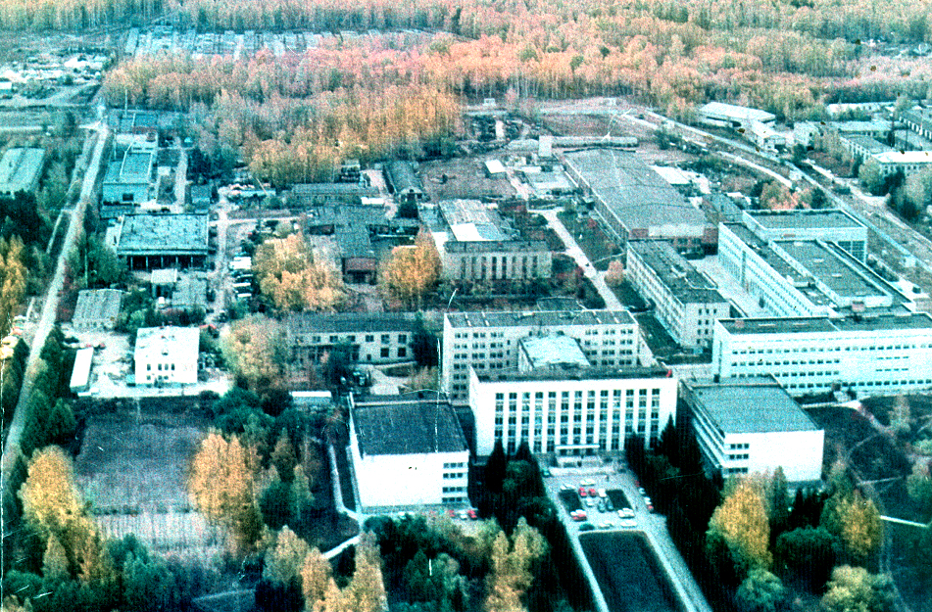
Thank you for your attention

