Slide 1
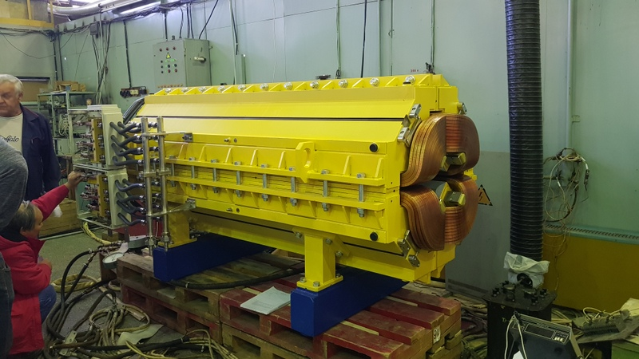
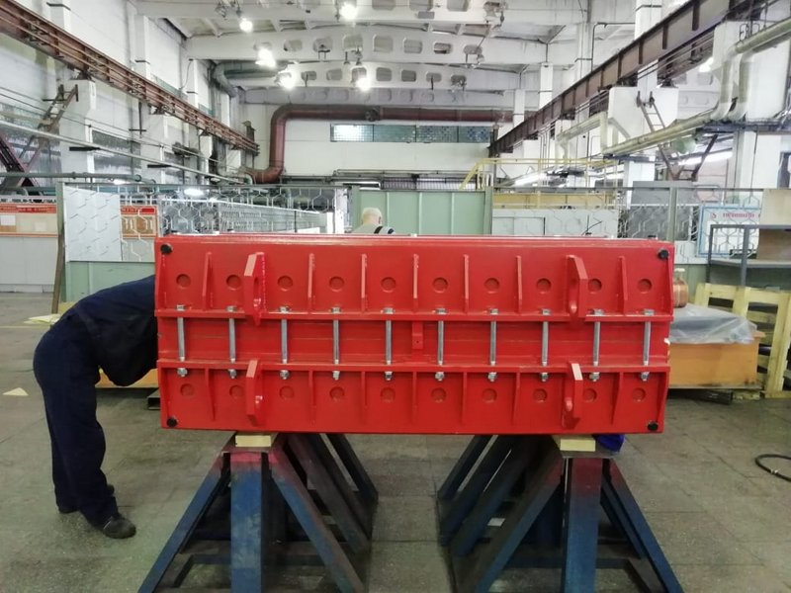
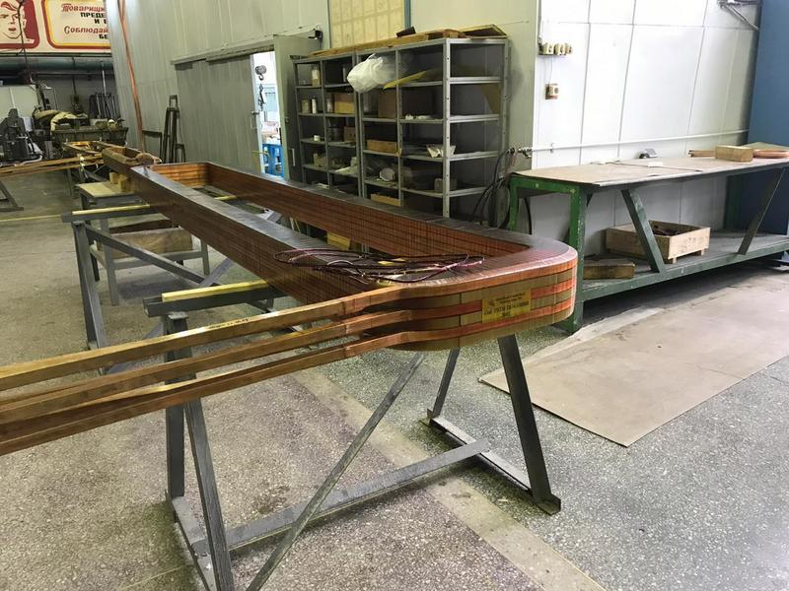
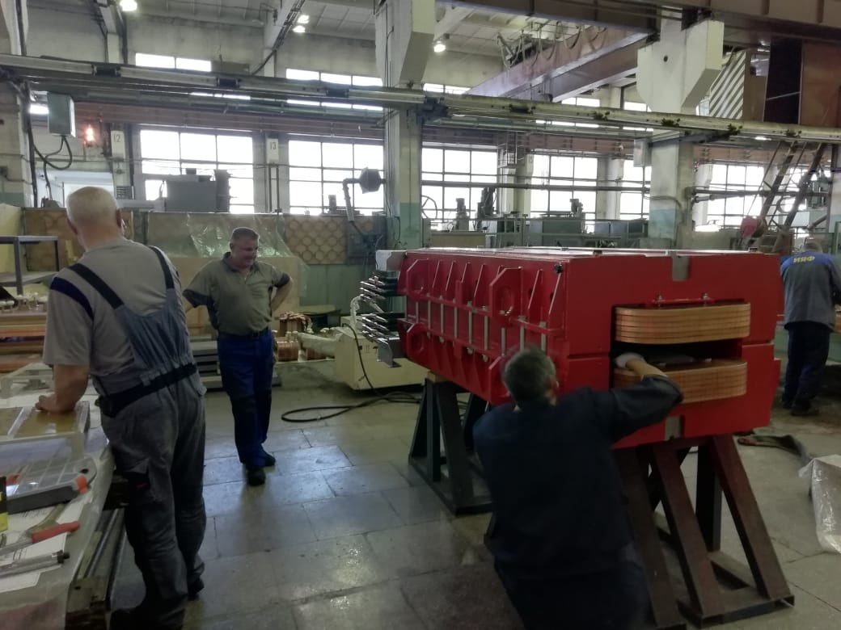
4rd BINP-FAIR Collaboration Coordination Workshop
FAIR Contract No. CC2.3.2-2 HEBT batch 2, 3 & 4
Dipole 4_0 | 2
Dipole 10_0 | 6
Dipole 13_0 | 2
Dipole 13_3 | 3
Dipole 19_0 | 4
Dipole 15_0 | 4
Dipole 15_1 | 1
Dipole 16_0 | 1
Dipole 17_0 | 1
Quadrupole 2 | 91
Quadrupole 2 long | 4
Quadrupole 10 | 4
Quadrupole 11 | 70
Quadrupole 12 | 12
Steering 13 | 5
Steering 18 | 48
Steering 100 | 45
Total magnets | 303
Delivered 42 magnets
Prepared for delivery 34 magnets.
Prepared for FAT 27 magnets.

Slide 2
4rd BINP-FAIR Collaboration Coordination Workshop Since the previous meeting: Was presented at FAT 27 magnets .
Was prepared for next FAT 27 magnets
Steering 18 – 6 pcs
Steering 100 – 10 pcs
Quadrupole 2 – 5 pcs
Quadrupole 11 – 5 pcs
Dipole 10_0 -1 pc

Slide 3
4rd BINP-FAIR Collaboration Coordination Workshop
FAT plan HEBT Magnets Batch 2, 3 & 4
Magnets | 2020 months |  |  |  |  |  |  |  | 2021 months
 | 5 | 6 | 7 | 8 | 9 | 10 | 11 | 12 | 1 | 2 | 3 | 4
dip4_0 |  |  |  |  |  |  |  |  |  | 1 |  | 1
dip10_0 | 1 | 1 |  | 1 |  | 1 |  | 1
dip13_0 |  | 1 |  | 1
dip13_3 |  |  |  | 1 |  | 1 |  | 1
dip19_0 |  |  |  |  |  |  |  | 1 | 1 | 1 | 1
dip15_1 |  |  | 1
dip16_0 |  |  | 1
dip17_0 |  |  |  | 1
Quadrupole 2 | 5 | 10 | 5 | 5 | 5 | 5 | 5 | 5 | 2 | 4 |  | 1
Quadrupole 2 cust |  |  |  |  |  |  |  |  |  |  |  | 4
Quadrupole 11 | 5 | 5 | 6 | 6 | 6 | 6 | 6 | 6 | 5 | 5 | 6
Quadrupole 12 |  |  |  |  | 1 |  | 5 |  |  |  | 6
Steering 13 |  |  |  |  |  | 1 |  | 4
Steering 18 | 6 | 12 |  | 10 |  | 2 |  | 4
Steering 100 | 10 |  | 5 | 5 | 5 | 5
Total | 27 | 29 | 18 | 30 | 17 | 21 | 16 | 22 | 8 | 11 | 13 | 6

Slide 4
4rd BINP-FAIR Collaboration Coordination Workshop
Documents for HEBT Magnets
Magnet | RA | Production Plan | Manual | Сert
dip4_0 | +
dip10_0 | + | + | + | +
dip13_0 | + | +
dip13_3 | +
dip19_0 | +
dip15_0 | + | + | + | +
dip15_1 | + | +
dip16_0 | + | +
dip17_0 | + | +
Quadrupole 2 | + | + | + | +
Quadrupole 2 cust
Quadrupole 10 | + | +
Quadrupole 11 | + | + | + | +
Quadrupole 12 | + | +
Steering 13 | + | +
Steering 18 | + | + | + | +
Steering 100 | + | + | + | +

Slide 5
4rd BINP-FAIR Collaboration Coordination Workshop
The main reason for the schedule delay is the documentation.
Two people have been added for this work.

