Slide 1
Oleksiy Dolinskyy May 25th 2020
CR: Requirements to reach intermediate objective

Slide 2
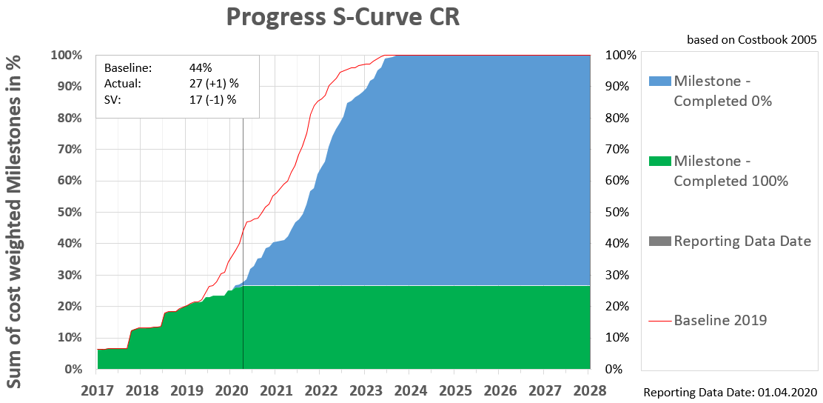
CR project Status
January 2019 – 22%
April 2020 - 27 % (instead 47%)
Progress +5% (instead planned 22%)

Slide 3
Requirements for 2020
Approve and accept 77 milestones for BINP (CDRs and FDRs)
(for today only 10 milestones accepted in 2020)
Approve and accept 20 milestones for GSI ( CDRs, FDRs, FAT, SAT)
(for today only 5 milestones accepted in 2020)
FoS CR dipole magnet must be build and delivered to FAIR
Establish assembly space and storage place at GSI for dipole magnets
Re-planing of the rooms in CR building, infrastructure and cable planning to be finalized
Results of RF debuncher R&D study from OCEM - expectation: reliability to be achieved (scientific challenge!)
Procurement for BINP: commitment of 1 M€ (600 k€ dipole power converter, 300 k€ kicker cable) is expected

Slide 4
Requirements for 2020
Stochastic Cooling:
Start design of SC kicker at FZJ. Specifications and CDR
Palmer-PU: assembly, installation and start of testing at COSY during beamtime
Power amplifiers: final decision: Either to accept existing product or to find new provider due to reliability issues
Procurement and commitment up to 2 M€

Slide 5
Requirements for 2020
Contracts:
Conclude collaboration contract with FZJ on design and construction of SC kicker system
Amendment 3 to the CR rest contract with BINP. The new accelerator components are required for ILIMA
Amendment 4 to the CR rest contract with BINP on spare parts.

