Slide 1
pbar scope
Klaus Knie
BINP-GSI workshop, May 2020

Slide 2
Sections of the pbar separator
GSI
BINP
HEBT
PS01 (air)
PS01 (vac.)
TCR1
building 6c (K0321A)
building 7 (H0209A)
More precisely: here we talk about the PS01 beamline
PS01 magnets will be pulsed (except dipole)

Slide 3
Magnets
Ion optics, magnets (PS): Presentations by S.Udrea, H. Leibrock on Friday
identical to TCR1
totally different
from TCR1
similar to TCR1

Slide 4
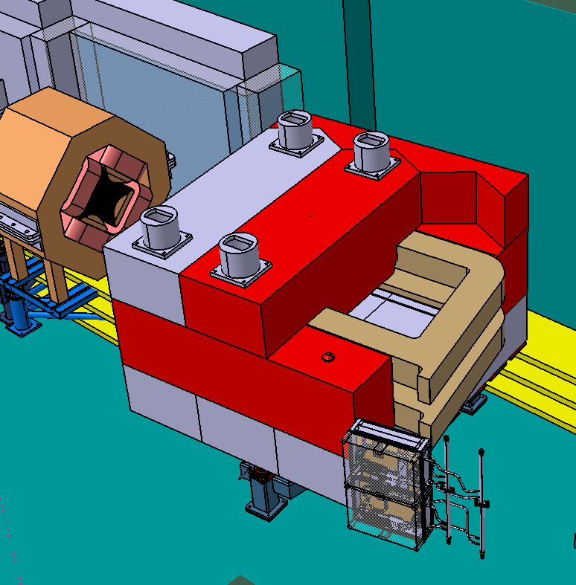
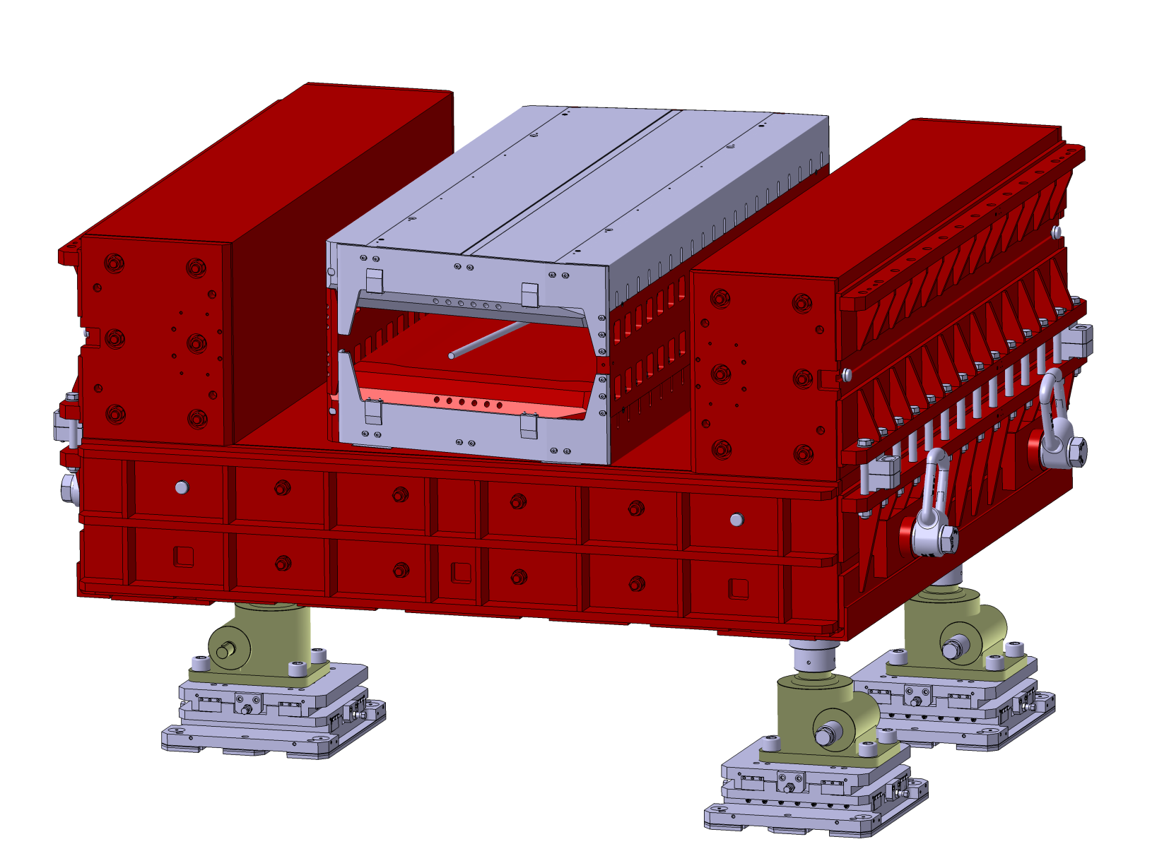
Dipole Magnet
pbar dipole:
no chamber
rad. hard coil
upper yoke in parts < 10 t
special connection box
identical with CR dipole

Slide 5
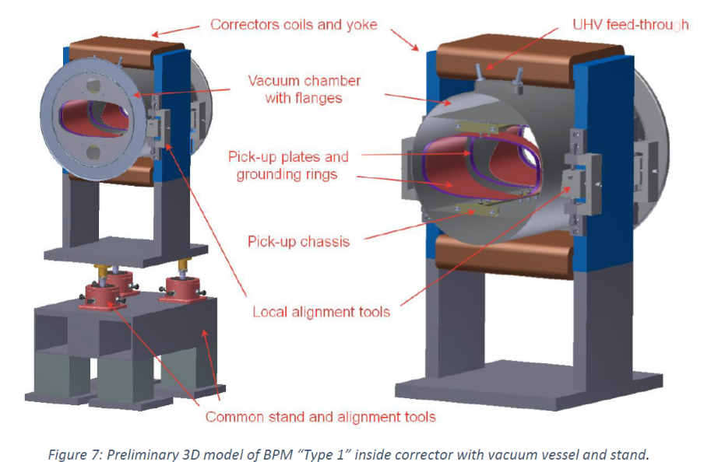
Beam Instrumentation
2 screens and 4 BPMs identical to TCR1/SFRS components needed for PS01
2x BPM
SCR + BPM
SCR + BPM
Presentation by A. Reiter on Friday

Slide 6
Summary
Component | identical to TCR1? | Contract | To be discussed
Dipole | ✓, ✘ | 2021 | Which parts can be produced by BINP
Power Supply | ✘ | 2021
8 Wide Quads | ✓ | now | tables
Pulsed PS | ✘ | now
Chambers | ✓(✘) | now | ion optics: 3 of 8 chambers might be different (star shape)
Sextupoles | ✓ | 2021 | ion optics: number unclear (0-4)
Pulsed PS | ✘ | 2021
Steerers | ✓ | 2021 | number unclear (6-12), tables
Pulsed PS | ✘ | 2021
Rest Vacuum | ✘ | 2021(?) | Freeze of IOL
Beam Instr. | ✓ | 2021

