Slide 1
Super-FRS requirements to reach intermediate results
Haik Simon
FAIR-BINP Workshop
May 25-29, 2020

Slide 2
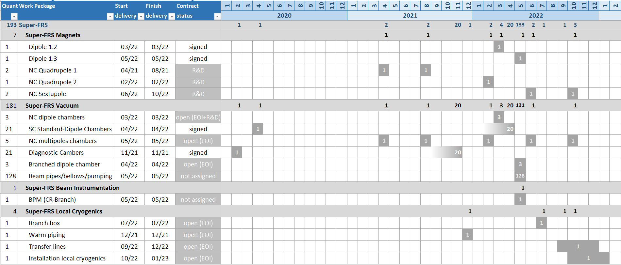
Delivery Matrix Nov. 2019
FDR First of Series
FAT First of Series

Slide 3
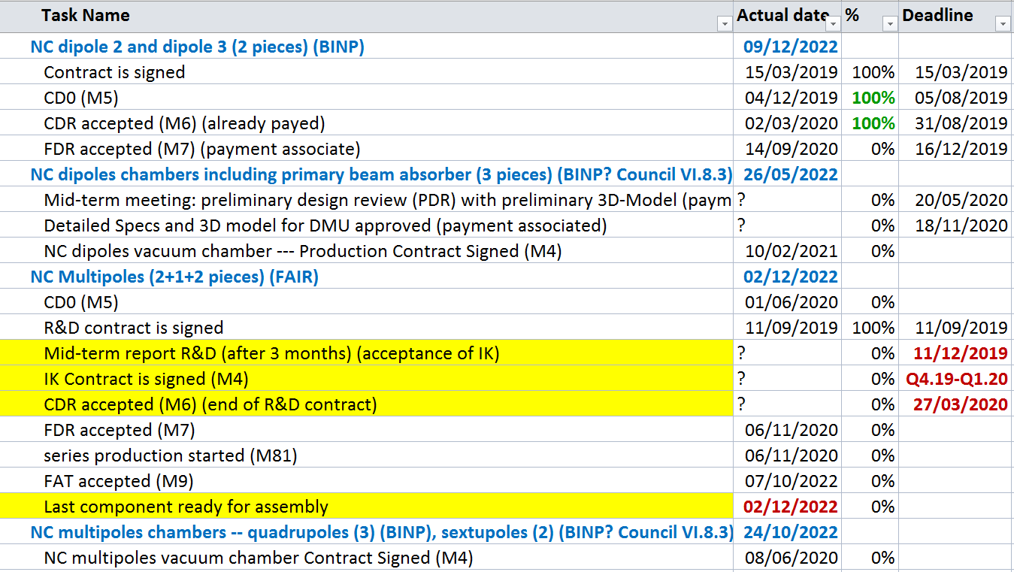
Overview components

Slide 4
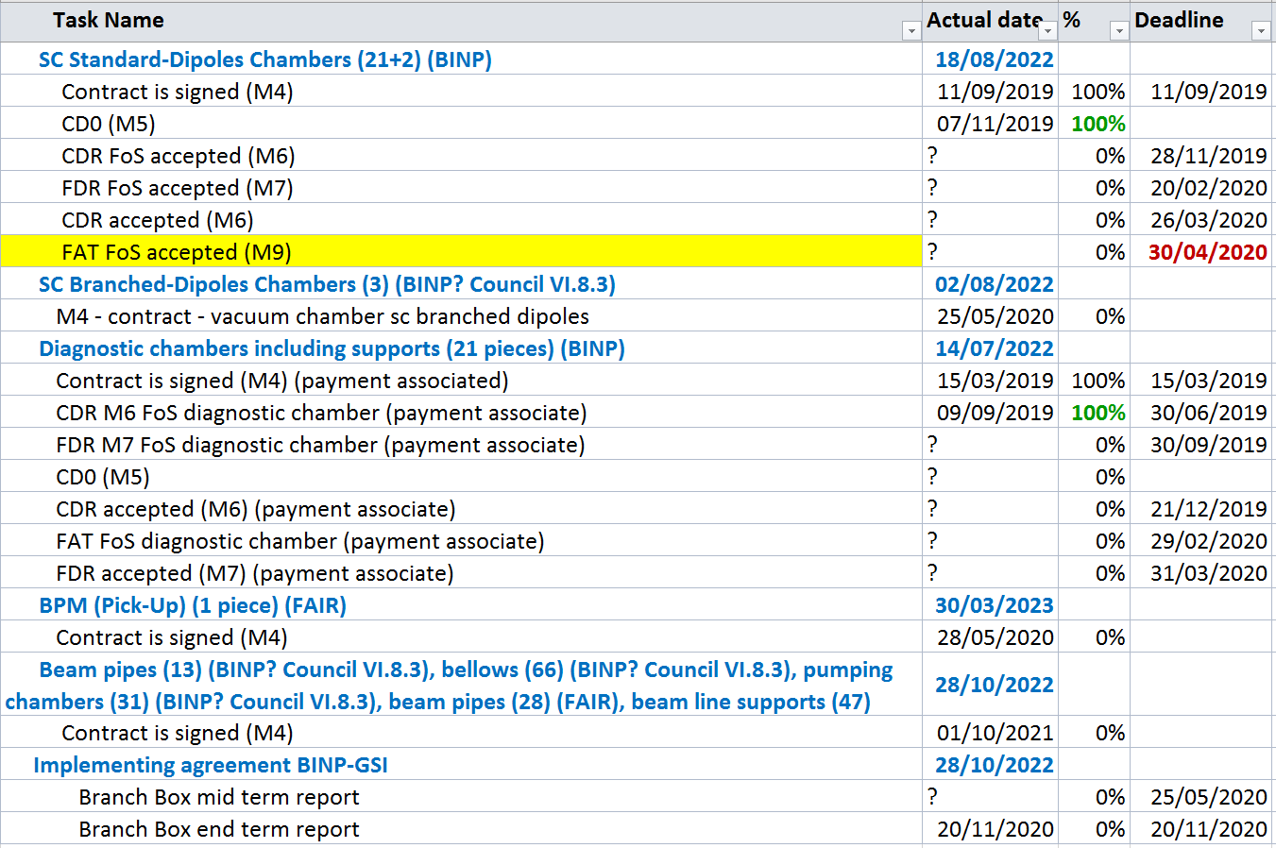
Overview components

Slide 5
Potential resource issue?
Name | Milestone | Real date | Contract date
NC dipoles | FDR accepted (M7) (payment associate) | 14/09/2020 | 16/12/2019
NC dipoles chambers R&D | Mid-term meeting: preliminary design review (PDR) with preliminary 3D-Model (payment associated) | ? | 20/05/2020
NC Multipoles R&D | Mid-term report R&D (after 3 months) (acceptance of IK – mechanical design) | ? | 11/12/2019
SC Standard-Dipoles Chambers | CDR FoS accepted (M6) | ? | 28/11/2019
SC Standard-Dipoles Chambers | FDR FoS accepted (M7) | ? | 20/02/2020
SC Standard-Dipoles Chambers | CDR accepted (M6) | ? | 26/03/2020
SC Standard-Dipoles Chambers | FAT FoS accepted (M9) | ? | 30/04/2020
Diagnostic chambers | FDR M7 FoS diagnostic chamber (payment associate) | ? | 30/09/2019
Diagnostic chambers | CDR accepted (M6) (payment associate) | ? | 21/12/2019
Diagnostic chambers | FAT FoS diagnostic chamber (payment associate) | ? | 29/02/2020
Diagnostic chambers | FDR accepted (M7) (payment associate) | ? | 31/03/2020
SC Branched-Dipoles Chambers | M4 - contract - vacuum chamber sc branched dipoles (design issue)
All delays seem to be related to the design
Prioritization of resources?

Slide 6
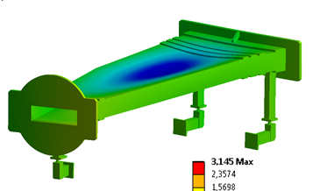
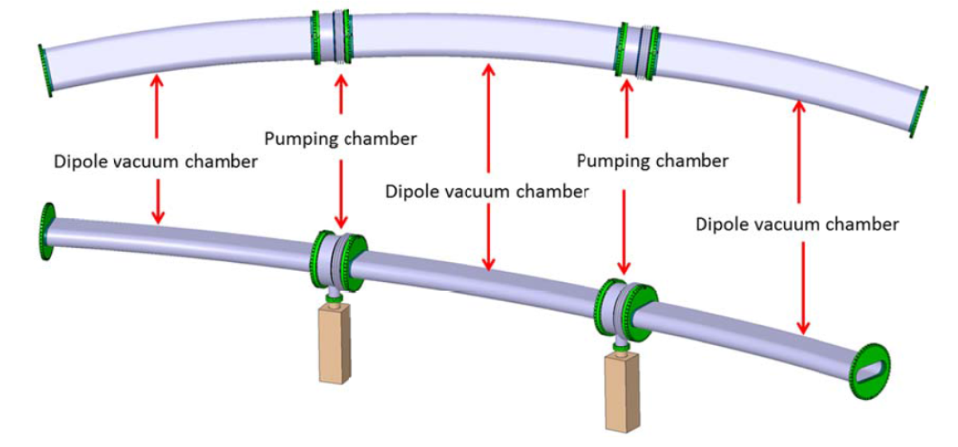

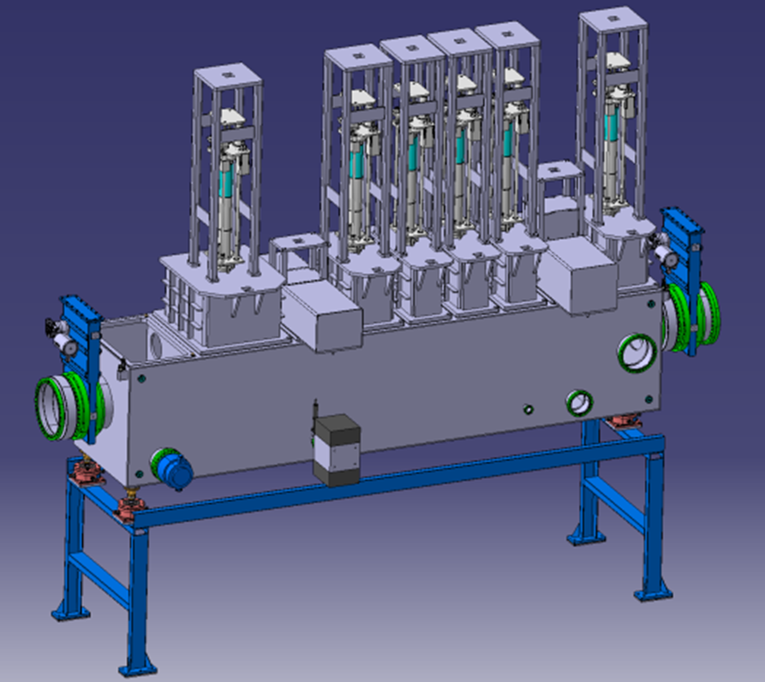
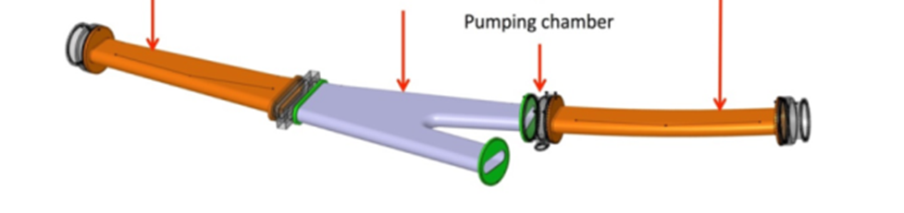
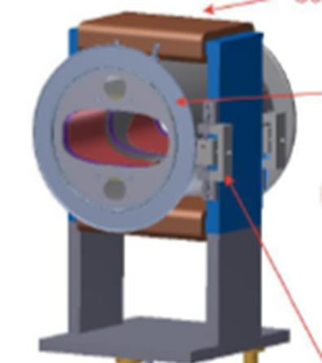
Status of vacuum components
NC-dipole chamber R&D
SC-standard dipole chambers
Apparent slight delay:
FoS design (02/2020) not ready
FAT FoS (04/2020): ?
late, but still ok
Pre-assembly FoS dipole: Q1/Q2 2021
Logistic issue (~ 60 tons/magnet)
Diagnostic chambers
Delay:
FoS design
( 09/2019 → ~ today )
FAT FoS
( 02/2020 → ? material procurements started )
SC-branched dipole chambers
BPM
Contract not finalised due to potential design issue. Production(s) to be scheduled in accordance to magnet delivery schedule
Necessary design adaptations may still delay the contract finalization
Few remaining contracts for standard
components on their way…

Slide 7
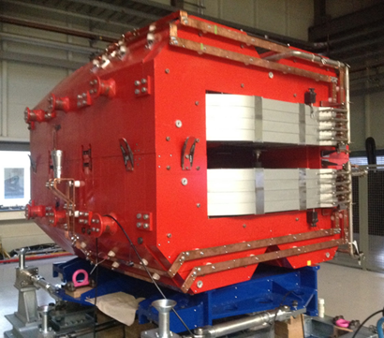
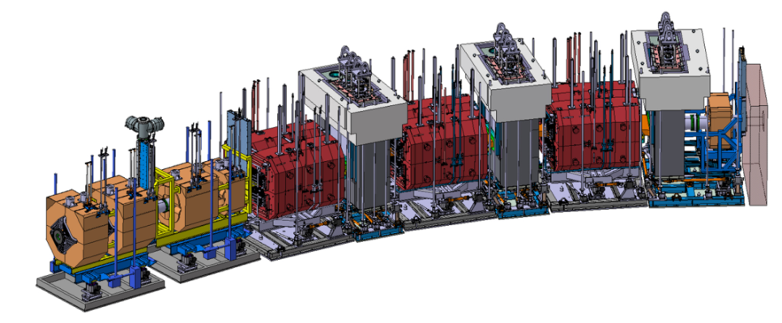
Status of NC dipoles
Detailed specs released
MIC ordered by FAIR
Contract signed on 15/03/2019
Conceptual Design Review (02/03/2020)
Final Design Review: expected on 09/2020 (delay: 9 months)
≈95 ton
Issue: purchase of iron
Originally planned purchasing together with nc multipoles may not occur.
➔ Cost of iron would be higher than expected
➔ purchasing strategy affects real cost of nc dipoles and multipoles!
Target Area

Slide 8
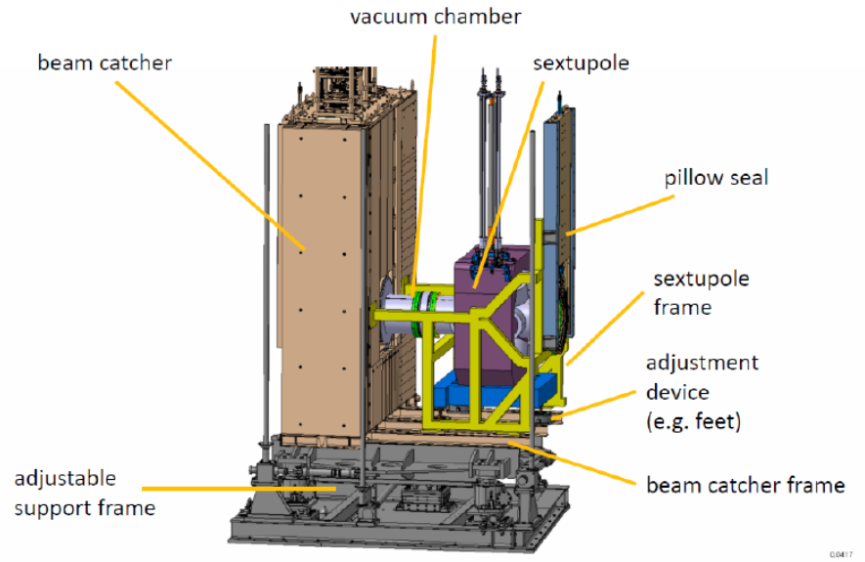
Status of NC multipoles
R&D contract signed on 16/09/2019
R&D first results basis for closure of IKC due on 11/2019
→ IKC Contract signature expected Q4/2019
End of R&D (CDR): March 2020 (not yet achieved)
Actual MSP Plan:
Contract signature: if now (?)
FDR: 11/2020
End of SAT: Dec 2022
Installation (actual LCM): January 2023
no buffer anymore !
≈30 ton
≈30 ton

Slide 9
Conclusions
Urgent: enabling decision on nc multipole production !
Issues: assure production and delivery of assembly
components according to harmonized schedule
Readiness of Super-FRS is one of few projects goals with
priority.

